Slide 1
EIC Accelerator Physics/Technology
Todd Satogata, Jefferson Lab
For the EIC Project and EIC Collaboration
CFNS/CTEQ School Lecture 1
8 June 2023
www.toddsatogata.net
satogata@jlab.org
EIC:
Notes:
Kierkegaard book, but Descartes!

Slide 2

Outline (Hour 1)
EIC overview
  From an accelerator physicist ☺
Relevant accelerator physics
  Synchrotrons
  (Brief) beam dynamics
  Phase space, emittance, “beta”
Luminosity
Collider interaction regions
  ”Low-beta” squeeze
Future 2nd
Detector
Location
Future
Detector
Location
Primary
Detector
Location
Primary
Detector
Location

Slide 3

Outline (Hour 2)
Please give feedback/make requests!
EIC interaction region
Luminosity revisited
Lumi optimization and limitations
  Superconducting magnets
  Crab cavities, crossing angle
  Beam sizes and cooling
  Space charge
  Synchrotron radiation
  Cooling
Luminosity ramp-up
Future 2nd
Detector
Location
Future
Detector
Location
Primary
Detector
Location
Primary
Detector
Location
(May look familiar from 2022 Gordon Conference talk)

Slide 4



EIC Requirements
EIC design goals
  High luminosity: L = (0.1-1)∙10³⁴ cm⁻² s⁻¹
    ➔ 10-100 fb⁻¹
  Collisions of highly polarized (>70%) e and p (and light ion) beams
    with flexible bunch by bunch spin patterns
  Large range of CM energies:
    E_{cm} = 20-140 GeV
  Large range of ion species:
    Protons – Uranium
  Ensure accommodation of a second IR
  Large detector acceptances; good background
    Hadron particle loss
    IR synchrotron radiation backgrounds
“High”
Unique
uniquely
challenging
“Low”
Diverse

Slide 5
EIC Accelerator Design Overview
Hadron storage ring (HSR): 40-275 GeV (existing)
  up to 1160 bunches, 1A avg beam current (3x RHIC, polarized)
  bright vertical beam emittance (1.5 nm); new vac sleeves
  hadron beam cooling
Electron storage ring (ESR): 2.5–18 GeV (new)
  up to 1160 polarized bunches
    high polarization by continual reinjection from RCS
  2.5 A avg beam current ➔ 9 MW SR power
  superconducting RF cavities
Rapid cycling synchrotron (RCS): 0.4-18 GeV (new)
  2 bunches at 1 Hz; spin transparent due to high periodicity
High luminosity interaction region (new; future 2nd IR)
  L = 10³⁴ cm⁻²s⁻¹ = 10 kHz-uba, superconducting magnets
  25 mrad crossing angle with crab cavities/crab crossing
  spin rotators (produce longitudinal polarization at IP)
Comparable to new mature
B-factory, e.g. SuperKEKB
Current 6x NSLS-II
Future 2nd
Detector
Location
Primary
Detector
Location

Slide 6
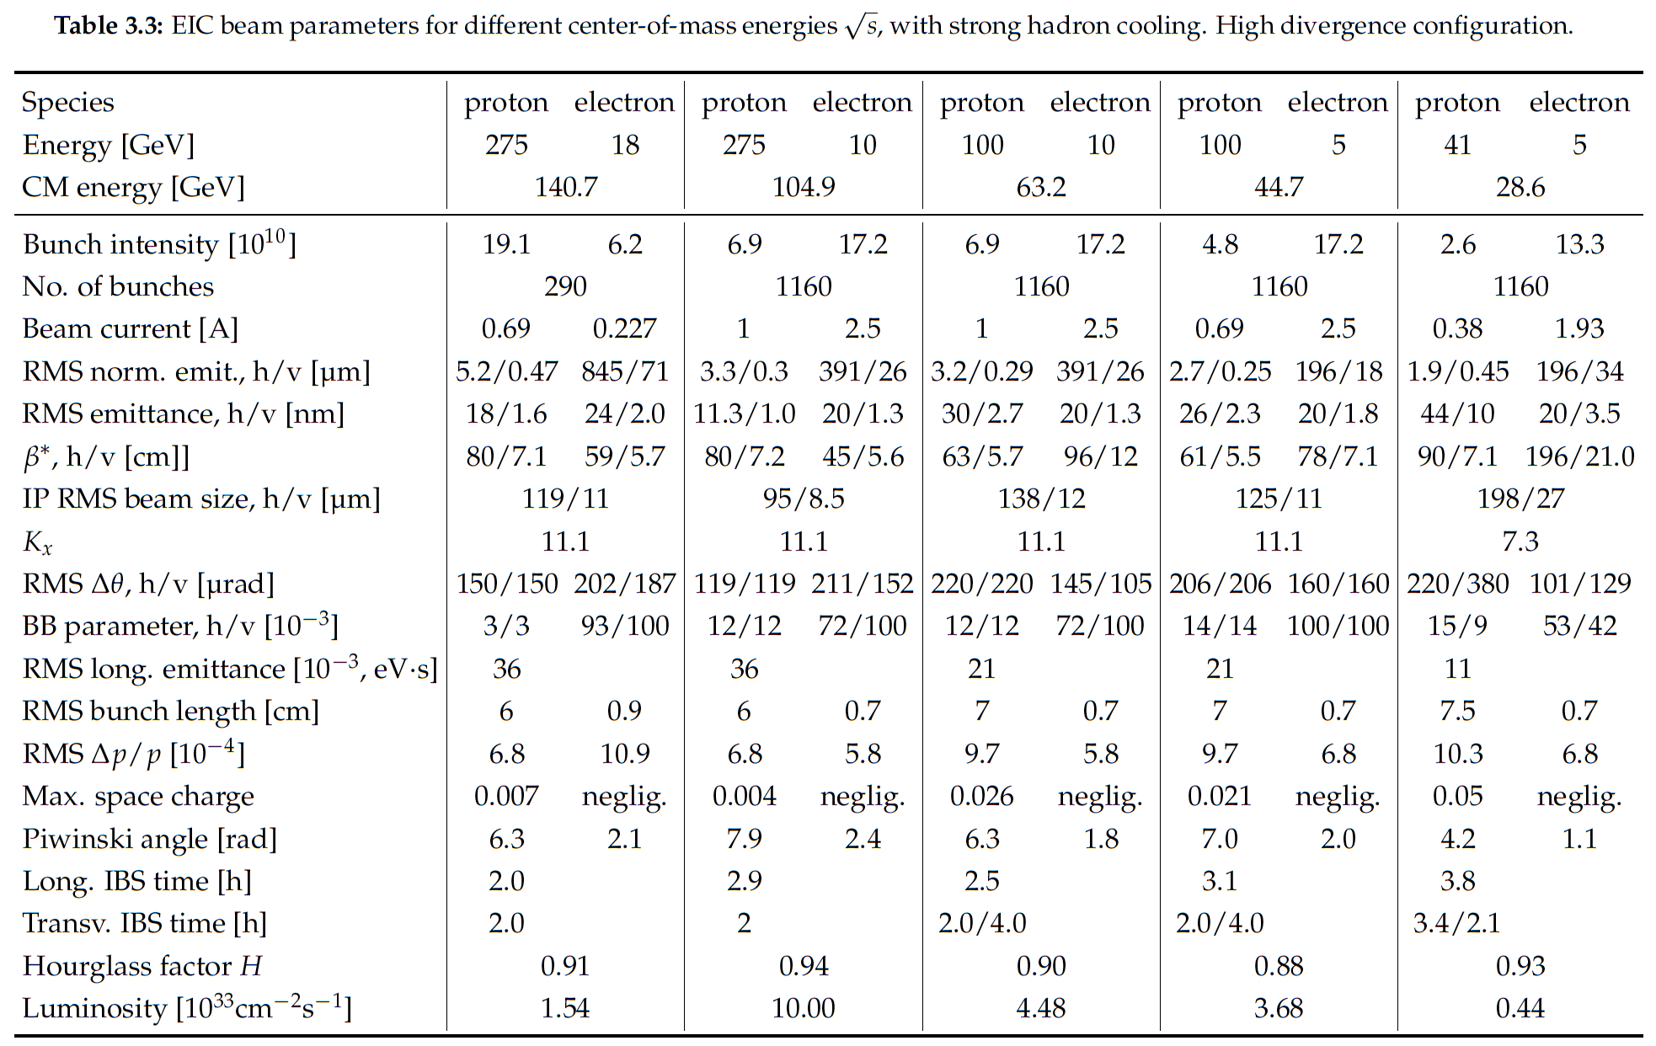

Notes:
LHC design 0.58A p (HL up to 1A), beam-beam parameter 3.4e-4 (3-5—3 HL-LHC)

Slide 7
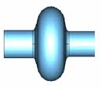
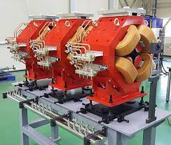
Whoa, wait! Emittance?
Oops - let’s start with some background, scales, and definitions
To zeroth order a separated Lorentz force rules:
  Charged particle beams are ensembles of oscillators
    Manipulated longitudinally by time-varying electric fields from RF cavities
      Typically 10s kV to MV at frequencies of 10s MHz to GHz
      Longitudinal focusing creates bunches (EIC: 10¹⁰⁻¹¹ particles/bunch)
      Sinusoidal weak restoring force => slow pendulum-like oscillator
    Manipulated transversely by (conservative) magnetic fields from magnets
      Typically 10s G (very low energy) to ~4 T+ (superconducting IR)
      Transverse focusing keeps bunches transversely confined
      Linear strong restoring force => fast SHO-like oscillator
Higher orders add messy nonlinearities, coupling, environmental interactions

Slide 8
Focusing on the transverse focusing
Oops - let’s start with some background, scales, and definitions
To zeroth order a separated Lorentz force rules:
  Charged particle beams are ensembles of oscillators
    Manipulated longitudinally by time-varying electric fields from RF cavities
      Typically 10s kV to MV at frequencies of 10s MHz to GHz
      Longitudinal focusing creates bunches (EIC: 10¹⁰⁻¹¹ particles/bunch)
      Sinusoidal weak restoring force => slow pendulum-like oscillator
    Manipulated transversely by (conservative) magnetic fields from magnets
      Typically 10s G (very low energy) to ~4 T+ (superconducting IR)
      Transverse focusing keeps bunches transversely confined
      Linear strong restoring force => fast SHO-like oscillator
Higher orders add messy nonlinearities, coupling, environmental interactions
One
dynamical
dimension
Two separate
dynamical
dimensions

Slide 9
Charged Particle Bending by Magnetic Fields
In a constant magnetic field, charged particles
move in circular arcs of radius ρ with constant
angular velocity ω:
  For (magnets with fields transverse to particle motion)
(Cyclotrons)

Slide 10
Rigidity: Bending Radius vs Momentum
Beam
(particles)
Accelerator (magnets, geometry)
This is such a useful expression in accelerator physics that has its own name: rigidity
Ratio of momentum to charge
  How hard (or easy) is a particle to magnetically deflect?
  Often expressed in [T-m] (right side! Easy to calculate B)
  Be careful when q≠e!!
A possibly useful expression
Notes:
Perpendicular B!
Add q[e] (or Z) to last equation
Be careful; very low-energy people may define rigidity relative to KE rather than p
RHIC: dAu tradeoff

Slide 11
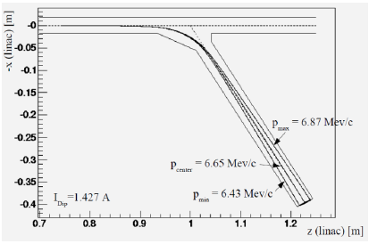
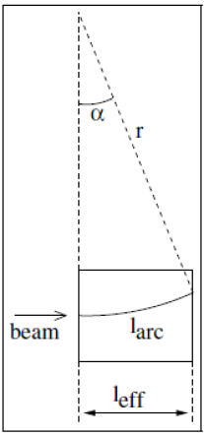
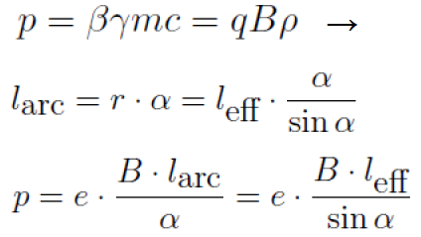
Application: Particle Spectrometer
Measure particle momentum by measuring bend angle from a calibrated magnetic field
Yujong Kim, 2010 USPAS accelerator physics lectures

Slide 12
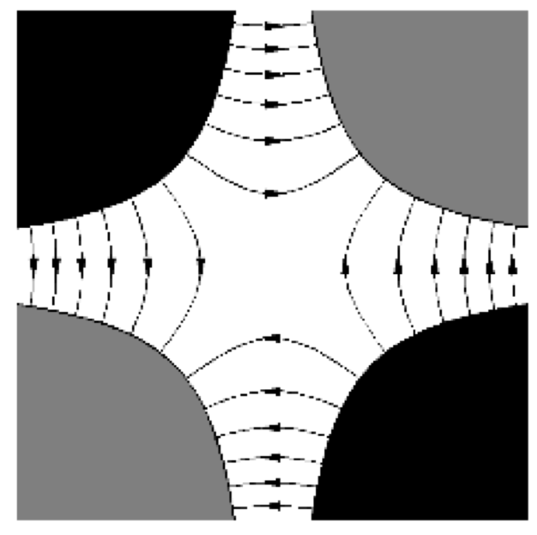
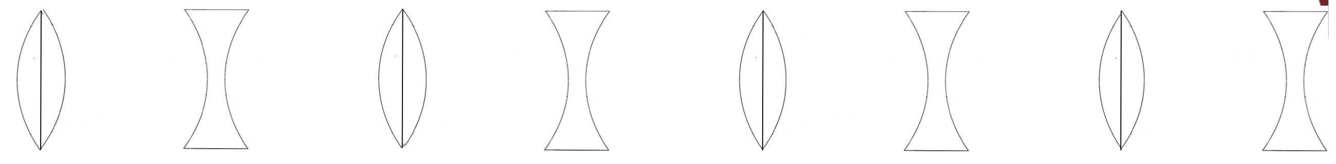
Transverse Charged Particle (De)Focusing
Dipoles (constant uniform field) bend particles: change
Quadrupoles (constant dB/dx and dB/dy) linearly (de)focus particles
  e.g. in horizontal B(x)=x*(dB/dx); Lorentz force is linear in x
  Free space Maxwell’s equations require that dB/dx=-dB/dy
    Discussion: Convince yourself this is true
Horizontal focusing = vertical defocusing
Vertical focusing = horizontal defocusing
Thankfully classical optics tells us alternating
focusing and defocusing is still net focusing

Slide 13
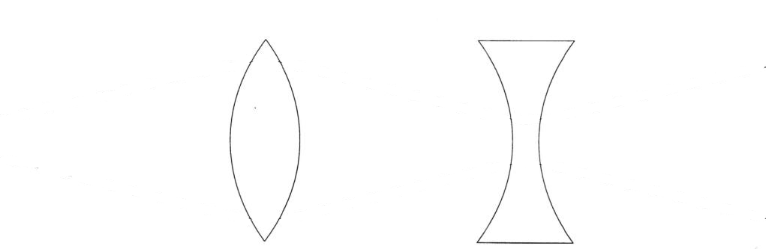
FODO Lives
http://www.toddsatogata.net/2017-USPAS/Lectures/2017-01-18-Chapter5.pdf
By convention horizontal focusing/defocusing is shown; vertical is opposite
Most accelerator lattices (including EIC) are designed in modular ways
  Design and operational clarity, separation of functions
One of the most common modules is a FODO module
  Alternating focusing and defocusing “strong” quadrupoles
  Spaces between are combinations of drifts and dipoles
  Strong quadrupoles dominate the focusing
  Periodicity is one FODO “cell”
  Horizontal beam size largest at centers of focusing quads
  Vertical beam size largest at centers of defocusing quads

Slide 14
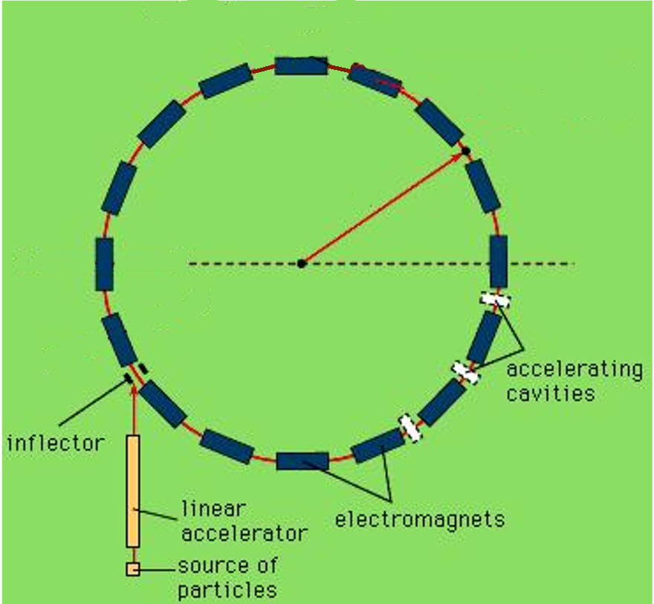
EIC HSR/ESR/RCS are Synchrotrons
”Ring accelerator”
Synchronize bending magnetic field B, beam momentum p
  ~constant design (average) “radius”
Separate RF (longitudinal focusing, acceleration) and magnets (transverse bending/focusing)
Circumference also ~constant
  Revolution frequency and RF frequency change with particle relativistic velocity β, momentum p
(RF)
(B field)

Slide 15
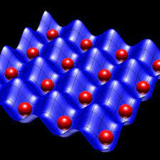
Synchrotrons: Periodic Focusing Systems
Periodic focusing systems with periodic boundary conditions
  A long academic history!
  Solid state, quantum mechanics...
Periodic 1D linear focusing system
  Hill’s Equation (homogeneous)
  Overall synchrotron is periodic, as are repeated FODO “cells”
Symmetry is locally broken for “insertions”
  Match boundary conditions between sections with different K values (focusing)

Slide 16
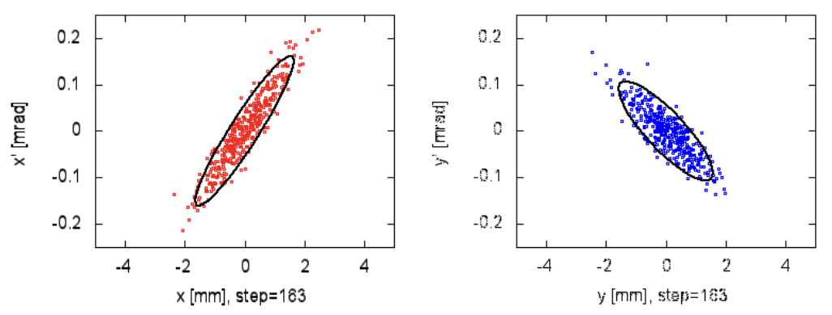
Phase Space and Emittance
Equations of motion are second-order differential equations
Like classical mechanics, particle trajectories are determined by their equation of motion (Hill’s equation) and two initial conditions
  Horizontal x’,y’ are angles
  Vertical
x’,y’ are small for high-energy accelerators
  Paraxial optics approximations apply
Transverse distributions are usually Gaussian
  RMS distribution ellipse area: emittance [mm-mrad]
Longitudinal similar but different

Slide 17
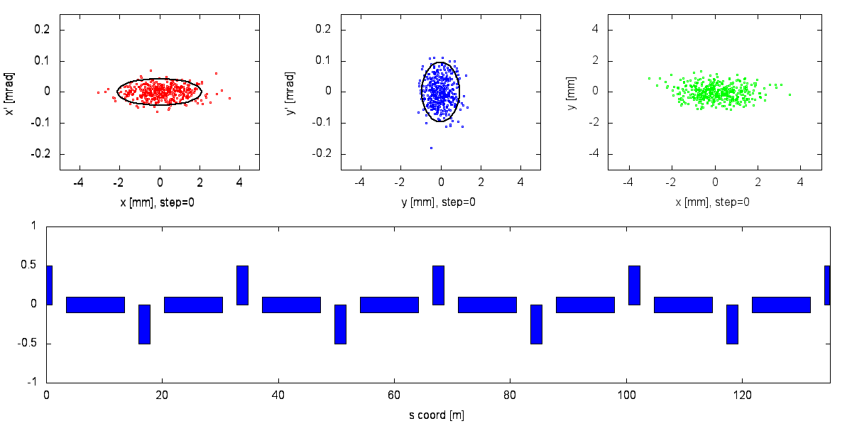
Typical
alternating
FODO
beam size
behavior
Ellipse areas
are horizontal
and vertical
emittances
Emittance is ”conserved” for linear particle motion
  Cooling, synchrotron radiation, IBS, noise etc. violate this conservation
Beam size depends on emittance and optics “beta function”

Slide 18
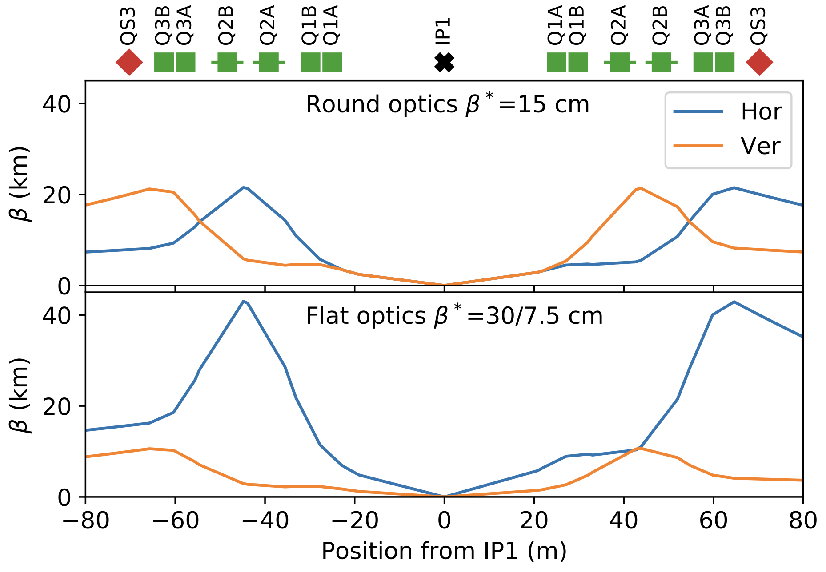
“Blah blah beta star blah blah”
lattice/magnets
beam
Beam size depends on emittance and optics “beta”:
Recall dipoles change
Quadrupoles change
  Look for kinks in beta function plots
Design and control of periodic
focusing (beta functions, beam
sizes): quadrupole layout/strengths
Betas are the main beam size knobs
PHYS. REV. ACCEL. BEAMS 23, 041001 (2020)

Slide 19
Notes:
LHC design 0.58A p (HL up to 1A), beam-beam parameter 3.4e-4 (3-5—3 HL-LHC)

Slide 20

Beta in Free Space
FODO has minimum beta in quadrupoles
  You don’t want our magnets in your detector
  BUT we all want small beam sizes for high luminosity
Can minimum beam size be achieved in ”free space”
  Yes! We can demonstrate in free space
  Design tensions:
    Low beta* for high luminosity
    Proximity of quadrupoles to IP
    Large-aperture quads feasibility/quality
    (Beam divergence near IP; ”hourglass”)
    (Downstream secondary focus)

Slide 21
Notes:
LHC design 0.58A p (HL up to 1A), beam-beam parameter 3.4e-4 (3-5—3 HL-LHC)

Slide 22
Luminosity (Lumi) Limits In One Slide™
Maximize collision frequency (~90 MHz)
  Limited by kicker rise times
  Limited by parasitic collisions (crabbing)
Maximize particles per bunch (~10¹¹)
  Limited by sources, space charge
  Limited by collective effects
    Interaction of beam with impedances
    Also total currents: I_{1,2}=q_{1,2}N_{1,2}f_{coll} ~1-3A
Minimize beam sizes at IP (~250/25 um)
  Limited by IR focusing, magnets
  Limited by chromatic dynamic aperture
  Limited by emittance growth (IBS)
Every parameter optimized
separately and collectively in the
EIC design
Try multiplying out the given numbers –
should be very close to 10³⁴ cm⁻²s⁻¹

Slide 23
Luminosity (Lumi) Limits In One Slide™
Maximize collision frequency (~90 MHz)
  Limited by kicker rise times
  Limited by parasitic collisions (crabbing)
Maximize particles per bunch (~10¹¹)
  Limited by sources, space charge
  Limited by collective effects
    Interaction of beam with impedances
    Also total currents: I_{1,2}=q_{1,2}N_{1,2}f_{coll} ~1-3A
Minimize beam sizes at IP (~250/25 um)
  Limited by IR focusing, magnets
  Limited by chromatic dynamic aperture
  Limited by emittance growth (IBS)
Every parameter optimized
separately and collectively in the
EIC design
Try multiplying out the given numbers –
should be very close to 10³⁴ cm⁻²s⁻¹

Slide 24
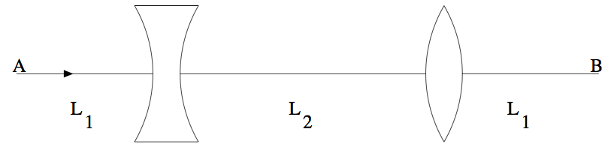
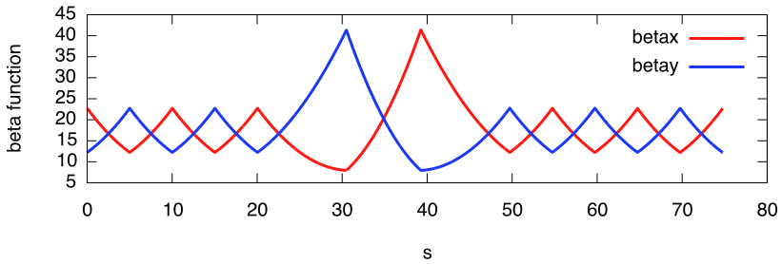
“π/2” Insertion
“Make smaller beam size in longer magnet-free region”
Among simplest insertions
Match boundary conditions at insertion ends
π/2 insertion
5m FODO drifts
l₁=7.95m, l₂=8.75m

Slide 25
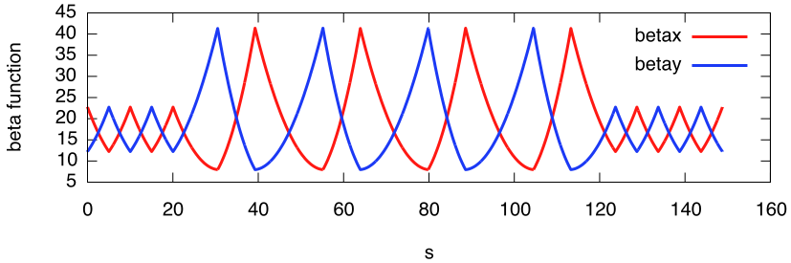
Multiple π/2 Insertions
I = Identity Matrix

Slide 26
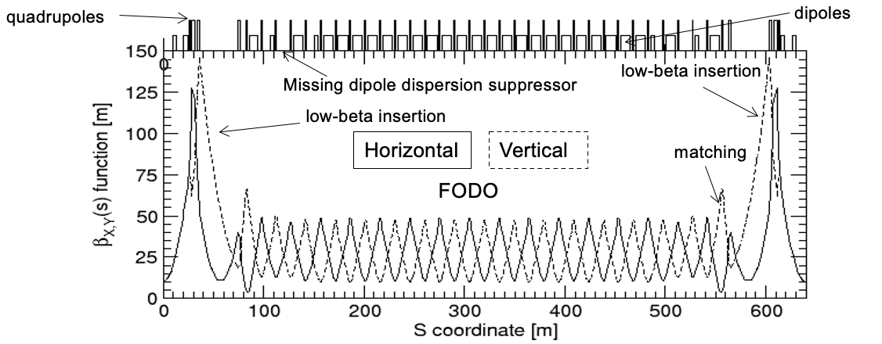
(1/6 of)
RHIC
Lattice
Note modular, symmetric design, including low-beta insertions
  Used for experimental collisions
  Minimum beam sizes σ_{x,y} , Maximize luminosity
  Large σ_{x,y} , beam sizes in “low beta quadrupoles”
Other facilities also have longitudinal bunch compressors
  Minimize longitudinal beam size (bunch length) for, e.g, FELs

Slide 27
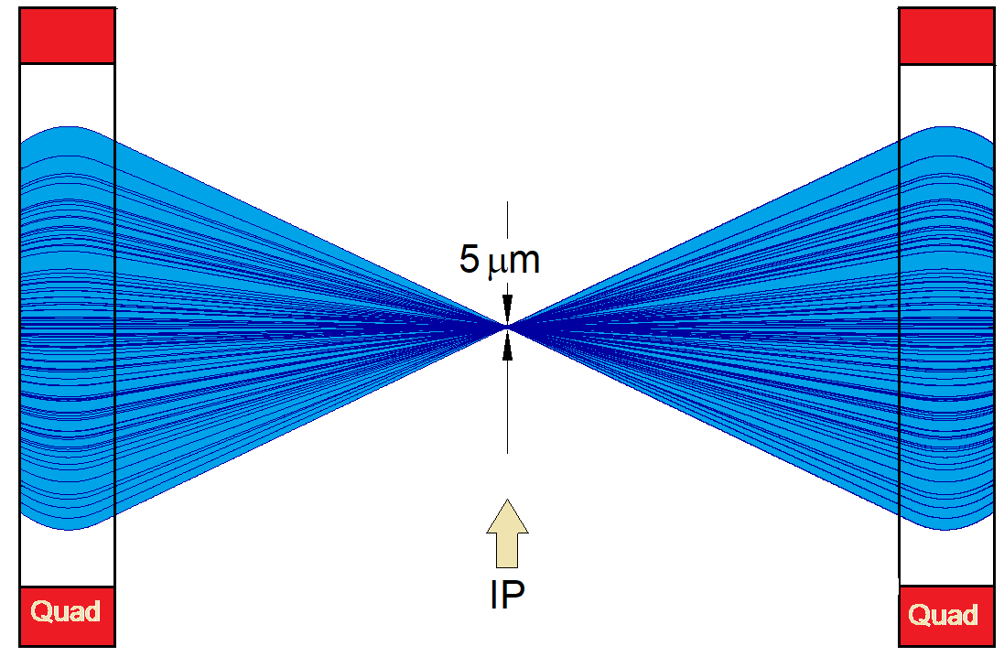
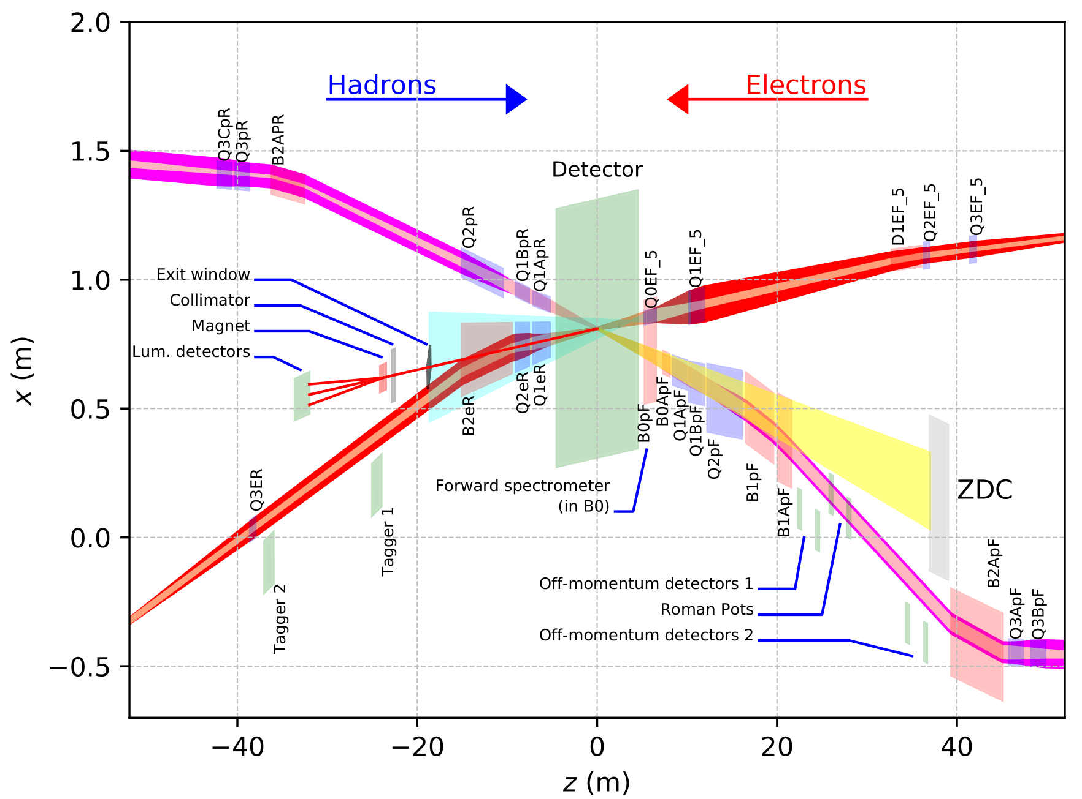
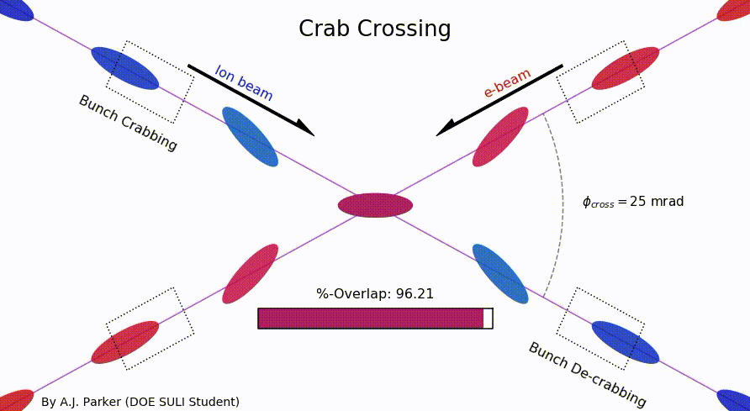
EIC Primary Interaction Region
Existing tunnel and
experiment halls
Focusing (quads)
as close to IP as
possible (~5m!)
Tensions in magnet
requirements:
high field
large apertures
e/p magnet
proximity near IP
Chromaticity:
focusing dependence
on particle energy
”Rear side”
Different
axis scales!
”Forward side”
25 mrad crab crossing
A. Parker (SULI)
D. Higinbotham

Slide 28
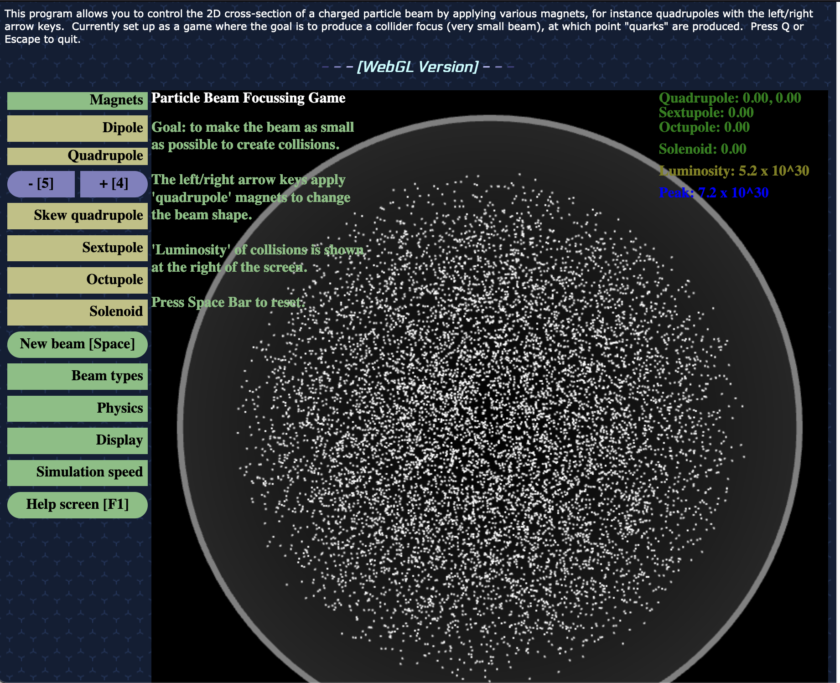
Final Focus/Luminosity Game
http://stephenbrooks.org/ap/beam2d/
Can you achieve a peak luminosity of
10³⁴ cm⁻² s⁻¹?
(NB: You may have to click on up/down rather than using the arrow keys)

