Slide 1



Particle Detectors and the ePIC Experiment
Lecture 2: EIC Detectors and ePIC
John Lajoie
2023 CFNS-CTEQ Summer School on
Physics of the Electron-Ion Collider

Slide 2
Outline of Lectures
Lecture 1: Particle Physics Detectors
  Interaction of Particles with Matter
  Tracking Detectors
  Calorimetry
  Particle Identification
Lecture 2: The ePIC Detector and the EIC
  Detector requirements at the EIC
  The design of the ePIC Detector
  Interaction Region Considerations

Slide 3
How Do You Study the Structure of Matter?
Deep Inelastic Scattering: e + p → e’ + X
● Golden process to probe nucleons and nuclei with electron beams
providing the unmatched precision of electromagnetic interactions
Q² = s ・ x ・ y
Q² – resolution power (virtuality of the photon)
s – center-of-mass energy squared
x - the fraction of the nucleon’s momentum carried by the struck quark
y – inelasticity
Center-of-mass energy √s: 20 – 140 GeV
● Explore QCD landscape over large range of resolution (Q²) and
quark/gluon density (1/x)

Slide 4
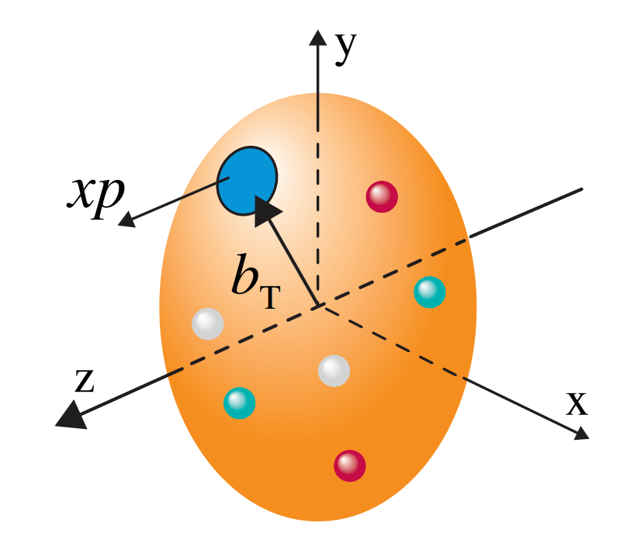
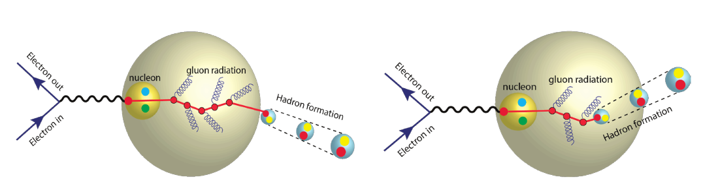
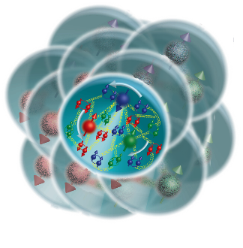
The EIC Science Mission
How do the nucleon properties like mass and spin emerge from quarks and their interactions?
How are the sea quarks and gluons, and their spins, distributed in space and momentum inside the nucleon?
What impact does a high-density nuclear environment have on the interactions, correlations, and behaviors of quarks and gluons?
Is there a saturation point for the density of gluons in nuclei at high energies, and does this lead to the formation of gluonic matter with universal properties across all nuclei, including the proton?
In what manner do color-charged quarks and gluons, along with colorless jets, interact with the nuclear medium? And how do the confined hadronic states emerge from these quarks and gluons?
What is the mechanism through which quark-gluon interactions give rise to nuclear binding?
4

Slide 5
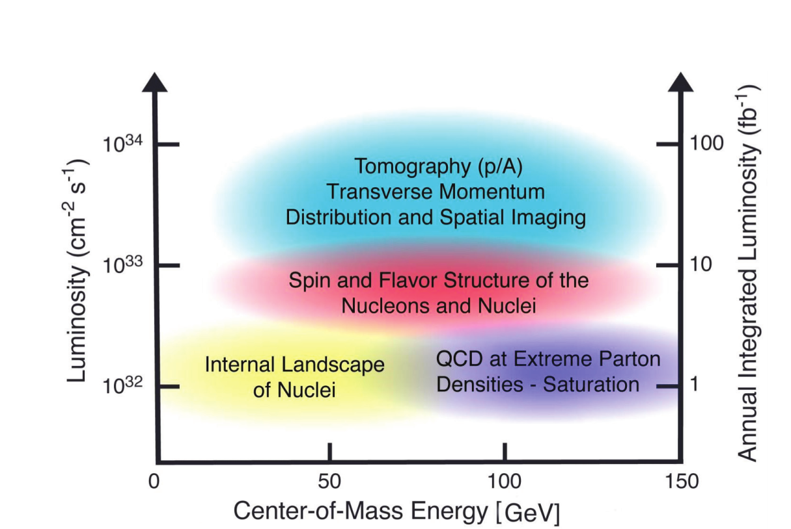
EIC Machine Parameters
Center of mass energy: 20 – 140 GeV
  Electrons: 2.5 – 18 GeV
  Protons: 40 – 275 GeV (ions: Z/A x E_{proton})
Luminosity: 10³⁴ /cm²/sec
Polarization: <70% (both electron and ion)
Ion Species: proton - Uranium
Detectors: up to 2 interaction regions
with (almost) complete coverage

Slide 6
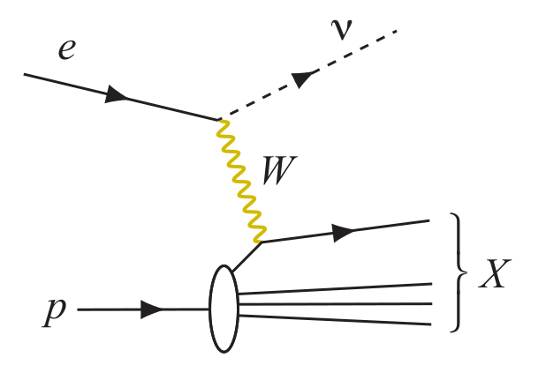
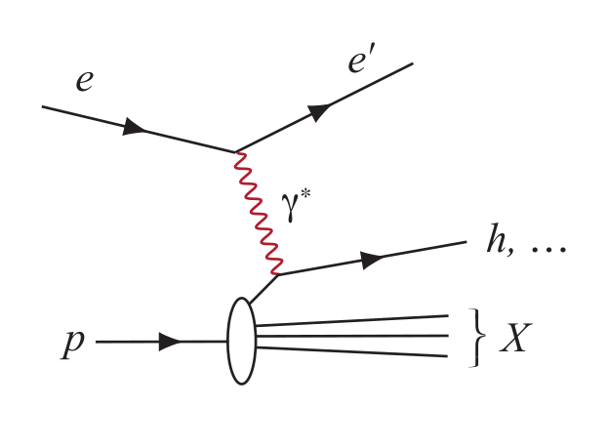
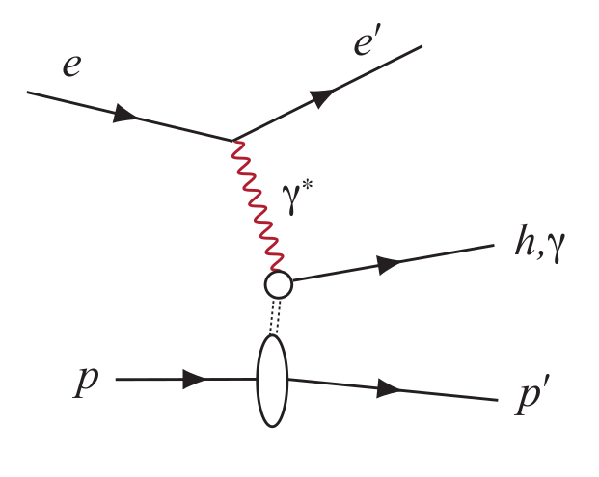
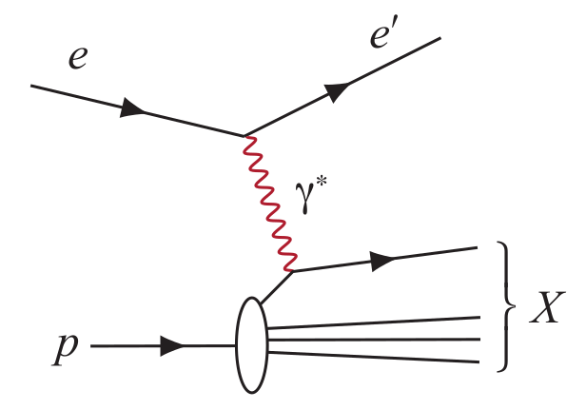
Experimental Processes to Access EIC Physics
DIS event kinematics - scattered electron or final state particles (CC DIS, low y)
Neutral Current DIS
Detection of scattered electron with high precision - event kinematics
Charged Current DIS
Event kinematics from the final state particles (Jacquet-Blondel method)
Semi-Inclusive DIS
Precise detection of scattered electron in coincidence with at least 1 hadron
Deep Exclusive Processes
Detection of all particles in event
Parton Distributions in nucleons and nuclei
Spin and
Flavor structure of nucleons and nuclei
Tomography Transverse Momentum Dist.
QCD at Extreme Parton Densities - Saturation
Tomography
Spatial Imaging

Slide 7
The EIC Yellow Report
The EIC yellow report was an enormous community exercise to quantify the physics and detector requirements to be able to purse EIC physics.
https://arxiv.org/abs/2103.05419

Slide 8
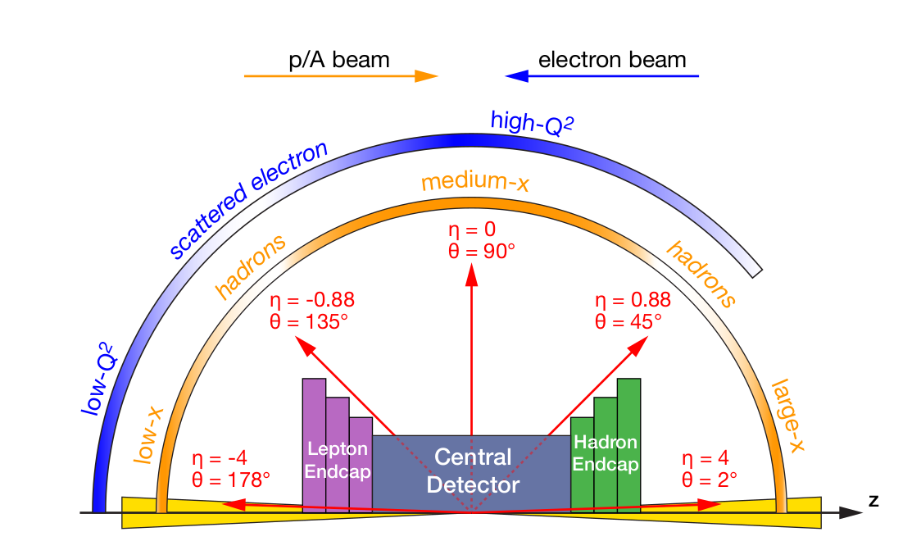
EIC Detector Requirements
Vertex detector → Identify primary and secondary vertices,
Low material budget: 0.05% X/X₀ per layer
High spatial resolution: 10 mm pitch CMOS Monolithic Active Pixel Sensor
Central and Endcap tracker → High precision low mass tracking
MAPS – tracking layers in combination with micro pattern gas detectors
Particle Identification → High performance single track PID for π, K, p separation
RICH detectors (RICH, DIRC)
Time-of-Flight high resolution timing detectors (LAPPDs, LGAD)
Novel photon sensors: MCP-PMT / LAPPD
Electromagnetic calorimetry → Measure photons (E, angle), identify electrons
PbWO₄ Crystals (backward), W/ScFi (forward)
Barrel Imaging Calorimeter (Si + Pb/ScFi)
Hadron calorimetry → Measure charged hadrons, neutrons and K_{L}⁰
Achieve ~70%/√E + 10% for low E hadrons (~ 20 GeV)
Fe/Sc sandwich with longitudinal segmentation
Very forward and backward detectors → Large acceptance for diffraction, tagging, neutrons from nuclear breakup
Silicon tracking layers in lepton and hadron beam vacuum
Zero-degree high resolution electromagnetic and hadronic calorimeters
DAQ & Readout Electronics → trigger-less / streaming DAQ, Integrate AI into DAQ
Radius/Distance from IP

Slide 9
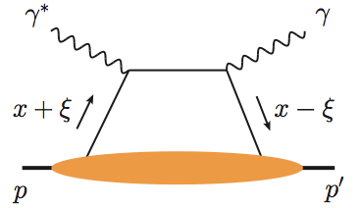
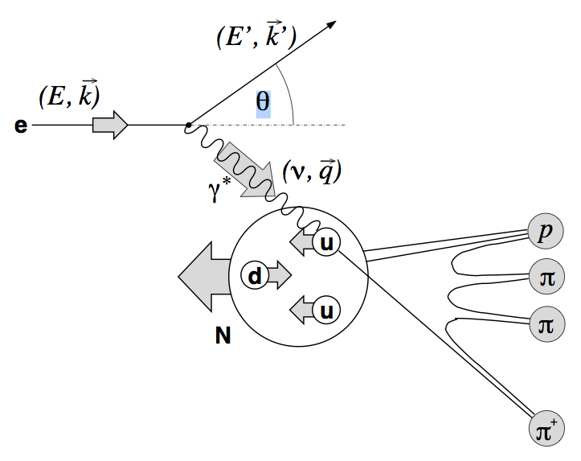
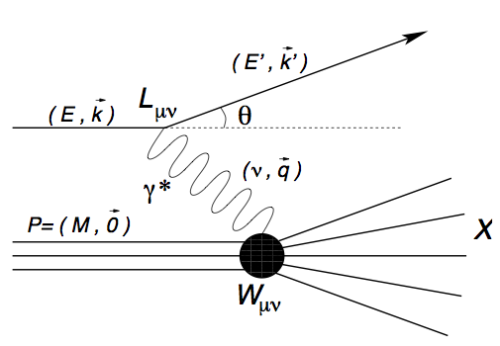
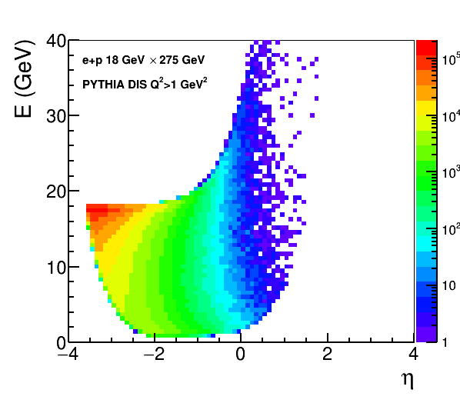
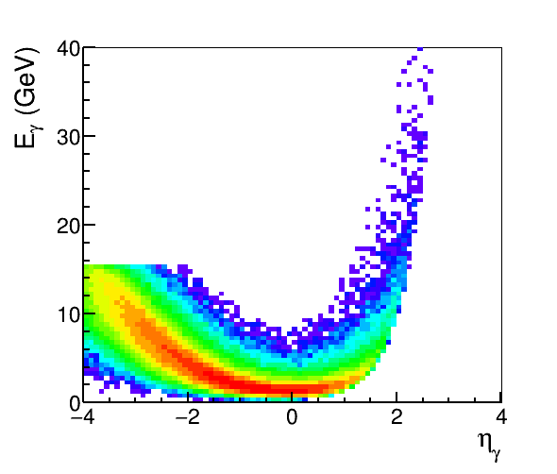
Example: EM
Calorimetry Requirements
Electron/photon PID, energy, angle/position:
Coverage (in rapidity and energy), resolution, e/𝜋, granularity, projectivity
DIS e
DVCS photons
SIDIS π0
MILOU DVCS
e+p 18×275 GeV
PYTHIA
18 x 275 GeV
e-endcap
Barrel
h-endcap

Slide 10

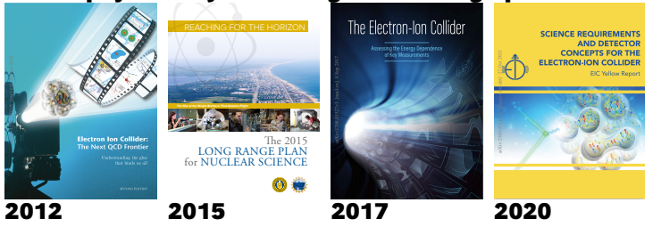
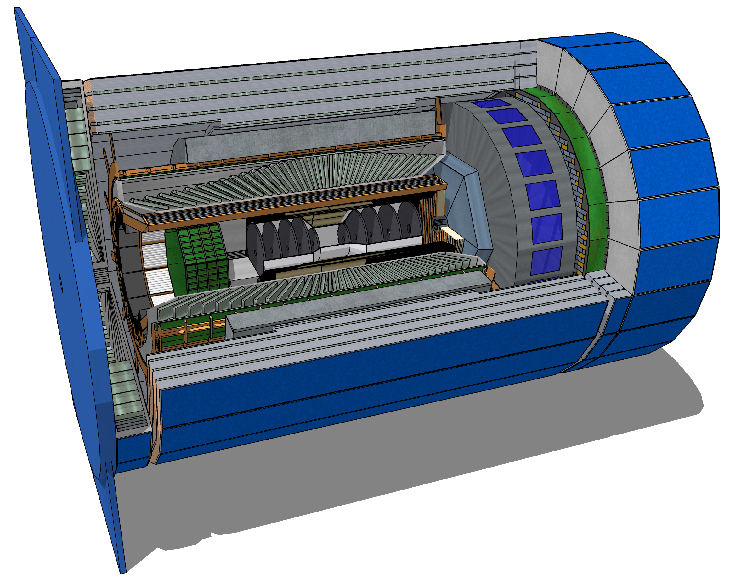
Detector Design Process Timeline
Detector and machine design parameters driven by physics objectives
Call for proposals issued jointly by BNL and JLab in March 2021 (Due Dec 2021)
  ATHENA, CORE and ECCE proposals submitted
DPAP closeout March 2022
  ECCE proposal chosen as basis for first EIC detector reference design
Spring/Summer 2022 – ATHENA and ECCE form joint leadership team
  Joint WG’s formed and consolidation process undertaken
  Coordination with EIC project on development of technical design
Collaboration formation process started July 2022
Charter ratified & elected ePIC Leadership Team February 2023
Working towards TDR and CD-3A and CD-2/3

Slide 11
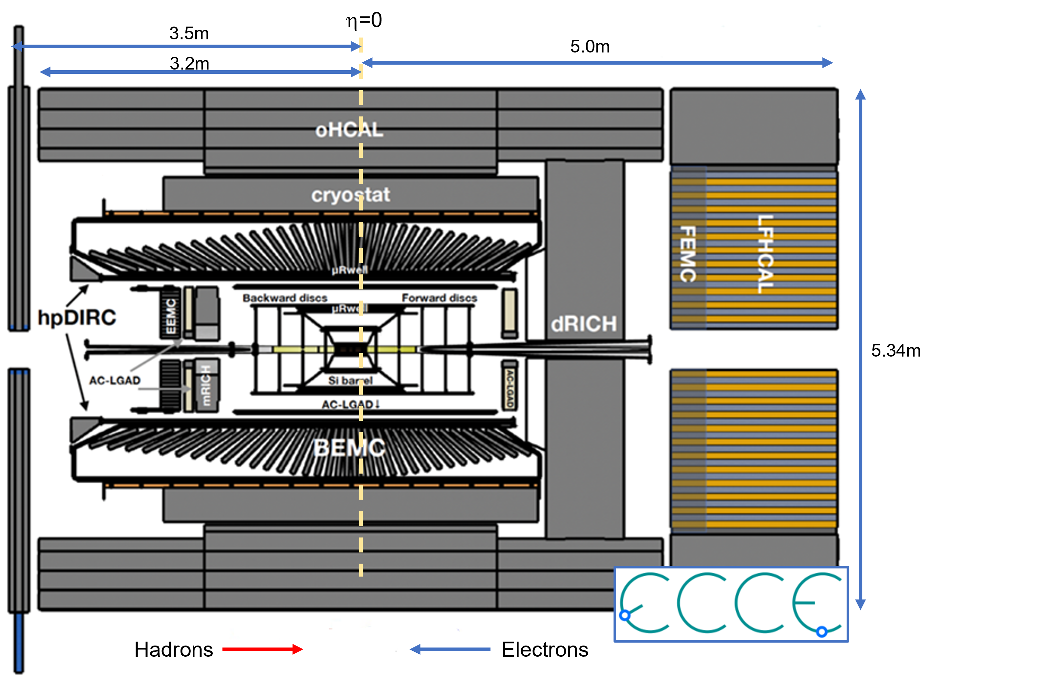
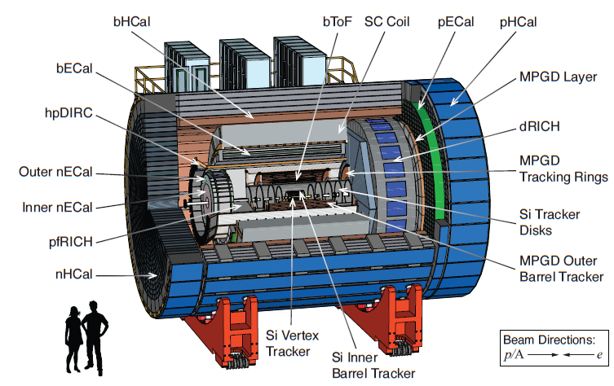

ECCE and ATHENA
Key conceptual differences – bore size and magnetic field!
Notes:
BaBar 2.8M 1.4T ATHENA 3.2M 3.0T

Slide 12
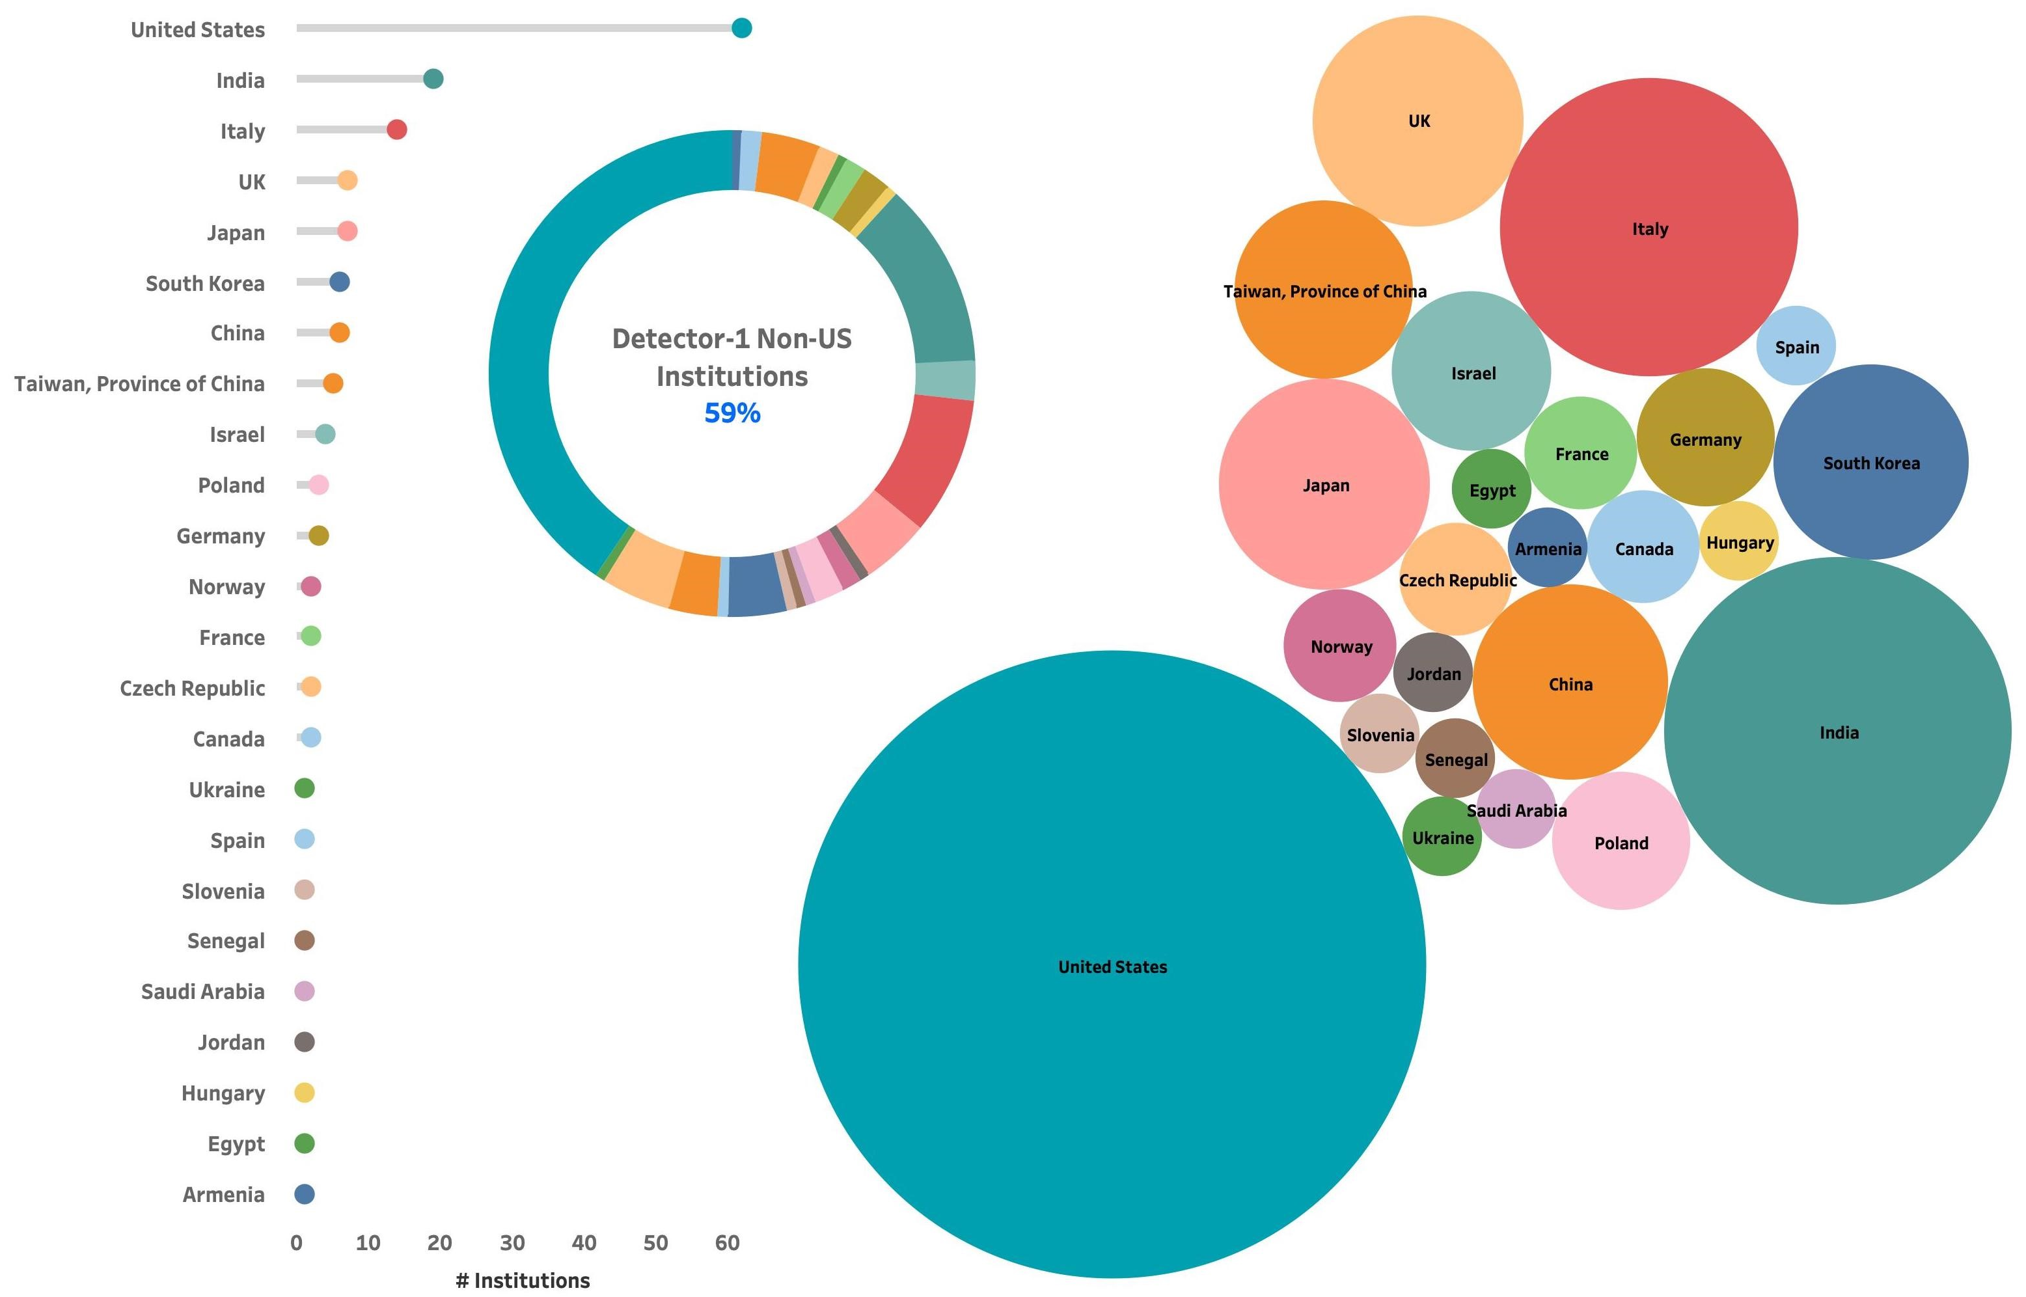
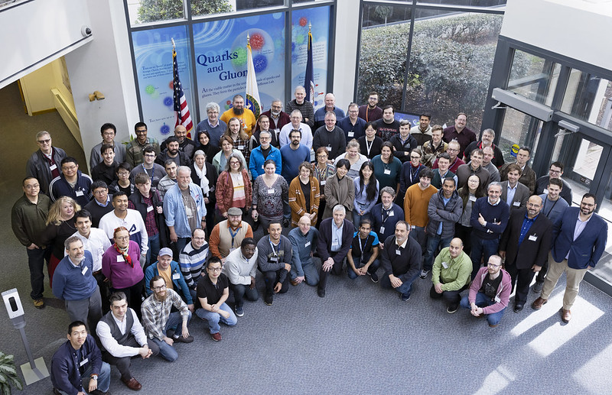
The ePIC Collaboration
160+ institutions
24 countries
500+ participants
A truly global pursuit for a new experiment at the EIC!
ePIC non-US
Institutions
59%
Notes:
24 countries total

Slide 13
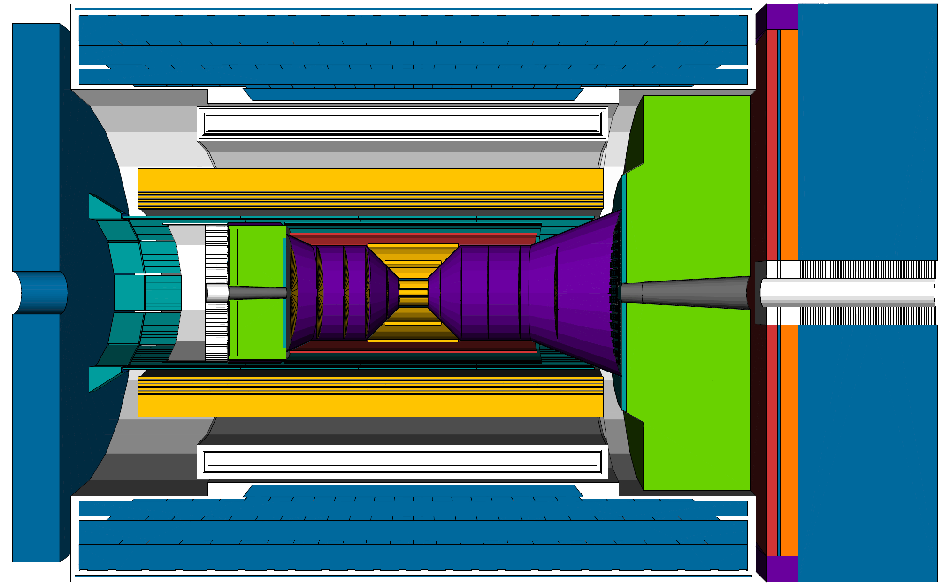
ePIC Detector Design
3.5m
η=0
5.0m
3.2m
Tracking:
  New 1.7T solenoid
  Si MAPS Tracker
  MPGDs (μRWELL/μMegas)
PID:
  hpDIRC
  pfRICH
  dRICH
  AC-LGAD (~30ps TOF)
Calorimetry:
  Imaging Barrel EMCal
  PbWO4 EMCal in backward
  direction
  Finely segmented EMCal +HCal
  in forward direction
  Outer HCal (sPHENIX re-use)
  Backwards HCal (tail-catcher)
Barrel HCAL
Solenoid
Backwards HCAL
Forward LFHCAL
Barrel EMCAL
TOF
dRICH
hpDIRC
pfRICH
SVT
5.34m
EEMC
FEMC
hadrons
electrons

Slide 14
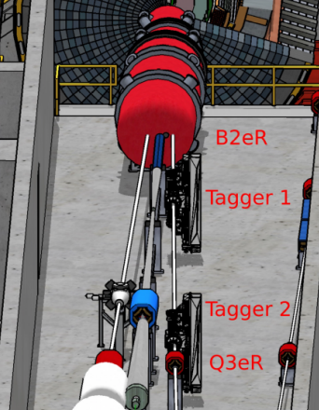
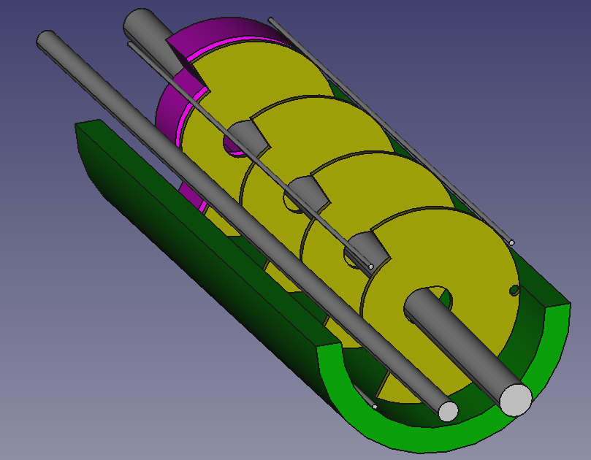
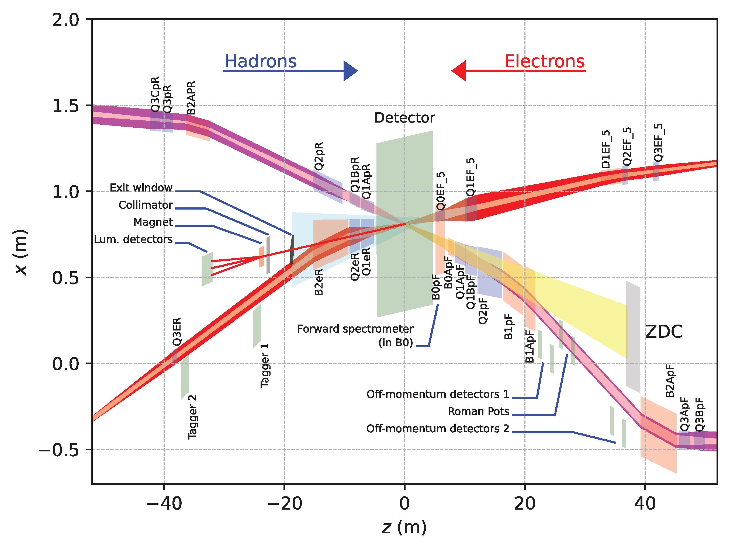
Far-Forward and Far-Backward Detectors
8.5m
PbW04 EMCAL
Si Tracking
Far-Backward Detectors
Luminosity monitor
Low-Q² Tagging Detectors
Far-Forward Detectors
B0 Tracking and Photon Detection
Roman Pots and Off-Momentum Detectors
Zero-Degree Calorimeter

Slide 15
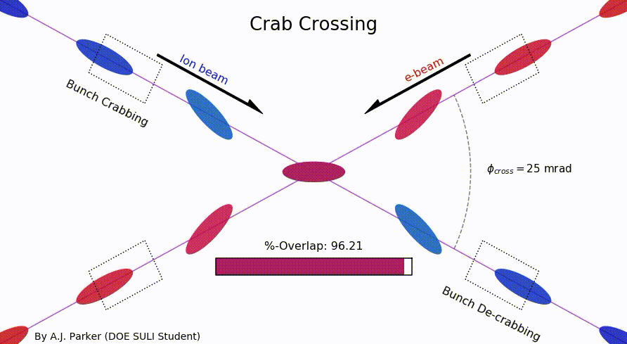
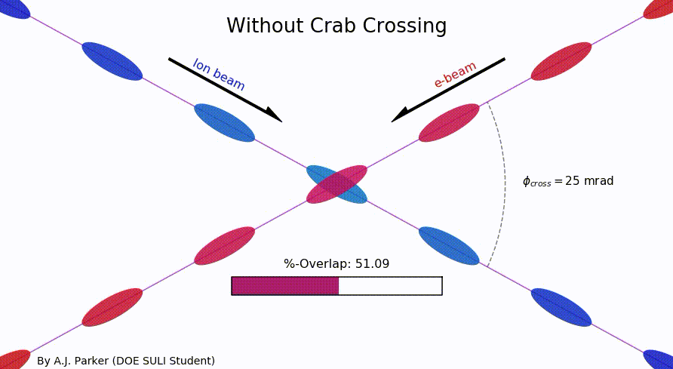
Why a Crossing Angle?
Brings focusing magnets close to IP
→ high luminosity
Beam separation without separation dipoles
→ reduced synchrotron radiation background
But significant loss of luminosity!
Solution: Crab crossing
Head-on collision geometry is restored by rotating the bunches before colliding (“crab crossing”)
Bunch rotation (“crabbing”) is accomplished by transversely deflecting RF resonators (“crab cavities”)
Actual collision point moves laterally during bunch interaction

Slide 16
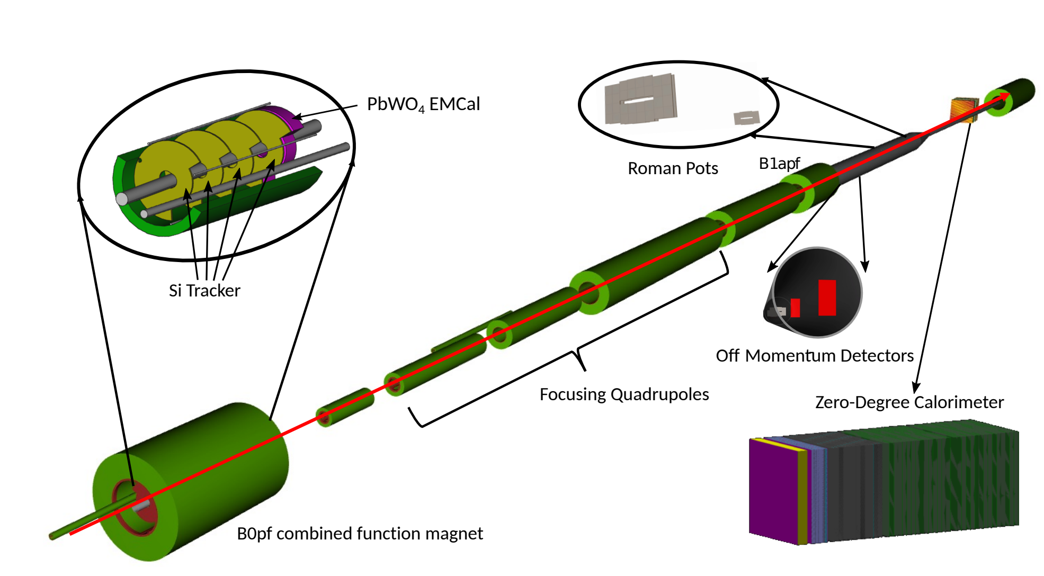
Far-Forward Detectors
B0 system: Measures charged particles in the forward direction and tags neutral particles
Off-momentum detectors: Measure charged particles resulting from, e.g., decays and fission
Roman pot detectors: Measure charged particles near the beam
Zero-degree calorimeter: Measures neutral particles at small angles
Detector | Acceptance
Zero-Degree Calorimeter (ZDC) | 𝜽 < 5.5 mrad (𝜂 > 6)
Roman Pots (2 stations) | 0.0 < 𝜽 < 5.0 mrad (𝜂 > 6)
Off-Momentum Detectors (2 stations) | 𝜽 < 5.0 mrad (𝜂 > 6)
B0 Detector | 5.5 < 𝜽 < 20.0 mrad (4.6 < 𝜂 < 5.9)

Slide 17
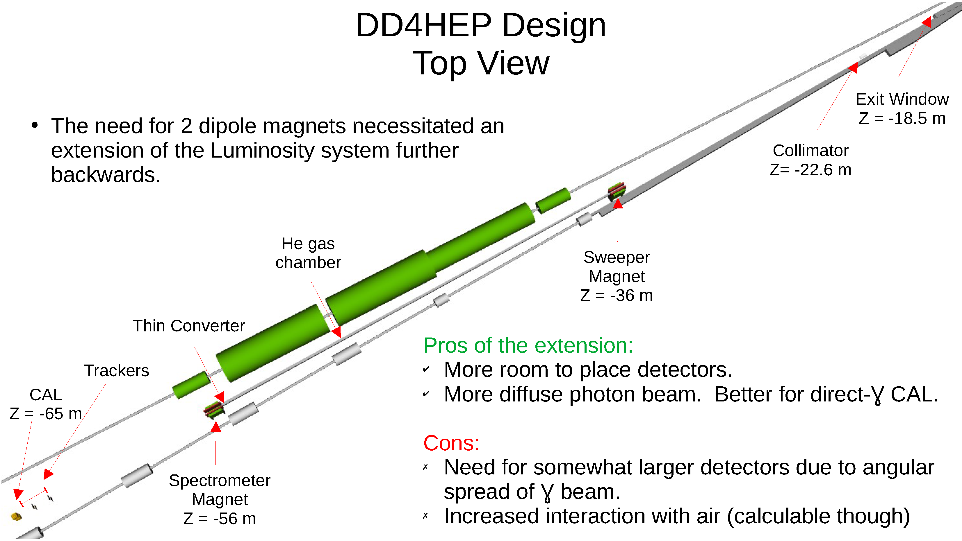
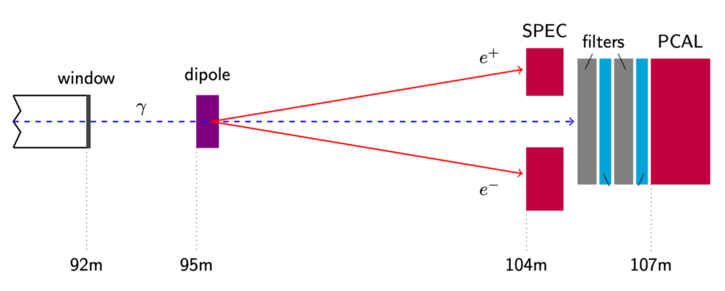
Far Backwards Detectors
Luminosity Spectrometer
Low-Q² tagger
~1% measure of luminosity
relative luminosity to 10⁻⁴
e+p → e γ p
e+Au → e γ Au
Clean photoproduction signal for
10⁻³ < Q² < 10⁻¹

Slide 18
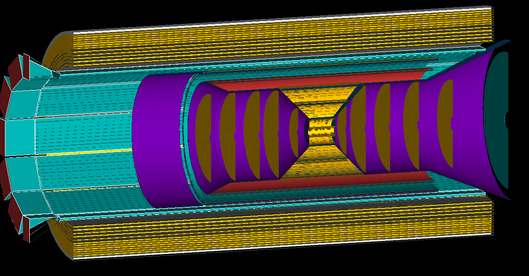
Tracking
Barrel tracking layers
AstroPix (MAPS) layer (behind DIRC)
Inner two vertex layers optimized for beam pipe bakeout and ITS-3 sensor size
Third layer dual-purpose (vertex + sagitta) - 5 layers total
Five discs in forward/backwards direction (ITS-3 based large area sensor design EIC LAS)
Cylindrical μMega provide pattern recognition redundancy
1st AstroPix layer of Barrel ECal provides ring seed direction, space point for pattern recognition
cylindrical μMegas layer
Service cones and cylinders
Backward/Forward tracking discs (5 layers)

Slide 19
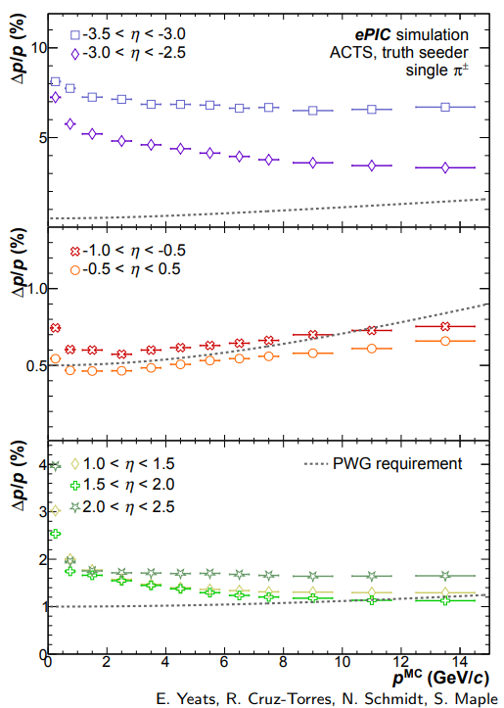
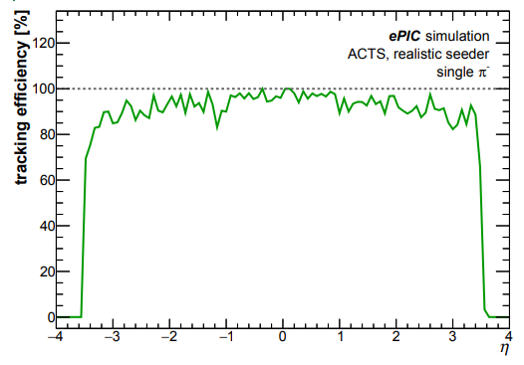
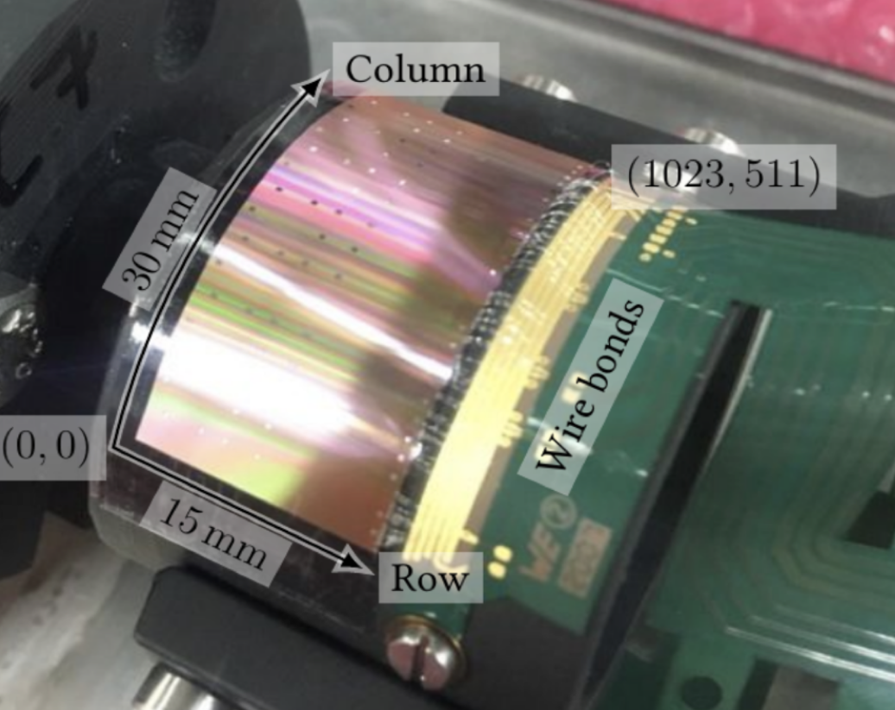
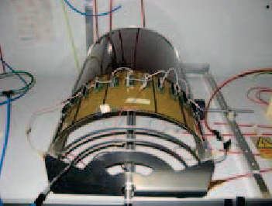
Tracking
Simulated performance
F. Bock, Hard Probes 2023
Technology
ITS3 MAPS based Si-detectors:
O(10µm) pitch, X/X⁰ ∼ 0.05 − 0.55%/ layer
Gaseous tracker:
σ = 55 µm, X/X₀ ∼ 0.2%/layer
AstroPix outer tracker layer:
500µm pixel pitch (σ = 144 µm)
F. Bock, Hard Probes 2023
First “μITS3” assembly at CERN
Cylindrical μMega
Meets EICUG Yellow Report design requirements
Backward momentum resolution complemented by calorimetric resolution

Slide 20
Si Detector Readout
STROBE selects 1 out of 3 latches to store state of discriminator; then MEMSEL allow reading out 1 out of 3 latches through priority encoder.
The precision of time measurement of ALPIDE/ALICE-ITS3 cannot be better than time between STROBES; but if STROBES are sent too often, same hits will be reported multiple times.
The ITS3 STROBE time is expected to be about 2μs – this will integrate over 200 bunch crossings!
Need a fast detector to sort ambiguities!

Slide 21
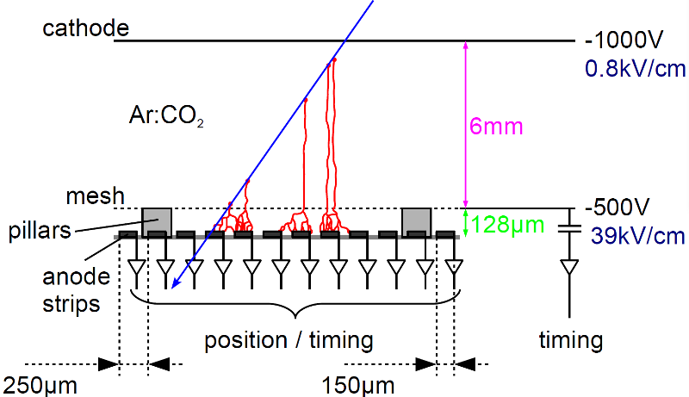
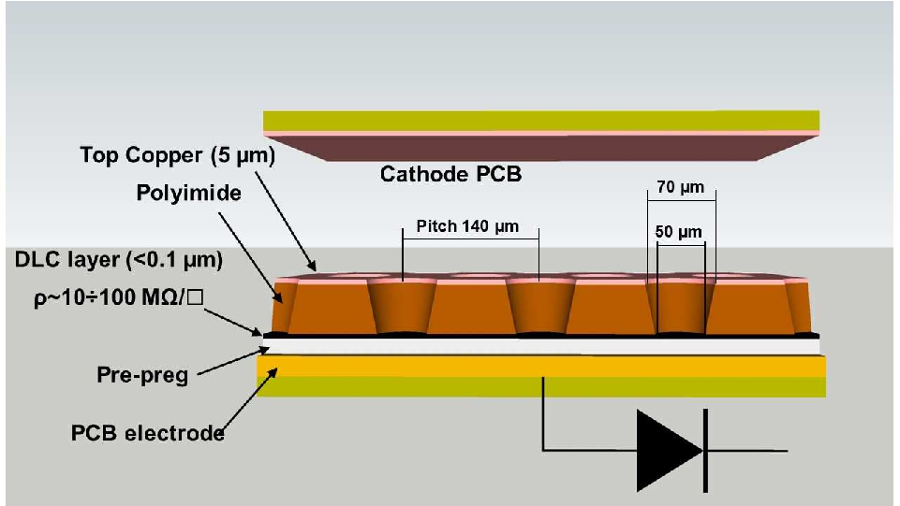
Micro Pattern Gas Detectors
Both types of detectors have good spatial resolution of order ~150μm with a fast time response (<10ns).
mMega detectors have been demonstrated in a cylindrical geometry.
μRWell Detector
μMega Detector

Slide 22
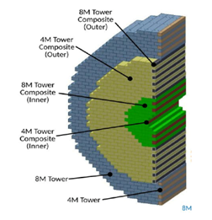
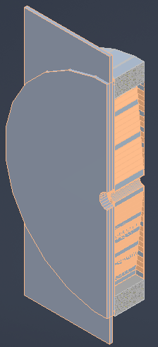
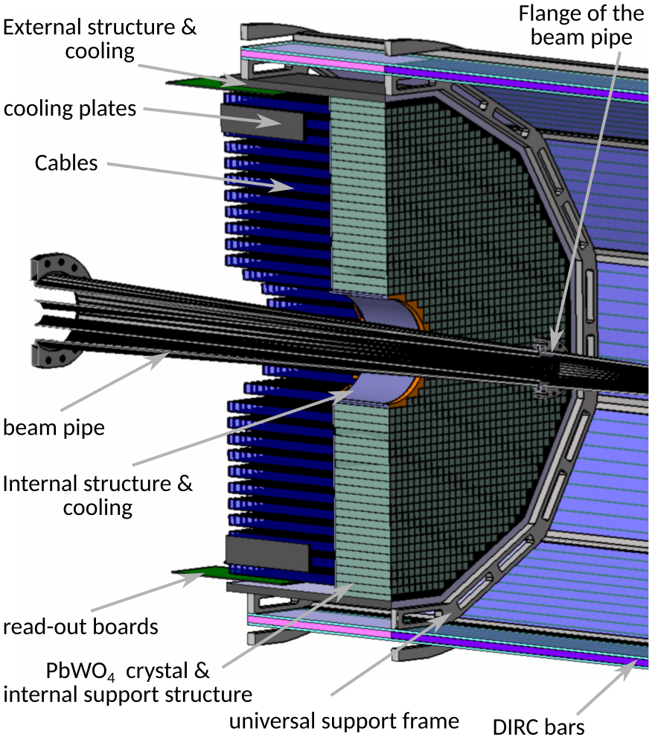
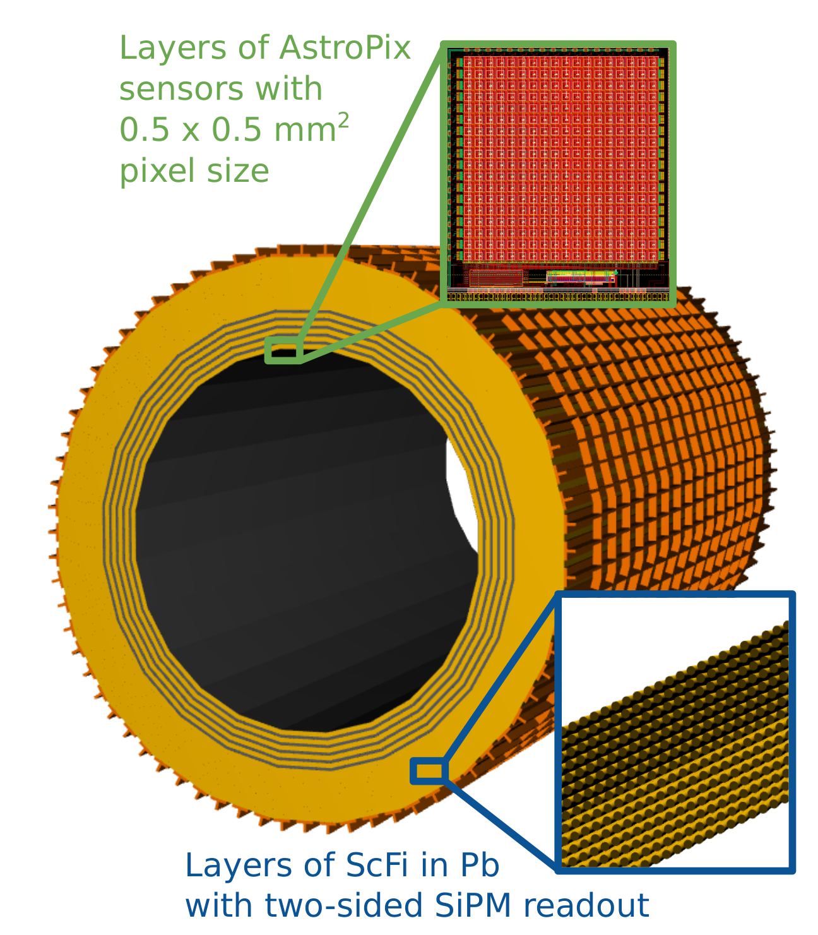
Calorimetry
Backwards HCal
Steel/Sc Sandwich
tail catcher
High granularity
W/SciFi EMCal
Longitudinally separated HCAL with high-η insert
Backwards EMCal
PbW04 crystals
Barrel HCAL
(sPHENIX re-use)

Slide 23
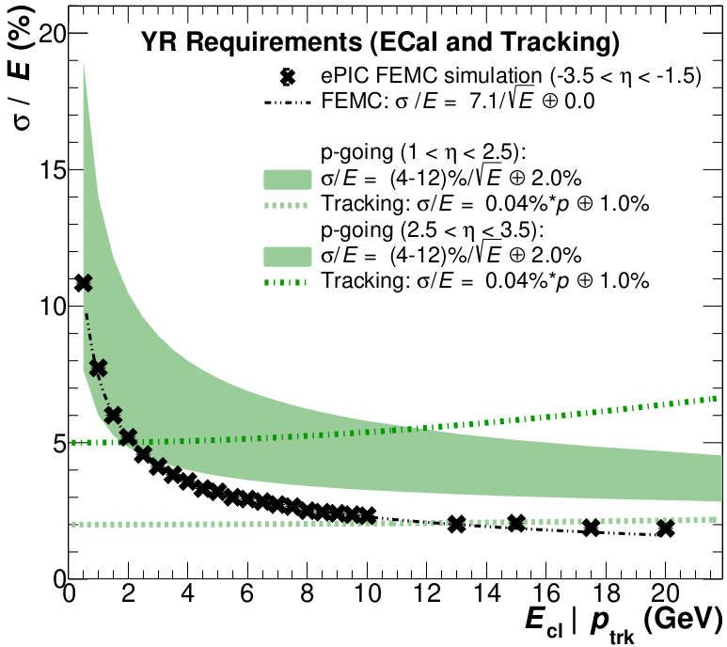
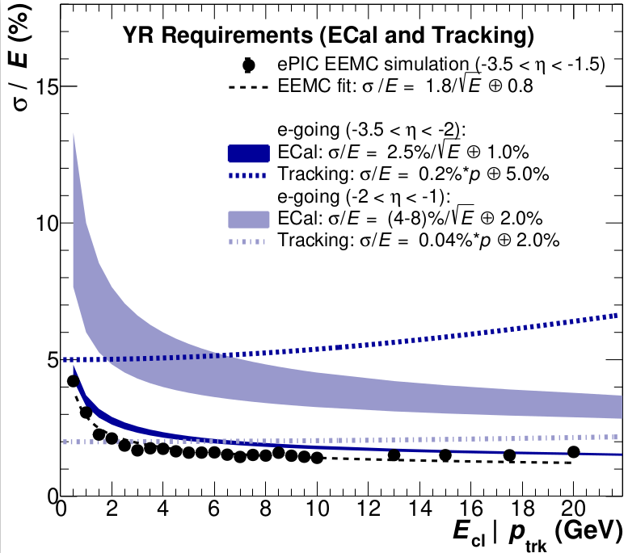
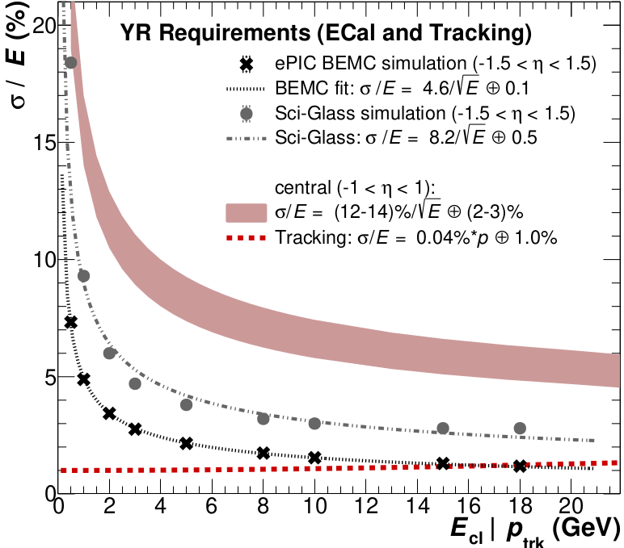
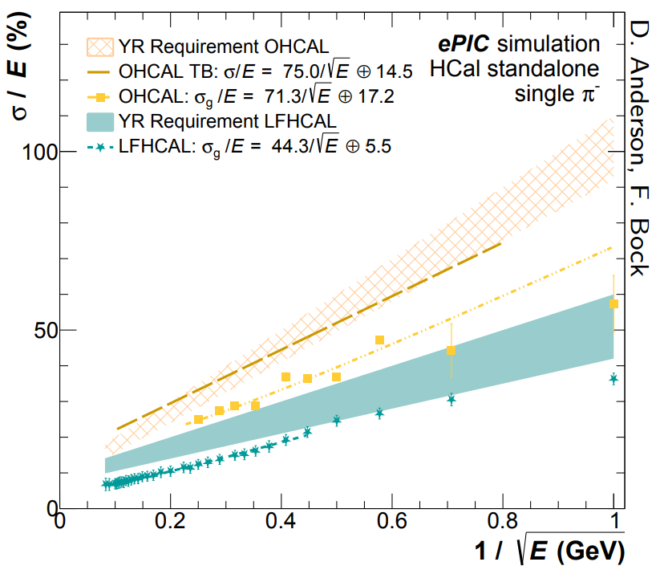
Calorimetry Performance
plots by N. Schmidt
F. Bock, Hard Probes 2023
Performance on energy resolution and matching
Technologies fulfill YR requirements on energy resolution
Ongoing simulation studies related to overlaps between different η regions for calorimetry and reconstruction algorithms
Ongoing work on Monte-Carlo validation
Validation for high Z absorbers

Slide 24
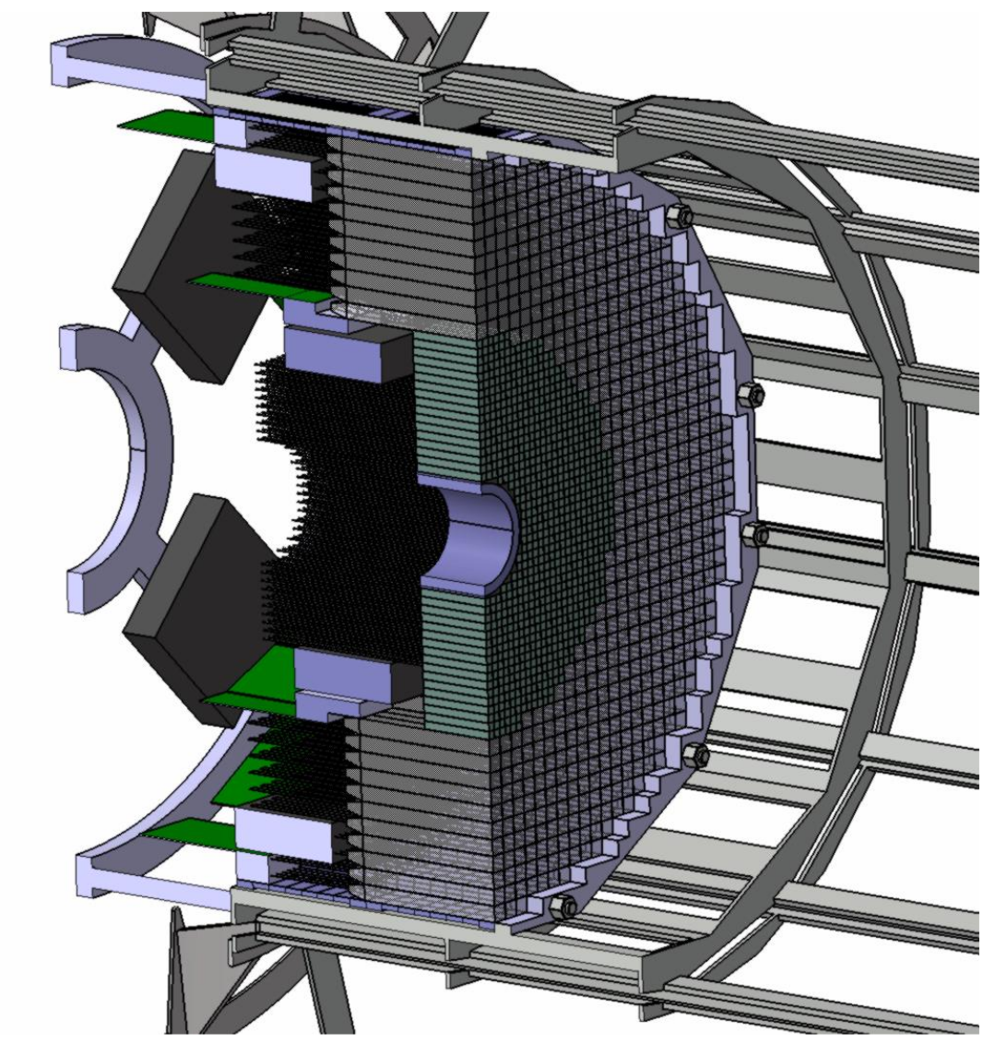
Backward Calorimetry
Backward EMCAL
Non-projective PbWO₄ calorimeter (EEEMC-Consortium)
  2 × 2 × 20 cm³ crystals
  Length ~20X/X₀, transverse size ~Molière radius
  Located inside the inner DIRC frame
  Preferred readout: SiPMs of pixel size 10μm or 15μm
  Cooling to keep temperature stable within ± 0.1 ◦C
Ongoing efforts advancing the design to increase coverage in η (−3.7 < η < −1.5) with inlay around beampipe
Backward HCAL in consideration
Possible upgrade path

Slide 25
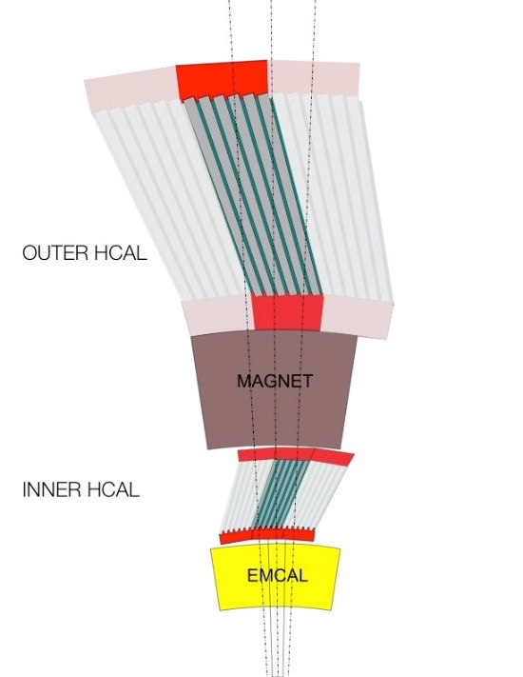
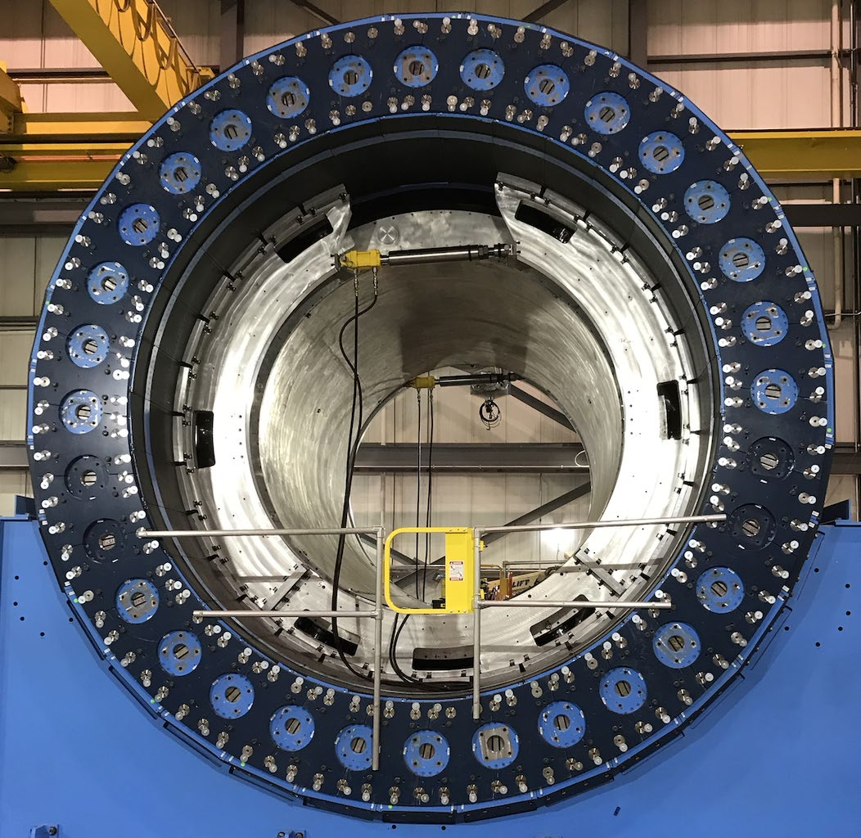
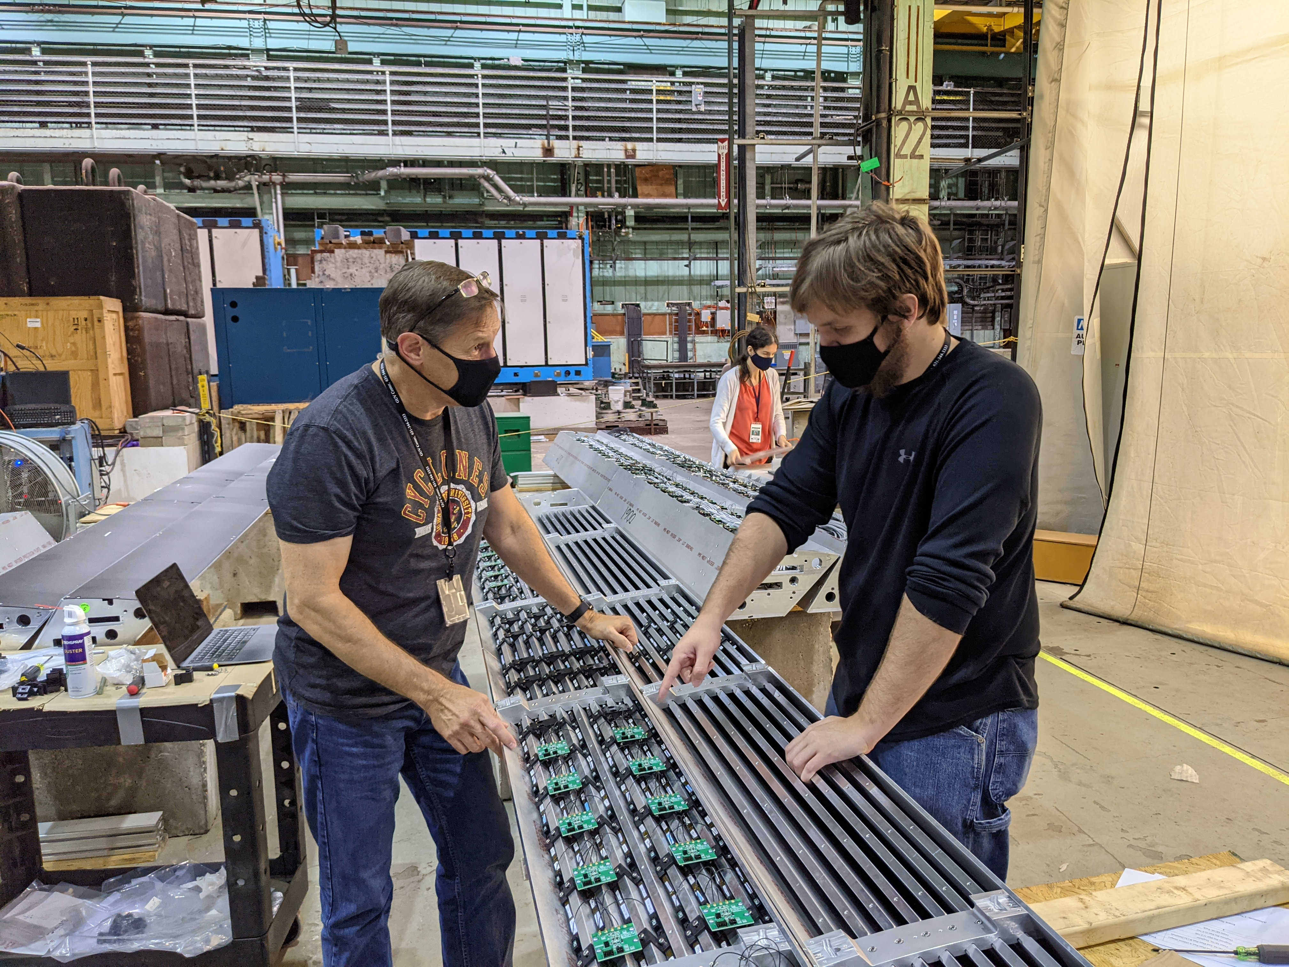
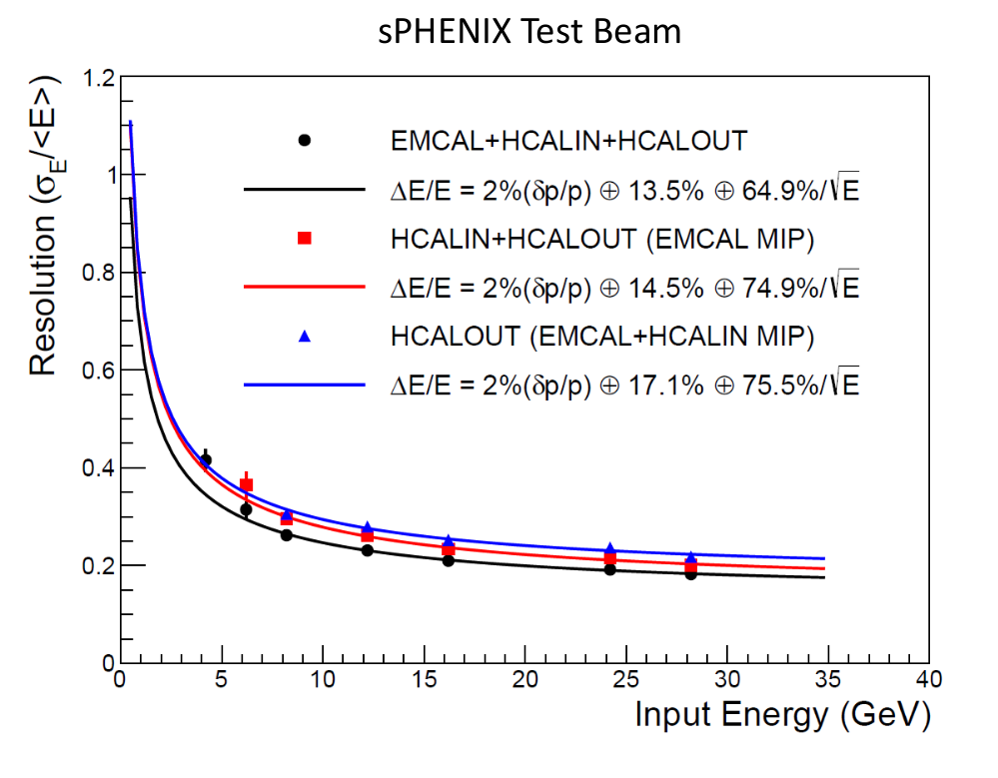
Barrel Hadronic Calorimetry
Reuse of sPHENIX outer (outside of the Solenoid) HCal ≈ 3.5λ_{l}
Steel and scintillating tiles with wavelength shifting fiber
Δη x Δφ ≈ 0.1 x 0.1
(1,536 readout channels, SiPMs)

Slide 26
Barrel EM Calorimetry
Hybrid concept
  Imaging calorimetry based on monolithic silicon sensors AstroPix (NASA’s AMEGO-X mission) - 500 μm x 500 μm pixels Nuclear Inst. and Methods in Physics Research, A 1019 (2021) 165795
  Scintillating fibers in Pb (Similar to GlueX Barrel ECal, 2-side readout w/ SiPMs) Nuclear Inst. and Methods in Physics Research, A 896 (2018) 24-42
6 layers of imaging Si sensors interleaved with 5 Pb/ScFi layers and followed by a large chunk of Pb/ScFi section (can be extended to inner HCAL)
Total radiation thickness for EMCAL of ~20 X₀
Detector coverage: -1.7 < η < 1.3 which overlaps with “electron-going” side endcap
Energy resolution - SciFi/Pb Layers: 𝟓.𝟑% /√𝑬 ⨁ 𝟏.𝟎%
Position resolution - Imaging Layers (+ 2-side SciFi readout): with 1st layer hit information ~ pixel size

Slide 27
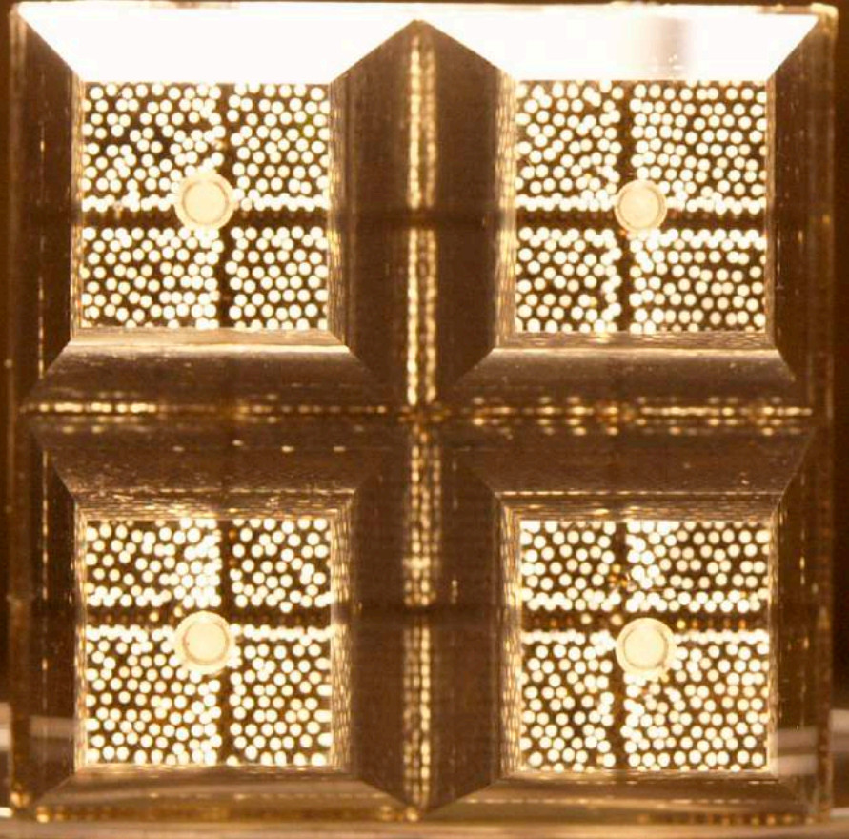

Forward EM Calorimetry
W/SciFi: scintillating fibers embedded in W/epoxy mix
  Similar to sPHENIX W/SciFi
  X /X₀ = 23 (17 cm + 10 cm readout), 2.5 x 2.5 cm towers (R_{M}=~2.3 cm)
  Easier construction for WSciFi calorimeter
  Compactness and higher EM-shower containment
R&D: Improvement of light collection eff. and uniformity
Simulations:
Expected E resolution ∼ 11%/√E ⊕ 2%
Can effectively separate ɣ/π⁰ (z = 3.5 m) with ML methods

Slide 28


Forward Hadronic Calorimetry
Design based on longitudinally separated steel and scintillator tiles (ORNL)
Inspired by Projectile Spectator Detector (CBM)
  60 layers of steel-sci plates + 10 layers of W-Sci plates (5 x 5 cm towers)
  7 signals per tower (from 10 plates)
  λ/λ₀ = 6.9 (HCAL only, larger shower containment)
Ongoing efforts to explore granular inlay around beampipe

Slide 29
Particle Identification
Sometimes it’s just not enough to know that a particle passed by (and maybe it’s charge). Some physics requires that we identify the particle as an electron, muon, proton, pion, kaon, etc.
Many techniques:
  Electrons: match momentum (tracking) and calorimetry (energy)
  Reconstruct a decay (calculate invariant mass)
  Penetration depth (muons)
  Time of Flight (sensitive to velocity)
  Cerenkov radiation (sensitive to velocity)
  …

Slide 30

Cerenkov Counters
Cerenkov light is emitted when a particle travels faster than the speed of light in a medium
  Similar to a sonic boom (but optical)
  Light emitted at a characteristic angle:
  Light depends on particle velocity
    Different momentum for different masses
  Threshold Counter:
    Just detect the light
  Ring Imaging Cerenkov (RICH):
    Image the ring, measure the angle
    Can be used to identify different particle types
    Typically, only a few photons, measurements are delicate!
Cerenkov radiation from nuclear fission reactor core.

Slide 31



Particle ID
Particle IDentification needs
Electrons from photons ⟶ 4π coverage in tracking
Electrons from charged hadrons ⟶ mostly provided by calorimetry and tracking
Charged pions, kaons and protons from each other on track level ⟶ Cherenkov detectors
  Cherenkov detectors, complemented by ToF
HRPPD
Need more than one technology to cover the entire momentum ranges at different rapidities

Slide 32





Particle ID
Dual-Radiator RICH(dRICH)
High-Performance DIRC
Quartz bar radiator (BaBAR bars)
light detection with MCP-PMTs
Fully focused
π/K 3б separation at 6 GeV/c
Proximity Focused (pfRICH)*
Long proximity gap (~40 cm)
Sensor: LAPPDs
up to 9 GeV/c 3б π/K sep.
C₂F₆ Gas Volume and Aerogel
Sensors tiled on spheres (SiPMs)
π/K 3σ sep. at 50 GeV/c
AC-LGAD
TOF (~30ps)
Accurate space point for tracking
forward disk and central barrel

Slide 33

hp-DIRC

Slide 34
Proximity Focusing RICH

Slide 35



LAPPD/HRPPD’s
LAPPD’s offer good gain, excellent timing and large area coverage with a configurable readout structure.
In the ePIC pfRICH they can be used both to detect Cerenkov photons from the aerogel as well as the passage of the primary particle.

Slide 36
Dual Radiator RICH

Slide 37


AC-LGAD TOF
CMS ETL (LGAD)
AC-LGAD detectors add an AC-coupled readout to provide both
fast timing response and excellent spatial resolution (4D).
Roman pot arrays

Slide 38

ePIC Streaming DAQ
No External trigger
All collision data digitized but aggressively zero suppressed at FEB
Low / zero deadtime
Event selection can be based upon full data from all detectors (in real time, or later)
Collision data flow is independent and unidirectional-> no global latency requirements
Avoiding hardware trigger avoids complex custom hardware and firmware
Data volume is reduced as much as possible at each stage

Slide 39


5 x 41 GeV
Note that the 5x41 GeV plots do not take advantage of the extended hpDIRC coverage
SciGlass EMCal Results
(from D. Kalinkin, 4/3/2023)
Imaging EMCal Results
(from M. Zurek, 4/6/2023)

Slide 40
Detector Services and Integration
Example path for services from interior of detector
Detectors require:
Support frames
Power
Cooling
Signals out
…
All of this represents dead, un-instrumented material in the path of the particles you are trying to detect!
Clever engineering and integration is required to minimize to optimize the capabilities of the combined detector.

Slide 41
Detector Backgrounds/Radiation
Three types of background/radiation sources we need to worry about:
  Primary collisions
  Synchrotron radiation
  Beam-gas induced
All of these couple with the beam parameters
  Divergence, energy spread, crossing angle, bunch length
Why are these “bad”?
  Detector occupancy
    Additional hits in detectors (especially for the tracker vertexing layers)
    Affects PID detectors due to scattering and secondary interactions
  Detector lifetime (radiation damage)

Slide 42
Primary Collisions (photons and charged)
Primary source of ionizing radiation and low energy neutrons
Radiation doses from gamma and charged particles fairly low across most of ePIC.
Regions of highest dose near the beam line - can reach ~ 100 kRad.

Slide 43
Primary Collisions (neutrons)
Primary source of ionizing radiation and low energy neutrons
1 MeV equivalent neutron fluence highest near the beamline -> implications for SiPMs.

Slide 44

Synchrotron Radiation
Extensive simulations by of SR by accelerator background WG group
  SynRad+ modeling software
  Input:
    3D model of beampipe
    Beam emittance, current Magnet locations and fields
  Output:
    Synchrotron Radiation – Position, Flux, Energy, Direction
Synchrotron Radiation Mitigation
  Photon absorber configuration:
  Wider beam pipe for
    13.5 σ clearance in x
    23 σ clearance in y
  Beampipe material/structure
    2-5 μm Au coating
    Sawtooth/ridge texture for photon
    absorption
Hits in first three layers of Si Tracker:

Slide 45


Synchrotron Radiation and Desorption
Pump ports
Geometry imported from SynRad+ to Molflow+
Photon flux density on surfaces
Convert to desorption
Pressure profile along beamlines
Applied as surface outgassing

Slide 46

Pressure in Forward Cryostat
eR IP1
FPA
eF IP1
eF IP2
eF IP3
eF IP4
eF IP5
Detector
Q0eF
Q1eF
10GeV, 2.5A
100 Ahr, no pumps in cryostat
+5/-15m Avg: 1.5e-7
+4.5/-5m Avg: 3.5e-8
10,000 Ahr, no pumps in cryostat
+5/-15m Avg: 1.3e-8
+4.5/-5m Avg: 3.3e-9
10,000 Ahr, all pumps
+5/-15m Avg: 3.0e-9
+4.5/-5m Avg: 2.7e-9

Slide 47



Beam-Gas Consequences
Proton Beam: $p/A+H^{2}→stuff$
(also a significant contribution to low-energy neutrons in detector hall)
Electron Beam: $e+H^{2}→e^{′}+γ+H^{2}$

Slide 48


ePIC Physics Studies
First large-scale simulation campaign completed
Regular simulation campaigns every month
Projected A₁ Uncertainties
Leptonic
Reconstruction
Double-Angle
Reconstruction
Charlotte Van Hulse
Ralf Seidl
Kong Tu

Slide 49
EIC Project Schedule
Conclusion of
RHIC Operations
06/2025
CD-2
01/2025
early
CD-4A
04/2031
early CD-4
CD-4A
04/2032
CD-0
12/2019
CD-1
06/2021
CD-3A
01/2024
CD-3
04/2025
CD-4
04/2034
Conceptual
Design
Preliminary
Design
Final
Design
Construction
Transition into
Operations
Start of
Operations
&
Science
Final Design LLPs
Approve final design
for all subdetectors
Design Maturity: ~90%
Need TDR
January 2023:
start change control
process for detector
April 2023:
train EVMS process
Approve preliminary design
for all subdetectors
Design Maturity: >60%
Need “pre-”TDR
Define Baseline:
Subdetector technologies,
Scope, Cost & Schedule
Long Lead Procurement items
Design Maturity: ~90%
Plan is tracked through EVMS
& Change control process
Need TDR for LLPs

Slide 50
Conclusions
Modern particle physics detectors subsystems are a marvel of advanced science, engineering, and humility.
  There is some beautiful physics in particle detection
  Each technology has its advantages and disadvantages
  There is constant development to improve and refine these technologies
The ePIC Detector is maturing into a detailed technical design to pursue the EIC science program.
  The key to a successful EIC detector is a combination of technologies that work together to meet the scientific requirements
  EIC detectors are an enormous undertaking that will require participation and expertise from both the RHIC and JLab communities, as well as key international contributions!

Slide 51


Slide 52


Slide 53

Lecture 1 Seed Question #1 : Neutrons (I)
Neutrons have no charge, so no EM interaction
Must have a strong interaction with nuclei in material
Reactions like are possible
For interactions with charged final states our previous discussion takes over:
  You can now either detect the α or the photon shower
For low (thermal) energies the primary process is neutron capture (n,γ)
Neutrons will lose energy through (strong) elastic scattering in the material
$$\left(n,p\right)\text{, }\left(n,α\right)\text{, }\left(n,2n\right)$$

Slide 54
Lecture 1 Seed Question #1 : Neutrons (II)
For a neutron scattering off a nucleus A:
For θ=180º (head-on collision):
  Heavy nuclei can slow neutrons down a lot
  For hydrogen this value is 0 – the neutron “knocks out” a proton
  This is important for calorimeters based on scintillator!
E = incident neutron energy
E’ = final neutron energy

Slide 55
Lecture 1 Seed Question #2: Sampling Fraction

Slide 56
Lecture 2 Seed Question #1 :
Here’s a simple thought exercise that requires a bit of schitzophrenia:
Start by imagining the perfect EIC experiment. Sketch out on a piece of paper a diagram of the experiment, including not just the central barrel but the far-forward detectors. Use what you have learned in the past week to guess where you want calorimetry, PID, tracking, etc. This doesn’t need to be perfect, just take what you have learned and pull it all together. Think about what detector systems need to work together.
Now, take a step back and for each detector system consider:
  What sort of services does this detector need? Power, gas, cooling, etc? How will you hold it up? How will you take it apart to service it between runs?
  Take a wild guess at what each detector will cost. Include not just the detector but the labor, engineering, etc. Again, just use some “physicist intuition” to estimate a number.

