Slide 1
EIC Accelerator Physics/Technology
Todd Satogata, Jefferson Lab
For the EIC Project and EIC Collaboration
CFNS/CTEQ School Lecture 2
9 June 2023
www.toddsatogata.net
satogata@jlab.org
EIC:
Notes:
Kierkegaard book, but Descartes!

Slide 2
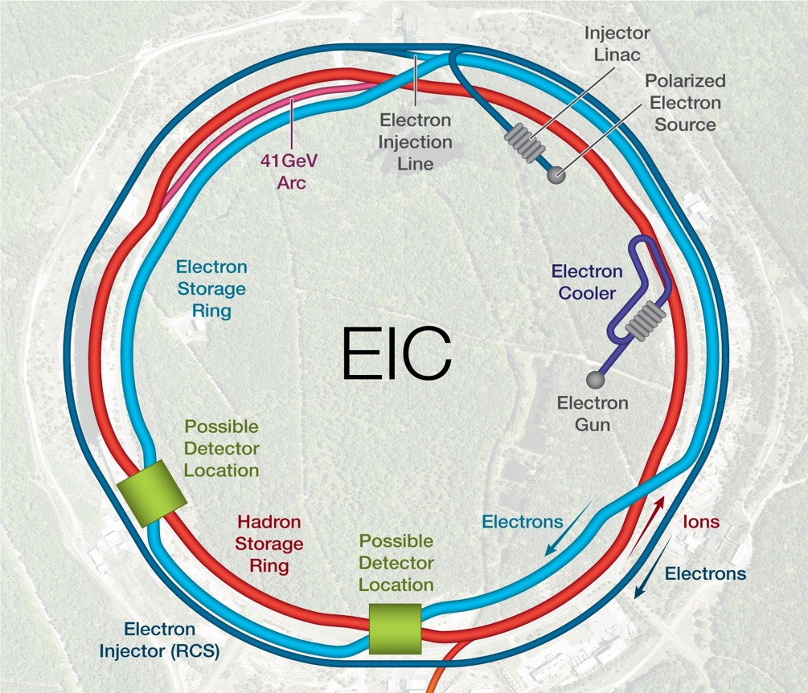

Outline (Hour 2)
EIC interaction region(s)
  Digression into accelerator R&D
Luminosity revisited
Lumi optimization and limitations
  Superconducting magnets
  Crab cavities, crossing angle
  Beam sizes and cooling
  Space charge
  Synchrotron radiation
  Cooling
Luminosity ramp-up
Future 2nd
Detector
Location
Future
Detector
Location
Primary
Detector
Location
Primary
Detector
Location
(Some may look familiar from 2022 Gordon Conference talk)

Slide 3
Differences in IR6/8
IR6 (Primary) and IR8 (Future) are fundamentally different
  Different halls
  IR6: Primary
    Both beams “inner” to “outer”
    Crossing angle “natural”
    Secondary focus ”unnatural”
    Less ESR synch radiation
  IR8: Future
    Both beams “outer” to “inner”
    Crossing angle extra bending
    Secondary focus looks feasible
    More ESR synch radiation
Future 2nd
Detector
Location
Future
Detector
Location
Primary
Detector
Location
Primary
Detector
Location

Slide 4
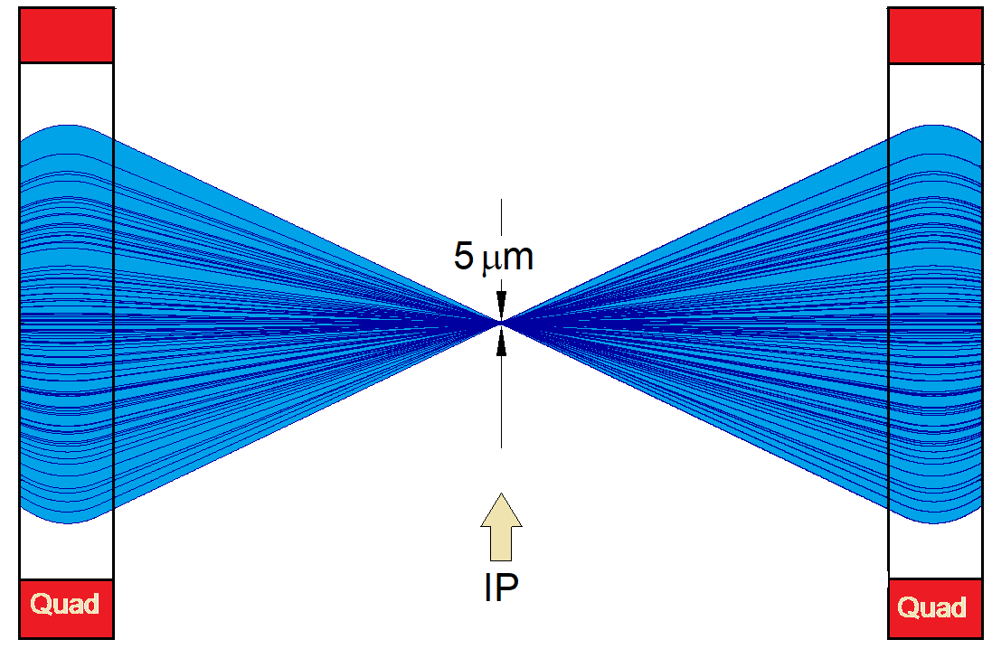
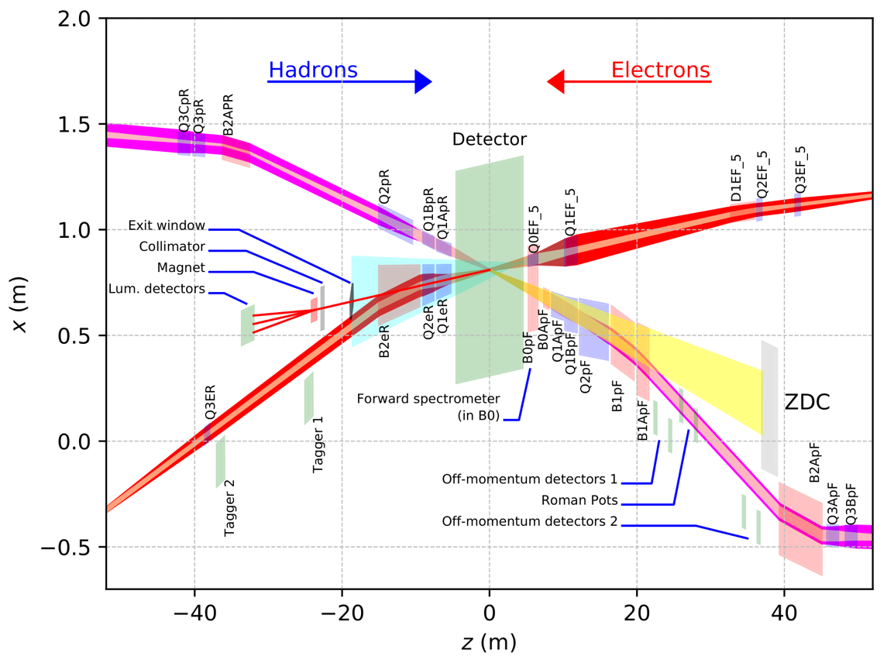
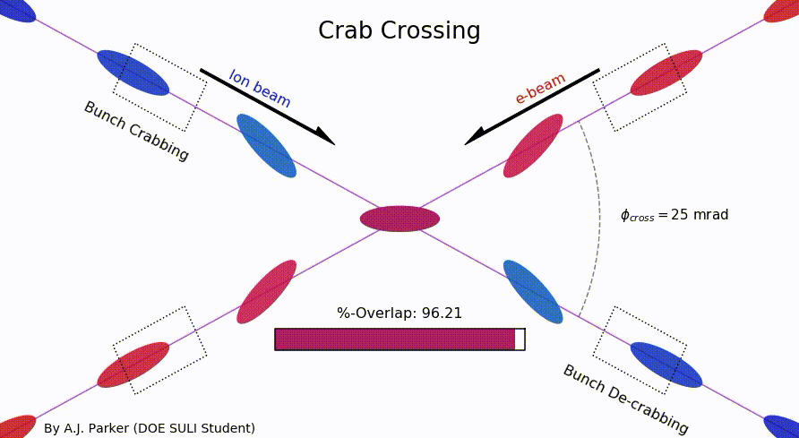
EIC Primary Interaction Region
Existing tunnel and
experiment halls
Focusing (quads)
as close to IP as
possible (~+/-5m!)
Tensions in magnet
requirements:
high field
large apertures
e/p magnet
proximity near IP
Chromaticity:
focusing dependence
on particle energy
”Rear side”
Different
axis scales!
”Forward side”
25 mrad crab crossing
A. Parker (SULI)
D. Higinbotham

Slide 5
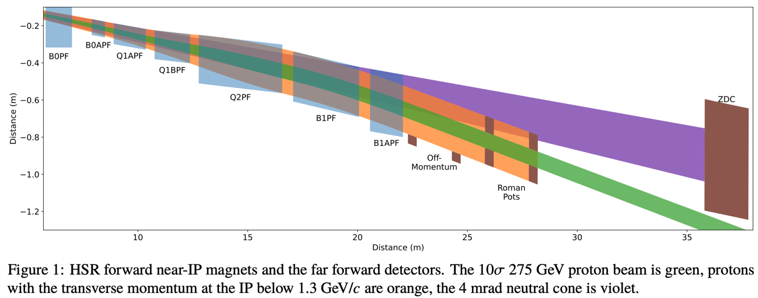
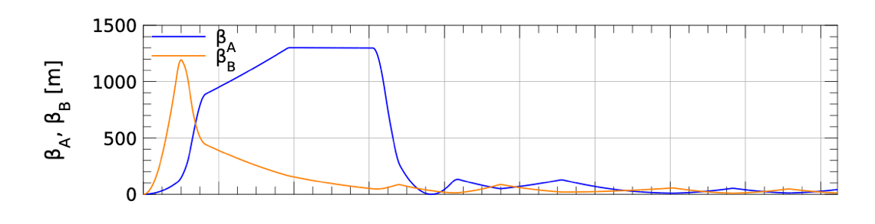
EIC Primary Interaction Region (HSR forward)
https://www.ipac23.org/preproc/pdf/MOPL158.pdf
HSR forward region most constrained
  Close path to arc
  β* 5.5cm for lumi
  Maximize acceptance (p_{t}=1.23 GeV/c)
  Minimize fringe fields on ESR
  Support crab cavity and spin rotator requirements
B: Dipoles
Q: Quadrupoles
Crab
cavities
No space for usable secondary focus
“Match”
Spin Rotator,
Snake
Match and
arc FODO lattice
β 1200m
to 5.5cm
in 10m!
0
20
40
60
80
100
120
140
160
180

Slide 6
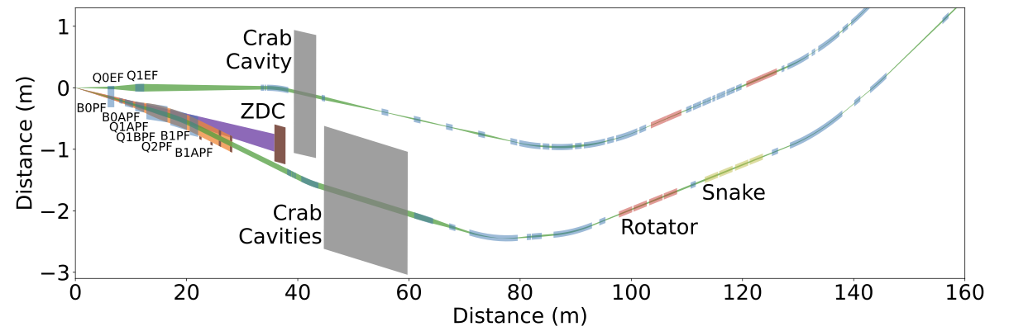
EIC Primary Interaction Region: Forward
https://www.ipac23.org/preproc/pdf/MOPL158.pdf
ESR
Rotator
Rotator
HSR
197 MHz crab cavities/cryostats transverse dimension constraints
HSR snake angle geometric constraint
Alex Jentsch excellent far-forward physics slides at 2022 CFNS school

Slide 7
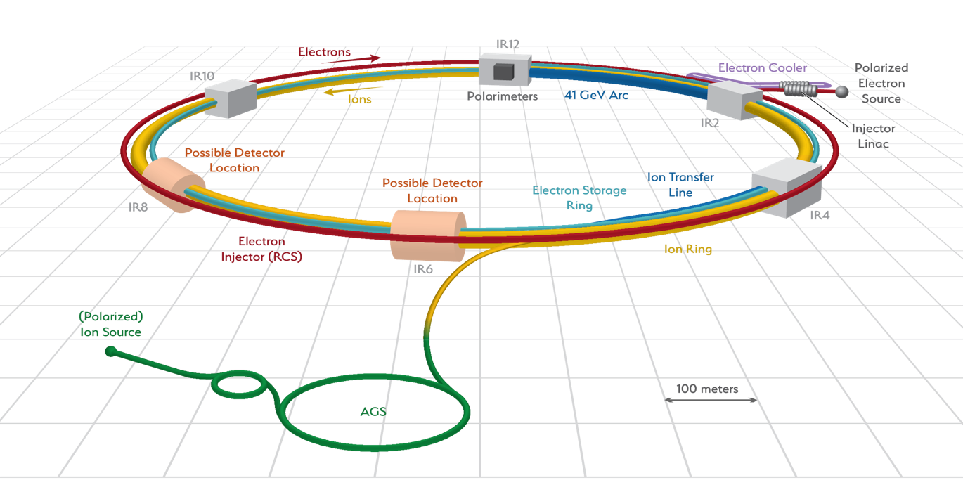
EIC Accelerator Technology Challenges, R&D
Existing tunnel and
experiment halls
ESR
Vacuum R&D
Electron Injection
Fast Kicker
Hadron Polarimetry
Cooler Electron Source
ESR Cavity
Prototype
HSR Vacuum Upgrade
ESR RF 500kW FPC
2nd IR
Polarized e⁻ Source
ePIC
ESR RF HOM Damper
Crab Cavity
Prototype
Proton Injection
Fast Kicker
IR Vacuum Chamber
IR Design and Magnet Prototyping

Slide 8
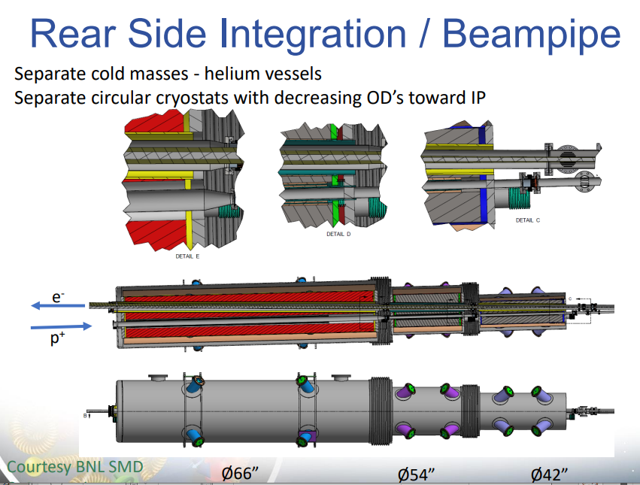
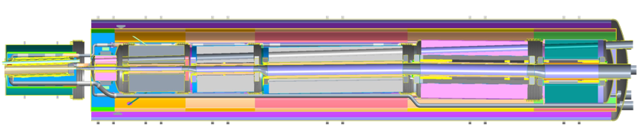
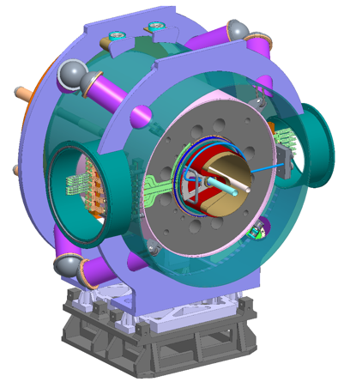
EIC R&D: IR Superconducting Magnets
Forward superconducting magnet integration
Multiple function spectrometer magnet at the forward hadron side

Slide 9
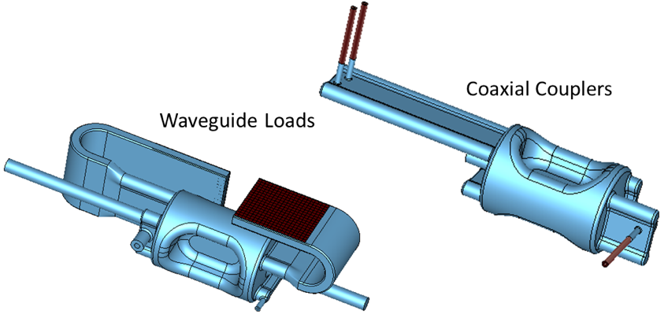
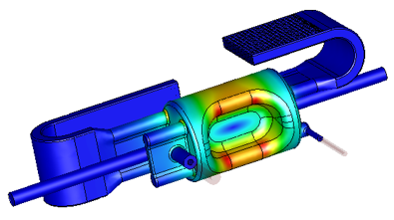
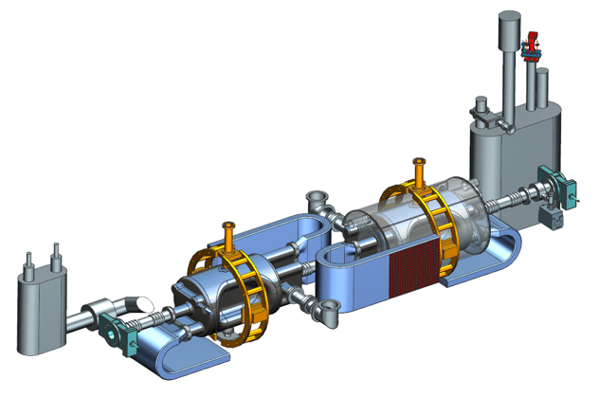
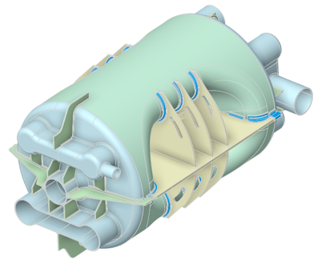
EIC R&D: Crab Cavities
Recent IPAC’23 invited talk
Higher Order Mode (HOM) damping schemes
Hadron collider crabbing unprecedented
  Collaborating with HL-LHC
    Beam dynamics, RF control stability
    SPS tests: Phys. Rev. Accel. Beams 24, 062001 (2021)
  Electron crabbing was performed at KEKB (arXiv:1410.4036)
Superconducting “RF dipole” cavity
  ODU design
  High electric field and overall field quality requirements
197 MHz HSR crab cavity being prototyped
  Jefferson Lab/ODU/(BNL) collaboration
  Two possible HOM damping schemes: Waveguide loaded and coaxial couplers
  Stress analysis near completion, with stiffeners
RF Design
Preliminary Cryomodule Design
(2 cavities per HSR cryomodule)
Stiffeners

Slide 10
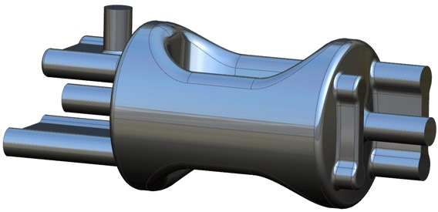
EIC 197 MHz Crab Dimensions
Recent IPAC’23 invited talk
0.59 m
Electromagnetic design requires to achieve:
  Cavity peak surface fields of E_{p} < 45 MV/m and B_{p} < 80 mT at 11.5 MV
  Bare cavity dimensions:
    Cavity length ≤ 1.5 m
    Cavity diameter (without couplers) ≤ 0.6 m
1.44 m
RF Property | Value
V_{t} [MV] | 8.5 | 11.5
E_{p} [MV/m] | 32.3 | 43.7
B_{p} [mT] | 58.1 | 78.6
Total V_{t} [MV] | 34
No. of cavities | 4 | 3
Operating Temp. [K] | 2.05
Stored Energy [J] | 50.3 | 92
R_{s} [Ω] (R_{BCS} = 0.4 nΩ) | 15
P_{diss} [W] | 9.6 | 17.6
Q₀ (G = 97.2 Ω) | 6.48×10⁹
Reasonable surface fields at nominal voltage of 8.5 MV
Dimension | Value
Cavity Length [mm] (iris-to-iris) | 921.9
Cavity Length [mm] (flange-to-flange) | 1435
Cavity Diameter [mm] | 587.2
Pole Length [mm] | 524
Angle [deg] | 20

Slide 11
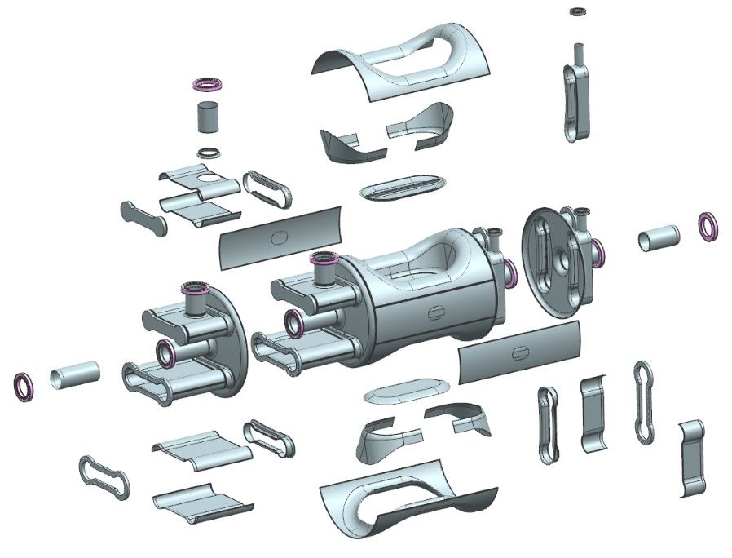
Prototype Crab Fabrication
Recent IPAC’23 invited talk
Majority of the cavity body is deep drawn from 4.17 mm Nb sheets
  A full Cu cavity will be fabricated to understand and verify the
  fabrication process
  Also, to perform room
  temp measurements
Flanges:
  Dogbone flanges – Nb with Indium seals
  All other flanges – 316 LN SS CF flanges with Cu gaskets
All material procurements are placed and most of the material have been received

Slide 12
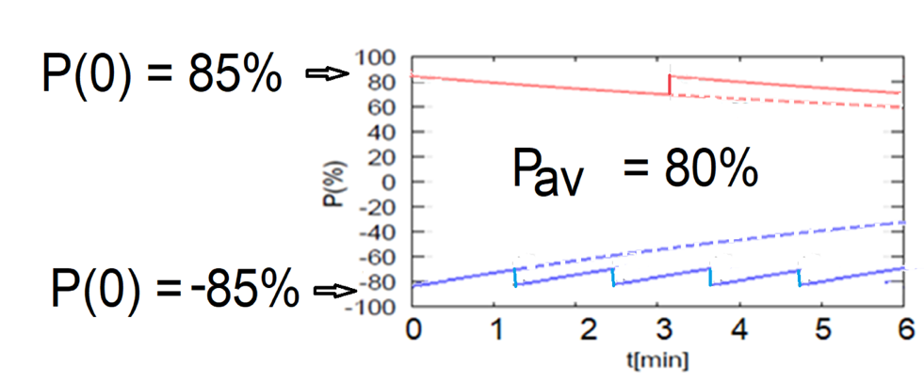
ESR Polarization: Continuous Injection
~1Hz injection of new highly polarized (~85%) electron bunches
  Will have to learn how to minimize backgrounds
Initial polarization decays towards P∞ < ~50%
  Equilibrium of self-polarization and synchrotron radiation stochastic excitation
  At 18 GeV, every bunch replaced in a few minutes
  Need both polarization directions present at the same time
Re-injection
B P
Refilled every 1.2 minutes
P_{av}=80%
Asymmetric polarizations P
with respect to dipole field B
P_{av}=80%
B P
Refilled every 3.2 minutes
Re-injections

Slide 13
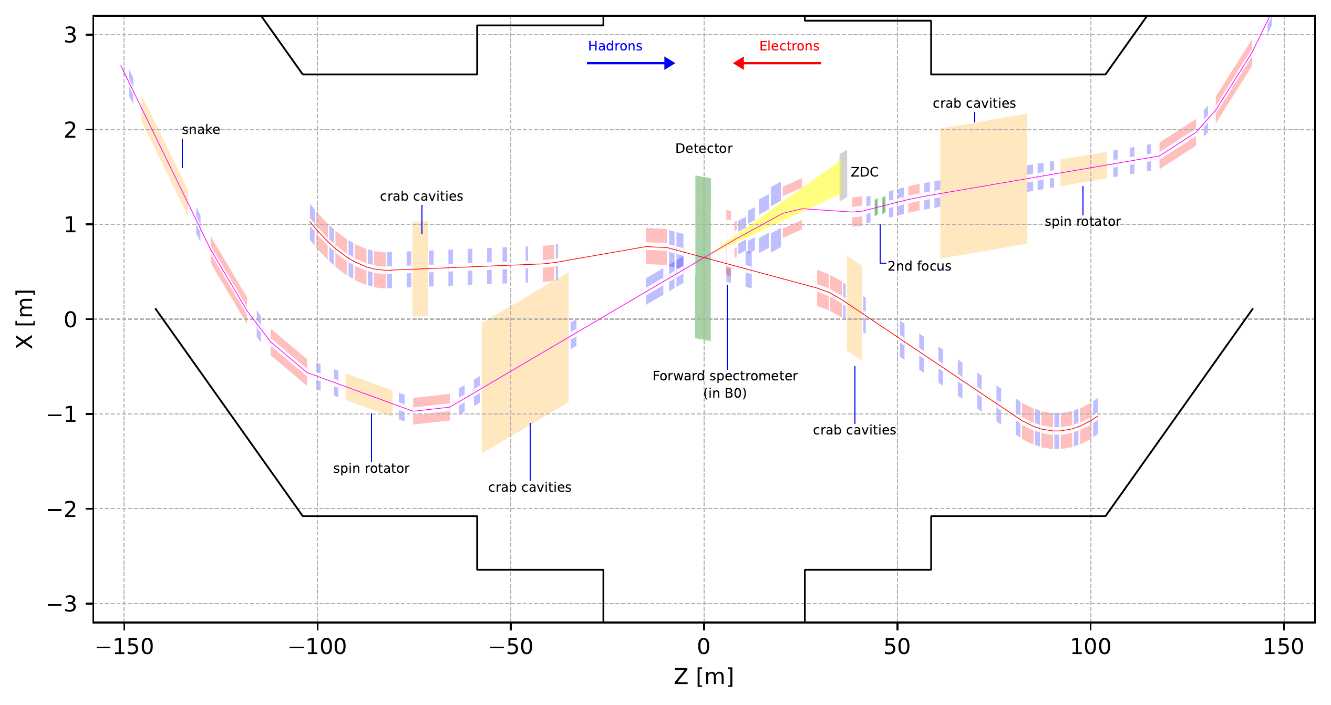
IR8 Preliminary Layout
First EIC 2nd Detector Workshop (May 2023)
IR8 Accelerator Talk (R. Gamage)
Electrons
Hadrons
35 mrad crossing angle
(Investigating 25 mrad)

Slide 14
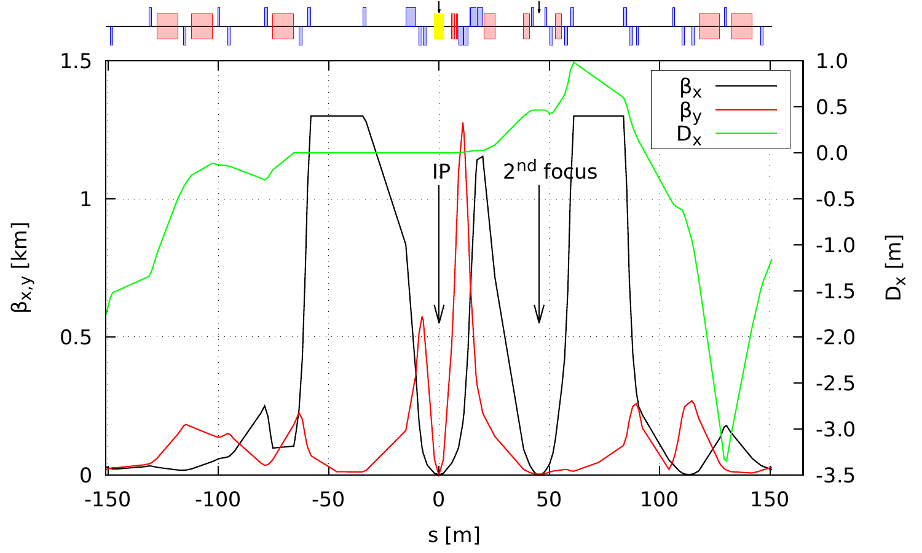
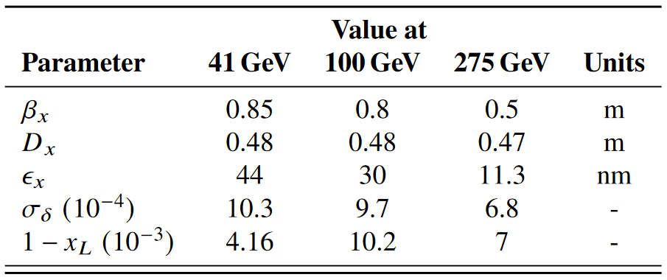
IR8 Preliminary Optics (including 2nd focus)
First EIC 2nd Detector Workshop (May 2023)
IR8 Accelerator Talk (R. Gamage)
Parameters at the 2nd focus for different energies

Slide 15
Luminosity (Lumi) Limits In One Slide™
Maximize collision frequency (~90 MHz)
  Limited by kicker rise times
  Limited by parasitic collisions (crabbing)
Maximize particles per bunch (~10¹¹)
  Limited by sources, space charge
  Limited by collective effects
    Interaction of beam with impedances
    Also total currents: I_{1,2}=q_{1,2}N_{1,2}f_{coll} ~1-3A
Minimize beam sizes at IP (~250/25 um)
  Limited by IR focusing, magnets
  Limited by chromatic dynamic aperture
  Limited by emittance growth (IBS)
Every parameter optimized
separately and collectively in the
EIC design
Try multiplying out the given numbers –
should be very close to 10³⁴ cm⁻²s⁻¹

Slide 16
EIC Primary Interaction Region
Existing tunnel and
experiment halls
Focusing (quads)
as close to IP as
possible (~5m!)
Tensions in magnet
requirements:
high field
large apertures
e/p magnet
proximity near IP
Chromaticity:
focusing dependence
on particle energy
”Rear side”
Different
axis scales!
”Forward side”
25 mrad crab crossing
A. Parker (SULI)
D. Higinbotham

Slide 17
Electrons and Hadrons in Synchrotrons (EIC)
Electrons
  Larger charge/mass ratio
    Smaller B to bend/focus (E, crab)
    Normal conducting magnets
    Polarization time dependence
  Synchrotron radiation
    Photonic backgrounds
    Damping
    Dynamic aperture: Touschek
    Large RF power needs
    Flat beam aspect ratio
  Harder collimation (multi-stage)
Hadrons
  Smaller charge/mass ratio
    Larger B to bend/focus (E, crab)
    Superconducting magnets
    No depolarization (in principle)
  No synchrotron radiation
    Hadronic backgrounds
    Negligible damping (EIC energies)
    Dynamic aperture: “Diffusion”
    Modest RF power needs
    Round beam aspect ratio
  Easier collimation (single-stage)

Slide 18
Lumi Limits In (more than) One Slide^{NoTM}
Maximize collision frequency (~90 MHz)
  Limited by kicker rise times
  Limited by parasitic collisions (crabbing)
Maximize particles per bunch (~10¹¹)
  Limited by sources, space charge
  Limited by collective effects
    Interaction of beam with impedances
    Also total currents: I_{1,2}=q_{1,2}N_{1,2}f_{coll} ~1-3A
Minimize beam sizes at IP (~250/25 um)
  Limited by IR focusing, magnets
  Limited by chromatic dynamic aperture
  Limited by emittance growth (IBS)
Challenge: colliding asymmetric beams
electrons: flat
hadrons: round
SuperKEKB: 10 um x 50 nm, 200:1!
EIC collision point: 11:1 transverse aspect ratio

Slide 19
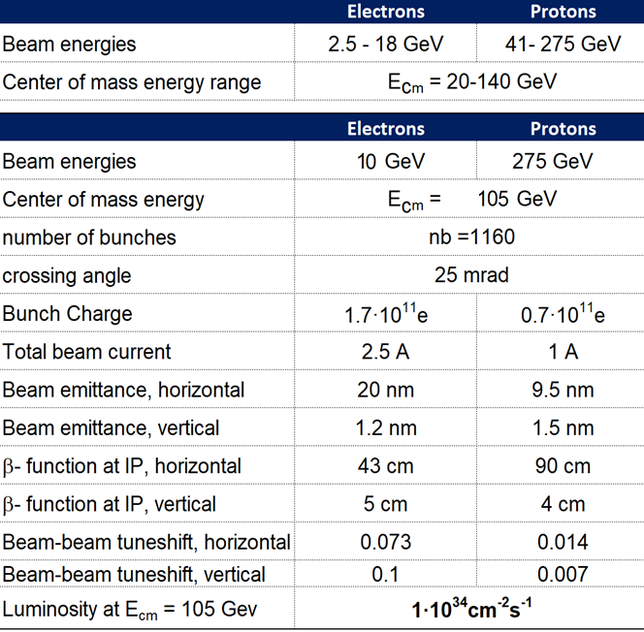
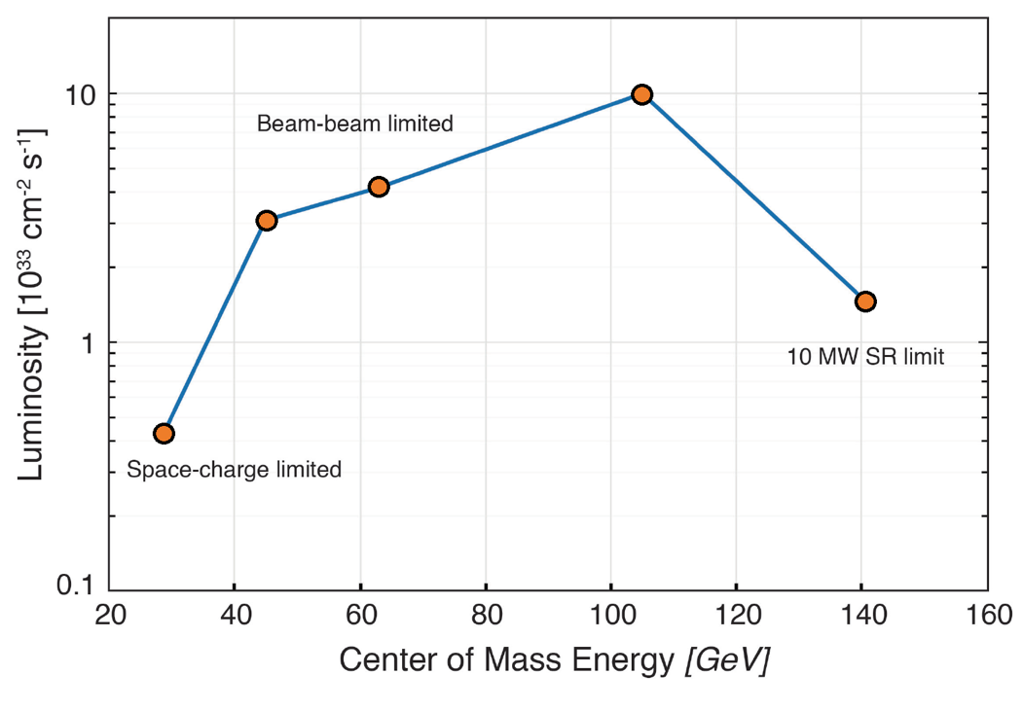

EIC CDR (CD-1) Parameters for E_{cm} and Luminosity
Beam-beam limited
beam size lumi scaling
10 MW SR limited
Space charge limited
5
5
10
10
e [GeV]
18
41
100
100
275
p [GeV]
275

Slide 20
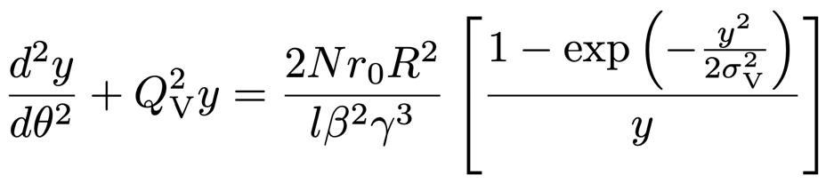
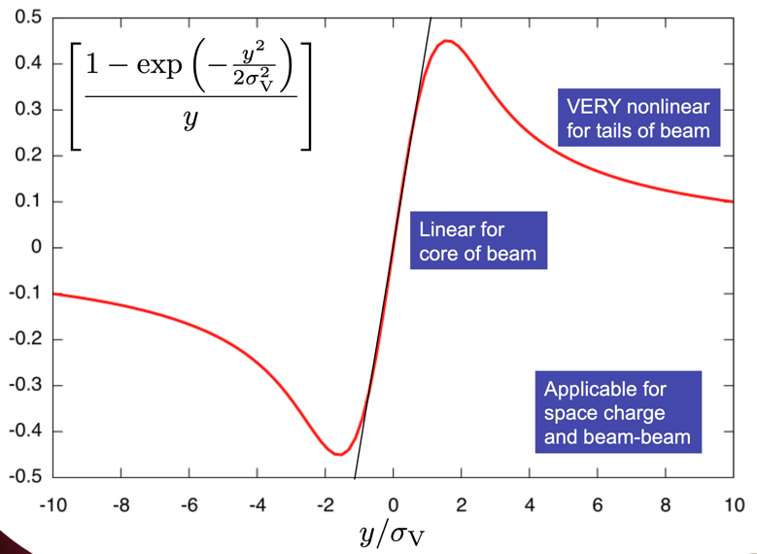
Lumi Limitations: Space-Charge (low E_{cm})
Dense charged particle bunches electrostatically repel in rest frame
Creates nonlinear space charge force and equation of motion in lab frame
Fortunately scales with 1/γ³ so worst at low energies
  Great example of time dilation
  Limits high-intensity injector emittances
  Force applies continuously within beam
Tolerable linear “space charge tune spread” of 0.05 limits total current of 41 GeV proton beam to ~0.4A.
(IBS: intra-beam hard scattering also contributes)

Slide 21
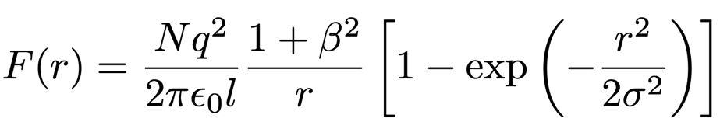
Lumi Limitations: Beam-Beam (mid E_{cm})
Colliding beams see each other’s collective charge distributions
Creates nonlinear beam-beam force and equation of motion similar to space charge
  BUT now the fields and force are in the lab frame already
  NO benefit of relativistic scaling
  Force applies only once per turn
Tolerable “beam-beam tune spead” of 0.015 limits highest EIC luminosity

Slide 22
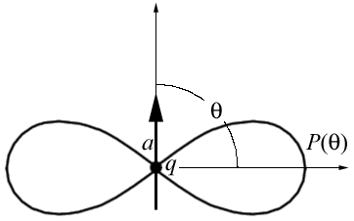
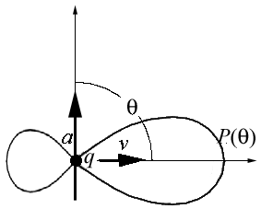
Lumi Limitations: Electron SR Power (high E_{CM})
Accelerated charged particles emit photons
  Electrons in synchrotron: radially accelerated
  Synchrotron radiation emitted in forward cone
    Cone opening angle
    Radiated power
  scaling much worse for electrons
    18 GeV e: =3.5x10⁴ vs 255 GeV p: =3x10²
Design: 9 MW @ 18 GeV (facility limit 10 MW)
Expensive: Power must be provided by SRF
Raise electron energy last (e current limit)
Dipole Radiation
Perpendicular to charge acceleration
Radial
acceleration
Relativistic Boost
Synchrotron Radiation
Relativistically boosted dipole radiation

Slide 23
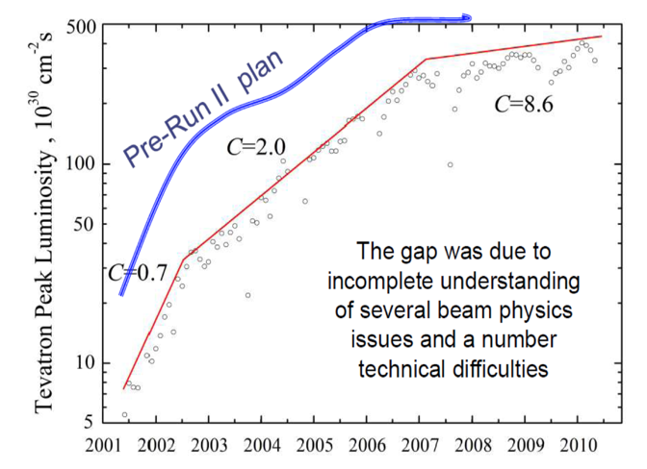
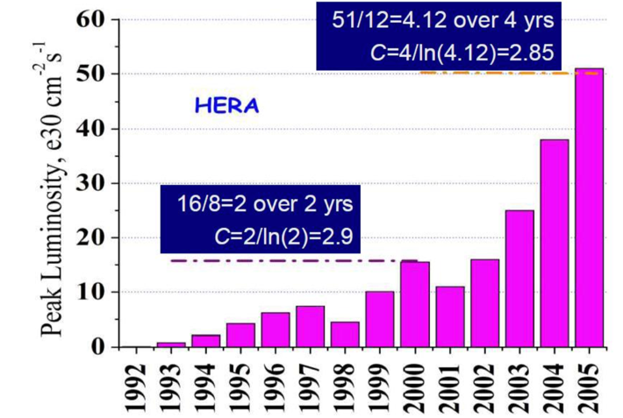
Collider Luminosity Ramp-Up
Tevatron Run-II: design 275x10³⁰
Luminosity ramp-up to design takes years
  Useful paper: arxiv 1202.3950 (V. Shiltsev)
  Contextualizes Tevatron Run-II and early LHC
  Luminosity ramp-up parameter C: complexity
    C: time (years) to increase lumi by e
    C=2: factor of e luminosity increase in 2 years
  Early commissioning can make quick strides
    C<1 (or <<1) but do not get too exuberant
  Long-term commissioning usually C~2-3
EIC will very likely take years to reach design luminosities
  But we will get there!
HERA: design 15x10³⁰

Slide 24
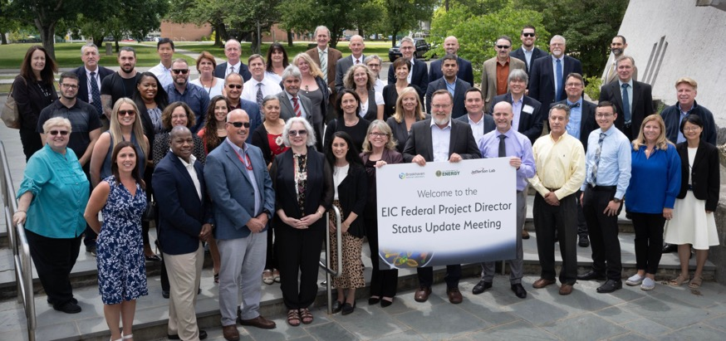
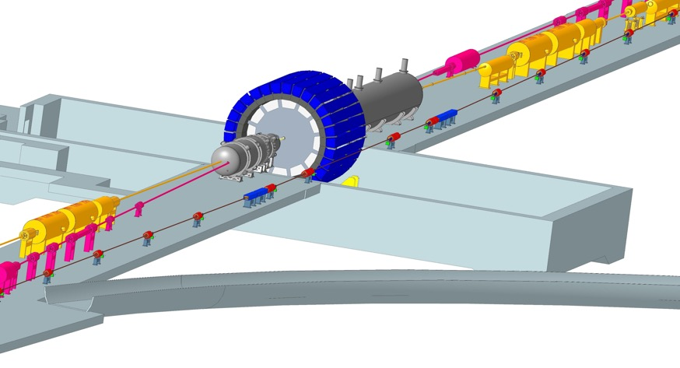
Summary
July 28-30, 2022 (BNL)
EIC design meets all design requirements
EIC luminosity is highly optimized
  Balances several individual parameter optimizations
EIC R&D progressing
  Focus: challenging technical components
e/p beam differences drive EIC choices
  e.g. luminosity vs E_{cm}, IP aspect ratio
Luminosity ramp-up will take time
  will last substantially beyond project end
  project provides excellent basis to get there!

Slide 25
Backup and assorted discussion slides

Slide 26
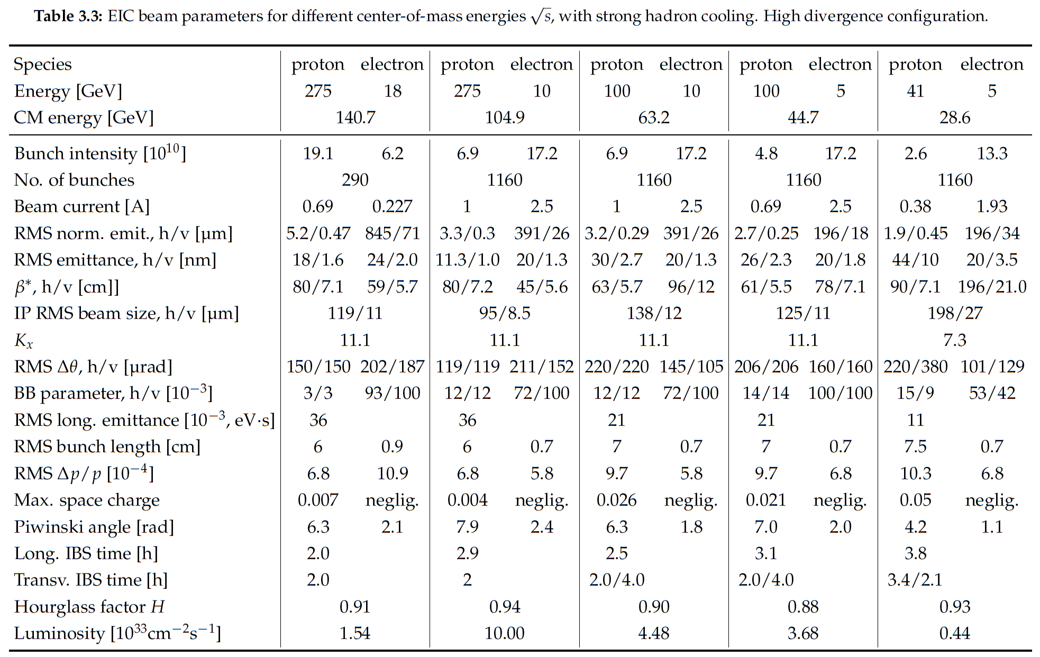

Notes:
LHC design 0.58A p (HL up to 1A), beam-beam parameter 3.4e-4 (3-5—3 HL-LHC)

Slide 27
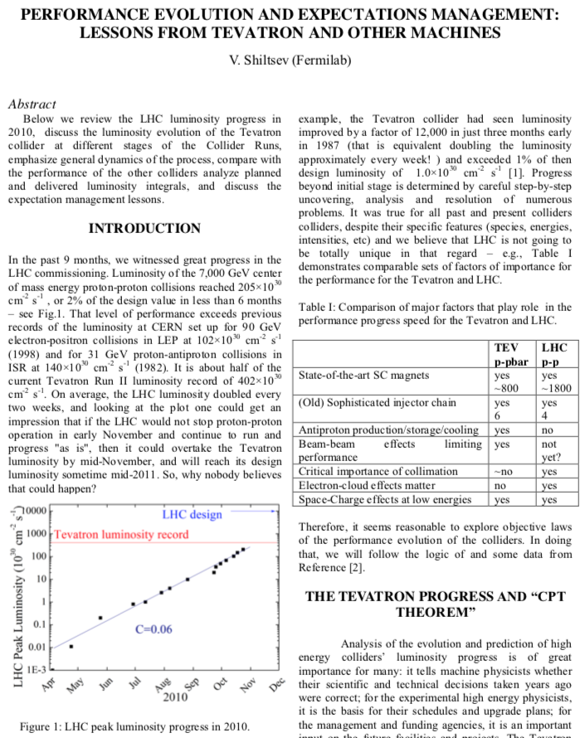
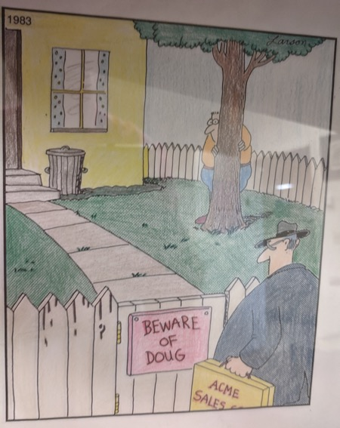
Beware of Doug (Higinbotham, JLab)
https://arxiv.org/pdf/1202.3950.pdf
Doug knows when I am on Teams.
Doug is inquisitive and asks good questions about EIC luminosity.
I made the tactical error of sharing
this paper with Doug.
  So here I am sharing it with you in the context of EIC luminosity ramp-up.

Slide 28
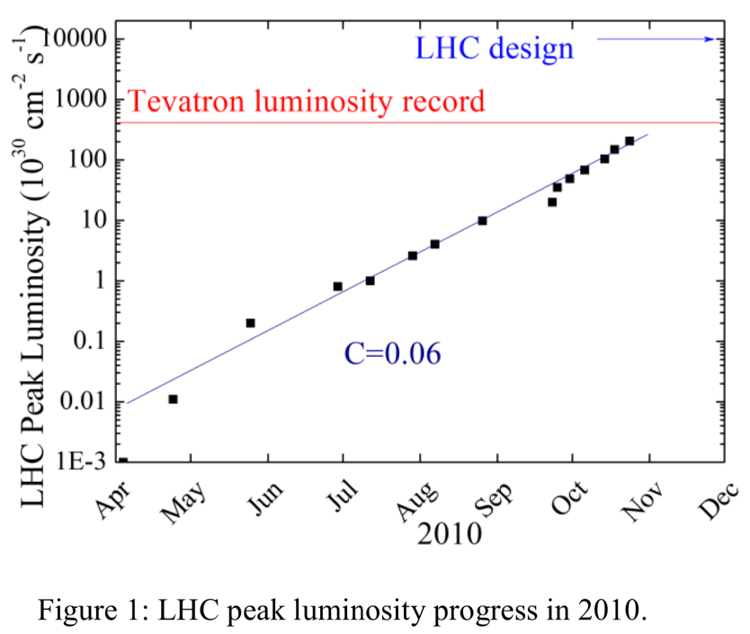
Paper Context
Paper originally presented at 2011 Chamonix LHC Performance workshop
Considerable excitement about exponential improvements in LHC lumi during 2010 commissioning
  Factor of >10⁴ in 6.5 months!
  Ended “only” factor 30 from design
C: exponential “complexity” of collider lumi improvement
  C=0.06 means it was “easy” to make LHC lumi progress in this era

Slide 29
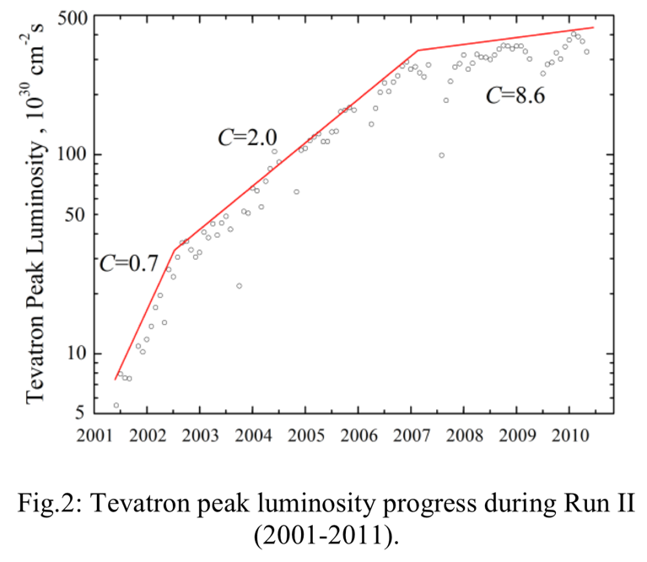
Lesson from the Tevatron
Tevatron Run-II experience over about a decade
  Three distinct phases
  Reflects increasing challenges of luminosity limitations
No silver bullets
  No sudden exponential jumps or reductions in complexity
  Instead many incremental improvements (~30) across many systems
Initial tuneup still “easy”
  But gets harder as low-hanging fruit are plucked
C: Time (y) to increase lumi by factor e
C=2: factor of e increase in lumi over 2y

Slide 30
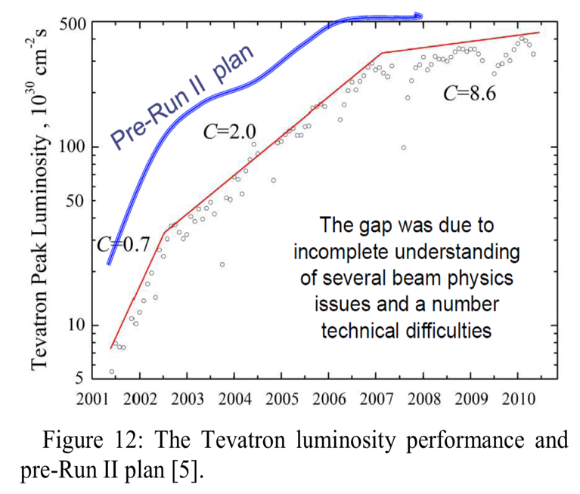
Lesson from the Tevatron
Tevatron Run-II experience over about a decade
  Three distinct phases
  Reflects increasing challenges of luminosity limitations
No silver bullets
  No sudden exponential jumps or reductions in complexity
  Instead many incremental improvements (~30) across many systems
Initial tuneup still “easy”
  But gets harder as low-hanging fruit are plucked
C: Time (y) to increase lumi by factor e
C=2: factor of e increase in lumi over 2y

Slide 31

Lessons from HERA
HERA experience over more than a decade
  C~3 over multiple phases
Major upgrade after ~10y (HERA-2)
  Nearly a new machine
  Addressed known facility luminosity limitations
  Even then, C~3 over years
Fewer low-hanging fruit
  Less time in C<1 regime
  A product of new type of collider or truly complex facility
  EIC also highly complex
HERA-2
“Silver bullet” was a machine upgrade

Slide 32
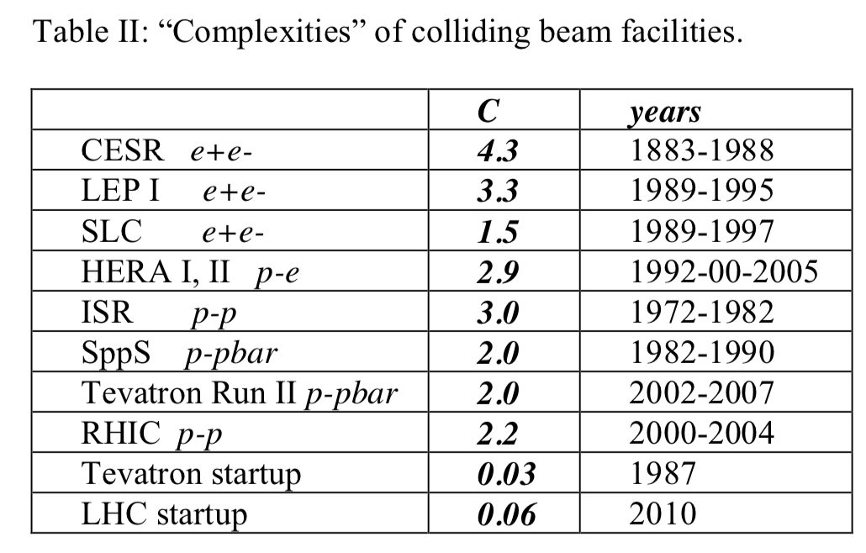
Tabulated Complexities
Luminosity evolution of many colliders suggests expecting a long evolution
Note that these complexities are for single colliding species types
  Usually built on top of existing, well-established injector complexes
RHIC and LHC have had decadal success colliding multiple species
  Edge effects of changing species are order of weeks (RHIC) or runs (LHC)

Slide 33
Tabulated Complexities
Luminosity evolution of many colliders suggests expecting a long evolution
Note that these complexities are for single colliding species types
  Usually built on top of existing, well-established injector complexes
RHIC and LHC have had decadal success colliding multiple species
  Edge effects of changing species are order of weeks (RHIC) or runs (LHC)

Slide 34
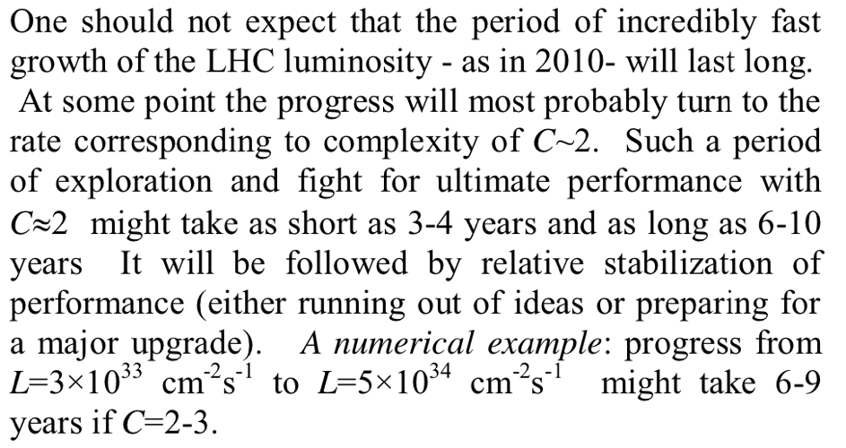
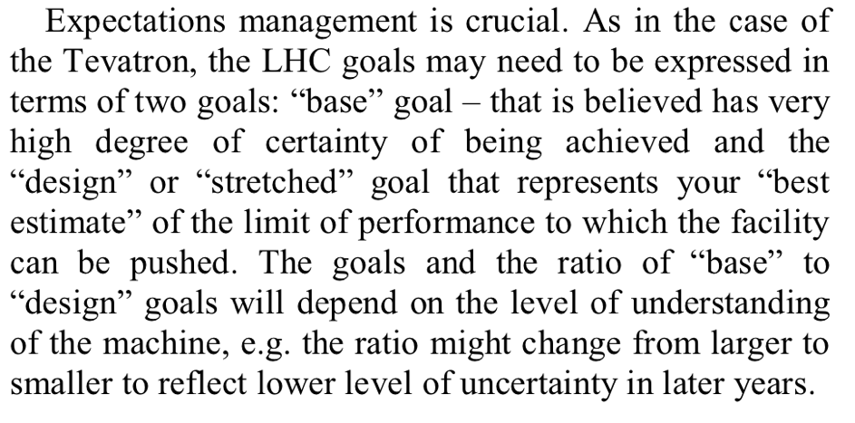
Paper Conclusions

Slide 35
LHC Experience: 2015-2018
sqrt(s)=13 TeV
After 5y of lower-energy operations
Luminosity ramp-up C<1
Then saturated to C>>1 quickly
2e34 vs Shiltsev ~5e34 => HL-LHC
“same” vert scales

Slide 36
IR8 Status
Randika Gamage
May 18th, 2023
First EIC 2nd Detector Workshop (May 2023)
IR8 Accelerator Talk (R. Gamage)

Slide 37
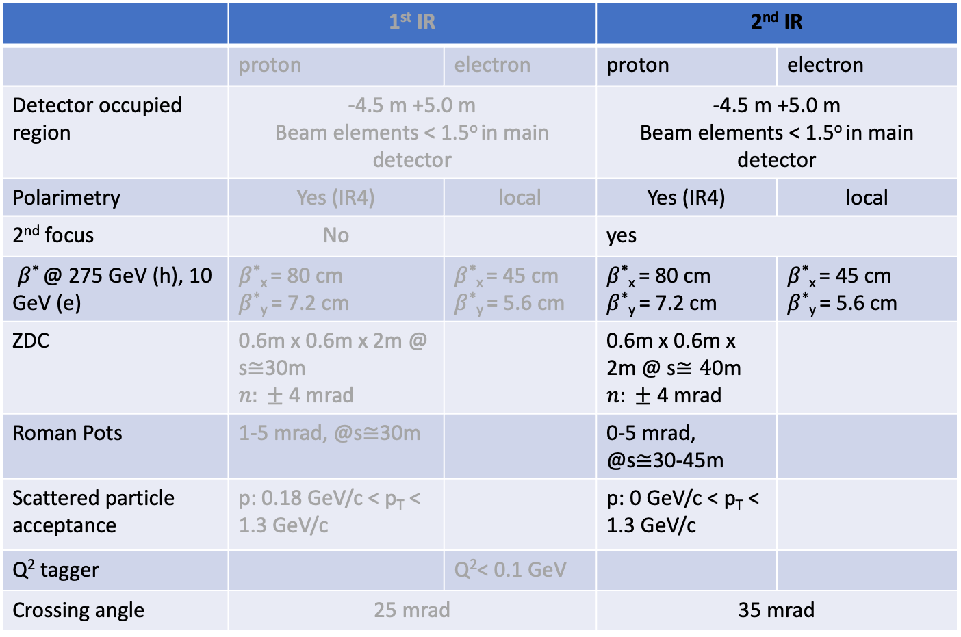
IR comparison
 | 1st IR |  | 2nd IR
 | proton | electron | proton | electron
Detector occupied region | -4.5 m +5.0 m Beam elements < 1.5º in main detector |  | -4.5 m +5.0 m Beam elements < 1.5º in main detector
Polarimetry | Yes (IR4) | local | Yes (IR4) | local
2nd focus | No |  | yes
$β$* @ 275 GeV (h), 10 GeV (e) | $β$*_{x} = 80 cm $β$*_{y} = 7.2 cm | $β$*_{x} = 45 cm $β$*_{y} = 5.6 cm | $β$*_{x} = 80 cm $β$*_{y} = 7.2 cm | $β$*_{x} = 45 cm $β$*_{y} = 5.6 cm
ZDC | 0.6m x 0.6m x 2m @ s$≅$30m $n: ±$ 4 mrad |  | 0.6m x 0.6m x 2m @ s$≅4$0m $n: ±$ 4 mrad
Roman Pots | 1-5 mrad, @s$≅$30m |  | 0-5 mrad, @s$≅$30-45m
Scattered particle acceptance | p: 0.18 GeV/c < p_{T} < 1.3 GeV/c |  | p: 0 GeV/c < p_{T} < 1.3 GeV/c
Q² tagger |  | Q²< 0.1 GeV
Crossing angle | 25 mrad |  | 35 mrad

Slide 38
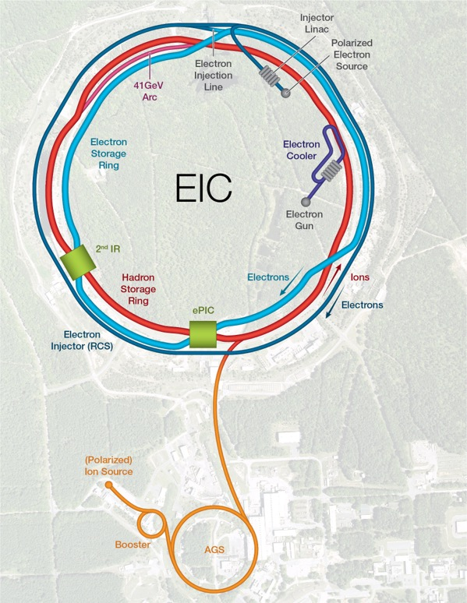
Requirements/Constraints
Fit into the existing RHIC IR8 experimental hall between arcs 7 and 9.
Preference for a secondary focus.
Same accelerator equipment as in IR6 (spin rotators, snake and crab cavities).
Second colliding IR and detector not in project, but the ability to have one is in the project scope.
Rear
Forward

Slide 39

IR6 layout
25 mrad crossing angle

Slide 40
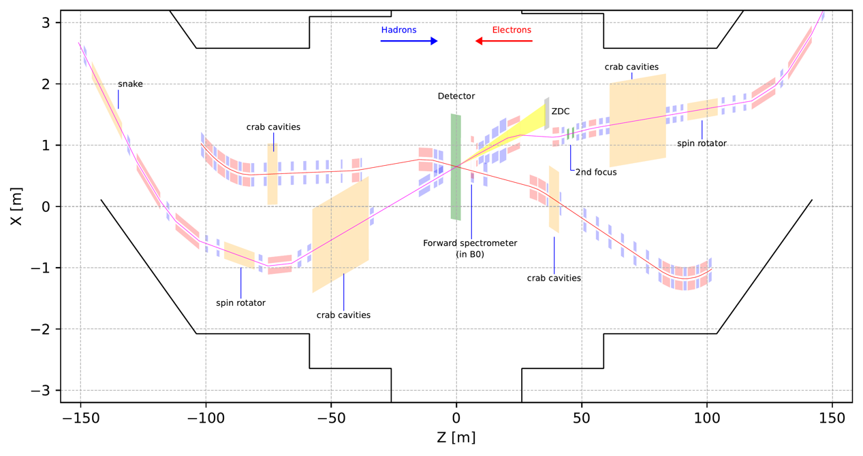
IR8 full layout (colliding)
35 mrad crossing angle (driven by accelerator geometry).
Second focus point at ~45m.
Space for similar accelerator equipment as IR6.

Slide 41
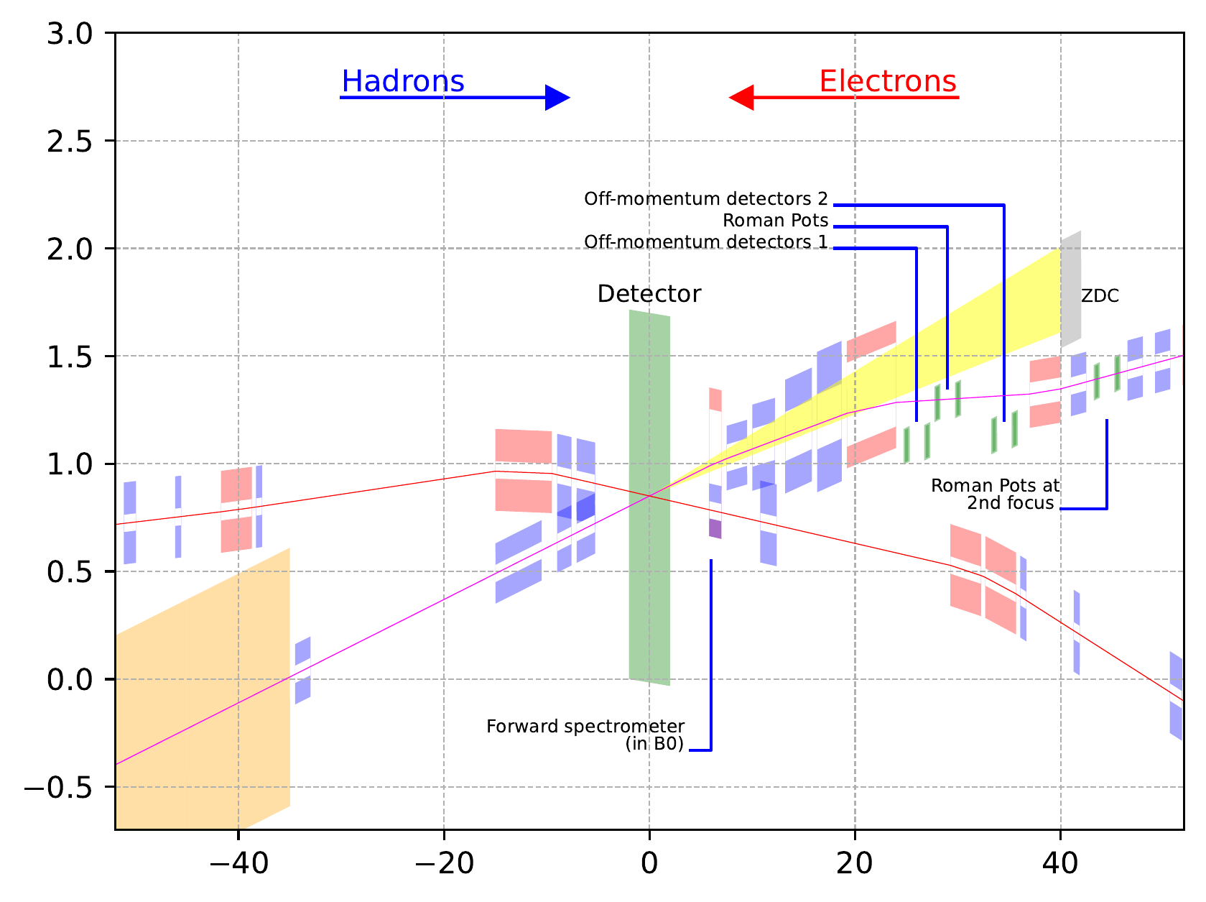
IR8 near IR layout
Space available for luminosity monitor, low Q2 tagger etc..
All ancillary detectors in outgoing hadron beam side (Forward) integrated

Slide 42
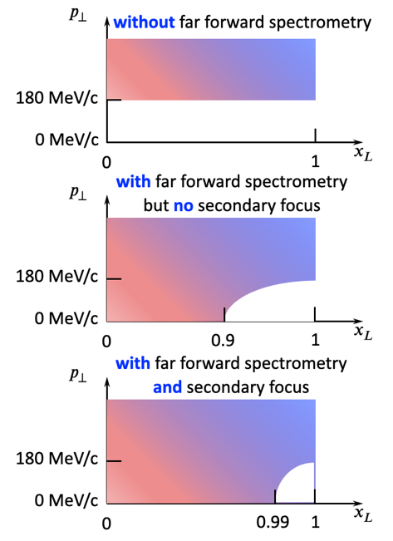

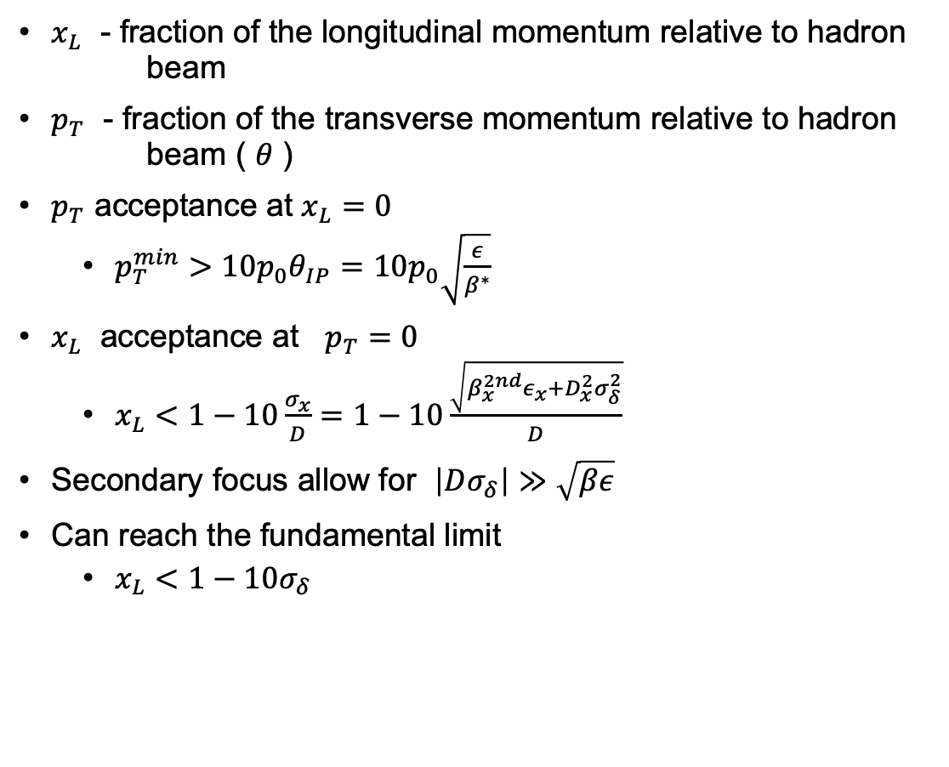
Acceptance as a function of $x_{L}$ and $p_{T}$
$x_{L}$ - fraction of the longitudinal momentum relative to hadron beam
$p_{T}$ - fraction of the transverse momentum relative to hadron beam ( $θ$ )
$p_{T}$ acceptance at $x_{L}=0$
  $p_{T}^{min}>10p_{0}θ_{IP}=10p_{0}\sqrt{\frac{ε}{β^{∗}}}$
$x_{L}$ acceptance at $p_{T}=0$
  $x_{L}<1−10\frac{σ_{x}}{D}=1−10\frac{\sqrt{β_{x}^{2nd}ε_{x}+D_{x}^{2}σ_{δ}^{2}}}{D}$
Secondary focus allow for $\left|Dσ_{δ}\right|≫\sqrt{βε}$
Can reach the fundamental limit
  $x_{L}<1−10σ_{δ}$

Slide 43
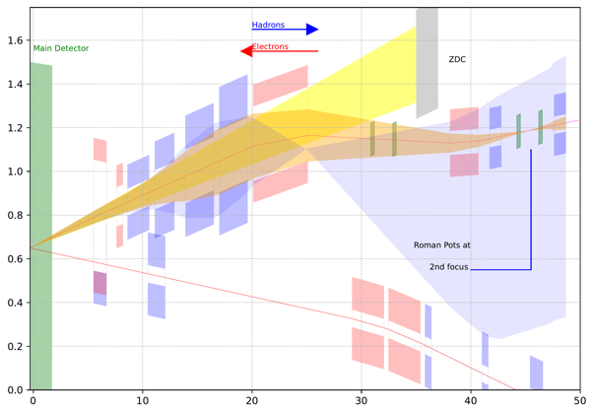
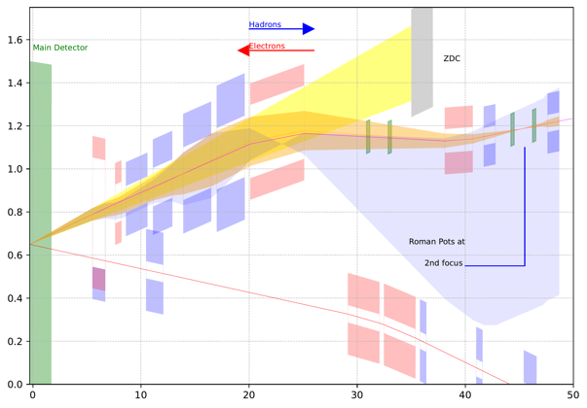
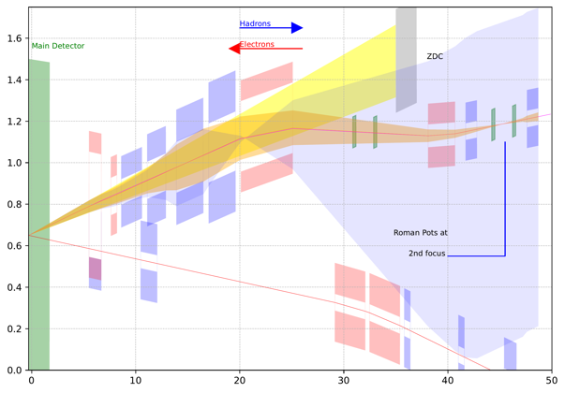

IR8 forward acceptance
Neutrons $±5$ mrad
Protons $±5$ mrad $x_{L}=1$
Protons $±5$ mrad $x_{L}=0.5$
275GeV
This is using NbTi magnets.
Final focusing quads and the dipoles properties (apertures, lengths etc..) was optimized for forward scattering neutron and proton acceptance.
41GeV
100GeV

Slide 44




IR8 second focus
Optimal $β_{x}^{2nd}=\frac{L_{RP}}{2}$
For the current design, $x_{L}<0.993$0
Limit of $x_{L}$ for the given momentum spread is $0.9932$ at 275GeV
Parameters at the 2nd focus for different energies

Slide 45


IR8 hadron optics
Limited matching space requires some high gradient magnets (quadrupoles) than what is available from existing RHIC magnets.
Near IR magnet include 7 FFQs, 2 Dipoles, 1 corrector and B0.
All magnets are assumed to be NbTi
275GeV
Magnets | RHIC | New
Quadrupoles | 11 | 11
Dipoles | 5 | 0
41GeV
100GeV

Slide 46

IR8 electron optics
Optics and design similar to IR6
Rear
Forward

Slide 47



Constraints
Space for magnets.
Geometry of the experimental hall.
Optics requirements for specific regions (eg: crab cavities)

Slide 48
Summary 2nd IR (IR8)
IR8 information
Second colliding IR and detector not in project, but the ability to have one is in the project scope.
This is a Pre-conceptual design.
The IR8 with the second focus adds complementarity to IR6.
Work to be done includes,
  Crab cavity space requirement for the 35 mrad crossing angle.
  Clearance check for the RCS (Rapid Cycling Synchrotron) bypass.
  Account for luminosity sharing by moving the IP by 0.2975m away from IR6.
  Low energy lattices (41,100 for protons and 5,10 for electrons)
  Further study needed for the feasibility of the IR magnets.
  Nb3Sn magnets are being evaluated as an option.
  Chromaticity compensation with two IR’s

