Slide 1
EIC Project Update
Elke Aschenauer and Rolf Ent
Co-Associate Directors for the Experimental Program
ePIC Convener Meeting
December 16th 2022

Slide 2
Background Taskforce
Need info on is the current machine design for vacuum and SR good enough to operate ePIC → questions during technical reviews
need SR rate in detectors
beam gas background rates
total hadronic and electromagnetic radiation load
neutron fluence → SIPMs, Silicon, ….
impact on track seeding and finding
overall rates as fct. of η and Φ
…………
formed a taskforce of people working on these talks at the project and ePIC
Jarda, Zhengqiao, Alex, Kolja, Joe, Jae, Wouter, David L., Rey, Elke
welcome everybody who wants to do concrete work
have met twice till now Friday 2nd of December 9:30 am, and Friday 16th of December
will report results to ePIC GDI and respective detector WGs and Project Accelerator WG
Wiki: https://wiki.bnl.gov/EPIC/index.php?title=Background
Indigo: https://indico.bnl.gov/category/461/
email-list coming

Slide 3
ePIC Readout Chain
Global Timing Unit (GTU)
-Interface between collider, Run Control, & DAM
-Config & Control
-Clock & Timing
Name
Sharing
Function
Attributes
Sensor
Detector Specific
-Multi-Channel
Sensor
-MAPS
-AC-LGAD
-MCP-PMT
-SiPM
-LAPPD
Adapter
Detector Specific
-HV/Bias distribution
-HV divider
-Interconnect routing
-Sensor Specific
-Passive
Front End Board
(FEB)
Detector Specific
-Amplification
-Shaping
-Digitization
-Zero Suppression
-ASIC/ADC
-Discrete
-Serial Link
Readout Board
(RDO)
Shared / (potential variations)
-Communication
-Aggregation
-Formatting
-Data Readout
-Config & Control
-Clock &Timing
-FPGA
-Fiber Link
Data Aggregation Module (DAM)
Shared / (FELIX)
-Computing Interface
-Aggregation
-Software Trigger
-Clock & Timing
-Config & Control
-Large FPGA
-PCIe
-Potentially Ethernet
Computing
COTS / Ethernet
-Data buffering and sinking
-Run Control
-Calibration Support
-QA / Scalers
-Collider Feedback
-Event ID/Building?
-Software Trigger
-Monitoring

Slide 4
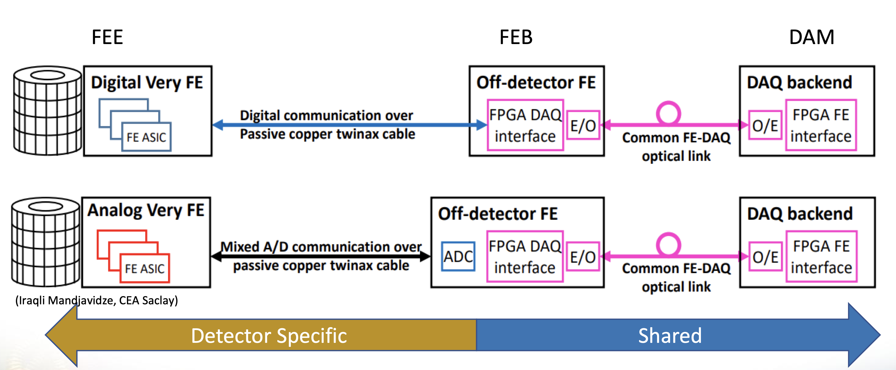
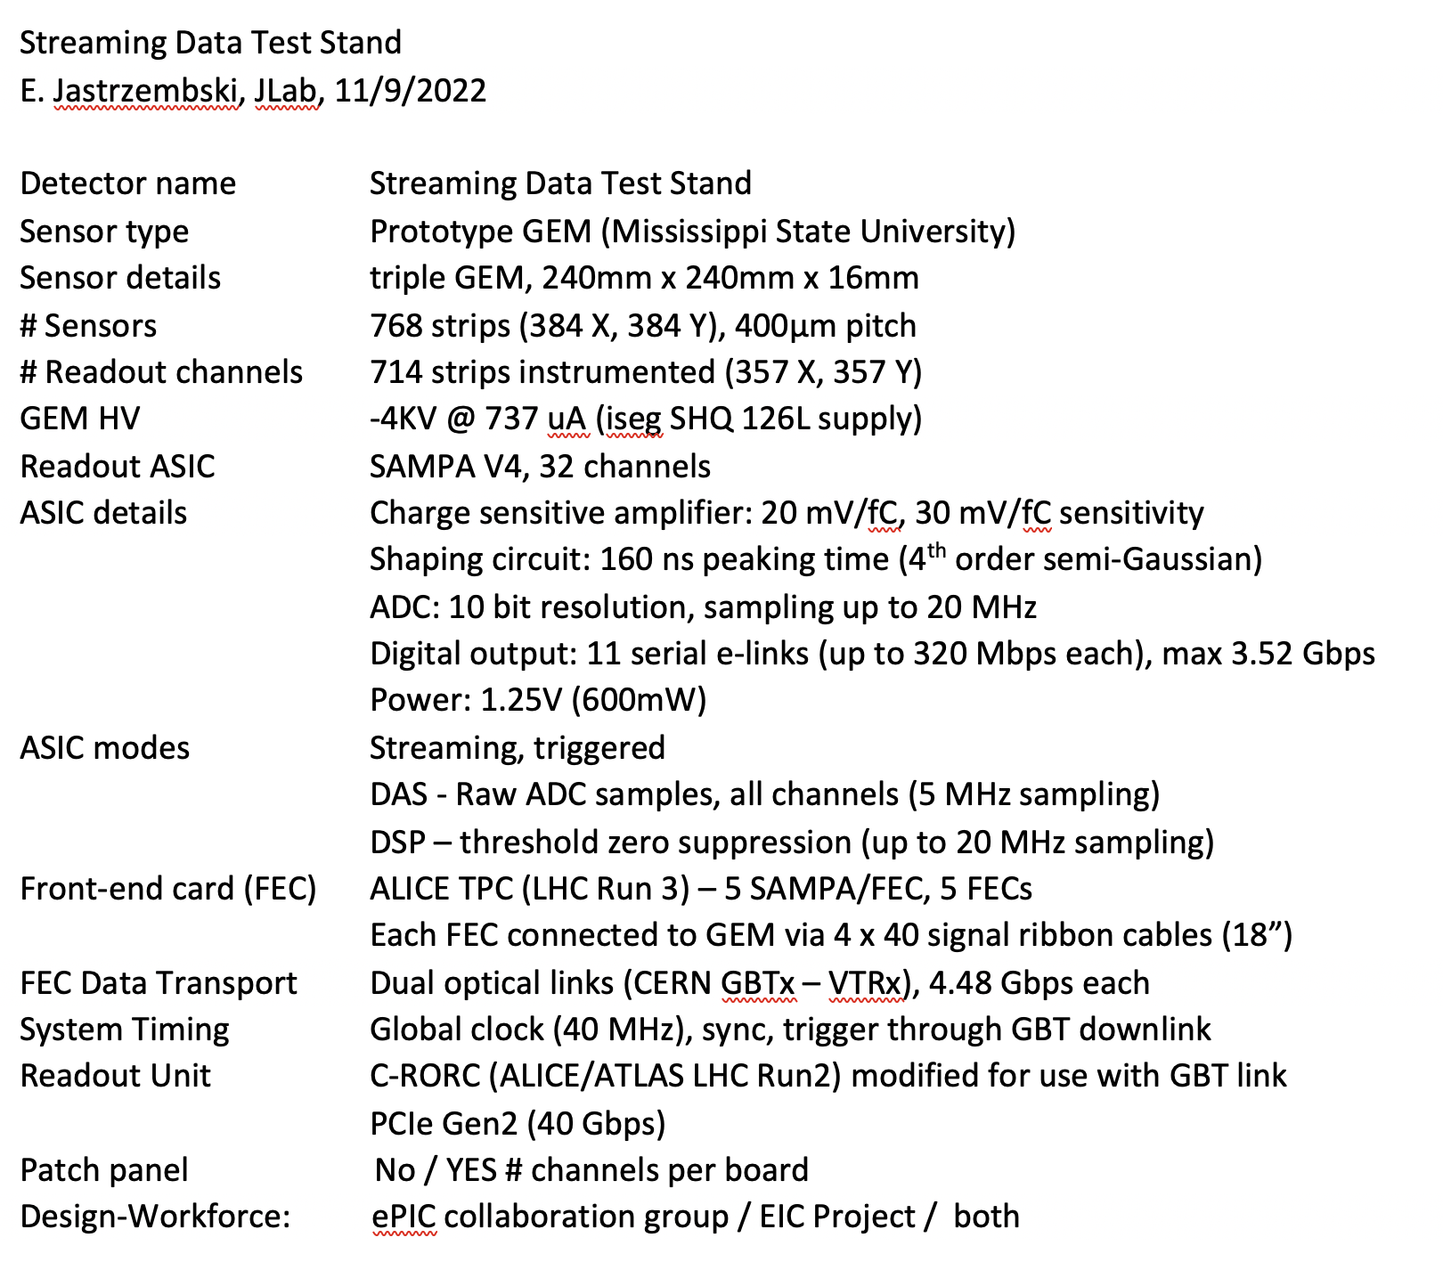
Next “ePIC – Project” Project: Subdetector Readout Chains
Have integrate read-out chain questionnaire for all subdetectors following this example to be filled by experts in the service excel-sheet
FEB
RDO
All linked to:
https://wiki.bnl.gov/EPIC/index.php?title=Project_Information#Documents%3A
Deadline: 9th of January 2023
Sensor
detector specific
FEB:
detector specific
RDO:
hopefully one board
common to many
subdetectors

