Slide 1
Full Simulation – First Look at ‘Jets’

Slide 2
Outline
Found Issues
Electron Finding
Endcap Clusters in Gap
Correction for Crossing Angle
Anisotropy in Positive Endcap Cluster Position
Jet Kinematics
Jet Resolutions

Slide 3
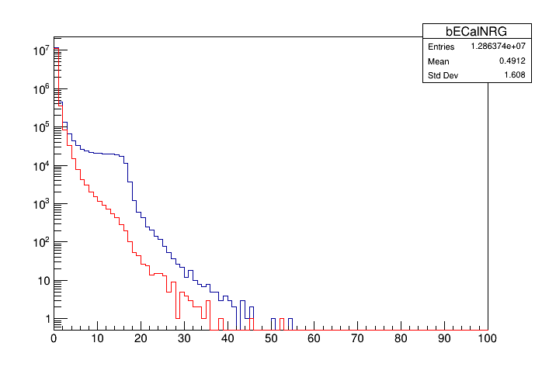
Rejecting Electrons
Remove electrons from jet clustering to avoid scattered beam particle
In nECal, pECal, and reco charged particles – do this with association branch
This branch seems to be missing for the barrel SciGlass calo
Identify position of electron from MC record and remove clusters within 0.1 eta-phi

Slide 4
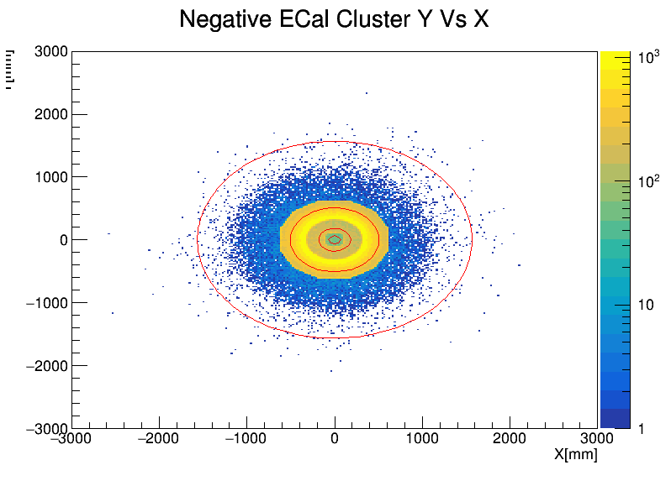
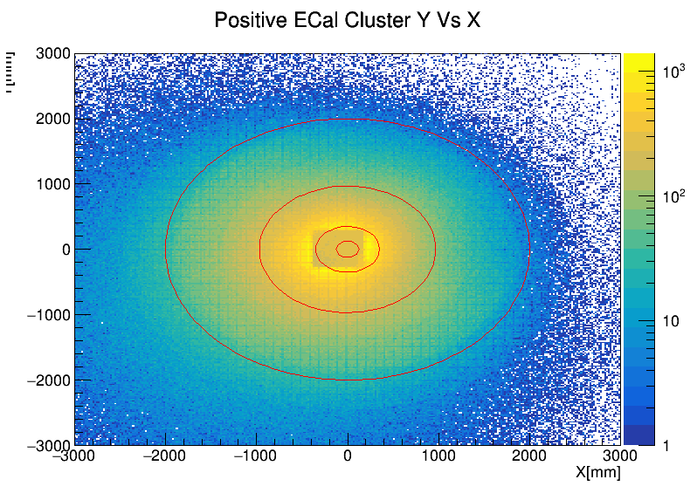
See that cluster positions intrude into the gap area around the beam pipes
Individual hits do not show this problem
Manually cut out clusters in this region
Clusters in Gap

Slide 5
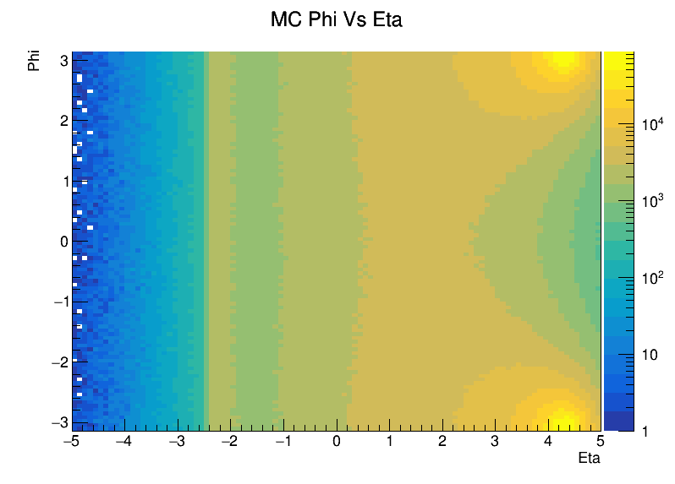
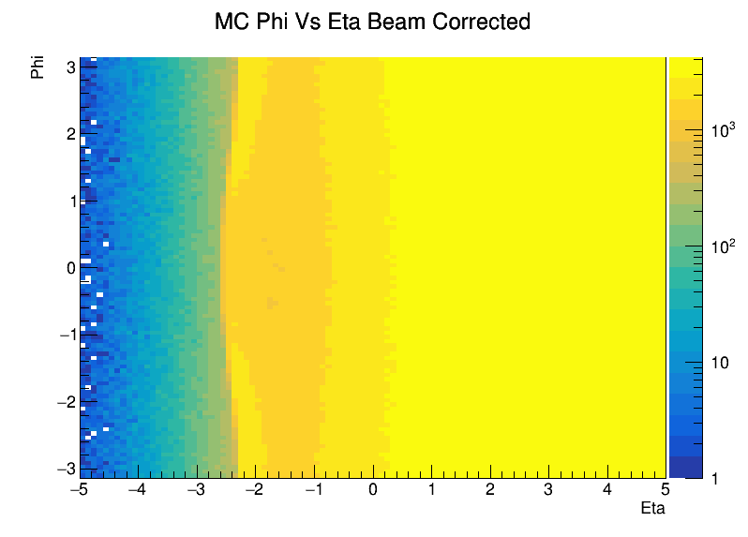
Crossing Angle Correction
Simulation generated with a crossing angle which causes distortions in eta-phi
For this study, correct by simply calculating particle/track/cluster position w.r.t. the outgoing hadron beam
This will cause distortions in the backward region
Don’t apply correction beyond a certain point (eta < 1.4)

Slide 6
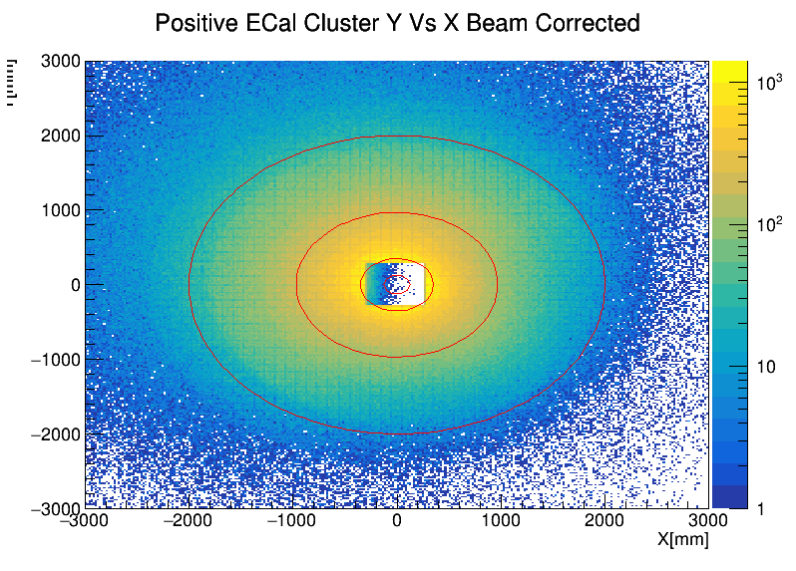
Crossing Angle Correction
See that correction centers the gap for positive endcap clusters
However, still seems to be azimuthal anisotropies even after correction

Slide 7
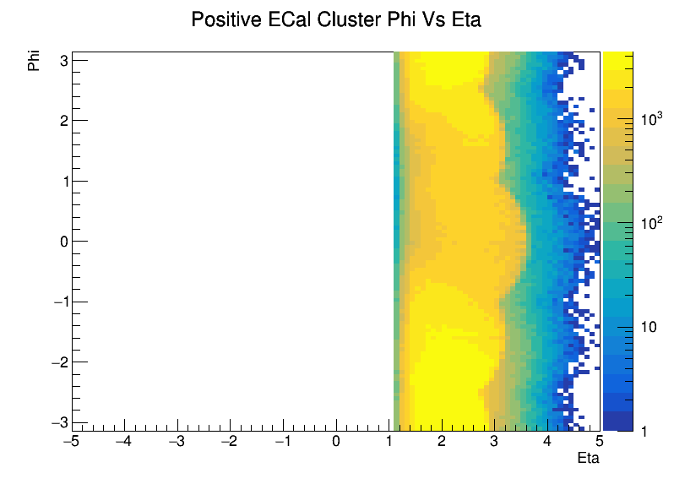
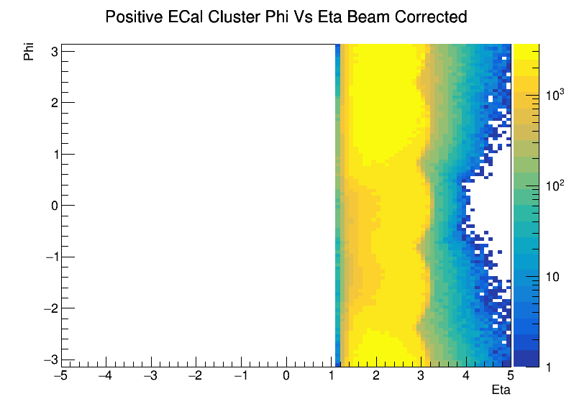
pECal Cluster Anisotropy
Crossing angle correction smooths out ‘bulges’
However, we still see hotspots in phi
Don’t see this behavior with reconstructed hits
Uncorrected
Corrected

Slide 8
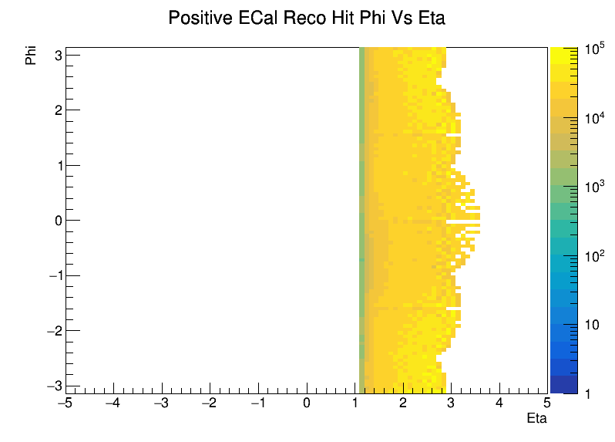
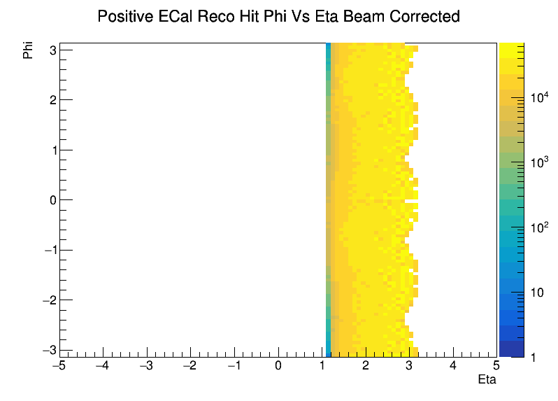
pECal Hit Behavior
The reconstructed hits show a much better response to the correction – no ‘bulges’ or anisotropies
Some issue with the clustering?
Uncorrected
Corrected

Slide 9
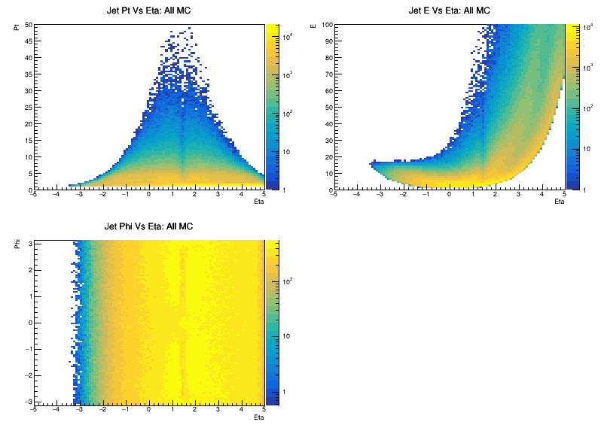
Jet Kinematics
Monte Carlo Jets

Slide 10
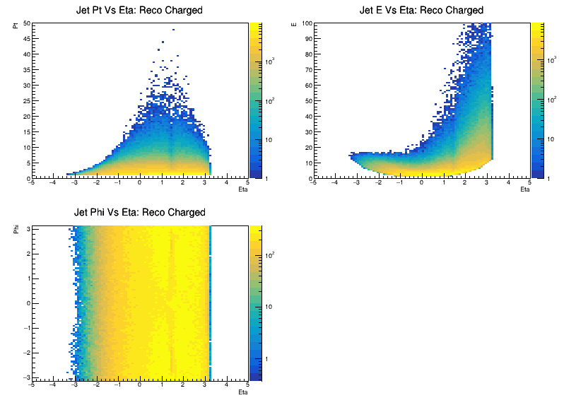
Jet Kinematics
Reco Charged Particle Jets

Slide 11
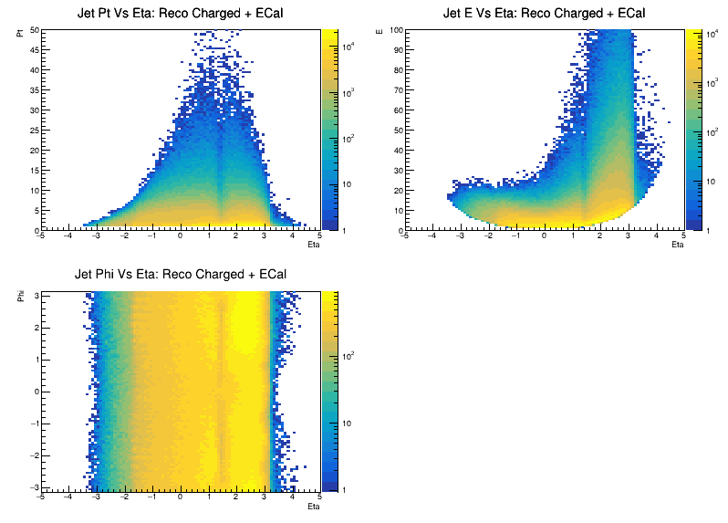
Jet Kinematics
Reco Charged Particle + ECal Jets

Slide 12
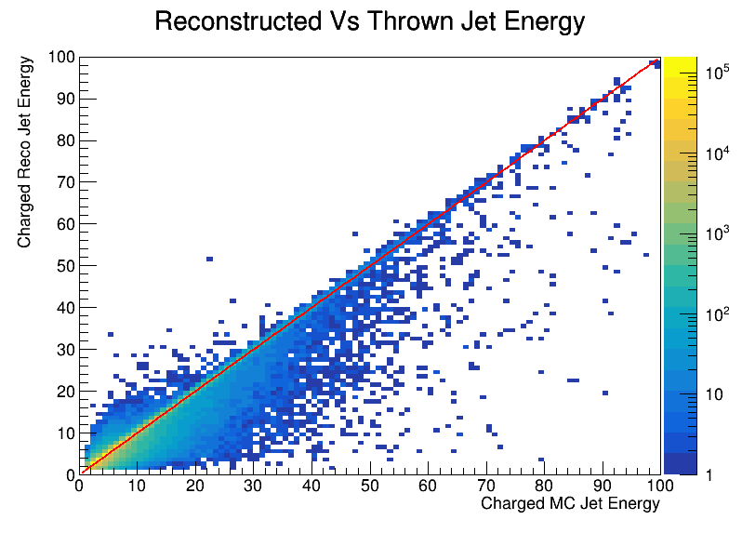
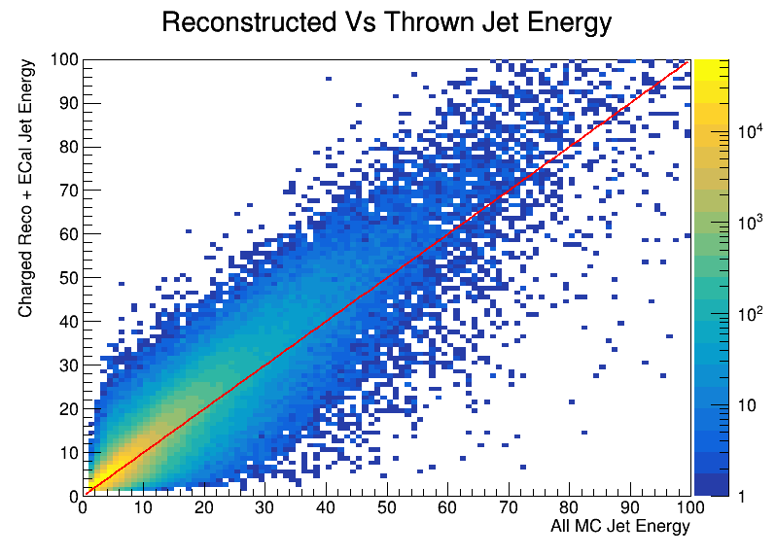
Jet Resolutions

Slide 13
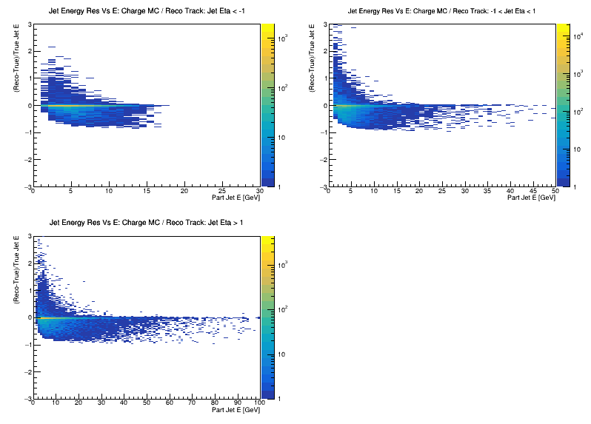
Jet Resolutions

Slide 14
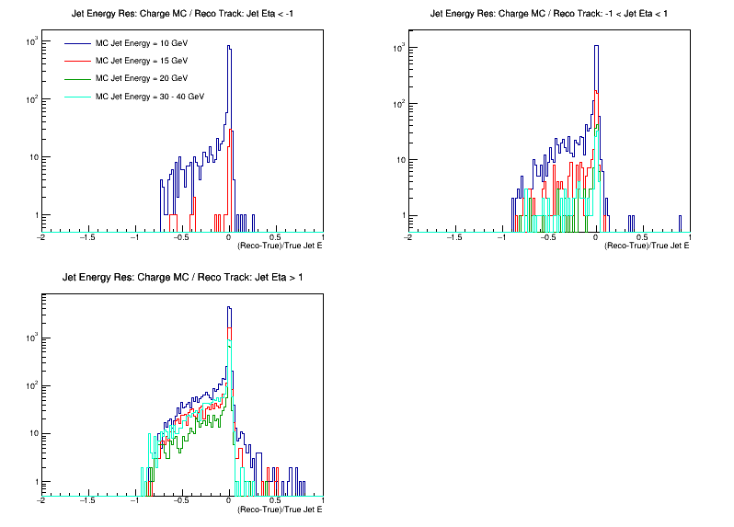
Jet Resolutions

Slide 15
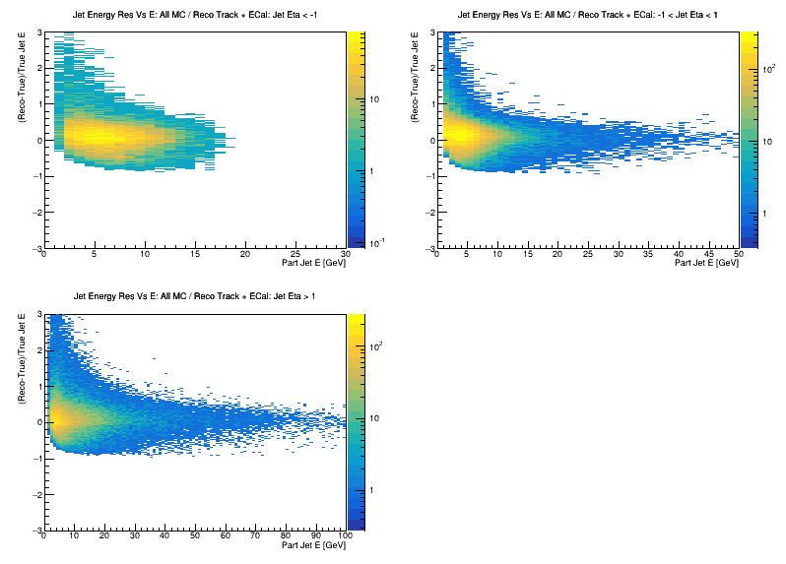
Jet Resolutions

Slide 16
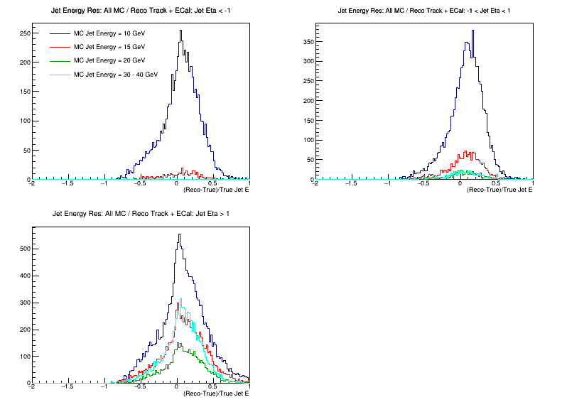
Jet Resolutions

