Slide 1
Particle Occupancy in pfRICH

Slide 2
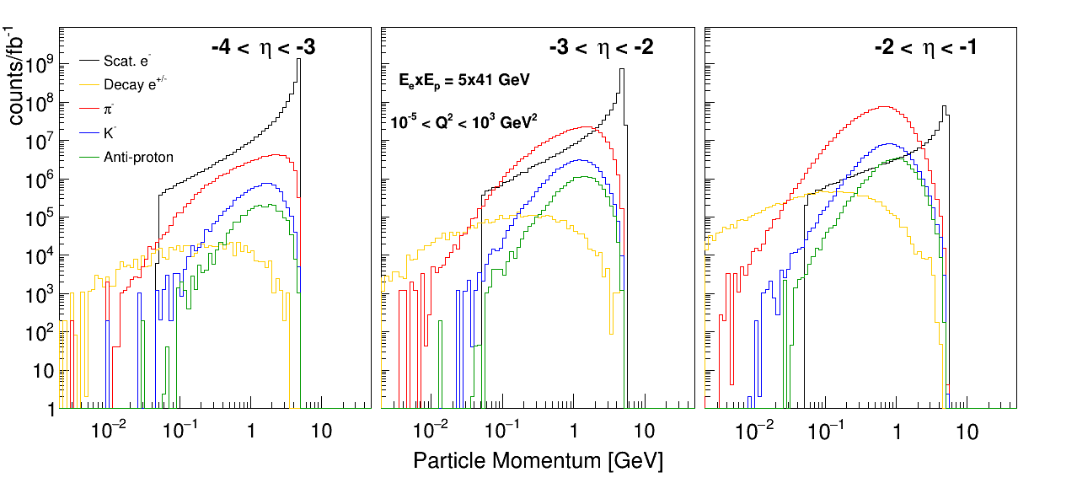
Particle Momenta: 5x41

Slide 3
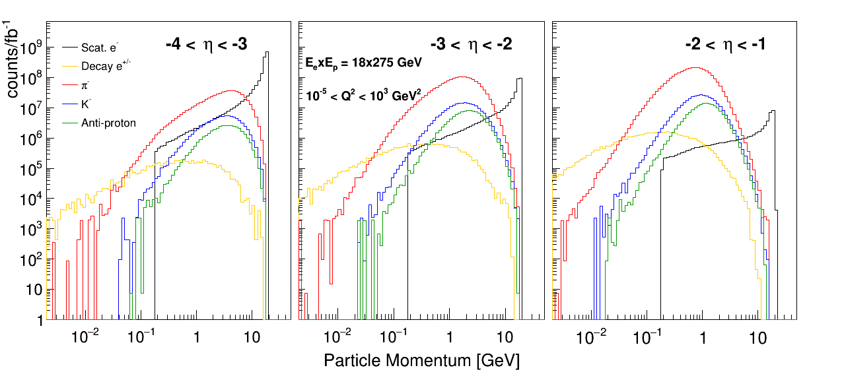
Particle Momenta: 18x275

Slide 4
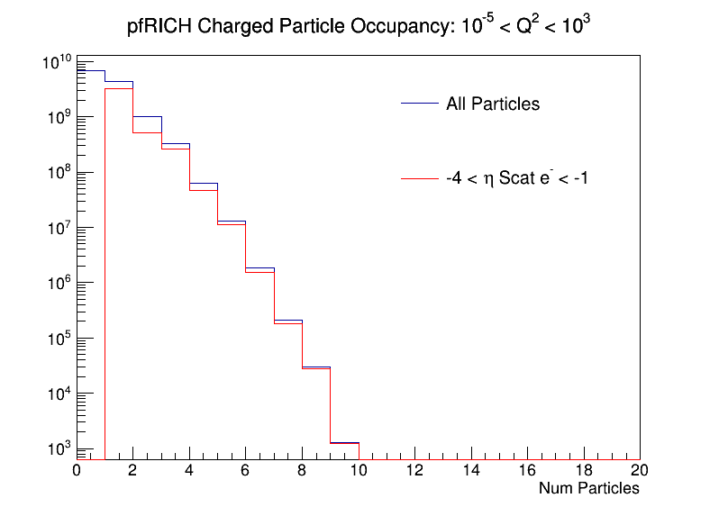
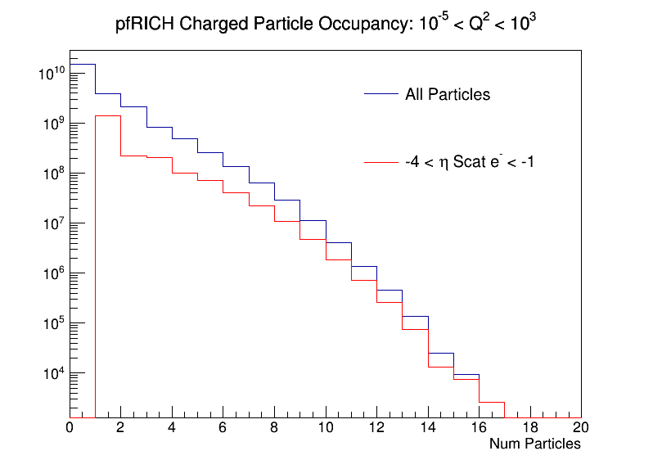
Particle Occupancy: -4 < eta < -1
Frequency with which a given number of particles will be in the approximate pfRICH acceptance (-4 < eta < -1) in a single event
5x41
18x275
Blue curve is for all events and red curve is for those events in which the scattered electron is within -4 < eta < -1

Slide 5
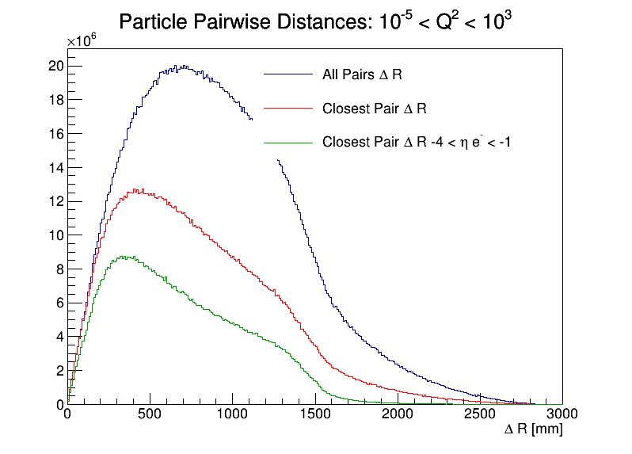
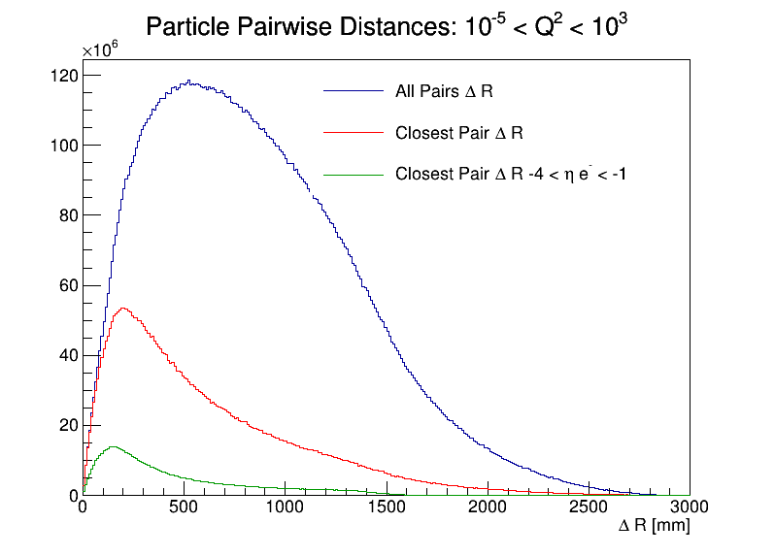
Particle Pairwise Distance: -4 < eta < -1
Blue = distance between each pair of particles in acceptance
Red = distance between closest two particles in acceptance
Green = same as red, but for events with electron in acceptance
5x41
18x275
Distance is in x-y plane at a z position of -1700 mm from the interaction point

Slide 6
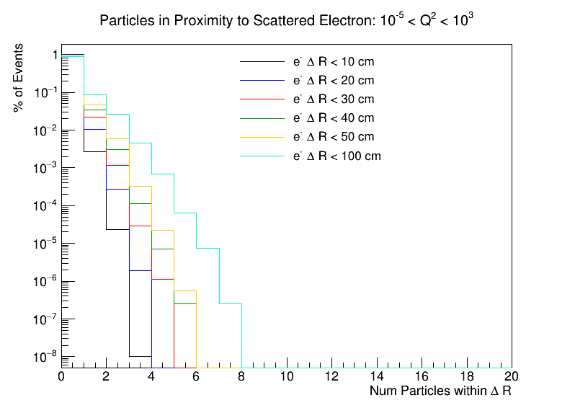
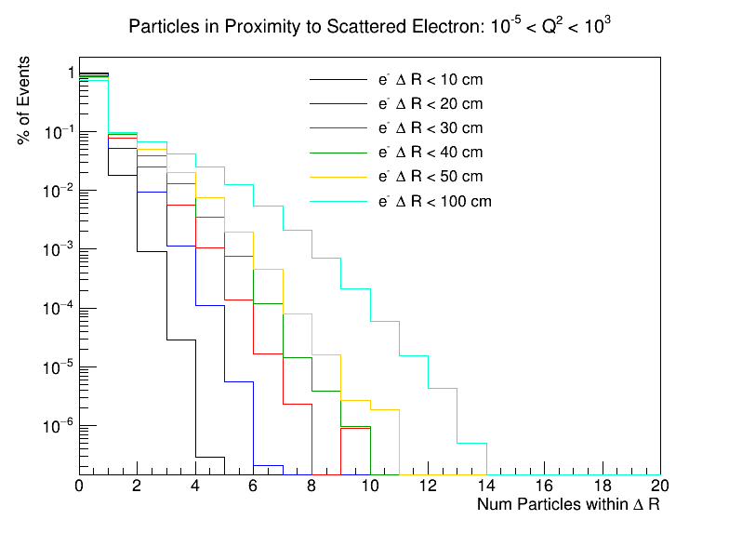
Electron Proximity: -4 < eta < -1
Measure of the number of particles near the scattered electron
Each curve represents a circle with given radius around the electron and x-axis is the number of particles within that area
5x41
18x275
Electron and other particles required to be in acceptance
For example: blue curve (5x41) says 1% of events will have 1 particle with 20 cm of electron, 0.03% of events will have 2 particles within 20 cm, etc

