Slide 1
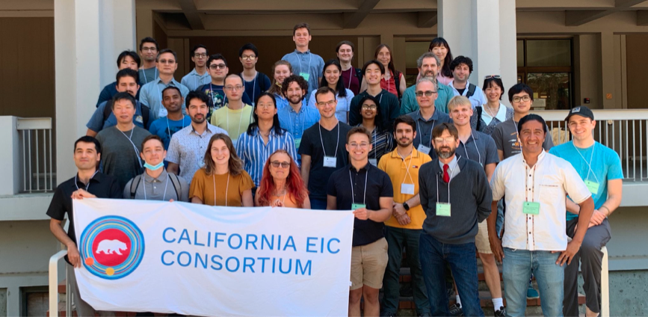
Consortium Accomplishments
+ Berkeley Overview
Barbara Jacak
January 27, 2023

Slide 2
Silicon tracker achievements in 2022
Designed & demonstrated performant layout
Simulations and reconstruction software development
Performance & Background studies
Generic & Project Engineering R&D secured
Conceptual design of mechanics & cooling
Cooling & material bench tests
Procure parts & techniques for in-beam sensor tests
Established collaboration with UC Davis on R&D
Established leadership roles in EIC Silicon Consortium, Tracking working group & Tracking software

Slide 3
Calorimetry achievements in 2022
Demonstrated W/SciFi technology; chosen for ePIC Ecal
Validated performance with simulations
Constructed & tested prototype parts
Established leadership role in Calorimetry working group and Ecal software
Conceptual design of Calorimeter Insert
Validated performance with simulations
Constructed & tested prototype building blocks
Published paper in NIM A
update!

Slide 4
Physics achievements in 2022
Established theory-experiment collaborations
Neutrino-tagged jets at EIC
Energy-energy correlators at EIC
Photoproduction (coherent and incoherent)
Tagged structure functions studies
Heavy flavor physics studies
update!

Slide 5
Silicon Plans for 2023
Sensor development
Develop large area sensor for EIC, for review in 2024
Bench and beam test & feedback to designers
Test set-up development for ER-1
Finalize layout
Optimize resolution & efficiency, including backgrounds
Mechanical design & simulation of mechanics
Overall support & cooling design
Selection of materials
Develop aluminum conductor flex cables
Prepare for EIC CD-2 in 2024

Slide 6
Calorimeter plans for 2023
update!

Slide 7
Physics studies planned for 2023
Publish energy-energy correlators paper
update!

Slide 8
RENEW program at DOE
We need to take advantage of this opportunity!
More discussion during this meeting
update!

Slide 9
UC Berkeley & LBNL Groups
UCB PD: Preeti Dhankher, Minjung Kim
LBNL PD: Rey Cruz Torres, Wenqing Fan, Shujie Li, Kyle Lee*, Yuanjing Ji, Tyler Hague, Peng Miao
UCB Grad students: Dhruv Dixit, Ezra Lesser, Beatrice Liang Gilman, Tucker Hwang, Anjali Nambrath, Emma Yeats
Alwina Liu graduated in December
Undergrad students: Kyle Devereaux, Richard Lew*, Remi Seddigh*, Benjamen Sterwerf, Andy Park, Oscar Tapia Gallegos, Shreya Puranam
LBNL staff: Ernst Sichtermann, Spencer Klein, John Arrington, Nikki Apadula, Yue Shi Lai¹, Yuan Mei, Xin Dong, Barbara Jacak

Slide 10
Leadership roles
Working group conveners
Spencer Klein, John Arrington
Tracking software liaison: Shujie Li
Silicon Consortium co-chair: Ernst Sichtermann
Generic & eRD111 lead: Nikki Apadula
CC members
Ernst Sichtermann, John Arrington, Barbara Jacak
Charter Committee: Barbara Jacak
Running for ePIC office
Ernst Sichtermann for CC chair
Barbara Jacak for Deputy Spokesperson (with Ken) Vote for us!!

Slide 11
Berkeley Group Works on
EIC, ALICE, STAR, sPHENIX, Jlab experiments
HI Physics goals
Transport properties of dense QCD matter (hot and cold)
Jet evolution and modification in dense matter
Hadronization process
Hadron Physics Goals
Where is the proton’s spin?
Short range correlations in nuclei & quark-level understanding
Parity violating asymmetry in e-e scattering for sin² _{w} at low Q²
Source of EMC effect
Our approach is to study with available machines now and design, build, and analyze EIC experiment to study with e+p, A

Slide 12
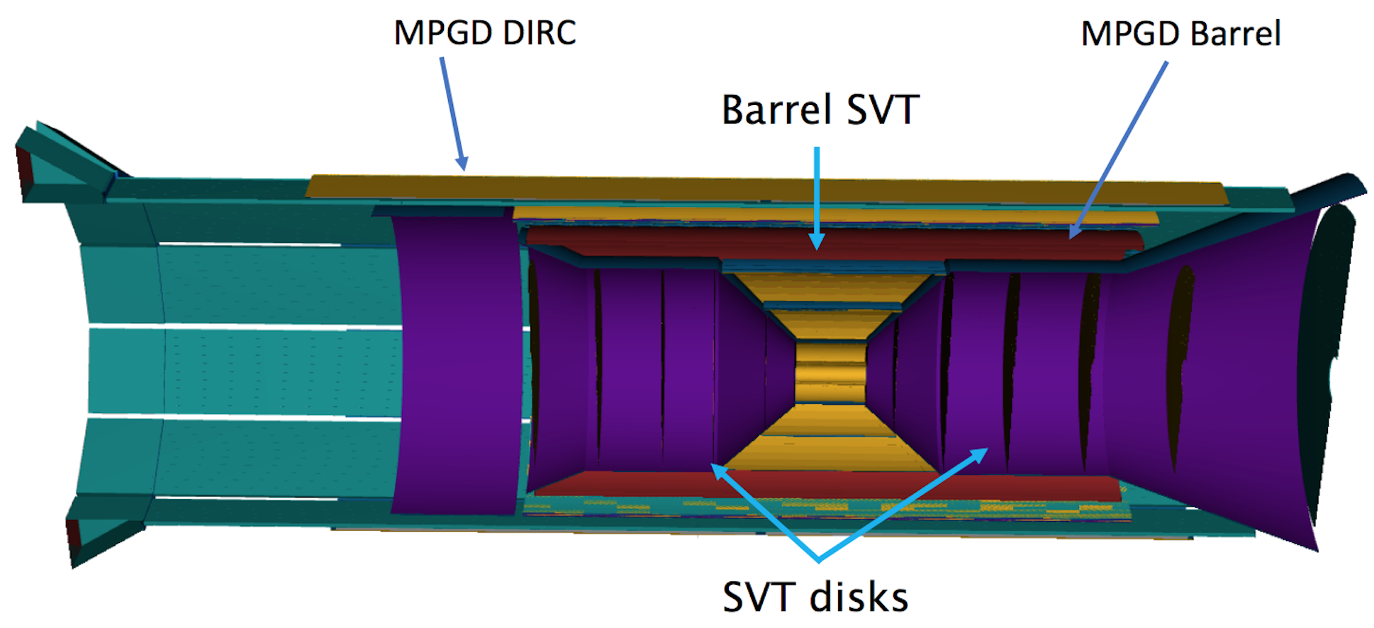
Silicon tracker design for EIC
Optimize layout
Simulate tracking performance
Momentum, position, angular resolution
Track length & projections
Pattern recognition (track finding)
Backgrounds
ACTS tracking software
Vertexing
R&D on mechanics
Tiling strategies
Cooling
Support structures; carbon foam, Kapton embedding
Ansys & engineering modeling of tracker mechanics

Slide 13
Silicon pixel sensor R&D
Bench tests
Prepare test boards for EIC
Bench (& beam) tests of MLR1 with ALICE colleagues
Duplicate Trieste set up at LBNL
Beam tests
Prepare for beam tests with 50 MeV protons at 88-inch cyclotron
Coordinate R&D studies for both ALICE & EIC
Collaborate with LANL to prepare telescope
Carry out beam test, coordinate goals with ALICE colleagues
Same for ER-1, when available
Analyze and publish the results!

Slide 14
EIC physics studies
Energy-energy correlators at the EIC
Heavy flavor measurements
Including detector specifications
Jet probes of cold nuclear matter
Photoproduction (coherent and incoherent)
Tagged structure functions
Collaborate on electron reconstruction software

