Slide 1
Synchrotron Radiation Update
Benjamen Sterwerf

Slide 2
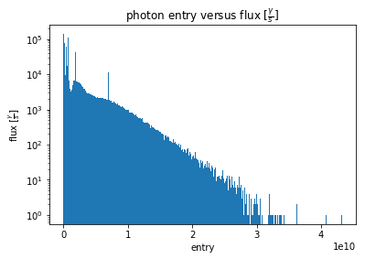
1.) Generator
Store each photon and its flux as a bin in a histogram.
Randomly sample photon using this flux distribution as the sampling distribution.
Each selected photon contributes 1/flux to the time integration
Results using 100 ns time integration window
Integration Window for 1 Event
Length of Time Integration

Slide 3
2.) Create a container for many multiple–photon events
Using a HEPMC3 file to store the many multiple-photon event
Disadvantage: Due to repositioning of momentum vectors from their respective vertices to the vertex (0,0,0) (found by Rey), we cannot store multiple-photon events as their own separate events.
Workaround: Create a single multiple-photon event-file where every HEPMC event is a single-photon and create a key that will keep track of which event the photons belong too in case the events ever need to be separated again.
Example format of one photon

Slide 4
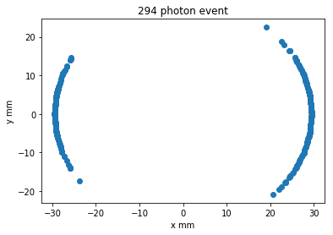
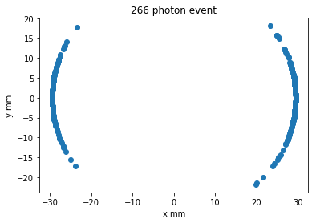
3) Propagate the HEPMC File through GEANT
Current implementation: HEPMC file contains 50000 multi-photon events.
Event time 100 ns
The events shown below happen right before interaction with the gold coating of the detector.
Example Event Inputs
Larger statistics on positive x>0 side of the detector verify the expectation that synchrotron radiation is emitted tangentially when the electron beam curves into the detector and will hit the side furthest from the center of curvature.
More SR hits on side of Detect furthest from the center of curvature (positive X side)

Slide 5
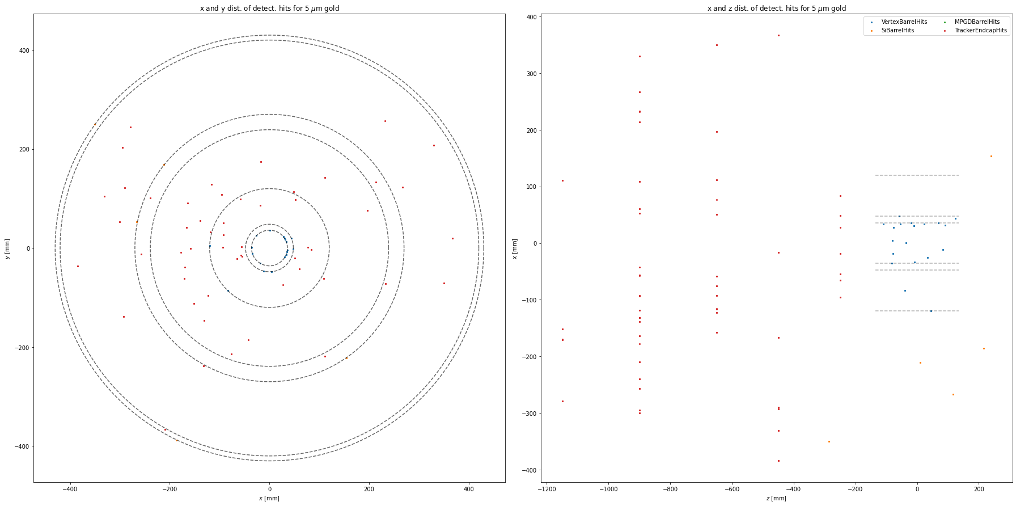
4) Reconstruction of Hit Distributions 5um Gold Coating

Slide 6
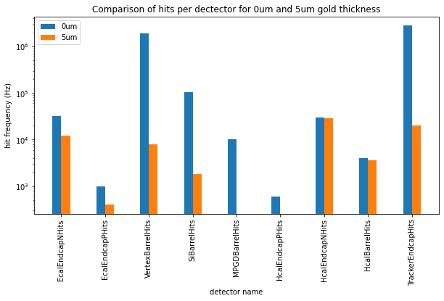
Hit Frequency Comparison between 0 and 5 um Gold Coating

Slide 7
DIS and SR Recombination Results

Slide 8
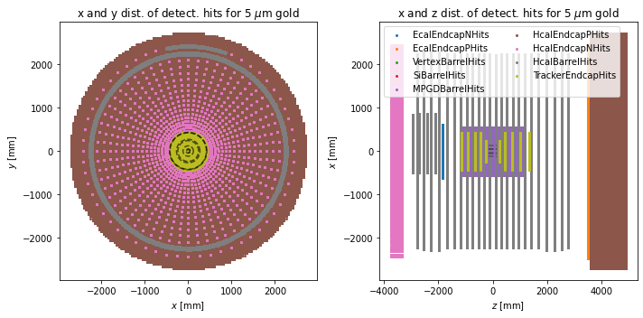
Beam Current Specifications
The provided Synchrotron Radiation Facet Files were provided for 2.5 mA electron beams with E=10GeV.
Therefore, the Pythia Events were Created according to this specification.
Later it will be possible to Change the Electron Beam current

Slide 9
Recombination Scheme
Pythia HEPMC Files
DIS Root Files
GEANT
Combined
Events
Synchrotron Radiation Facet Files
Generator
SR HEPMC Files
GEANT
SR Root Files
Event Processing
Separated SR Event Dataframe
SR Event Tracker

Slide 10
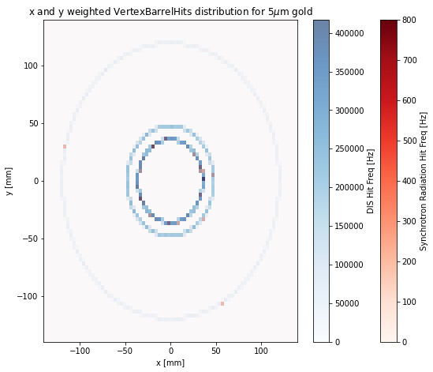
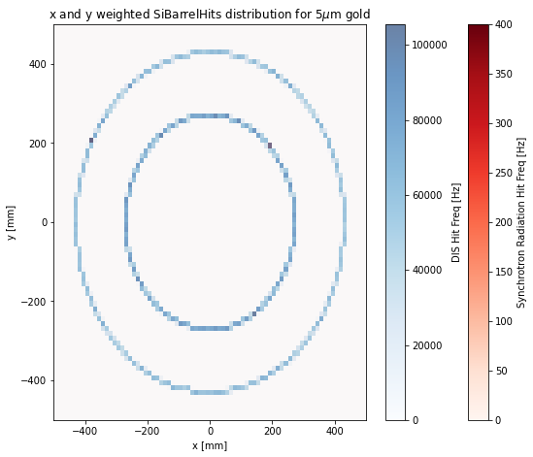
Combined DIS and SR Plots Per Subdetector (XY)

Slide 11
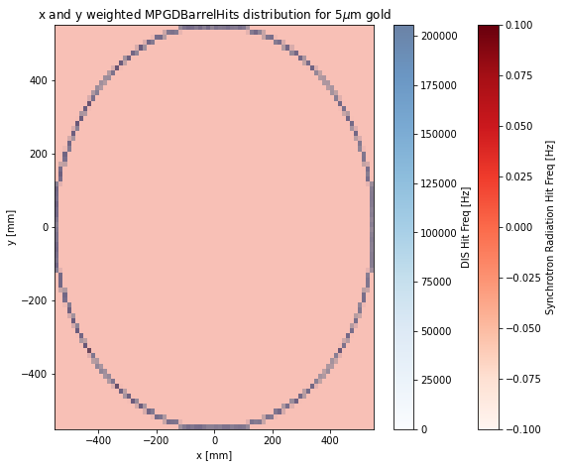
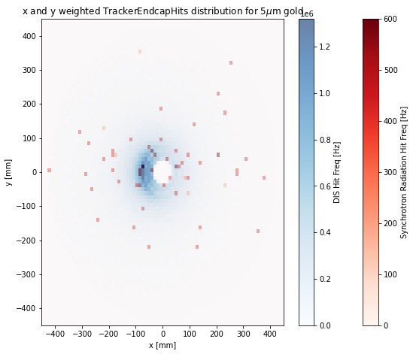
Combined DIS and SR Plots Per Subdetector (XY)

Slide 12
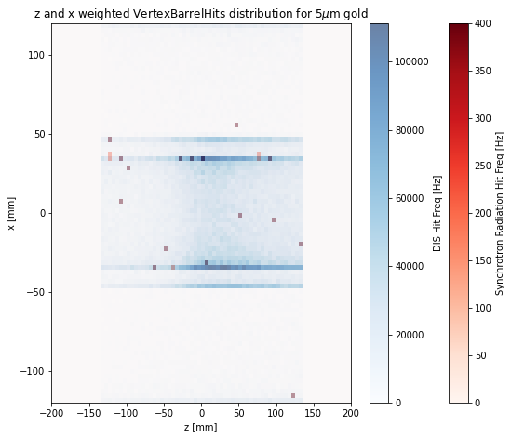
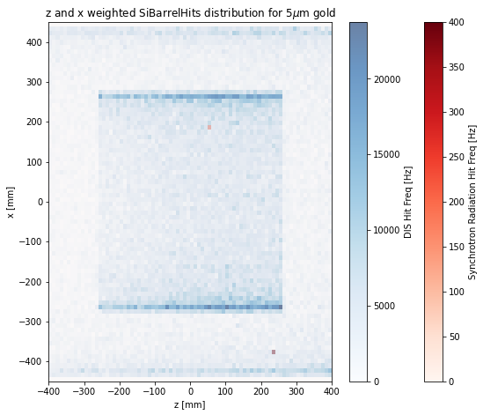
Combined DIS and SR Plots Per Subdetector (XZ)

Slide 13
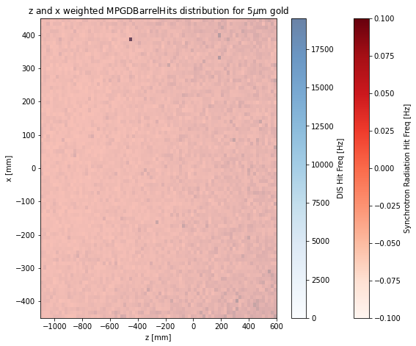
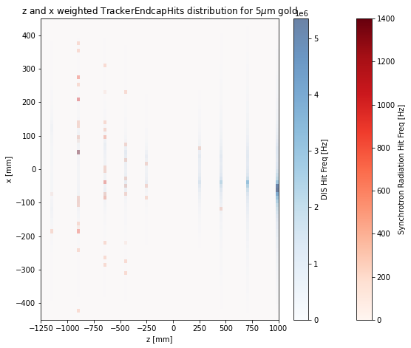
Combined DIS and SR Plots Per Subdetector (XZ)

Slide 14
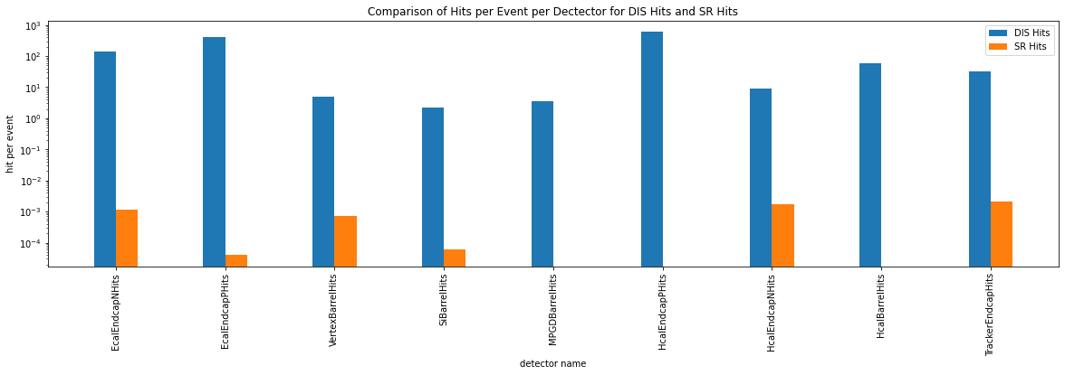
Hit Frequency Per Subdetector Comparison
Hits Per Event Per Subdetector Comparison

Slide 15
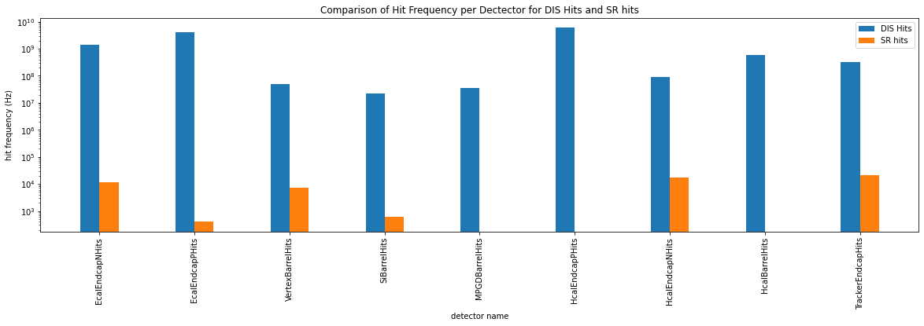
Hit Frequency Per Subdetector Comparison
Hit Frequency Per Subdetector Comparison

Slide 16
Summary Slide
Created a photon event Generator with user defined parameters
Created the capability to transform these events into multi-event HEPMC3 files with HEPMC defined as either:
Each event corresponding to a single photon (Pre-vertexing fix), with a key to sort individual photons
Each event corresponding to an actual event ()
Propagating these photons through geant to recreate hit distributions
Match Event Specifications with DIS events and pair the background hit distributions with the signal hit distributions created using Pythia.
Next Steps
Currently working on developing an admixing technique for the background and signal events in order to look at effects on tracking reconstruction.

