Slide 1
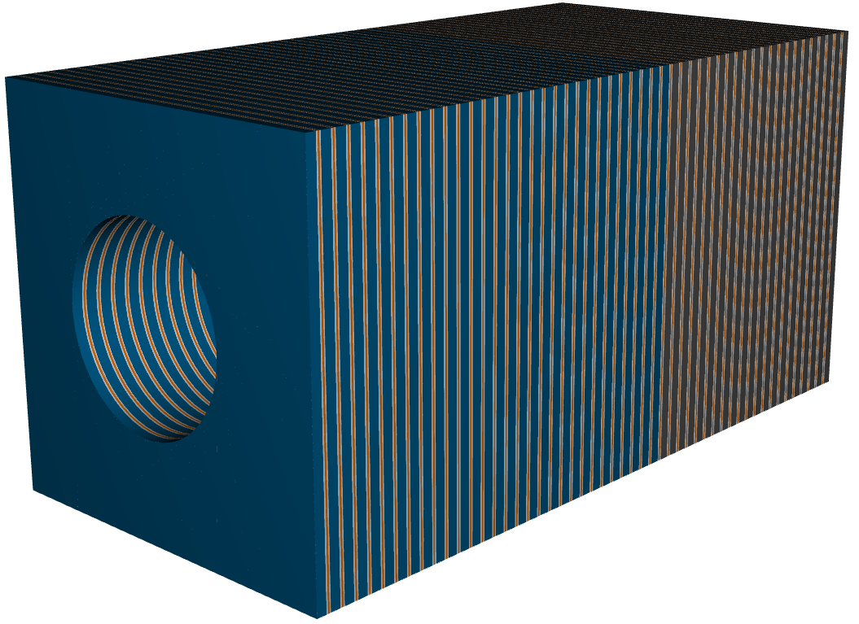

Summary of calorimeter insert design and performance
Ryan Milton
UCR
California EIC Consortium Meeting,
Jan. 27-28, 2023

Slide 2
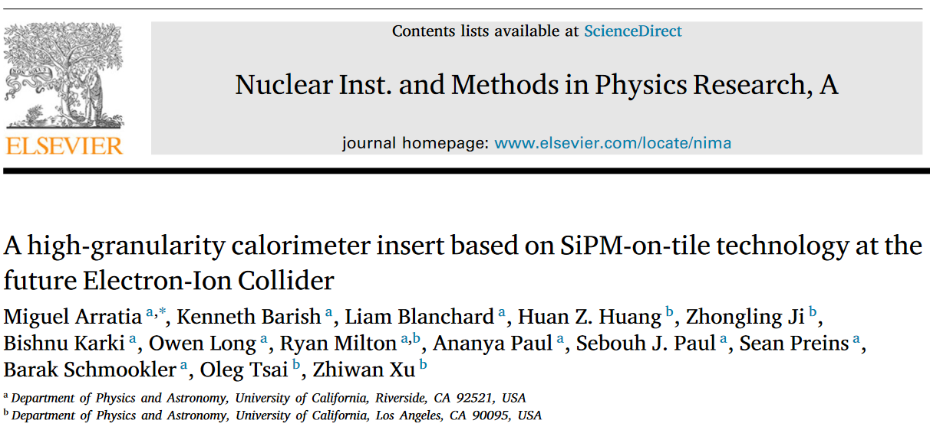
Since last meeting
Joint UCLA/UCR NIMA paper on forward HCal insert design and simulation performance
  Nuclear Inst. and Methods in Physics Research, A 1047 (2023) 167866
Insert implemented in ePIC simulations (Bryce Canyon)
Numerous studies ongoing:
  Machine learning (UCR, LLNL, Ben Nachman)
  SiPMs and scintillators
  Prototype and beam test
  Jet studies in ePIC

Slide 3
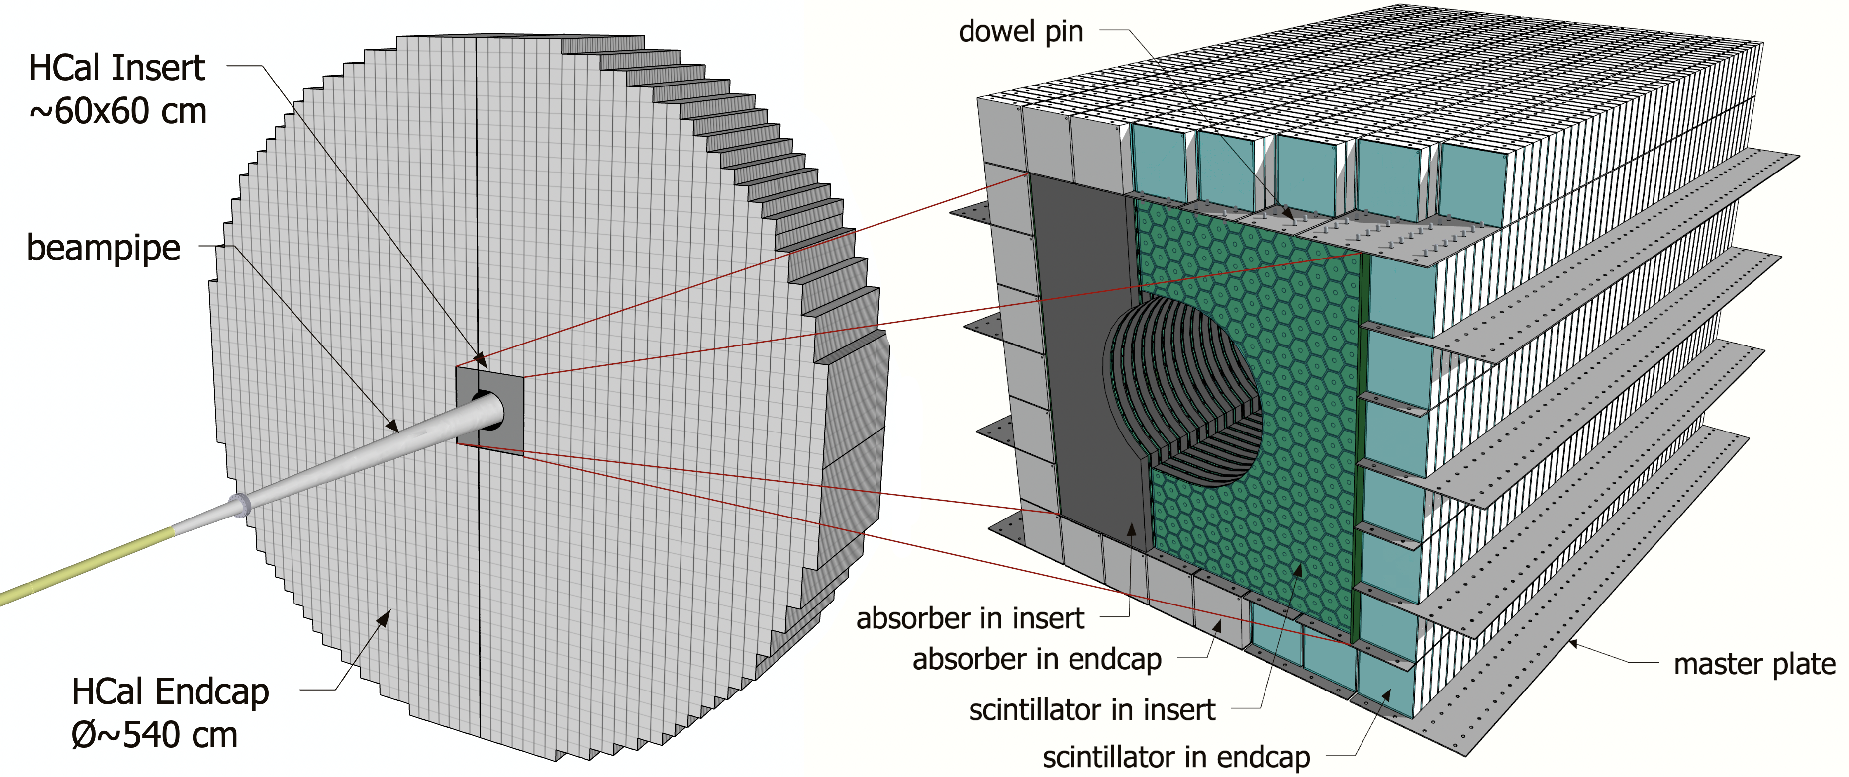

Insert recap
Instruments near the beampipe in forward region, $3<η<4$ or ${2.1}^{∘}<θ<{5.7}^{∘}$
High-granularity to yield a good angular resolution
  Allows measurements of jets and hadronic final states in DIS reactions
Fully integrated into the hadron endcap and solves mechanical issues in complex region

Slide 4
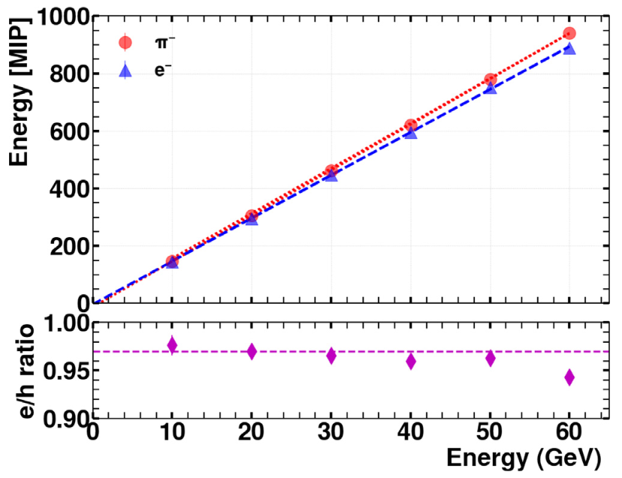
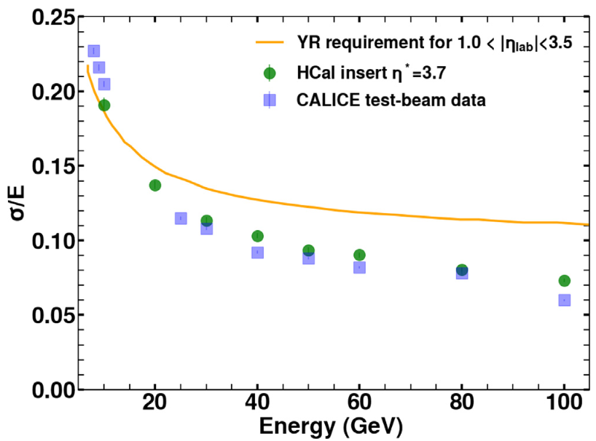


Performance metrics recap
Good energy linearity and e/h close to 1
  Don’t need extra compensation techniques for hadronic showers
Energy resolutions validated against CALICE W/Sc sampling calorimeter
$$η^{∗}=3.7$$
Resolutions of $π^{−}, η^{∗}=3.7$

Slide 5
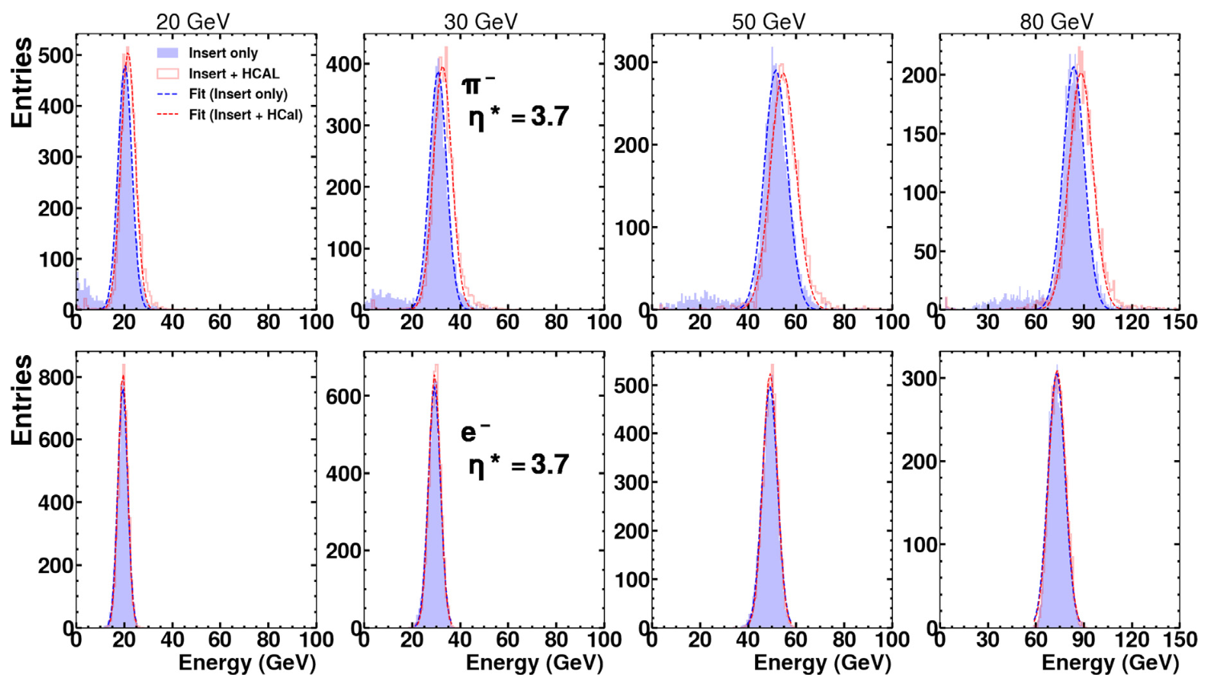


Handling leakage
Combine insert + HCal energies with: $E_{total}=\frac{E_{insert}}{SF_{insert}}+\frac{E_{HCal}}{SF_{HCal}}$
Low energy tails indicate leakage out of insert into HCal
Top:
$π^{−},$ $η^{∗}=3.7$
Bottom:
$e^{−},$ $η^{∗}=3.7$

Slide 6
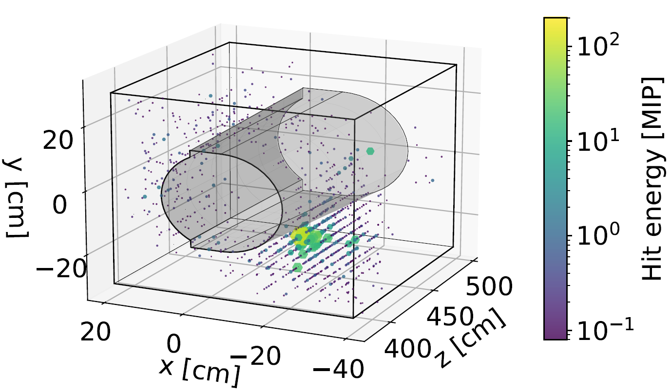


Studying absorber materials
Original design: 30 layers W/Sc (.17 $λ_{n}$ each) + 21 layers Fe/Sc (.107 $λ_{n}$ each), 7.3 $λ_{n}$ total
Steel necessary to contain the magnetic flux
Tungsten desirable for compact showers and compensated response
What is the optimal splitting between tungsten and steel?
Blue: Tungsten, Gray: Steel
50 GeV $π^{−}$ at $η^{∗}=3.7$

Slide 7
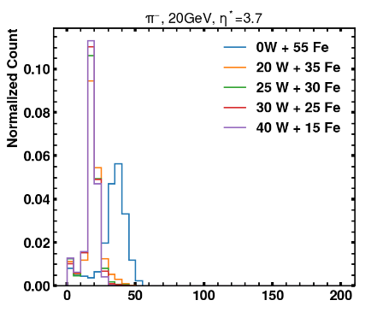
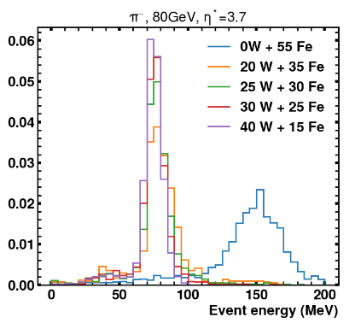
Hadronic response to layer numbers
Higher average energy with all steel, but much wider distribution
  Large low energy tail as well
Even just a little bit of tungsten narrows the distribution

Slide 8
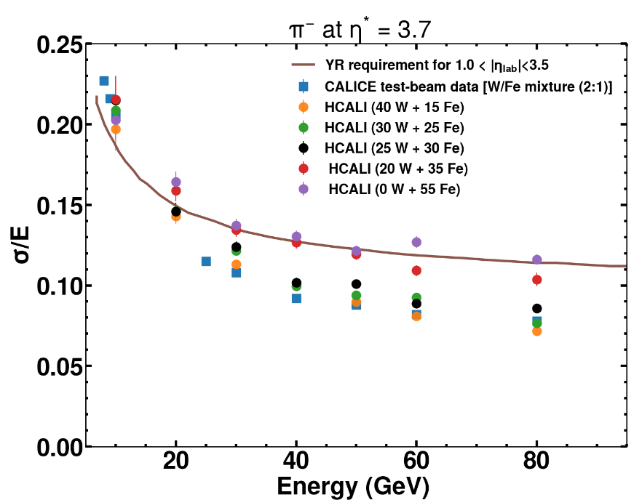
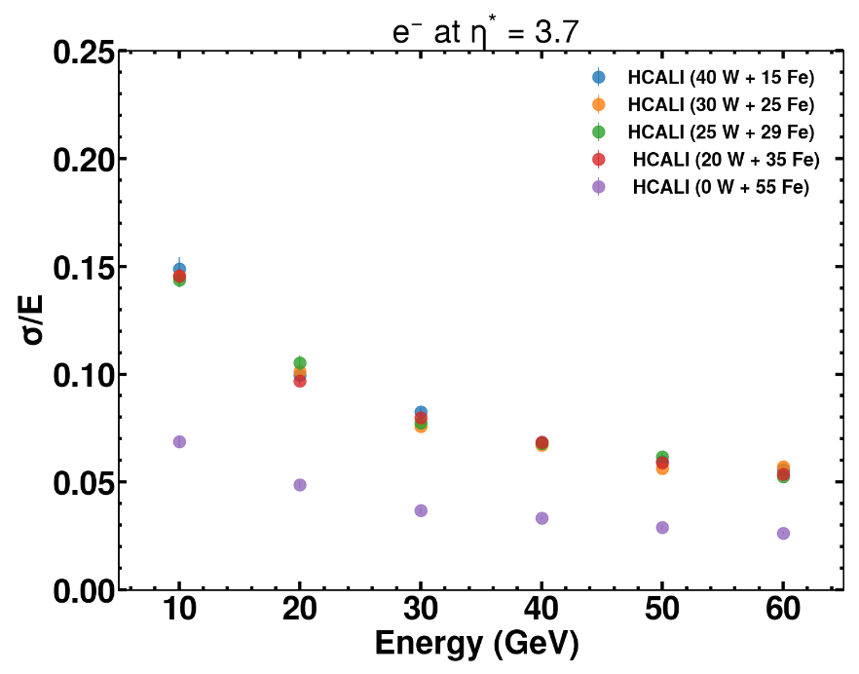
Energy resolutions
Tungsten improves hadronic resolution but with diminishing returns
Steel has better energy resolutions with electromagnetic showers

Slide 9
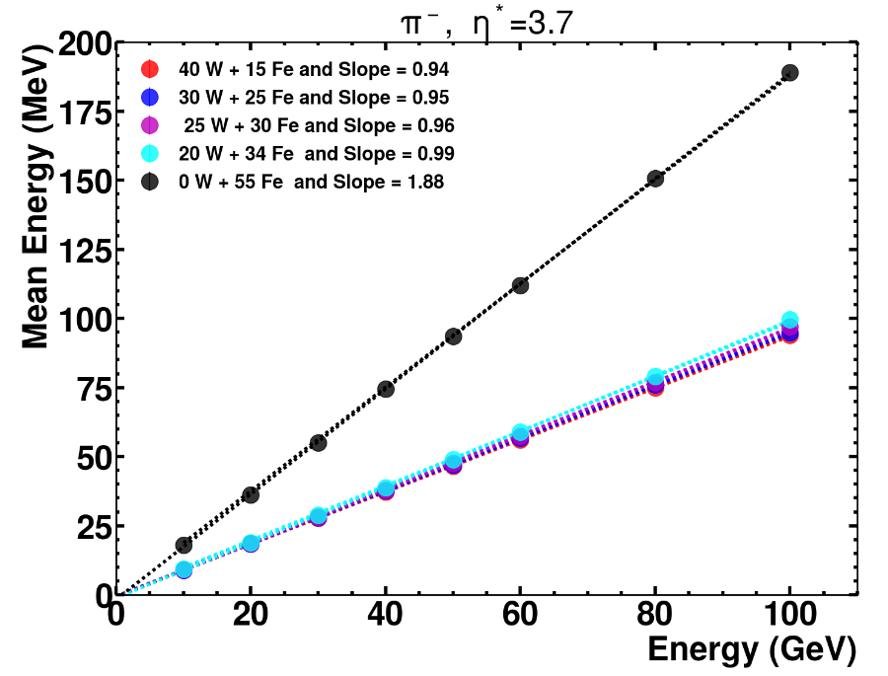
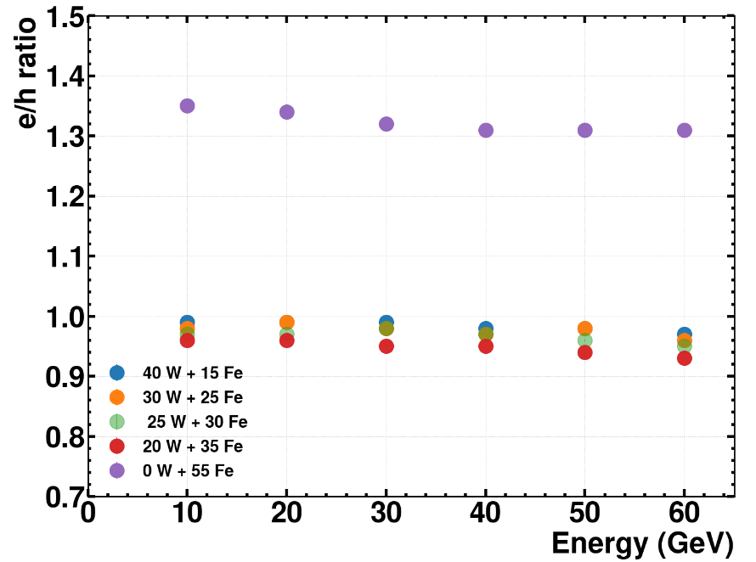
Tungsten perks
Improved energy linearity with tungsten
Significantly improved e/h ratio

Slide 10
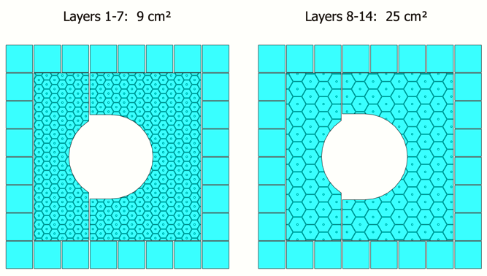
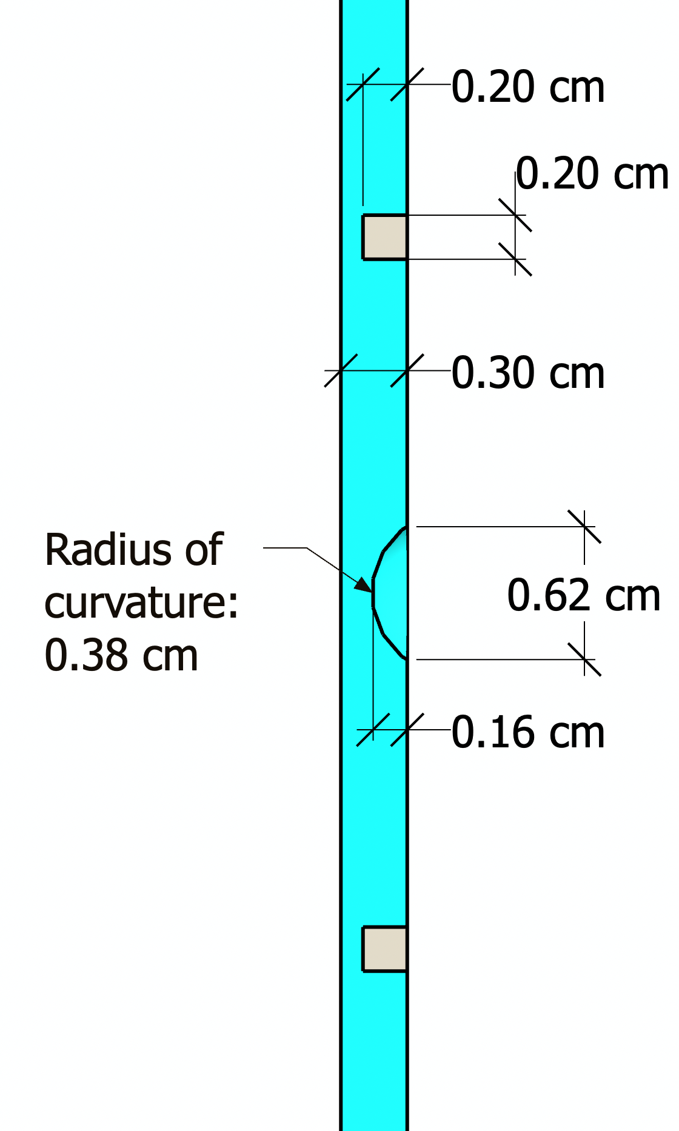
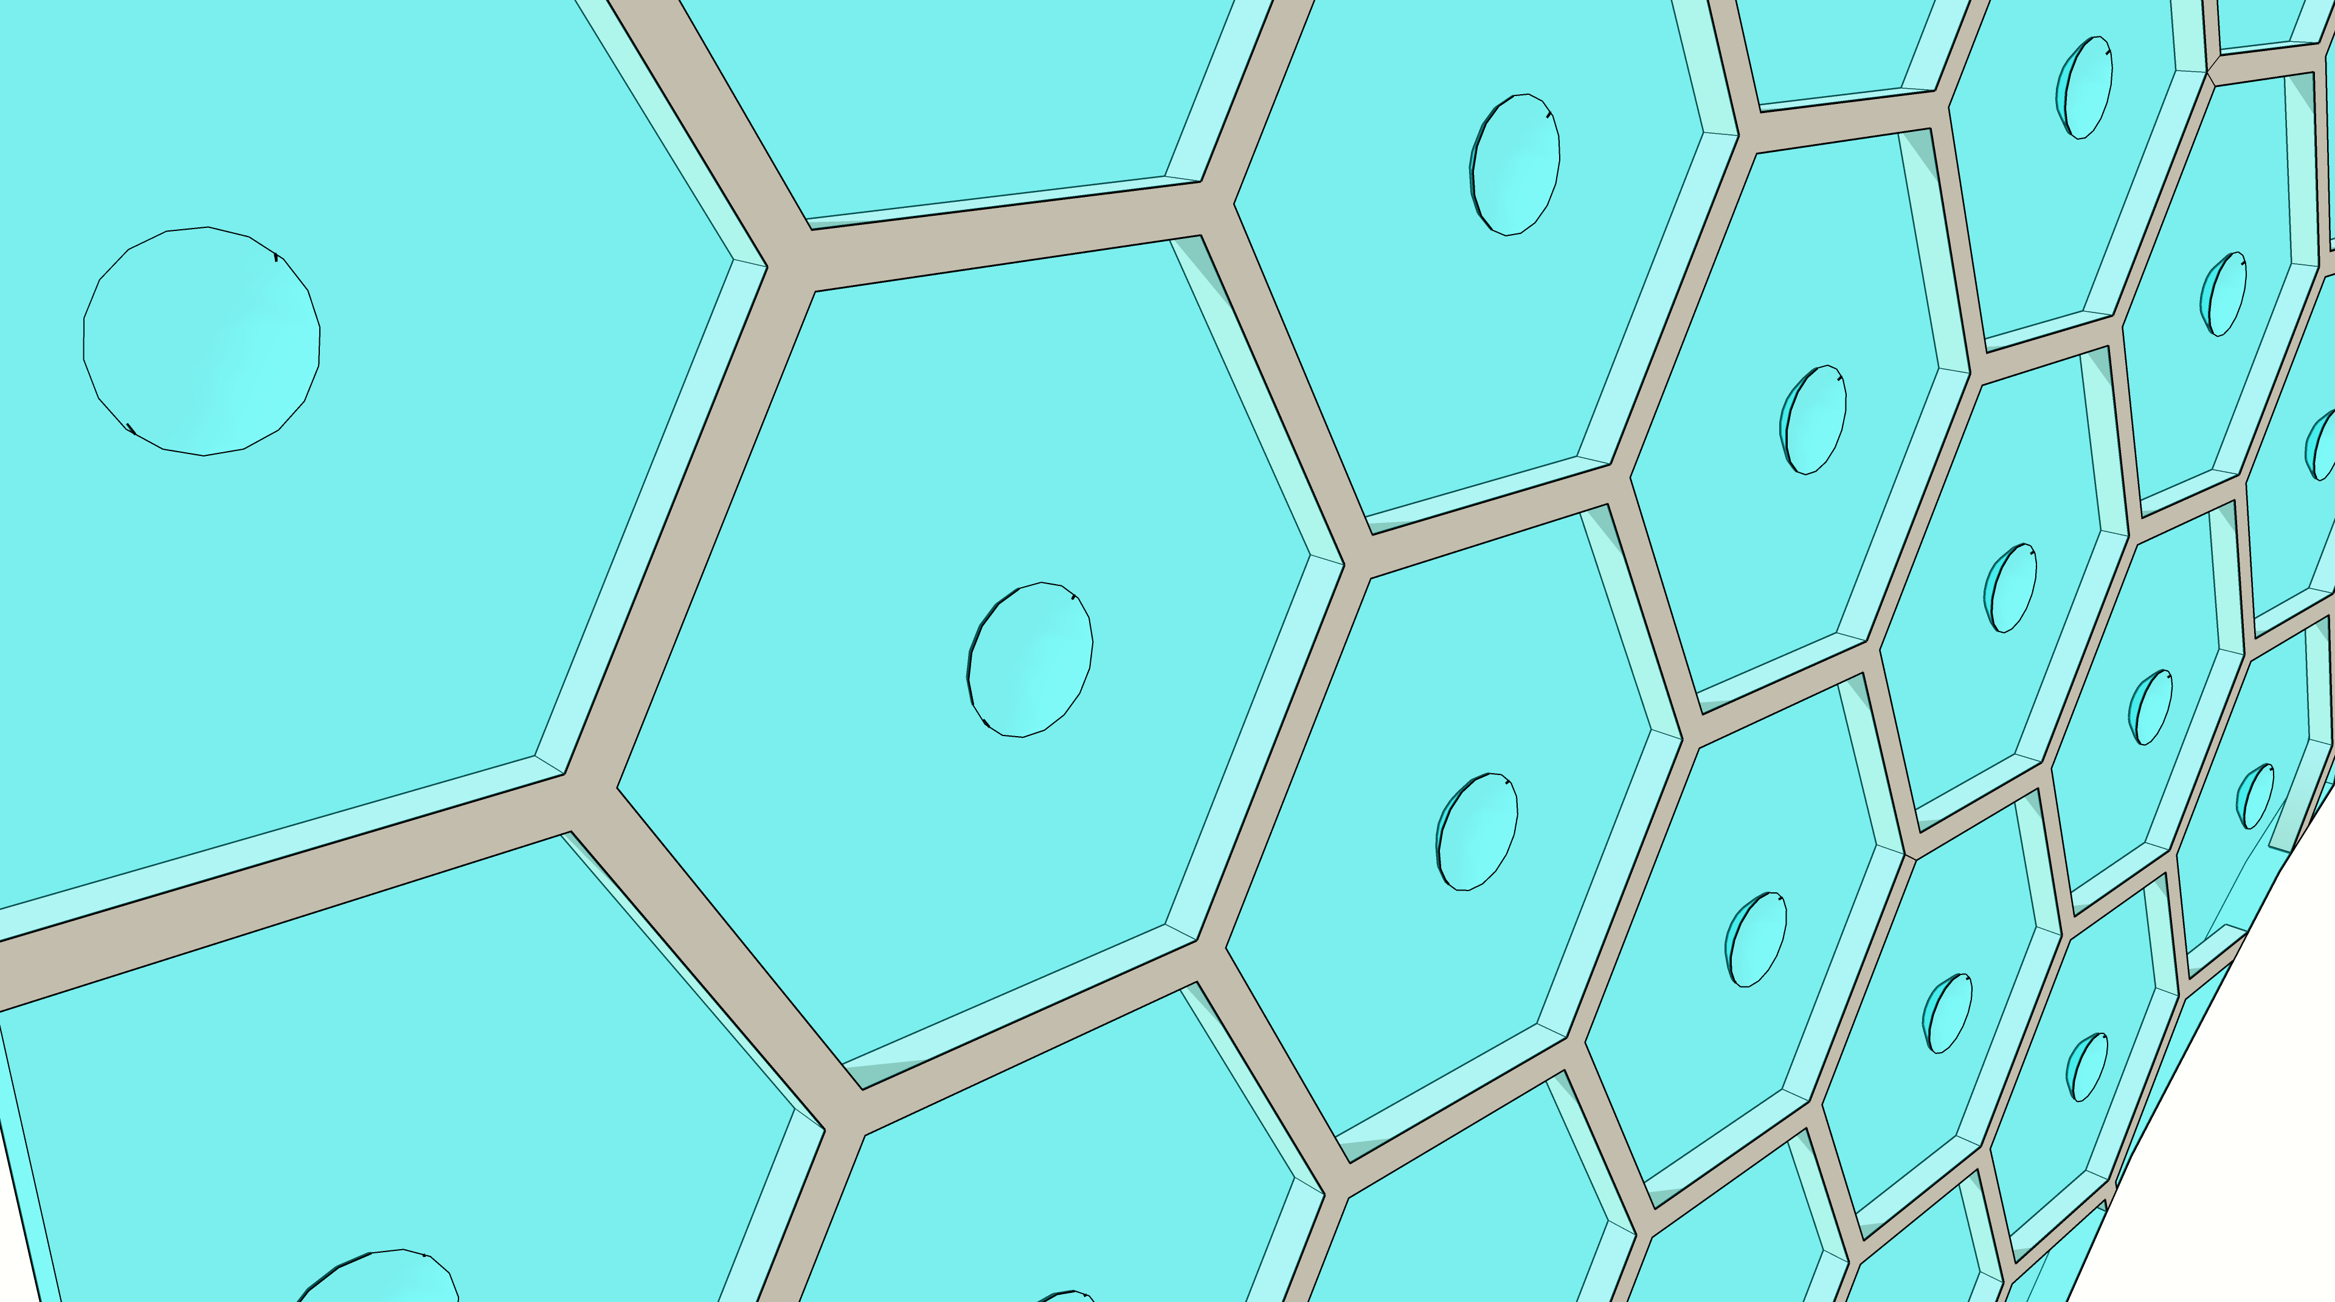


Scintillator design
Hexagonal cells to easily tessellate the area
SiPM-on-tile design
  SiPMs hosted on PCBs fit into hemispherical dimples
Epoxy in grooves between cells to reduce optical crosstalk
Potentially changing granularity throughout insert
$\sim 60$ cm
$\sim 60$cm

Slide 11
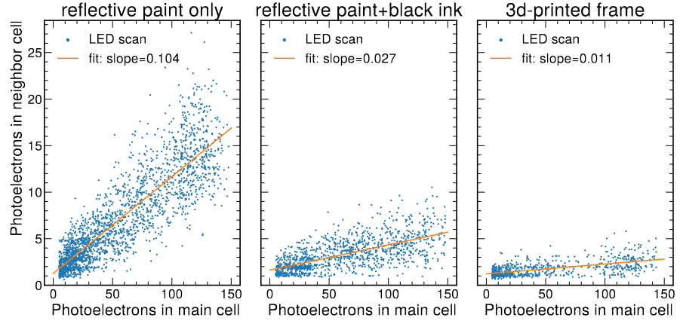
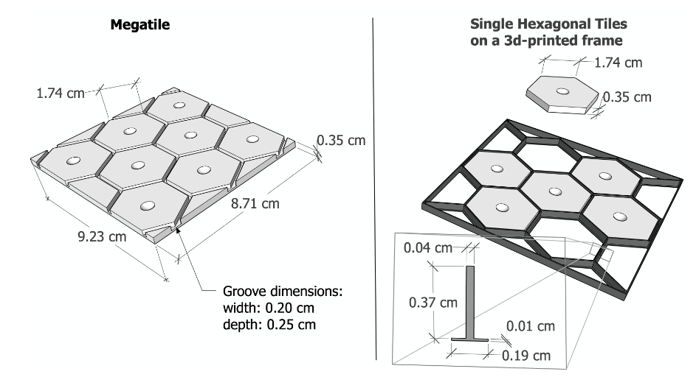
Optimizing scintillator cells
Moving away from megatiles to 3D-printed frames with individual cells
3D-printed frames reduce optical crosstalk between cells
Frame size and shapes can be adjusted
Will hear more about scintillator efforts in later talks

Slide 12
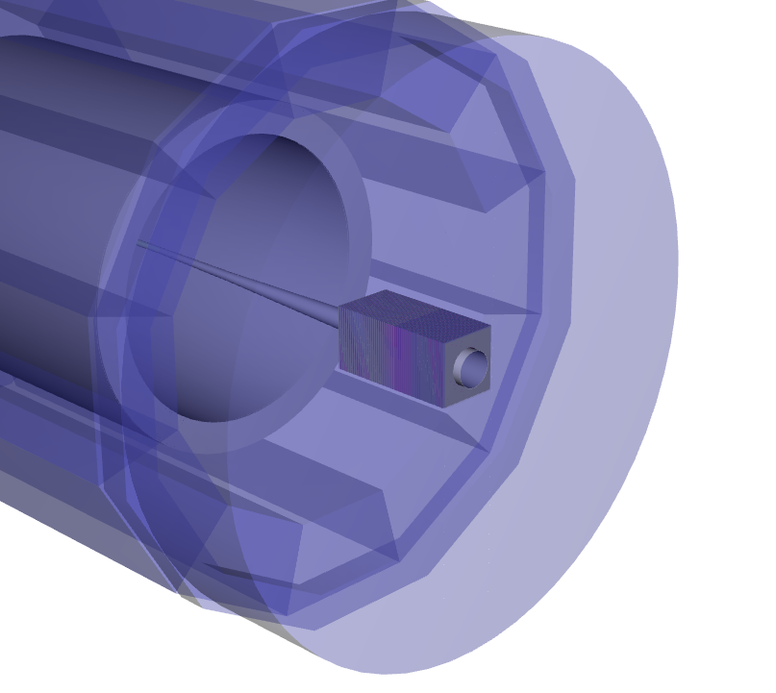
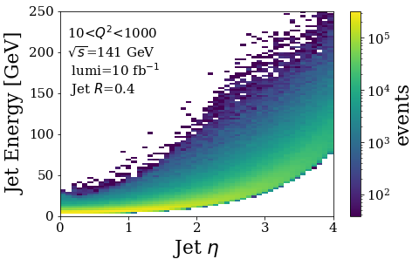

Jet studies in ePIC simulations
ECal insert and HCal insert implemented in Bryce Canyon ePIC simulations
Highest energy jets produced in the $3<η<4$ range
  Calorimeters in this range critical for measurement
Insert
ECal insert and HCal insert in ePIC simulation
Pythia8 simulation

Slide 13
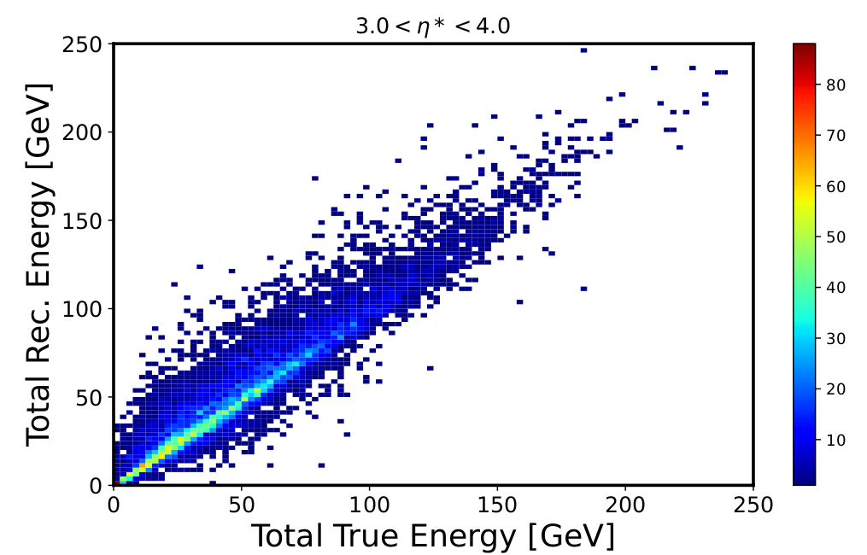
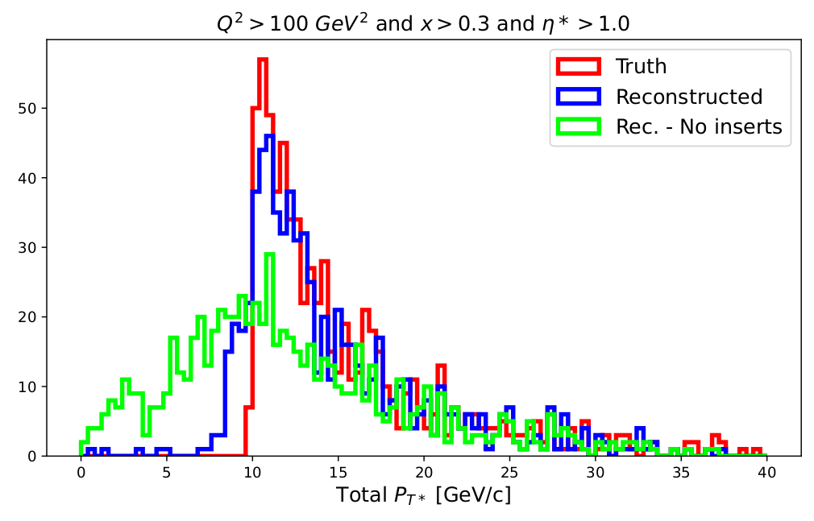

Jet metrics in forward endcap
Linear response of truth energy vs reconstructed energy
Total $P_{t}$ measured agrees with the truth values
  Worse agreement without the insert (Arches) and only using HCal
  Critical for reconstruction of $Q^{2}$
These studies used both the ECal insert and HCal insert
Studies by Barak Schmookler

Slide 14
Summary and future plans
HCal insert enables detection near beampipe in forward region with validated energy resolutions and controlled leakage
HCal insert design is being optimized for W/Steel layers and scintillating cell designs
Future plans:
  Further jet studies within forward calorimeters from ePIC simulations
  Papers on scintillators and potentially ECal insert
  Turning my attention to machine learning efforts for hadron endcap
    With Consortium members from UCR, LLNL, and Ben Nachman
Thank you!

Slide 15
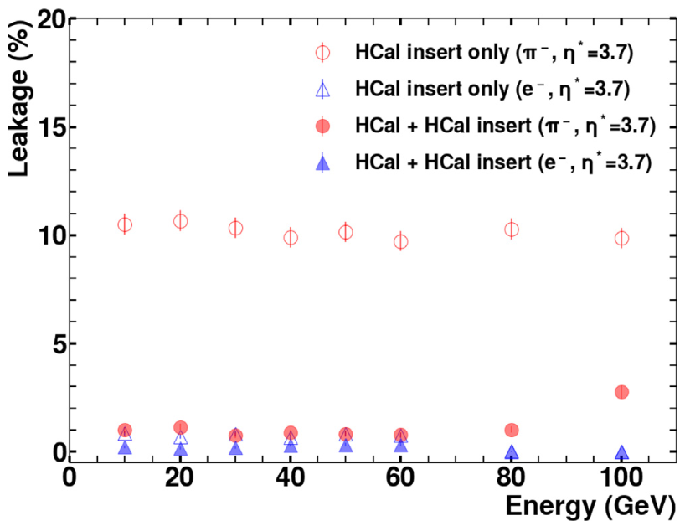
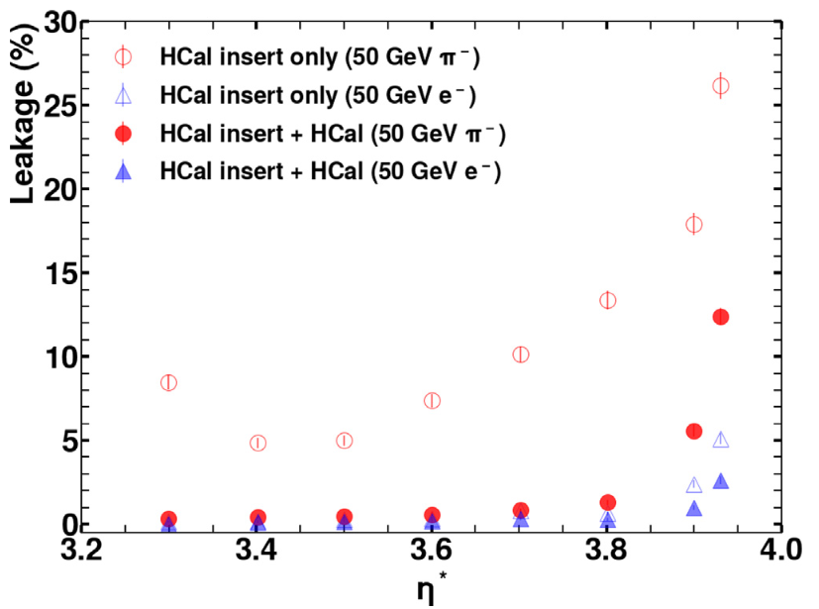

Backup: Quantifying leakage
Leakage: Energy that escapes from the detector
  Will result in events with lower energy deposition
$Leakage=\frac{\# events with E_{total} < μ −3σ}{\# events}$
  $μ$, $σ$ from Gaussian fits of energy distributions
Some transverse leakage out of insert, mostly captured by HCal

Slide 16
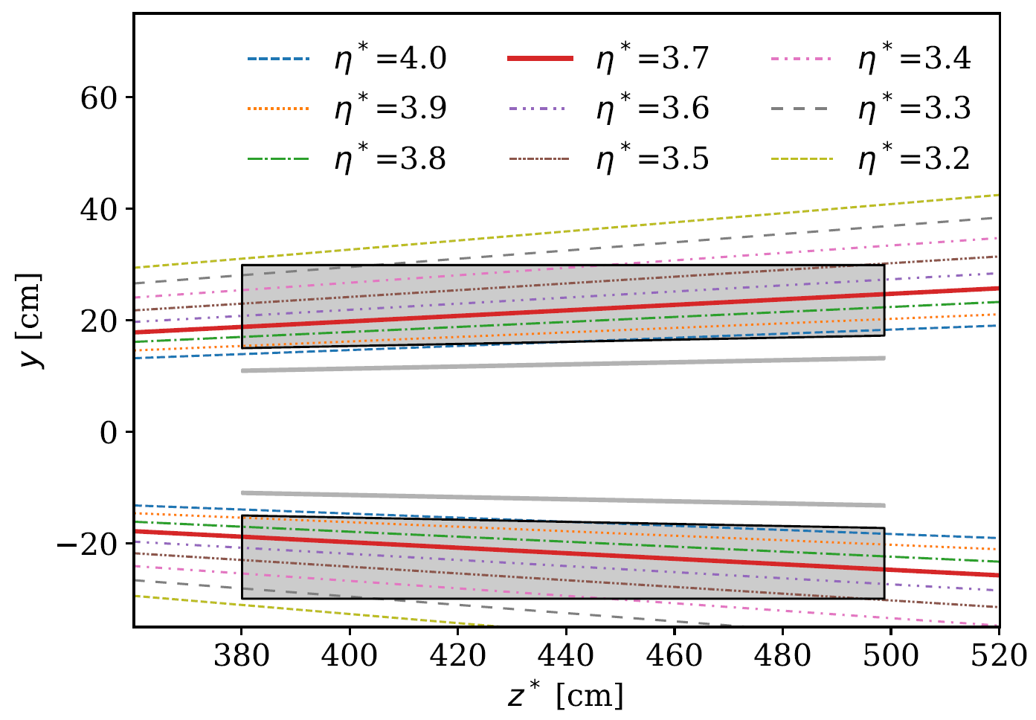
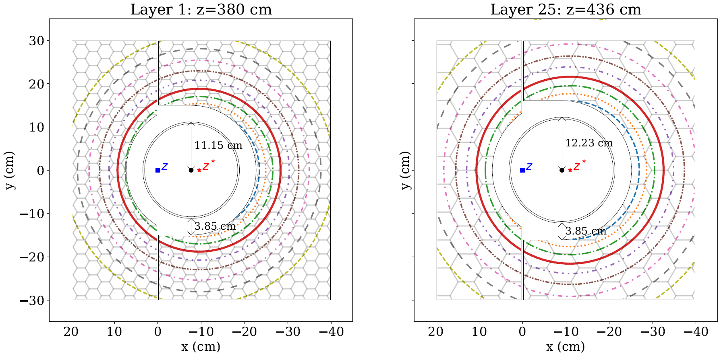
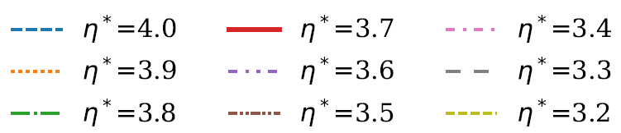


Backup: Geometric acceptance
Consistent acceptance between $3.5≤η^{∗}≤3.8$throughout entire insert
For $3.2≤η^{∗}≤3.4$, some acceptance but still captured by HCal
  For $3.0≤η^{∗}<3.2$, mainly captured by HCal
$z^{∗}$and $η^{∗}$are with respect to proton beam axis
$η^{∗}$ acceptance for $yz^{∗}$cross section

Slide 17
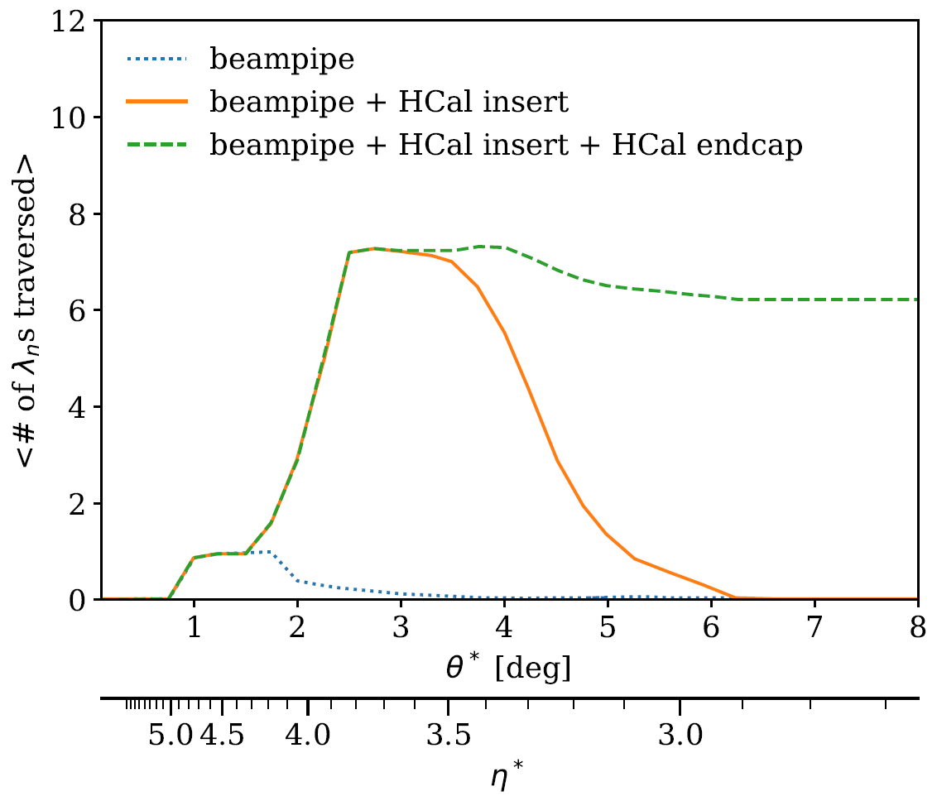
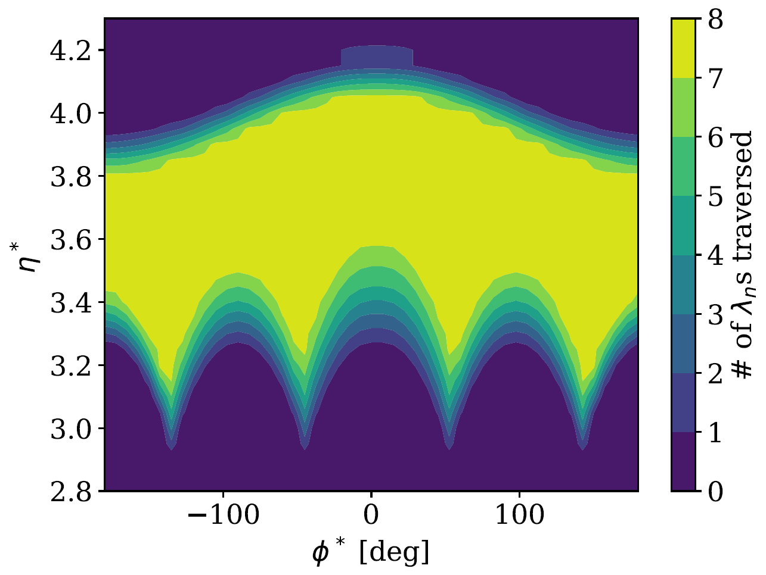



Backup: Quantifying geometric acceptance and containment
Can quantify how well the insert accepts and contains particles at different angles
  Number of interaction lengths ($λ_{n}$) traversed
  Insert is about 7.3 $λ_{n}$ long
Number of $λ_{n}$’s traversed in insert alone
Number of $λ_{n}$’s traversed averaged over $φ$

Slide 18
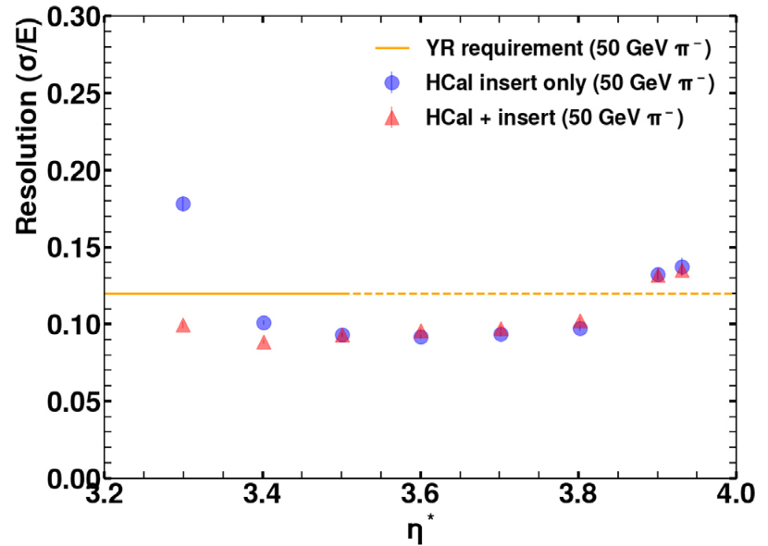


Backup: Performance against $η^{∗}$
Resolutions of $π^{−}$vs $η^{∗}$

Slide 19
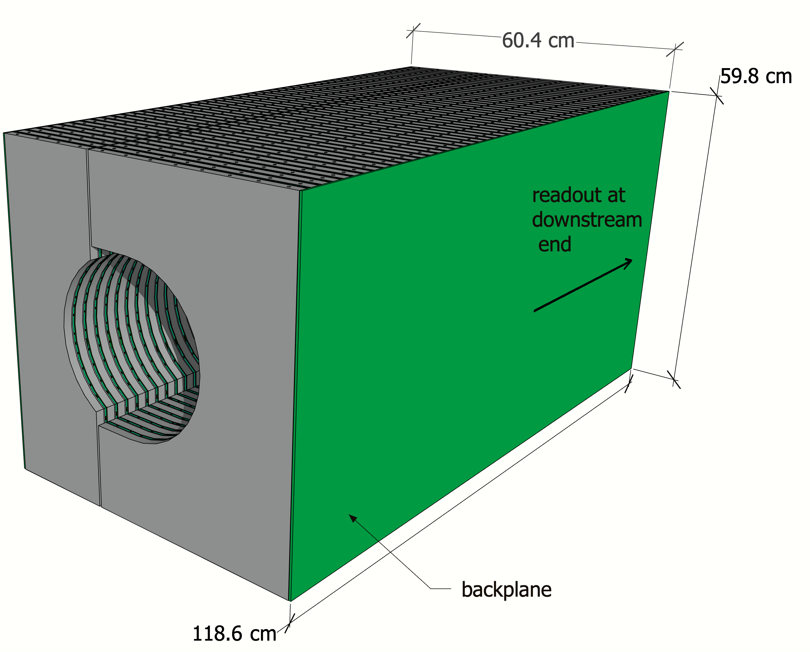
Backup: Insert readout
PCBs will plug into PCB backplanes on either side of the insert
Readouts are at the downstream end of the backplanes

