Slide 1
Construction of the First Calorimeter Insert Prototype
Peter Carney

Slide 2
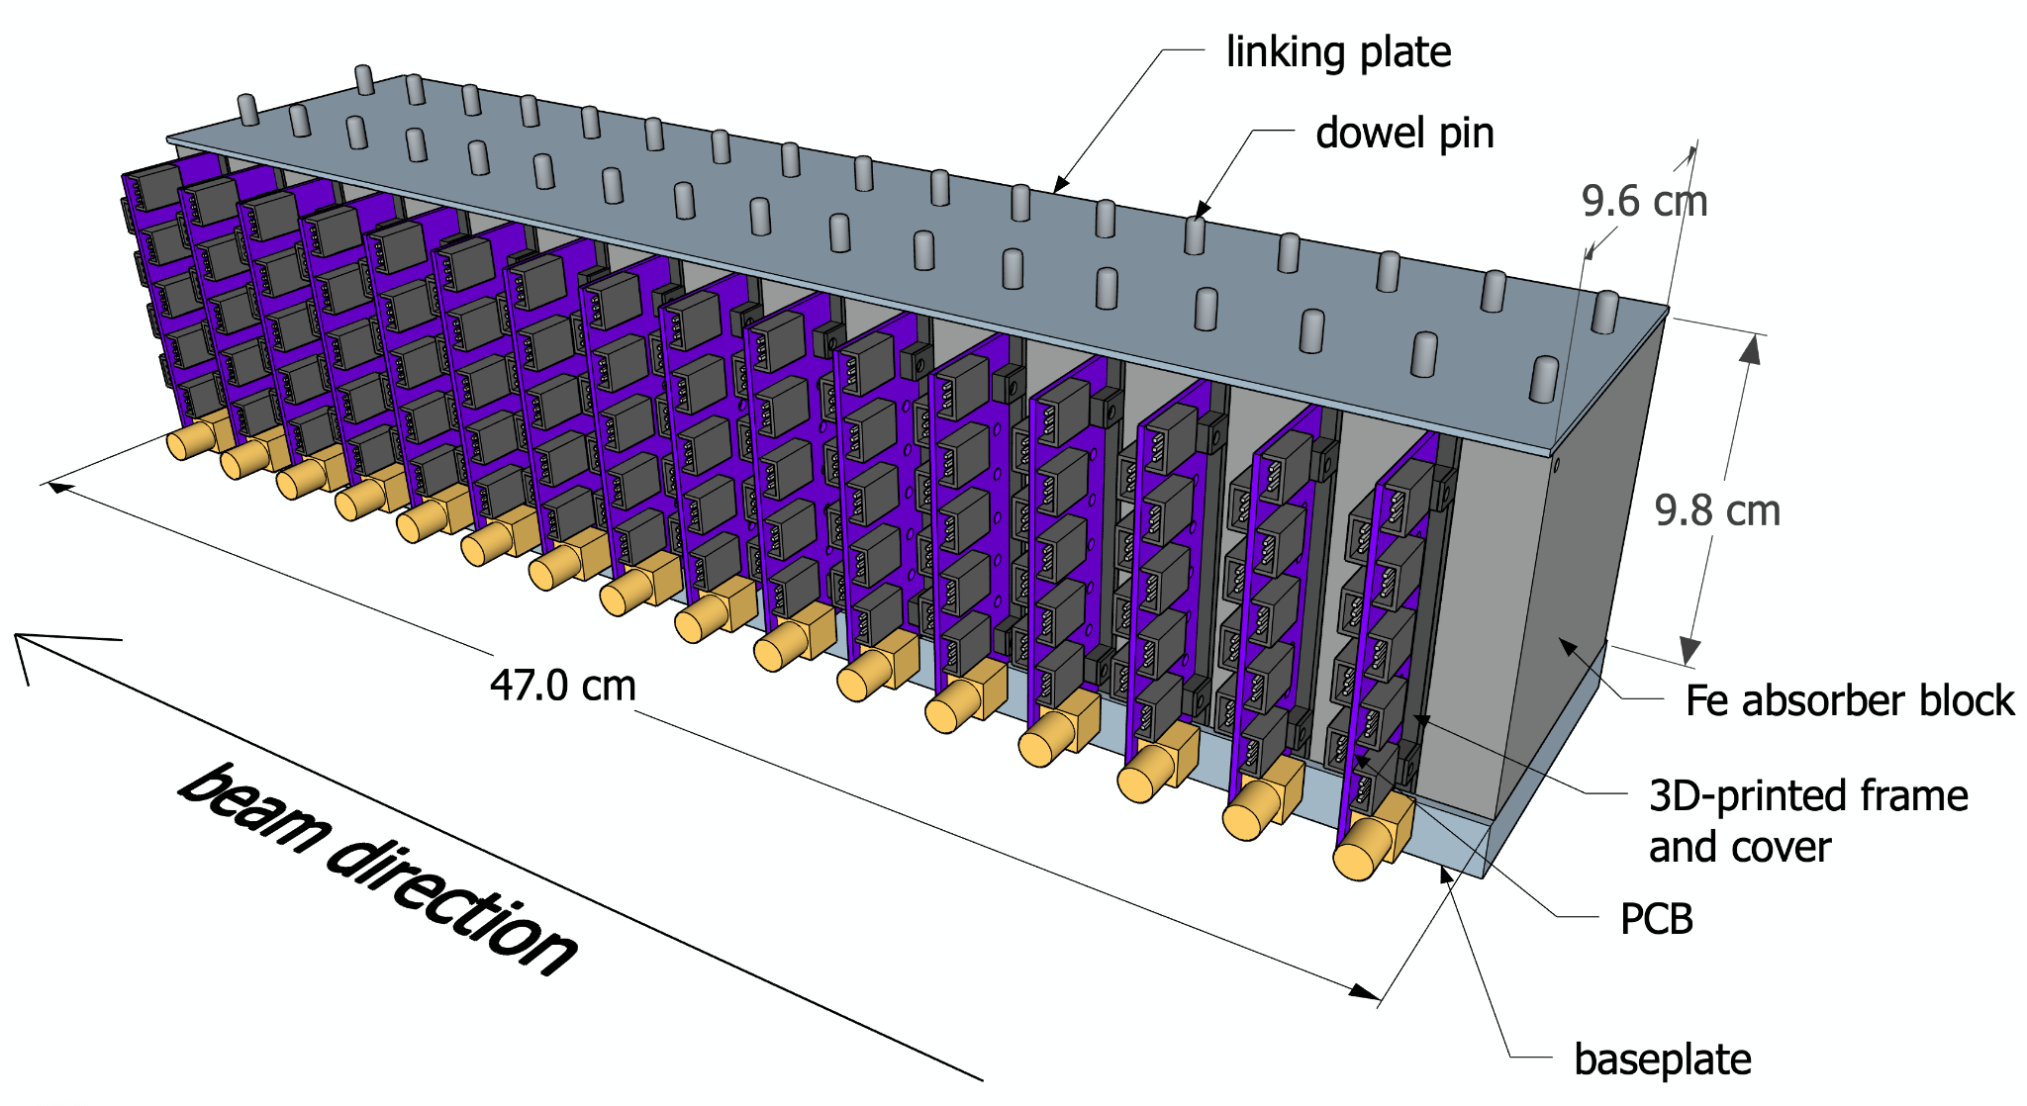
Overview of Calorimeter and Board Structure

Slide 3
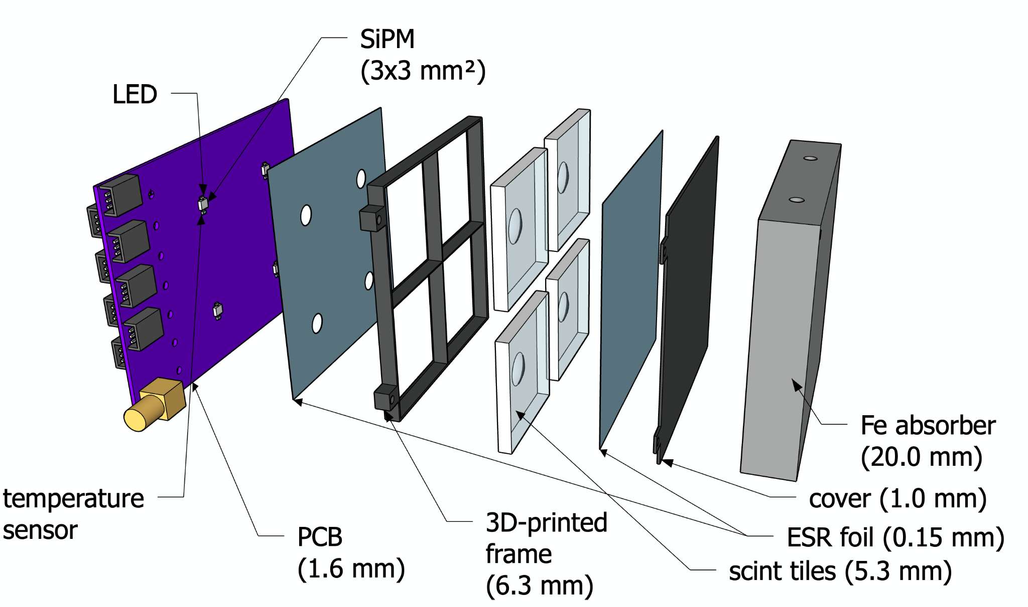

Slide 4
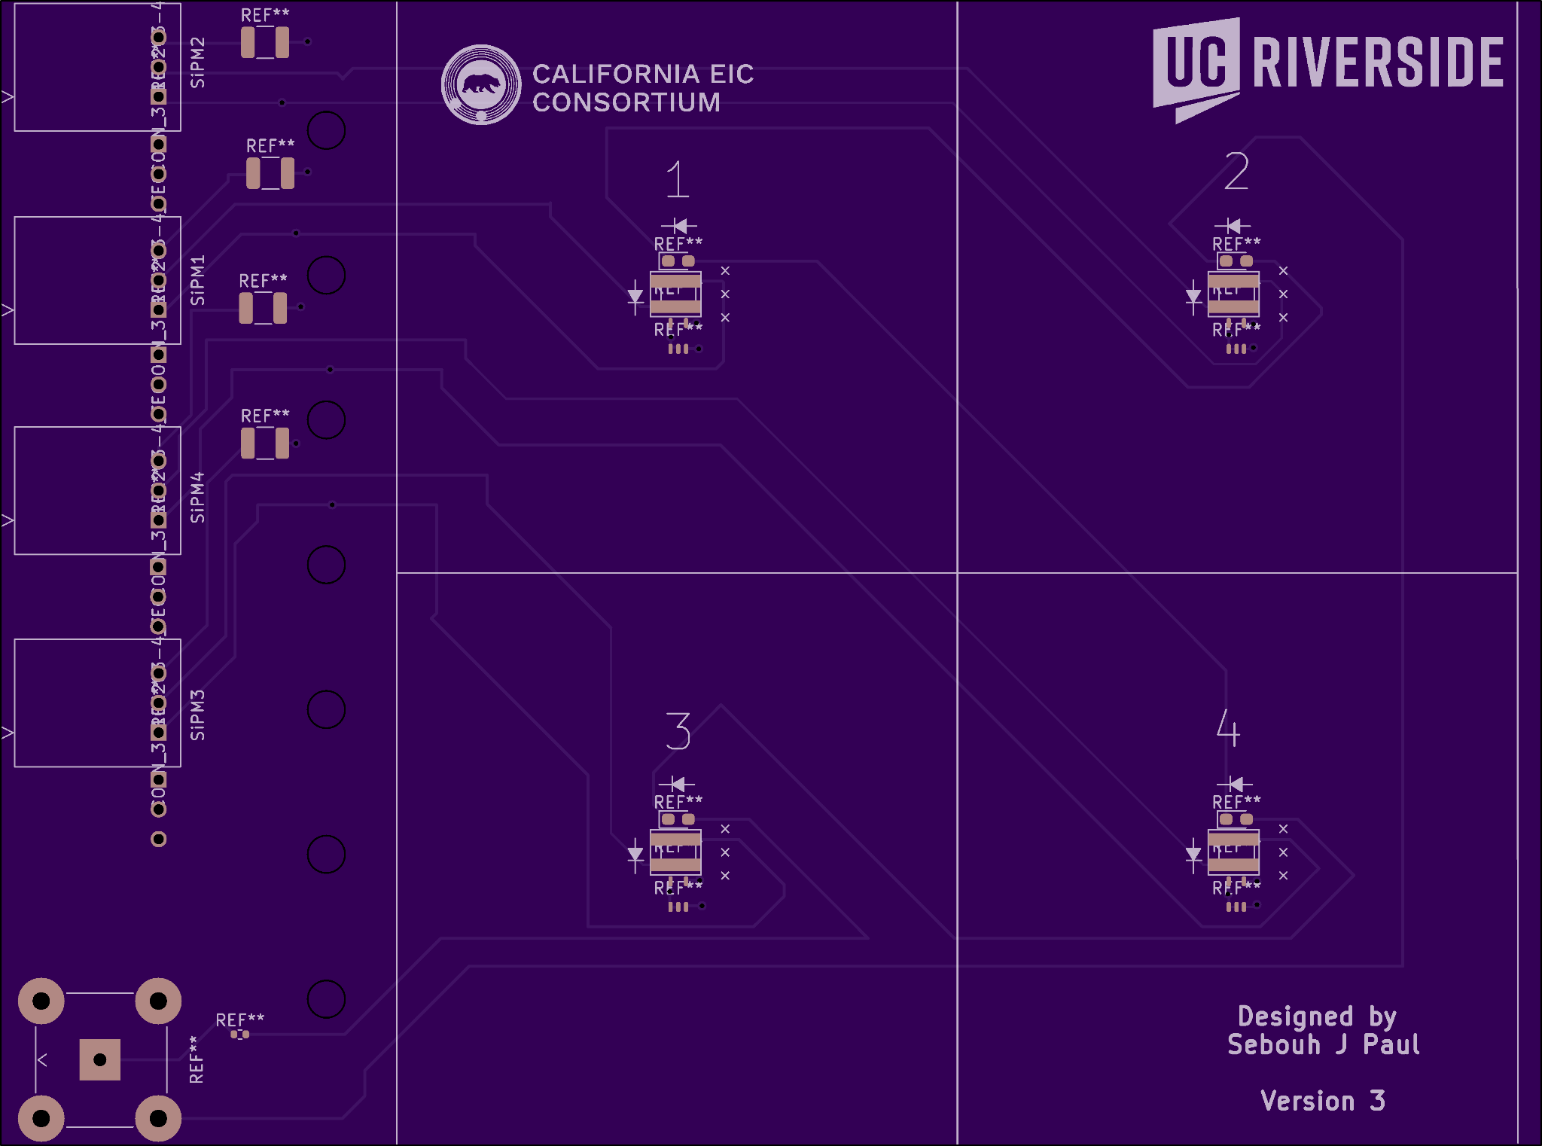
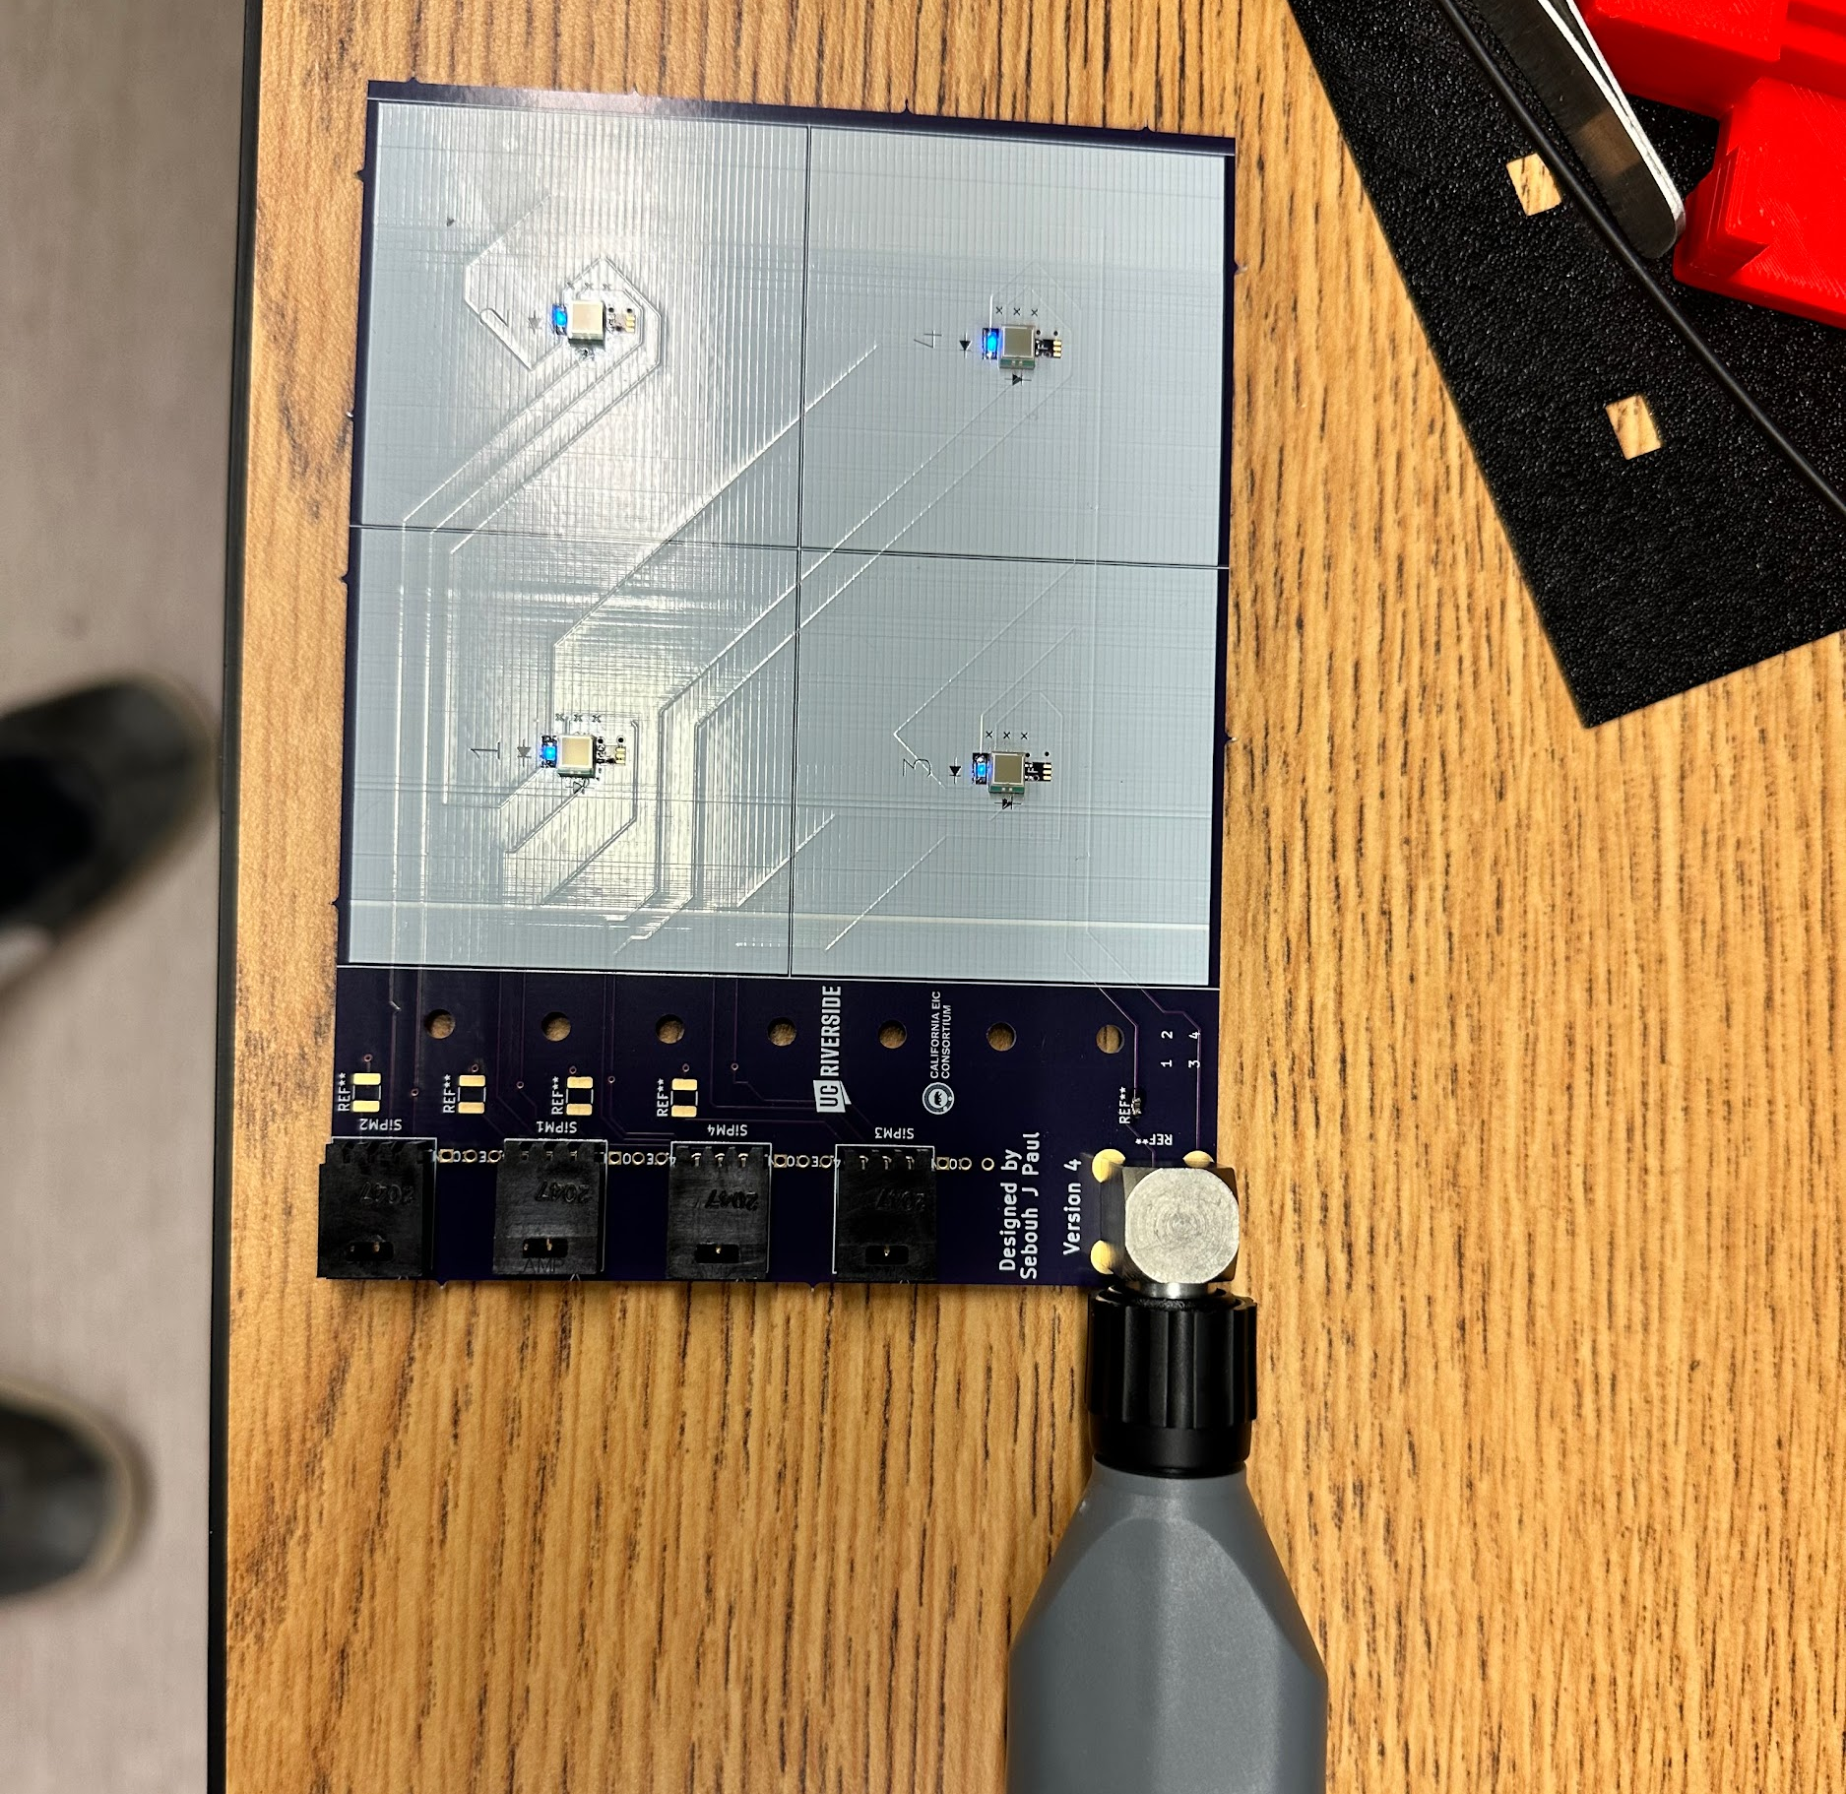
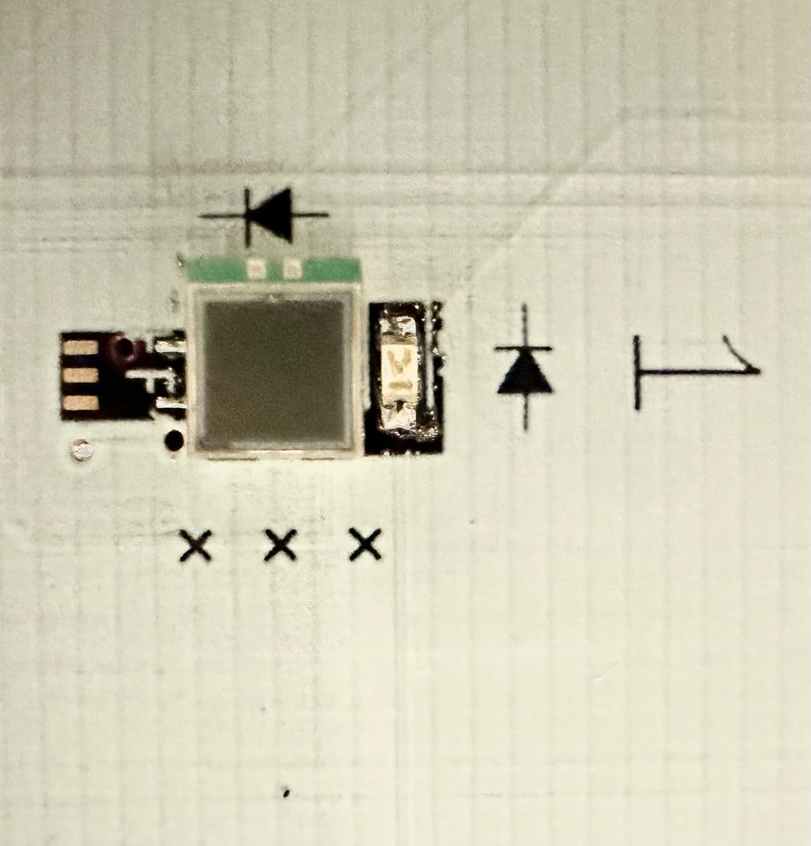
Phase 1: Soldering Components onto PCBs
Silicon Photomultipliers SiPM soldered onto PCB with soldering paste.
LEDs used for testing.

Slide 5
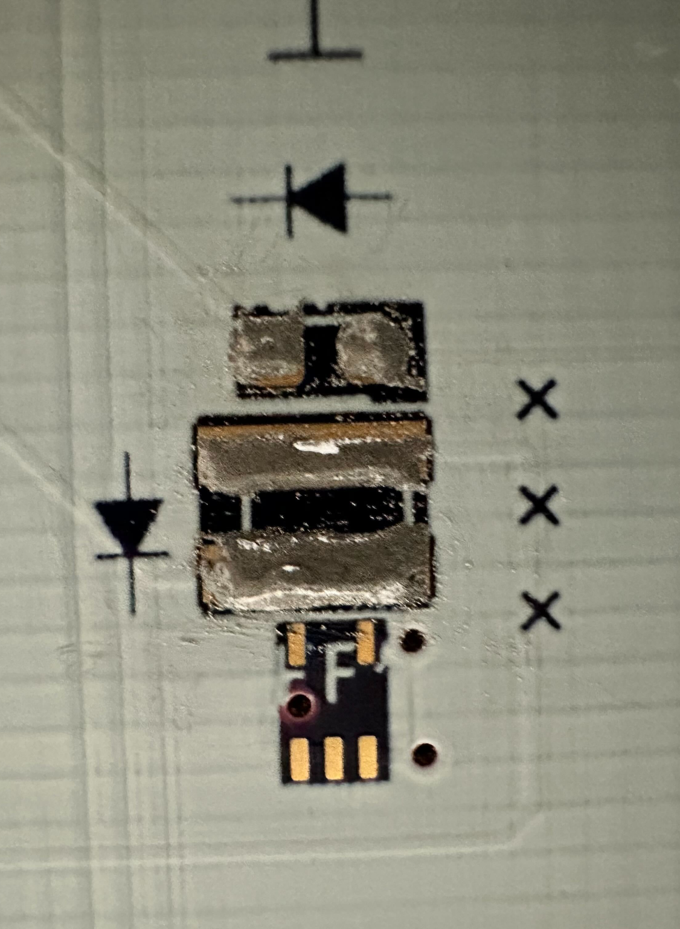
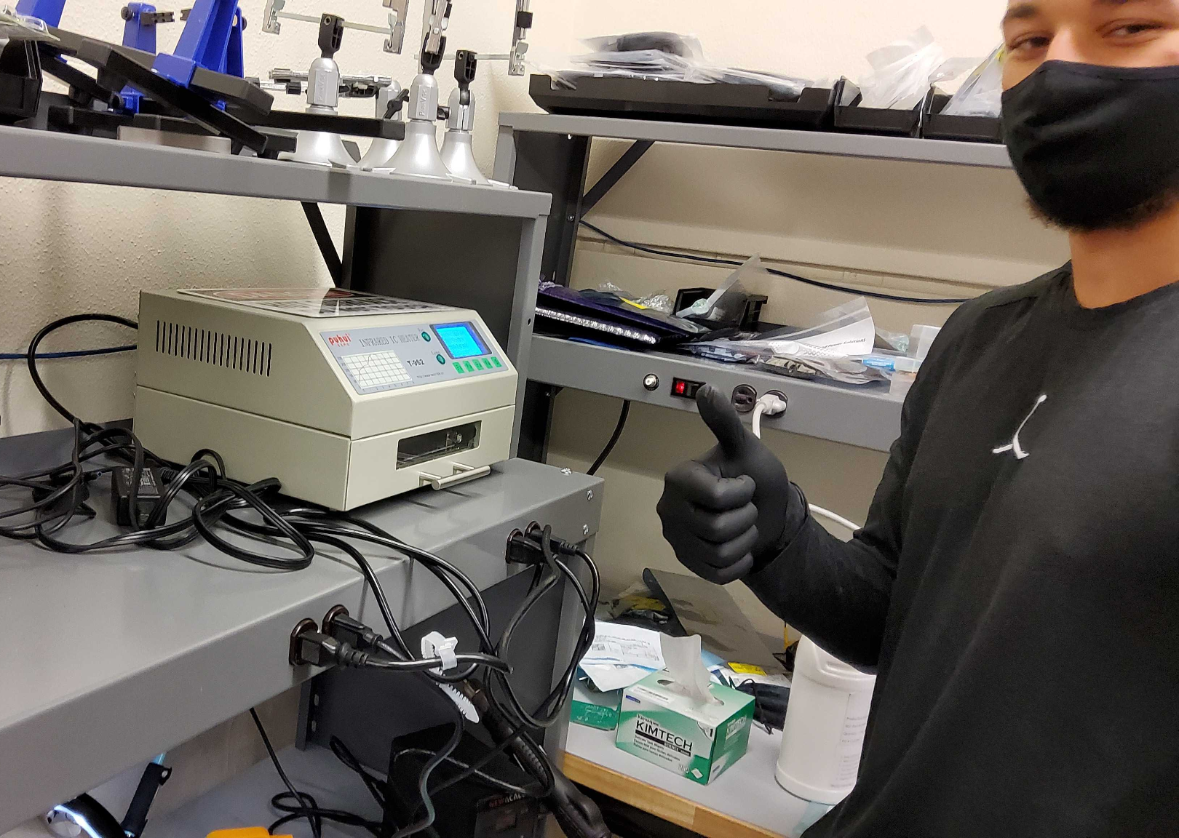
Phase 1 Continued: Soldering onto PCBs

Slide 6
Phase 2: Foils
Foils placed above and below Scintillating tiles.
Optimal for reflecting photons
Helps with gain, and uniformity of cells. Doesn’t matter where the particle hits in the tile, it will pick up any place on the tile evenly.
Further Testing for uniformity in cells used with radioactive source.

Slide 7
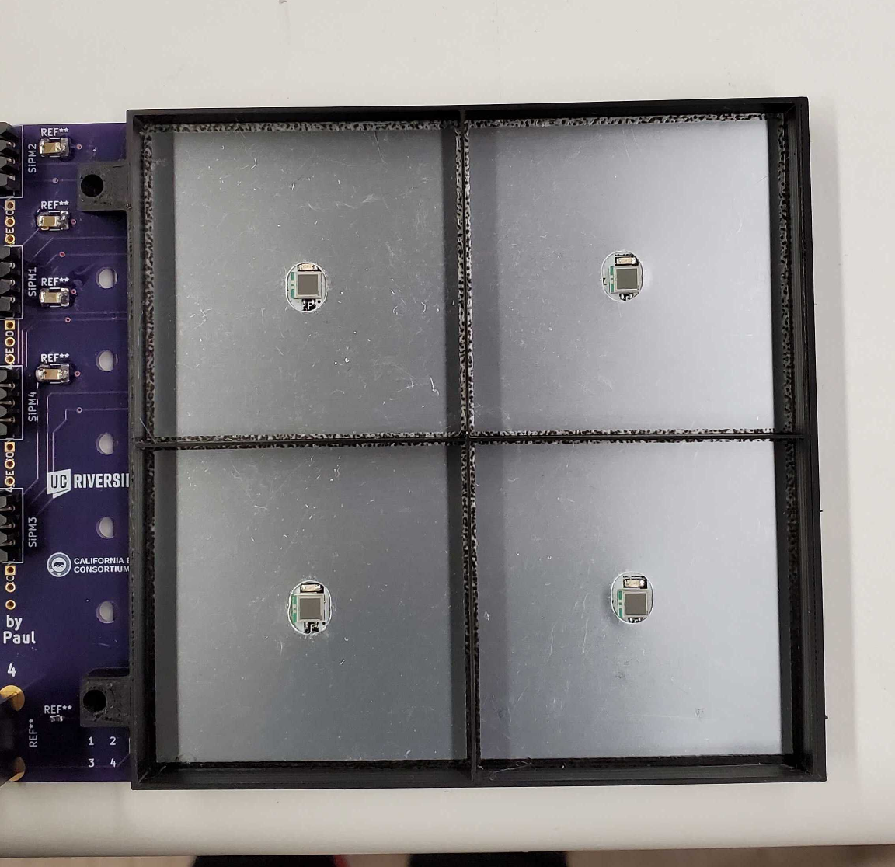
Phase 3: Frames
Frames are 6.3mm thick. Fit tightly around cell.
Used from preventing light leaks from one cell to another.

Slide 8
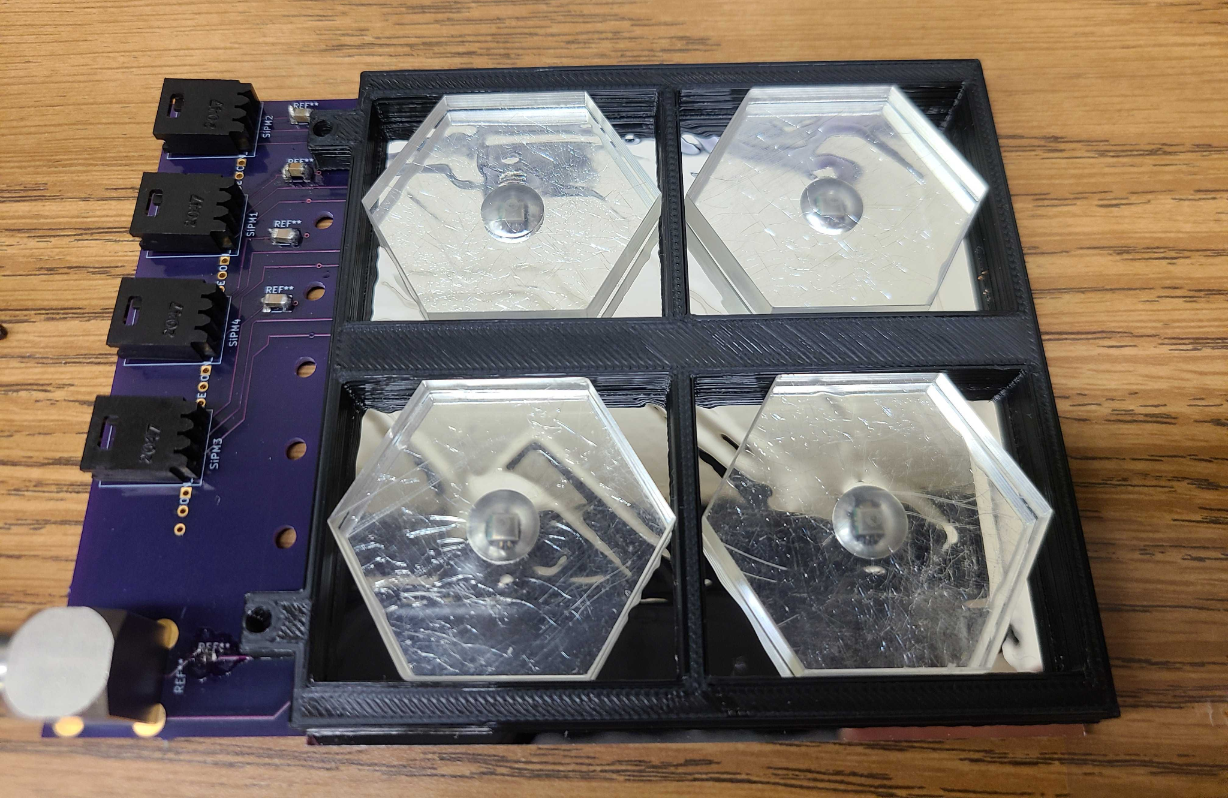
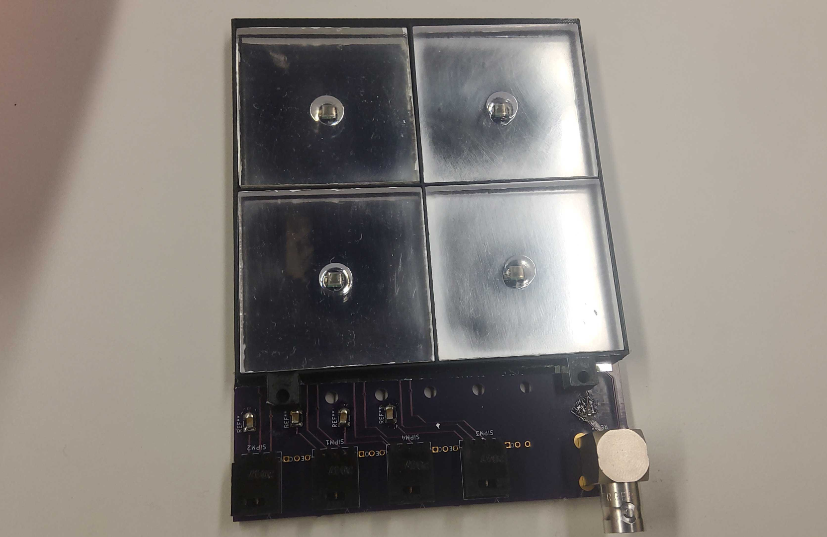
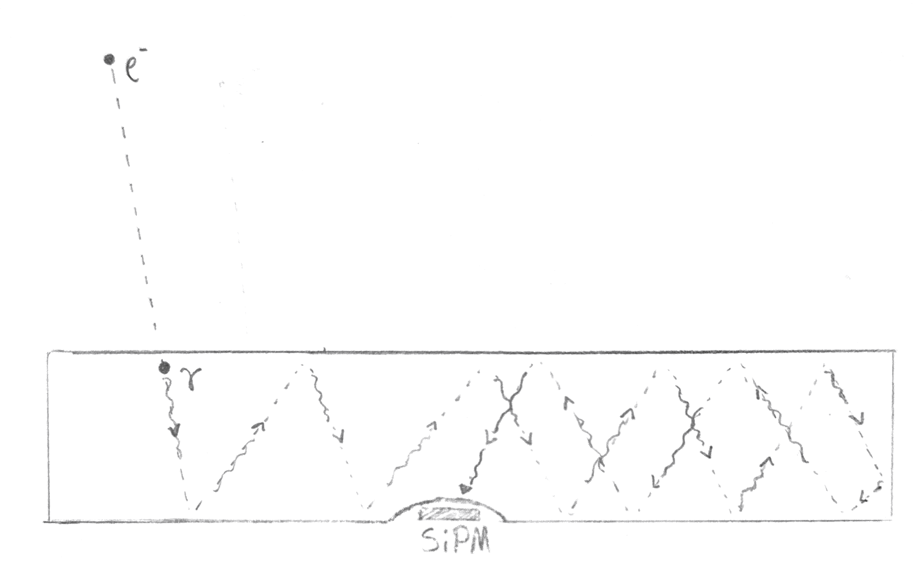
Phase 4: Scintillating Tiles
Each tile undergoes thorough polishing process.
Tile emits photons from upon high energy particle contact.
Light is reflected and focused into SiPM.

Slide 9
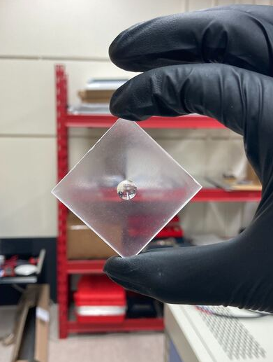
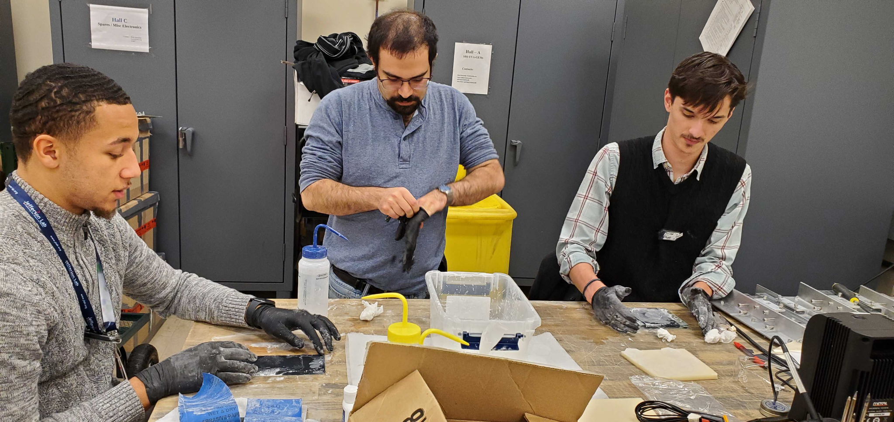
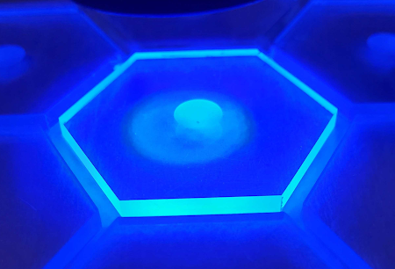
Polishing Tiles

Slide 10
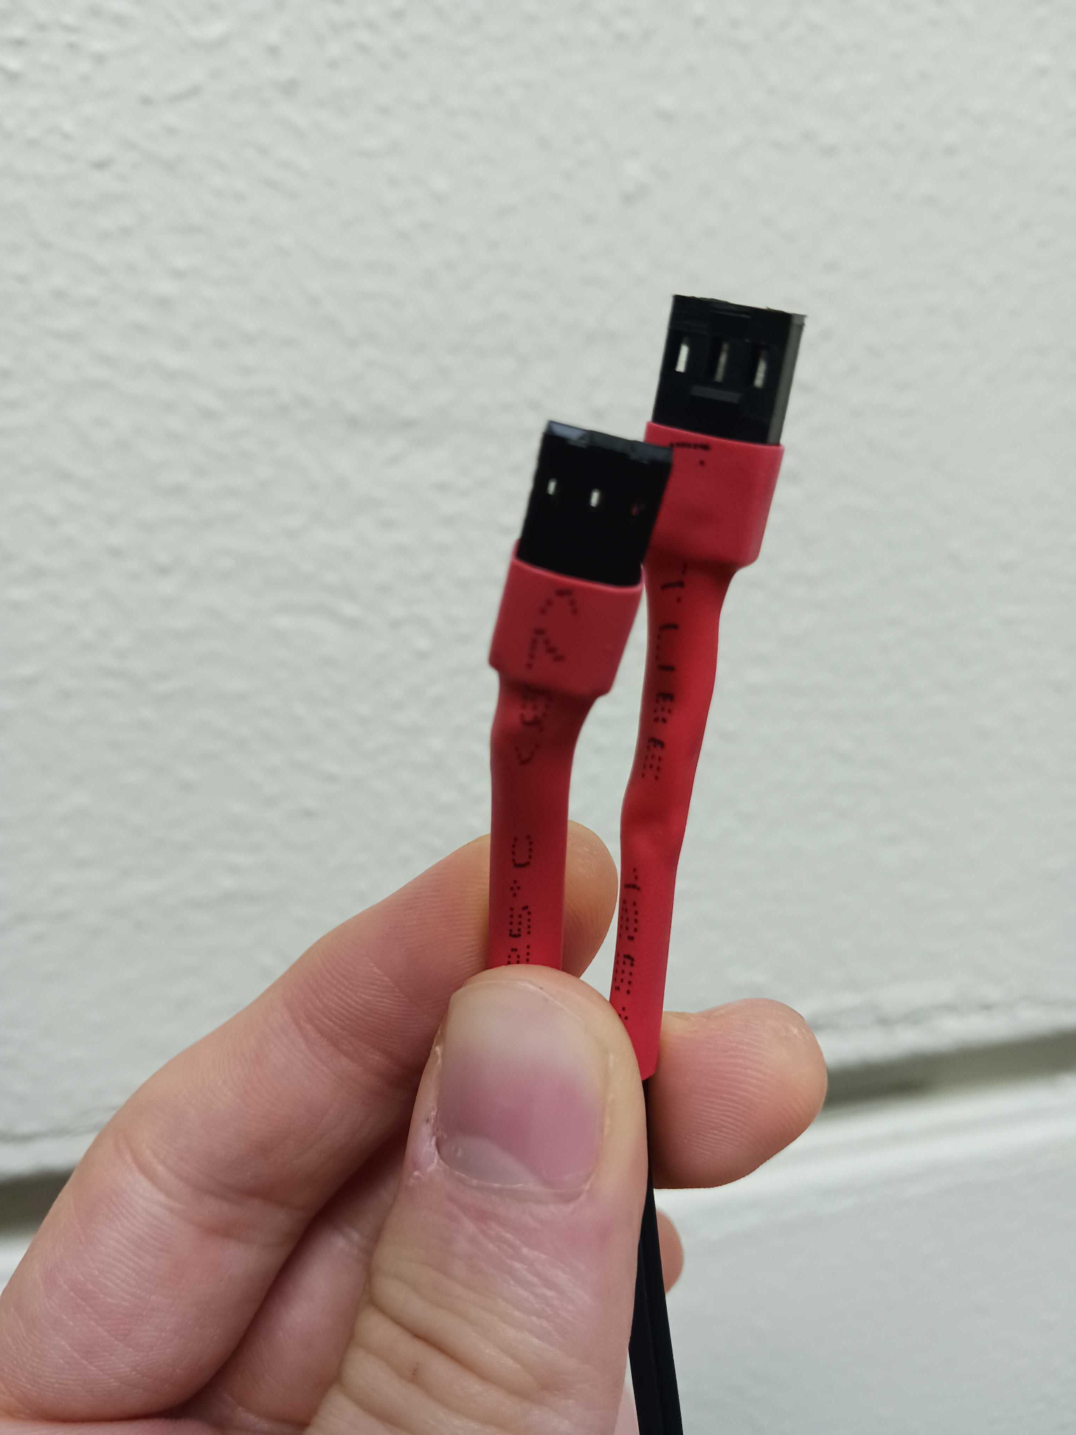
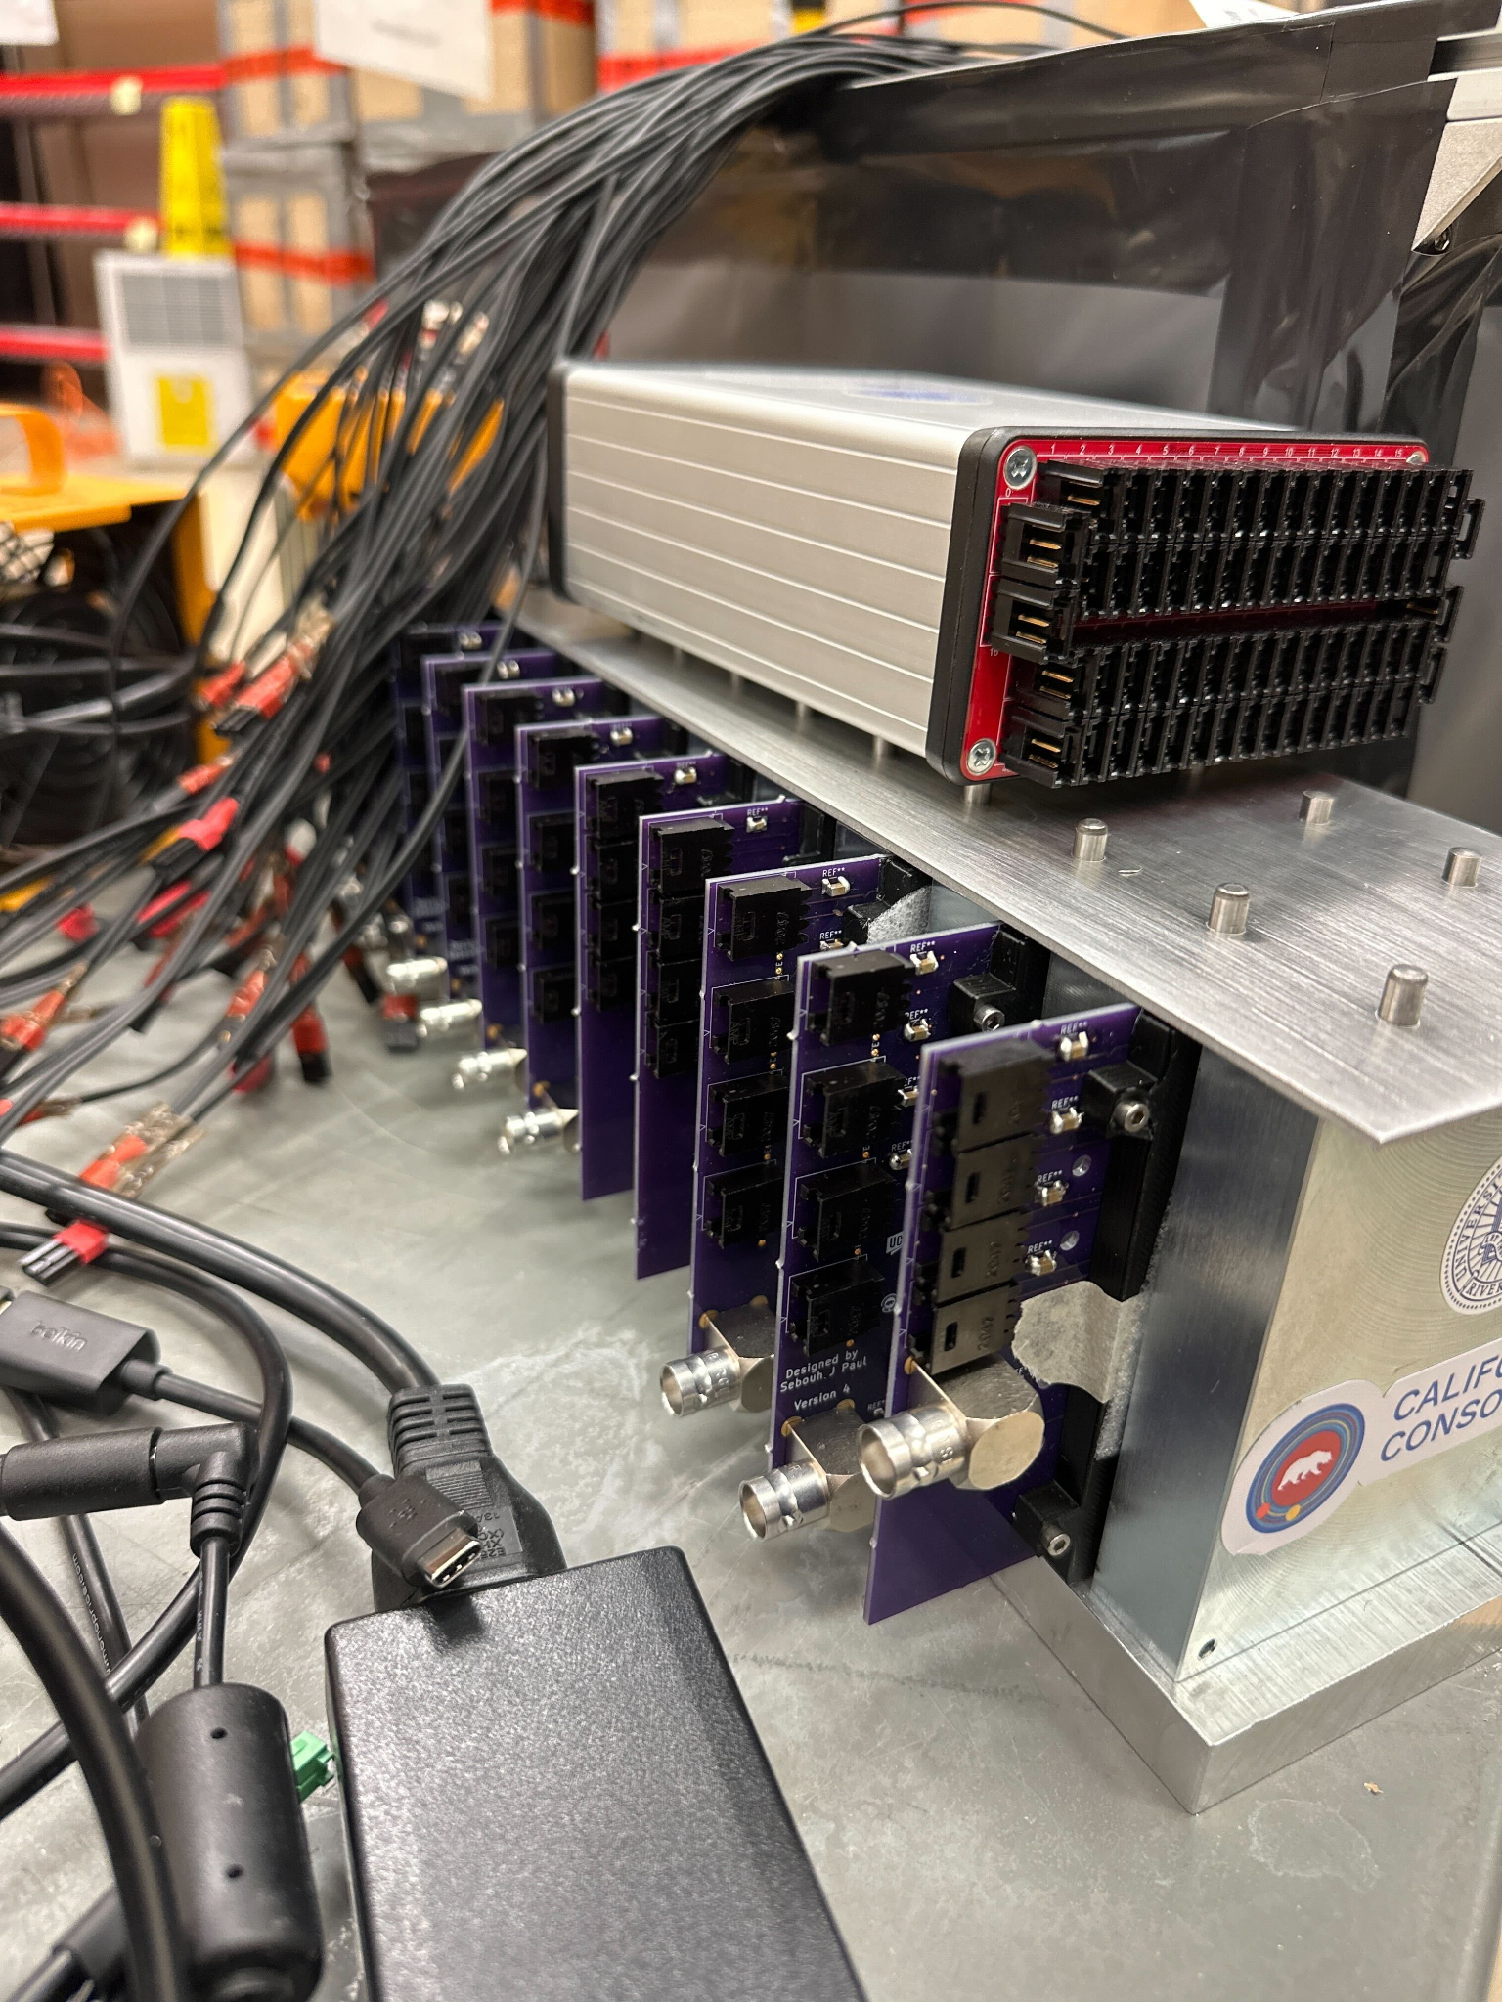
Phase 5: Cables

Slide 11
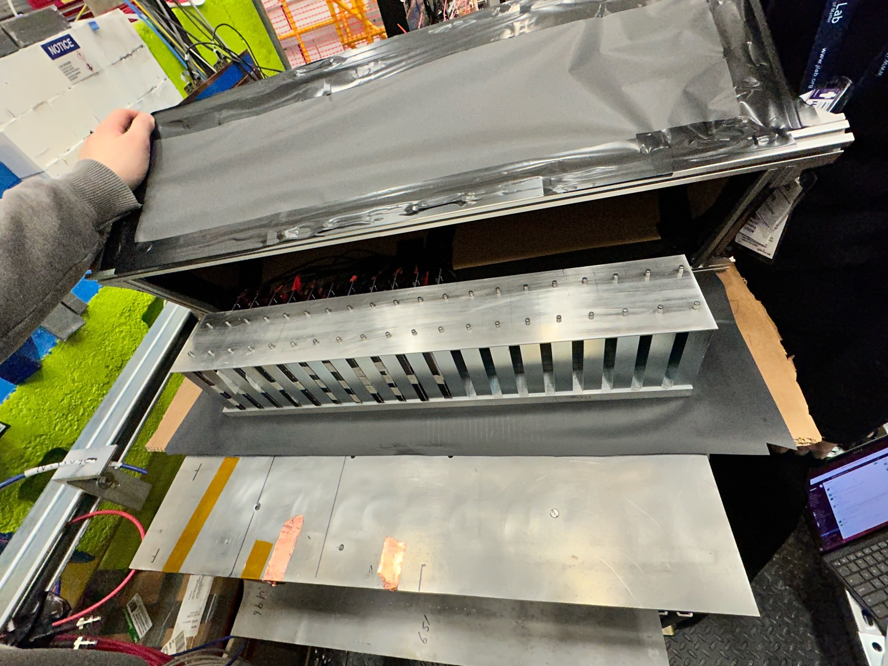
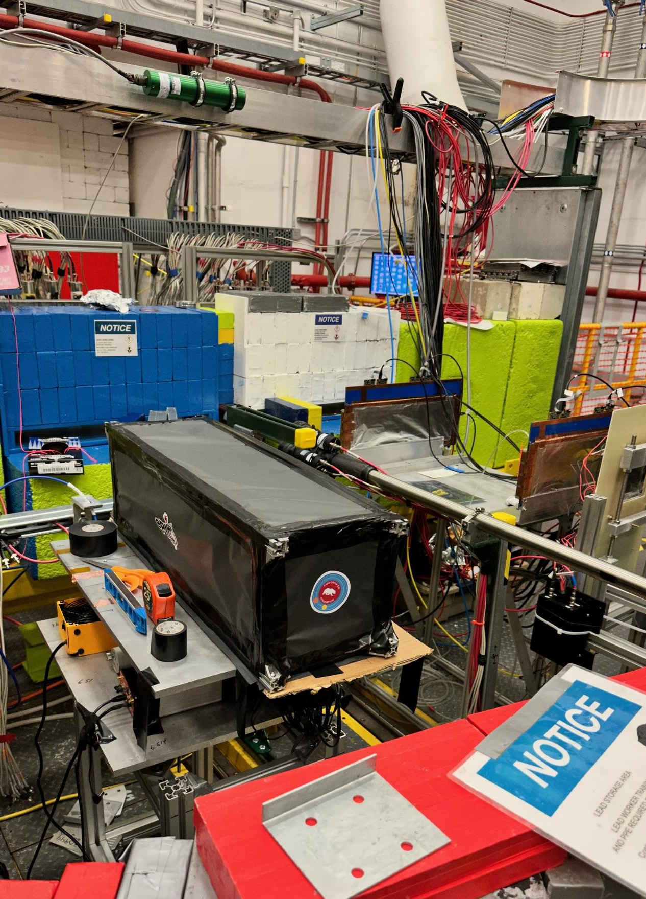
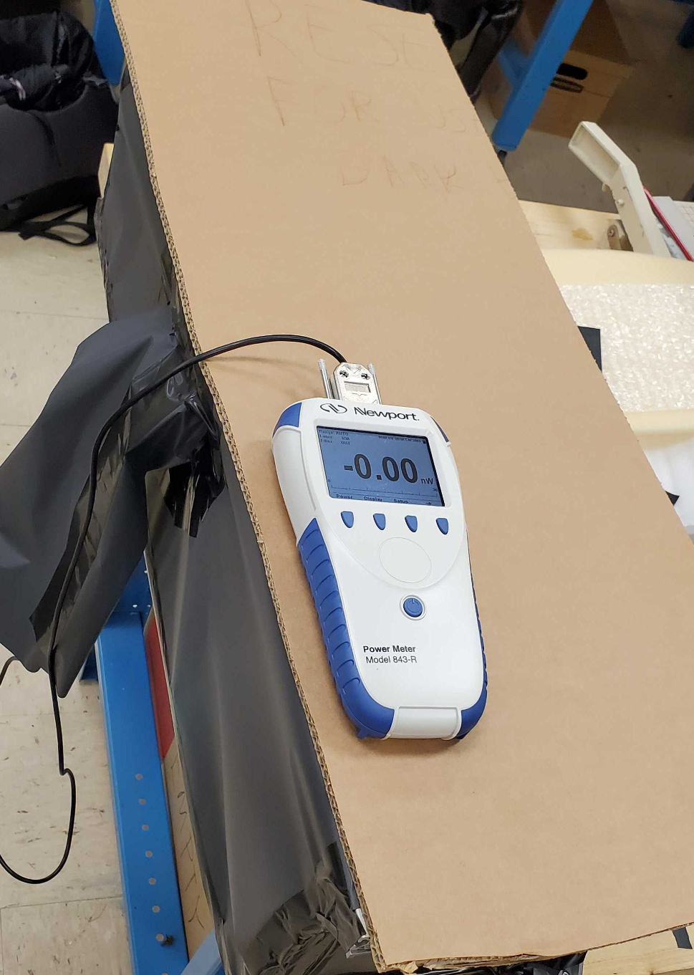
Building the Dark Box

Slide 12
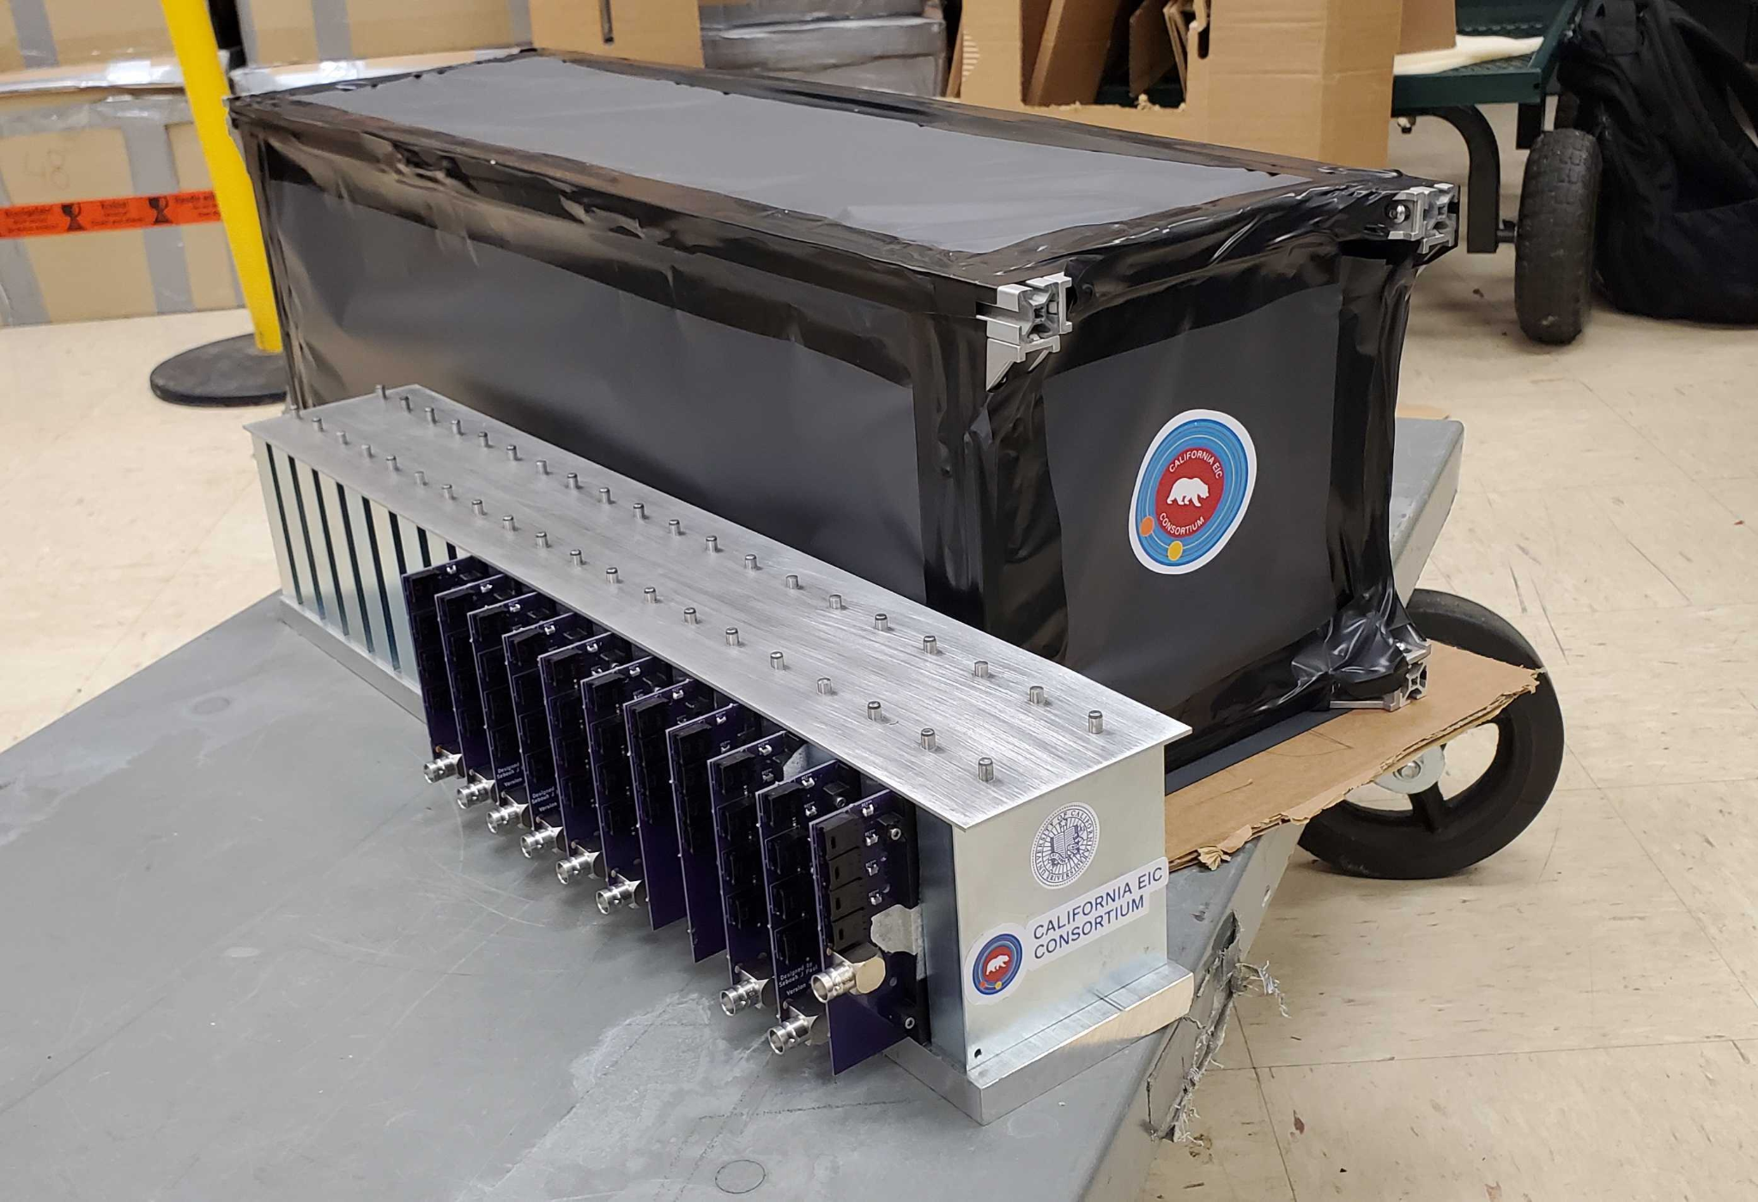
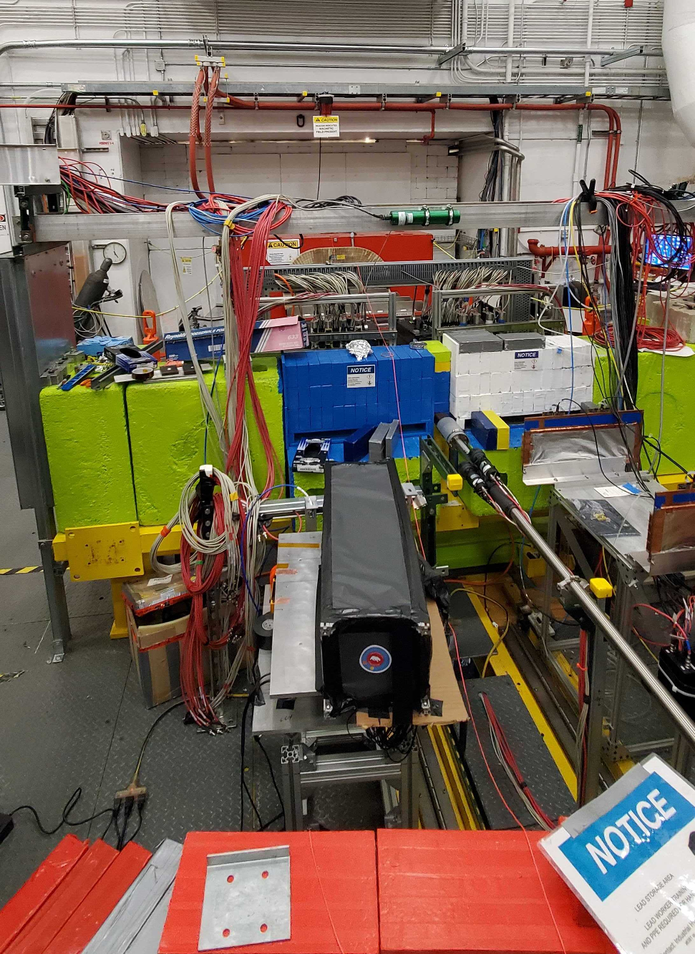
Completed Calorimeter Insert Prototype

Slide 13
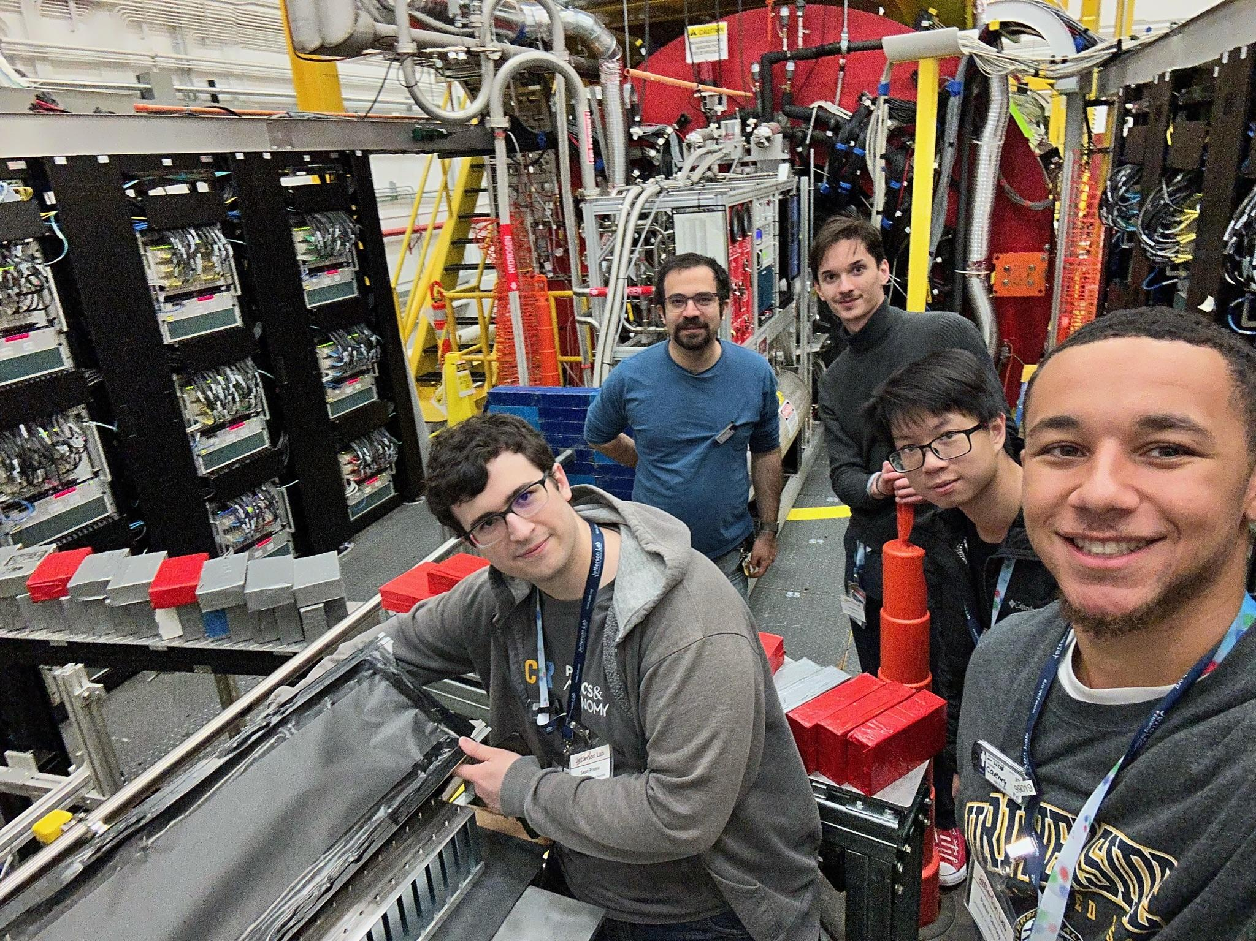
Future Steps
Test Different configurations of designs… hexagonal PCB’s.
Add more PCB layers to Calorimeter prototype.
Test prototype at Fermilab and Brookhaven

