Slide 1
Milling plastic scintillator cells for calorimeter insert
By Bruce Bagby Bañuelos

Slide 2
Objective
Manufacture Plastic Scintillator cells to prototype Calorimeter insert
Ultimately construct Calorimeter Insert using lab-manufactured Scintillator cells

Slide 3
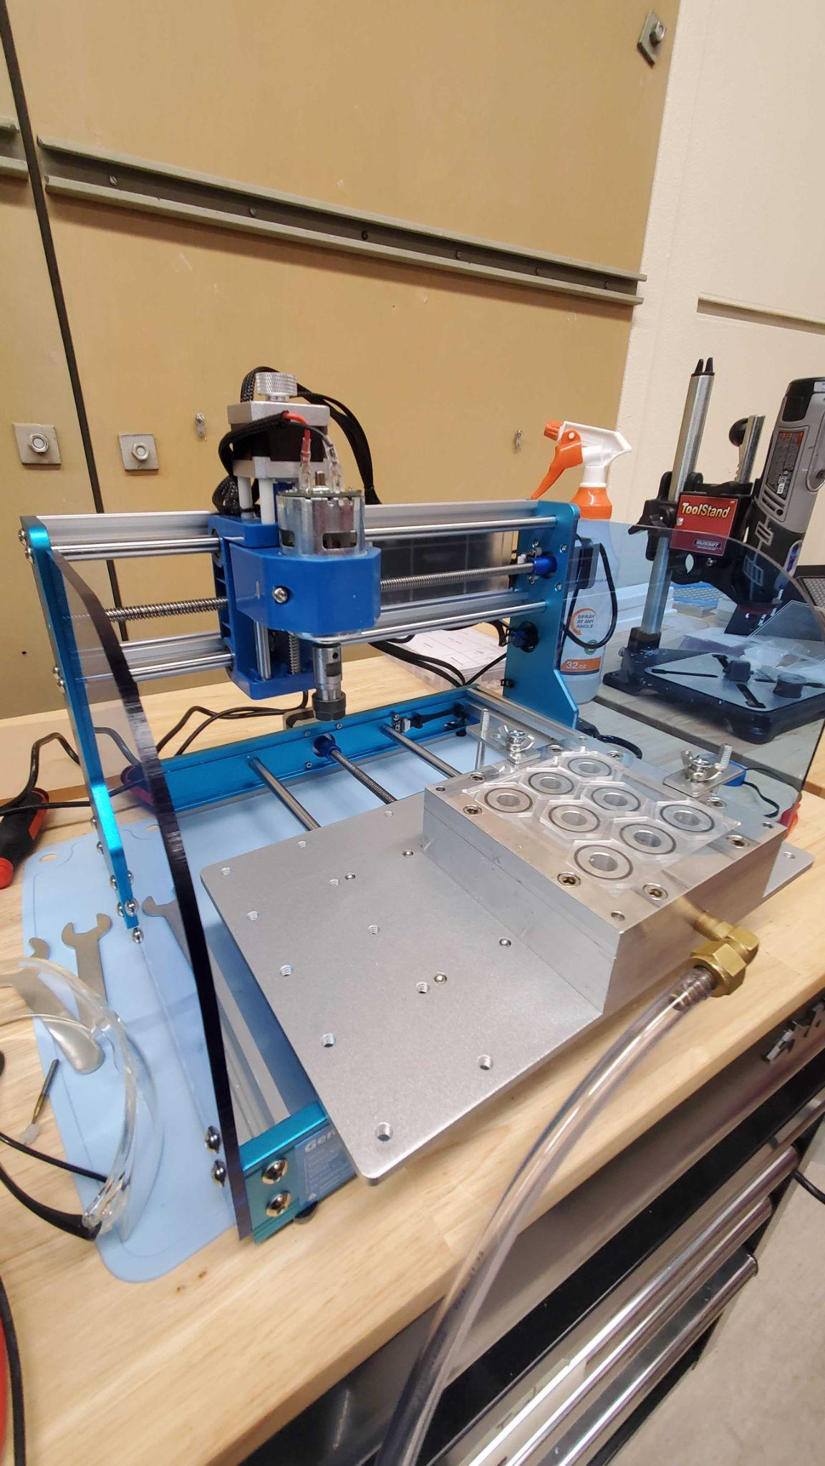
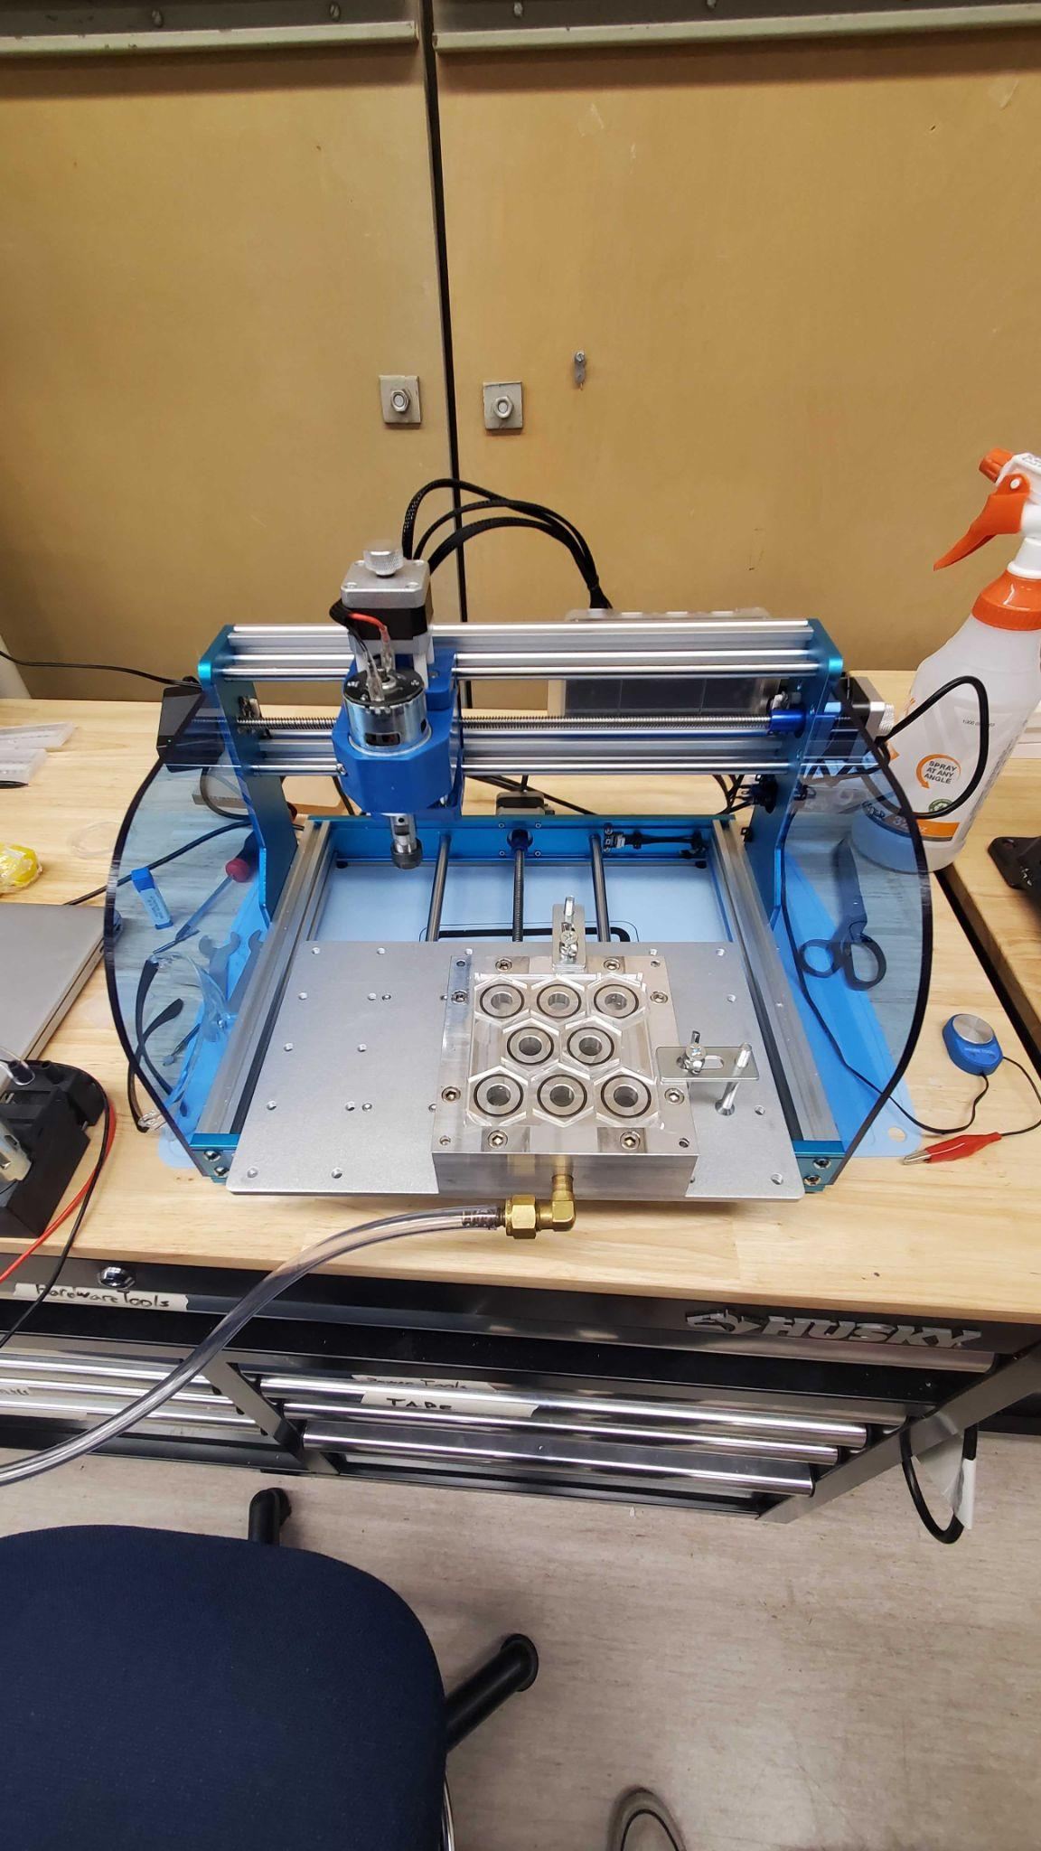
Prover 3018 V2 Desktop CNC
Dimensions:
290mm x 180mm x 40mm
Affordable
Accessible
Designed for Hobbyists
Relatively Straightforward

Slide 4
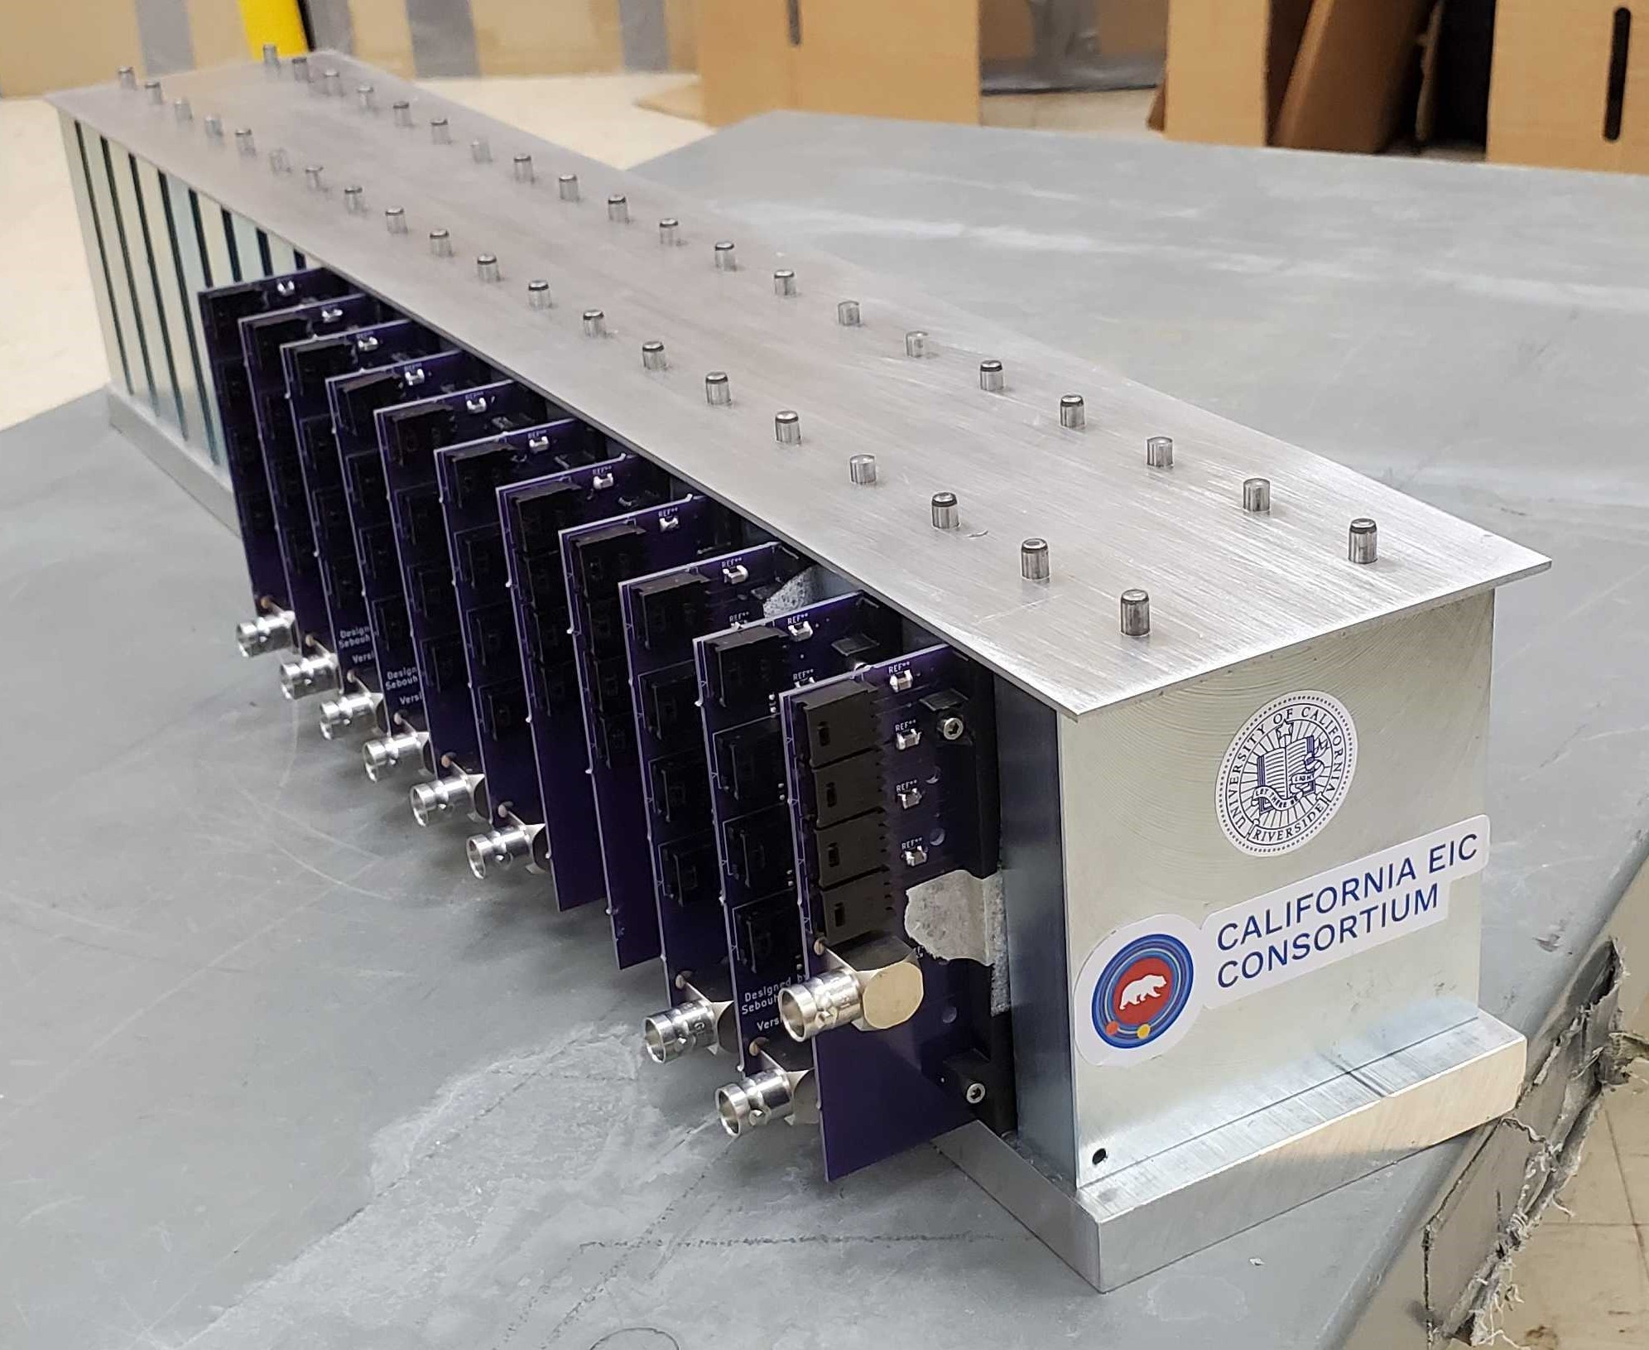
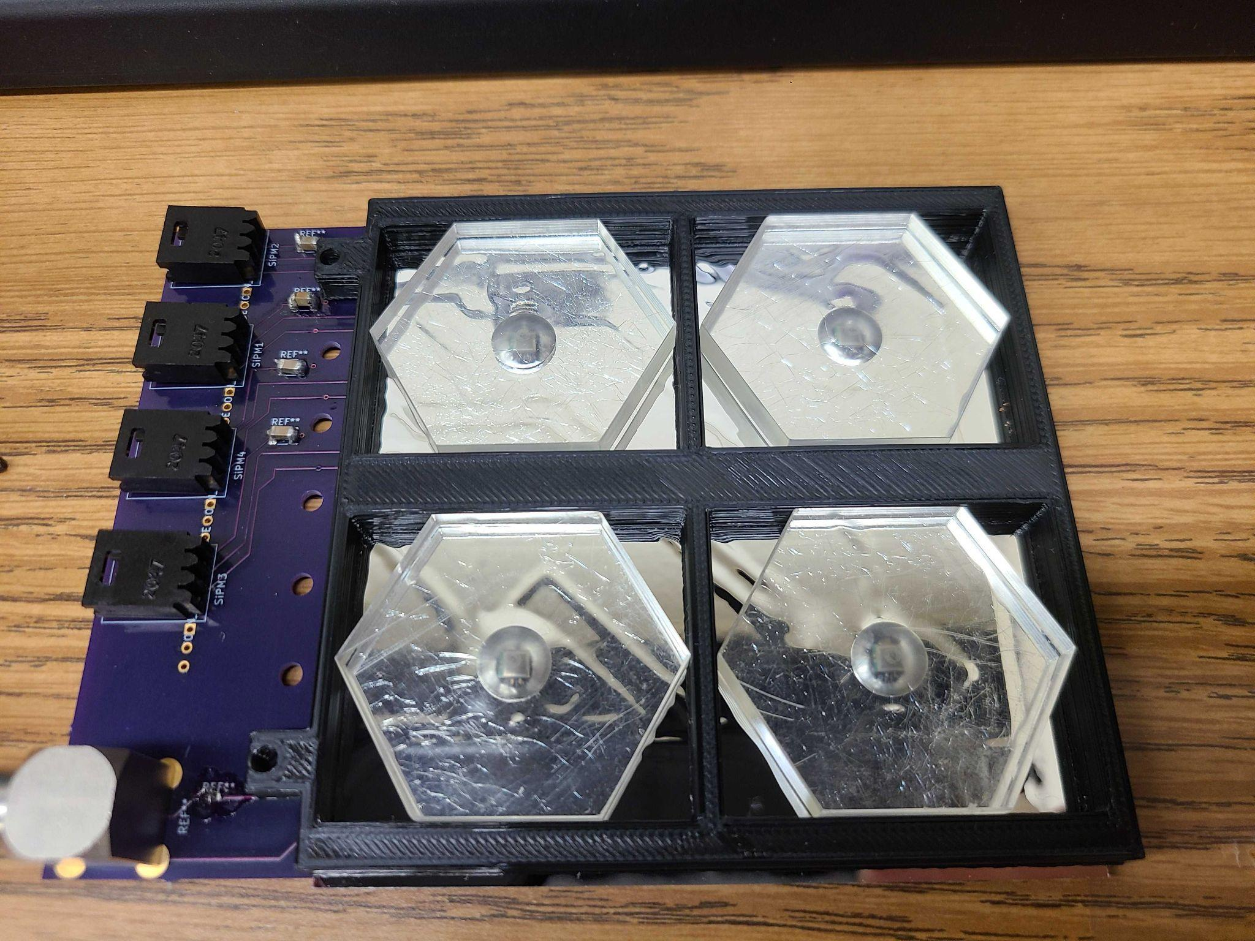
Prototype Calorimeter
Made and Assembled by the Arratia Group!
PCBS designed and Soldered in lab
Scintillators from repurposed material - Polished in lab.

Slide 5
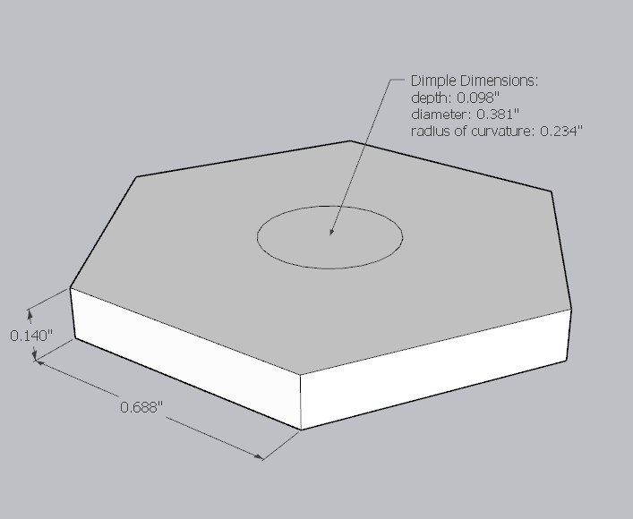
Scintillator Cells
Current Dimensions:
Long Diameter ~ 34mm
Thickness ~ 3.5mm
Dimple Diameter ~ 9mm
Future Cell Variations:
Different cell sizes
Different dimple geometries and sizes

Slide 6
General Process
CAD
CAM
CNC Machine Software
Cutting
Model Design:
Dimensions of desired piece
Softwares:
Fusion 360
Solidworks
Sketchup
Manufacturing:
Defines how the model is cut
Specify milling bit, cut process, stock material
Softwares:
MasterCAM
Fusion 360
Controls CNC:
Takes nc file from CAD - Interprets G-code
Softwares:
Candle
Milling Bits:
Bit size
Flute Number
Bit type
Material Fixing:
Vacuum fixed
clamped
Coolant:
Water
air

Slide 7
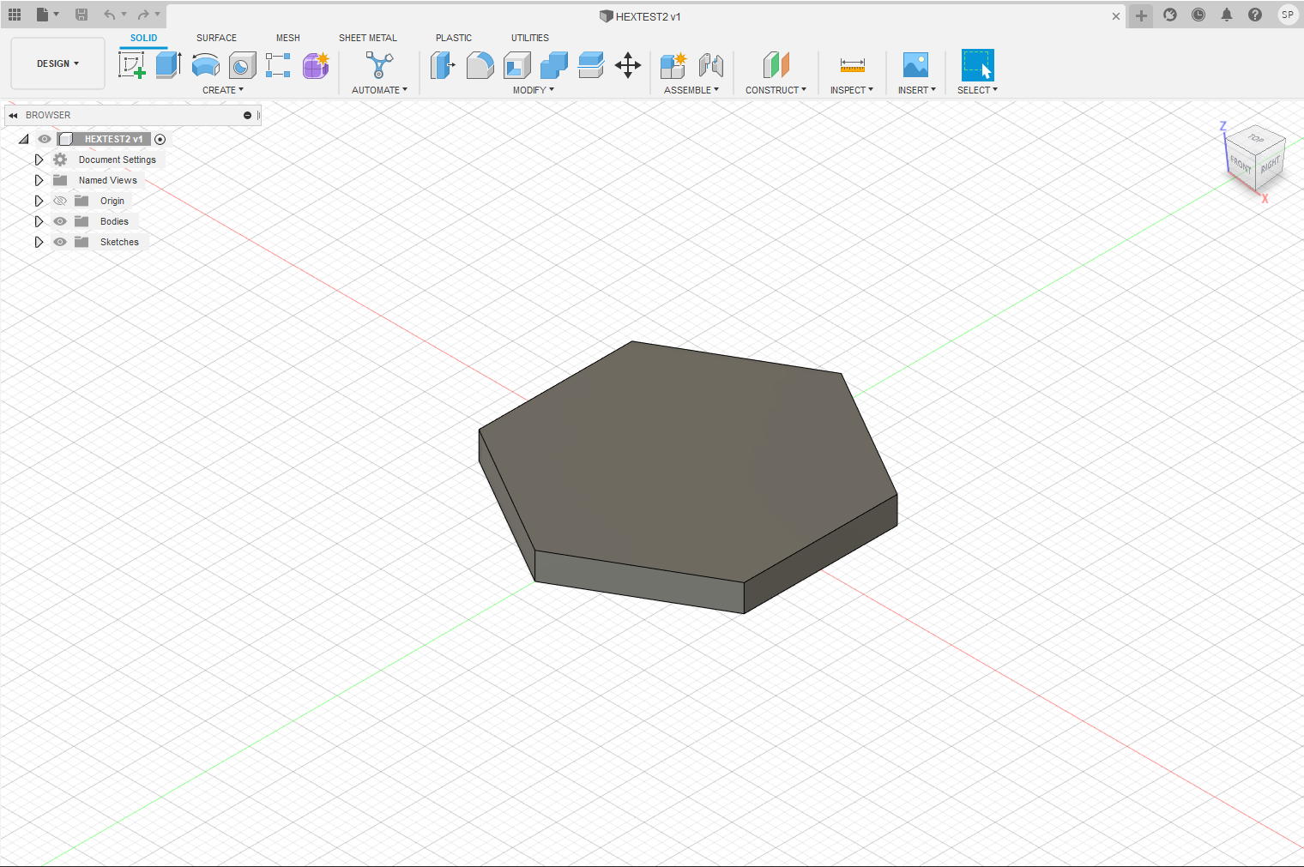
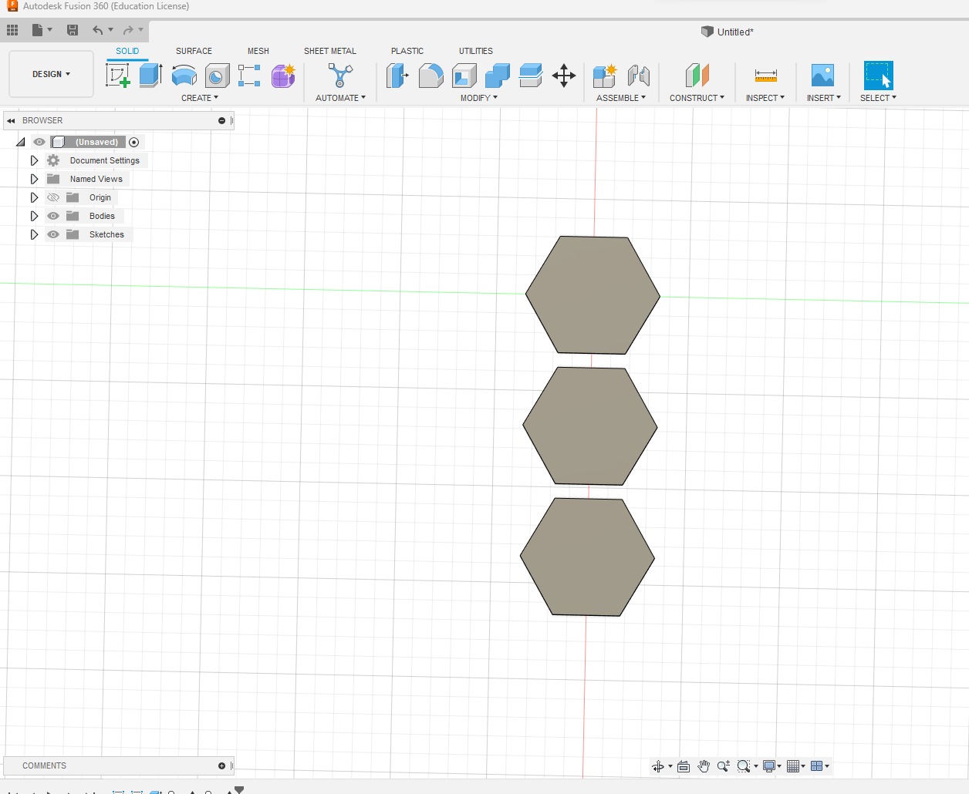
CAD - Fusion 360

Slide 8
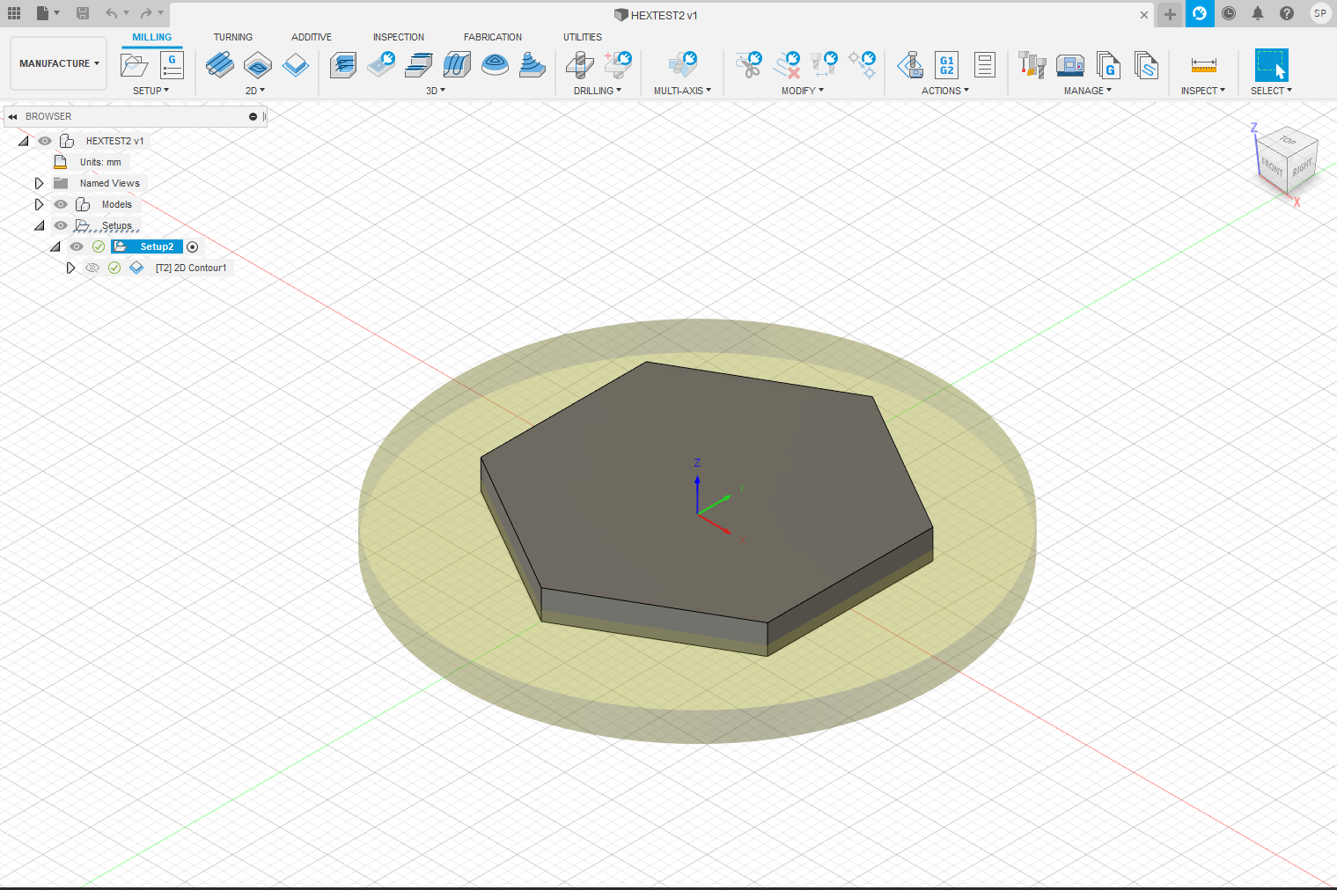
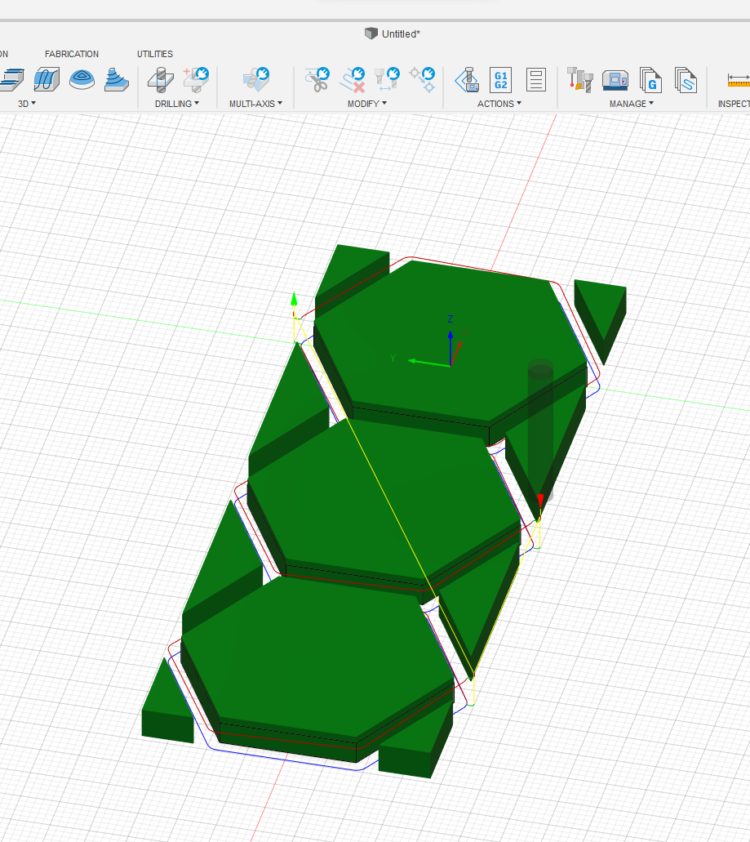
CAM

Slide 9
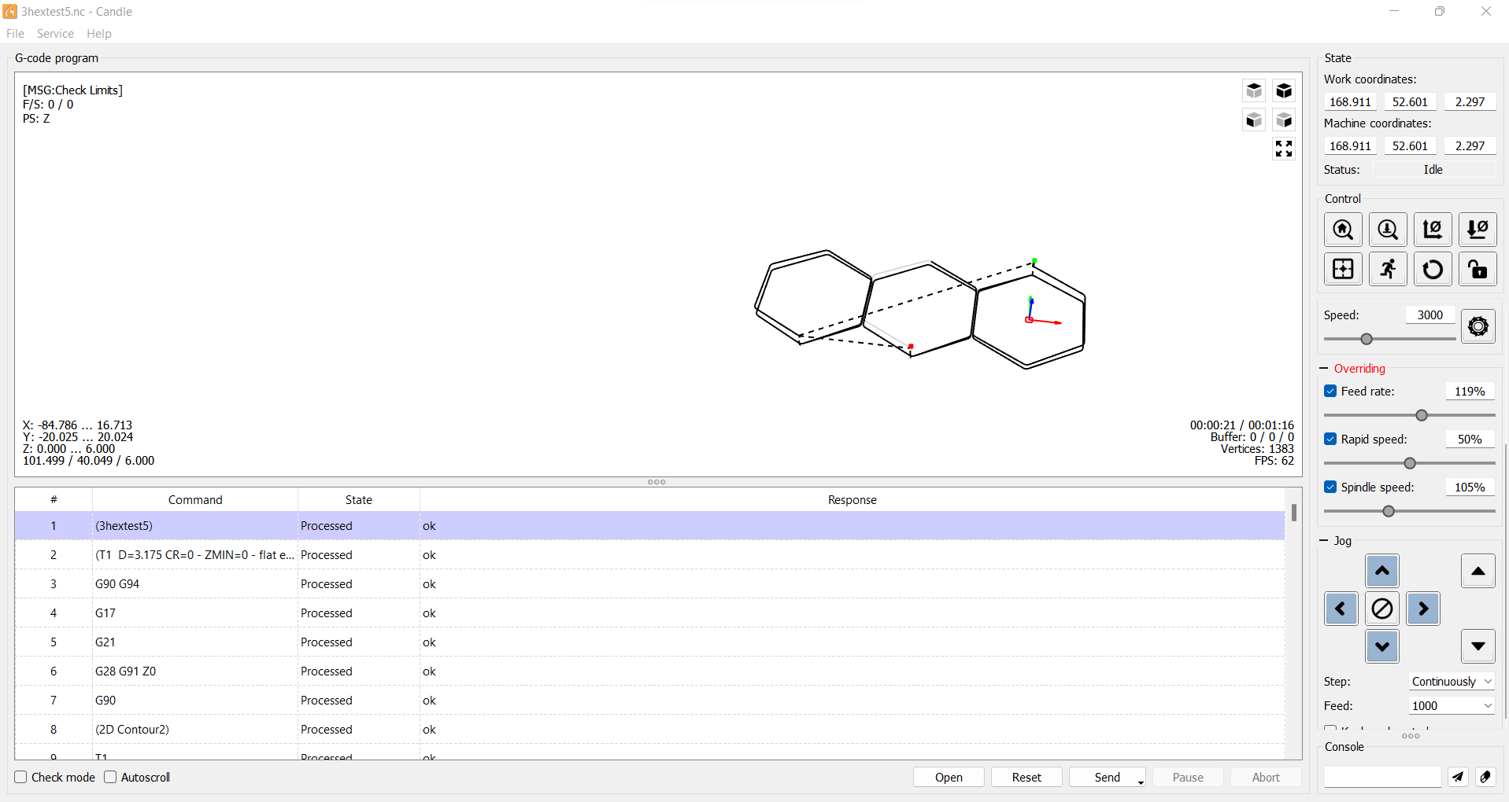
CNC Control Software - Candle

Slide 10
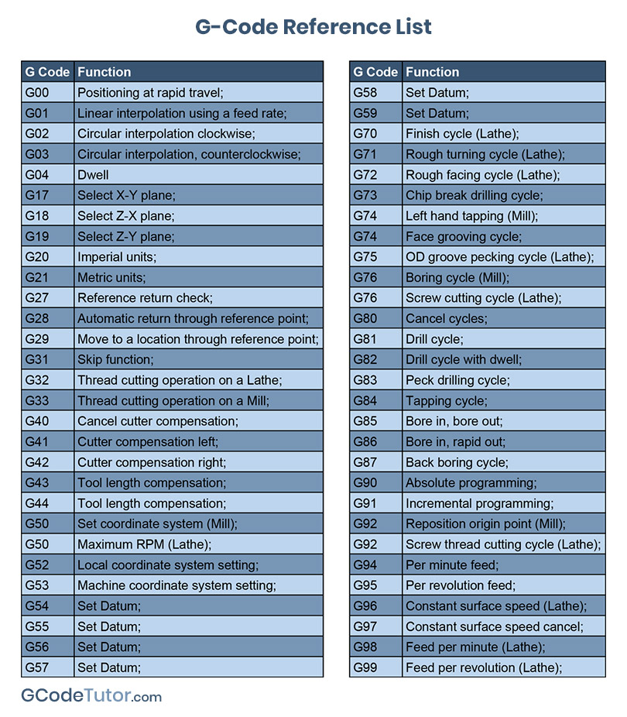
A little on G-code
A programming language designed for controlling CNCs (used also in 3d printing)
A series of commands from 0 to 99
Softwares built with GRBL firmware do not recognize all of these commands

Slide 11
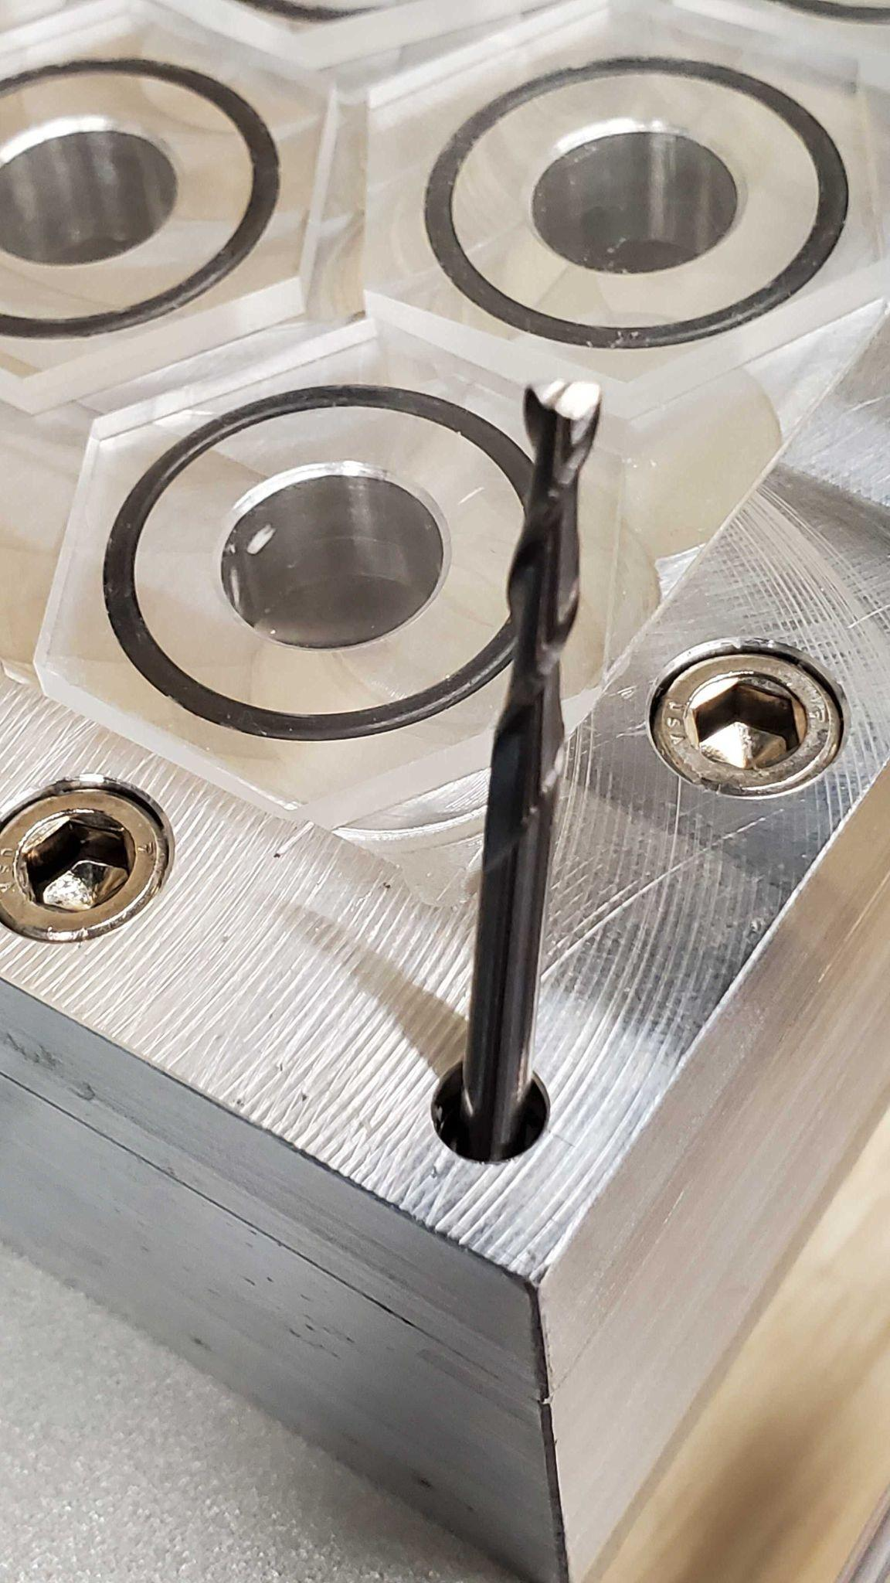
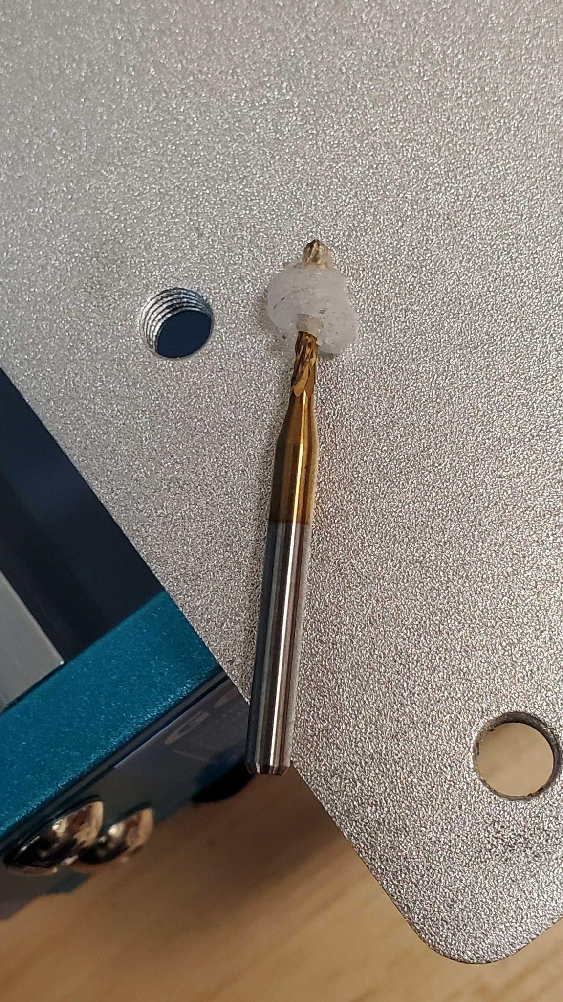
Milling Bits
Different Bit types for different cuts:
Edge Cuts: 2-flute Flat End
Dimple: Ball End
Chip Evacuation and Heating:
Flute number

Slide 12
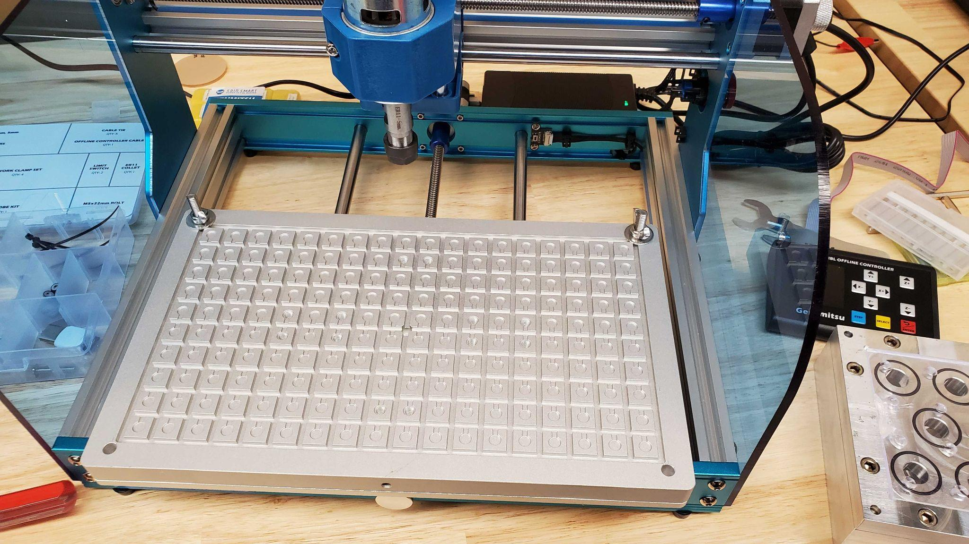
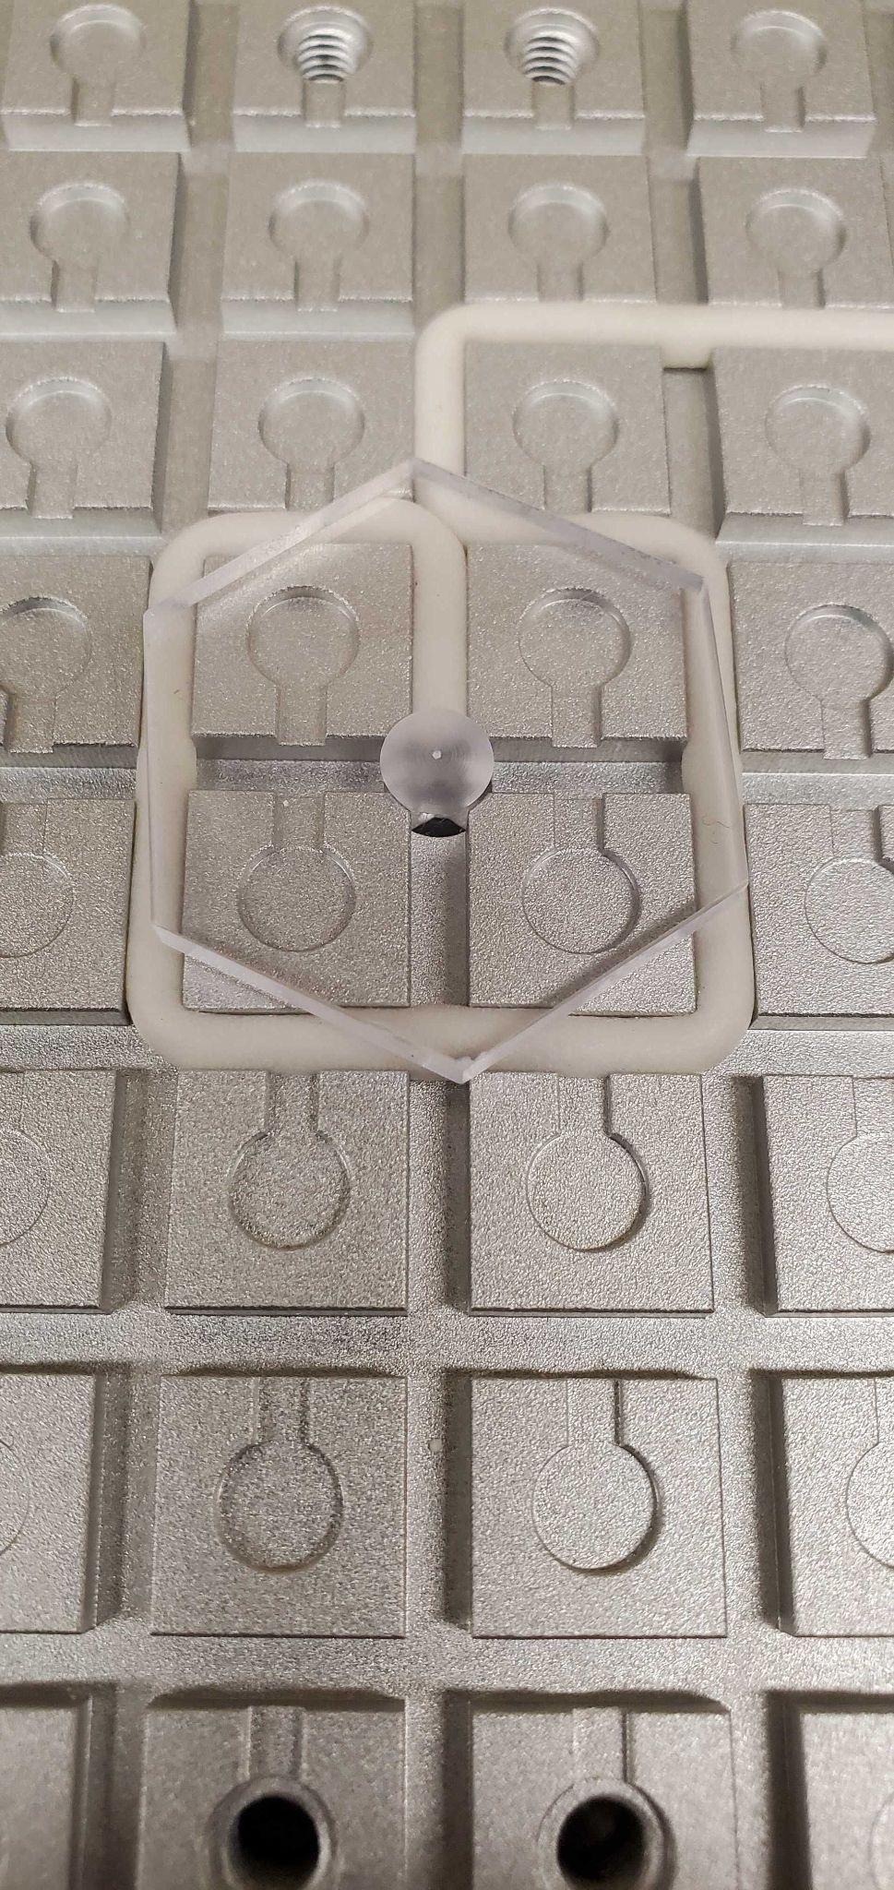
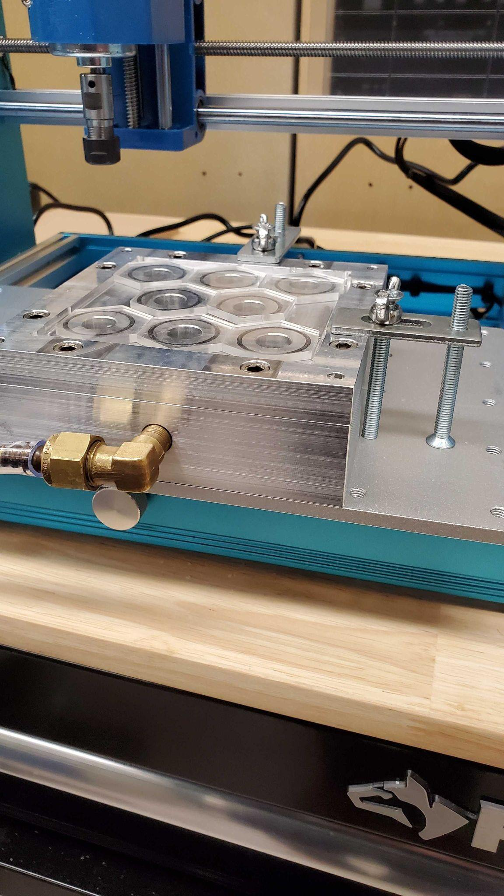
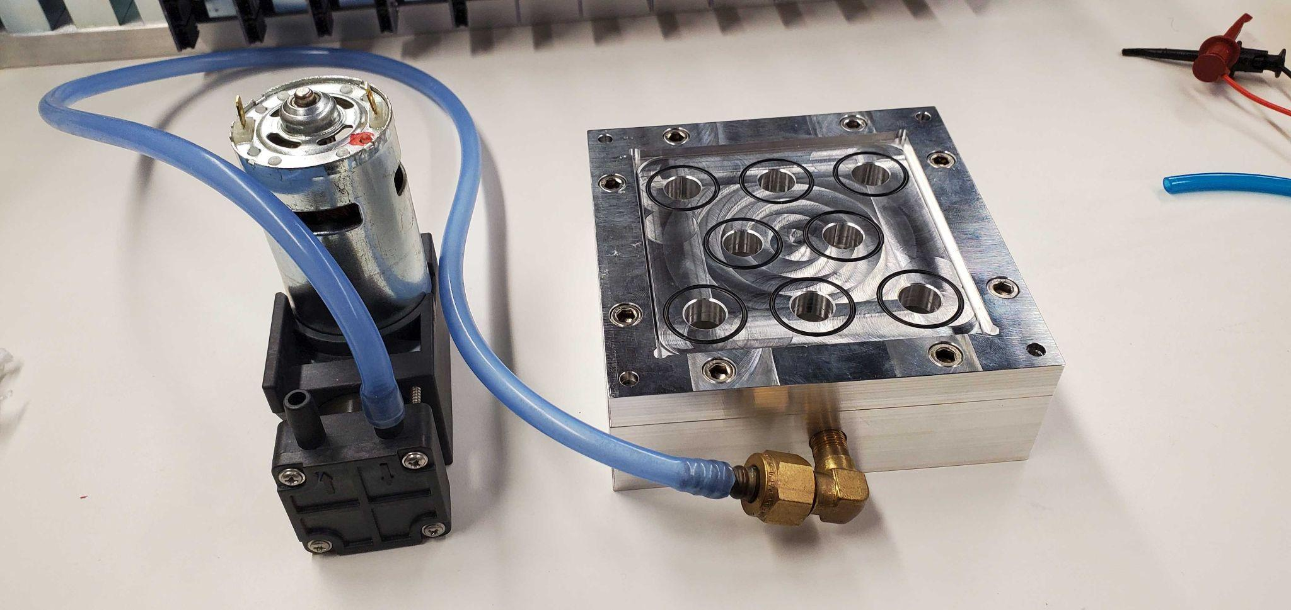
Cutting Setup
Vacuum Setup:
Specialized Vacuum Chuck
Holds ~ 10cm^2 stock material
Vacuum Table
Small Vacuum

Slide 13
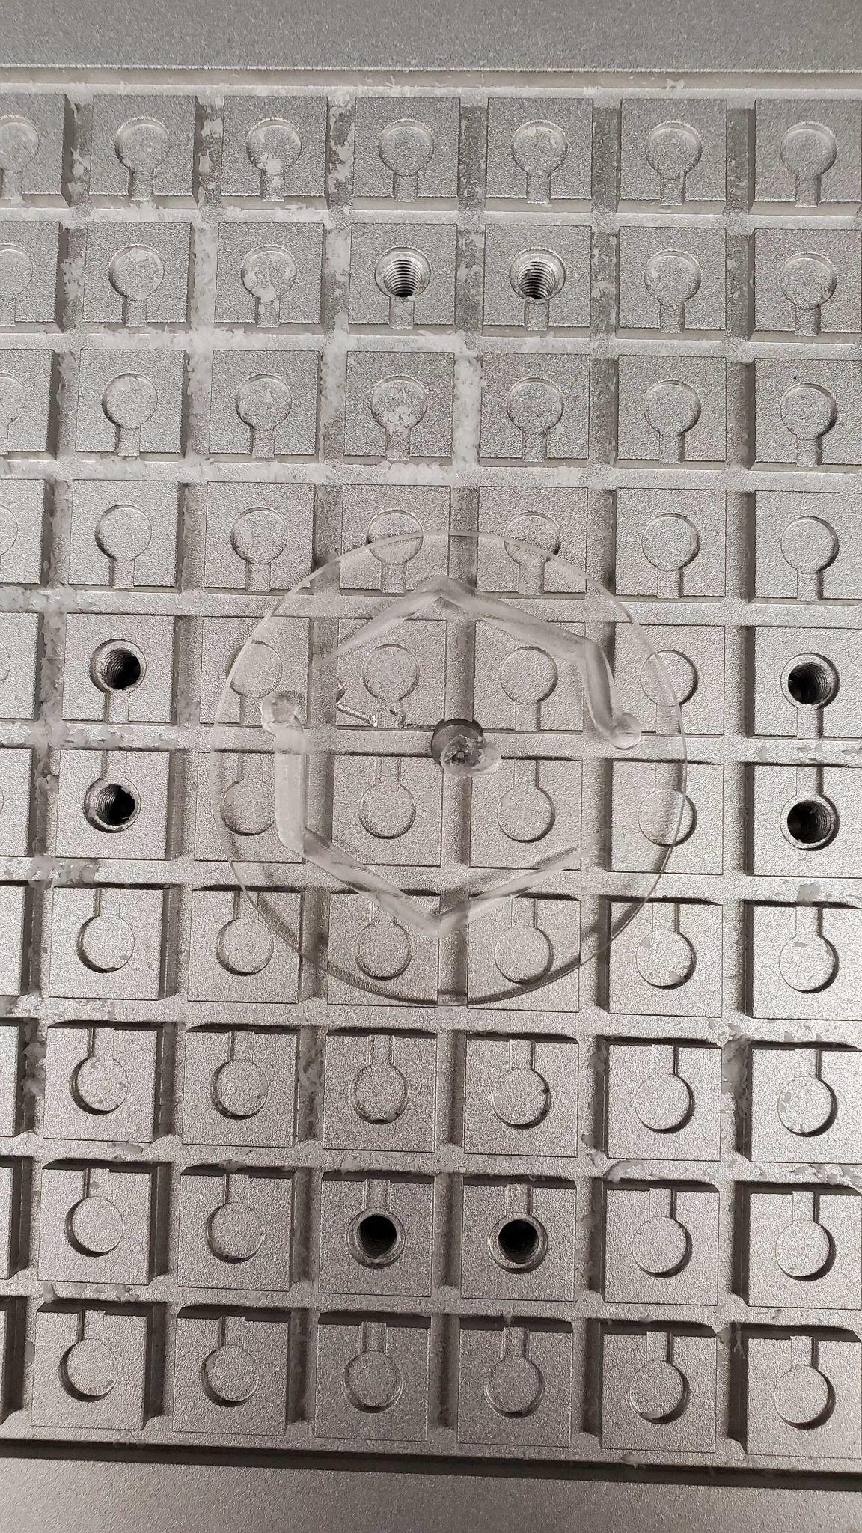
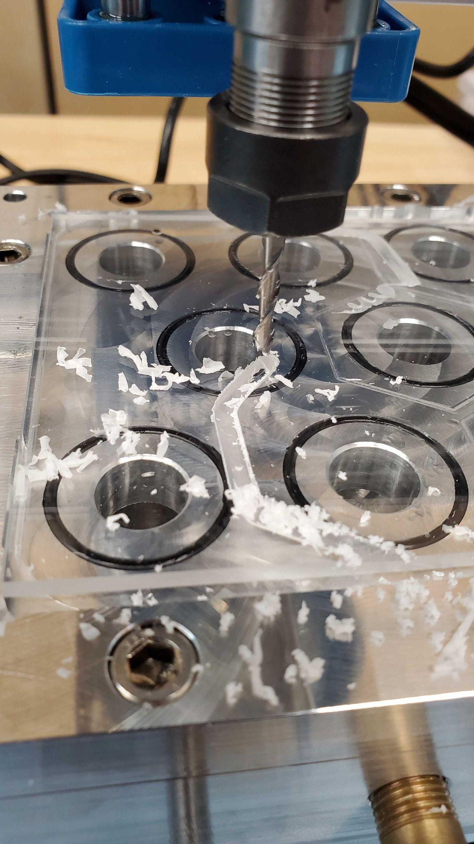
Cutting Tests
Main issues:
Vacuum Breaks When Water Coolant is applied
Heating
Poor Defined CAM Height

Slide 14
Summary
Fusion 360 for CAD and CAM
Candle for CNC machine control
⅛” 2 flute bit for edge cuts
Ball end mill bit
Future Goals
Design and manufacture multiple variations of scintillator cells for testing
Manufacture Scintillators for Calorimeter Inserts

