Slide 1
Sr-90 Scanner for Scintillator-Cell uniformity Tests
Samir Kulkarni

Slide 2
Scintillator Cells
Turns particle’s energy into light
Light radiates outward to SiPM
3 variables effect SiPM energy
particle energy
distance traveled
amount of material particle passes through

Slide 3
SiPM reads different energy based on distance
Add reflective foil to keep light in cell
Create dimple to offset distance effects

Slide 4
Scanner Design
Objective: create a setup to measure uniformity of cells and layers. This will be used for prototyping and to test layers before assembling
Shoot particles perpendicular to cell
Use step motors to move beam
Compare measured energy at each point

Slide 5
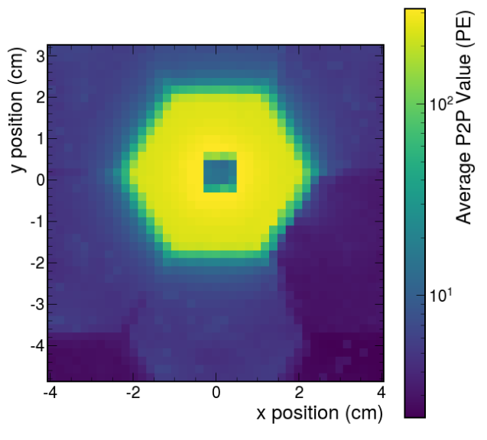
LED Tests
Used LEDs for the beam
Known light intensity
Can’t fully cover cell in foil
Able to show cross-talk in connected cells

Slide 6
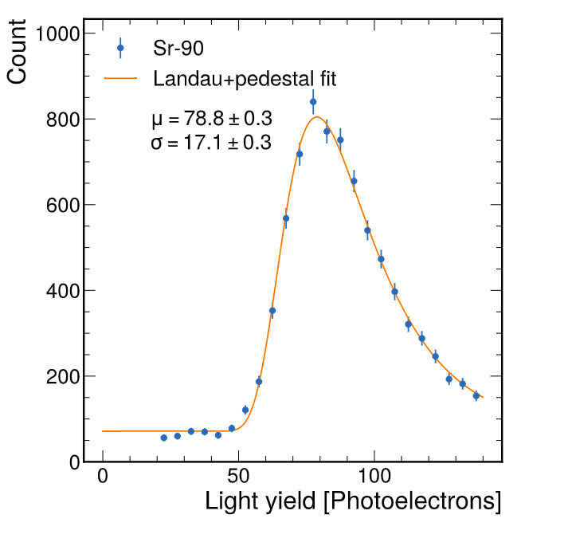
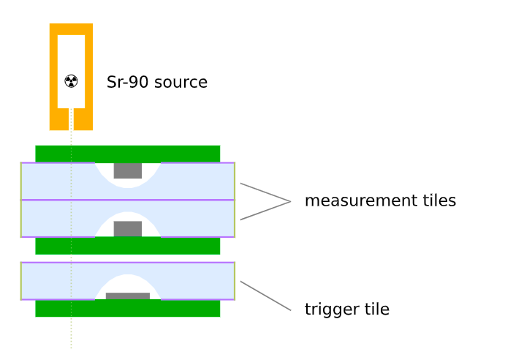
Sr-90 Scanner
Radioactive Isotope – Emits β⁻ radiation
Can penetrate reflective foil
Distribution of energies
Select for minimum ionizing particles
Only record data when bottom cell gets signal

Slide 7
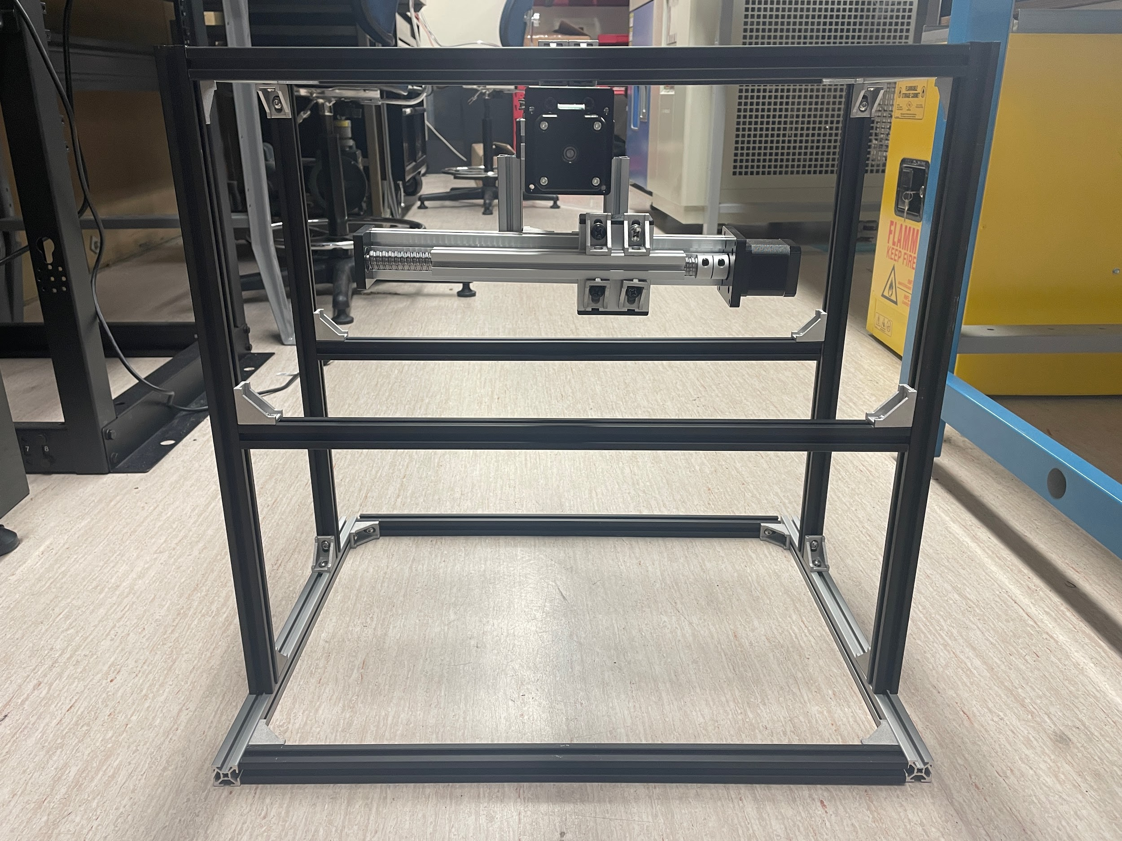
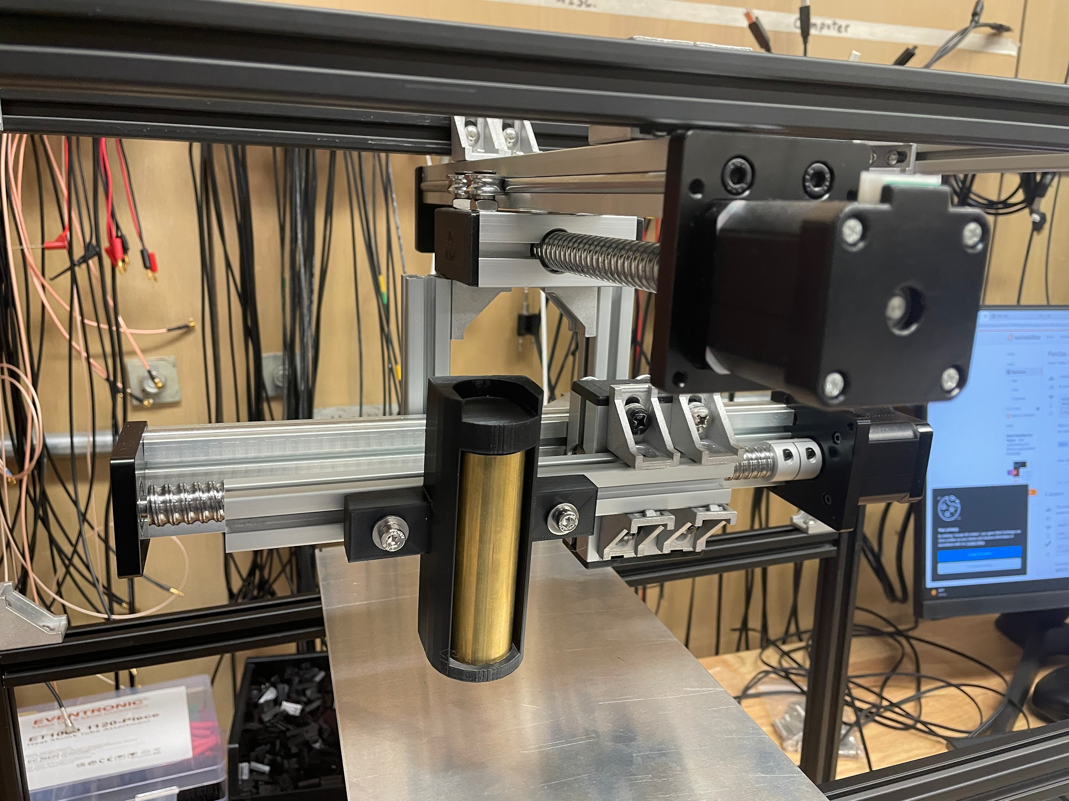

Slide 8
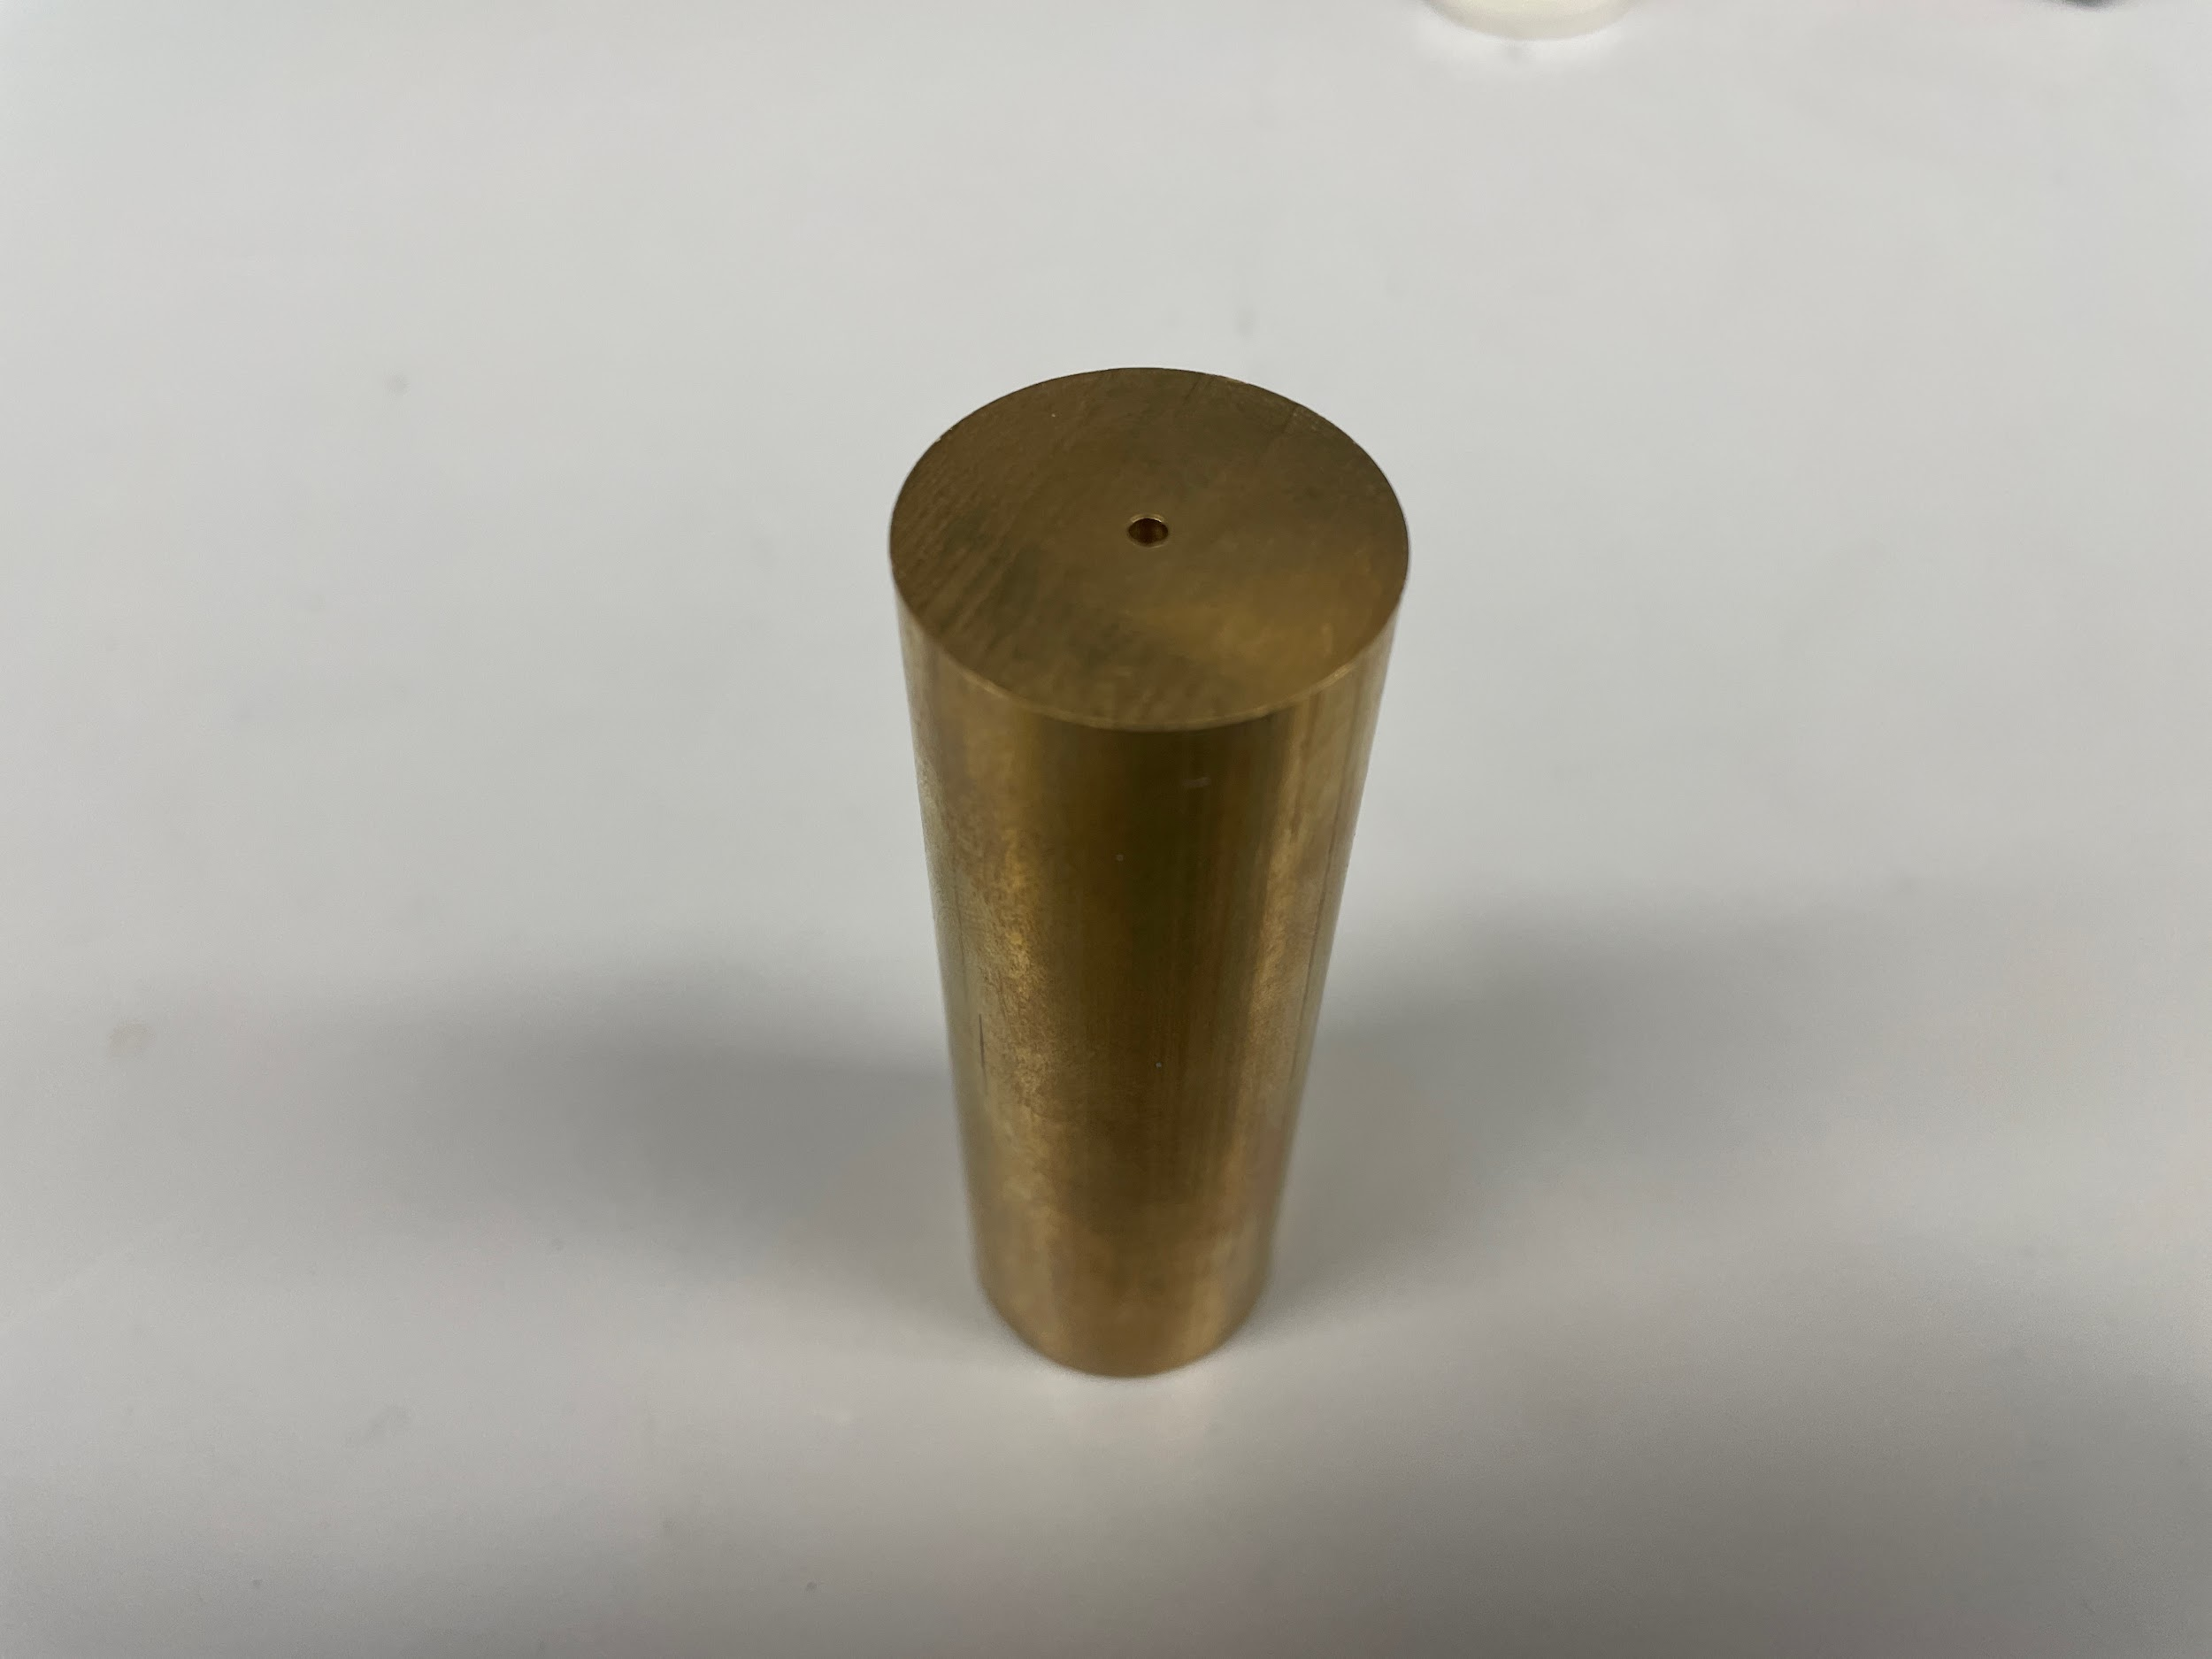
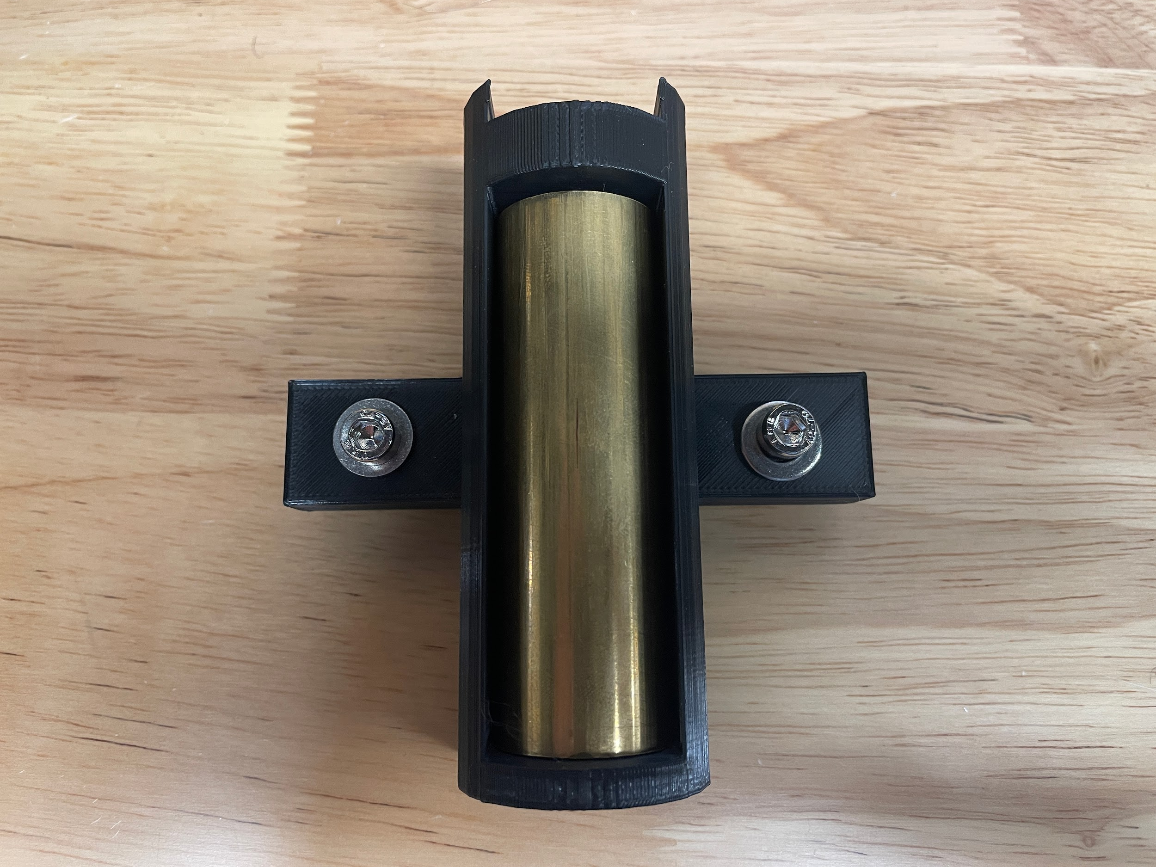
Collimator
Selects for electron direction
Brass tube
3D print object to connect source, collimator, and motor

Slide 9
What Next?
Check current uniformity
Test different cell shapes/sizes as well as dimple shapes

Slide 10
The End

