Slide 1
Readout for Calorimeter Insert Prototype and Calibration with Cosmic Rays
JiaJun Huang

Slide 2
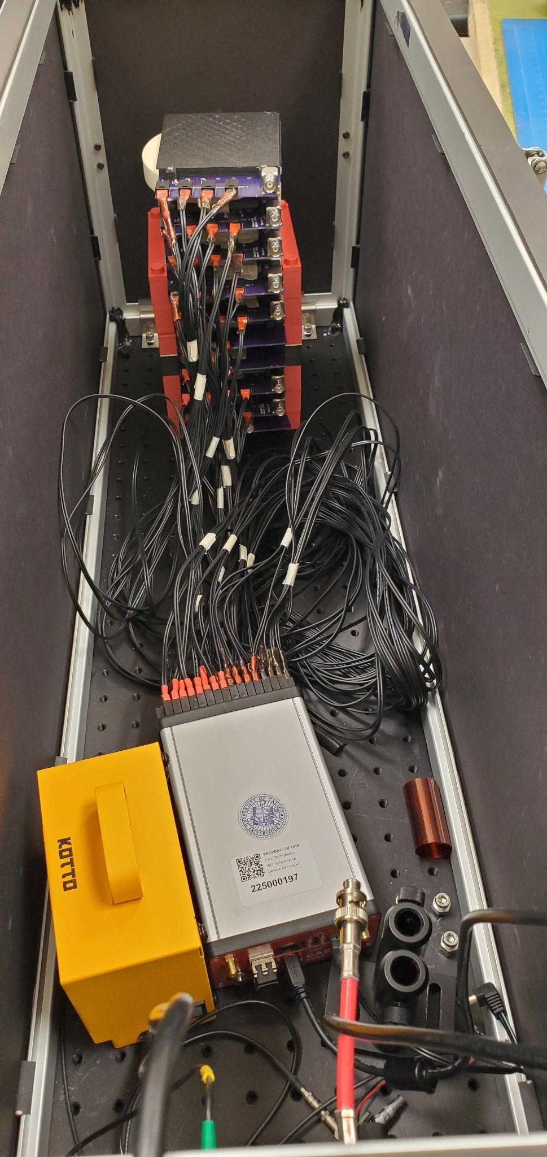
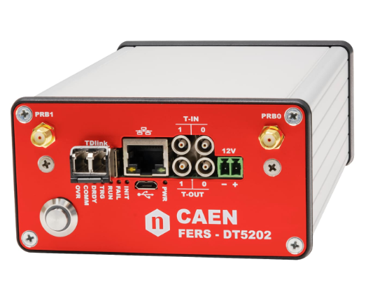
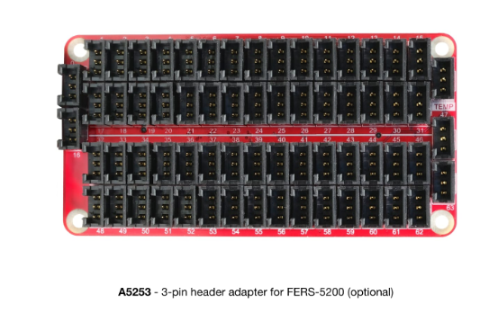
Prototype Preparation
Ten PCB Boards
Four SiPMs
Four Square/Hexagon Tiles
Reflective Foils
3D Printed Frames
CAEN DT5202
Unit to bias and readout 64 SiPMs
Notes:
Release date of CAEN

Slide 3
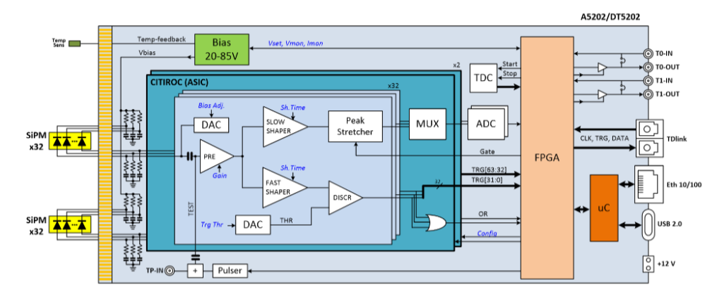
CAEN Configuration
Bias
Gain: LG and HG
Threshold
Triggering Logic
Output: ASCII Files
Timestamp & ADC counts
Notes:
Reads out in both gains

Slide 4
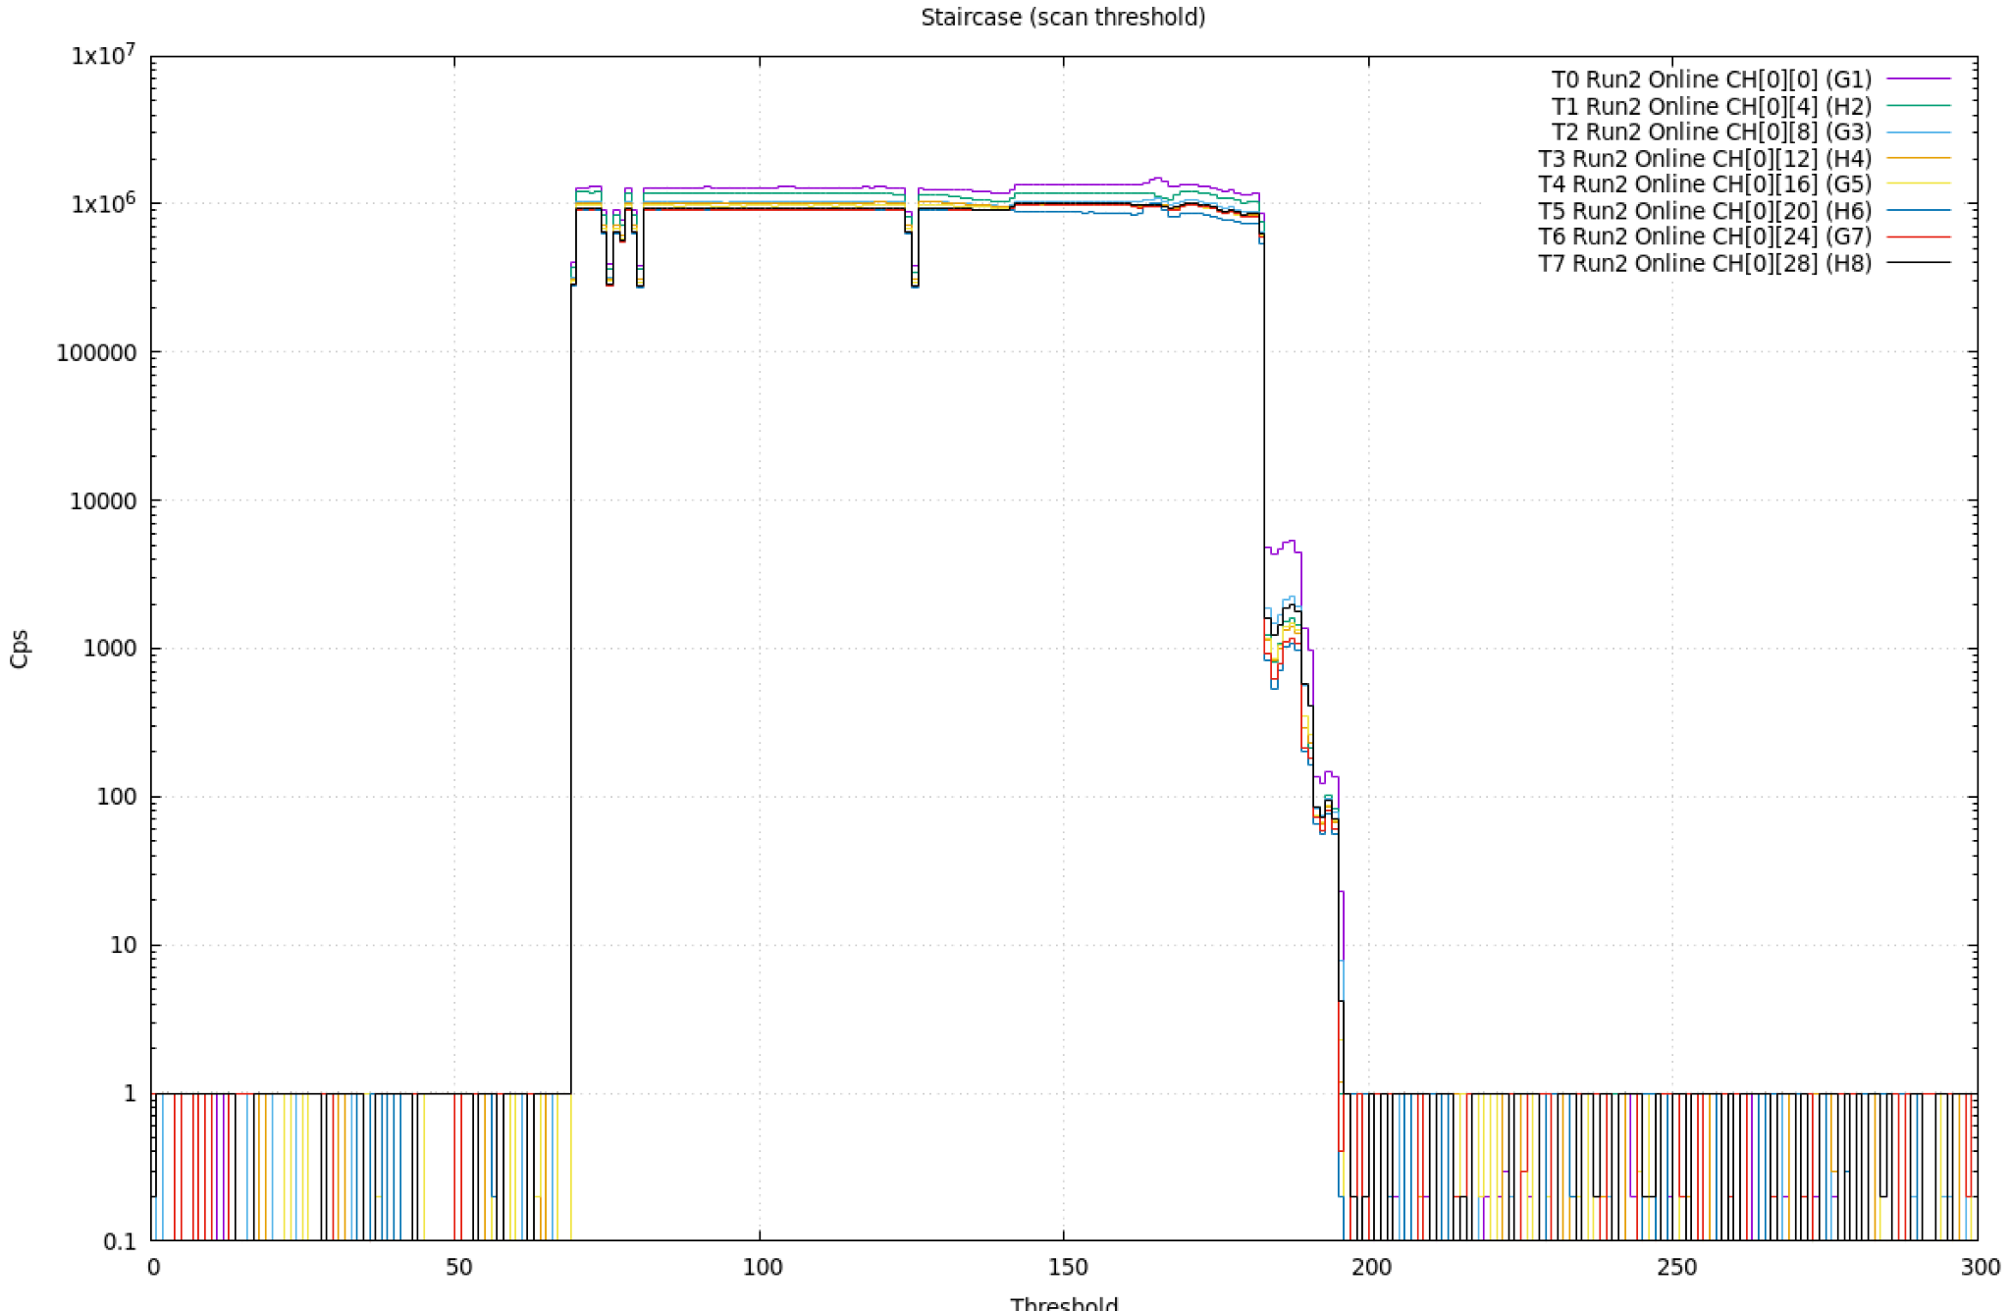
CAEN Readout
Threshold Scan
Four cells must trigger to record counts
Run for each gain setting
Noise
Cosmics

Slide 5
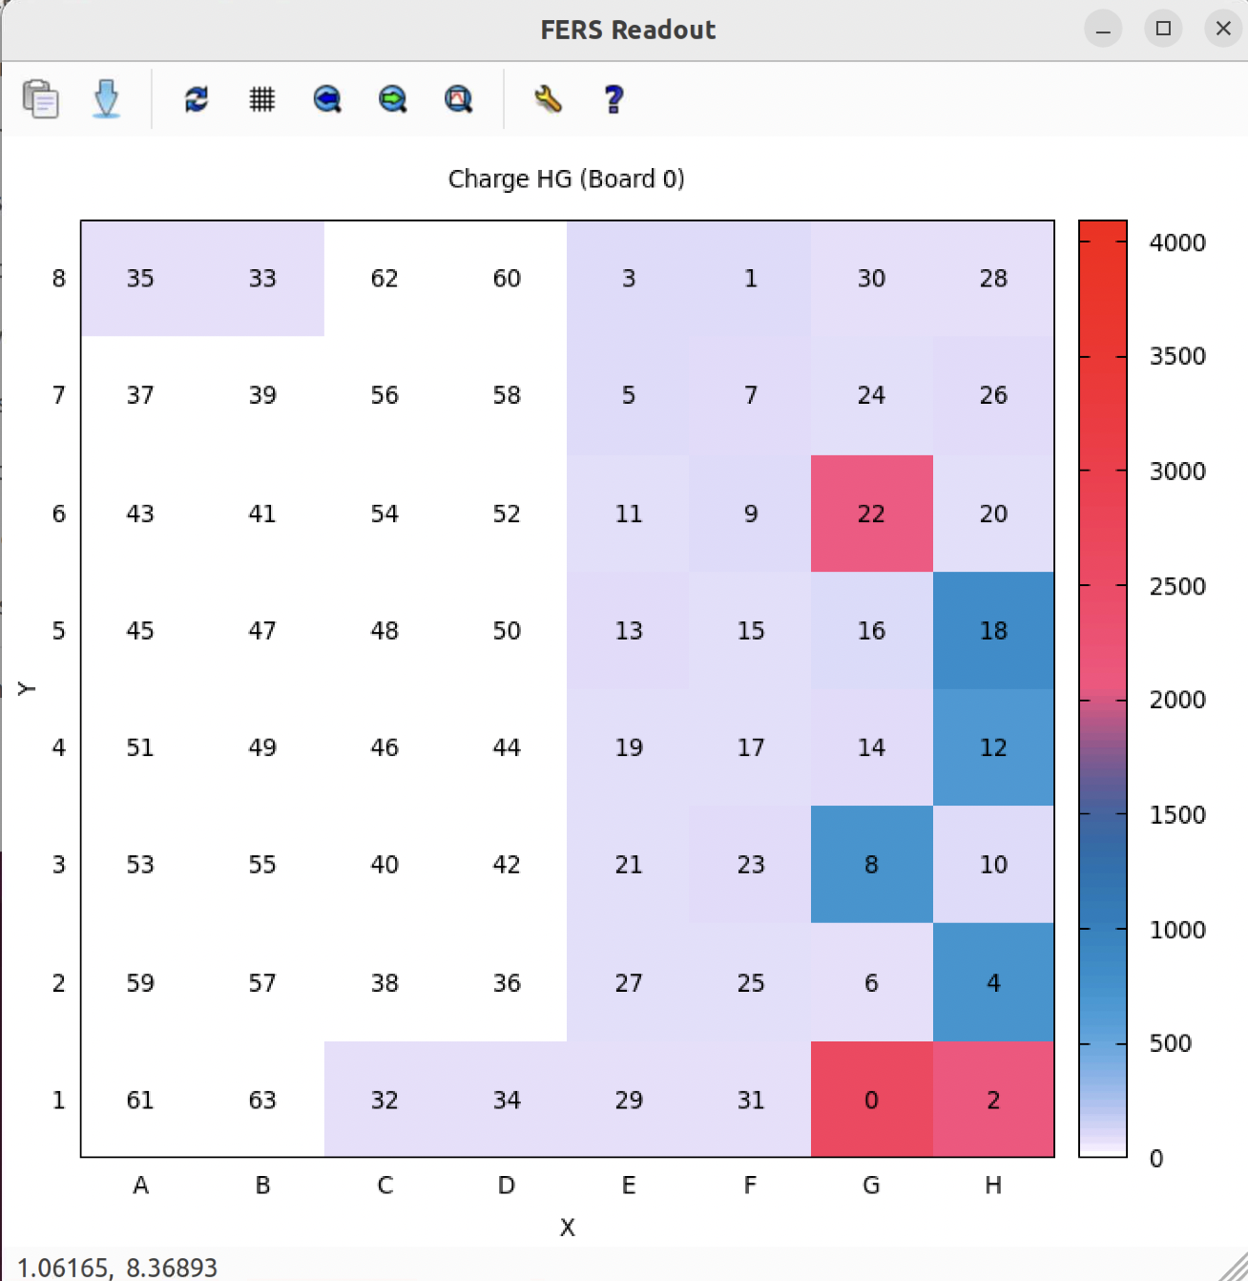
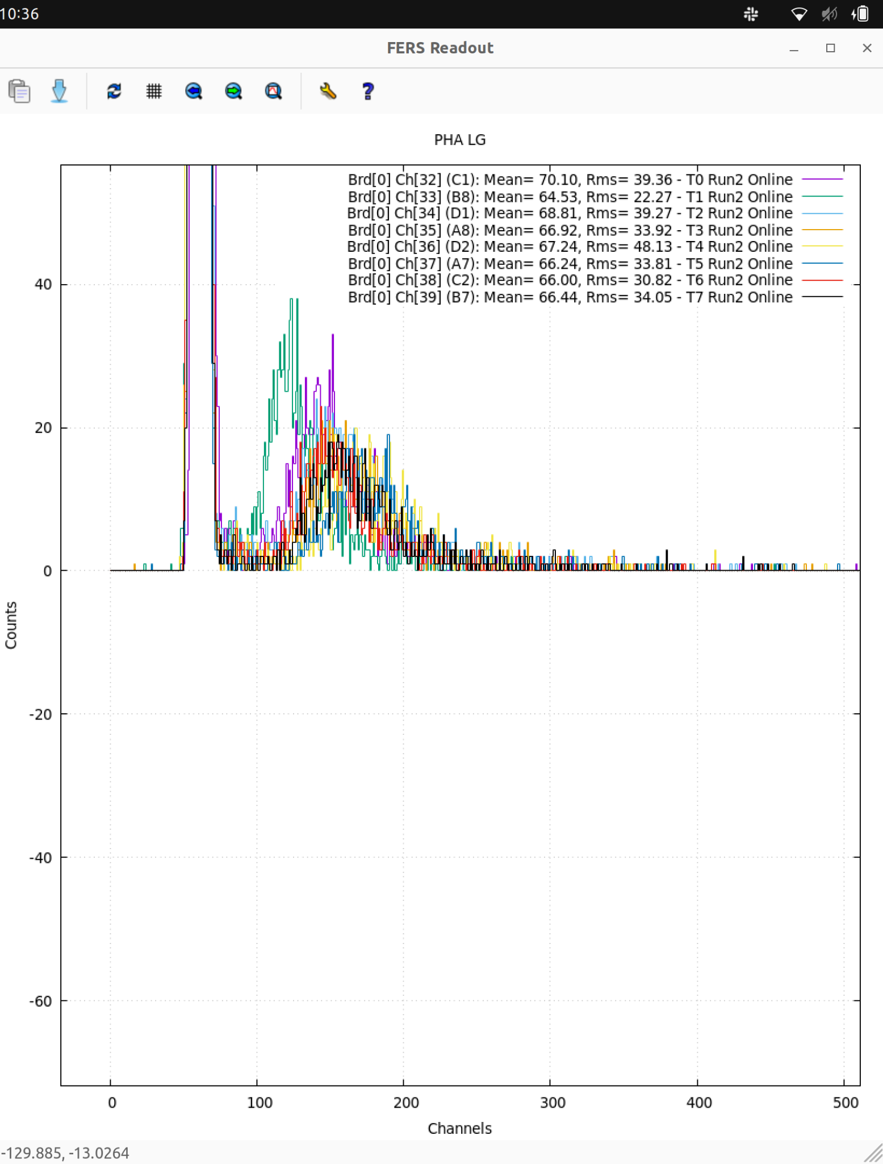
1D & 2D Visualization
Collection of minimum ionizing particle Muons that triggers at least four SiPM channels.

Slide 6
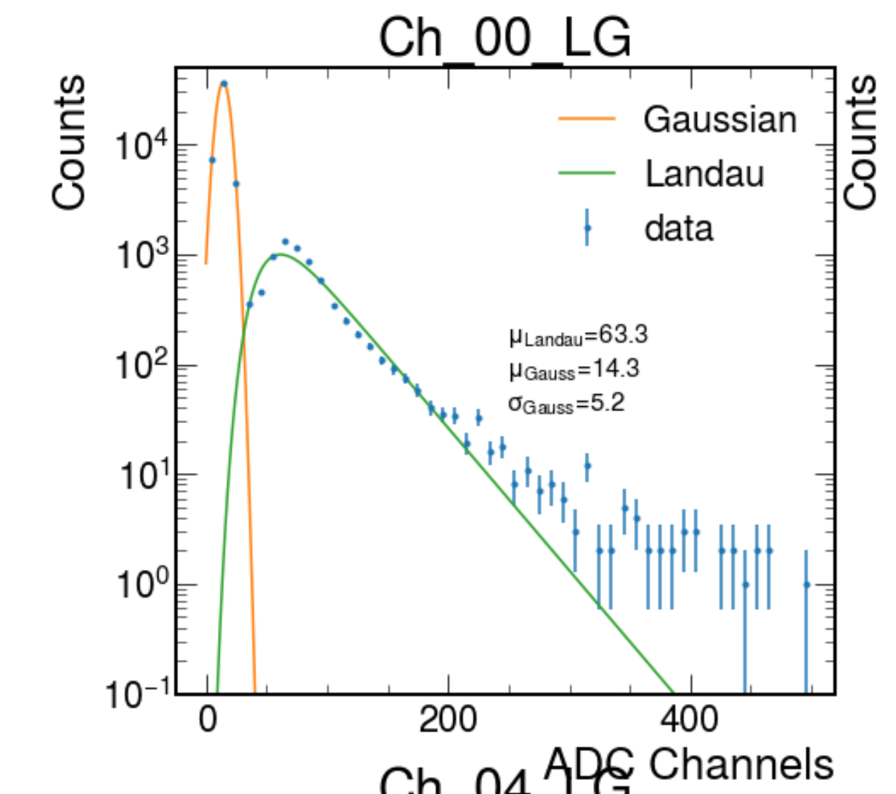
Signal Channel Readout
Fit pedestal to Gaussian
Fit data to Landau
Extract peak value as MIP value
Subtract Gaussian from Landau

Slide 7
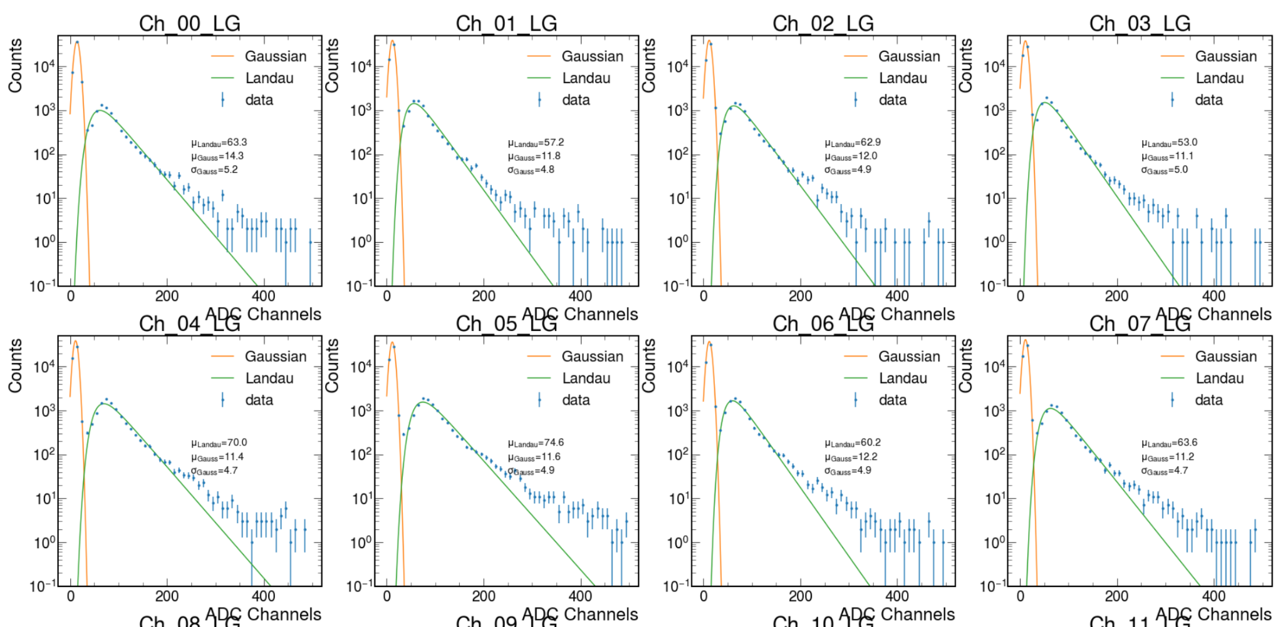
Cosmic Ray Events

Slide 8
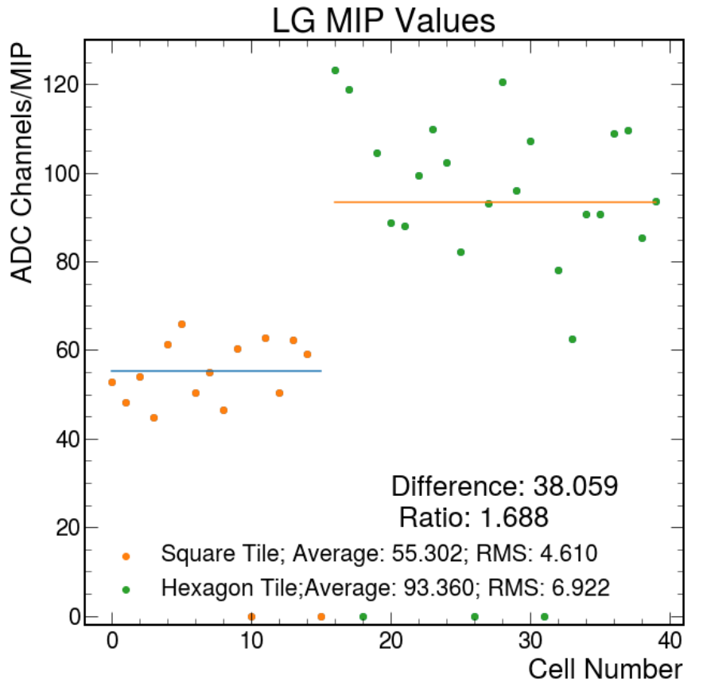
Single MIP per ADC Channels
Difference in tile shape (square/hexagon) yields different MIP values
If not accounted for channel to channel variation, it can degrade the resolution of the calorimeter system

Slide 9
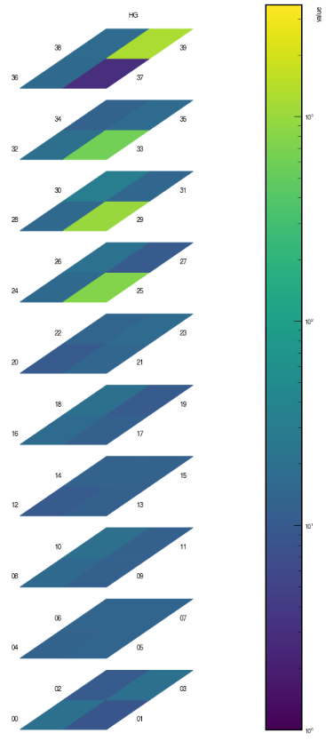
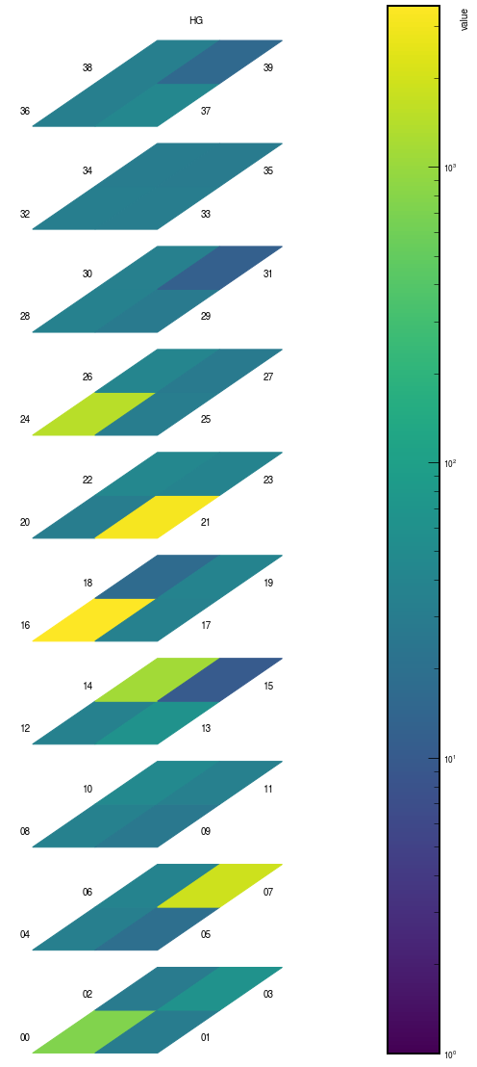
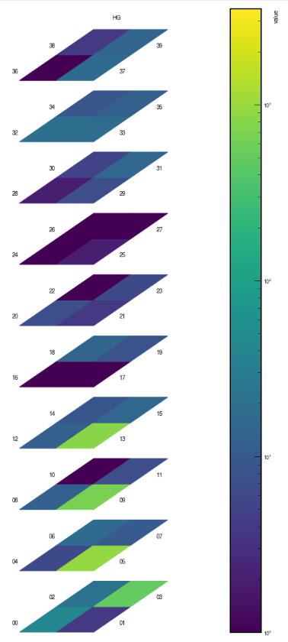
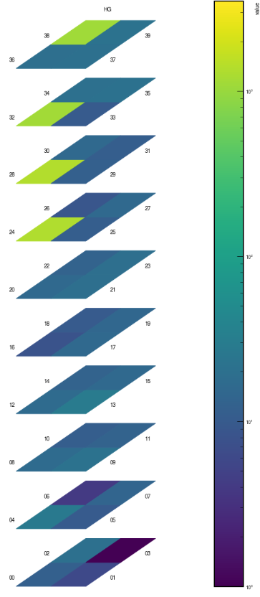
2D Cosmic Ray Event

Slide 10
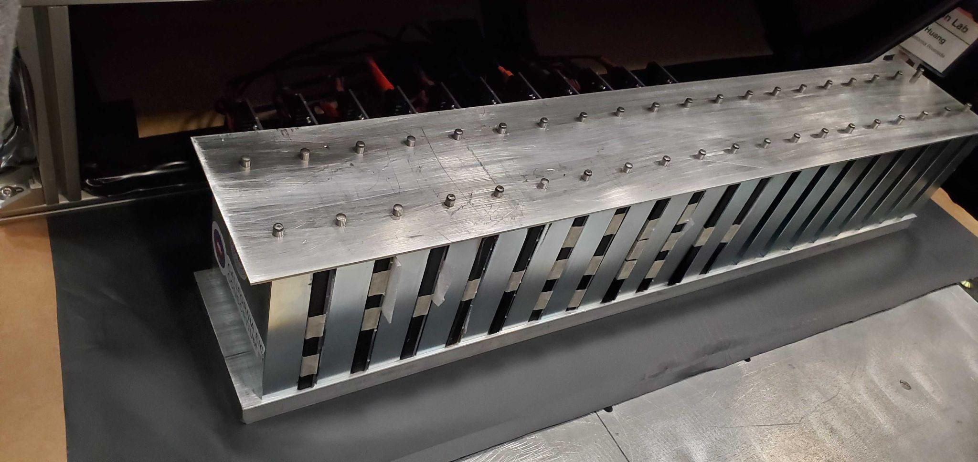
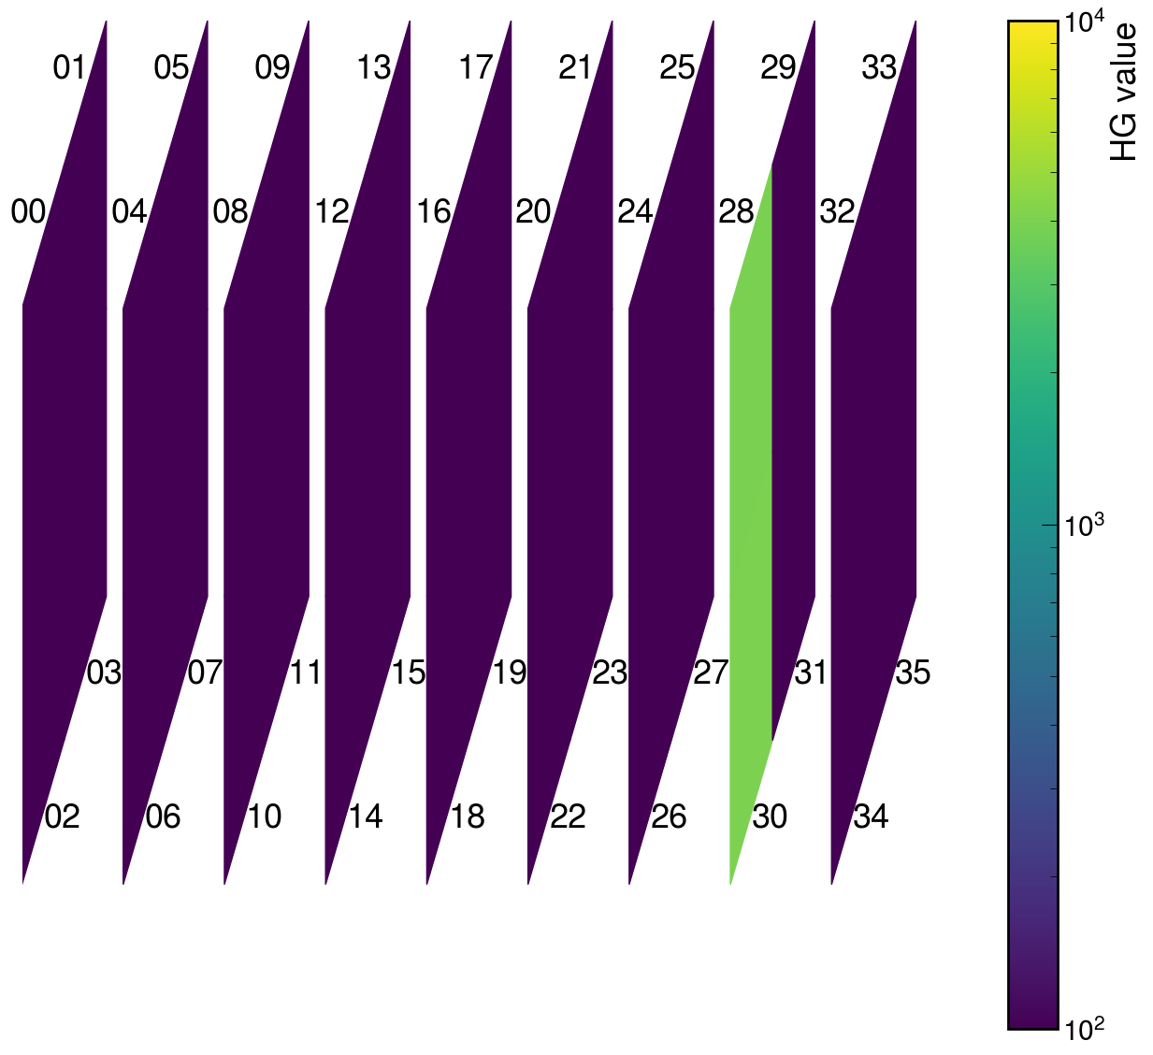
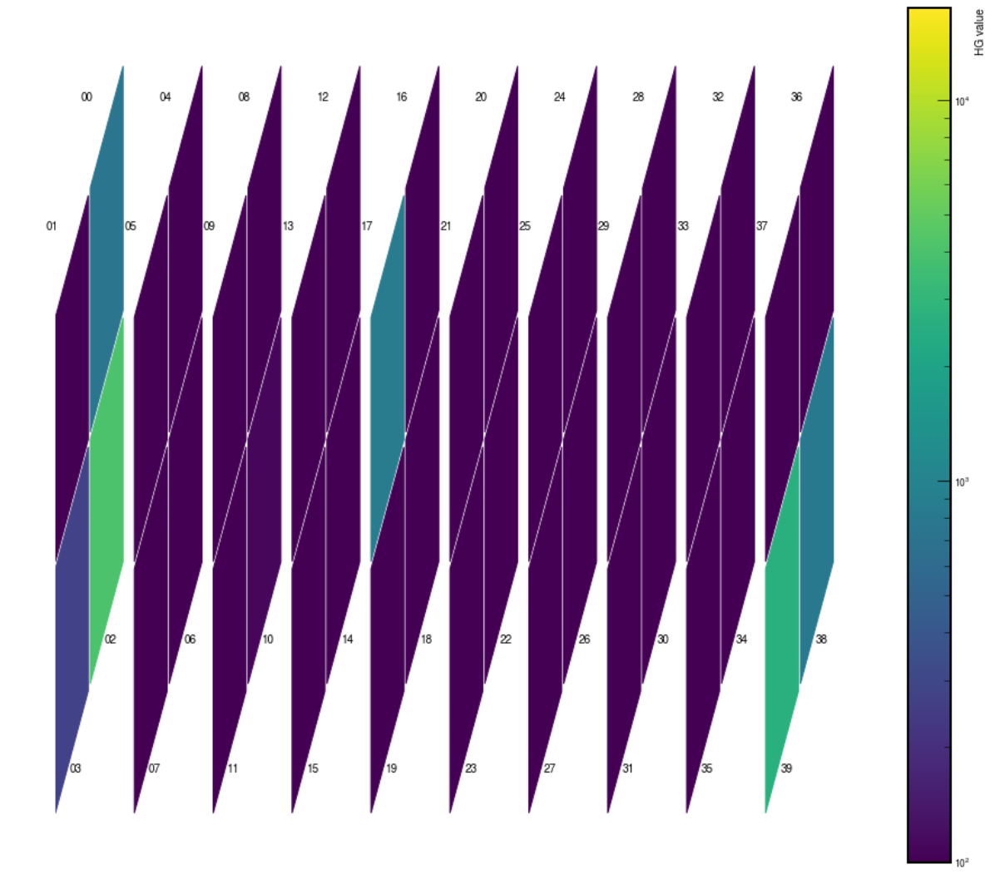
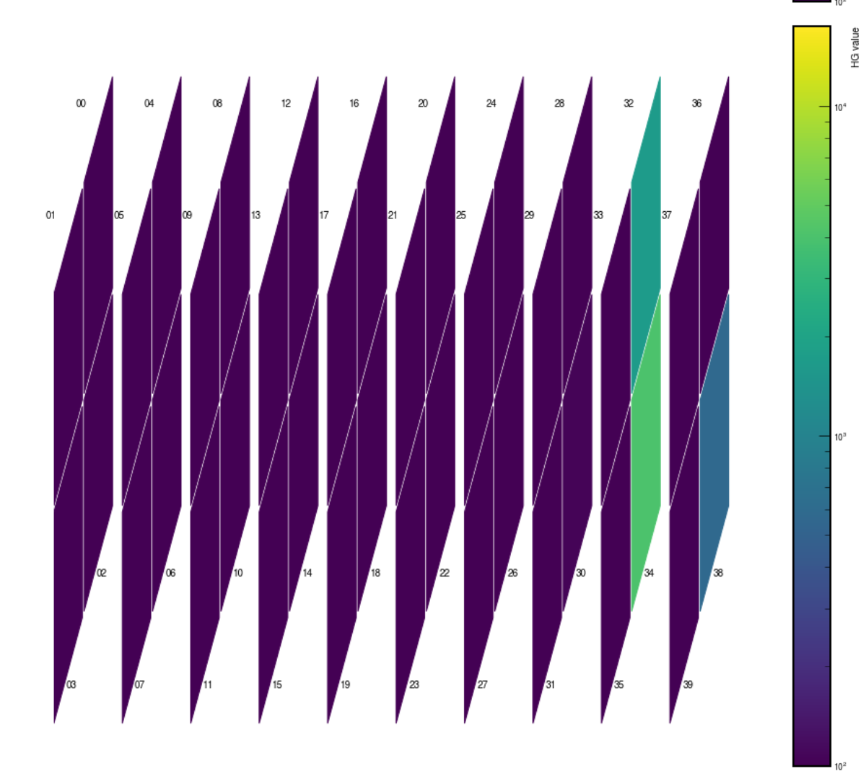
Hall D Prototype
Data collection of detector in horizontal position in progress.

Slide 11
Conclusion
Capable of collecting beam data
MIP value for individual cells
Used to calibrate the energy measurement of the detector for each cell independently

