Slide 1
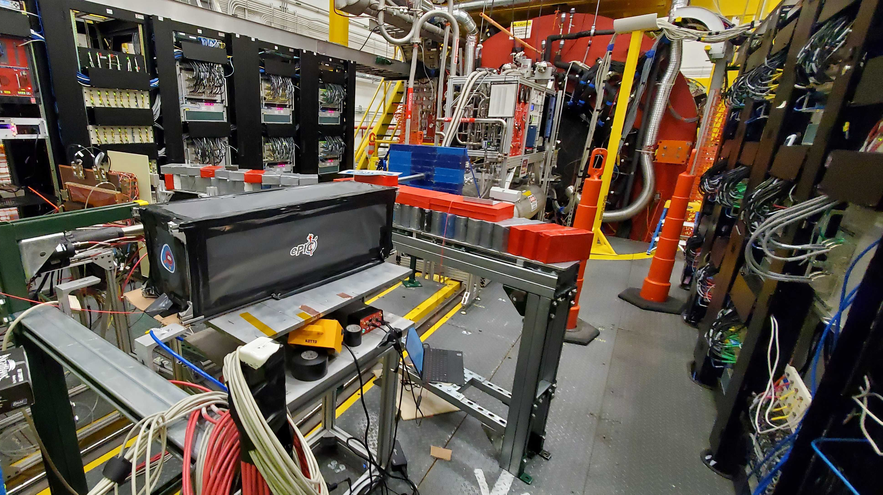
Results of first test beam of calorimeter insert at JLab
Sean Preins
1/28/2023

Slide 2
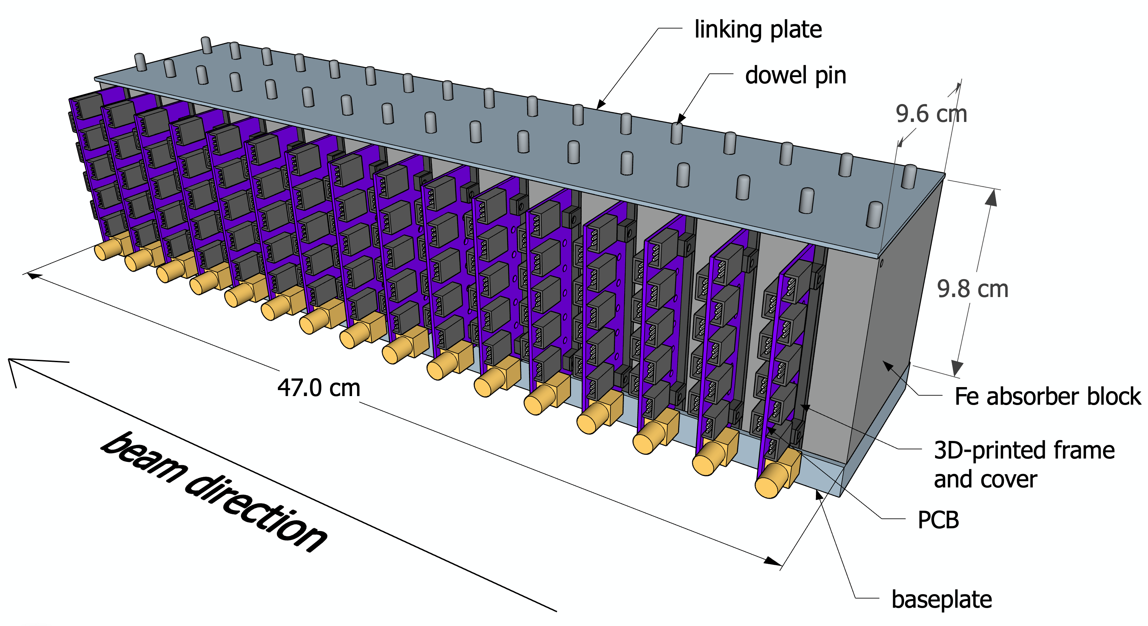
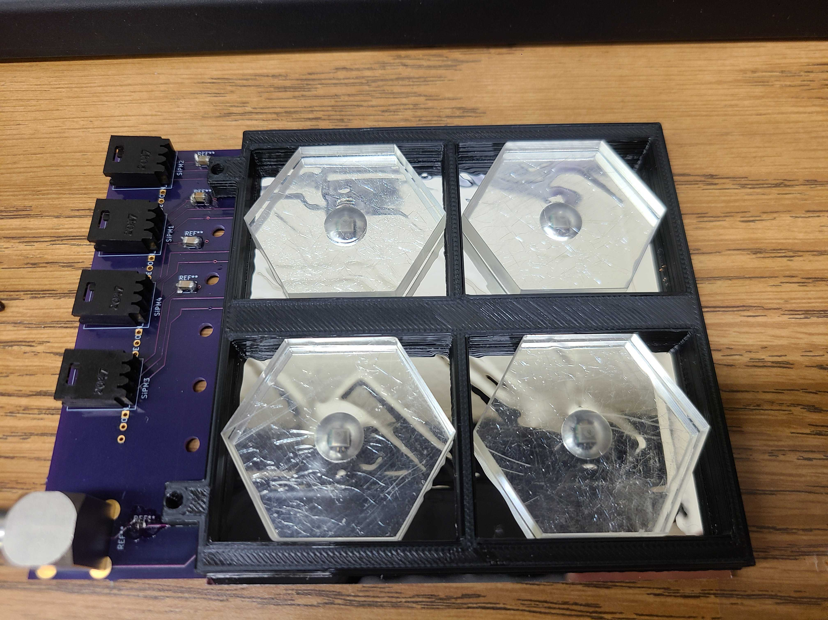
Operating Prototype Specs
Characterize components, work as proof of concept
Consists of 10 layers, each subdivided into four scintillating tile cells (40 channels)
Effectively 11.4 radiation lengths long
Cross sectional area of 2x2 Moliere radii

Slide 3
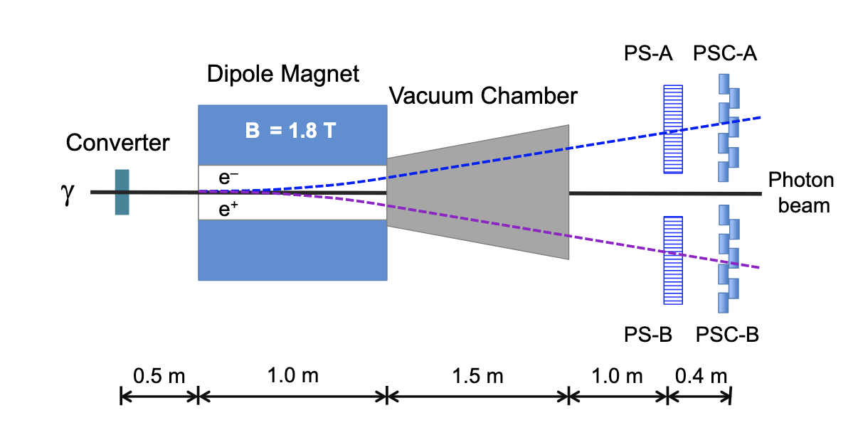
Hall D Beam Characteristics
The prototype is situated in front of the Hall D pair spectrometer, off the beamline
It receives ~4 GeV positrons at a variable luminosity (maximum of ~3 kHz)
Coordinating with GlueX to synchronize data acquisition with a beam rate scan
Prototype

Slide 4
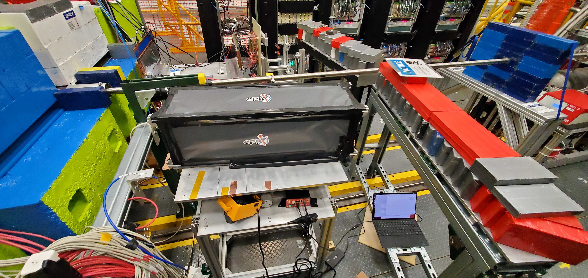
DAQ Setup
Detector
CAEN Unit
DAQ Laptop
Remote Laptop
Internet
(VNC Viewer)

Slide 5
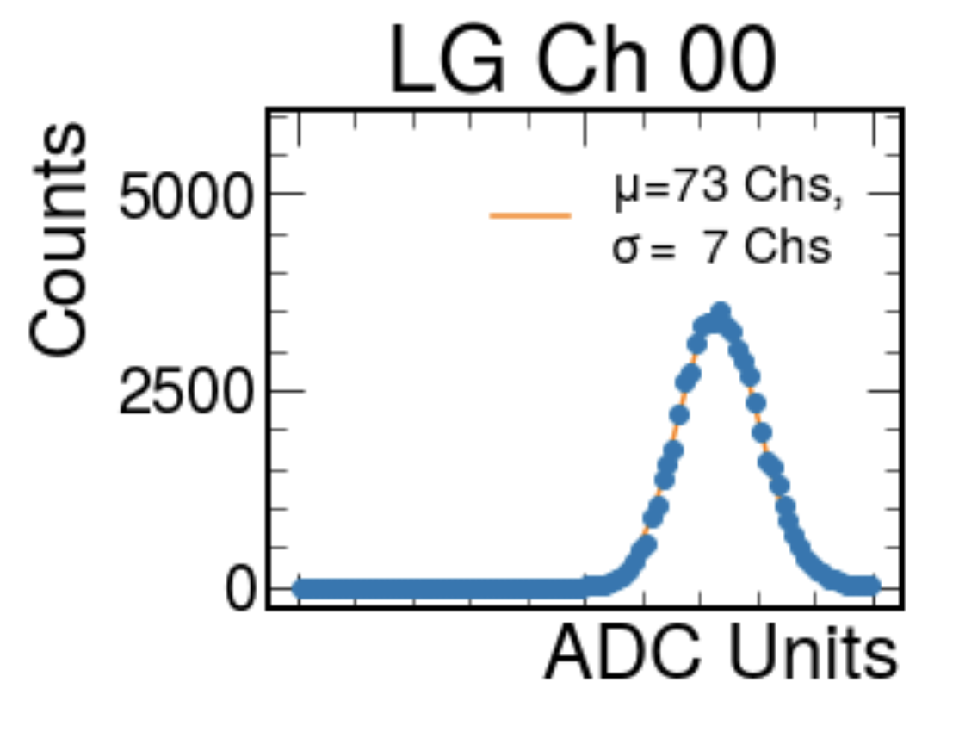
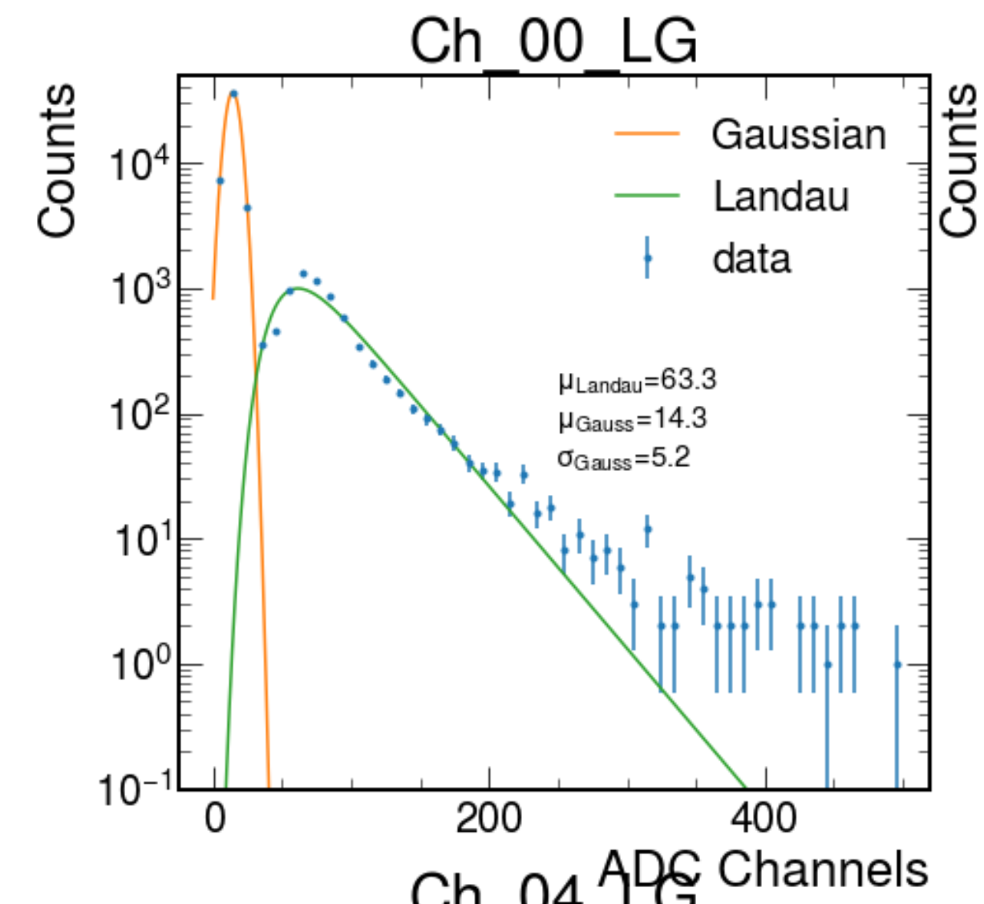
Data Acquisition Procedure
Decide on CAEN settings
Record cosmic rays to determine how to convert between ADC Channels and MIPs
Record noise data from random triggers to determine the pedestal position and width for each channel
Apply pedestal cuts to all data going forward
Record beam data, sum the total energy per event, and the layer-by-layer breakdown

Slide 6
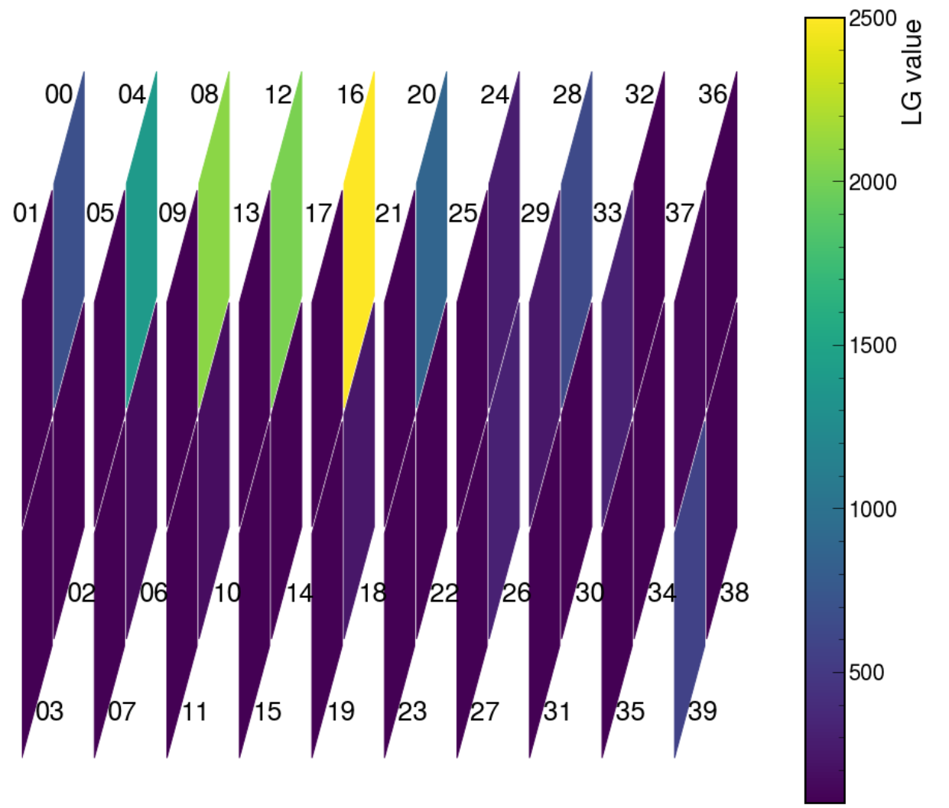
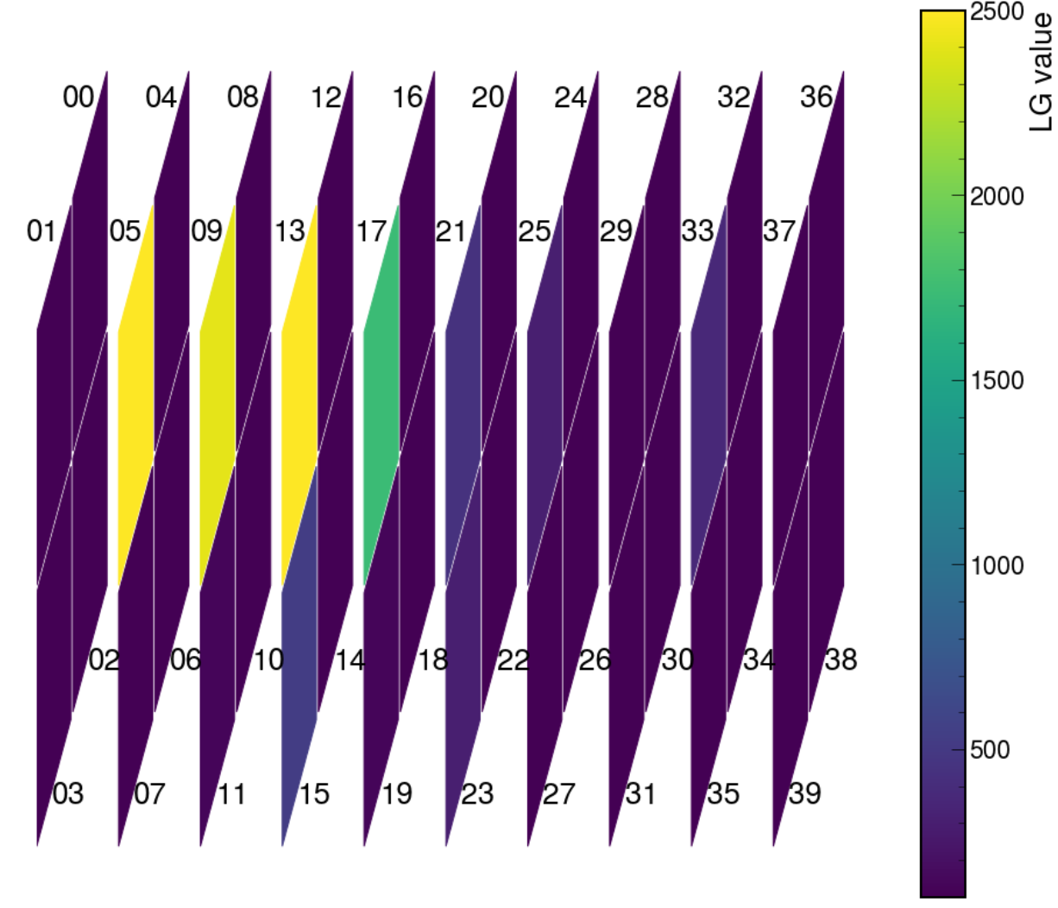
Single Events
We generally see only the top two rows show beam-like events
Our detector was likely positioned slightly low relative to the beamline (can be adjusted)

Slide 7
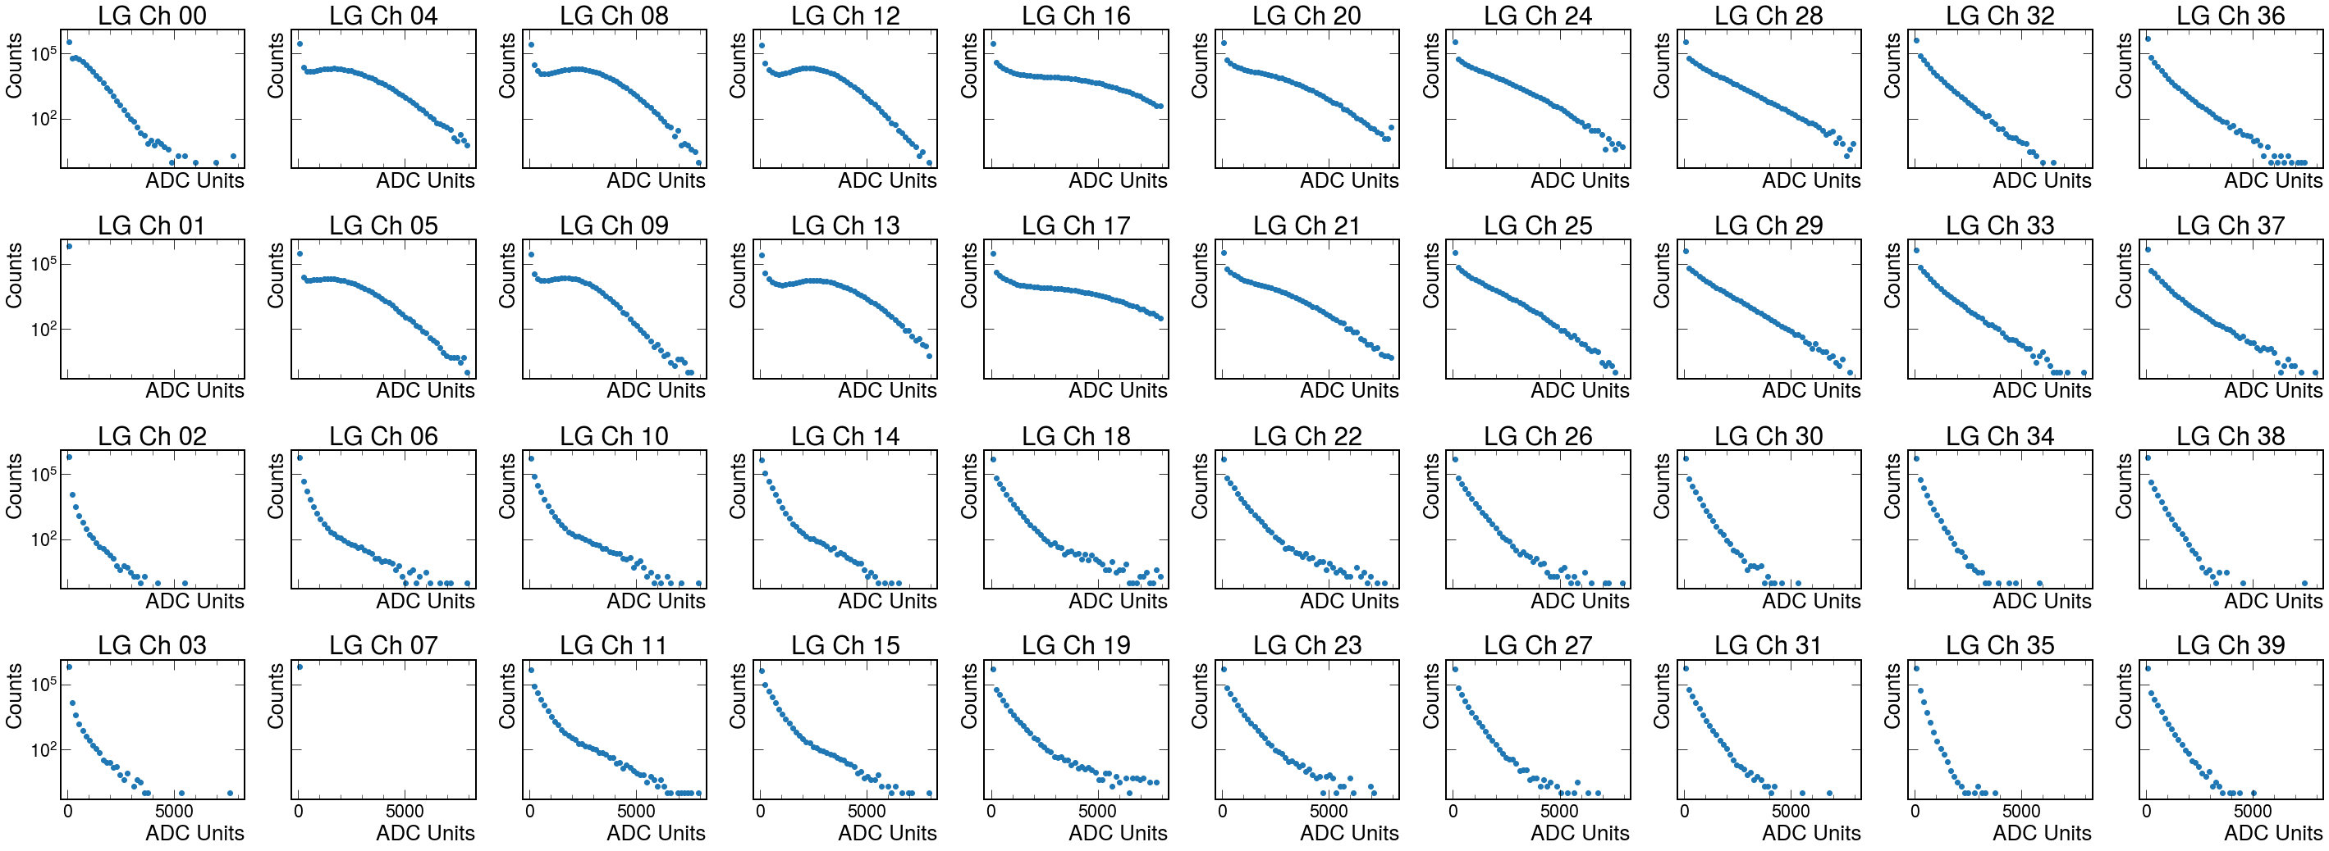
Channel Energy
Beam

Slide 8
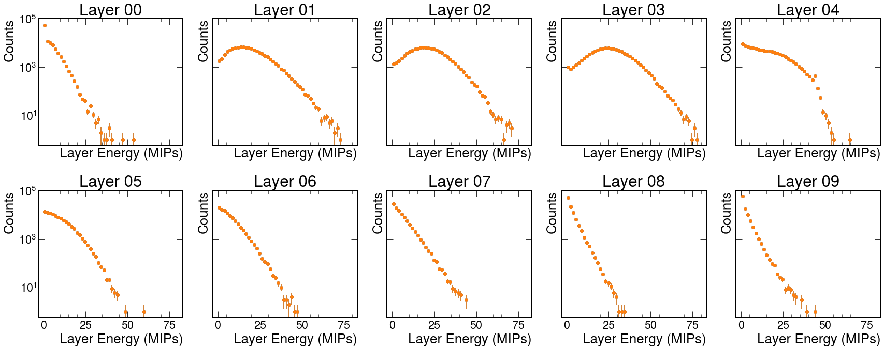
Layer Energy

Slide 9
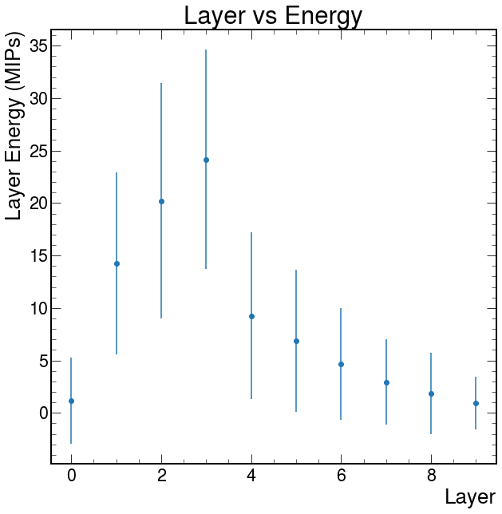
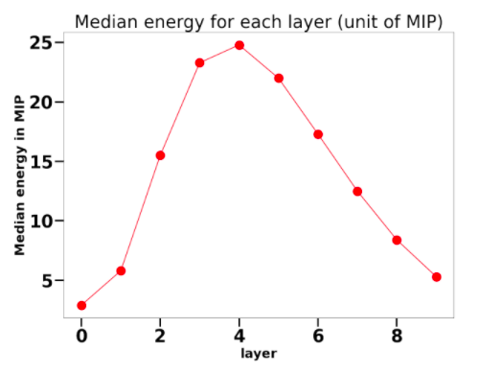
Test Beam
Simulation
The energy profile trend is promising, and will likely be improved
The first four layers and last six use different cell shapes, which may explain the discontinuity

Slide 10
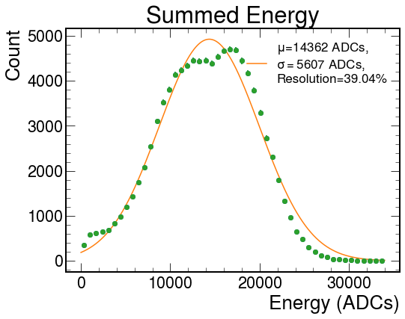
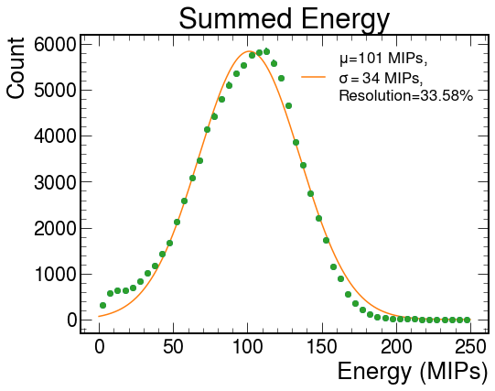
Total Energy
Uncalibrated
Calibrated
Calibrating each channel improves the energy resolution a significant amount, but there is room for improvement...

Slide 11
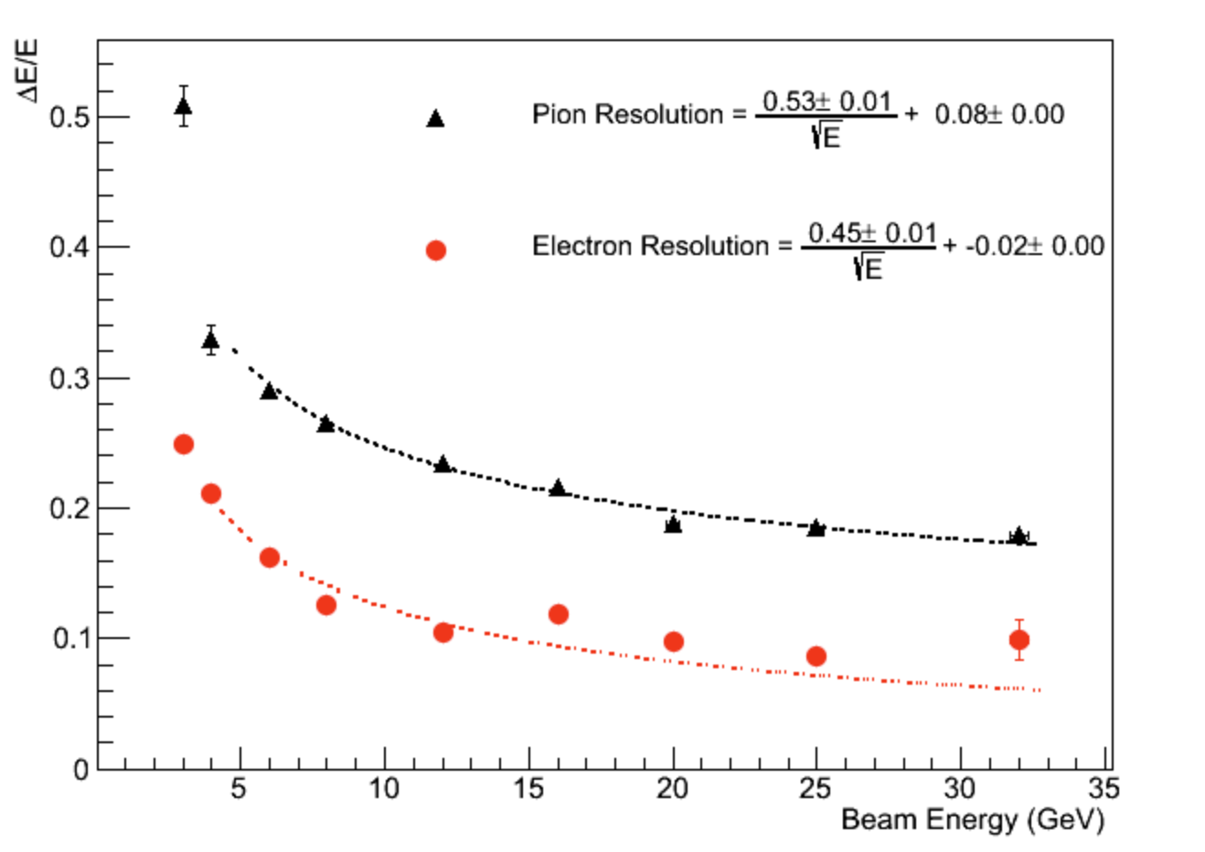
Relatively poor electron resolution when compared with a recent UCLA Pb/Sc calorimeter test beam
Several possible reasons, several fixes!
Hexagonal cells have a large amount of dead space between them
Many events may not be horizontally contained
Scintillating tiles may not be optically ideal
MIP values may need recalibration in its current configuration

Slide 12
To Do
Collect enough cosmic ray data during beam-off time to generate more accurate MIP values for each channel
Continue to refine the CAEN settings to find the most appropriate gain and threshold settings for both beam and cosmic ray data
Upgrade the prototype (add trigger layer, fix dead cells, add layers, increase granularity...)
Continue to improve and characterize detector components (create more robust cables, investigate light yield from different cell shapes, etc.)
Prepare for new test beams! Hall B, Fermilab, Brookhaven

Slide 13
