Slide 1
EIC Polarimetry Summary
Oleg Eyser (BNL) and Dave Gaskell (JLAB)
ePIC Meeting
January 26, 2023

Slide 2
EIC Polarimetry Technical Status Review
Review took place virtually: Jan. 17-18
Committee:
Dipangkar Dutta (Mississippi State University)
Jenny List (DESY)
Paolo Lenisa (Ferrara University)
Frank Rathmann (Ju ̈lich)

Slide 3
Agenda
Tuesday, Jan. 17
08:00-08:30 Executive Session
08:30-09:00 Welcome and Introduction to the EIC Project (Elke Aschenauer and Rolf Ent)
09:00-09:30 Polarized Beams at the EIC (Vadim Ptitsyn)
09:30-10:10 Hadron Polarimetry Overview (Oleg Eyser)
10:10-10:40 R&D for Hadron Polarimetry (Bill Schmidke)
10:40-11:00 Break
11:00-11:40 Electron Polarimetry Overview (Dave Gaskell)
11:40-12:10 Backgrounds for Compton Polarimetry (Mike Sullivan)
12:10-12:40 Laser System for Compton Polarimetry (Ciprian Gal)
Wednesday, Jan. 18
09:00-11:30 Executive Session
11:30-12:00 Closeout

Slide 4
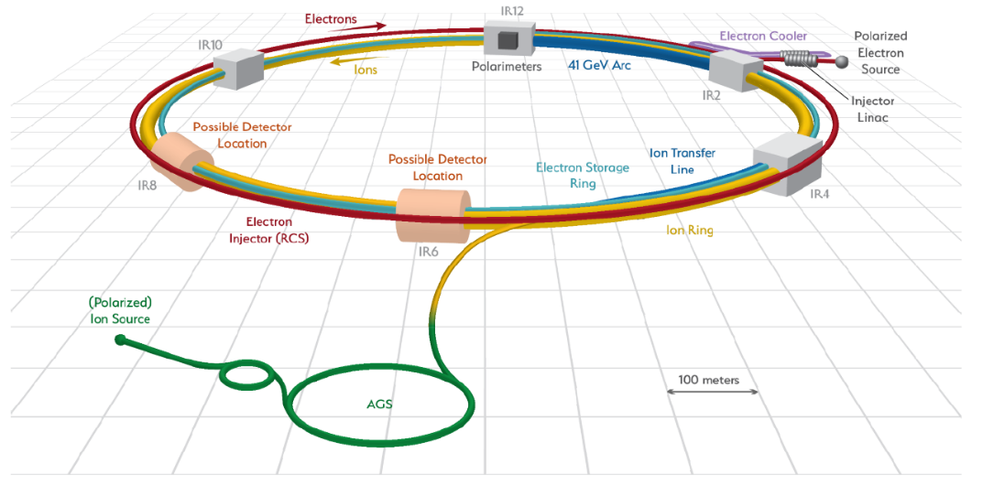
Hadron Polarimetry
IR-4
Hadron polarimetry
HJET for absolute polarization
pC for time dependence and bunch profile
IR-6
Local polarimetry
pC for hadron polarization orientation
Compton backscattering for electron polarization
Hadron polarimetry only measures transverse spin asymmetries.
Oleg Eyser

Slide 5
IR-4 Layout
RCS
ESR
Sector 4
Sector 3
HSR Q4
D0 replacement
dipole
HSR Triplet
3X HSR 98 MHz
10X Kickers
Hadron Storage Ring
Tagger location & drift space
→ W. Schmidke’s presentation
HJET
Carbon polarimeter
Choice of location driven by size of HJET setup and the following drift space
Oleg Eyser

Slide 6
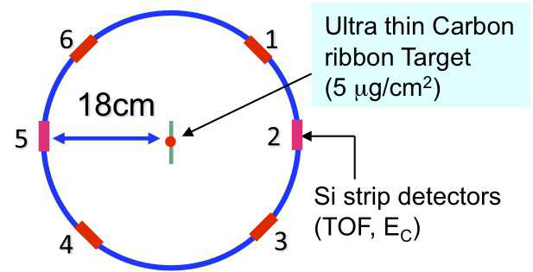
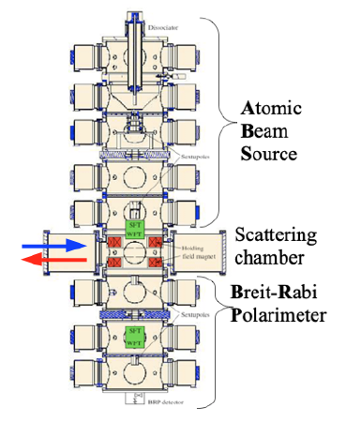
Hadron Polarimetry
Hadron polarization measured via transverse single-spin asymmetry
p-carbon provides fast, relative measurement
H-Jet provides absolute calibration

Slide 7
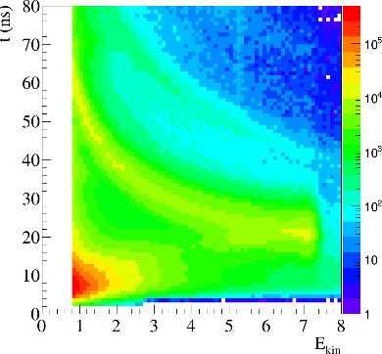
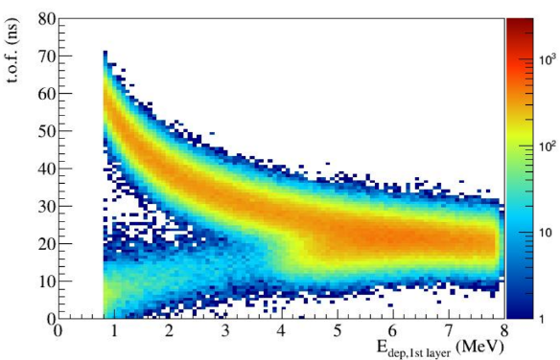
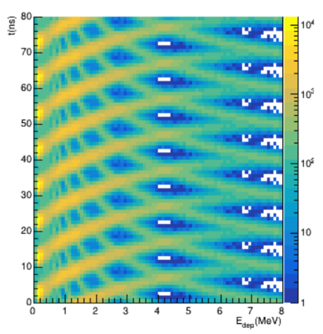
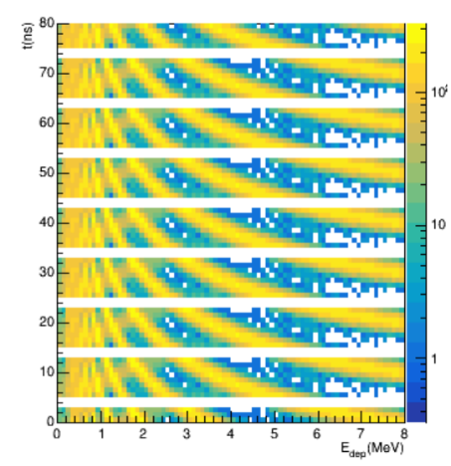
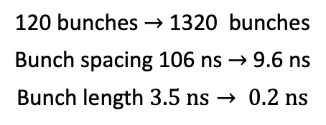
From RHIC to EIC
RHIC Data
Simulation (PYTHIA+GEANT4)
Bunch length
Detector resolution
120 bunches $→$ 1320 bunches
Bunch spacing 106 ns $→$ 9.6 ns
Bunch length $3.5 \text{ns}→ 0.2 \text{ns}$
Signal from recoil protons and punch-through particles overlap from different bunches
Veto punch-through with second detector layer
  see W. Schmidke’s presentation
Oleg Eyser
7

Slide 8
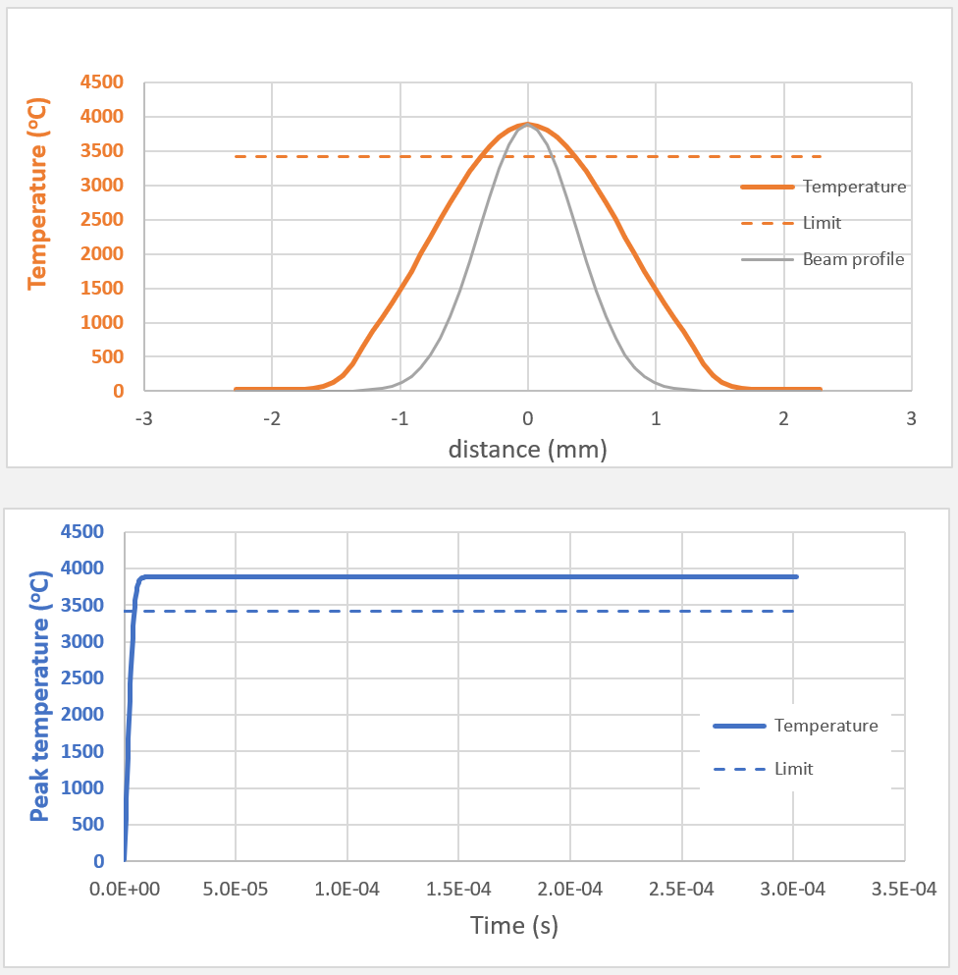
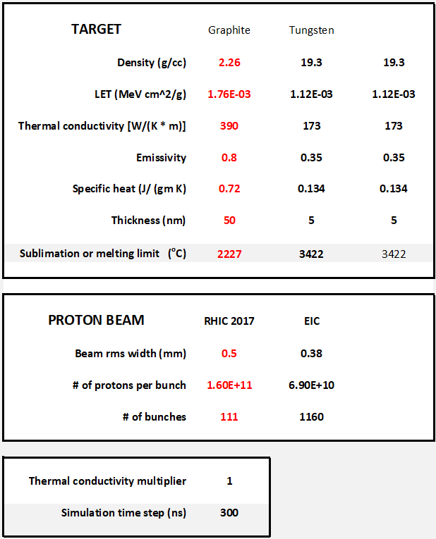
Beam Heating of Target Material
*Calculation by Peter Thieberger
EIC conditions
Oleg Eyser

Slide 9
Hadron Polarimetry R&D - Backgrounds
Use multi-layer detectors to tag fast, high energy particles → backgrounds
→ Reduce reliance on time-adc correlation
Present detectors too thick
Bill Schmidke

Slide 10
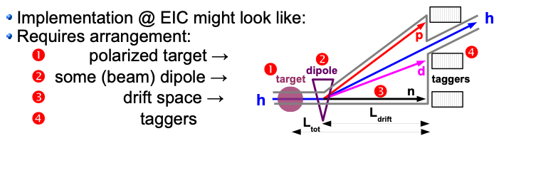
Hadron Polarimetry R&D - Tagging
For ³He, breakup will contaminate elastic signal → tag p, n, d to reject breakup
Bill Schmidke

Slide 11
Electron Polarimetry
Mott Polarimeters
Rapid Cycling Synchrotron Compton polarimeter
Electron Storage Ring Compton polarimeter

Slide 12
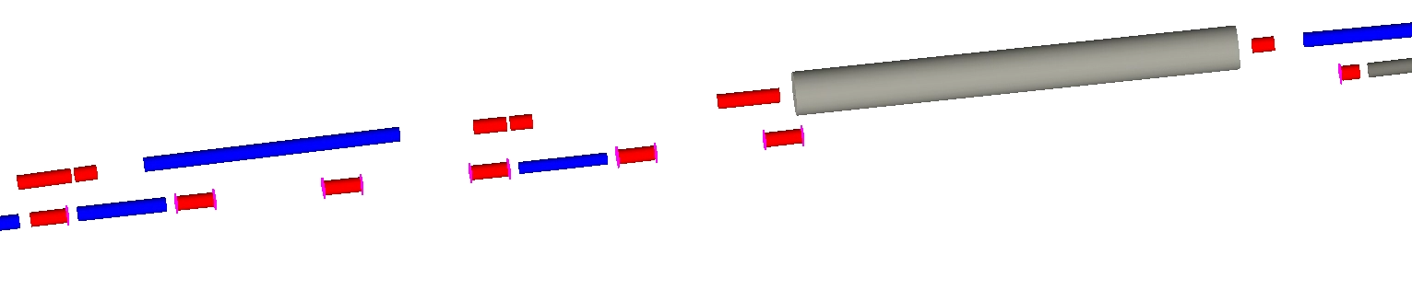
ESR Compton Polarimeter
Quads
Dipoles
Hadron beamline
electron beamline
laser
Compton IP (before quad)
Electron detector
Photon detector
ESR Compton will be upstream of detector IP
Key components:
Laser system → single-shot laser, pulsed at bunch frequency (25 or 100 MHz)
Position sensitive electron detector → placed after dipole and horizontally defocusing quad (diamond strip detector)
Photon detector → calorimeter (tungsten powder, looking into PbWO4 or BaF2) + position sensitive detector (diamond strip)

Slide 13
Polarization components at ESR Compton
At Compton interaction point, electrons have both longitudinal and transverse (horizontal) components
Longitudinal polarization measured via asymmetry as a function of backscattered photon/scattered electron energy
Transverse polarization from left-right asymmetry
Beam energy | P_{L} | P_{T}
5 GeV | 96.5% | 26.1%
10 GeV | 86.4% | 50.4%
18 GeV | 58.1% | 81.4%
Beam polarization will be fully longitudinal at detector IP, but accurate measurement of absolute polarization will require simultaneous measurement of P_{L} and P_{T} at Compton polarimeter

Slide 14
RCS Compton Polarimeter
IP 6
RCS electrons
Quads
Dipoles
Laser IP
Photon detector
Measurement times:
Assuming off-the-shelf, low duty cycle laser (example: RPMC lasers: 30 mJ at 2 Hz)
E_{beam} | <A²> | T_{1%}
5 | 5.48% | 164 s
10 | 9.56% | 61 s
18 | 13.96% | 33 s
On average, 10,000 backscattered photons/bunch
Simple MC used to verify measurement time
Need position sensitive detector operating in multiphoton-mode

Slide 16
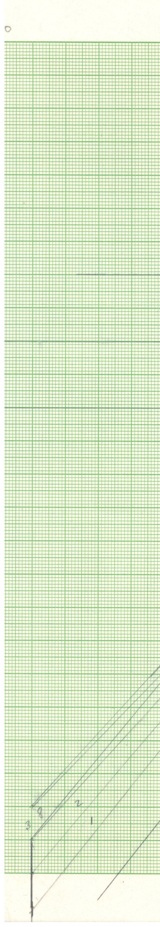
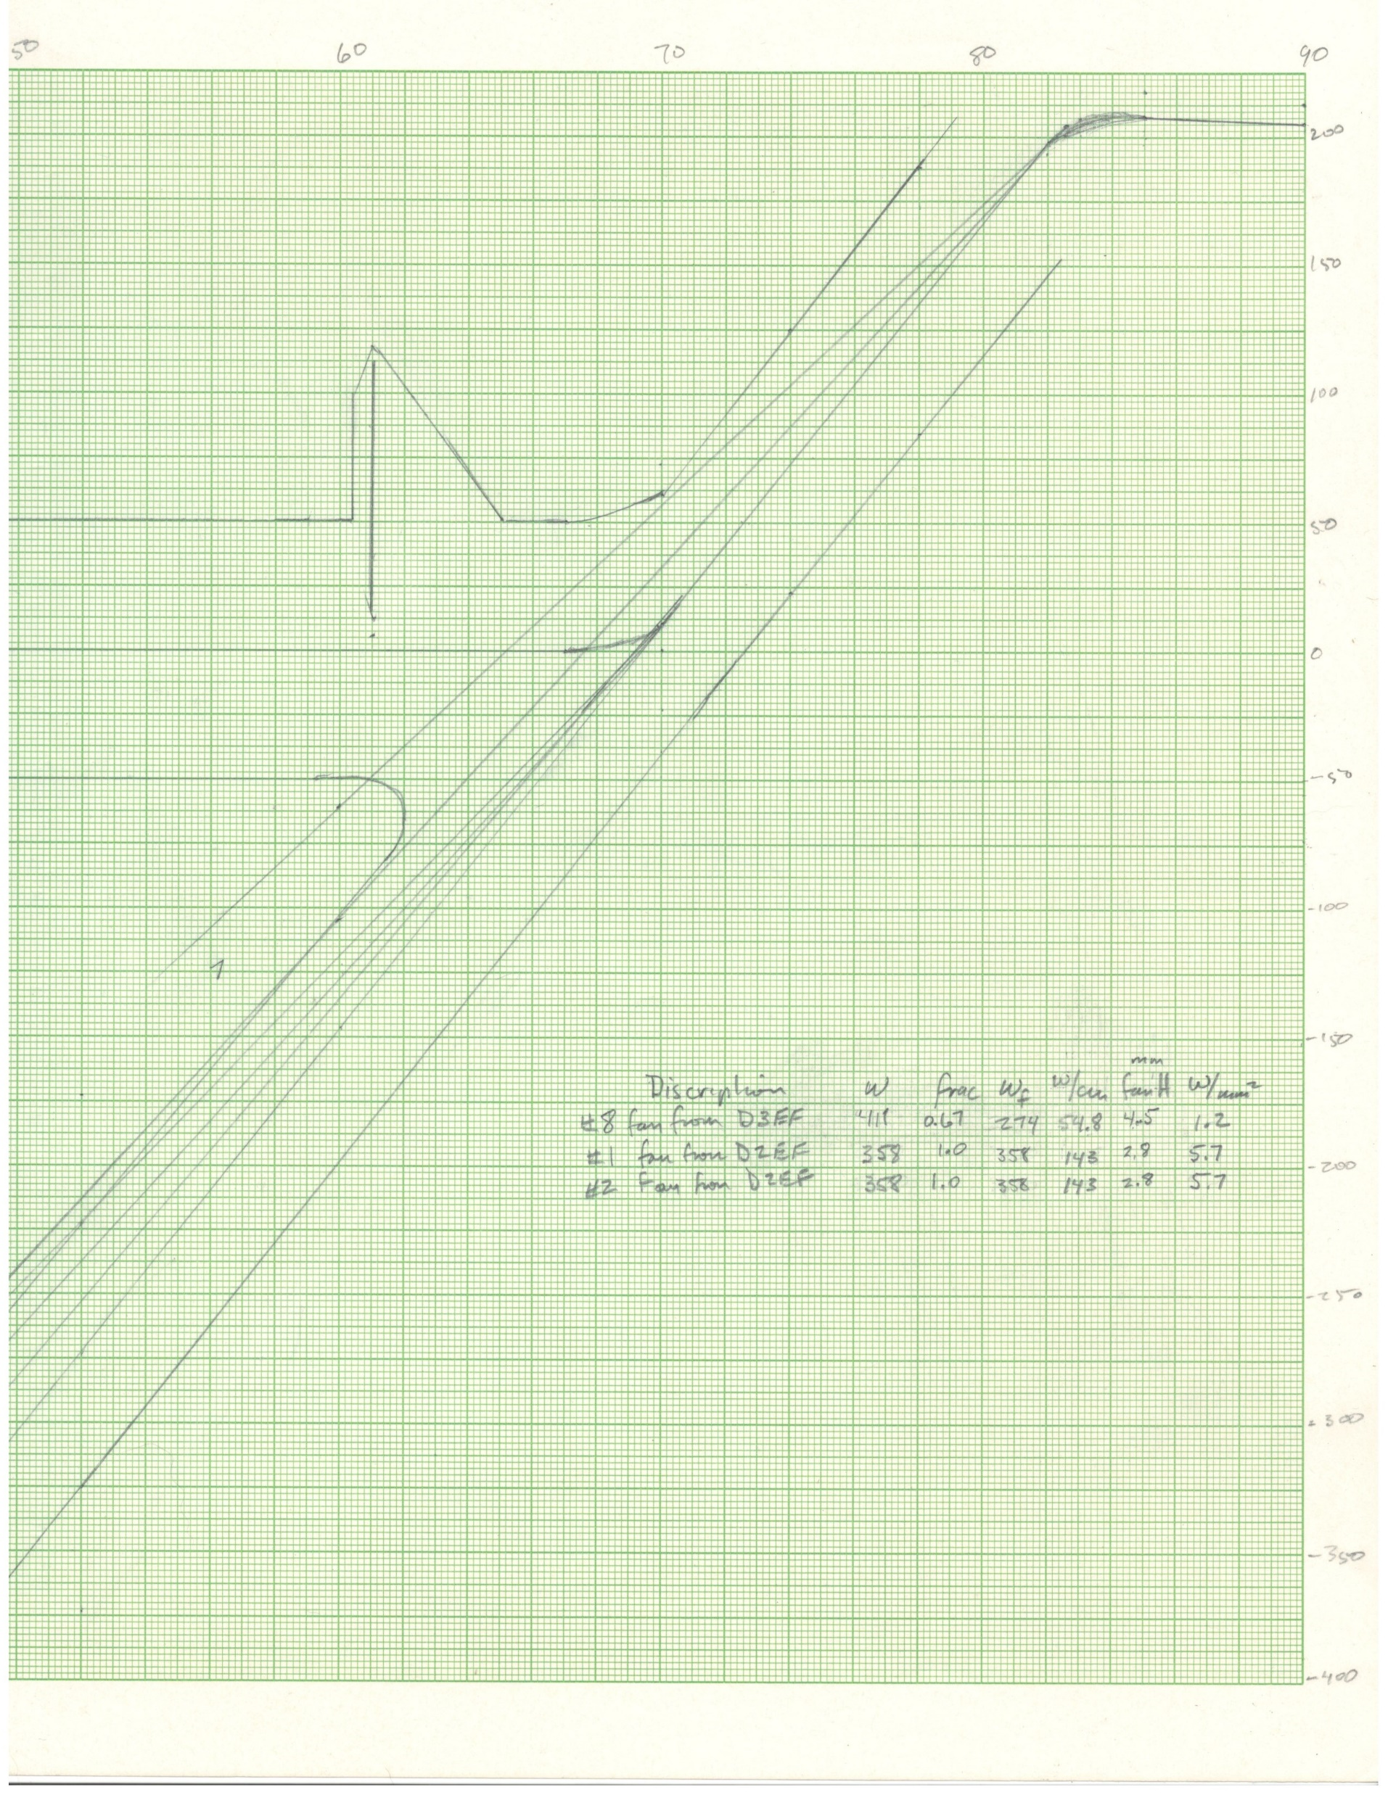
Backgrounds
Estimated synchrotron power on backscattered photon exit window
18 GeV
From D3: 12.2 W/mm²
From D2: 55.0 W/mm²
10 GeV
From D3: 10.5 W/mm²
From D2: 44.0 W/mm²
Synchrotron radiation on electron detector relatively small
→ May need RF shield
10 m
Electron detector
D3
D1 and IP
10 cm
D2
Laser interaction
Photon detector
16
Mike Sullivan

Slide 17
Summary of recommendations
H-Jet → target gas analyzer should be installed, pursue thinner silicon detector
p-Carbon → explore larger beam size, thinner silicon detectors, pursue further R&D at AGS
³He polarimetry → theoretical assessment of analyzing power, pursue R&D during remaining RHIC run
ESR Compton → alternate silicon detector (diamond), detailed simulations of polarimeter region, explore use of synchrotron radiation for transverse polarization
RCS Compton → detailed study of detector requirements for multi-photon mode

Slide 20
Extra

Slide 21
Recommendations (Hadron Polarimetry)
HJET polarimeter:
  A target gas analyzer, i.e., a quadrupole mass spectrometer should be installed to be able to determine the molecular fraction in the jet beam.
  The option of using thinner SI detectors should be investigated, as this allows to veto punch through events more efficiently.
pC polarimetry:
  Besides further investigation of other potential target materials, the possibilities to mitigate the issue by increasing the beam size through reduced focusing at the IR4 should be studied.
  As already mentioned in the section on the HJET, also here the option of using thinner SI detectors should be investigated, as this allows to veto punch through events more efficiently.
  As an additional pC polarimeter is installed in the AGS, an effort should be made to obtain beam time at the AGS for further R&D studies to test and improve the SI detectors.

Slide 22
Recommendations (Hadron Polarimetry)
³He polarimetry:
  It would be useful to have available a theoretical assessment of hh elastic analyzing power and cross sections, and further information on feasibility/simulation studies for 3He polarimetry.
  We encourage further studies regarding 3He polarimetry R&D during the remaining RHIC runs.

Slide 23
Recommendations (Electron Polarimetry)
ESR Polarimetry
  An alternative detector concept based on Silicon strip detector should be developed.
  Perform detailed simulation studies of the polarimeter region including background, shielding, rf shielding, etc. Once available, the design should be reviewed again.
  Explore transverse polarization measurement with spin-dependent synchrotron radiation using the existing ESR lattice.
RCS Polarimetry
  Carry out a detailed study of the detector requirements to measure the transverse polarization in multi-photon mode in the RCS from different bunches.
  The RCS polarimeter may be the ideal place to exploit spin-dependent synchrotron radiation.

Slide 24
HJET Polarimeter
Findings
  After RHIC shutdown in 06/2025, the existing HJET will be moved from IR-12 to IR-4.
Comments/Concerns
  The plans presented for refurbishing elements and upgrading the detector readout appear sound.
  The issue that signals from recoil protons and punch-through particles overlap from different bunches can be addressed by adding a second detector layer.
  Thought should be given to upgrade the magnetic holding field system of the HJET to enable also measurements with sideways and/or longitudinal target polarization. This may provide a unique opportunity to truly determine all components of the beam polarization vector p⃗ at one location in the EIC.
Recommendations
  A target gas analyzer, i.e., a quadrupole mass spectrometer should be installed to be able to determine the molecular fraction in the jet beam.
  The option of using thinner SI detectors should be investigated, as this allows to veto punch through events more efficiently.

Slide 25
pC polarimetry:
Findings
  The two available pC polarimeters (double and single chambers) will be relocated after RHIC shutdown to IR 4 and IR 6.
Comments/Concerns
  In particular the placement of a pC polarimeter in front of the main detector at IR 6 is highly appreciated, as this allows to study the beam spin evolution of the transverse components (px andpy)fromIR4toIR6.
  Due to the higher beam current at EIC compared to RHIC, heating of the C fiber targets beyond the sublimation temperature is a concern.
  As already mentioned above regarding the HJET, also here the issue that signals from recoil protons and punch-through particles overlap from different bunches can be addressed by adding a second detector layer.
Recommendations
  Besides further investigation of other potential target materials, the possibilities to mitigate the issue by increasing the beam size through reduced focusing at the IR4 should be studied.
  As already mention in the section on the HJET, also here the option of using thinner SI detectors should be investigated, as this allows to veto punch through events more efficiently.
  As an additional pC polarimeter is installed in the AGS, an effort should be made to obtain beam time at the AGS for further R&D studies to test and improve the SI detectors.

Slide 26
³He polarimetry:
Findings
  Absolute polarimetry requires detection of elastic scattering, i.e., here 3He - 3He scattering. The calibration would entail using in a first step a polarized 3He target and to measure the analyzing powers and cross sections of the elastic process. Once this is established, 3He (h) beam polarimetry can be performed on an unpolarized 3He target.
  The issue is to find out how to veto the inelastic reactions involving breakup of h, i.e., hh → h + dp or hh → h + npp. The available detectors at the pC polarimeters lack the resolution to distinguish elastic hh from hh involving breakup.
  The concept presented for the EIC would rely on the use of an additional dipole magnet and a drift space.
  A test has been performed using Taggers installed near the HJET, and beam HJET target interactions were observed.
Comments/Concerns
  The development of 3He polarimetry is not yet as advanced as the one for protons or electrons. In addition, information about the performance requirements appear to be missing.
Recommendations
  It would be useful to have available a theoretical assessment of hh elastic analyzing power and cross sections, and further information on feasibility/simulation studies for 3He polarimetry.
  We encourage further studies regarding 3He polarimetry R&D during the remaining RHIC runs.

Slide 27
(Deuteron beams):
Comments/Concerns:
  Albeit not being part of the baseline, the work on the polarized deuteron source should not be postponed too much, as the international expertise is likely to fade away during the next years.
  The polarimetry for d beams needs to be addressed.

Slide 28
ESR polarimetry
Findings
  The longitudinal polarimeter planning and design is advanced and in good shape. Some of the details of the implementation into the electron ring needs to be worked out.
  The detector concept for the longitudinal polarimeter has been chosen and the design of the laser system needs to be tested and implemented.
  The detector concept for the transverse polarimeter is not yet well defined.
  The planned program on the laser transport and diagnostics is excellent, beyond the application in the EIC polarimeter.
Comments/Concerns
  The chosen detector concept using diamond strip detectors appears reasonable, but unlike silicon, the commercial availability may be more challenging.
  R&D on the laser transport and diagnostics should be continued and fully supported with personnel and financial resources.
  The implementation of the polarimeter system in the electron ring of EIC appears to be more challenging compared to JLAB, also regarding synchrotron power and rf loading.
  The transverse polarimetry detector requires both more simulations and R&D.
  The cost estimates shown seem reasonable for this stage of the project.
Recommendations
An alternative detector concept based on Silicon strip detector should be developed.
Perform detailed simulation studies of the polarimeter region including background, shielding, rf shielding, etc. Once available, the design should be reviewed again.
Explore transverse polarization measurement with spin-dependent synchrotron radiation using the existing ESR lattice.

Slide 29
RCS polarimeter
Findings
  Expect to copy the ESR polarimetry, but challenges of the implementation in the EIC tunnel need to be explored.
  The measurement concept and the detector requirements seem quite different from theones in the ESR. No details were presented.
Comments/Concerns
  The concerns regarding transverse polarimetry mentioned above apply here as well.
  Regarding the RCS polarimeter, there were too few details given, in order to be able to critically review its aspects and costs.
  We suggest to study whether in addition, monitoring of longitudinal polarization in the RCS appears feasible.
Recommendations
  Carry out a detailed study of the detector requirements to measure the transverse polarization in multi-photon mode in the RCS from different bunches.
  The RCS polarimeter may be the ideal place to exploit spin-dependent synchrotron radiation.

