Slide 1
EIC Project Update
Elke Aschenauer and Rolf Ent
Co-Associate Directors for the Experimental Program
ePIC Bi-weekly Meeting
February 10th 2023

Slide 2
The Big Event

Slide 3
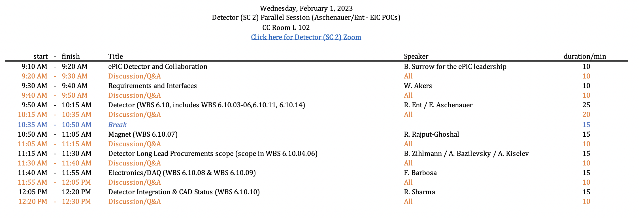
Closeout - Detector
Plenary talk:

Slide 4
Closeout - Detector

Slide 5
Closeout - Detector
Project as a whole was reviewed well
Plans for CD-3A and how to move to CD-2 and CD-3
have been endorsed

Slide 6
Project Schedule
Conclusion of
RHIC Operations
06/2025
Review
14-16 Nov
CD-2
01/2025
early
CD-4A
04/2031
early CD-4
CD-4A
04/2032
CD-0
12/2019
CD-1
06/2021
CD-3A
01/2024
CD-3
04/2025
suggestion
to combine ☺
CD-4
04/2034
Conceptual
Design
Preliminary
Design
Final
Design
Construction
Transition into
Operations
Start of
Operations
&
Science
Final Design LLPs
Approve final design
for all subdetectors
Design Maturity: ~90%
Need full TDR
January 2023:
start change control
process for detector
April 2023:
train EVMS process
Approve preliminary design
for all subdetectors
Design Maturity: >60%
Need “pre-”TDR
Define Baseline:
Subdetector technologies,
Scope, Cost & Schedule
Long Lead Procurement items
Design Maturity: ~90%
Plan is tracked through EVMS
& Change control process
Need TDR for LLPs
EIC Critical Decision Plan
CD-0/Site Selection December 2019 ✓
CD-1 June 2021 ✓
CD-3a January 2024
CD-2 January 2025
CD-3 April 2025
CD-4a early finish April 2031
CD-4a April 2032
CD-4 early finish April 2032
CD-4 April 2034

Slide 7
Planning for CD-3A
Need to move design / definition or requirements for Long Lead Procurements (LLP) to 90% design maturity by October 2023
Detector LLPs
1.7 T Solenoid
subdetector parts limited by vendor capabilities
SiPMs for calorimeters and dRICH
PbWO4 – crystals
fHCal: Steel – plates, WSF, and scintillator plates
requirements for procurement need to be fully defined
Baselining technologies of remaining two subdetectors, define scope, cost, schedule
Any further technology changes will go through the formal change control process with thresholds for approval defined in the Project Execution Plan – a formal document signed off by DOE
Will start EVMS reporting in summer → will have to work the plan

Slide 8
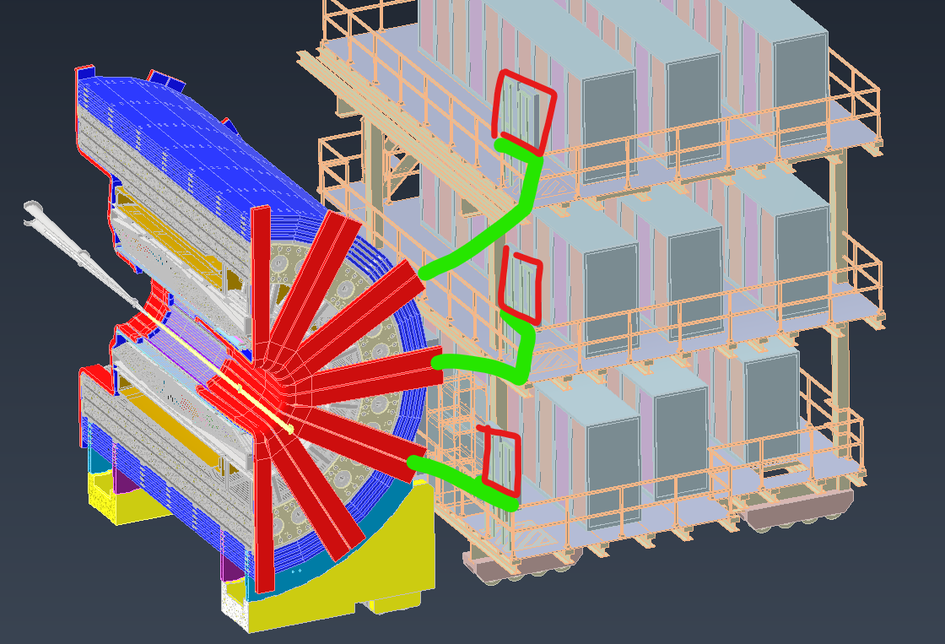
Consequences from Recommendations
Thanks to everybody providing input, but still some are missing
Need to make the next iteration on all service needs and solve the factor 3 over space problem:
Refine info in excel-sheet at https://wiki.bnl.gov/EPIC/index.php?title=Project_Information
Need to define readout chain for all subdetectors
provide input to https://wiki.bnl.gov/EPIC/index.php?title=Project_Information#Documents%3A
If there is an issue to provide the required information, contact us (== project) and we are happy to help
The next steps
placement of RDOs & DAM boards
total cable length

Slide 9
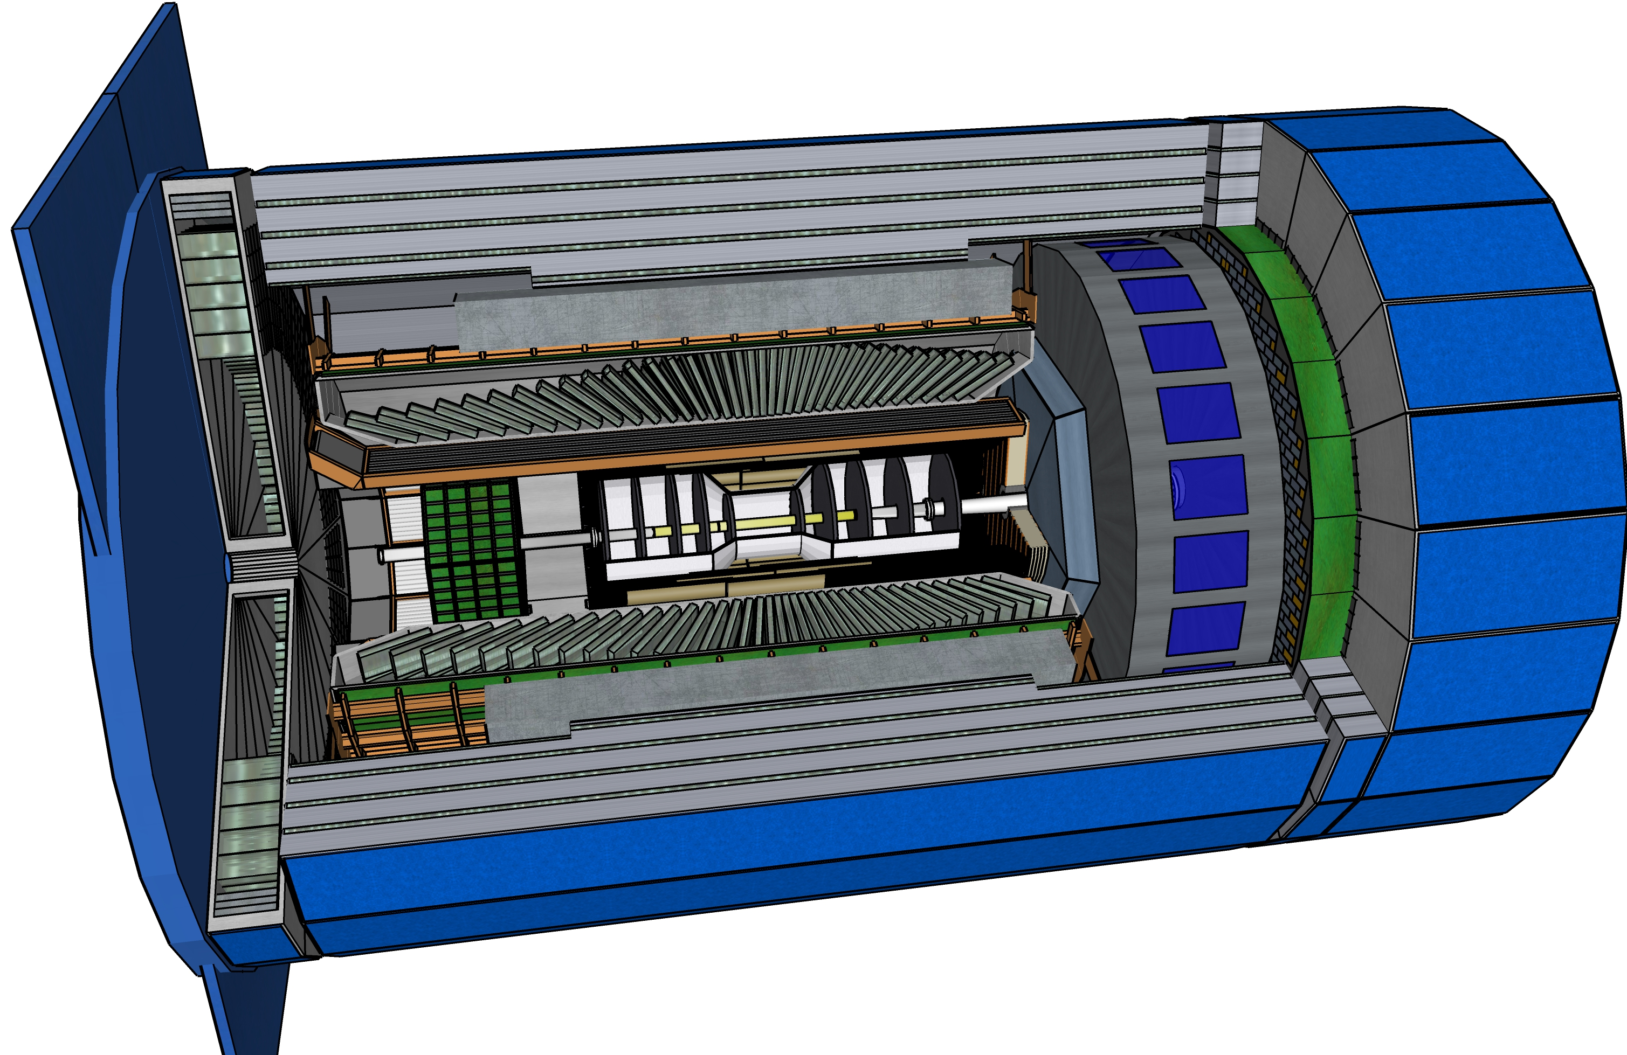
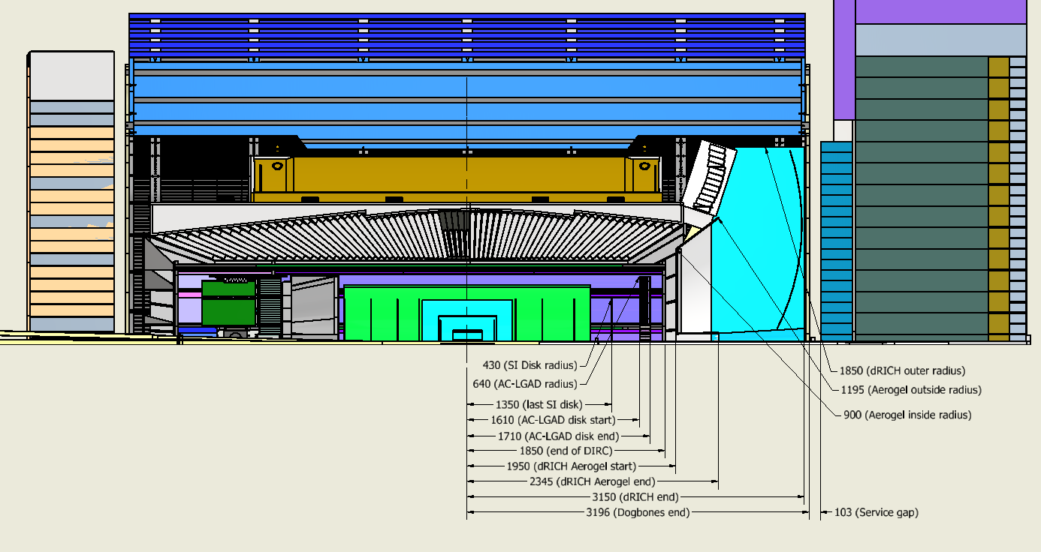
Latest Geometry Update: dRICH
Update to synchronize simulations and design
and needs for services

Slide 10
Progress on Background
No significant progress since collaboration meeting, see talk by Rey https://indico.bnl.gov/event/17621/contributions/70622/subcontributions/2130/attachments/45447/76682/230110_Backgrounds_ReyCruzTorres.pdf
Need urgently information as request by GDI on our behalf of us for approximation of the digitization model, parameterized as zero-suppression threshold, integration time, and noise rate
see https://docs.google.com/spreadsheets/d/1s8oXj36SqIh7TJeHFH89gQ_ayU1_SVEpWQNkx6sETKs/edit#gid=0

Slide 11
International Engagement DOE, EIC Project, Host Labs
EIC International Boards
EIC Advisory Board
Includes leaders of international and domestic partner institutions, chaired by JLab Director
BNL Director welcoming new members interested in contributing to the EIC accelerator facility
Next Meeting: March 9th 2023
Resource Review Board (RRB) for the EIC experiments
Similar to the LHC RRBs, includes funding agency reps
EIC RRB pre-planning meeting October 12-13, 2022
1st EIC RRB meeting in person April 3-4, 2023 on Long Island
Charter is drafted by host labs (BNL & JLab) and one international partner
→ will be ratified at the next meeting
Attendance: one representative by funding agency as member → can be several agencies per country
one Principal Investigator per agency as observer
(for this first meeting we invited a handful “extra” countries/agencies as observer)
Excellent response: 7 out of 11 funding agencies responded positive, and we expect a few more. Also 3 out of 6 observing countries will attend, also here further positives are expected.
DOE International Funding agency meetings
had by now several meetings with international funding agency representatives
Most recent one: 11/17/2022 in person in Washington DC
Next one planned late spring 2023
Perhaps also an ad-hoc international funding agency meeting at EICUG/ePIC meeting in Warsaw
Many meetings with individual country representatives, i.e., scientific attaches, funding agency representatives, ……

