Slide 1
ePIC DAQ WG Meeting
Agenda
  Presentations & Topics :
    Introduction: – Chris Cuevas
      Agenda items
      Jo Schambach – Silicon Tracker ReadOut scheme
      ePIC Detector Digitization Model document – Discussion/Questions?
      https://docs.google.com/spreadsheets/d/1s8oXj36SqIh7TJeHFH89gQ_ayU1_SVEpWQNkx6sETKs/edit#gid=238482234
      3. Open discussion regarding ePIC Management Plan presented at Feb-17 Convener meeting. [See Backup Slides]
      4. Reminder about cable spreadsheet information-
      https://docs.google.com/spreadsheets/d/1_yYA_IL1JDk2V1IwX0GcDDyQSEmnvtyn/edit#gid=1937012437
    Announcement
      DAQ WG Conveners met with Dr. Taku Gunji from the Center for Nuclear Study @University of Tokyo.
        Taku shared experience from PHENIX and ALICE and would like to join efforts on ePIC DAQ projects
      EIC Asia Workshop -> EIC Asia Workshop (16-18 March 2023) · (Indico) (riken.jp)
        Seeking a speaker for ePIC DAQ overview

Slide 2
ePIC DAQ WG Meeting
    Any Other DAQ Business?
      Subgroup updates/comments/remarks?
    Action Item: Next meeting is 2023-March 2 09:00EST

Slide 3
Backup Slides

Slide 4
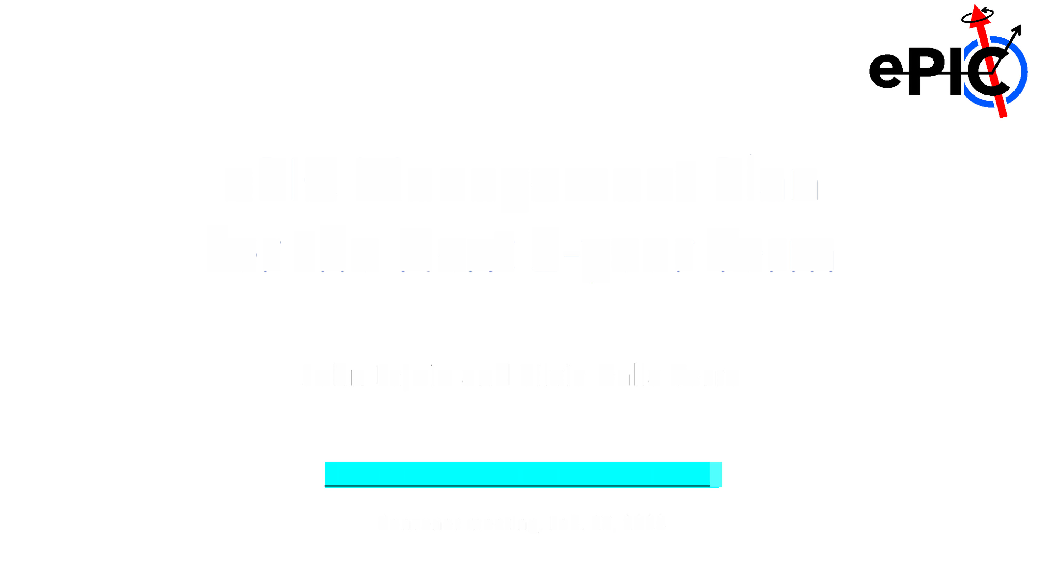
ePIC
Management
Plan
Term
for
the
Next 2-year
John
Lajoie and Silvia
Dalla Torre
ABOUT STRUCTURING THE DETECTOR SECTOR
Convener meeting, Feb. 17, 2023

Slide 5
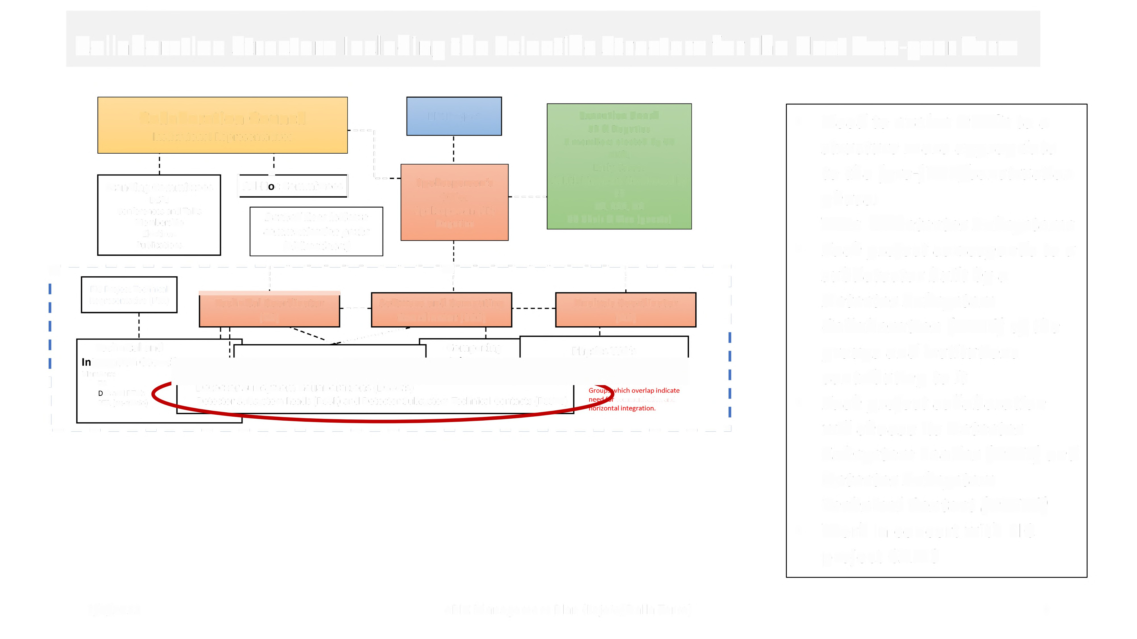
Collaboration Structure
Including the
Scientific Structure
for
the
Next Two-year Term
Collaboration Council
Institutional Representatives
---,
I
I I I I
EiC Project
Executive Board
SP & Deputies
3 members elected by CC
DE&I
Early Career
Addtl. Members Nominated by
SP
TC, SCC, AC
CC Chair & Vice (guests)
•
Need to evolve DWGs to a
structure more appropriate
to the (pre-)TDR/construction
phase:
WGs Detector Subsystems
Each project corresponds to a
subdetector built by a
Detector Subsystem
Collaboration (DSSC) of the
groups and institutions
contributing to it
Each project collaboration will
choose its Detector
Subsystem Leader (DSSL) and
Detector Subsystem
Technical Contact (DSSTC)
Work in concert with EiC
project CAMS
standing Committees
DE&I Conferences and
Talks Membership
Elections
Publications
] Ad-Hoc committees [
'_•
Spokesperson's
Office
Spokesperson {SP)
Deputies
-----
Dashed lines indicate
communication paths
(bidirectional)
r
- - - - - - -
Elf Project [echnical
Representative (PTR)
-
- - -:----------------:----------------:- - -
-
-
...
I
I
I
•
:
:
-- Software and Computing
Coordinator (SCC)
:
Analysis Coordinator
(AC)
rh
Technical Coordinator
(TC}
-- -
--- ---
Technical and
Meambers: «cw.r:
b.a«orcs
PTR (ex-officio)
....
Computing
Physics WG's
I
I
-
Detector Subsystem Collaborations (DSSC's)
Detector Subsystem Leads (DSSL) and Detector Subsystem Technical Contacts (DSSTC)
communication and
•
^{I} ------------------------------------J
•
1/9/2023
ePIC Management Plan (Lajoie/Dalla Torre)
2

Slide 6
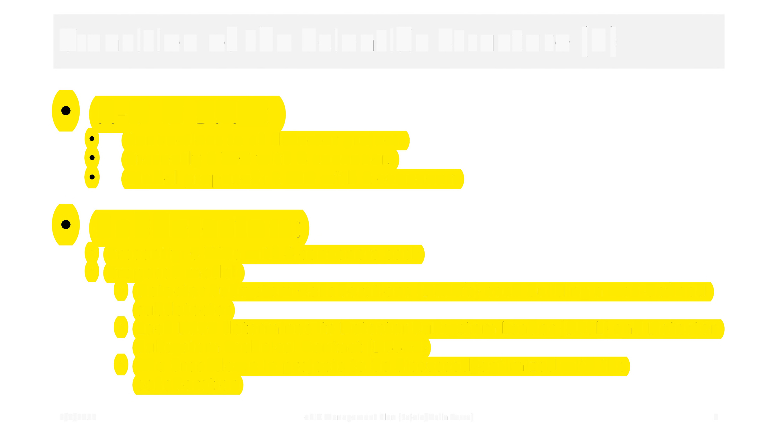
Transition
of the
Scientific
Structure
(3)
R-O &
DAQ:
Connections to all detector projects
Presently 1 WG with 4 conveners
Model proposed: 1 WG with 2 conveners
Su bdetectors:
Presently: 6 WGs with 4 conveners each
Proposed model:
•
•
•
Detector Subsystem Collaborations (DSSC's)
subdetector
each building a well-defined
•
Each DSSC determines its Detector Subsystem Leader
Subsystem Technical Contact (DSSTC)
The breakdown in projects to be discussed/optimized collaboration
(DSSL) and Detector
•
with the
1/9/2023
ePIC Management Plan (Lajoie/Dalla Torre)
3

Slide 7

Why this
transition?
•
Fu nctiona I to:
Finalize the detector sub-systems for the TDR (CD2&3) Prepare the construction period
•
•
•
Please, note that the present 2-y term coincides with period of preparation of the TOR !
•
Groups involved in the Detector Sub-Systems:
Make their responsibility explicit
Support their engagement and enthusiasm
Clarify the communication chain in matter of Detector Sub-Systems
•
•
•
•
Collaboration community:
Support the aggregation of different groups within the same Detector Sub-System
Offer an opportunity of enlargement of the collaboration also via the direct efforts of the groups
System to encourage partners, who are presently not ePIC members
•
•
in a Detector Sub•
•
Fina ncia I Aspects
The explicit links of groups in a Detector Sub-System to their Detector Sub-System realization supports actions (by PM,
ePIC management and Detector Project members) for in-kind contributions
•
•
Project progress:
Establish direct links between the Detector Sub-Systems and the EiC Project CAMs
•
1/9/2023
ePIC Management Plan (Lajoie/Dalla Torre)
4

Slide 8
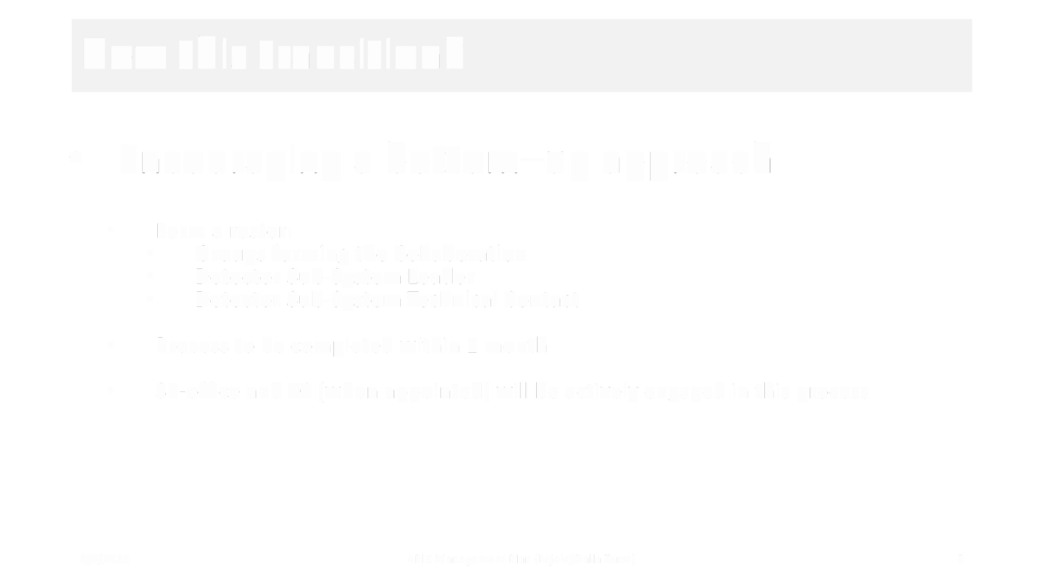
How
this
transition?
•
Encouraging a
bottom-up
approach
•
Form a roster:
Groups forming the Collaboration
Detector Sub-System Leader
Detector Sub-System Technical Contact
•
•
•
•
Process to be completed within 1 month
•
SP-office and TC (when appointed) will be
actively
engaged in this
process
1/9/2023
ePIC Management Plan (Lajoie/Dalla Torre)
5

Slide 9
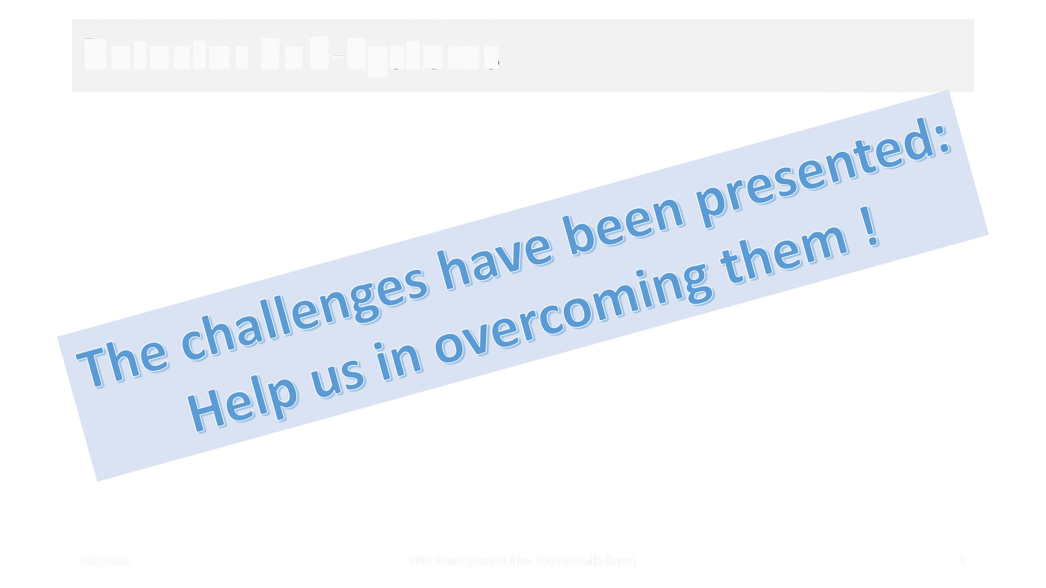
Detector Sub-Systems
l/9/2023
ePIC M anagement Pl an (Lajoie/Dalla Torre)
6

Slide 10

Questions for
Discussion
•
Comments about the proposed new
structure of the detector sector
•
Comments about the transition to the new structure of the
sector
• What is regarded as critical in the transition?
• Which kind of support/help is needed to facilitate the transition?
detector
•
What are the required skills for the DSSL and DSSTC?
1/9/2023
ePIC Management Plan (Lajoie/Dalla Torre)
7

Slide 11
Useful Links Worth Repeating (Thanks Jo!)
Mailing list: eic-projdet-daq-l@lists.bnl.gov
Indico page: https://indico.bnl.gov/category/409/
Wiki: https://wiki.bnl.gov/eic-project-detector/index.php/DAQ
Meeting once a week on Thursday mornings at 0900 EST
Agenda item “Electronics Progress Reports from Detector Groups” is meant for written bullets in the minutes of the indico timetable presenting for each detector group any plans, tests, progress on detector readout and electronics
Mattermost channel: https://eic.cloud.mattermost.com/main/channels/det1-daq (signup: https://eic.cloud.mattermost.com/signup_user_complete/?id=i8gnmob4stdrpjfrezhegxs3ew)
Talks from last Streaming Readout Workshop: https://indico.jlab.org/event/519/timetable/#all.detailed
Live Notes from SRO workshop: https://docs.google.com/document/d/1vFz1Z9c4Ck7eaE_eMcJgzg_UNUsYwC1OnygzlX95yic/edit#heading=h.175xdrpf8ddv
A summary report for the SRO workshop is here: https://docs.google.com/document/d/1X6Ms_oubcWx-8DUiExMFIJdCC6svWNbWKiz7OQjMCeQ/edit?usp=sharing
Next workshop likely organized by this WG, with single-topic agenda (one day meeting at BNL?): first pressing item is definition of the electrical-optical interface for FEEs, both hardware and logical (protocol); next item: timing distribution system
schambachjj@ornl.gov

