Slide 1
Overview of Isotope Program at BNL 2023
Cathy S. Cutler, Director of MIRP
DOE SC Isotopes Program Site Visit
January 2023
Sit Visit

Slide 2
Outline
Overview of Isotope Program at BNL
Strategic plan overview for nuclear facilities
Update on RRPL transition to nuclear order
CARP Plans
  Near term (FY2023) Project Plan and Status
  Long Term Plan
  Waste Management
  Transportation
Business Sensitive

Slide 3
BNL IP Highlights
Successful completion of AP Hot Cell ARR.
Commissioning of AP Hot Cell started
Completed longest run of LINAC to support IP
Directors Review of LIUP2 completed and indicated ready to start
NCSS run onsite first time in 3 years
Dr. Sanders and Dr. Gajecki provisional patent filed and won pitch contest
Dr. Sanders LIBN 40 under 40 Award
Dr. Hatcher Lamarre LIBN Diversity in Business Awards
Elected to SNMMI Vice President Elect
Received Science and Technology Award
Business Sensitive

Slide 4
Strategic Plan Overview for Nuclear Facilities
RRPL and BLIP are approved as accelerator facilities
Due to change in accelerator order RRPL will need to transition to Nuclear order
  Commission AP hot cells
  Short term the Interim Solution authorization document elements of 10CFR830, continue to operate under approved SAD/ASE + Compensatory Measures (TBD). “Several Months”
  Long Term solution authorization document will operate under10CFR 830
  CARP minimum Haz Cat 3
    Waste management
    Transportation
Business Sensitive

Slide 5
Future Facilities
Cyclotron operate as an accelerator facility will be maintained below SOR of 0.4
Targets will be brought to RRPL for processing
CARP plan to receive maximum Th targets that can be irradiated at BLIP.
Have a design and tested a 100 g target
This is roughly 4 times what we currently are approved for.
BLIP can irradiate up to five 100 g targets.
This gets us into the realm of the 100 Ci of Ac-225 needed per year to support clinical evaluations.
Business Sensitive

Slide 6
Infrastructure / Facility Capabilities
Existing / Infrastructure Needs
  Current Capability – Building 865, Waste Management Facility
    1997 - Designed and operated as a Nuclear Hazard Category 3 Facility
    DOE approved for Segmentation Operation (i.e., 2017 Quasi-Nuclear Facility)
    Relatively easy transition to Hazard Category 3 operation (e.g., minor ventilation system upgrades)
  Building 801, Radiochemical Research and Production Laboratory (RRPL)
    1951 (69 years old) and will not support Isotope program growth.
    Not clear can meet Nuclear Safety requirements (i.e., 10CFR830, Nuclear Safety Management; DOE Order 420.1C, Facility Safety, DOE-STD 1020-2016, Natural Phenomena Hazards (NPH) Analysis and Design Criteria)
    New Facility would be required to support “Increased Capabilities of the Isotope Program”
Business Sensitive

Slide 7
Transition to 10CFR830
RRPL will need to transition to operate under the Nuclear Safety Rules (10CFR830).
The process for doing this has been agreed upon between BNL and DOE. There are “two steps”
  Short Term: After the AP Hot Cells are commissioned, the RRPL will operate under the existing SAD and ASE with additional compensatory measures.
  Long Term: BNL will implement the required infrastructure to operate RRPL fully under 10CFR830.
Business Sensitive

Slide 8
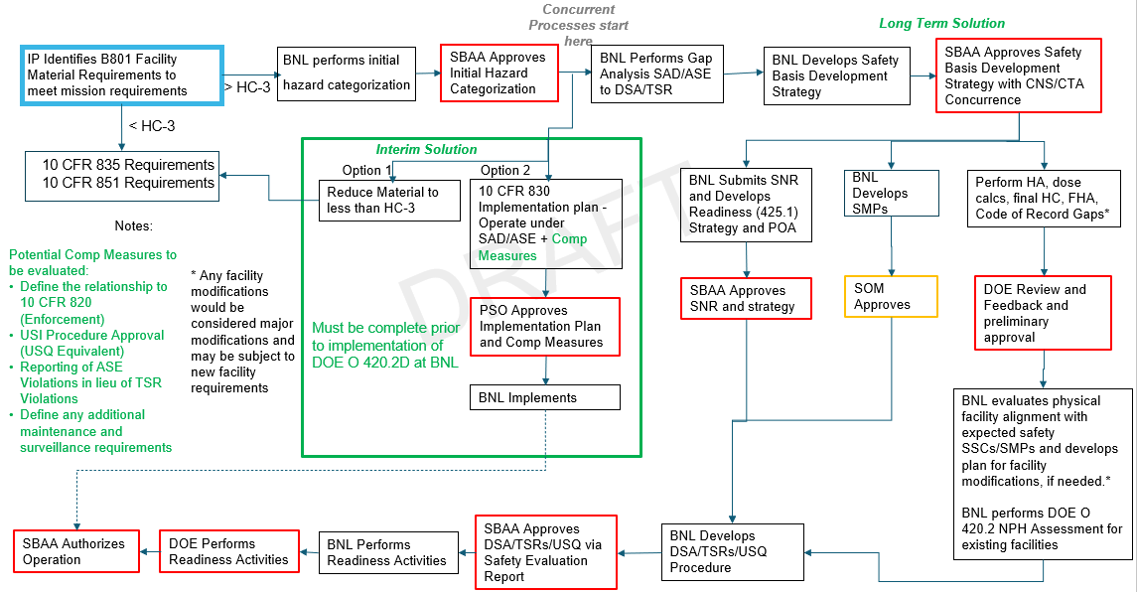
Business Sensitive

Slide 9
Laboratory Groups
BNL has formulated 4 groups that will start working on the long term solution to implementing 10CFR830
Current SAD/ASE vs. 10CFR830
Natural Phenomena Hazards and facility assessment
Transition and Accountability
Resources needed for the first prong
A steering committee is being formed to direct these efforts
Business Sensitive

Slide 10
MIRP Interim Solution Team
MIRP Interim Solution Team was formed to perform the initial hazard categorization and implement compensatory measures to supplement the existing safety basis until 10CFR830 is fully implemented.
Ray Fliller – Assoc. Chair of ESSHQ for CAD – Team Lead
Cathy Cutler – MIRP Program Director, CAD
Mark Blackburn – RadCon
DJ Carter – WP&C and CONOPs SME
Stephen Laherty – NQA-1 Engineer, QMO
Members of the transition team are on the other groups as well.
Business Sensitive

Slide 11
Determining the SOR
Targets: The isotope content after irradiation is determined from FLUKA calculations. The quantities of each isotope is divided by the threshold value and then are summed using a validated excel spreadsheet to determine the SOR for each target.
Foils: limited to 200 mCi the worst-case Ac-227 is used.
Radiotracers: Quantities above 0.005% of the HC3 threshold are included
Holdup: Legacy building contamination, low level waste and contamination in water tanks.
Business Sensitive

Slide 12
Example Haz Cat Inventory Calculation
Isotope | Activity (Ci) | DOE-STD-1027 HC-2 TQ [Ci] | DOE-STD-1027 HC-2 Ratio | DOE-STD-1027 HC-3 TQ [Ci] | DOE-STD-1027 HC-3 Ratio | Fissile Mass [g]
Co-60 | 2.00E+00 | 1.90E+05 | 1.05E-05 | 2.80E+02 | 7.14E-03 | --
I-131 | 1.00E-01 | 1.80E+03 | 5.56E-05 | 9.20E-01 | 1.09E-01 | --
Cs-137 | 5.00E+00 | 8.90E+04 | 5.62E-05 | 6.00E+01 | 8.33E-02 | --
Ac-227 | 2.00E-02 | 4.30E+00 | 4.65E-03 | 4.20E-02 | 4.76E-01 | --
U-235 | 4.00E-05 | 2.40E+02 | 1.67E-07 | 4.20E+00 | 9.52E-06 | 1.85E+01
Cf-252 | 2.00E+00 | 2.20E+02 | 9.09E-03 | 3.20E+00 | 6.25E-01 | --
SORs |  |  | 1.39E-02 |  | 1.30E+00
Summary
  - HC-3 SOR exceeds 1
  - HC-2 SOR less than 1
  - U-235 mass less than ANSI limit (700-g)
Conclusion
  - Facility designated as Hazard Category-3
Hazard Category-2
SOR_{HC2} >1
Hazard Category-3
SOR_{HC3} >1
Below HC-3
SOR_{HC3} <1
12

Slide 13
Anticipated Future Inventory
The following changes to the inventory are anticipated (and not necessarily approved) for the RRPL inventory.
Addition of a La Target
  Inventory will have either 1 La Target or 1 As target.
Addition of an Ag Target
Removal of 4 RbCl targets at EOB+6days
Removal of NiSb
Addition of targets from the Cyclotron – total amount limited to SOR=0.4 relative to HC3
100mg Th Target
Business Sensitive

Slide 14
Can RRPL Operate below HC3?
No. RRPL cannot operate below HC3 thresholds and meet program needs.
This graph shows the SOR through CY2022. It is routinely above 1.0 The orange line is the SOR calculated using the 2018 standard. This shows that even if the standard is updated, the SOR remains over 1.
Business Sensitive

Slide 15
Compensatory Measures
Performing a gap analysis between the existing safety basis and 10CFR830
This will form the basis for compensatory measures
Existing Unreviewed Safety Issue (USI) process will be supplemented to have more triggers to engage the process than required by current procedures.
Business Sensitive

Slide 16
Conclusion for Nuclear Transition
RRPL must transition to operate under nuclear safety rules
BNL is starting the transition. The first step is the initial hazard categorization.
We show that for the present and near-term future inventory of nuclear material at RRPL will be above Hazard Category 3, and below Hazard Category 2.
RRPL must operate above Haz Cat 3 thresholds to fulfill programmatic requirements.
The initial hazard categorization is that RRPL should be a Hazard Category 3 nuclear facility.
Business Sensitive

Slide 17
Clinical Alpha Radionuclide Producer (CARP)
Current facilities at Brookhaven National Laboratory (BNL) cannot accept or process Curie quantities of isotopes, but Curie levels of production will be needed to support clinical trials and FDA-approved drugs.
Year-round supply of Curie quantities of actinium-225 (Ac-225) is needed and is not currently available.
The radioactive inventory of Curie-level targets will require processing under the DOE nuclear facility Orders and regulations.
The legacy production facilities currently utilized by the BNL Isotope Production program were not designed to meet the regulatory requirements of Hazardous Category 3 (Haz Cat 3) nuclear facilities that will be needed to process the Curie-level thorium targets to meet the projected demand for hundreds of Curies of Ac-225.
Business Sensitive

Slide 18
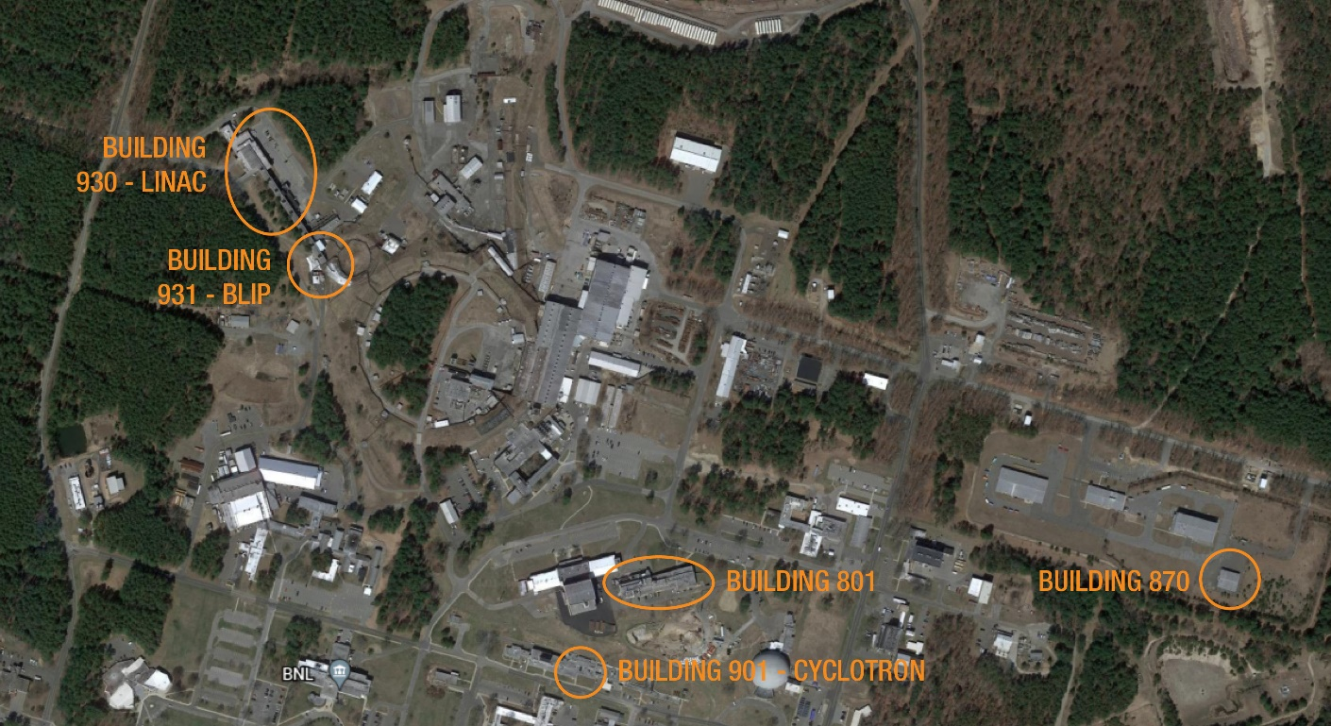
Aerial view of the BNL MIRP complex with following facilities indicated –
Cyclotron (Building 901), LINAC (930), RRPL (housed in Building 801),
proposed CARP(building 870) and BLIP (in 931)
Official Use Only

Slide 19
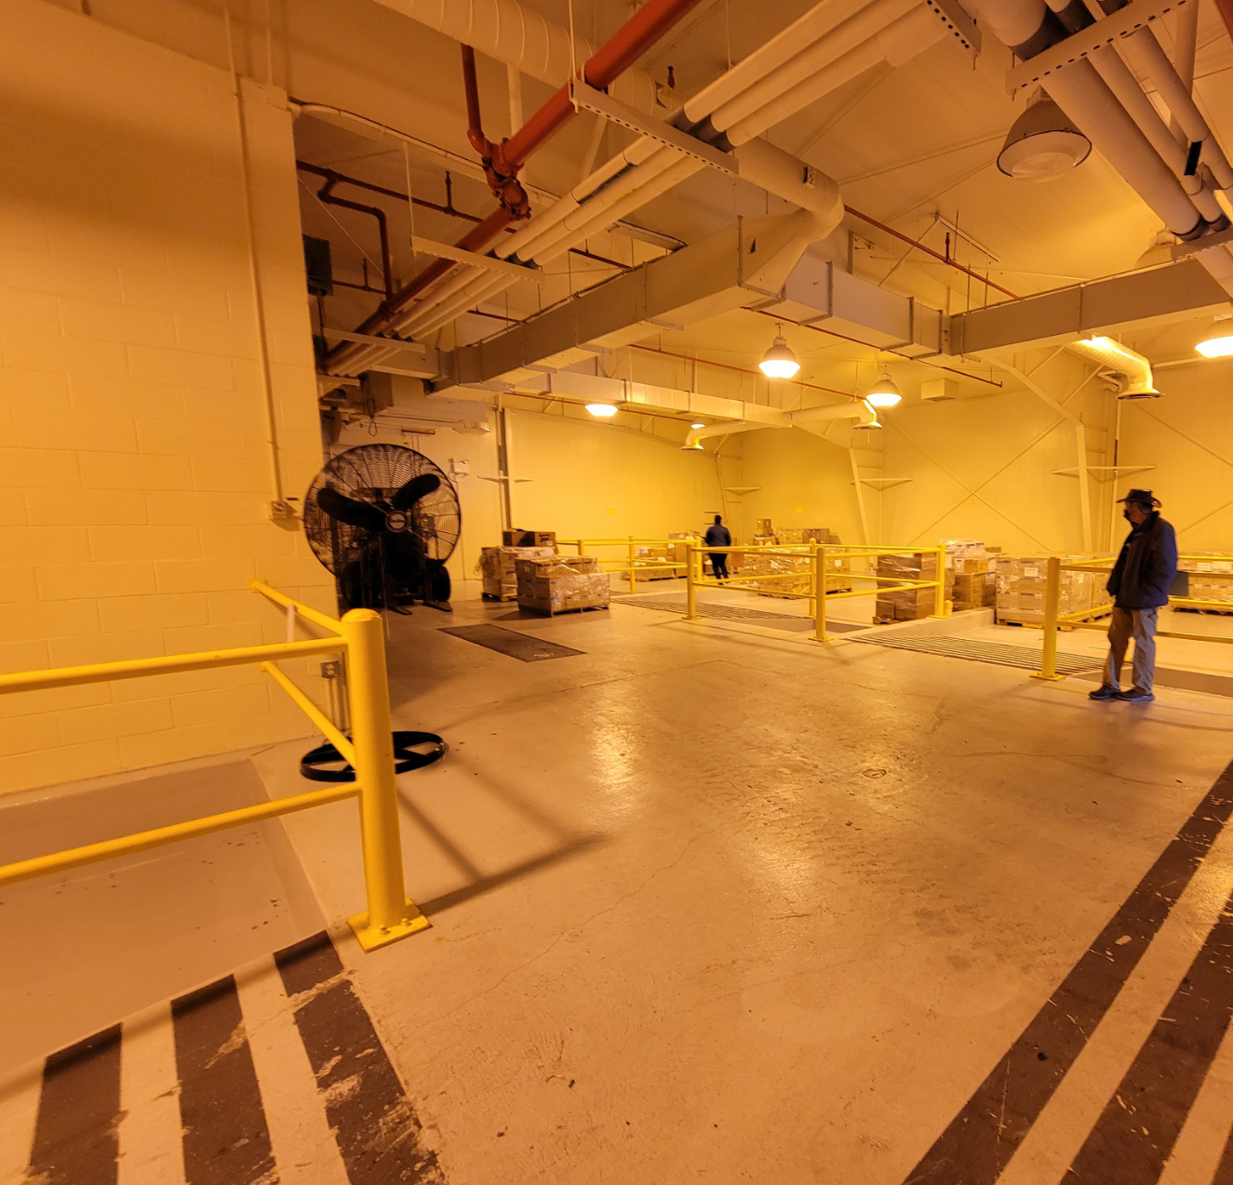
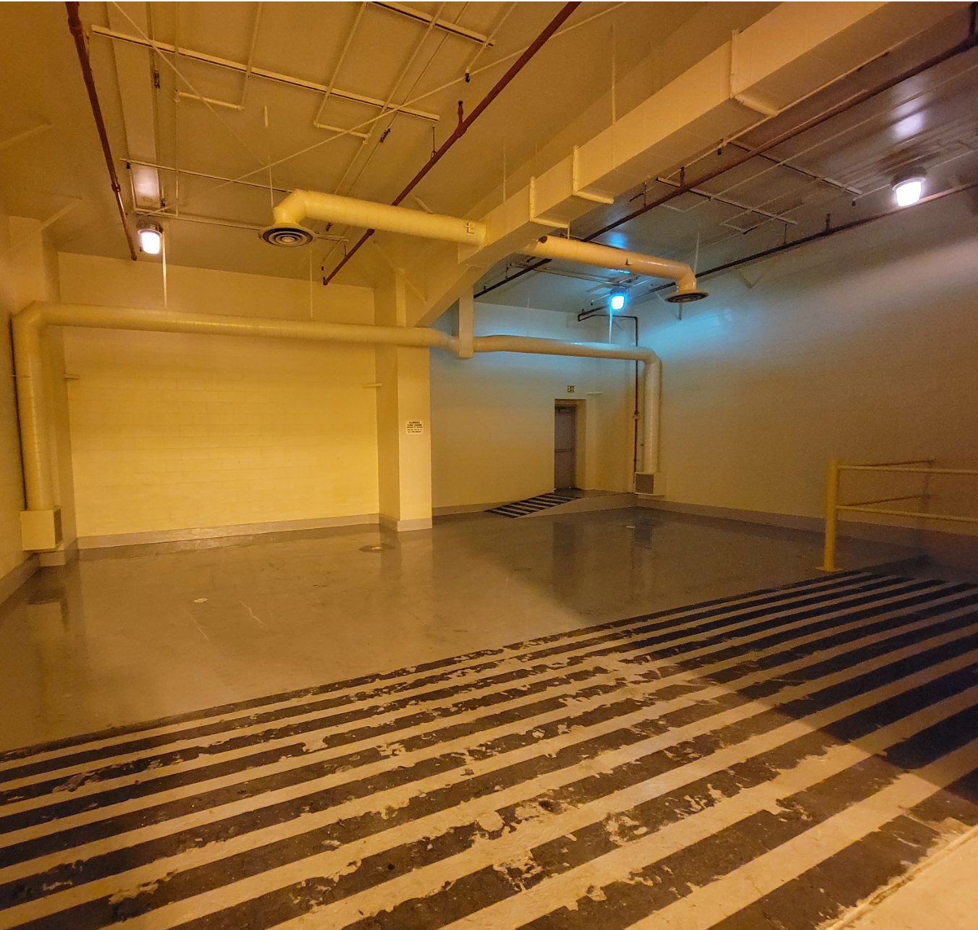
Repurposing Former HC3 Facility, Bldg. 870
Official Use Only
Waste management Facility was designed as a Haz Cat-3 facility and has two bays that we could add hot cells.
New building originally built for mixed waste not used has a number of bays and a lab allowing for hot cell installation.
Business Sensitive

Slide 20
Clinical Alpha Radionuclide Producer (CARP)
The existing Building 870 was designed and operated as a Haz Cat-3 non-reactor nuclear facility that previously was used for mixed waste storage.
The facility was re-designated as a ‘radiological facility’ in 2008, can be re-configured, and modified, to support the hot cells and Ac-225 production.
The new facility would be designed, and operated, to fully conform to the nuclear orders and regulations.
The building will be outfitted with modular hot cells, glove boxes, and laboratory equipment.
The hot cells would be constructed of concrete or equivalent shielding with an outer layer of steel.
There would be two production lines (north and south) for redundancy in the event that one production line is down for maintenance and/or repair.
The hot cells would have the capability of interfacing with horizontal and vertical casks.
Business Sensitive

Slide 21
Near Term Plan
NEPA form to inform environmental analysis
Define SDIT team
Rollup budget
Define the Work – Process 10’s of Ci of Ac-225
Analyze the hazards – 5, 100 g targets of Th from BLIP year-round processing
Establish the controls
Project Executive Plan
SDIT- Safety Design Integration Team
Facility level design basis accidents (DBA)
CSDR – Conceptual Safety Design Report
PSDR – Preliminary Safety Design Report
Risk and Opportunities Assessment
Business Sensitive

Slide 22
Project Management Overview
Preliminary Project Execution Plan
The project will be managed in accordance with DOE order 413.3B.
BNL is in the process of identifying and assigning a well-qualified project management team at CD-0 approval. Ad out for a project manager.
A tailoring strategy will be utilized to try to minimize the project schedule, maximize deliverables and reduce PM cost.
After achieving CD-O approval, the project will seek CD-1/3A approval to initiate long lead procurements in order to reduce the schedule and mitigate risk.
The project will then seek a simultaneous CD-2/3B approval to establish a baseline and to being construction
The project will seek to leverage existing ORNL programmatic documents and processes as much as possible to address DOE 0.413.3B requirements
The project will be managed using Earned Value Management System.
Business Sensitive

Slide 23
Follow DOE-STD-1189
Mandatory implementation
Integrates safety into the design process
Applicable to the design and construction of:
  New DOE hazard category (HC) 1, 2, and 3 nuclear facilities
  Major modifications to DOE HC 1, 2, and 3 nuclear facilities (as defined by 10 CFR 830)
  Other modifications to DOE HC 1, 2, and 3 nuclear facilities managed under the requirements of DOE O 413.3A
In Summary – DOE-STD-1189 “…objective is to reduce the likelihood of costly late reversals of design decisions involving safety.”
Business Sensitive

Slide 24
Onsite transportation of materials are subject to requirements of DOE Order 460.1D, Packaging and Transportation Safety
DOT-Compliant packaging
Non-equivalent packaging
49 CFR 171-180 and 350-399 AND
Develop Transportation Safety Document per DOE Guide 460.1-1 (only for onsite use) OR
Develop Safety Analysis Report for Packaging per DOE Order 460.1-1 (may be used for offsite use)
Develop Transportation Safety Document per DOE Guide 460.1-1 for onsite use
Business Sensitive
24

Slide 25
Larger Type B Options
Two containers appear to be viable options; NAC Optimus L and Croft 2999A
  Meeting scheduled with BNL on September 23, 2022 to discuss container options.
Name / Certification | Target Capacity | Weight (lbs.) / overall dimensions | Outer/Inner containment dimensions | Packaging Cost (k$) | Pros | Cons
NAC OPTIMUS-L/ USA/9390/B(U) F-96 | 1 ⁽¹⁾ | 9,180 / 70” H x 49” dia (52 cu ft) | 51.4” H x 34.5 “ dia / ~27” H x ~18“ dia | 275-325K per unit / 15K /week lease | A modern large drum-like design with a highly flexible and large sized containment vessel moving forward Can incorporate a variety of user designed shield materials and configurations (e.g., lead, tungsten, DU), allows customization for BNL and LANL needs Could be lowest cost after initial inner shield design completed U.S. company with extensive experience with NRC amendments and reviews | Requires SARP amendment Requires design of inner shield, fabrication, inclusion in the SARP amendment Vertical loading/unloading Weight issue at BNL
Croft 2999A SAFESHIELD/ USA/9519/B(U) F-96 (DOE) | 4 | 8,594 / 55” H x 41” dia (24 cu ft) | Inner flask CV 35.9” H x 26.3” dia | 600K per unit/ no lease cost | A modern design that incorporates shielding into the containment vessel smallest and lightest overall packaging LANL has experience with this container | Requires SARP amendment Container is highest cost packaging and design agency located in UK is a cost and schedule consideration. Vertical loading/unloading
Removable Tungsten (1760 lbs) or Lead shield assembly (2,810 lbs)
Business Sensitive

Slide 26
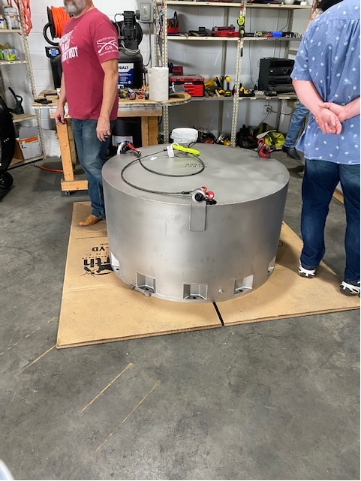
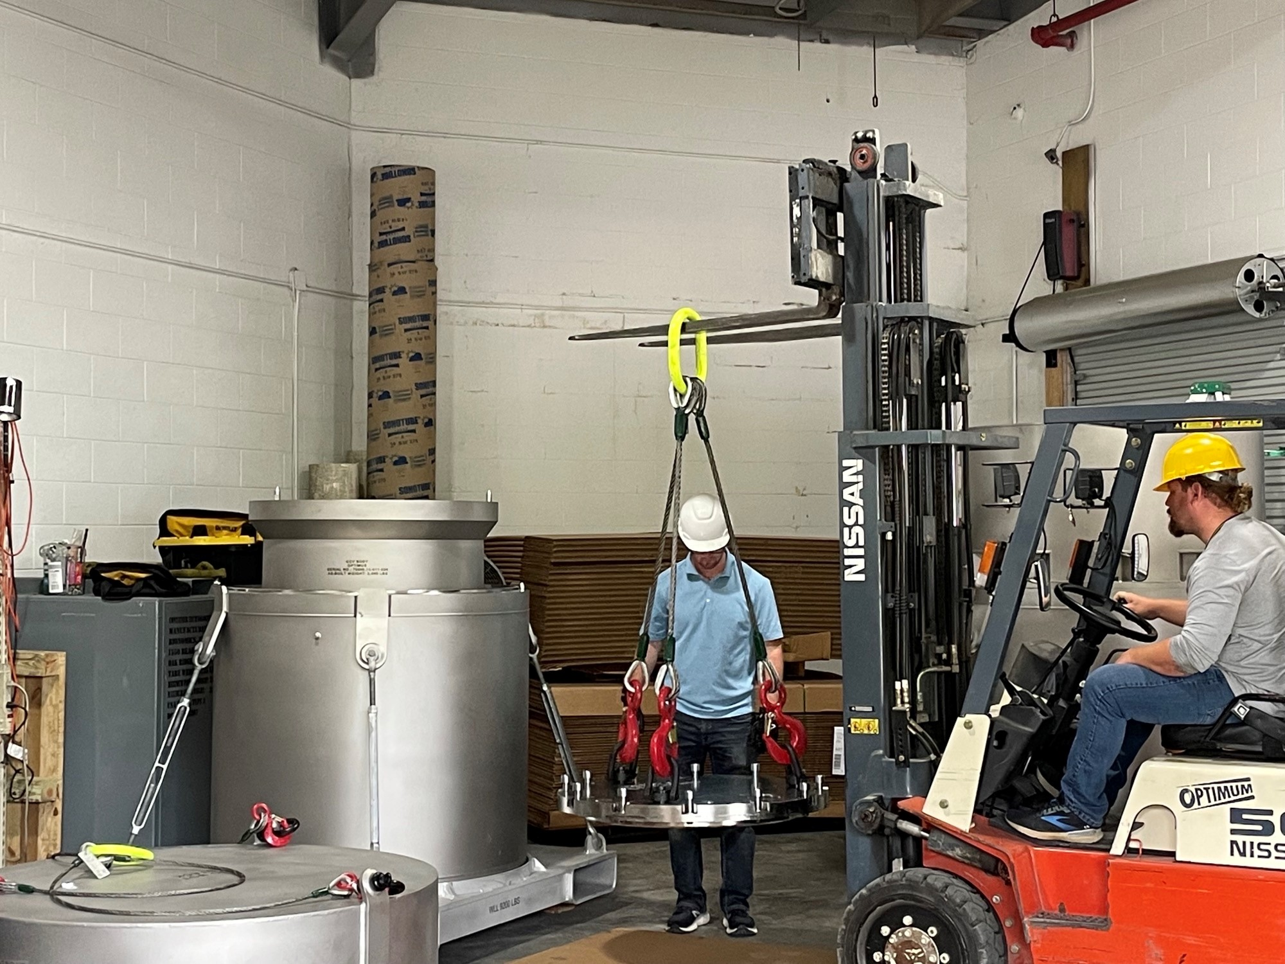
Larger Type B Options, cont.
TetraTech provided a cost estimate for inner shield design as outlined below, ~$310K
  The payload-package will consist of fabrication drawings of the shield, shield basket, and target can
  Supporting documentation such as the target source term and shielding calculations
  User requirements needed for handling at BNL and LANL
  Documentation necessary for incorporation of the Ac-225 target payload-package into the SARP
  NAC International would apply for SARP amendment based on content and payload-package
  Oversight of procurement and fabrication of the payload-package
  Definitions:
    “Shield” is a heavily shielded assembly that carries the irradiated targets
    and is placed into a shield basket within the Optimus-L containment
    “Shield basket” is a structure for centering the shield and distributing
    the concentrated weight of the shield within the Optimus-L containment
    vessel
    “Target can” facilitates loading the targets into and out of the shield
    and may require features for semi-remote handling due to the
    high target radiation levels.
32.5” D x 47” H
Business Sensitive

Slide 27
Summary
Ongoing work to commission AP hot cells
RRPL categorization first step under BSA review
Preparing short term solution for RRPL operations to meet IP needs
Long Term for RRPL implement full nuclear operations new safety basis document, new training requirements, nuclear maintenance program and NQA1 program
CARP follow DOE 413.3B and 1189
Business Sensitive

Slide 28
Questions
Thank You
Business Sensitive

