Slide 1
Updates on dRICH simulation
Chandradoy Chatterjee
INFN Trieste

Slide 2
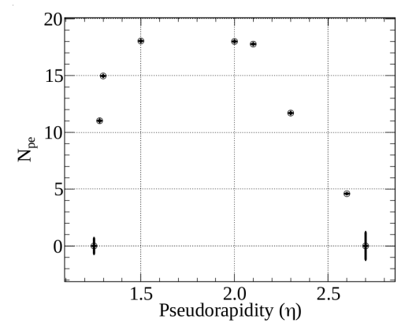
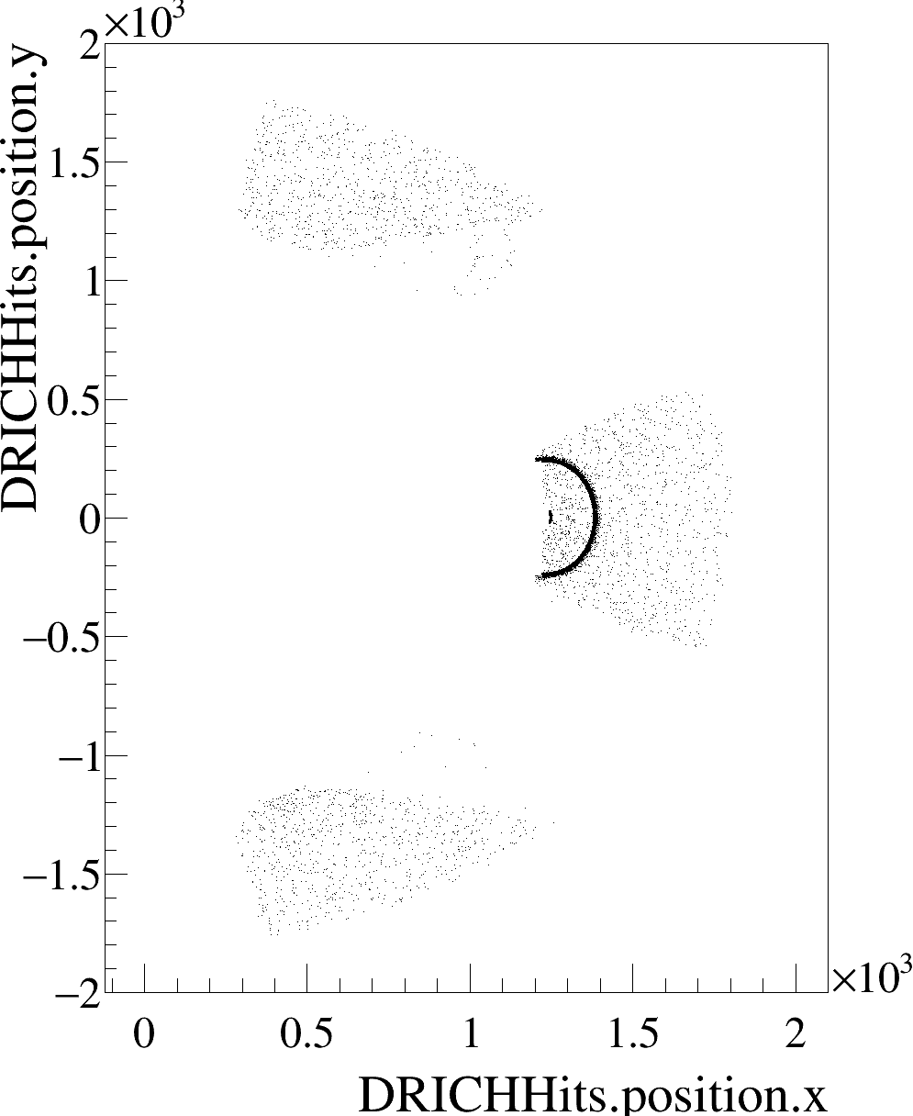
Acceptance
eta 2.6 (phi = 0)
Simulated hits! Low Npe is not an effect of reconstruction.
Effect of untuned geometry!
The optics in ePIC is cutting out most of the ring around eta 2.6

Slide 3
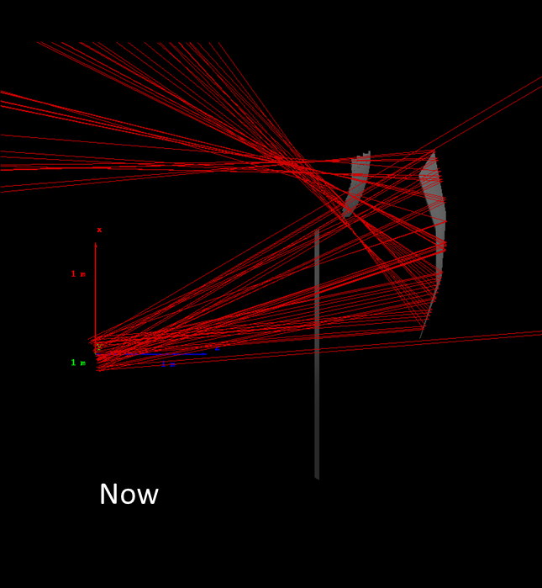
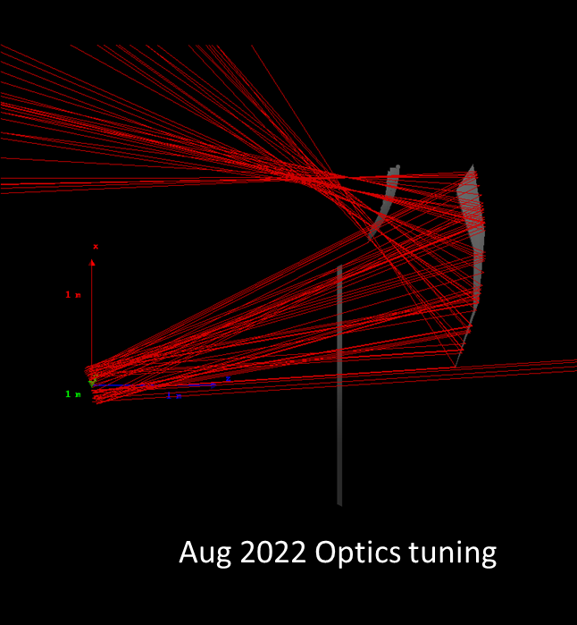
Verification using photon beams

Slide 4
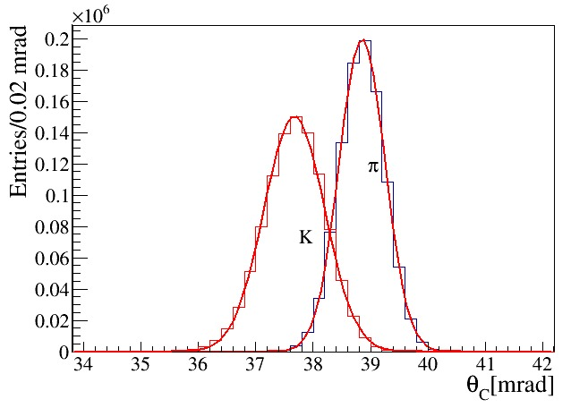
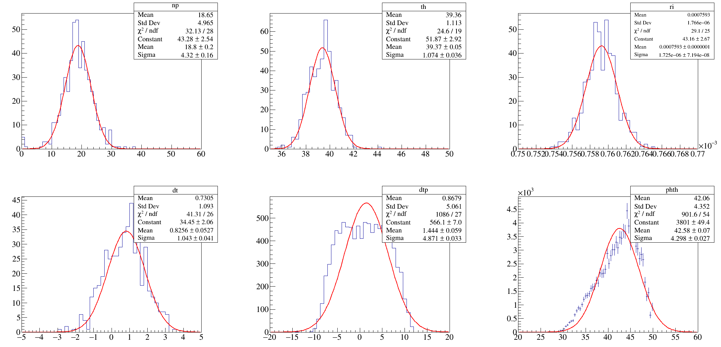
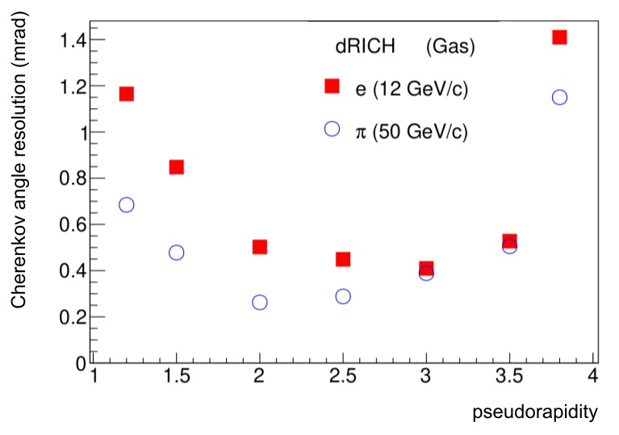
Gas at eta 1.5
Npe
Ring angle
(n-1)
Ring residual
SPE residual
SPE Angle
Using 1.00075 as nominal refractive index; we have ~1.2 mrad difference pi/K Cherenkov theta (peak to peak) → 3 sigma separation ~ 0.4 mrad ring level → ATHENA was able to provide the separation around eta values 1.5-3.5

Slide 5
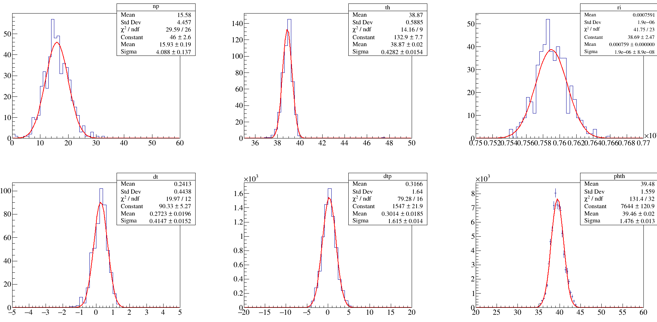
gas at 2.2

Slide 6
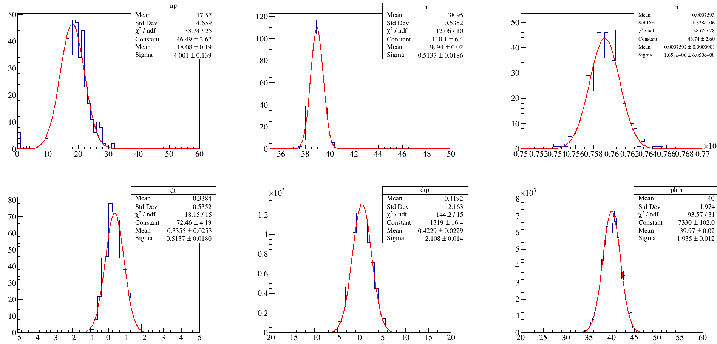
gas at 2.0

Slide 7
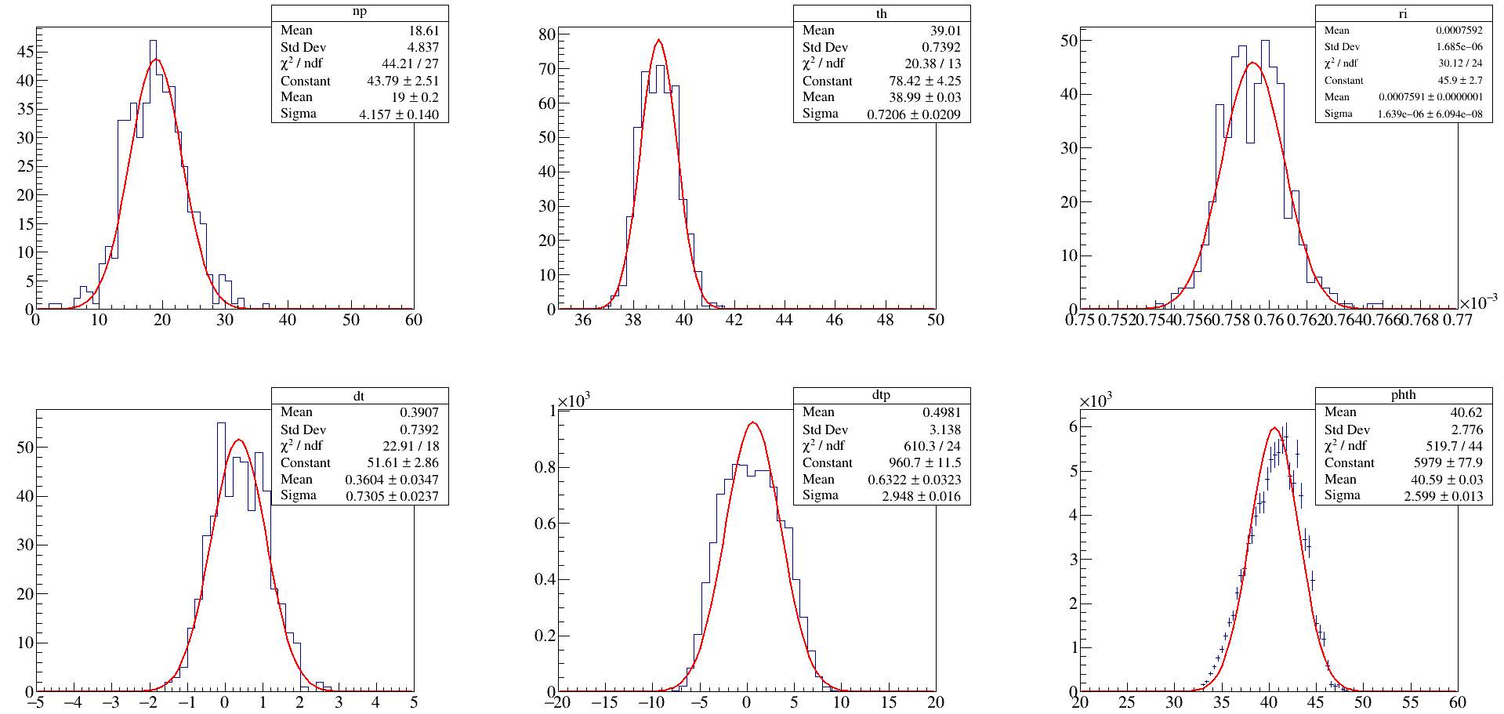
gas at 1.8

Slide 8
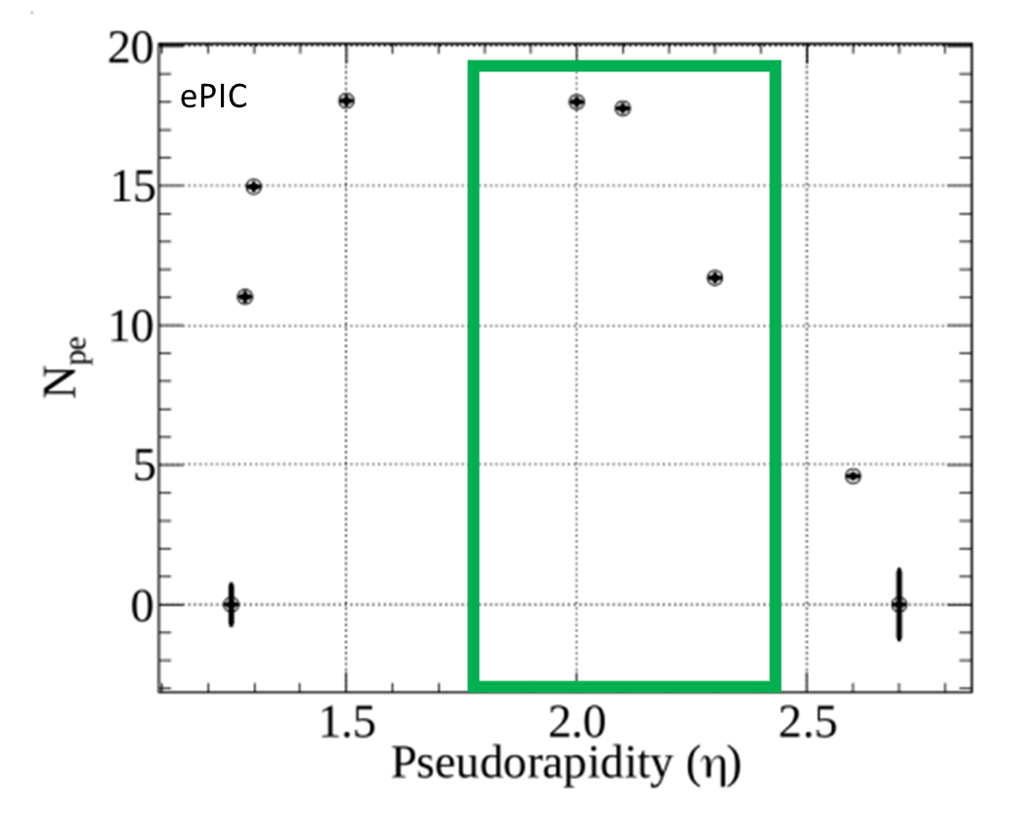
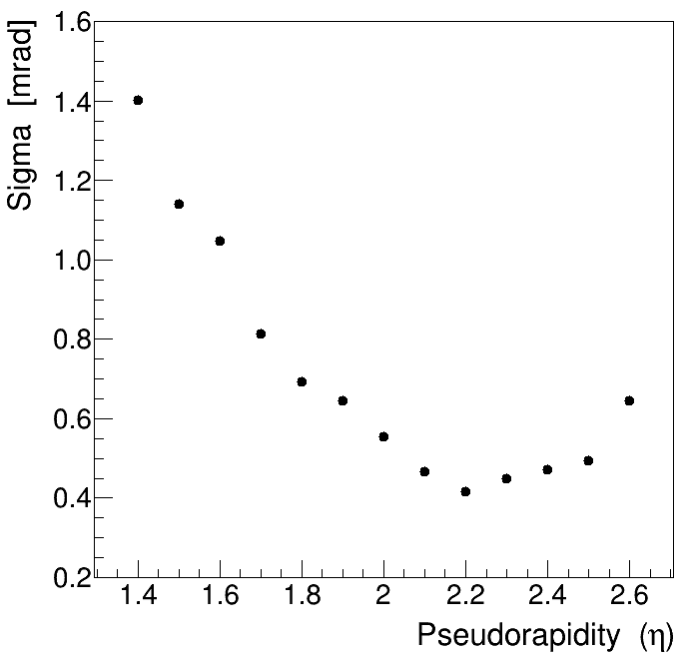
Effective Acceptance
Sigma values cross checked
by Luigi (INFN Salerno)
Two-fold problem:
a) Low Npe and missing rings in higher eta
b) Smeared SPE resolution due to Sp. Ab.
a) The placement is clearly sub-optimal. The values correspond to the design was obtained in Aug 2022.
Degradation most likely caused by small envelope changes for 22.11 production preparation?
b) The Spherical aberration. We can not obtain good resolution over “small-mid-high” eta. We can adopt solution of compromise or open the dual mirror/double reflection chapters.

Slide 9
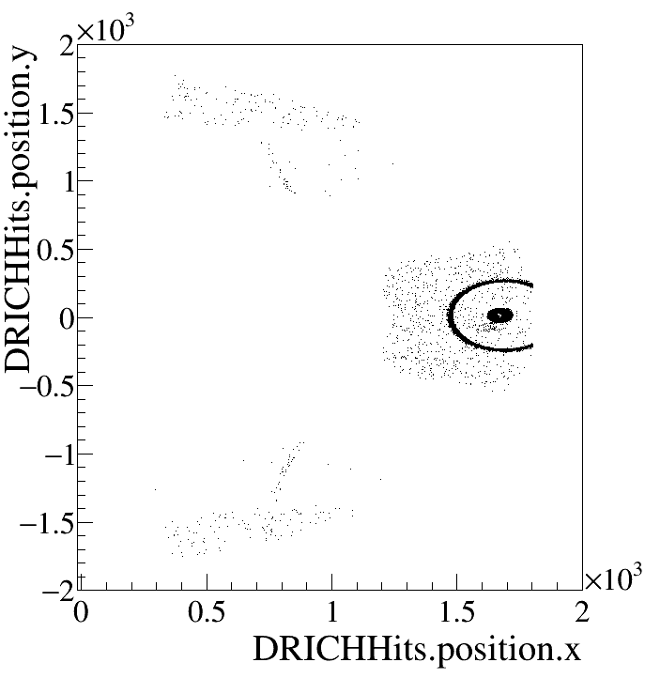
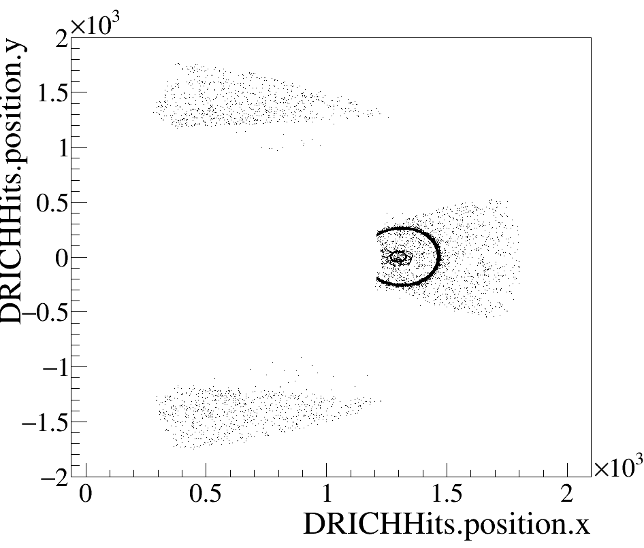
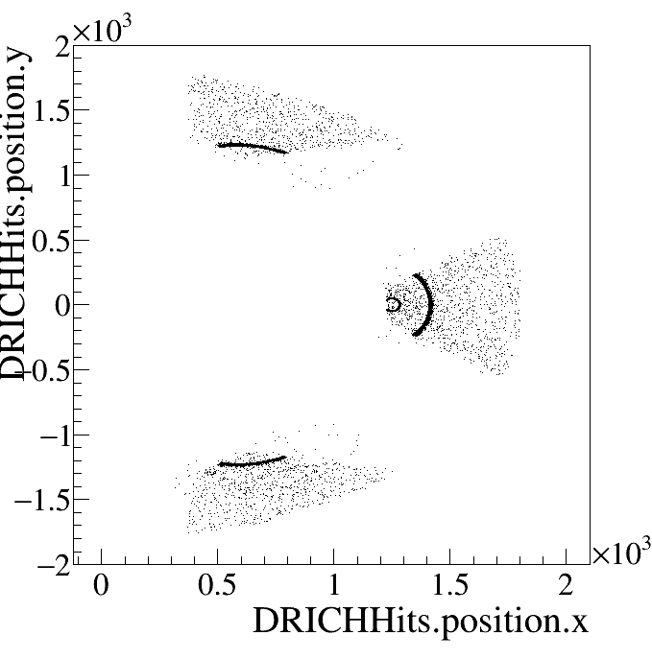
Optics Tuning helps
Now
eta ~1.5
Yesterday
Now
eta ~2.6
eta ~2.6
Now
eta ~3.5
Tuning helps!
Not the right parameters yet!
But promising that from almost 1.5 to 3.5 majority of the ring is contained.

Slide 10
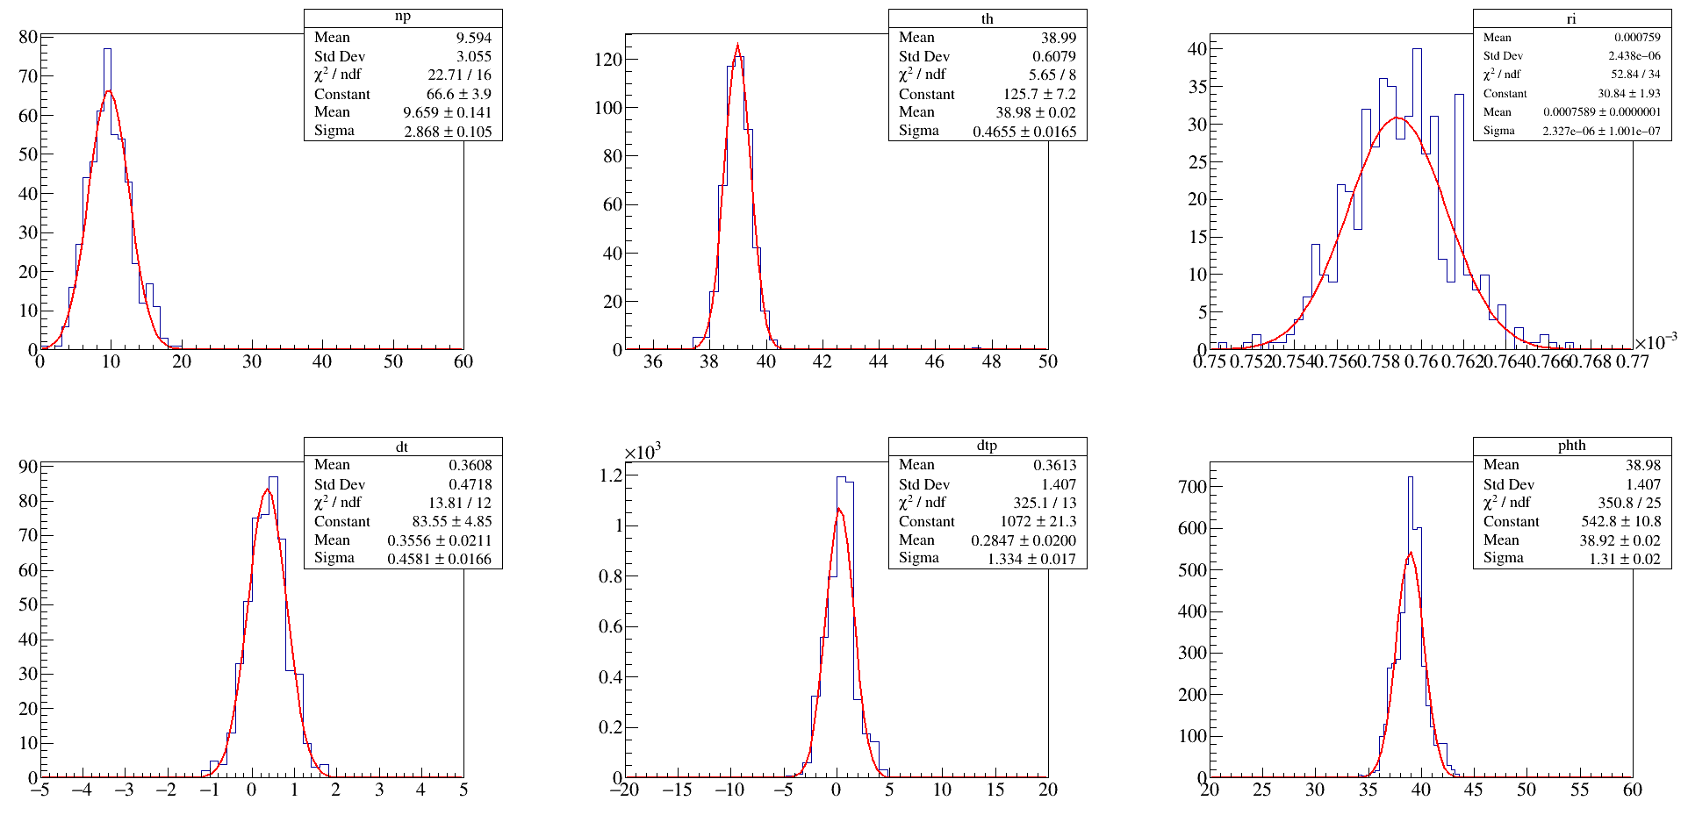
Gas information At eta 3.5

