Slide 1
Modular RICH Detector Simulation –
Rayleigh Scattering
Cheuk-Ping Wong
Georgia State University
03-25-2016

Slide 2
Last Update
No Rayleigh Scattering was observed in the simulation

Slide 3
This week
Updated GEMC to version 2.3
Simulation results using material definitions of aerogel from both Hubert and Marco

Slide 4
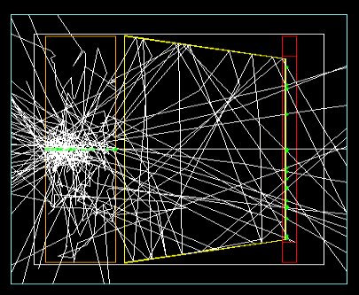
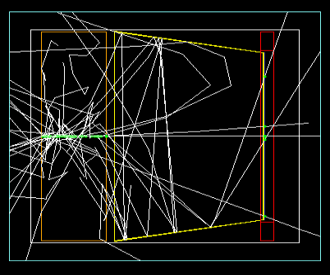
100 Optical Photon w/ 2-4 eV
-- optical photon
Hubert’s Agel
Marco’s Agel
More Rayleigh Scattering occurs when Hubert’s agel is used (see slide 7,13-16)

Slide 5
Simulation Setup
100 k optical photons
Momentum = 1.7-6.2 eV (i.e. λ=200-730 nm)
Launching at (x,y,z)=(0,0,64.585) mm, i.e. right at the front of aerogel
Fresnel lens is removed from the detector
Aerogel
  Hubert -- the one we always used
  Marco – RichAerogel3 which is predefined

Slide 6
Analysis Setting
Unscattered photon
  Hits on the sensor, and
  Moves forward (pz>=0), and hits at (x,y)=(0,0)mm
Scattered photon
  Hits inside agel, and
  Not moves forward or not hits at (x,y)==(0,0)mm

Slide 7
Photon Spectrum from Diff. Agel
Absorption? (see slide 15)
Divide blue and red histograms by black histogram
→ normalized photon spectra (next slide)

Slide 8

Normalized Photon Spectrum from Diff. Agel
Clarity of Marco’s agel is less than ½ of Hubert’s
→Marco’s agel gives less scattering photons (see slide 9-10)
$$\text{Transmission}=Ae^{−LC/λ^{4}}$$
The shorter wavelength hits (shade region) will be filtered out by the Fresnel Lens

Slide 9
Photon Spectrum
Due to absorption?
Marco’s agel has higher transmission if Rayleigh Scattering is implemented

Slide 10
Normalized Photon Spectrum
Marco’s agel has higher transmission if Rayleigh Scattering is implemented

Slide 11
Only Consider Photons that Hit on the Sensor
Only count the (both scattered and unscattered) photons that hit on the sensor
Less scattered photons are counted
More details on slide 16 to 20

Slide 12
Summary
Fig. 1 (slide 8) and Fig. 2 (slide 7) on Hubert’s agel notes are reproduced
Marco’s agel has lower clarity (<1/2 of Hubert’s)
Marco’s agel has higher transmission than Hubert’s if Rayleigh Scattering is implemented

Slide 13
Next
Rescale Scattering length of Marco’s agel as suggested by Marco
Shift the Rayleigh Scattering array
Put Fresnel lens back in the simulation
Simulation w/ incident pion- and w/ Rayleigh Scattering on
Likelihood Analysis

Slide 14
Back Up

Slide 15
Absorption Length vs Photon Wavelength
In log scale
Hubert’s agel has longer absorption length
→ better transmission if there’s no Rayleigh Scattering

Slide 16
Simulation Setup
100 k optical photons
Momentum = 2-4 eV (i.e. λ=200-730 nm)
Launching at (x,y,z)=(0,0,64.585) mm, i.e. right at the front of aerogel
Fresnel lens is removed from the detector

Slide 17
Analysis Setting
Only count the (scattered and unscattered) photon that hits on the sensor
Unscattered photon
  Moves forward (pz>=0), and
  Hits at (x,y)=(0,0)mm
Scattered photon
  Not moves forward, or
  not hits at (x,y)==(0,0)mm

Slide 18

Normalized Photon Spectrum of Different Aerogels
Agel from Marco has higher transmission
(Lower Clarity, higher transmission, see slide 20)
$$\text{Transmission}=Ae^{−LC/λ^{4}}$$

Slide 19
Photon Spectrum
(before normalization)

Slide 20
Normalized Photon Spectrum
R.S. Off
R.S. On
R.S. On
Rayleigh Scattering decreases transmission of aerogel
Agel from Marco has higher transmission if Rayleigh Scattering is implemented

Slide 21
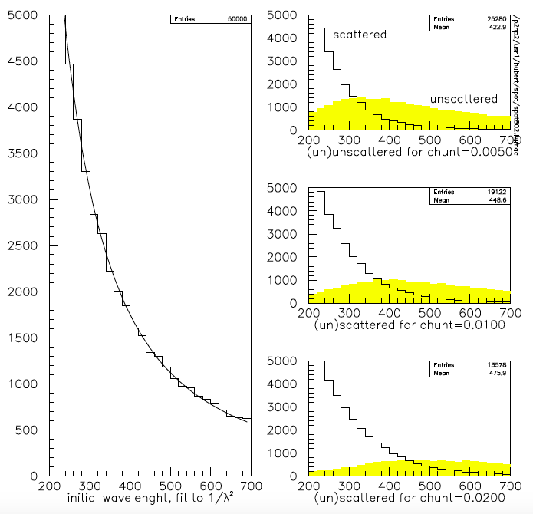
Scattered and Unscatterd photon spectrum in Hubert’s notes
Preferred Aerogel : lower clarity, higher transmission in longer wavelength region
Count of Scattered (black line) photon is much higher than unscattered photon (yellow shade) in shorter wavelength region
The NA44 Aerogel Cherenkov Trigger, Hubert van Hecke and Douglas E. Fields.

