Slide 1
Section of the Fast-Cycling FFA Synchrotron
FY2024 NPP LDRD Type B Pre-Proposal
Principal Investigator(s) – Dejan Trbojevic
January 32, 2023

Slide 2
FY2024 NPP LDRD Type B Pre-Proposal
Proposal title: Section of Fast-Cycling FFA Synchrotron
Primary Investigator: Dejan Trbojevic
Other Investigators: Stephen Brooks, George Mahler, Robert Michnoff, Steven Trabocchi,
Indicate if this is a cross-directorate proposal. Yes ___ No x
If yes, identify other directorates/organizations:
Proposal Term: From: Oct 2024 To: Oct 2026

Slide 3
FY2024 NPP LDRD Type B Pre-Proposal
Proposal title and brief abstract: A collaboration and visit to the Radiation Oncology of the Stony Brook University Hospital Cancer Center resulted in a proposal by Chairman professor Ruy Samuel submitted to the Dean. The Stony Brook proposal of the ~$40M proton radiation facility in collaboration with BNL includes: 1. The permanent magnet fast cycling synchrotron; 2. Transport beam lines a) Injection beam line from the cyclotron to the synchrotron with the b) extraction beam lines for connection of the synchrotron to the experimental beam line and to the 3. Permanent proton gantry. The injector for the synchrotron is the existing 16.5 MeV proton isotope production GE cyclotron with a separate extraction beam line. The proof of principle of the Fast-Cycling Fixed Field Alternating (FFA) Synchrotron accelerates protons from 10 the 250 MeV, it occupies a very small 10x6 m area, and it is made of of the small permanent magnets.
Program: Spin-off the Nuclear Physics Program
Return on Investment: This proposal is connected to the mission of the Collider Accelerator Department for the DOE to allow transfer of technology from the scientific results made at the BNL The Radiation Oncology Department at Stony Brook University Hospital wrote the proposal (in attachments) for the Proton Radiation facility capable of doing FLASH therapy and this is just a small section of the Fast-cycling synchrotron made of permanent magnets. The permanent magnet technology was developed in CAD-BNL during the project CBETA where 230 combined function magnets were designed, built, characterized, installed and fully commissioned with the beam. It is an already proven technology.
Broader impact on the activities at the laboratory: Future advancement for the injector accelerator’s chain as this is the first FIXED FIELD FAST CYCLING SYNCHROTRON Proof of Principle.
Total planned funding per year in FY24 and FY25:
FY24 - $200k
FY25 - $180k

Slide 4
Description of the LDRD Pre- Proposal
This is an extraordinary accelerator as the acceleration in the synchrotrons does not depend on limitations in iron magnet field variation.
The fastest synchrotrons have cycles of the order of ~15-60 Hz while we are proposing accelerator cycle frequency of 1.3 kHz as the acceleration time is limited only by the RF. In the present design the. Protons are accelerated within the same beam pipe aperture as of the regular synchrotrons, but the magnetic field is fixed. Achieved energy range of 16.5 to 250 MeV. The permanent magnets synchrotron not only saves on electrical energy, as there is no power required as for the iron magnets, but their size and overall cost is significantly smaller. This proposal represents a proof of principle for future proton drivers (they could be made of very small multilayer fixed field superconducting wires). The permanent magnet synchrotron is going to be used in cancer proton therapy facility at Stony Brook University.
The goal of the LDRD is:
To design, build, test, and assemble an array of permanent magnets into a representative building block of a future synchrotron
To test the energy transparency of the magnet assembly
Six arc cells block is a fraction of total FFA synchrotron, and its testing is sufficient to demonstrate a full synchrotron lattice.

Slide 5
Fast Cycling FFA Synchrotron
The proposal is based on the existing US patent by the PI of this proposal: D. Trbojevic, Title: “Non-scaling fixed field alternating gradient permanent magnet cancer therapy accelerator”, patent number: US 9661737 B2, Date of the patent: May 23, 2017 (belongs to the DOE) .
https://patentimages.storage.googleapis.com/42/5e/92/f7da1cf617d6e3/US9661737.pdf

Slide 6
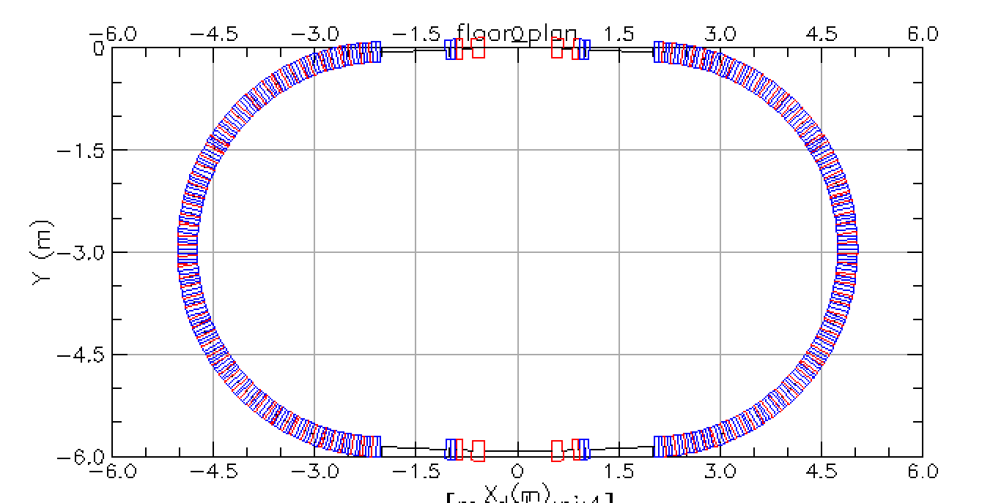
Fast Cycling FFA Synchrotron 10-250 MeV
Racetrack layout
Extraction Injection straight section
Section of the FFA arc
RF straight section

Slide 7
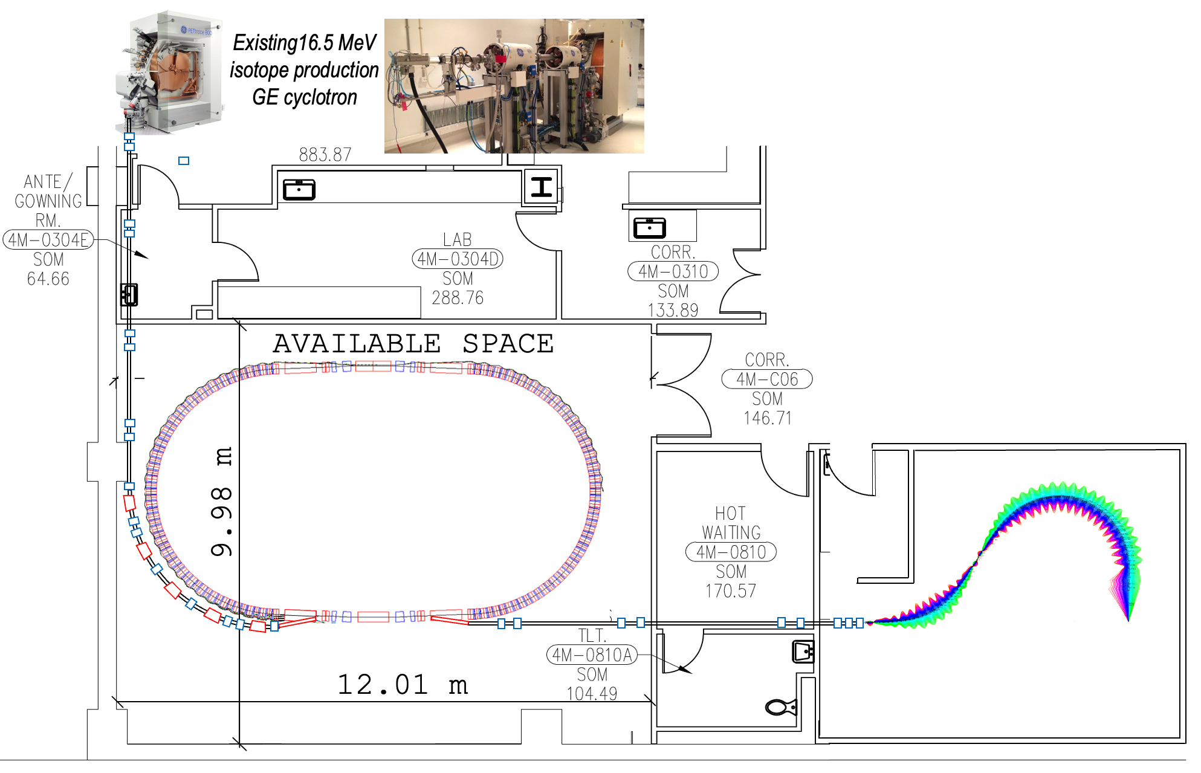
Fast Cycling FFA Synchrotron 16.5-250 MeV in available space at Stony Brook University Hospital

Slide 8
Application of fast-cycling FFA synchrotron for proton FLASH cancer therapy
FLASH cancer therapy: Multiple biological studies and even few patients’ treatments around the world in recent years confirmed significant improvements in the cancer treatment results; termed FLASH radiotherapy, involves delivering the same treatment dose but in much shorter time intervals — fractions of a second as opposed to minutes — and in far fewer fractions or even a single fraction and therefore at dose rates that are thousands of times higher [1].
The 16.5 MeV commercially available cyclotron has frequency of 42 MHz and provides 120 mA. This makes 1.8x10⁷ protons per bunch. As the synchrotron accelerates 30 bunches this makes per each synchrotron cycle N_{PROTONS} = 1.15 x 10⁸ x 30 = 5.4 x 10⁷. To achieve the 3.8 x 10¹¹ protons for FLASH therapy it is required to run the synchrotron per one FLASH treatment N=3.8 x 10¹¹/3.23 x 10⁹~ 700. The total time for the FLASH treatment is t_{FLASH}=700 x 898 μs = 632 ms!
[1] Konrad P. Nesteruk and Serena Psoroulas, “FLASH Irradiation with Proton Beams: Beam Characteristics and Their Implications for Beam Diagnostics”, applied sciences, 2021, 11, 2170, https://doi.org/10.3390/app11052170

Slide 9
Summary Slide
This LDRD will allow us to build an arc section of the fast-cycling FFA synchrotron and make a first step towards Stony Brook University Hospital proton FLASH therapy facility.
After the magnets of the arc block are successfully tested and corrected by multiple magnetic measurements the arc block will be tested with a 10-250 MeV proton beams. We expect a full confirmation with the beam measurements showing us that a proof of principle of the Fast-Cycling-Proton-Synchrotron with permanent magnets could be built.
In proton acceleration within the non-relativistic energy range the main problem is the limitation on the speed of magnetic field response to the change of energy. This limitation is now eliminated by using the permanent magnets for the same energy range. This is an extraordinary solution. It is possible to get synchrotron cycling with 1.3 kHz with respect to present maximum possible rates of 15-60 Hz. One of possible application is in FLASH cancer radiation therapy.
This proof of principle would enable new areas of research at BNL and magnets with multi-layer superconducting wires can establish:
Small, energy efficient, and fast cycling proton drivers for NPP and HEP
Fast cycling synchrotron for muon collider or accelerator driven system (ADS) for transmutation of nuclear waste.

