Slide 1
Optimization of the MPGD layers of EPIC detector
F. Bossù, L. Gonella, K. Gnanvo, L. Xuan
EPIC Detector Tracking WG
March 23, 2023

Slide 2
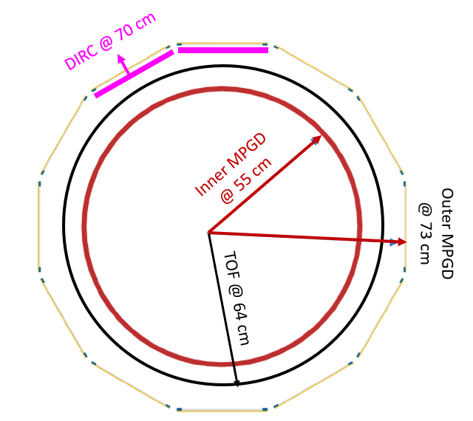
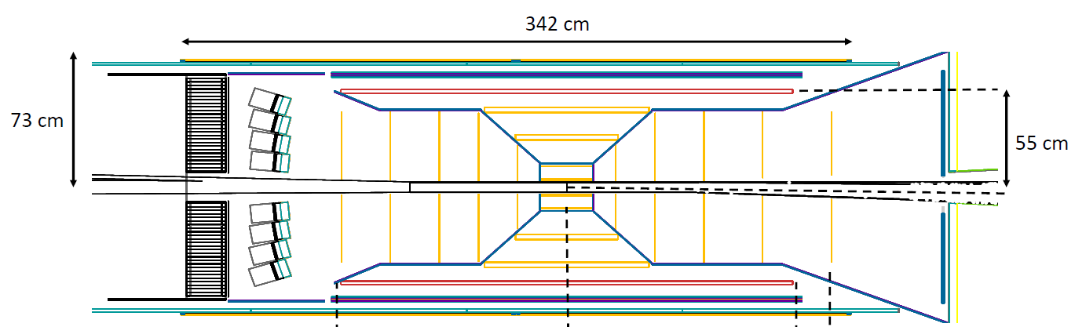
Barrel MM layer: Current configuration
MPGD layer does not contribute to momentum or transverse point resolution
Pattern recognition layer ➔ How many MPGD layers needed will be clear only after background simulation studies
Fast timing layer in addition to TOF layer
Issues with current design in barrel tracker
MM layer @ radius 55 cm between AC-LGAD and last Si Sagitta
Not optimal ➔ material thickness of the MM layer (which has worst resolution) will reduce the benefice of the TOF layer as tracking in the barrel
Why do the MPGD and TOF cover an |eta | up to 1.5 and not limited to 1.1
Impact on the Si support structure and services
Impact on tracking performance in the forward nd backward endcap
η = 1.1

Slide 3
Barrel MM layer: Questions from Elke (email 03/23/2023)
Points which need to be answered before an integration can proceed:
- what rapidity (+/-) needs to be covered by the MPGD —> length in z
- how does this length in z be optimally covered by a micromegas, 2 or 3 sectors in z
- if the MPGD layer spans a wider range in z as the MAPS Sagita layers to provide additional hit points to the disks in the endcaps, how does the material of the MAPS barrel layer services impact the precision of the MPGD tracking point
- how is the service routing of the MAPS layers impacted by the length of the MPGD layer
—> how does this impact the performance of other detectors becuase of the material budget distribution.
- if 3 sectors how do the services be routed to the middle sector
- what is the radius of the MPGD layer

Slide 4
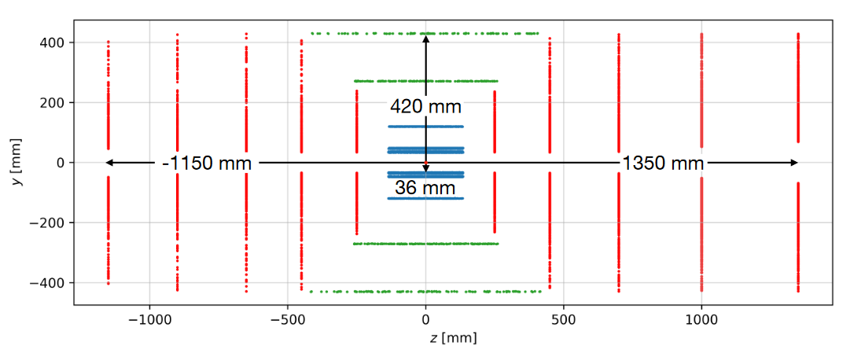
Barrel MM layer: Alternative option 1
Pros:
- two “fast” timing layers to help seed the track (plus TOF)
- cover only |eta| < 1.1
- easier to build and integrate
Cons:
less measurement points in the region 1.1 < |eta| < ~1.5
Poor resolution
TOF
MPGD

Slide 5
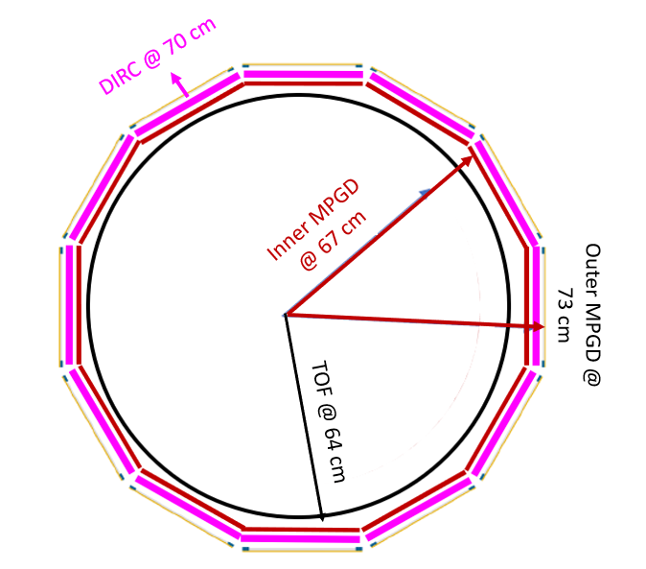
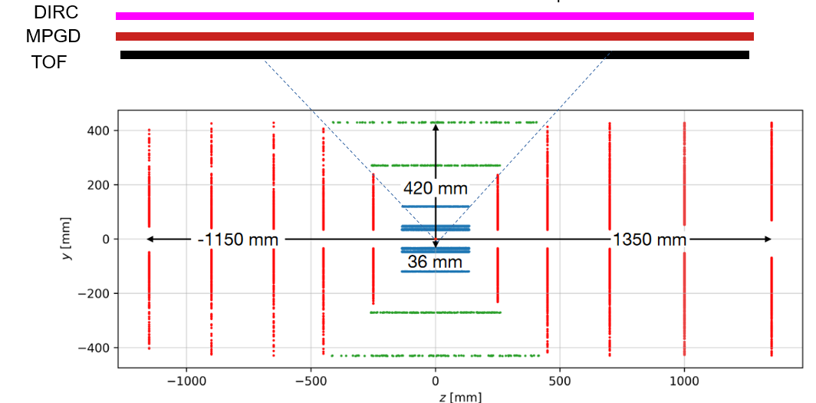
Barrel MM layer proposal: Alternative option 2
Swap order of TOF layer and MPGD layer(s) and switch from cylindrical to planar MPGDs
12 sector along radial direction ➔ like DIRC with Thin Gap MPGDs
One single long module along z
possible with µRWELL➔ CLAS12 µRWELL prototype)
PROS
Will allow 2 × 2D layers in one detector envelop
Vastly improved resolution along z axis
CONs: require to radius TOF radius by a couple of cm
Need to evaluate the impact on TOF performance

Slide 6
Forward

Slide 7
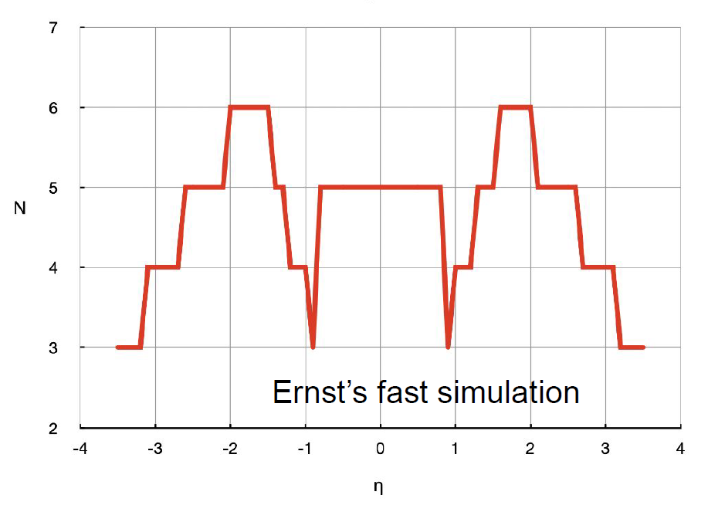
Forward Tracker: Extend the coverage around eta > 1.1
Option 1: Increase the diameter of the Si disc if this is a reasonable option
Natural solution to increase coverage but will add to the overall cost
Might not be straightforward approach ➔ need input from Si-trackers experts
Option 2: Complement the Si Disc by MPGD
Will be more cost effective but complicate the overall integration
Add fast MPGD layer behind TOF
MPGD rings
tgMPGD disc
TOF

Slide 8
Backward

Slide 9
Barrel backward: Thin Gap MPGD option
Possible MPGD solution:
- 2 to 4 layers in about 4cm just in front of the bRICH
- provide a “fast” set of points to help seed the track in the silicon

Slide 10
Barrel backward: µTPC or GridPix option
Alternative MPGD solution:
- 1 thick (~5cm drift volume) layer in µTPC mode
- will provide a track segment
- but slow

Slide 11
Barrel backward: SciFi option
SciFi tracker
- several layers of 250µm diameter fibers
- fast detectors
- but:
- how: integration of SiPM with cooling. Where?
- who: which institute(s)?

Slide 12
Back - up

Slide 13
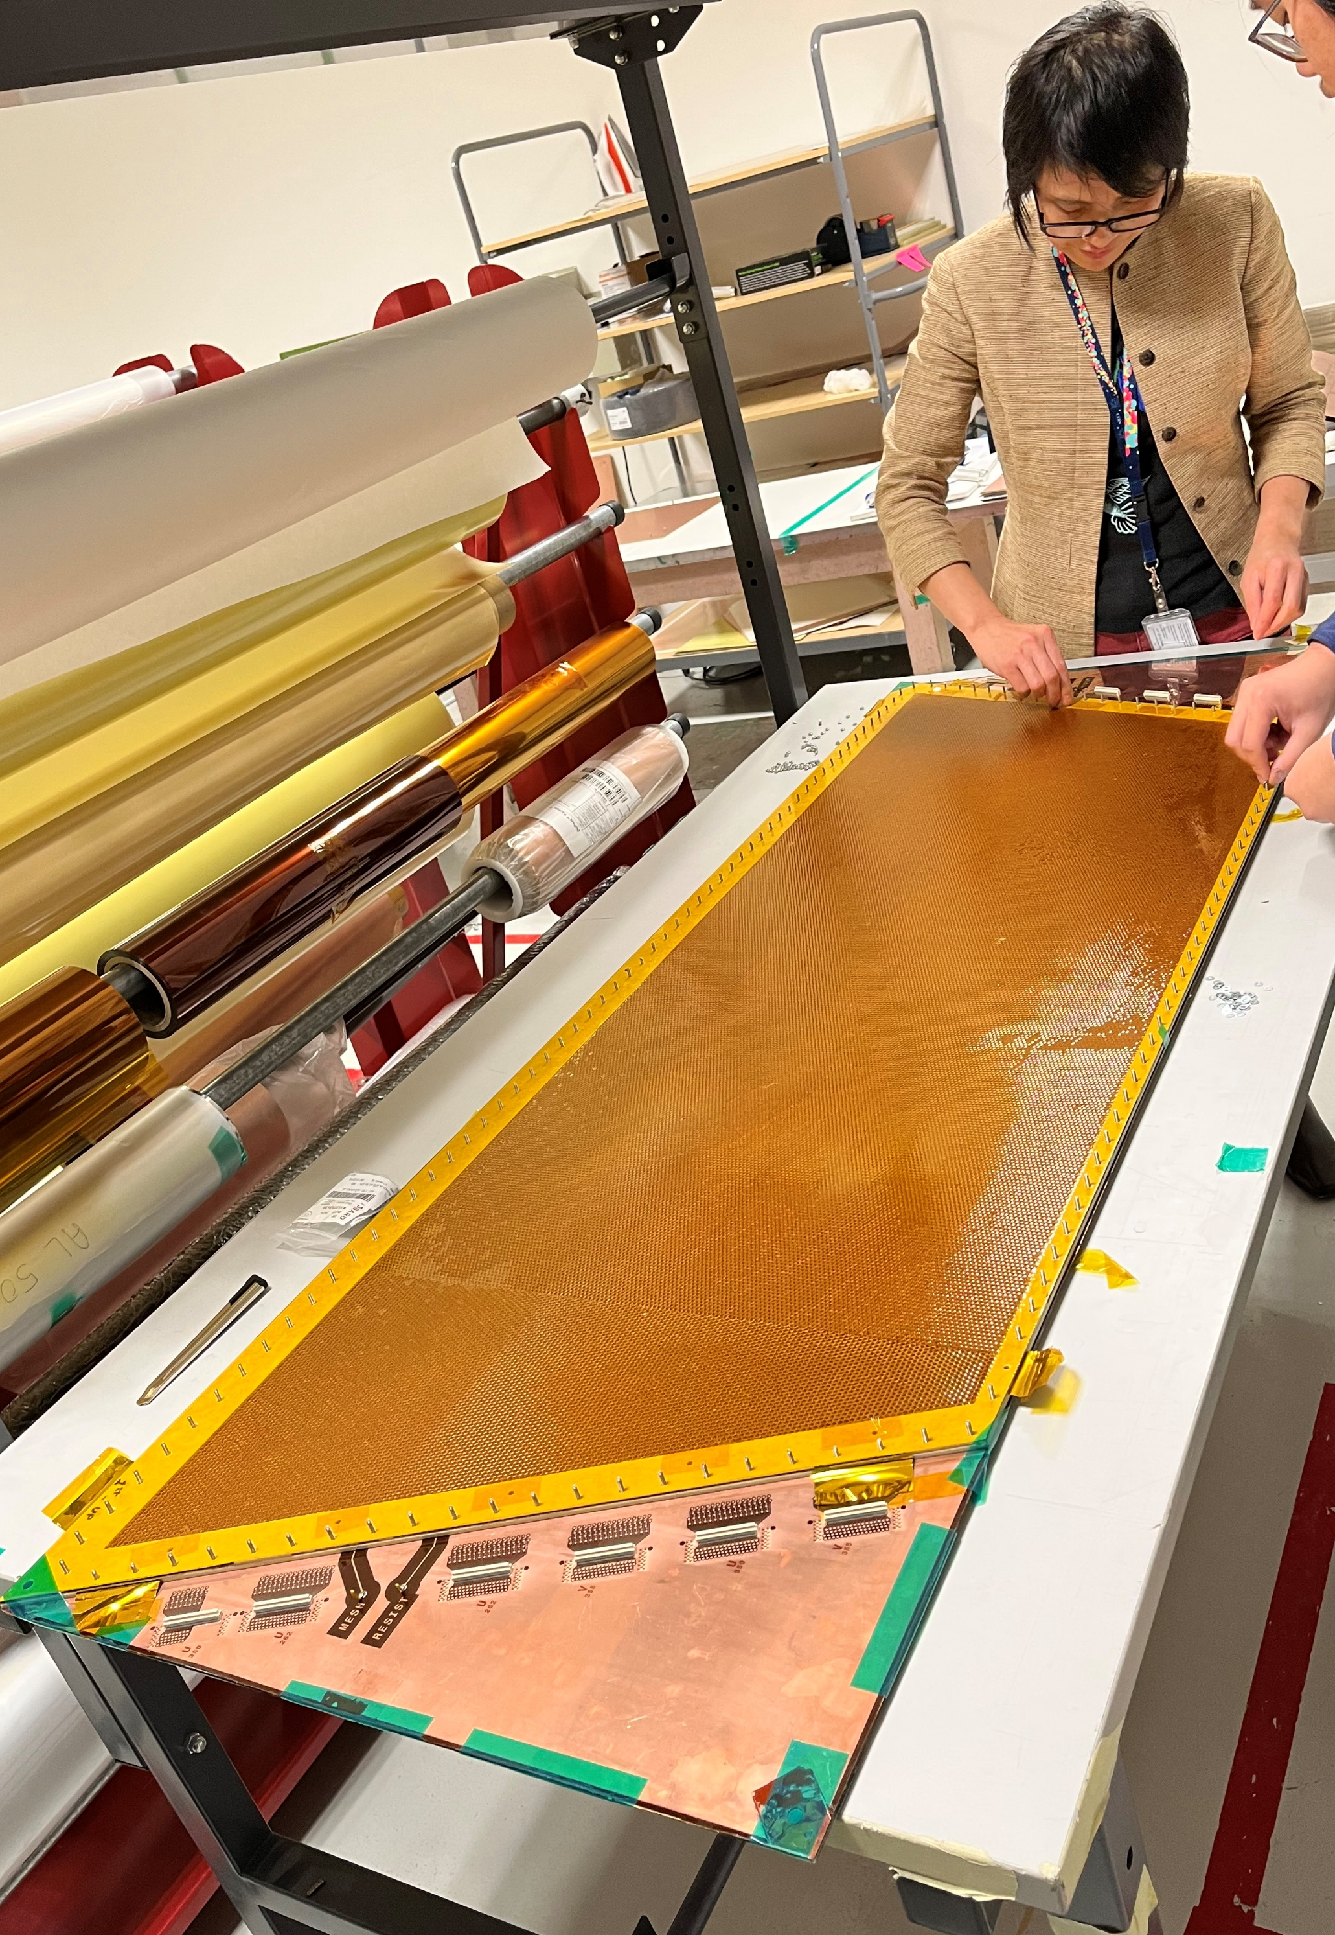
CLAS12 Luminosity Upgrade: Forward µRWELL Tracker
Prototype was completed in 12/2022 and is under test at JLab as of now
Few issues under investigation, mostly related to the fact that this is first prototype of this nature (largest area) ➔ no show-stopper identified
A lot of R&D questions also relevant for EIC MPGD layers are been studied with this prototype (large area, capacitive-sharing readout ….)
Dimension specifications

