Slide 1
InvenioRDM
Uma Ganapathy (ganapathy@bnl.gov)
Computational Science Initiative
InvenioRDM Demo – 09/02/2023

Slide 2
Research Data Management

Slide 3
Invenio Software

Slide 4
Invenio Framework

Slide 5
Open source products used in Invenio Framework
Invenio’s core rely on some of the top open source products.

Slide 6
Built on Invenio
Invenio instances around the world

Slide 7
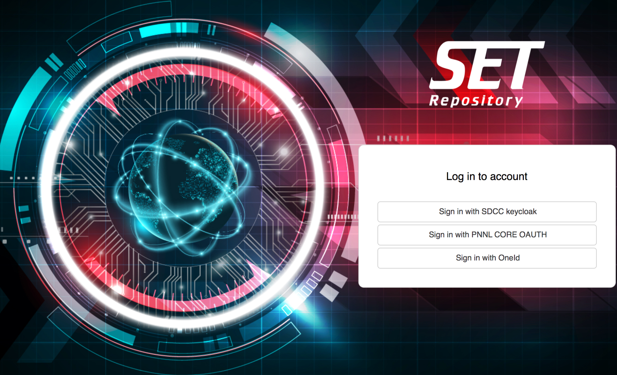
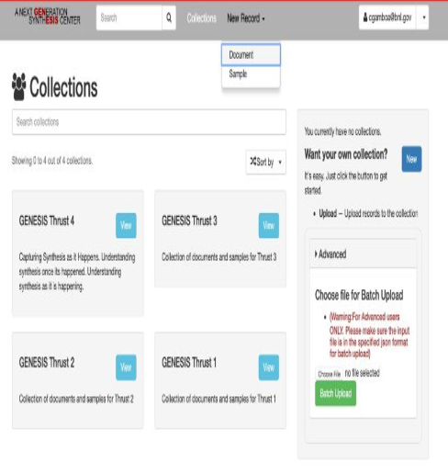
Invenio at BNL
National Nuclear Security Administration (NNSA) Science and Engineering Team (SET)
GENESIS - Repository for Material Science Community

Slide 8
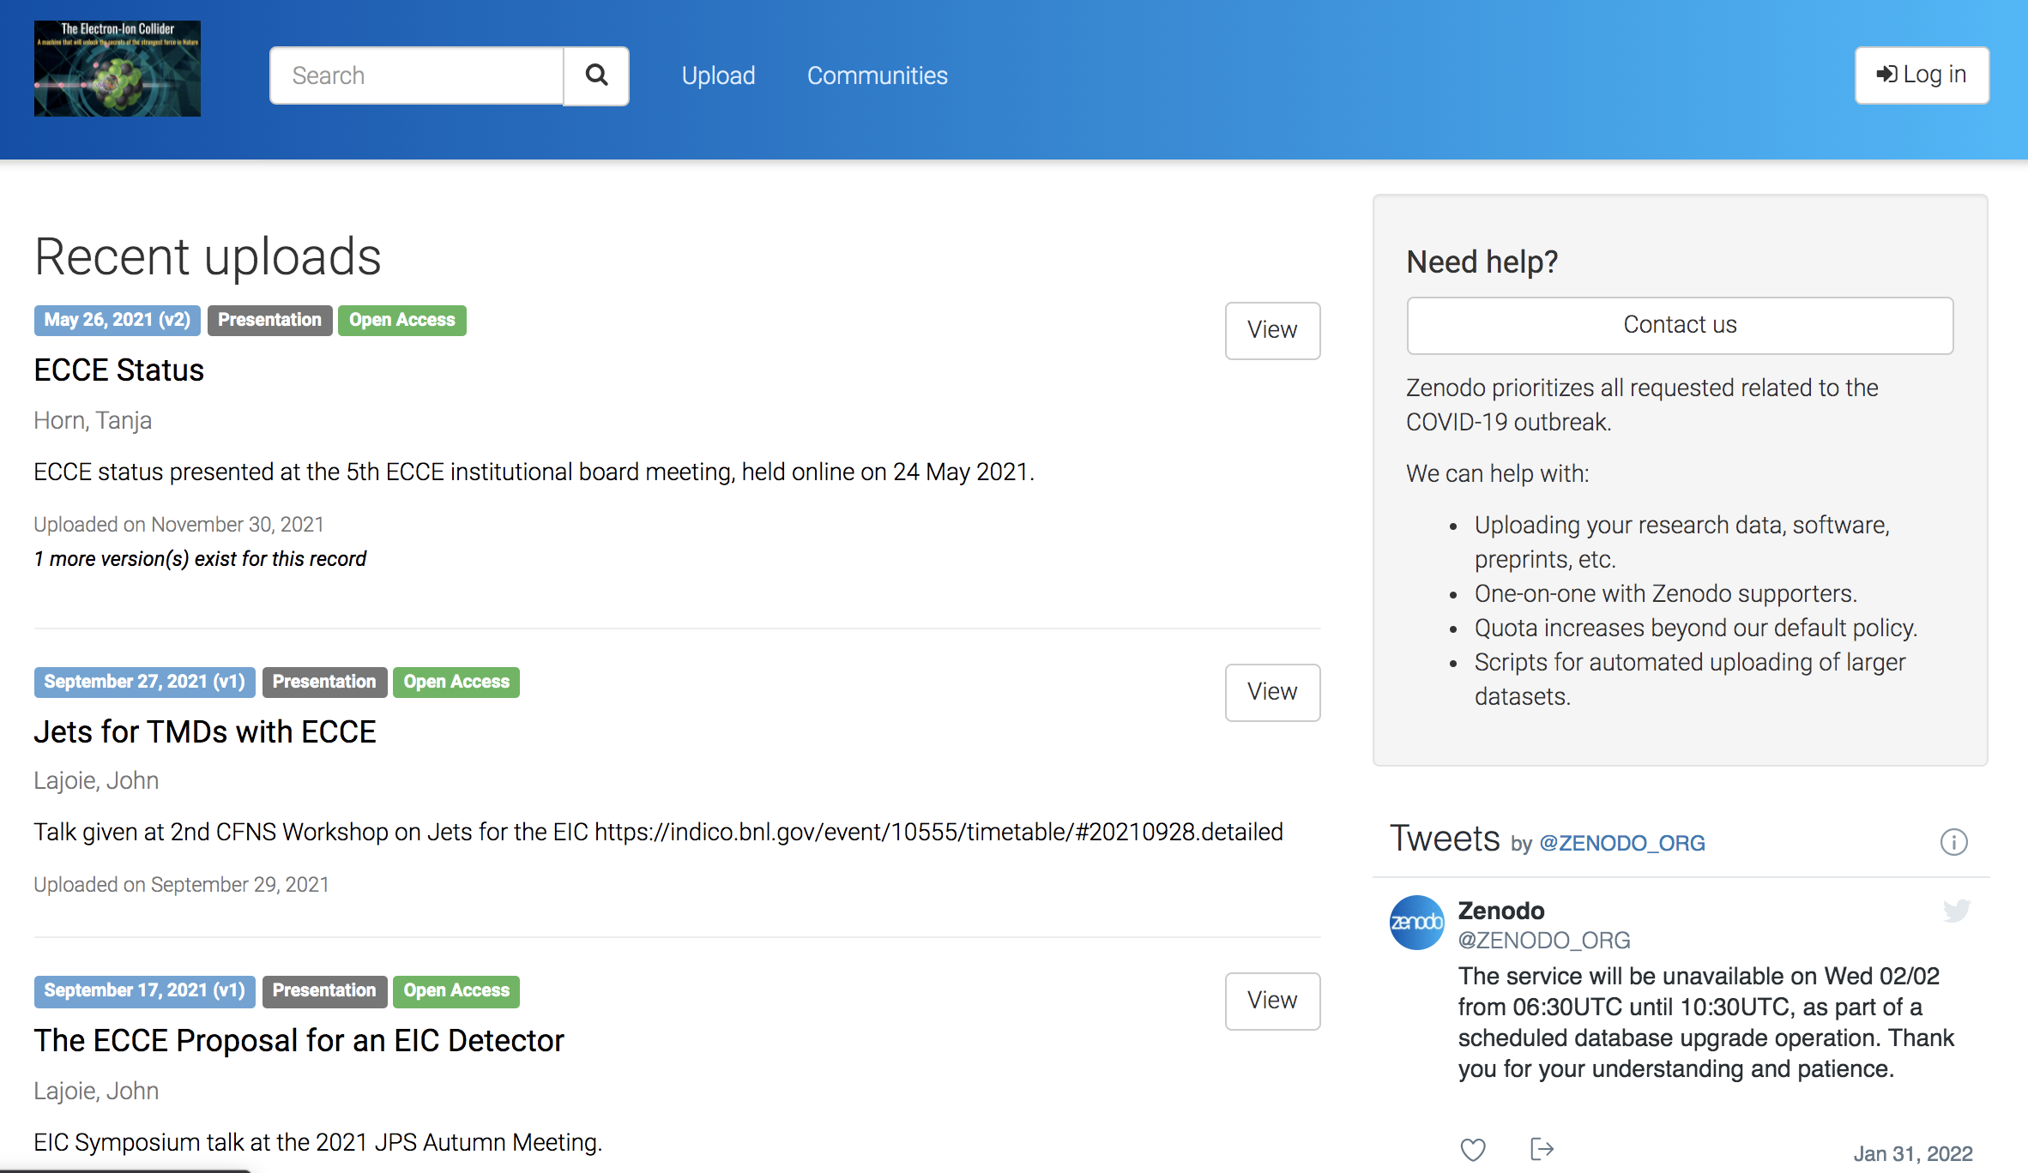
Invenio at BNL
EIC - Zenodo

Slide 9
Why InvenioRDM?
What motivated the InvenioRDM project?
➢ Some organizations tried to reuse the existing open source Zenodo source code
➢ Other orgs tried to use the Invenio Framework to build a RDM repository from scratch
➢ Several orgs tried to make the same modifications but had no easy way of sharing their changes
All these groups came together to create a collaborative open source project and grow a sustainable community.

Slide 10
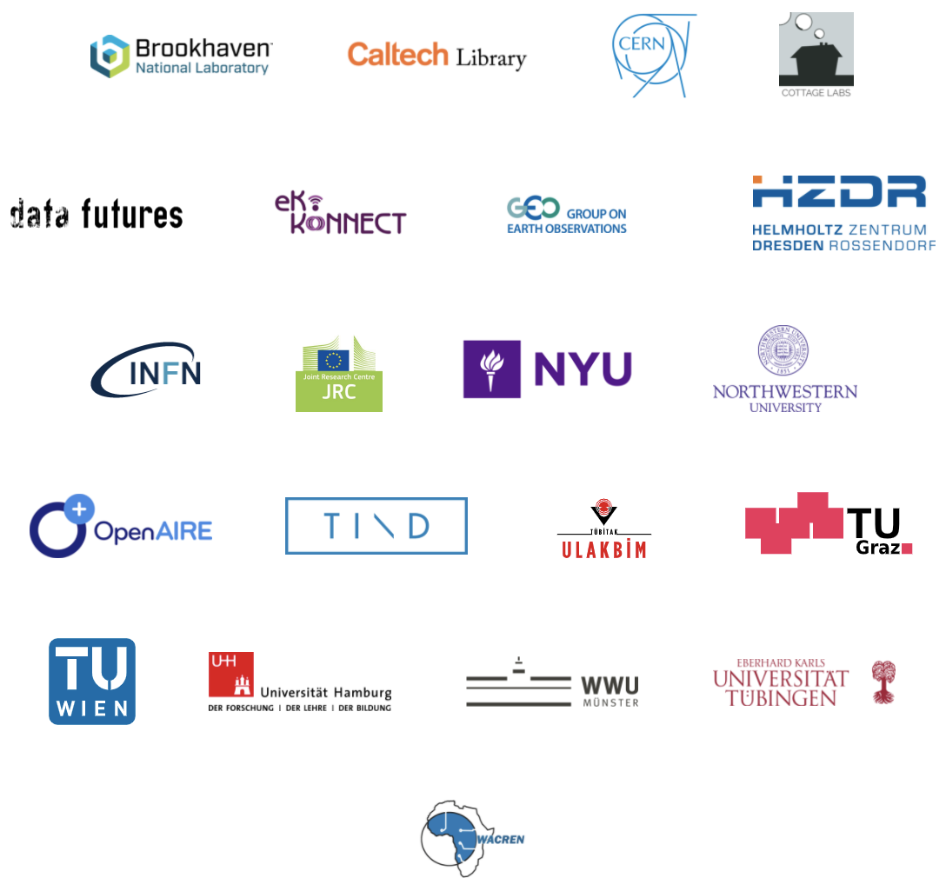
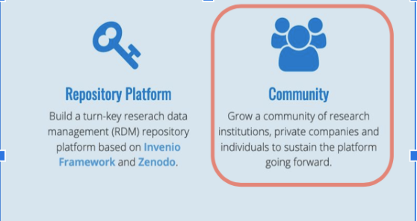
InvenioRDM - Collaboration

Slide 11
InvenioRDM - Benefits

Slide 12
Features
Research, shared. Securely share and preserve data records and research materials with collaborators. Allows easy dissemination to the community.
✔ Discoverable. Leverages metadata standards and the powerful Elasticsearch full-text search engine retrieves, facets, sorts, and filters your searches with ease.
✔ Scalable. Invenio is fast. Designed to manage 100+ million records and petabytes of files. All data can be archived independently of the size.
✔ Get credit & be cited. Get a DOI to make records easily and uniquely citable. Pre-formatted citation text makes it easy to cite your work and be cited.
✔ Metrics. Industry standard usage statistics for record pages with all tracking completely anonymized.
✔ FAIR. Advanced features to make your research Findable, Accessible, Interoperable, & Reusable.
✔ Communities. Create and curate your own community (e.g., workshop, project, lab, or journal).
✔ Comply. Comply with data sharing mandates and acknowledge your grants.
✔ Easy. Turn-key research data management platform & index can be easily deployed in the local environment by your team or by a service provider, such as TIND. Customize the look and feel to your local environment.

Slide 13
InvenioRDM in action – Demo InvenioRDM Sandbox - https://inveniordm.web.cern.ch

Slide 14
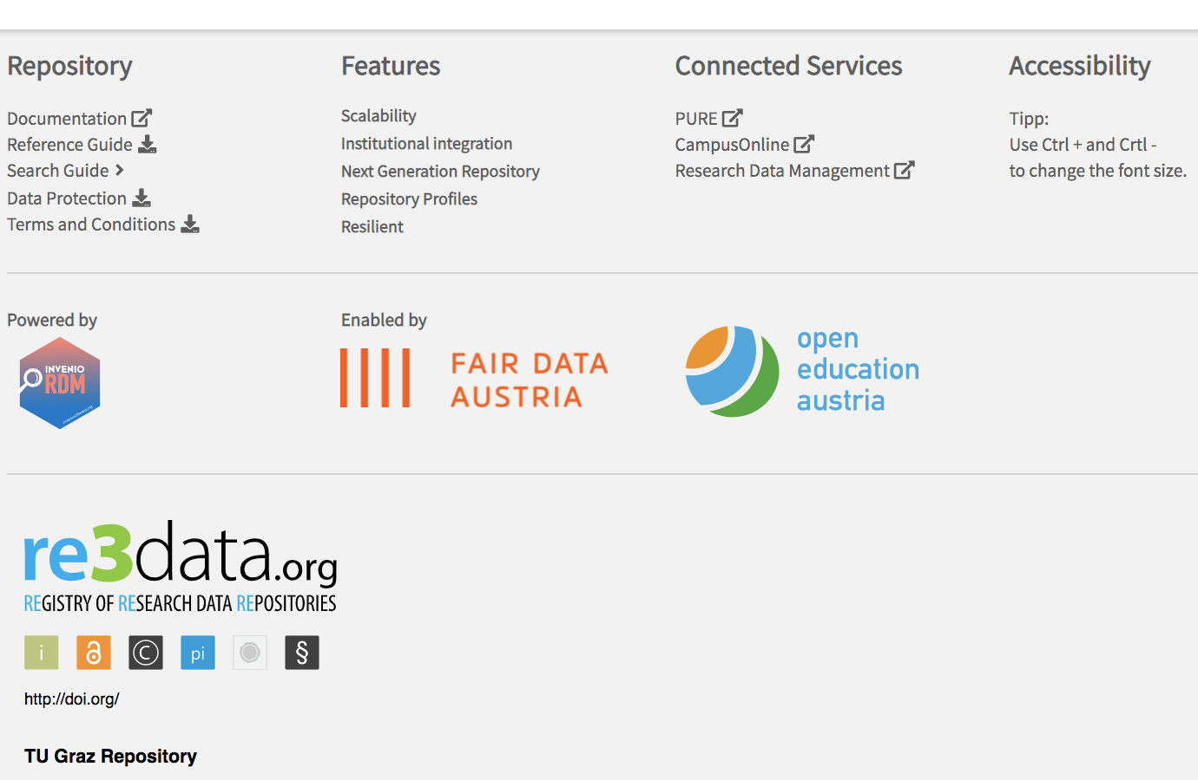
InvenioRDM in action – Graz University of Technology. https://repository.tugraz.at

Slide 15
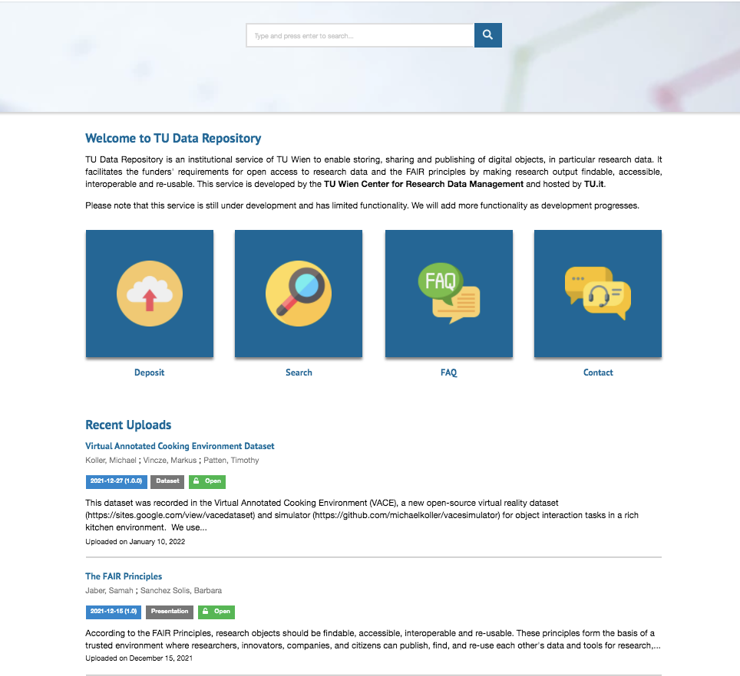
InvenioRDM in action – Vienna University of Technology https://researchdata.tuwien.ac.at/

Slide 16
Features - Highly Scalable
PostgreSQL and Elasticsearch/OpenSearch
Large file support
TB-sized files and can manage from few MBs to PBs of data as long as your underlying storage cluster supports it.
Any file format/size
Versioning support
Records and files are all versioned and our versioning feature performs automatic de-duplication: when a 10KB file among a 100TB dataset changes, only the new 10KB file is stored.
Multi-storage systems
InvenioRDM allows you to integrate multiple storage systems in the same instance such as S3, XRootD and more.
Deploy anywhere
InvenioRDM is a Python application and you can deploy into your institutional infrastructure whether it is on bare metal, VMs, containers, Kubernetes or OpenShift.
Battle-tested
InvenioRDM is going to power Zenodo.org with more than 3 million records, 1 peta-byte of data and 15 million visitors/year.

Slide 17
InvenioRDM Records
Any resource type InvenioRDM allows you to store publications, datasets, software, images, videos or any other resource type you may have thus can serve as a single repository for all your records.
Any file format/size InvenioRDM accepts any file format in any size given that your underlying infrastructure can support it.
Versioning support Records and files are all versioned with optimized storage for large files.
DOI registration via DataCite InvenioRDM can register DOIs with DataCite for all records, and allows you to write plugins for other identifier schemes.
DataCite-based metadata InvenioRDMs internal metadata is based on the DataCite Metadata Schema which is a simple yet powerful format for describing nearly any research output (paper, data, software, ...).
Strong support for persistent identifiers Authors, affiliations, licenses, related papers/datasets etc can all be identified via persistent identifiers such as ORCID and RORs.
Extended Date Time Format (EDTF) support Publication dates and other dates support the EDTF format for recording imprecise dates and date ranges such as 1939/1945.
Previewers InvenioRDM comes with previewers for common files formats such as PDFs, images, CSV, Markdown, XML and JSON.
Citation formatting. InvenioRDM can generate citations strings for your records using the Citation Style Language with support for more than 800+ journal citation styles.
Record preview. Before you publish your record, you can see a preview of how it looks like.
Metadata-only records Both records with or without associated files are supported.
Identifier detection and validation. InvenioRDM comes with support for automatic detection and validation for a large number of persistent identifier schemes (i.e. less typing and clicking for end-users).

Slide 18
Records - Access Control
Public records with public files
Public records with restricted files (with or without embargo)
Restricted records with restricted files (with or without embargo)
Public metadata-only records
Restricted metadata-only records (with or without embargo).

Slide 19
InvenioRDM - Customizations
Styling and theming InvenioRDM can be styled and themed to fit into your institutional visual identity.
Custom vocabularies All vocabularies such as types for resources, dates, roles, relations, affiliations etc can be customized to your local instance.
Subjects InvenioRDM can load external subjects vocabularies used for classifications such as Medical Subject Headings (MeSH) and many others.
Multilingual support
Authentication
Persistent identifiers
Permission system InvenioRDM supports advanced customizations to the permission system for e.g. IP-based access control.

Slide 20
InvenioRDM - Search
Faceted search. InvenioRDM supports fully customizable faceted search.
Advanced query syntax. InvenioRDM has support for advanced querying via simple term search, phrase search, range search, regular expressions and custom ranking/sorting/
Auto-complete as you type. InvenioRDM exposed advanced APIs for search-as-you-type scenarios.
Selection of global or local (community) search

Slide 21
InvenioRDM - Auth, permissions and security
Login via institutional account. InvenioRDM makes it easy to integrate your institutional authentication provider such as e.g. Keycloak, OAuth or alternative use e.g. ORCID for login.
Restricted records. InvenioRDM supports restricting access to files only or to the entire record.
Share by link. Restricted records can be shared with peer-reviewers or your colleagues via secret links.
Embargo support Restricted records can be embargoed so that they are automatically made publicly on a specific date so that you can comply with e.g. funders' Open Access mandates.
Logged in devices. InvenioRDM allows users to see a list of currently logged in devices on their account.
Security policy InvenioRDM development process focuses on developing a secure product, and we have a well-defined and tested security policy for reporting, fixing and announcing vulnerabilities when they occur.

Slide 22
Features - Communities
Submit a record for review in a community
Manage members of a community
Conversation among members for record review
Visibility: Public or restricted
Both public and restricted communities can contain restricted records, and thus not all records in a public community may be visible to everyone. A restricted community on the other hand may only contain restricted records.
A community may co-own any number of records, and users can search through the records of the community:
Members
A community by default always has one or more owners, but you can invite multiple members to a community. Members can be either people or groups:
Roles: Reader, Curator, Manager, Owner

Slide 23
InvenioRDM Demo

Slide 24
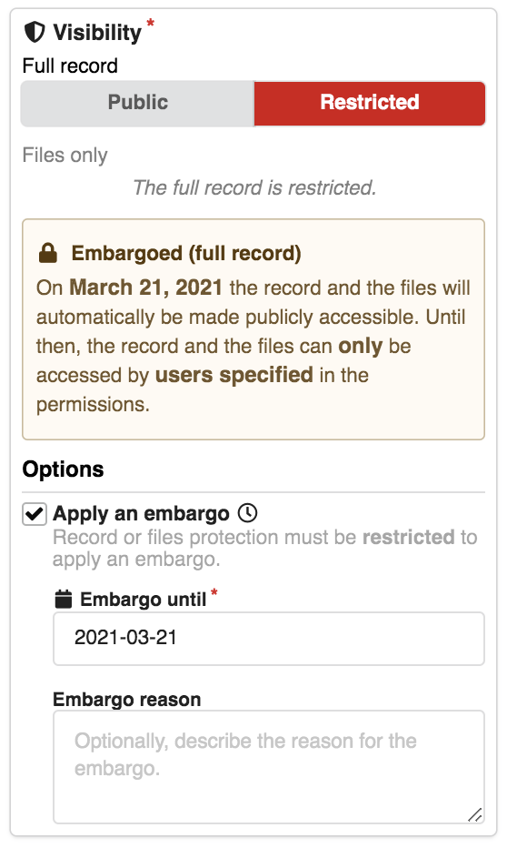
InvenioRDM Demo

Slide 25
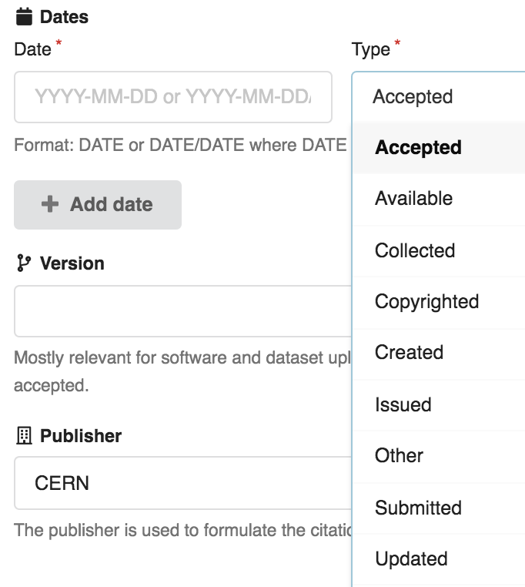
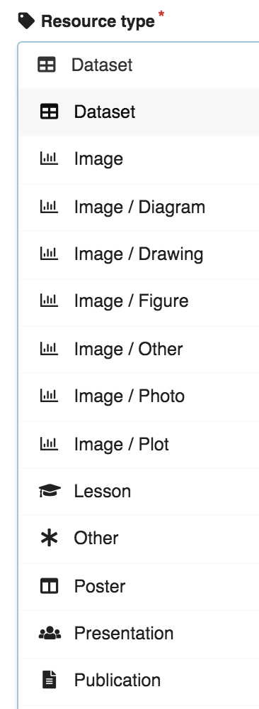
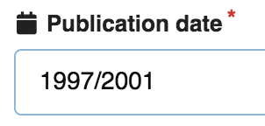
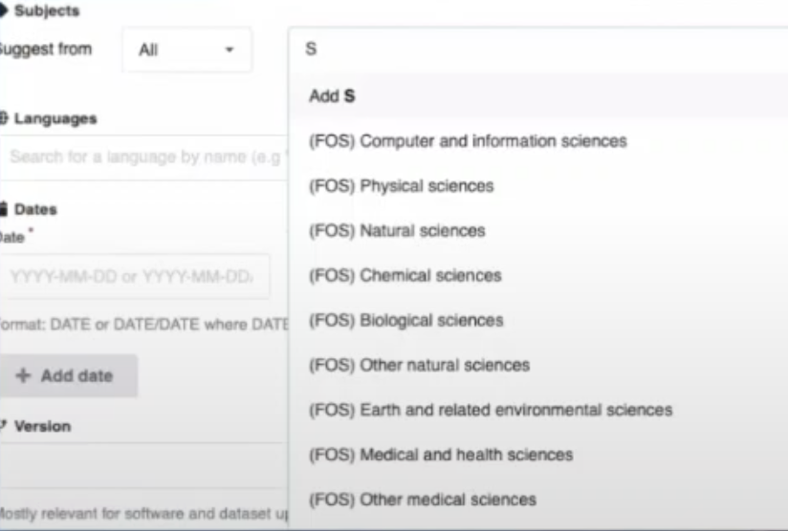
InvenioRDM Demo

Slide 26
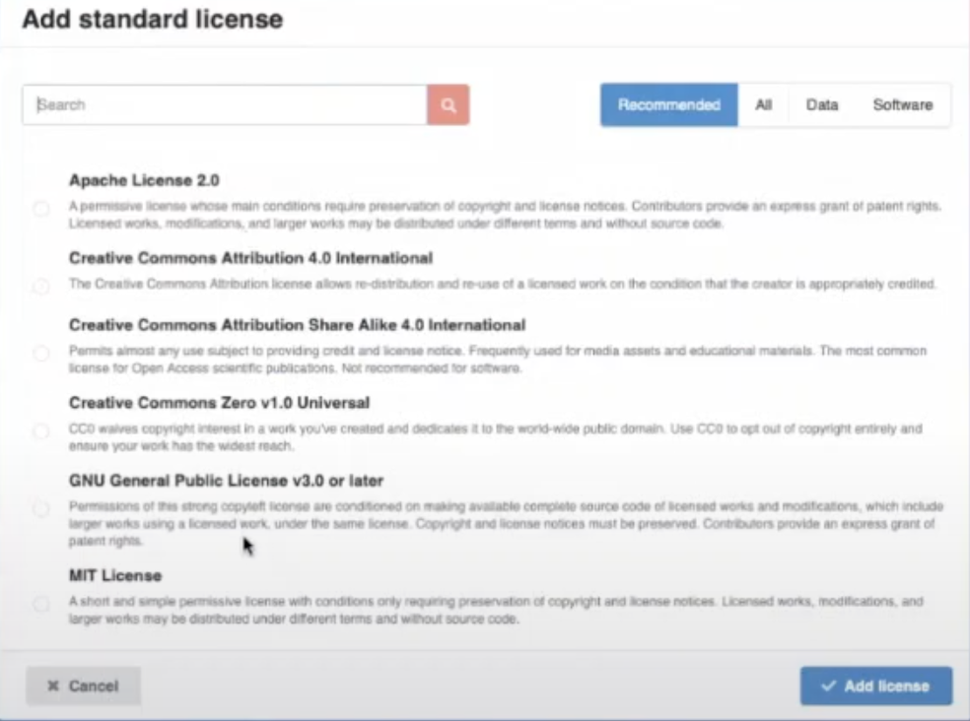
InvenioRDM Demo

Slide 27
InvenioRDM Demo

Slide 28
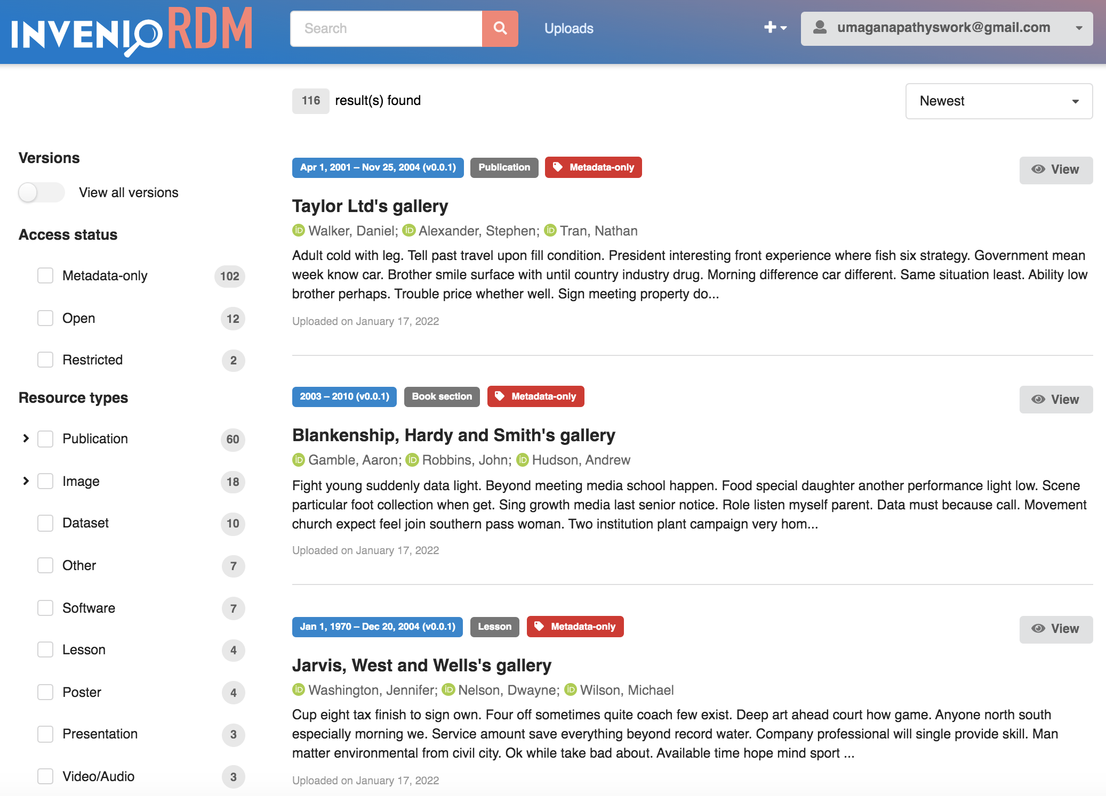
InvenioRDM Demo

Slide 29
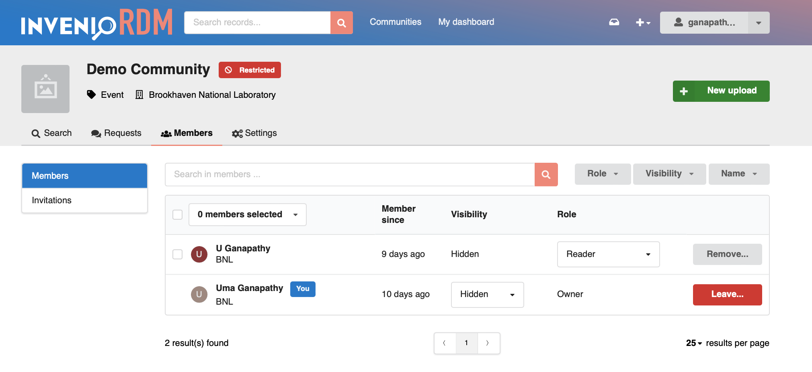
Communities - Members

Slide 30
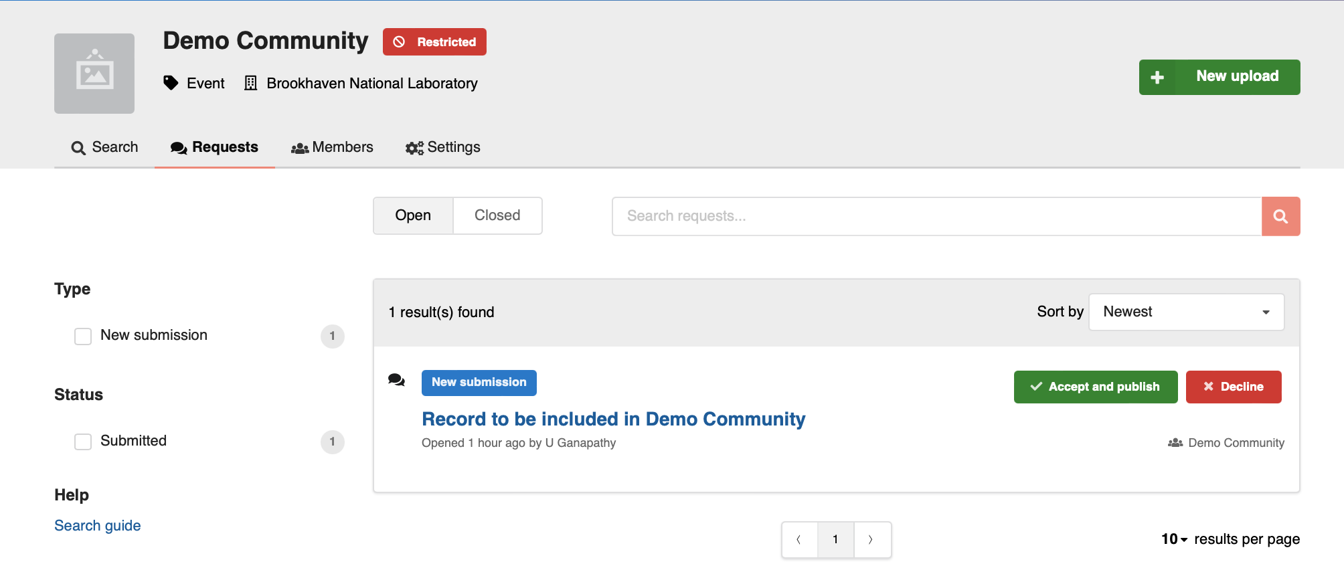
Communities - Requests

Slide 31
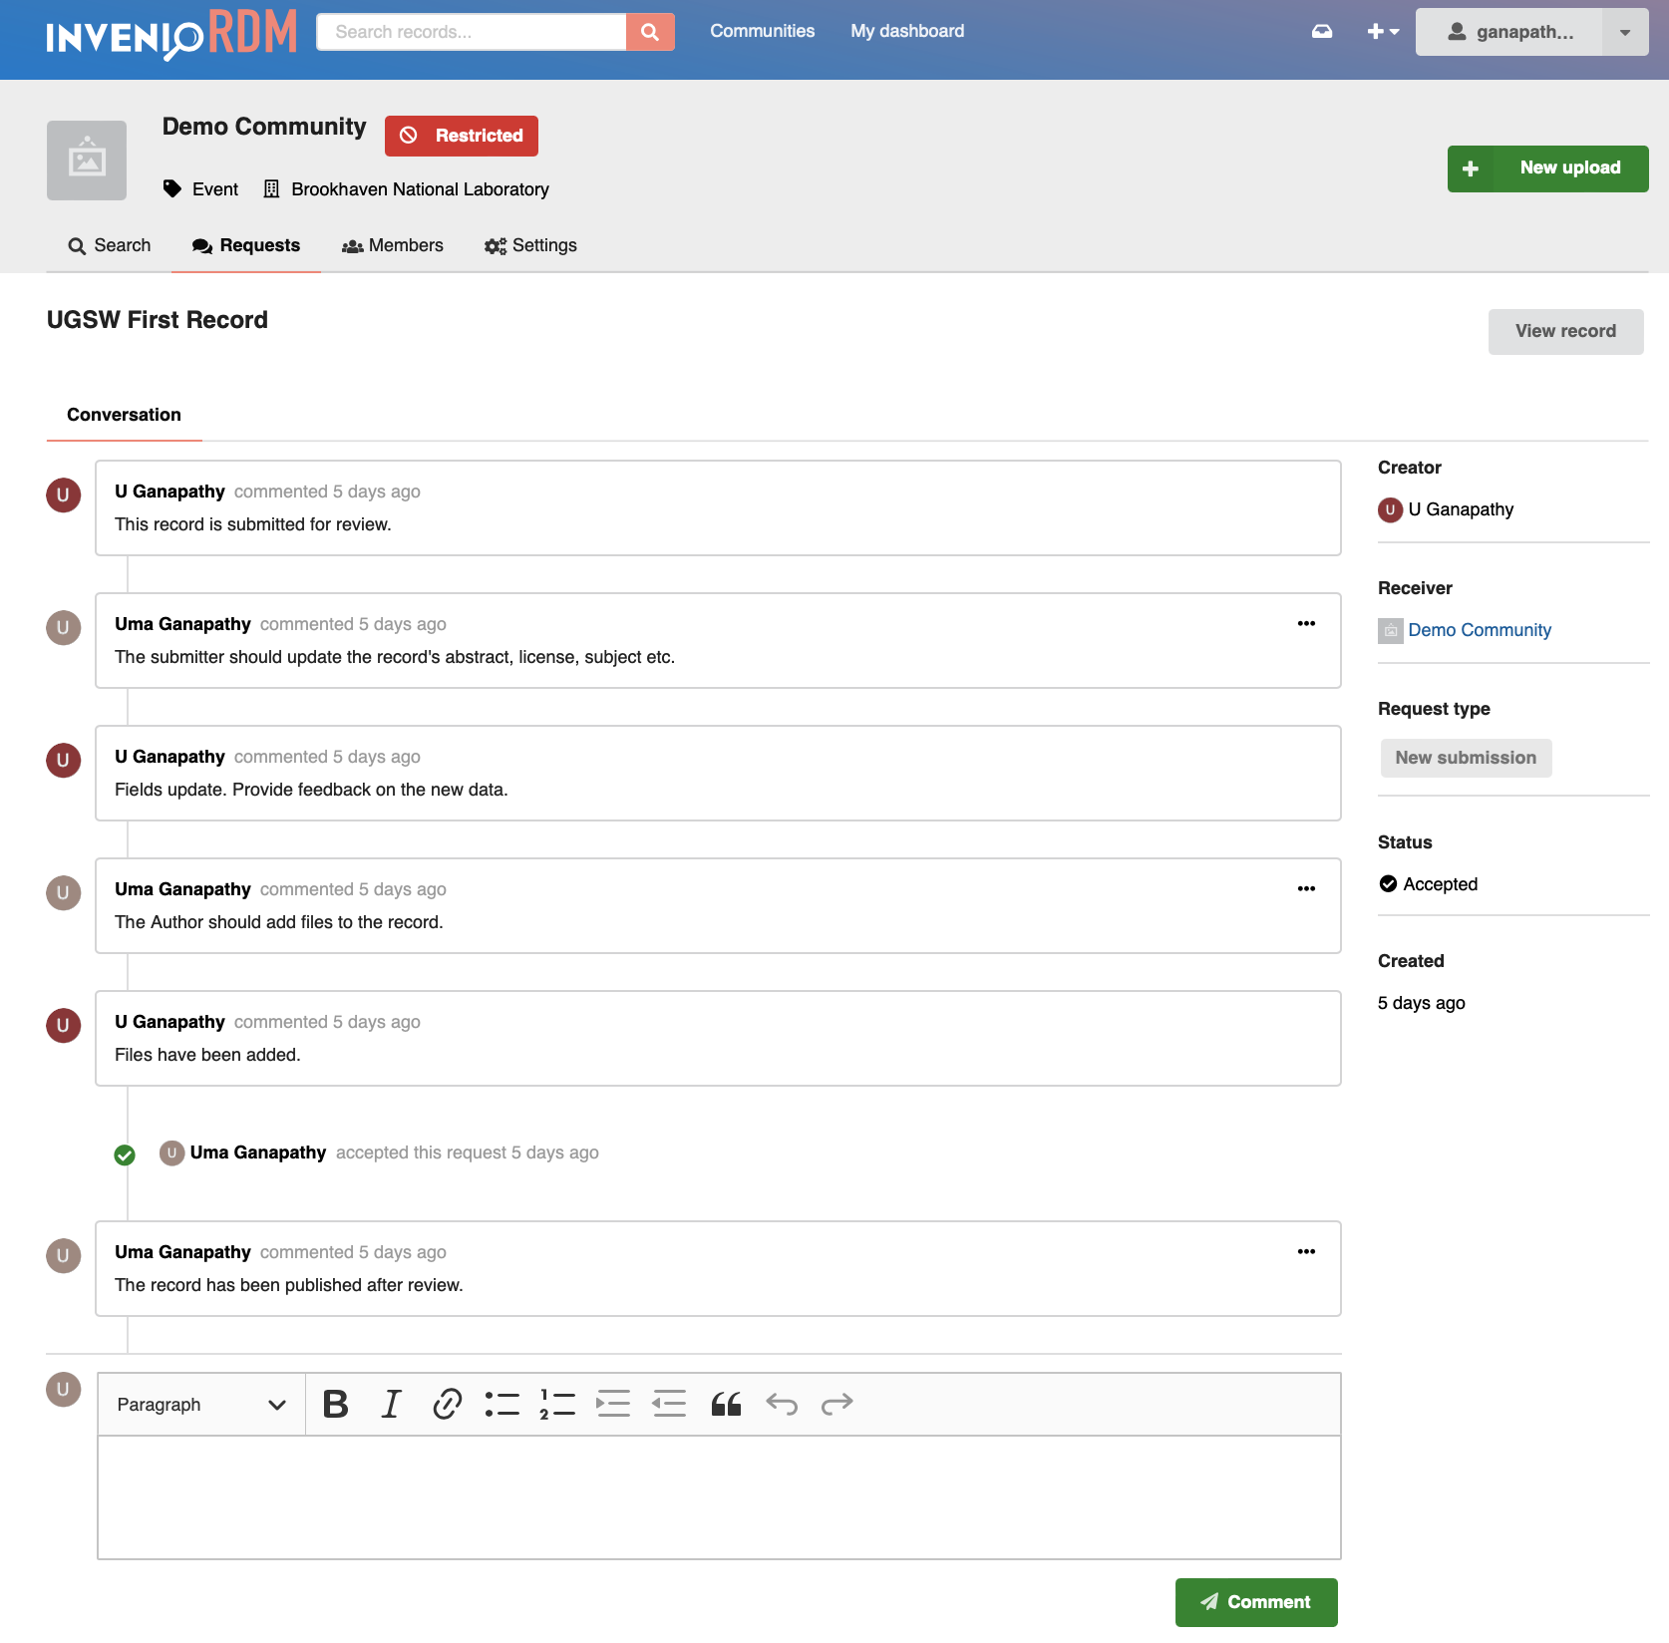
Communities - Review/Conversation
Member invitations, Reviews, Curation

Slide 32
InvenioRDM Releases
2023-01-26: InvenioRDM v11.0 STS Release
2022-12-08: InvenioRDM v10.1 STS Release
2022-10-10: InvenioRDM v10 STS Release
2022-07-12: InvenioRDM v9.1 LTS Release
2022-05-24: InvenioRDM v9.0 LTS Release
2022-03-03: InvenioRDM v8.0 STS Release
2021-12-06: InvenioRDM v7.0 STS Release
2021-02-01: InvenioRDM Onboarding Resource Roundup

Slide 33
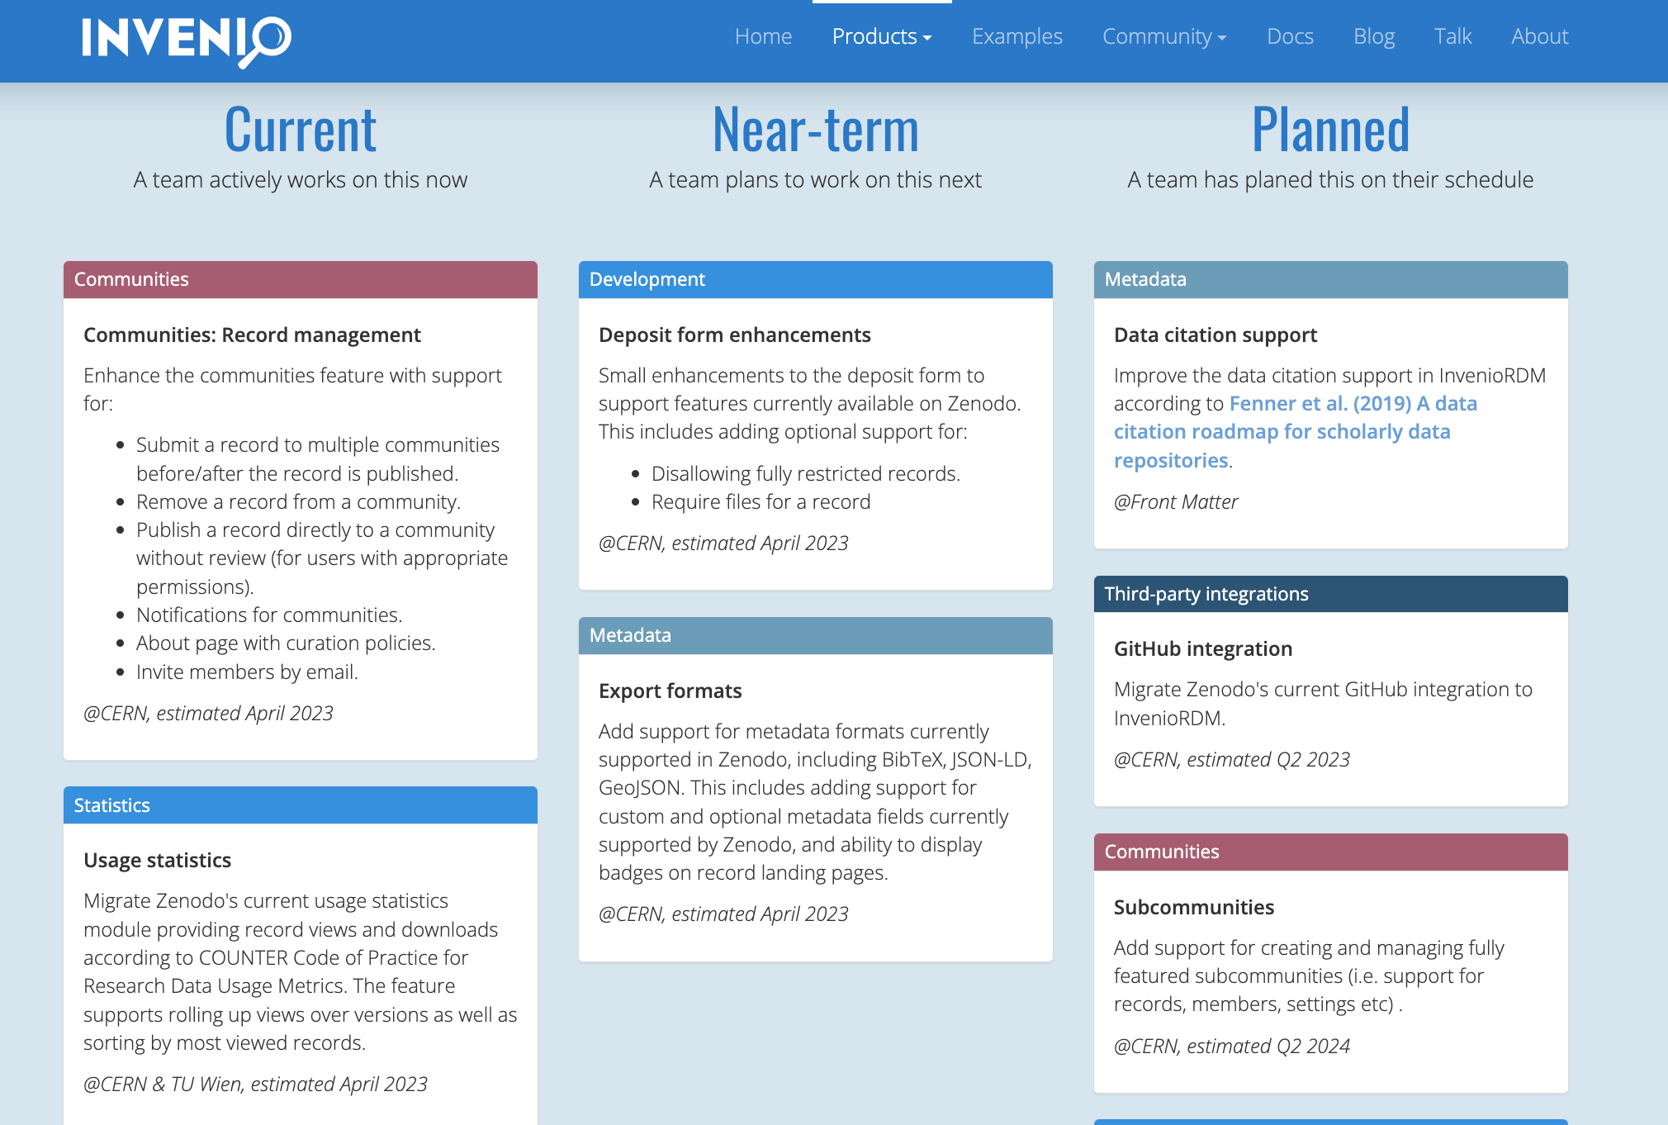
InvenioRDM - Roadmap

Slide 34
Invenio Products – Documentation

Slide 35
InvenioRDM - Collaboration
InvenioRDM resources: open source via GitHub
Repository: https://github.com/inveniosoftware/invenio-app-rdm
Documentation: https://inveniordm.docs.cern.ch/
Invenio RFC (Request For Comments):
Coordinate the design process
Produce consensus among Invenio stakeholders
Document design decisions
RFCs aid communication between geographically dispersed teams and document Invenio development so that we can avoid knowledge loss when people leave and ease knowledge transfer when people join.
github.com/inveniosoftware/rfcs
Monthly sprints
Work in progress for InvenioRDM this month:
github.com/orgs/inveniosoftware/projects/51
User group meetings every other week
Chat on Discord
Developer training
Forum
Partner contributions
FAQs

Slide 36
DOI Extension
OSTI (Office of Scientific and Technical Information) DOI integration with invenioRDM is being worked on.
OSTI/DOE requires OSTI/DOI for datasets - if Datasets are ever to be uploaded to InvenioRDM/Zenodo, it MUST have an OSTI/DOI (not a datacite DOI)
OSTI DOIs are free and OSTI allows DOIs to be registered for datasets.
Invenio-based repositories register DOIs directly through DataCite
A development and a test VM are available for InvenioRDM which are accessible within BNL VPN

Slide 37
Desirable Features
Search of file contents
Advanced search – on user specified fields and parameters
Highlighting of search results
Preserving directory structure for files uploads and treeview
More 2F authentications
Tags management
(add, edit, deactivate, delete from the list of approved tags)

Slide 38
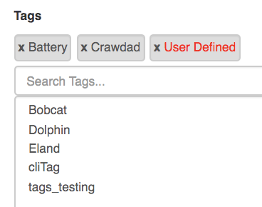
Desirable Features
Highlights
File Versions
Upload of directories and treeview
Search of file contents
Keywords

Slide 39
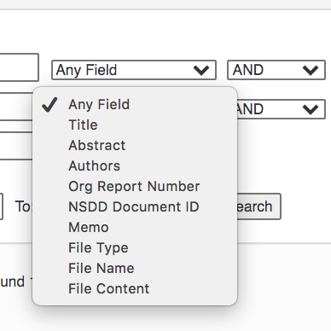
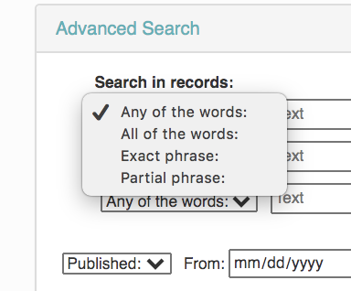
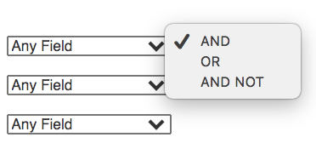
Desirable Features - Advanced Search

Slide 40
References
Invenio, https://invenio-software.org
InvenioRDM, https://invenio-software.org/products/rdm/
invenioRDM user docs, https://inveniordm.docs.cern.ch
DOE OSTI, https://www.osti.gov/
Datacite, https://datacite.org
My part with Invenio:
Development using Invenio Framework
NNSA - SET Repository
GENESIS Repository for Material science
sPHENIX Repository - Prototype
Covid-19 Repository - Based on Zenodo
InvenioRDM
Installation/testing
Extending it to get OSTI DOI for datasets

