Slide 1
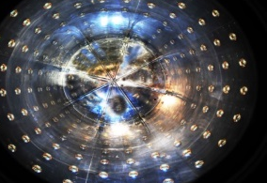
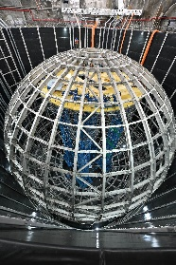
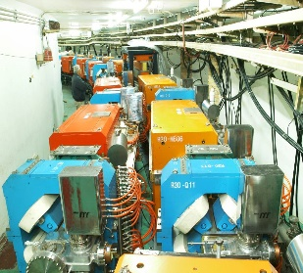
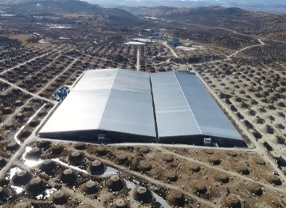
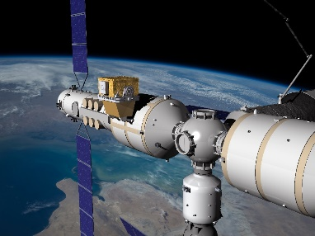
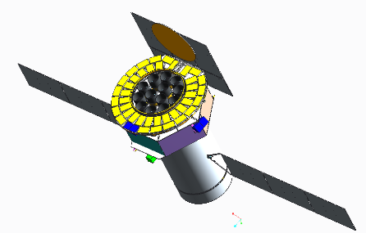
Plans of Particle and Astro-Particle Physics in China
Yifang Wang
Institute of High Energy Physics, Beijing
P5@BNL online, Apr.13 , 2023

Slide 2
Outline
Hadrons
Higgs
Neutrinos
Astro-Physics
Dark matter and other searches
Summary

Slide 3
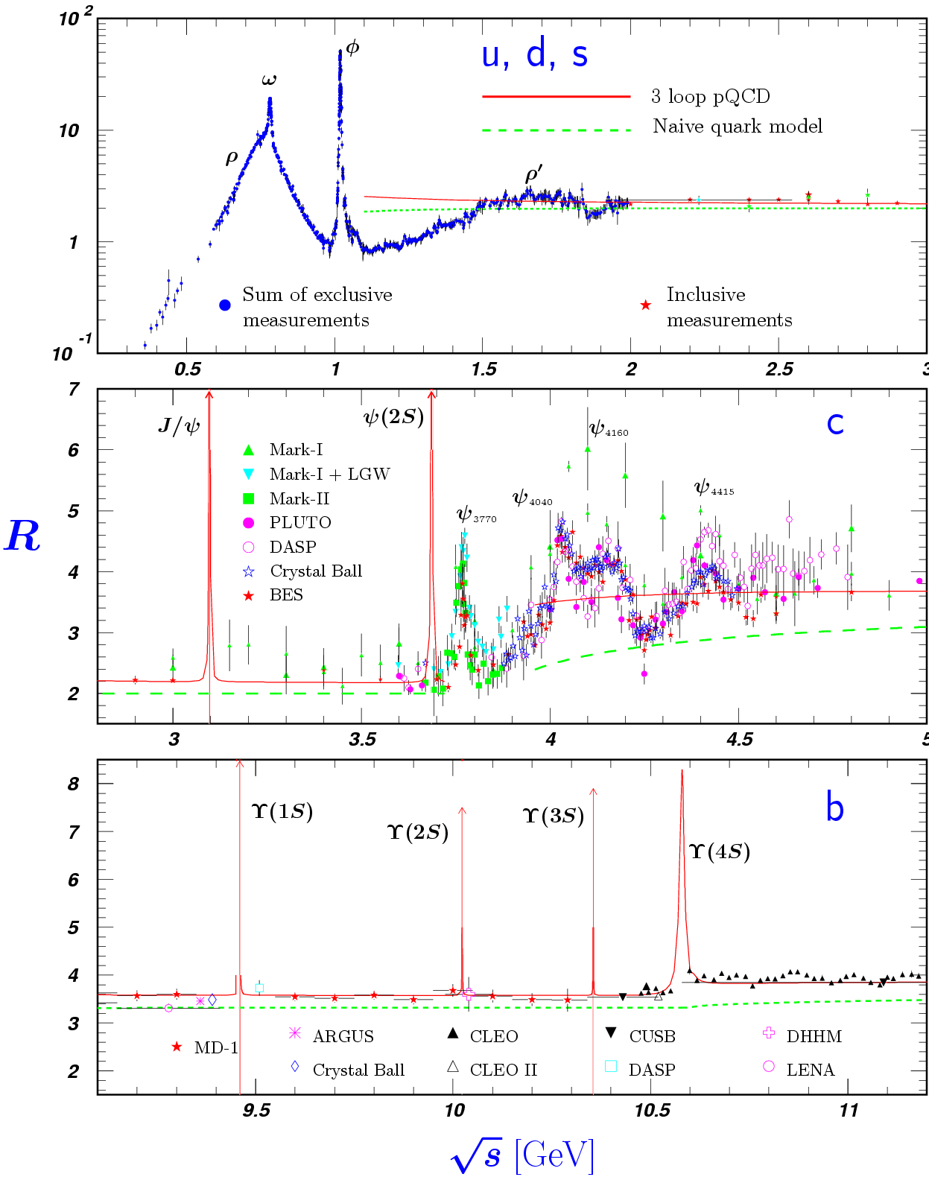


Hadrons：BEPCII/BESIII 2009-2030
Reach physics at threshold for exotic states, XYZs, EW test, QCD studies, etc.
More than 500 papers published and 40 fb⁻¹ more data requested
Upgrade to be completed in 2024:
  Luminosity × ~3
  Maximum beam energy from 2.45 to 2.8 GeV ➔ for charmed baryons
Large international collaboration:
  > 500 members from 74 Institutions in 15 countries
BEPCII
Future physics program of BESIII

Slide 4
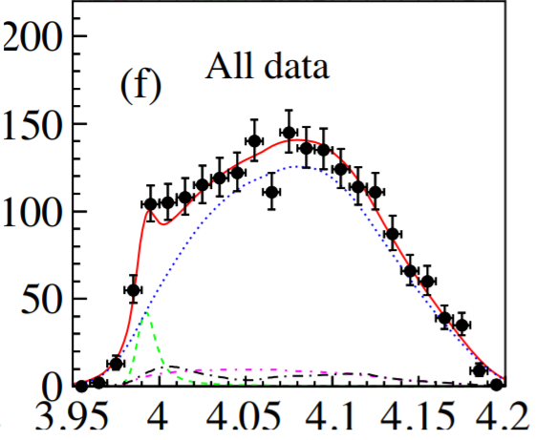
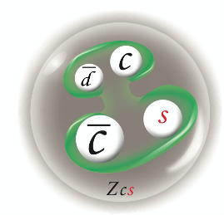
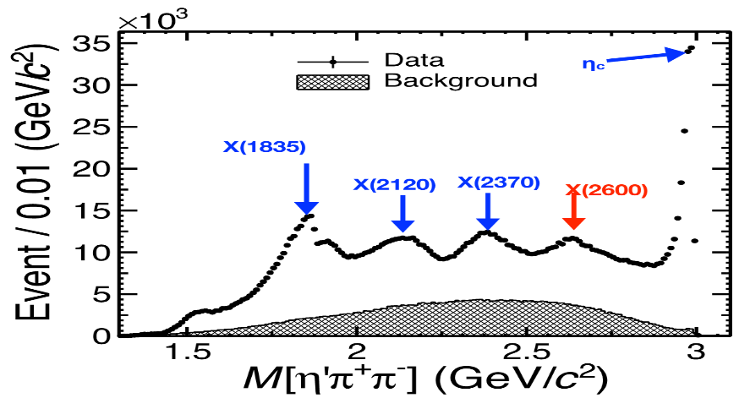

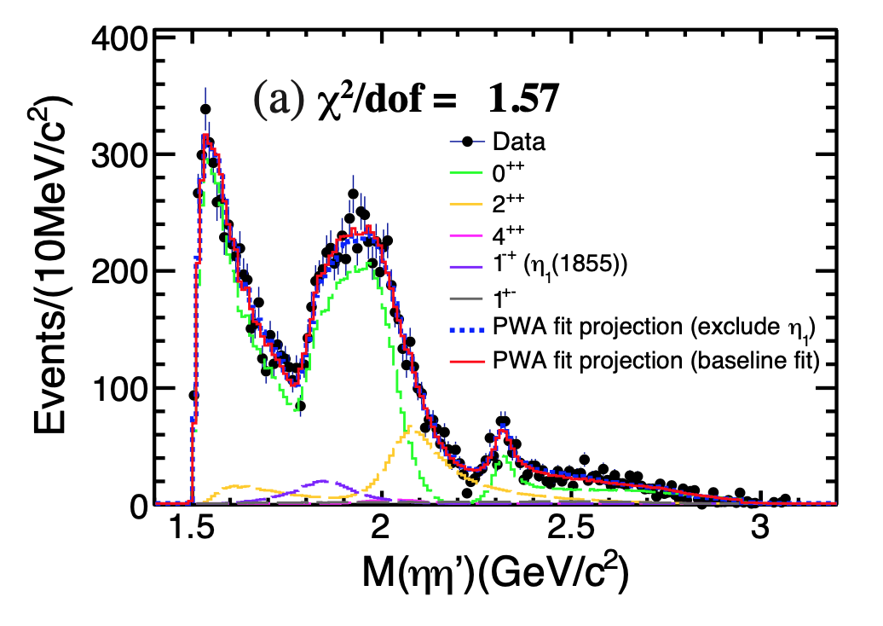
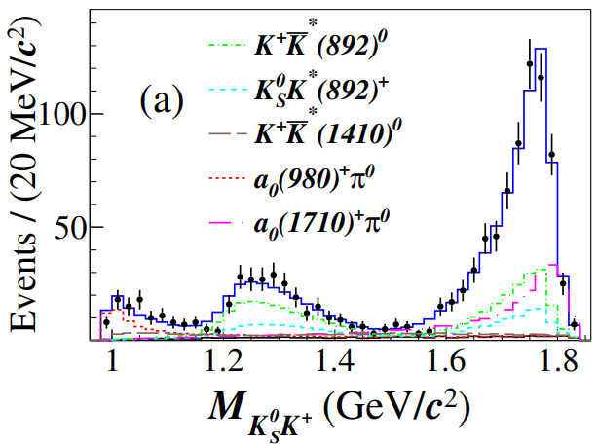


Latest Results from BESIII
Observation of Z_{cs}(3985)
Observation of X(2600)
Phys. Rev. Lett. 129, 042001 (2022)
Phys. Rev. Lett. 129, 112003 (2022)
Observation of 1⁻⁺ η₁(1855)
Observation of Isospin=1 scaler $a_{0}\left(1817\right)+$
Phys. Rev. Lett. Accepted, arXiv:2202.00621
Phys. Rev. Lett.，arXiv:2204.09614
$$D_{s}^{+}→K_{S}^{0}K^{+}π^{0}$$

Slide 5
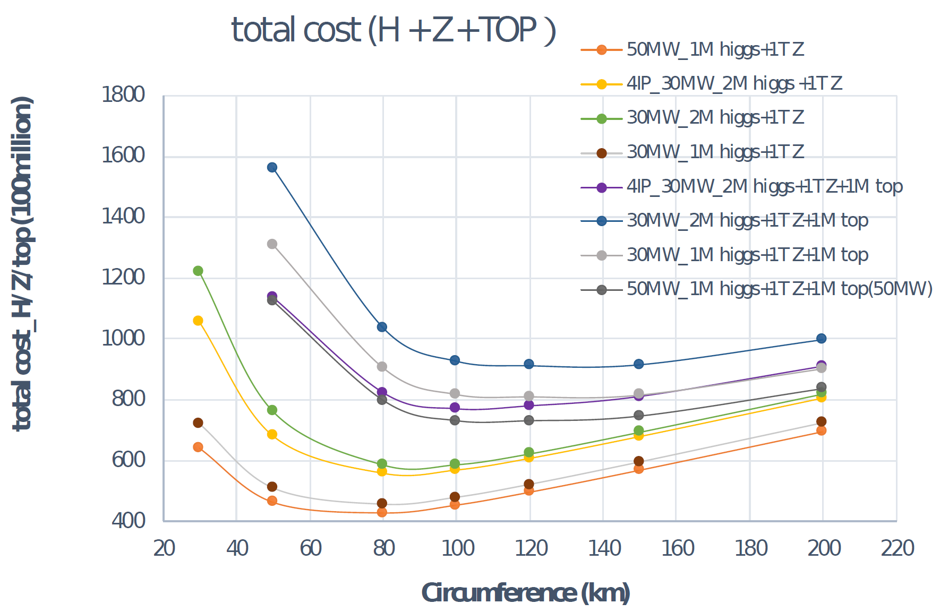
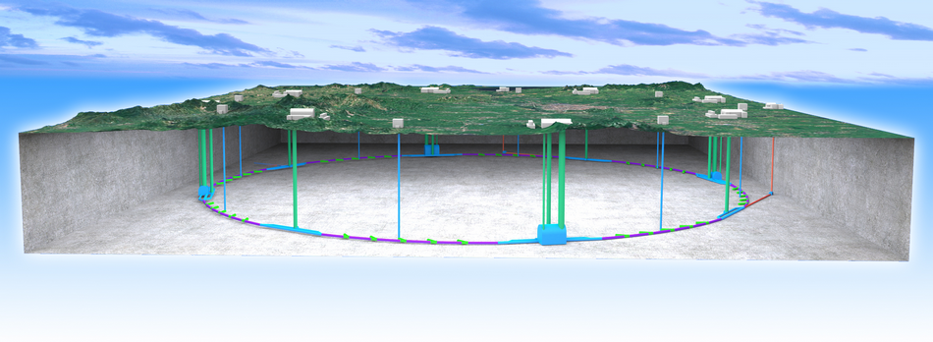
Higgs：CEPC
Cost vs.. circumference
The idea of a Circular e+e- Collider(CEPC) followed by a possible Super proton-proton collider(SPPC) was proposed in Sep. 2012, and quickly gained the momentum in IHEP and in the world
D. Wang et al 2022 JINST 17 P10018
  The tunnel can be re-used for pp, AA, ep colliders up to ~ 100 TeV ➔ compatibility study needed now

Slide 6
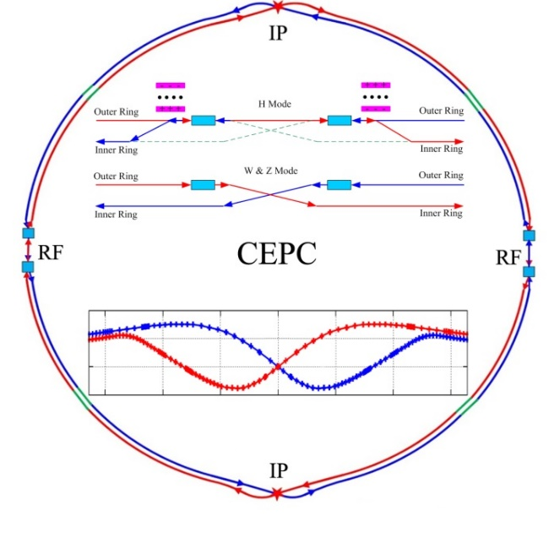
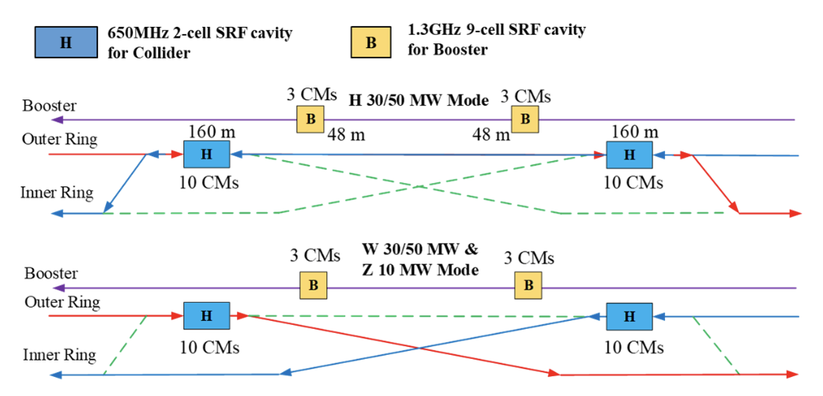
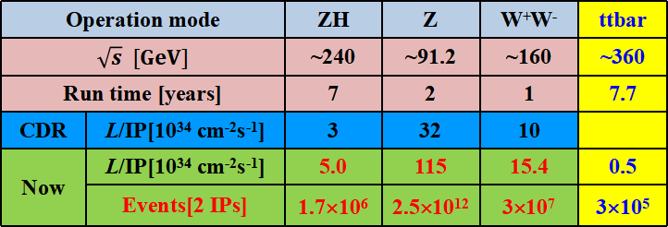
CEPC Accelerator Design & Status
Strong support from MoST, CAS and NSFC, at a total funding level of > 40 M $
CDR completed, TDR to be completed soon
Internationally competitive performance based on the detailed design & studies, such as DA and beam-beam effects
Storage ring
& RF
Tunnel
H
W and Z
Baseline design(100 km, 30 MW)：
LINAC Injector
Operation mode |  | ZH | Z | W⁺W⁻ | ttbar
$$\sqrt{s} [GeV]$$ |  | ~240 | ~91.2 | ~160 | ~360
Run time [years] |  | 7 | 2 | 1 | 7.7
CDR | L/IP[10³⁴ cm⁻²s⁻¹] | 3 | 32 | 10
Now | L/IP[10³⁴ cm⁻²s⁻¹] | 5.0 | 115 | 15.4 | 0.5
 | Events[2 IPs] | 1.7×10⁶ | 2.5×10¹² | 3×10⁷ | 3×10⁵
Upgradable to 50 MW, High Lumi Z, ttbar;
Compatible to pp collider

Slide 7
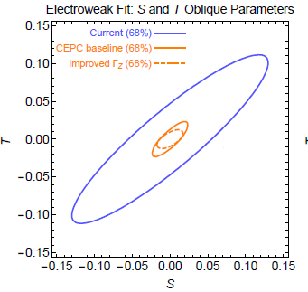
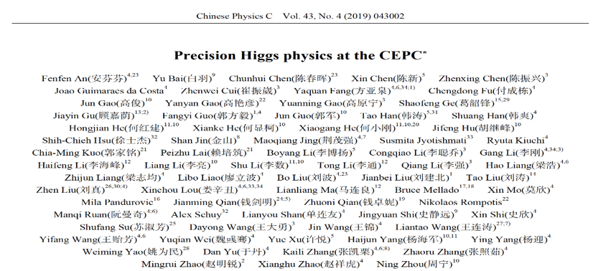
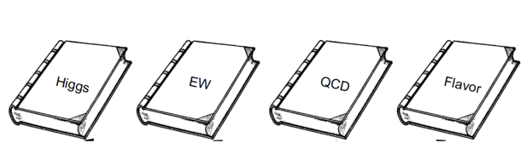
Scientific Objectives: “Discovery + precision measurement”
Higgs coupling measurement can be improved by orders magnititude
Direct and indirect proble to new physics up to 10 TeV, an order of magntitude higher then HL-LHC
Electroweak measurement can be improved by
a large factor
Physics white papers published and to be published

Slide 8
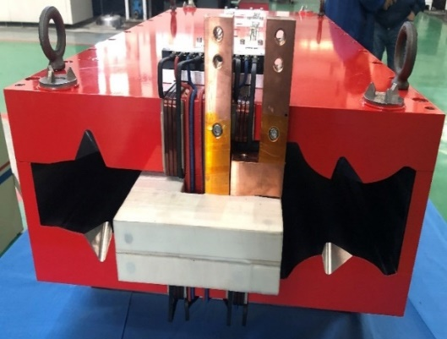
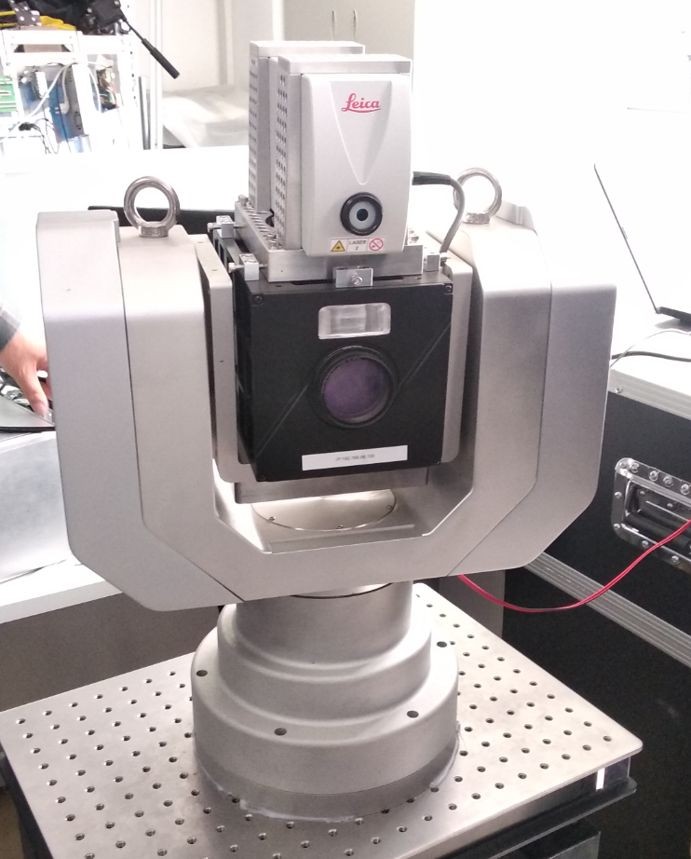
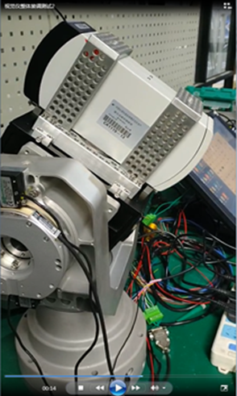
Accelerator R&D and Prototypes
SRF cavities: 1.3GHz for the booster and 650 MHz for collider rings
  prototyes meet requirements
High efficiency Klystrons to save energy
  prototypes in progress, Eff. ~ 70%
Magnets, vacuum pipes, beam diagnostics, polarized electron gun, positron source, … in good shape
A lot of synergies with HEPS, a 6 GeV light source under construction
experience from BEPCII, CSNS, etc.
650MHz
1.3GHz
magnets
Klystrons
Multi Functional Alignment Instrument

Slide 9
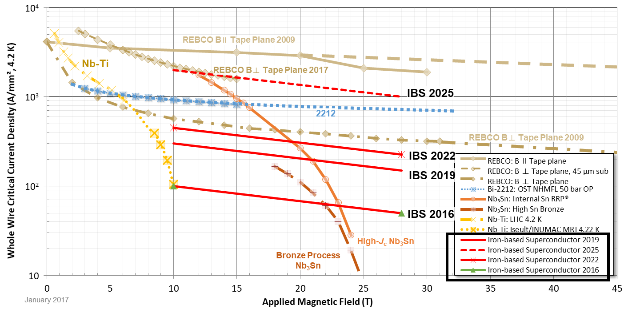
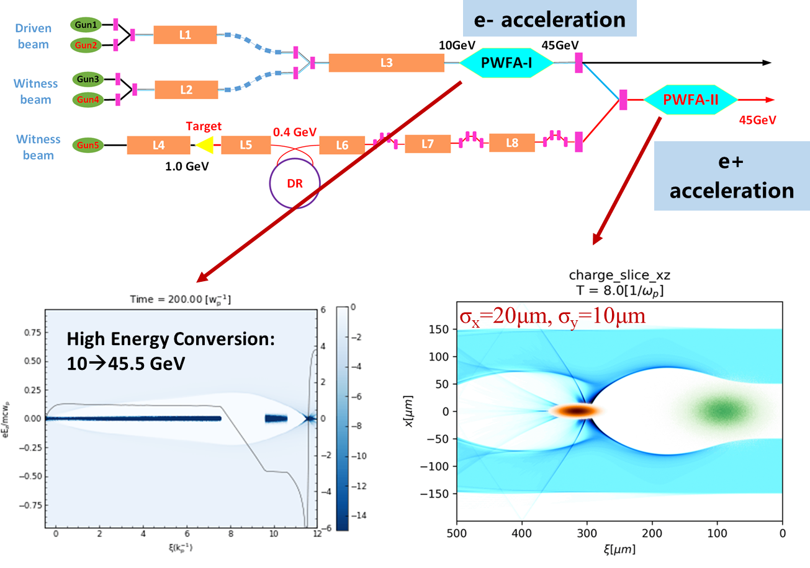
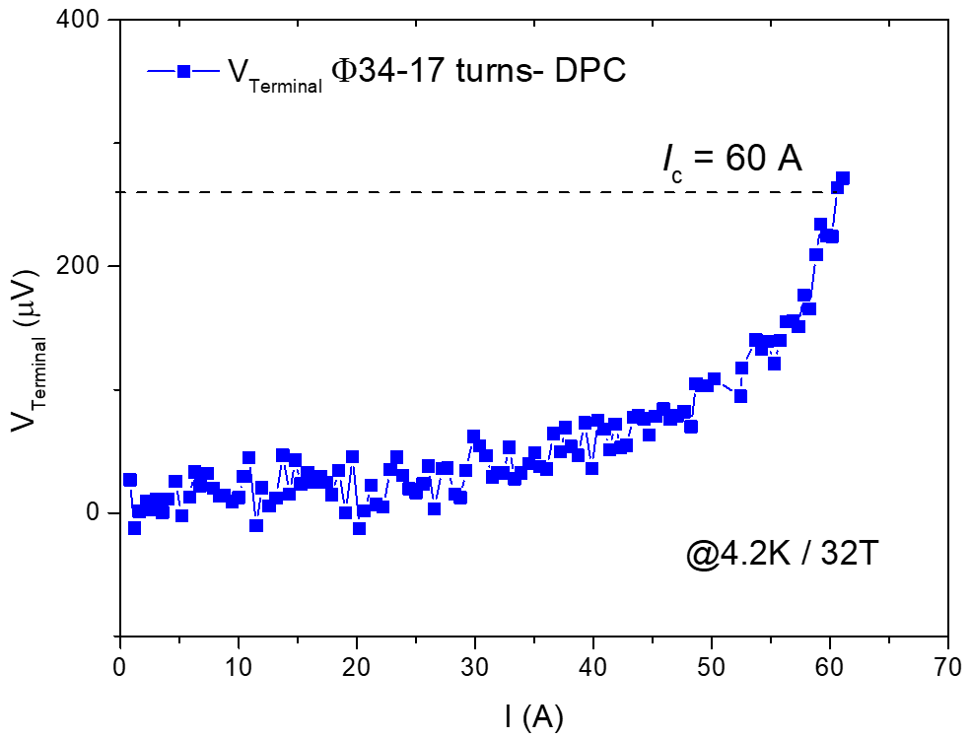
New Technologies for Future
Plasma wake-field accelerator for the injector to save cost
Iron-based HTc superconducting tech. for SPPC
Fast development of IBS material
PWFA as an alternative Linac injection
Notes:
Ket technology DR&D, status with good standing and progress,
Comparison to leading particle physics labs in the world, IHEP is progressing to the leading front
Pursuing new technologies:
PWFA for e+, e- acceleration, high gradient for linear accelerator as injector option, higher E_inj -- collaboration
IBS – national collaboration to drive the DRD

Slide 10
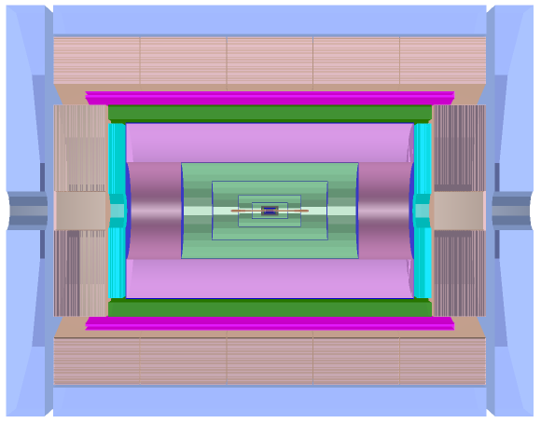
Detector Design and R&D
Advantage: Higher sampling ratio for better energy resolution: < 40%/√E
Challenges: Light yield, transparency, mass production of scint. glass
Solenoid Magnet (3T / 2T )
PFA HCAL based on
Scint. Glass/Steel
Advantage: HCAL absorber as the return yoke.
Challenges: thin enough magnet not to affect the jet resolution
PFA ECAL based on Transverse Crystal towers
Advantage: e/γ energy resolution< 3%/√E, 2D readout with timing for 3D capabilities
Challenges: ambiguity of showers if overlapping; high energy π⁰ reconstruction
Si Tracker
Si Vertex
A Drift chamber optimized for PID
Advantage: good PID while improving Si tracking
Challenges: withstand high event rate; good readout for dN/dx
Muon chamber+Yoke
Silicon pixel sensors and readout chips for better resolution and lower power
TPC or draft chambers for higher event rate and faster readout(dN/dX & waveform)
Reconstruction algorithm for showers in Long crystal bars using timing for 3D info.
Scintillation glass development for higher density and light yield
Thin solenoid superconducting magnet

Slide 11
Ideal Schedule

Slide 12
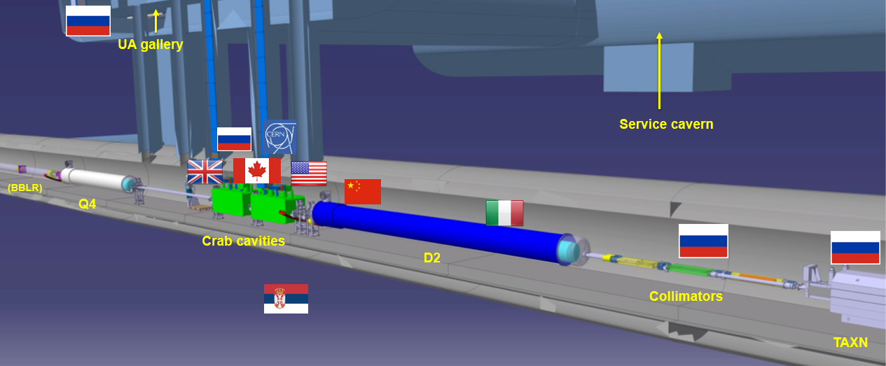
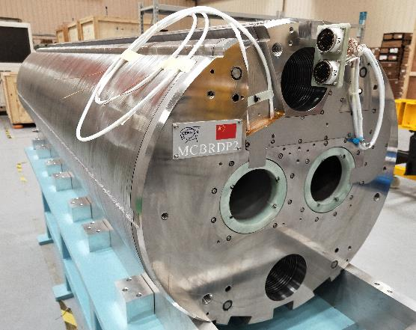
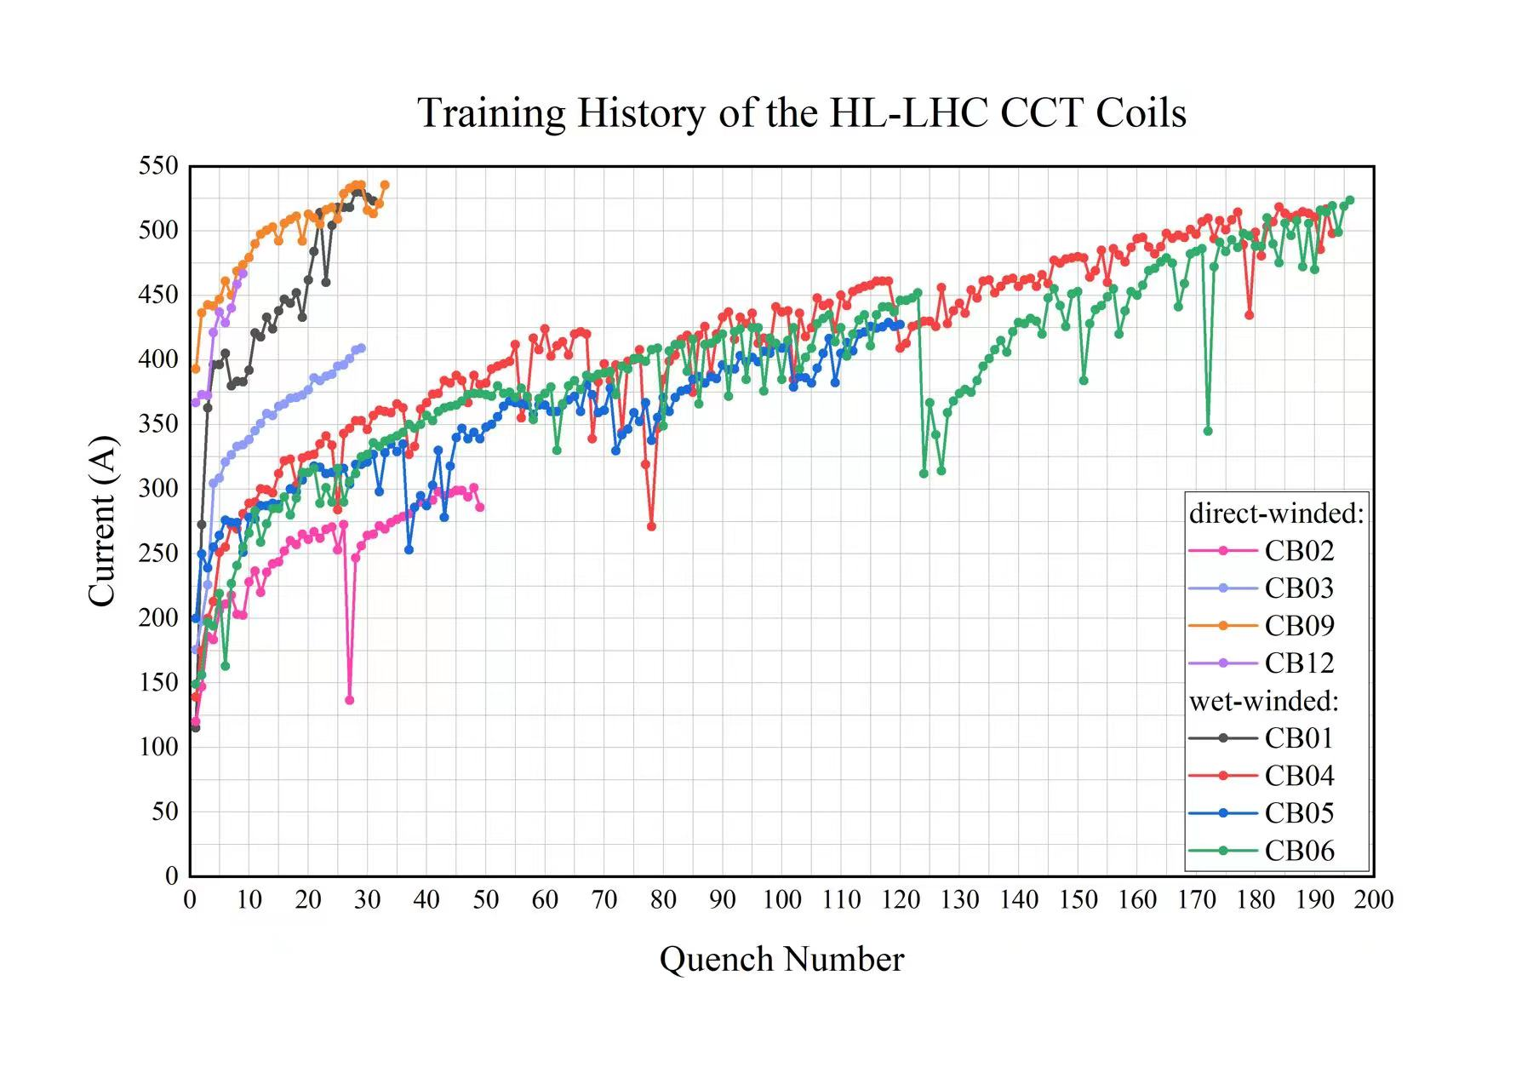
Higgs: International Projects
China is a member of LHC
  HL-LHC CCT magnets(by IHEP+IMP)
  LHC experiments: ATLAS, CMS upgrade and physics analysis
China is eager and happy to join international projects, ILC, FCC, etc.
China will be happy to join any US-leading major HEP projects, if possible
ATLAS
CMS

Slide 13
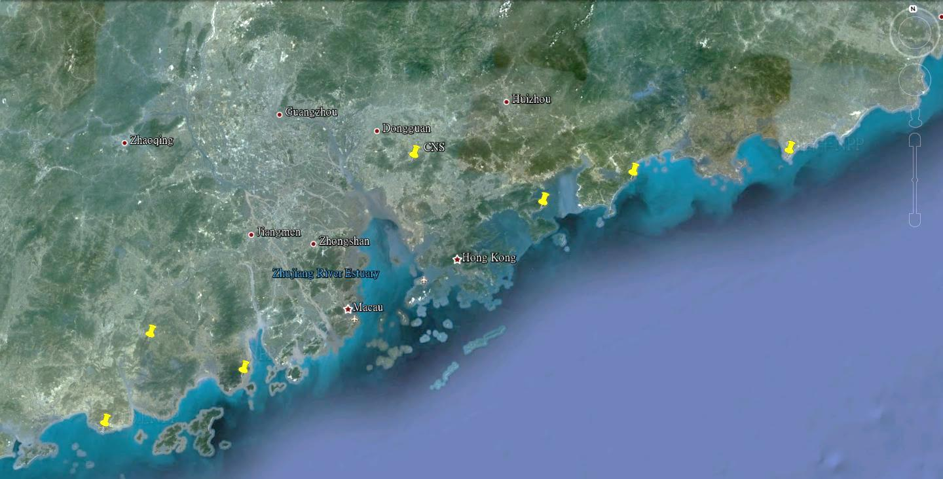
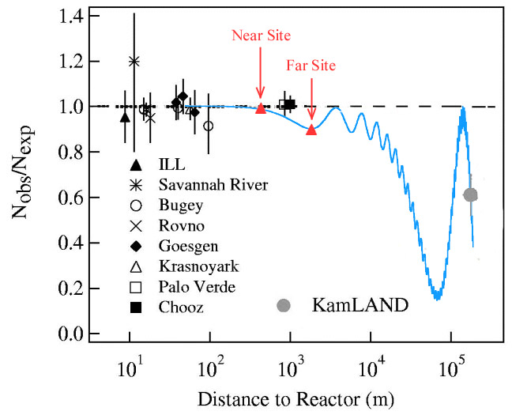

Neutrinos: JUNO Experiment
A 20 kt liquid scintillator detector at ~53 km baseline from reactors
A collaboration of >700 members from 79 Institutions in 14 countries and regions
Daya Bay
Overburden ~ 700 m
JUNO
Previous site candidate
Guang Zhou
2.5 h drive
Lufeng
NPP
Shen Zhen
Huizhou
NPP
Daya Bay NPP
Zhu Hai
Hong Kong
Macau
 | Target mass [t] | energy resolution
JUNO | 20,000 | 3% @ 1 MeV
Borexino | 300 | 5% @ 1 MeV
KamLAND | 1,000 | 6% @ 1 MeV
Daya Bay | 20 | 8% @ 1 MeV
53 km
53 km
Taishan
NPP
Yangjiang NPP

Slide 14
Physics at JUNO
Energy resolution of ~3%@1 MeV leads to a sensitivity of NMO at 3σ@ 6 yrs*26.6 GW
Atmospheric neutrinos contribute another ~ 1 σ @ 6 yrs
Most of neutrino oscillation parameters can be improved to a sub-percent level
Solar, supernova and geoneutrinos
 | Current (PDG2020) | JUNO (100 d) | JUNO (6 y)
Δm²₃₁ Δm²₃₂ | 1.3% | 0.8% | 0.2%
Δm²₂₁ | 2.4% | 1.0% | 0.3%
sin²θ₁₂ | 4.2% | 1.9% | 0.5
sin²θ₁₃ | 3.2% | 47.9% | 12.1%
huge stat. if burst SNν nearby
high prob. to discover diffused SNν

Slide 15
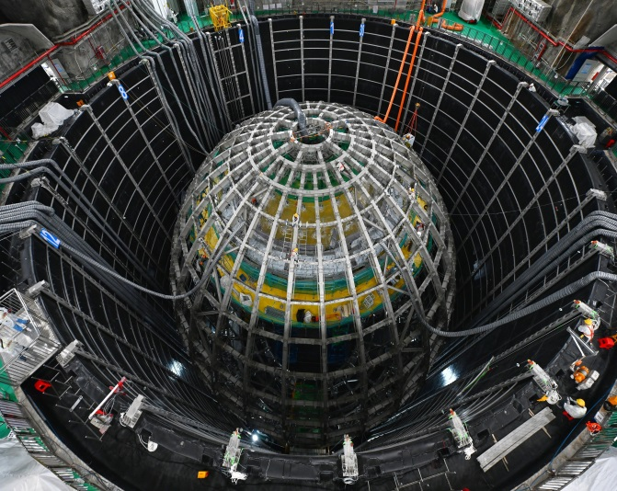
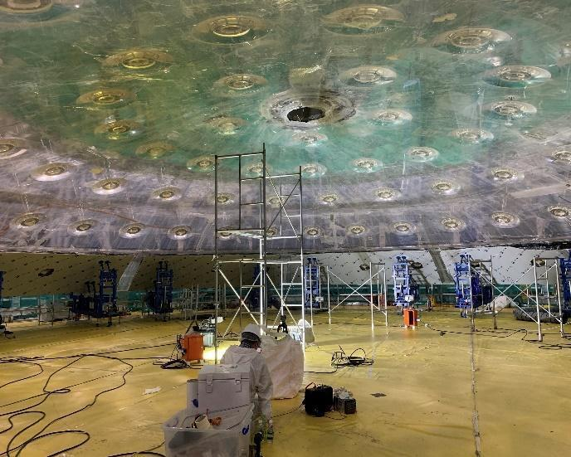
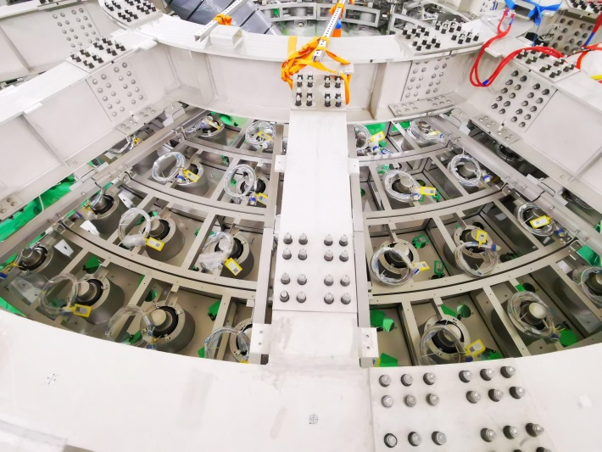
Status of JUNO
Installation in progress:
  SS structure completed
  Acrylic sphere bonding in progress
  PMT installation started
LS mixing and purification system mostly ready, will start operation next year
Good energy resolution(3%@1MeV) and low backgrounds(10⁻¹⁷ g/g) seems realizable

Slide 16
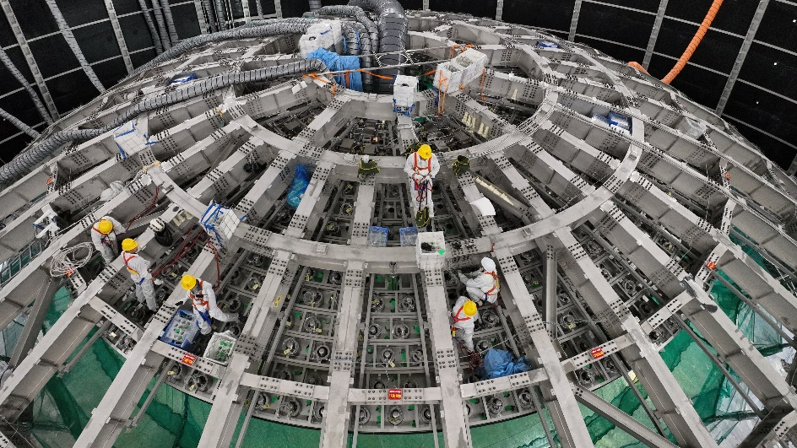
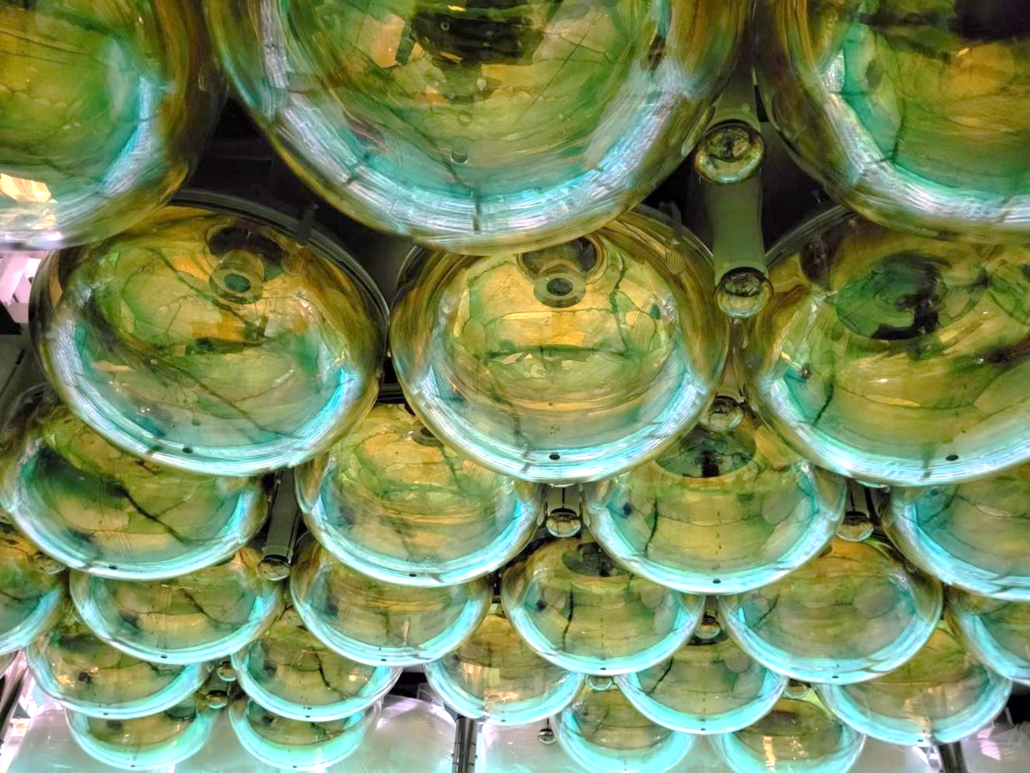
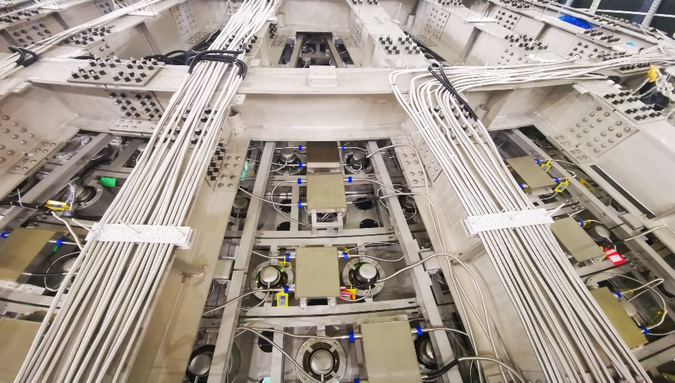
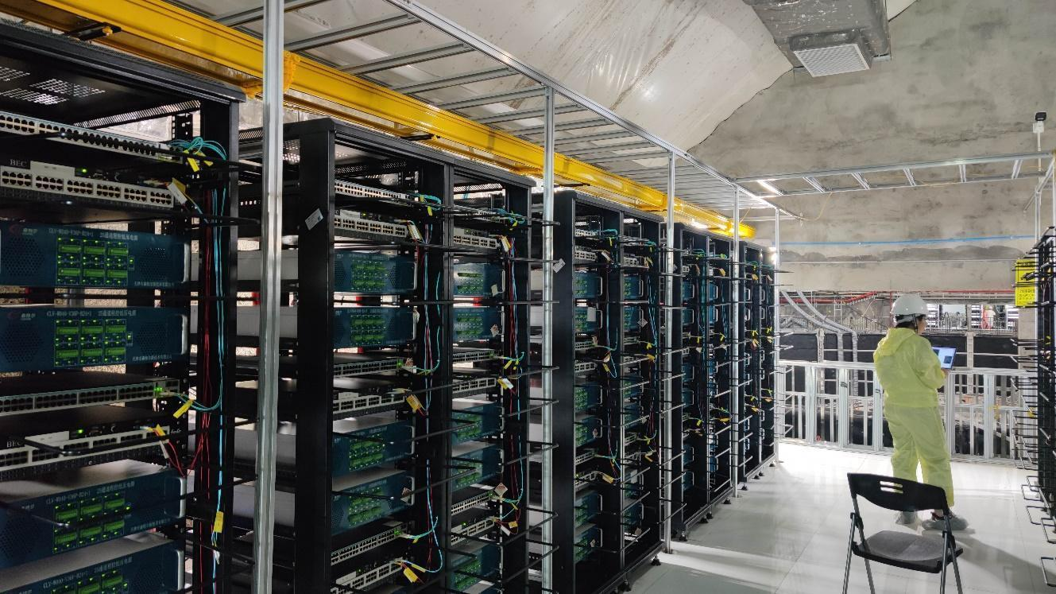
PMT & Electronics Installation
PMT installation
Installed 20”&3” PMTs
Installed electronics & cables
underground electronics room

Slide 17

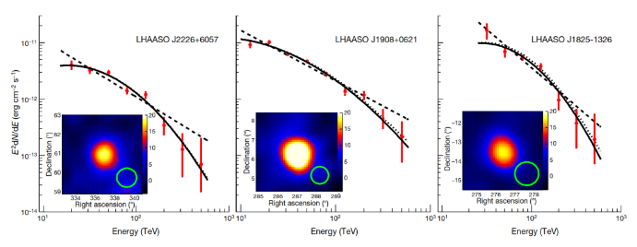
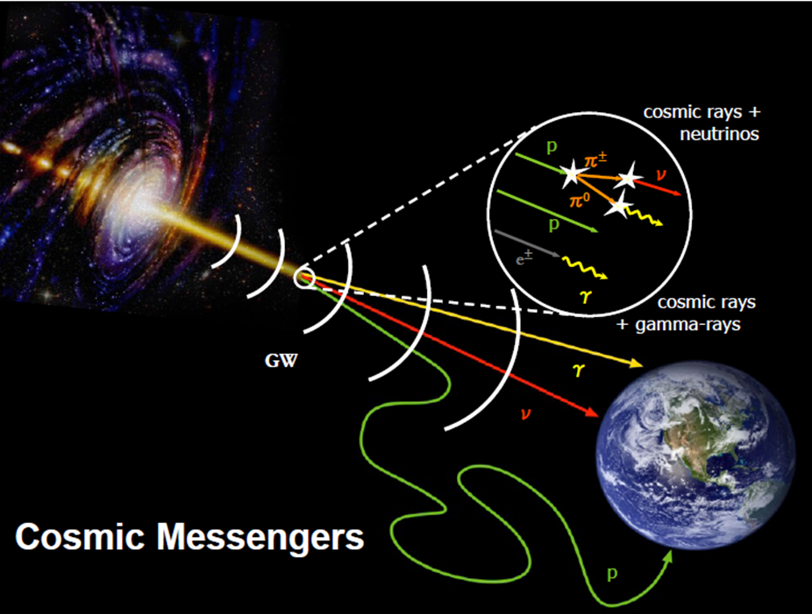
AstroPhysics: Cosmic-Rays and γ-astronomy
⎯ Large High Altitude Air Shower Observatory(LHAASO)
World largest air shower array(with e, μ, water Č detectors and Č telescope) for the high energy γ-astronomy and cosmic-ray physics
Construction just completed and interesting results obtained:
    Highest γ-rays from the Milky Way： 1.4 PeV
    many γ-ray sources up to ~1 PeV identified → PeVatrons in Milky Way
Future
    Large Array of Cherenkov Telescopes（LACT）
    Under-water neutrino telescope
Sichuan, 4410m above the sea

Slide 18
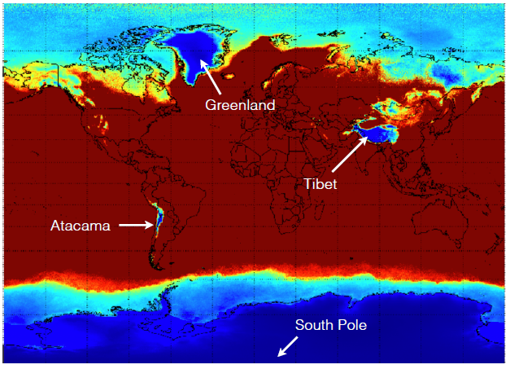
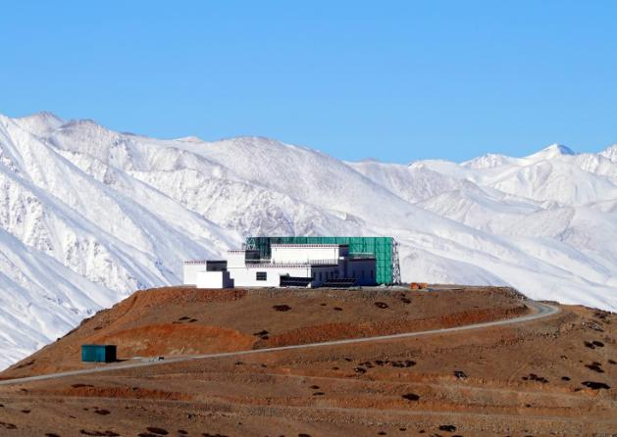
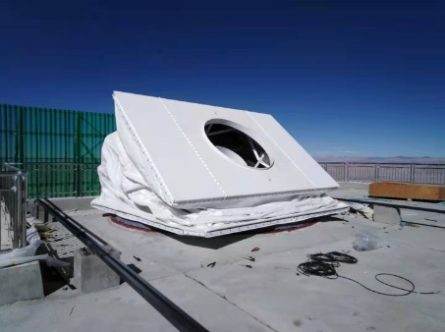
CMB: ALICPT
located in Ali, Tibet with an altitude of 5250m
  Best site in the north hemisphere for CMB
  can be a very important node of an international network
a collaboration with the Stanford University and other international partners
Hopefully to start the observation soon with 1 module (the telescope can house 19 modules)

Slide 19
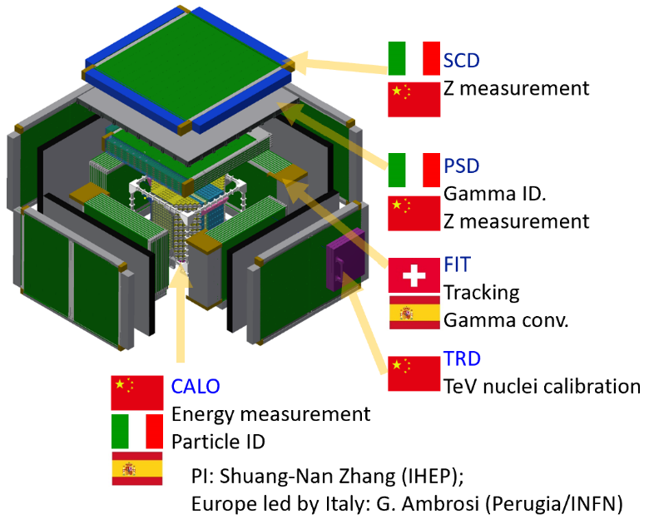




Future Space Programs
A 3D crystal calorimeter for ×10 acceptance and ×10 higher energy on board of the Chinese Space Station, to be launched in ~2027
  dark matter searches
  Gamma-ray sky survey
  Precise cosmic ray spectrum and composition to calibrate LHAASO
Large international collaboration
Enhanced X-ray Timing and Polarimetry satellite for
  Neutron stars, black holes, etc. to study extreme gravity, magnetism, density, etc.
With cutting-edge technologies:
  Large eff. Area (~3.5 m²@6 keV)
  High spectral resolution (<180 eV@6 keV)
  Polarimetry
Large international collaboration
HERD
eXTP

Slide 20
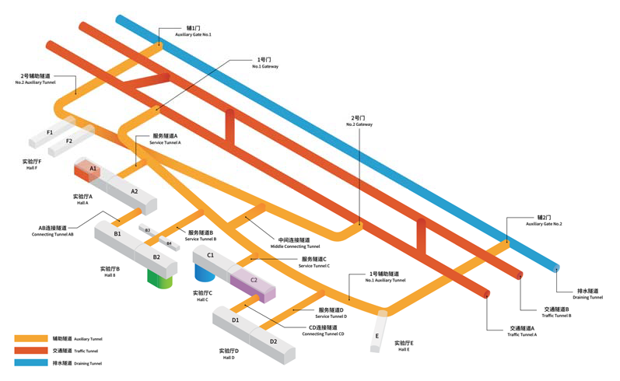
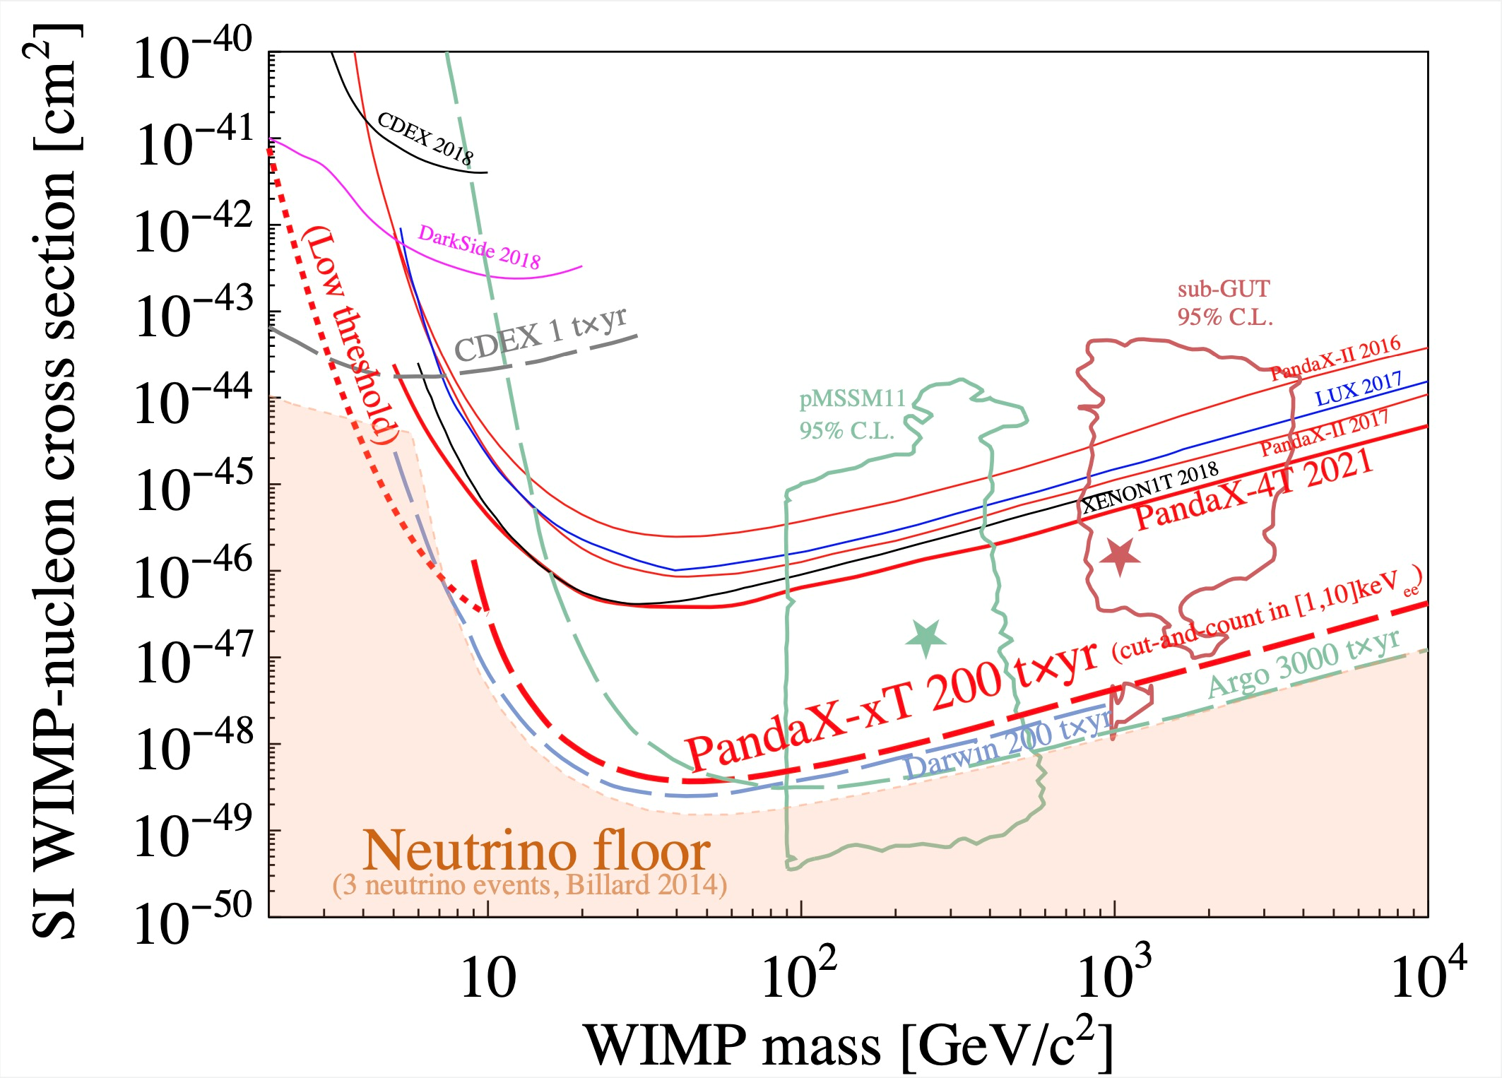
Dark Matter：JinPin Underground Lab
The deepest underground laboratory in the world with an overburden of 2400 m
Current experiments: dark matter searches and 0νββ searches
  Xe-based PandaX-4t (4t LXe)
  Ge-based CDEX-300 (300 kg)
Future：
  PandaX-xT (~50t LXe)
  CDEX-1T (1t ⁷⁶Ge)

Slide 21
Summary: Current and Future
 |  | Current | Future
Accelerator-based | Precision frontier | BESIII | ILC, FCC CEPC
 |  | LHCb, Belle II, PANDA, COMET, GlueX,…
 | Energy frontier | CMS、ATLAS
Non-accelerator-based | Underground | Daya Bay, JUNO | JUNO-ββ
 |  | EXO, Darkside | nEXO, ARGO
 |  | PANDAx, CDEX | Panda-xT, CDEX-1T
 | Surface | ARGO/Asγ, LHASSO | LACT
 | Space | AMS, SVOM | HERD eXTP
 |  | HXMT,Polar,DAMPE

