Slide 1
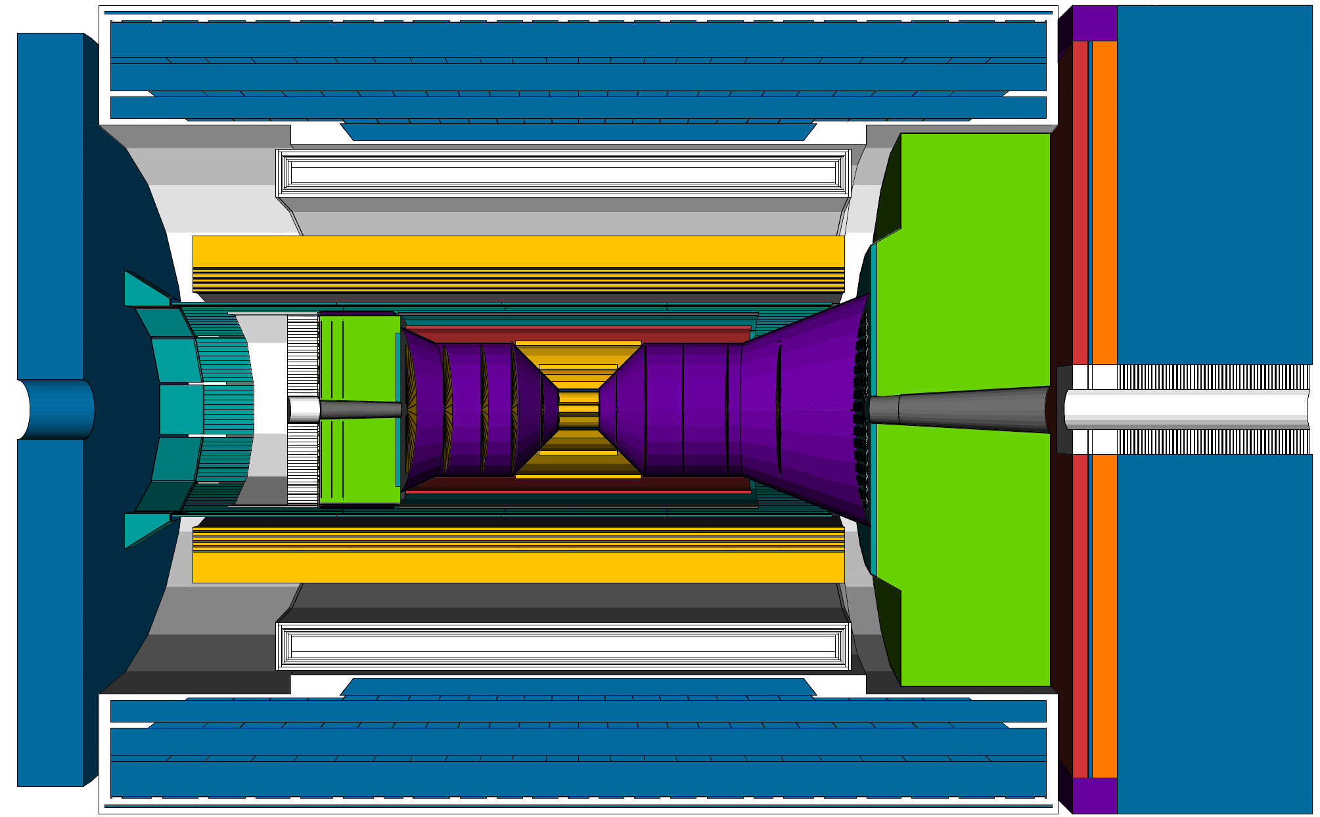
ePIC Detector Overview
May 18, 2023
1st International Workshop on a 2nd Detector for the Electron-Ion Collider
Maria ŻUREK, Argonne National Laboratory

Slide 2
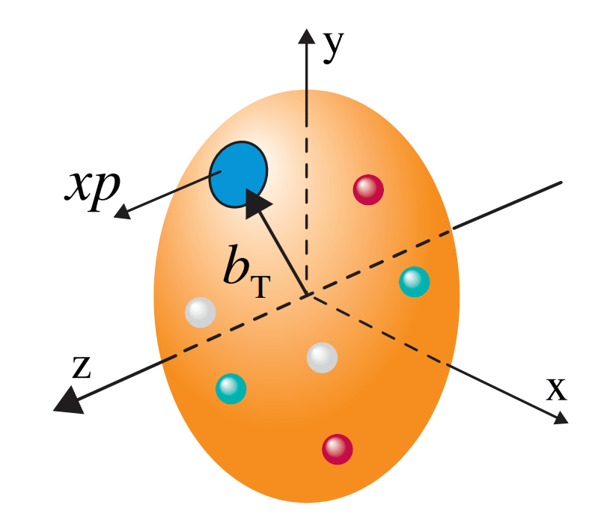
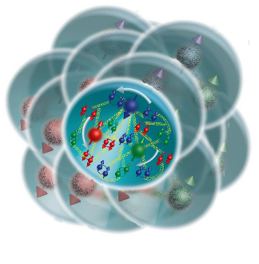
The Physics Quest of the EIC
How do the nucleon properties like mass and spin emerge from their partonic structure?
How are the sea quarks and gluons, and their spins, distributed in space and momentum inside the nucleon?
What impact does a high-density nuclear environment have on the interactions, correlations, and behaviors of quarks and gluons?
Is there a saturation point for the density of gluons in nuclei at high energies, and does this lead to the formation of gluonic matter with universal properties across all nuclei, including the proton?
In what manner do color-charged quarks and gluons, along with colorless jets, interact with the nuclear medium? And how do the confined hadronic states emerge from these quarks and gluons?
What is the mechanism through which quark-gluon interactions give rise to nuclear binding?
‹#›

Slide 3
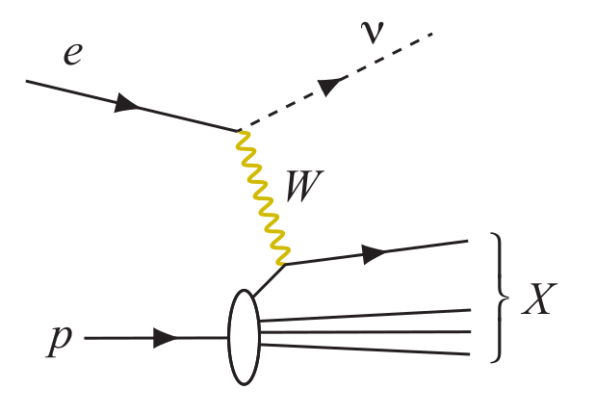
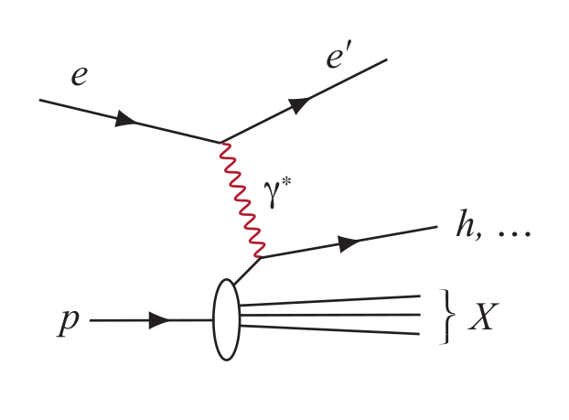
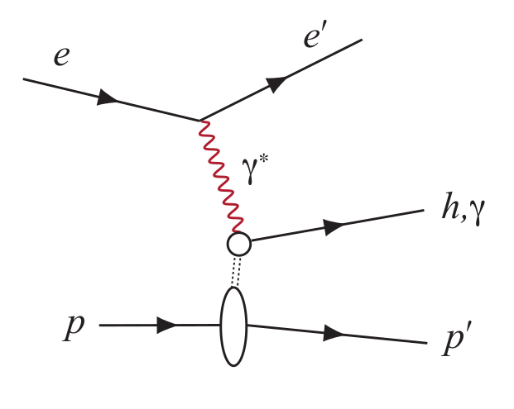
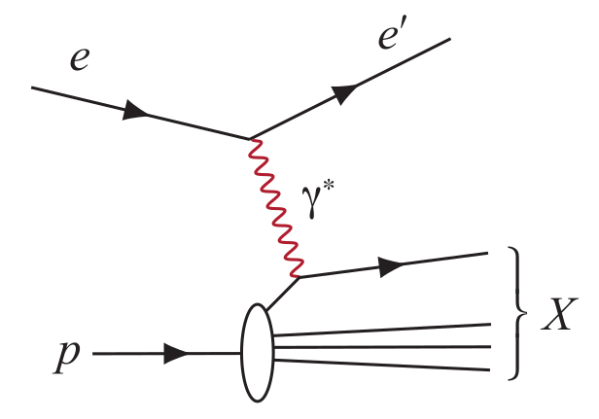
Experimental Processes to Access EIC Physics
DIS event kinematics - scattered electron or final state particles (CC DIS, low y)
Neutral Current DIS
Detection of scattered electron with high precision - event kinematics
Charged Current DIS
Event kinematics from the final state particles (Jacquet-Blondel method)
Semi-Inclusive DIS
Precise detection of scattered electron in coincidence with at least 1 hadron
Deep Exclusive Processes
Detection of all particles in event
Parton Distributions in nucleons and nuclei
Spin and
Flavor structure of nucleons and nuclei
Tomography Transverse Momentum Dist.
QCD at Extreme Parton Densities - Saturation
Tomography
Spatial Imaging

Slide 4
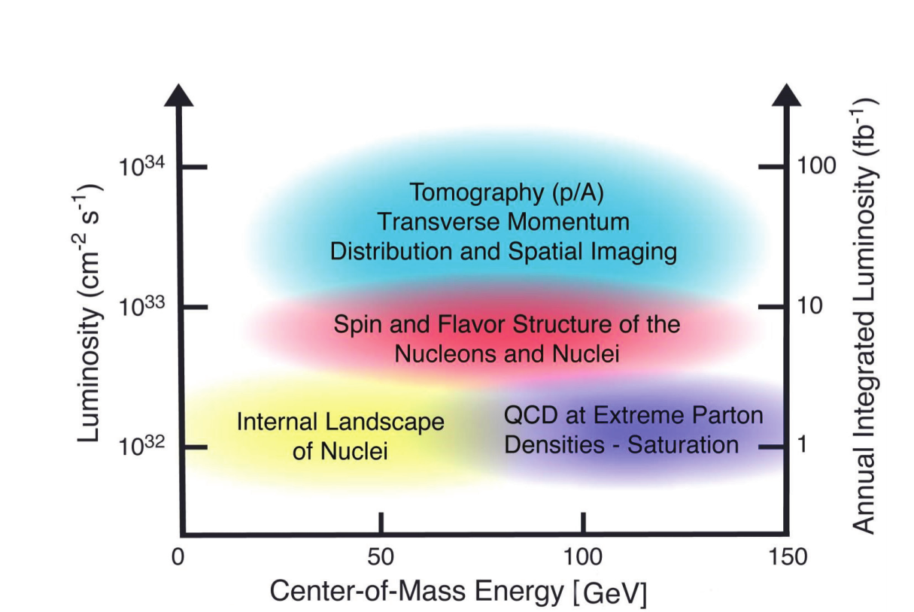
Experimental Access to EIC Physics
Access to EIC Physics through
Large kinematic coverage
Polarized electron and hadron beams and unpolarized nuclear beams with high luminosities
Detector setup fulfilling specific requirements of the polarized e-p/A collider

Slide 5
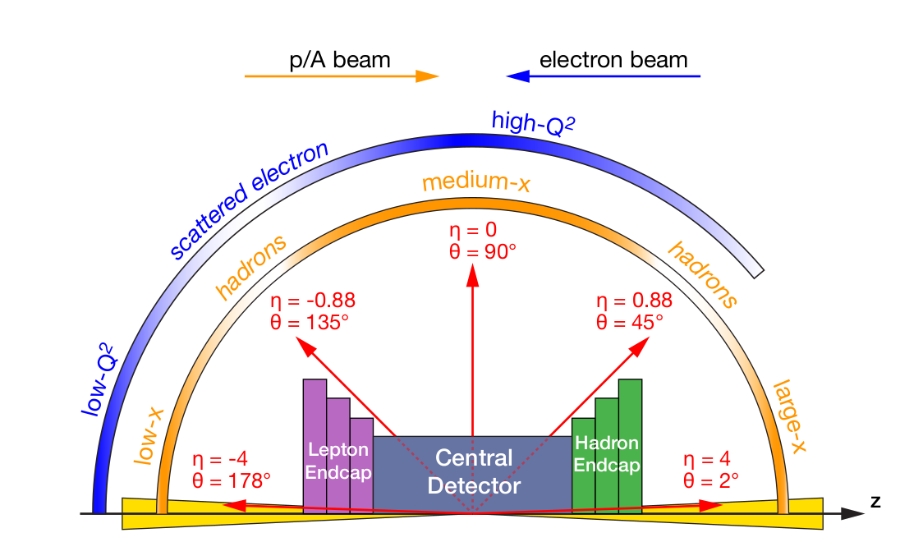
EIC Detector Requirements
Vertex detector → Identify primary and secondary vertices,
Low material budget: 0.05% X/X₀ per layer
High spatial resolution: 10µm pitch CMOS Monolithic Active Pixel Sensor
Central and Endcap tracker → High precision low mass tracking
MAPS – tracking layers in combination with micro pattern gas detectors
Particle Identification → High performance single track PID for π, K, p separation
RICH detectors (RICH, DIRC)*
Time-of-Flight high resolution timing detectors (LAPPDs, LGAD)
Novel photon sensors: MCP-PMT / LAPPD
Electromagnetic calorimetry → Measure photons (E, angle), identify electrons
PbWO₄ Crystals (backward), W/ScFi (forward)
Barrel Imaging Calorimeter (Si + Pb/ScFi)*
Hadron calorimetry → Measure charged hadrons, neutrons and K_{L}⁰
Challenge achieve ~50%/√E + 10% for low E hadrons (~ 20 GeV)
Fe/Sc sandwich with longitudinal segmentation
DAQ & Readout Electronics → trigger-less / streaming DAQ, Integrate AI into DAQ
Very forward and backward detectors → Large acceptance for diffraction, tagging, neutrons from nuclear breakup
Silicon tracking layers in lepton and hadron beam vacuum
Zero-degree high resolution electromagnetic and hadronic calorimeters
*Motion to initiate the change control process endorsed by ePIC Collaboration Council, April 23

Slide 6
Detector Design Process Timeline
Detector and machine design parameters driven by physics objectives
Call for proposals issued jointly by BNL and JLab in March 2021 (Due Dec 2021)
ATHENA, CORE and ECCE proposals submitted
DPAP closeout March 2022
ECCE proposal chosen as basis for first EIC detector reference design
Spring/Summer 2022 – ATHENA and ECCE form joint leadership team
Joint WG’s formed and consolidation process undertaken
Coordination with EIC project on development of technical design
Collaboration formation process started July 2022
Charter ratified & elected ePIC Leadership Team February 2023
Technology selections for ePIC and the implementation of the new management structure endorsed by the Collaboration Council April 2024 (Technology Reviews took place in March 2023)
Motions to initiate the change control process for the barrel EMCal and for the backward RICH
Working towards TDR and CD-3A and CD-2/3
Notes:
Mention DE&I in context of charter – modern collaboration, built in from the start.

Slide 7
ePIC Detector Design
Tracking:
New 1.7 T solenoid
See talk by Renuka Rajput-Ghoshal
Si MAPS Trackers
MPGD layer before DIRC
Particle ID:
DIRC
pfRICH
dRICH
AC-LGAD (~30ps TOF)
Calorimetry:
Si and Pb/ScFi Barrel EMCal
PbWO4 EMCal in backward direction
Finely segmented EMCal + HCal in forward direction
Outer HCal (sPHENIX re-use)
Backwards HCal (tail-catcher)
BHCAL
Solenoid
HCAL
FEMC
LFHCAL
BEMCAL
dRICH
DIRC
pfRICH
EEMC
Tracker
hadrons
electrons

Slide 8
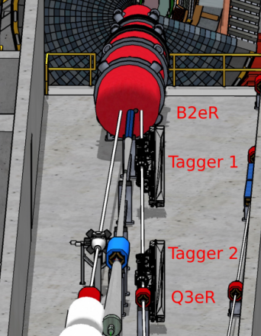
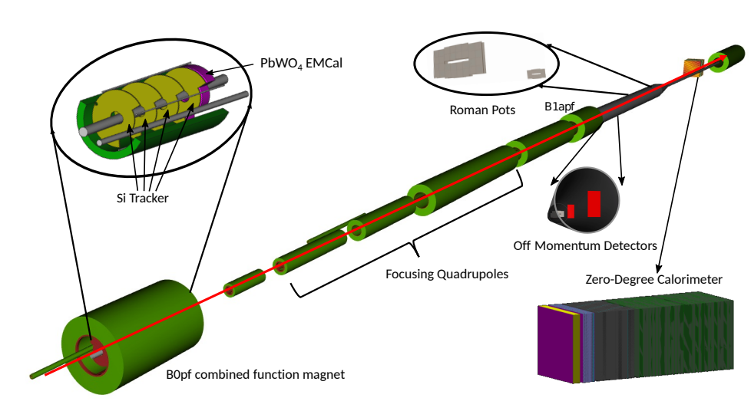
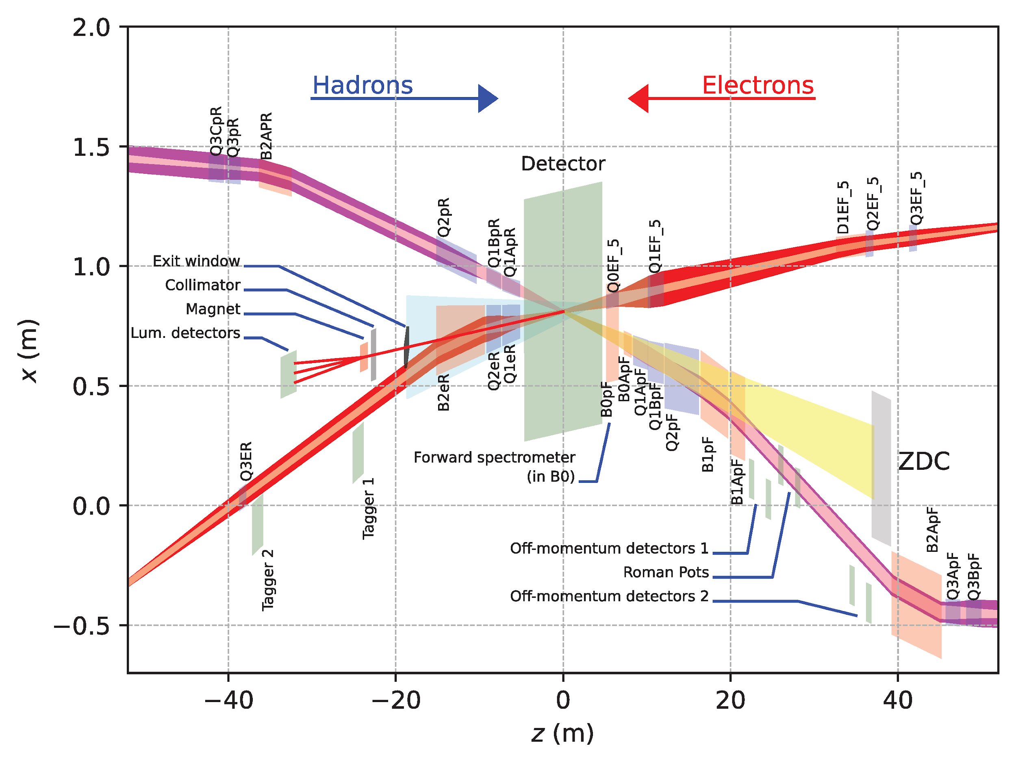
Far-Forward and Far-Backward Detectors
Far-Backward Detectors
Luminosity monitor
Low-Q² Tagging Detectors
Far-Forward Detectors
B0 Tracking and Photon Detection
Roman Pots and Off-Momentum Detectors
Zero-Degree Calorimeter

Slide 9
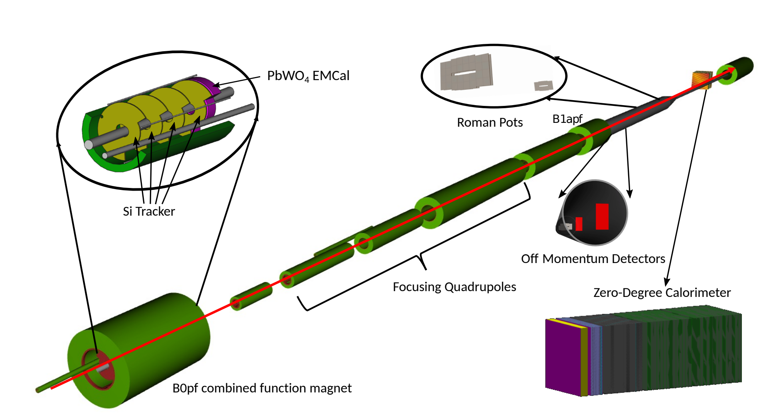
Far-Forward Detectors
B0 system: Measures charged particles in the forward direction and tags neutral particles
Off-momentum detectors: Measure charged particles resulting from, e.g., decays and fission
Roman pot detectors: Measure charged particles near the beam
Zero-degree calorimeter: Measures neutral particles at small angles
Detector | Acceptance
Zero-Degree Calorimeter (ZDC) | 𝜽 < 5.5 mrad (𝜂 > 6)
Roman Pots (2 stations) | 0.0 < 𝜽 < 5.0 mrad (𝜂 > 6)
Off-Momentum Detectors (2 stations) | 𝜽 < 5.0 mrad (𝜂 > 6)
B0 Detector | 5.5 < 𝜽 < 20.0 mrad (4.6 < 𝜂 < 5.9)

Slide 10
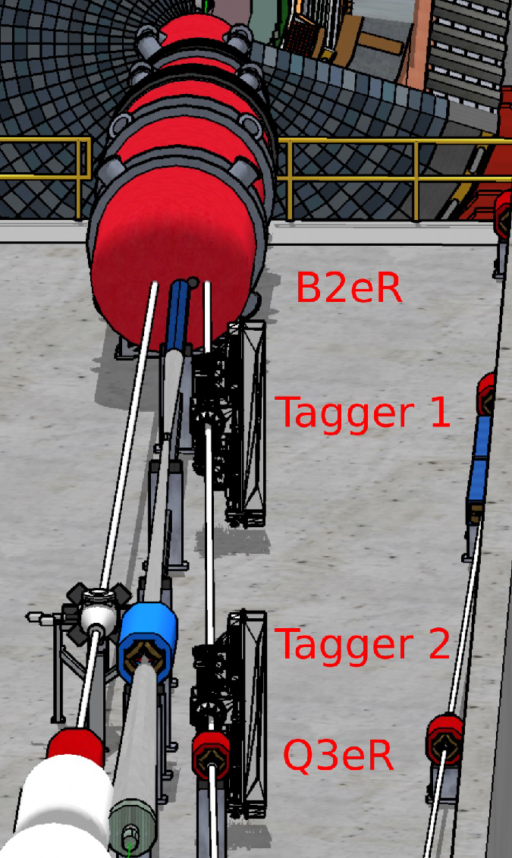
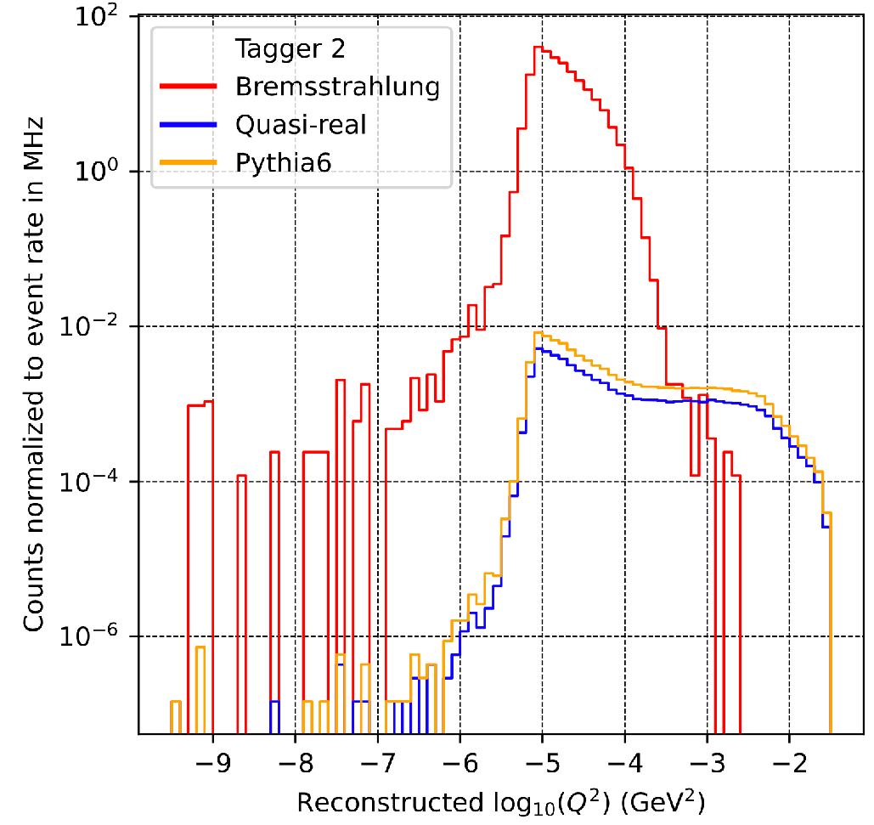
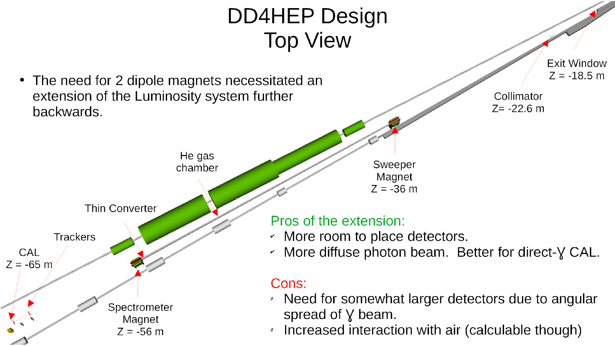
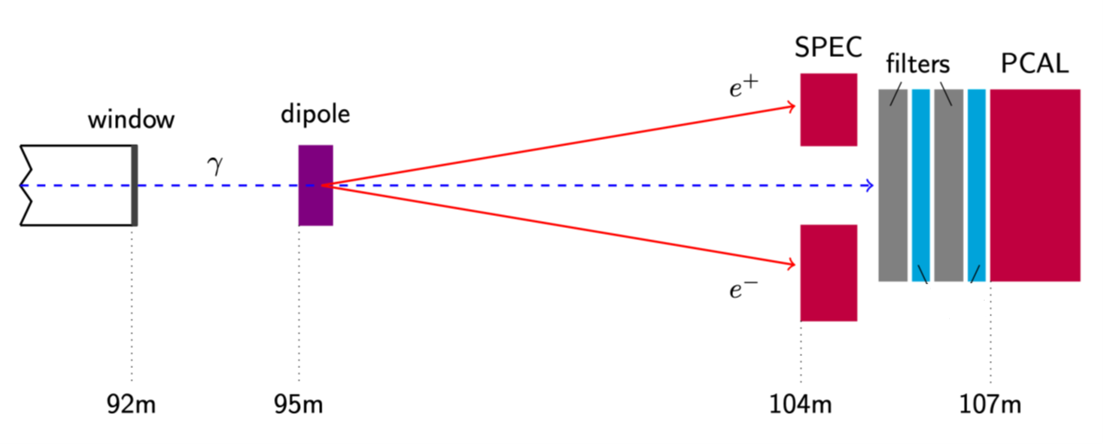
Far-Backward Detectors
Low-Q² tagger
Luminosity Spectrometer
e+p → e γ p
e+Au → e γ Au
AC-LGAD and PbWO4 ECal
~1% measure of luminosity
relative luminosity to 10⁻⁴
Double-layer AC-LGAD tracker and PbWO4 ECal
Clean photoproduction signal for 10⁻³ < Q² < 10⁻¹

Slide 11
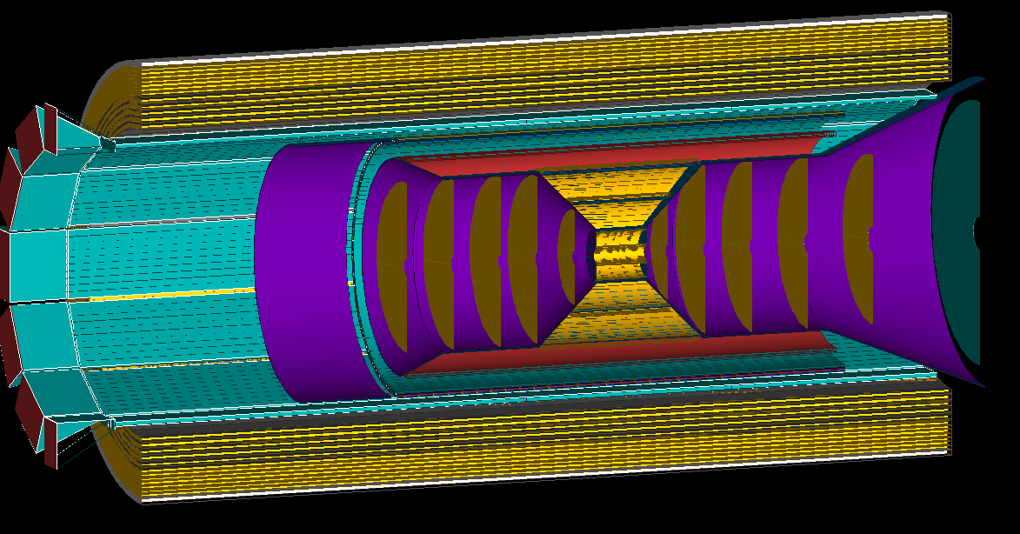
Tracking
AstroPix (MAPS) layer (behind DIRC)
Barrel tracking layers
Inner two vertex layers optimized for beam pipe bakeout and ITS-3 sensor size
Third layer dual-purpose (vertex + sagitta) - 5 layers total
Five discs in forward/backwards direction (ITS-3 based large area sensor design)
Cylindrical μMega provide pattern recognition redundancy
1st AstroPix layer of Barrel ECal provides ring seed direction, space point for pattern recognition
cylindrical μMegas layer
Service cones and cylinders
Backward/Forward tracking discs (5 layers)

Slide 12
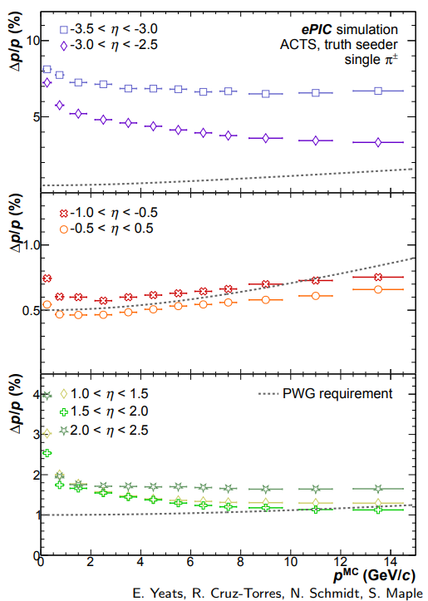
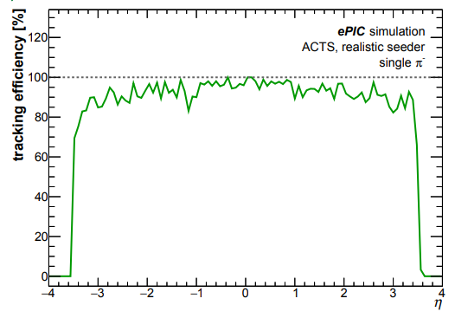
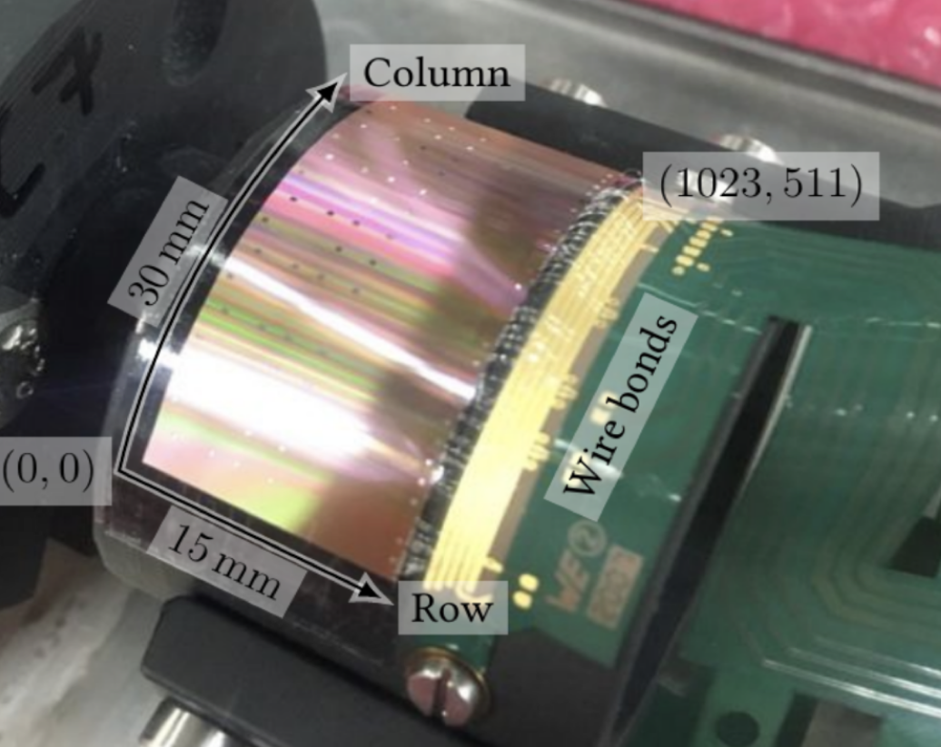
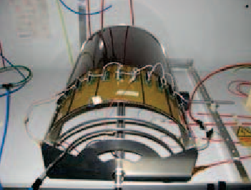
Tracking
Simulated performance
F. Bock, Hard Probes 2023
Technology
ITS3 MAPS based Si-detectors:
O(10µm) pitch, X/X⁰ ∼ 0.05 − 0.55%/ layer
Gaseous tracker:
σ = 55 µm, X/X₀ ∼ 0.2%/layer
AstroPix outer tracker layer:
500µm pixel pitch (σ = 144 µm)
F. Bock, Hard Probes 2023
First “μITS3” assembly at CERN
Cylindrical μMega
Meets EICUG Yellow Report design requirements
Backward momentum resolution complemented by calorimetric resolution

Slide 13
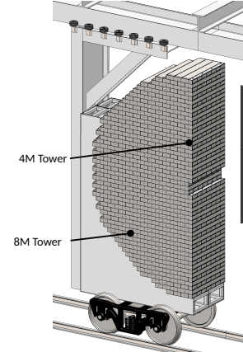
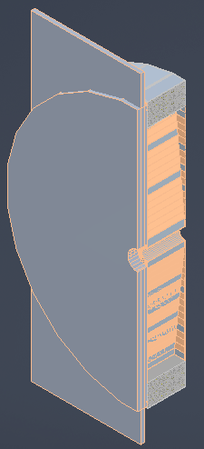
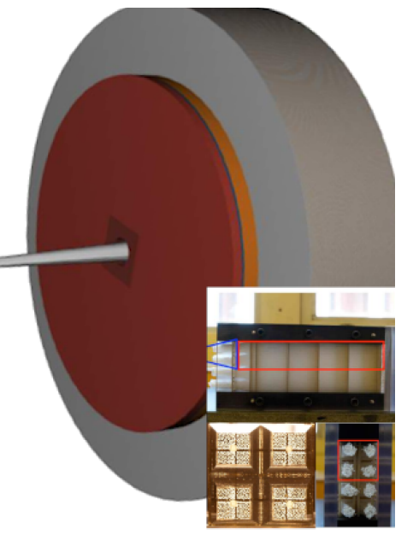
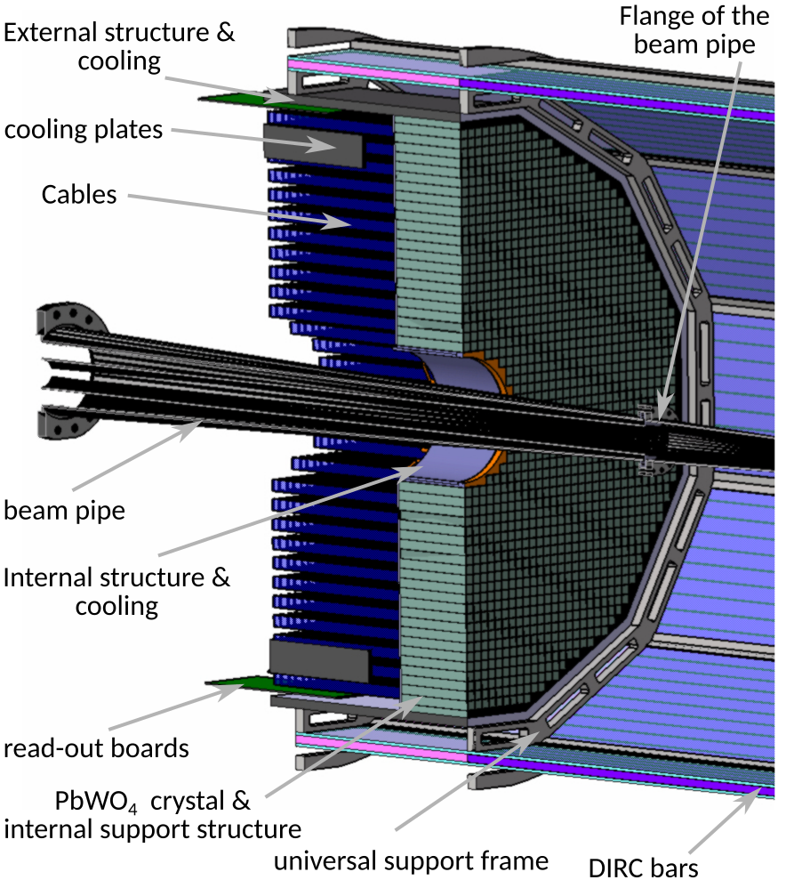
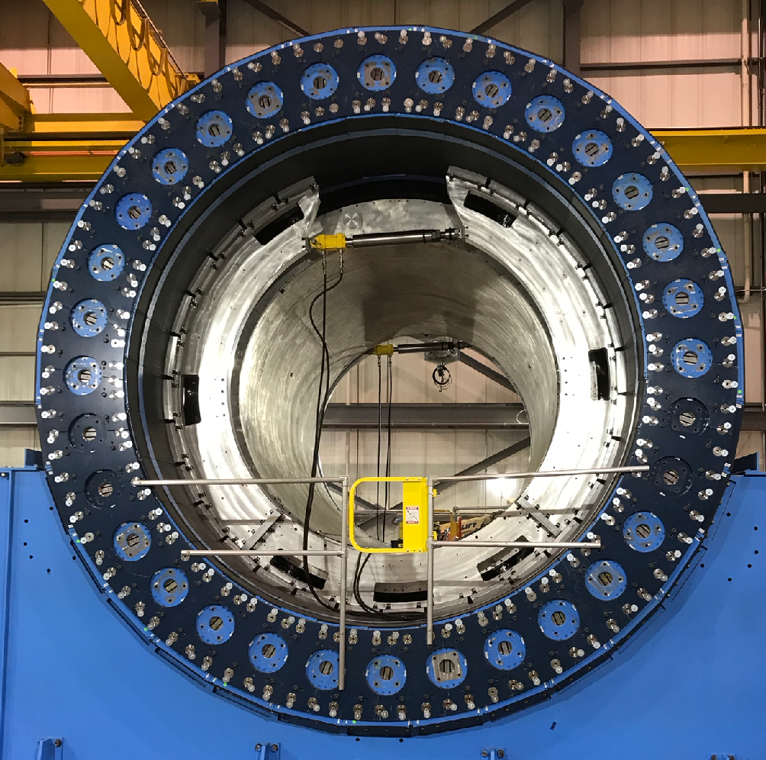
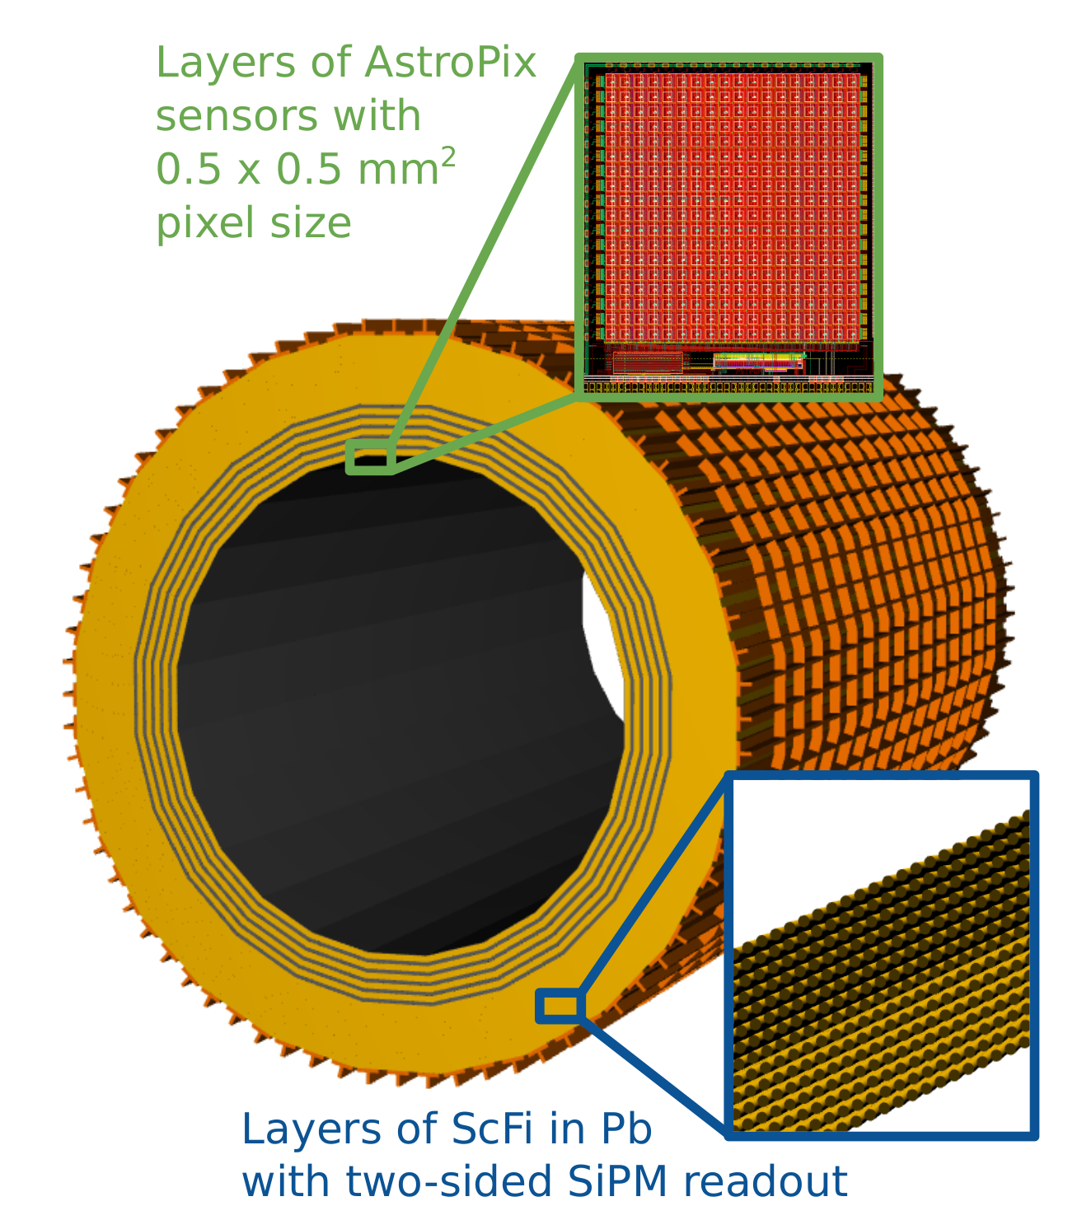
Calorimetry
See talks by N. Schmidt and B. Page
Backwards HCal
Steel/Sc Sandwich
tail catcher
High granularity W/SciFi EMCal
Longitudinally separated HCAL with high-η insert
*Motion to initiate the change control process (from Sci-Glass ECal) endorsed by ePIC CC, April 23
Backwards EMCal
PbWO₄ crystals
Barrel HCAL (sPHENIX re-use)
Imaging Barrel ECAL*

Slide 14
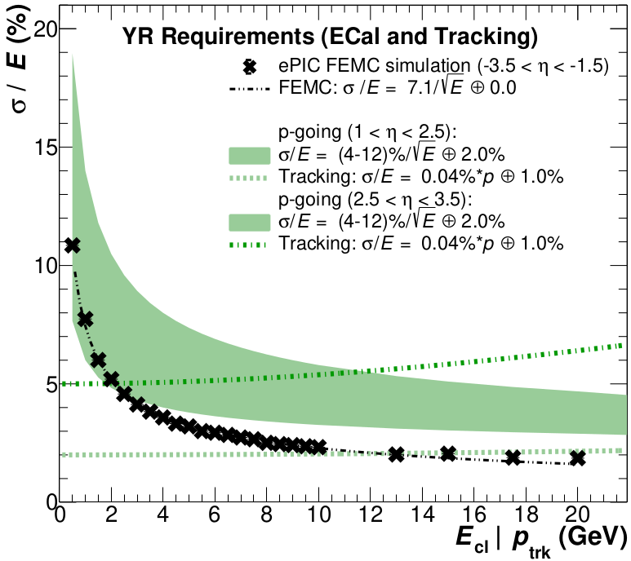
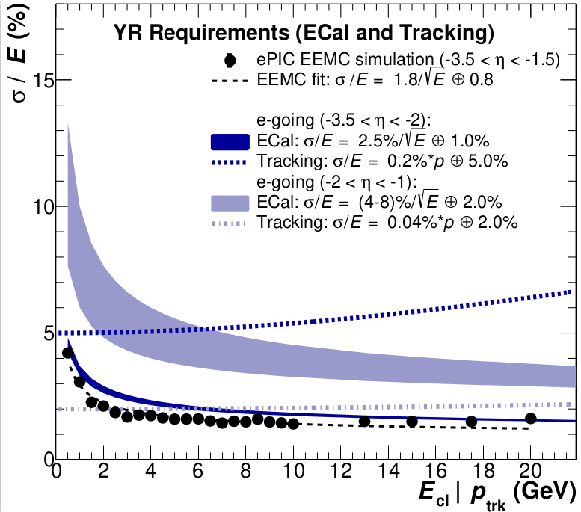
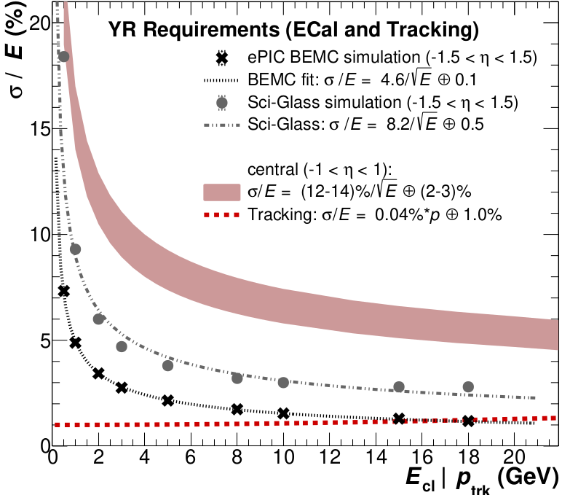
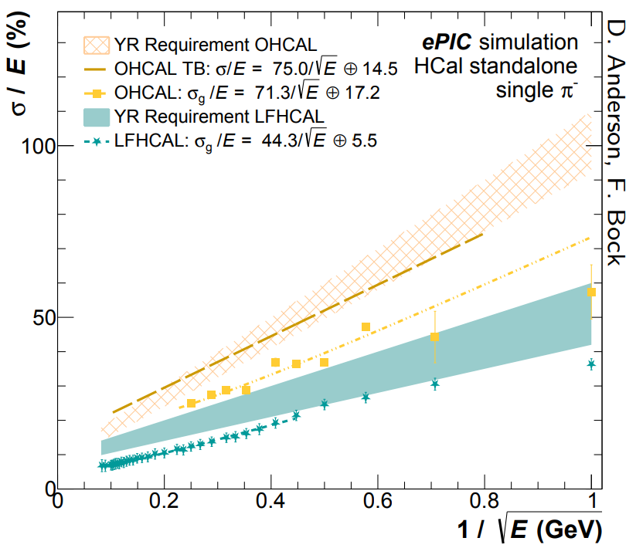
Calorimetry
See talks by N. Schmidt and B. Page
plots by N. Schmidt
F. Bock, Hard Probes 2023
Performance on energy resolution and matching
Technologies fulfill YR requirements on energy resolution
Ongoing simulation studies related to overlaps between different η regions for calorimetry and reconstruction algorithms
Ongoing work on Monte-Carlo validation
Validation for high Z absorbers

Slide 15
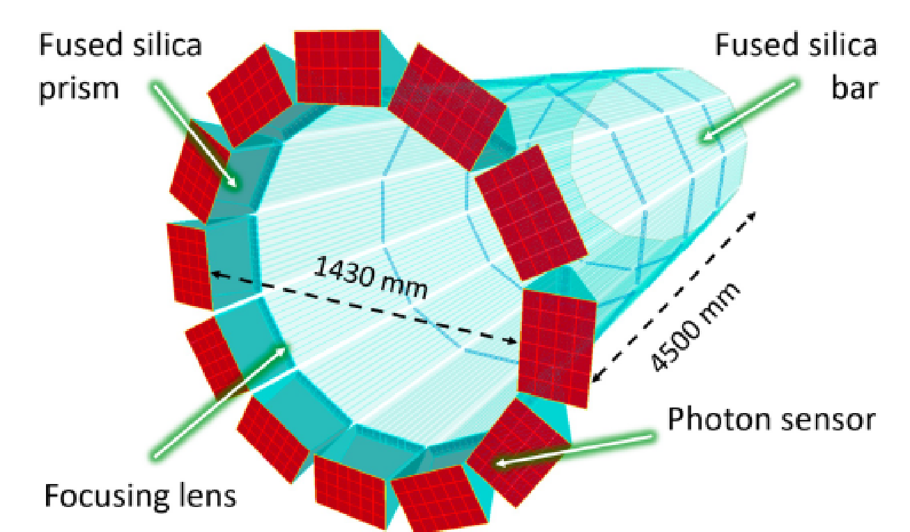
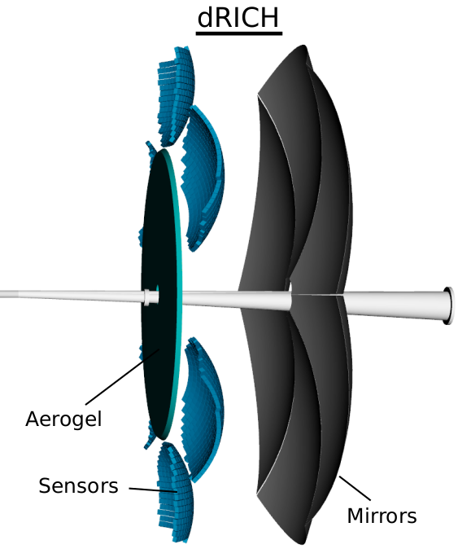
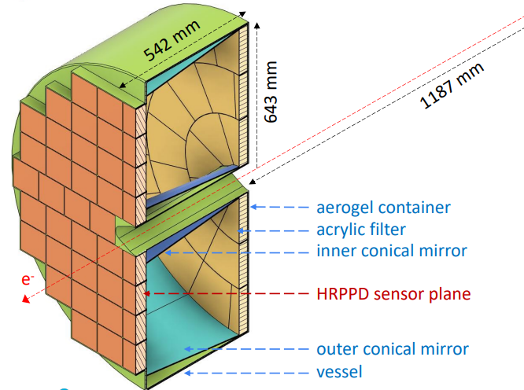
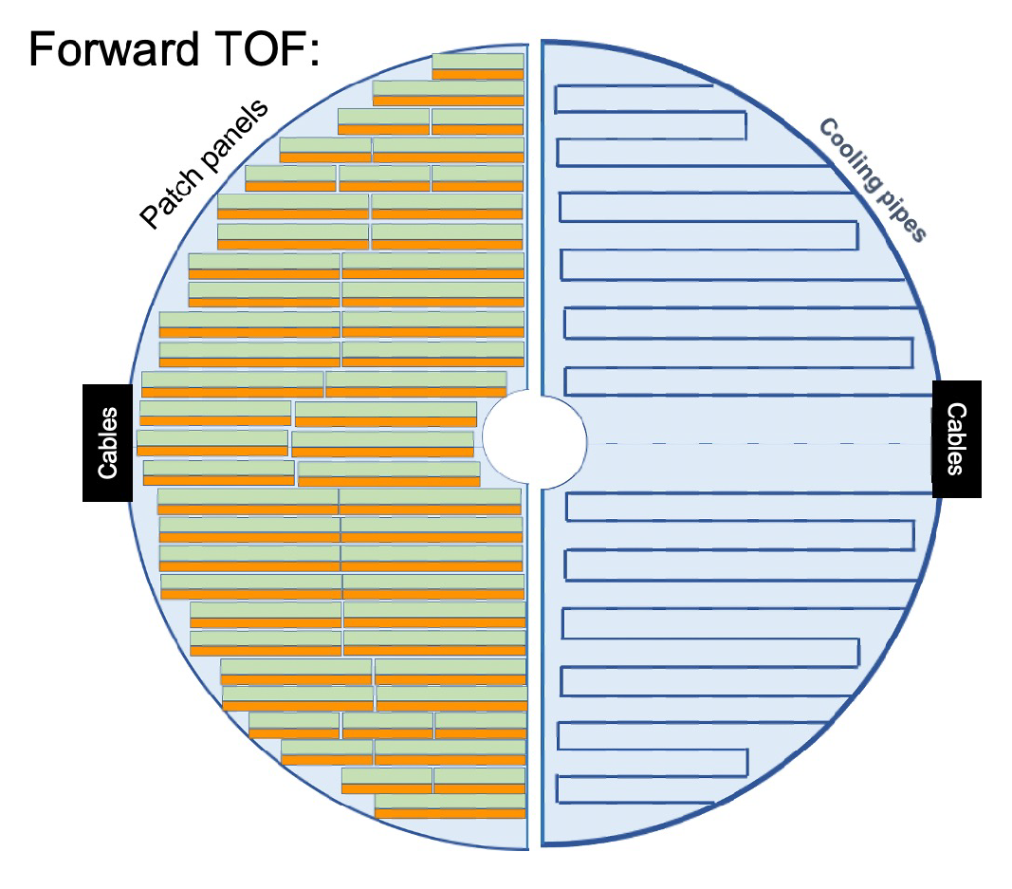
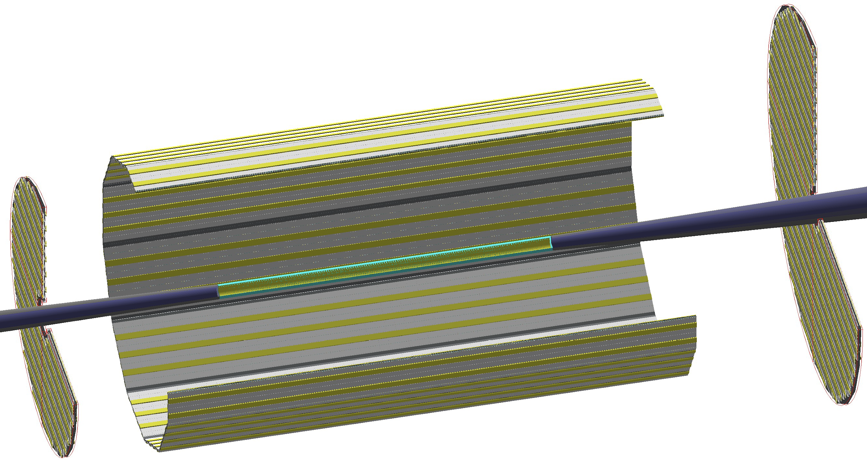
Particle ID
See talks by Z. Ye, G. Kalicy, P. Garg, Y. Ilieva, A. Lyashenko
Dual-Radiator RICH(dRICH)
High-Performance DIRC
Quartz bar radiator (BaBAR bars)
light detection with MCP-PMTs
Fully focused
π/K 3б separation at 6 GeV/c
Proximity Focused (pfRICH)*
Proximity gap >40 cm
Sensor: LAPPDs
up to 9 GeV/c 3б π/K sep.
C₂F₆ Gas Volume and Aerogel
Sensors tiled on spheres (SiPMs)
π/K 3б sep. at 50 GeV/c
AC-LGAD TOF (~30ps)
*Motion to initiate the change control process (from Modular RICH mRICH) endorsed by ePIC CC, April 23
Accurate space point for tracking
forward disk and central barrel

Slide 16
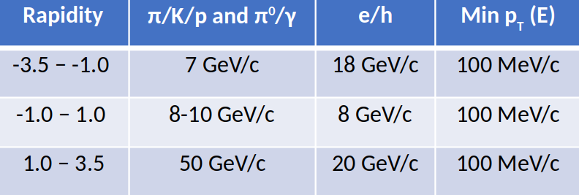
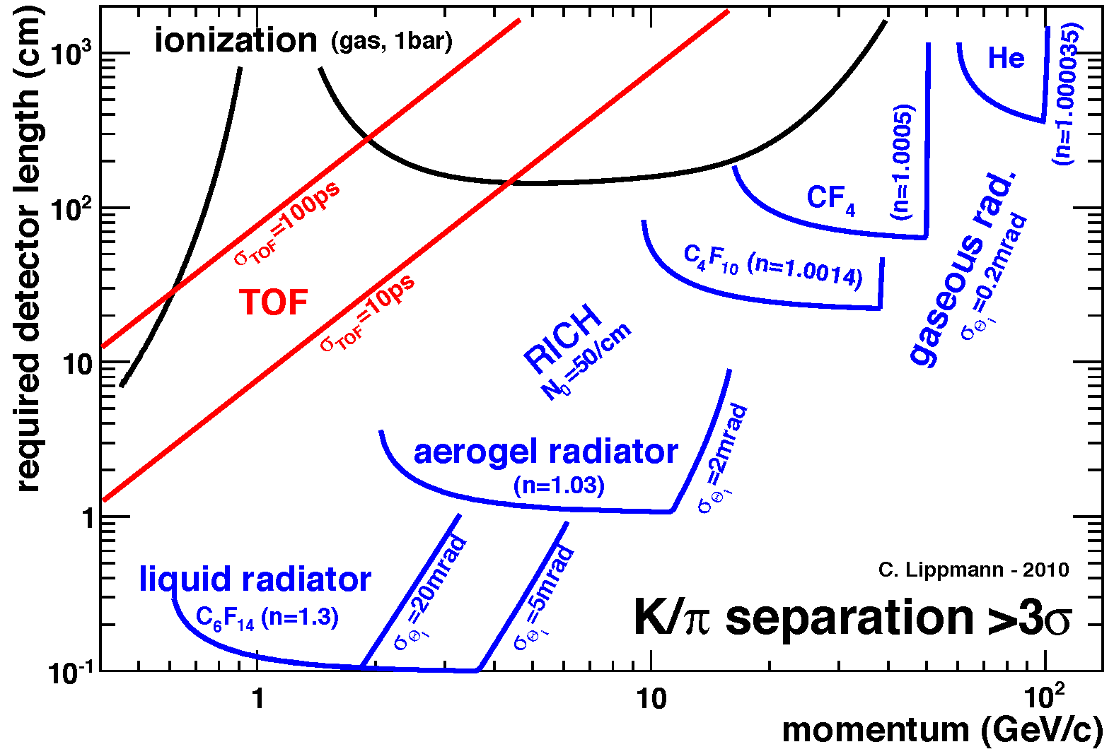
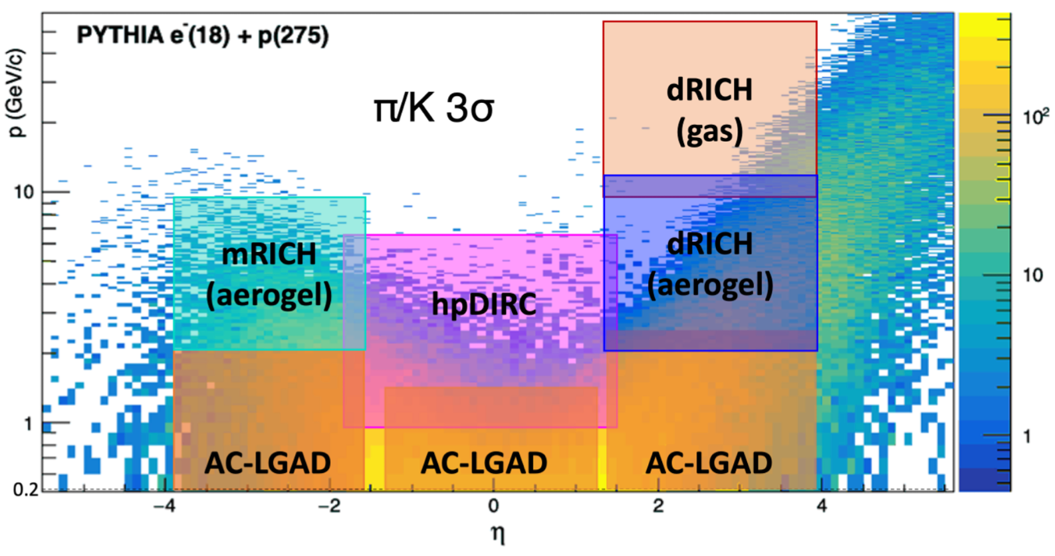
Particle ID
See talks by Z. Ye, G. Kalicy, P. Garg, Y. Ilieva, A. Lyashenko
Particle IDentification needs
Electrons from photons ⟶ 4π coverage in tracking
Electrons from charged hadrons ⟶ mostly provided by calorimetry and tracking
Charged pions, kaons and protons from each other on track level ⟶ Cherenkov detectors
Cherenkov detectors, complemented by other technologies at lower momenta ToF or dE/dx
Need more than one technology to cover the entire momentum ranges at different rapidities

Slide 17
ePIC Software
Our software design is based on lessons learned in the worldwide NP and HEP community and a decision-making process involving the whole community. We will continue to work with the worldwide NP and HEP community.
Modular Simulation, Reconstruction, and Analysis Toolkit using tools from the NP-HEP community
Edm4eic data model based on edm4hep and podio.
Geometry Description and Detector Interface using DD4hep.
MC Event Generators
Detector Simulations in Geant4
Readout Simulation (Digitization)
Reconstruction
in JANA2
Physics
Analyses
Continuous Integration for Detector and Physics Benchmarks and Reproducibility
We are providing a production-ready software stack throughout the development:
Milestone: Software enabled first large-scale simulation campaign for ePIC.
We have a good foundation to meet the near-term and long-term software needs for ePIC.

Slide 18
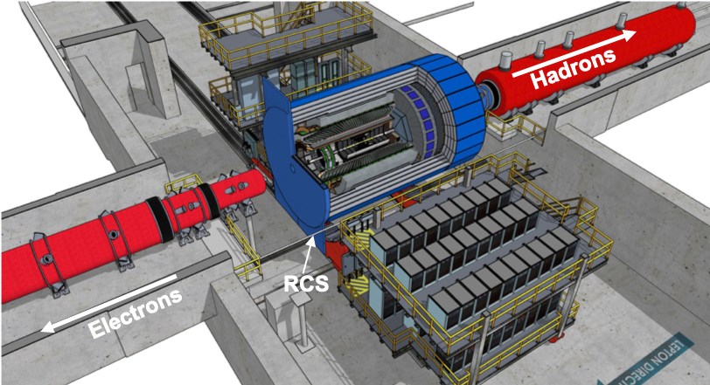
Optimize Physics Reach
Integrated interaction and detector region (+/- 40 m)
Get ~100% acceptance for all final state particles, and measure them with good resolution. All particles count!
Compute-Detector Integration
Extend integrated interaction and detector region into detector readout (electronics), data acquisition, data processing and reconstruction, and physics analysis.

Slide 19
Compute-Detector Integration to Maximize Science
Problem Data for physics analyses and the resulting publications available after O(1year) due to complexity of NP experiments (and their organization).
Alignment and calibration of detector as well as reconstruction and validation of events time-consuming.
Goal Rapid turnaround of data for physics analyses.
Solution Compute-detector integration using:
AI/ML for autonomous alignment and calibration as well as reconstruction in near real time,
Streaming readout for continuous data flow and heterogeneous computing for acceleration.
Front End data
Data Processor
Physics Analysis
Front-End
Front End data
Analysis data
Front-End
Front End data
Front-End
Data Flow:
100 Tbps
10 Tbps
0.1 Tbps

Slide 20
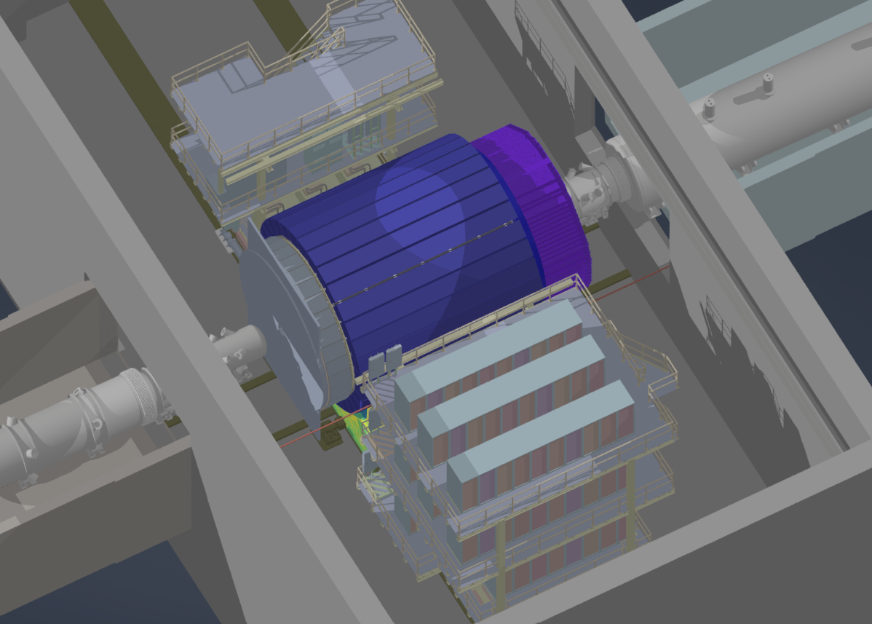
Work Underway on ePIC Design
Preparations to the change control process for pfRHIC and Imaging Barrel ECAL
Tracking optimization
Achieve a realistic, low-mass design with good performance
Engineering Design: Full CAD design of ePIC ongoing to facilitate realistic detector integration, including cabling and services
Preparations to the CD-3a (Long Lead Procurement items) - Reviews Summer/Fall 2023
CD-2/3 in April 2025 - Approved final design for all subdetectors - Design Maturity: ~90%

Slide 21
EIC Project Schedule
Conclusion of
RHIC Operations
06/2025
early
CD-4A
04/2031
early CD-4
CD-4A
04/2032
CD-0
12/2019
CD-1
06/2021
CD-3A
01/2024
CD-2/3
04/2025
CD-4
04/2034
Conceptual
Design
Preliminary
Design
Final
Design
Construction
Transition into
Operations
Start of
Operations
&
Science
Final Design LLPs
- Approve final design for all subdetectors
- Design Maturity: ~90%
- Need TDR
January 2023:
start change control
process for detector
April 2023:
train EVMS process
- Define Baseline: Subdetector technologies, Scope, Cost and Schedule
- Long Lead Procurement items Design Maturity: ~90%
- Plan is tracked through EVMS and Change control process
- Need TDR for LLPs

Slide 22
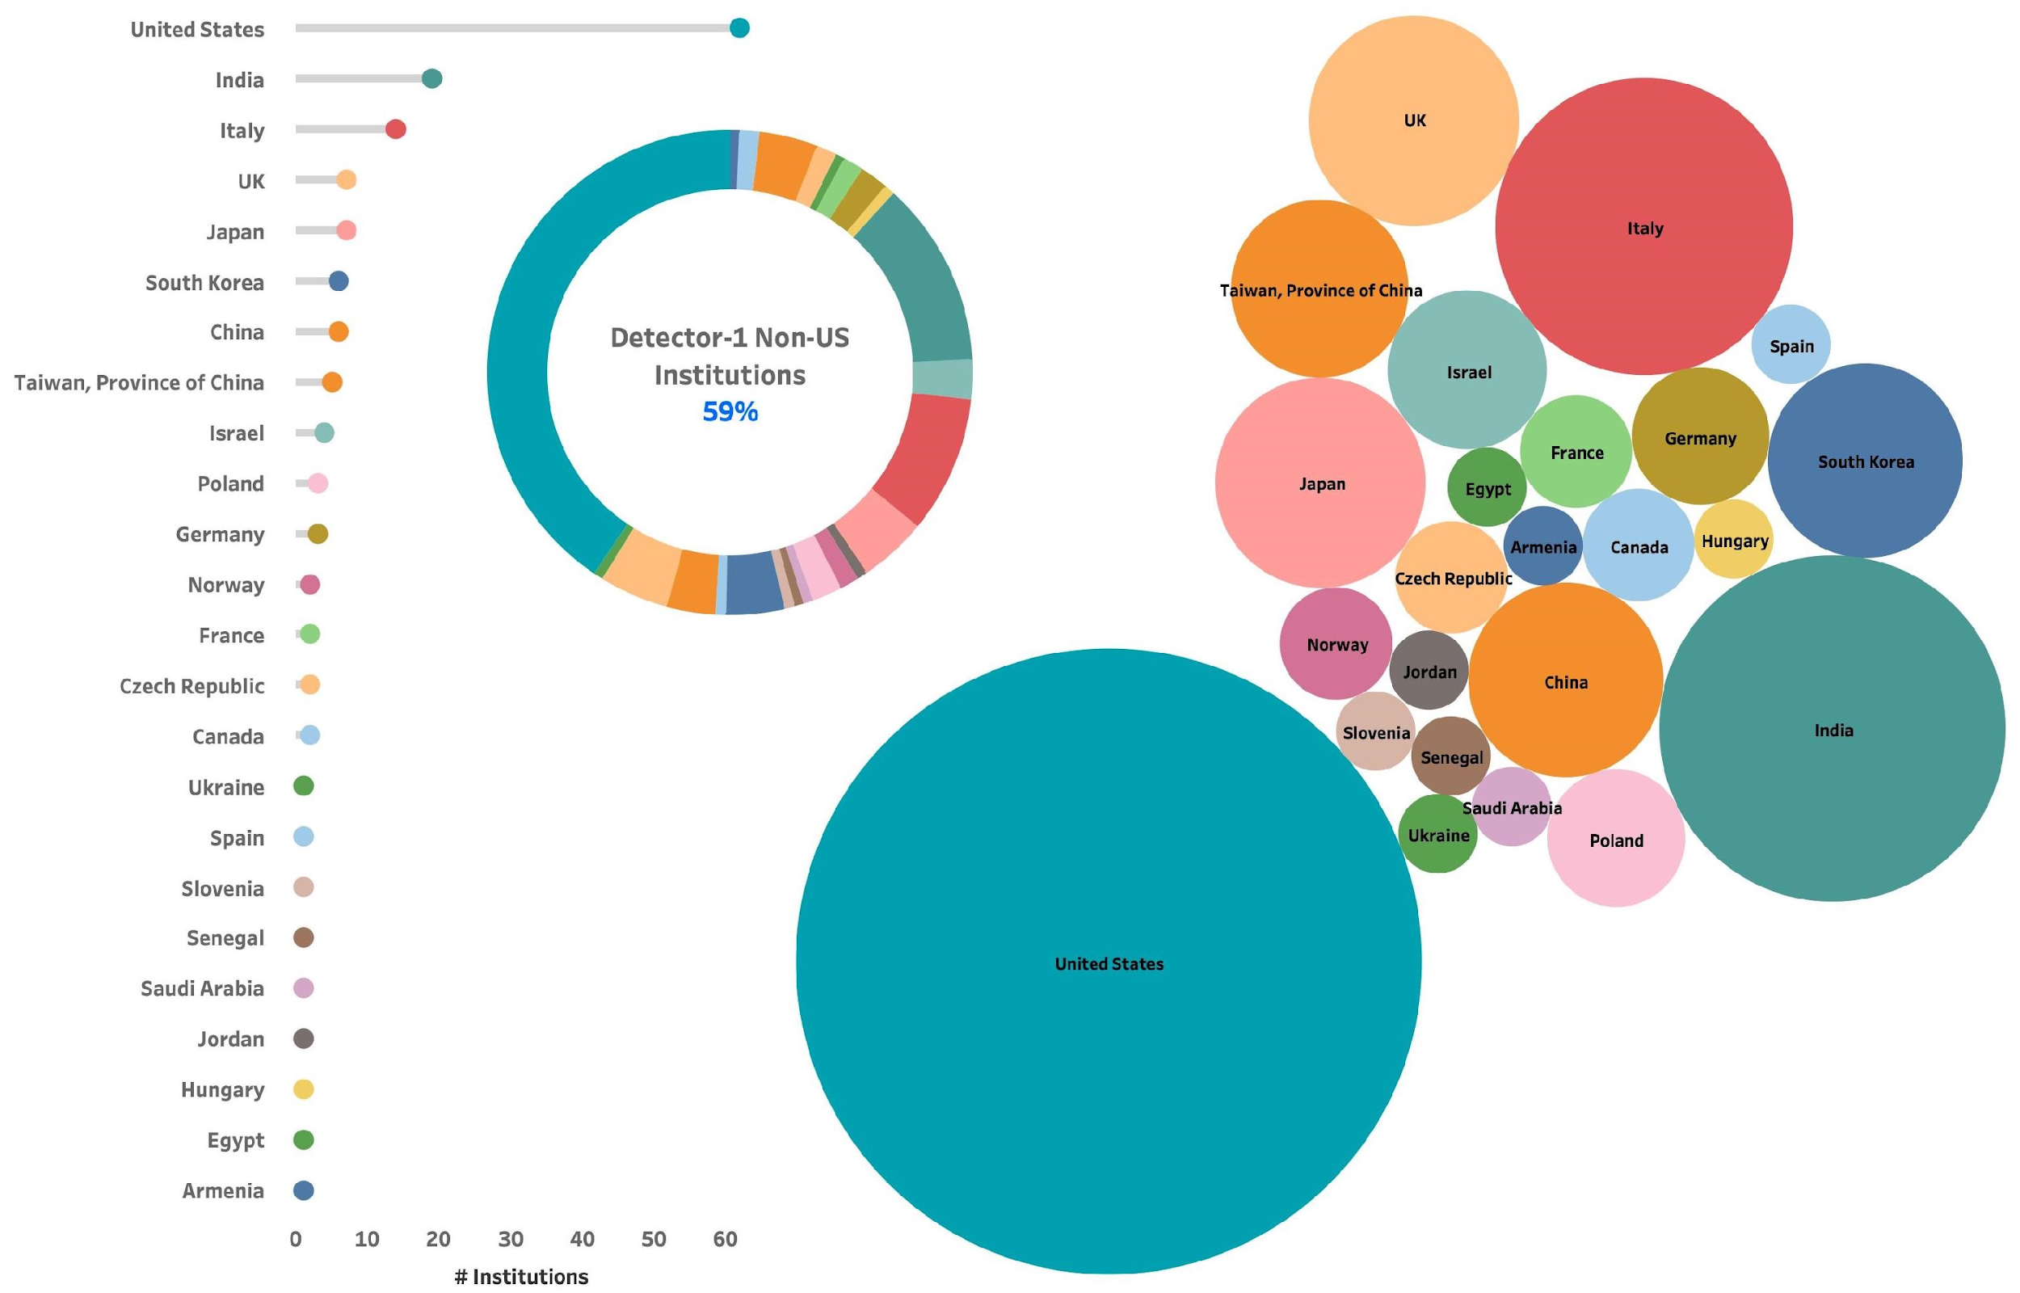
Summary
The ePIC Detector is maturing into a detailed technical design
EIC detectors are an enormous undertaking that requires participation and expertise from both the RHIC and JLab communities
Motion to initiate the change control process for calorimeter and RICH technologies endorsed by ePIC CC
Progress towards DOE milestones: CD-3A reviews start in Summer/Fall 2023!
Indico Meeting Agenda:
https://indico.bnl.gov/category/402/
ePIC Wiki:
https://wiki.bnl.gov/EPIC/index.php?title=Main_Page
ePIC Mailing Lists:
https://lists.bnl.gov/mailman/listinfo
Look for “eic-projdet-xxx” lists
non-US Institutions 59%

Slide 23
Backup

Slide 24
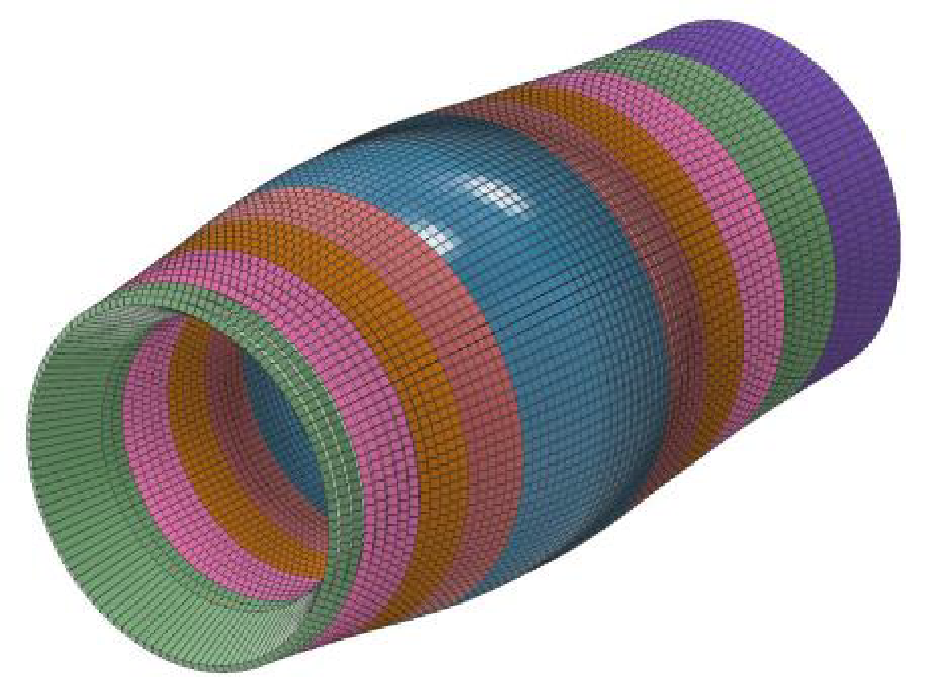
Barrel ECal Technology Selection
Homogeneous Calorimeter:
SciGlass: cost-effective radiator
Geometry and mechanical design based on PANDA
Anticipated readout with SiPM matrices
Hybrid Design:
Imaging calorimetry based on monolithic silicon sensors (AstroPix)
6 layers of imaging Si sensors interleaved with 5 SciFi/Pb layers
Followed by a large section of Pb/ScFi (can serve as inner HCAL)

Slide 25
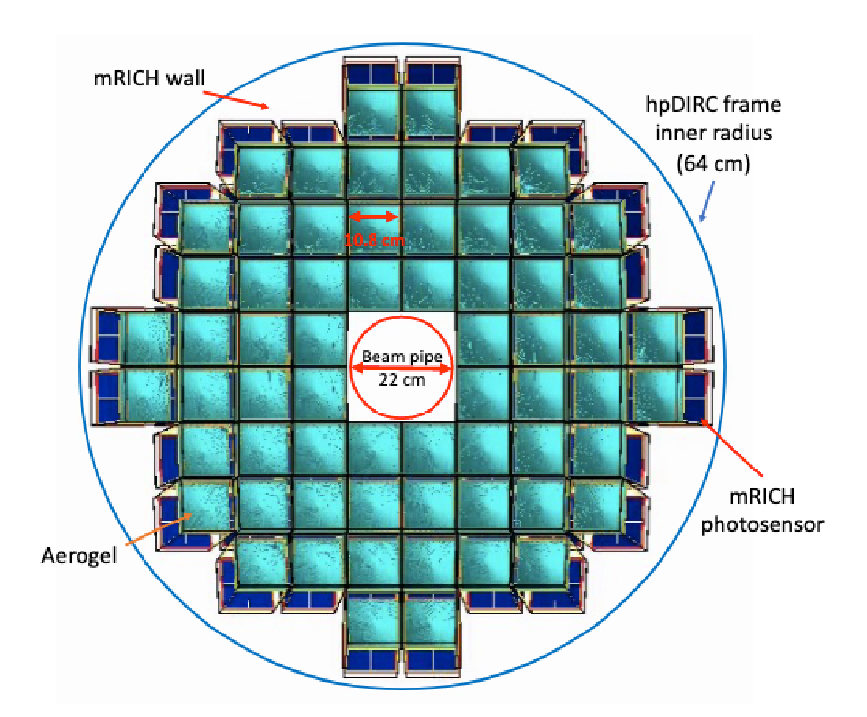
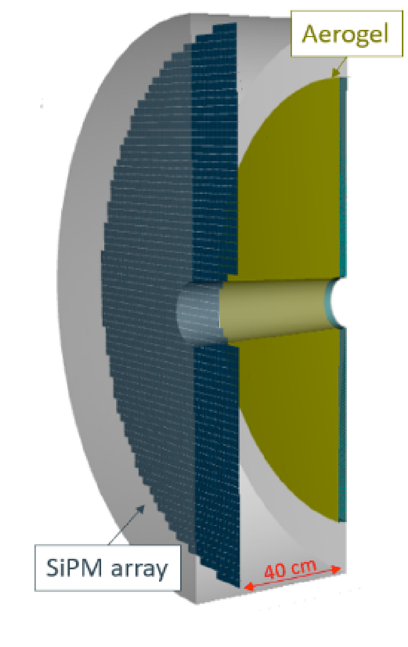
Backwards PID Technology Selection
Modular RICH (mRICH)
Aerogel radiator
Longitudinally compact due to Fresnel lens focusing
Modules have dead area
Proximity Focusing RICH (pfRICH)
Aerogel radiator
Gas threshold-based electron ID
Requires expansion volume
Both with use LAPPD/HRPPD readout to provide additional timing information

Slide 26
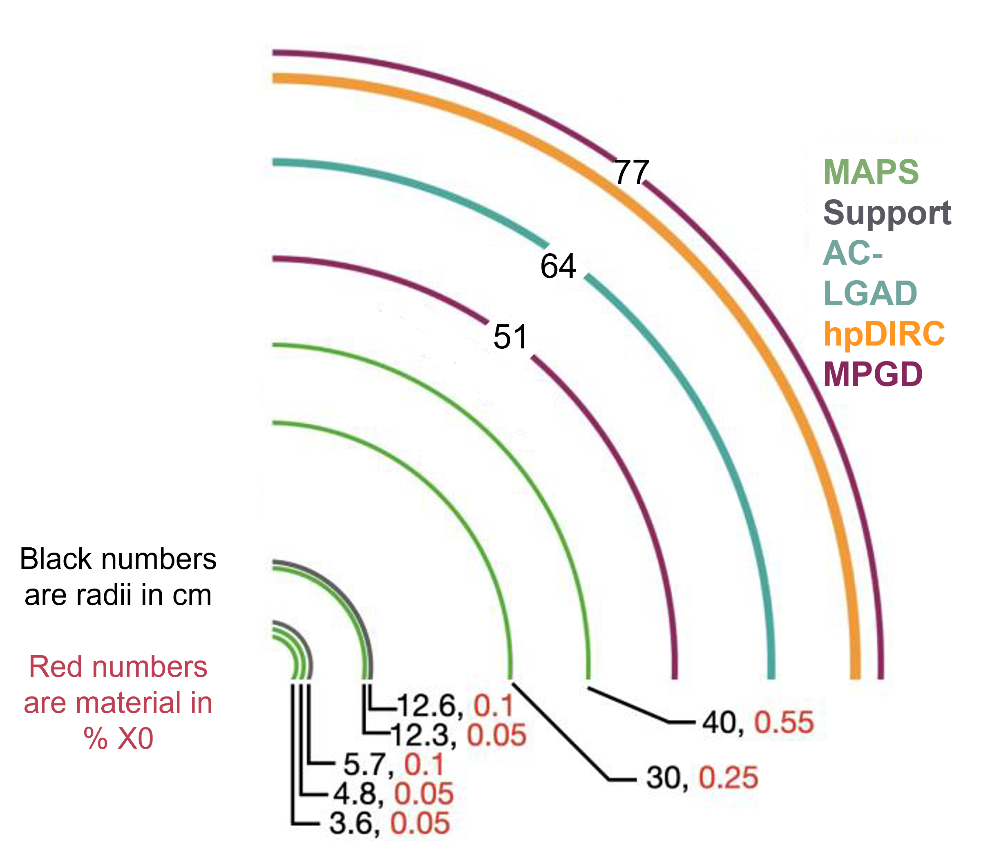
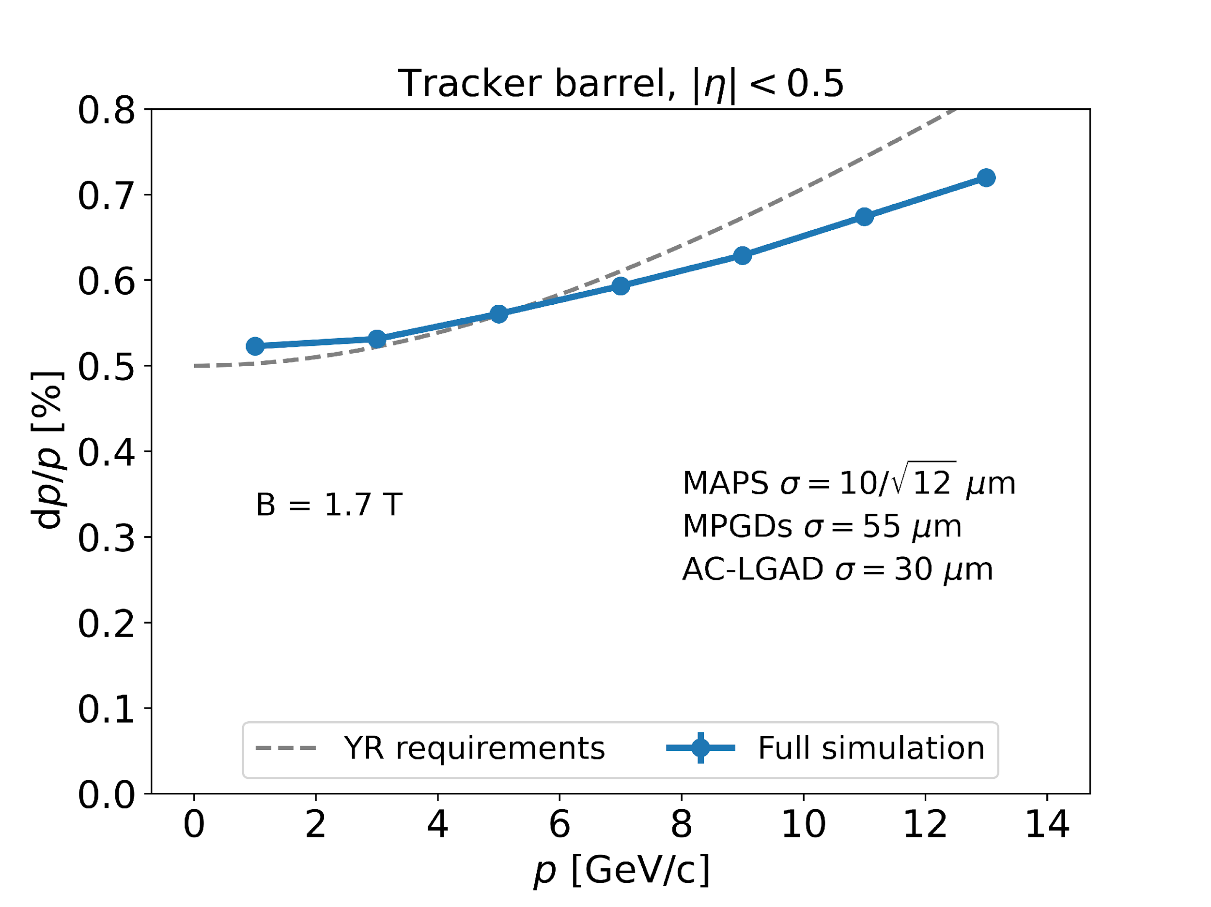
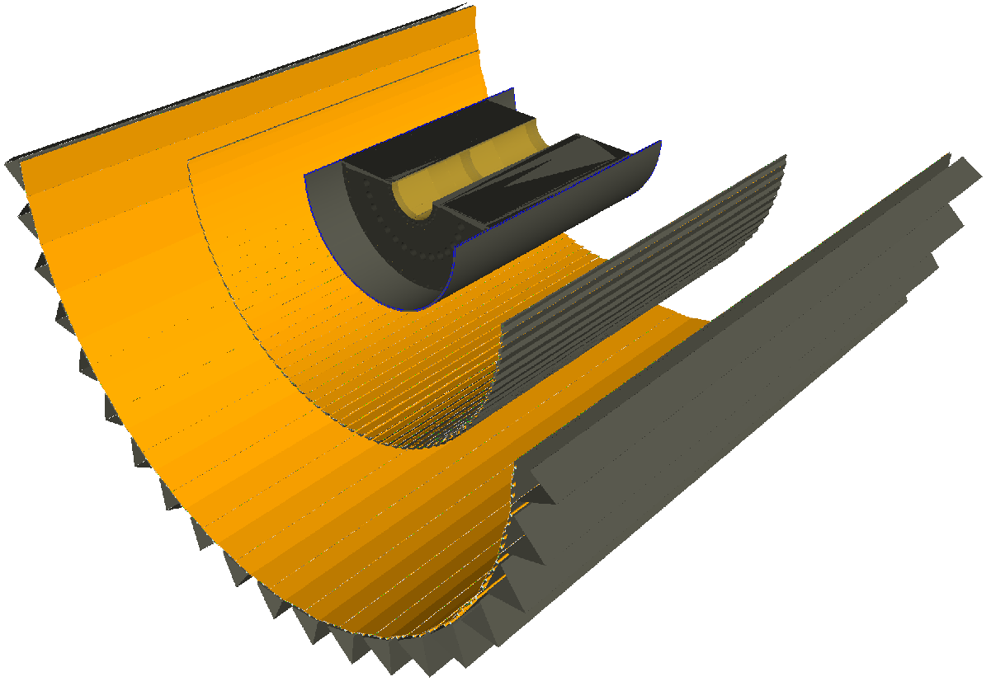
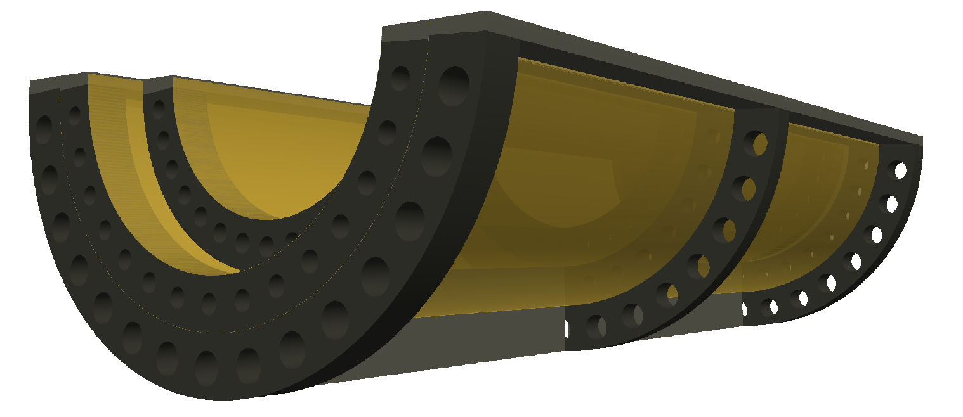
Tracking
Si Tracker based on ALICE ITS3 65nm MAPS sensors.
Five layers in barrel, supplemented by MPGDs for pattern recognition.
Five discs in forward/backward directions (+MPGD in forward)
Meets EICUG Yellow Report design requirements.
First “μITS3” assembly at CERN

Slide 27
EIC Calorimetry Requirements
EIC Community outlined physics, detector requirements, and evolving detector
concepts in the EIC Yellow Report.
Main tasks of the ECAL
Detect the scattered e and separate them from π.
Improve the electron momentum resolution at backward rapidities.
Detect neutral particles (photons, π⁰), and measure the energy and the coordinates of the impact.
Separate secondary electrons and positrons from charged hadrons.
Provide spatial resolution of two photons sufficient to identify decays π⁰ → γγ at high energies.
 | -4 < η < -2 | -2 < η < -1 | |η| < 1 | 1 < η < 4
E resolution | 2% ⁄√𝐸 ⨁ (1−3)% | 7% ⁄√𝐸 ⨁ (1−3)% | (10−2) % ⁄√𝐸 ⨁ (1−3)% | (10-12) % ⁄√𝐸 ⨁ (1−3)%
e/π separation | up to 10⁻⁴ | up to 10⁻⁴ | up to 10⁻⁴ | 3σ e/π
Min E [GeV] | 0.1 | 0.1 | 0.1 | 0.1

Slide 28
EIC Calorimetry Requirements
EIC Yellow Report
DIS electrons
DVCS photons
SIDIS π⁰
E-endcap
H-endcap
E-endcap
H-endcap
E-endcap
H-endcap
EIC Yellow Report
e/π separation:
Depends on momentum and η
Tightest constrain from parity violating asymmetries 10⁻⁴
ΔG requires ~ 10⁻³

Slide 29
Backward Calorimetry
Backward EMCAL
Non-projective PbWO₄ calorimeter (EEEMC-Consortium)
2 × 2 × 20 cm³ crystals
Length ~20X/X₀, transverse size ~Molière radius
Located inside the inner DIRC frame
Preferred readout: SiPMs of pixel size 10μm or 15μm
Cooling to keep temperature stable within ± 0.1 ◦C
Ongoing efforts advancing the design to increase coverage in η (−3.7 < η < −1.5) with inlay around beampipe
Backward HCAL in consideration
Possible upgrade path
→ See C. Muñoz Camacho for EEEMCal, https://indico.bnl.gov/event/15493/
→ See B. Page, https://indico.bnl.gov/event/15686/

Slide 30
Barrel EM Calorimetry
Hybrid concept
Imaging calorimetry based on monolithic silicon sensors AstroPix (NASA’s AMEGO-X mission) - 500 μm x 500 μm pixels Nuclear Inst. and Methods in Physics Research, A 1019 (2021) 165795
Scintillating fibers in Pb (Similar to GlueX Barrel ECal, 2-side readout w/ SiPMs) Nuclear Inst. and Methods in Physics Research, A 896 (2018) 24-42
6 layers of imaging Si sensors interleaved with 5 Pb/ScFi layers and followed by a large chunk of Pb/ScFi section (can be extended to inner HCAL)
Total radiation thickness for EMCAL of ~20 X₀
Detector coverage: -1.7 < η < 1.3
Energy resolution - SciFi/Pb Layers: 𝟓.𝟑% /√𝑬 ⨁ 𝟏.𝟎%
Position resolution - Imaging Layers (+ 2-side SciFi readout): with 1st layer hit information ~ pixel size

Slide 31
Barrel Hadronic Calorimetry
Reuse of sPHENIX outer (outside of the Solenoid) HCal ≈ 3.5λ_{l}
Steel and scintillating tiles with wavelength shifting fiber
Δη x Δφ ≈ 0.1 x 0.1
(1,536 readout channels, SiPMs)
⟶ See: J. Lajoie, https://indico.bnl.gov/event/15493/

Slide 32
Forward EM Calorimetry
Sampling EMCal design:
W/SciFi: scintillating fibers embedded in W/epoxy mix
Similar to sPHENIX W/SciFi
X /X₀ = 23 (17 cm + 10 cm readout), 2.5 x 2.5 cm towers (R_{M}=~2.3 cm)
Easier construction for WSciFi calorimeter
Compactness and higher EM-shower containment
4 SiPMs / tower
R&D: Improvement of light collection eff. and uniformity
Simulations:
Expected E resolution ∼ 11%/√E ⊕ 2%
Can effectively separate ɣ/π⁰ (z = 3.5 m) with ML methods
→ See O. Tsai, https://indico.bnl.gov/event/15686/

Slide 33
Forward Hadronic Calorimetry
Two design based on longitudinally separated steel and scintillator tiles
Inspired by Projectile Spectator Detector (CBM)
60 layers of steel-sci plates + 10 layers of W-Sci plates (5 x 5 cm towers)
7 signals per tower (from 10 plates)
λ/λ₀ = 6.9 (HCAL only, larger shower containment)
Ongoing efforts on granular inlay around beampipe
→ See F. Bock, https://indico.bnl.gov/event/15810/
→ See O. Tsai, https://indico.bnl.gov/event/15810/

