Slide 1





GridPIX Mini-TPC
Klaus Dehmelt^{1,2}, ∗∗P. Garg⁵, ∗Thomas Hemmick^{1,2}, Jochen Kaminski³, Peter Kluit⁴, Nikolai Smirnov⁵
¹Department of Physics and Astronomy, Stony Brook University, USA
²Center for Frontiers in Nuclear Science at Stony Brook University, USA
³Institute of Physics, University of Bonn, Germany
⁴Nikhef, The Netherlands
⁵Department of Physics, Yale University, USA

Slide 2
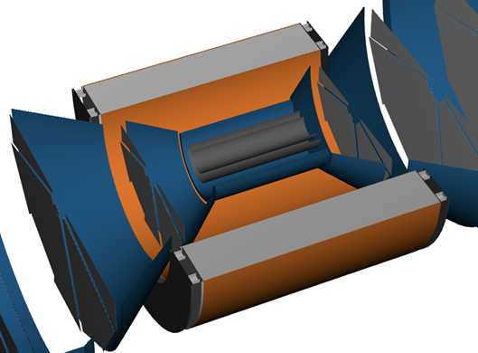
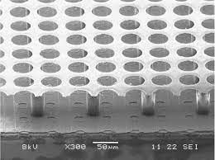
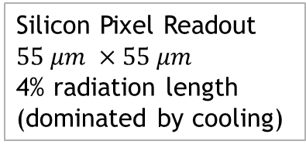
Brief Introduction
Originally as “upgrade path” for ATHENA.
Not discussed in current EPIC baseline.
Ideally suited for Detector 2.
Provides:
  PID (pi-K-p) from 100 MeV/c to 800 MeV/c
  ROBUST tracking (enormous number of hits per track)
  Virtually immune to synchrotron background.
Field Cage
1% radiation length, entrance and exit
Silicon Pixel Readout
$$55 μm ×55 μm$$
4% radiation length
(dominated by cooling)
Gas Volume
Readout
High Voltage (-10kV)
Low radiation Length
ATHENA’s Vision
T2K gas (low diffusion)

Slide 3
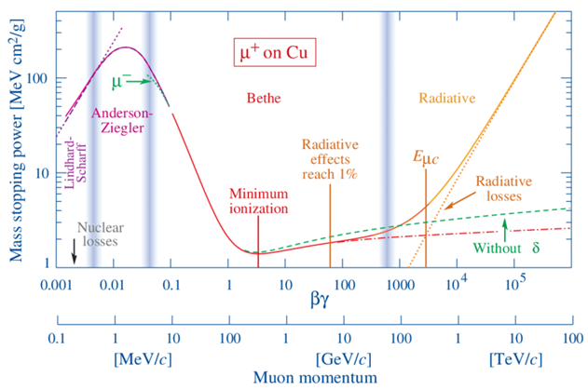
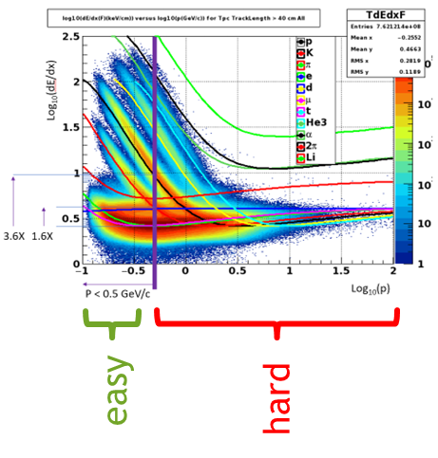
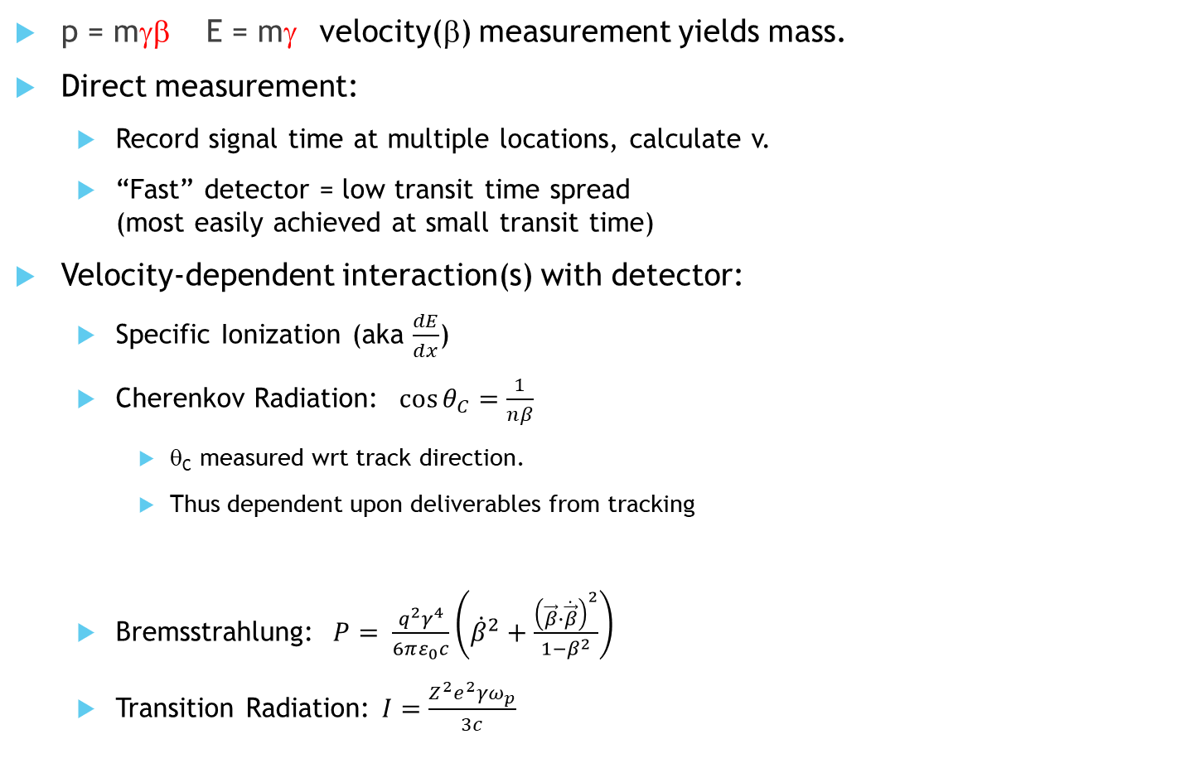
PID ~ Velocity
p = mγβ E = mγ velocity(β) measurement yields mass.
Direct measurement:
  Record signal time at multiple locations, calculate v.
  “Fast” detector = low transit time spread
  (most easily achieved at small transit time)
Velocity-dependent interaction(s) with detector:
  Specific Ionization (aka $\frac{dE}{dx}$)
  Cherenkov Radiation: $\cos{θ_{C}=\frac{1}{nβ}}$
    θ_{C} measured wrt track direction.
    Thus dependent upon deliverables from tracking
  Bremsstrahlung: $P= \frac{q^{2}γ^{4}}{6πε_{0}c}\left({\dot{β}}^{2}+\frac{{\left(\vec{β}∙\dot{\vec{β}}\right)}^{2}}{1−β^{2}}\right)$
  Transition Radiation: $I=\frac{Z^{2}e^{2}γω_{p}}{3c}$
eID mechanisms

Slide 4
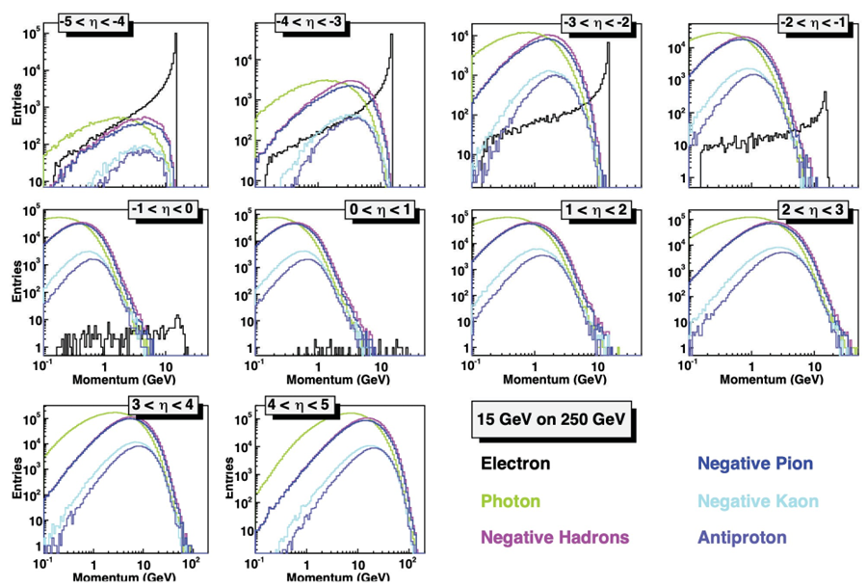
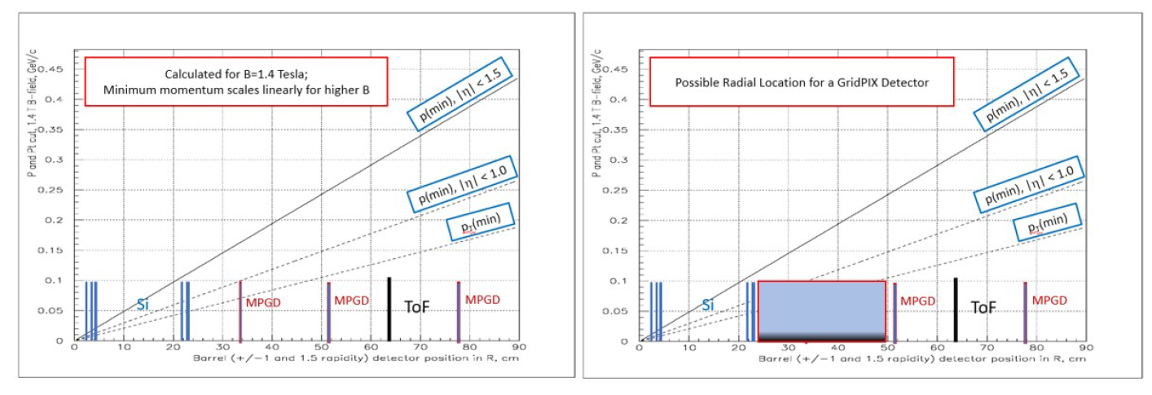
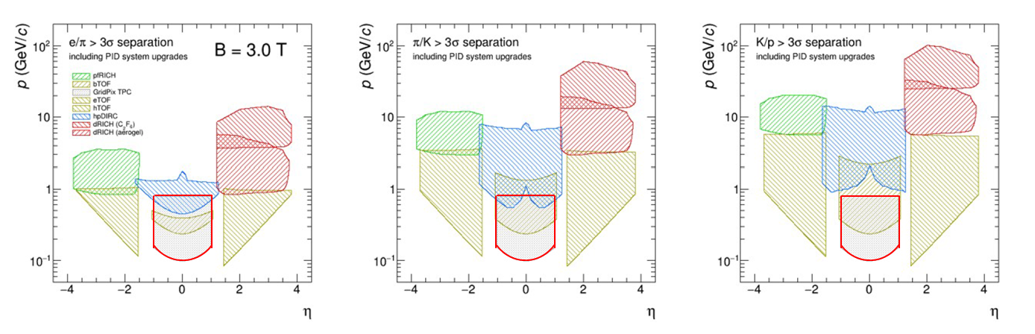
Physics Motivation
Many envision a Detector 2 with 3T or higher field.
Near η=0, soft particles dominate
TOF-PID has competition between p_{min} and resolving power
At the lowest momenta particle identification by dE/dx is advantageous.
Promising technology for EIC detector 2
dE/dx in ATHENA upgrade promised lowest PID reach

Slide 5
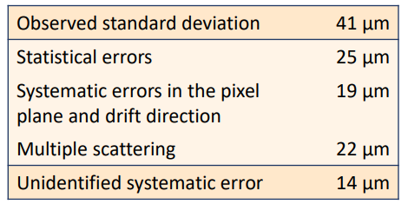
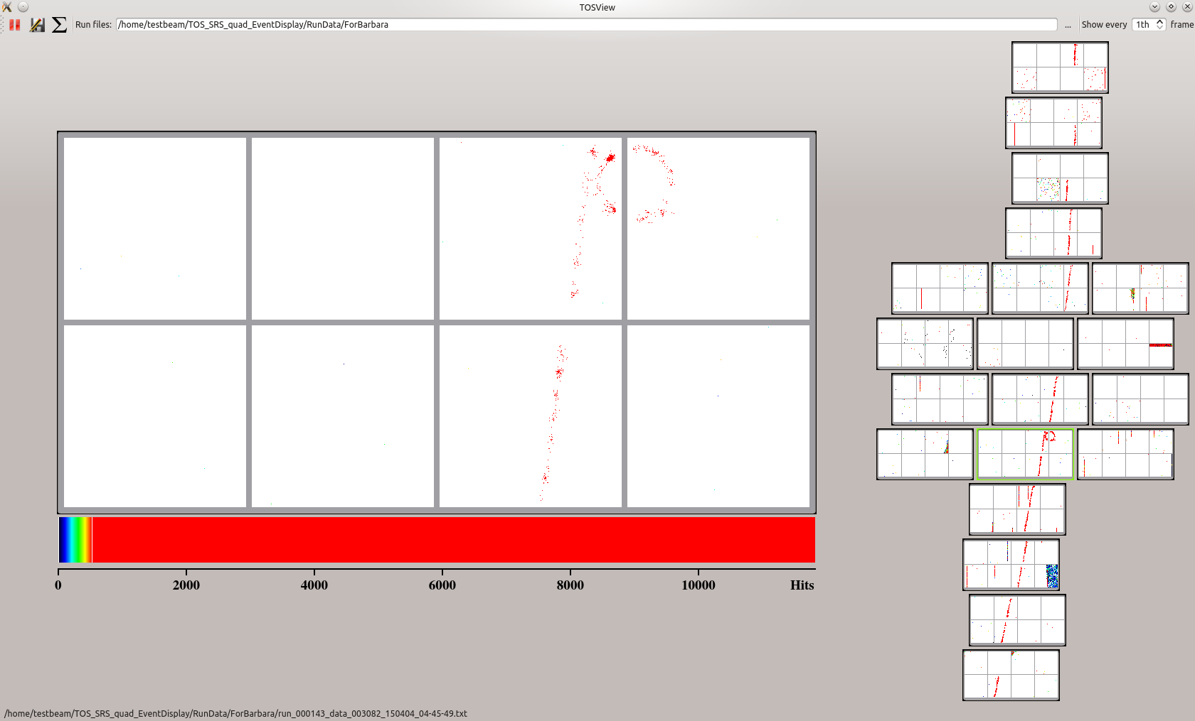
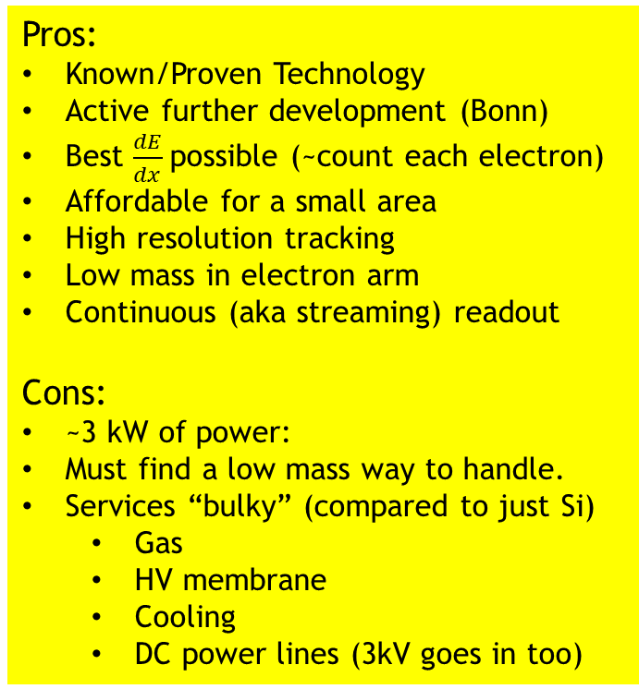
GridPIX Overview
3D e-by-e tracking
Pros:
Known/Proven Technology
Active further development (Bonn)
Best $\frac{dE}{dx}$possible (~count each electron)
Affordable for a small area
High resolution tracking
Low mass in electron arm
Continuous (aka streaming) readout
Cons:
~3 kW of power:
Must find a low mass way to handle.
Services “bulky” (compared to just Si)
  Gas
  HV membrane
  Cooling
  DC power lines (3kV goes in too)
Ultimate dE/dx device.
  Avalanche grid in front of 55 x 55 μm² pixels.
  >90% efficiency for single electrons.
  Goals:
    Enough diffusion to get every electron into a different hole.
    Count electrons one-by-one.
  Three generations of development and continuing.
Small area is not particularly expensive.
  1800 chips (order/produce/test 3600) = $716k
  Careful: 1.2-5.4 kW of power (occupancy dependent).

Slide 6
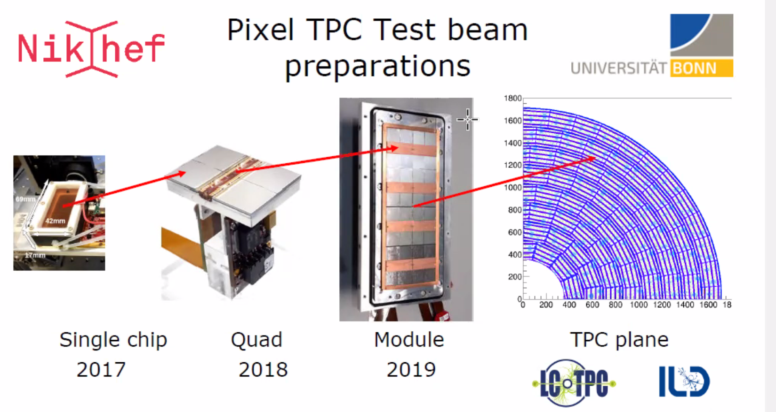

Slide 7
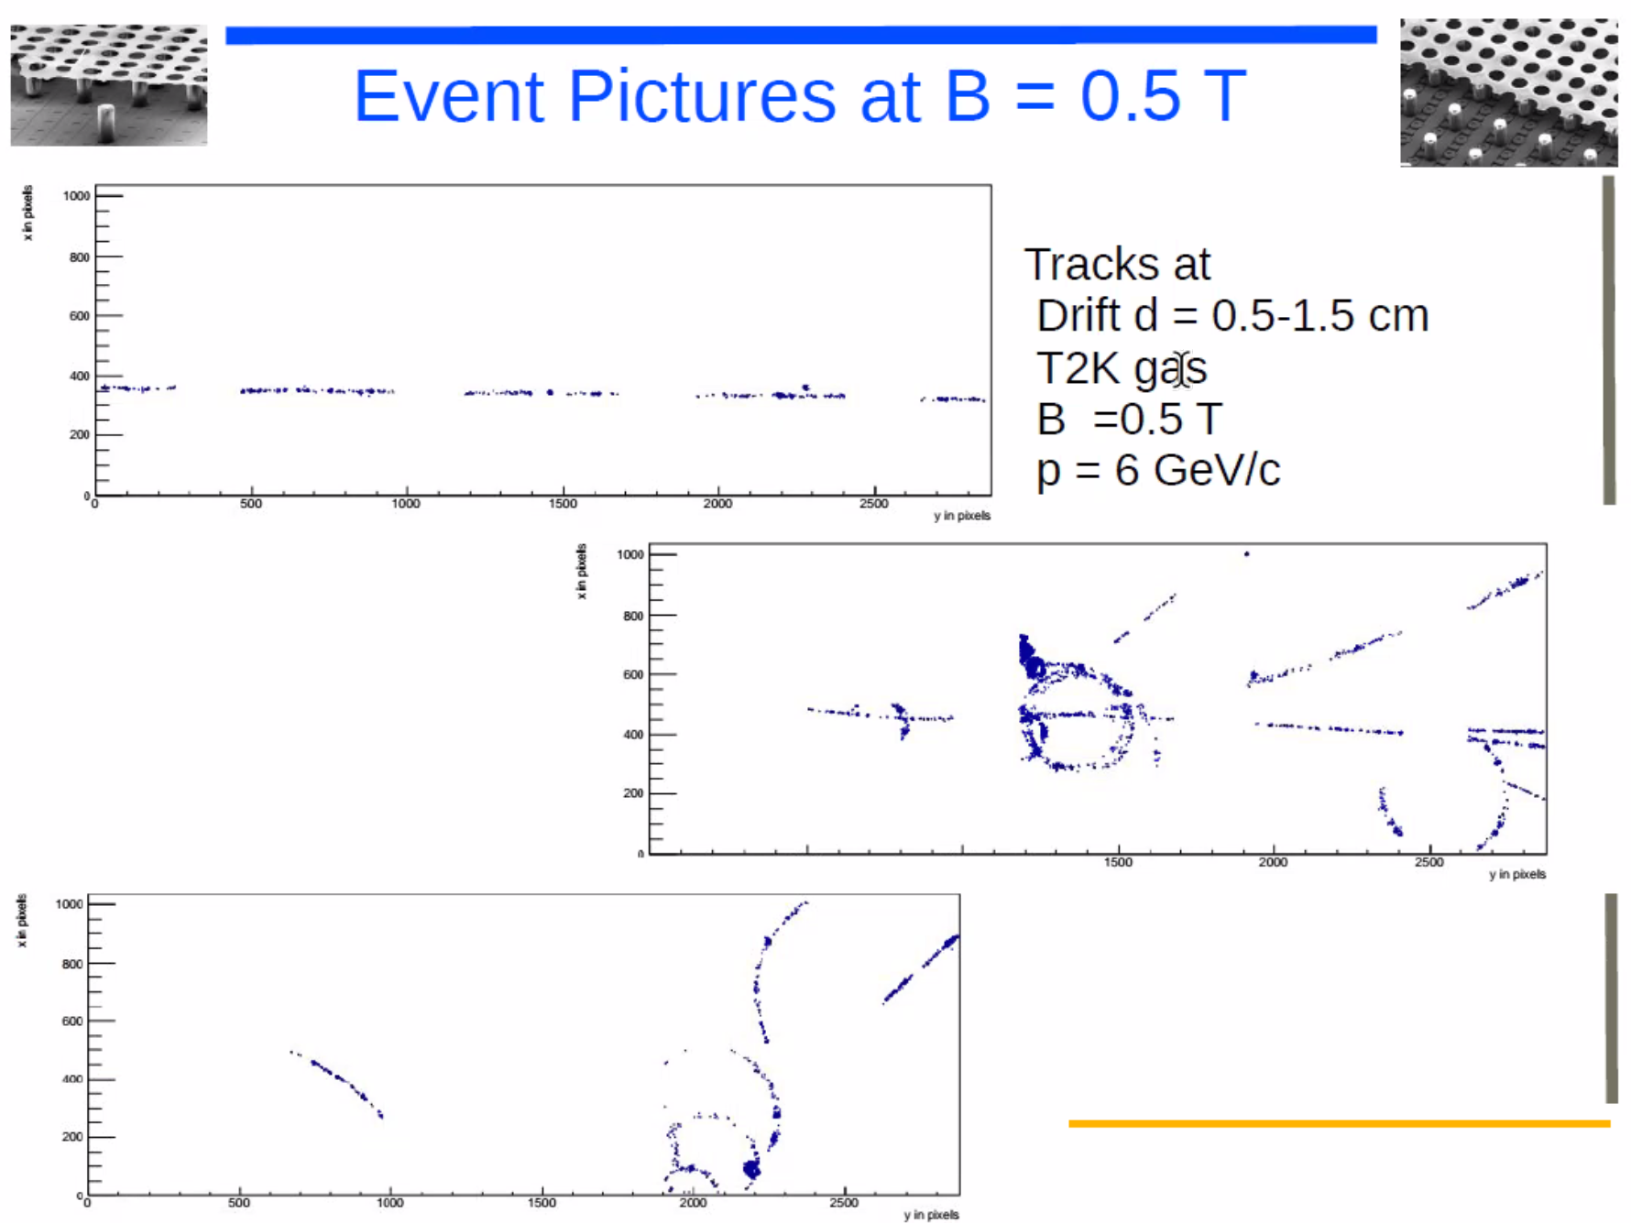
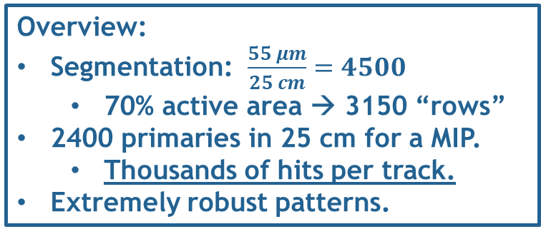
June 2021
Overview:
Segmentation: $\frac{55 μm}{25 cm}=4500$
  70% active area → 3150 “rows”
2400 primaries in 25 cm for a MIP.
  Thousands of hits per track.
Extremely robust patterns.

Slide 8
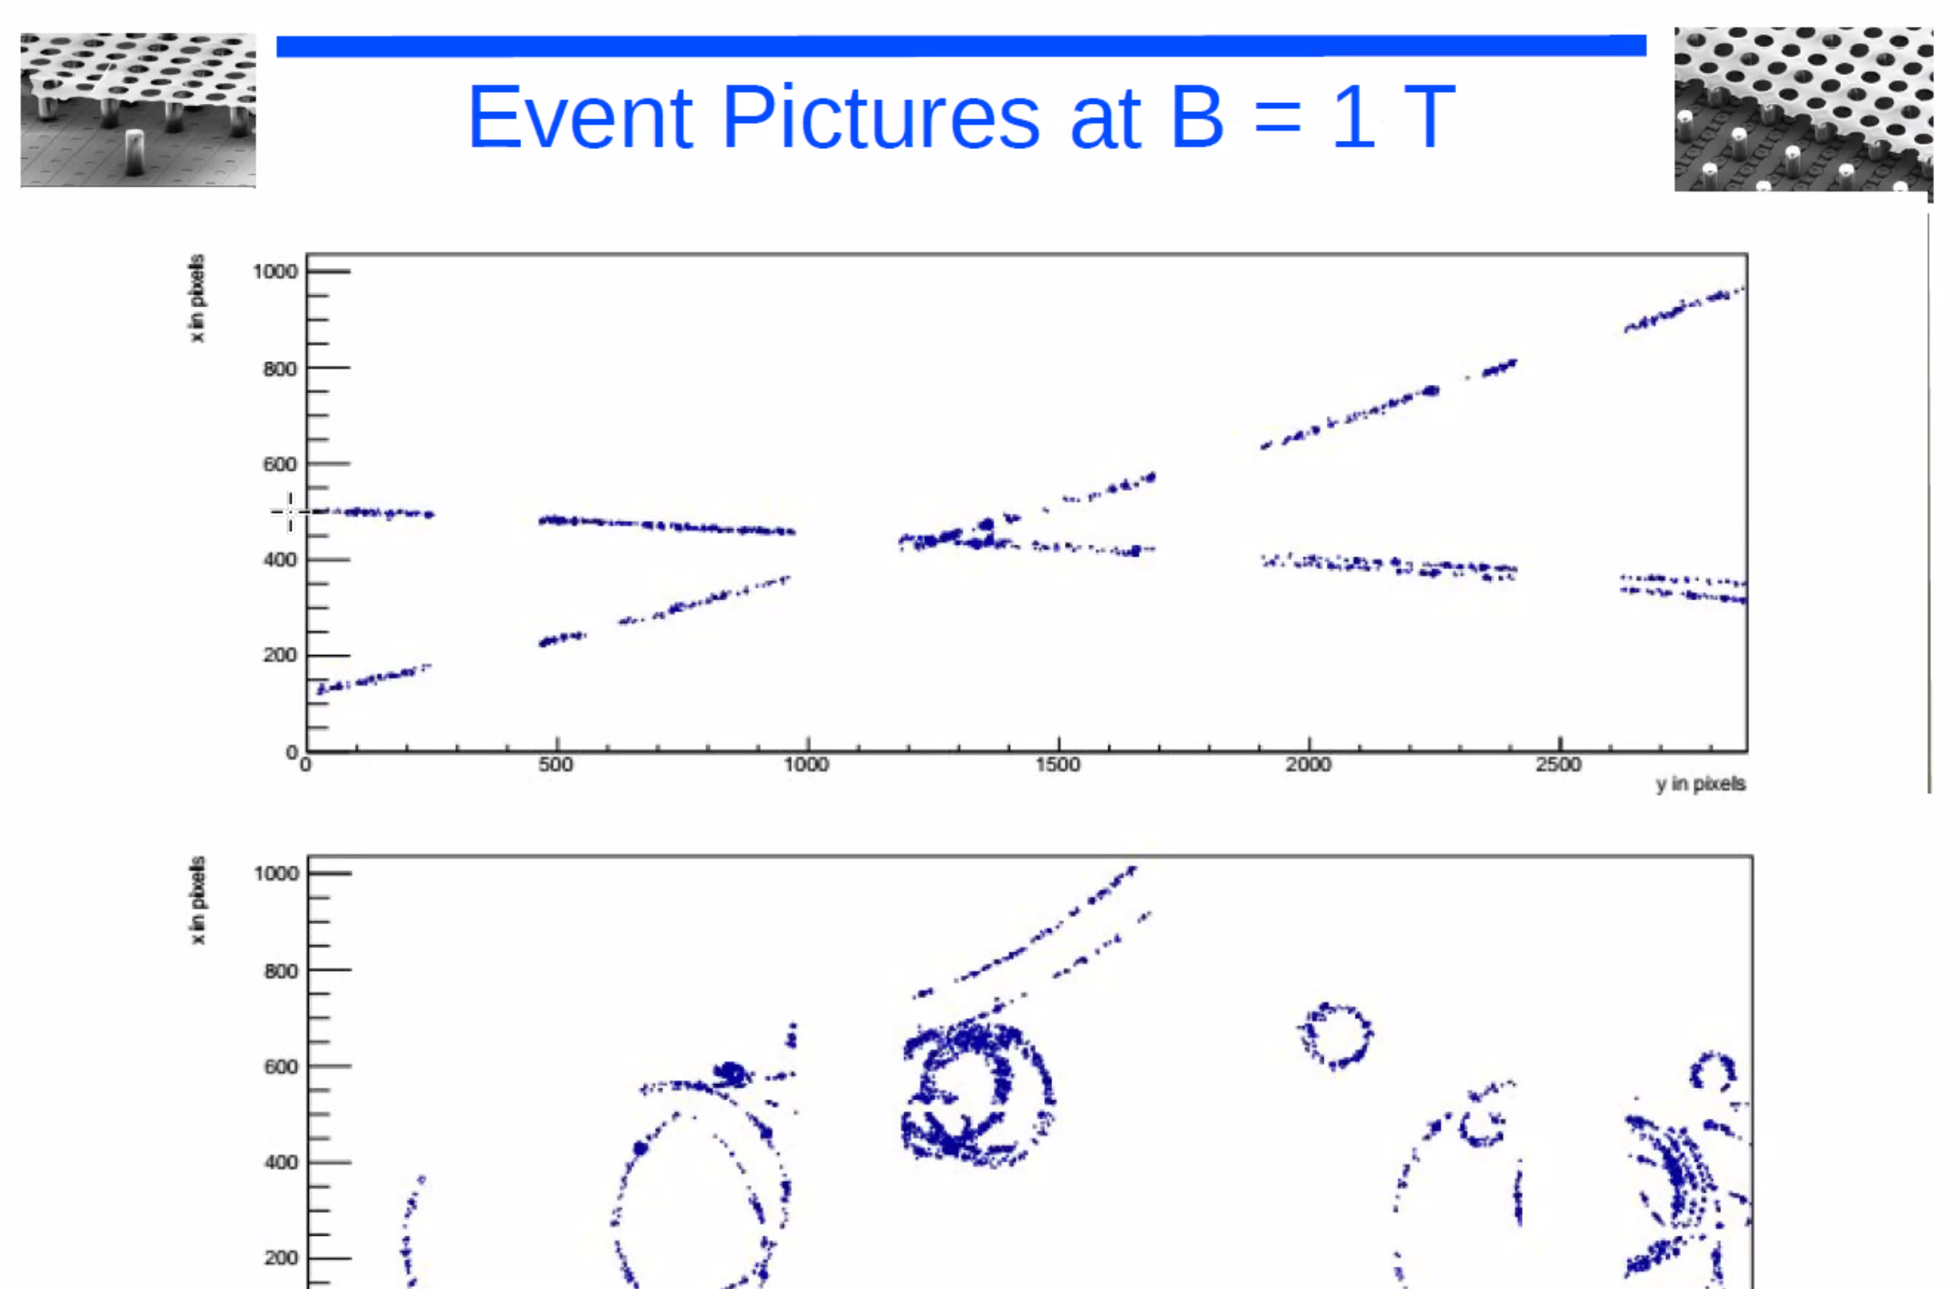

Slide 9
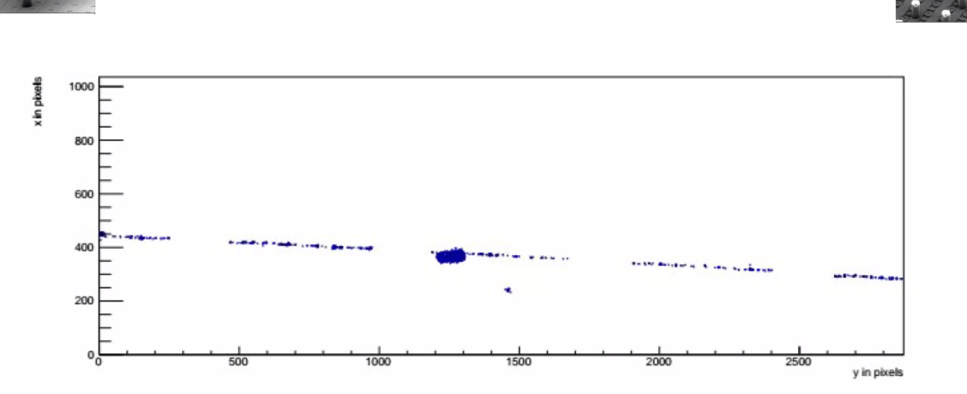
Delta Rays can be removed very often by Topology.

Slide 10
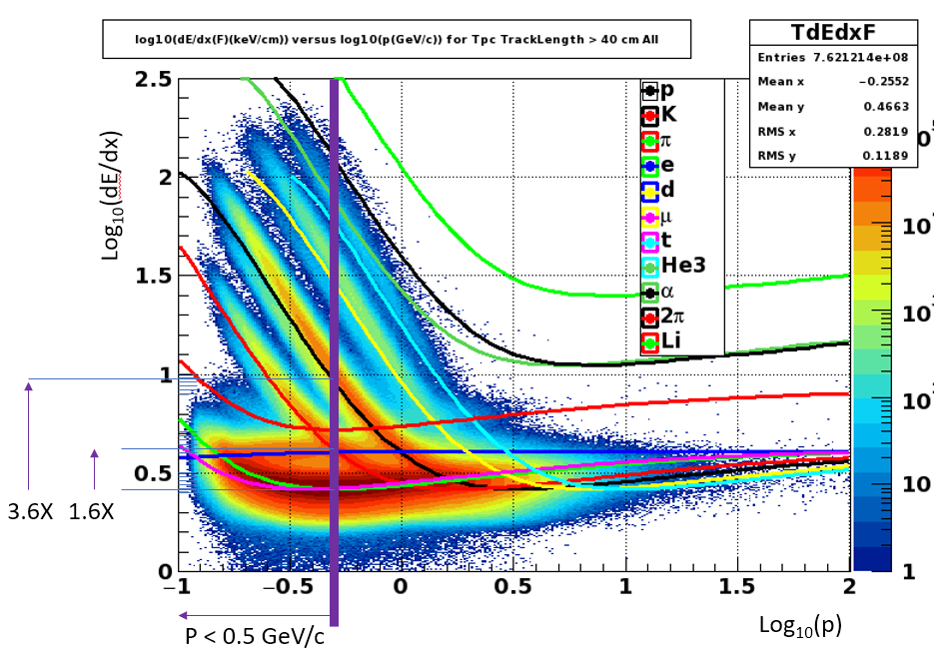
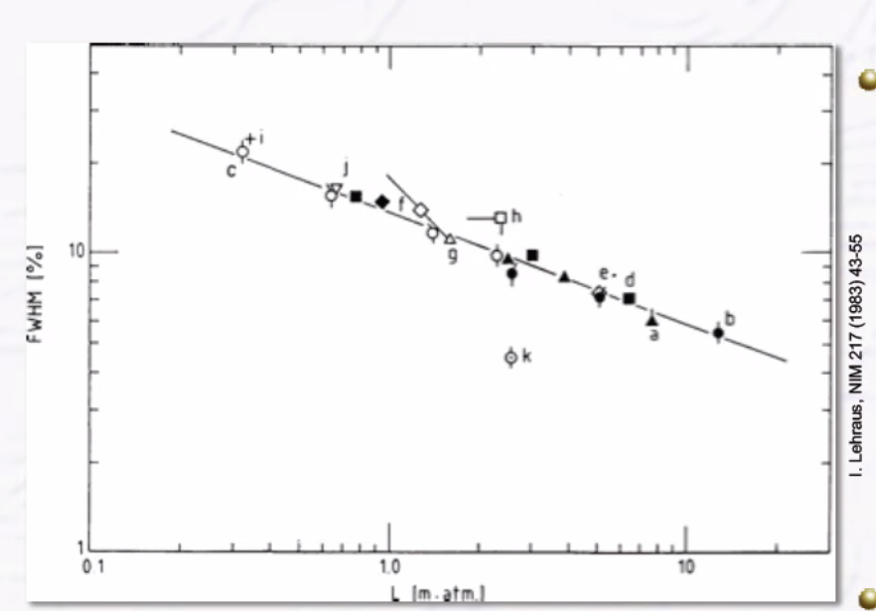
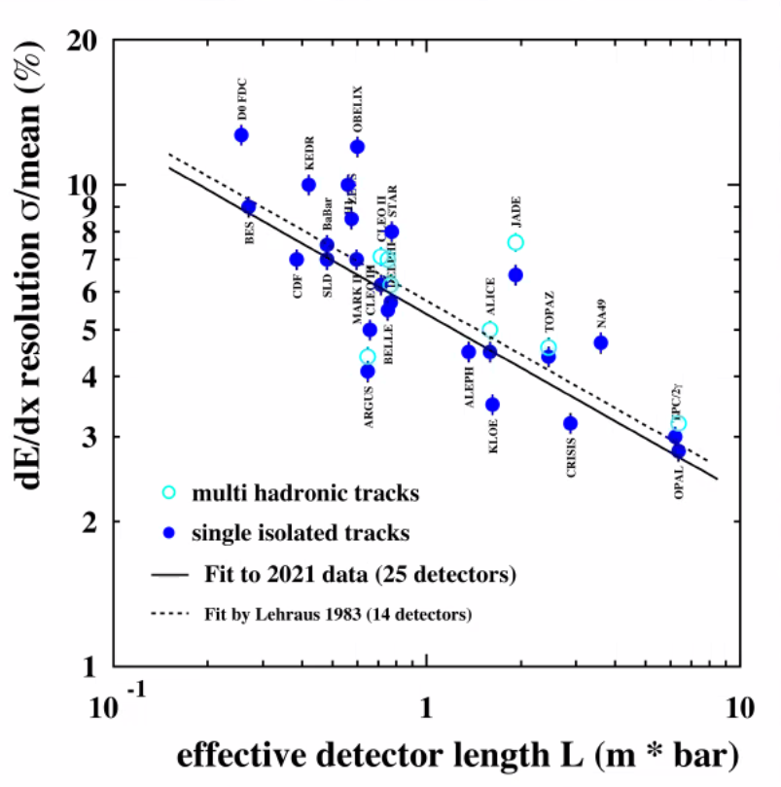
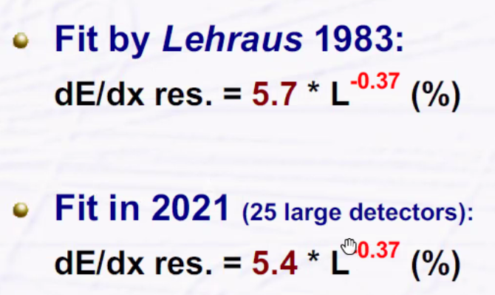
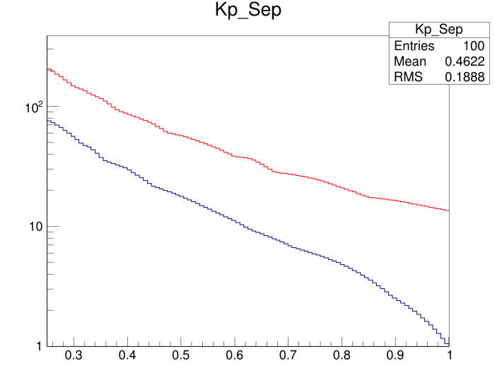
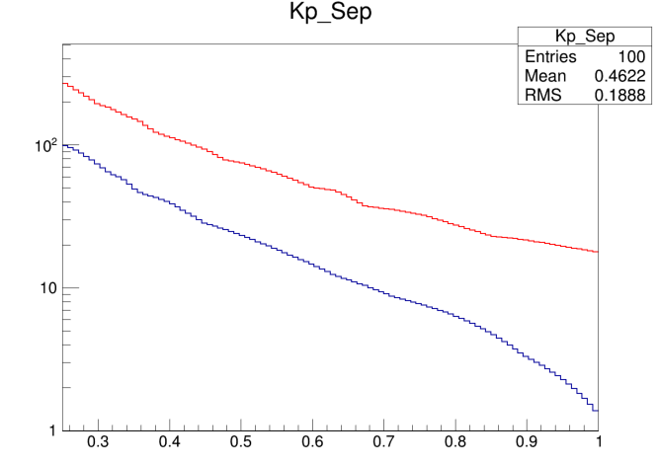
Anticipated dE/dx Performance
easy
hard
#σ
Lehraus Plot
Using 5.4 as a standard TPC
  5.4*(0.25)^{-0.37} = 9.0
Measured for GridPIX (truncated Mean)
  4.1% at 1 meter
  4.1*(0.25)^{-0.37} = 6.85
Roughly 20 sigma at 0.5 GeV/c
Useful range overlaps with DIRC
#σ
9.0%
6.85%
K-p
K-p
π-K
π-K
Momentum
Momentum

Slide 11
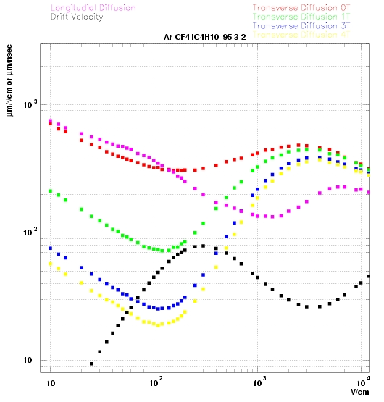
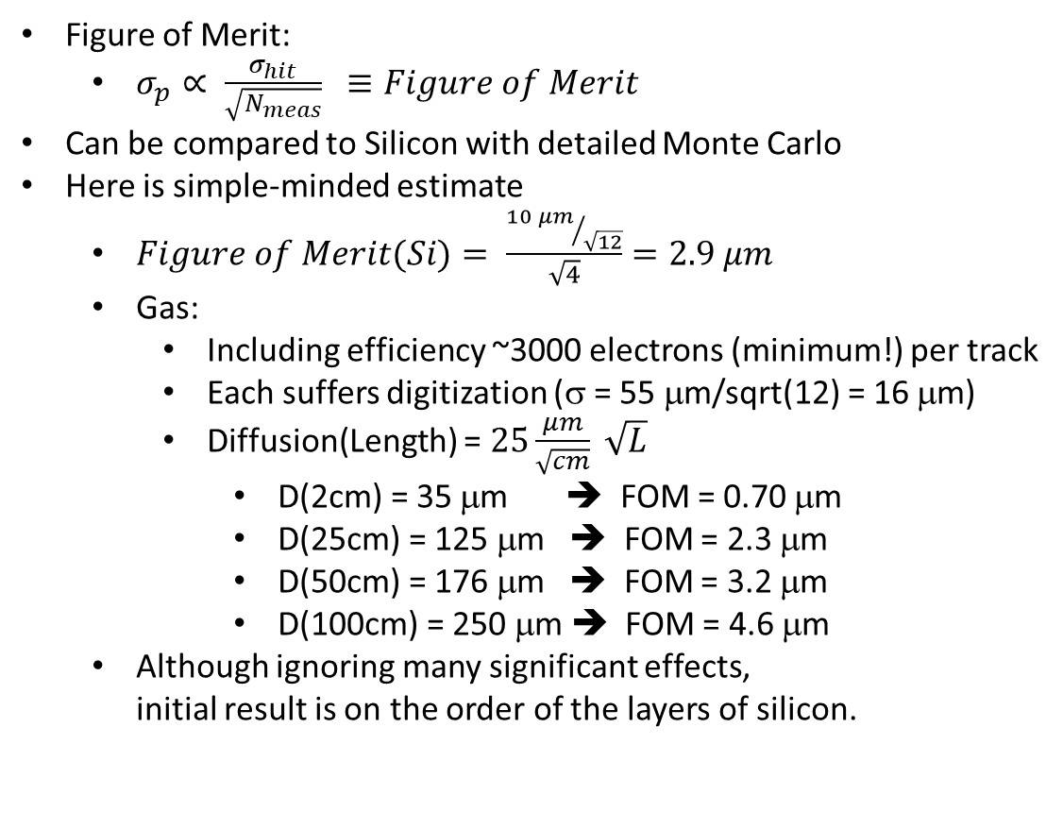
Overly Simplified Momentum Resolution
Figure of Merit:
  $σ_{p}∝ \frac{σ_{hit}}{\sqrt{N_{meas}}} ≡Figure of Merit$
Can be compared to Silicon with detailed Monte Carlo
Here is simple-minded estimate
  $Figure of Merit(Si)= \frac{{10 μm}/{\sqrt{12}}}{\sqrt{4}}=2.9 μm$
  Gas:
    Including efficiency ~3000 electrons (minimum!) per track
    Each suffers digitization (σ = 55 μm/sqrt(12) = 16 μm)
    Diffusion(Length) = $25\frac{μm}{\sqrt{cm}} \sqrt{L}$
      D(2cm) = 35 μm ➔ FOM = 0.70 μm
      D(25cm) = 125 μm ➔ FOM = 2.3 μm
      D(50cm) = 176 μm ➔ FOM = 3.2 μm
      D(100cm) = 250 μm ➔ FOM = 4.6 μm
  Although ignoring many significant effects,
  initial result is on the order of the layers of silicon.
Momentum resolution is likely very good
Pattern recognition is certainly SUPERB!!!

Slide 12
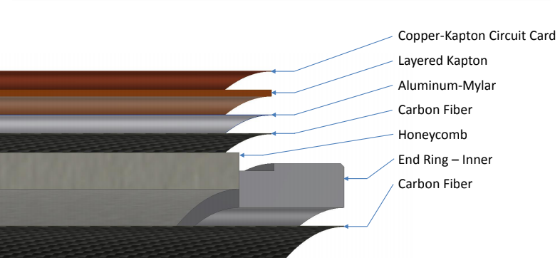
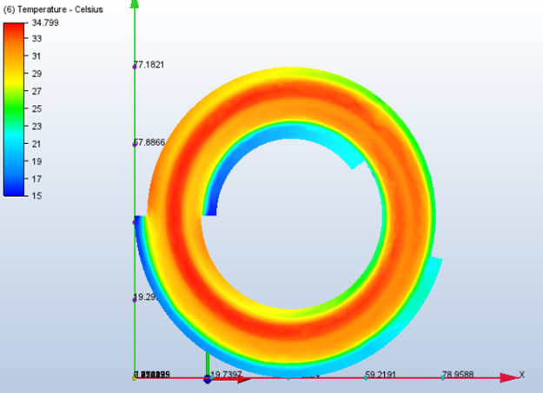
Radiation Length
Barrel:
End Cap:
sPHENIX:
45 kV & 18 layers kapton.
EIC:
10 kV & 5 layers kapton.
Temperature Profiles: 3 kW
Coolant above the dew point
  Conventional Cooling OK at 4%
  CO₂ cooling promises ~2% ?

Slide 13
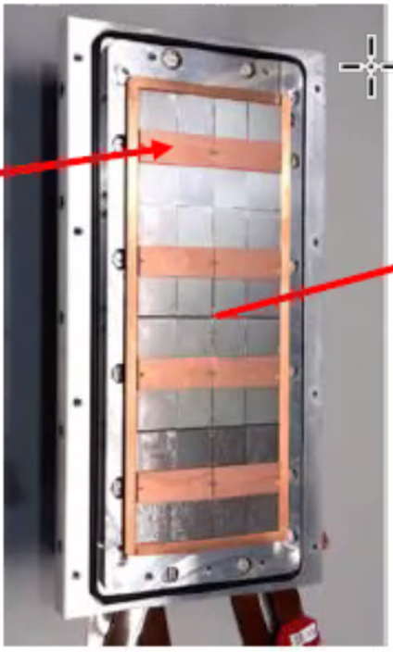
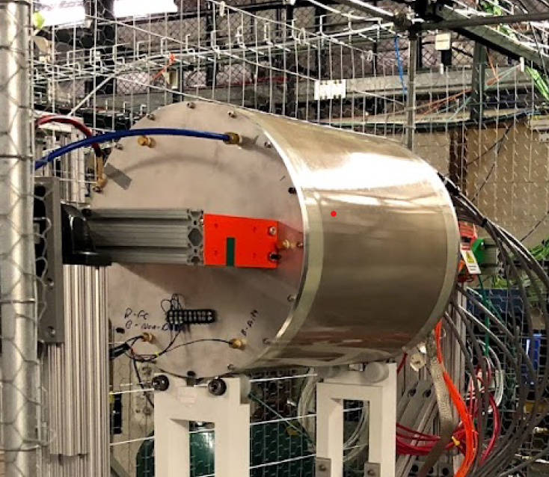
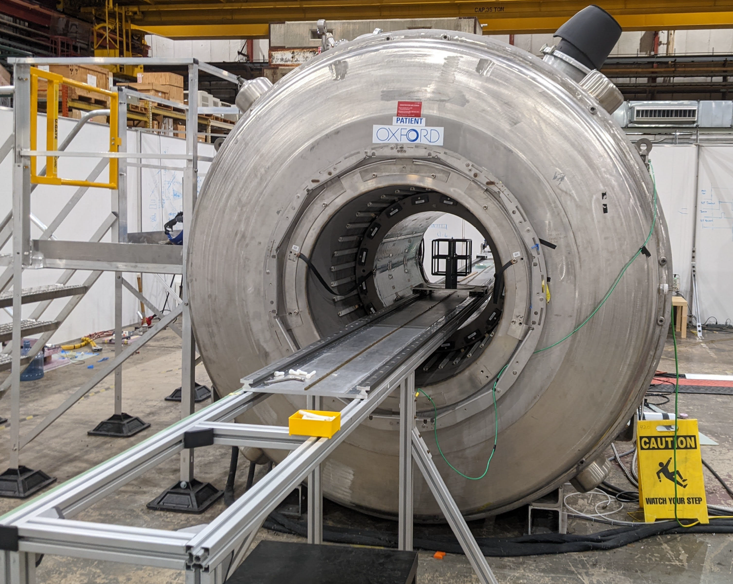
Initial R&D Plan
+
=
Ability to study PID
sPHENIX TPC Prototype Field Cage
Nikhef
32-chip Module
Fermilab Test Beam
  Mixed beam at low energies
  Identified by beam line Cherenkov
Cosmic Rays at Argonne
  0-4 Tesla Field available.
  Limits diffusion, maintains “clusters”
=
Ability to study clusters
Argonne Magnet Facility

Slide 14
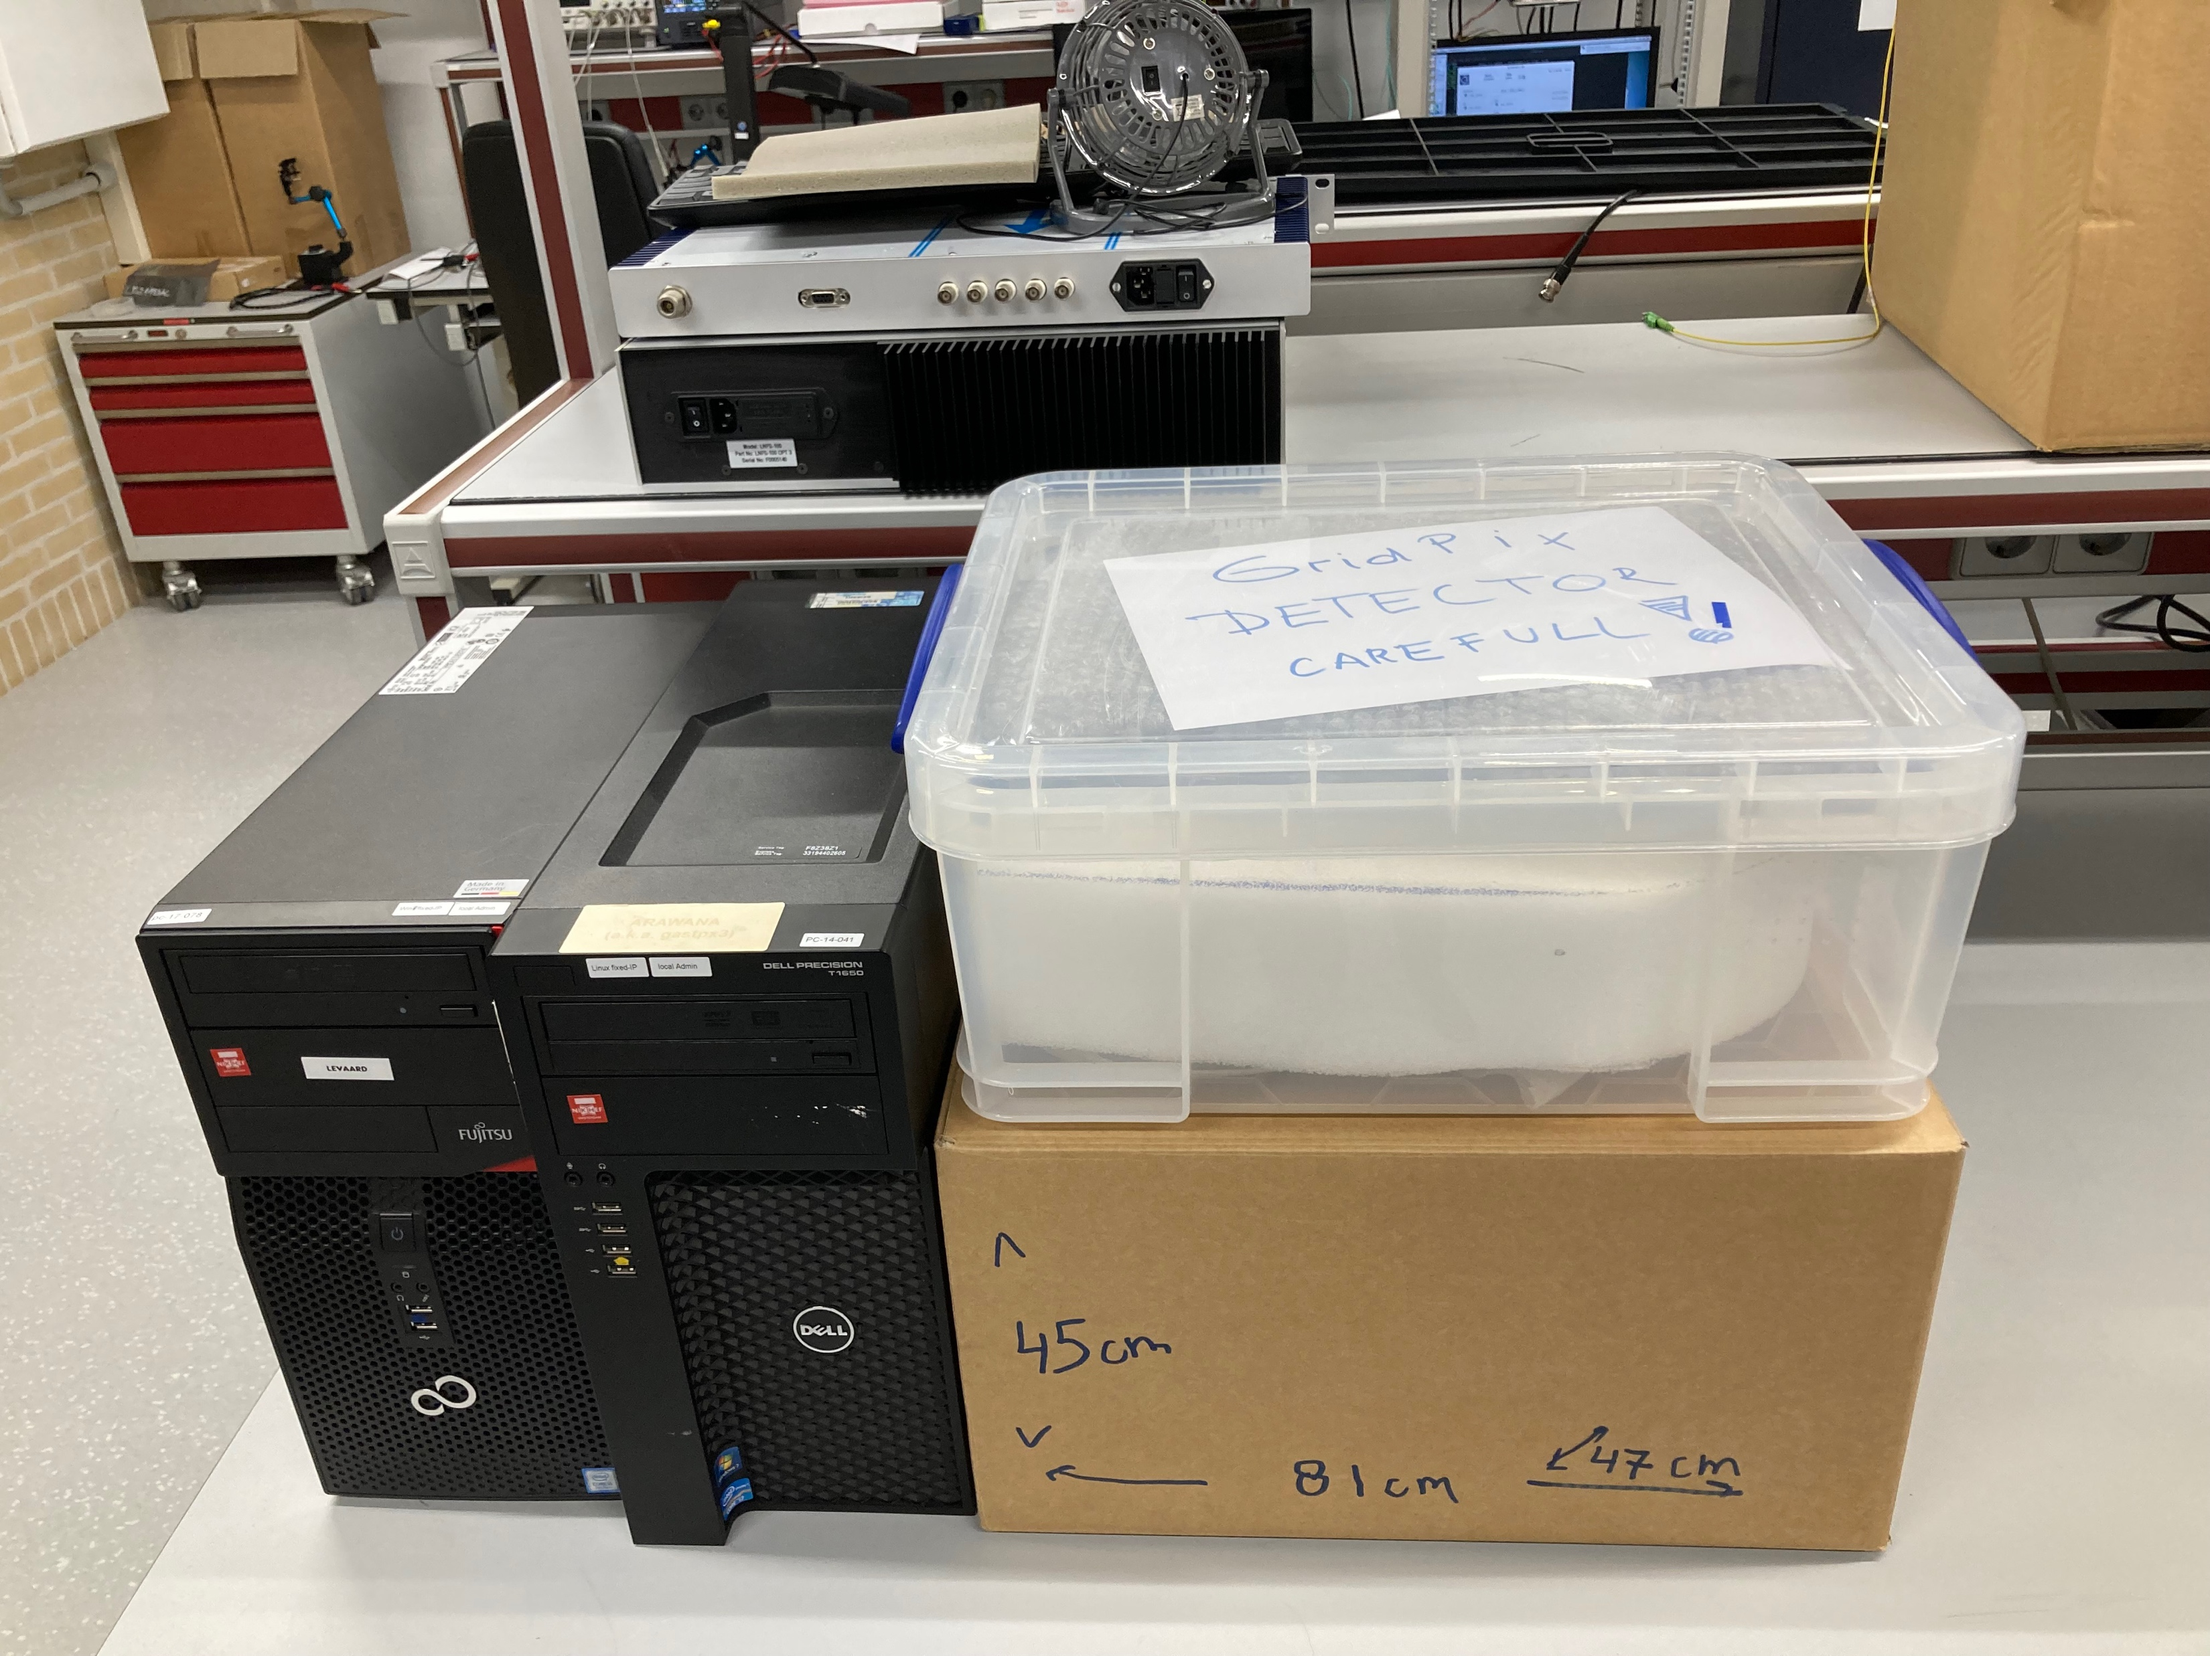

8-QUAD module with field cage
Nikhef will send to Stony Brook a 32-chip module & COMPLETE DAQ.
Timing is in the hands of the lawyers:
  SBU & J-Lab
    Show me the money!
  SBU & Nikhef
    Loan agreement, shipping payment, insurance, …

Slide 15
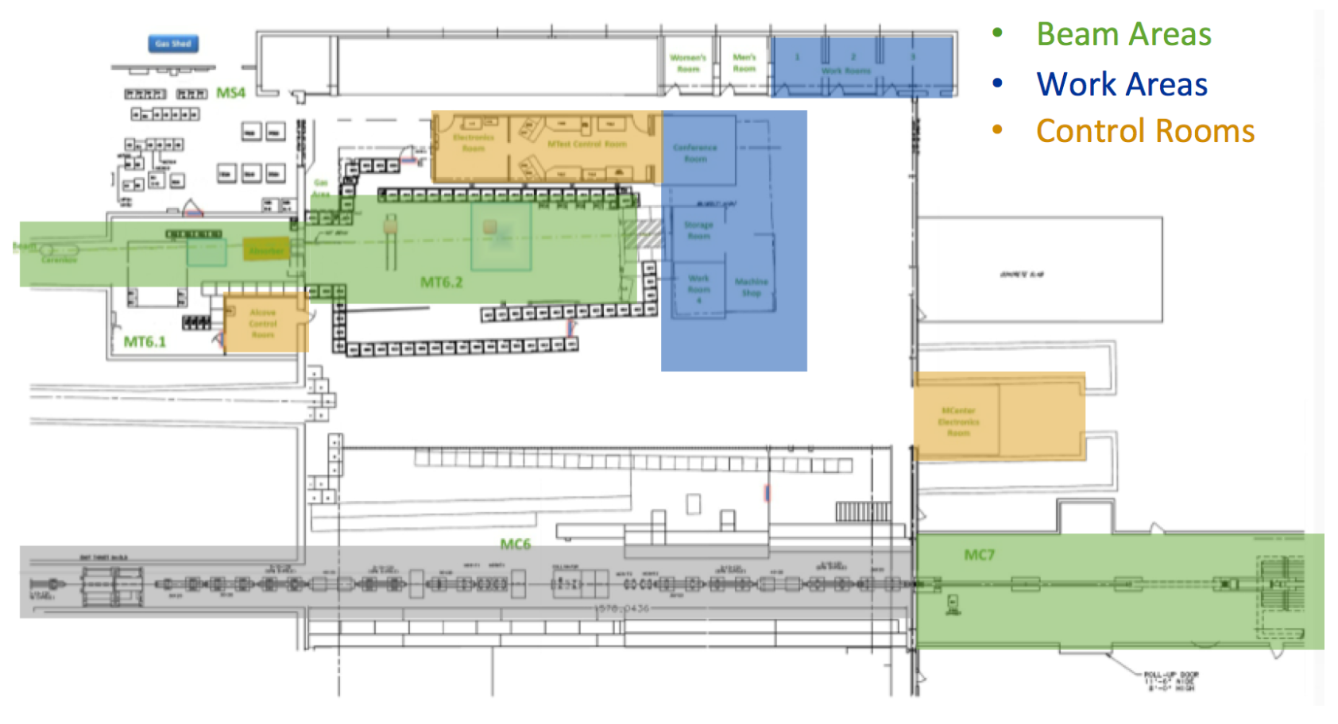
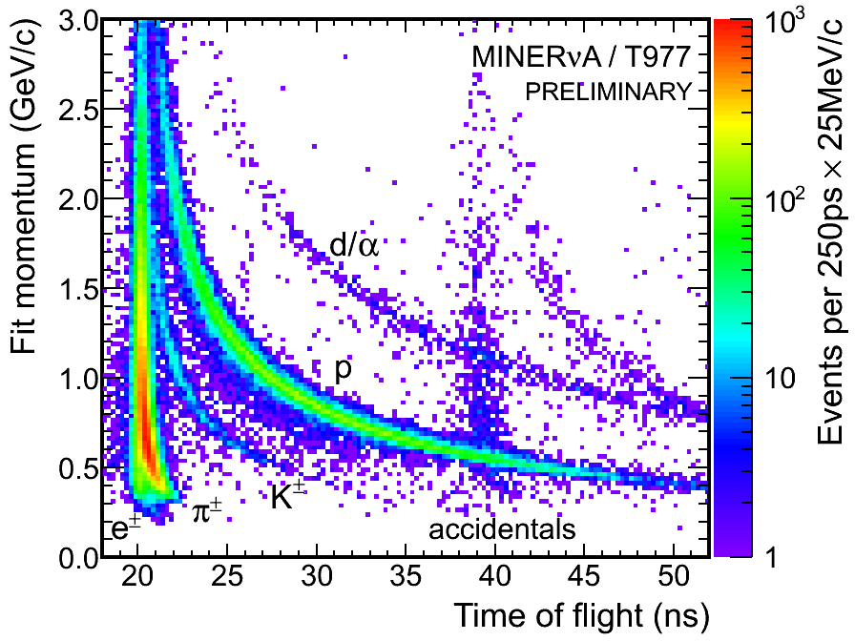
Fermilab Beam Lines
MTest
MCenter
MTest is the “test beam” most familiar to the community.
  Primary Beam 120 GeV protons
  Secondary Beam 8-32 GeV mixed (Cherenkov PID)
MCenter is less familiar
  Secondary Beam ala Mtest
  Tertiary Beam below 1 GeV (TOF PID)
Hemmick & Garg will be there Monday and Tuesday next week

Slide 16
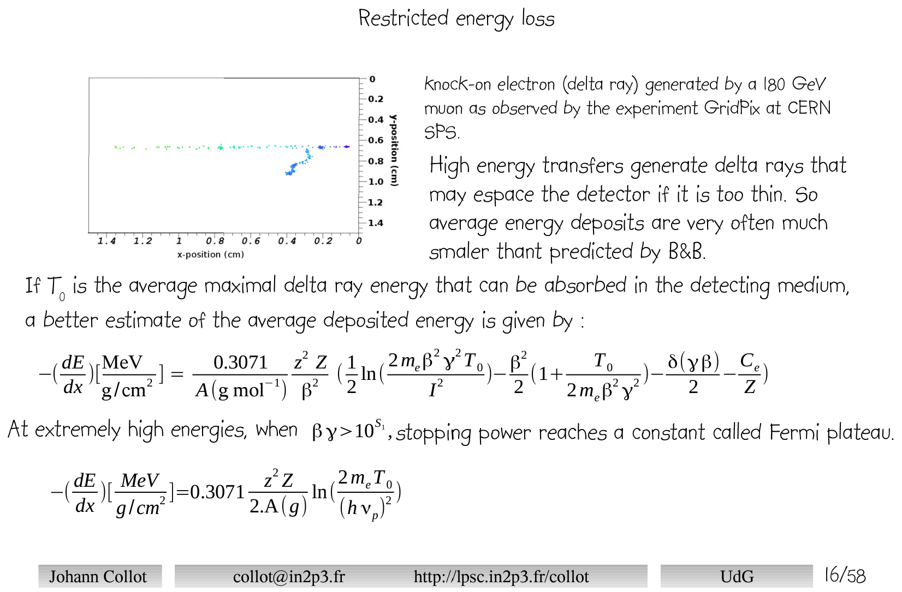
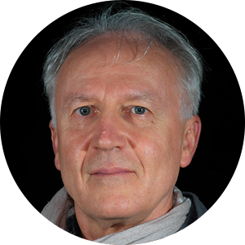
Comment on Deltas
Are Delta Rays entirely junk?
Best Delta measurement ever
    Contributor to overall ionization rate.
    Significant contributor to relativistic rise.
    Fully distinguished Delta contribution on every track may provide PID opportunity.
Directing high momentum beams to the test can yield information.
“Long” tracks can be manufactured by multi-event overlays.

Slide 17
Summary
A mini-TPC with GridPIX readout seems an ideal technology for Detector 2 at EIC
  Especially useful at future luminosity,
  Robust pattern recognition against synchrotron background.
  Data reduction/background suppression to tracklets possible in hardware.
Excellent PID performance at the lowest momenta.
Possibilities to study a long detector for PID in Relativistic Rise (PID → 10 GeV/c)
NOTE:
Evgeny Shulga talk/measurement on complete elimination of Ion Back Flow
Nikolai Smirnov talk with more on Gridpix and other innovative ideas.

Slide 18
Backups

Slide 19
Homework-3
What R&D will be needed after the FNAL beam test?
  Theme: Demonstrations this far with GridPix are not yet “deployable” in an experiment.
    Water cooling is only a proof of principle; CO₂ cooling should be implemented
      lower radiation budget, higher performance, more uniform temperature (important for parallel plate avalanche)
    Extending drift length over which cluster-counting PID can be effective
      Alternate gas choices (e.g. He + CF₄ + iC₄H₁₀, etc…)
      Goal: Extend cluster counting to 1 meter of drift.
      Deal with cluster merging in post processing of data.
      NOTE: Second EIC detector may use 3 Tesla field, thereby minimizing cluster merging.
    Readout Plane Technology (the next generation beyond the quad):
      The chips should more directly contact a cold plate without making separate quads.
      The (expensive) flex solution to bring the readout to the back should be redesigned.
      The multiplexer (that combines the data streams of 16 chips) should be redesigned/optimized for full sector readout.
      On-board tracklet formation
        effective rejection for background synchrotron radiation at electron machine at highest luminosity.

Slide 20
Homework-1
GridPIX post-processing to prevent discharges is not addressed. This is a critical item for the long-term use. Can you discuss any overhead and risks this might entail in an EIC detector?
  In the post processing a SixNy is deposited on the TPX3 chip. This protection layer prevents the detector from sparking and protects the chip.
  This protective layer works well and for single chip detector, the quad detector and the 8 quad module.
  All detectors were successfully tested in three test beam campaigns. No problems with discharges occurred.
  The only problem that occurred in the test beam campaign of the 8-quad module was that we had to disconnect the HV of the grid of one chip due to a short. For a large system the distribution of the HV should be changed to allow for remote disconnection of the HV of the grid.

Slide 21
Prepared boxes
Dimensions in cm (no margin)
length depth height
45 47 81
Wooden box should be
50 x 50 x 85 cm³

Slide 22
Overly Simplified Momentum Resolution
Figure of Merit:
  $σ_{p}∝ \frac{σ_{hit}}{\sqrt{N_{meas}}} ≡Figure of Merit$
Can be compared to Silicon with detailed Monte Carlo
Here is simple-minded estimate
  $Figure of Merit(Si)= \frac{{10 μm}/{\sqrt{12}}}{\sqrt{4}}=2.9 μm$
  Gas:
    Including efficiency ~3000 electrons (minimum!) per track
    Each suffers digitization (σ = 55 μm/sqrt(12) = 16 μm)
    Diffusion(Length) = $25\frac{μm}{\sqrt{cm}} \sqrt{L}$
      D(2cm) = 35 μm ➔ FOM = 0.70 μm
      D(25cm) = 125 μm ➔ FOM = 2.3 μm
      D(50cm) = 176 μm ➔ FOM = 3.2 μm
      D(100cm) = 250 μm ➔ FOM = 4.6 μm
  Although ignoring many significant effects,
  initial result is on the order of the layers of silicon.

Slide 23
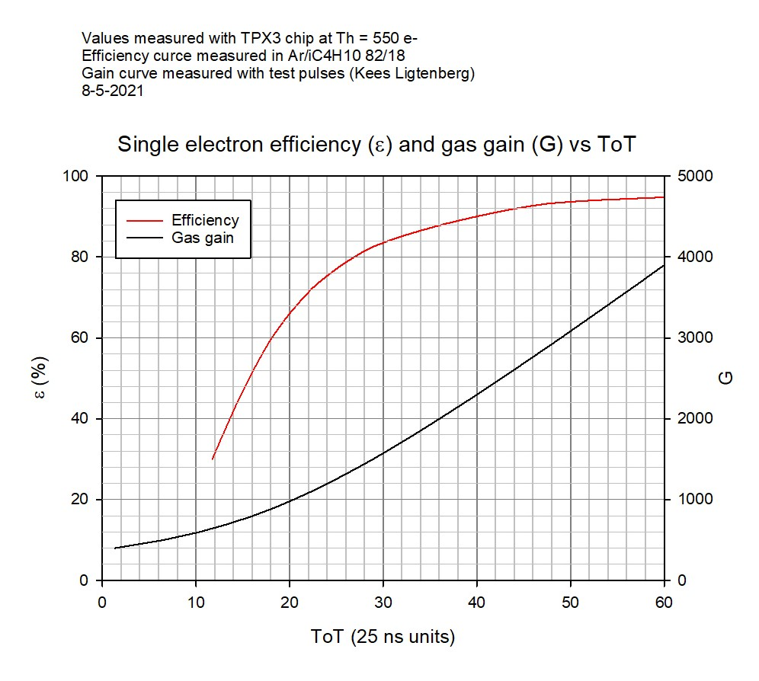
Calibration curve ToT gas gain

Slide 24
Remote desktop and data taking
SLOW CONTROLS
Windows
DAQ TPX3
Linux
DAQ Si
Linux
In hall
outside magnet
Si telescope
Levaard
arawana
Switch
Control room
Remote hut
Windows
Linux
HV, Gas and
run control (tunnel to arawana)
SPDR controls (2)
DAQ running
root file production

Slide 25
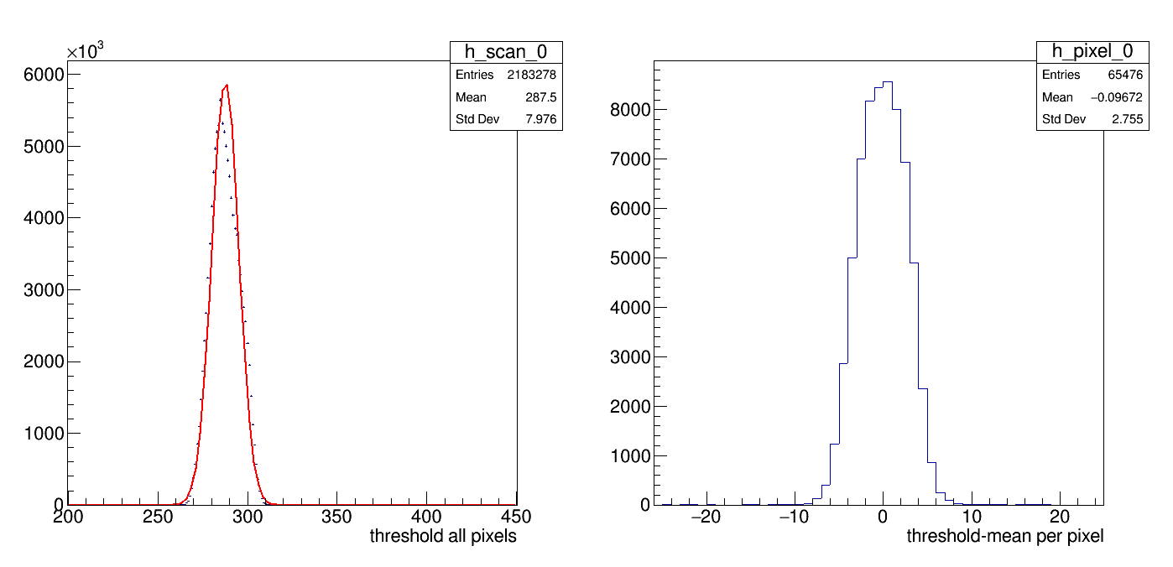
Equalisation results chip 0
ThresholdFinalChip0.gif
One has sigma noise is 7.9 counts and the tune per pixel is 2.8 counts
One trim dac unit corresponds to 12 counts . So one expects 12/sqrt(12.)

Slide 26
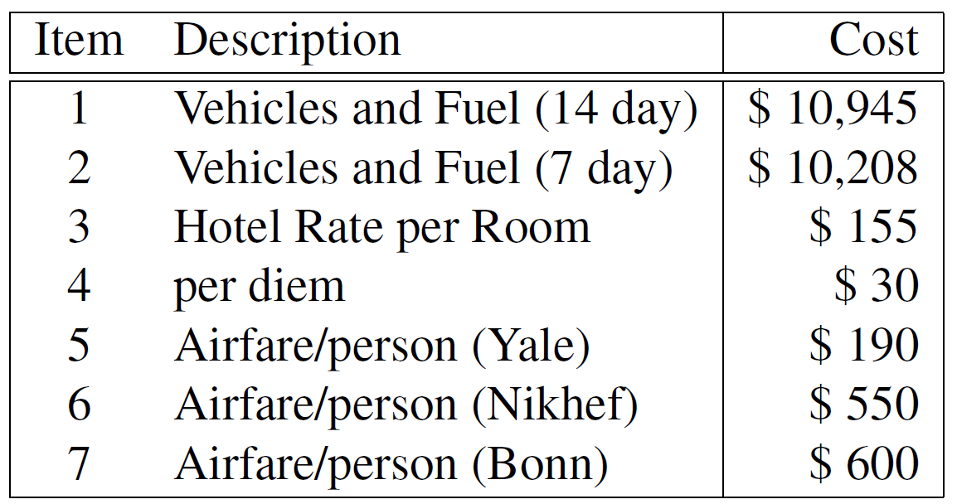
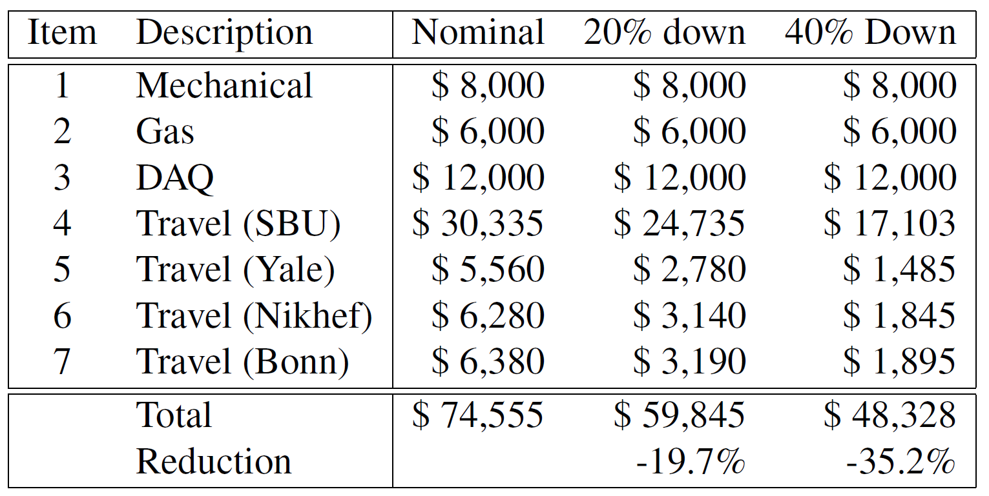
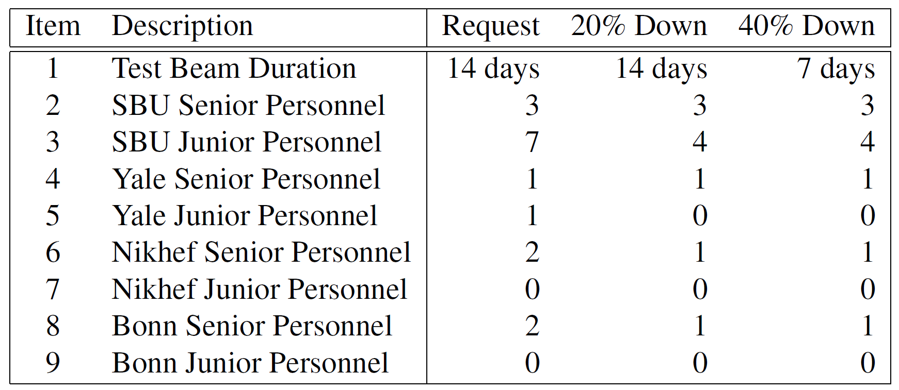
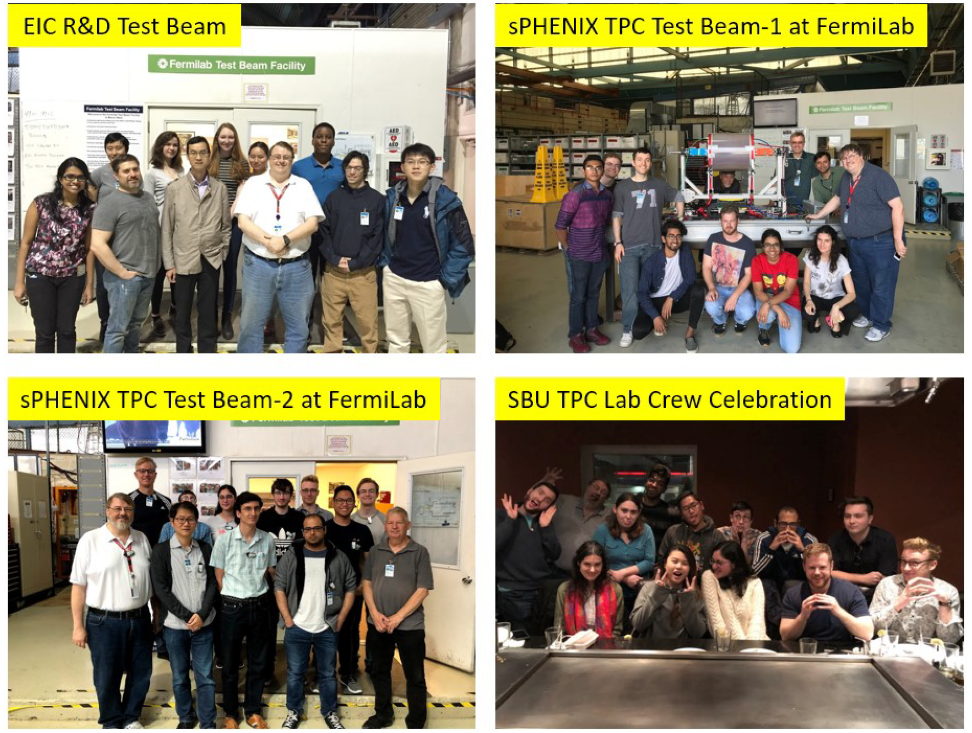
Budget Summary
Cost
Basis
We can only do the Fermilab in the first year.
The budget leverages existing apparatus
Two methods of realize reduced scenario:
  Limit the number of personnel
  Shorten the run
Large numbers of students are realistic
We have a long tradition of respecting DEI

