Slide 1
µRWELL-PICOSEC: Development of Fast Timing Detector based µRWELL Technology
Kondo Gnanvo
JLab Radiation Detectors & Imaging Group (RD&I Group)
International Workshop on the 2nd Detector For EIC - Temple Univ. - 05/18/2023
Wenze Xi, Jack McKisson, Brian Kross
JLab - RD&I Group
Klaus Dehmelt , Wenglian Lee
Stony Brook University

Slide 2
Outline
Introduction and concept of picosecond timing with Micro Pattern Gaseous Detectors (MPGDs)
Development of µRWELL-PICOSEC detector within the JLab LDRD FY23 (LD2309).
Preliminary results of first prototype.
Ongoung R&D and approaches to address challenges and limitations of µRWELL-PICOSEC.

Slide 3
µRWELL-PICOSEC: Development of fast timing µRWELL detector
Background & Rationale:
Develop precise and fast timing cost effective gaseous detectors for application in particle physics and medical instrumentation.
Properties such as stability, radiation hardness, large area, segmented readout are highly desirable for such timing detectors.
Proof of concept of precise timing detectors based on MPGDs has been established by the MM-PICOSEC collaboration with Micromegas
Development of picosecond detector based on µRWELL technology has the potential to satisfy such requirements.
Application in Future Experiments at JLab and the EIC and beyond:
EIC detector I upgrade and future detector II: Fast timing technology such as µRWELL-PICOSEC can be an attractive alternative options to AC-LGADs for TOF, LAPPDs for Cerenkov photosensors technologies currently under consideration.
Added value performance of μrPICOSEC: high-rate capability, stable in strong B-field, radiation hard, large-area, low-cost
High-luminosity / high energy upgrades at JLab: we anticipate demand for cutting edge technologies for high performance and cost effective PID detectors such as TOF and Cerenkov to satisfy the physic requirements of future experiments.
Potential application in medical instrumentation i.e TOF-PET devices

Slide 4
µRWELL-PICOSEC compared to alternative technologies
This R&D target
This R&D target
Time of Flight (TOF) detectors
Photosensors for Cerenkov detectors
 | MRPCs | AC-LGAD | µrPICOSEC
Time resolution (ps) | 20 – 70 ✓ | 20 ✓ | 25 ✓
Rate (MHz / cm²) | 0.05 ✗ | N/A | > 1 ✓
Position resolution (mm) | ~ 10 ✗ | 0.030 ✓ (claim) | < 1mm ✓
Performance in high B-field | Yes | Yes | Yes ✓
module size | 20 × 20 cm² ✓ | N/A | 20 × 20 cm² ✓
Cost ($ M / m²) | 0.2 – 0.4 ✓ | High ✗ | 0.2 – 0.4? ✓
 | SiPMs | MCP-PMTs | LAPPDs | µrPICOSEC
Time resolution (ps) | < 100 | < 100 | 50 ✓ | 50 ✓
Position resolution (mm) | > 1✗ | 1✗ | 0.3 – 1 ✓ | < 1 ✓
Performance in high B-field | Yes | Limited | Limited | Yes ✓
Radiation hardness | dark current ✗ | N/A | N/A | Yes ✓
Cost ($ M / m²) | 0.8 – 1 ✗ | > 1 ✗ | 0.8 – 1 ✗ | 0.2 – 0.4 ✓

Slide 5
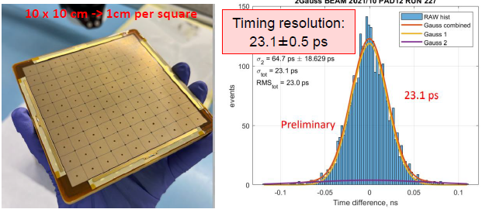
MM-PICOSEC Collaboration at CERN
PICOSEC-MM: Development of fast timing (picosecond resolution) MPGD using Micromegas amplification
Large ongoing collaboration based at CERN with several major institutions from France, Greece, Poland, China … and US (JLab and SBU)
Proof of principle picosecond timing with MPGD established with several PICOSEC-MM prototypes:
Single-channel and small gap (100 µm) prototype ➔ 17 ps with MIPs
Large-area (10 cm × 10 cm) and multi-channel (100 pads) prototype ➔ 25 ps with MIPs and 70 ps with single photon (laser)
PICOSEC-MM collaboration and RD51 collaboration ➔ strong connection (i.e., beam test campaign and GDD lab at CERN)
The RD & I group at JLab is member of both RD51 and PICOSEC-MM
Strong synergy between PICOSEC-MM & µrPICOSEC ➔ leverage on expertise & experience of PICOSEC-MM community
Aune et al ., Nuclear Inst. and Methods in Physics Research, A 993 (2021) 165076, https://doi.org/10.1016/j.nima.2021.165076
Bortfeldt et al., Nuclear Inst. and Methods in Physics Research, A 903 (2018) 317–325, https://doi.org/10.1016/j.nima.2018.04.033

Slide 6
MM-PICOSEC Collaboration at CERN
Latest performance results of MM-PICOSEC

Slide 7
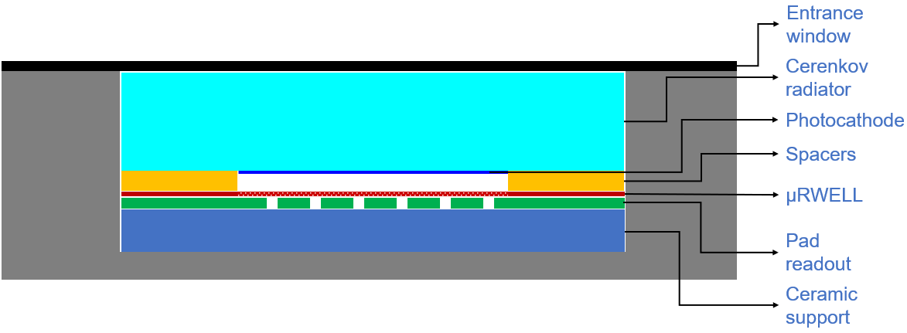
µRWELL-PICOSEC detector concept
Concept of µRWELL-PICOSEC: Develop fast timing gaseous detector using µRWELL amplification ➔ timing resolution of tens of ps
Cherenkov photons: relativistic charged particle creates Cerenkov photons ➔ prompt photons i.e., timing resolution.
Photoelectrons: convert the Cerenkov photons into electrons, all electrons created at the same z position ➔ timing resolution
Pre-amplification: First amplification of electrons 100 to 200 µm gas in high drift field region ( ~20 kV/cm)
Amplification : Final electron amplification in µRWELL gain structure ➔ high electric field (>40 kV/cm)
Electronic Signal: Arrival of the amplified electrons to the anode creates a signal.
Cerenkov photons in radiator
Photoelectrons in photocathode
1
Pre-amplification in 200 µm gas
2
3
uRWELL amplification
Collection of electronic signal
4

Slide 8
Dual operation modes for µRWELL-PICOSEC
Timing detector for relativistic charged particles:
Cerenkov radiator crystal transparent in VUV region
High quantum efficiency (QE) photocathode in VUV medium ~ 7 photoelectrons for 3 mm MgF2
Goal for timing resolution (~25 ps)
Applications:
Time of Flight detector
T0 detector
Single photon photodetector:
High quantum efficiency (QE) photocathode in (VUV) medium which is most radiated by any radiator medium
Window transparent to Cerenkov radiation
High gain for single photon timing goal of ~50 ps
Applications:
Photosensor for RICH detectors
T0 tagger at neutrino detector (liquid Ar scintillator light)
Charged particle
Photon
Cerenkov radiator
Glass window

Slide 9
JLab LDRD FY23- LD2309: Development of µRWELL-PICOSEC detector
Develop µrPICOSEC prototypes and demonstrate the proof of concept with the timing performance.
Design µRWELL amplification / multi-channel readout to combine with Cerenkov radiator and photocathodes.
Optimize the mechanical structure for uniformity over large area (100 cm²) and thin gap (100 - 200 µm) prototypes.
Full characterization of the prototype with laser source and in beam as well as test in high magnetic field.
Achieve the goal of a timing resolution better than 50 ps for charged particle with first prototype.
Investigate alternative radiator and photocathode materials.
Cesium Iodide (CsI) is unstable under humidity and susceptible to aging due to ion bombardment.
We will explore alternative and more robust photocathode materials with similarly high photoelectron yield.
Investigate ideas of focusing optic devices integrated with radiator for precise position measurement in addition to timing.
Implement multi-channel fast electronics readout and DAQ system for µrPICOSEC detector.
Lab bench precision measurement of the timing performances of µrPICOSEC prototypes.
Development of readout and DAQ system for 100-pads channels for µrPICOSEC prototypes.

Slide 10
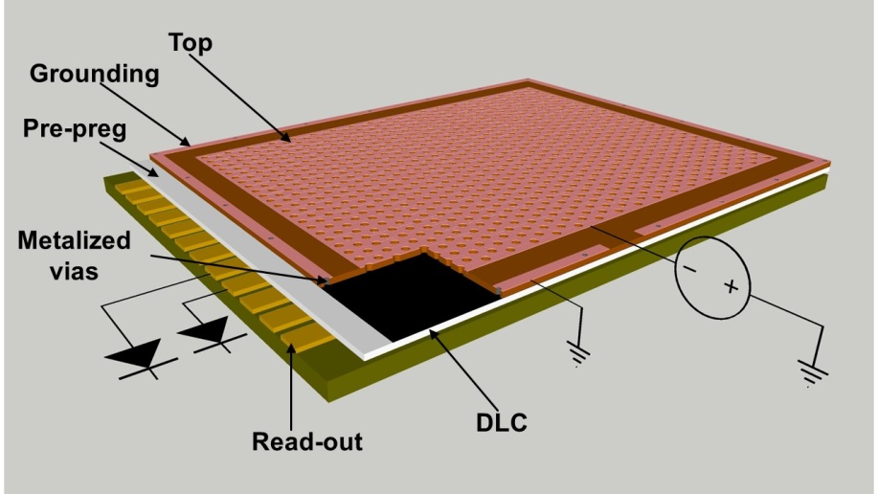
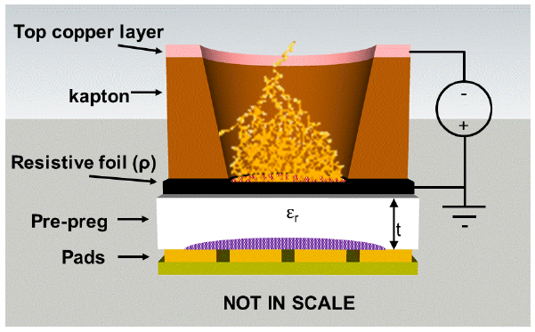
LD2309: Amplification & readout of μRWELL-PICOSEC
µRWELL detector
Design of µRWELL foil
Single layer amplification MPGD
Simple amplification structure using same material as GEM foil
Resistive technology ➔ intrinsically robust against spark
Large area capability
Specially well suited for PICOSEC technology
µRWELL is a resistive MPGD ➔ improve detector stability
Amplification gap 50 µm vs. to 128 µm for MM ➔ improve timing
Segmented µRWELL (PEP) ➔ improve rate capability & timing
Integration of capacitive-sharing readout structures
Capacitive-sharing pad readout will allow precise position information capability with limited readout channel number
Combining segmented µRWELL and capacitive-sharing ➔ best of both world
Segmented µRWELL: excellent timing resolution
Capacitive-sharing readout: excellent position resolution
Concept capacitive-sharing pad readout

Slide 11
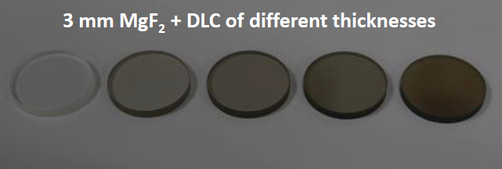
LD2309: Investigating radiators and photocathodes options
Photocathode:
Current technology: Cesium Iodide (CsI)
Pros:
High quantum efficiency (QE) in vacuum ultraviolet (VUV) region which is most radiated by any radiator medium
Cons:
Sensitivity to water ➔ performance rapidly deteriorates
Ion bombardment (IBF) of CsI is challenging for high rate
We will investigate alternative materials with similar level of QE:
Candidates are B4C, DLC and Nano diamond (ND)
Goal is to achieve similar level of QE ➔ Extensive R&D
Radiation hardness and unsensitivity to humid condition
Radiator:
Current technology: Magnesium Fluoride (MgF2)
Pros:
Transparency in vacuum ultraviolet (VUV) region which is most radiated by any radiator medium
Cons:
Low photon yield
large Cerenkov angle sin (Ɵ_{c}) ➔ poor spatial information
Smaller Ɵ_{c} material will results in even lower photon yield
We will investigate alternative radiator materials:
For higher photon yield capability
Explore focusing optic elements integrated into radiator material
combine high photon yield in a small area
Improve timing resolution and position resolution capability
Evaporator facility at Stony Brook University (SBU):
Radiator and photocathode materials studies performed at SBU
SBU to provide an Ion-Beam Assisted Physical Vapor Deposition (IBA-PVD) apparatus in an Ultra-High Vacuum (UHV) vessel to for the studies:
Needs to complement with cryogenic vacuum pumping device to improve the status of UHV to perform the for the proposed investigation
https://indico.cern.ch/event/757322/contributions/3387110/attachments/1839691/3015624/MPGD2019_WangXu_f.pdf
This R&D effort isled by Stony Brook Univ. colleagues

Slide 12
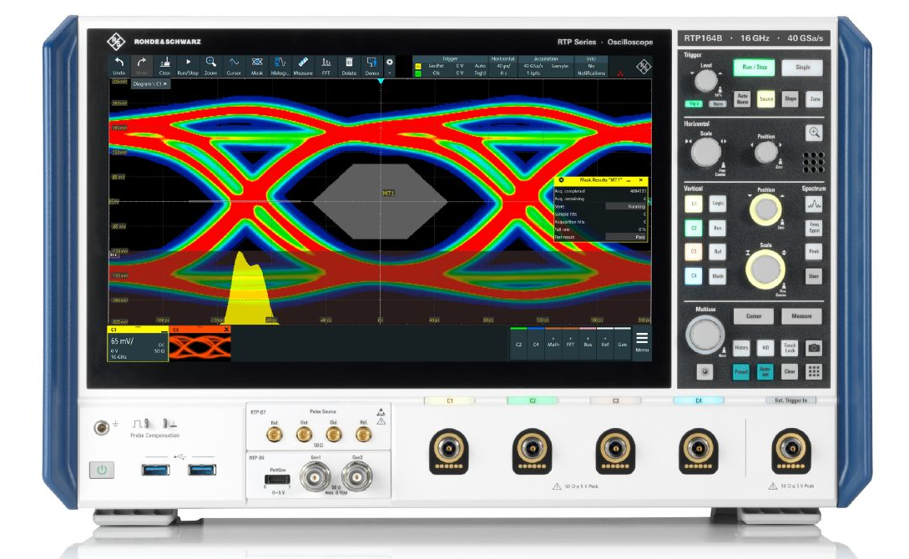
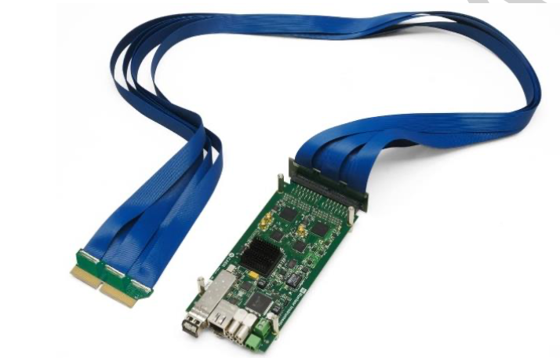
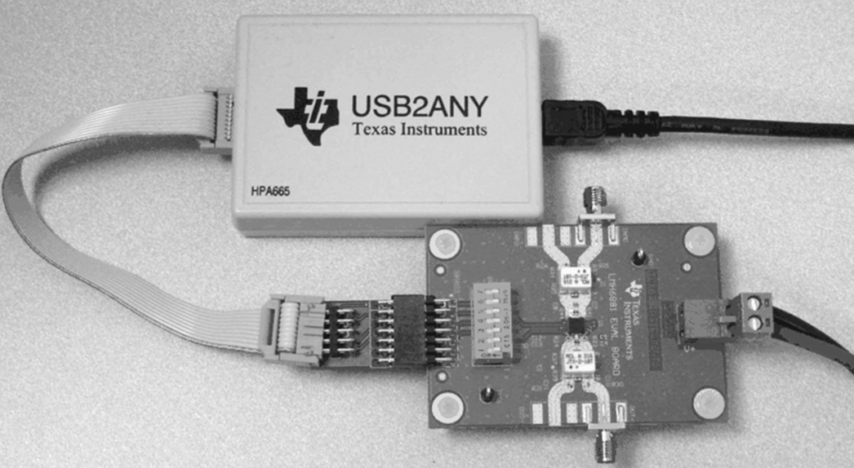
LD2309: Development of Readout and DAQ for uRWELL-PICOSEC
Testing:
High performance oscilloscope: Rohde & Schwarz, model RTP164B
Provide 2 × 16 Ghz bandwidth channels for
Sub-picosecond timing resolution with statistical analysis
Measurement for differential SNR for detector output
40 Gsamples/s
16 bits measurement precision
Rohde & Schwarz, model RTP164B
Data Acquisition System:
Provide 64 TDC channels with each channel:
~7 ps RMS timing resolution
LVDS input differential signals
3.5 Gbits/s Optical ethernet bus
+
LMH6881: Programmable differential amplifier
CAEN FERS-5203: 64-channel Pico-TDC

Slide 13
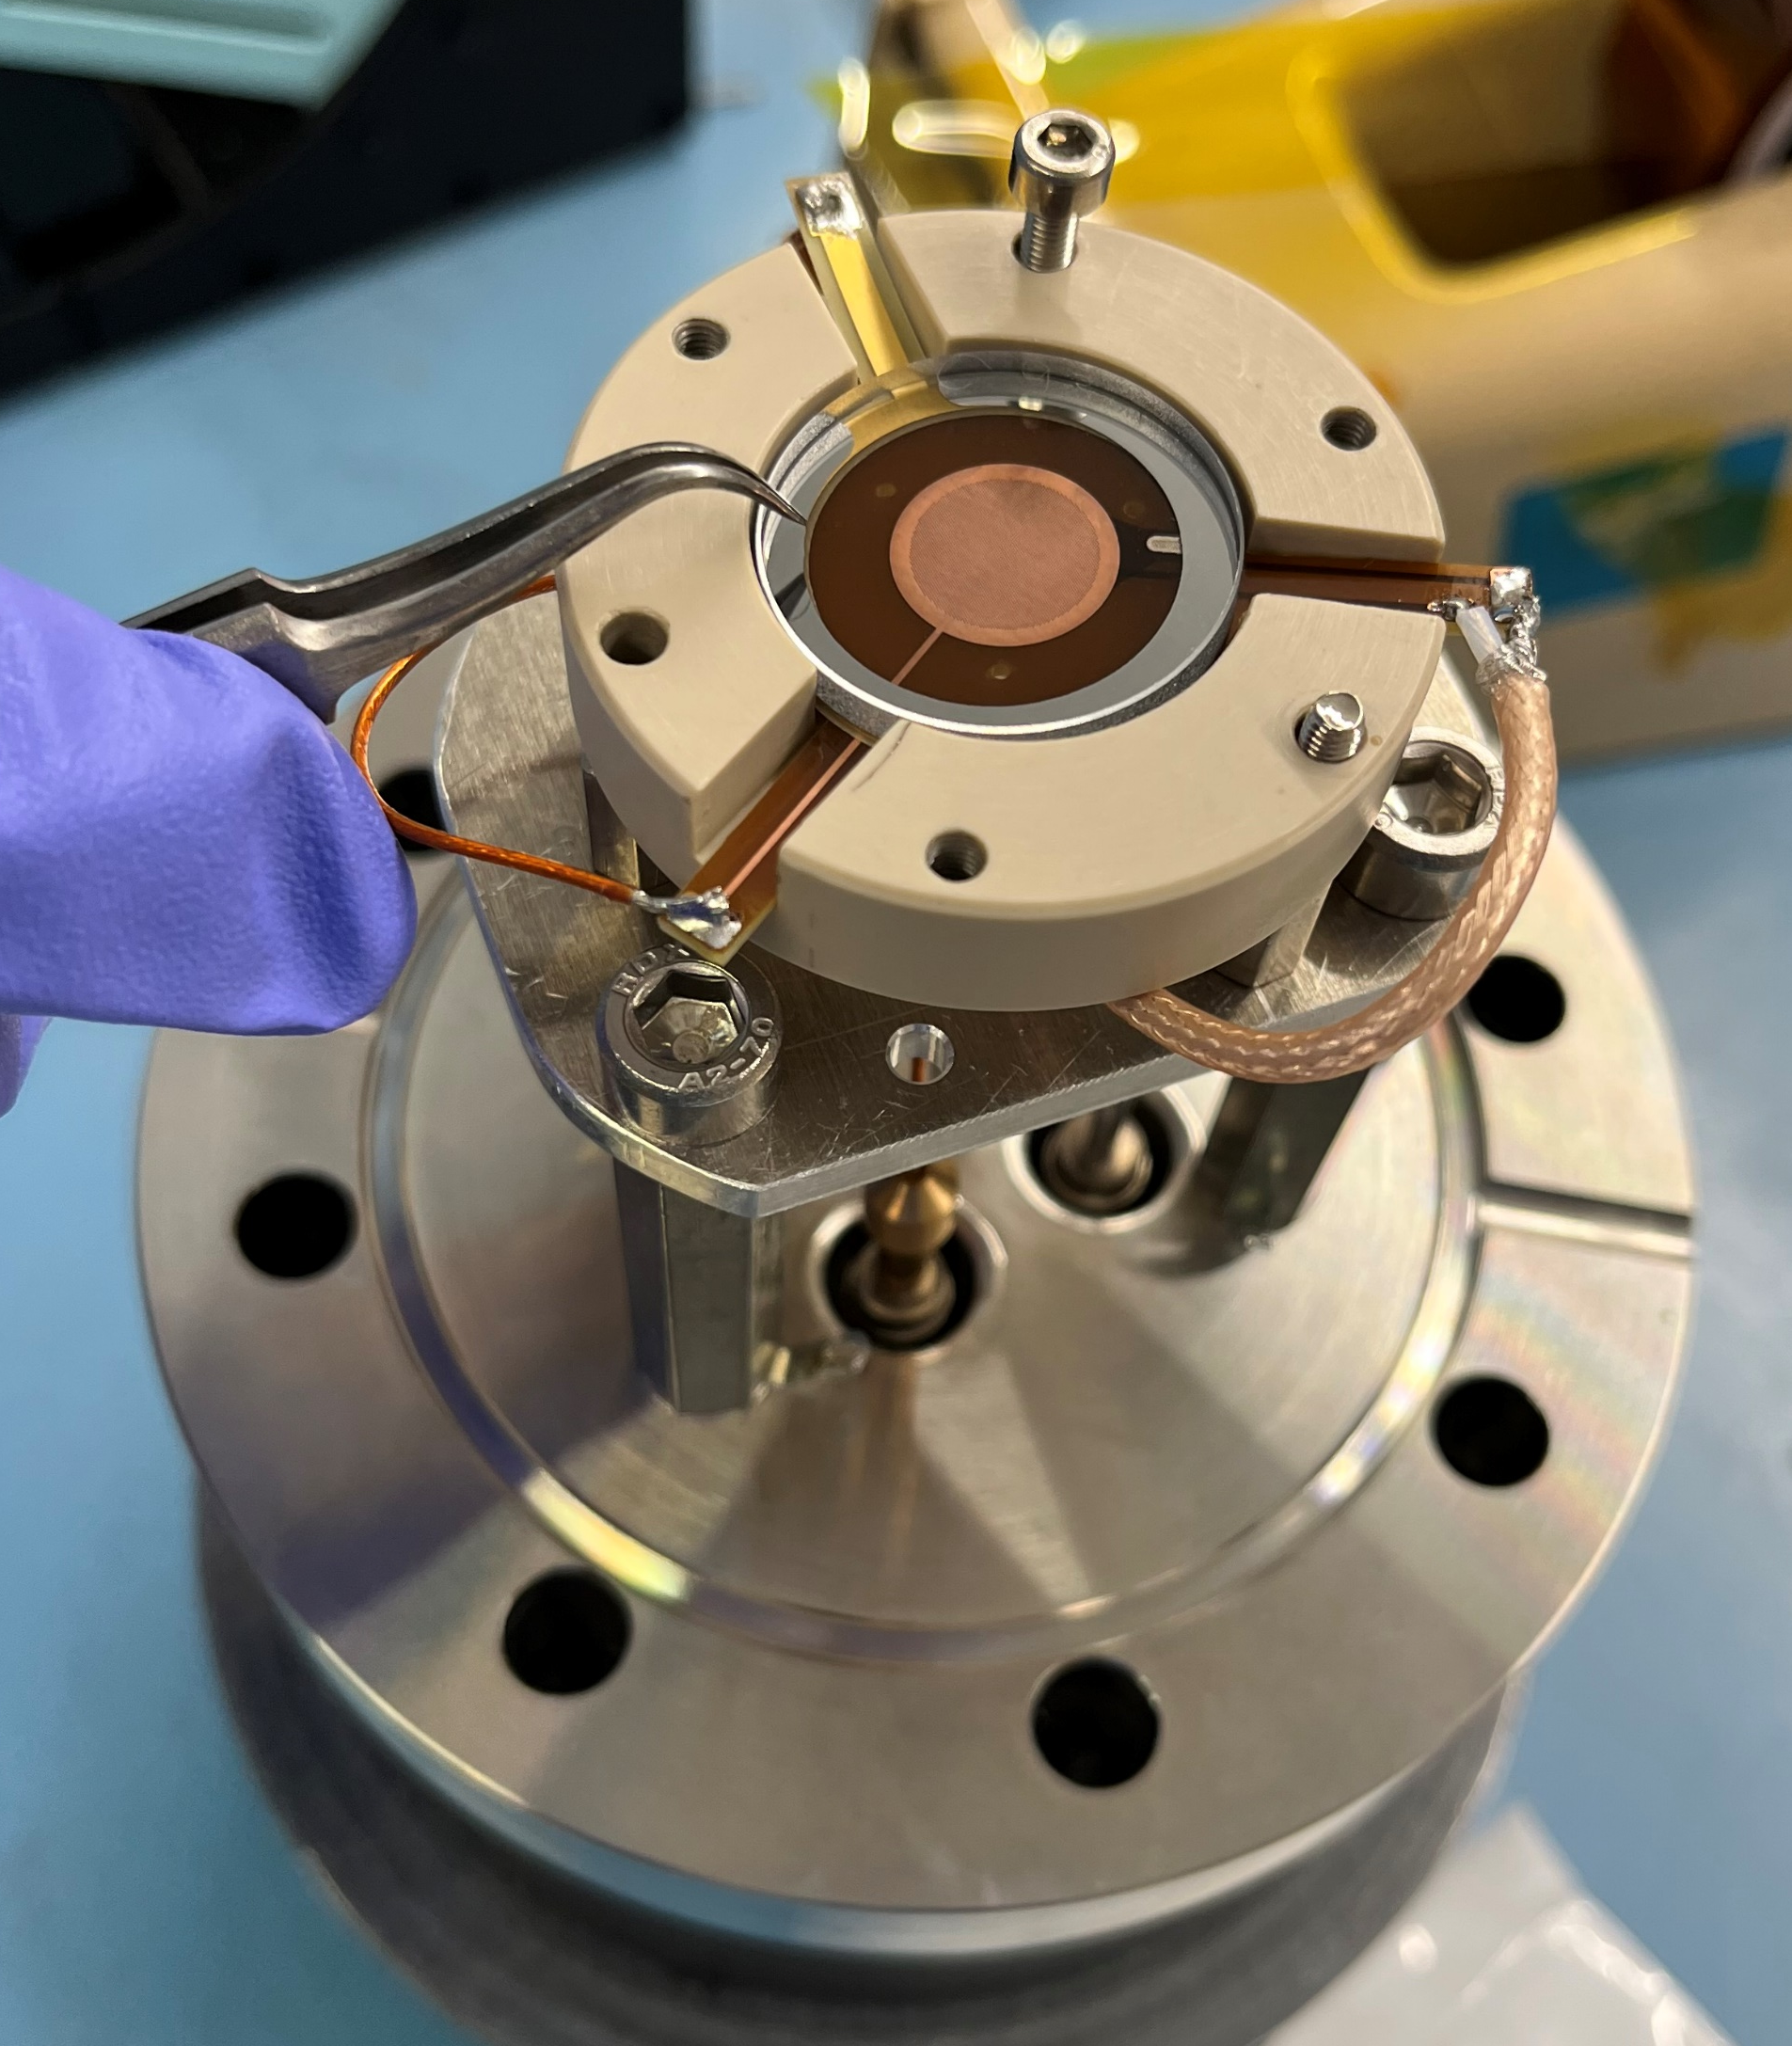
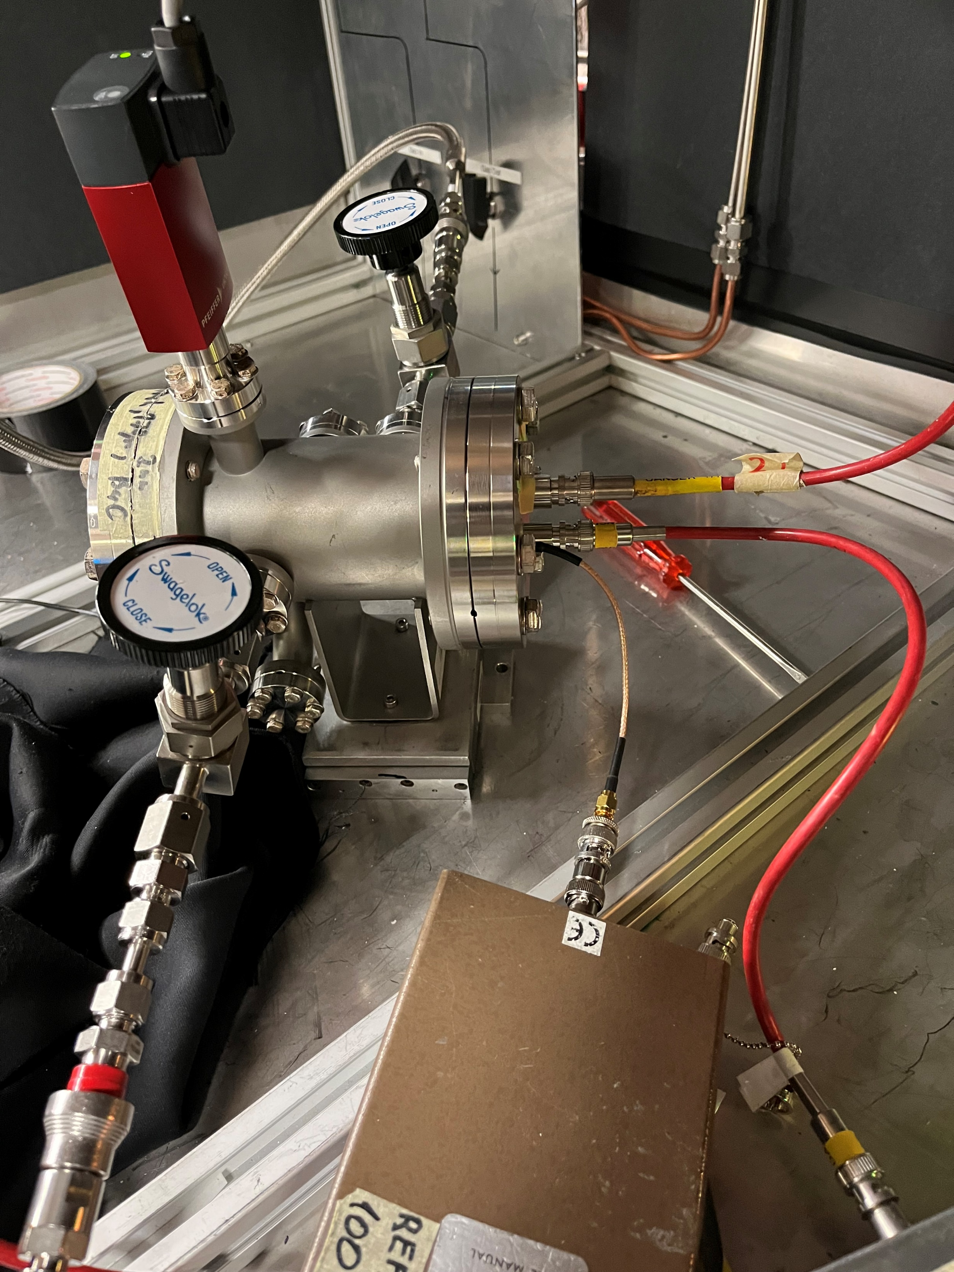
LD2309 First prototype: Small single-channel uRWELL-PICOSEC
First µRWELL-PICOSEC prototype
Single-pad small prototype
3 cm diameter active area
3 mm thick radiator + CsI photocathode
Sensor: 50 µm µRWELL + Kapton
µRWELL Holes: pitch / outer diameter-inner diameter 140 µm / 70 µm / 50 µm
Preliminary tests with laser source (GDD lab, December 2022)
Demonstrate that the µRWELL works in picosecond mode
Prototype very resilient against sparks
Poor timing performance compared to Micromegas (MM-PICOSEC)
Lessons learned from preliminary tests
Several parameters to be tweaked to improve resolution
Single-pad µRWELL-PICOSEC prototype
Prototype on test bench at CERN GDD Lab
cathode
GND
µRWELL electrode

Slide 14
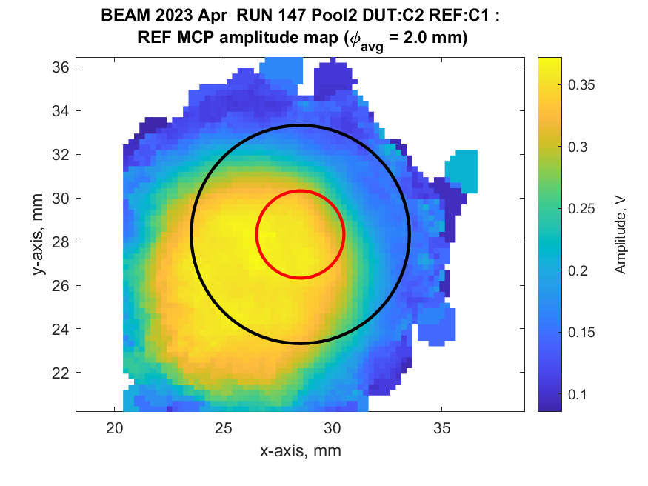
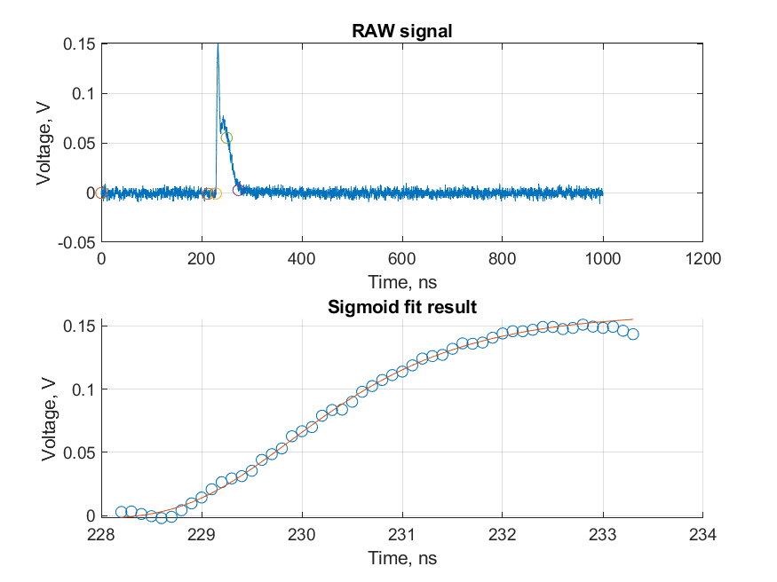
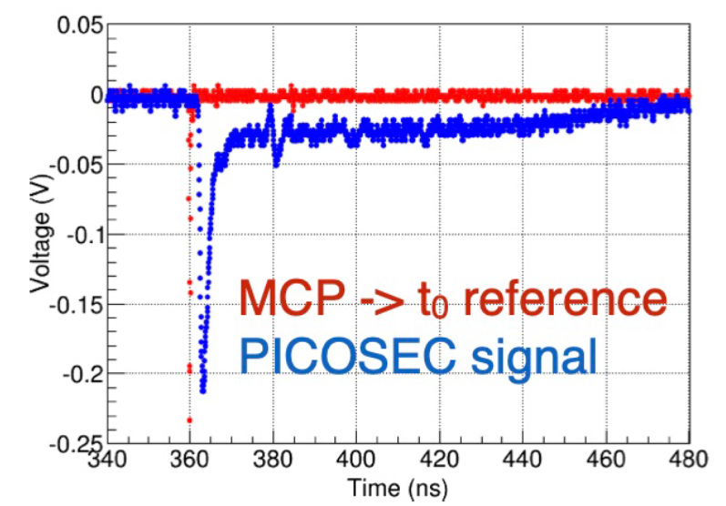
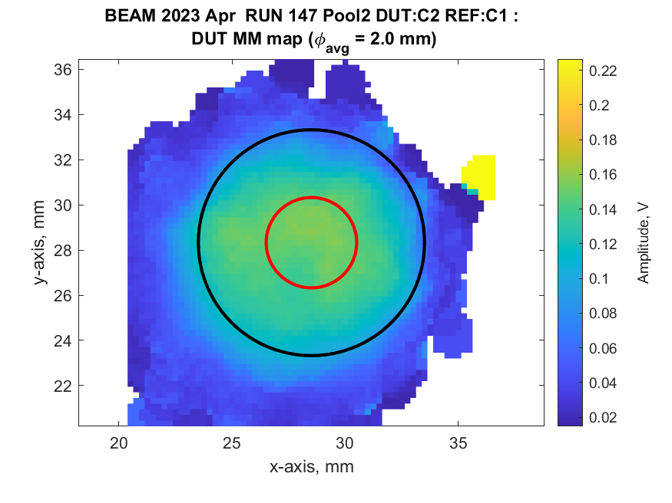
LD2309 First prototype: Test beam and preliminary results
Prototype was tested again in beam at CERN (April 2023)
More extensive tests in pion beam (RD51-PICOSEC coll. beam test (April 2023)
HV scan to determine optimal anode HV vs. cathode HV combination
HV Anode (µRWELL) ➔ 160 V – 300 V
Cathode HV ➔ 380 V – 520 V
Analysis of the data is ongoing
Signal amplitude XY map
Reference timing - MCP
Typical uRWELL-PICOSEC signal
uRWELL-PICOSEC

Slide 15
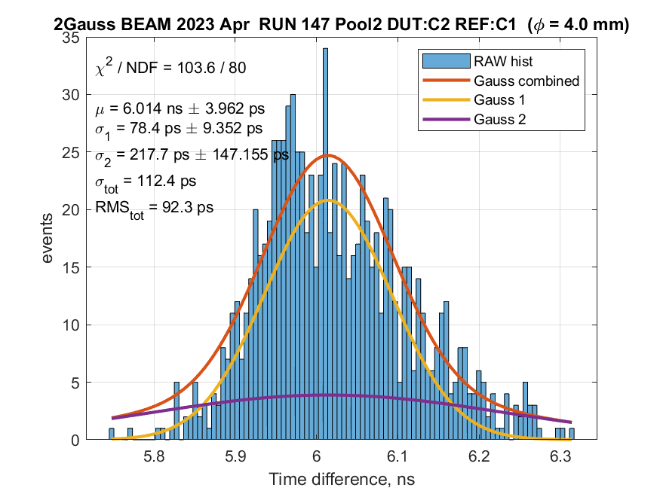
LD2309 First prototype: Preliminary timing performances
HV scan (drift pre-amplification and µRWELL amplification)
Best timing resolution with prototype: 84 ps for voltage setting Anode = 300 V and cathode 480 V
Preliminary ➔ Analysis is ongoing
Run number | Anode | Cathode | Time resolution | Ampl | Rise Time | Efficiency
147 | 300 | 380 | 92.3 | 150 | 2.61 | 63.4
153 | 270 | 430 | 101 | 272 | 2.54 | 87.2
154 | 270 | 420 | 89 | 183 | 2.47 | 85.6
155 | 270 | 410 | 90 | 133 | 2.48 | 79.7
150 | 250 | 450 | 98 | 254 | 2.48 | 87.8
151 | 250 | 440 | 91.5 | 177 | 2.42 | 86.7
152 | 250 | 430 | 84.5 | 134 | 2.43 | 79.4
159 | 200 | 500 | 92.5 | 222 | 2.36 | 77.9
165 | 200 | 480 | 83.8 | 136 | 2.32 | 74
162 | 200 | 460 | 96.5 | 73 | 2.31 | 44.4
158 | 160 | 520 | 92.8 | 130 | 2.26 | 75.6
161 | 160 | 480 | 136 | 36 | 2.01 | 28.2
Timing resolution

Slide 16
LD2309 First prototype: First takes on preliminary test results
80 ps time resolution for the first prototype is very encouraging, but ~4 × higher than MM-PICOSEC and R&D goal
Differences in amplification structure between Micromegas and µRWELL could help explain the
Amplification gap: Micromegas 128 um vs. µRWELL 50 um
Mesh area in Micromegas 20% vs. 80% in µRWELL
➔ Input capacitance from the amplification structure to the signal is significantly higher µRWELL .
Electric field lines in the pre-amplification drift region are different between Micromegas and µRWELL
➔ This also has a strong impact on the path of the electrons drift to the amplification devices, need to find the right electronic field balance between pre-amplification and amplification for an optimize timing
Recent beam test results with resistive Micromegas suggest that the resistivity of the DLC layer has to be tuned for optimal timing

Slide 17
LD2309 First prototype: New prototypes in beam test (July 2023 @ CERN)
4 new µRWELL-PICOSEC PCBs under fabrication to study the parameters for better timing performance
Increase the gap between the µRWELL foil and the pick-up pad electrode from 50 µm to 150 µm
➔ reduce the capacitance noise effect
Samples with different µRWELL hole parameters to study impact of electric field and geometric transparency
Standard configuration: pitch = 140 um / outer diam. = 70 um / inner diam. = 50 um ➔ 20% transparency
3 new configurations: 140 um / 85 um / 65 um; 120 um / 70 um / 50 um and 120 um / 85 um / 65 um
➔ 50% transparency and more straight field lines
All 4 new PCB samples will be assembled into µRWELL-PICOSEC prototypes and tested in beam in July 2023
Direct comparison of performance with the standard gap and standard holes configuration
Next steps:
Evaluate the effect of resistive layer (DLC) resistivity on timing resolution (Not be part of the current July 2023 test beam)
Develop large area (10 cm × 10 cm) 100-pad µRWELL-PICOSEC prototype and test performance in beam
Develop capacitive-sharing prototype to extract position information as well

Slide 18
Summary
Exciting ongoing R&D effort to develop gaseous based picosecond level fast timing detector using MPGDs technologies
MPGD-PICOSEC detectors provide alternative options to Si-based fast timing detectors for TOF in Particle Physics and potential application in medical instrumentations
CERN based MM-PICOSEC collaboration demonstrate < 20 ps level timing capabilities for high energy charged particle with large-area Micromegas detectors in combination with Cerenkov radiator and photocathode.
µRWELL could also be used as alternative amplification structure for PICOSEC technologies
Preliminary results on first µRWELL-PICOSEC prototype developed within the JLab LDRD program delivers ~ 80 ps timing performance ➔ Several ideas to improved further these performance by a factor ×4 are under investigation
µRWELL-PICOSEC could be a technology suitable for TOF applications as well as photo-sensor options for EIC Detector II but sustained R&D effort is require to bring the technology to experiment-ready level in time for Detector II operation

Slide 19
Back-up

Slide 20
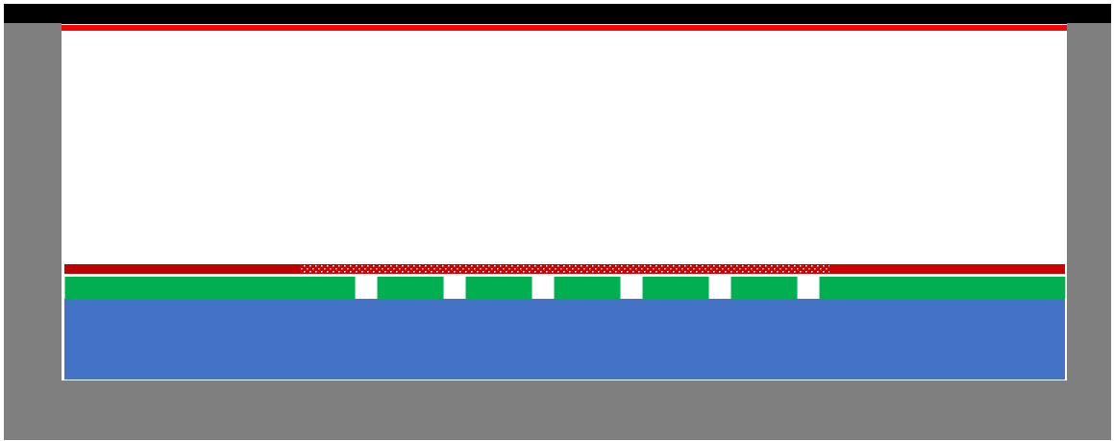
µrPICOSEC vs. standard µRWELL detector
 | Standard µRWELL detector | µrPICOSEC: picosecond uRWELL detector
Primary electrons production | Ionization of gas molecule by charged particles, typically, 3 mm gas ➔ limitation for timing performance | Charged particles creates Cerenkov photons in radiator ➔ photons conversion in photocathode ➔ produced photoelectrons
Amplification mechanism | Primary charges drift to µRWELL amplification stage ➔ amplification with typical gain of 10⁴ | Photoelectrons are pre-amplified in high e-field in 100 to 200 um gas then a second amplification by µRWELL ➔ total gain can reach 10⁷
Signal collection structures | Strips, pads, large capacitance, high rate | Pads, small capacitance critical for high S/N
Position resolution | ~50 to 100 µm space point resolution | To be evaluated
Timing resolution | ~ 4 ns with specific gas mixture | Goal: 25 to 50 ps for charged particle Goal: 50 to 100 ps for single photon detection
Area of application | Tracking: large-area, low-cost, precision position | PID: Time of flight (TOF) & photosensors for Cerenkov detectors
Standard µRWELL
µrPICOSEC
3 mm
gas
0.1 mm gas

Slide 21
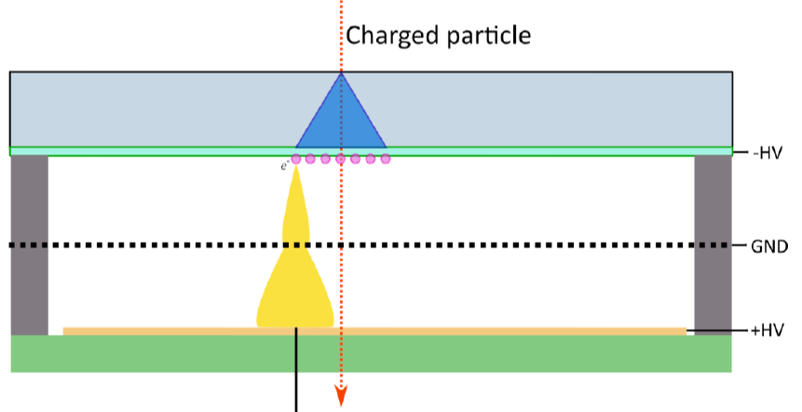
µRWELL-PICOSEC vs. MM-PICOSEC
μRWELL-PICOSEC and MM-PICOSEC belongs to the MPGD-based fast timing detector family
Different amplification structure will allow different optimization of the technologies in term of operation stability and timing performance
Parallel development of will mutually benefit the two technologies and offer options for applications
 | MM-PICOSEC | µRWELL-PICOSEC | Comments
Radiator / photocathode | Same technology can be share by both | Same material can be shared by both | No difference
Pad readout structure | Same technology can be share by both | Same technology can be shared by both | No difference
Amplification structure | Metallic mesh (micromegas) ➔ 128 µm gap (?) | Cu-clad Kapton foil ➔ 50 µm gap ✓ (?) | Thinner gap ➔ expect better timing performance with μrPICOSEC
Resistive / metallic | Both options available ✓ | Only resistive | Resistive ➔ more stable Metallic ➔ better timing
Segmentation MPGD | Segmentation of the metallic mesh will be challenging | µRWELL Cu-electrode can be segmented (PEP) ✓ | Signal from segmented uRWELL ➔ improved timing performance (?)
MM-PICOSEC
µRWELL-PICOSEC
0.1 mm gas

Slide 22
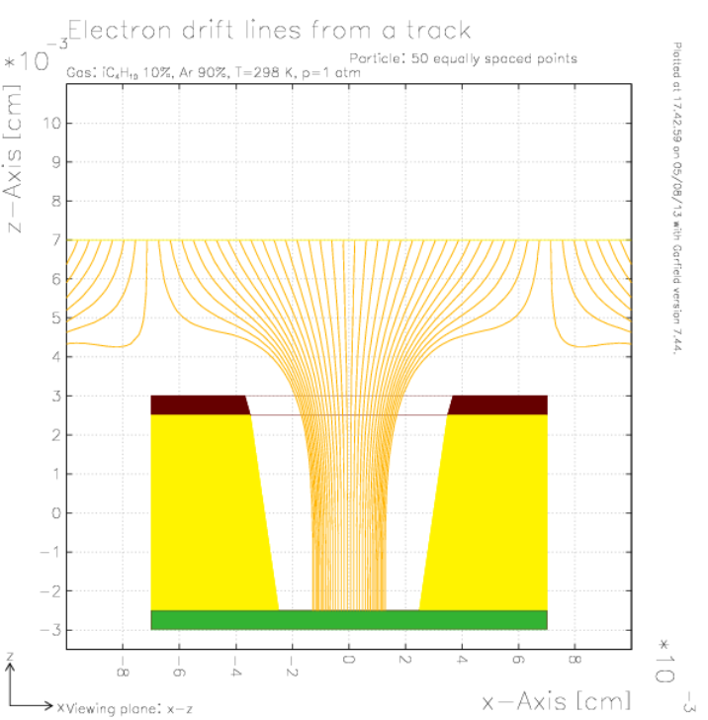
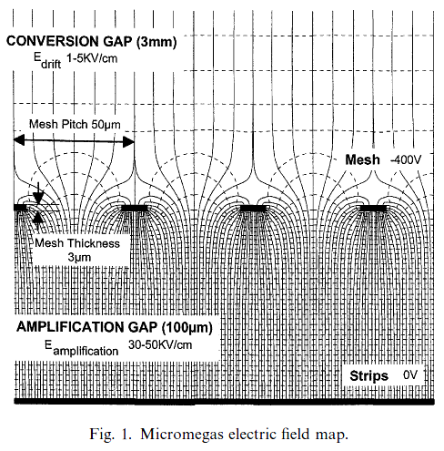
µRWELL-PICOSEC vs. MM-PICOSEC: Drift Field Lines
MM-PICOSEC
µRWELL-PICOSEC
Mesh pitch = 50 µm
Mesh width = 3 µm
Holes pitch = 150 µm
Mesh diameter = 70 µm

Slide 23
Gas mixture choices
Lukas Sohl
RD51 miniweek 11/02/2020

