Slide 1

EIC 2nd Detector : Vision and Realization
Abhay Deshpande
EIC Science Director @ BNL
Center for Frontiers in Nuclear Science (CFNS)
Stony Brook University

Slide 2
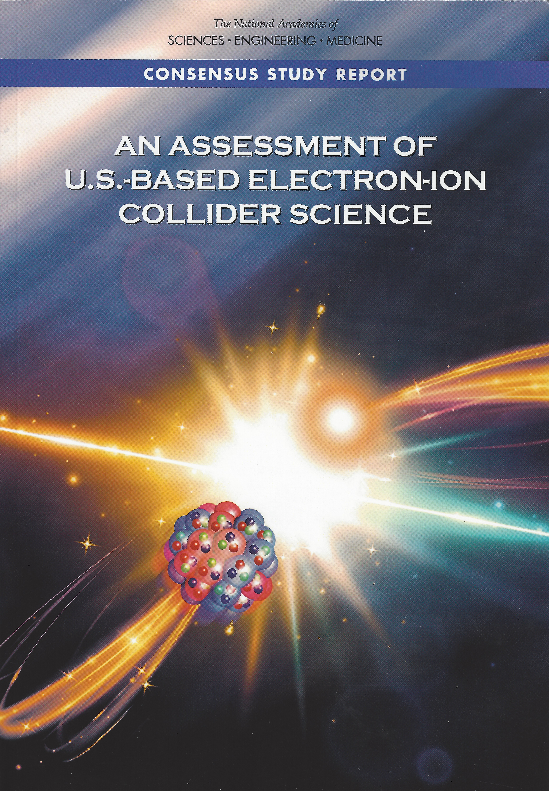
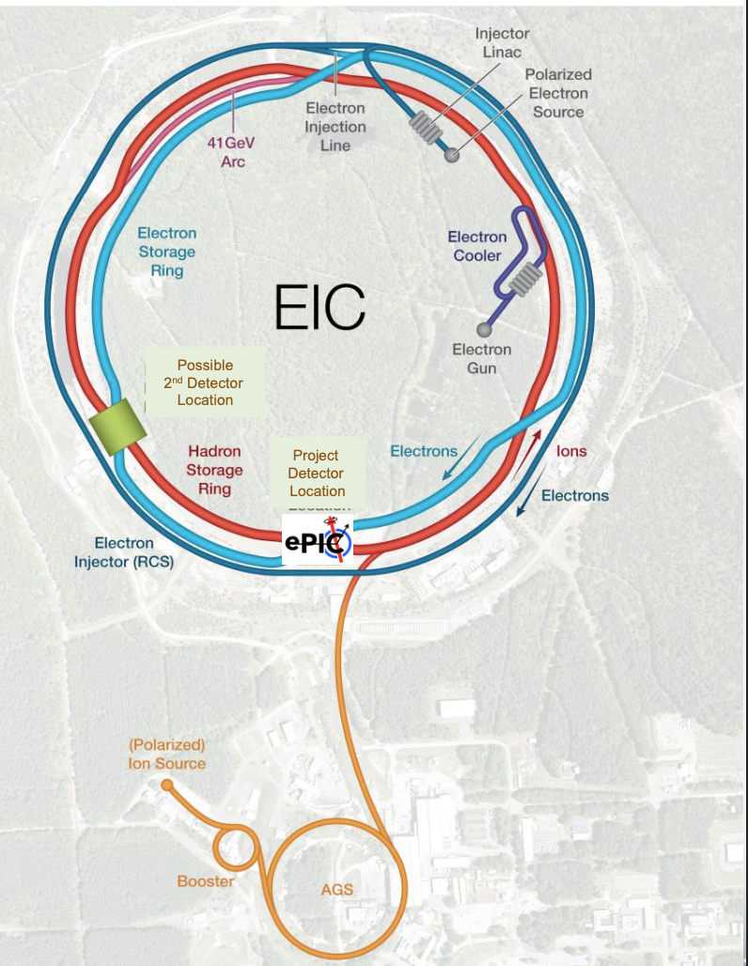
Electron Ion Collider Project: Accelerator & ~70% 1st detector
More in Jim Yeck’s talk
Physics of EIC ➔ Elements of CD0 (Science Need) from DOE
Emergence of Spin
Emergence of Mass
Physics of high-density gluon fields
Machine Design Parameters:
High luminosity: up to 10³³-10³⁴ cm⁻²sec⁻¹
  a factor ~100-1000 times HERA
Broad range in center-of-mass energy: ~20-140 GeV
Polarized beams e-, p, and light ion beams with flexible spin patterns/orientation
Broad range in hadron species: protons…. Uranium
Up to two detectors well-integrated detector(s) into the machine lattice

Slide 3
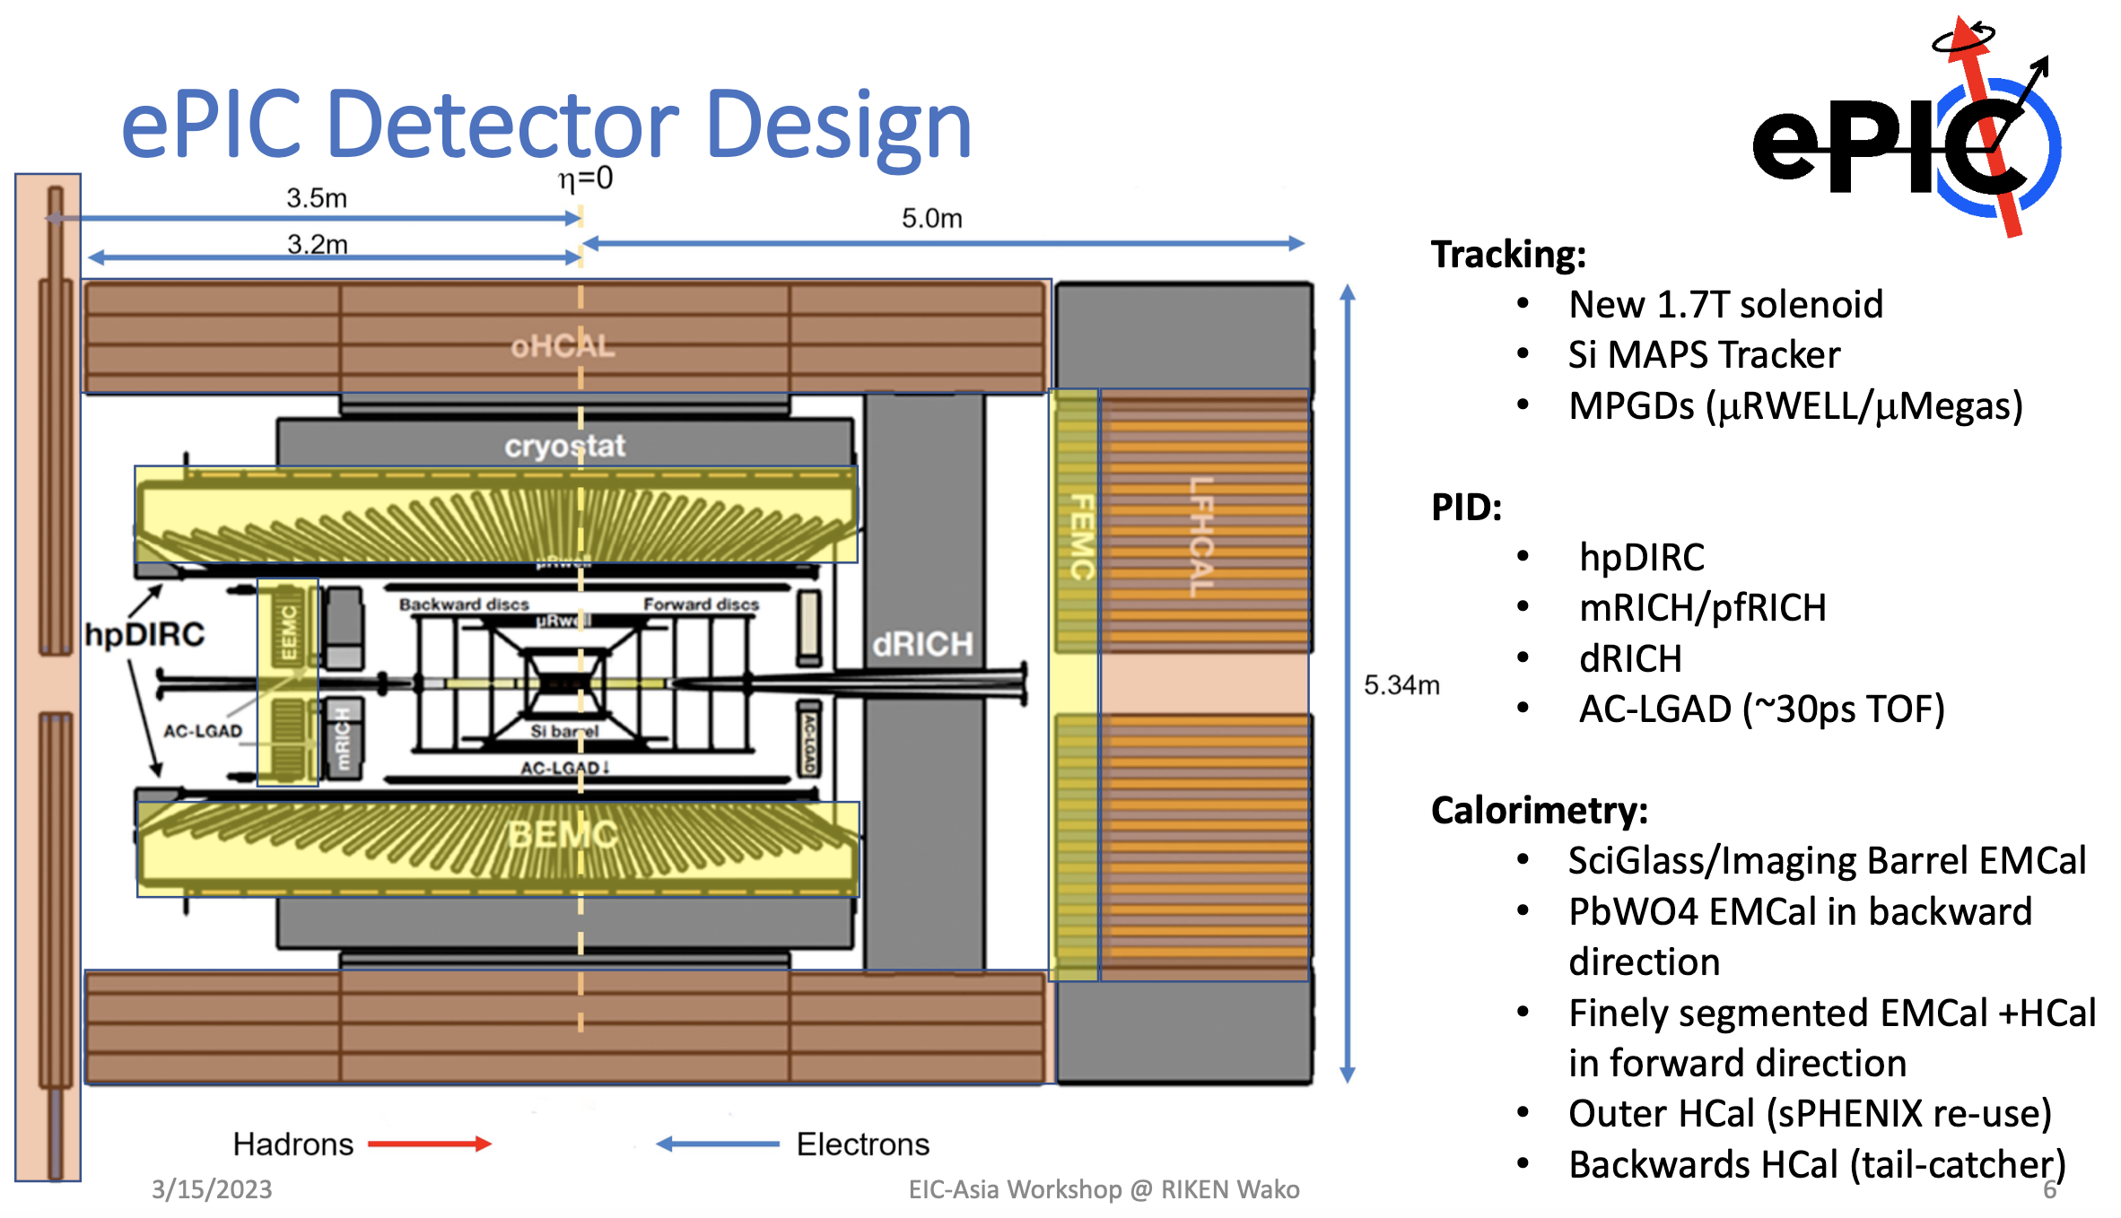
Slide from John Lajoie

Slide 4
Value of more than 1 detector

Slide 5
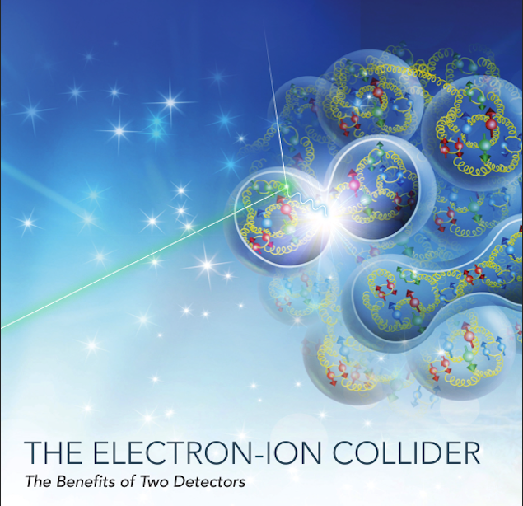
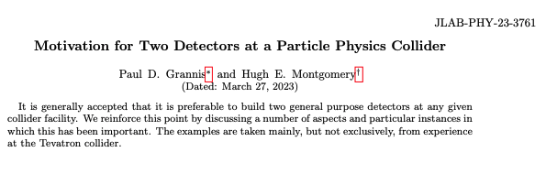
Two documents: with overlapping arguments
arXiv: 2303.08228v2 March 24, 20234
Case for two detectors being made from Nuclear and Particle Physics
Ent and Milner et al for the EICUG SC

Slide 6
History: Discoveries established with more than one detectors in Nuclear Science
Discovery of gluon : TASSO, JADE, Mark J, and PLUTO @ DESY
H1 and ZEUS at Rise of F₂ and hence the gluon dominance at low-x
BRAHMS, PHOBOS, PHENIX and STAR Discovery and establishing the existence of Quark Gluon Plasma
Measurements at DESY and JLab eventually led to “parton imaging”
EMC discovered and then SMC/CERN and EXXX/SLAC established nucleon spin crisis (low-x) & EMC discovered and then NMC established nuclear effects on nucleon PDFs (also low-x)

Slide 7
Two detectors (independent cross checks) builds trust in novel discoveries and prevents historical mistakes
Building Trust
Quark Gluon Plasma: RHIC Experiments
Discovery of Top Quark D0/CDF
Discovery of Higgs Boson: ATLAS and CMS
Gravitational Waves: LIGO and VIRGO
Neutrino oscillations
Mistakes or misinterpretations:
Cold fusion
17 KeV neutrinos in Tritium
Superluminal neutrinos
Leptoquarks
Pentaquarks from 2000’s

Slide 8
Complementary detectors (collaborations):
1 + 1 > 2
More than one detectors with different acceptances, optimizations and technologies: Redundancy, cross-calibration and independent validation of important results
Complementary acceptance -- confirming or refuting discoveries – studying from different “point of views”
Complementary Technologies – multiple examples of systematic uncertainties improvement due to different Particle ID, Calorimetry, Tracking, magnetic field strengths and orientations. H1/ZEUS, PHENIX/STAR, CDF/D0 and ATLAS/CMS vs. LHCb
Impact of different perspectives that different collaborators bring to the same problem.
  Complementary analyses strategies build confidence in conclusions

Slide 9
The 2nd detector
NSAC documents talk about possibly ~4 detectors
NAS Report: planning for up to 2 well-integrated detectors
EICUG desires 2 Detectors
EIC Project has 1 Machine, 1 IR and ~1 Detector
  without negating the possibility of the 2nd IR/Detector

Slide 10
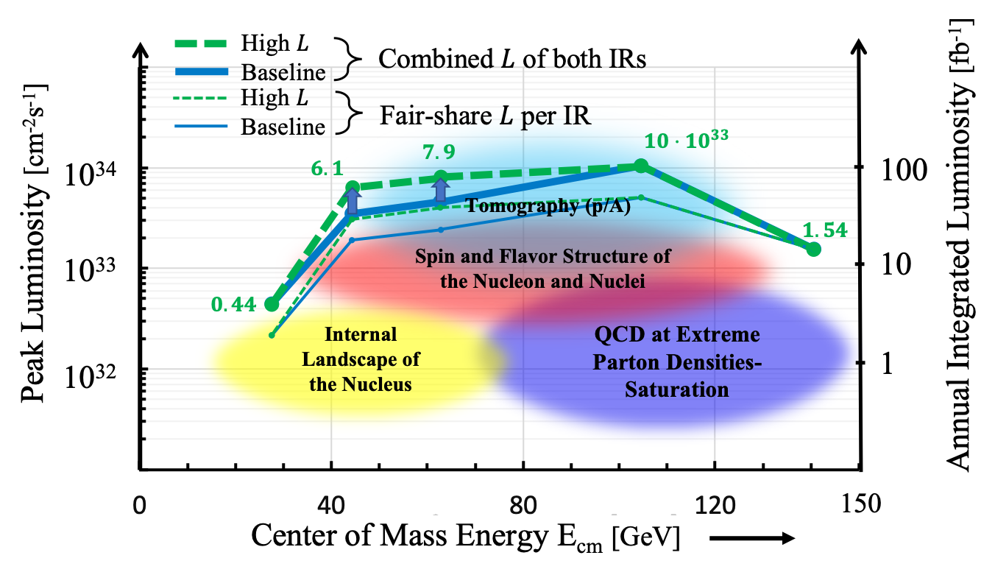
Adding IRs : Luminosity gets shared
(at beam-beam limit)

Slide 11
While EIC project (machine and 1st detector) have to succeed….
I think we have everything we need to sow the seeds for a 2nd detector

Slide 12
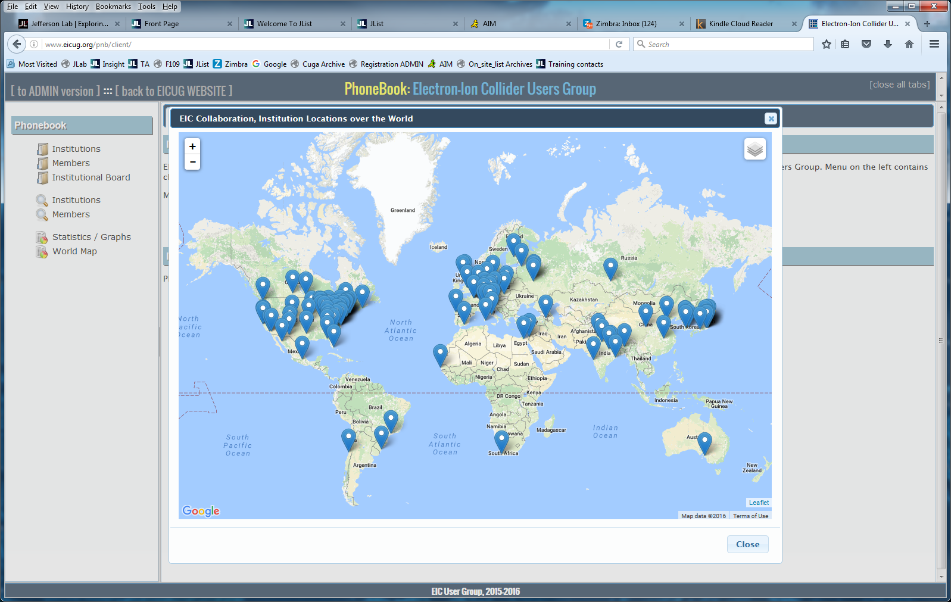
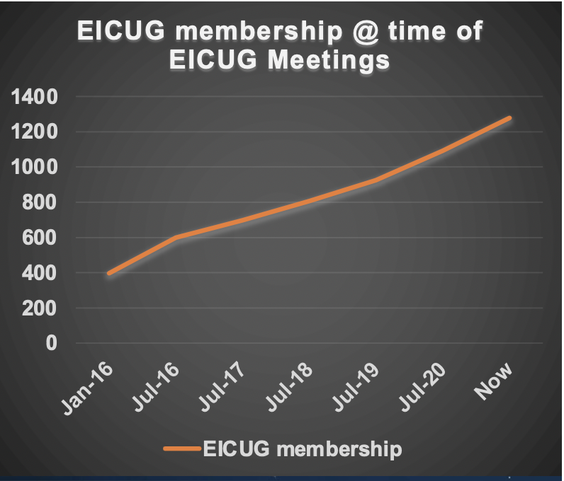
EIC Layout and International EIC Users Group
Opportunity for more than one detector exists
EIC layout allows for more than one interaction point
EIC Users Group is large & growing
  700 in 2016 to 1400 in 2023 – potential to grow further
  Have we explored the potential of all countries and subgroups in the UG?
  Is there (not) significant potential growth in international contribution?

Slide 13

Complementarity for 1st-IR & 2nd-IR
Opportunity for complementary detector designs for different IRs exists!
1st IR (IP-6) ePIC
2nd IR (IP-8)
Geometry:
ring inside to outside
ring outside to inside
tunnel and assembly hall
are larger
Tunnel: ⦰ 7m +/- 140m
tunnel and assembly hall are smaller
Tunnel: ⦰ 6.3m to 60m then 5.3m
Crossing Angle:
25 mrad
35 mrad
secondary focus
different blind spots
different forward detectors and acceptances
different acceptance of central detector
Luminosity:
More luminosity at lower E_{CM} ?
Optimize Doublet focusing FDD vs. FDF
→ impact of far forward p_{T} acceptance
Experiment:
1.7 Tesla or 3 (?) Tesla
different subdetector technologies
ECA & RE

Slide 14
Focus first on Physics beyond the EIC’s core (CD0) science
(there will be others: some overlapping, some exclusive due to different IR design)
Potential Physics topics beyond Core EPIC detector’s mandate exist
Physics with nucleons and nuclear targets:
Quark Exotica: 4,5,6 quark systems…? Much interest after recent LHCb led results.
Nuclear Fragments from light and heavy nuclei : e-A – Connecting to low energy nuclear physics (exotic nuclei), studying the shapes of nuclei and their nternal substructure; entanglement, entropy, fragmentation, hadronization and such phenomena
New Studies with proton or neutron target: (mostly overlapping?)
Impact of precision measurements of unpolarized PDFs at high x/Q², on LHC-Upgrade results(?)
Precision calculation of α_{S} : higher order pQCD calculations, twist 3
Heavy quark and quarkonia (c, b quarks) studies with 1000 times lumi of HERA (and polarization)
Precision electroweak and BSM physics:
Electroweak physics & searches beyond the SM: Parity, charge symmetry, lepton flavor violation
LHC-EIC Synergies & complementarity: (muon detectors were of particular interest)

Slide 15
Vision for the 2nd detector: C³
Complementary (IR, detector technologies & design)
  Continue to explore complementary ready and not-yet-ready technologies
  Generic detector R&D program – Run through JLab
Complementary (physics)
  A significant list of physics topics (some-exclusive to 2nd IR, some-overlapping) exists: drill down and see which of those can develop into strong pillars of science for the 2nd detector.
  New physics developing around the world : we need to monitor constantly
Complementary (people)
  New non-US/outside groups who may bring new interests & funding in future
  New US groups – other than those with significant responsibilities in ePIC

Slide 16
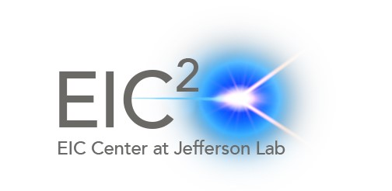
Path forward: focused workshops and detector studies on new physics topics:
Look at complementary detector technologies (to ePIC) and attract groups that are experts in them to the EICUG
Focused discussions on new physics topics (not just listed in this talk but also beyond) to try to make a unique case complementary to ePIC/EIC White Paper
Build community – new groups/faces/resources needed to contribute and become part of new detector effort
Resources:
  Generic detector R&D – supported by DOE administered from JLab
  Center for Frontiers in Nuclear Science @ Stony Brook (& EIC – Theory Institute at BNL) and the EIC² at JLab

Slide 17
Observation and Remarks:
EIC project’s path is well understood. Its success is paramount.
2nd detector is essential for completing the Vision of EIC
  C³ : Complementary physics, technology and people
It is time to march forward developing a design and case for the 2nd detector: Detailed studies through series of workshops, outreach and critical evaluation for each developing argument ➔ Plan an INT- Program in ~2025 like we had in 2010
I look forward to discussions in this workshop

