Slide 1
EIC Project Perspective on a Second Detector
1st International Workshop on a 2nd Detector for the Electron-Ion Collider
Jim Yeck, EIC Project Director
May 17, 2023

Slide 2

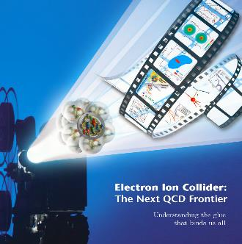

EIC Project Requirements
Project Design Goals
High Luminosity: L= 10³³ – 10³⁴cm⁻²sec⁻¹, 10 – 100 fb⁻¹/year
Highly Polarized Beams: 70%
Large Center of Mass Energy Range: E_{cm} = 20 – 140 GeV
Large Ion Species Range: protons – Uranium
Large Detector Acceptance and Good Background Conditions
Accommodate a Second Interaction Region (IR)
Conceptual design scope and expected performance
meets or exceed NSAC Long Range Plan (2015) and
the EIC White Paper requirements endorsed by NAS (2018).
EIC is a unique, high-energy, high-luminosity, polarized beam collider that will be one of the most challenging and exciting accelerator complexes ever built -- only new collider constructed in next decade(s).

Slide 3
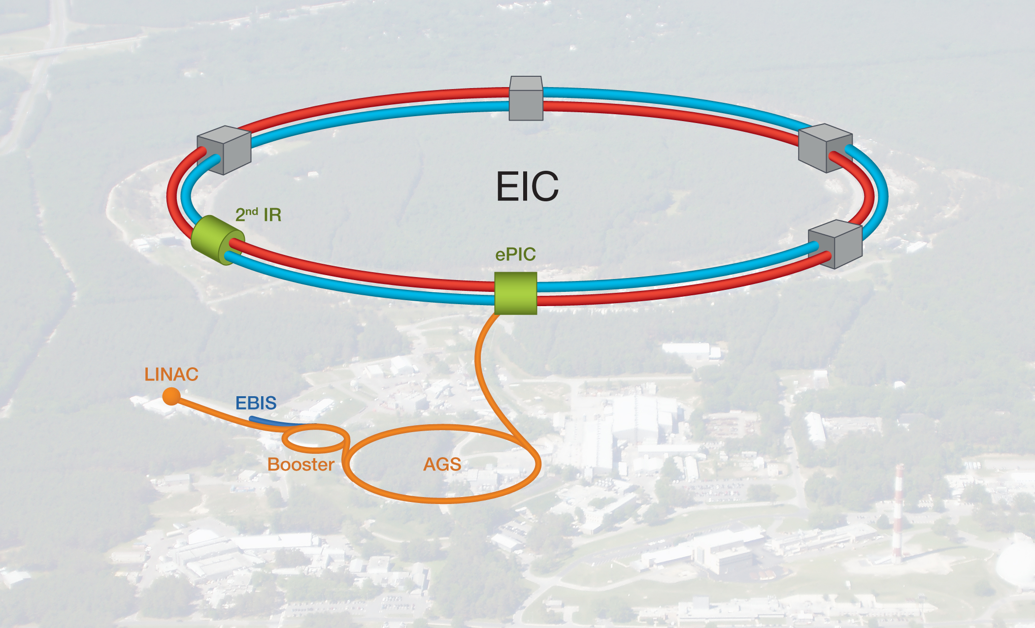
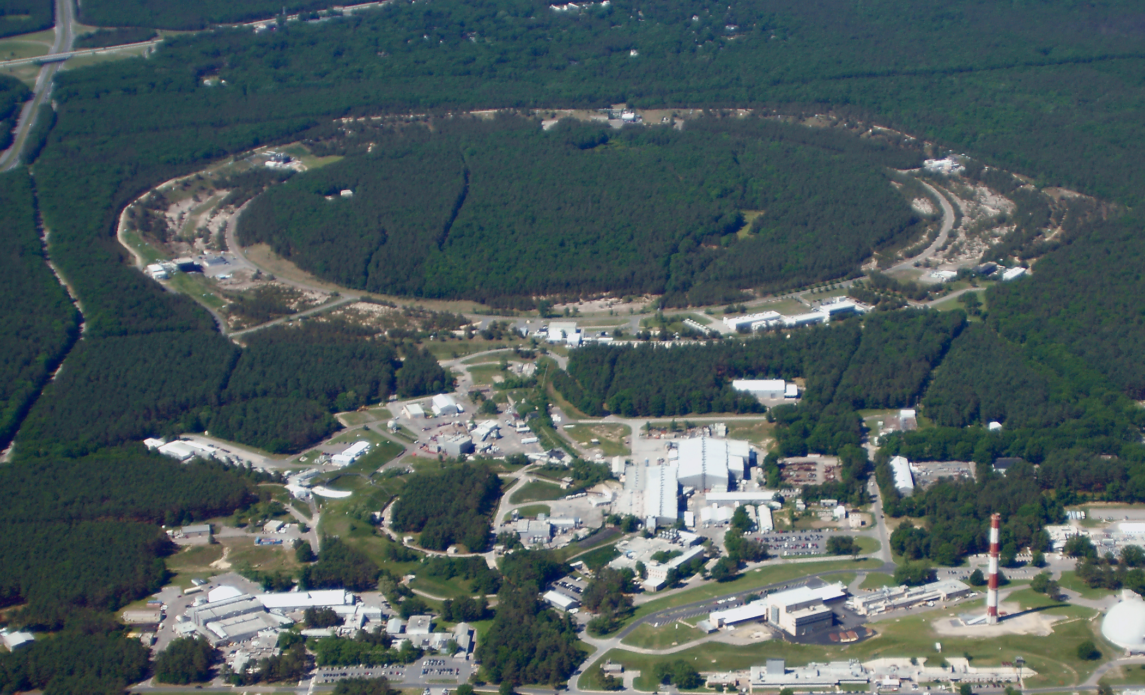
EIC Double Ring Design
Based on Existing RHIC Facility
RHIC Operations Concludes in 2025

Slide 4
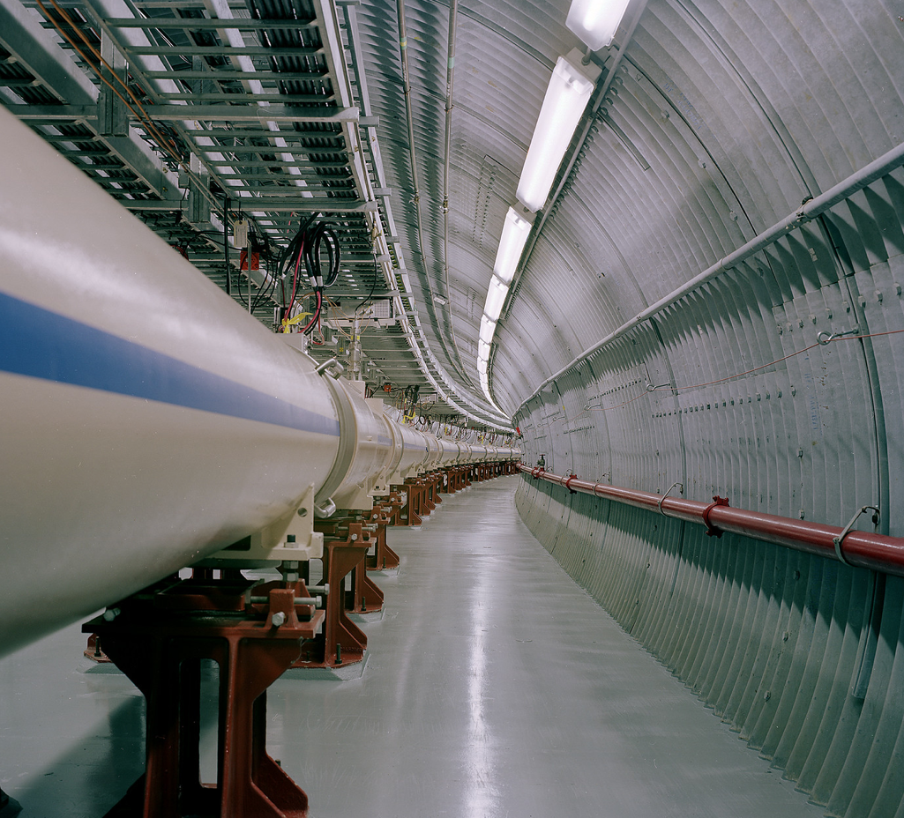
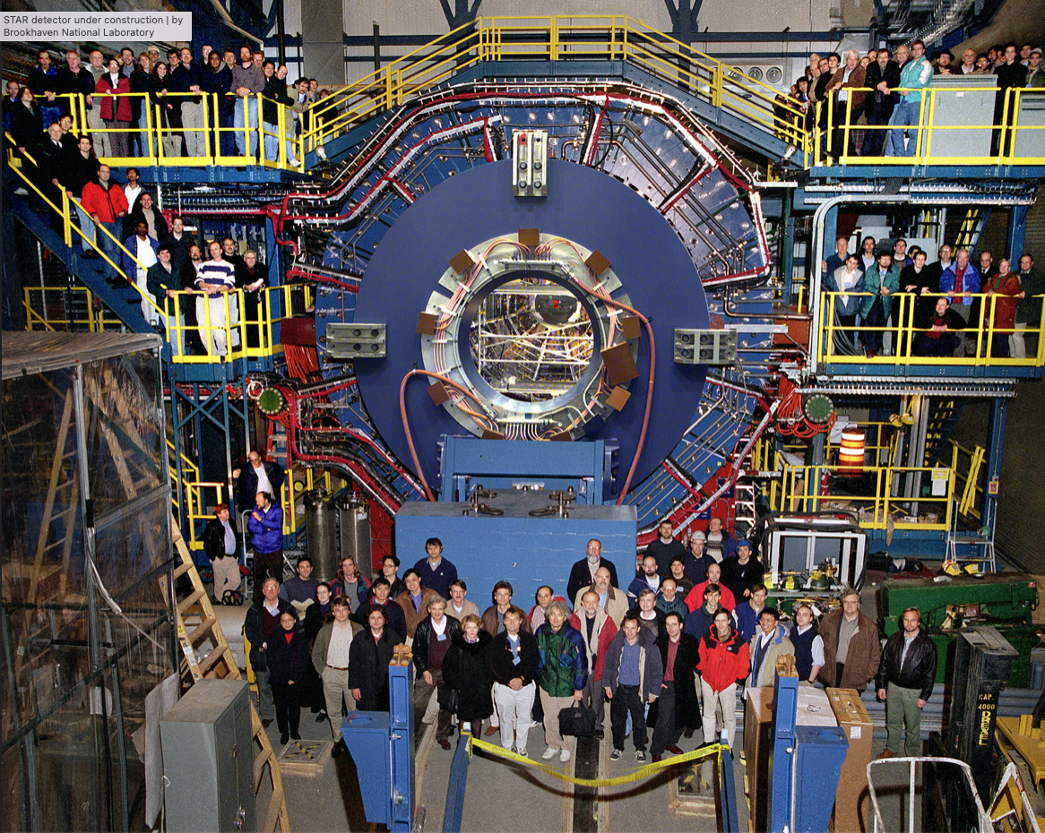
RHIC Infrastructure

Slide 5
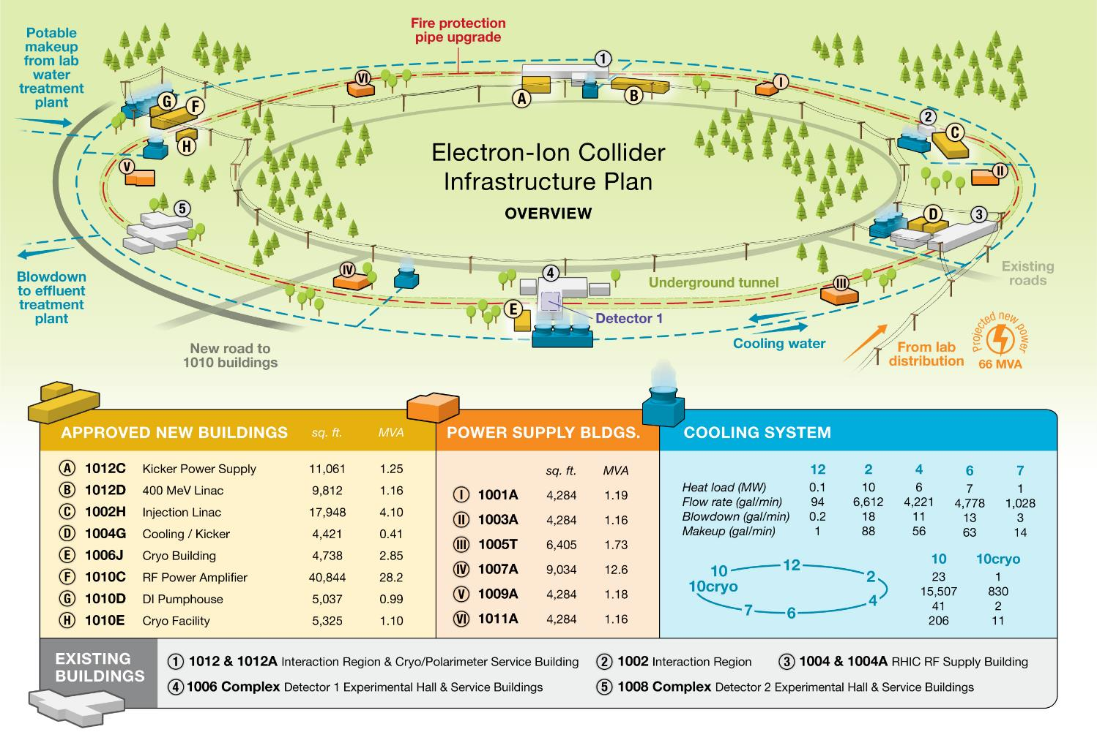
New Infrastructure Planned
New York State will provide new EIC support buildings ($100M).

Slide 6
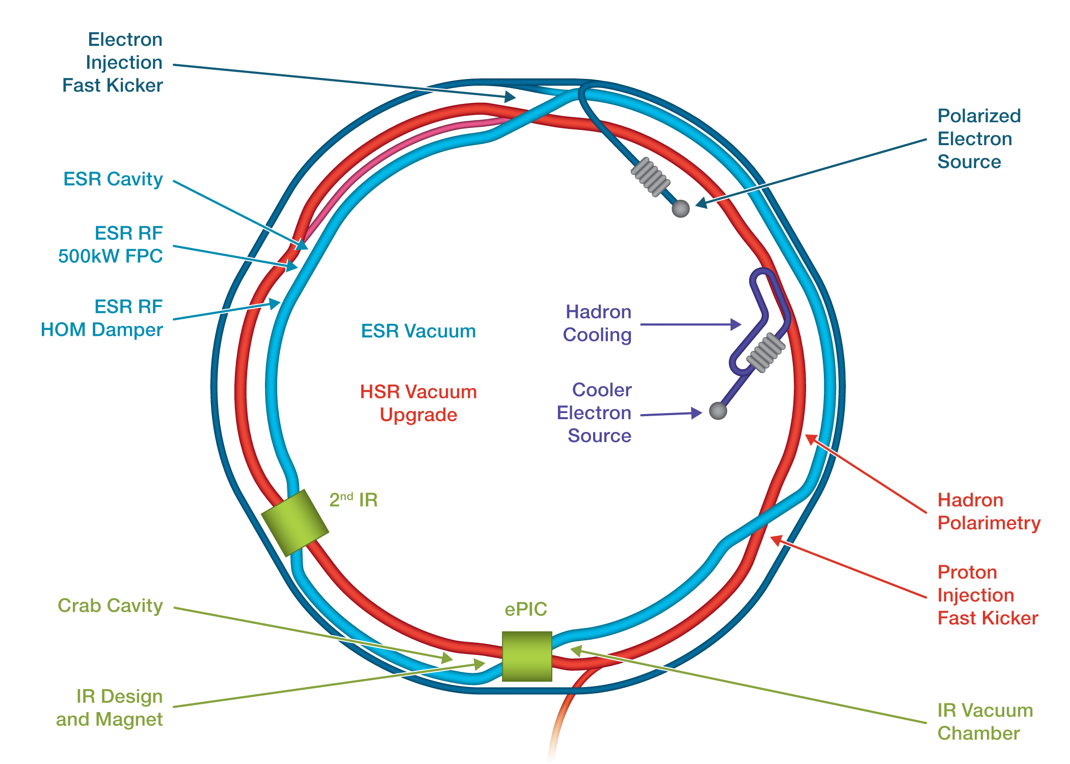
Accelerator Science and Technology-Design and R&D

Slide 7
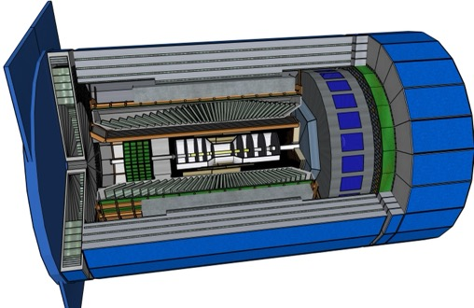
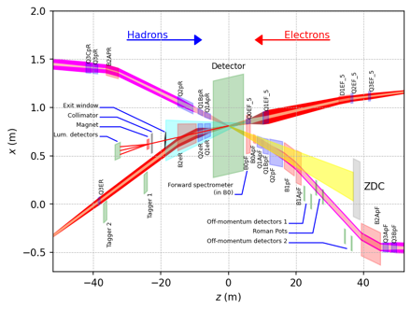
ePIC Detector
Asymmetric beam energies
→ require an asymmetric detector Barrel
with electron and hadron endcap
→ 9.5 m
→ Tracking, particle identification, EM
calorimetry and hadronic calorimetry
functionality in all directions
→ very compact detector Integration
will be key
Imaging science program with protons and nuclei
→ requires specialized detectors
integrated in the Interaction Region
over 80 m
Science program required momentum resolution
→ requires a large bore 2T magnet
(1.7 T magnet operation point, stretch goal 2T)
that has same geometry as the BaBAR magnet.
Streaming readout electronics model
  → highest scientific flexibility
9.5 m

Slide 8
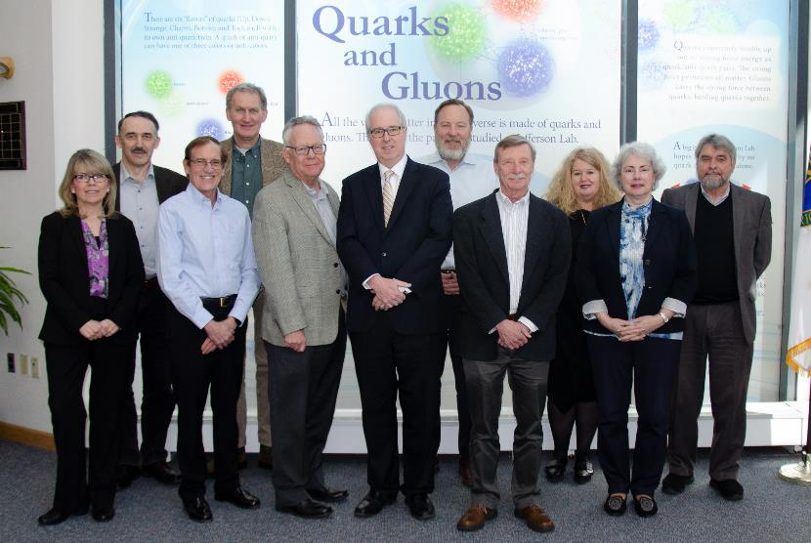
BNL/TJNAF Special Partnership
BNL/JLab partnership established in early 2020
Integrated project management and scope
Serving together as hosts for the EIC experimental program

Slide 9

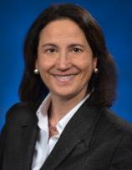
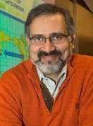
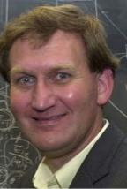

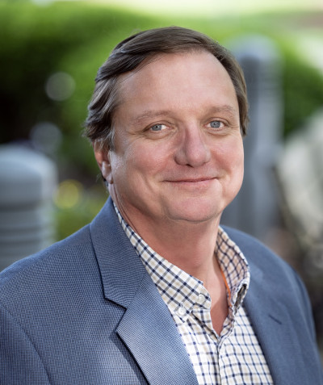
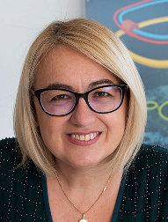
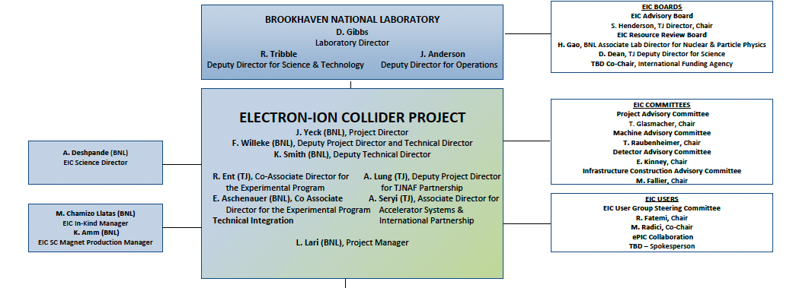
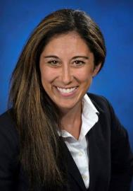
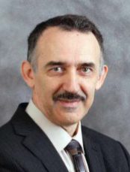

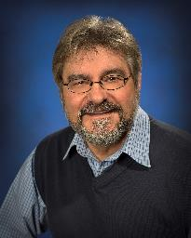
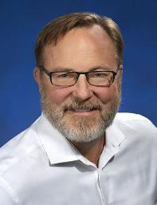
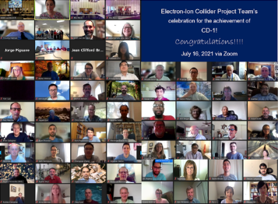

Slide 10
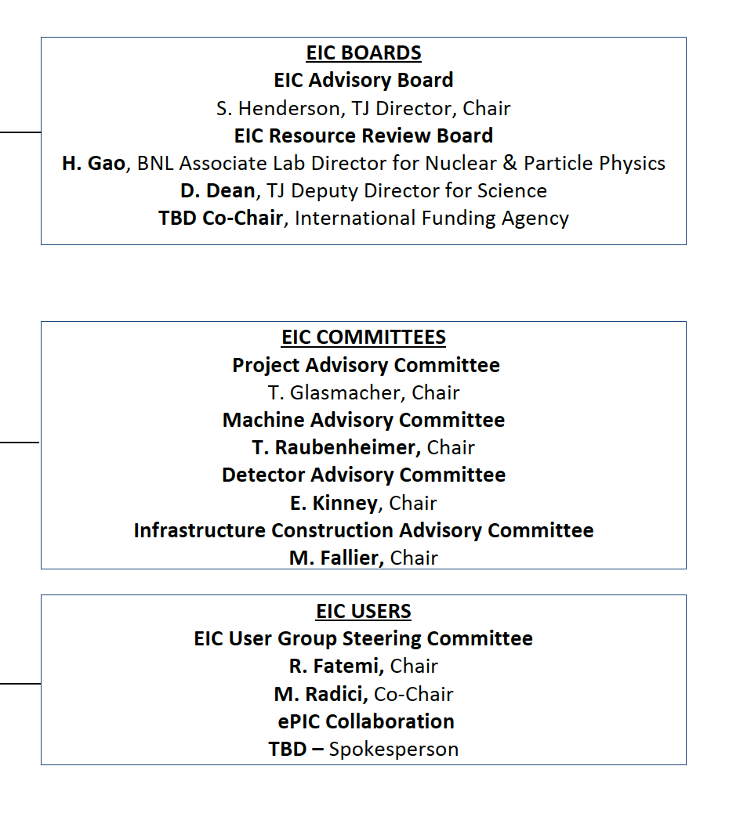
Boards and Advisory Committees
D. Bettoni
DOE, BNL, and JLab envision an EIC facility that is “fully international in character.”
International EIC Advisory Board provides oversight and advice on the construction of the facility, focusing on the accelerator: ANL, BNL, LBNL, TJNAF, TRIUMF - Canada, IN2P3 and CEA - France, STFC - UK, INFN - Italy.
International EIC Resource Review Board provides oversight of experiments, 1st meeting April 2023. Delegates from Africa, Asia, Europe, North and South America.
International EIC Project Advisory Committee provides advice on the successful delivery of the DOE Project including management, scope, schedule, cost, and performance.
John Lajoie, Spokesperson
Silvia Dalla Torre, Deputy Spokesperson

Slide 11
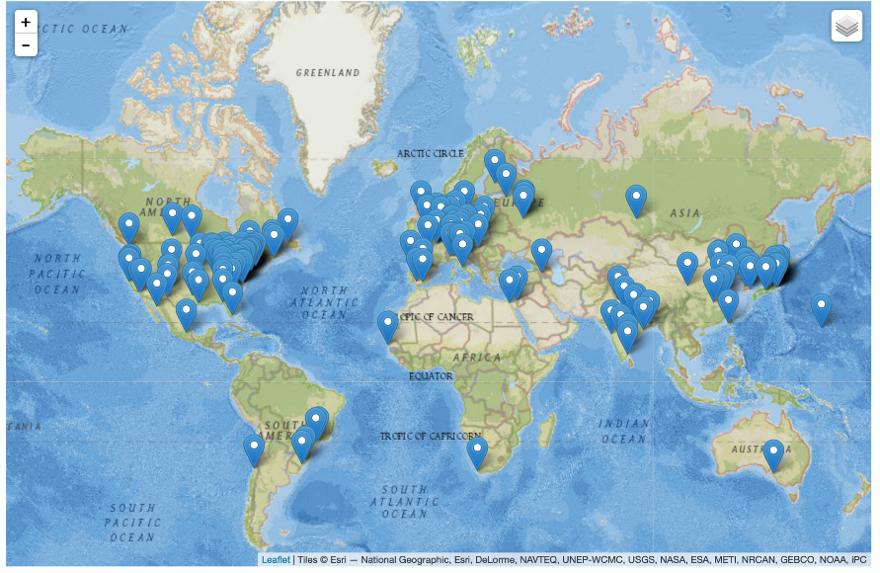
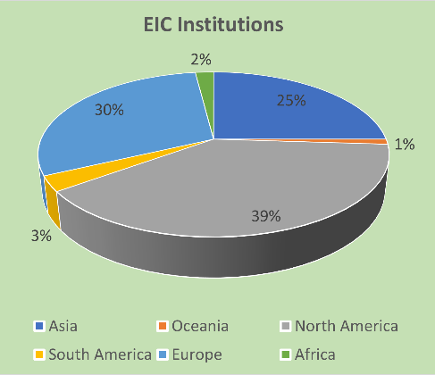
Institutions
The EIC User Group: https://eicug.github.io/
Formed in 2016, Currently:
1361 collaborators,
36 countries,
267 institutions
International Participation
Growing
Annual EICUG meeting
2016 UC Berkeley, CA
2016 Argonne, IL
2017 Trieste, Italy
2018 CUA, Washington, DC
2019 Paris, France
2020 Miami, FL
2021 VUU, VA & UCR, CA
2022 Stony Brook U, NY
2023 Warsaw, Poland
11

Slide 12
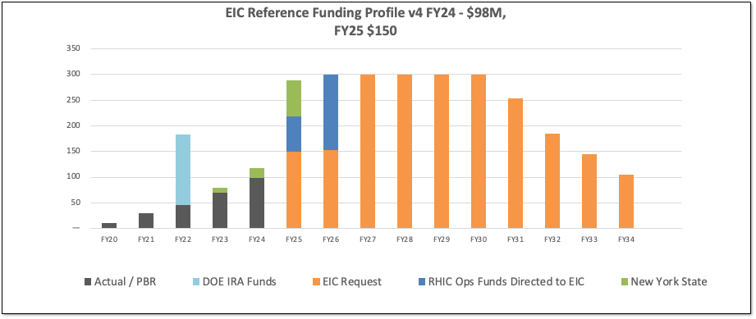
DOE EIC Funding Plans
DOE Inflation Reduction Act funding of $138M allocated in September 2022. Actual FY2023 funding is $70M. DOE request for FY2024 is $98M.
RHIC shut down planned for June 2025. Significant RHIC Operations funding will be redirected to EIC construction starting in FY2025 and reaching ~$150M/year in FY2026.
Current funding supports DOE CD-3A, Long Lead Procurement Approval, in January 2024. Long lead procurement mitigate risks: technical, supply chain, inflation, and schedule.

Slide 13
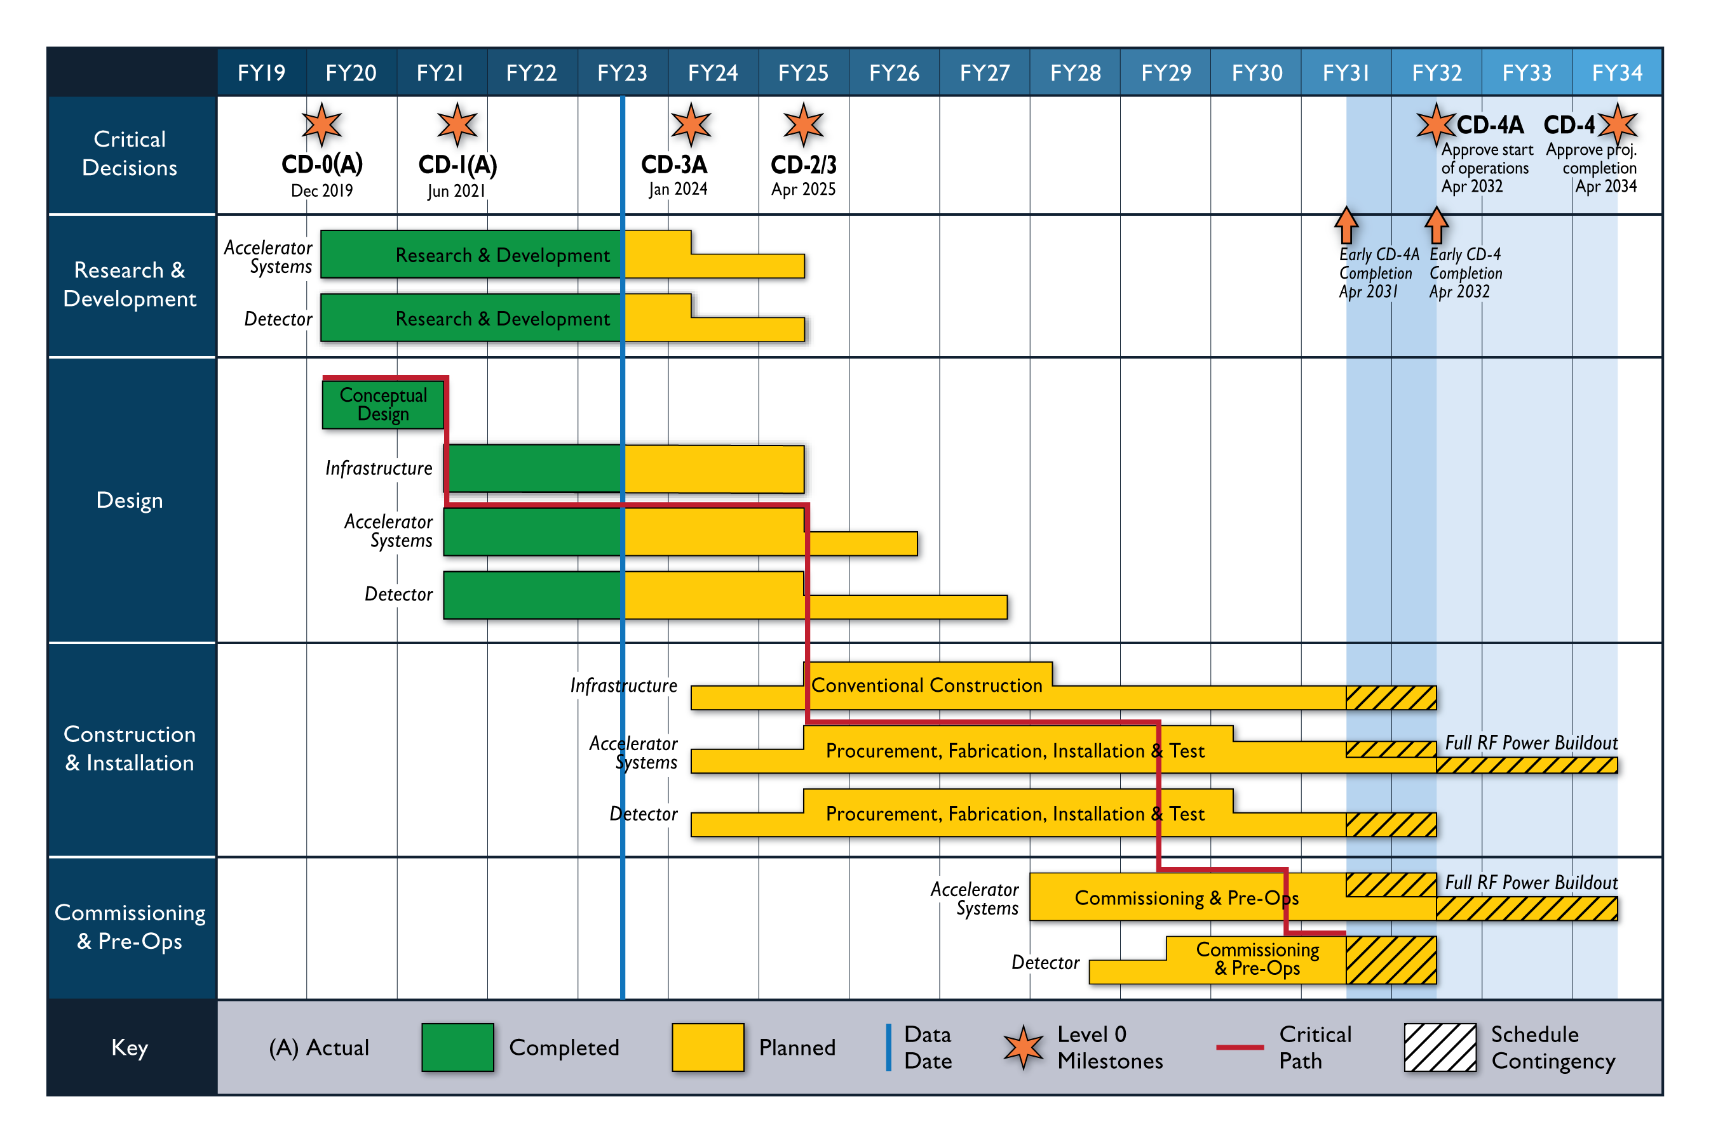
Schedule

Slide 14
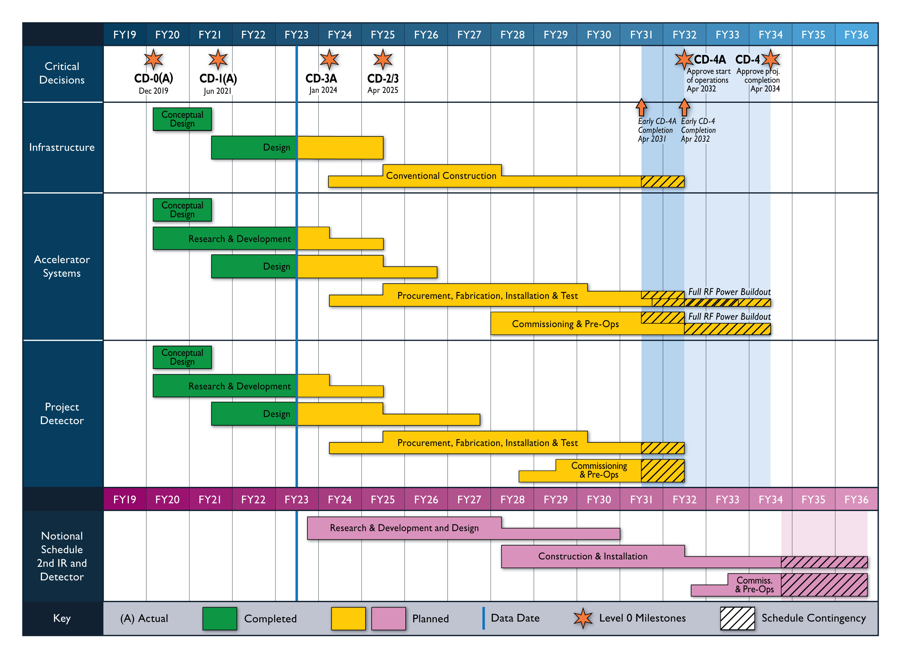
Reference Schedule for 2nd IR and Detector

Slide 15
Preparing the EIC Experimental Program
Year-long EIC User Group driven EIC Yellow Report activity (December 2019 – February 2021
  Science Requirements and Detector Concepts for the EIC
  arXiv:2103.05419 & Nucl. Phys. A 1026 (2022) 122447 – 488 citations (03/31/2023)
BNL and TJNAF Jointly Leading Efforts Towards Experimental Program | BNL and TJNAF Jointly Leading Process to Select Project Detector
2020 | Call for Expressions of Interest (EOI) https://www.bnl.gov/eic/EOI.php | May 2020
 | EOI Responses Submitted | November 2020
 | Assessment of EOI Responses | On-going&
2021 | Call for Collaboration Proposals for Detectors https://www.bnl.gov/eic/CFC.php | March 2021
 | BNL/TJNAF Proposal Evaluation Committee | Spring 2021
 | Collaboration Proposals for Detectors Submitted | December 2021
2022 | Decision on Project Detector – baseline “ECCE” | March 2022
 | Process to consolidate ECCE & ATHENA to the EIC Project Detector | Spring 2022
 | ePIC Collaboration* Formed – 160 institutions | July 2022
2023 | ePIC Charter ratified & elected Leadership Team | February 2023
 | Resources Review Board Meeting | April 2023
 | ePIC Detector remaining technology choices made | April 2023
&Remains ongoing until formal agreements are in place – it originally led to confirmation that in-kind level assumed for the EIC detector was in range.

Slide 16
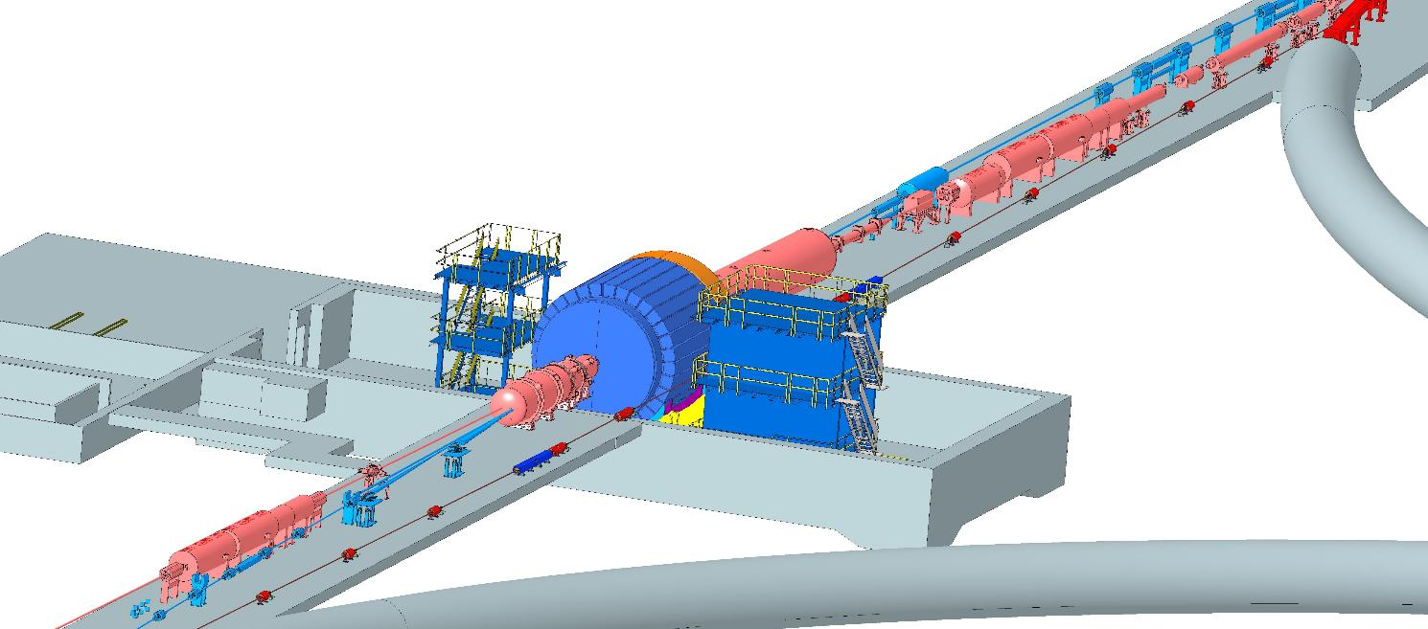
Interaction Region Layout
ESR Forward side
Forward Side
SC Magnet Cryostat
HSR Injection Line
Central Detector
Rear Side
SC Magnet Cryostat
HSR Forward Side
HSR: Hadron Storage Ring
ESR: Electron Storage Ring
RCS: Rapid Cycling Synchrotron
SC: Superconducting
HSR
Rear Side
RCS
With Detector Bypass
ESR Rear side
Every cm counts → and integration and communication with accelerator team is crucial

Slide 17
International Interest & In-Kind
Entity | Interest and Important Facts
NSF | NSF-MSRI pre-proposal submitted by 10 US universities – aims at full scope of backward EM calorimetry (eECal). Armenia, Czech, France/IN2P3 as unfunded contributors. Invited to submit proposal.
Armenia | Contributions, mainly labor to eECal and many EM calorimetry and particle id detectors component tests.
Canada | EIC included in 2022 Canadian Subatomic Physics Long-Range Plan; Interested in Compton Polarimetry, Electromagnetic Calorimetry and Software
China | Forward EM Calorimeter
Czech | Working with funding agency; Interested in eECal (PbWO4 crystals and glass) and Silicon
France/IRFU | Interested in SC magnet design, electronics and MPGD/tracking. Saclay/IRFU provided 30% design work for magnet as in-kind, contributions to 60% and ongoing 90% design.
France/IN2P3 | International contribution to backward EM calorimetry (including in-kind design) and to readout electronics (e.g., ASICs for AC-LGAD detectors and Calorimetry). IRFU & IN2P3 discussing together for higher-level contributions.
India | Consortium is working with Funding agency; Interested in detector software (non-project scientific contribution), contributions to DAQ/slow controls, and PID – ToF as hardware (investigating Forward AC-LGAD to make links with Si plants).
Italy/INFN | Working with INFN since a while; Aims at major scope of forward particle identification detector (dRICH), at (part of) the Si/MAPS tracker scope, and at photo-sensor contributions. Further investigating possible interest in EIC detector magnet scope.
Israel | B0 Detectors (Si tracking and PbWO4)
Japan | Interested in a US-Japan agreement; Aims at full scope of Zero-Degree Calorimeter in collaboration with Taiwan/Korea. Pursuit of full scope of barrel AC-LGAD detector as EIC-Asia consortium. Contribution to DAQ/streaming. Possible aerogel.
Korea | Fiber-based EM calorimetry (barrel and/or hadronic ZDC), Small work package for barrel AC-LGAD as part of EIC-Asia consortium (includes also Japan,Taiwan), collaboration on Si tracking detector (backward Si disks), Si-based hadronic calorimetry for ZDC.
Poland | Actively working with ministry/funding agency; Interested in detectors along the beam line (luminosity detector, Roman Pots)
Taiwan | Pursuit of full scope of barrel AC-LGAD as part of EIC-Asia consortium. LYSO-based EM calorimeter for ZDC, Also optical readout/fiber. Possible later interest in PCBs. Computing.
UK | STFC seed funding for UK detector R&D (3M£). Interest in Si/MAPS tracker, polarimetry and detectors along the beams (Low-Q2/TimePix). Follow-up grant request for 5-7 years submitted early 2023 (includes accelerator part).

Slide 18
Perspective on 2nd Detector
Project Design Goals
  Accommodate a Second Interaction Region (IR)
DOE, and BNL and JLab as the Host Labs, are establishing a governance structure intended to support the EIC. This includes the construction of a 2nd IR and detector.
  EAB, RRB, DOE International Agreements
Successful delivery of the EIC Project will be a major challenge, and the priority of the EIC project leadership team
2nd IR and Detector will be installed after the EIC project is complete
  Science case must be compelling given resources required
  IR and detector technologies should be state of the art
  International engagement should be significant
Organized effort needed now to prepare plans and build support for the 2nd IR and Detector

Slide 19
Questions?

