Slide 1
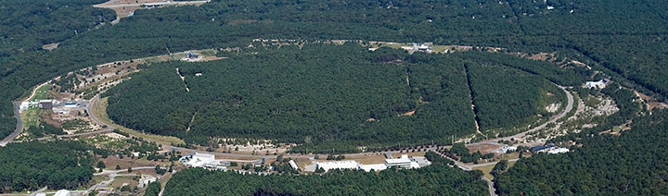
Why Two Detectors for Colliders?
?
1st International Workshop on a 2nd Detector for the EIC
Paul Grannis
Stony Brook University
May 17, 2023

Slide 2
In Dec. 2022, the Electron-Ion Collider User Group invited Hugh Montgomery to discuss the motivation for a second detector at the Electron Ion Collider.
In that talk, Mont discussed some of our experiences with High Energy physics experiments at the Tevatron (and LHC) which would illustrate these motivations. (https://indico.bnl.gov/event/17693/)
Subsequently we expanded his talk somewhat in the paper:
“Motivations for Two Detectors at a Particle Collider”,
Paul D. Grannis and Hugh E. Montgomery,
arXiv:2303.08228
This talk is based on that paper
25

Slide 3
The scientific norm is that our knowledge derives from observations and that such observations must be reproducible. In earlier simpler days that came from other experiments …
Parity violation first seen by Wu et al. (<p•B>≠0 in Co⁶⁰ β decay), but rapidly also seen in <σ•p>≠0 in π−μ−e decay (Garwin et al.) and the negative helicity of ν_{e} (Goldhaber et al. )
CPV (Fitch,Cronin et al.) in K_{L} decays supported by Abashian et al. (at BNL) and confirmed by Manning et al. (at Rutherford Lab)
J/ψ discovery by Richter et al. (SLAC Mark I) and Ting et al. (BNL)
Rising pp σ_{tot} Pisa Stony Brook and CERN-Rome at ISR
Scaling in DIS: Brasse et al. at DESY and Friedman et al. at SLAC
Neutrino oscillations (massive neutrinos) SuperK, SNO, KamLand …
Conversely, unexpected results from just one experiment are treated with skepticsm: e.g. DAMA Dark Matter; sterile neutrinos suggested by LSND
24

Slide 4
In the collider era, experiments became more complex, but the need for confirmation still dictated two general purpose experiments at the same or complementary colliders:
_
SppS: UA1 and UA2
e⁺e⁻ : Mark II, SLD at SLC and ALEPH, DELPHI, L3, OPAL at LEP
HERA: H1 and ZEUS
Tevatron: CDF and D0
RHIC: PHENIX and STAR
B factory: BaBar at PEP II and BELLE at KEK-B
LHC: ATLAS and CMS
But there are pressures on the 2 detector model – because of funding shortfalls, or the need to share only one interaction region (e.g. linear colliders)
23

Slide 5
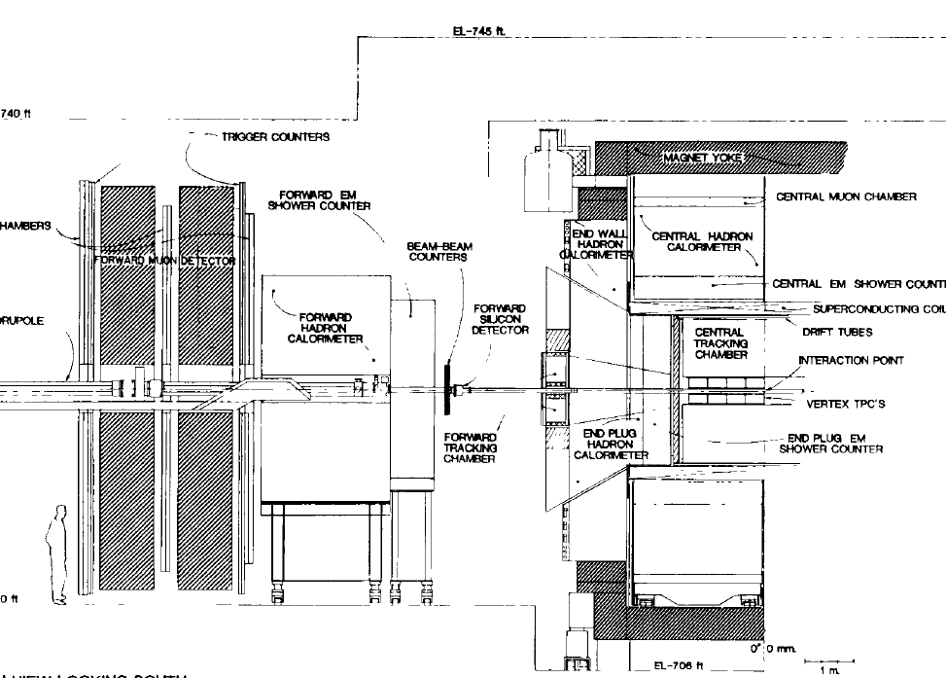
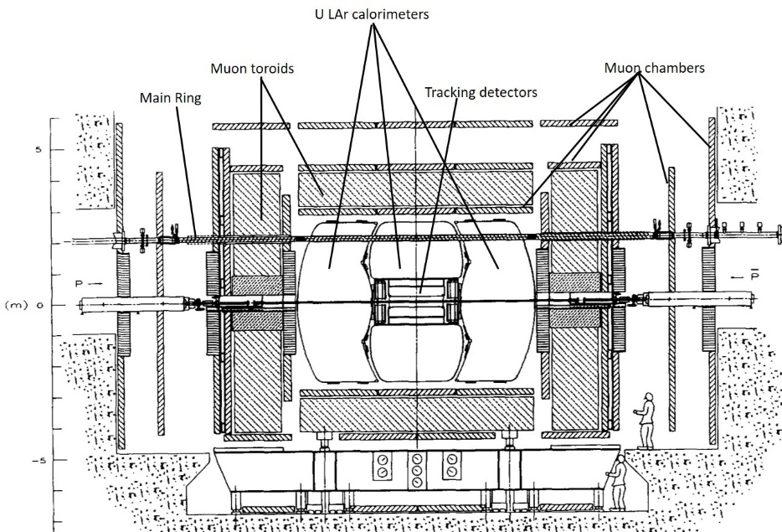
_
Tevatron Run I pp collisions at 1.80 TeV 100 pb⁻¹ 1992 – 2000
CDF Run I Detector
Solenoid magnet for good momentum resolution
Most analyses η_{CAL} < 1
Muons to η = 1
Si vertex detector added for Run I
Main ring lifted above detector – shines on muon system
D0 Run I Detector
No central magnetic field
Small tracking region
Calorimetry to η~4
Muons to η∼3
Main ring went through calorimeters – no data during MR passage
22

Slide 6
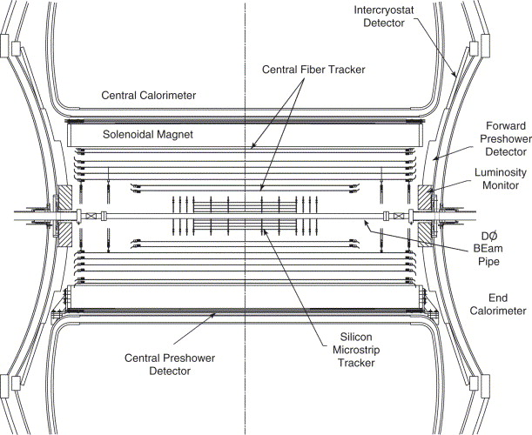
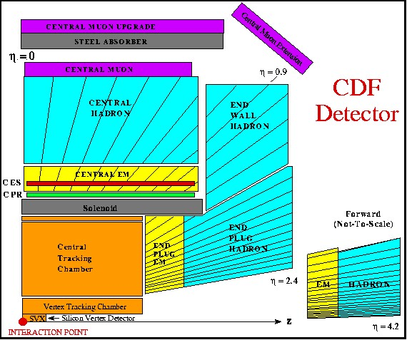
_
Tevatron Run II pp collisions at 1.96 TeV 10 fb⁻¹ 2001 – 2011
(The Main Ring disappeared!)
D0 Run II Tracking
D0 completely rebuilt the tracking with silicon strip vertex detector, scintillating fiber and preshower detectors inside a new 2T solenoid, and replaced its forward muon chambers and trigger planes (not shown).
CDF Run II
CDF replaced its tracking chamber and forward calorimeter, added some muon detectors and installed a new silicon vertex detector
The experiments became more similar
21

Slide 7
Instances where two independent experiments were critical for confirmation of major new discoveries.
20

Slide 8
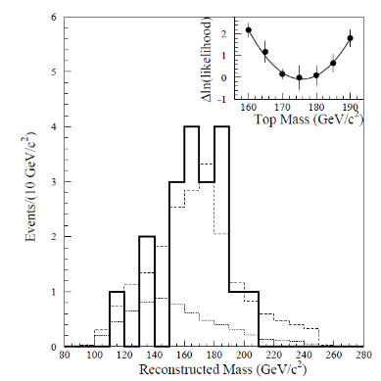
Run I Top discovery
_
Seek tt production. Each top decays to Wb and each W decays to lν or qq. Final states are (dilepton) l⁺v l⁻v bb or (single lepton) l±v qq bb. b-quark tagging and jet topology are important for background suppression.
CDF relied heavily on its displaced vertex capability. They saw 6 dilepton events and 43 single lepton events, all with tagged b-jets by either displaced vertex or semi-muonic decay.
no b-tag
b-tag
background
D0 with no momentum or displaced vertex measurement, relied upon calorimeter and topological variables (aplanarity and H_{T}=scalar sum of jet E_{T}). They saw 3 dilepton events, 8 with single lepton with topological tag and 6 with semi-muonic tag.
Standard cuts
Relaxed A,HT cuts
bknd
top
19

Slide 9
Tevatron Top discovery
CDF initially measured σ_{tt} ~2xSM and D0 had m_{t} about 25 GeV too high. But the results were consistent within uncertainties and later evolved to common values.
The significance for fluctuation of backgrounds to give the number of signal events was 4.8σ for CDF and 4.6σ for D0. (Neither achieved the gold standard 5σ on its own, so the mutual evidence was essential for discovery.)
Two independent measurements and the very different detector capabilities and analysis techniques gave added robustness to the claim for discovery.
18

Slide 10
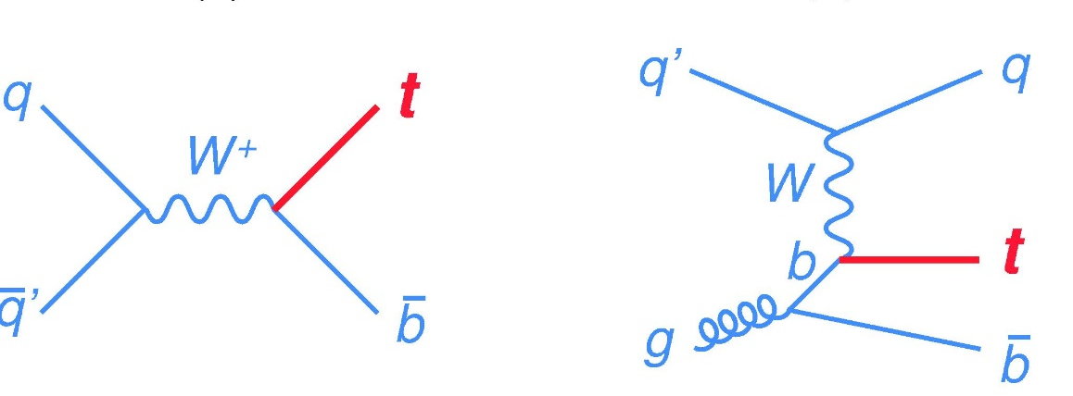
Single top quark observation
s-channel
t-channel
Single top quarks are produced by the EW interaction through the Wtb coupling. Both s-channel and t-channel processes are relevant at the Tevatron.
_
The single top production cross section is ~1/2 that of tt production. There are fewer final state objects than in tt, and the backgrounds are larger so digging the signal out was a tour de force of multivariate analyses. The CDF and D0 analyses were similar this time.
Using Run II data, both CDF and D0 observed the t-channel process individually, but had only evidence for smaller s-channel signal.
_
Only by combining could CDF and D0 reach 5σ observation.
17

Slide 11
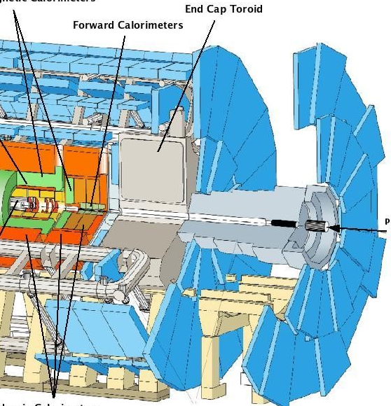
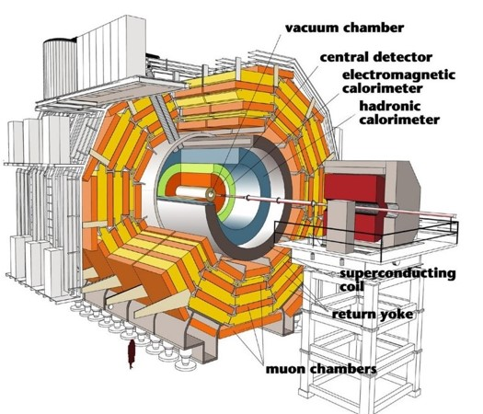
LHC Higgs discovery
At LHC, the two general purpose detectors adopted very different solutions for electromagnetic calorimetry:
ATLAS employed LAr active sampling detectors with unit gain and stable response behind the solenoid magnet.
CMS chose lead tungstate crystals in front of the solenoid, with superior resolution for each block, but a difficult calibration for thousands of crystals.
16

Slide 12
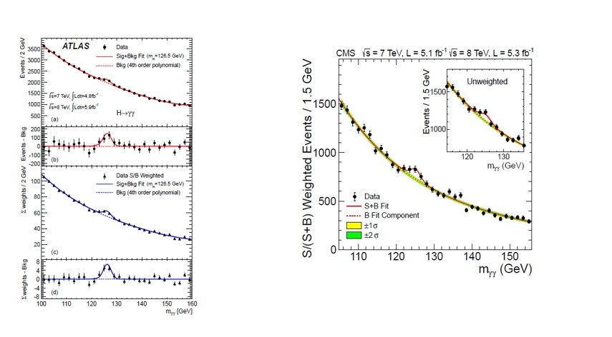
LHC Higgs discovery
The Higgs discovery was made in the decay channels H→ZZ*→4 leptons and H→γγ, using the EM calorimeters. Despite the differences in technology and intrinsic resolution, the resulting γγ peaks were similar.
The orthogonality of the detectors reinforced the solidity of the discovery.
15

Slide 13
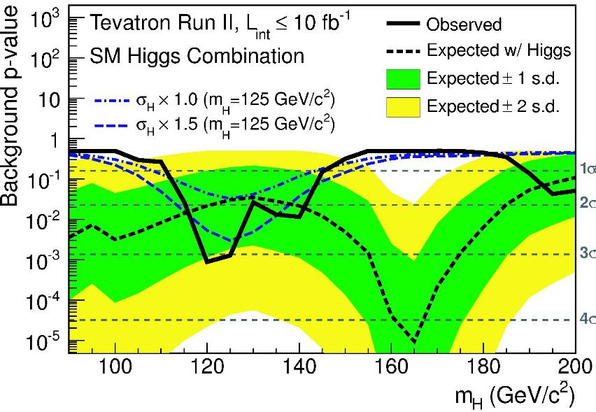
Tevatron Higgs evidence
At the same time that the LHC experiments discovered the Higgs boson in rare bosonic decay modes, the Tevatron experiments combined their data on W/Z+H production with H→bb – the dominant decay.
Neither experiment could make a claim on their own, Only when taken together could CDF and D0 reach 3σ evidence.
The combination of two detectors promoted a marginal result to Evidence.
14

Slide 14
Instances where a second experiment corrected a mistaken observation by the other experiment
13

Slide 15
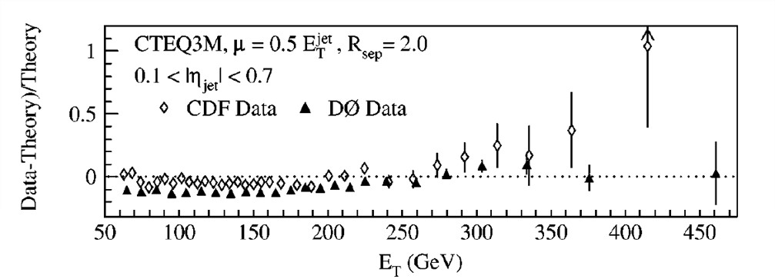
Inclusive jet production at high p_{T}
In 1996, CDF reported an excess of jets at large p_{T} (as would be expected if quarks had substructure). The subsequent D0 result showed good consistency with QCD prediction.
12

Slide 16
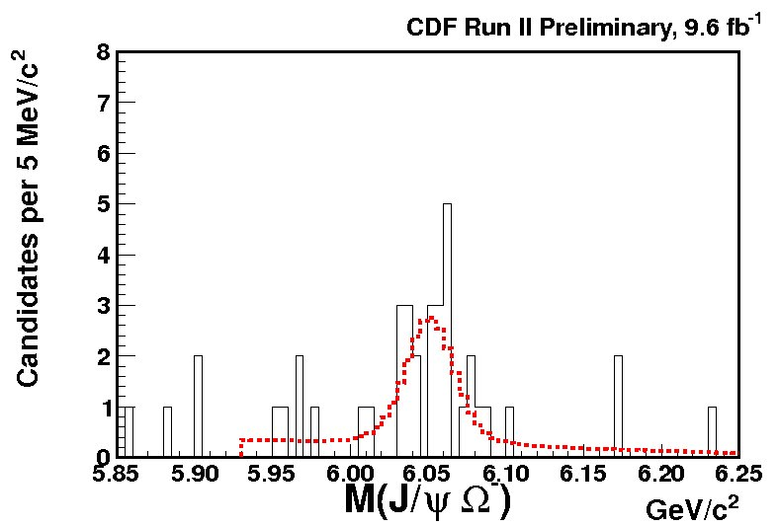
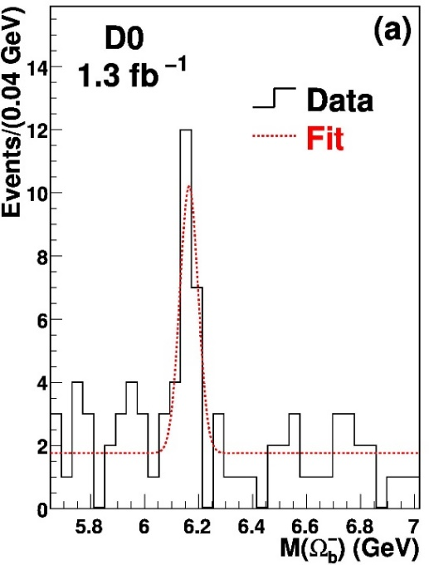
Omega-b observation
D0 published observation of the Ω_{b} baryon (ssb) with M=6165 ± 16 MeV. With more data CDF (and then LHCb) observed Ω_{b} with M=6048 ± 4 MeV. With added data, D0 did not see the Ω_{b} and produced a public note:
We found no mistakes, but in view of CDF/LHCb results,
our result should be disregarded.
D0 claim
11

Slide 17
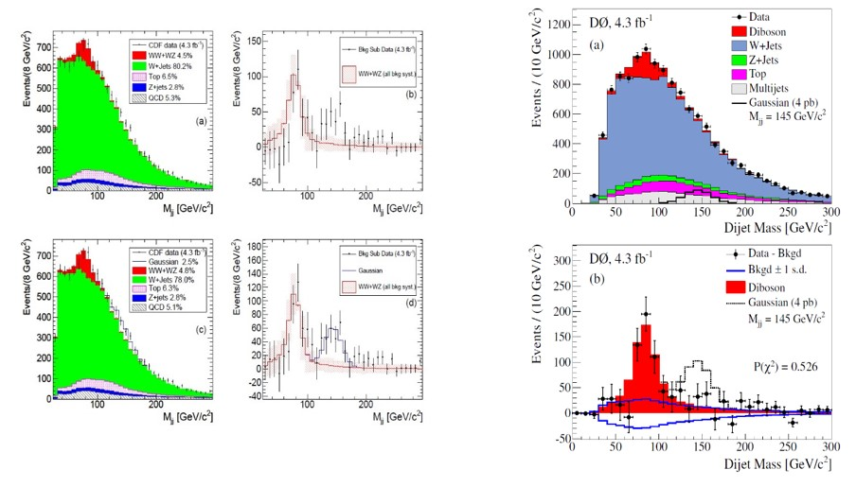
Dijet resonance
In 2011, CDF announced evidence for a dijet resonance at M_{jj} = 145 GeV produced in association with a W boson.
A subsequent D0 analysis ruled out such a state at likelihood of <10⁻⁵
10

Slide 18
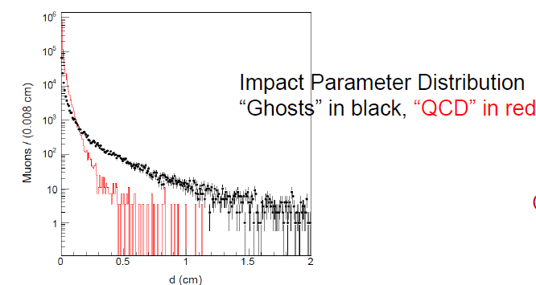
Ghost muons
CDF observed displaced dimuon events that left no tracks within 1.5 cm of the primary vertex that were in significant excess over what would be expected for SM QCD muon production, π/K decays, hadronic punchthrough.
D0’s analysis with similar selections found an insignificant excess (0.4±0.6%) of such events, consistent with expectations.
In several cases, independent measurements provided critical protection against incorrect results
9

Slide 19
Instances where a one experiment had a unique capability such that the second experiment could not corroborate
8

Slide 20
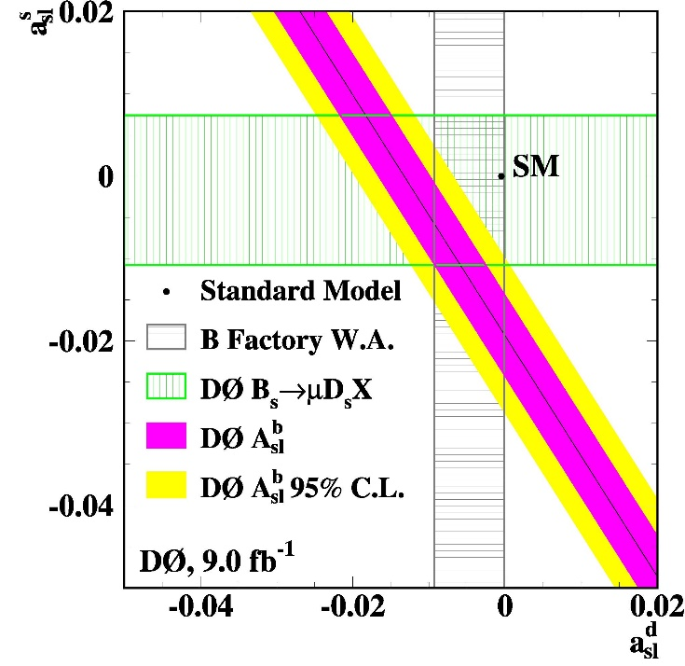
CP violation in B_{d} and B_{s} decays
The asymmetry of positive and negative leptons in semileptonic decays of B_{s} and B_{d} is a measure of CP violation in the weak interaction.
A related CP observable is the asymmetry between μ⁺μ⁺ and μ⁻μ⁻ final states arising from BB production and mixing.
_
D0 was able to control the systematic uncertainties by periodic reversal of both solenoid and muon toroid magnetic field polarities, thus cancelling most false asymmetries.
The resulting dimuon asymmetry was 3.6σ
Without the magnet reversal the measurement was not possible for other experiments. The unconfiremed result remains in limbo.
7

Slide 21
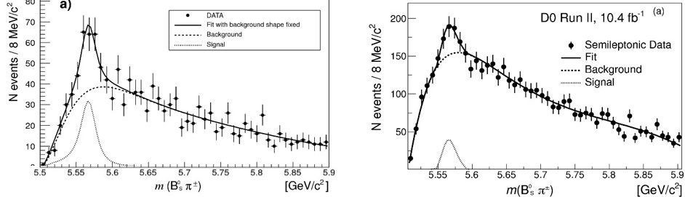
Sighting an exotic bsud meson
Both CDF and D0 (and B and Charm factories, LHC experiments) observed several exotic hadrons (e.g. mesons with qqqq content).
D0 reported observation of a (buds) exotic state X5568) in two distinct decay channels: X→ B_{s}(ψ φ) π and X→B_{s}(μ⁺ D_{s}⁻) π. It looked so solid –
- -
--
Hadronic Bs
Semileptonic Bs
But CDF and LHC experiments did not see it. There is evidence that the dense partonic environment in the LHC can evaporate exotic mesons, and CDF had no forward muon coverage where the D0 signal was strongest.
But the inability to confirm leaves the X(5568) in question
6

Slide 22
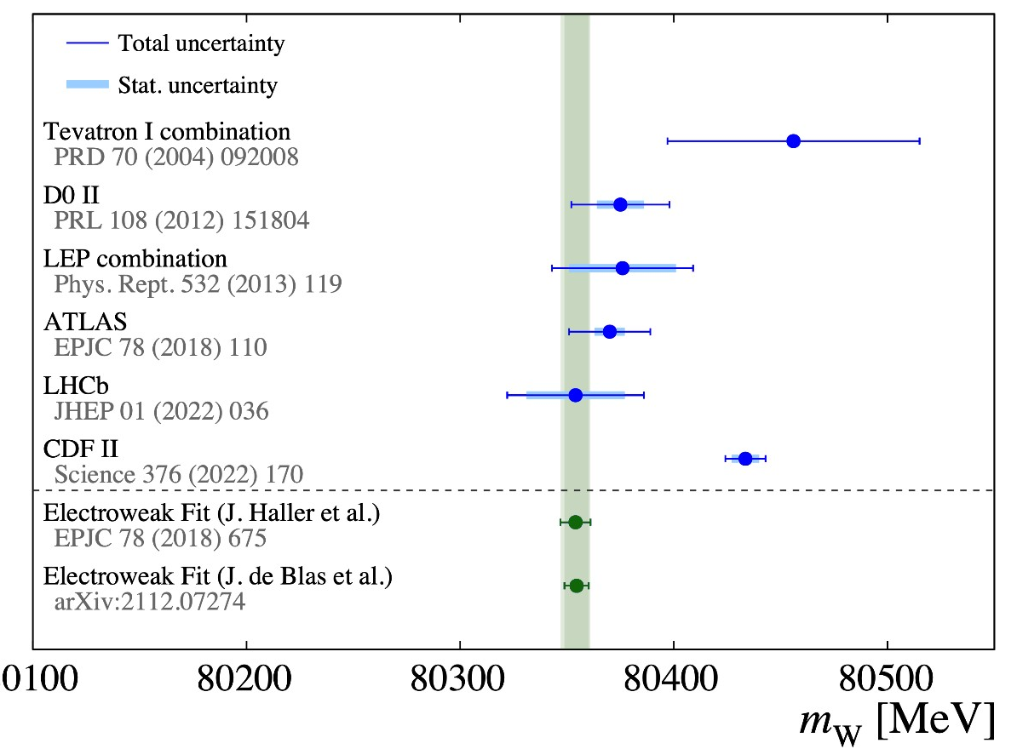
Divergent results on W mass
Prior to 2022, all precision measurements of W boson mass (LEP, CDF, D0 ATLAS, LHCb) were in good agreement.
But in 2022, CDF superseded its previous Run II result with a much more precise measurement that disagreed with the others at the level of 3 – 4σ.
New measurements of comparable precision for cross checking the CDF result are not likely until the advent of future e⁺e⁻ colliders.
Thus considerable uncertainty remains on how to interpret the new result
5

Slide 23
Some summary comments
4

Slide 24
Complementary technologies can be very important in verifying new discoveries.
Two competitive and independent collaborations make vigorous confirmation of each other’s new results and weed out erroneous claims.
Independent analyses and some degree of skepticism within a single collaboration could be useful. But the ethic of seeking a common voice within collaborations tends to suppress internal dissent.
Perhaps the strongest benefit of two experiments is the complementarity and competitiveness of two groups of people, inventing new techniques, algorithms, etc.
A second detector a bit later than the first may be OK – the machine performance gains with time.
3

Slide 25
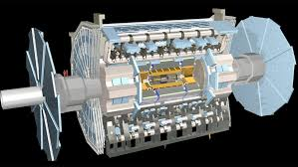
I would suggest that even if two physical detectors cannot be afforded, having two independent collaborations – each fed raw data from the single detector through a big Tee, with each performing their own software development, calibrations, analysis methods etc. independently – would retain a large fraction of the benefit of having two experiments.
Collaboration
ALPHA
Collaboration
OMEGA
(Such a scheme would have corrected the mistaken observations discussed above, and would have provided verifications of the discoveries to reasonable extent.)
2

Slide 26
The benefit of two experiments is large.
Complementary results give needed confidence for validating discoveries or verifying unexpected results.
Since any one experiment will be wrong some of the time, having only one detector compromises the program.

