Slide 1

Flash Talk: Rare Isotope Production and Detection at the EIC
brynna Moran
Other Collaborators: Barak Schmookler, Ben Collis, Abhay Deshpande, Zach Finger, Ciprian Gal, Mark Harvey, Isaiah Richardson, Oleg Tarasov, Pawel Nadel-Turonski
1st International Workshop on a 2nd Detector for the EIC

Slide 2
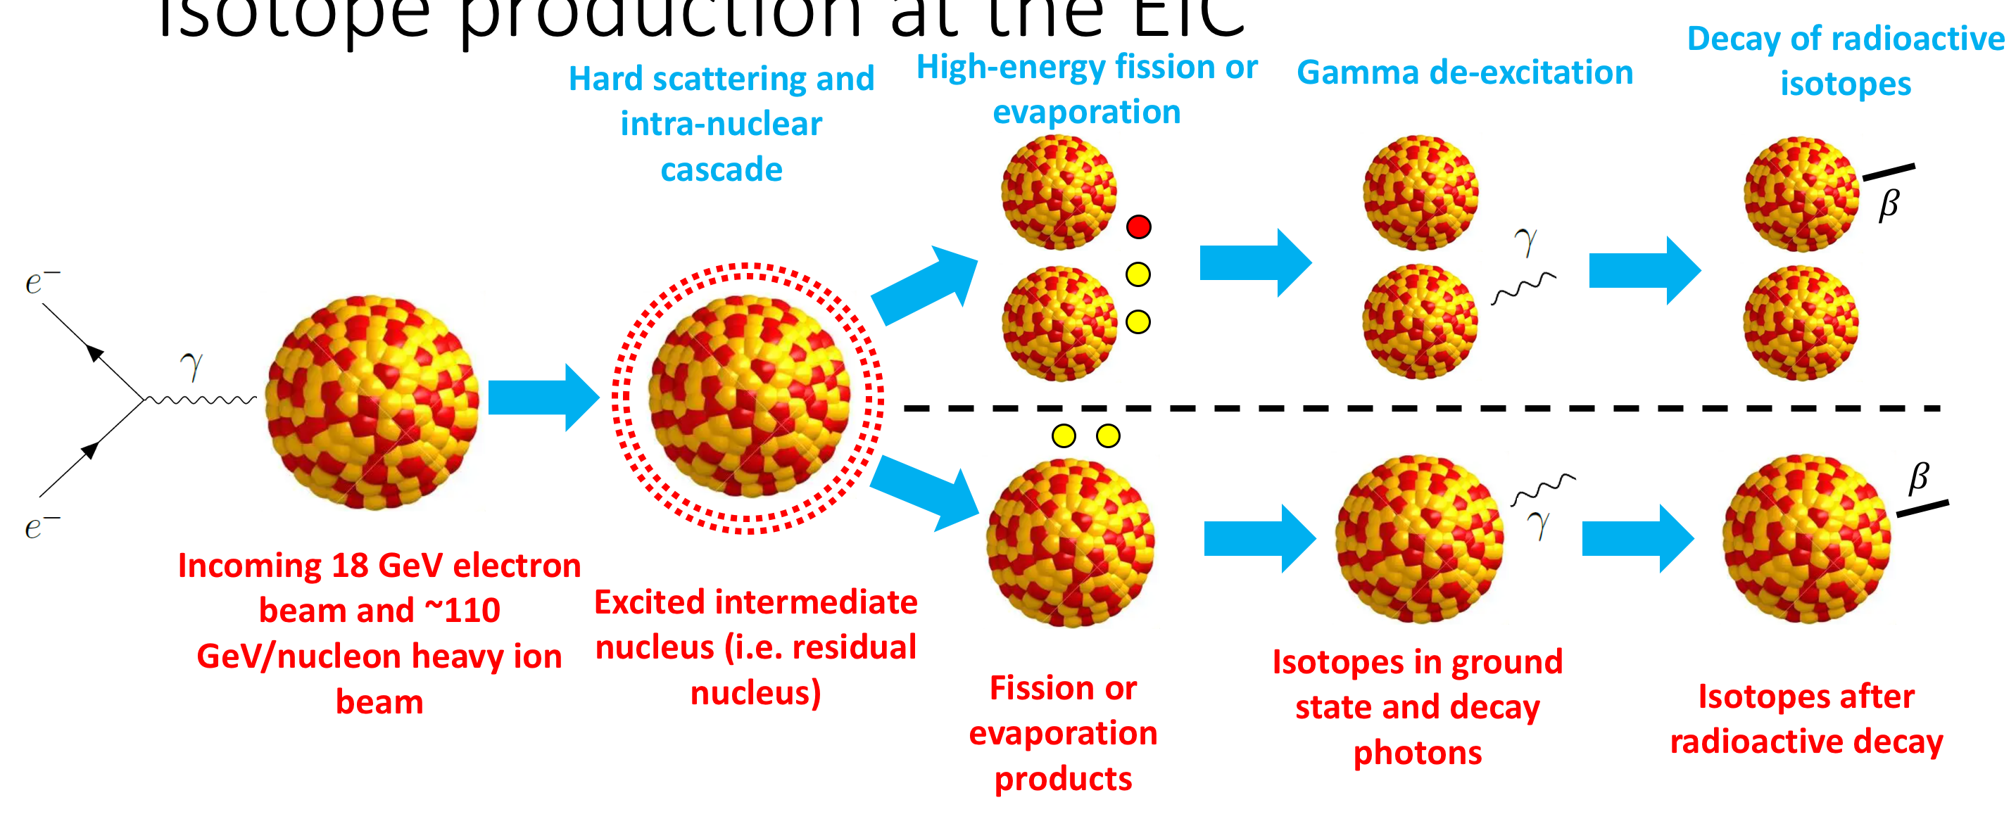
Why do we care about rare isotopes?
Decay of radioactive isotopes
Process:
    →
EIC energy scale means gamma decay of short-lived exotic nuclei will be detectable, unlike dedicated facilities
Survey-type experiment: aid in Abrasion-Ablasion models
  Ex. Hadron formation time

Slide 3
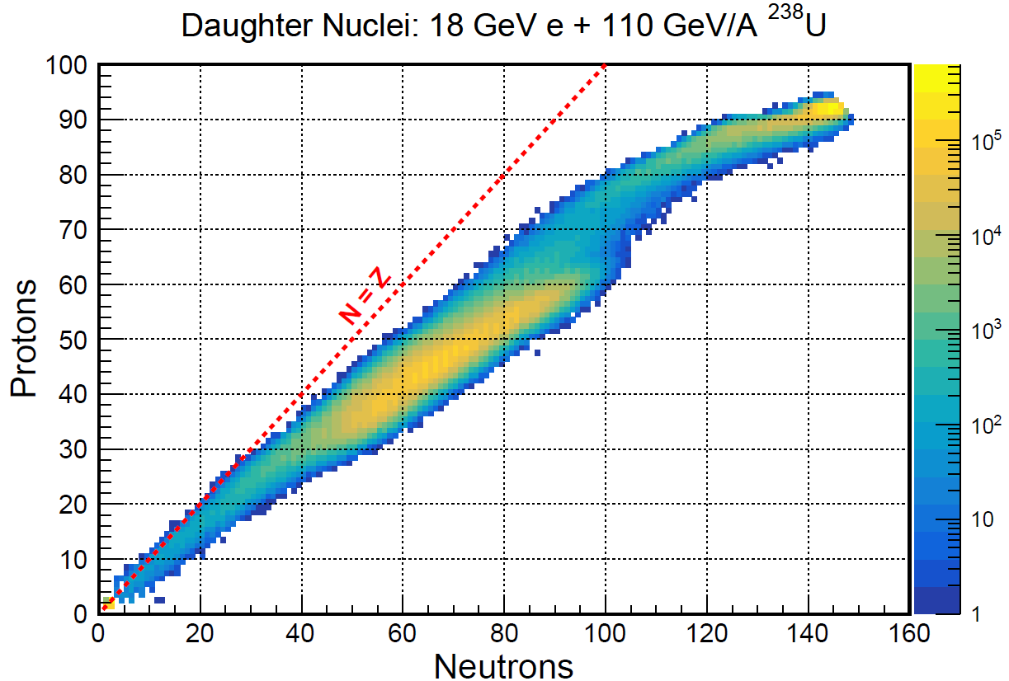
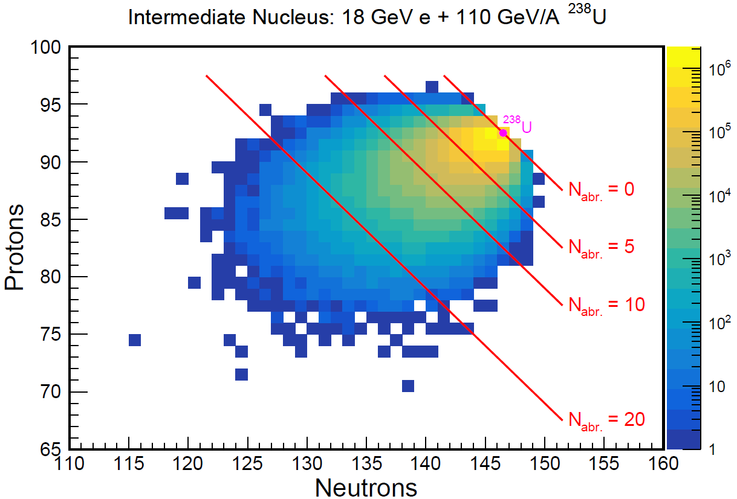
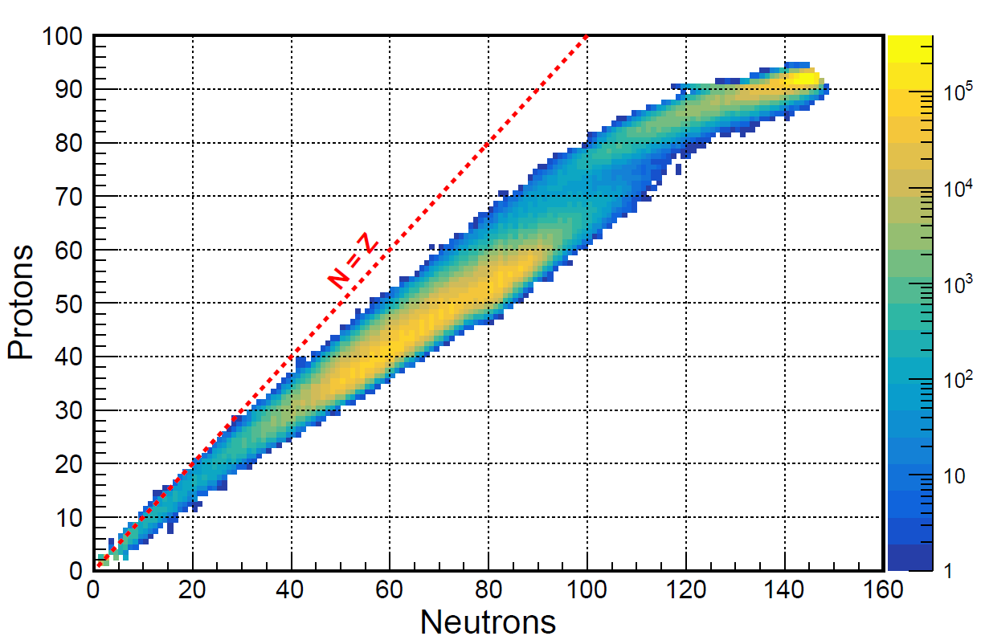
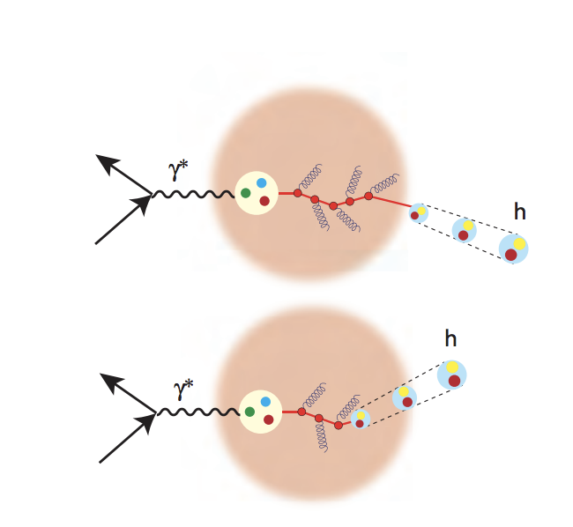
Work so far:
FLUKA
Production studies with BeAGLE and FLUKA/ABLA07
  Rare isotopes are being created!
  From FLUKA -> ²⁰⁷Th
Initial BeAGLE Parameters: : 10 τ₀, 10 Generations, 3 Shadowing
  τ₀ → Hadron formation time (in femtoseconds)
  Generations →If hadron forms inside nucleon, generation parameter describes how many times we allow for re-interaction
  Shadowing →Describes the method software models nuclear shadowing (either models the DIS interaction as point-like or allowing multiple nucleons to be hit)
ABLA07
Intermediate excited nucleus via BeAGLE
Daughter fragments via FLUKA (top) and ABLA07 (bottom)
Effect of changing BeAGLE initial parameters

Slide 4
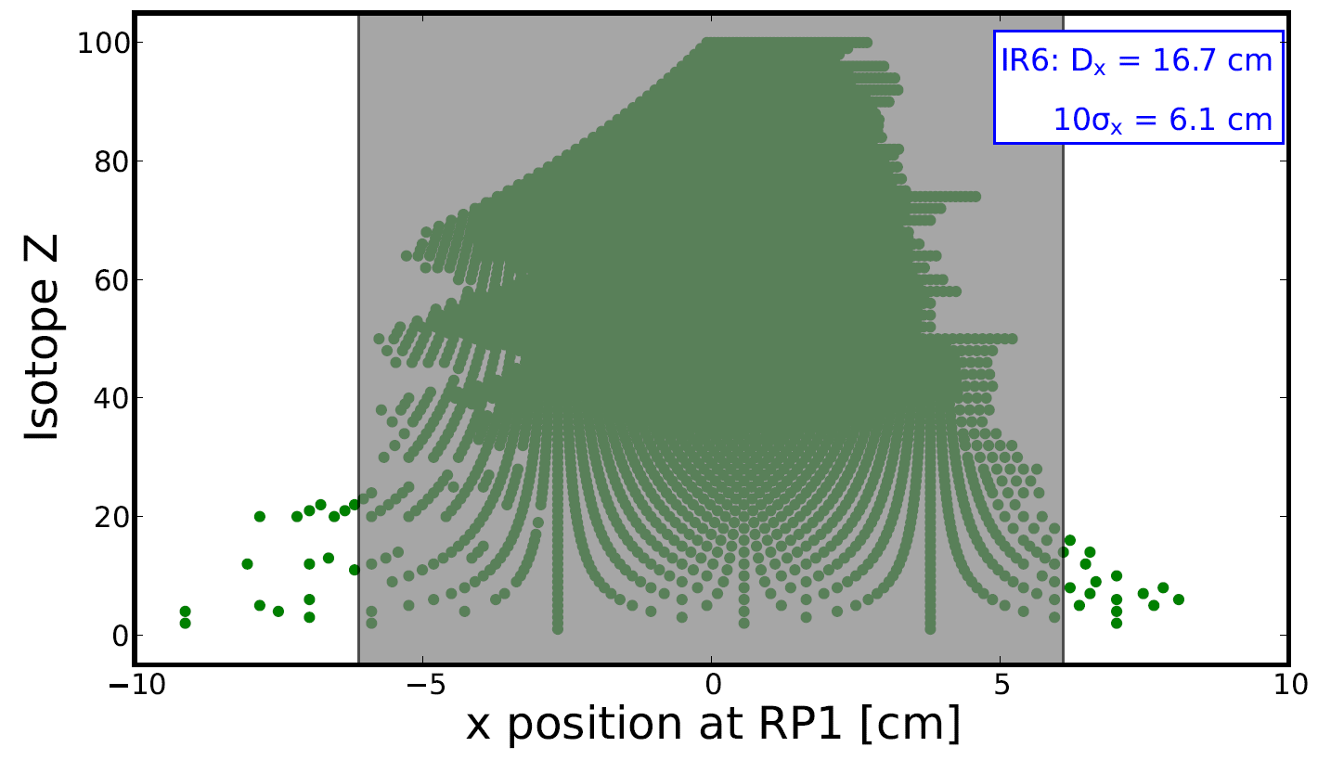
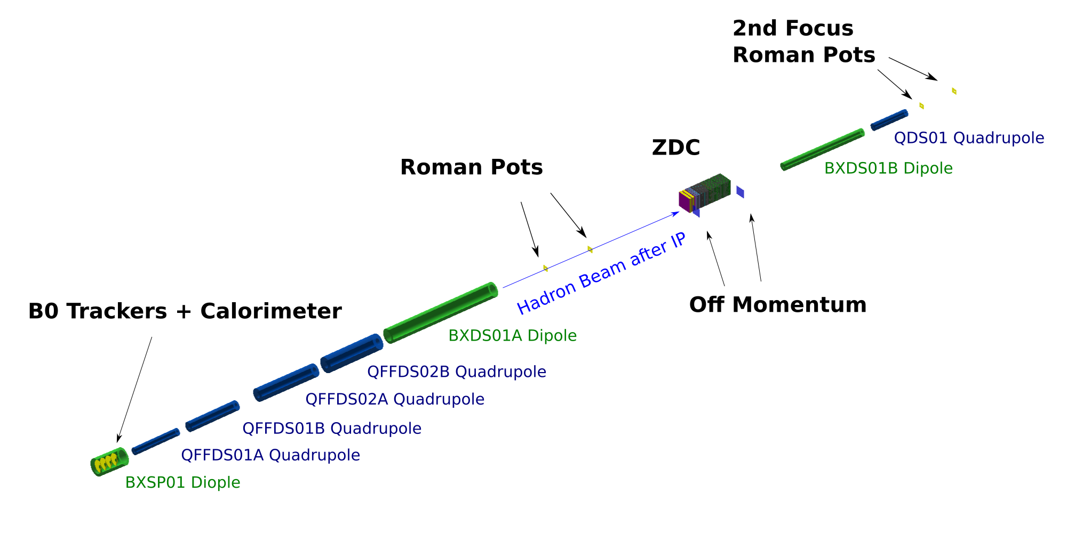
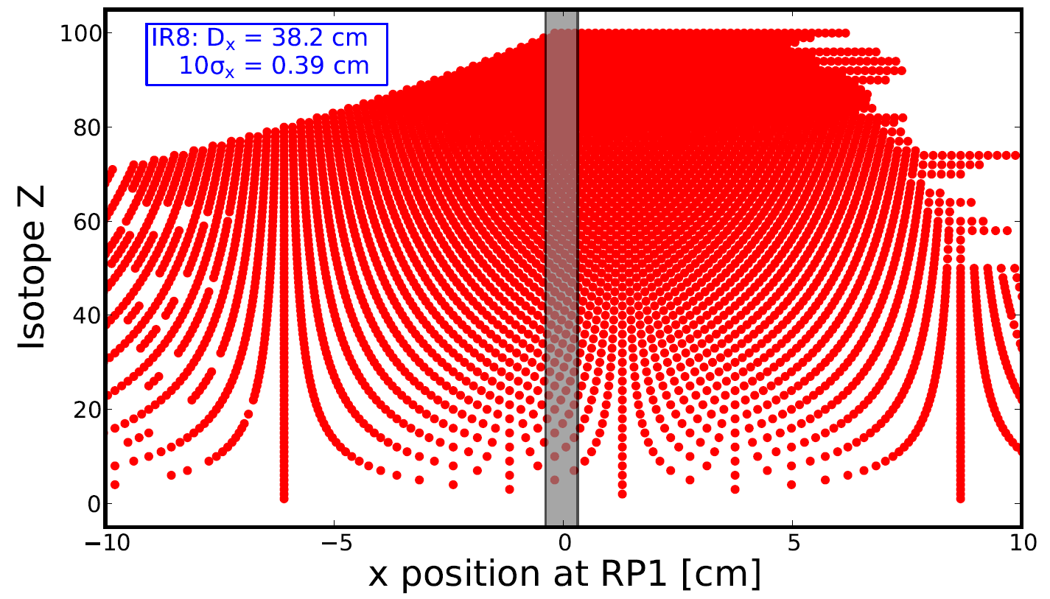
Work so far:
IR6
Detection in Far Forward Region with Fun4ALL
A determined by Roman Pots, Z by Cherenkov detector,
𝛾 decay from ZDC
2nd focus allows us to identify these
fragments
IR8
IP8 Far Forward Region layout we used

Slide 5
Next Steps
Initial detection studies in IP6 → now redo in IP8!
ZDC Energy resolution → Work ongoing
More work on residual nucleus excitation energy spectrum and production rates, including collaboration with experts from FRIB using the software LISE++

