Slide 1


Passive bi-Polar Grid for Ion Back-Flow suppression
  E. Shulga
arXiv:2007.13616, IEEE:9279256
Measurement of the ion blocking by the passive bi-polar grid
E. Shulga (1), Vladislav Zakharov (2), Prakhar Garg (2), Thomas Hemmick (2), Alexander Milov (1) (1) Weizmann Institute of Science
(2) Stony Brook University

Slide 2
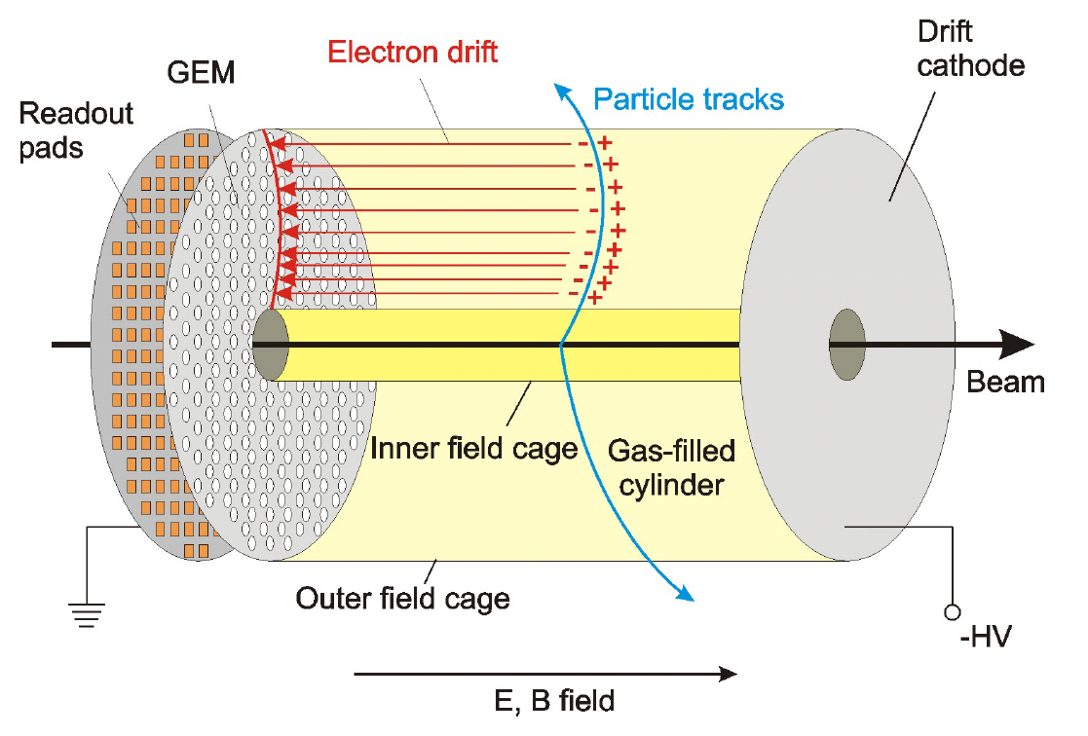
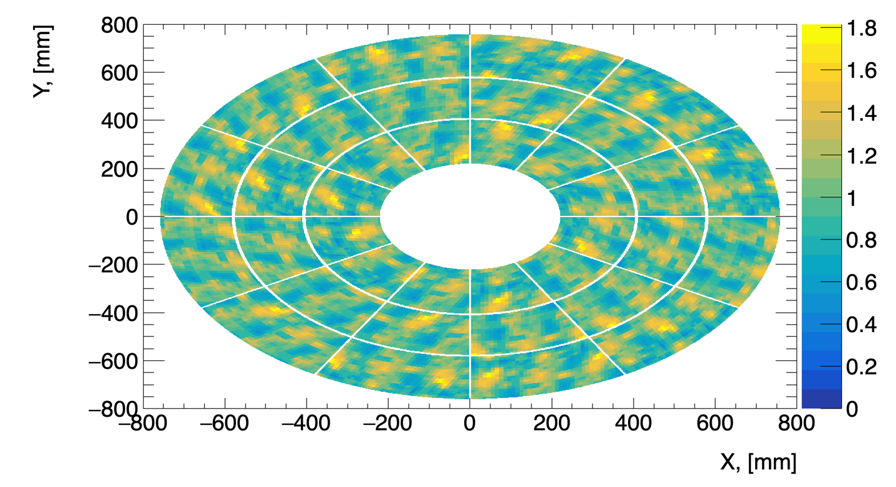
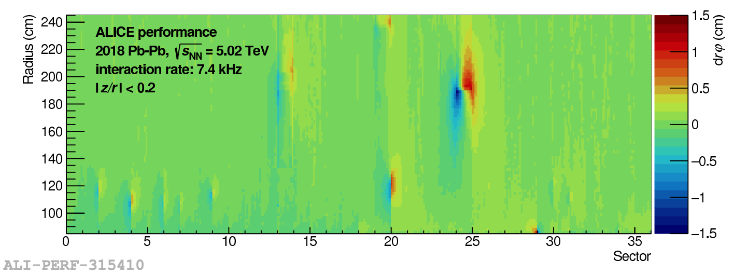
Space charge effects
Space charge (SC) is formed in the TPC
Electric fields are distorted due to SC
Tracking performance is affected
95 % of SC is Ion Backflow (IBF)
Minimization of IBF is our goal
ALICE Pb-Pb 𝞅 distortion measurements

Slide 3
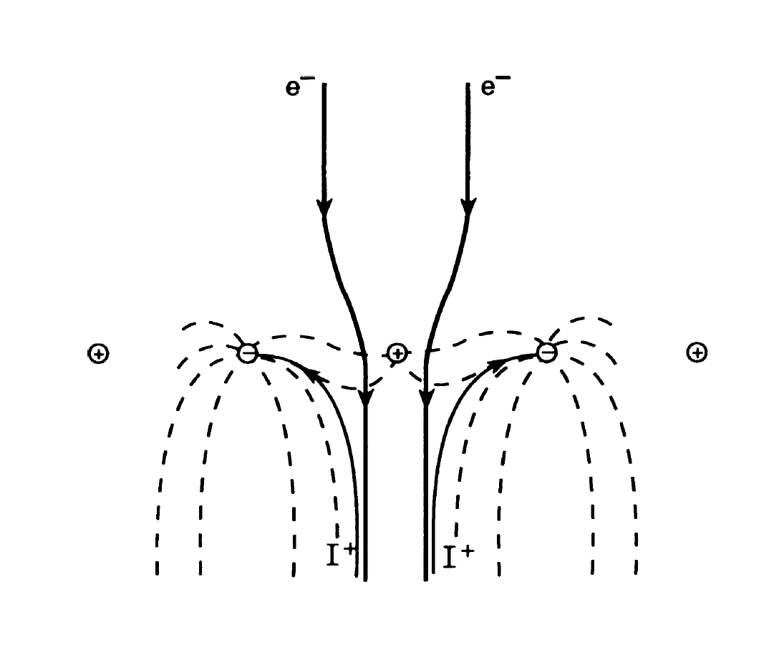
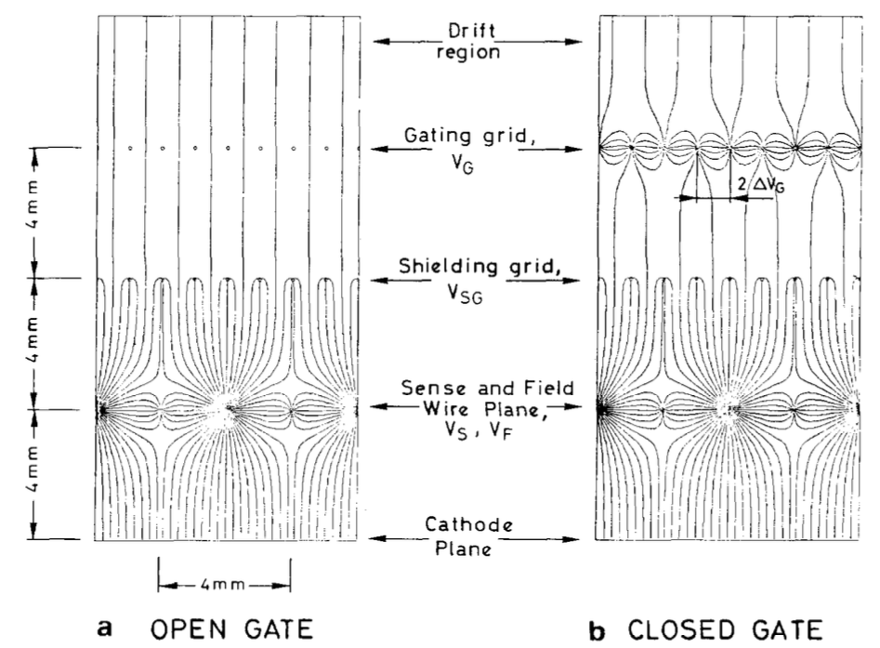
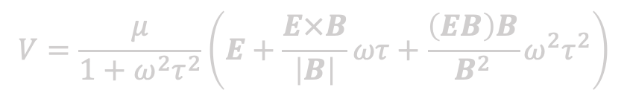
Gating grid: static mode
Standard approach: gating
However!
In 1985 it was shown that gating grid technique can be improved in case of high magnetic field:
  Amendolia, Blum et al “Influence of the magnetic field on the gating of a time projection chamber”
  https://www.sciencedirect.com/science/article/pii/0168900285908071
$$V=\frac{μ}{1+ω^{2}τ^{2}}\left(E+\frac{E×B}{\left|B\right|}ωτ+\frac{\left(EB\right)B}{B^{2}}ω^{2}τ^{2}\right)$$
In the presence of magnetic field additional force appears. It is pushing electrons along and through the mesh wires.
The mesh could be configured such, that majority of electrons pass through, and ions are blocked.

Slide 4
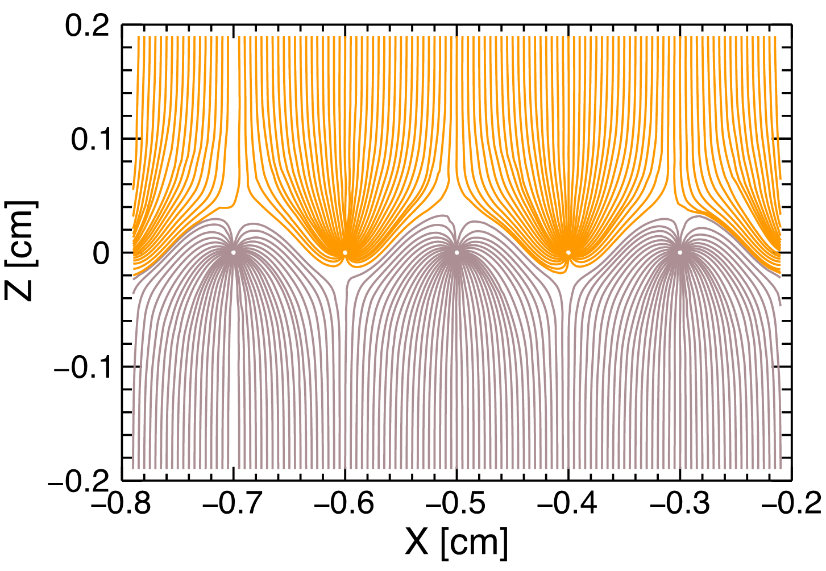
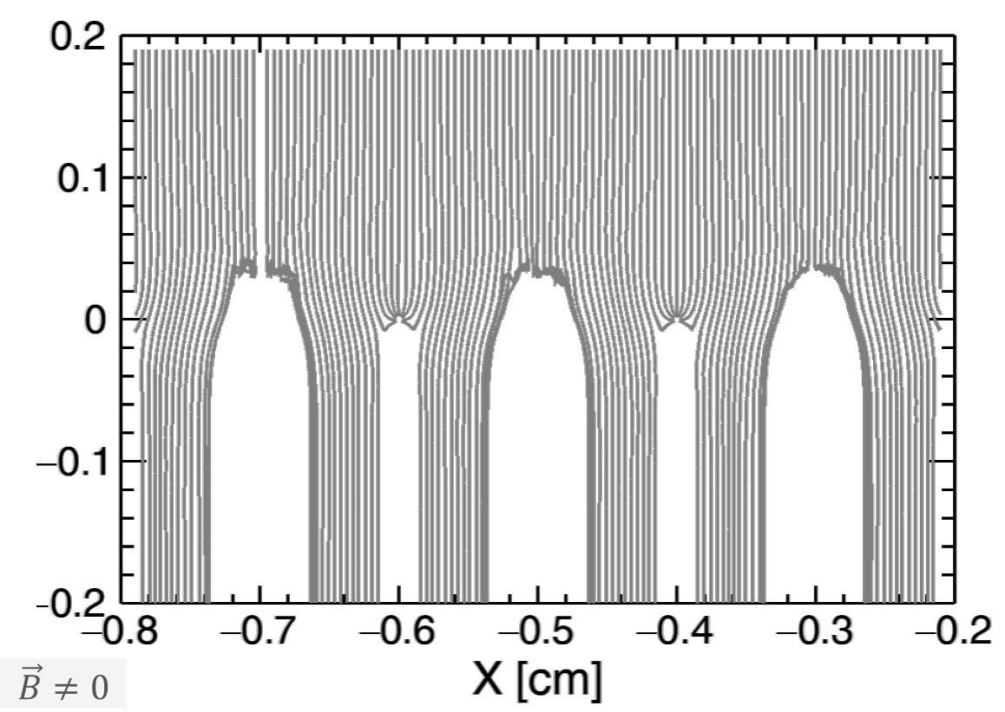


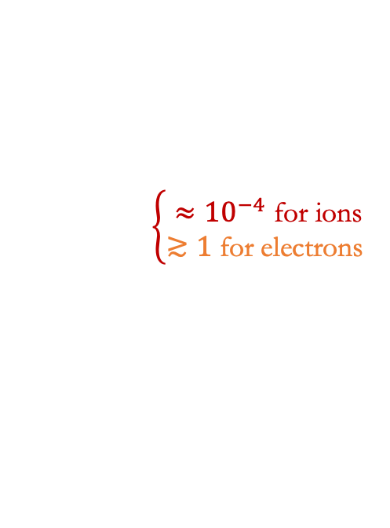

Gating grid: static mode
Gating grid can be optimized to collect ions and be transparent to electrons:
GARFIELD++ simulations
$$\vec{B}>0$$
$$\vec{B}=0$$
$$V=\frac{μ}{1+ω^{2}τ^{2}}\left(E+\frac{E×B}{\left|B\right|}ωτ+\frac{\left(EB\right)B}{B^{2}}ω^{2}τ^{2}\right)$$
with
µ = mobility,
$ω=\frac{eB}{mc}$ (cyclotron frequency),
$τ=τ\left(E\right)$ (mean collision time),
$B=\left[0,0,B_{z}\right]$.
$B_{z}$>1 T is required (sPHENIX and future experiments)
$$\left\{\begin{aligned}≈{10}^{−4} \text{for} \text{ions} \\ ≳1 \text{for} \text{electrons} \end{aligned}\right.$$

Slide 5
Ion Blocking by the Passive Bipolar Grid
Transparancy =
Ion transparancy =
Results show that IBF can be suppressed down to 0 with a cost of 45% of primary electrons @ B≥1.2 T
Comparison to simulations have been performed, better measured gases provide better results, improvement could be obtained in the future
Beam test is planned @ the Argon National Laboratory to increase magnetic field
Garfield++ simulations have shown good results for Ar/CH4
arXiv:2007.13616
IEEE:9279256

Slide 6
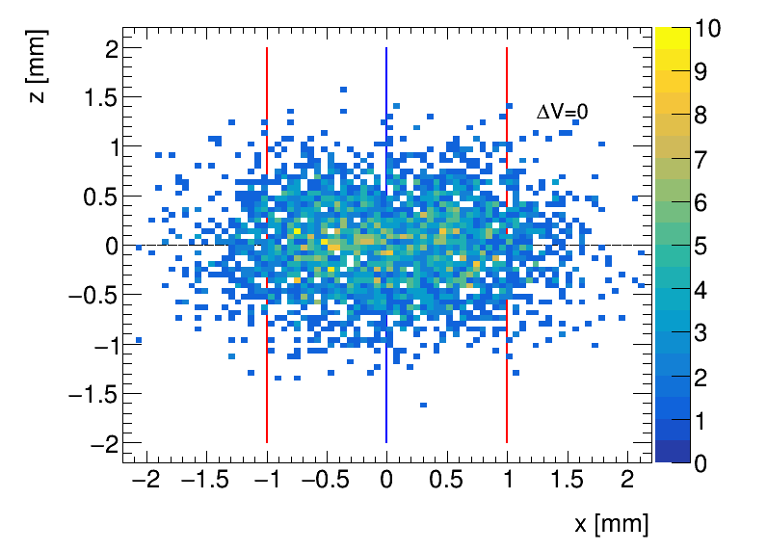
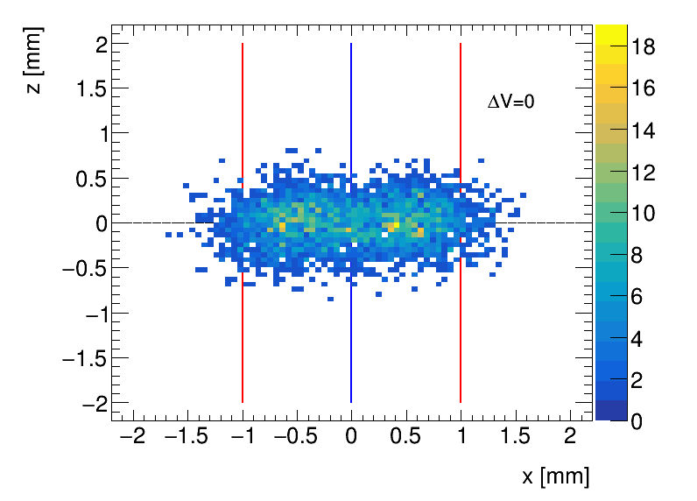
BPG effect on the drift of electrons
Garfield++ Simulations Ar/CH₄ (90:10): 55 µm binning
B=0
B=1.2 T
Garfield++
Linear bias corresponding to Lorentz angle
Produced BPG for the sPHENIX TPC modules for testing @ ANL
Designed a setup with GridPix detector (from Bonn group) to measure the bias

Slide 7
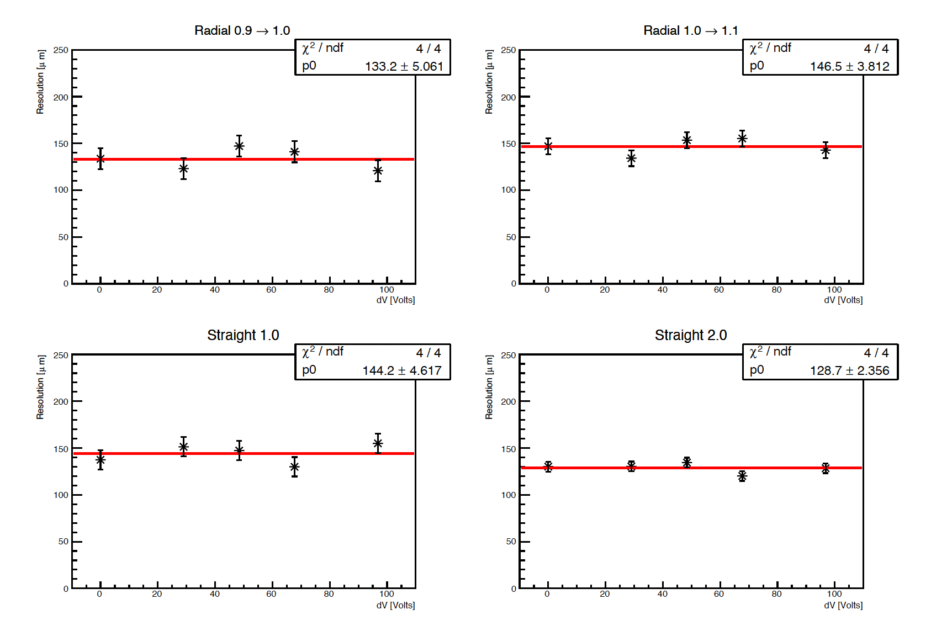
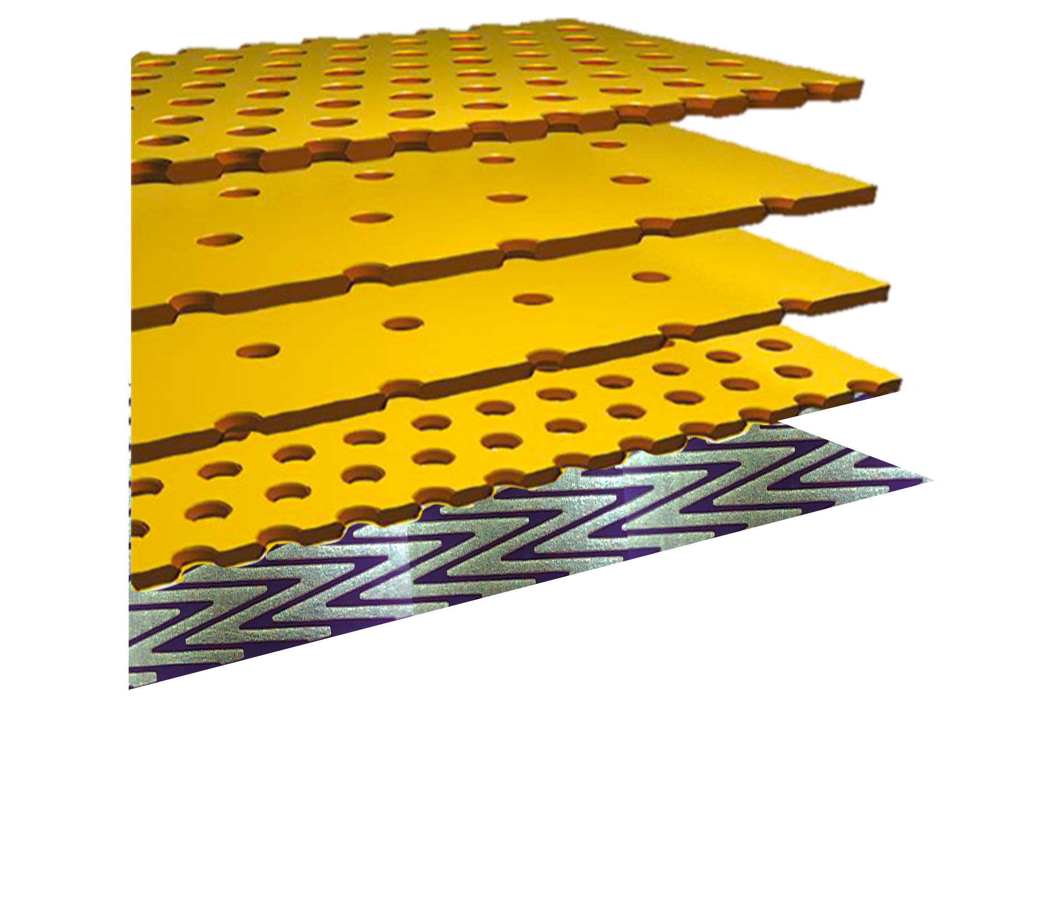
ANL measurements
𝐸_{drift} = 400 V/cm
-𝚫V
+𝚫V
-𝚫V
+𝚫V
𝐸_{transfer} = 600 V/cm
Quad-GEM
1
2
3
4
Zig-zag readout
Measurements at ANL show that application of 𝚫V does not affect track reconstruction resolution using zig-zag pads

Slide 8
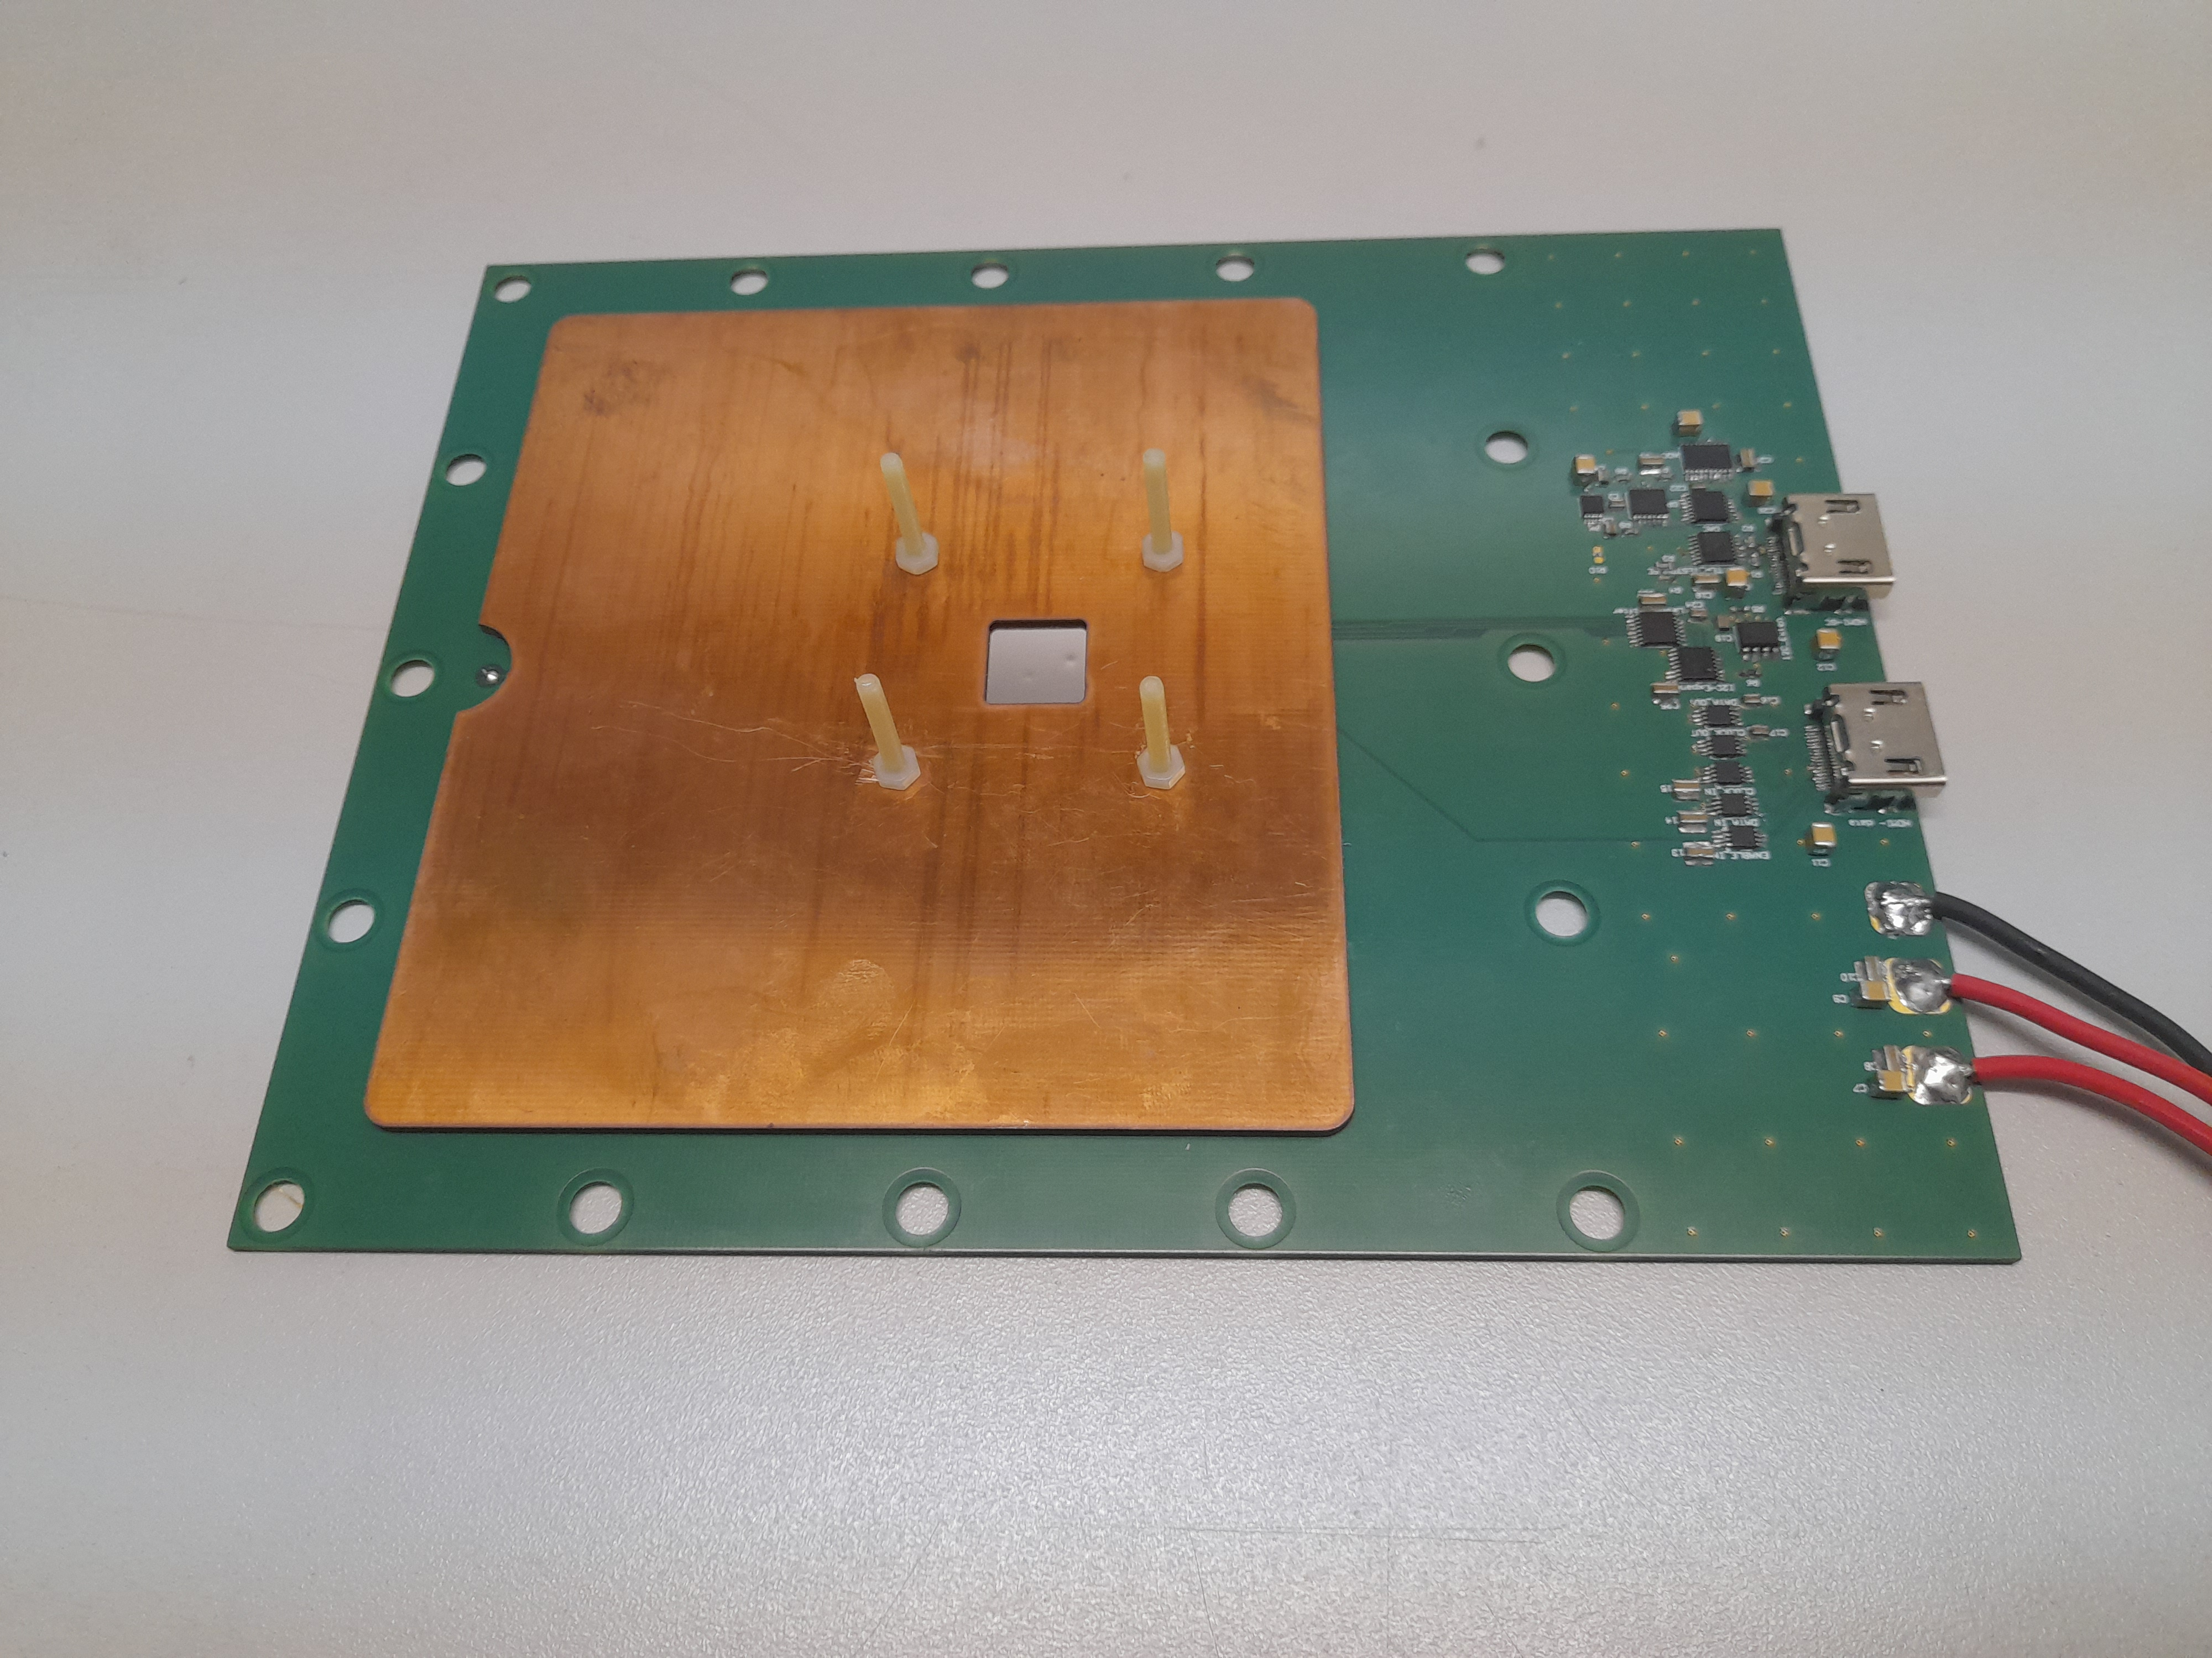
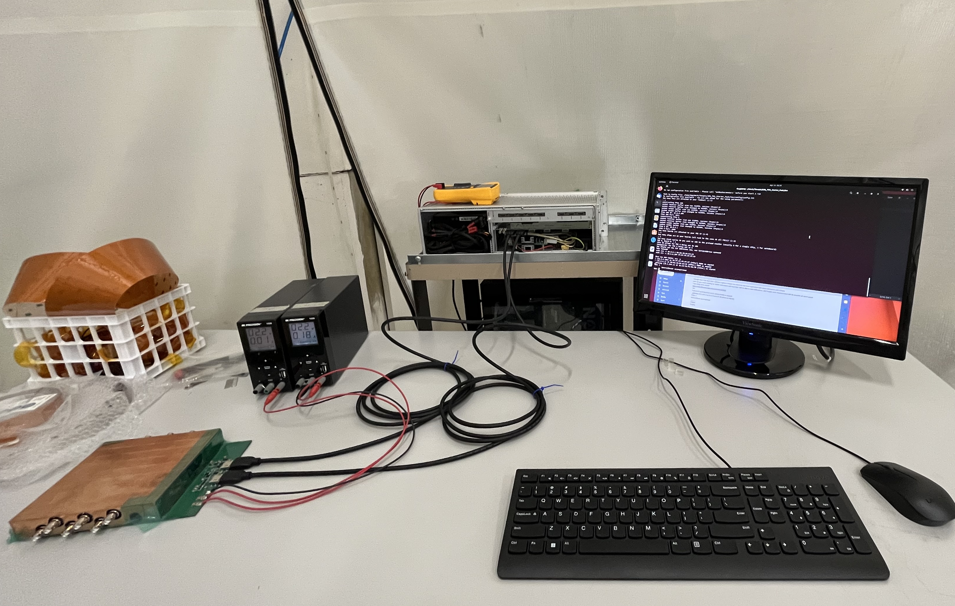

BPG effect on the drift of electrons
GridPix setup
Setup is at SBU (designed in collaboration with J. Kaminsky Bonn)
Setting up DAQ system (SRS) and calibrating the device
Plan to perform measurements in the next few months @ ANL 3 T magnet

Slide 9
Conclusions
Results show that IBF can be suppressed down to 0 with a cost of 45% of primary electrons @ B≥1.2 T (for Ar/CH₄ 90:10)
Recent results from ANL suggest that the resolution is not affected, more studies are planned
The Passive Bipolar grid can be used with any MPGD improving IBF, providing possibility for 0 IBF TPC in the future

Slide 10
Backup

Slide 11
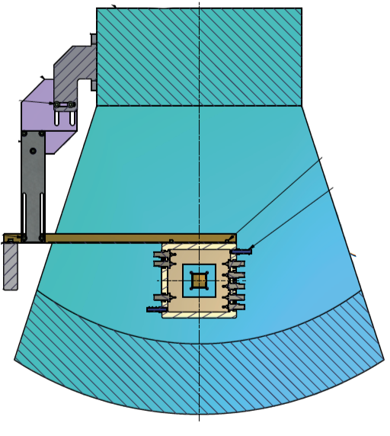
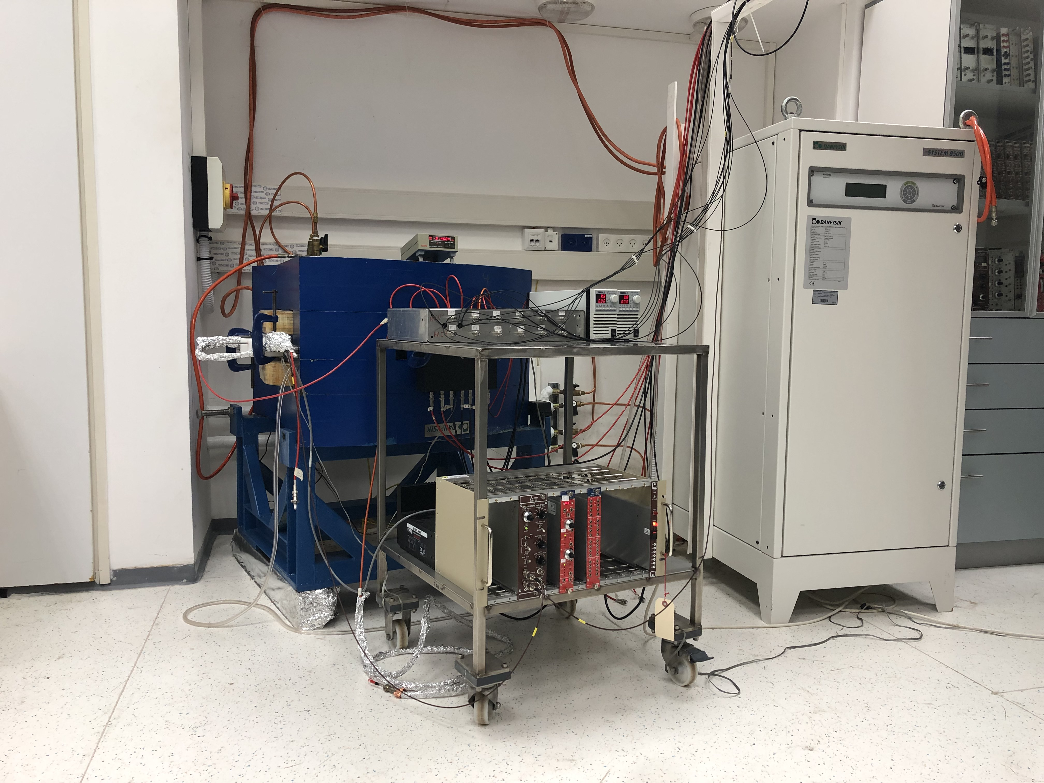
Bi-polar grid: setup
Magnet vs. full setup inside
Magnetic field is up to 1.2 T
The magnet bore size is 32 mm and it was the main limiting factor in our setup
Operation of magnet, CAEN HV modules, MCA, preamplifiers, amplifires

Slide 12
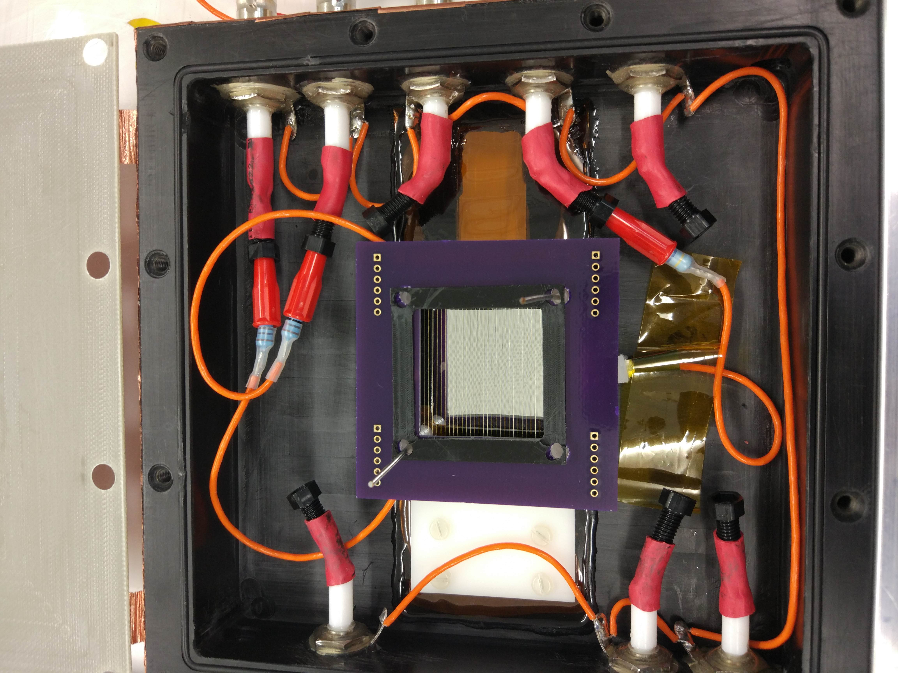
Bi-polar grid: setup
Setup and calibration of gas mixing system
Wire grids winding/gluing/soldering
Design and production of setup, PCBs, readout electrode, HV setup

Slide 13
Ion Blocking by the Passive Bipolar Grid
Results show that IBF can be suppressed down to 0 with a cost of 45% of primary electrons @ B≥1.2 T
Comparison to simulations have been performed, better measured gases provide better results, improvement could be obtained in the future
Beam test is planned @ the Argon National Laboratory to increase magnetic field
Garfield++ simulations have shown good results for Ar/CH4
arXiv:2007.13616
IEEE:9279256

Slide 14
Energy resolution
Electron transparency of the grid is used to estimate energy resolution evaluation due to the presence of the grid above the amplification volume
May 18 2023
E Shulga
14

Slide 15
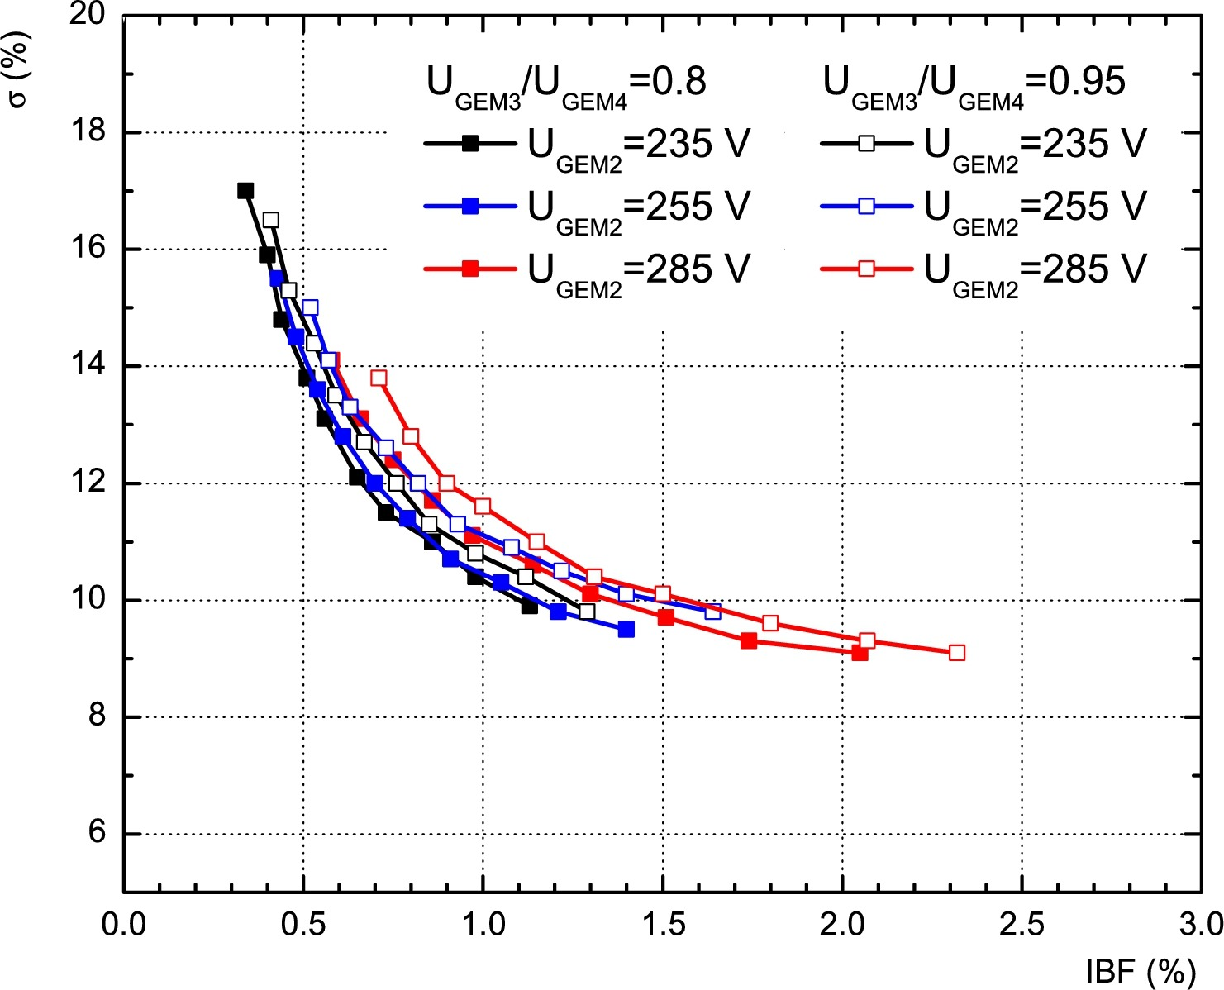
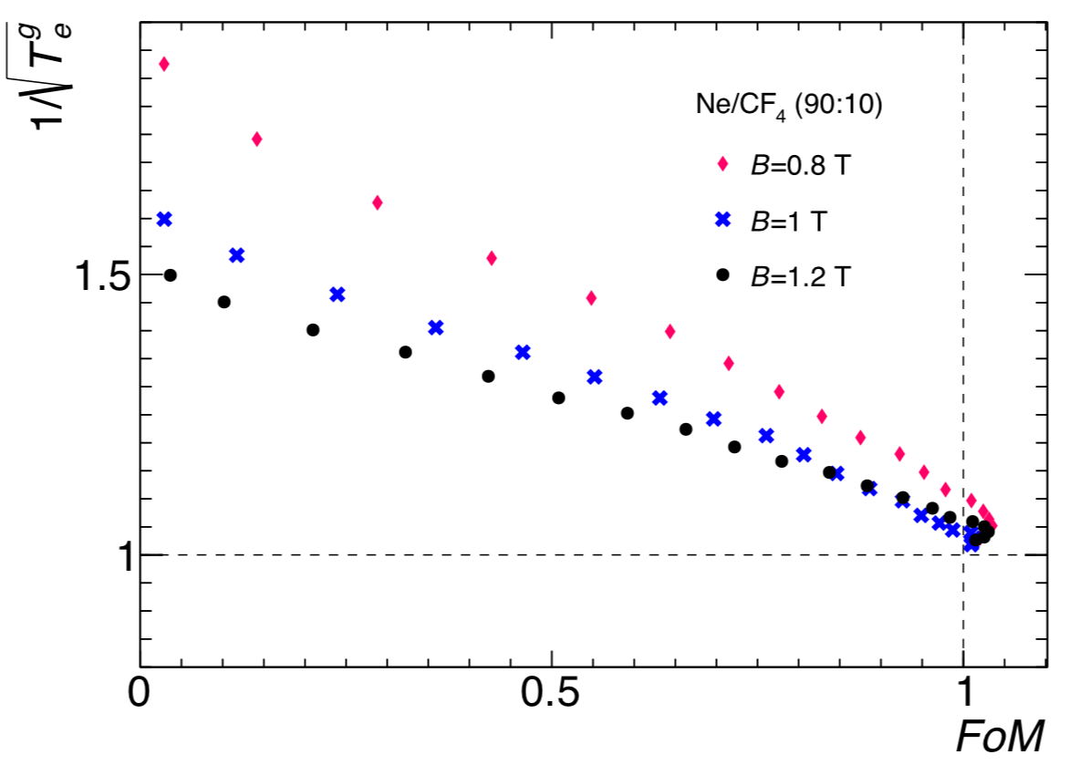
Quad-GEM setup improvement
4-GEM setup can be improved with Bi-polar grid installed in front of it

Slide 16
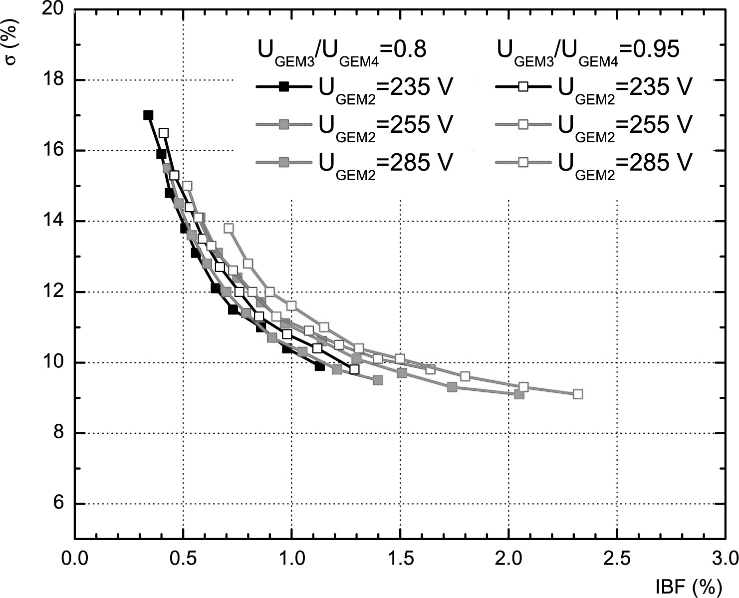
Quad-GEM setup improvement
Any starting point could be improved with reasonable energy resolution loss

Slide 17
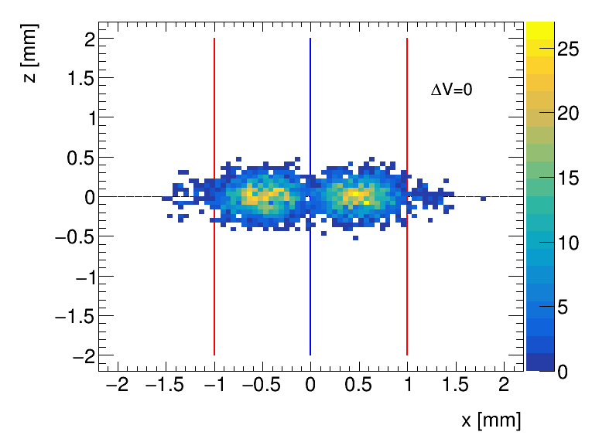
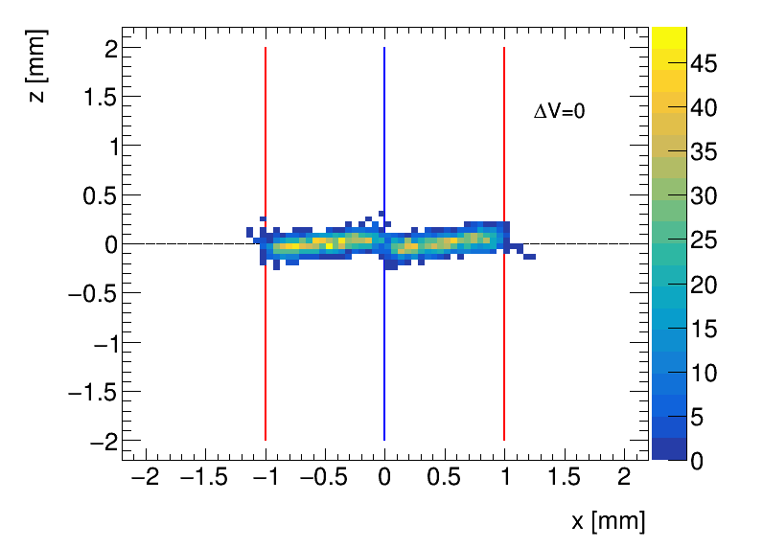
BPG effect on the drift of electrons
Garfield++ Simulations Ne/CF4 (90:10): 55 µm binning
B=0
B=1.2 T
Linear bias corresponding to Lorentz angle
Designed a setup with GridPix detector (from Bonn group) to measure the bias

