Slide 1
Current state and planning for EIC light ion polarization
Haixin Huang (BNL)
on behalf of polarization design team
Workshop: Electron-Nuclei Interaction at EIC
July 7, 2023

Slide 2
Outline
Proton polarization in EIC as Baseline
He-3 polarization in EIC and Snake upgrade
Potential for polarized deuterons
Conclusion

Slide 3
RHIC Polarized Beam Complex
 | Max Energy [GeV] | Pol. At Max Energy [%]
Source+Linac | 0.2 | 82-84
Booster | 2.5 | 82-84
AGS | 23.8 | 67-70 | p-Carbon
RHIC | 255 | 55-60 | Jet, full store avg*
2 Siberian Snakes/ring
Spin flipper
Absolute Polarimeter (H jet)
RHIC pC Polarimeters
PHENIX
* Includes both ramp loss and store decay
STAR
 | Relative Ramp Polarization Loss (Run 17, full run avg)
AGS | 17 %
RHIC | 8 %
Spin Rotators
(longitudinal polarization)
Spin Rotators
(longitudinal polarization)
LINAC
BOOSTER
Helical Partial
Siberian Snake
Pol. H⁻ Source
200 MeV Polarimeter
AGS
AGS Polarimeter
With pulsed skew quads in the AGS (they will be tested for run24), the polarization loss in the AGS will be mostly eliminated.
With precooler at injection and six snakes, it is expected that polarization will be preserved in Hadron Storage Ring (HSR) in EIC.
Strong AGS Snake

Slide 4
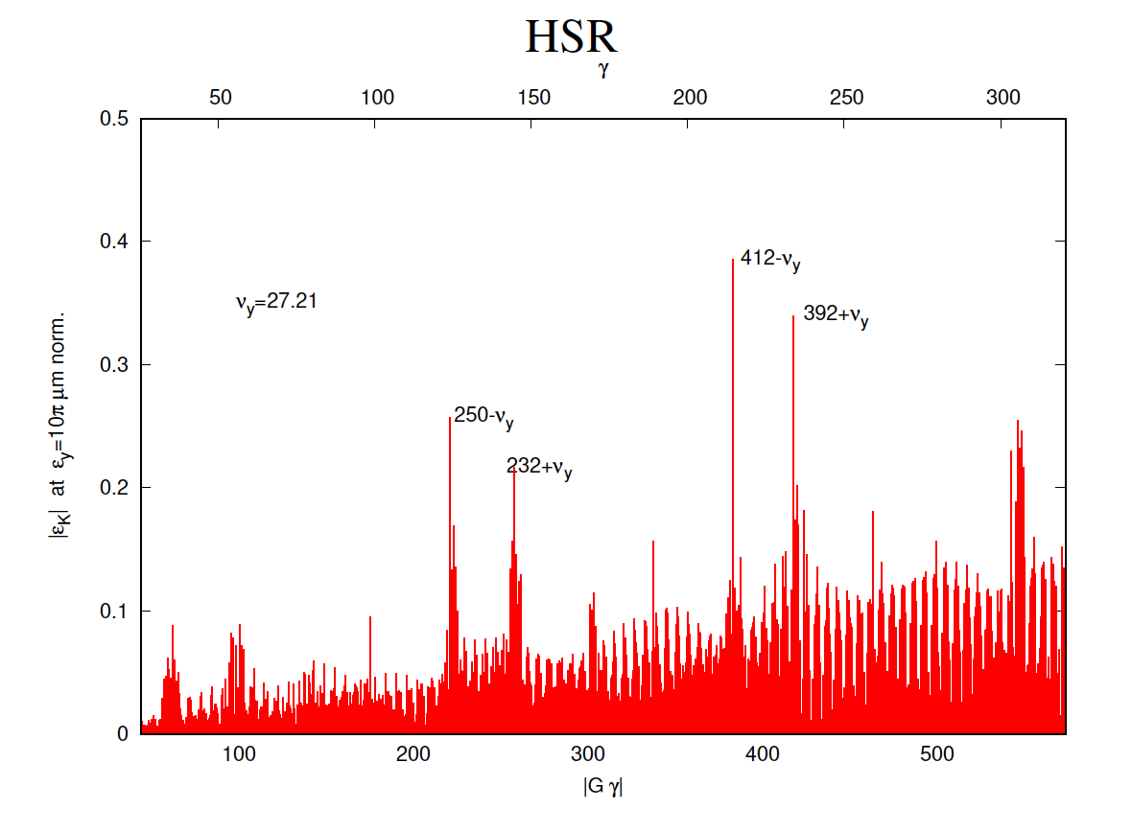
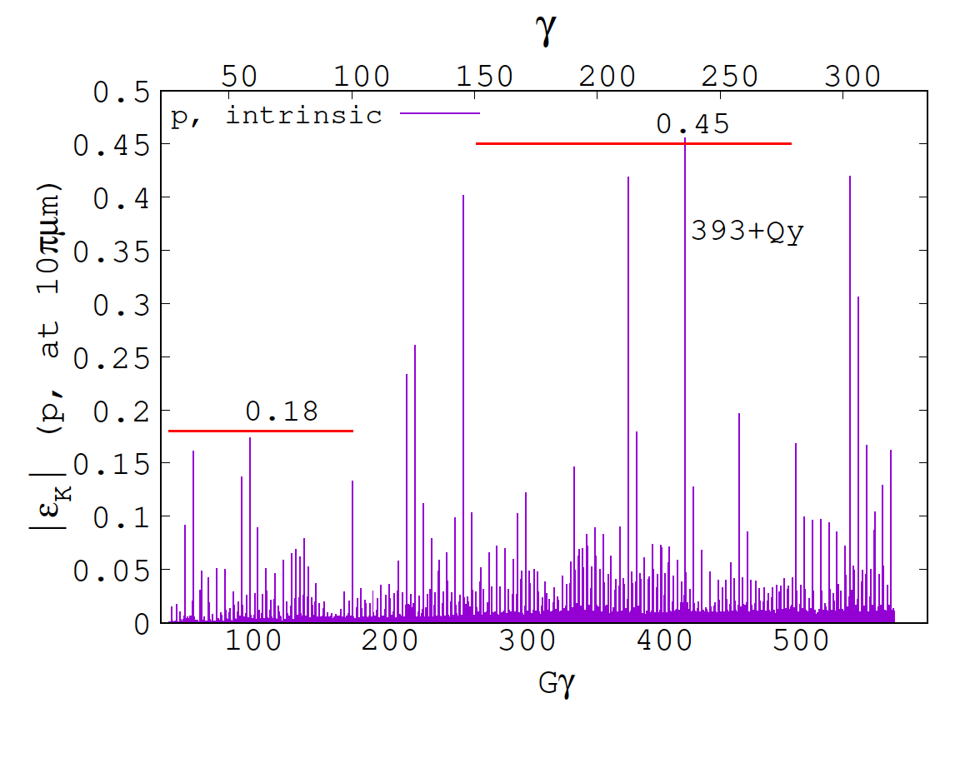
Depolarizing Resonance Strength Comparison
RHIC
Systematic resonances, located at 392+Qy, 412-Qy, 232+Qy, 250-Qy, appear weaker in HSR, compared to RHIC, the reverse occurs for non-systematic resonances, the latter effect could be an indication that the 3-periodicity of former RHIC lattice is in jeopardy in its HSR evolution.
A potential adverse configuration which results regarding resonance crossing, is the presence of wide non-systematic resonances in the direct vicinity of systematic resonances.

Slide 5
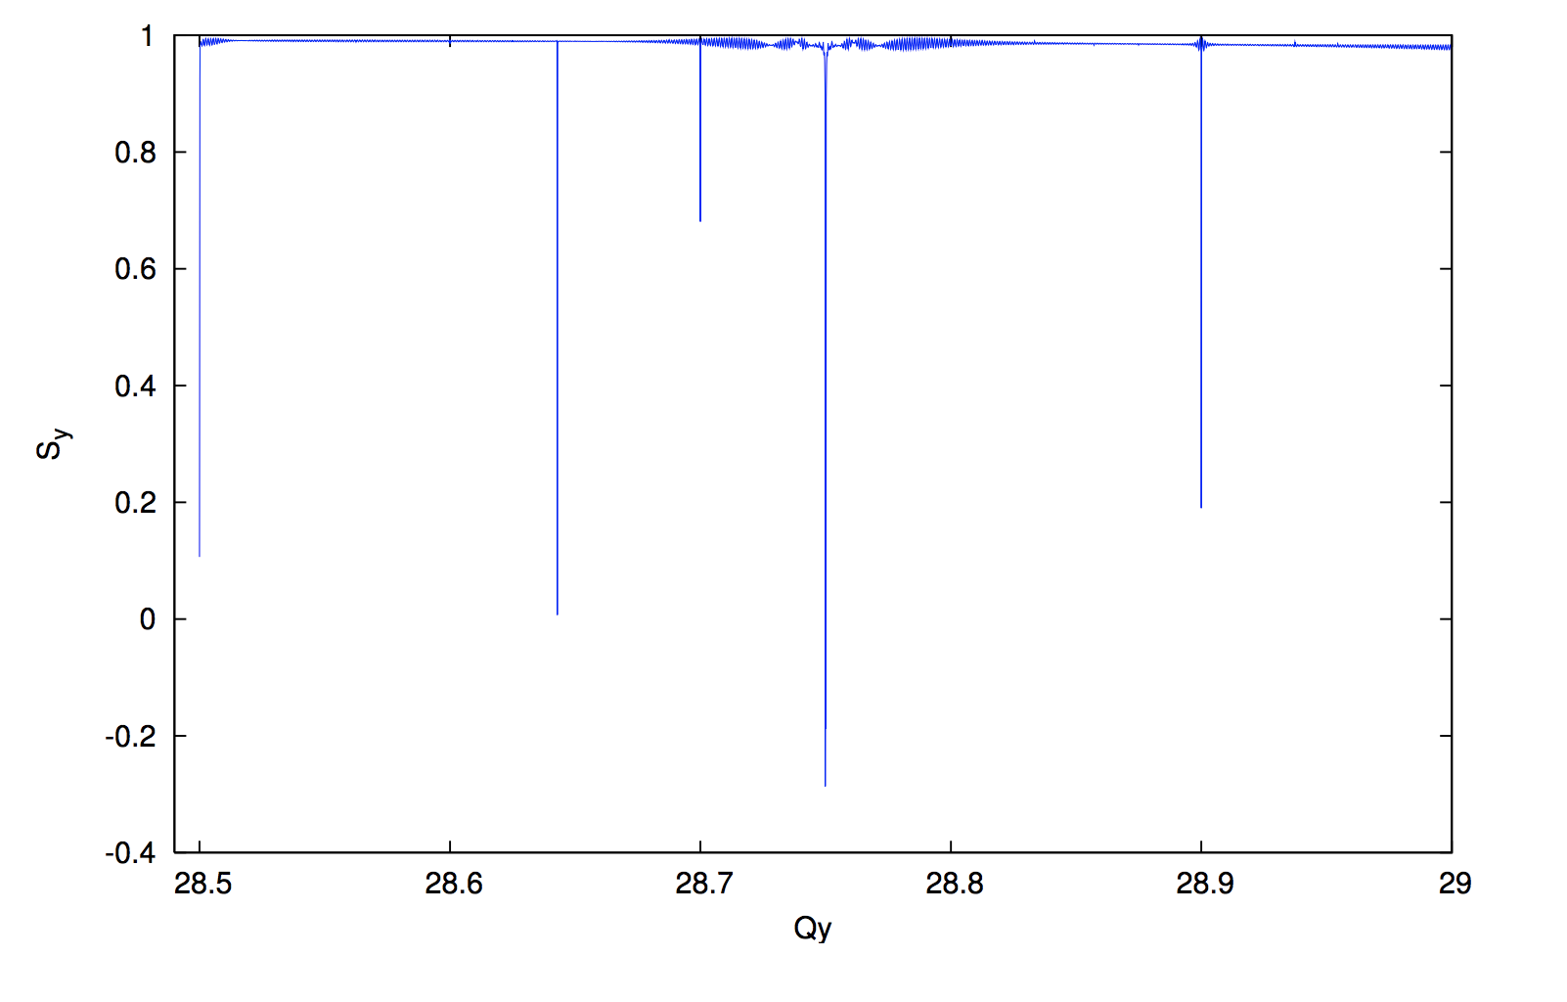
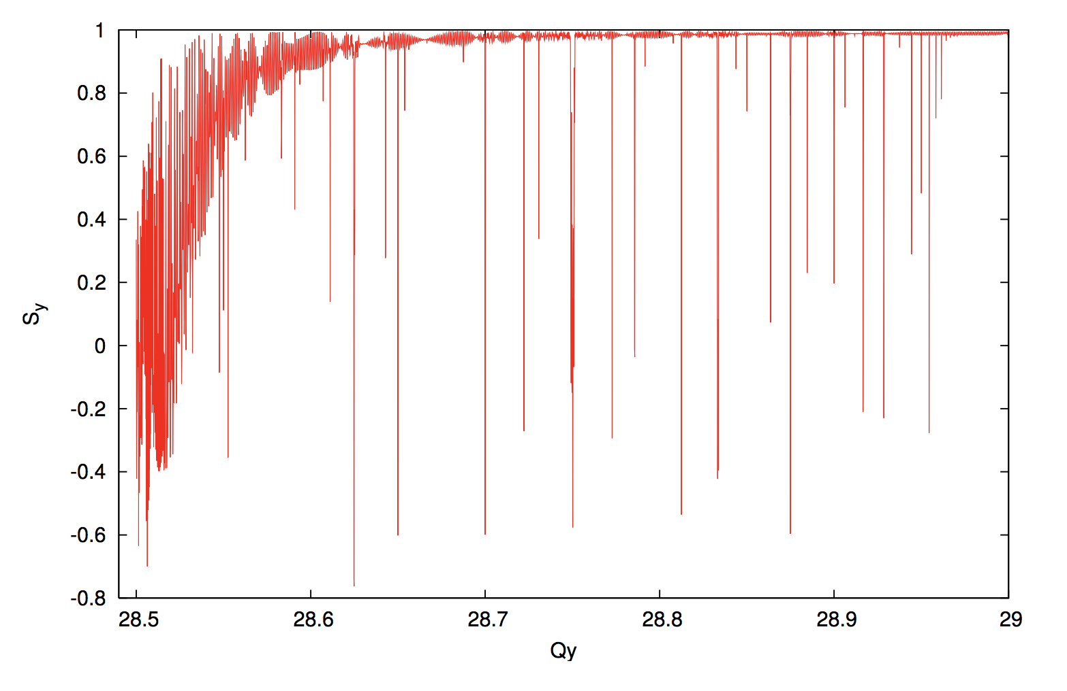
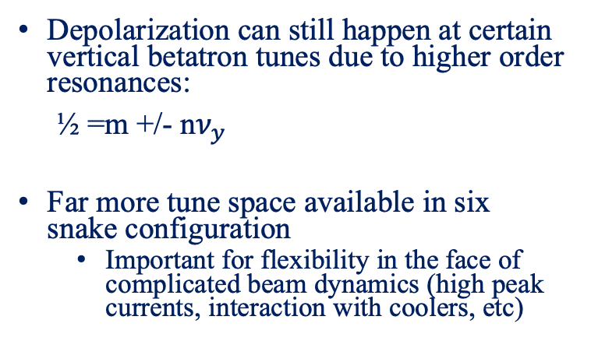
Snake Resonances in RHIC and EIC
Experimental observation of
Snake Resonances in RHIC
Depolarization can still happen at certain vertical betatron tunes due to higher order resonances:
½ =m +/- n$ν_{y}$
Far more tune space available in six snake configuration
  Important for flexibility in the face of complicated beam dynamics (high peak currents, interaction with coolers, etc)
RHIC with 2 Snakes
Snake resonance spectrum
EIC Hadron Ring with 6 Snakes
S_{y}
S_{y}
RHIC tune space
6-snakes
2-snakes
Q_{y}

Slide 6
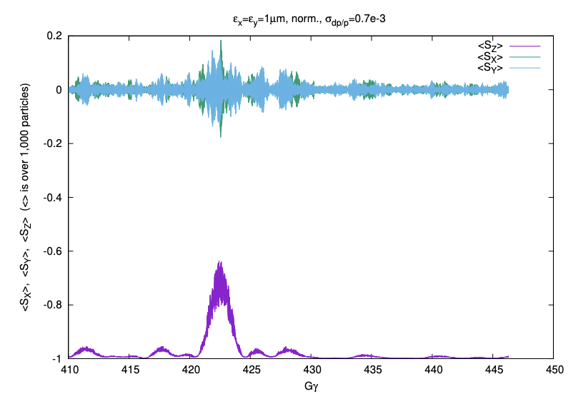
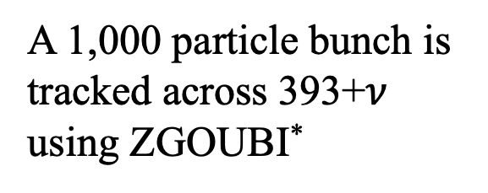
Crossing of Strongest Spin Resonance in EIC
EIC will have pre-cooling at injection. Vertical emittance is expected to be cooled down to 0.5-1mm-mrad.
Simulations show that two snakes preserve proton polarization with cooled rms emittance of 1 mm-mrad
A 1,000 particle bunch is tracked across 393+$ν$ using ZGOUBI*
(courtesy to Francois Meot)
* F. Méot, H. Huang, V. Ptitsyn, V. Ranjbar, G. Robert-Demolaize, V. Schoefer, and V. Morozov, RHIC optics and spin dynamics with snakes and rotators, Phys. Rev. Accel. Beams 25, 121002 (2022).

Slide 7
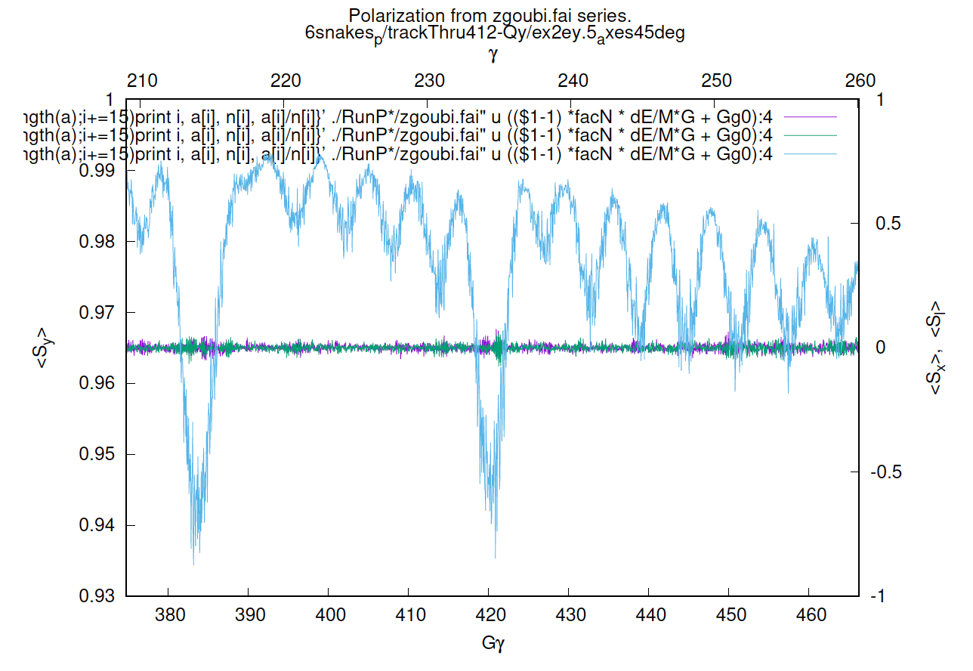
Crossing of Strongest Spin Resonance in EIC
EIC will have pre-cooling at injection. Vertical emittance is expected to be cooled down to 0.5-1mm-mrad.
Simulations show that six snakes in HSR lattice preserve proton polarization with cooled rms emittance of 0.5 mm-mrad
A 1,000 particle bunch is tracked across 393+$ν$ using ZGOUBI*
(courtesy to Kiel Hock)

Slide 8
Outline
Proton polarization in EIC as Baseline
He-3 polarization in EIC and Snake upgrade
Potential for polarized deuterons
Conclusion

Slide 9
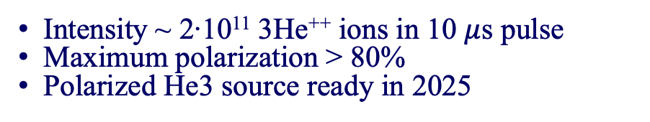
Polarized He-3 source and Extended EBIS
Extended EBIS
The He3 source is being realized as a part of an extension of existing EBIS
Additional solenoid extends the trap length leading to 40-50% heavy ion intensity increase
He-3 is polarized using Metastability Exchange Optical Pumping (MEOP) mechanism
Ionized in the ionization cell using electron beam (up to 10A)
High magnetic field (5T solenoid)
Intensity ~ 2∙10¹¹ 3He⁺⁺ ions in 10 $μ$s pulse
Maximum polarization > 80%
Polarized He3 source ready in 2025

Slide 10
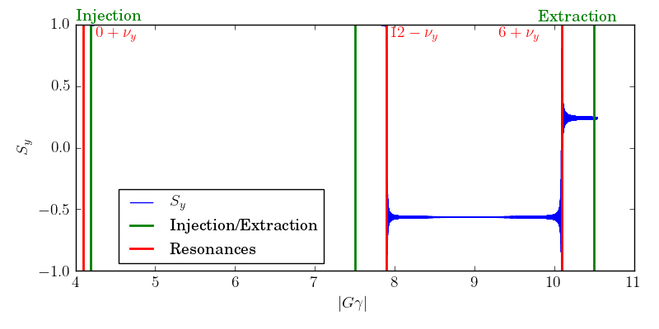
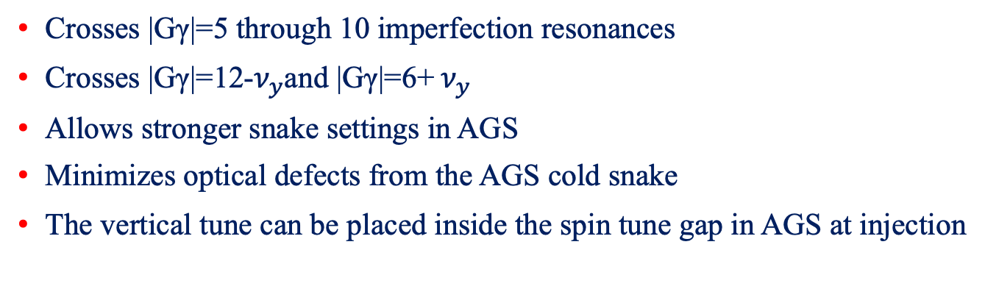
Overview of He-3 in the Booster
He-3 are injected into the Booster at |Gγ|=4.19
The injected intensity from EBIS is expected to be 2×10¹¹ with a polarization of 80%.
Extraction is possible at |Gγ|=7.5 and |Gγ|=10.5
Extraction at |Gγ|=10.5
Crosses |Gγ|=5 through 10 imperfection resonances
Crosses |Gγ|=12-$ν_{y}$and |Gγ|=6+ $ν_{y}$
Allows stronger snake settings in AGS
Minimizes optical defects from the AGS cold snake
The vertical tune can be placed inside the spin tune gap in AGS at injection

Slide 11
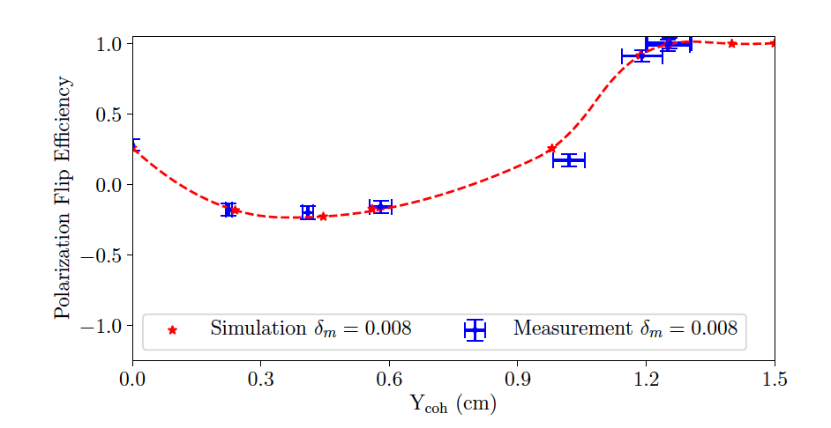

Booster AC Dipole Beam Test
The Booster AC dipole design strength is 25Gm.
Using a spare power amplifier from RHIC, AC dipole can reach 15Gm which is enough for the functionality test.
The function of the Booster AC dipole has been tested with polarized protons at 0+$ν$_{y}. Full spin flip is achieved. Simulations show good agreement with measurements.
preliminary

Slide 12
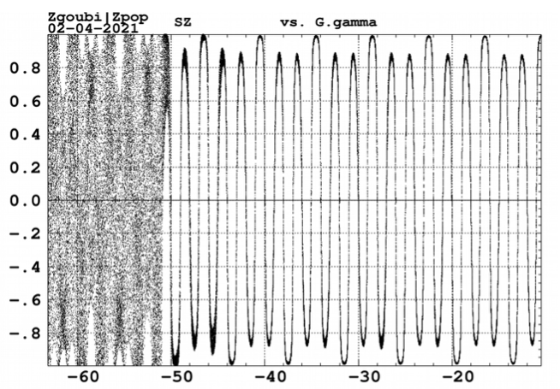
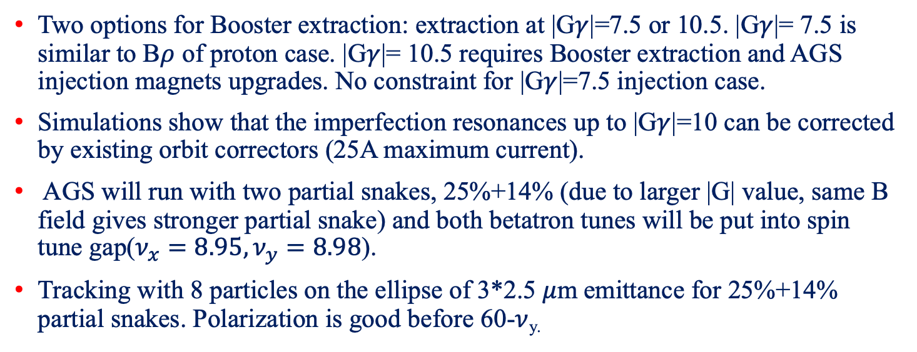
Polarized He-3 in Booster and AGS
Two options for Booster extraction: extraction at |G$γ$|=7.5 or 10.5. |G$γ$|= 7.5 is similar to B$ρ$ of proton case. |G$γ$|= 10.5 requires Booster extraction and AGS injection magnets upgrades. No constraint for |G$γ$|=7.5 injection case.
Simulations show that the imperfection resonances up to |G$γ$|=10 can be corrected by existing orbit correctors (25A maximum current).
AGS will run with two partial snakes, 25%+14% (due to larger |G| value, same B field gives stronger partial snake) and both betatron tunes will be put into spin tune gap($ν_{x}=8.95, ν_{y}=8.98$).
Tracking with 8 particles on the ellipse of 3*2.5 $μ$m emittance for 25%+14% partial snakes. Polarization is good before 60-$ν$_{y.}
With the source available in 2025, polarized He-3 development is possible in the AGS behind last RHIC run and during EIC construction.

Slide 13
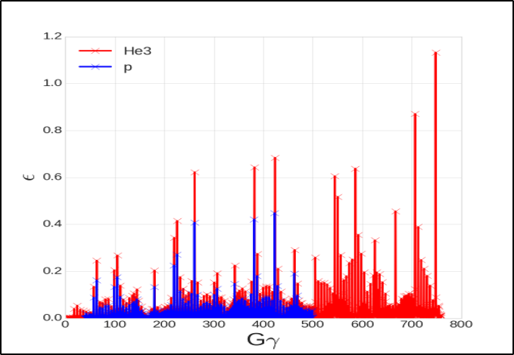
Polarized ³He in Present RHIC
Existing Siberian snakes and spin rotators for ³He in RHIC
Much stronger resonance strength requires more snakes.
The snakes and spin rotators from the 2nd RHIC ring can be reconfigured as additional snakes.
 | p | ³He⁺²
m, GeV | 0.938 | 2.808
G | 1.79 | -4.18
E/u, GeV | 24-275 | 16-183
|Gγ | | 46.5-525.5 | 72.6-819.4

Slide 14
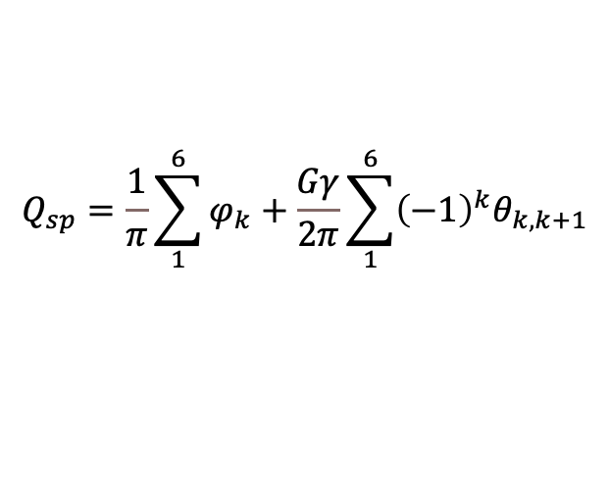
Six Snakes
-45º
Number of Snakes will be increased from 2 to 6
Snake arrangement is perfectly symmetric with 60 degree bending angle between Snakes.
Additional Snakes are put in DU7 ”dummy” sections, free of magnets.
$$Q_{sp}=\frac{1}{π}\sum_{1}^{6}{φ_{k}}+\frac{Gγ}{2π}\sum_{1}^{6}{{\left(−1\right)}^{k}θ_{k,k+1}}$$
Due to the injection region constraint, the snake at IP6 can not be put into the desired place. The proposed snake locations are as following with counting starting at IP12: snake1 = 𝜙, snake2=𝜋/3 − 𝜙, snake3 = 2𝜋/3−𝜙, snake4 =𝜋+𝜙, snake5 = 4𝜋/3−𝜙, snake6= 5𝜋/3− 𝜙, where 𝜙 = 0.0435rad.

Slide 15
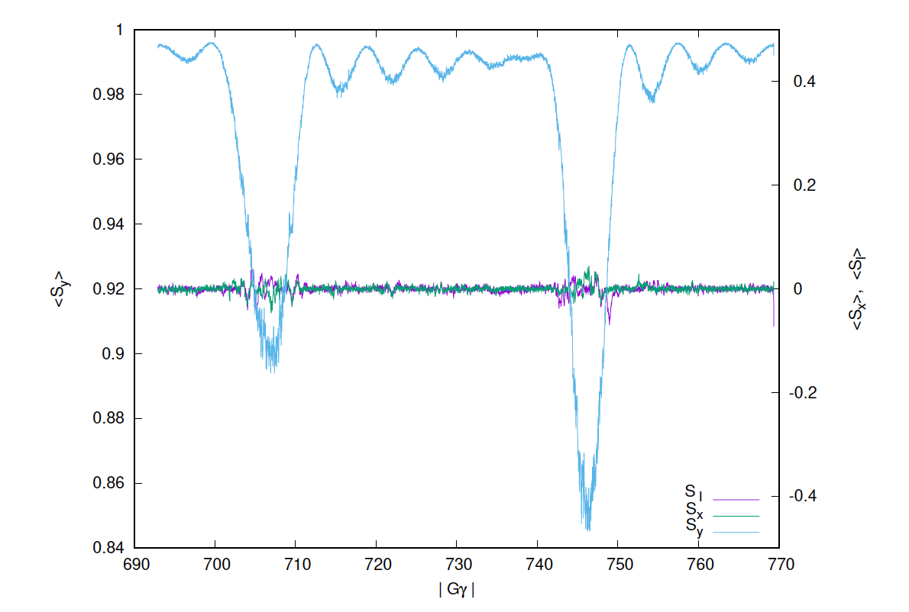
³He Simulation Results
(courtesy to Francois Meot)
10%/hour
Simulations through the strongest depolarizing resonances for 3He at 735−𝑄𝑦 and 717 + 𝑄𝑦 in RHIC lattice. The simulation was done for 1000 particles with Gaussian distributions in 6D phase space. The acceleration rate is about five times that of the proton acceleration rate in operation. The betatron tunes are 𝑄𝑦 = 28.685 and 𝑄𝑥 =29.673. The rms normalized emittance is 𝜀 = 1 𝜇m in both planes.
Simulations with HSR lattice is underway.

Slide 16
Outline
Proton polarization in EIC as Baseline
He-3 polarization in EIC and Snake upgrade
Potential for polarized deuterons
Conclusion

Slide 17
Polarized Deuterons in EIC
Unpolarized deuteron beam has been used in RHIC during ion physics program.
Present EIC physics program does not include polarized deuterons.
Small deuteron G:
Much higher magnetic field required for spin rotation
(Siberian Snakes not feasible)
But:
  Weaker resonances
  Small number of resonances
  (makes it possible to deal with individual resonances)
In EIC hadron ring
 | p | ³He⁺² | d
m, GeV | 0.938 | 2.808 | 1.876
G | 1.79 | -4.18 | -0.143
E/u, GeV | 24-275 | 10-183 | 12-137
|Gγ | | 45.5-525.5 | 48.5-818 | 1.6-20.9
H. Huang, F. Méot, V. Ptitsyn, V. Ranjbar, and T. Roser, Polarization preservation of polarized deuteron beams in the electron ion collider at Brookhaven National Laboratory, Phys. Rev. Accel. Beams 23, 021001(2020).

Slide 18
Polarized Deuterons in EIC Hadron Ring
Gγ range: -1.6 to -20.9. 19 imperfection resonances. With rms orbit error of 0.3mm, the strongest resonance strength is less than 0.0015. From the nominal ramp rate in RHIC d-Au run, the ramp rate is about dγ/dt=90/220s=>resonance crossing rate α=1.2E-7.
A partial snake can be used to overcome these resonances. The required partial snake snake strength is 0.22%. The existing snake is not strong enough. Adding a solenoid is a solution. 15Tm warm solenoid (0.45% partial snake) should work. AGS Solenoid: 4.7Tm and 2.4m long.

Slide 19
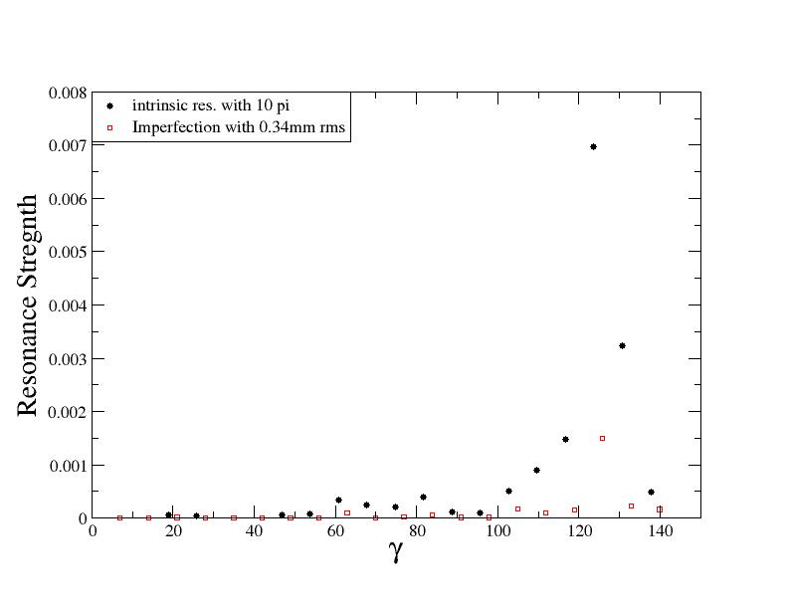
Resonance Strength for Deuterons in Hadron Ring (DEPOL)
From the d-Au run in 2016, the expected rms emittance of deuteron should be less than 2π. The rms orbit error should be under 0.3mm. The resonance strengths are estimated with these beam conditions with run17 pp lattice (Q_{y}=29.673).

Slide 20
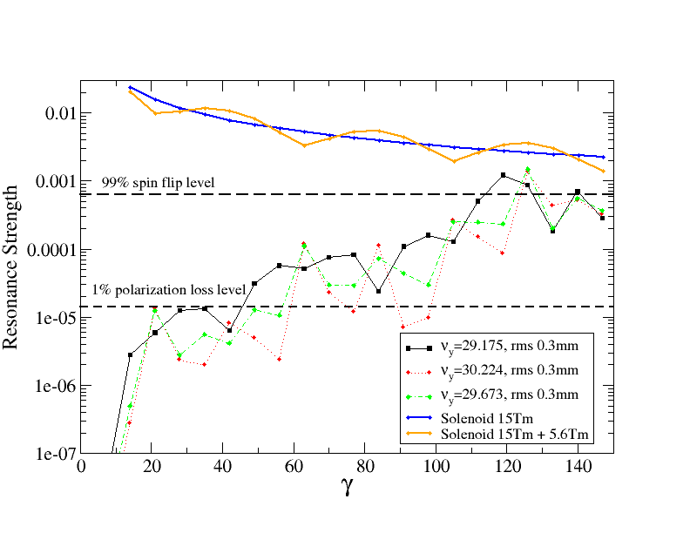
Imperfection Resonance Strength for Three Lattices
The partial snake strength with single and two partial snakes.

Slide 21
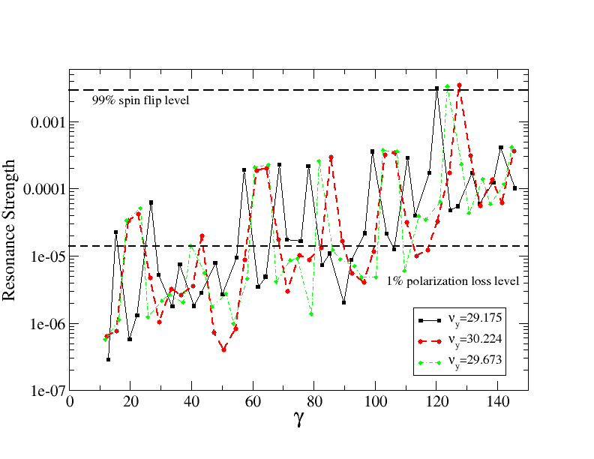
Intrinsic Resonance Strength for Deuterons
Intrinsic resonances with three different tunes.

Slide 22
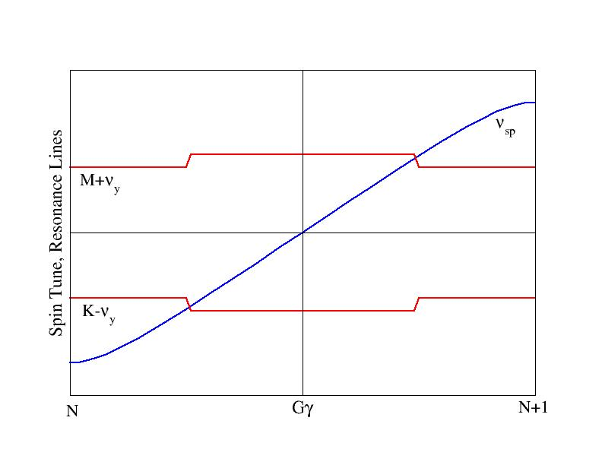
Modest Vertical Tune Jump
For an isolated resonance,
And resonance crossing rate is given by:
AGS tune jump system gives change of ν_{x} is 0.04 in 100 μs. If we use a similar PS for about 11 times larger rigidity, the expected tune change would be 0.04 in 1140μs or 0.013 in 380μs (30 turns). We actually will use a tune jump system with 0.04 in 50 turns. The resonance crossing speed would be 7E-5, which is 600 times faster than the regular ramp rate in RHIC. One possibility is to use γ_{tr} quads.

Slide 23
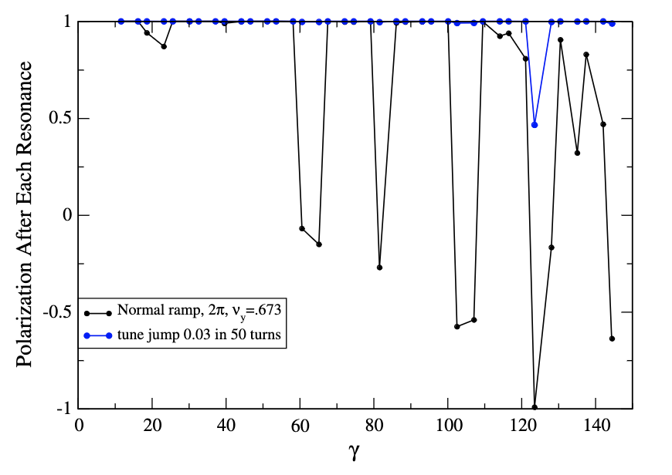
Polarization after Each Resonance
At the strongest resonance, normal ramp is better than tune jump.

Slide 24
Summary
Currently, RHIC proton ring can deliver 60% polarization at 255GeV for collisions with 1.8*10¹¹ bunch intensity.
For the planned various EIC operation scenarios, AGS can deliver 67-70% polarization. Additional polarization gain would come from the newly installed pulsed skew quads system(will be tested in run24).
Polarized ³He⁺² development is expected in about two years when the source is available. An AC dipole has been installed in the Booster and tested with polarized proton beam. Its success opens possibility to increase AGS injection energy so that stronger partial snake can be used and more tune space will be available for putting both betatron tunes into spin tune gap.
Polarized deuteron possibility has been explored. The imperfection resonances can be overcome by a solenoid partial snake. The intrinsic resonance can be overcome with modest tune jump. If deuteron beam is determined to be needed, source development should start.

Slide 25
Backup Slides

