Slide 1
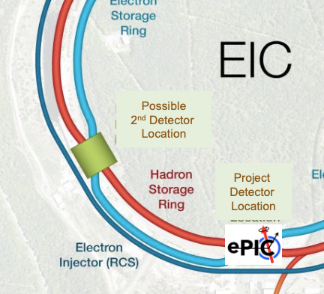
Opportunities with the 2nd IR for studies of eA interaction at the EIC
Pawel Nadel-Turonski
CFNS Stony Brook University
The 2nd detector
Workshop on Electron-Nuclei Interaction at EIC, CFNS Stony Brook University, July 6-7, 2023

Slide 2
Motivation for a 2nd detector
Needed to unlock the full discovery potential of the EIC
  Cross checks of key results are essential!
  Implies a general-purpose collider detector able to support the full EIC program
New physics opportunities
  Take advantage of much-improved near-beam hadron detection enabled by a 2nd focus,
  Impacts, for instance, exclusive / diffractive physics; greatly expands the ability to measure recoiling nuclei and fragments from nuclear breakup.
  New ideas beyond the Yellow Report and CD0 (EW, BSM)? Your input is essential!
Complementary design features
  Possible to reduce combined systematics (as for H1 and ZEUS)
  Particularly important for the EIC where high statistics mean that uncertainties for a large fraction of the envisioned measurements will be systematics limited

Slide 3
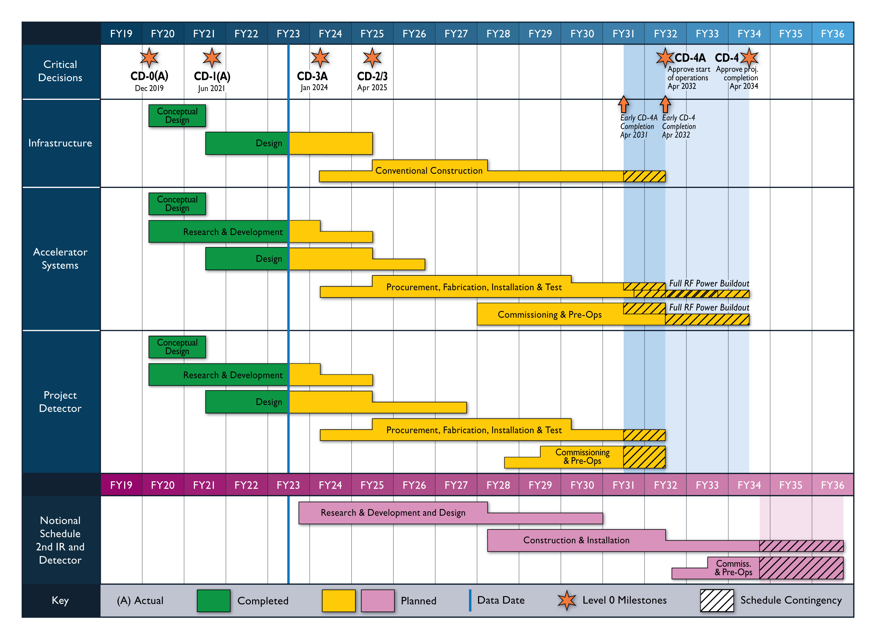
Reference schedule for a 2nd IR and Detector
Jim Yeck, EIC 2nd detector WS, May 2023
Second detector

Slide 4
Forward detection at the EIC is unique due to a numerical coincidence
At the EIC, the longitudinal momentum loss of the scattered “target” particles is not negligible. In the relevant range of x, it is typically larger than the intrinsic momentum spread of the beam.
  In DIS, dp/p ~ x (the momentum of the struck parton).
  The intrinsic momentum spread (1σ) in the beam is typically a few times 10⁻⁴.
For x larger than the (10σ) beam momentum spread we can thus in principle detect all scattered particles – even ones emerging at zero degrees (p_{T} = 0).
  At lower x one cannot reach p_{T} = 0, but the low-p_{T} acceptance can be greatly improved
Ions that change their rigidity (A/Z) behave like a proton experiencing a longitudinal momentum loss.
  A heavy ion losing one nucleon changes its rigidity by ~10⁻², which is comparable to the (10σ) beam momentum spread, making it possible to detect (tag) A-1 nuclei

Slide 5

Three strategies for detecting forward-going particles
$$σ=\sqrt{βε+{\left(D\frac{Δp}{p}\right)}^{2}}$$
These are mutually supportive and ideally we want to benefit from all three
Drift
  A particle scattered at a small angle will eventually leave the beam (which could be far away).
  When using only this method, the scattering angle has to be larger than the angular spread (divergence) of the beam, which is determined by the strength of the focus at the collision point (β*).
Dispersion (D) translates a longitudinal momentum loss into a transverse displacement
  dx = D dp/p , where dx is the transverse displacement at p_{T} = 0
  With D = 0.4 m, dp/p = 0.01, and p_{T} = 0, the transverse displacement for would be 0.4 cm
A 2nd focus can reduce the (10σ) beam size at the detection point
  Enables detectors to be placed closer to the beam – very effective in combination with dispersion
  Without a 2nd focus (IR6): 4 cm (high luminosity / divergence), 2 cm (low luminosity / divergence)
  With a 2nd focus (IR8): 0.2 cm (high luminosity / divergence)

Slide 6
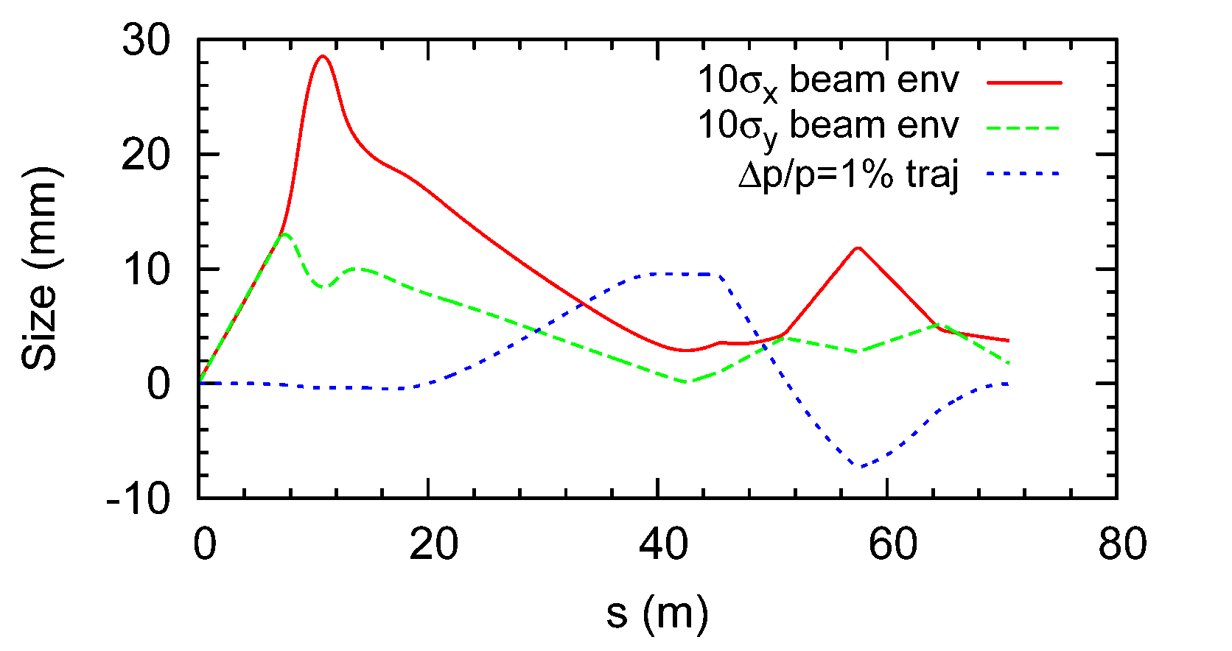

Beam optics and the actual trajectory of a p_{T} = 0 particle (blue)
For optimal detection, the (2nd) focus has to coincide in x and y at the point of maximum dispersion (green line).
  σ_{x} and σ_{y} should be comparable at the 2nd focus (and thus β_{x} < β_{y} since ε_{x} > ε_{y})
A zero degree particle (blue) briefly emerges from the beam at the 2nd focus about 40 m downstream of the IP where it can be detected
  Particles with a non-zero angle emerge earlier .
$$σ=\sqrt{βε+{\left(D\frac{Δp}{p}\right)}^{2}}$$
The 2nd focus refers to the beam. Scattered particles have their maximum transverse displacement here.
V. Morozov

Slide 7
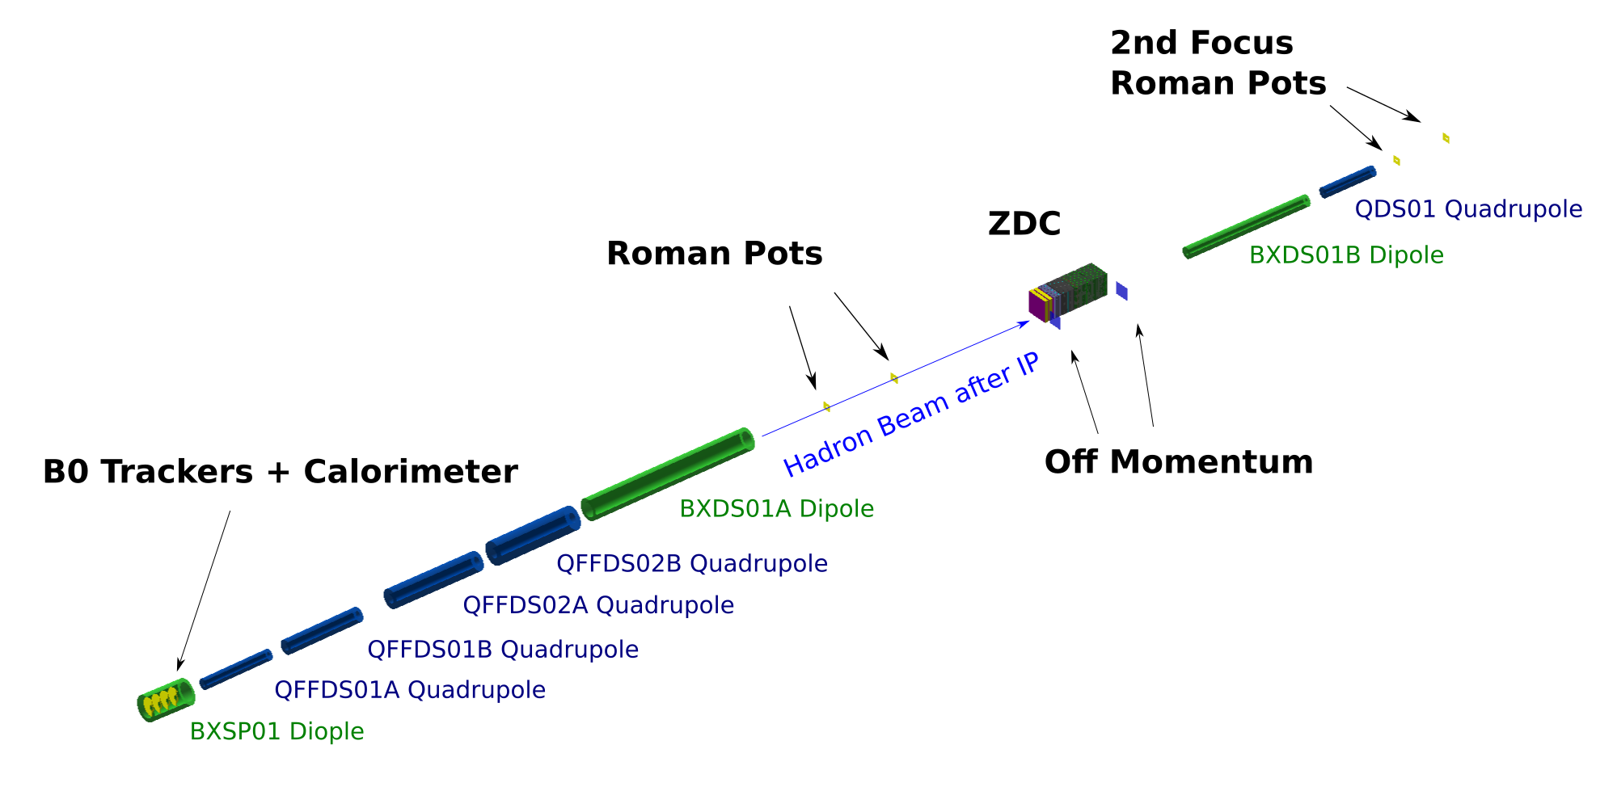
IR magnet layout showing the 2nd focus
Green dipole magnets change dispersion
Blue quadrupole magnets focus the beam, changing the beta function (x and y)
Dispersion slope control section
(D’ = 0 at 2nd focus preserves angle)
Main dipole - generates most of the dispersion
Focusing section crating both focuses (IP & 2nd)
Small dipole covering the range between the endcap and Roman pots

Slide 8





EIC far-forward acceptance with and without a 2nd focus
Ion fragments from ²³⁸U
Exclusive protons
$$p_{⊥}$$
(x_{L} = p’ / p_{beam} ~ 1 – x)
Excluded
Without 2nd focus: (EPIC @IR6)
Detected
Detected
Detected
Excluded
⬅ Z’ vs x_{RP}
$p_{⊥}$vs x_{L}➔
0.9
1
$$x_{L}$$
0
Limited by D and 2nd focus (β₂)
Limited by angular acceptance (β*)
With 2nd focus: (Detector 2 @ IR8)
$$p_{⊥}$$
Order-of-magnitude improvement in forward acceptance
Detected
Excluded
0
0.99
1
$$x_{L}$$
x position ~ A/Z

Slide 9

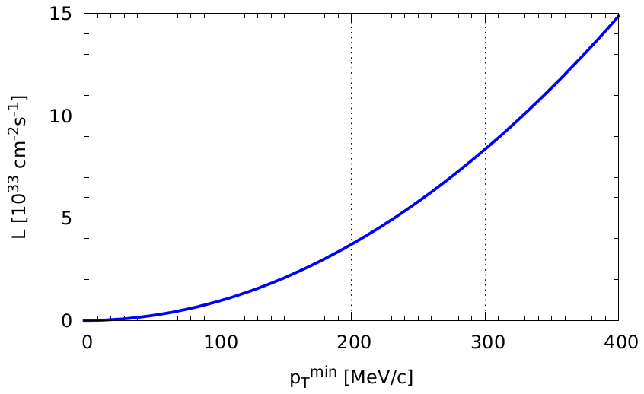


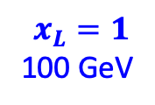
Luminosities in IR6 (ePIC) and IR8 (Detector 2)
The maximum luminosity will be similar for both Detector 1 and 2.
When operated together, they will share the beam current (luminosities can be different).
$$x_{L}=1$$
100 GeV
(x_{L} = p’ / p_{beam} ~ 1 – x)
In IR6, a higher luminosity reduces the forward low-p_{T} acceptance.
Second focus
Highest $L$
$$x_{L}<0.99$$
High-divergence (small β*)
Due to the 2nd focus, IR8 can operate at max luminosity without any acceptance penalty for x > 0.01, and a smaller one at lower x
High-acceptance (large β*)
This complementarity will allow for a global optimization. Detector 2 will have a natural advantage for exclusive / diffractive physics, and in particular for detection of nuclei.

Slide 10
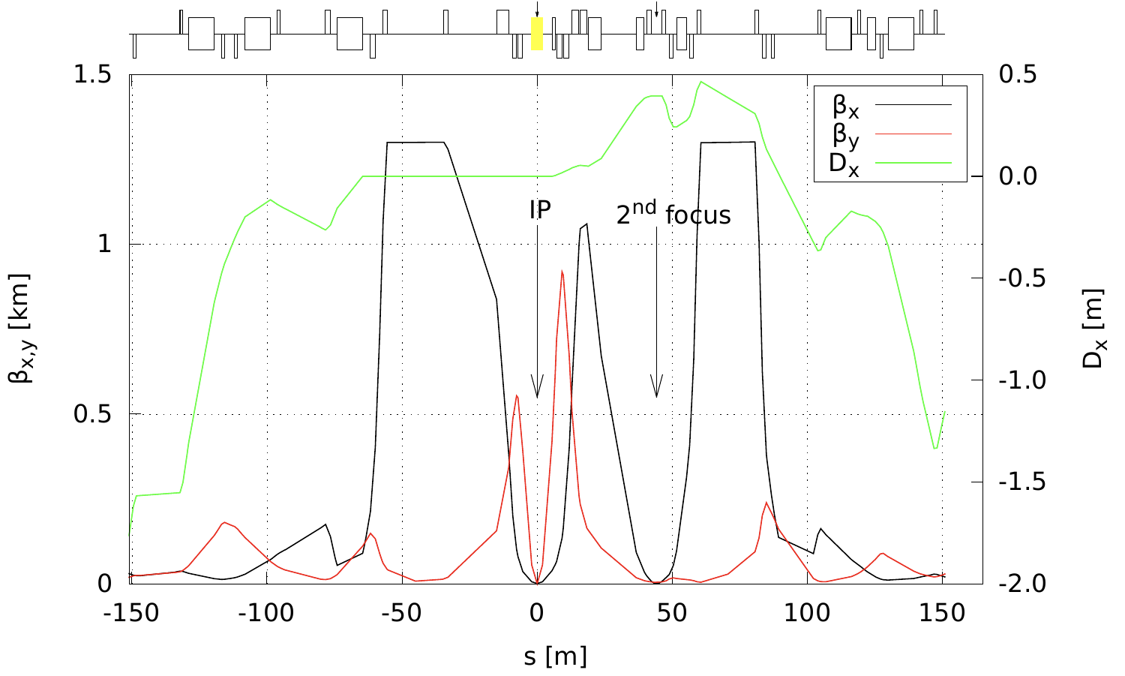
Crossing angle
The crossing angle has little impact on forward detection and is unrelated to the 2nd focus. The value (35 mrad) is driven by the space needed for the crab cavities
  A larger crossing angle is helpful for beamline separation n IR8 since the B0 dipole is inbending
  A 2nd focus would work equally well with a 25 mrad crossing angle.

Slide 11
Example: exclusive coherent scattering on nuclei
For light nuclei, the 2nd focus enables detection with essentially 100% acceptance down to p_{T} = 0 (w.r.t the beam) for x > 0.01A.
  Very clean measurement with no incoherent background
  The first diffractive minimum will be accessible also at low x.
For heavier nuclei, incoherent events can be suppressed by detecting fragments (including neutrons and photons) from the breakup.
  Fragments are particularly important for the high-t tail
B. Schmookler et al.
⁴He
1 fm⁻¹ = 0.2 GeV
1 fm⁻² = 0.04 GeV²
10 fm⁻² = 0.4 GeV²
20 fm⁻² = 0.8 GeV²
Fragments produced in scattering on ²³⁸U

Slide 12
Example: tagging of heavy spectators
Both IR6 and IR8 support tagging of spectator protons from light ions (d, He)
  These spectators have magnetic rigidities that are very different from that of the beam ions
The produced fragments will also contain rare isotopes.
  Gamma spectroscopy possible by measuring boosted forward-going photons in coincidence
  Interest from the FRIB community
A 2nd focus will allow tagging of heavy spectators
  A-1 nuclei up to Zr-90
  A-2, etc, for almost any nucleus
Tagging of heavy spectators enables, for instance, measurements of reactions on a bound nucleon
B. Schmookler et al.

Slide 13
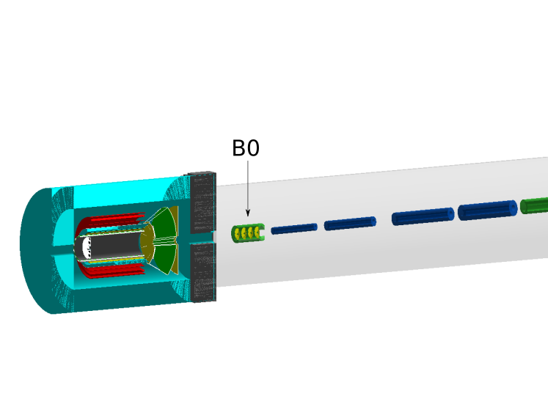
Opportunity: improved detection of nuclear photons
ZDC
B0 + anti-solenoid
Nuclear de-excitation photons
18 GeV e on 110 GeV/A ²³⁸U
High-resolution detection of nuclear (gamma) photons can be made possible by placing LYSO EMcals in front of the ZDC and behind the B0 dipole magnet
  LYSO has similar performance to PbWO4 at high energy, but a much larger photon yield at energies corresponding to nuclear gammas
B. Moran et al.
Extending the acceptance beyond what can be covered by the ZDC (< 5 mrad) would greatly improve the ability to detect several gammas in coincidence (for spectroscopy)
It would also enhance the ability to use nuclear photons for vetoing breakup
  The ZDC acceptance is rather limited and most photons fall outside of it

Slide 14
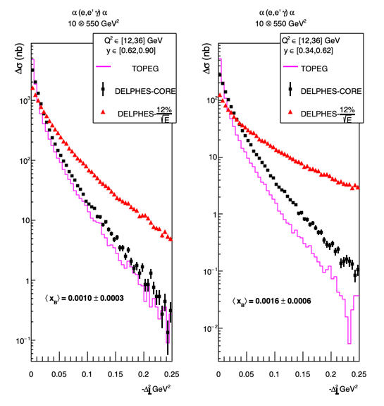
Example of detector synergies: reconstruction of Δ_{perp} using the DVCS photon
(137.5 GeV/A)
(137.5 GeV/A)
With a 2nd focus, light ions from coherent processes can be detected down to p_{T} = 0 (w.r.t. the beam)
For heavier ions (e.g., ¹²C to ⁹⁰Zr), the recoiling ion cannot be detected, but the excellent acceptance for ion fragment makes it possible to provide a clean breakup veto to ensure exclusivity.
For heavy ions, the only way to reconstruct Δ_{perp} (essentially p_{T} w.r.t the virtual photon) is to use the scattered electron and DVCS photon
  This method is also very helpful for lighter nuclei
The study on the left shows the importance of the photon energy resolution of the barrel EMcal
  CORE (black) used PbWO₄ with 1-2% resolution
  ePIC’s GlueX-like EMcal would fall in-between the PbWO₄ (black) and 12% (red) points.
C. Hyde

Slide 15
Implementation of the 2nd focus into IR8
The concept of an EIC IR with a 2nd focus was inspired by the CELSIUS fixed-target ring in Uppsala, Sweden, and developed at JLab during 2009-2015.
  After 2015, when the dispersion slope control section was added, there have not been any conceptual changes to the 2nd focus.
  The JLab implementation used to develop the concept was highly optimized
The 2nd focus was ported essentially unchanged to IR8 (except for a lower dispersion), but several other aspects changed without detailed comparative studies, e.g.,
  the triplet focusing was changed to a split doublet (driven by a desire to run at low energies)
  the large dipole was not split in two to optimize it for higher proton energies
  the B0 was copied over from IR6, where various constraints have made it very complicated (fixed-field with an embedded electron quad followed by a variable-field ion dipole corrector)
Since then only minor tweaks have been made without revisiting any of the more fundamental assumptions. This is sufficient to demonstrate the validity of the 2nd focus idea and satisfy the requirement of the CD process, but it may not be what we would eventually want to build.
  An optimized layout that would not in any way affect the electron ring may not only improve physics performance, but also reduce cost and risk, and synergize with accelerator operations. (A lower β^{max} benefits both acceptance and chromaticity, for instance)

Slide 16
Aspirational goals for a 2nd EIC detector
MAGNETIC FIELD – Solenoid field up to 3T, allowing for high resolution momentum reconstruction for charged particles.
EXTENDED COVERAGE for precision electromagnetic calorimetry – important for DVCS on nuclei.
MUONS – enhanced muon ID in the barrel and (possibly) backward region.
BACKWARD HADRONIC CALORIMETER – Low-x physics, reconstruction of current jets in the approach to saturation.
SECONDARY FOCUS – tagging for nearly all ion fragments and extended acceptance for low-p_{T}/ low-x protons. Enables detection of short-lived rare isotopes.
Renee Fatemi, EIC 2nd detector WS, May 2023

Slide 17
EIC UG 2nd detector / IP8 working group – a timeline
December 2021 – DPAP review of EIC detector proposals
  The call included criteria for proposals to be a 2nd detector
  While the DPAP did not make a selection of a 2nd detector, it endorsed the idea
Spring 2022 – EICUG-SC produced a brochure on a 2nd EIC detector
  Distributed to same international funding agencies that received copies of the yellow report
July 2022 – the Det II / IP8 WG was formed. Everyone is welcome to join!
  Conveners: Klaus Dehmelt (CFNS/SBU), Charles Hyde (ODU), Sangbaek Lee (ANL), Simonetta Liuti (UVA), Pawel Nadel-Turonski (CFNS/SBU), Bjoern Schenke (BNL), Ernst Sichtermann (LBL), Thomas Ullrich (BNL), Anselm Vossen (Duke/JLab)
Several workshops were / are already organized by the WG
  December 2022: first in a series of CFNS workshops at Stony Brook U. (98 participants)
  May 2023: 1st International workshop on Detector II at Temple U. (115 participants)
  July 2023: Detector II workshop as part of the EIC UG meeting in Warsaw, Poland

Slide 18
Thank you!

Slide 19
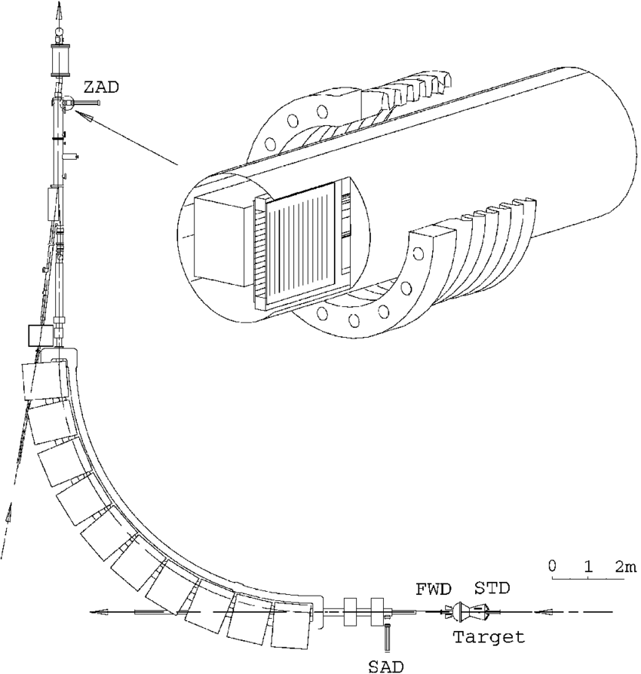
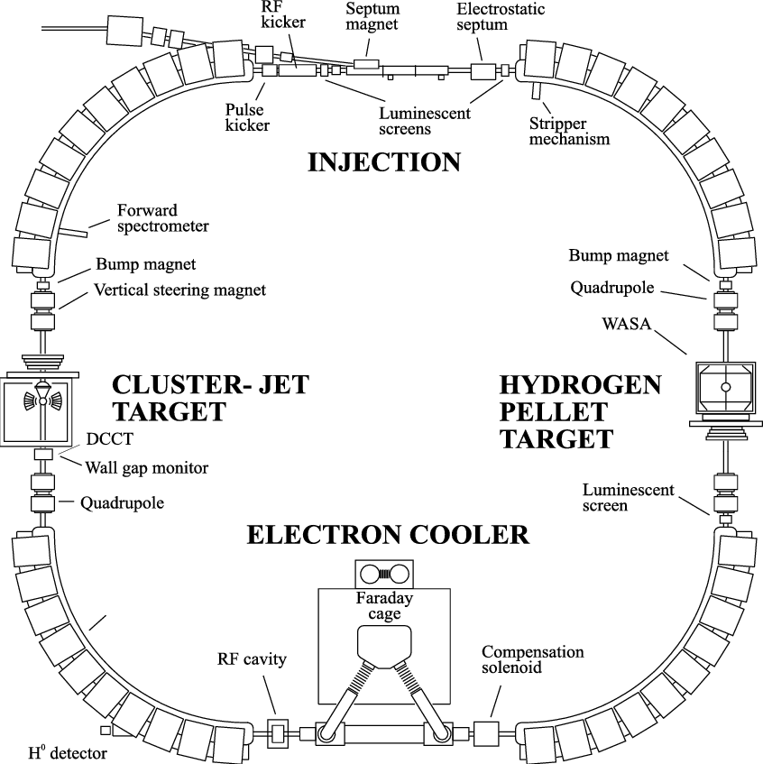
Far-forward detection at the CELSIUS storage ring in Uppsala, Sweden
Focus with Roman pots
trackers
2nd Roman pot
Z-tagger
bellows
dipoles
quads
ZDC

Slide 20
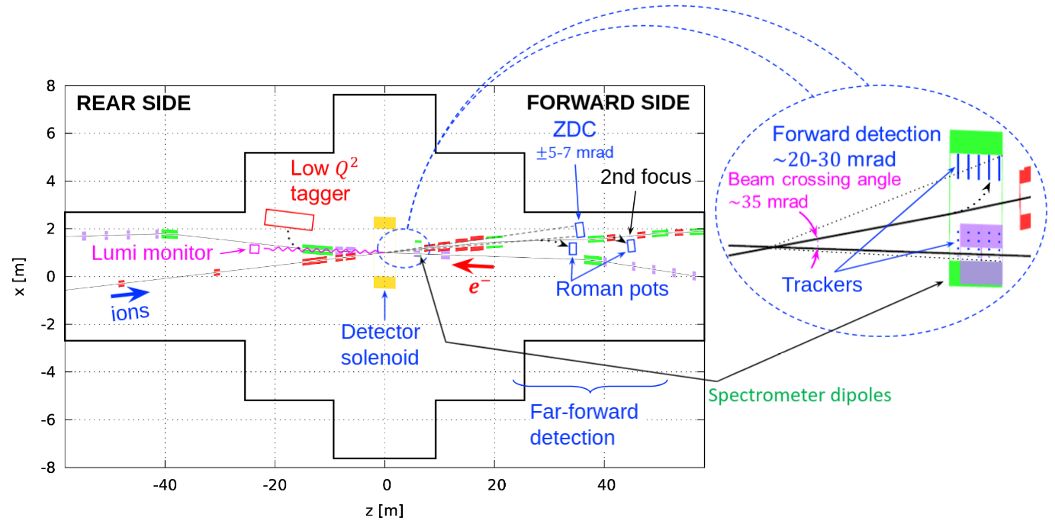
Large-p_{T} acceptance
neutrals
spectators
2nd focus
In contrast to low-p_{T}, where acceptance is limited by the beam, there is no upper limit in p_{T}.
  Particles that are not detected at the 2nd focus will be detected in the drift section before it, or in the B0 magnet in front of the quads (red), or in the hadron endcap of the central detector
  Losses will occur in the transitions.
Large apertures are a challenge for the magnets, but do depend on the 2nd focus or IR layout.

Slide 21
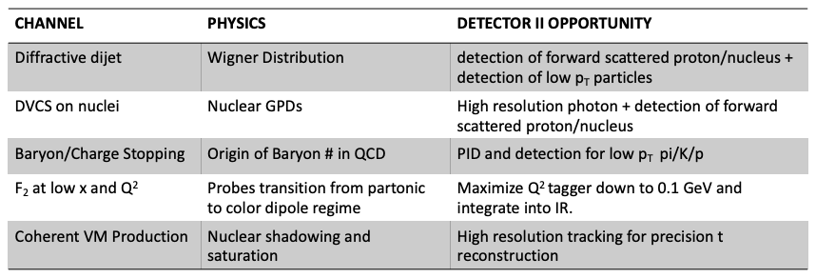
Five initial benchmark channels for Detector 2 simulations
Please note that these were selected to illustrate particular opportunities
You are most welcome to add your favorite process!

