Slide 1


Atomic nuclei imaging at the Electron-Ion Collider with the ePIC experiment
Niseem Magdy
niseemm@gmail.com
Inspire-hep: 1305036
ORCID: 0000-0002-6458-6552

Slide 2
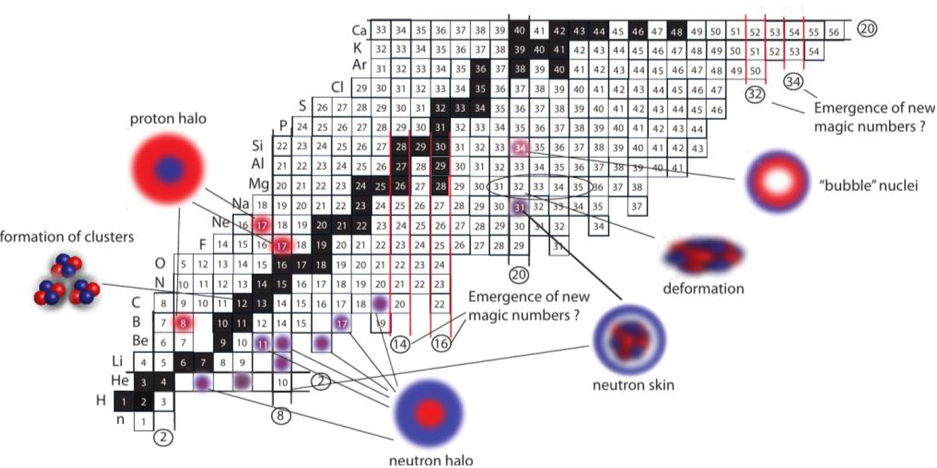
Motivation
The rich structure of atomic nuclei:
  Clustering, halo, skin …
  Quadrupole/octupole/hexdecopole deformations

Slide 3

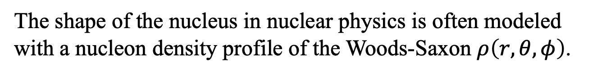
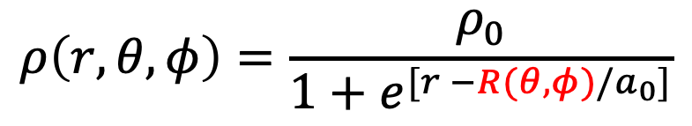
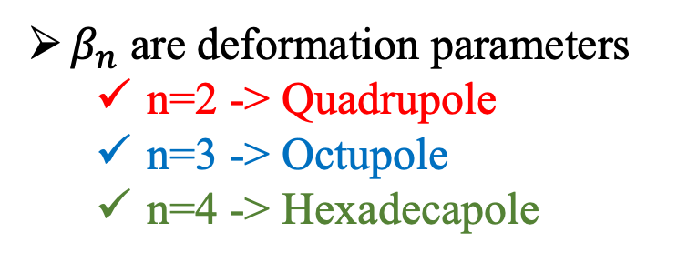
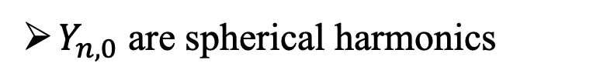


Motivation
The shape of the nucleus in nuclear physics is often modeled with a nucleon density profile of the Woods-Saxon $ρ\left(r,θ,φ\right)$.
$Y_{n,0}$ are spherical harmonics
$$1+ β_{2}Y_{2,0}$$
$$1+ β_{3}Y_{3,0}$$
$$1+ β_{4}Y_{4,0}$$
$β_{n}$ are deformation parameters
  n=2 -> Quadrupole
  n=3 -> Octupole
  n=4 -> Hexadecapole
$$ρ\left(r,θ,φ\right)=\frac{ρ_{0}}{1+e^{[r −R(θ,φ)/a_{0}]}}$$
$$R\left(θ,φ\right)=R_{0} \left(1+ β_{2}Y_{2,0}(θ,φ)+ β_{3}Y_{3,0}(θ,φ)+β_{4}Y_{4,0}(θ,φ)\right)$$

Slide 4
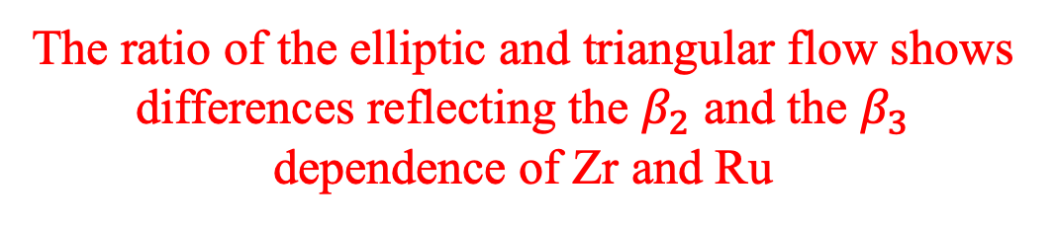
Motivation
J. Jia
Phys. Rev. C 105 (2022) 1, 014905
J. Jia et al.
Phys.Lett.B 833 (2022) 137312
In heavy ion collisions;
The ratio of the elliptic and triangular flow shows differences reflecting the $β_{2}$ and the $β_{3}$ dependence of Zr and Ru

Slide 5
Motivation
What can we learn about the nuclear shape and structure (α clustering)?
Can α particles be the building blocks of some nuclei?
Has direct experimental evidence ever been provided?
Nature Communications, 13, 2234 (2022)

Slide 6
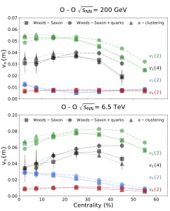
Motivation
Phys.Rev.C 104 (2021) 4, L041901
In heavy-ion collisions;
No difference was observed between Woods-Saxon and α clustering
Clustering in heavy-ion collisions is too complicated to be measured.

Slide 7




Motivation
EIC can be a unique tool for understanding the nuclear structure
  Understanding the nuclear deformation
  Understanding the α clustering
$He^{ 4}$ = $α$ particle
$Be^{ 8}$ = $2 α$ particles
$C^{ 12}$ = $3 α$ particles
Can EIC provide additional constraints on nuclear deformation and the α clustering?
  Using the BeAGLE model
    Modifying the nucleus information in the model

Slide 8
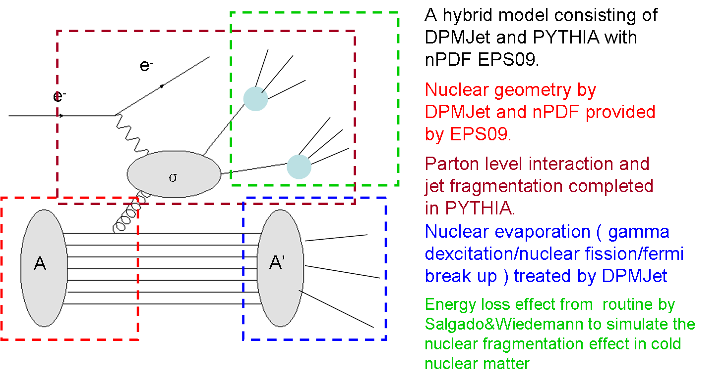

The BeAGLE model:
PRD 106, 012007 (2022)

Slide 9
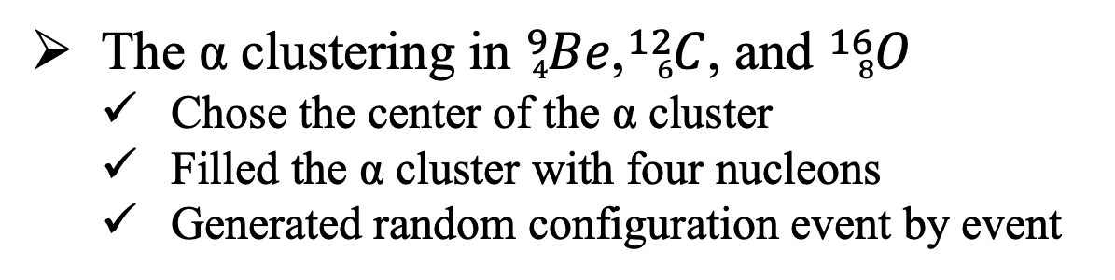
The α clustering
Model Setup
The α clustering in ${}_{4}^{9}{Be}$,${}_{6}^{12}C$, and ${}_{8}^{16}O$
  Chose the center of the α cluster
  Filled the α cluster with four nucleons
  Generated random configuration event by event
The BeAGLE model is updated to consider the α clustering
2- α Clustered on the Z axes
3- α Clustered in the x-y plane
3- α Clustered in the x-y plane
1- α Clustered on the Z axes
Potential measurements
Incoherent scattering
Nuclei homogeneity
The system energy/momentum

Slide 10




The α clustering
Incoherent scattering
Case-1: Woods–Saxon
Case-2: Clustering fixed orientation
BeAGLE
$$dσ/dt$$
$$|t|(GeV)$$
$$|t|(GeV)$$
$$|t|(GeV)$$
The inclusive $dσ/dt$ is sensitive to α clustering in $Be^{9}$, $C^{12}$, and $O^{16}$

Slide 11
The α clustering
Incoherent scattering
Case-1: Woods–Saxon
Case-2: Clustering fixed orientation
BeAGLE
$$dσ/dt$$
$$|t|(GeV)$$
$$|t|(GeV)$$
$$|t|(GeV)$$
The inclusive $dσ/dt$ is sensitive to α clustering in $Be^{9}$, $C^{12}$, and $O^{16}$

Slide 12
The α clustering
Incoherent scattering
Case-1: Woods–Saxon
Case-2: Clustering fixed orientation
BeAGLE
$$dσ/dt$$
$$|t|(GeV)$$
$$|t|(GeV)$$
$$|t|(GeV)$$
The inclusive $dσ/dt$ is sensitive to α clustering in $Be^{9}$, $C^{12}$, and $O^{16}$

Slide 13
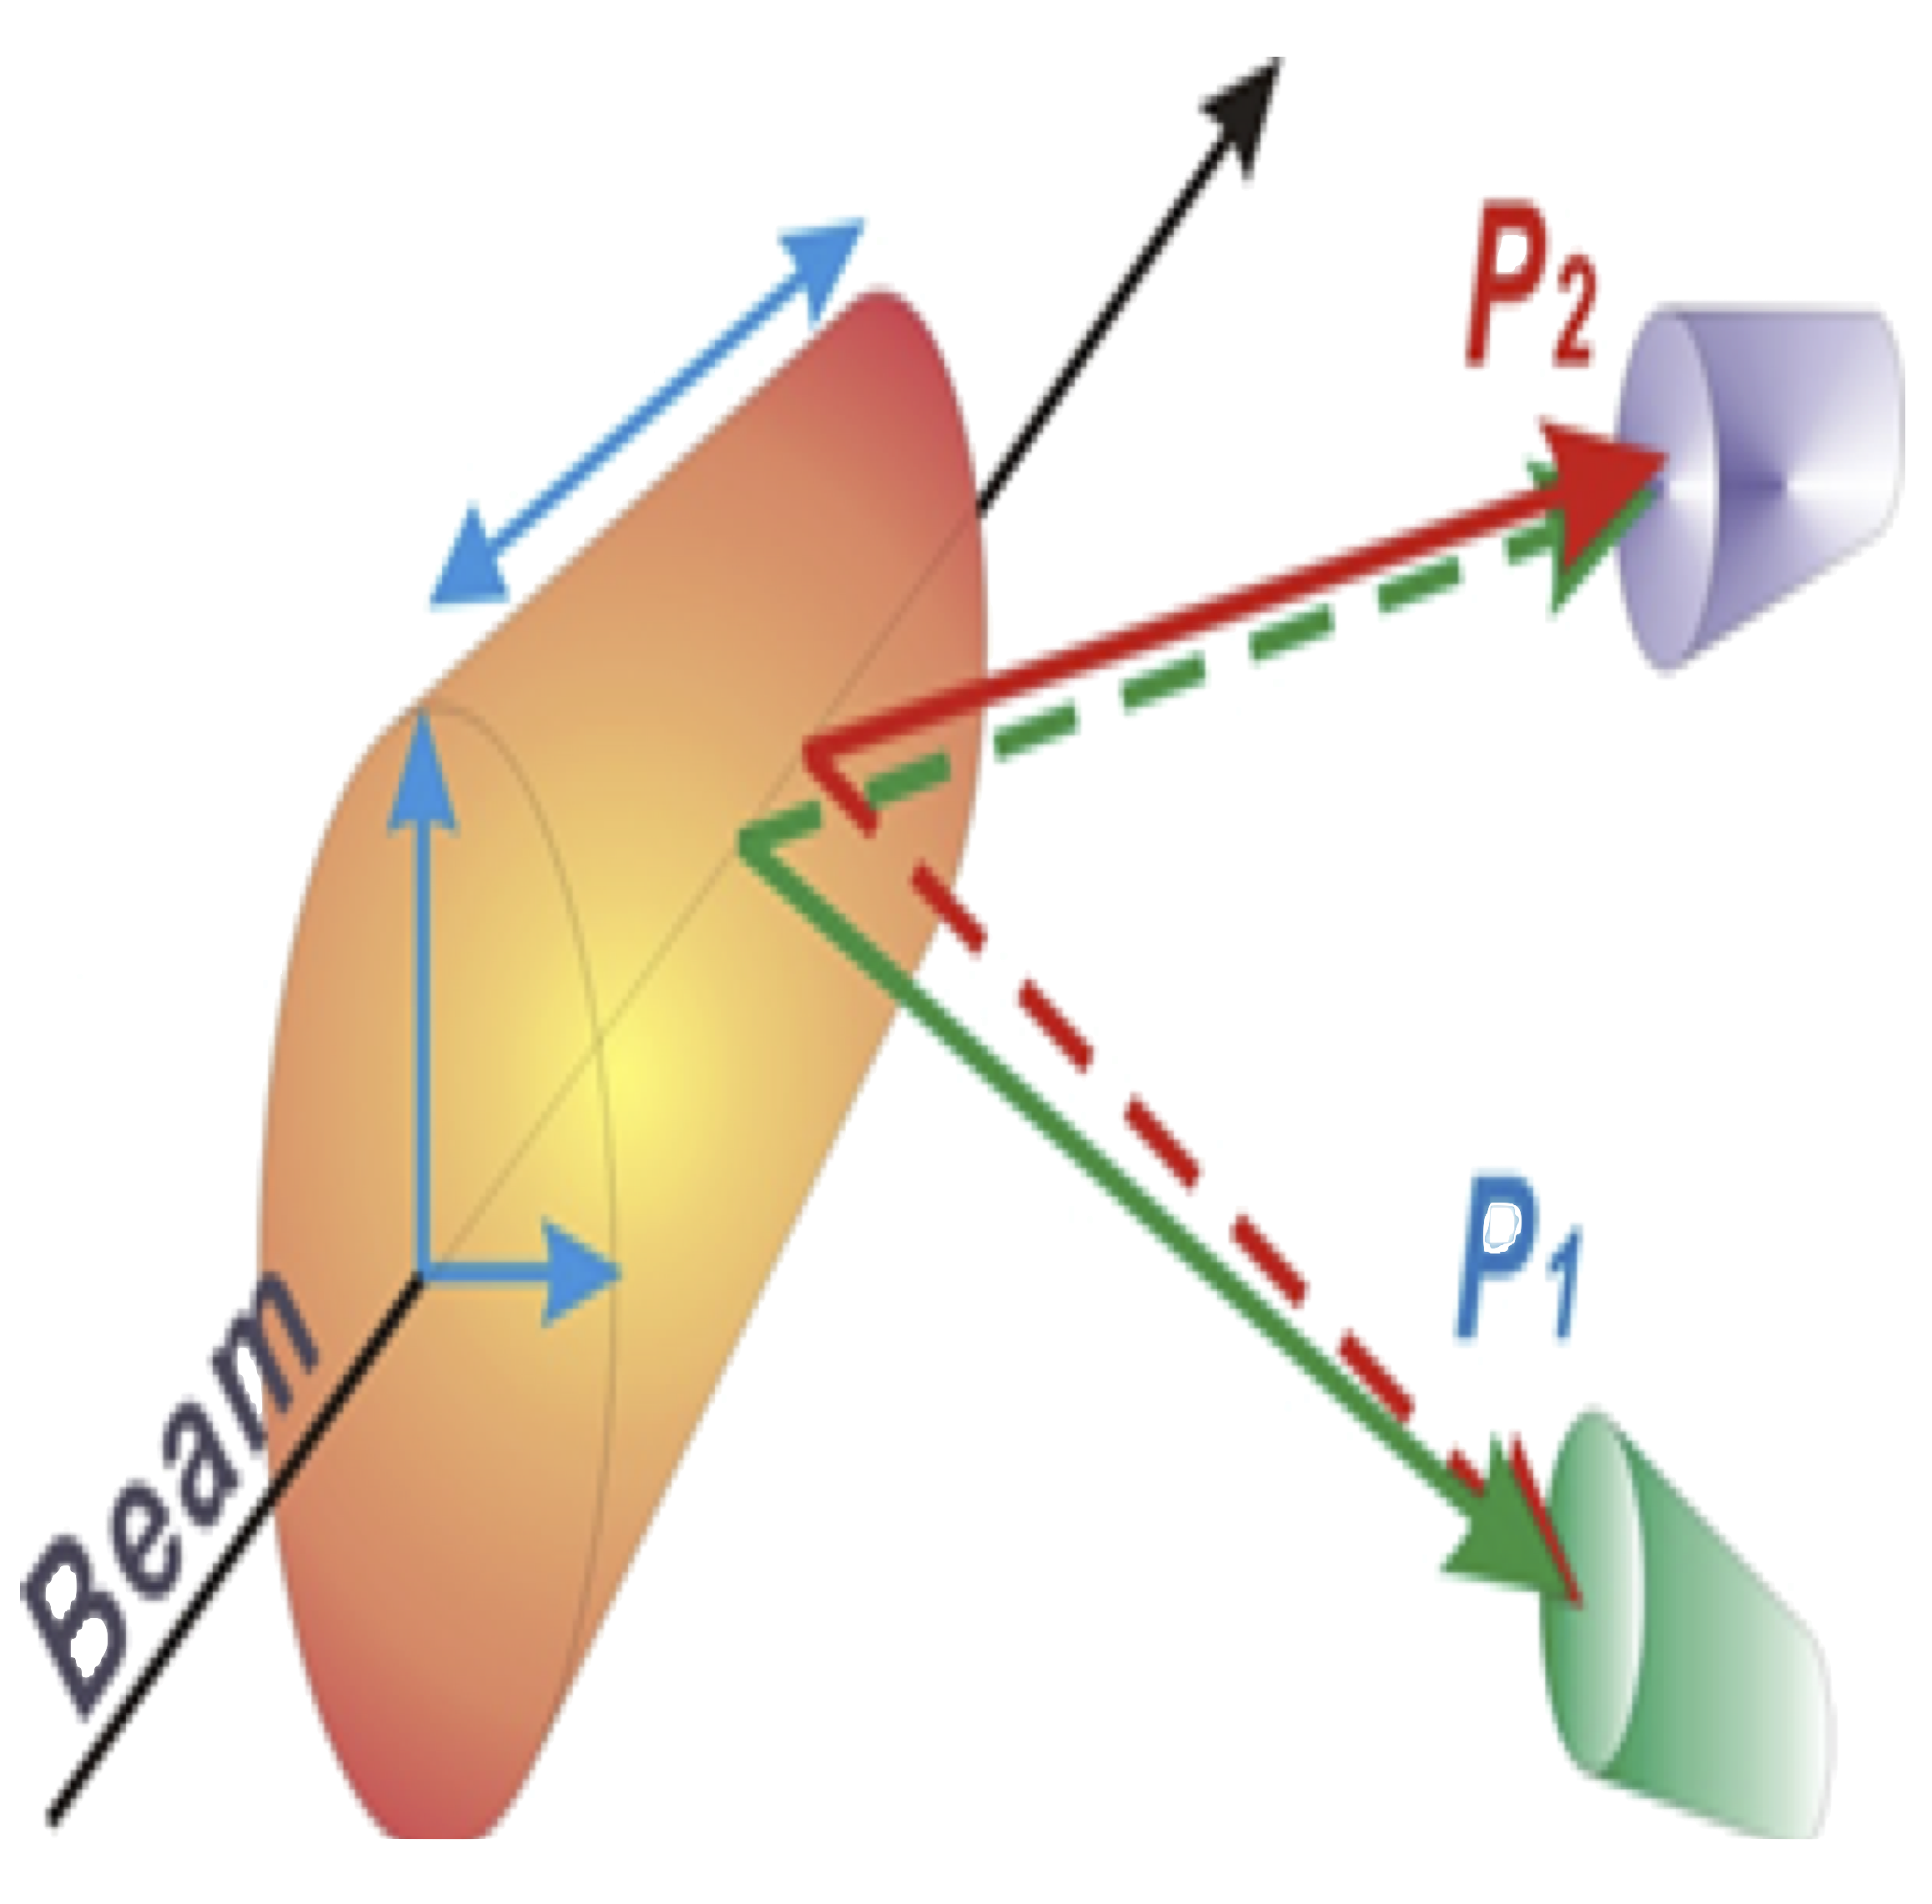


The α clustering
Lei Shen, Bo-Song Huang, and Yu-Gang Ma
Phys.Rev.C 105 (2022) 1, 014603
Nuclei homogeneity
The homogeneity of the system via femtoscopy measurements [two pion/proton correlations]
Femtoscopy measurements can be sensitive to SRC and clustering.
$$q=\vec{{|P}_{1}} −\vec{P_{2}}|$$
BeAGLE
$$(fm)$$
Femtoscopy measurements can be sensitive to the system size.

Slide 14
The α clustering
Nuclei homogeneity
Case-1: Woods–Saxon
Case-2: Clustering fixed orientation
BeAGLE
Femtoscopy measurements can be sensitive to the clustering.
We are planning to extend the study to the SRC effect.

Slide 15
The α clustering
Nuclei homogeneity
Case-1: Woods–Saxon
Case-2: Clustering fixed orientation
BeAGLE
Femtoscopy measurements can be sensitive to the clustering.
We are planning to extend the study to the SRC effect.

Slide 16
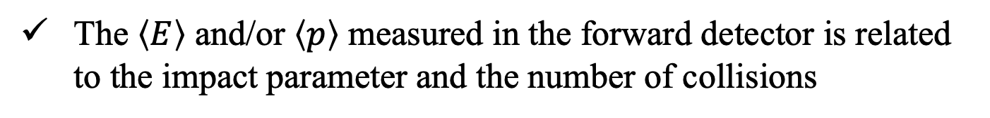
The α clustering
The system energy/momentum
The $\left\langle E\right\rangle$ and/or $\left\langle p\right\rangle$ measured in the forward detector is related to the impact parameter and the number of collisions
Case-1: Woods–Saxon
Case-2: Clustering fixed orientation
The $\left\langle E\right\rangle$ in $B_{0}$ is sensitive to α clustering in $Be^{9}$, $C^{12}$, and $O^{16}$

Slide 17
The α clustering
The system energy/momentum
The $\left\langle E\right\rangle$ and/or $\left\langle p\right\rangle$ measured in the forward detector is related to the impact parameter and the number of collisions
Case-1: Woods–Saxon
Case-2: Clustering fixed orientation
The $\left\langle E\right\rangle$ in $B_{0}$ is sensitive to α clustering in $Be^{9}$, $C^{12}$, and $O^{16}$

Slide 18
The α clustering
The system energy/momentum
The $\left\langle E\right\rangle$ and/or $\left\langle p\right\rangle$ measured in the forward detector is related to the impact parameter and the number of collisions
Case-1: Woods–Saxon
Case-2: Clustering fixed orientation
The $\left\langle E\right\rangle$ in $B_{0}$ is sensitive to α clustering in $Be^{9}$, $C^{12}$, and $O^{16}$

Slide 19





The α clustering
Case-1: Woods–Saxon
Case-3,4: Clustering random orientation
The system energy/momentum
The $\left\langle E\right\rangle$ and/or $\left\langle p\right\rangle$ measured in the forward detector is related to the impact parameter and the number of collisions
$Case$-3
$Case$-3
$Case$-4
$Case$-4
$Case$-3
The $\left\langle E\right\rangle$ in $B_{0}$ is sensitive to α clustering in $Be^{9}$, $C^{12}$, and $O^{16}$

Slide 20
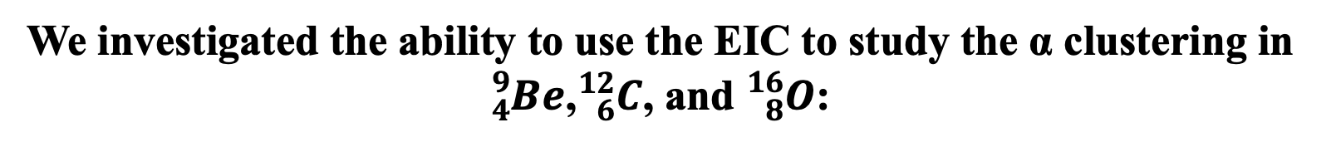
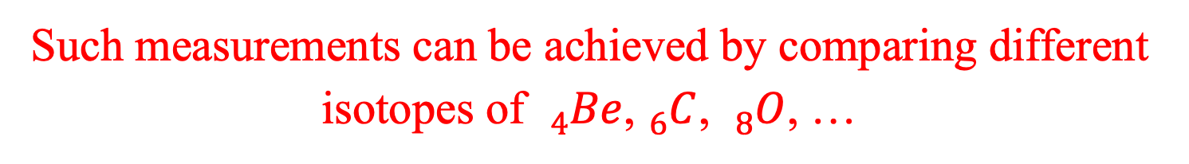
Conclusions
We investigated the ability to use the EIC to study the α clustering in ${}_{4}^{9}{Be}$,${}_{6}^{12}C$, and ${}_{8}^{16}O$:
We proposed three measurements
  Incoherent scattering
  Nuclei homogeneity
  The system energy/momentum
Our proposed measurements are sensitive to α clustering and its configuration.
Such measurements can be achieved by comparing different isotopes of ${}_{4}^{}{Be}$,${}_{6}^{}C$, ${}_{8}^{}O$, …
Thank You

Slide 22
Third Measurement

Slide 23
Correlations of the $\left\langle E_{ZDC}\right\rangle$ and impact parameter
Neutrons from all sources can be used for centrality definition.

Slide 24
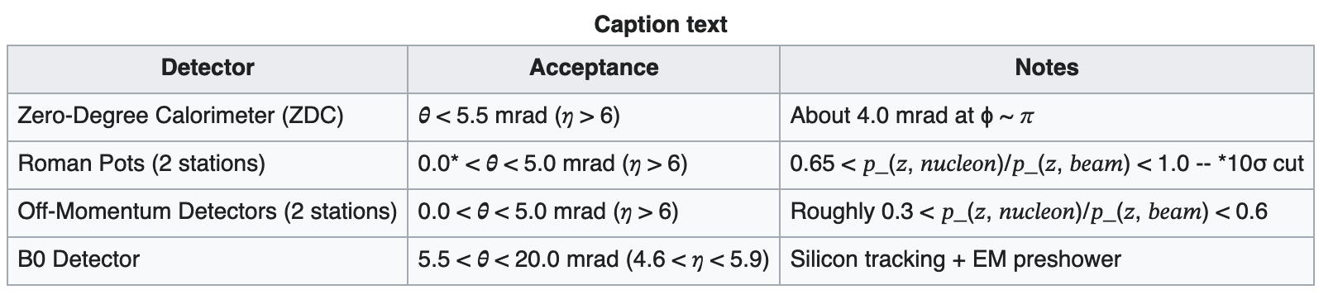



The detector’s acceptance:
$$B_{0}$$
$$ZDC$$
$$η$$
In this current study, we are using: ZDC and B₀ detectors

Slide 25
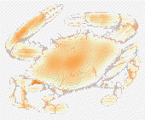
We use a hadronic afterburner that introduces such information.
Scott Pratt, model

Slide 26
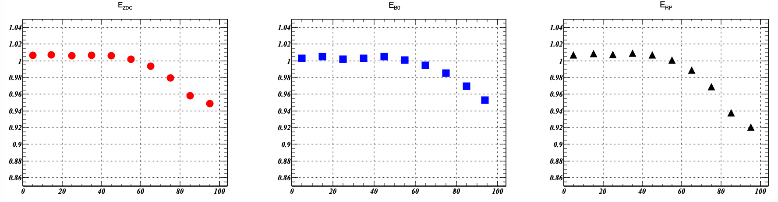

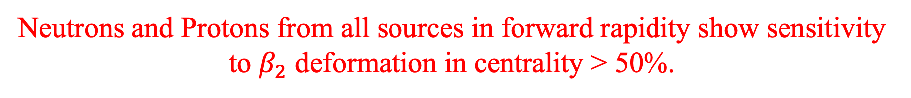

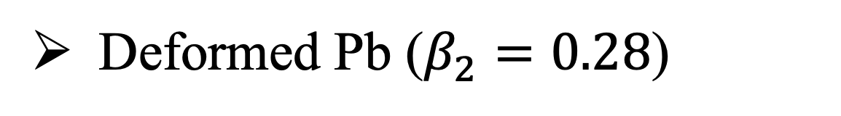





Deformed Pb ($β_{2}=0.28$)
The ratio of the undeformed to deformed Pb
Neutrons in ZDC
Neutrons in B0
Protons in RP
$$e+Pb$$
BeAGLE
$$e+Pb$$
$$e+Pb$$
$$e+Pb$$
BeAGLE
BeAGLE
BeAGLE
$$Cent(\%)$$
$$Cent(\%)$$
$$Cent(\%)$$
Neutrons and Protons from all sources in forward rapidity show sensitivity to $β_{2}$ deformation in centrality > 50%.

Slide 27
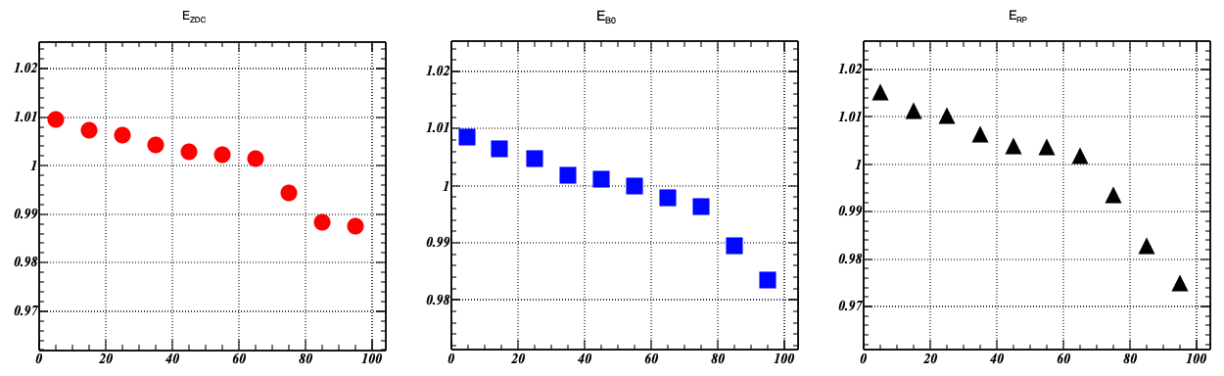

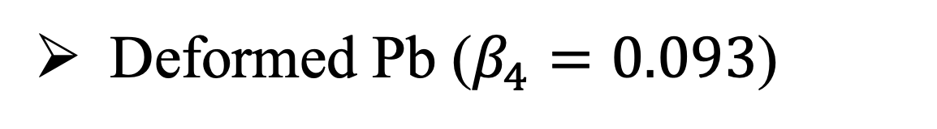

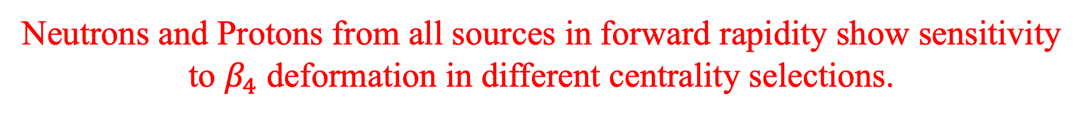




Deformed Pb ($β_{4}=0.093$)
The ratio of the undeformed to deformed Pb
Neutrons in ZDC
Neutrons in B0
Protons in RP
$$e+Pb$$
$$e+Pb$$
$$e+Pb$$
BeAGLE
BeAGLE
BeAGLE
$$Cent(\%)$$
$$Cent(\%)$$
$$Cent(\%)$$
Neutrons and Protons from all sources in forward rapidity show sensitivity to $β_{4}$ deformation in different centrality selections.

Slide 28
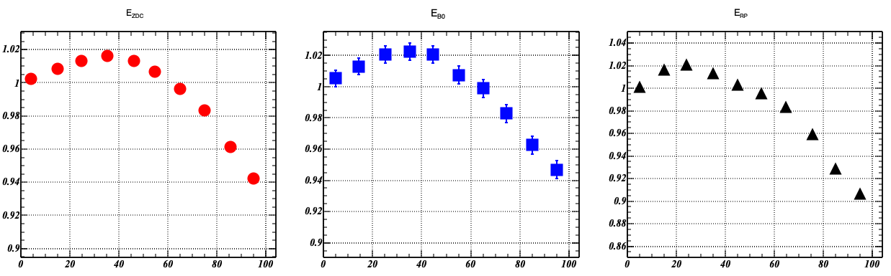

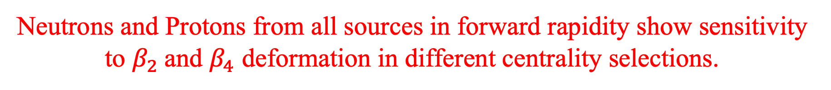

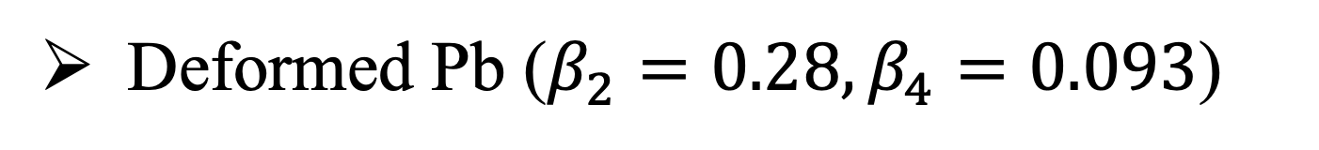



Deformed Pb ($β_{2}=0.28, β_{4}=0.093$)
The ratio of the undeformed to deformed Pb
Neutrons in ZDC
Neutrons in B0
Protons in RP
$$e+Pb$$
$$e+Pb$$
BeAGLE
$$e+Pb$$
BeAGLE
BeAGLE
$$Cent(\%)$$
$$Cent(\%)$$
$$Cent(\%)$$
Neutrons and Protons from all sources in forward rapidity show sensitivity to $β_{2}$and $β_{4}$ deformation in different centrality selections.

Slide 29
The α clustering
Nuclei homogeneity
Case-1: Woods–Saxon
Case-2: Clustering fixed orientation
BeAGLE
Femtoscopy measurements can be sensitive to the clustering.
We are planning to extend the study to the SRC effect.

