Slide 1
Spin Precession at NIKHEF, JLab and the Electron Ion Collider
( polarized sources, magic energies & Siberian Snakes, oh my! ) by
Douglas W. Higinbotham

Slide 2

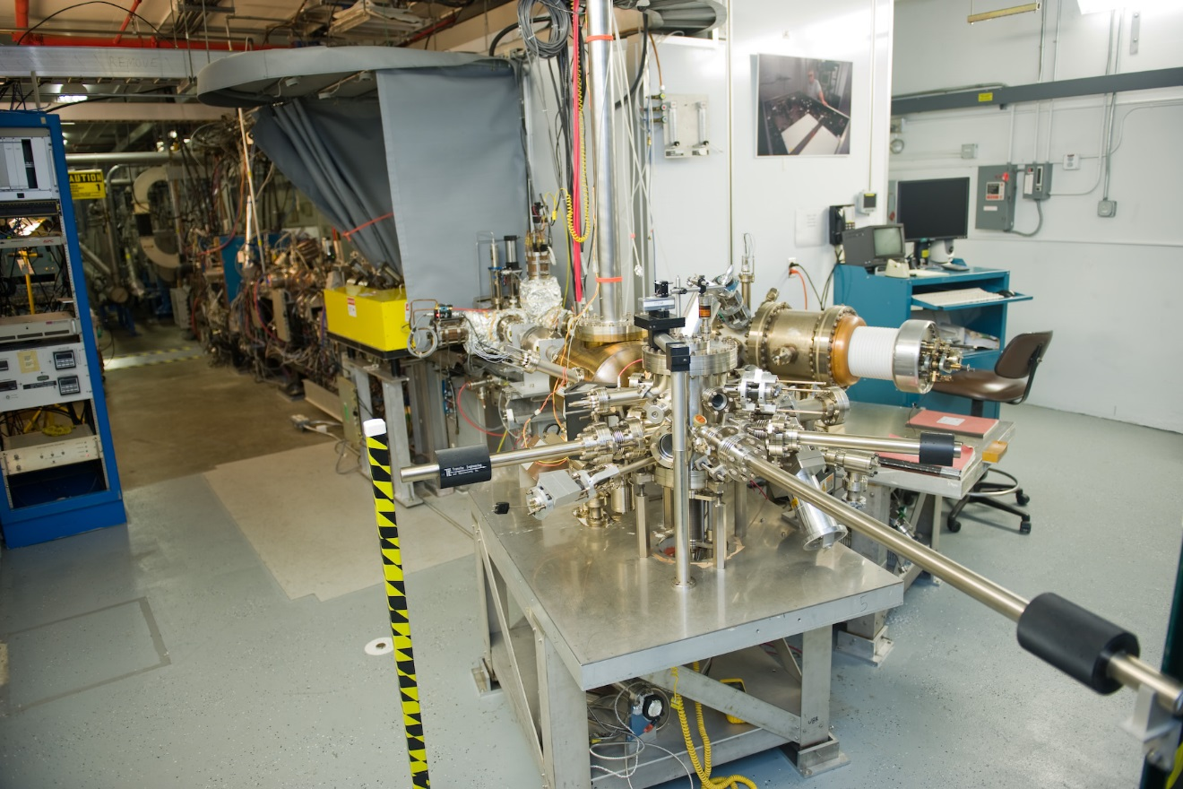
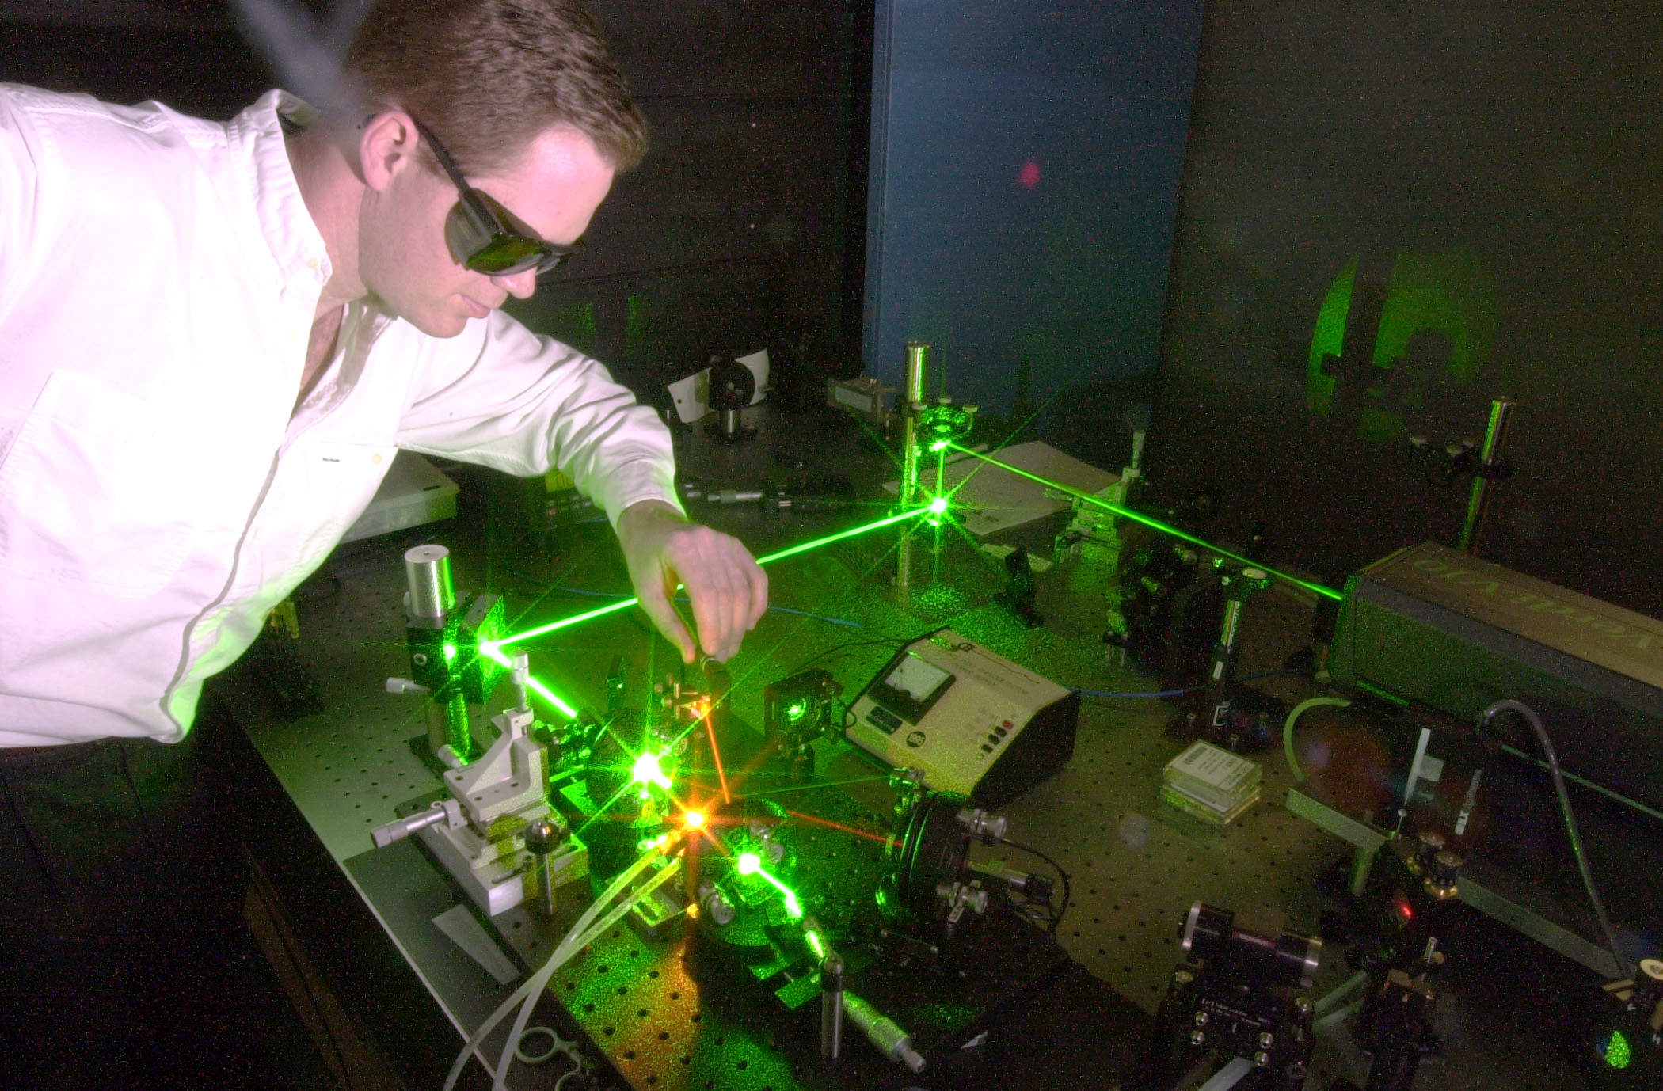
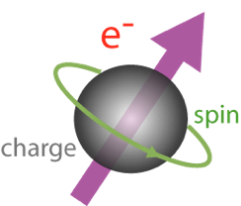
Polarized Electron Source: Photoelectric Effect
Albert Einstein won his Nobel prize for explaining this effect in 1921.
By using polarized laser light and strained GaAs, we can make electrons with ~85% longitudinal polarization.
Photos from Jefferson Lab’s injector. The key for this working well is ultra-high vacuum (UHV) to prevent damage to the GaAs cathode.
2

Slide 3
Why not just use the Sokolov–Ternov effect?!
Instead of making polarized electrons at the source, it is possible to store unpolarized electrons and letting polarization build-up naturally ( the Sokolov-Ternov effect).
Doesn’t work quickly at low energy and polarization will build up in only one direction (anti-parallel to the dipole fields).
HERA made great use of the Sokolov-Ternov effect with their 27.5 GeV electrons.
Size of the ring also matters (smaller better).

Slide 4
Electron Polarization @ NIKHEF with a Full and Partial Snake
The NIKHEF storage ring with a full Siberian Snake could provide stored, longitudinally polarized electrons at any energy.
When the NIKHEF Snake broke, we were able to continue doing physics by going to 440.65 MeV along with a partial snake.
https://doi.org/10.1103/PhysRevLett.84.3855
The hard core version of a spin precession experiment is the Muon g-2 measurement at Fermilab.
NIKHEF/JLab/EIC use our knowledge of anomalous magnetic moments, while Fermilab is pushing the limits of the standard model with ~0.1 ppm measurements.
4

Slide 5
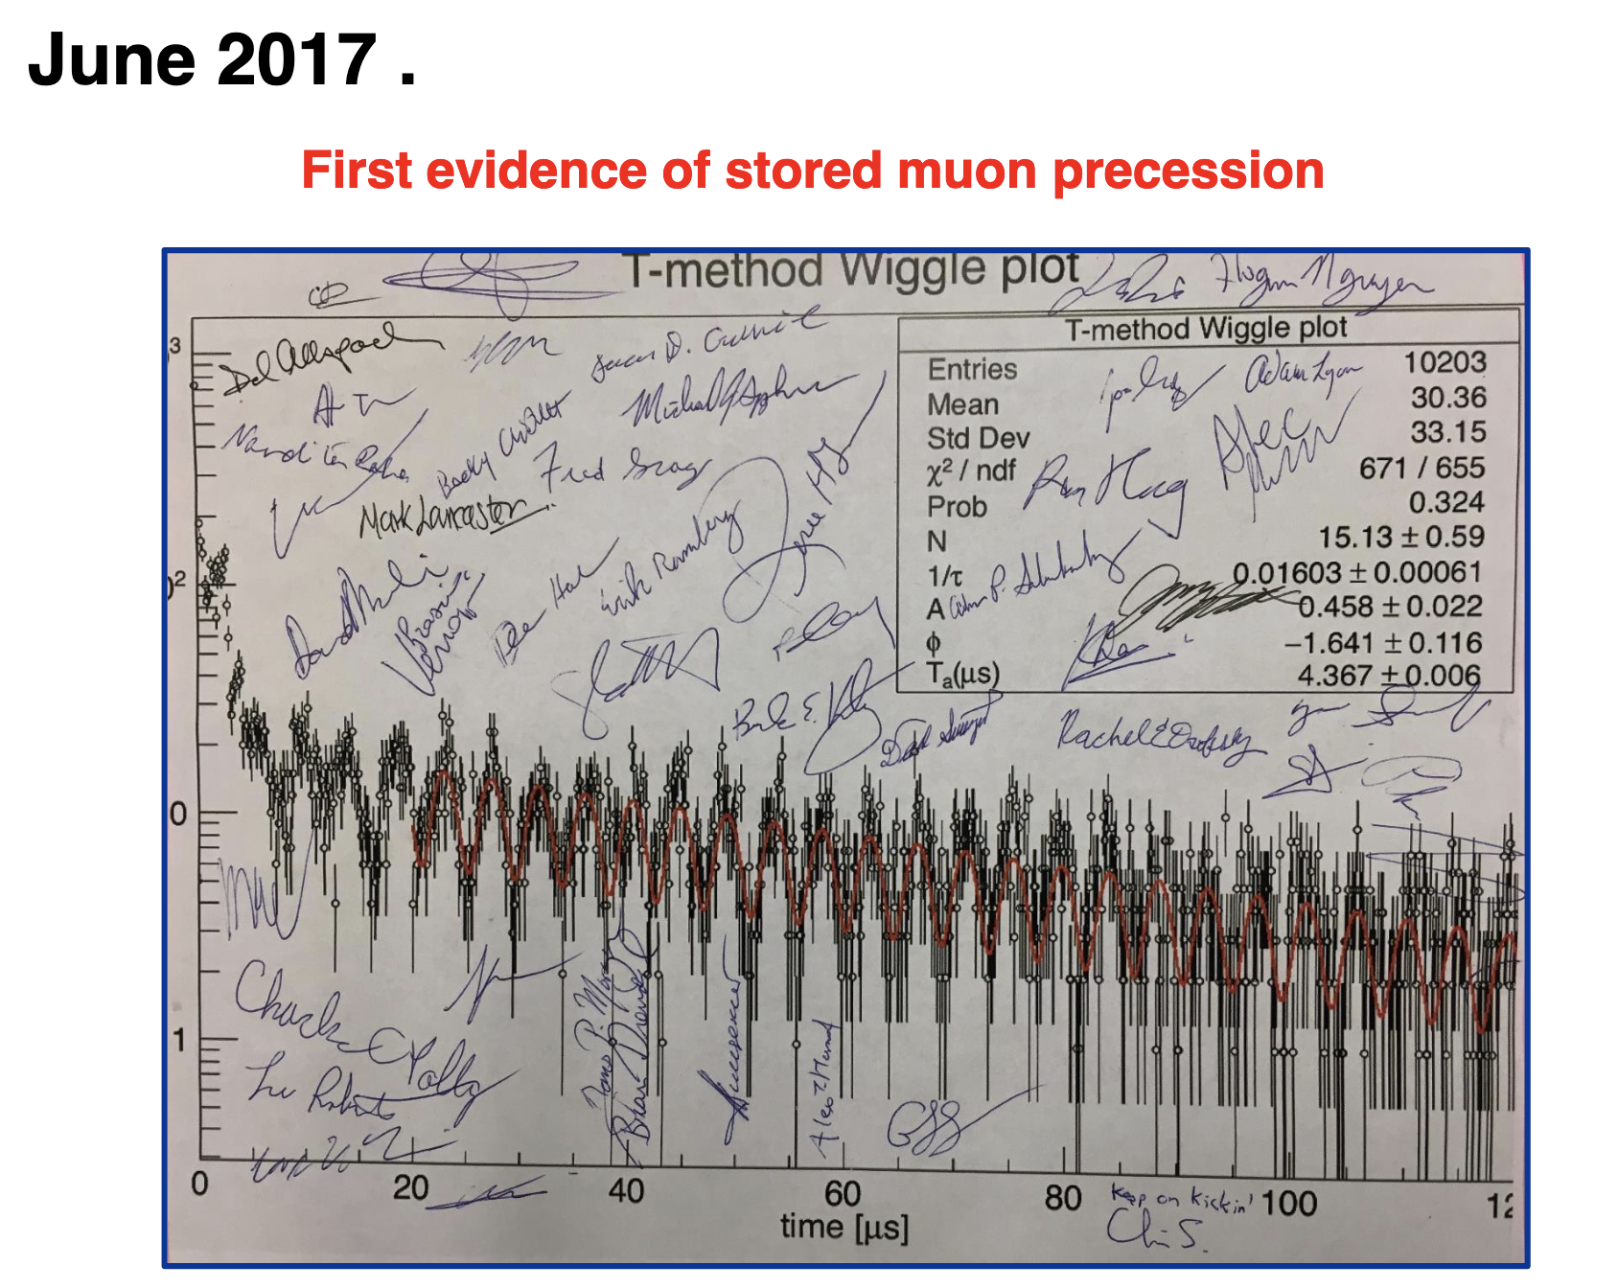
Beautiful First Results from the Fermilab Muon g-2 Experiment

Slide 6
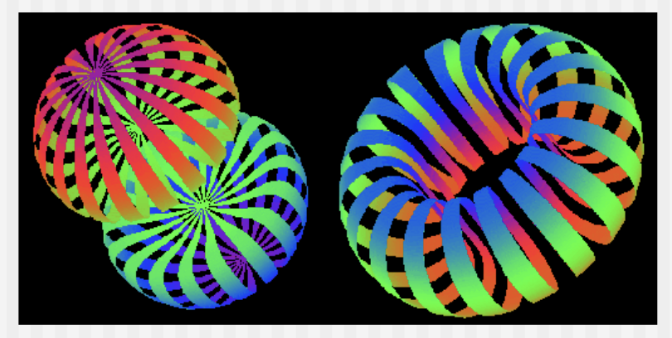
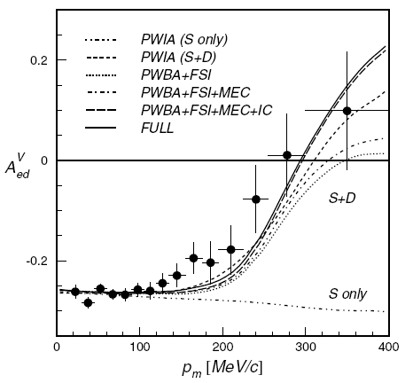
Deuteron D(e,e’p) Asymmetry Results
NIKHEF: Passchier et al., Phys. Rev. Lett. 88 (2002) 102302.
BLAST: A. DeGrush et al., Phys. Rev. Lett. 119 (2017) 18250.
CLAS: M. Mayer et al., Phys. Rev. C95 (2017) 024005.
S
D
p
n
p
n
(L=0)
(L=2)
6

Slide 7
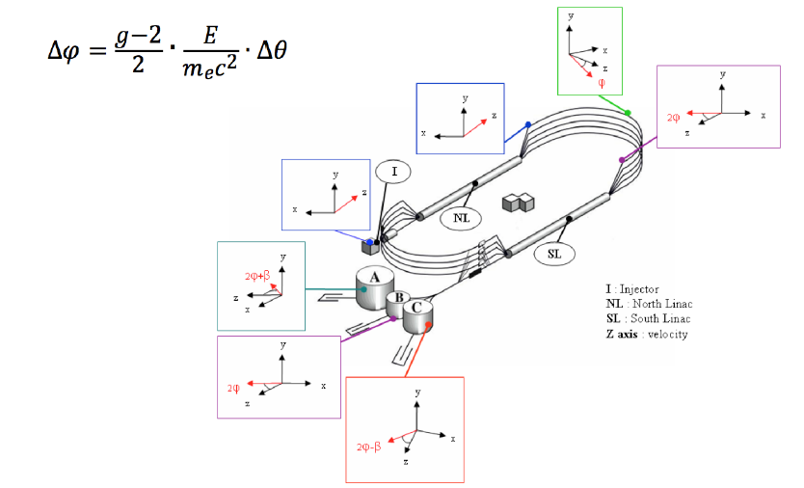
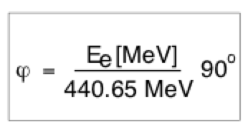
Spin Precession in CEBAF
Like a trick shot, by carefully picking the beam energy, highly polarized electrons can
be sent to multiple experimental halls at once.
I = Injector
NL = North Linac
SL = South Linac
A, B, C exp. halls
https://doi.org/10.1063/1.3215753
7

Slide 8
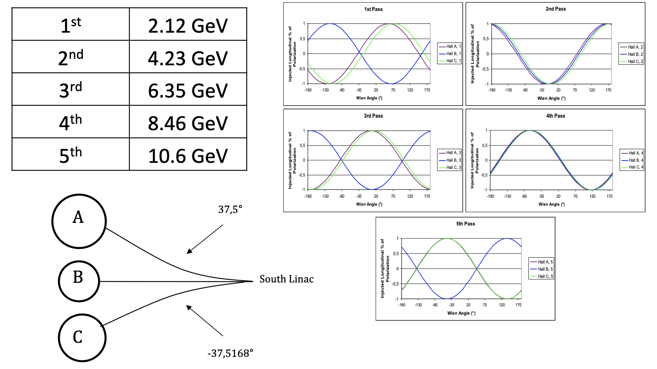
Magic CEBAF Energies
Last JLab run was very close to this with 1.047 GeV/linac + 0.1 GeV injector energy.

Slide 9
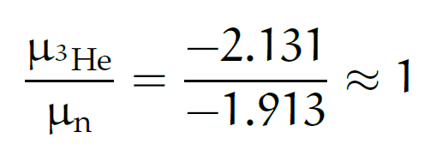
³He ground-state wave-function
S
1.) Spatially symmetric state S (90%):
Spin is dominated by spin of neutron, thus can be used as an effective polarized neutron target:
2.) State D (8%):
Generated by tensor component of NN force.
3.) Mixed symmetry state S’ (2%):
Arises from differences between T=0 and T=1 forces and hence reflects (spin-isospin)-space correlations.
n
p
p
D
(L=0)
n
p
p
S’
n
(L=2)
p
p
(L=0)
9

Slide 10
Results for ³He(e,e’d)p
M. Mihovilvic et al., Phys. Rev. Lett. 113 (2014) 232505
Measured asymmetries are of order of 1%.
Theories reasonably well describe behavior of the data. Hannover (Bonn), Bochum (AV18), Pisa (AV18 + Urbana IX)
Calculations underestimate the measured asymmetries.
Hard to determine what is causing the discrepancy: FSI, SRC, 3NF and/or ?? but clearly state-of-the-art calculations don’t agree with the data.
10

Slide 11
What was special about a figure-8 EIC design?
The figure eight design is naturally spin preserving as net angular change is zero.
In a ring, you of course go 360 degrees in one direction per turn.
Notes:
Contrast with HERA could be made more explicit. Table/column presentation.

Slide 12
Six Snakes Planned for the EIC
(i.e. one can make the circular design work, it can just get complicated/expensive)
-45º
Ideally multiple snake arrangement is perfectly symmetric with 60 degree bending angle between Snakes.
Due to the injection region constraint, the snake at IP6 can not be put into the desired place. The proposed snake locations are as following with counting starting at IP12: snake1 = 𝜙, snake2=𝜋/3 − 𝜙, snake3 = 2𝜋/3−𝜙, snake4 =𝜋+𝜙, snake5 = 4𝜋/3−𝜙, snake6= 5𝜋/3− 𝜙, where 𝜙 = 0.0435rad.
( slide adapted from the Haixin Huang’s yesterday )

Slide 13
Deuteron Polarization at the EIC
Magnetic moment of the proton is 2.79 nuclear magnetons, neutron moment is -1.91, 3He is -2.13 (i.e. we already know pol. 3He not equal to pol. n) ) BUT the deuteron moment is 0.857 nuclear magnetons making it significantly harder to manipulate with Siberian snakes
Assuming the deuterons can be accelerated from an atomic beam source without loosing polarization (this is a non-trivial challenge of depolarizing resonances), the idea of magic energies can be used to allow longitudinal deuteron polarization at an interaction region in the EIC without (hopefully) having to further upgrade the Siberian snakes.
Assuming an EIC deuteron energy range of 20.5 to 137.5 GeV/nucleon, there are a total of 17 energies where the deuteron polarization can in principle be made longitudinal at least at one interaction point: 26.2, 32.8, 39.4, 45.9, 52.5, 59.0, 65.6, 72.1, 78.7, 85.3, 91.8, 98.4, 104.9, 111.5, 118.1, 124.6, and 131.2 GeV/nucleon.
Of these energies, there are 5 where the deuteron polarization can be made longitudinal at both interaction points: 39.4, 59.0, 78.7, 98.4, and 118.1 GeV/nucleon.
Two of those are very close to the yellow report energies of 41 and 110 GeV.

Slide 14
Summary
For lower energy electron machines, polarized sources are used from making polarized electrons. Sources also allow for rapid spin flips.
NIKHEF used (by accident) a partial Siberian Snake and nicely showed how going close to a magic energy can make it possible to preserve polarization without a full Snake.
AT Jefferson Lab, the beam only has only a full turns, but we set the energy carefully in order to send high polarization to multiple halls at the same time.
Polarized protons and ³He are envisioned as part of the early EIC.
As we have learned at this conference, we should be able to have polarized deuterons making use of partial Snakes and magic energies for the deuteron. ( circa ~2040 )

