Slide 1


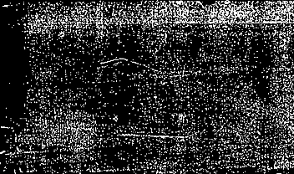
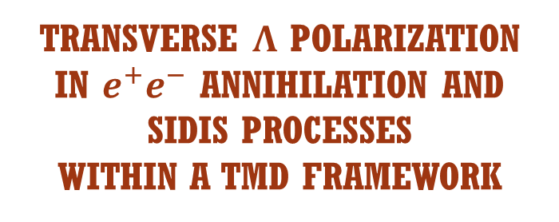
Transverse Λ polarization in $e^{+}e^{−}$ annihilation and
SIDIS processes within a TMD framework
WORKSHOP ON
TMDs: Towards a Synergy between
Lattice QCD and Global Analyses
Umberto D’Alesio
in coll. with
L.Gamberg, F. Murgia & M. Zaccheddu
JHEP 12 (2022) 074
arXiv:2306.xxxxx

Slide 2


Outline
Motivations
$e^{+}e^{−} →h_{1}{ h}_{2}+X$:
  TMD formulation and fit of transverse Λ polarization Belle data
  Extraction of the polarizing FF
  SU(2) symmetry and role of charm contribution
SIDIS
  TMD formalism
  Predictions for EIC
Concluding remarks

Slide 3
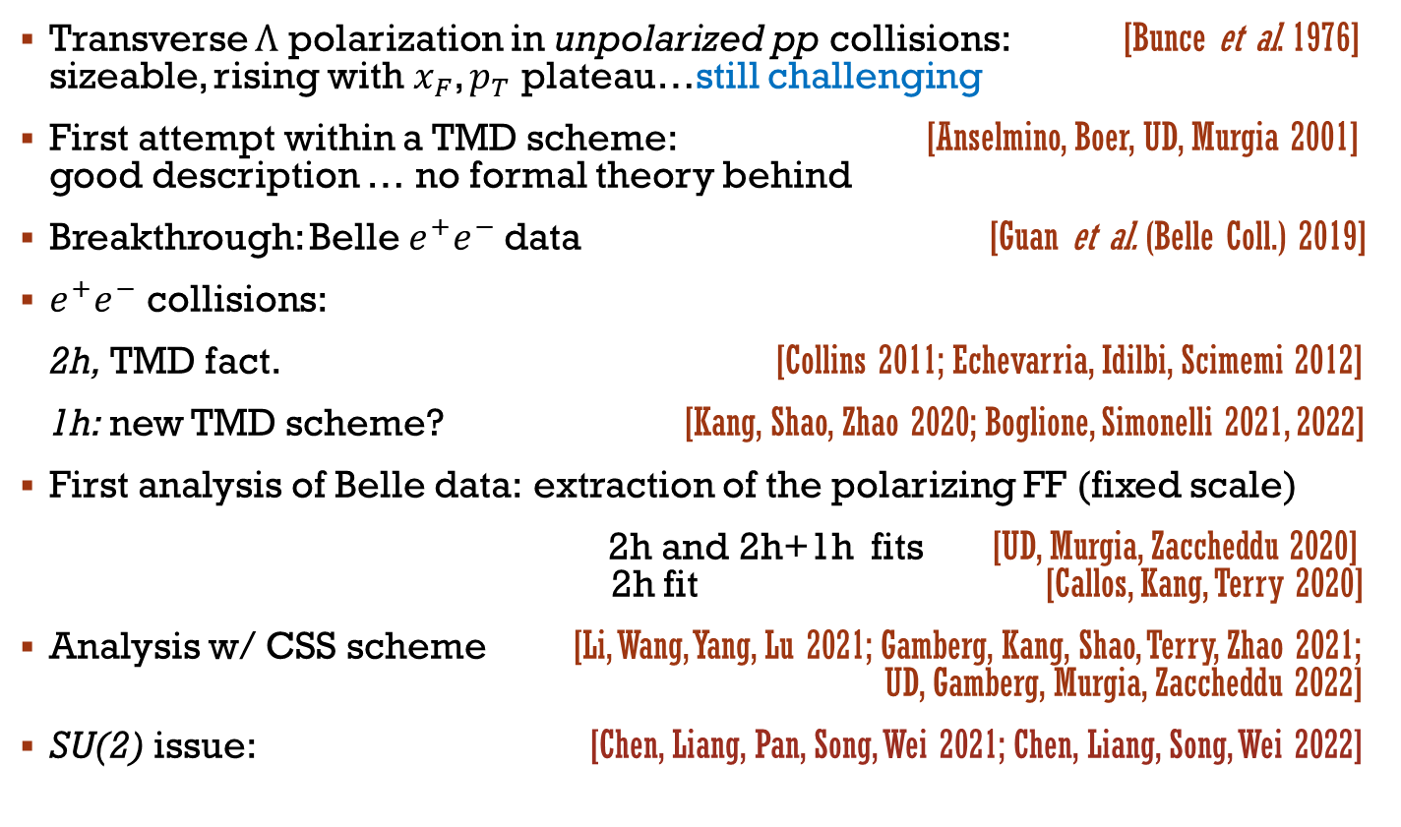
Motivations and more
Transverse Λ polarization in unpolarized pp collisions: [Bunce et al. 1976] sizeable, rising with${ x}_{F}$, $p_{T}$ plateau…still challenging
First attempt within a TMD scheme: [Anselmino, Boer, UD, Murgia 2001] good description … no formal theory behind
Breakthrough: Belle $e^{+}e^{−}$data [Guan et al. (Belle Coll.) 2019]
$e^{+}e^{−}$ collisions:
2h, TMD fact. [Collins 2011; Echevarria, Idilbi, Scimemi 2012]
1h: new TMD scheme? [Kang, Shao, Zhao 2020; Boglione, Simonelli 2021, 2022]
First analysis of Belle data: extraction of the polarizing FF (fixed scale)
2h and 2h+1h fits [UD, Murgia, Zaccheddu 2020] 2h fit [Callos, Kang, Terry 2020]
Analysis w/ CSS scheme [Li, Wang, Yang, Lu 2021; Gamberg, Kang, Shao, Terry, Zhao 2021; UD, Gamberg, Murgia, Zaccheddu 2022]
SU(2) issue: [Chen, Liang, Pan, Song, Wei 2021; Chen, Liang, Song, Wei 2022]

Slide 4
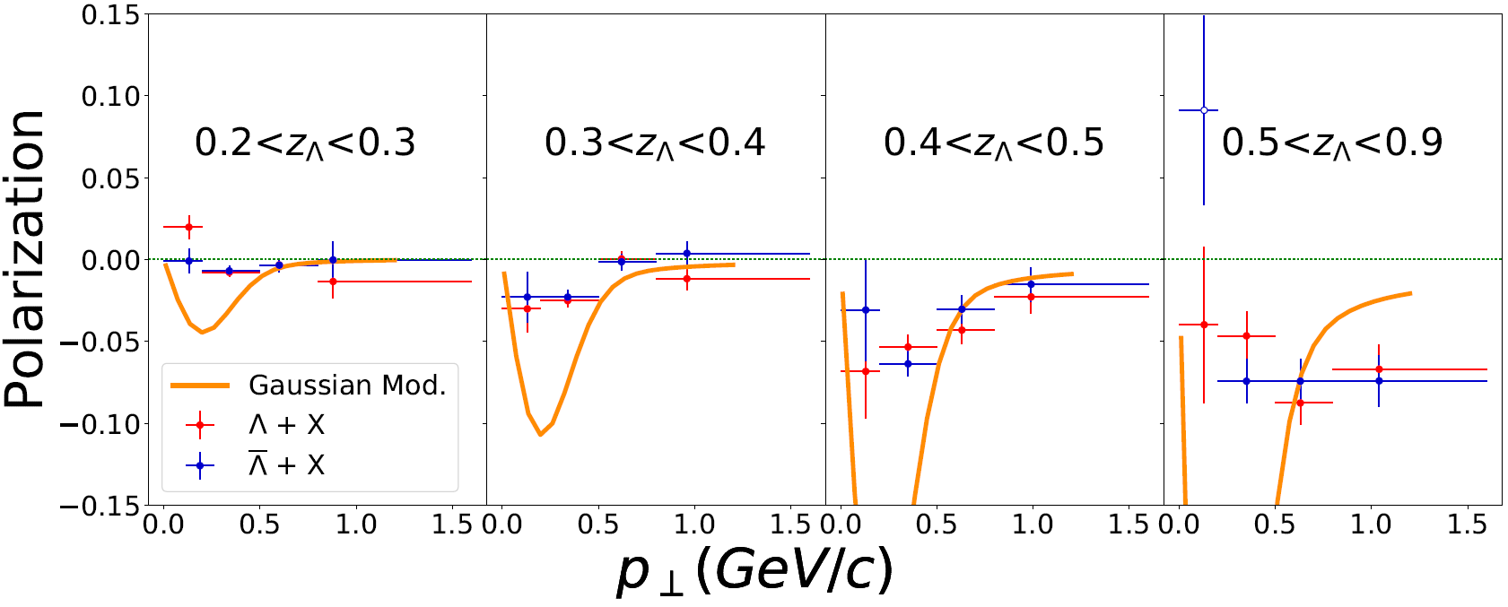
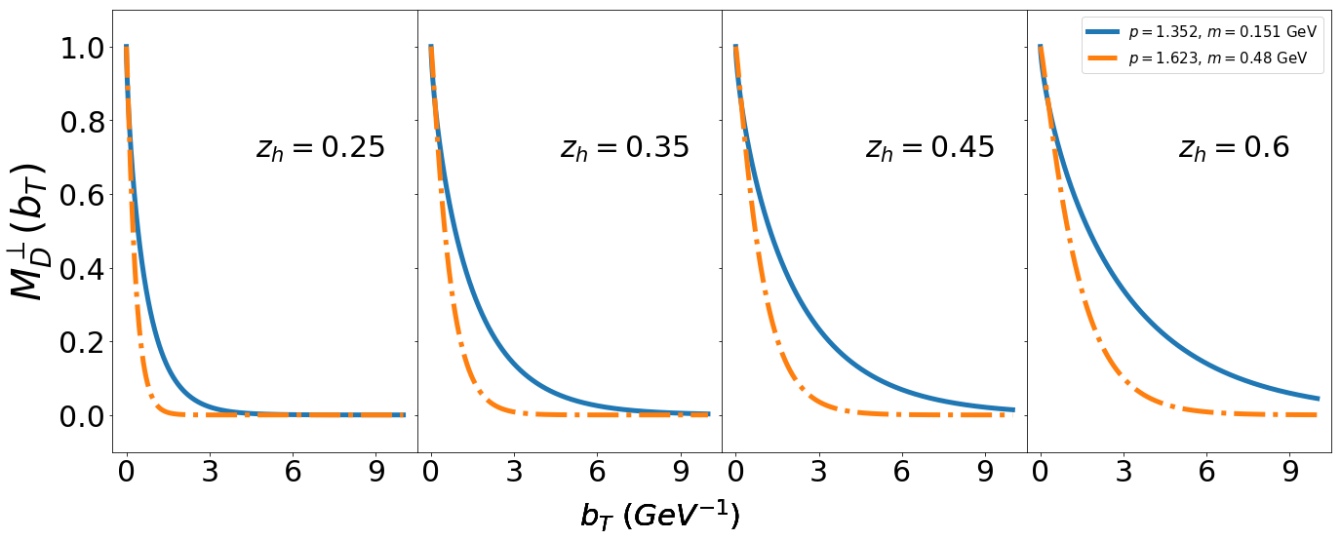
OPEN ISSUES (the last analysis)
[UD, Gamberg, Murgia, Zaccheddu 2022]
Tension between 2h & 1h data description
1h estimates from 2h-fit
Non perturbative models
to fit 2h and 1h data
Maybe two factorization schemes

Slide 5
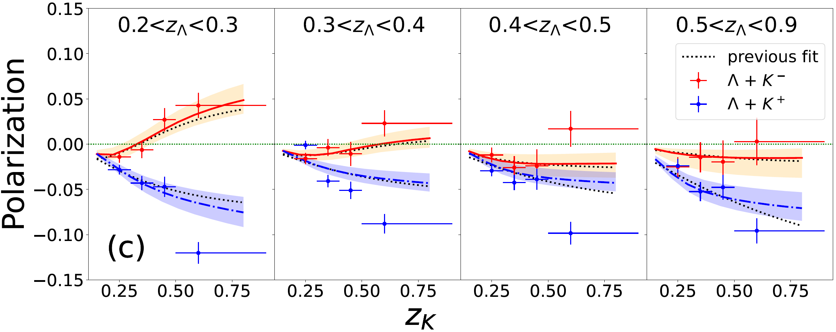

Large-$z$ $KΛ$ data: failure w/ or w/o proper TMD framework
Free three-flavor ($u,d,s$) fit strong SU(2) violation ($d≅−u$)
HERE, focus on: SU(2) symmetry and role of charm

Slide 6
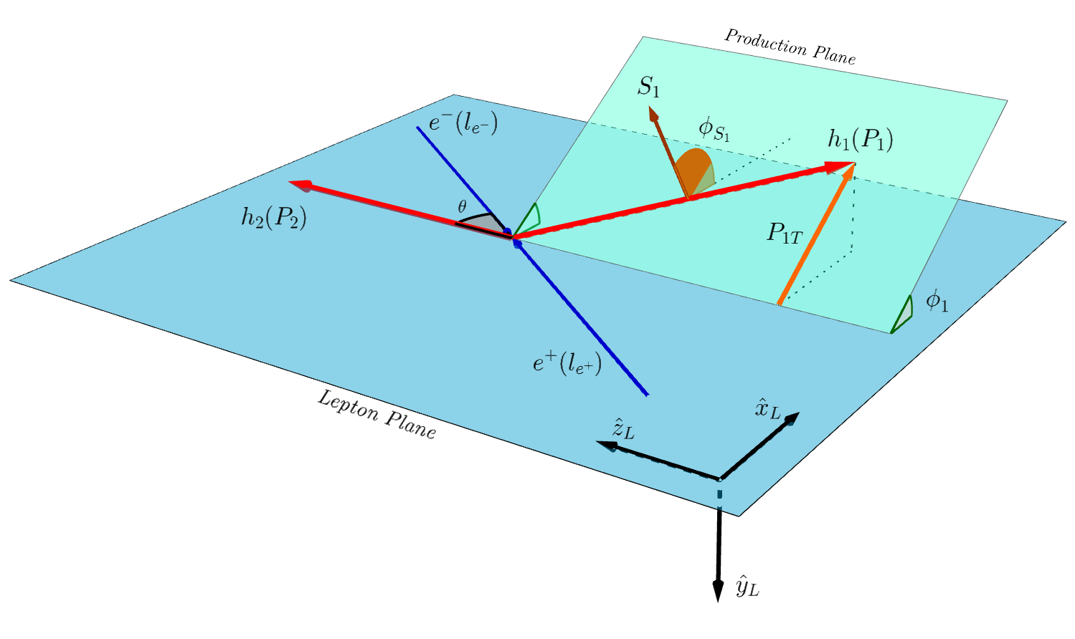

$e^{+}e^{−} →$ $h_{1}\left(P_{1}\right){ h}_{2}\left(P_{2}\right)+ X$
[Boer, Jakob, Mulders 1997; Pitonyak, Schlegel, Metz 2014; UD, Murgia, Zaccheddu 2021]

Slide 7
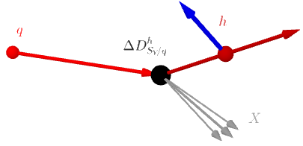





$e^{+}e^{−} →$ $h_{1}\left(P_{1}\right){ h}_{2}\left(P_{2}\right)+ X$
Convolution in $k_{T}$space
CSS approach…move to $b_{T}$space
1st moment of the pFF
$$q$$
$$h$$
polarizing FF
$$X$$

Slide 8
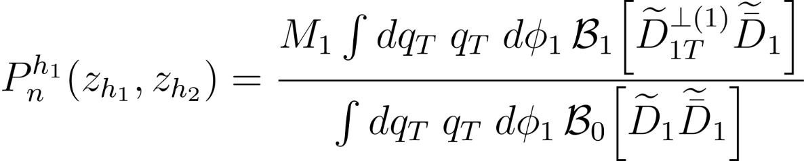

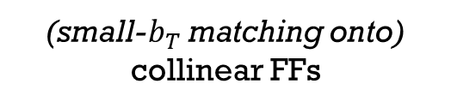
$e^{+}e^{−} →$ $h_{1}\left(P_{1}\right){ h}_{2}\left(P_{2}\right)+ X$
Polarization along n (Ʇ to the production plane)
$$q_{T}<0.27 Q$$
TMD fact.
Denominator (known)
(small-$b_{T}$ matching onto)
collinear FFs
Nonpert.
CS Kernel
Perturbative
Sudakov factor
Nonpert. funct.s

Slide 9
Perturb.
CS Kernel
RG cusp
anomalous dimensions
Nonperturbative functions from Bacchetta, Delcarro, Pisano, Radici, Signori 2017
Coll. FF sets: for $π/K$ de Florian. Sassot, Stratmann 2007; for $Λ$ Albino, Kniehl, Kramer 2008

Slide 10
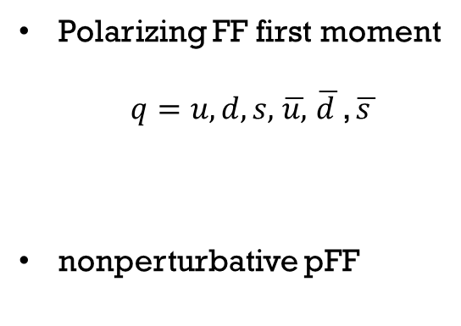
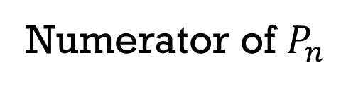
Numerator of $P_{n}$
Polarizing FF first moment
$q=u,d,s,$ $\overline{u,}$ $\overline{d }$, $\overline{s }$
nonperturbative pFF

Slide 11
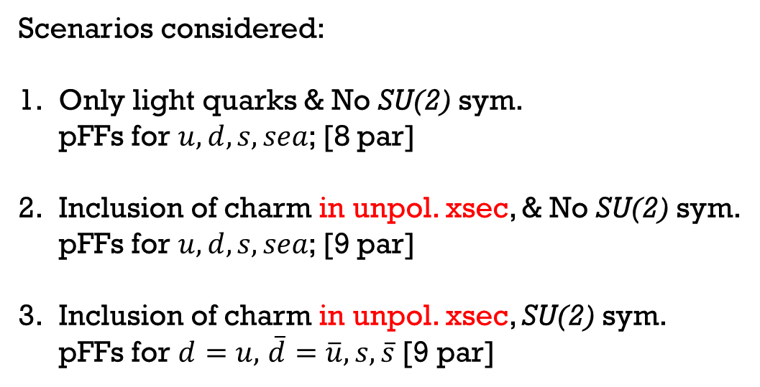
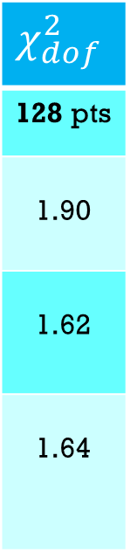
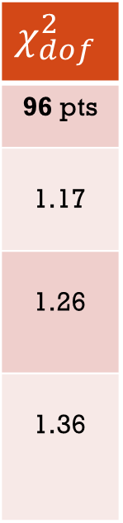
FIT of Belle data [NLL]
Data selection: $Λ+π/K$: $z_{π.K}$[0.5-0.9] bin excluded $→$ 96 data points (128)
$$χ_{dof}^{2}$$
96 pts
1.17
1.26
1.36
$$χ_{dof}^{2}$$
128 pts
1.90
1.62
1.64
Scenarios considered:
Only light quarks & No SU(2) sym.
pFFs for $u, d,s, sea$; [8 par]
Inclusion of charm in unpol. xsec, & No SU(2) sym.
pFFs for $u,d,s, sea$; [9 par]
Inclusion of charm in unpol. xsec, SU(2) sym.
pFFs for $d=u,$ $\overline{d}=\overline{u}, s, \overline{s}$ [9 par]

Slide 12
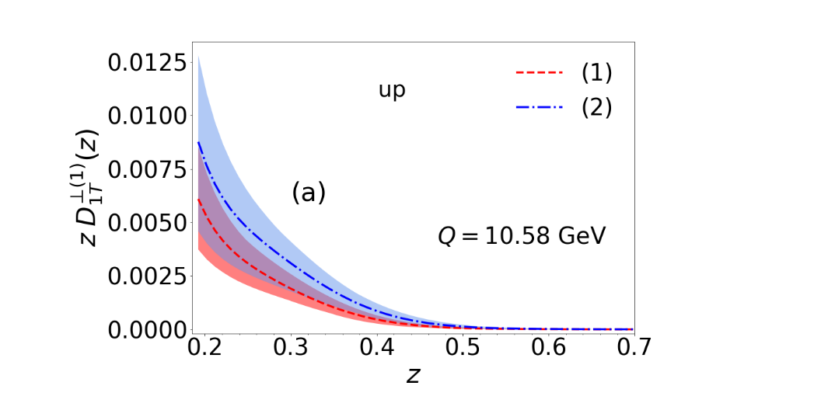
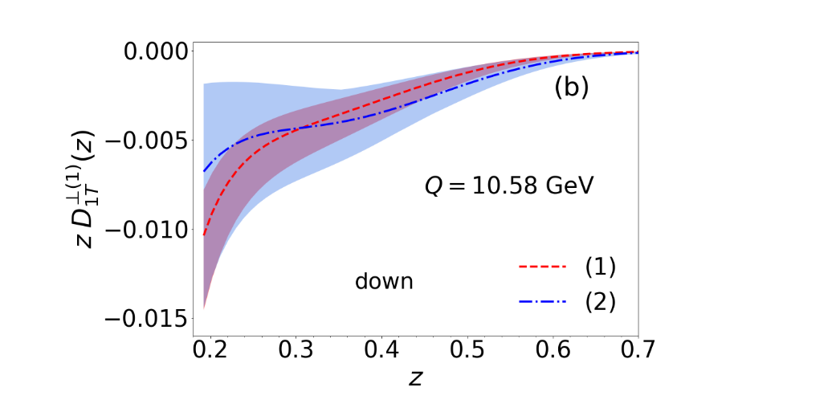
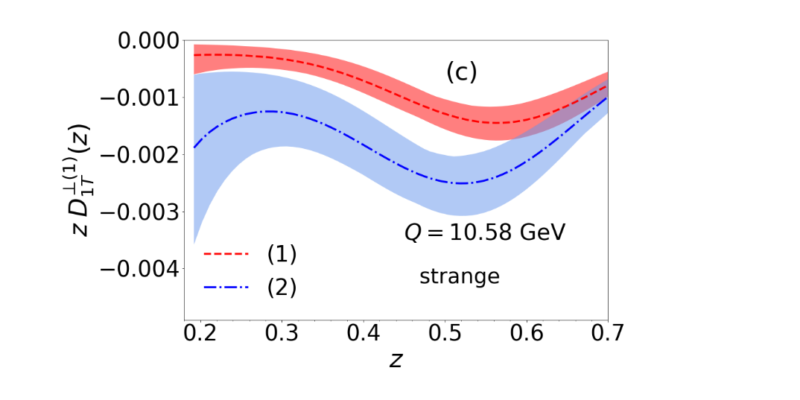
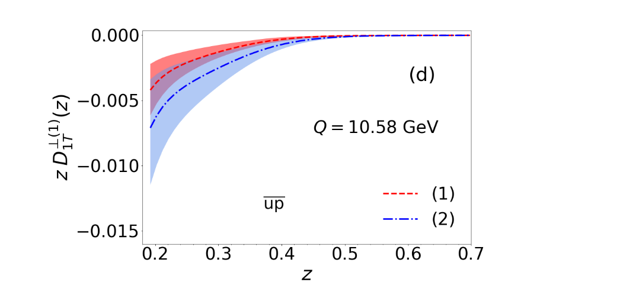
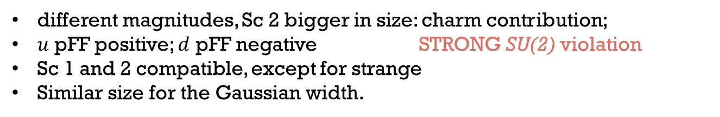
First moments: Sc 1, 2 NO SU(2) symm.
different magnitudes, Sc 2 bigger in size: charm contribution;
$u$ pFF positive; $d$ pFF negative STRONG SU(2) violation
Sc 1 and 2 compatible, except for strange
Similar size for the Gaussian width.

Slide 13
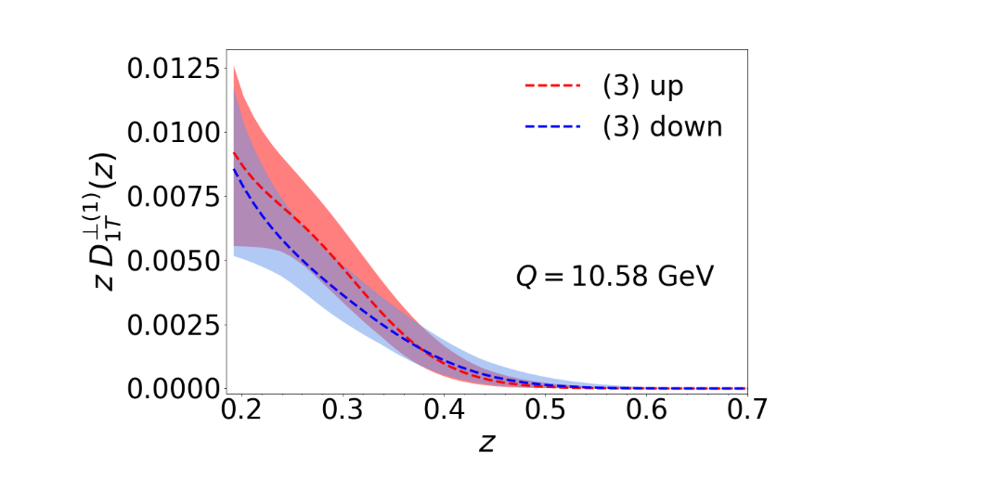
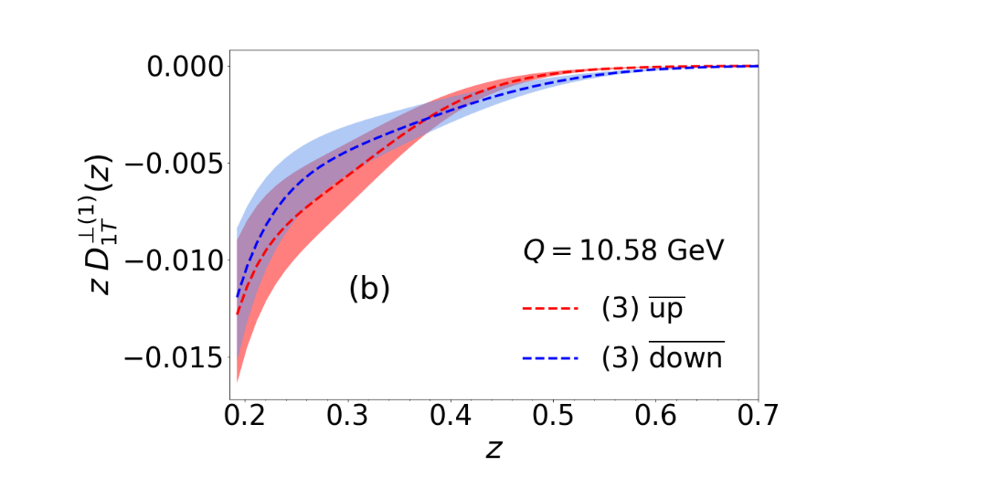
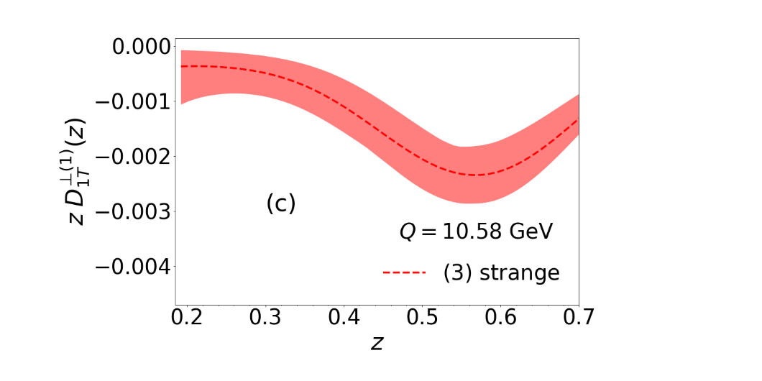
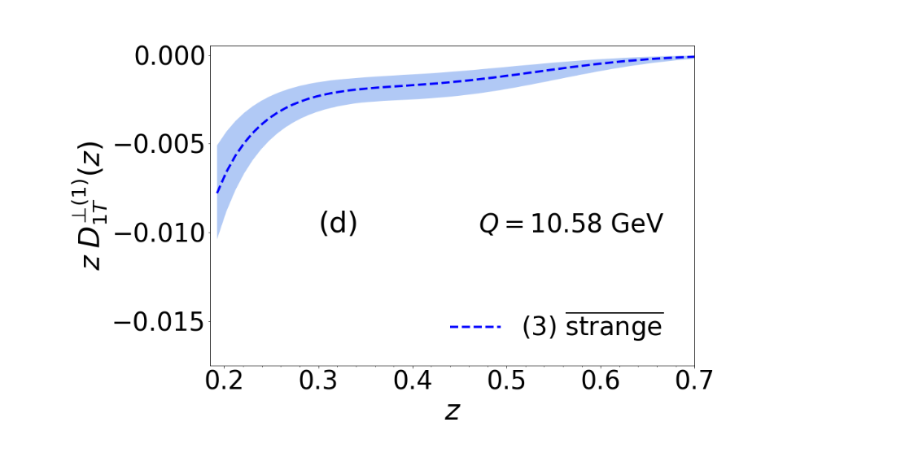
First moments: Sc 3 WITH SU(2) symm.
$u,d$ pFFs positive; all others pFFs negative
sea contribution larger in size w.r.t. Sc. 1 & 2

Slide 14
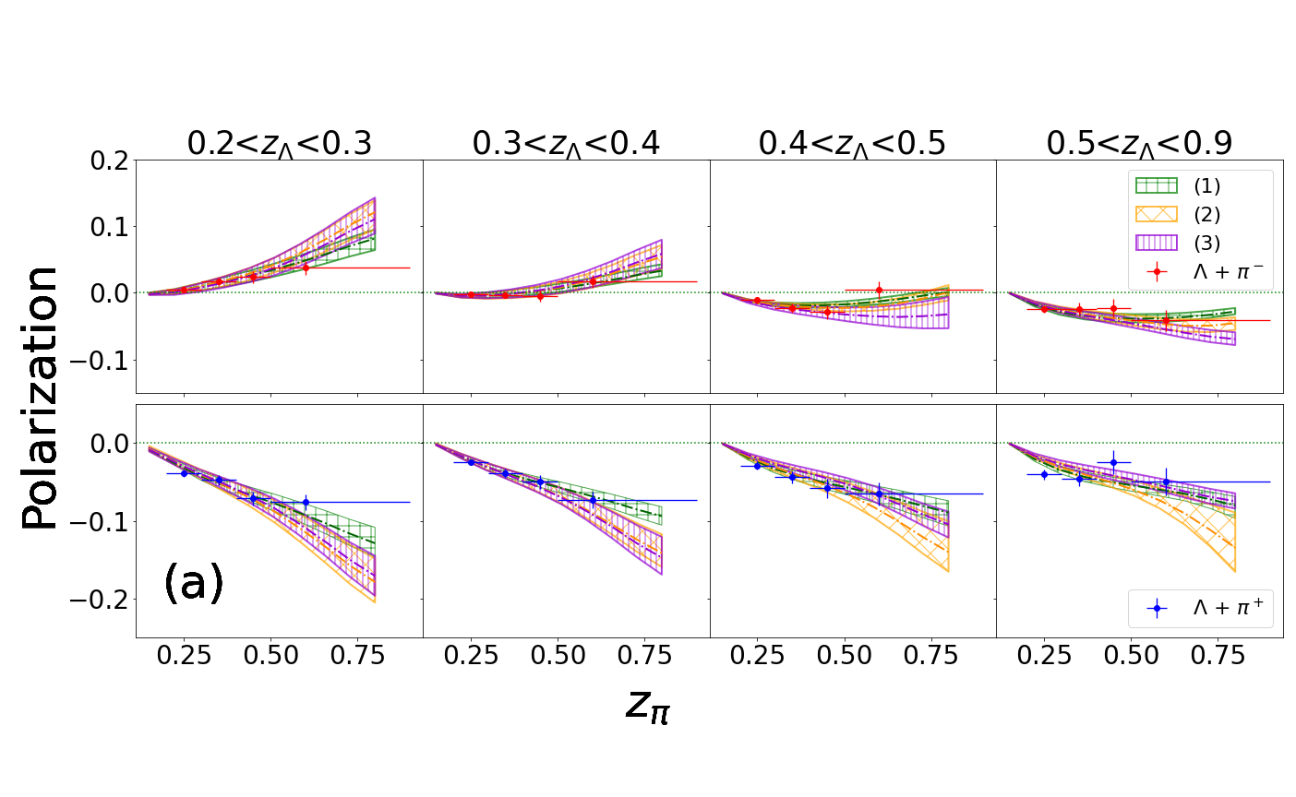
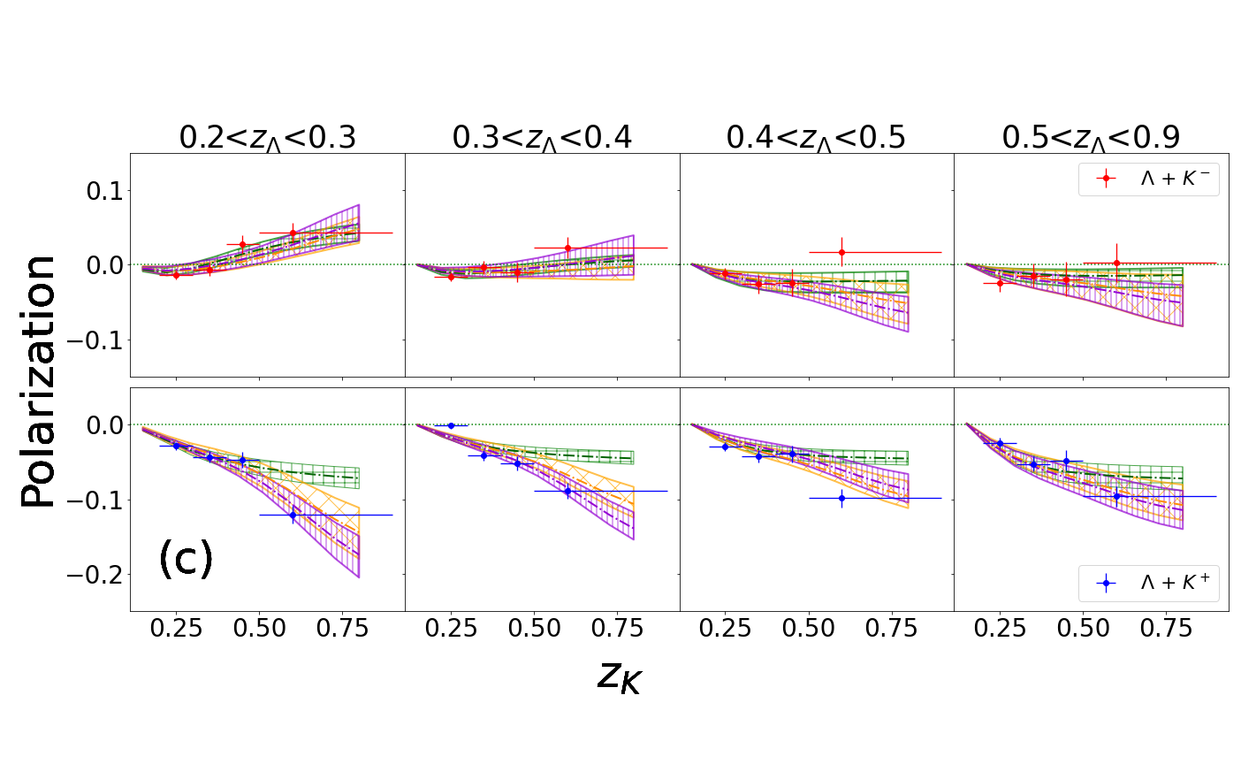
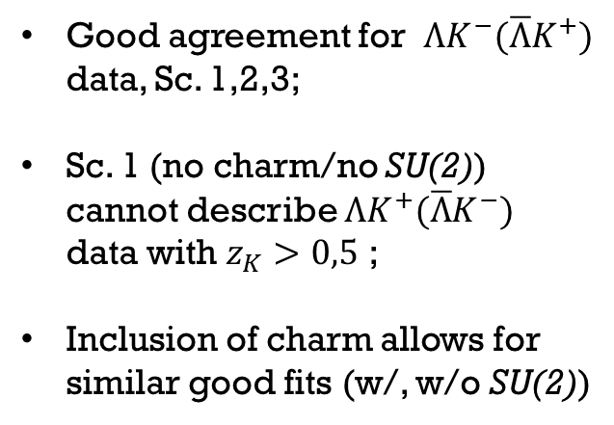
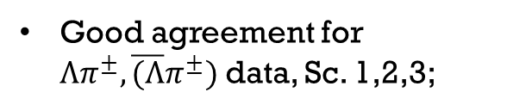
Data description
Good agreement for $Λπ^{±},\overline{(Λ}π^{±})$ data, Sc. 1,2,3;
Good agreement for $ΛK^{−}(\overline{Λ}K^{+})$ data, Sc. 1,2,3;
Sc. 1 (no charm/no SU(2)) cannot describe $ΛK^{+}(\overline{Λ}K^{−})$ data with $z_{K}>0,5$ ;
Inclusion of charm allows for similar good fits (w/, w/o SU(2))

Slide 15
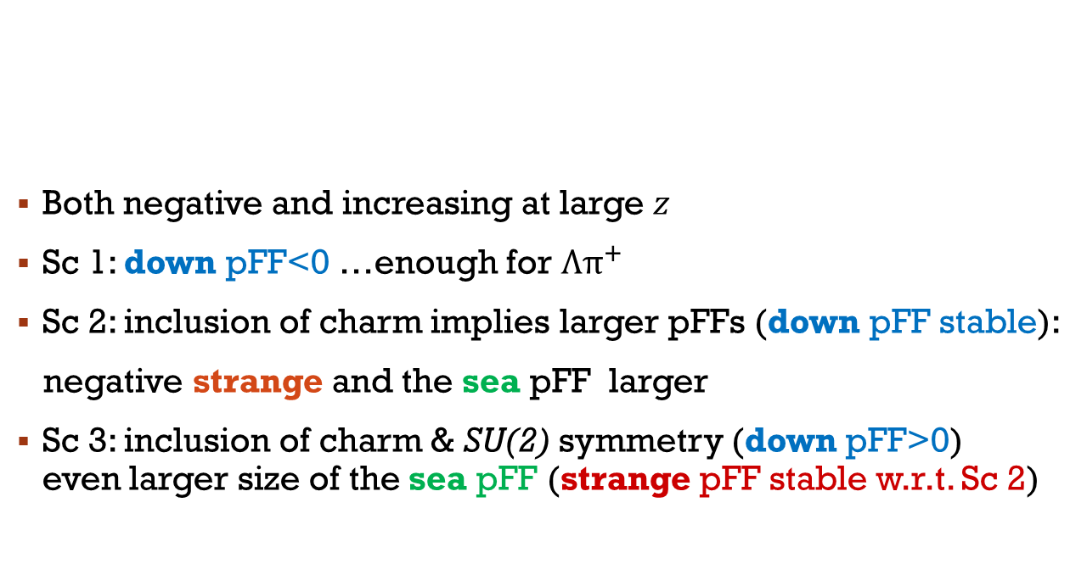
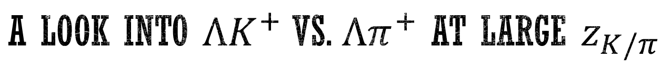
A look into $ΛK^{+}$ vs. $Λπ^{+}$ at large $z_{K/π}$
Both negative and increasing at large $z$
Sc 1: down pFF<0 …enough for Λ$π^{+}$
Sc 2: inclusion of charm implies larger pFFs (down pFF stable):
negative strange and the sea pFF larger
Sc 3: inclusion of charm & SU(2) symmetry (down pFF>0) even larger size of the sea pFF (strange pFF stable w.r.t. Sc 2)

Slide 16
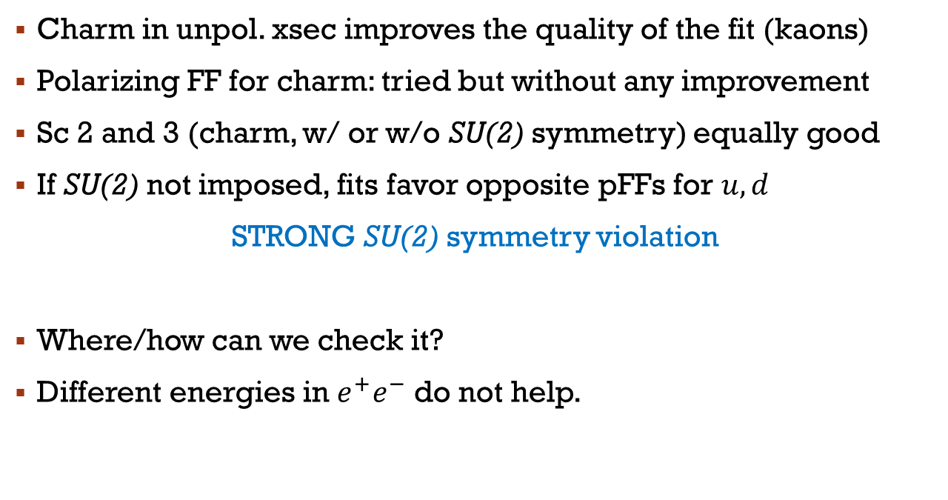
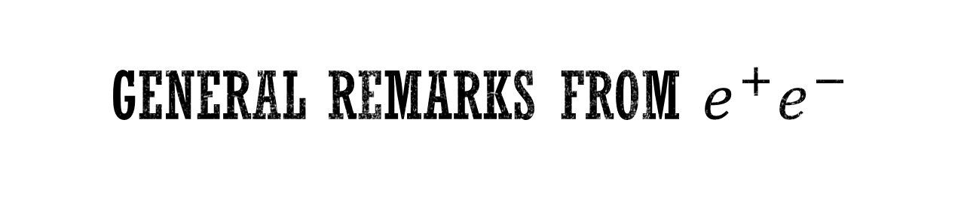
General remarks from $e^{+}e^{−}$
Charm in unpol. xsec improves the quality of the fit (kaons)
Polarizing FF for charm: tried but without any improvement
Sc 2 and 3 (charm, w/ or w/o SU(2) symmetry) equally good
If SU(2) not imposed, fits favor opposite pFFs for $u,d$
STRONG SU(2) symmetry violation
Where/how can we check it?
Different energies in $e^{+}e^{−}$ do not help.

Slide 17
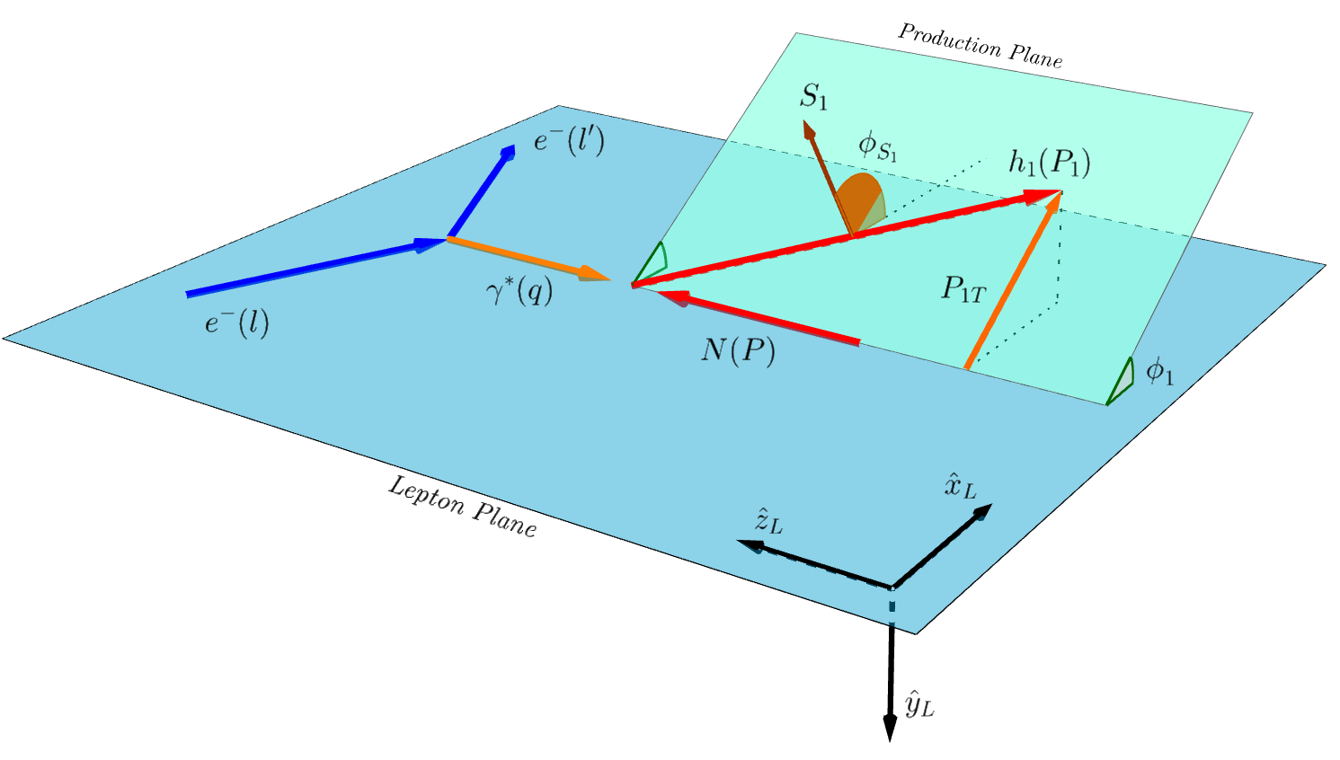
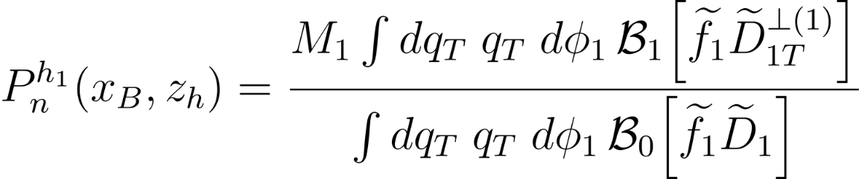
SIDIS
Bacchetta, Delcarro, Pisano, Radici, Signori 2017
Coll PDF
Nonpert funct.

Slide 18
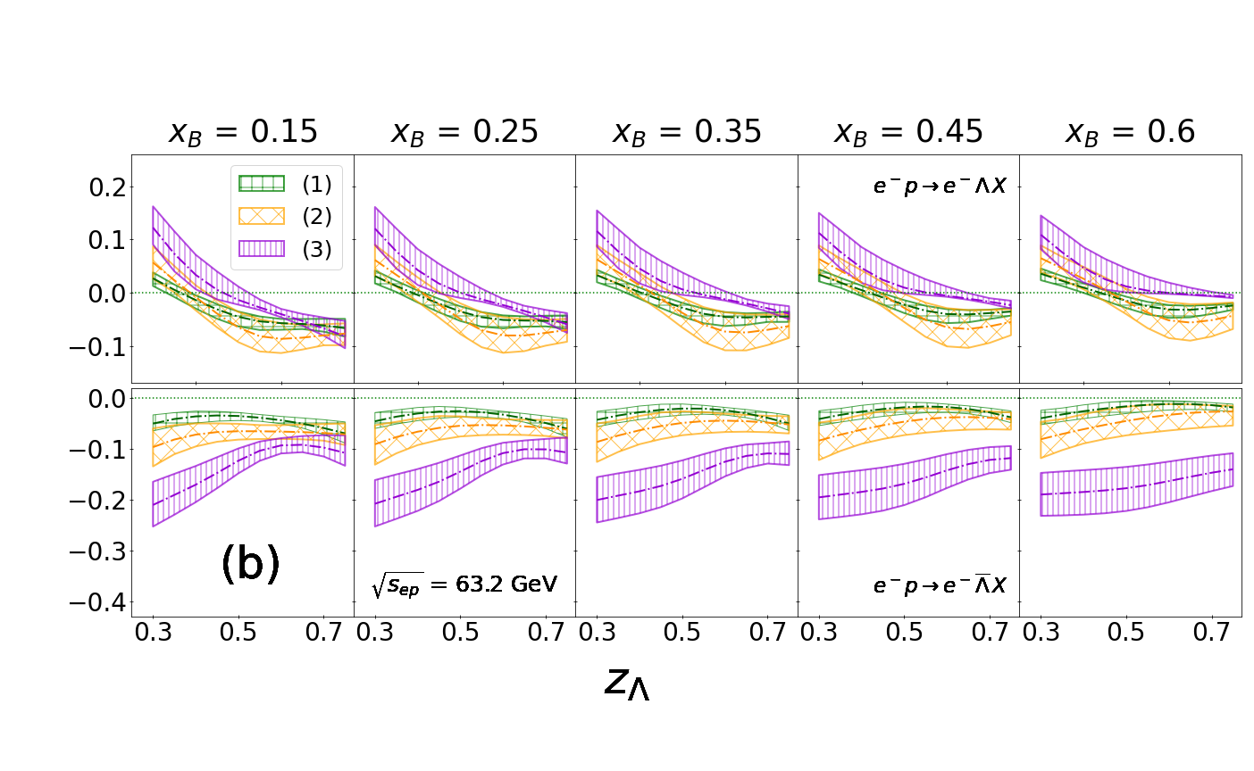

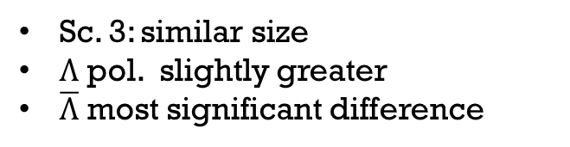
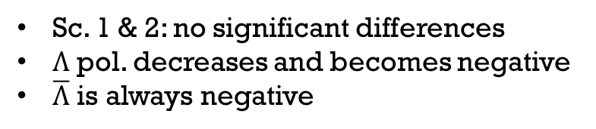
PREdICTIONS FOR EIC
Unpolarized PDFs:
CT14nnlo set
[Dulat et al 2016]
No ch, No SU(2)
ch, No SU(2)
ch & SU(2)
Sc. 1 & 2: no significant differences
$Λ$ pol. decreases and becomes negative
$\overline{Λ}$ is always negative
Sc. 3: similar size
$Λ$ pol. slightly greater
$\overline{Λ}$ most significant difference
Impact study in SIDIS@EIC (Sc 1 at LO) Kang, Terry, Vossen, Xu, Zhang 2022

Slide 19
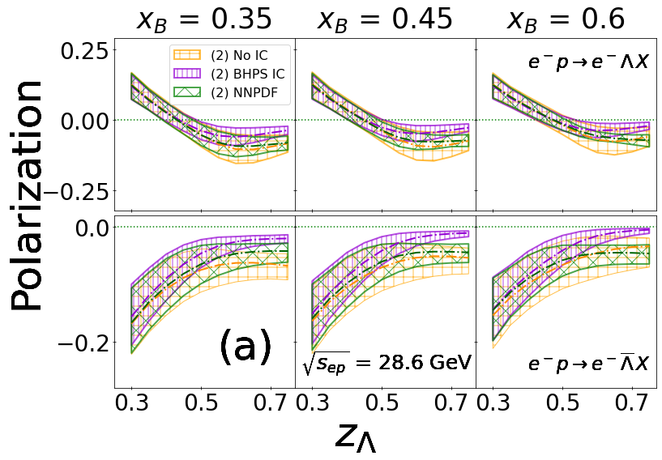
Intrinsic charm in the proton within Scenario 2
CT14 nnlo IC set with BHPS model
[T.-J. Hou et al., 2018]
NNPDF4.0 nnlo set [NNPDF Coll. 2022]
BHPS and NNPDF: similar polarization values
compatible with no intrinsic charm case

Slide 20
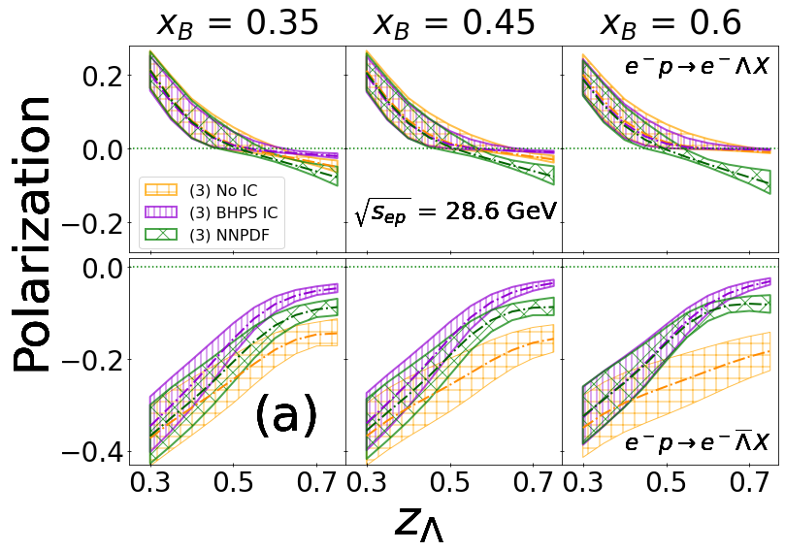
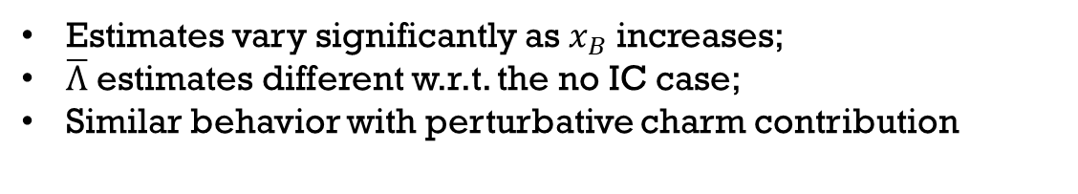
Intrinsic charm in the proton within Scenario 3
CT14 nnlo IC set with BHPS model
[T.-J. Hou et al., 2018]
NNPDF4.0 nnlo set [NNPDF Coll. 2022]
Estimates vary significantly as $x_{B}$ increases;
$\overline{Λ}$ estimates different w.r.t. the no IC case;
Similar behavior with perturbative charm contribution

Slide 21
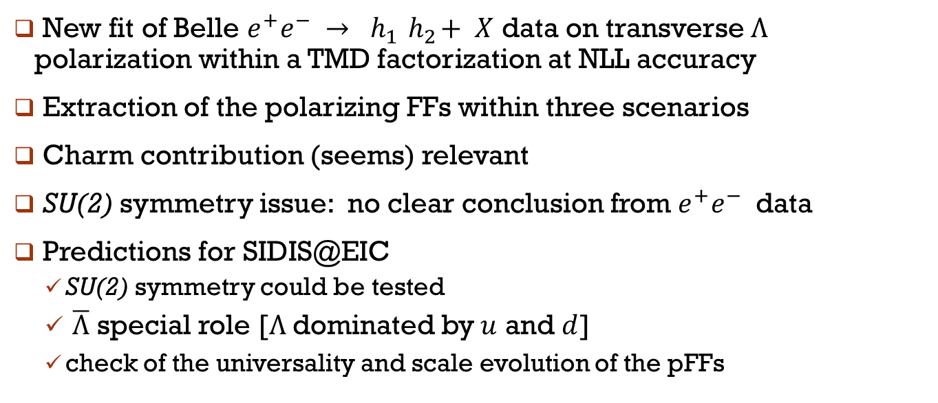
Concluding Remarks
New fit of Belle $e^{+}e^{−} →$ $h_{1}{ h}_{2}+ X$ data on transverse Λ polarization within a TMD factorization at NLL accuracy
Extraction of the polarizing FFs within three scenarios
Charm contribution (seems) relevant
SU(2) symmetry issue: no clear conclusion from $e^{+}e^{−}$ data
Predictions for SIDIS@EIC
  SU(2) symmetry could be tested
  $\overline{Λ}$ special role [Λ dominated by $u$ and $d$]
  check of the universality and scale evolution of the pFFs
THANKS for the ATTENTION

Slide 22
Back-up slides

