Slide 1
A journey through the Heavy-light Sudakov Universality Class
Yizhuang Liu， Jagiellonian University

Slide 2
The talk is based on our theoretical works in:
Threshold resummation for computing large-x parton distribution through large-momentum effective theory (arxiv: 2305.04416) (Threshold limit of perturbative quark quasi-PDF)
Computing Light-Front Wave Functions Without Light-Front Quantization: A Large-Momentum Effective Theory Approach (Phys. Rev. D 105 (2022)) (Large ${2xP}_{z}$ limit of quasi-LFWF amplitudes)
Transverse-momentum-dependent parton distribution functions from large-momentum effective theory (Phys.Lett.B 811 (2020), 135946) && TMD soft function from large-momentum effective theory (Nucl.Phys.B 955 (2020) 115054) (Large ${2xP}_{z}$ limit of quasi-TMDPDFs)
Large-momentum effective theory (Rev. Mod. Phys. 93 (2021))

Slide 3
Outline
High energy limit of QFT : factorization && scaling && universality.
The HL Sudakov universality class .
Overview.
Quasi-TMDPDF && LFWF amplitudes.
Reduced soft factor. Lattice application.
Threshold limit of quark quasi-PDF.

Slide 4
High energy limit of QFT
Successful of QFT in late 1940s: $g−2;l$amb shift.
Development of massive renormalization perturbation theory: Power-counting theorems/Symanzik polynomials/BPHZ….
However, $Q^{2}→∞$ limit not under control. Large logarithms/Landau poles. Proper interpretation not clear.
Early 1970s, multiple clues: perturbative asymptotic freedom/RGE-analysis /scaling in statistical physics && DIS/..… leads to the conjecture: local QFTs are likely universal scaling limits.
The “maximally universal’’ region: $m≪Q≪\frac{1}{a}$. Scale-invariant up to logarithms. CFT && massless PT. High energy limit of QFT.

Slide 5
Universality & OPE & factorization
Euclidean correlator: $G\left(zm\right)=z^{2d_{O}}\left\langle 0\left|O\left(z\right)O\left(0\right)\right|0\right\rangle$. Universal $z^{2}→0$ limit:
$G\left(zm\right)→{α(z)}^{\frac{−2γ_{o}^{1} }{β_{0}}}\exp{\int_{0}^{α\left(z\right)}{(\frac{2γ_{O}^{1}}{β_{0}α}−\frac{{2γ}_{O}\left(α\right)}{β\left(α\right)})dα G[α(z)]+O\left(mz\right)\text{.}}}$
$α\left(z\right)→\frac{2π}{β^{0}\ln{(mz)}}$ : the running coupling constant.
$γ_{O}^{1}:$the LO anomalous dimension.
Controlled asymptotic expansion as $z^{2}→0$.
REG resumed form of perturbative series. PT is universal.

Slide 6
Universality & OPE & factorization
Consistency condition on PT: multiplicative renormalizability. Singularity in Feynman integrals transmutes to anomalous dimensions && critical exponents that controls the high-energy limit.
Proven using the same power-counting techniques as massive perturbation theory. Key structure: scaling behavior of Symanzik polynomials.
Anomalous dimension $γ_{O}(α)$ has no explicit $ln μ$dependence. Single log evolution.
PT is asymptotic with factorial growth. Renormalon ambiguity/Instantons…

Slide 7
OPE & factorization: the Bjorken limit.
Next simplest object. Structure function: $F\left(z^{2},λ\right)={\left\langle P\left|J\left(z\right)J\left(0\right)\right|P\right\rangle }_{c}$.
The Bjorken limit : $z^{2}→0$ at fixed $λ=z⋅P$&& ${−Q}^{2}→∞$ at fixed $x_{B}=−\frac{Q^{2}}{2P⋅Q}$. Not completely Euclidean.
This limit can still be controlled by single log RGE.
$F_{n}\left(Q^{2}\right)∼C_{n}(α(Q))$ $\exp{(\int_{α(μ)}^{α(Q)}{\frac{γ_{n}\left(α\right)−2γ_{J}\left(α\right)}{β\left(α\right)}dα) O_{n}\left(μ\right)+}}$ high power
$F_{n}\left(z^{2}\right) \sim \tilde{C_{n}}\left(α\left(z\right)\right) \exp{(\int_{α\left(μ\right)}^{α\left(z\right)}{\frac{γ_{n}\left(α\right)−{2γ}_{J}\left(α\right)}{β\left(α\right)}dα) O_{n}\left(μ\right)}}+$ high power

Slide 8
Bjorken limit: emergence of partonic picture
In priori, $F\left(z^{2},λ\right){\left.​\right|}_{z^{2}→0}$ is not necessarily controlled by single log RGE. Why people believe ?
Besides experimental evidence, the logic works as follows.
PT version $F_{n}^{q}(z^{2},α(μ))$ indeed satisfies single logarithm RGE . FINE $α$ scaling of Symanzik polynomials.
Anomalous dimension of $F_{n}^{q}(z^{2},α(μ))$ matches precisely with that of $O_{n}$.
$f\left(λ,μ\right)=$ $\sum_{n=0}{\frac{1}{n! }O_{n}\left(μ\right)λ^{n}=\frac{1}{2P^{+}}⟨P|\overline{ψ}\left(x^{−}\right){W(x^{−},0)γ}^{+}ψ(0)|P⟩}$ naturally interpretated as parton distribution function. Consistent with parton picture.
Supported by CSS leading region analysis && SCET.

Slide 9
Light-Light Sudakov universality class
Not all high energy limit of QCD controllable by single log RGEs. The famous factorizable example: light-quark Sudakov form factor.
$\left\langle p^{′}\left|\overline{ψ}Γψ\right|p\right\rangle$ with $Q^{2}={\left(p−p^{′}\right)}^{2}→∞$, $p^{2}=p^{′2}=0$.
Double logarithm at one-loop.
No power-counting theorem proven yet. RGE conjectured and verified to four loops.
Key feature: anomalous dimension contains logarithm, but only one!
$μ\frac{d\ln{H_{LL }(Q^{2},α(μ))}}{dμ}=2Γ_{cusp}\left(α\right)ln\frac{Q^{2}}{μ^{2}}+2γ_{V}(α)$.

Slide 10
Light-Light Sudakov universality class: TMD factorization
Appearing in TMD factorizations && threshold limits.
TMD factorization/resummation (Drell-Yan like)
$$F\left(Q^{2},b_{⊥},x_{A},x_{B}\right)=H_{LL}\left(α\left(Q\right)\right)\exp\left[S_{suda}\left(α\left(Q\right)\right)\right] exp⁡[2K\left(b_{⊥}\right)\ln{Q^{2}b_{⊥}^{2}}]$$
${ × f}_{TMD}\left(x_{A},b_{⊥}\right)f_{TMD}\left(x_{B},b_{⊥}\right)$+high power
The $H_{LL}\exp{S_{suda}}$: RGE resumed Sudakov form factor.
The $f_{TMD}(x,b_{⊥})$: transverse-momentum dependent PDFs.
New feature: the Rapidity anomalous dimension (Collins-Soper kernel) $2K\left(b_{⊥}\right)$ for light-like gauge-link staples at separation $b_{⊥}$.
Heuristic “proofs”: CSS argument based on reduced diagram of leading region && SCET.

Slide 11
Light-Light Sudakov universality class: threshold limit
The same LL Sudakov form factor also appears in threshold limits of various objects. For example: quark structure function in PT && hard kernel for DIS.
Threshold limit: $x→1$ in $F_{q}(\frac{Q^{2}}{μ^{2}},x ,α(μ))$.
To leading power ${\left(1−x\right)}^{−1}$, one has threshold factorization
$F_{q}\left(\frac{Q^{2}}{μ^{2}},x,α\left(μ\right)\right)$ $=H_{LL}\left(\frac{Q^{2}}{μ^{2}},α\left(μ\right)\right)J_{q}\left(Q^{2}\left(1−x\right),α\left(μ\right)\right)+O(1−x)$
LL Sudakov form factor && quark jet function $J_{q}$.

Slide 12
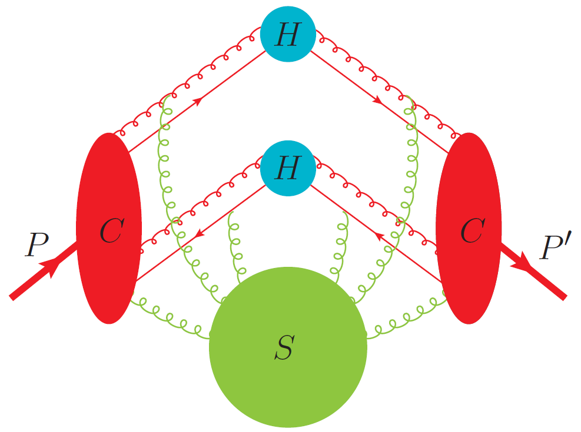
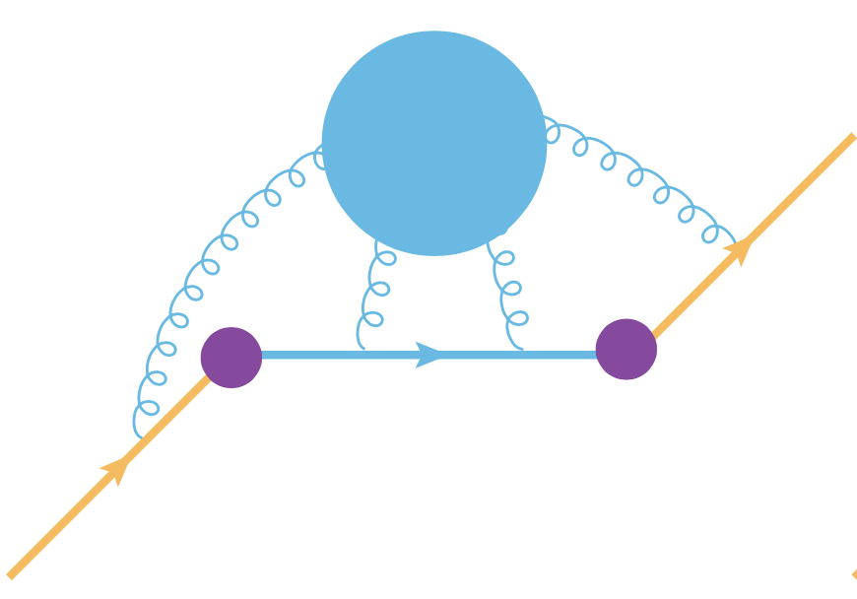
LL Sudakov. TMD && Threshold
TMD factorization for a space-like form-factor
Threshold limit of quark structure function

Slide 13
Outline
High energy limit of QFT : factorization && scaling && universality.
The HL Sudakov universality class .
Overview
Quasi-TMDPDF && LFWF amplitudes.
Reduced soft factor. Lattice calculation.
Threshold limit of quark quasi-PDF.

Slide 14
Overview of the class
Correlators with space-like gauge-links naturally arise in LaMET formalism of lattice parton distributions.
LL current: $J^{μ}\left(x\right)=\overline{q}γ^{μ}q→$ HL current: $\tilde{J}\left(x\right)=\overline{q}Q_{n_{z}}$.
$Q_{n_{z} }\left(z\right){\overline{Q}}_{n_{z}}\left(0\right)=Pexp ig \int_{0}^{z}{dz^{′}A_{z}(z^{′})}:$ space-like gauge-link.
Quark quasi-PDF: $\tilde{f_{q}}\left(x,ζ_{z}=4x^{2}P_{z}^{2}\right)$ in threshold limit $x→1$.
Quasi-TMDPDF: $\tilde{f}\left(x,ζ_{z}=4x^{2}P_{z}^{2},b_{⊥}\right)$ at large $ζ_{z}$.
Quasi-LFWF of light meson: ${\tilde{ψ}}_{\overline{q}q}$ $\left(x,{\overline{x},ζ}_{z},\overline{ζ_{z}},b_{⊥}\right)$ at large $ζ_{z}$.

Slide 15
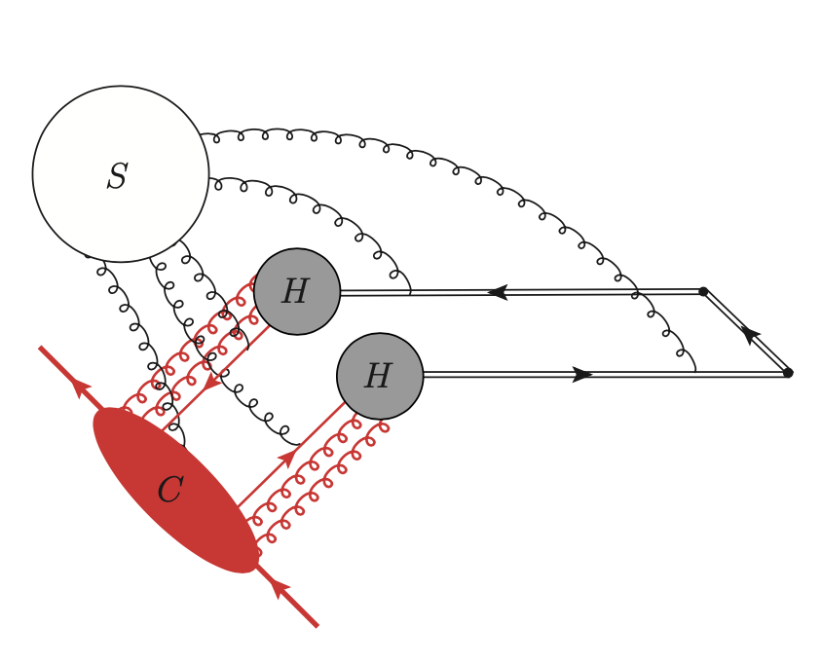
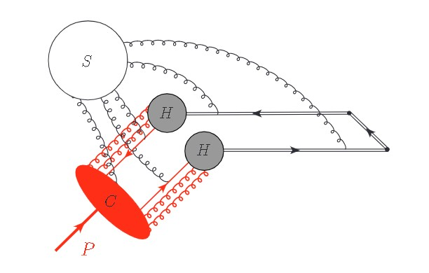
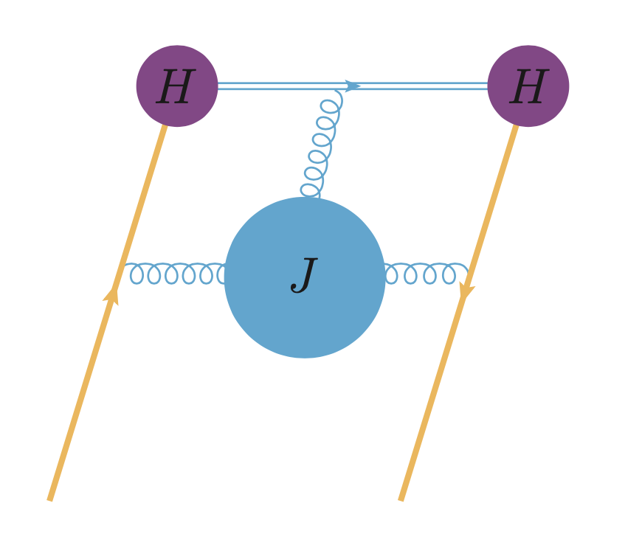
Overview of the class
quasi-TMDPDF
quasi-LFWF
threshold limit of quark quasi-PDF
Space-time pictures of the HL Sudakov Universality Class

Slide 16
The HL Sudakov form factor
HL Sudakov form factor: $H_{HL}^{σ}(\ln{\frac{ζ_{z}}{μ^{2}}},α(μ))$.
External $p^{2}=0 \&\& n^{2}≠0$, $ζ_{z}=4{\left(p⋅n\right)}^{2}≠0$.
NL: $H_{HL}^{±}=1+\frac{αC_{F}}{4π}\left(−4−\frac{5π^{2}}{6}+2L_{±}−L_{±}^{2}\right)$ with $L_{±}=$ $\ln{\frac{ζ_{z}}{μ^{2}}}±iπ$.
RGE: $μ\frac{d}{dμ}\text{ln}{ H}_{HL}^{σ}\left(\ln{\frac{ζ_{z}}{μ^{2}}},α\left(μ\right)\right)\text{=}Γ_{cusp }\left(α\right)\ln{\frac{ζ_{z}}{μ^{2}}}+{\tilde{γ}}_{H}\left(α\right)−iπσ$ $Γ_{cusp }\left(α\right)$.
Imaginary part depends on $σ=sign(−n⋅p)$.
Single log anomalous dimension ${\tilde{γ}}_{H}=2γ_{F}+γ_{V}+2γ_{HL}−γ_{s}$.

Slide 17
Quasi-TMDPDF/LFWF at large $ζ_{z}$
Quasi TMDPDF factorizes in the large $ζ_{z}=4x^{2}P_{z}^{2}$ limit as $\tilde{f}\left(x,b_{⊥},ζ_{z}\right)={\left|H_{HL}\left(ζ_{z}\right)\right|}^{2}\exp{(\tilde{S}\left(ζ_{z}\right))}\exp{(\frac{1}{2}K\left(b_{⊥}\right)ln ζ_{z}b_{⊥}^{2}})$ ${ ×S}_{r}^{−\frac{1}{2}}\left(b_{⊥}\right)f_{TMD}(x,b_{⊥})$+ high power
Quasi LFWF amplitudes factorizes similarly:
${\tilde{ψ}}_{q\overline{q}}\left(x, b_{⊥},ζ_{z}\right)= H_{HL}(ζ_{z})H_{HL}({\overline{ζ}}_{z})exp{\tilde{(S}(ζ_{z},\overline{ζ_{z}}))}\exp{(\frac{1}{2}K\left(b_{⊥}\right)ln \sqrt{\overline{ζ_{z}}ζ_{z}}b_{⊥}^{2}})$ ${ × S}_{r}^{−\frac{1}{2}}\left(b_{⊥}\right)ψ_{q\overline{q}} (x,b_{⊥})$+ high power

Slide 18
Quasi-TMDPDF/LFWF at large $ζ_{z}$
The HL form factor at scale $μ=ζ_{z}$: $H_{HL}\left(ζ_{z}\right).$
The RGE re-summation factor: $\exp{\tilde{S}(ζ_{z})}.$
Asymptotically, $\tilde{S}\left(ζ_{z}\right)→−\frac{Γ_{0}}{β_{0}^{2}α\left(ζ_{z}\right)}\ln{\frac{e}{α(ζ_{z})}}$. Systematic expansion in increasing orders of $α\left(ζ_{z}\right).$
The rapidity evolution factor: $\exp{\frac{1}{2}K\left(b_{⊥}\right)ln ζ_{z}b_{⊥}^{2}}$.
The standard TMDPDF/LFWF amplitudes : $f_{TMD}(x,b_{⊥}$) && $ψ_{q\overline{q}}(x,\overline{x},b_{⊥})$.
Sudakov

Slide 19
The new ingredient: reduced form factor $S_{r}$
The $S_{r}(b_{⊥})$ is a new NP function: the reduced soft factor.
Defined through ratio of three TMD soft factors.
$S_{r}\left(b_{⊥},μ\right)=\lim_{δ^{+},δ^{−}→0}\frac{S(b_{⊥},μ ,δ^{+},δ^{−})}{S\left(b_{⊥},μ,δ^{+},n_{z}\right)S(b_{⊥},μ ,{−n}_{z},δ^{−})}$
Standard TMD soft factor: $S(b_{⊥},μ ,δ^{+},δ^{−})$.
The HL soft factor: $S\left(b_{⊥},μ,δ^{+},n_{z}\right)$. Both light ($δ^{+}$) and heavy ($n_{z}$) Wilson-lines.
Only a single log anomalous dimension: $γ_{HH}≡2γ_{HL}−γ_{s}≡Γ_{S}$.
Insensitive to time-ordering. Interpreted as LFWF of a $\overline{Q}Q$ pair.
$$δ_{+ }$$
$$δ_{−}$$
$$n_{z}$$
$$n_{z}$$

Slide 20
Extraction of $S_{r}$ from an auxiliary space-like form factor
Auxiliary form factor $F$allows TMD factorization into LFWFs.
Quasi-LFWF factorize into LFWFs and $S_{r}.$
Therefore,
$${ S}_{r}\left(b_{⊥},μ\right)= \frac{\left\langle P^{′}\left|\overline{ψ}Γψ\left(b_{⊥}\right)\overline{ψ}Γψ\left(0\right)\right|P\right\rangle }{∫dx dx^{′}C\left(x,x^{′}\right){\tilde{ψ}}^{†}\left(x^{′},b_{⊥},μ,P^{′}\right)\tilde{ψ}\left(x,b_{⊥},μ,P\right)}.$$
Lattice
PQCD
The reduced diagram of the form factor $\left\langle P^{′}\left|\overline{ψ}Γψ\left(b_{⊥}\right)\overline{ψ}Γψ\left(0\right)\right|P\right\rangle$ .

Slide 21
$S_{r} f$rom lattice
Lattice Parton Collaboration, arXiv:2005.14572
CLS A654
Preliminary results of $S_{r}$ by LPC . Only tree-level matching.

Slide 22
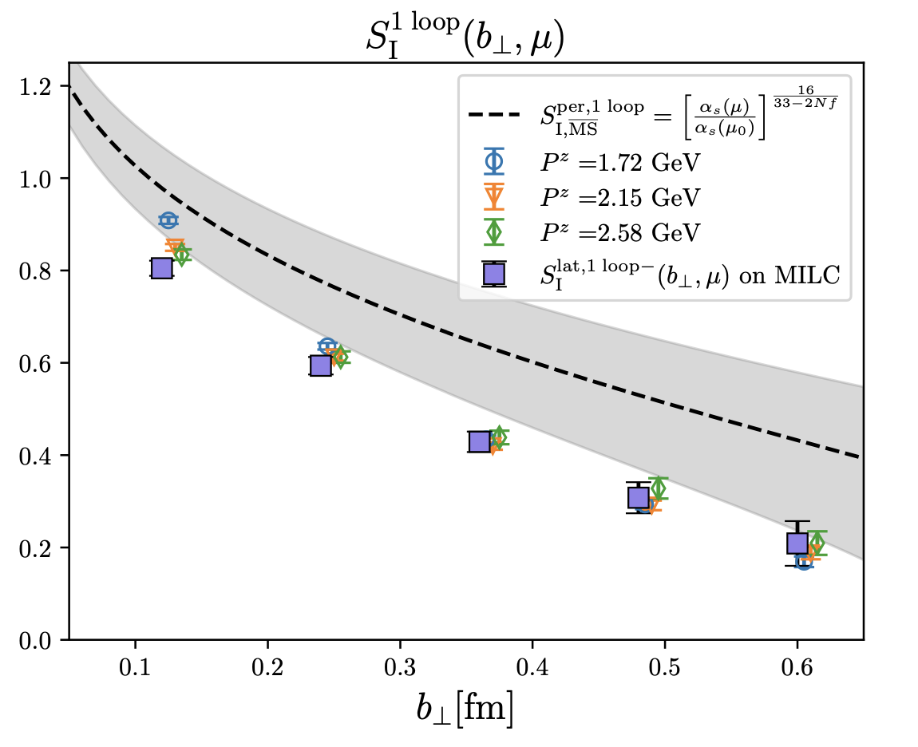
$S_{r} f$rom lattice
Lattice Parton Collaboration, arXiv:2306.06488
MILC a12m310

Slide 23
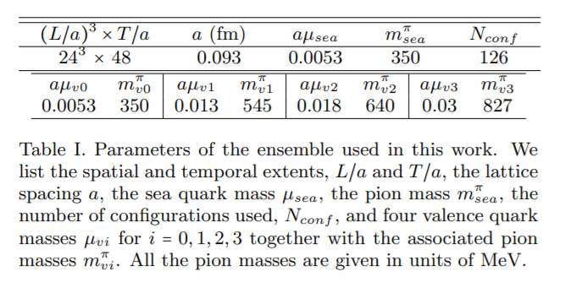
$S_{r} f$rom lattice
Yuan Li and others, arxiv:2106.13027
ETMC configuration
Preliminary results of $S_{r}$ . Only tree-level matching.

Slide 24
Threshold limit of quark quasi-PDF
The perturbative quark PDF has threshold logarithms as $y→1$.
Factorizable in terms of HL Sudakov hard kernel and space-like jet function at power ${\left(y−1\right)}^{−1}$.
One has
${\tilde{f}\left(y,L_{z},α\left(μ\right)\right){\left.​\right|}_{y→1}= \left|H_{HL}\left(L_{z},α\left(μ\right)\right)\right|}^{2}$ $J_{f}(\left(1−y\right)p_{z},L_{z},α(μ))$.
Reproduces the correct $y→1$ limit from exact calculation at NNLO.
Allowing extraction of $H_{HL}$ at NNLO.
$$L_{z}=\ln{\frac{4p_{z}^{2}}{μ^{2}}}$$

Slide 25
Space-like jet function
The $J_{f}$ combines a space-like jet function $J(|z|)$ with phase factor of HL Sudakov form factor.
In coordinate space,
$$J_{f}\left(\left|z\right|,sign\left(z\right),L_{z}\right)= J\left(\left|z\right|\right)\exp{[iArg(H_{HL}^{sign\left(z\right)}(L_{z}))}]$$
Imaginary part crucial to match to the threshold limit DGLAP $P\left(z\right){\left.​\right|}_{z→1}=\frac{2Γ_{cusp }}{{\left(1−z\right)}^{+}}−\left(γ_{V}+γ_{s}\right)δ(1−z)$.
$J(\left|z\right|)$ relates to a time-like version $J(t)$ through analytic continuation $t→−i|z|$ to all orders.
$J(t)$ equals to a known heavy-quark jet function at NNLO**.
**Jain && Scimemi && Stewart arxiv:0801.0743

Slide 26
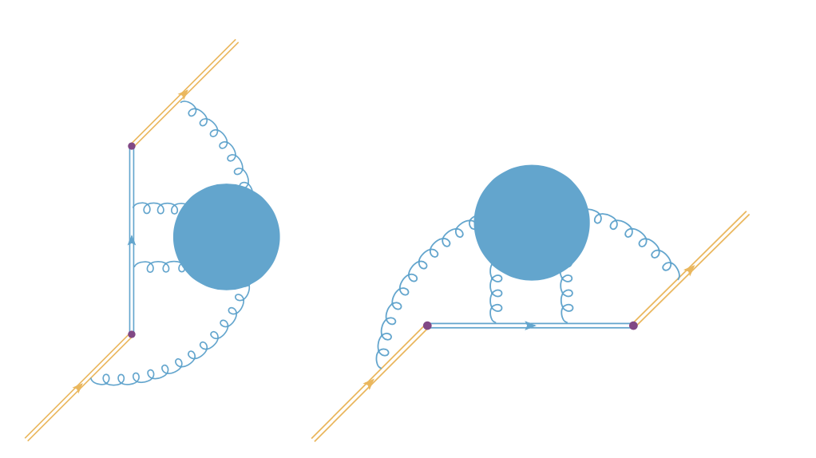
Space-like jet function
RGE of space-like jet function
$μ\frac{d}{dμ}\ln{J\left(\left|z\right|μ,α\left(μ\right)\right)=Γ_{cusp }\left(α\right)\ln{\frac{e^{2γ_{E}}μ^{2}z^{2}}{4}}}−{\tilde{γ}}_{J}(α)$.
Single log anomalous dimension $\tilde{γ_{J}}={2γ}_{HL}−2γ_{s}$.
Allows threshold RGE re-summation.
The time-like jet function $J(t)$ (left )and space like jet function $J(|z|)$ (right).

Slide 27
Application: HL Sudakov form factor at NNLO
As an application, we extracted the NNLO Sudakov form factor.
All logarithms are determined by the $β$ function and anomalous dimensions.
The constant term of $\ln{{\left|H_{HL}\right|}^{2}}$ and the phase angle at NNLO reads
$c_{H}=\left(\frac{241ζ_{3}}{144π^{2}}+\frac{11π^{2}}{320}−\frac{559}{1728}−\frac{971}{324π^{2}}\right)C_{F}C_{A}+\left(\frac{−45ζ_{3}−2π^{4}+30π^{2}−30}{24π^{2}}\right)C_{F}^{2}+ \left(\frac{36ζ_{3}+51π^{2}+1312}{1296π^{2}}\right)C_{F}n_{f}T_{F}$
$c_{a}=\left(\frac{11}{4π^{2}}−\frac{11}{24}−\frac{475}{108π^{2}}\right)C_{F}C_{A}+\left(−\frac{3ζ_{3}}{π^{2}}+\frac{7}{12}−\frac{1}{2π^{2}}\right)C_{F}^{2}+\left(\frac{1}{6}+\frac{38}{27π^{2}}\right)C_{F}n_{f}T_{F}$
Agrees with direct calculation.
X.J&&Y.L&&Y.S, arxiv: 2305.04416

Slide 28
Summary and Outlook
Universality in High energy limit of QFT
Sudakov universality class: $Γ_{cusp}$ induced double log evolution.
TMD factorization && threshold limit of quark structure function.
Heavy-light Sudakov universality class appears naturally in LaMET formulation of lattice parton distribution.
Quasi-TMDPDF && LFWF amplitude && threshold limit of quark quasi-PDF.
Allows lattice extraction of TMD parton densities.
NNLO Heavy-light Sudakov form factor extracted from threshold limit.
In the future, apply the threshold re-summation to improve the accuracy of lattice extraction of collinear PDF.

