Slide 1
1st (in-person) EIC Research Review Board (RRB) meeting Welcome
Abhay Deshpande
Distinguished Professor at Stony Brook University
EIC Science Director, Brookhaven National Laboratory
Director of Center for Frontiers in Nuclear Science (CFNS)

Slide 2
Stony Brook University & Brookhaven National Laboratory
BNL is managed on behalf of the DOE by Brookhaven Science Associates, a partnership between Research Foundation for State University of NY on behalf of Stony Brook University (SBU) and Battelle BSA also engages six premier research universities (Columbia, Cornell, Harvard, Massachusetts Institute of Technology, Princeton & Yale) in the governance and oversight of the Laboratory.
SBU President serves as the Chair of the BSA Board
BNL Director serves as the President of BSA Board.
Proximity of Stony Brook to BNL ➔ Stony Brook is the largest single institution of Scientist Users at BNL (RHIC, NSLS-II, CFN and other user facilities)
The Electron Ion Collider (EIC) – the future flagship project at BNL -- has long history of support for the EIC at Stony Brook University (starting from 2003) including help set up the Center for Frontiers in Nuclear Science (CFNS)

Slide 3
Center for Frontiers in Nuclear Science (CFNS) A Center for developing, promoting & supporting the EIC and its science
https://www.stonybrook.edu/cfns
8 Workshops/year led by world-wide members of EIC User and bi-monthly joint seminars (SBU/BNL)
EIC directed Post Doctoral Program:
8-10 Postdoctoral fellows
CFNS and joint University postdocs
~18 postdocs graduates now on tenure track positions
Edward Bouchet Program for URM students and postdocs in Nuclear Physics
Annual Summer School ~50 students/yr from around the world since 2019.
Future: Help European EIC School starting 2023 and Asian EIC School starting 2024, in future also in Africa/Latin America
Established in September 2017 (for ~10 years) with generous financial support from the Simons Foundation and NY State.
A collaboration between Stony Brook & BNL to create a frontier research center to promote the US Electron Ion Collider (EIC)
Vision:
To support and help the US EIC Users community to develop the best possible physics, detector design, technology choices. Invest in and support early career scientists in the field getting involved in EIC.

Slide 4
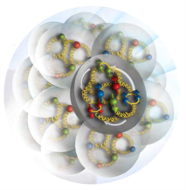
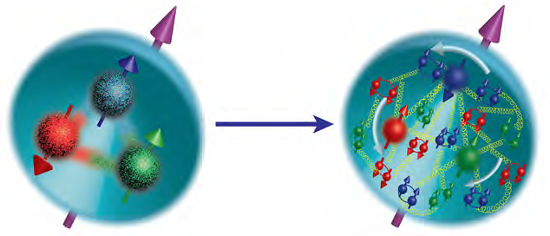
EIC Science: International Context for the RRB
1960/1970’s
SLAC/USA: discovery of quarks DESY/Germany: discovery of gluons
1980/1990’s Seeds of EIC science:
CERN/Europe: Discovery of proton spin crisis, CERN/Europe: protons in Nuclei different
HERA/Germany: study of quarks & gluons, Jefferson Lab/USA: precision study of quarks
2000/2010/2020’s
RHIC BNL/US/(Japan): polarized gluon/protons first studies, BNL/CERN : Quark Gluon Plasma
Now scientists from around the world, who worked at all above laboratories are coming to work at BNL on the Electron Ion Collider

Slide 5
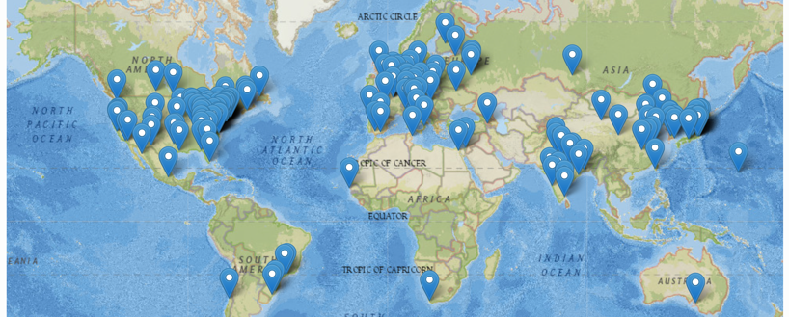
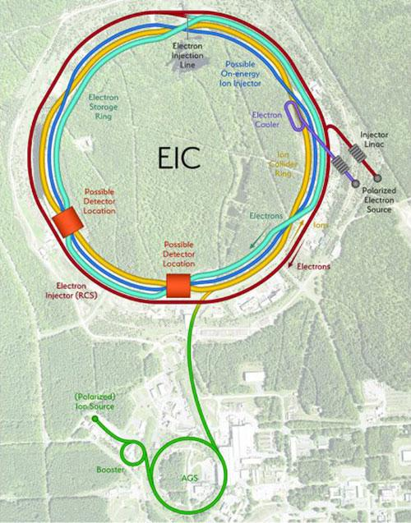
EIC People: International Context: You (the RRB) can help

Slide 6
Thank you and welcome!
1st In-person RRB Meeting for the EIC

