Slide 1
Report from the EIC Advisory Board
Stuart Henderson
Director, Jefferson Lab

Slide 2
EIC Boards and Advisory Committees
DOE, BNL, and JLab envision an EIC facility that is “fully international in character.”
EIC Advisory Board provides oversight and advice on the construction of the facility, focusing on the accelerator (BNL, TJNAF, LBNL, ANL, TRIUMF, IN2P3, CEA, STFC, INFN).
EIC RRB to provide oversight of the experiments
EIC Project Advisory Committee provides advice on the successful delivery of the DOE Project (management, scope, schedule, cost, and performance).

Slide 3
EIC Advisory Board Members
Stuart Henderson, Director, TJNAF (Chair)
Diego Bettoni, Vice President of INFN
Marcella Grasso, Deputy Scientific Director, IN2P3
Paul Kearns, Director of ANL
Mike Lamont, Director of Accelerators & Technology-CERN
Reynald Pain, Director of IN2P3/CNRS
Franck Sabatié, Director of IRFU-Saclay
Nigel Smith, Director of TRIUMF
Mark Thomson, Executive Chair, STFC, UK Research & Innovation
Mike Witherell, Director of LBNL
Scientific Secretary: Maria Chamizo-Llatas, EIC In-Kind Manager/Deputy ALD, BNL
EIC Advisory Board reports to Doon Gibbs, Director of BNL

Slide 4
Origin of the EIC Advisory Board
The notion of an advisory board comes from best practices for management of large projects, particularly those involving multiple laboratories
SNS Project at ORNL: US DOE Lab Directors
LCLS-II Project at SLAC: US DOE Lab Directors
Started in 2021 with two members to ensure good two-lab coordination; has expanded in membership as more partners have joined
To realize the “fully international” character of the EIC facility, we felt it important to incorporate all partners into the EIC Advisory Board
All are stakeholders, with vested interest in the success of the Project
Want to instill a relationship of shared success and shared ownership in that success
EIC Project benefits from the extensive experience
Members are at the level of lab directors and funding agency leaders who are empowered to make decisions and direct resources
“The EIC Advisory Board (EAB) provides guidance and advice to the BNL Director on the design and construction of the EIC accelerator facility. Membership includes the leaders of institutions participating in the construction of the accelerator facility. Board members may also include leaders of institutions with common accelerator S&T interests. The EAB is expected to meet two to three times a year.”

Slide 5
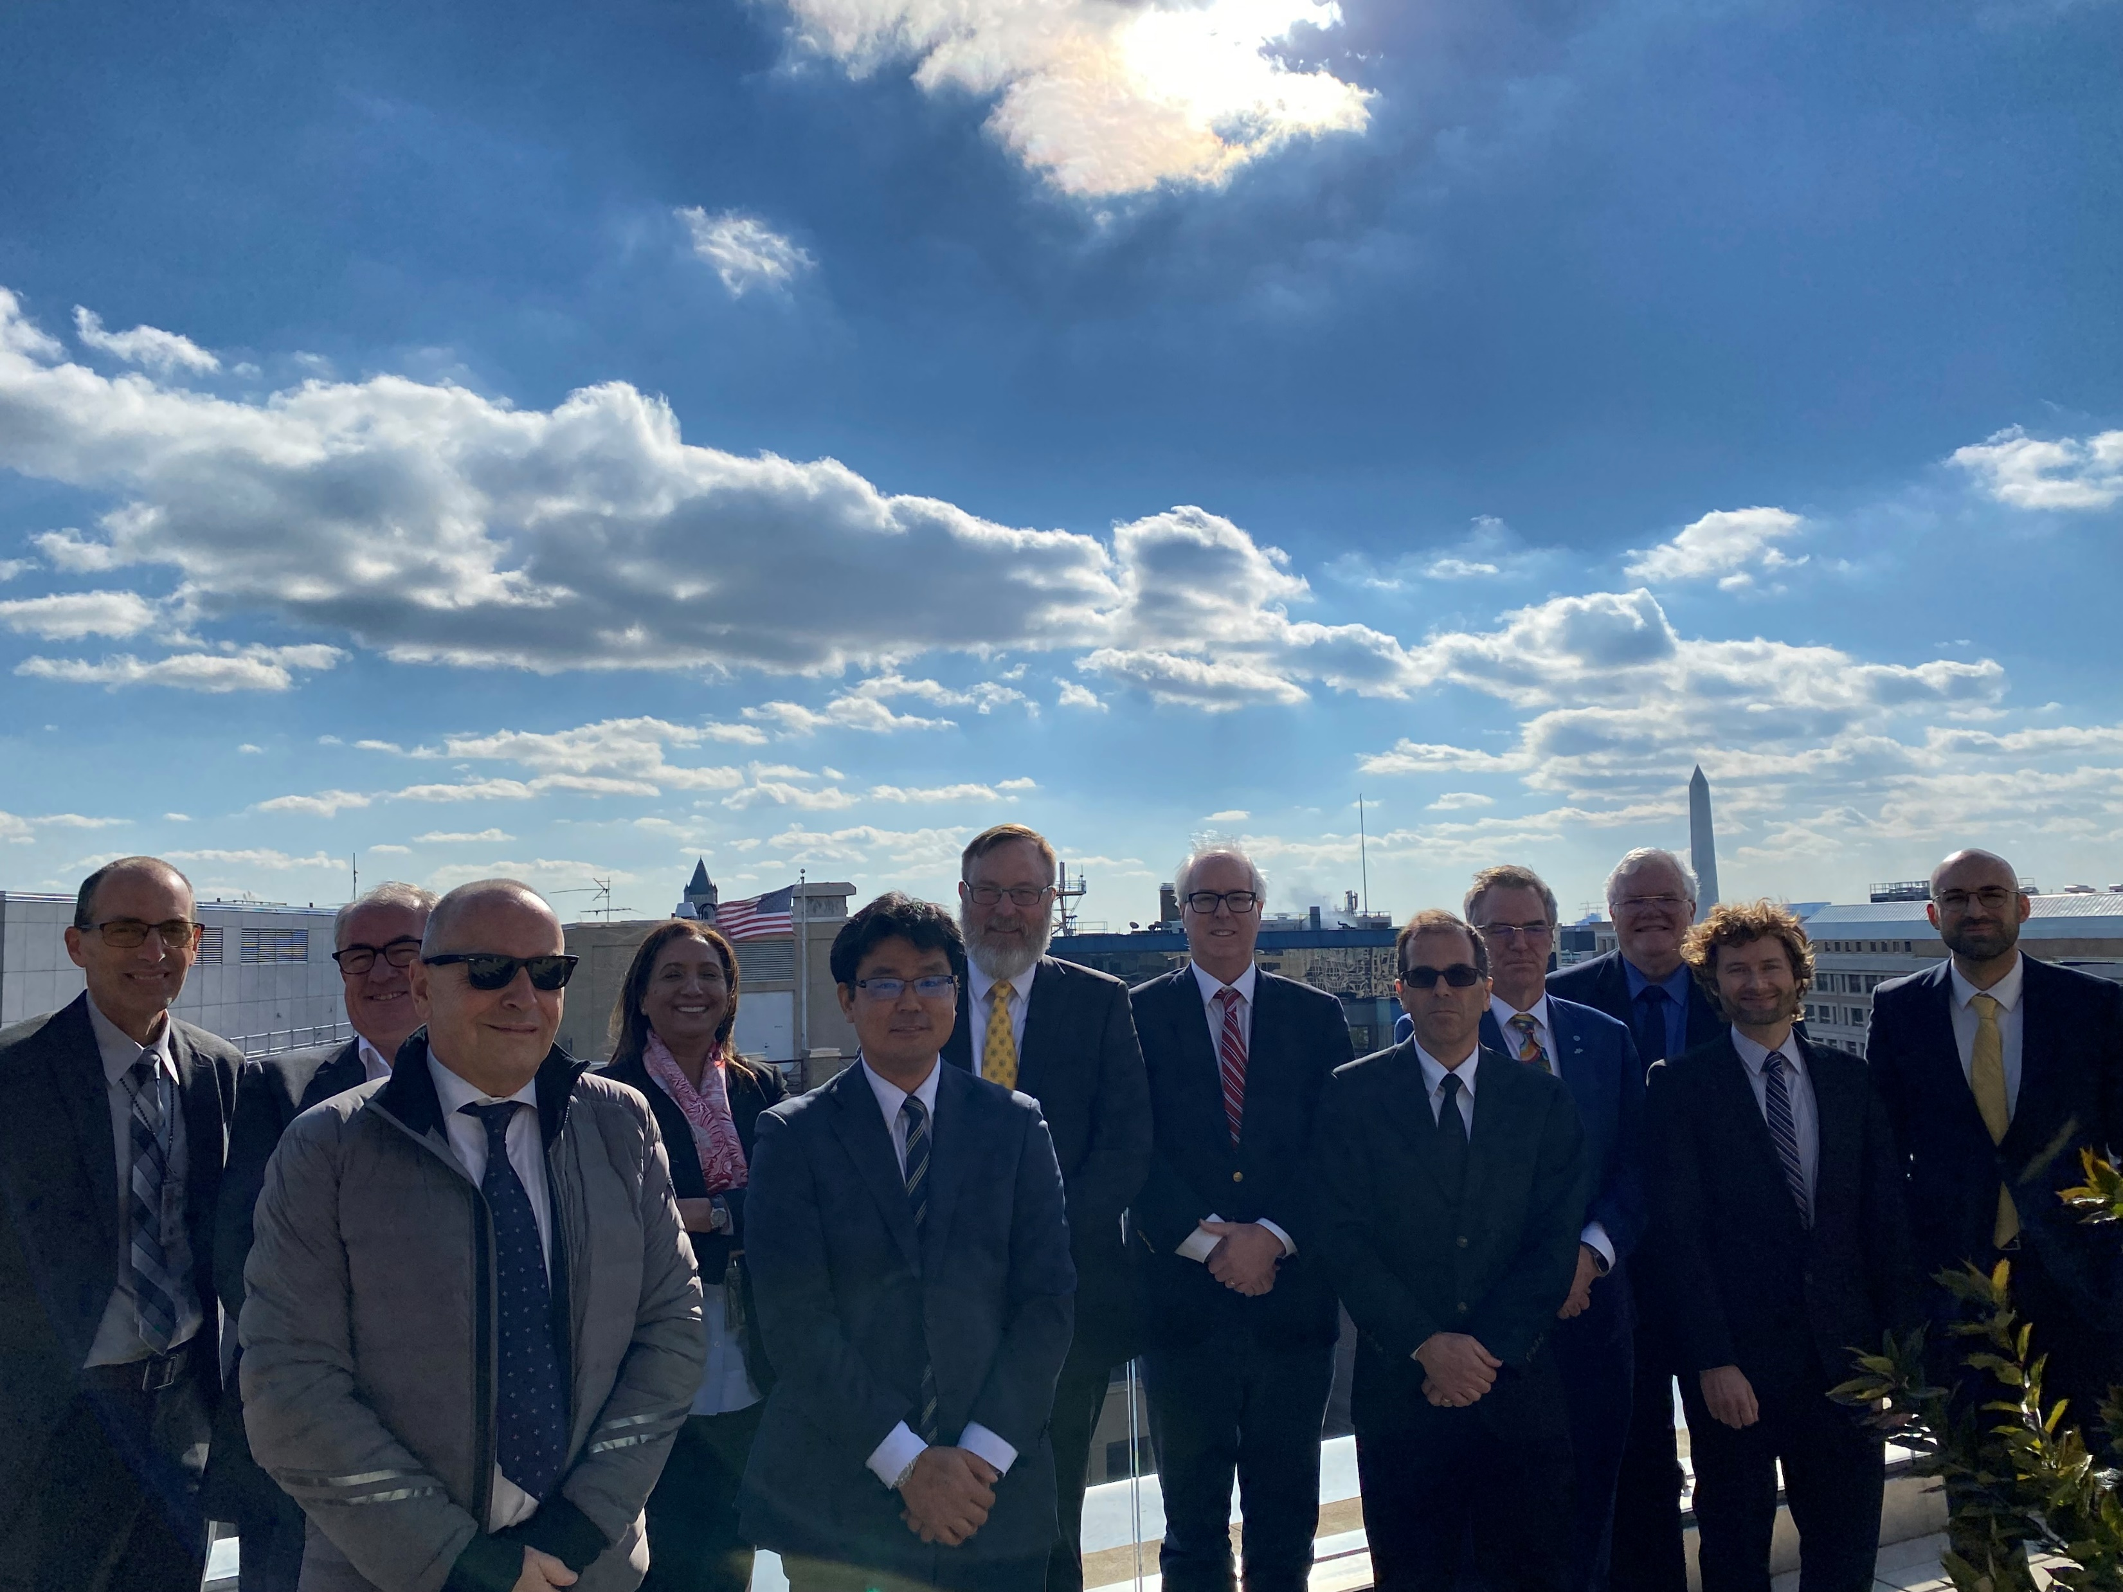
Recent Activities
Two meetings in its “modern” form with expanded membership
Recent Timeline:
EIC Funding Agency Meeting in Washington DC, November 17, 2022
EIC Advisory Board Meeting December 8, 2022
Update on EIC project progress and outlook
Review of Funding Agency meeting outcomes, additional reports of plans from international partners
EIC Advisory Board Meeting March 9, 2023
Update on EIC project progress and outlook, including DOE OPA Review
Overview of progress in EIC accelerator collaboration
Review of progress on international engagement and updates from partners

Slide 6
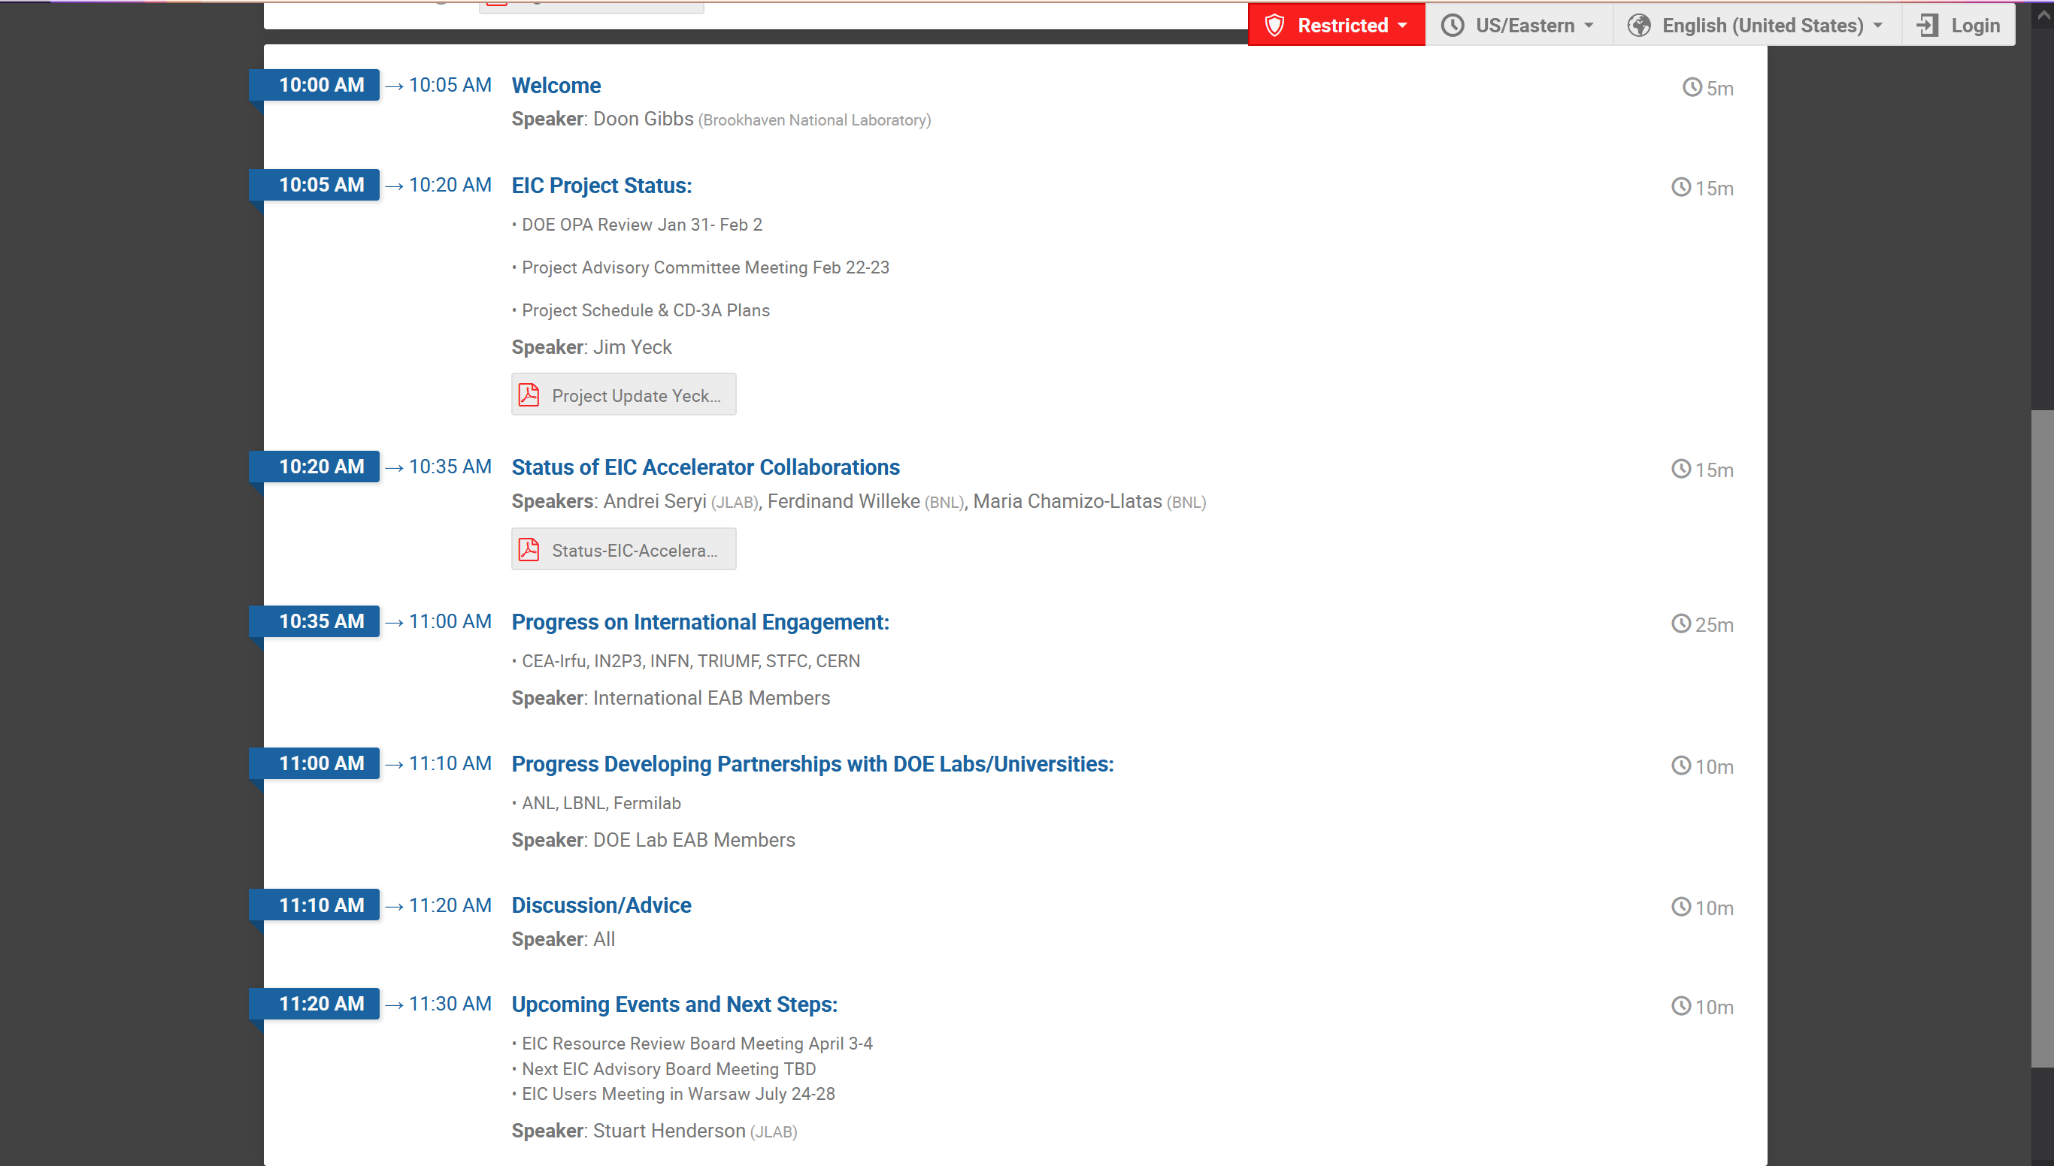
EIC Advisory Board Agenda March 9, 2023

Slide 7
Developing accelerator collaboration & in-kind: Status of discussions
Early broad efforts: 2020 & 2021 EIC Acc Collaboration workshops
Now focus on bi-lateral efforts with potential partners to develop specific mutually beneficial scope for collaboration/contributions
Recent significant progress on defining scope, examples:
Canada/TRIUMF: all 394 MHz crab cavities
Collaboration on pulsed magnets for EIC Electron Storage Ring
UK Acc team: part of 1773 MHz SC RF CMs; ERL design, etc.
Italy/INFN: HSR vacuum system impedance/e-cloud mitigation
Advanced promising developments:
France/CEA: spin rotators solenoids
France/IJCLab: ERL CMs
CERN: high current beamline design, etc.

Slide 8
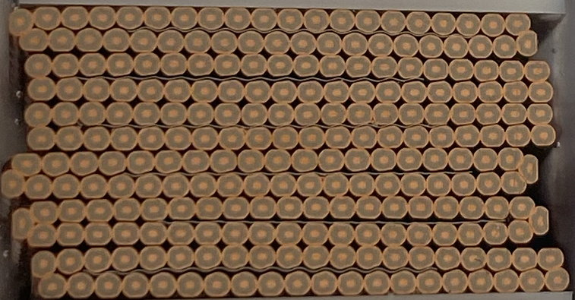
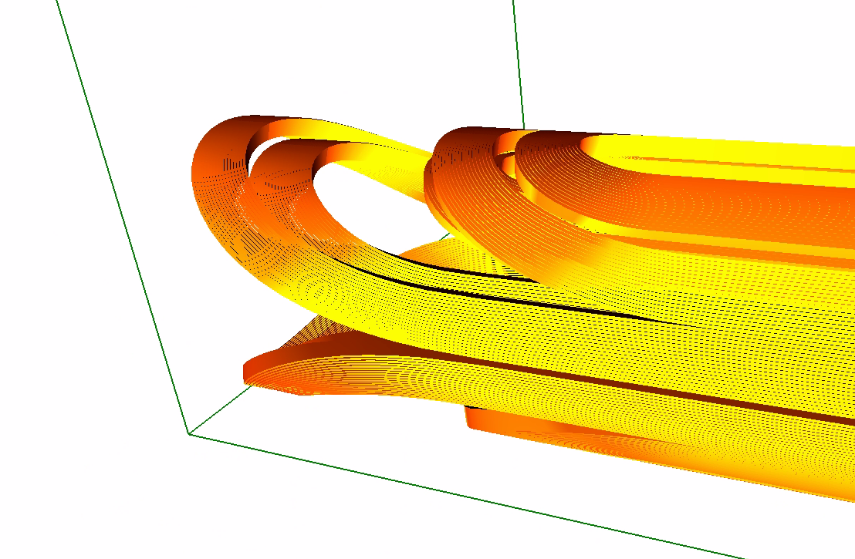
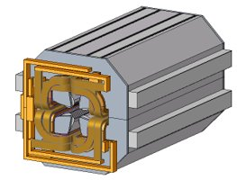
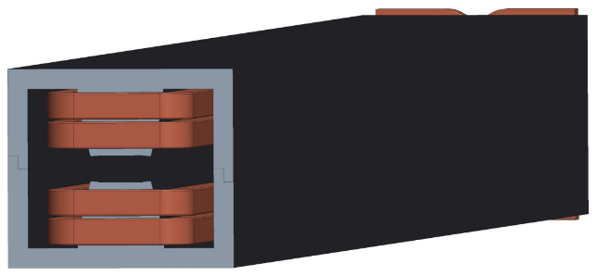
Partnerships with other DOE Labs
SLAC: - Beam Dynamics and IR design ongoing
LBNL: - Beam dynamics Simulations, ongoing
- s.c. cable production MOU in preparation
- design of superconducting “matching” magnets MOU in preparation
ANL: - Design of RCS Quadrupole magnets in progress
- Design of RCS Sextupole Magnets MOU in preparation
- Beam dynamics (strong hadron cooling) ongoing
FERMILAB: - Beam dynamics (e-Polarization) ongoing
- Design of RCS dipole magnets in progress
- S.C. IR magnet quench Protection MOU in preparation
ORNL: -Beam dynamics in progress

Slide 9
Outlook
We appreciate the significant interest and engagement from international community and international funding agencies and laboratories
Considerable progress on defining potential accelerator-related contributions from partners and defining roles (both domestic and international)
EIC Advisory Board is a valuable group and forum to help ensure open communication and a forum to develop relationships, strengthen engagement and learn from members
Its focus will inevitably evolve from initial focus on partnership formation, toward execution and delivery
Next meeting following this RRB meeting in early summer, prior to EIC User’s Meeting

