Slide 1

Detector Advisory Committee Report:
Report on the DAC to the EIC Resources Review Board
Introduction to DAC
History of Activities
New committee members
Edward Kinney, DAC Chair

Slide 2
Detector Advisory Committee (DAC)
Formed in Fall 2020 to advise Laboratory and Project Management on issues related to the EIC detector design, EIC Users Group activities and associated R&D efforts
Composed of 12 members, bringing technical expertise on Calorimetry, Tracking, Particle Identification, Readout Electronics, Data Acquisition, Detector Infrastructure, and EIC science.
Meets once or twice a year to review project progress and evaluate R&D proposals and reports.
After first two years, 1/3 of original members have rotated off and are being replaced. In the future, we will move to staggered 3 year terms.

Slide 3
Original DAC Members
Detector Advisory Committee – DAC 2020-2022
Name | Institution | Expertise
Edward Kinney | Boulder CO | EIC Science, general
Ewa Rondio | Warsaw | EIC Science, general
Werner Riegler | CERN | Integration
Greg Rakness | FNAL | Integration
Peter Krizan | U Ljubljana | Particle Identification
Ana Amelia Machado | University of Campinas, Brazil | Particle Identification, Sensors
Heidi Schellman | Oregon State | Computing
Brigitte Vachon | McGill | Electronics
Glenn Young | BNL | Calorimetry
Etiennette Auffray | CERN | Calorimetry
Andrew White | U. Texas Arlington | Tracking
Chi Yang | SDU China | Tracking

Slide 4
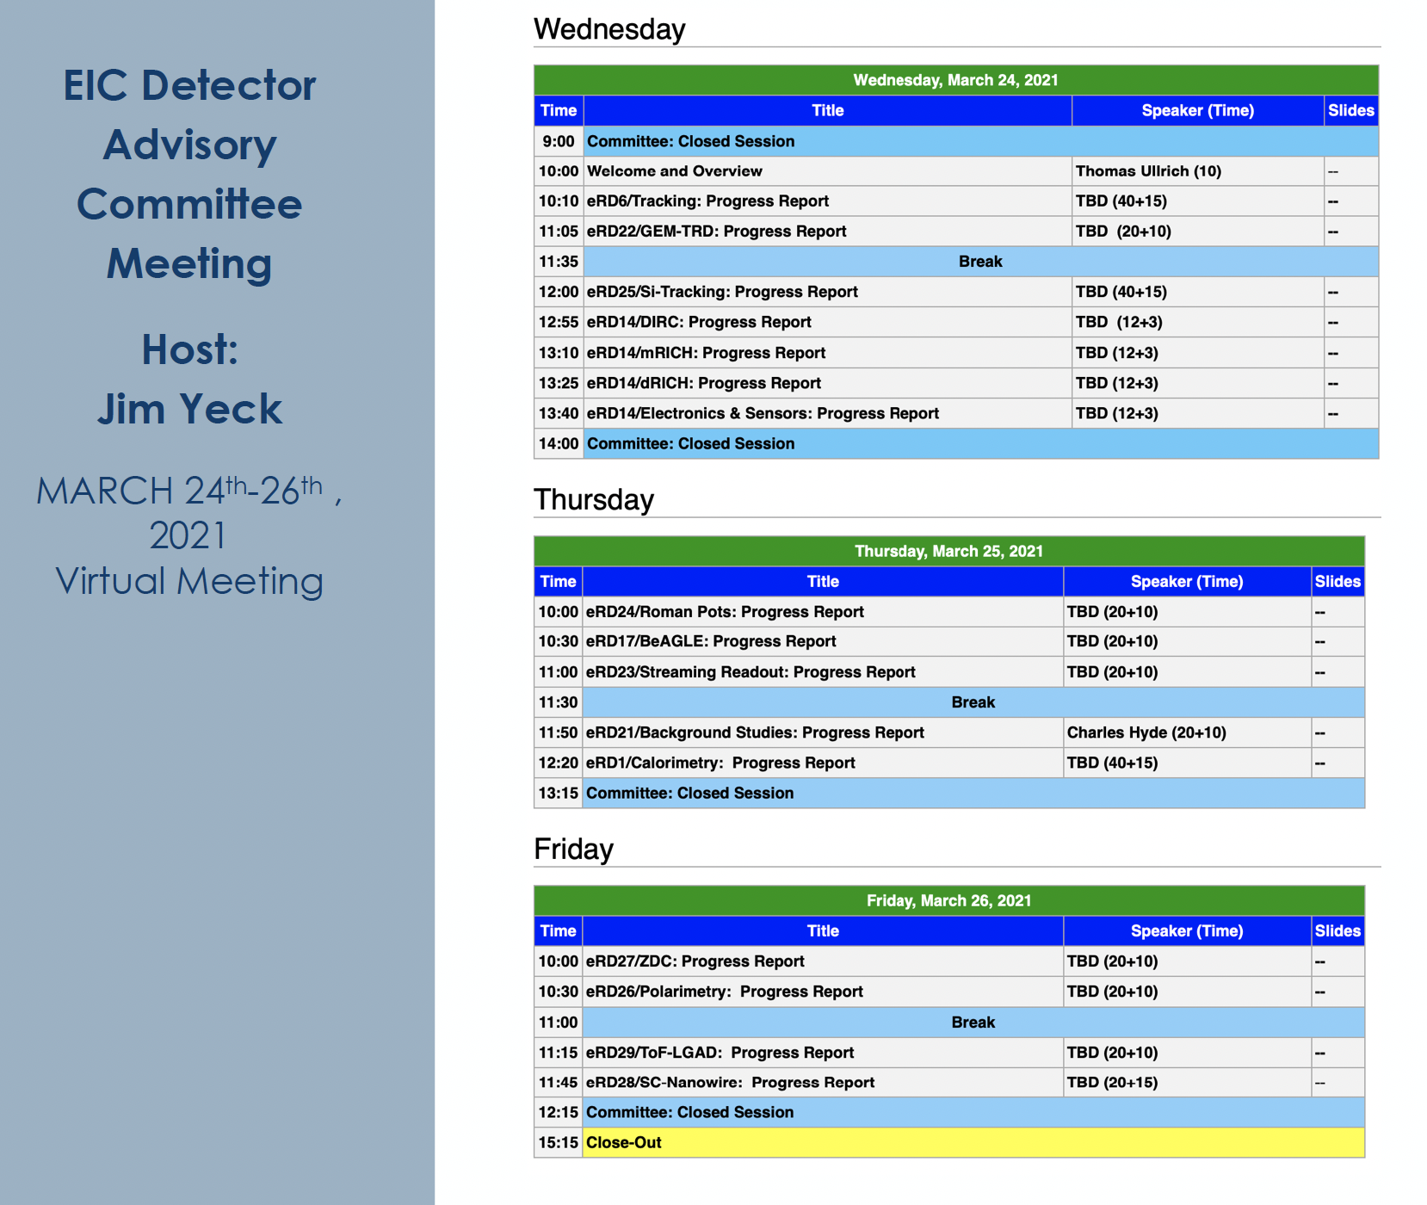
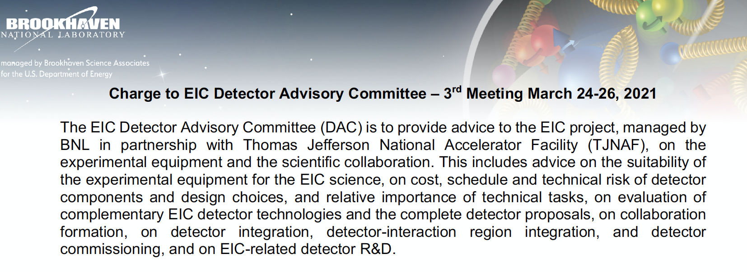
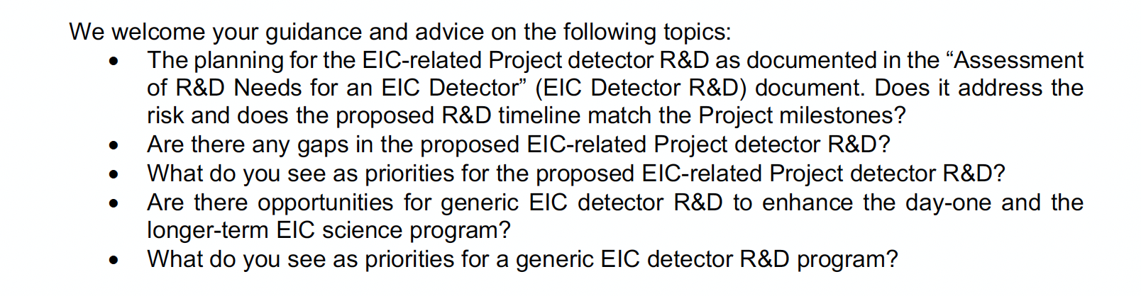
Typical Agenda/Charge to the DAC
Reports are formally made to Project Management, but available to the public!

Slide 5
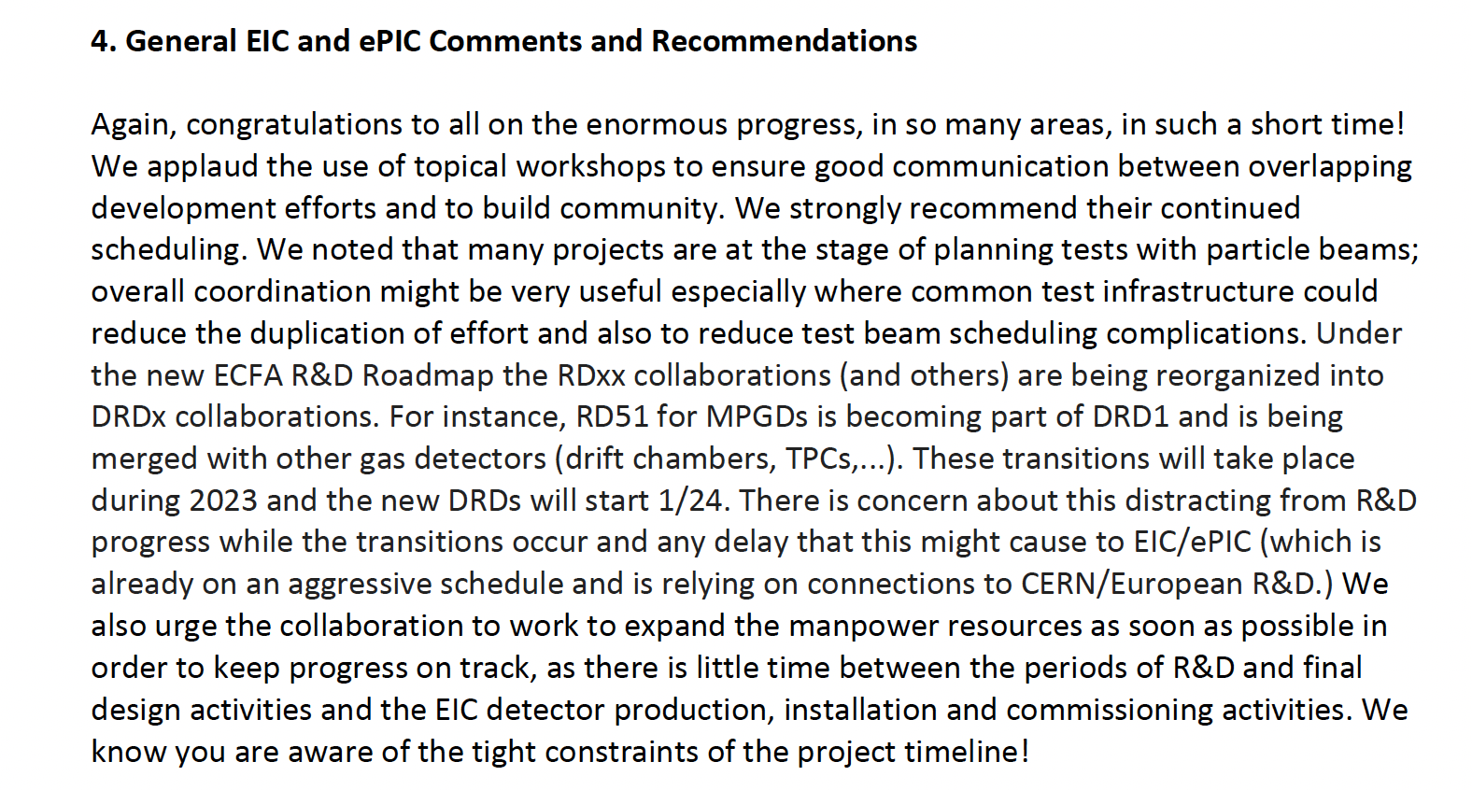
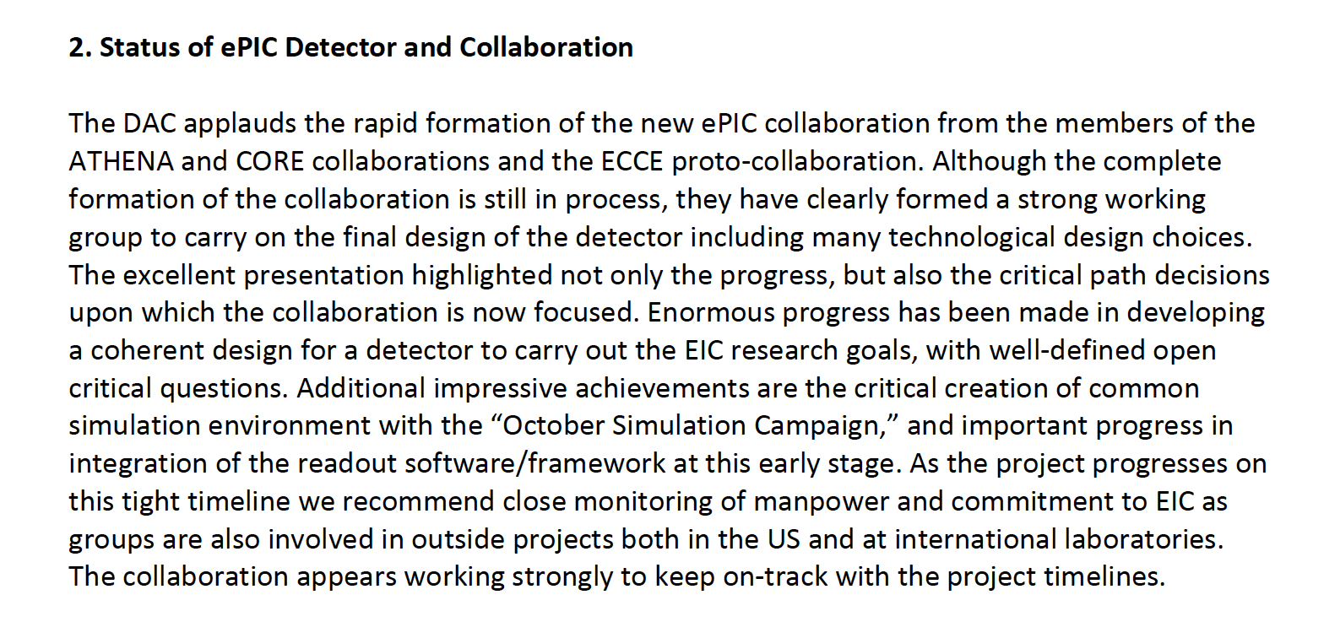
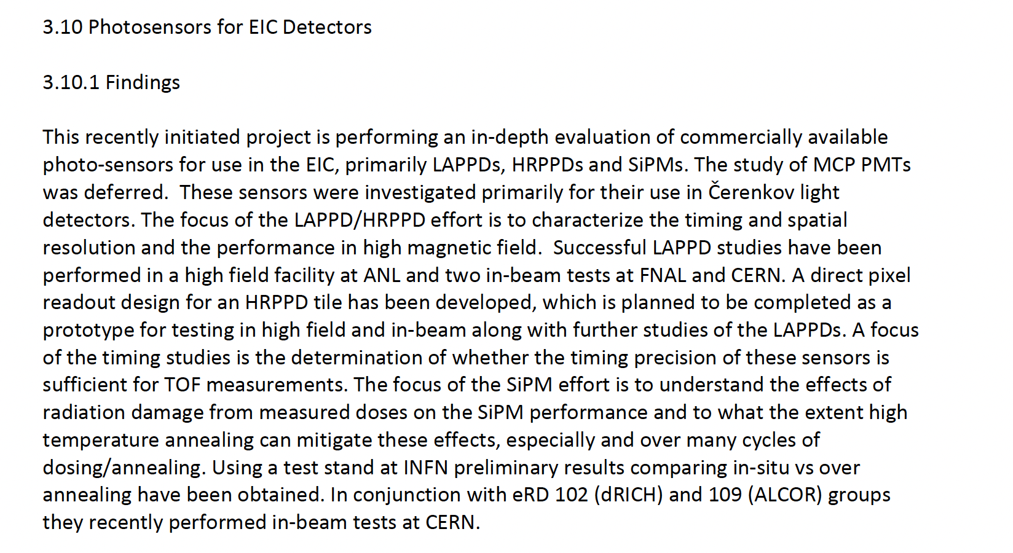
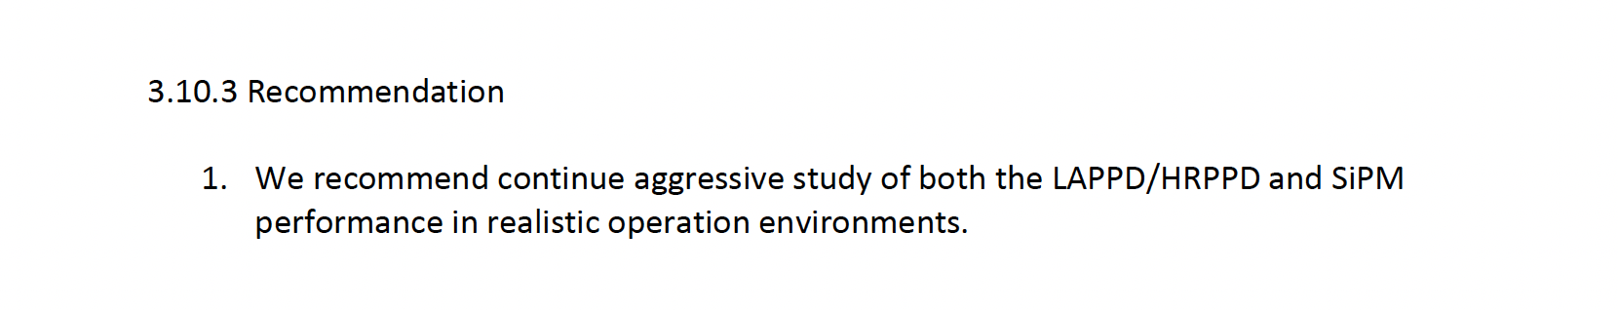
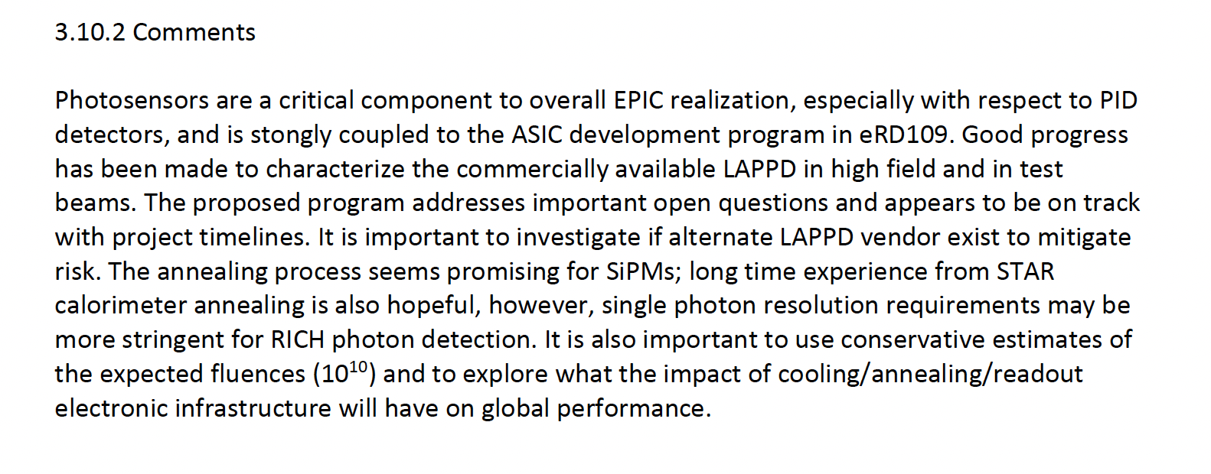
Highlights from October 2022 Review

Slide 6
Past Meetings/Tasks of DAC
  September 28-29, 2020. Bring the DAC up to speed and prepare them for upcoming charges, e.g., related to input on assessment of the call for Expressions of Interest (EoI).
  December 18, 2020. Update DAC on the EIC Project and Yellow Report status, the EoI assessment, international engagement, and planning for call for detector proposals.
  March 24-26, 2021. Transition from the generic EIC detector R&D to the Project detector R&D.
  December 2021 – January 2022. Evaluation of detector technologies, cost and schedule as input to the Detector Proposal Advisory Panel.
  October 19-21, 2022. Review the ongoing project detector R&D. Advise for the FY23 detector R&D.

Slide 7
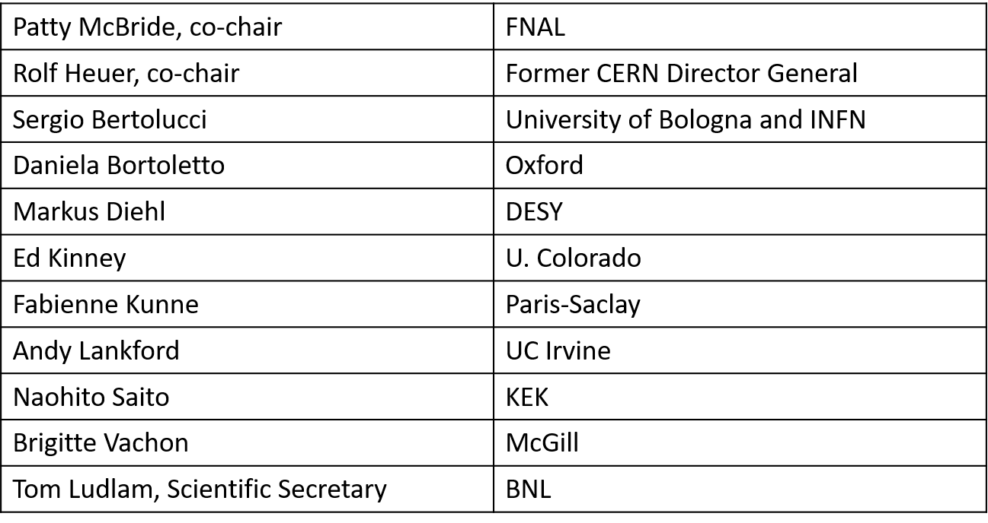
Role in Detector Proposal Review
December 2021 – January 2022. Evaluation of detector technologies, cost and schedule as input to the Detector Proposal Advisory Panel.
Two members of DAC served on DPAP to coordinate communication of results of DAC evaluation
Detector Proposal Advisory Panel (DPAP)

Slide 8
New 2023 DAC Membership
Detector Advisory Committee 2023
Name | Institition | Expertise
Edward Kinney | Boulder CO | EIC Science, general
Ken Wyllie | CERN | ASICs/electronics
Petra Merkel | FNAL | R&D, Integration
Antonis Papanestis | Rutherford Appleton Laboratory | Particle Identification
Peter Krizan | U Ljubljana | Particle Identification
Ana Amelia Machado | University of Campinas, Brazil | Particle Identification, Sensors
Heidi Schellman | Oregon State | Computing
Brigitte Vachon | McGill | Electronics
Stefano Miscetti | INFN Frascati | Calorimetry
Etiennette Auffray | CERN | Calorimetry
Andrew White | U. Texas Arlington | Tracking
Chi Yang | SDU China | Tracking

Slide 9
Summary and Outlook
DAC formed to bring additional outside expertise and advice to the project during the critical and rapid early phases of the project.
New committee members have joined in 2023
Plans for this year: Review the ePIC detector and in-kind engagement, and the next phase of Project Detector R&D

