Slide 1
EIC Project Detector Overview
Elke-Caroline Aschenauer (BNL) Rolf Ent (JLab)
Co-Associate Directors for the Experimental Program

Slide 2


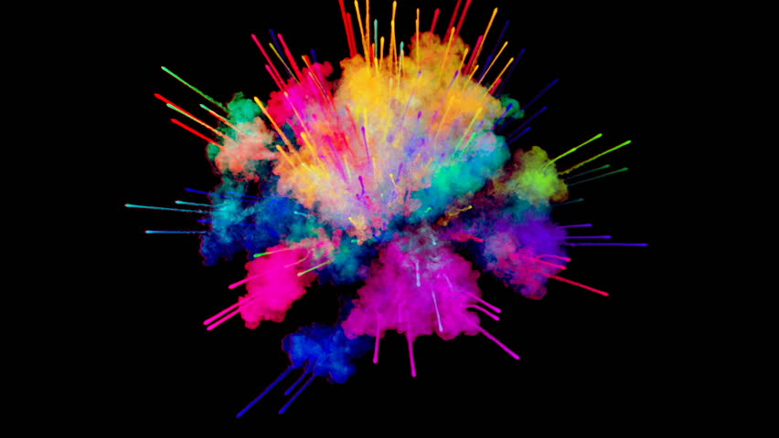
High Level EIC Scope
Project Design Goals
High Luminosity: L= 10³³ – 10³⁴cm⁻²sec⁻¹, 10 – 100 fb⁻¹/year
Highly Polarized Beams: 70%
→ requires high precision polarimetry
Large Center of Mass Energy Range:
E_{cm} = 29 – 140 GeV
→ Large Detector Acceptance
Large Ion Species Range: protons – Uranium
→ Requires forward detectors integrated in beam lattice
Good Background Conditions
Accommodate a Second Interaction Region (IR) → IR-8
Possible
2nd Detector
Location
IR-8
Project
Detector
Location
IR-6
p/A beam
e beam
p: 41 GeV, 100 to 275 GeV
e: 5 GeV to 18 GeV

Slide 3
EIC Experimental program preparation
Year-long EIC User Group driven EIC Yellow Report activity (December 2019 – February 2021
  Science Requirements and Detector Concepts for the EIC
  arXiv:2103.05419 & Nucl. Phys. A 1026 (2022) 122447 – 488 citations (03/31/2023)
BNL and TJNAF Jointly Leading Efforts Towards Experimental Program | BNL and TJNAF Jointly Leading Process to Select Project Detector
2020 | Call for Expressions of Interest (EOI) https://www.bnl.gov/eic/EOI.php | May 2020
 | EOI Responses Submitted | November 2020
 | Assessment of EOI Responses | On-going&
2021 | Call for Collaboration Proposals for Detectors https://www.bnl.gov/eic/CFC.php | March 2021
 | BNL/TJNAF Proposal Evaluation Committee | Spring 2021
 | Collaboration Proposals for Detectors Submitted | December 2021
2022 | Decision on Project Detector – baseline “ECCE” | March 2022
 | Process to consolidate ECCE & ATHENA to the EIC Project Detector | Spring 2022
 | ePIC Collaboration* Formed – 160 institutions | July 2022
2023 | ePIC Charter ratified & elected Leadership Team | February 2023
 | Resources Review Board Meeting | April 2023
 | ePIC Detector remaining technology choices made | April 2023
&Remains ongoing until formal agreements are in place – it originally led to confirmation that in-kind level assumed for the EIC detector was in range.

Slide 4
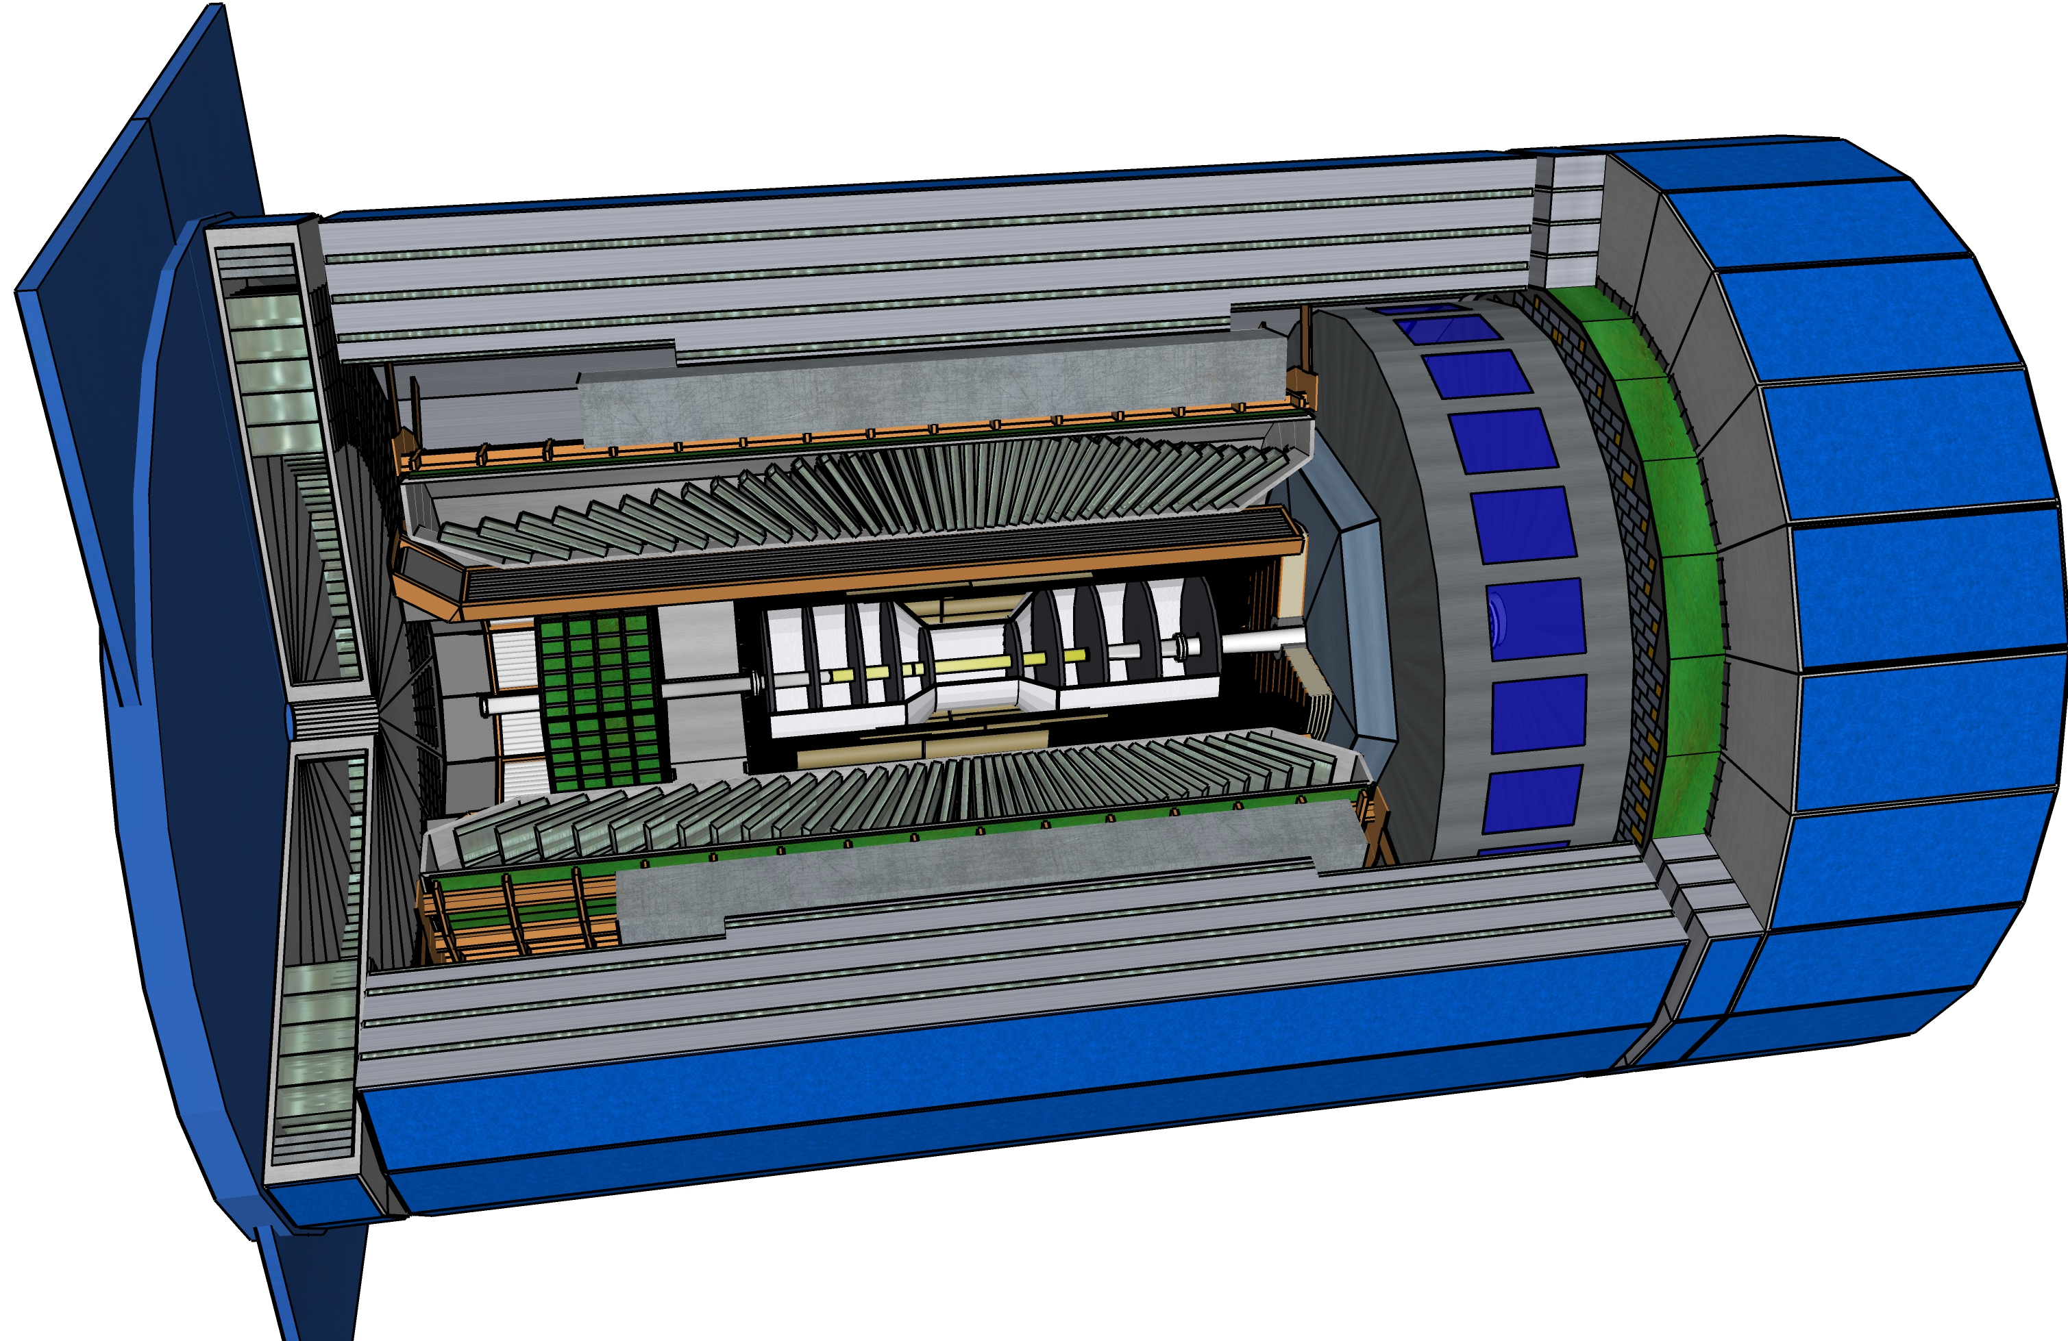
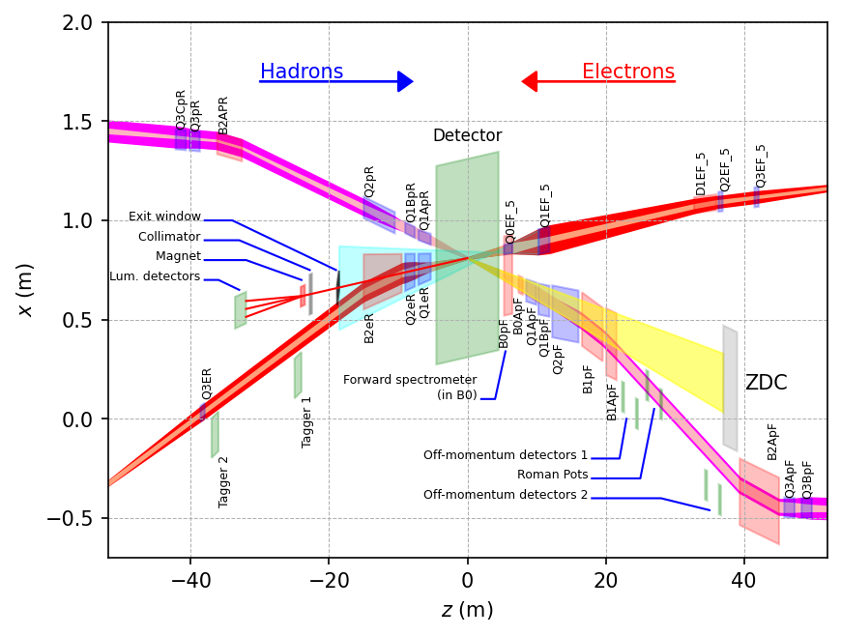
ePIC Detector
Asymmetric beam energies
→ require an asymmetric detector Barrel
with electron and hadron endcap
→ 9.5 m
→ Tracking, particle identification, EM
calorimetry and hadronic calorimetry
functionality in all directions
→ very compact detector Integration
will be key
Imaging science program with protons and nuclei
→ requires specialized detectors
integrated in the Interaction Region
over 80 m
Science program required momentum resolution
→ requires a large bore 2T magnet
(1.7 T magnet operation point, stretch goal 2T)
that has same geometry as the BaBAR magnet.
Streaming readout electronics model
  → highest scientific flexibility
9.5 m

Slide 5
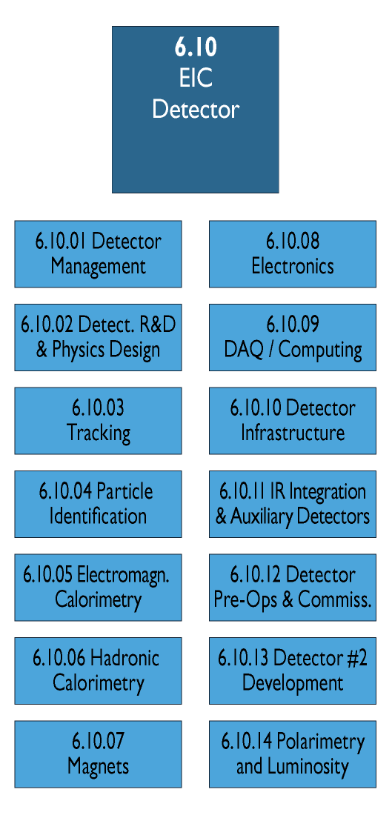
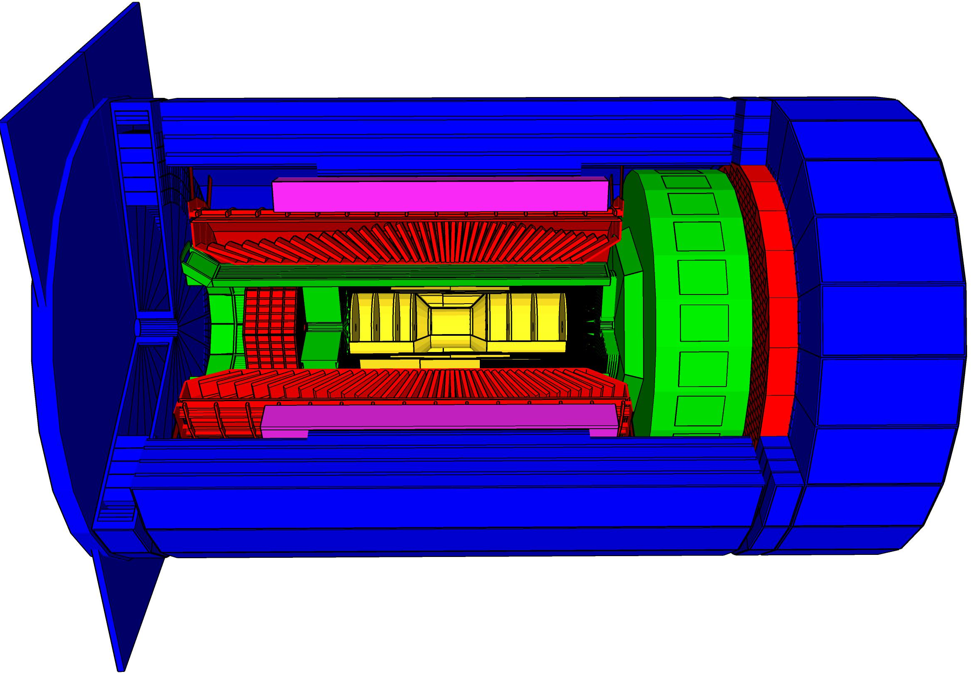
Scope Experimental Equipment
hadronic calorimeters (HCAL)
Solenoidal Magnet
e/m calorimeters (ECal)
Time.of.Flight (ToF), DIRC,
RICH detectors
9.5m
MPGD trackers
MAPS tracker
23 Subdetectors
incl. Polarimeters
+ Data Acquisition (DAQ)
provides coordination that
2nd detector remains possible
Experiment Equipment fully integrated
in EIC Project (WBS 6.10)
→ schedule, risk and cost
→ current total cost: $285M

Slide 6
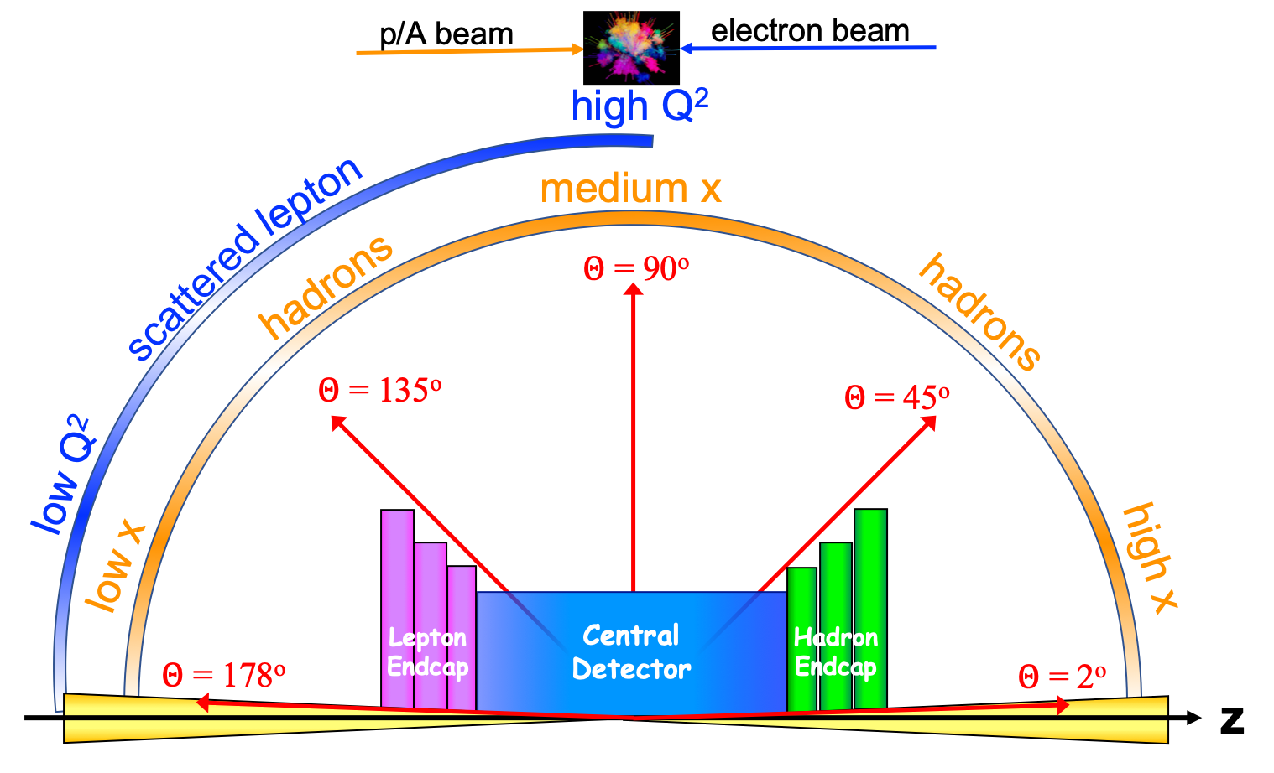
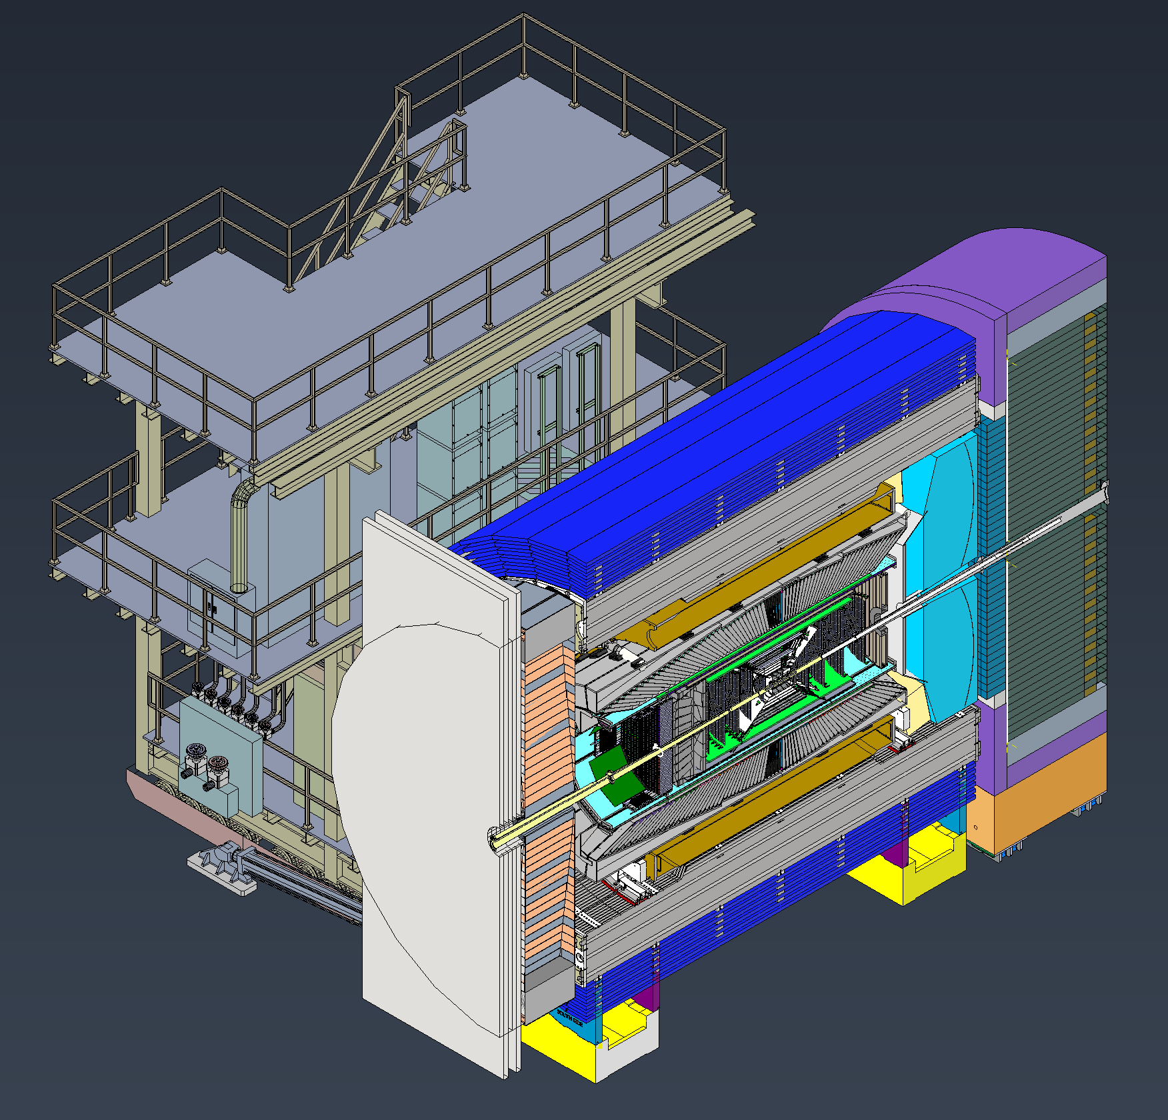

The ePIC Detector
Detailed CAD model of central detector and extended IR region continuously refined as design progresses

Slide 7
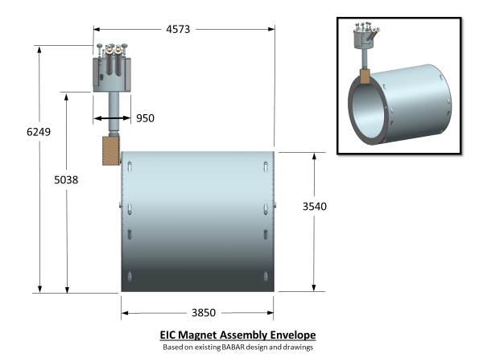
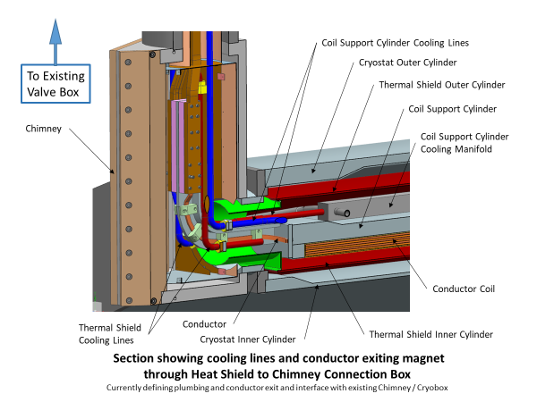
EIC Detector Solenoidal Magnet - MARCO
Joint CEA-Saclay-JLab-BNL effort
Magnet status:
  CD-1 Approval June 2021
  3T Detector solenoid preliminary design report December 2021
  Incremental (30%) Design and Safety Review February 2022
  DPAP closeout report – led to reduced field (< 3 T) March 2022
  Contract for 60% Design Review April 2022
  60% design team formation and kick off meeting May 3, 2022
  Mid-Project Progress meeting (@BNL, hybrid meeting) June 28, 2022
  Point design adjusted to stretch goal of 2 T (operation at 1.7 T) August 10, 2022
  60% Design and safety Review October 18, 2022
  90% Design contract in place December 2022
  Found qualified vendor willing to make conductor January 2023
  RFI out March 2023
  Sample Conductor contract March/April 2023
Magnet planning:
  Progress meeting (@JLab, hybrid meeting) April 18, 2023
  90% Design completion September 2023 (90% design completion is 100% - final design - for “Vendor Design-Build” procurement).
  Final Design Review (FDR) Week of October 2-6 2023
→ Magnet is ready for procurement at CD-3A date (expected January 2024)
7

Slide 8
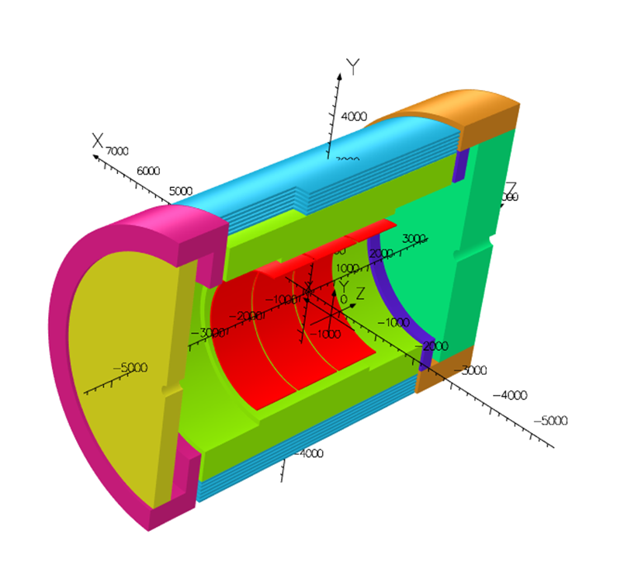
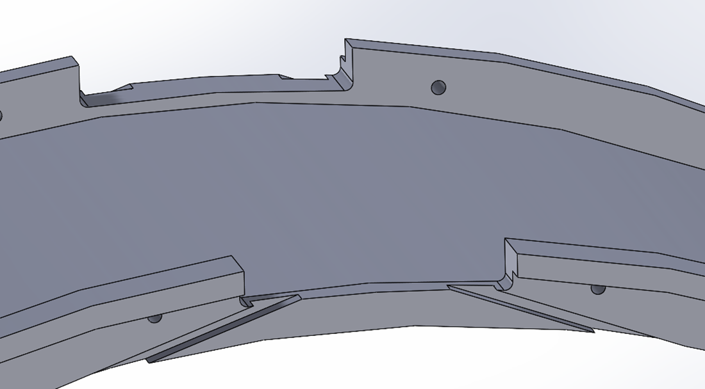
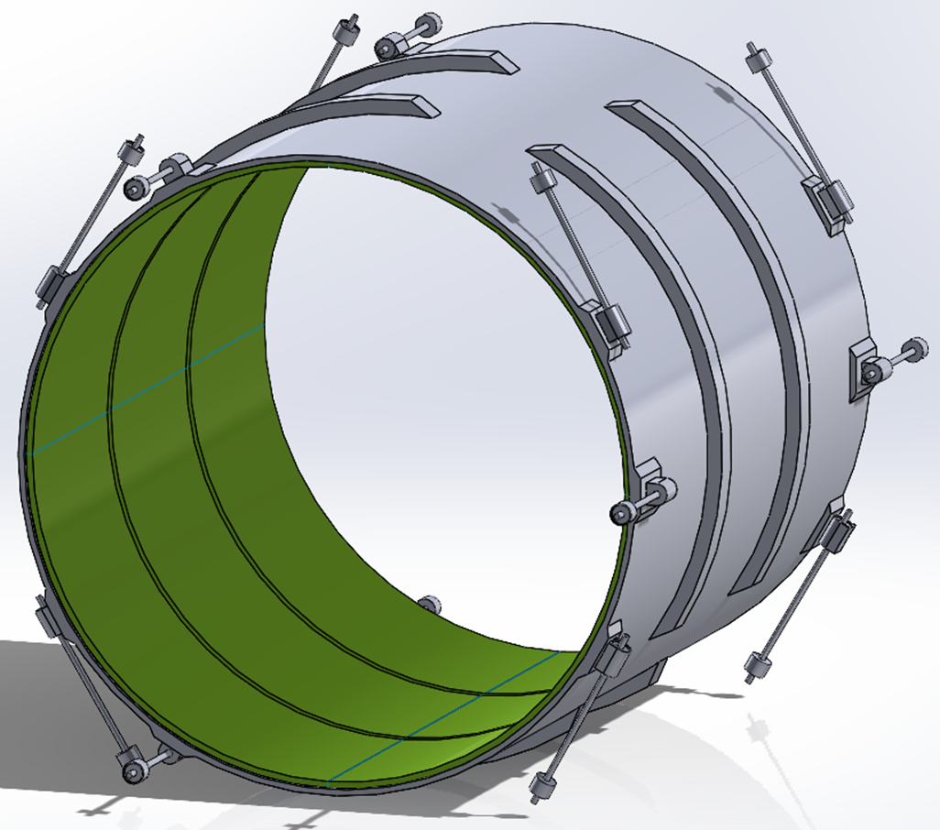
MARCO Magnet Design Details
Conductor is based on CEA-Saclay experience as used for previous magnets
Coil is divided in 3 modules with 557 Turns each. This is done mainly to accommodate possible conductor length.
The two most important design parameters are conservative: large temperature margin and large critical current margin
Mechanical analysis Ongoing
Conductor exits

Slide 9
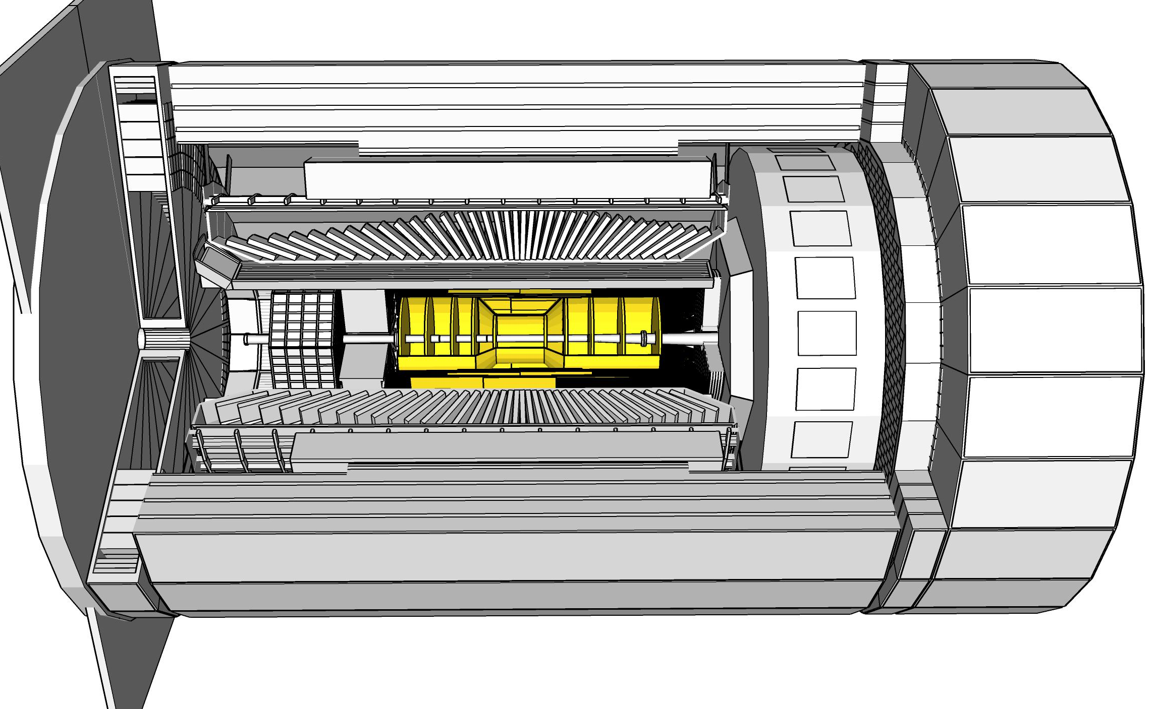

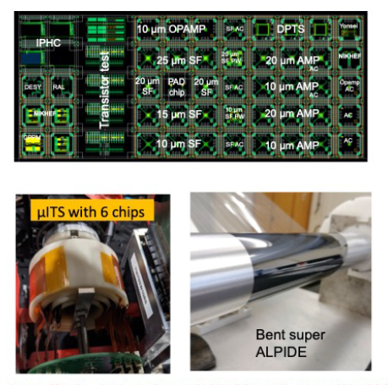
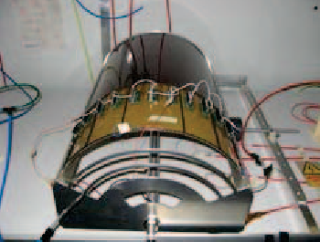
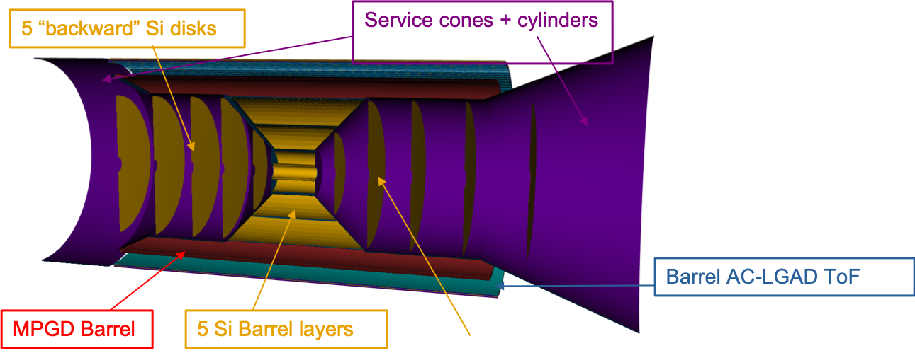
ePIC Tracking Detectors
Monolithic Active Pixel Silicon Tracker:
1 single technology: 65-nm MAPS
  small pixels (10 μm) and power
  consumption (<20 mW/cm²)
  low material budget
  (0.05% to 0.55% X/X₀ / layer)
  based on ALICE ITS3 development
  MAPS Vertex layers
  MAPS Barrel, forward and
  backward disks
Multi Pattern Gas Detectors:
additional space points at large radii
Cylindrical microMEGAS
→ Additional space point for
pattern recognition / redundancy
→ Ongoing geometry
optimization
μRWELL planar layer
behind hpDIRC
→ Impact point and direction for the
ring seeding of hpDIRC
→ Additional space point for pattern
recognition / redundancy
world’s first
at
world’s first
at

Slide 10
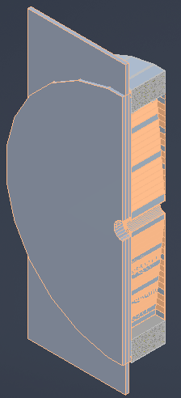
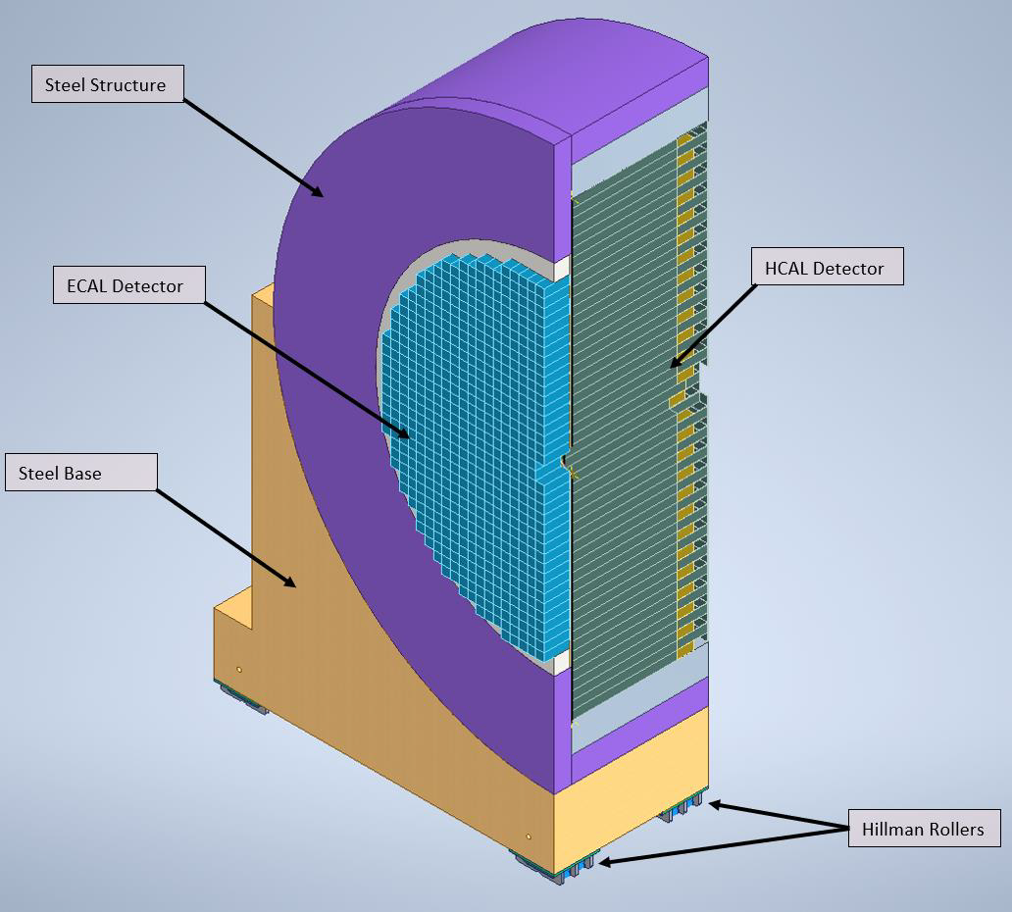
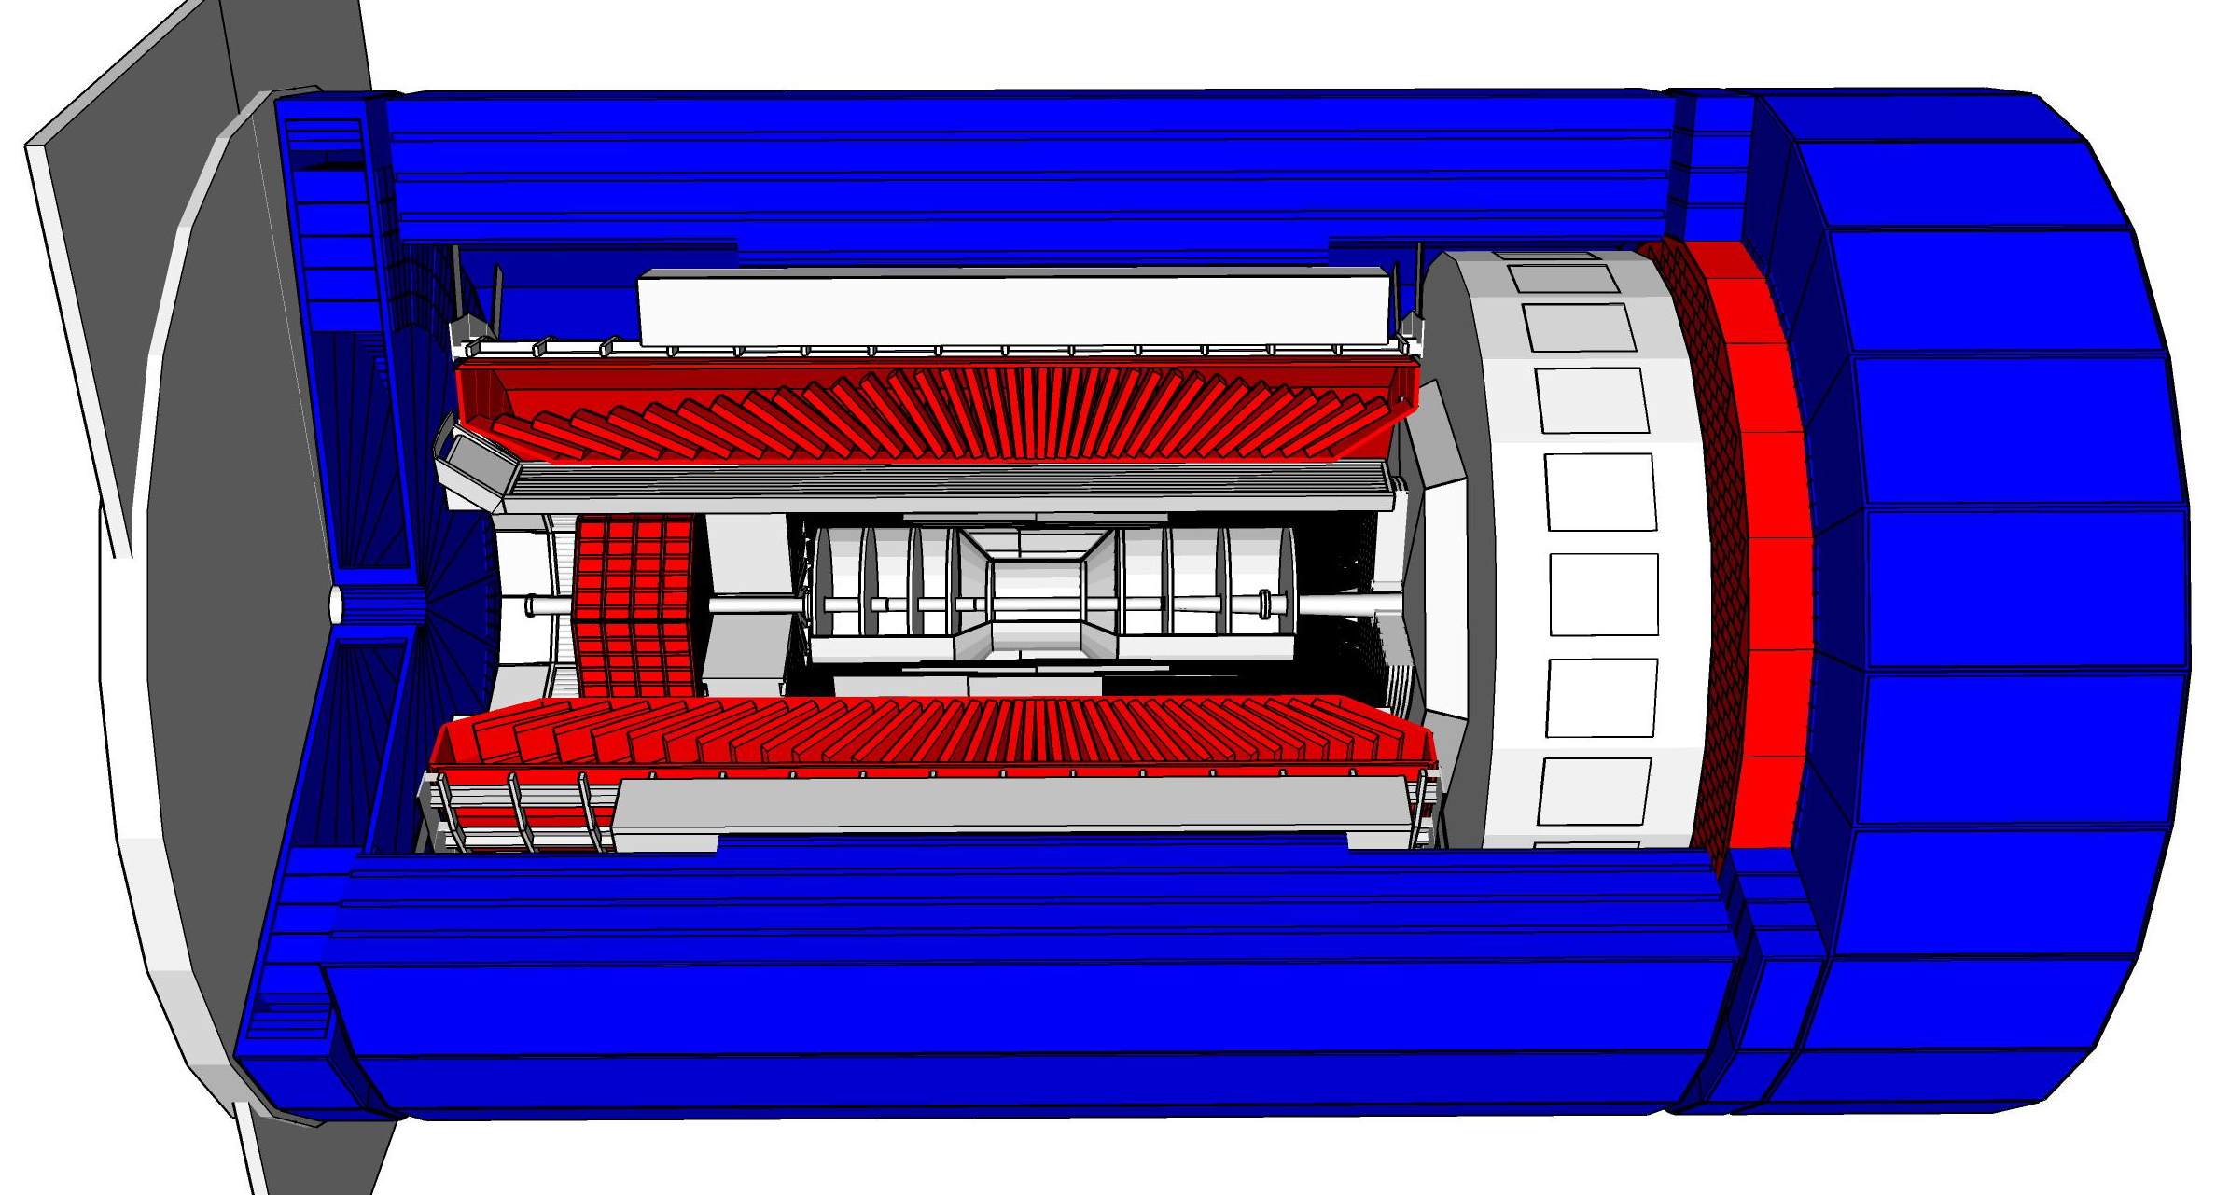
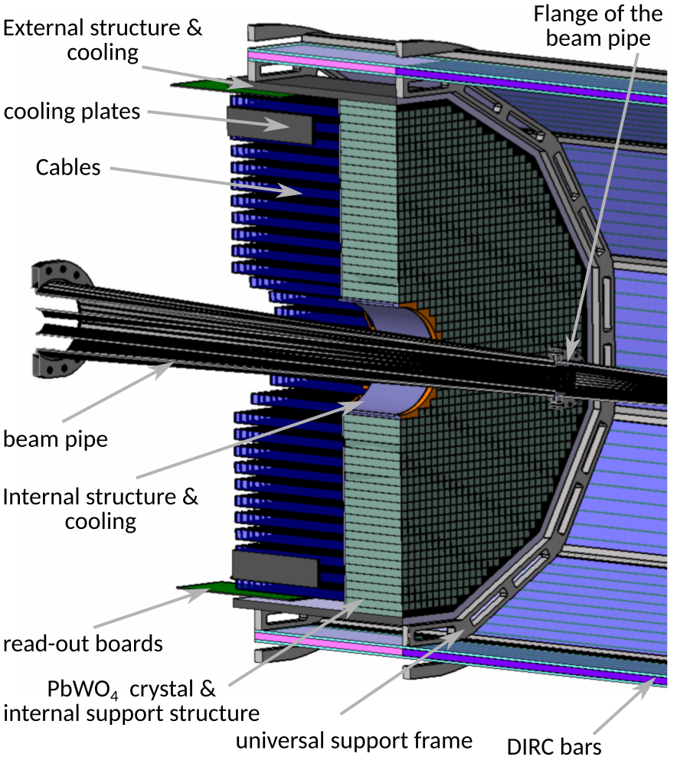
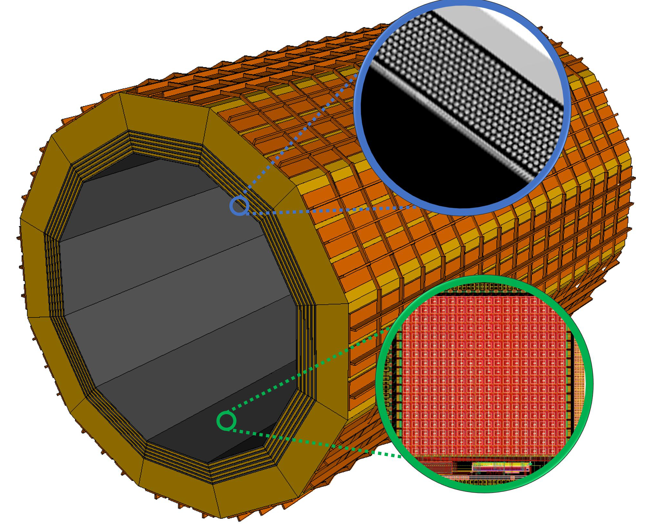
ePIC Calorimetry
Backwards HCal
Steel/Sc Sandwich
tail catcher
Barrel HCAL
(re-used from sPHENIX)
High granularity
W/SciFi EMCal
Longitudinally separated HCAL
Steel/Sc & W/Sc sandwich
with SiPMs embedded in Scintillator
world’s first
at
Backwards EMCal
PbW04 crystals
with SiPMs as Photonsensors
world’s first
at
Complementary options for BECAL:
SciGlass or
Imaging Calorimeter
world’s first
at
world’s first
at
2 options for the
barrel calorimetry
Review completed 03/14/23
Decision by 04/21/23
Imaging Layer

Slide 11
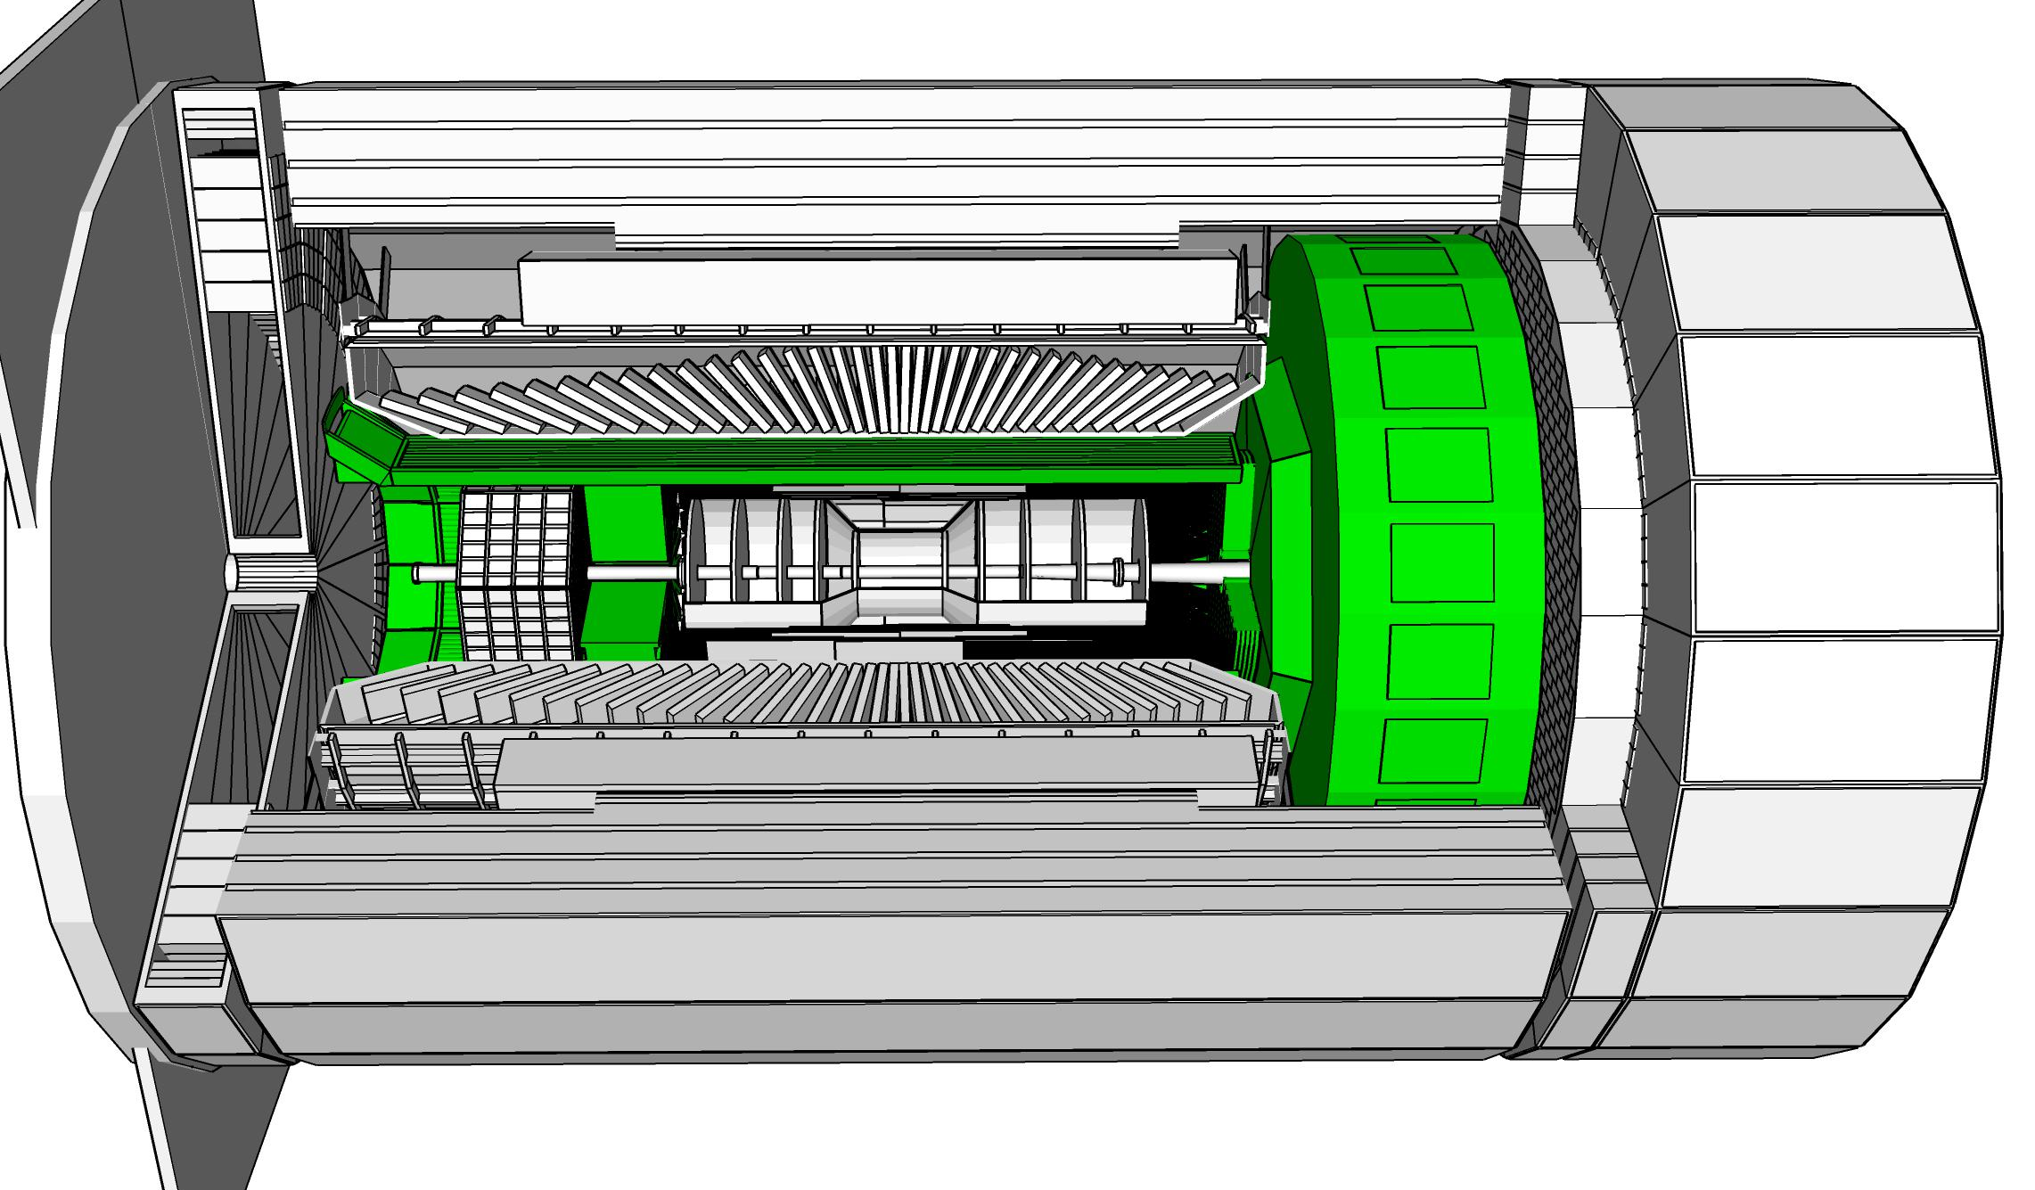

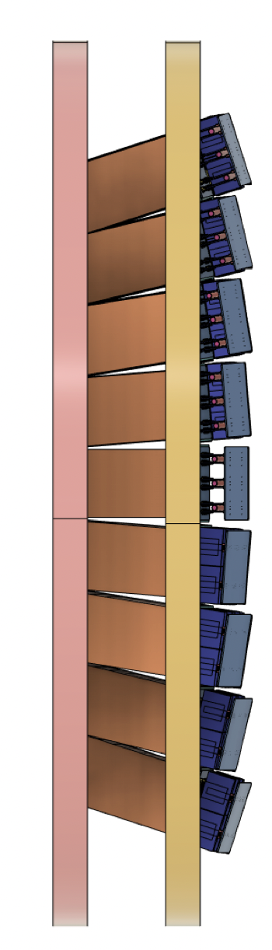
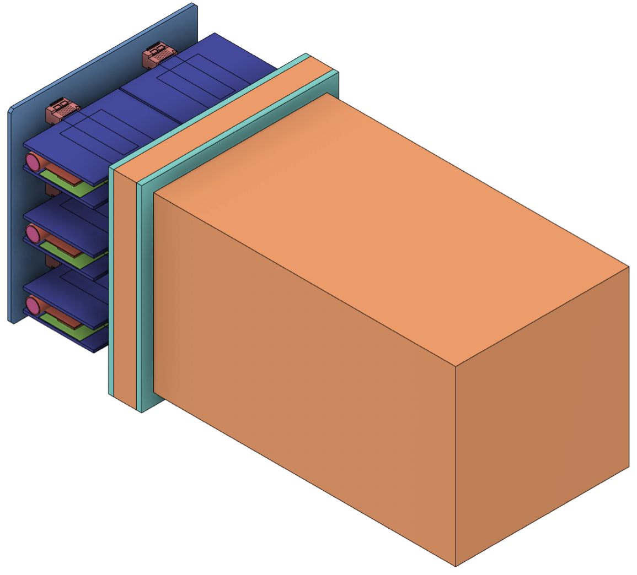
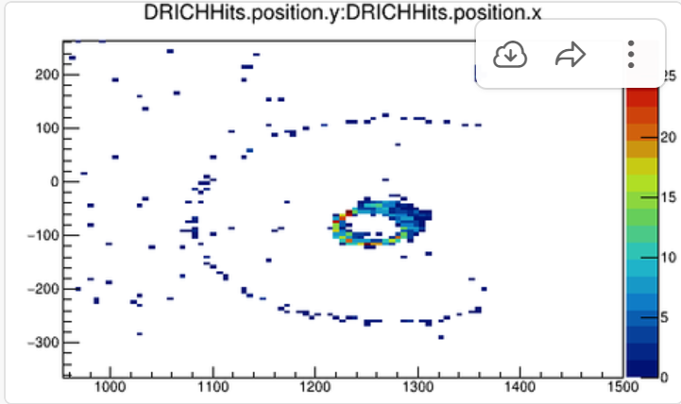
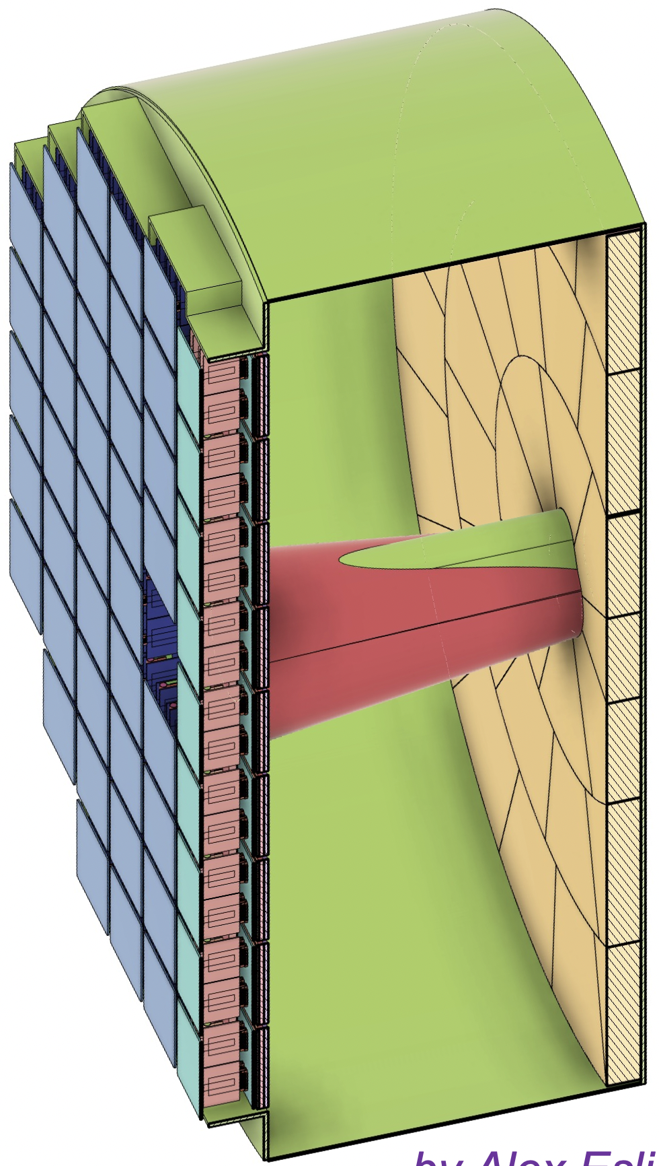
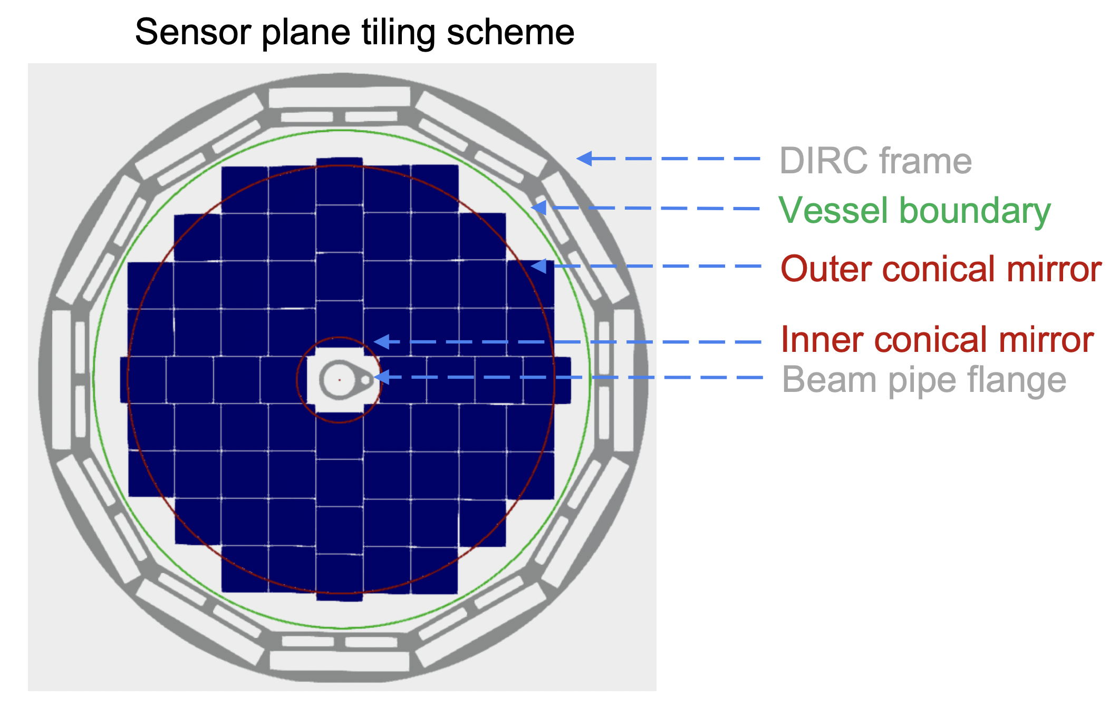
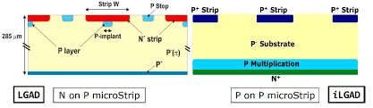
ePIC Particle Identification Detectors
Backward RICH:
Aerogel Cherenkov Det.
e, π, K, p separation
→ π/K 3σ sep. at 10 GeV/c
Photon-sensor:
LAPPDs to include TOF
hpDIRC (High Performance DIRC)
Quartz bar radiator → Reuse of BaBAR DIRC bars
light detection with MCP-PMTs
Fully focused
π/K 3σ sep. at 6 GeV/c
dual Radiator RICH
Aerogel
z: 4cm
radius: 110 cm
air gap
0.3 mm acrylic filter
Spherical Mirrors
6 Azimuthal Sectors
world’s first
at
Option-1:
mRICH (Modular RICH)
Focused by Fresnel lens
C₂F₆ Gas Volume
120 cm length
radius: 185 cm
Tapered bore radius
Al vessel
Sensors tiled on spheres
→ SiPMs as Photonsensors
Option-2:
Single volume proximity focusing aerogel RICH with long proximity gap (~30 cm)
world’s first
at
π/K 3σ sep. at 50 GeV/c
AC-LGAD (Low Gain Avalanche Detector)
20-35 psec
Accurate space point for tracking
forward disk and central barrel
R&D and PED by International consortium HEP & NP
world’s first
at
Review completed 03/21/23
Decision by 04/21/23

Slide 12
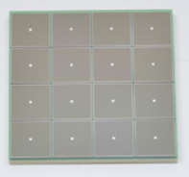
Electronics
We have 23 different detector technologies in the ePIC detector
It would be intractable if all have different readout electronics
→ the goal is to minimize the number of different ASICs and use common
readout solutions
Global Timing Unit (GTU)
-Interfaces to
Collider Run Control & DAM
-Config & Control
-Clock & Timing
Electronics Readout Chain
On Detector
SMT BGA
Sensor
Adapter
Front End Board (FEB)
Readout Board (RDO)
Data Aggregation Module (DAM)
Computing
Detector Group | Channels | AC-LGAD | SiPM/PMT | MPGD
 | MAPS | AC/DC-LGAD | SiPM/PMT | MPGD
TOTAL | 32 B | 7.1M-54M | 370k | 100k
ASIC | ITS-3 | EICROC FCFD HPsOC ASROC FAST | Discrete/COTS HGCROC3 ALCOR-EIC | SALSA
We expect to need ITS-3 and 4-5 different ASICs
Based on existing ASICs → reduce cost & time
Much synergy with international efforts

Slide 13
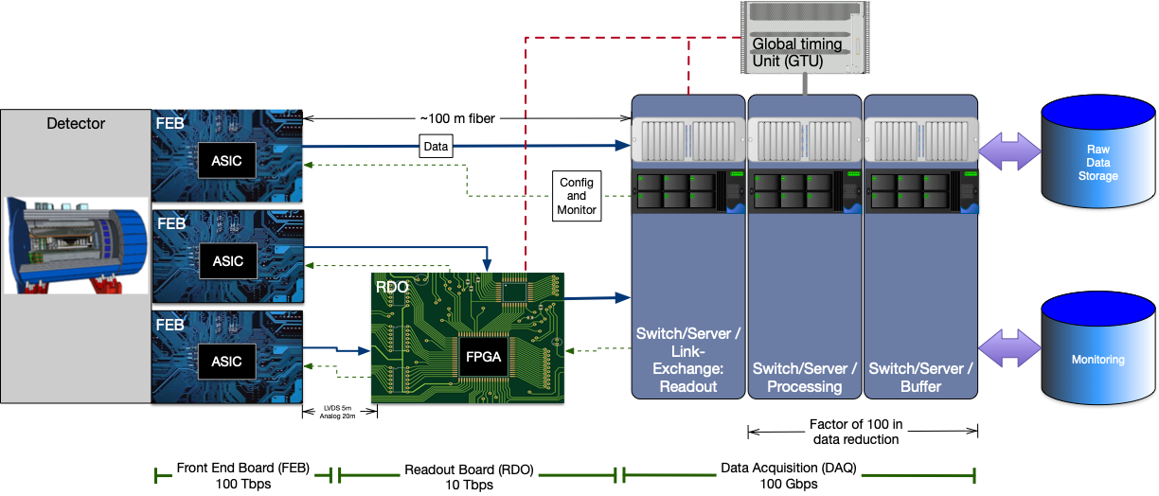
Streaming Readout Architecture
Triggerless streaming architecture gives much more flexibility to do physics
Rates quoted are at output of each stage
Integrate AI/ML as close as possible to subdetectors → cognizant Detector

Slide 14
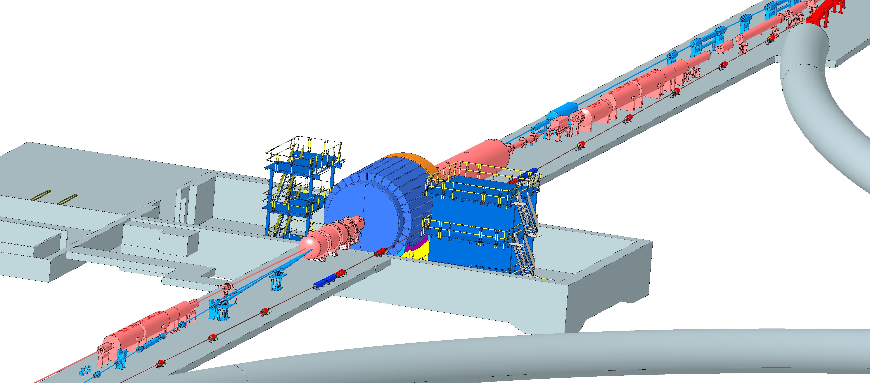
Interaction Region Layout
ESR Forward side
Forward Side
SC Magnet Cryostat
HSR Injection Line
Central Detector
Rear Side
SC Magnet Cryostat
HSR Forward Side
HSR: Hadron Storage Ring
ESR: Electron Storage Ring
RCS: Rapid Cycling Synchrotron
SC: Superconducting
HSR
Rear Side
RCS
With Detector Bypass
ESR Rear side
every cm counts → integration and communication with accelerator team is crucial

Slide 15
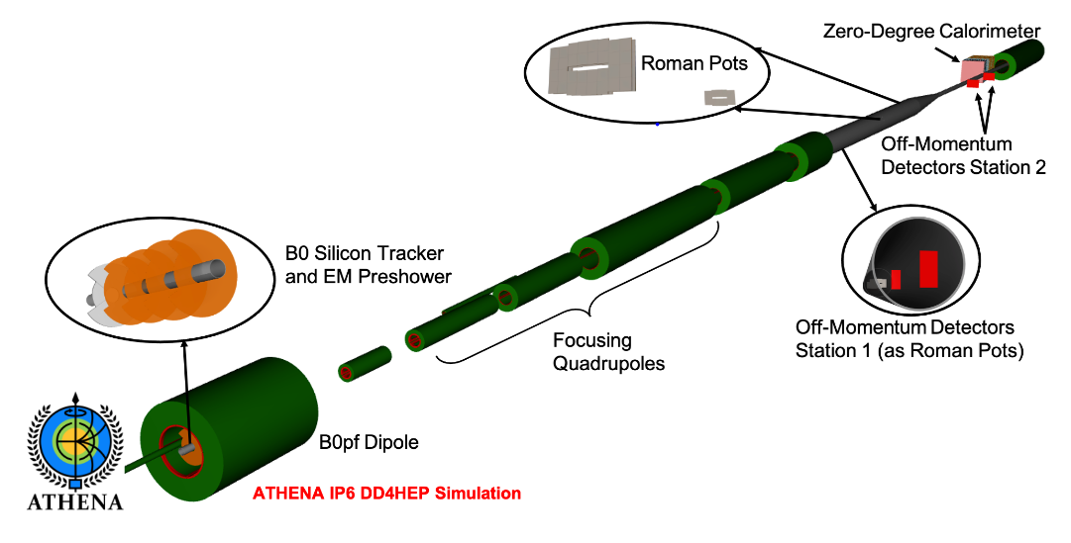
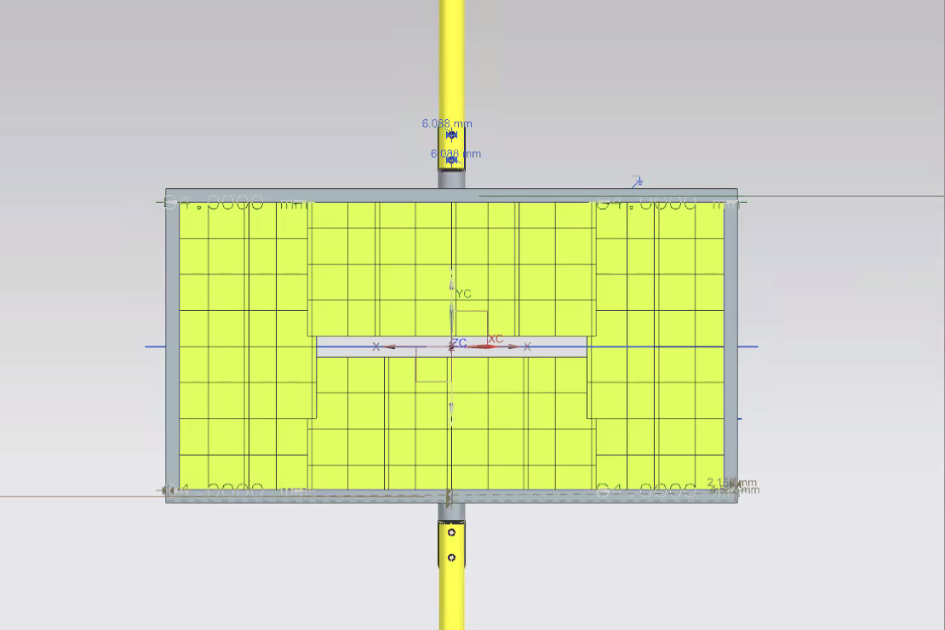
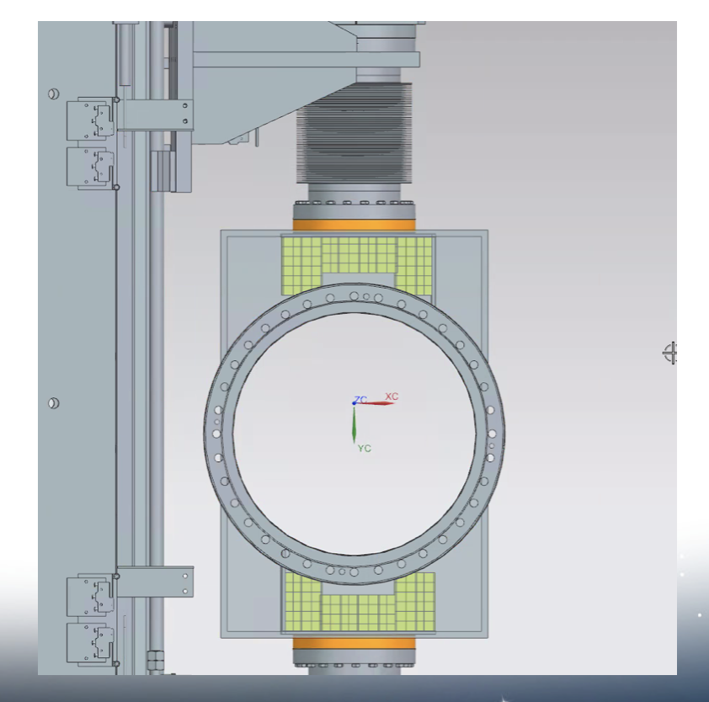
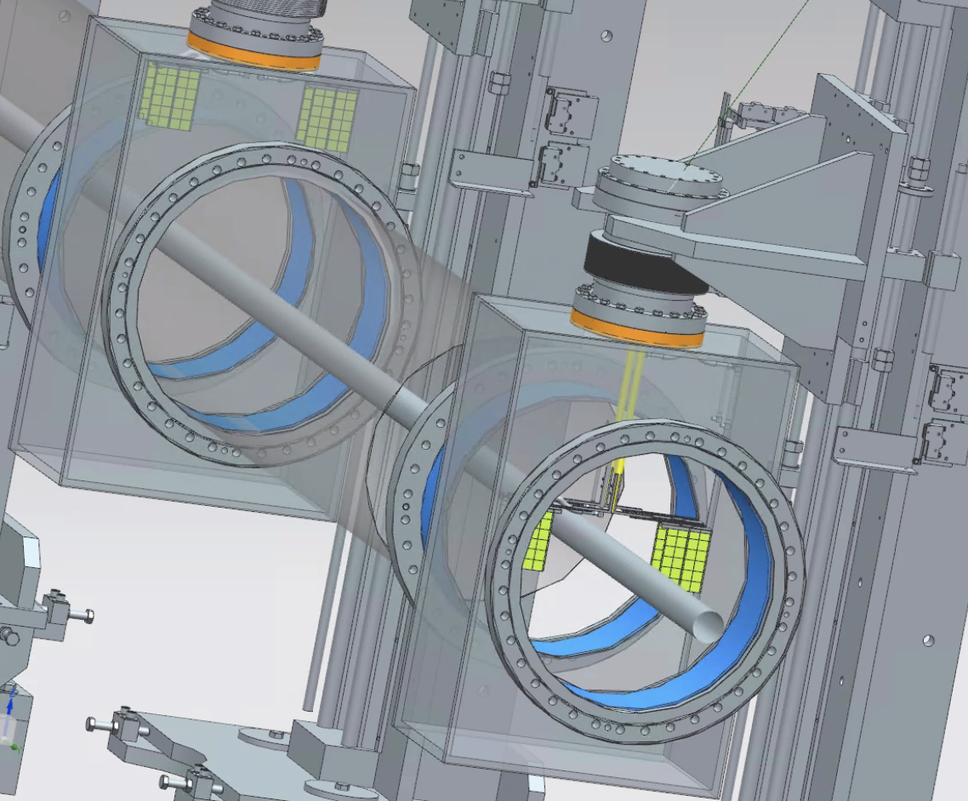
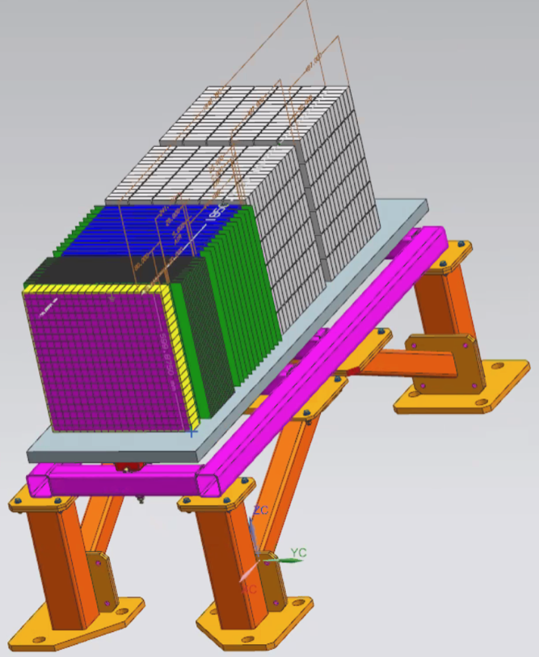
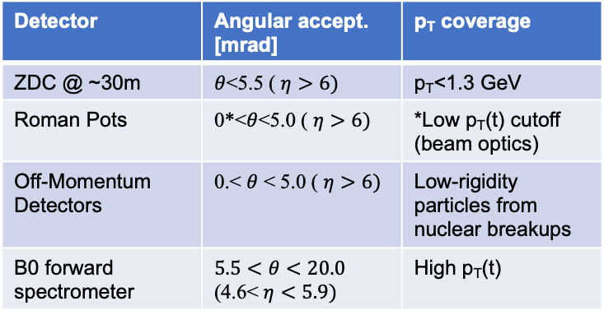
Far-Forward Ancillary Detector Integration
Roman Pots
Off-momentum
detectors
IP magnets & ancillary detectors fully simulated in GEANT including all beam effects
Technologies defined
Silicon: AC-LGAD & MAPS
Zero Degree Calorimeter:
  ECAL (PbWO4)
  HCAL (PbSi + PbScint)
Detector | Angular accept. [mrad] | p_{T} coverage
ZDC @ ~30m | $θ$<5.5 ( $η>6)$ | p_{T}<1.3 GeV
Roman Pots | 0*<$θ$<5.0 ( $η>6)$ | *Low p_{T}(t) cutoff (beam optics)
Off-Momentum Detectors | 0.< $θ$ < 5.0 ( $η>6)$ | Low-rigidity particles from nuclear breakups
B0 forward spectrometer | $$5.5<θ<20.0$$ (4.6< $η<5.9)$ | High p_{T}(t)
ECAL
PbW0₄
PbSi PbSc

Slide 16
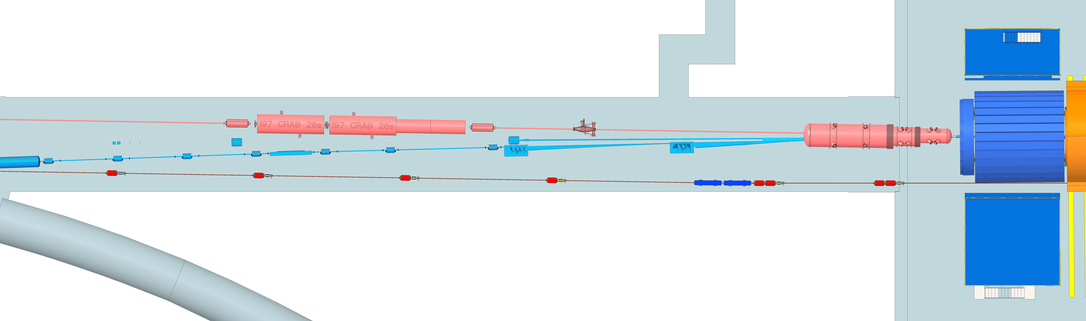
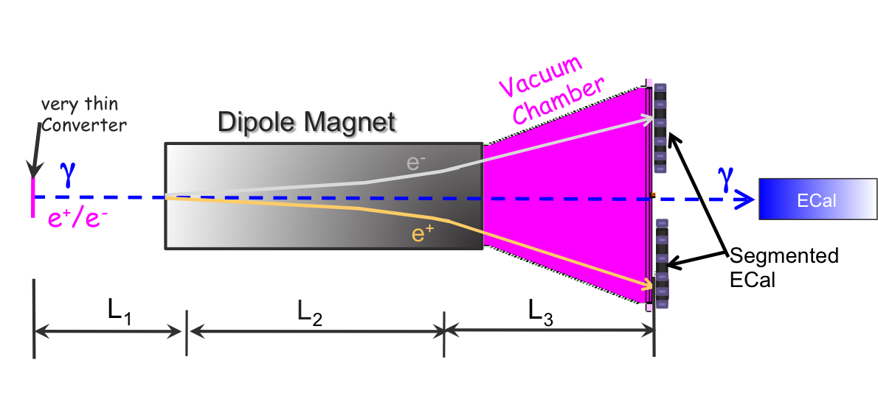
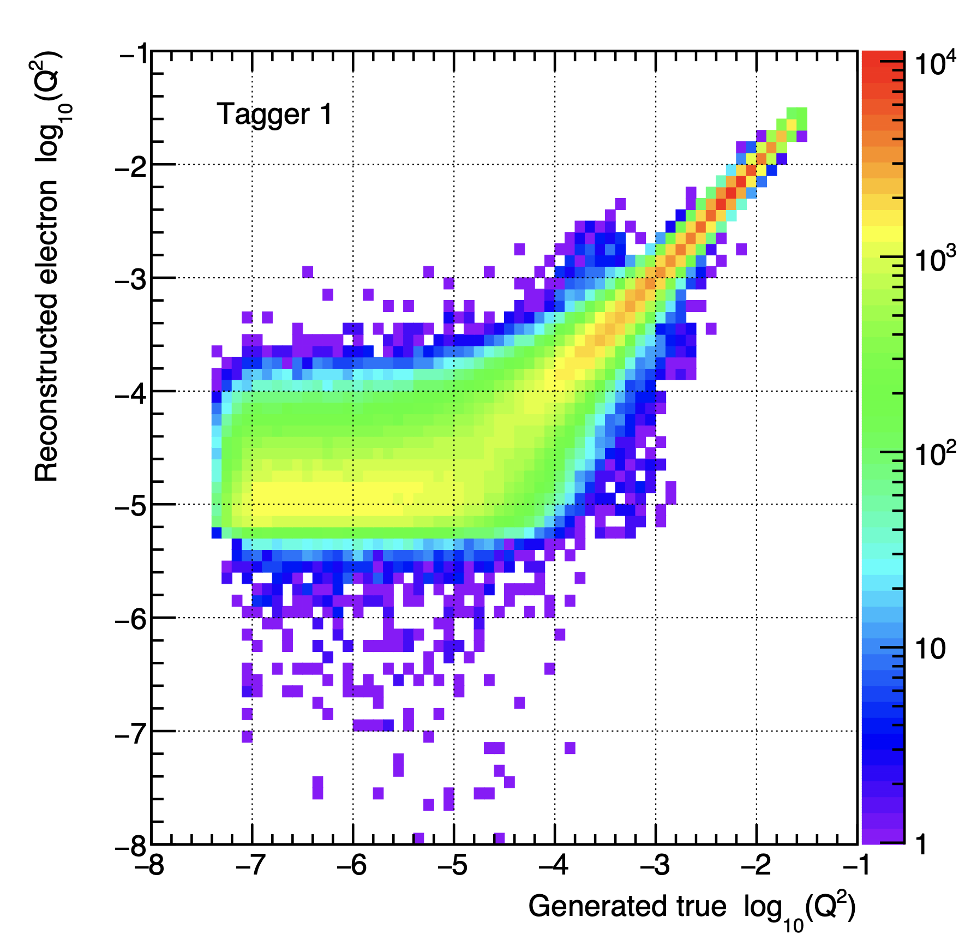
Far-Backward Detectors
Luminosity Detector and Low Q² Tagger
local hadron
polarimeter
luminosity detector
low Q²-tagger
Luminosity Detector Concept:
Use Bremsstrahlung ep → epγ as reference cross section
Goals for Luminosity Measurement:
Integrated luminosity with precision δL/L< 1%
Measurement of relative luminosity:
physics-asymmetry/10 → ~10⁻⁴ – 10⁻⁵
IP magnets, Lumi & low-Q² detectors fully simulated in GEANT including all beam effects and CAD layout
Low Q²⁻Tagger:
Purpose:
Detection of scatter electron for Q² < 0.1 GeV²
Critical for calibration of Lumi-detector
Beam divergence and energy spread impact performance
Technology:
Electromagnetic calorimetry with Si-tracking
→ strong synergy with luminosity detector
Combine
pair spectrometer → high precision
with
zero degree photon calorimeter
→ fast feedback for collider
Technology:
Electromagnetic calorimetry with Si-tracking

Slide 17
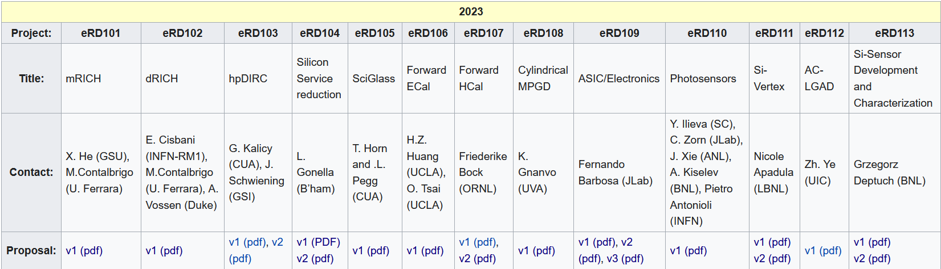
EIC Project Detector R&D Program & In-Kind
https://wiki.bnl.gov/conferences/index.php/ProjectRandDFY23
INFN-Ferrara, Glasgow
INFN-Roma1, INFN-Ferrara
GSI
IJCLab-Orsay, INFN-Genova, AANL/Armenia
Valparaiso
IJCLab-Orsay, CEA Saclay, INFN-Torino
IJCLAB/Omega/
Saclay/NCKU
International
Partners
Birmingham, Brunel, RAL, INFN-Bari, INFN-Trieste, IMP, CCNU
Nurnberg, GSI, INFN-Bologna, Cosenza, Ferrara, Genova, Trieste
Birmingham, Brunel, RAL, INFN-Bari, INFN-Trieste, IMP, CCNU
Chinese EMCal
Consortium
CEA Saclay
Strong synergies with CERN
CERN – EIC R&D Day November 2021 https://indico.cern.ch/event/1063927/
MAPS: ALICE-3 – ITS-3 development
PID: LHC-b and ALICE-3
Photon-sensors: LAPPDs with LHC-b
MPGD: long-term CERN R&D program RD51
DAQ: strong developments on streaming DAQs for all LHC experiments
AI/ML and high-performance distributed computing

Slide 18
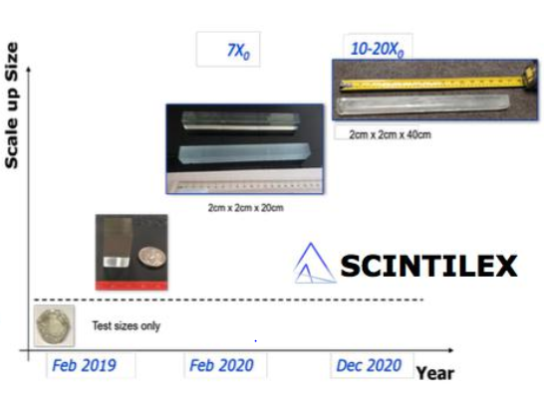
Some EIC Detector R&D Highlights
dRICH (and GEM) test at CERN beam
Synergy with CERN/ALICE R&D, submission of Si ITS3/MAPS TowerJazz 65 nm. EIC contribution through RAL group is high-speed data transmission IP blocks (LVDS receiver, CML transmitter).
Further EIC R&D is ongoing ITS3 stitched sensor design.
Scale-up of scintillating glass, in synergy with DOE SBIR/STTR
(EIC R&D is beam prototype tests)
Two radiators with 180 GeV hadron beam with reference readout
40 cm long SciGlass

Slide 19
Detector E&D Progress – In-Kind User Contributions
Much engineering and design progress courtesy in-kind contributions!
Example I: Backward EM Calorimeter: France/IJCLab
Example II: Barrel EM Calorimeter: US universities (CUA, MIT)
Example III: dRICH: INFN institutions
Example IV: Si vertex tracker design: UK/STFC
Example V: Barrel MicroMegas MPGD: France/CEA-Saclay
Example VI: Magnet E&D contribution: France/CEA-Saclay
Barrel (SciGlass) EM Calorimeter design
Backward EM Calorimeter design
Pre-CD-2 baseline contributions to the detector PED from in-kind are estimated to be around $5M

Slide 20
International Interest & In-Kind - Updated
Entity | Interest and Important Facts
NSF | NSF-MSRI pre-proposal submitted by 10 US universities – aims at full scope of backward EM calorimetry (eECal). Armenia, Czech, France/IN2P3 as unfunded contributors. Invited to submit proposal.
Armenia | Contributions, mainly labor to eECal and many EM calorimetry and particle id detectors component tests.
Canada | EIC included in 2022 Canadian Subatomic Physics Long-Range Plan; Interested in Compton Polarimetry, Electromagnetic Calorimetry and Software
China | Forward EM Calorimeter
Czech | Working with funding agency; Interested in eECal (PbWO4 crystals and glass) and Silicon
France/IRFU | Interested in SC magnet design, electronics and MPGD/tracking. Saclay/IRFU provided 30% design work for magnet as in-kind, contributions to 60% and ongoing 90% design.
France/IN2P3 | International contribution to backward EM calorimetry (including in-kind design) and to readout electronics (e.g., ASICs for AC-LGAD detectors and Calorimetry). IRFU & IN2P3 discussing together for higher-level contributions.
India | Consortium is working with Funding agency; Interested in detector software (non-project scientific contribution), contributions to DAQ/slow controls, and PID – ToF as hardware (investigating Forward AC-LGAD to make links with Si plants).
Italy/INFN | Working with INFN since a while; Aims at major scope of forward particle identification detector (dRICH), at (part of) the Si/MAPS tracker scope, and at photo-sensor contributions. Further investigating possible interest in EIC detector magnet scope.
Israel | B0 Detectors (Si tracking and PbWO4)
Japan | Interested in a US-Japan agreement; Aims at full scope of Zero-Degree Calorimeter in collaboration with Taiwan/Korea. Pursuit of full scope of barrel AC-LGAD detector as EIC-Asia consortium. Contribution to DAQ/streaming. Possible aerogel.
Korea | Fiber-based EM calorimetry (barrel and/or hadronic ZDC), Small work package for barrel AC-LGAD as part of EIC-Asia consortium (includes also Japan,Taiwan), collaboration on Si tracking detector (backward Si disks), Si-based hadronic calorimetry for ZDC.
Poland | Actively working with ministry/funding agency; Interested in detectors along the beam line (luminosity detector, Roman Pots)
Taiwan | Pursuit of full scope of barrel AC-LGAD as part of EIC-Asia consortium. LYSO-based EM calorimeter for ZDC, Also optical readout/fiber. Possible later interest in PCBs. Computing.
UK | STFC seed funding for UK detector R&D (3M£). Interest in Si/MAPS tracker, polarimetry and detectors along the beams (Low-Q2/TimePix). Follow-up grant request for 5-7 years submitted early 2023 (includes accelerator part).

Slide 21
Project Schedule
Conclusion of
RHIC Operations
06/2025
Review
14-16 Nov
CD-2
01/2025
early
CD-4A
04/2031
early CD-4
CD-4A
04/2032
CD-0
12/2019
CD-1
06/2021
CD-3A
01/2024
CD-3
04/2025
will
combine
CD-2 & CD-3
CD-4
04/2034
Conceptual
Design
Preliminary
Design
Final
Design
Construction
Transition into
Operations
Start of
Operations
&
Science
Final Design LLPs
Approve final design
for all subdetectors
Design Maturity: ~90%
Need full TDR
January 2023:
start change control
process for detector
April 2023:
train EVMS process
    EIC Critical Decision Plan
    CD-0/Site Selection December 2019 ✓
    CD-1 June 2021 ✓
    CD-3a January 2024
    CD-2 January 2025
    CD-3 April 2025
    CD-4a early finish April 2031
    CD-4a April 2032
    CD-4 early finish April 2032
    CD-4 April 2034
Define Baseline:
Subdetector technologies,
Scope, Cost & Schedule
Long Lead Procurement items
Design Maturity: ~90%
Plan is tracked through EVMS
& Change control process
Need TDR for LLPs

Slide 22
High Level Installation Schedule
Oct 2028
Jan 2029
early
CD-4A
04/2031
early CD-4
CD-4A
04/2032
CD-3
04/2025
April 2029
Dec 2029
CD-4
04/2034
June 2030
Oct 2030
Jan 2031
Construction
IR-6 ready
for installation
Transition into
Operations
Start of
Operations
&
Science
lower half
barrel Hcal
installed
Solenoid
delivered
Endcap HCals
completed
Solenoid
Field mapping
done in beam position
Hadron Endcap
Detectors
installed
Trackers, dRICH
ECal
done in IP-6 Assembly Hall
Barrel Ecal
ready
for installation
Barrel Hcal
& Solenoid
installed
followed by low
power test
Lepton Endcap
Detectors
installed
Trackers, bRICH
ECal
Barrel Detectors
installed
ECal, DIRC,
ToF, Trackers
Take Away:
Solenoid and Barrel HCal need to be ready by Jan 2029
all other subdetectors need to be ready between 06/29 to 06/30 depending on their location in the detector

Slide 23
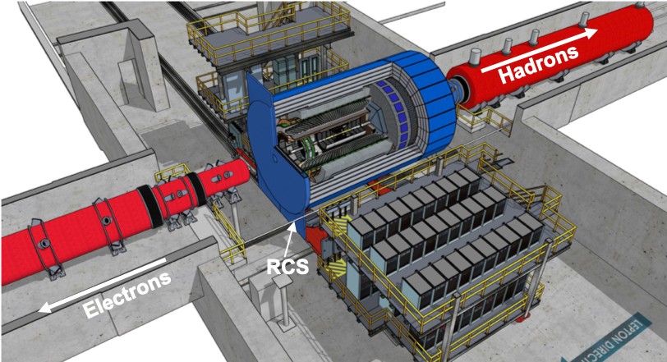
Summary
a modern forward looking general purpose detector
  several novel technologies that will advance the state of the art
  scope well defined → last two technology choices finalized by 04/21/2023
    Long Lead Procurements identified and corresponding design prioritized
  construction and installation timelines understood
collaboration will be fully integrated in project structure (see backup p. 26 & 27)
  Detector subsystem technical leads will be technical contact of subsystem on Level-4
  L5 Work Package leaders as defined in the detector subsystem - structures
Progress in R&D and PED has already now large intellectual and in-kind contributions from the international community -- THANK YOU
Collaboration on all subsystems with and without in-kind contribution is extremely welcome
  the EIC project is planning on in-kind at a level that corresponds to the expressions of interest → 1/3 of total detector cost

Slide 24


Slide 25


Slide 26
Collaboration – Project Integration
6.10.04 Particle
Identification
Level-3
Rolf & Elke
Level-2
6.10.04.01 Backward RICH
Level-4
6.10.04.02 Barrel DIRC
Level-4
6.10.04.03 dRICH
Level-4
6.10.04.04 Time-of-Flight
Level-4
DIRC-Photon-sensors
Level-5
DIRC-Quartz-bars
Level-5
6.10.04.04.01
bToF
Level-5
6.10.04.04.02
fToF
Level-5
Integrating Collaborators:
L3: CAM from the project
Fold in users/collaborators as
on L4: CAM + technical contact == DSTC
  bRICH
  DIRC
  dRICH
  ToF
on L5 Work Package leaders
as defined in the DSS - structure
  Photon-Sensors
  Quartz-Bars
  ………..
We need a control account manager (CAM) at each WBS level. WBS levels go down to where it is meaningful to accumulate cost and schedule variance. There can be many Work Packages below.

Slide 27
Collaboration – Project integration
6.10.04 Particle
Identification
Level-3
CAM from Project
6.10.04.01 Backward RICH
Level-4
6.10.04.02 Barrel DIRC
Level-4
CAM from Project
+
DSTC from
6.10.04.03 dRICH
Level-4
6.10.04.04 Time-of-Flight
Level-4
Photonsensors
Level-5
can be
the same
→ one WP
Photonsensors
Level-5
Work Package lead
from
Photonsensors
Level-5
6.10.04.04.01
bToF
Level-5
6.10.04.04.02
fToF
Level-5
Cooling
Level-5
DIRC-Quartz-bars
Level-5
Cooling
Level-5
Cooling
Level-6
Work Package lead
from
Readout
Level-5
merge
if PS are the same
→ one WP
Readout
Level-5
Work Package lead
from
Gas system
Level-5
Readout
Level-6
Vessel / Boxes
Level-5
and more
Vessel
Level-5
Sensor
Level-6
Sensor
Level-6
Mirror /F-Lens
Level-5
Mirror
Level-5
Support
Structure
Level-6
Support
Structure
Level-6
Support
Structure
Level-5
Aerogel
Level-5
Readout
Level-5
and more
and more
and more

Slide 28
Current Detector Costs
CD-1 cost estimates updated June 2022 folding in costs estimated as part of the proposal process
further refinements through the recent month
  Status January 2023 including escalation and burdens
Cost, schedule and risks will be further refined in collaboration with ePIC for CD-3A
Total Cost: $283.9M
Cost: $29.72M
Cost: $8.83M
Cost: $12.32M
Cost: $31.44M
Cost: $29.56M
Cost: $36.48M
Cost: $14.73M
Cost: $38.02M
Cost: $9.05M
Cost: $36.74M
Cost: N/A
Cost: $20.71M
Cost: $9.74M

Slide 29
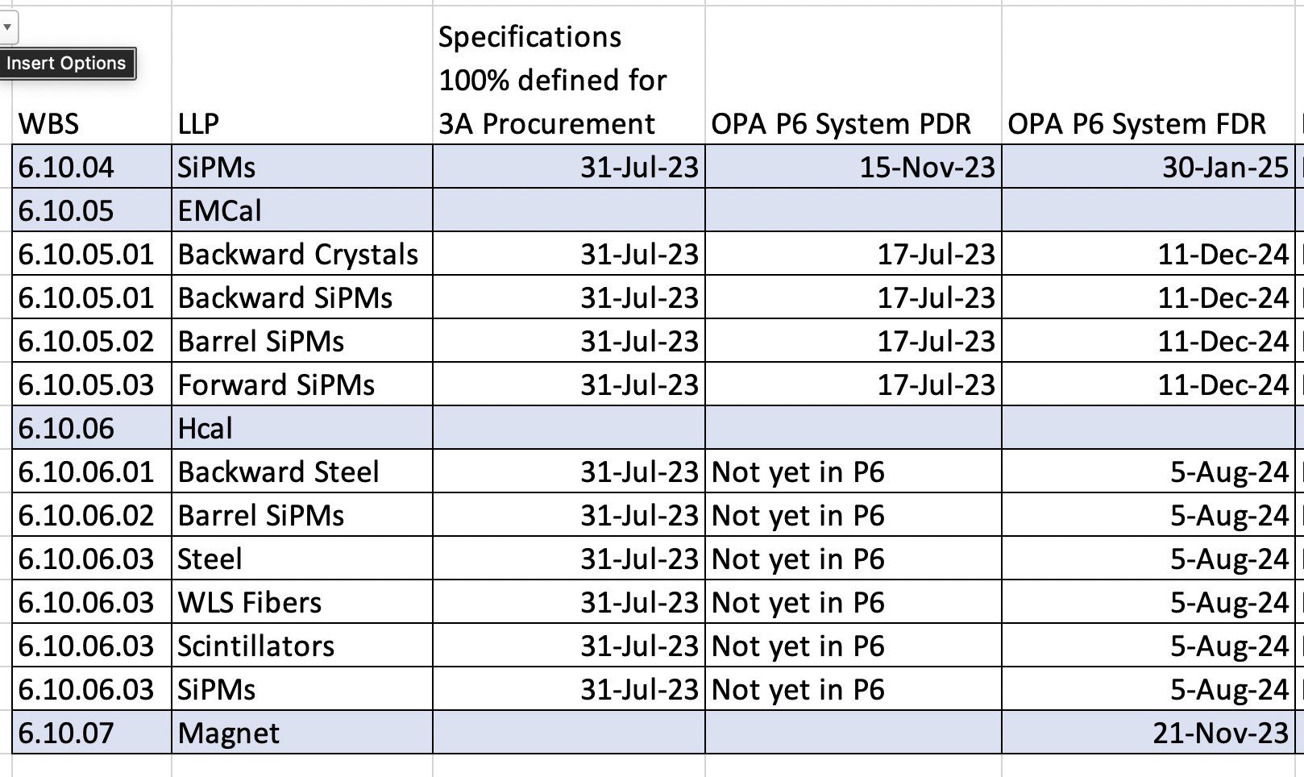
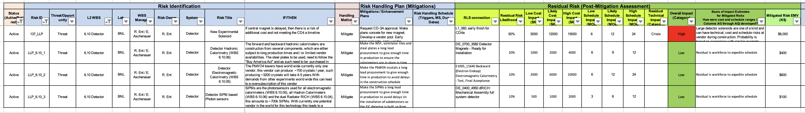
Long Lead Procurements Overview
WBS 6.10.07 1.7 T Solenoid
  Magnet is long-lead as the detector assembly and installation requires the availability of the fully-tested magnet
  limited world-wide vendors and long production time (estimated from recent 12 GeV magnets)
Electromagnetic and Hadronic Calorimeters and SiPMs
  WBS 6.10.04, 05, 06 SiPMs for calorimeters and dRICH
  WBS 6.10.05 PbWO4 – crystals
  WBS 6.10.06 forward HCal: Steel – plates and scintillator plates
  These long-lead items are driven by limited world-wide vendors → competition by other projects around the world
  production times and/or labor-intensive manufacturing tasks
  SiPMs staggered procurement
→ PDRs, FDR & Specifications readiness
integrated in P6
→ LLPs related Risks are defined

Slide 30
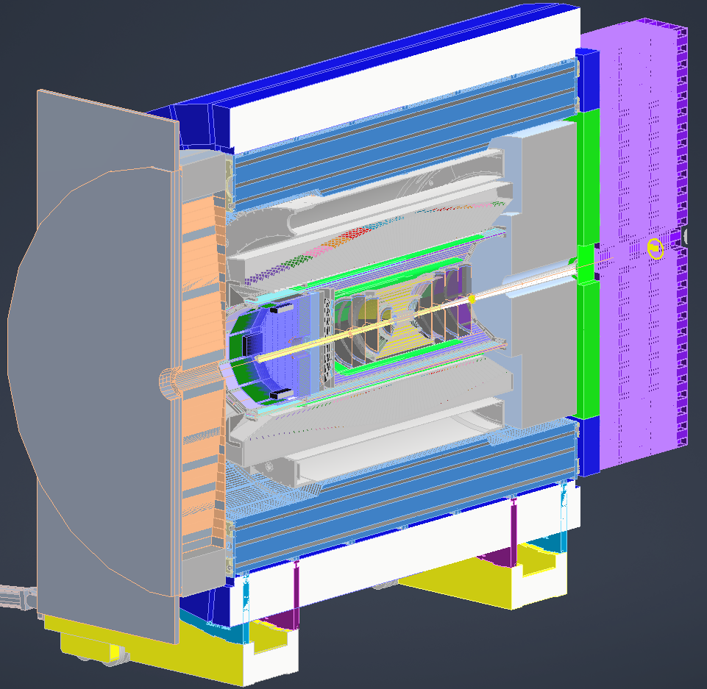
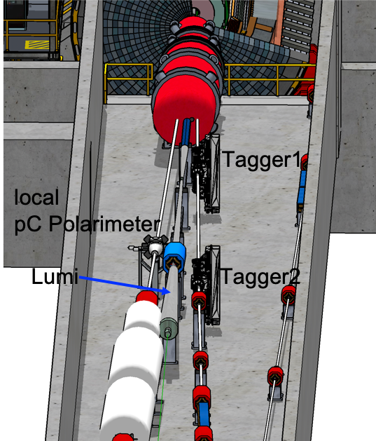
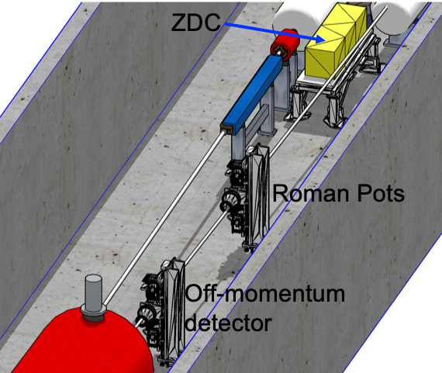
What is new/special for a EIC GPD
Vertex detector → Identify primary and secondary vertices,
  Low material budget: 0.05% X/X₀ per layer;
  High spatial resolution: 10 μm pitch CMOS Monolithic Active Pixel Sensor
Central tracker → Measure charged track momenta
  MAPS – tracking layers in combination with micro pattern gas detectors
  MPGD: μ-RWell or MicroMegas
electron and hadron endcap tracker → Measure charged track momenta
  MAPS – disks in combination with micro pattern gas detectors
Particle Identification → pion, kaon, proton separation on track level
  RICH detectors (modular and dual radiator RICH, DIRC) & Time-of-Flight
  high resolution timing detectors (LAPPS, LGAD) 10 – 30 ps
  novel photon sensors: MCP-PMT / LAPPD
Electromagnetic calorimeter → Measure photons (E, angle), identify electrons
  PbWO₄ Crystals (backward), W/SciFi Spacal (forward)
  Barrel: Pb/SciFi+imaging part or new Scintillating glass → cost effective
Hadron calorimeter → Measure charged hadrons, neutrons and K_{L}⁰
  challenge achieve ~50%/√E + 10% for low E hadrons (<E> ~ 20 GeV)
  Fe/Sc sandwich with longitudinal segmentation
DAQ & Readout Electronics: trigger-less / streaming DAQ
  Integrate AI into DAQ → cognizant Detector
Very forward and backward detectors → scattered particles under very small angles
  Silicon tracking layers in lepton and hadron beam vacuum
  Zero – degree high resolution electromagnetic and hadronic calorimeter
Polarimetry
  Lepton: integrated transverse and longitudinal Compton polarimeter
  Hadron: absolute and relative hadron polarimetry in the CNI region
Radius/Distance from IP

Slide 31
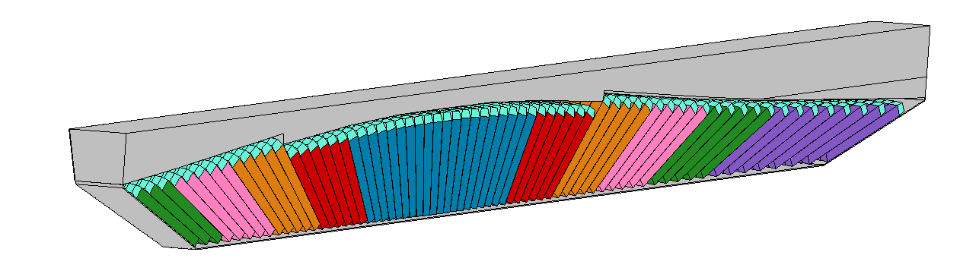
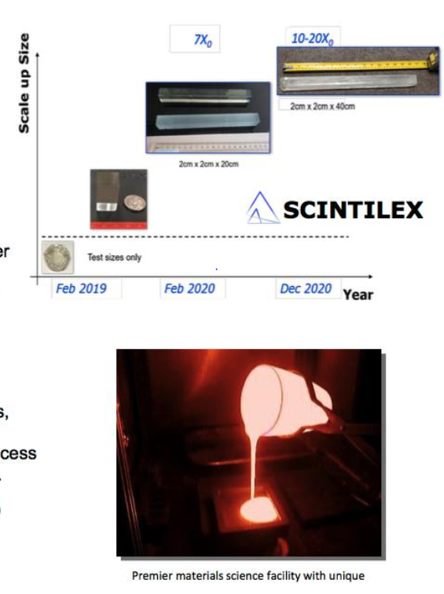




ePIC BARREL ECAL
Charge Question #4
Barrel ECal with SciGlass blocks with projective geometry
EEEmCAL consortium
Alternate: Barrel ECal with a hybrid
imaging calorimeter
5 imaging layers
preceded by a
time-layer
Pb/SciFi
ANL, Regina, Manitoba, UCSC

Slide 32





Flux Return layout
Requirement for fringe field: <10 Gauss at forward and backward side
and at RCS location
Challenges detector design not symmetric
→ critical that forces get balanced
Consequences on design:
backward HCal moved as far back as possible
add both sPHENIX flux return doors behind bHCal
forward HCal need to have first tungsten/Sc
and then Steel/Sc
add additional steel around barrel HCal
layered barrel extra flux return
6 layers 50 mm steel 40 mm air
Reach 14 gauss and lower

Slide 33


IR-Integration and Interfaces
Space Constrains:
-4.5 m – IP – +5m not negotiable
50 cm space to 1st IR-magnet occupied by vacuum pumps, valves, …..
IP moved 81 cm towards ring inside compared to RHIC; y: 432 cm above floor
limited installation possible in Collider Hall
  endcap hadron calorimeters need to be split transverse to beam pipe
  RCS vacuum needs to be broken
Electrons
Hadrons
RCS
9.5 long detector does not fit through the door
  Door-Size: 823 cm x 823 cm
  endcap hadron calorimeters need to stay in collider hall, if detector rolls in assembly hall
RCS to IP: radial distance 335.2 cm at a height of 372 cm from floor
  Maximum outer radius ~ 3.2 m

Slide 34


Electron and Hadron Polarimetry
Electron Polarimeter:
Method: Compton Backscattering
longitudinal polarization → Energy Asymmetry
transverse polarization → Energy dependent position asymmetry
Requirement:
Need to measure both polarization components
beam is only at IP fully longitudinal polarized
Beamline integration
Backscattered photon cone clearance through quads
Electron detector will need to be ~5 mm from electron beam
  Investigating a Si in vacuum ala off-momentum
  detectors can be used?
In close contact with Accelerator group for SR simulations
and beam backgrounds
Hadron Polarimeter:
Method: RHIC H-Jet and pC Polarimeters
measure polarization through left-right asymmetries in CNI region
Requirement:
Need to measure
absolute polarization → H-jet (slow)
need to measure polarization lifetime, profile and fast feedback to collider
Beamline integration
new location at IP-4
H-Jet and pC fully integrated in lattice, including taggers for He-3 polarimetry
Challenge
make RHIC polarimeters work for the different EIC beam conditions

Slide 35
EIC Project Detector R&D
Photon-Sensors:
WBS 6.10.04 & 05 & 06
Assess current state of LAPPD performance. Improve design through iterations to fulfill EIC specifications
  Spatial resolution for Cherenkov imaging applications
  Timing resolution in a single photon mode
  Timing resolution for Time-of-Flight purposes
  Performance in a strong (inhomogeneous) magnetic field
  QE & PDE spectrum optimization
  Geometric form factor optimization
MAPS-Tracker:
Development of a full tracking detector solution composed of 65 nm MAPS sensors Modules from stitched sensors, barrel & discs, mechanics, integration & cooling
reduce the services material load
→ Improved powering and readout system
Development of the EIC sensor: design & characterization
MPGDs:
Development of prototypes of cylindrical MPGDs & planar thin gap MPGDs
AC-LGAD:
Develop system including sensors, ASIC & services for auxiliary detectors and ToF
Electronics & DAQ/Computing
Development of readout solutions for
calorimeters with SiPMs, ASIC based & ADC based
dRICH with SIPMs based on ALCOR
AC-LGAD readout chain with EICROC & FCFD
MPGD readout based on SALSA-ASIC
PID-Detectors:
DIRC: focus on Cosmic ray telescope (CRT), validation of BaBar bars reuse option, and completion of cost optimized hpDIRC design
mRICH: optimize photonsensors + electronics; testbeam of improved prototype
dRICH: Characterize mirror & aerogel; Assessment of dRICH prototype performance with the EIC detection plane
HCals:
Prototype SC-tile production using machining & injection molding & detailed characterization
Sensor board development
first prototype of one full segment
ECals:
bECAL: Full characterization of full SciGlass block designed for EIC by beam test
fECAL: construct 64 channel prototype to optimize light uniformity, light guides, verify performance by test beam
Hadron Polarimetry:
R&D through Accelerator
validate concepts to veto breakup of He-3
new targets for pC-polarimeters

Slide 36




What is needed to address the EIC Physics
large kinematic coverage:
bridge between measurements in different regimes (s, x, Q²)
access to x and Q² over a wide range
→ center-of-mass energy √s: 20 – 140 GeV
polarized electron and hadron (p, He-3) beams:
access to spin structure of nucleons and nuclei
Spin vehicle to access the spatial and momentum structure of the nucleon in 3d
Full specification of initial and final states to probe q-g structure of NN and NNN interaction in light nuclei
unpolarized nuclear beams: d to Pb
accessing the highest gluon densities → saturation
quark and gluon interact with a nuclear medium
high luminosity 10³³-10³⁴ cm⁻²s⁻¹ :
mapping the spatial and momentum structure of nucleons and nuclei in 3d
access to rare probes, i.e. Ws

Slide 37







Far-forward physics at EIC
e+p DVCS events with proton tagging.
e+d incoherent J/Psi events with proton or neutron tagging
Diffraction
Rapidity
gap
Saturation (coherent/incoherent
J/$ψ$production)
Meson structure:
with neutron tagging (ep$→\left(π\right)→$e’ n X)
Lambda decays ($Λ→$p$π−$ and $Λ→nπ0$)
e+He3 with spectator proton tagging.
Tagging of coherent light ions (d, He3, He4) from coherent scattering.
e+Au events with neutron tagging to veto breakup and photon acceptance.
….

Slide 38


Particle ID
In general, need to separate:
Electrons from photons → 4π coverage in tracking
Electrons from charged hadrons → mostly provided by calorimetry & tracking
Charged pions, kaons and protons from each other on track level→ Cherenkov detectors
  Cherenkov detectors, complemented by other technologies at lower momenta
  Time-of-flight or dE/dx
Physics requirements:
Need more than one technology to cover the entire momentum ranges at different rapidities
Rapidity | π/K/p and π0/γ | e/h | Min pT (E)
-3.5 − -1.0 | 7 GeV/c | 18 GeV/c | 100 MeV/c
-1.0 − 1.0 | 8-10 GeV/c | 8 GeV/c | 100 MeV/c
1.0 − 3.5 | 50 GeV/c | 20 GeV/c | 100 MeV/c

Slide 39
International Engagement
We have had many meetings and site visits in 2022 & 2023, including:
Japan - EIC Collaboration Meeting via Zoom on June 22, 2022 (Elke & Rolf)
US-Israel BSF visit to BNL on September 12, 2022 (Haiyan, Rolf, Mike F/DOE)
Visit to meet and discuss EIC -South Africa consortium at INPC (International Nuclear Physics Conference) in Cape Town, South Africa Sep 9-17, 2022 (Elke)
EIC-Project - Taiwan Experimental Program Informational Meeting Sept 19, 2022 (Elke & Rolf)
Visit to BNL by Japan representatives on November 01-02, 2022: two persons (Okamura and Kadotani) from Embassy of Japan (working under Koji Aribayashi), together with one (Sakuraba) from Japan Consulate of NY (Elke participating)
APCTP Workshop on the Physics of Electron-Ion Collider (First EIC-Asia meeting) at ACTP-Korea from November 2-4, 2022 (Jim, Abhay, Mike F/DOE, also Tim H/DOE and Rolf remote) https://indico.knu.ac.kr/event/592/
Visit to meet and discuss EIC-Latin America consortium at the Latin American Symposium on High Energy Physics November 14-18, 2022 (Elke)
Visit to meet and discuss EIC-India participation in EIC from December 18-20, 2022 (Abhay, Elke)
EIC-Asia workshop in RIKEN-Wako, Japan from March 16-18 (Elke, Rolf, Abhay)

