Slide 1
mRICH Design & Integration
Alex Eslinger
Jefferson Laboratory

Slide 2
Summary
6. Integration: Status of the proposed detector integration into the current baseline detector
Discuss the overall design concepts
Show the subcomponents:
Purpose
Constraints
Possible material choices
Current Assembly and Installation Plans
New mRICH Prototype Design
Future Work
Conclusion

Slide 3
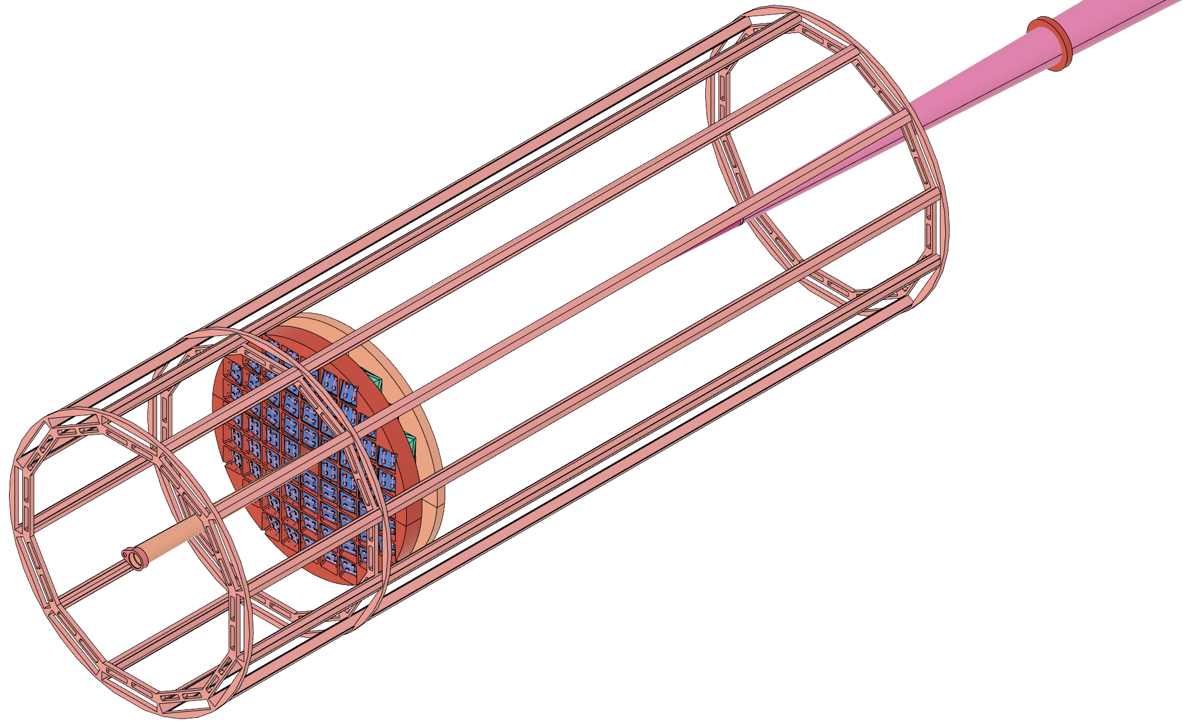
Overall Design Concept

Slide 4
Subcomponents: HRPPD Sensor
Purpose:
Sensor used to signal photon detection from Cherenkov photons (produced by Incom)
Constraints:
Size (small enough for projective view, large enough for focal length)
Material Choice:
Quartz/Ceramic
Additional Details:
HRPPD is defined as the baseline sensor for the bRICH
The mRICH requires a smaller sensor (which can be accommodated)
Typical sensor has been 120x120mm
This mRICH-sized sensor is 112x112mm
Cooling
PCB
ASICs
To Fresnel lens

Slide 5
Subcomponents: Modules/Containers
Purpose:
Light-tight the housing which holds the optical components and set the sensor plane at the optical distance.
Constraints:
Minimize Material Budget
Material Choice:
Carbon fiber (~0.5mm thickness)
Additional Details:
The latest version incorporates the baseline sensor configuration (HRPPD)
HRPPD
Aerogel (4cm)
Retaining Clips
Mirrors
Fresnel Lens (6in FL)
CF Box

Slide 6
Subcomponents: Support Disks
Purpose: Accurately locate the modules in 3D space and project the modules towards the IR.
Constraints:
Material Budget
Assembly/Disassembly
Material Choice:
Machinable Polyurethane Foam
Additional Details:
GSU Machine Shop has ordered samples to determine the level of detail when compared to the density

Slide 7
Assembly Plan
Once each module is constructed, the quadrants will then be loaded with the modules.
The back wall has a stepped flange that allows the box to locate itself within the foam wall
Several options (i.e. tape) can seal the back of the sensor to the foam to provide additional light-tightening

Slide 8
Installation Plan
Once quadrants are assembled, they can be inserted into the DIRC frame.
The graphic on the right shows the order of assembly
This order is important because of the flange geometry
The starting position is at the bottom so that gravity does not work against us as we avoid the beam pipe
Advantages:
Better acceptance around the beam pipe
Ability to physically fit more modules
Disadvantages:
More complicated engineering design for support and fixture
More complicated surveying after installation (may be able to deal with misalignments up to ~0.1deg with calibration)

Slide 9
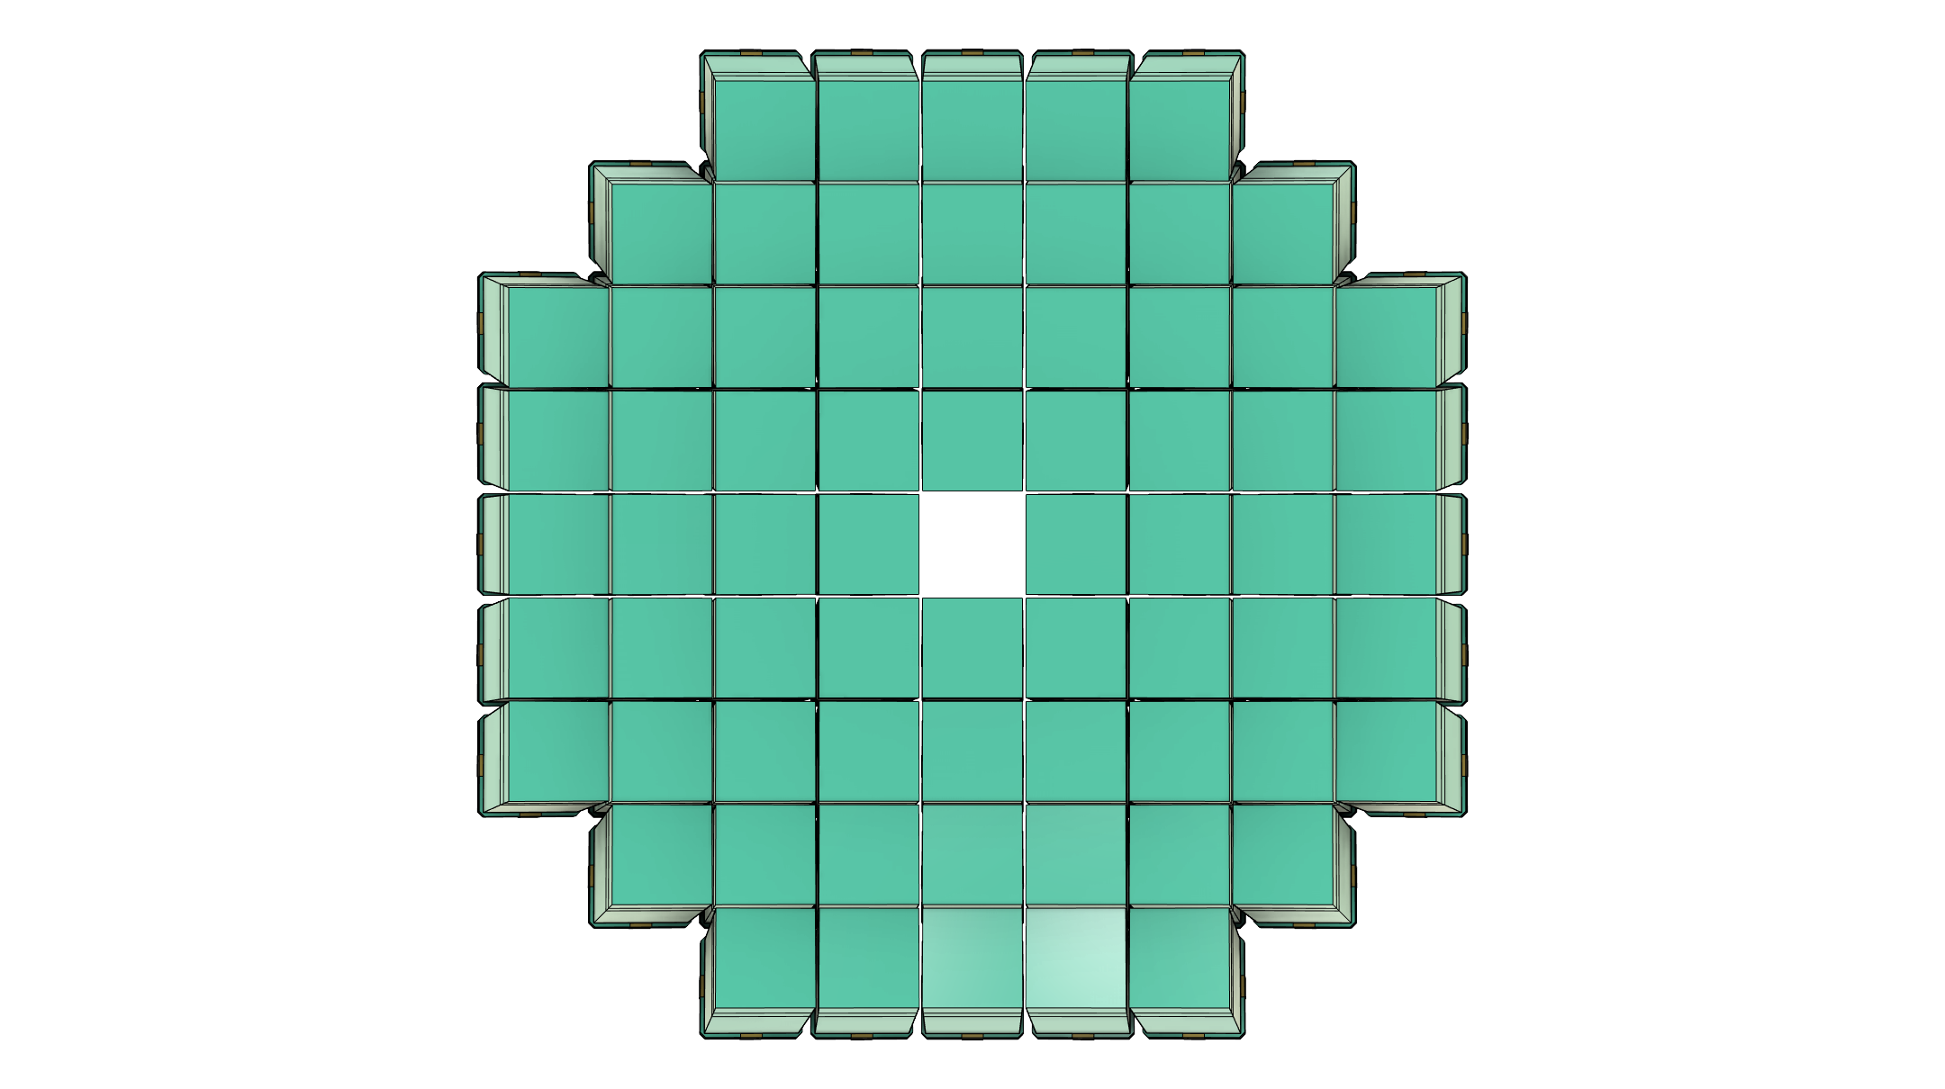
mRICH Array (Without Support)
Front View
Side View
Back View

Slide 10
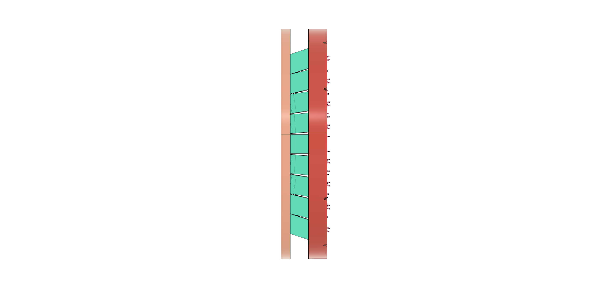
mRICH Array (With Support)

Slide 11
mRICH Prototype Design
Alex Eslinger
Jefferson Laboratory

Slide 12
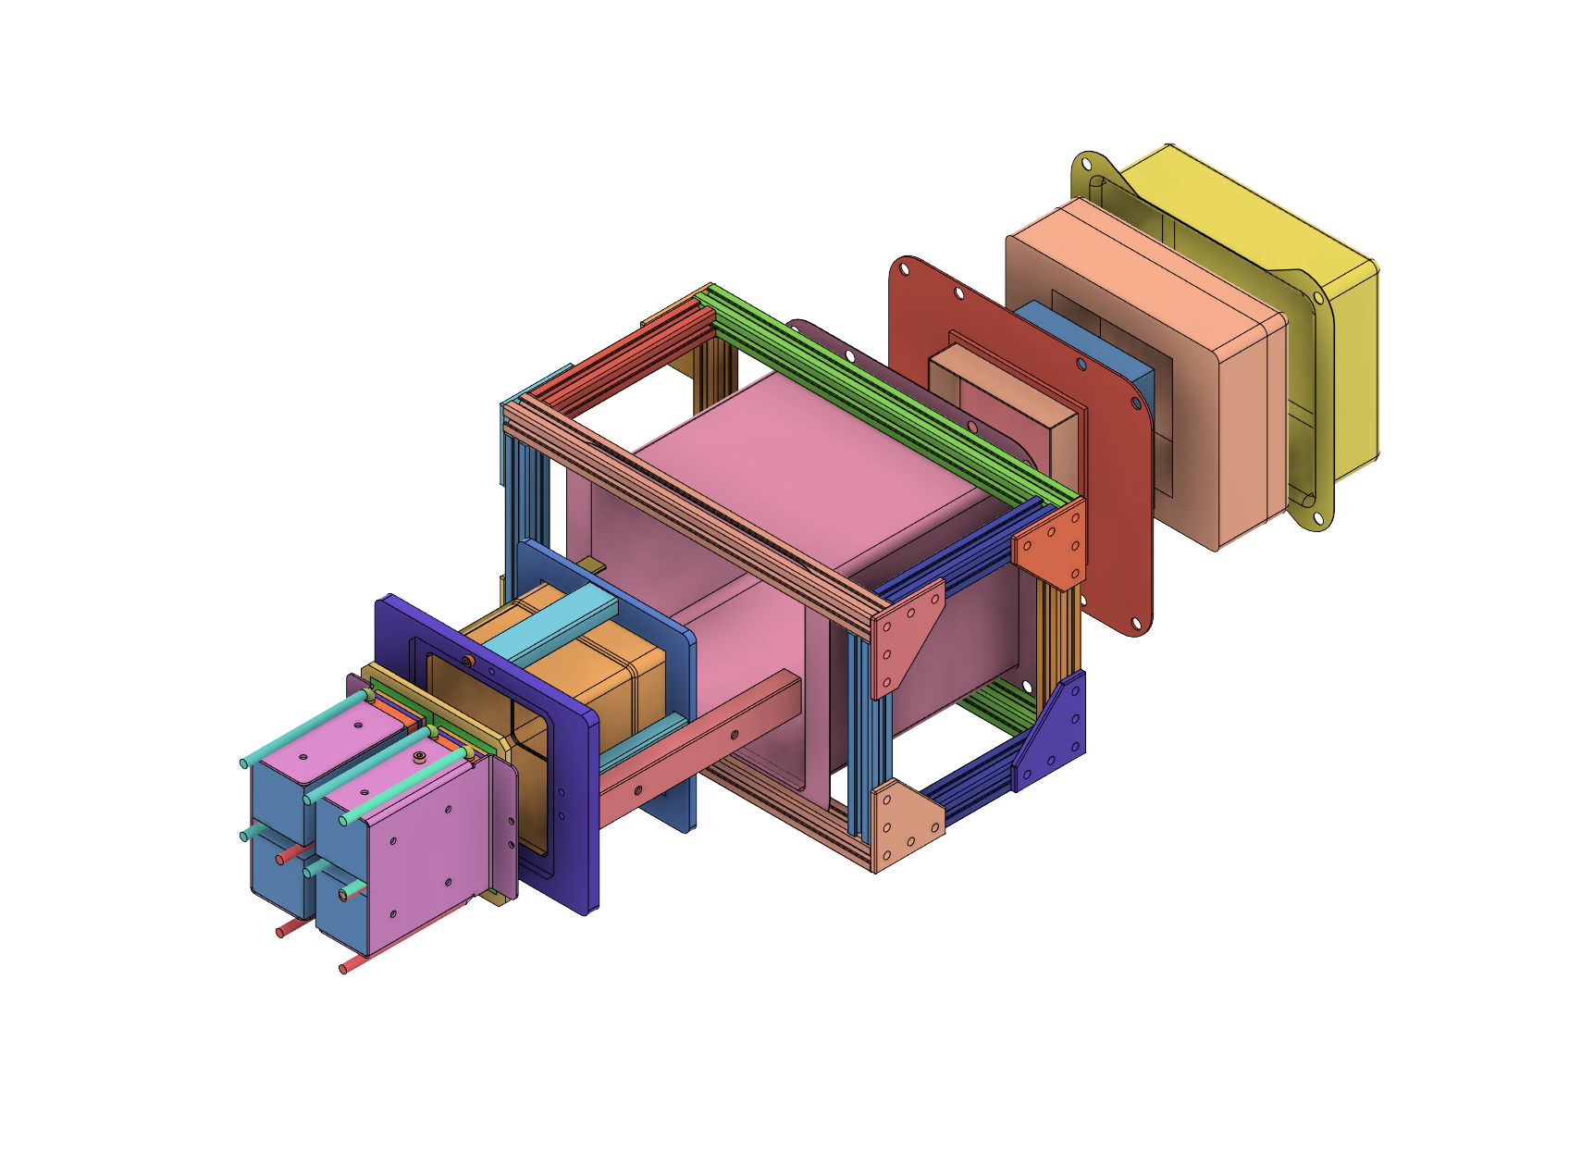
Prototype Design
eRD101: Prototype Design
Prototype: dRICH-Style Sensor
Prototype: HRPPD Sensor

Slide 13
New mRICH Prototype
Key features:
Optimization of sensor plane location
Ability to test multiple sensors with the same setup
Ability to quickly change the aerogel tiles (thicker/thinner/index of refraction)
Detents for simple adjustments
Ability to remove mirrors
Verify cooling and readout electronics
CF frame like the actual design
Light tight?
Stiff enough?
Version 1
(Original)
Version 2
(Current/In Progress)

Slide 14
Future Work
The support structure needs to be finalized. The concept is sound, but the design of the rotating tooling and the supporting structure that will accept the quadrants will have to be analyzed and fully developed.
The prototype design should be brought to a final level to start production of componentry and purchase the necessary materials
Investigate design options to use more z-space to get rid of dead area between modules (reference Murad’s discussion yesterday)

Slide 15
Conclusion
The mRICH design process started over a year ago and developed quickly. The simplicity of the design allows the detector to be modified as more experimental information becomes available.
The conceptual design of the mRICH has been completed to the point that it is ready to be developed further through validation and optimization
The supporting structure and installation method present a tradeoff. Better acceptance near the beam pipe in exchange for a more complex engineering design task
The prototype is already in its second iteration and is moving quickly towards being finalized

