Slide 1
Background embedding software
Dmitry Romanov
07 March 2023

Slide 2
Current data flow
DD4Hep
EICrecon
Detector
Detector
Detector
Detector
Digitization
Reco
Global reco
hepmc
Hits in detectors edm4hep
Reconstructed Particles edm4eic

Slide 3
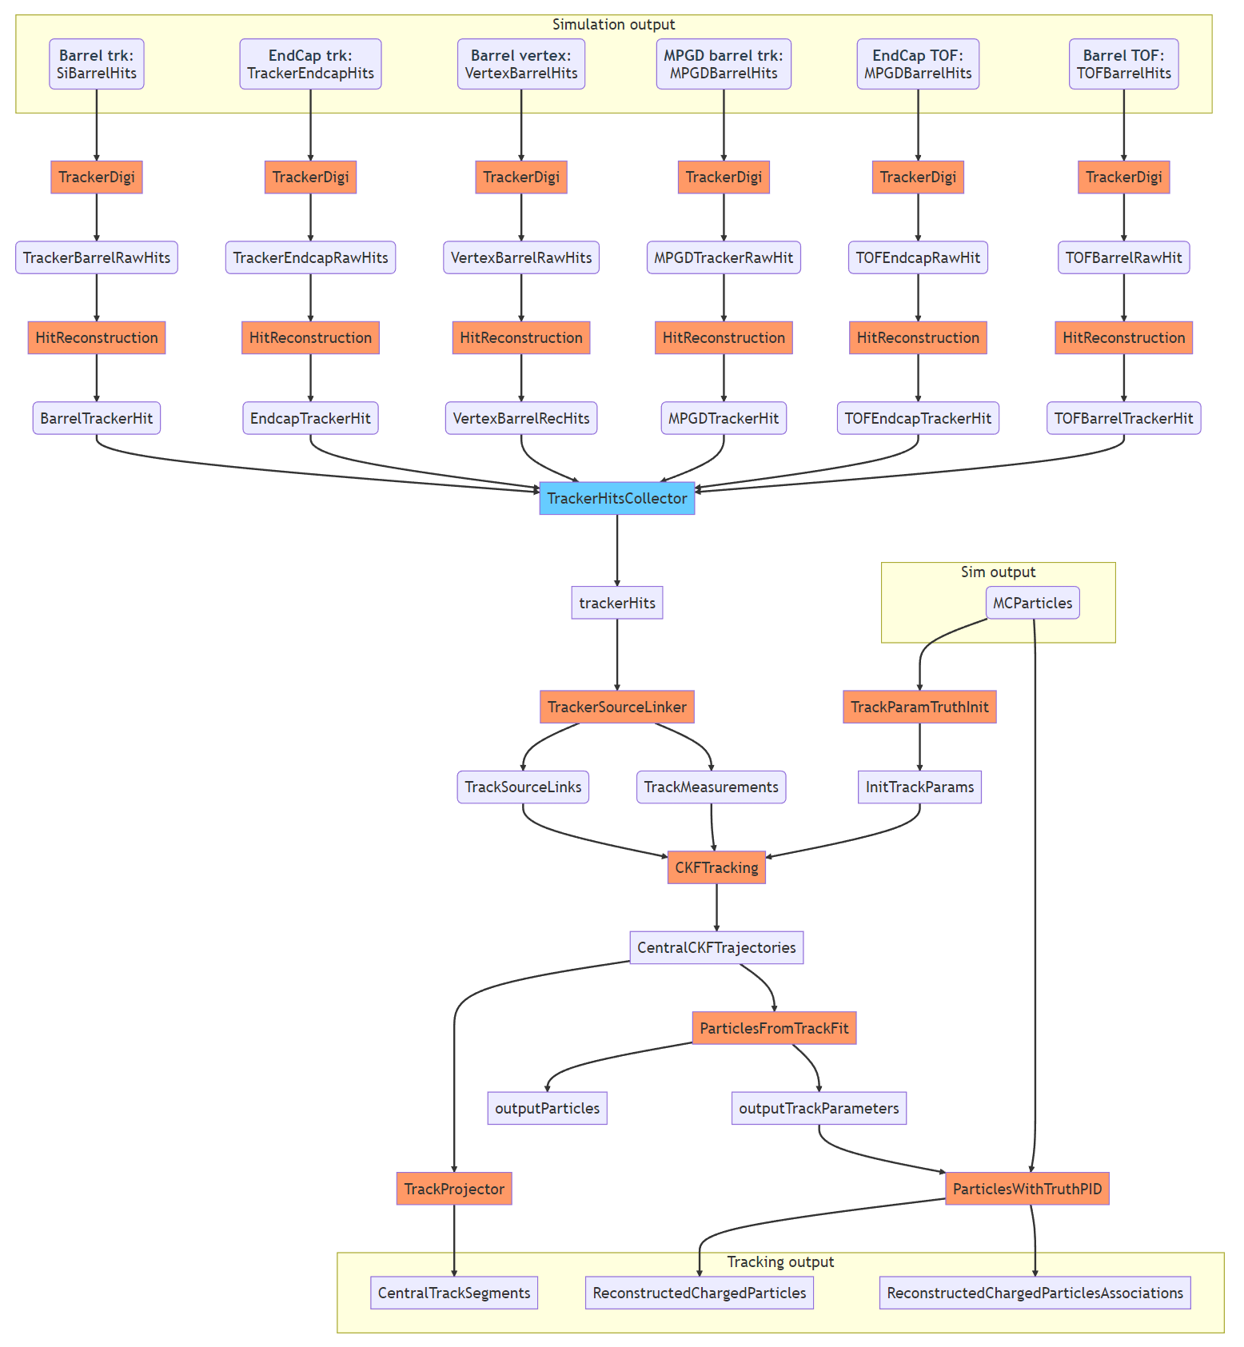
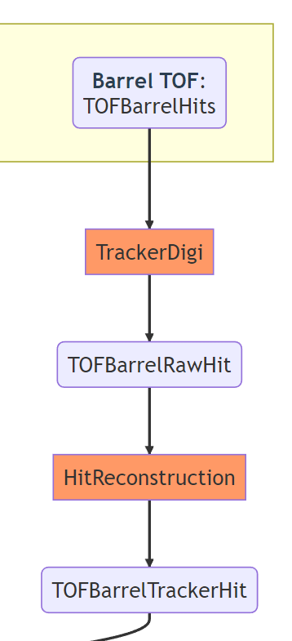
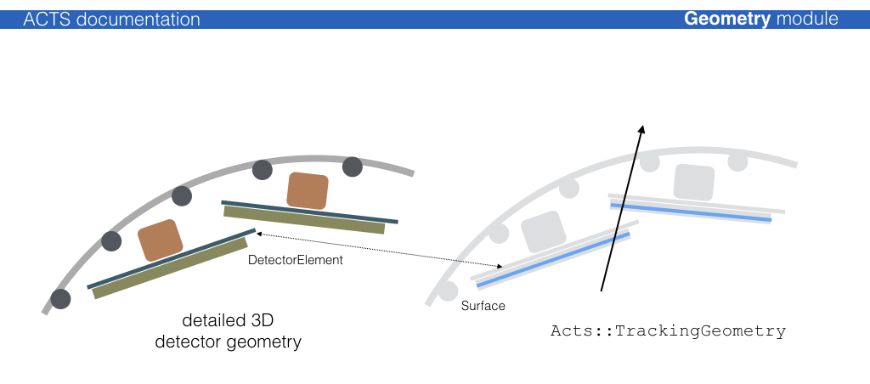
What happens inside EICrecon (tracking example)
(This picture is from ACTS documentation. the geometry on pictures is not from EPIC)

Slide 4
What happens inside EICrecon (tracking example)
Geo element ID #87468734
(This picture is from ACTS documentation. the geometry on pictures is not from EPIC)

Slide 5
Where to merge background
DD4Hep
EICrecon
Detector
Detector
Detector
Detector
Digitization
Reco
Global reco
hepmc
Hits in detectors edm4hep
Reconstructed Particles edm4eic
Stage of dataflow where merging background events is the most convenient

Slide 6
Where to merge background
DD4Hep
Detector
Detector
Detector
Detector
hepmc
Hits in detectors edm4hep
Background Embedding
EICrecon
Digitization
Reco
Global reco
Hits in detectors edm4hep
DD4Hep
Detector
Detector
Detector
Detector
Hits in detectors edm4hep
Background

Slide 7
Similarity with afterburner

Slide 8
Afterburner retrospective
Framework independent afterburner that implements effects of crossing angle, beam effects, vertex simulation
C++ clear API for implementation in scripts and other frameworks
Can be used in ROOT macros or linked as a library
abconv – simple command line interface CLI that convert files
The results are being validated with other implementation

Slide 9
Suggested background embedder
Standalone software with minimal dependencies (on PODIO and edm4hep)
Requires DD4Hep simulated hits, produces edm4hep output
Try to keep C++ so that it is easily embeddable in framework or analysis as needed

