Slide 1
The Imaging Calorimeter for ePIC Integration
EPIC Barrel ECal Review, March 13-14, 2023
Paul E Reimer
PHY, Argonne National Laboratory

Slide 2
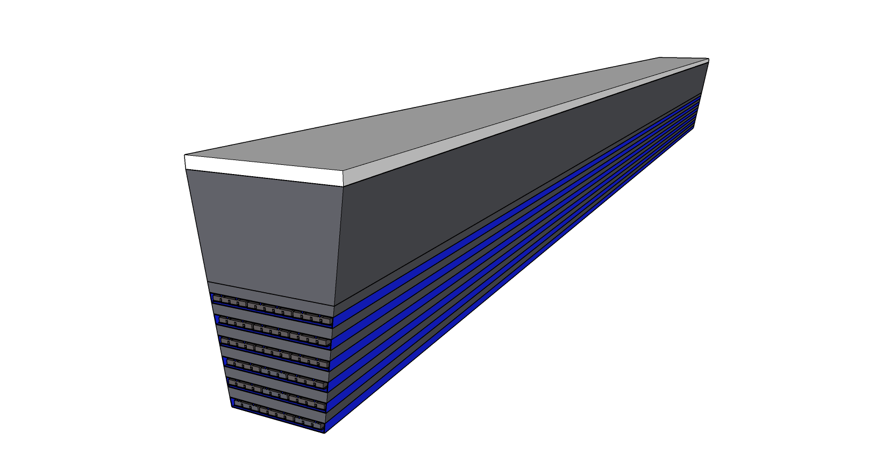
Mechanical Integration:
Stave Subassembly
Fiber Direction
Pb/SciFi
AstroPix inside
C Fiber Drawers

Slide 3
Stave Mechanical Properties
Fixed Surface
Fixed Surface
Fixed Surface

Slide 4
Mechanical Integration: Imaging Layers
AstroPix Si layers are preloaded into “drawers”
Drawers are slid into carbon fiber openings at end of stave
AstroPix layers may be removed for serviceability

Slide 5
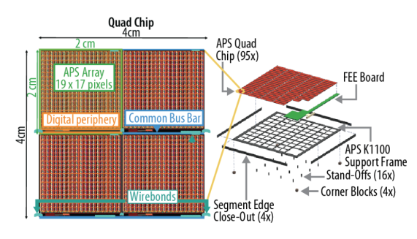
Imaging Layer Design
Tracker segment design for AMEGO-X
arXiv:2208.04990
Guide rail channels
C Fiber
support structure
Design and integration under development
Based on typical Si tracker layer design
AstroPix Sensors
Drawer Concept

Slide 6
Mechanical Integration:
Stave Subassembly
GlueX Self-Supporting Arch
ePIC Imaging & GlueX
Pb/SciFi construction
Similar length
GlueX
Smaller radius
Monolithic construction
Fiber Direction
 |  | ePIC | GlueX
Diameter (m)
 | Inner | 1.6 | 1.3
 | Outer | 2.6 | 1.8
Length (m) |  | 4.35 | 3.90
# Staves |  | 24 (48) | 48
Mass/stave (T) |  | 2.2 (1.1) | 0.58
Pb/SciFi
AstroPix inside
C Fiber Drawers

Slide 7
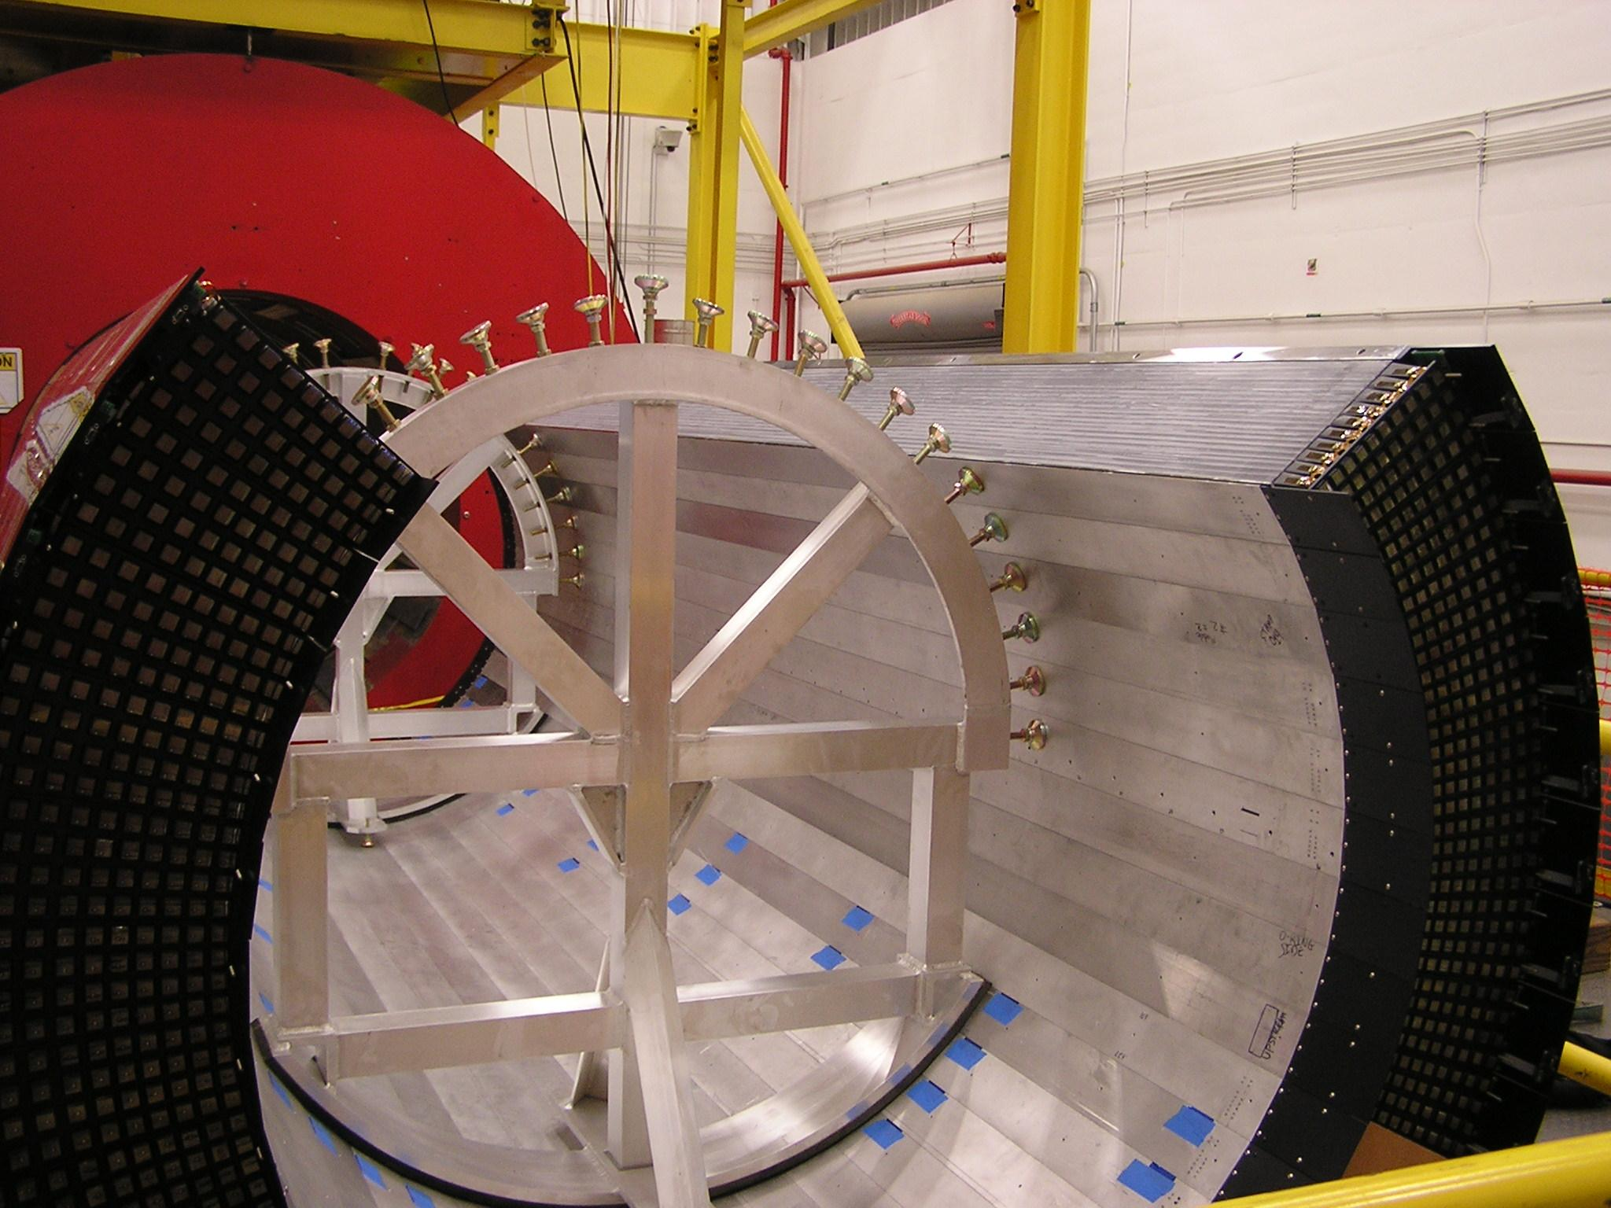
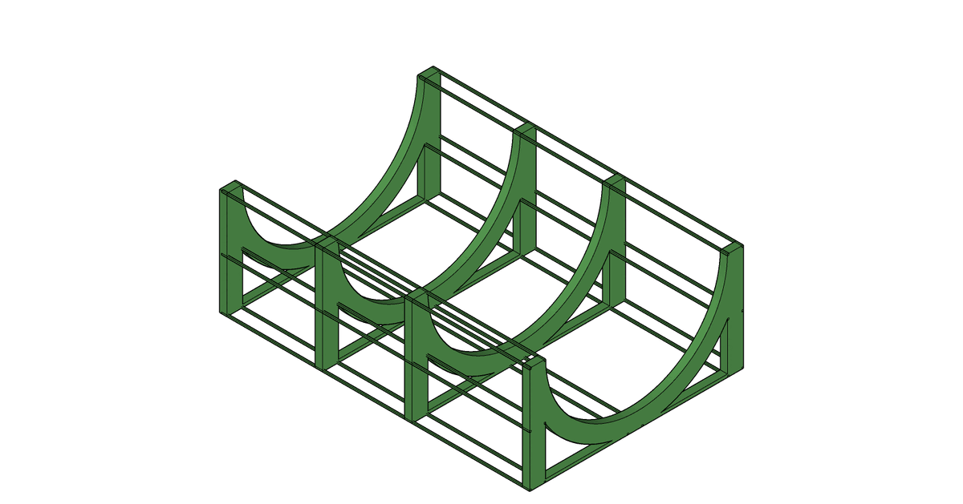
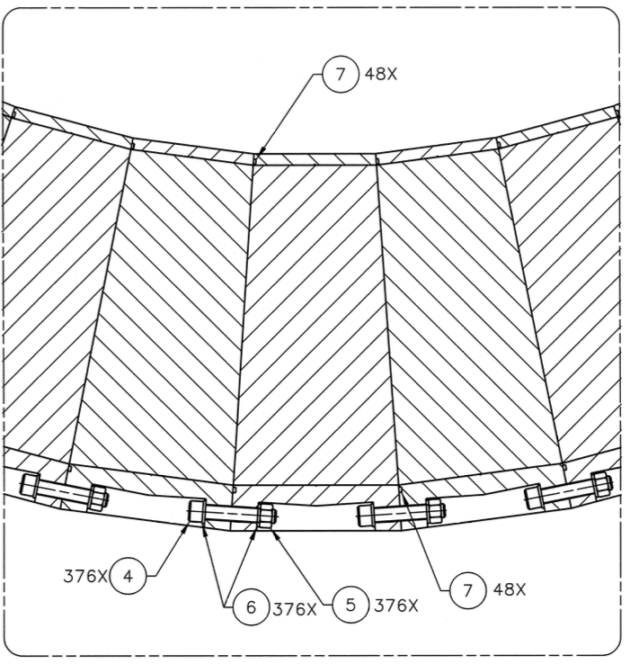
Mechanical Integration:
GlueX Self-Supporting Arch
ePIC Imaging & GlueX
Pb/SciFi construction
Similar length
GlueX
Smaller radius
Monolithic construction
GlueX Barrel ECal Assembly
 |  | ePIC | GlueX
Diameter (m)
 | Inner | 1.6 | 1.3
 | Outer | 2.6 | 1.8
Length (m) |  | 4.35 | 3.90
# Staves |  | 24 (48) | 48
Mass/stave (T) |  | 2.2 (1.1) | 0.58
GlueX Stave Interconnections

Slide 8
Mechanical Integration: Barrel Assembly
Follow existing SciGlass Barrel design
Existing mechanical design concept works
Adjustments for 1.5 x more mass
Possibly fewer, heavier rails since barrel is a single unit.

Slide 9
Cooling Strategies
Cooled Surface
Pb/SciFi
SiPMs will be water cooled at each end of stave
AstroPix

Slide 10
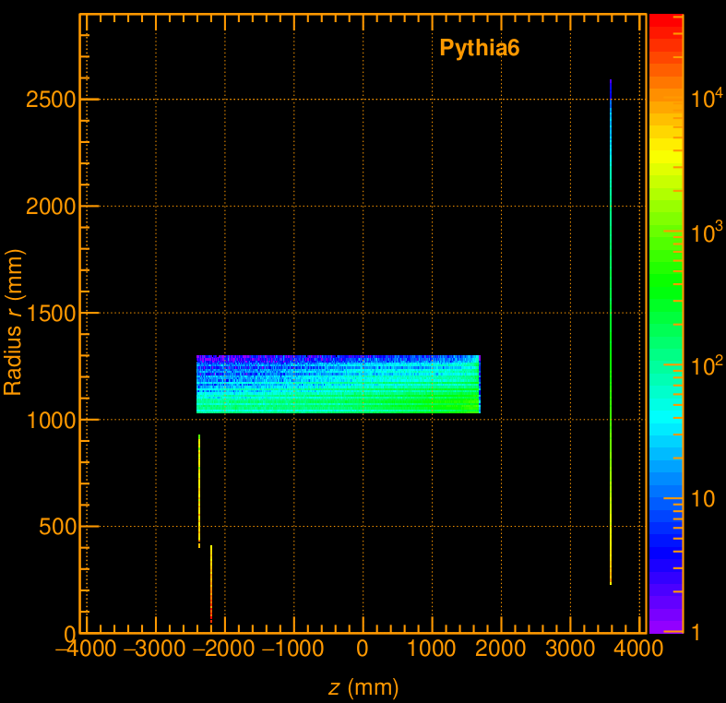
Rates
Studied in context of both ATHENA and ePIC
Both cases—artificially low thresholds
Rates are extreme upper limits
ePIC reports $2.26×{10}^{7}$Hz
$5×{10}^{6}$Hz for ATHENA
Distributed over $524×{10}^{6}$ pixels
not uniformly distributed over $η$
https://wiki.bnl.gov/athena/index.php?title=Beam_backgrounds#Primary_Collision_Background

Slide 11
Utilities and Services
Cables |  |  |  |  |  | Unit |  |  | Per stave |  | Total
Item | Description | Quantity | Dimension | Notes | Tray Rated? (Y/N) | Diameter | units | Area | Qunatity | Area | Staves | Quantity | Area
Pb/Scifi
Upstream Signal | RG58 | 1680 | 0.195 in Dia | Signal from FEE to rack | Y | 0.20 | in | 0.03 | 70 | 1.19 | 24 | 1680 | 50.17
Upstream Bias Voltage |  | 24 | 0.5 in Dia | Bias voltage from rack to FEE. V and Grnd for each channel. Gauge will depend on length of cable. | Y | 0.50 | in | 0.20 | 1 | 0.20 | 24 | 24 | 4.71
Upstream Signal | RG58 | 1680 | 0.195 in Dia | Signal from FEE to rack | Y | 0.20 | in | 0.03 | 70 | 1.19 | 24 | 1680 | 50.17
Downstream Bias Voltage |  | 24 | 0.5 in Dia | Bias voltage from rack to FEE. V and Grnd for each channel. Gauge will depend on length of cable. | Y | 0.50 | in | 0.20 | 1 | 0.20 | 24 | 24 | 4.71
Need to check table provided to Project and reproduce here.

Slide 12
Utilities and Services
 | Cables, Fibers, etc. |  |  |  |  |  | Unit |  |  | Per stave |  | Total
# | Item | Description | Quantity | Dimension | Notes | Tray Rated? (Y/N) | Diameter | units | Area | Qunatity | Area | Staves | Quantity | Area
 | Si Imaging
 | Imaging readout upstream | optical fiber | 48 |  | Assume two fibers |  | 4.00 | mm | 12.57 | 2 | 25.13 | 24 | 96 | 1206
 | Imaging readout downstream | optical fiber | 48 |  | Assume two fibers |  | 4.00 | mm | 12.57 | 2 | 25.13 | 24 | 96 | 1206
 | Upstream Control | Cat 8 | 24 | 5 mm dia |  |  | 5.00 | mm | 19.63 | 1 | 0.20 | 24 | 24 | 471
 | Downstream Control | Cat 8 | 24 | 5 mm dia |  |  | 5.00 | mm | 19.63 | 1 | 0.20 | 24 | 24 | 471
 | Upstream Bias Voltage |  | 24 | 0.5 in Dia | Bias voltage from rack to FEE. Gauge will depend on length of cable. Approximate for a bundle to feed entire stave | Y | 0.50 | in | 0.20 | 1 | 0.20 | 24 | 24 | 5
 | Downstream Bias Voltage |  | 24 | 0.5 in Dia | Bias voltage from rack to FEE. Gauge will depend on length of cable. Approximate for a bundle to feed entire stave | Y | 0.50 | in | 0.20 | 1 | 0.20 | 24 | 24 | 5

Slide 13
Utilities & Services
Cooling, etc. |  |  |  |  |  | Unit |  |  | Per stave |  | Total
Item | Description | Quantity | Diameter | Notes | Tray Rated? (Y/N) | Diameter | units | Area | Qunatity | Area | Staves | Quantity | Area
Pb/Scifi
Upstream Cooling in | 3/8" water line | 24 | 3/8 in | One line per stave, Plan for 5 C water |  | 0.38 | in | 0.11 | 1 | 0.11 | 24 | 24 | 2.65
Upstream Cooling out | 3/8" water line | 24 | 3/8 in | One line per stave |  | 0.38 | in | 0.11 | 1 | 0.11 | 24 | 24 | 2.65
Downstream Cooling in | 3/8" water line | 24 | 3/8 in | One line per stave, Plan for 5 C water |  | 0.38 | in | 0.11 | 1 | 0.11 | 24 | 24 | 2.65
Downstream Cooling out | 3/8" water line | 24 | 3/8 in | One line per stave |  | 0.38 | in | 0.11 | 1 | 0.11 | 24 | 24 | 2.65
AstroPix
Upstream Cooling in | 3/8" water line | 24 | 3/8 in | One line per stave, Plan for 5 C water |  | 0.38 | in | 0.11 | 1 | 0.11 | 24 | 24 | 2.65
Downstream cooling out | 3/8" water line | 24 | 3/8 in | One line per stave, Plan for 5 C water (duplicate Pb/SciFi) |  | 0.38 | in | 0.11 | 1 | 0.11 | 24 | 24 | 2.65

Slide 14
Charge Items and Responses
Integration:
Status of the proposed detector integration into the current baseline detector? Slides 2-8
Status of the design of the electrical/electronic infrastructure
channels counts Slides 11, 12
power supplies (Pending final requirements of SiPMs and AstroPix sensors, cabling for voltages bias from equip. rack to staves in electronics table)
heat Slides 9, 13
rate Slide10
Cooling strategies Slides 9, 13

Slide 15
Additional Material

Slide 16
Stave Mechanical Properties
Fixed Surface

Slide 17
Stave Mechanical Properties
Fixed Surface

Slide 18
Stave Mechanical Properties
Fixed Surface

Slide 19
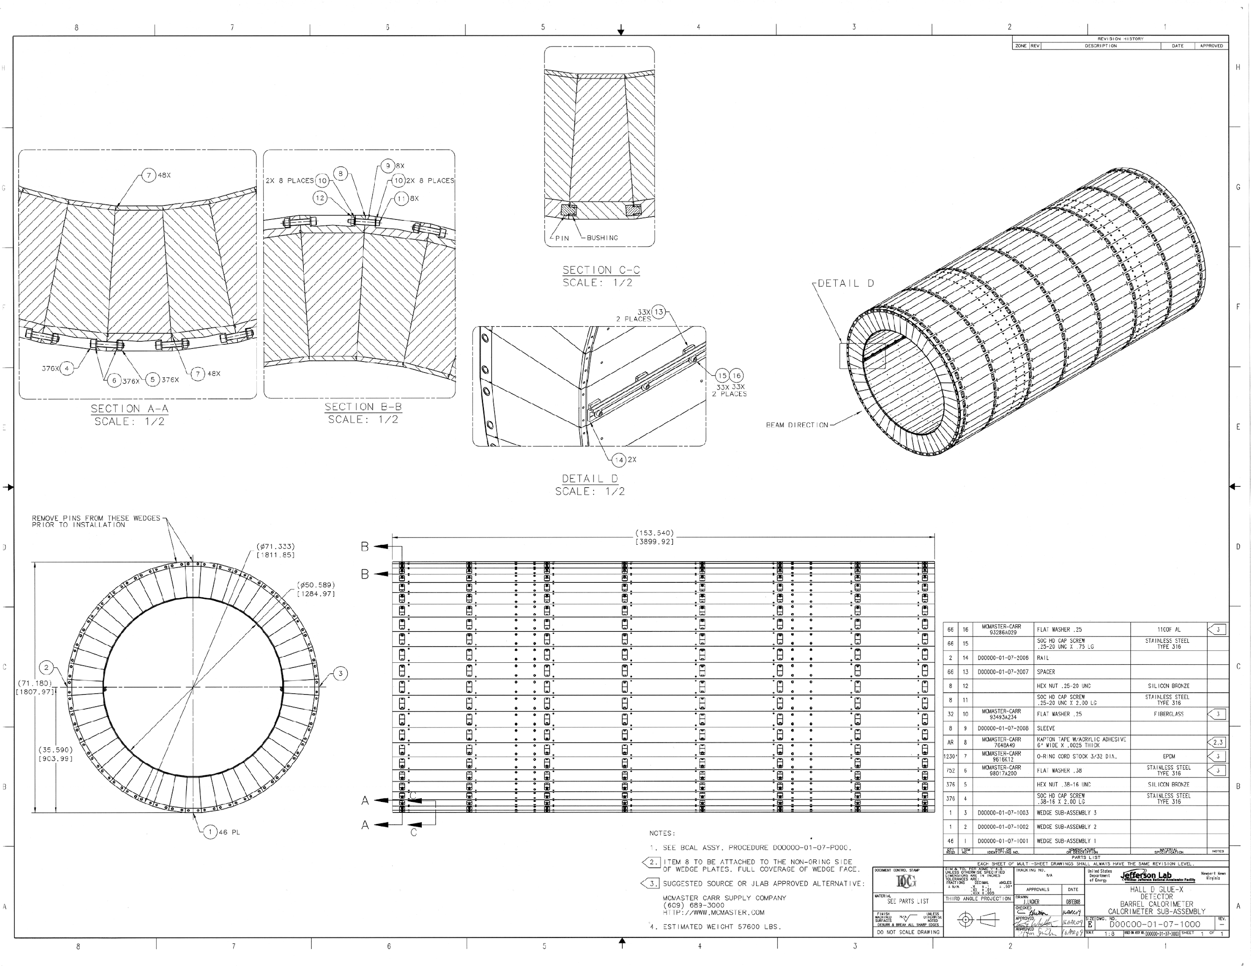
GlueX Assembly Drawing

