Slide 1
Sci-Glass Barrel EMCAL Detector Mechanical Design and Integration
Joshua Crafts, The Catholic University of America
Barrel ECAL Review
March 14, 2023

Slide 2
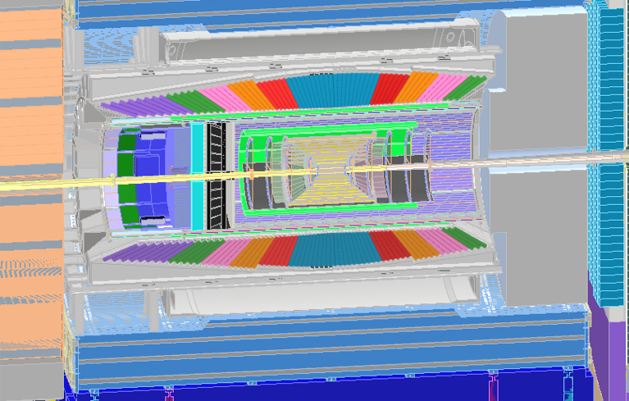
Design Considerations
Goal: Provide continuous coverage in EM Calorimetry in particular on the electron going direction.
Barrel Electromagnetic Calorimeter (Barrel EMCal)
DIRC
Si Tracker
Backward Electromagnetic Calorimeter
RiCH
Solenoid Magnet
Barrel Hadron Calorimeter

Slide 3
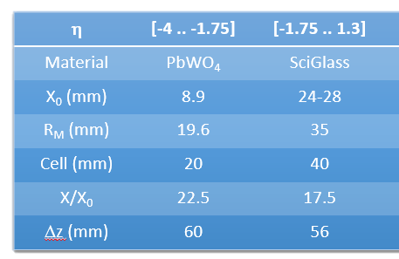
Detector Mechanical Requirements
Physics kinematic region enabled by the Barrel EMCal
High precision, hermetic detection of the scattered electron is required over a broad range in ƞ and over an energy range from 0.3 to tens of GeV as well as allowing sufficient overlap with the Endcap EMCal detector.
  In the very backward direction high precision is required for electron kinematics measurement.
  In backward and barrel region it is required for clean electron identification. In the barrel region, driven by high-x and high-Q² science drivers.
Here, we selected Sci-Glass for the barrel as it supports excellent e/h separation due to its good energy resolution, matched to the backward region needs.
Requirements
Good energy resolution
  e.g., region -2 < ƞ < -1 requires ~7%/√E

Slide 4
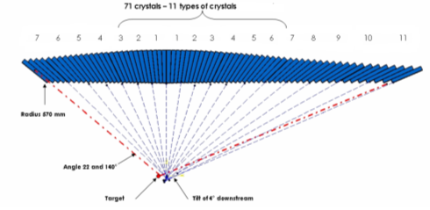
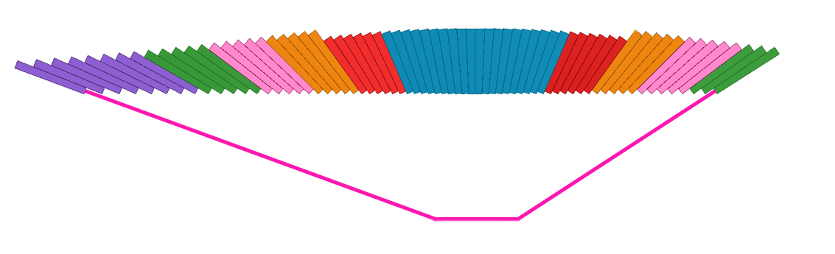
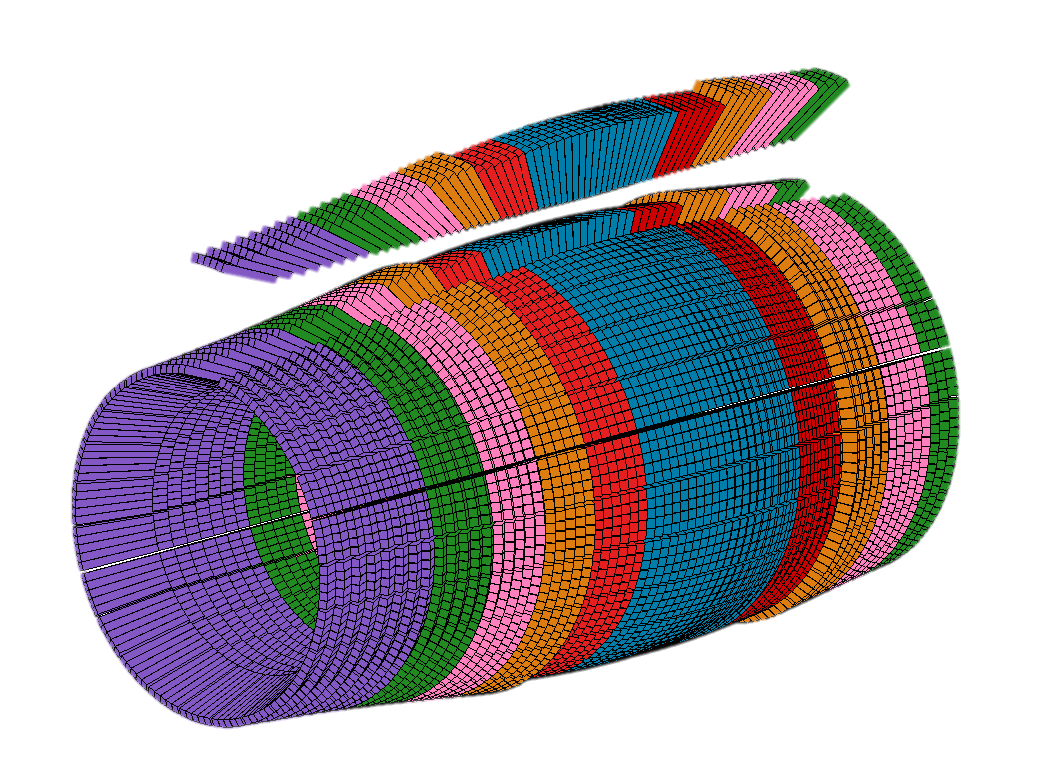
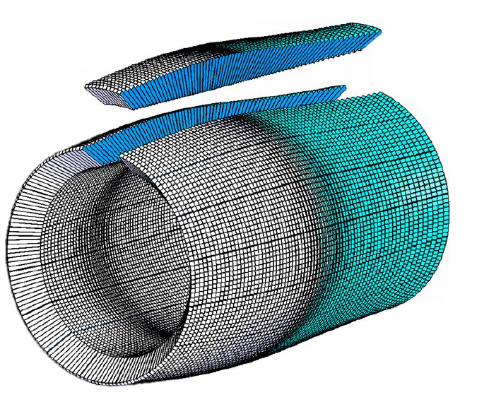
EIC Barrel EMCAL Mechanical Design
The design is based on that of the PANDA Barrel EMCAL taking into account the different needs of the EIC
PANDA
EIC BEMCal
4.7m
F6
F5
F4
F3
F2
F1
F2
F3
F4
F5
50cm
68 Sci-Glass blocks per slice with 6 family variations.
Central section (family 1 & 2) reduced in length to 40cm to allow for clearance others at 45.5cm.
Slices combined into groups of 5 separated by 2.811° radially to produce a wedge
120 slices combined to create 24 wedges separated by 15° radially (see next page)
Central region of 50 cm considered due to non-fixed target.
Currently 8,160 towers to complete the barrel

Slide 5
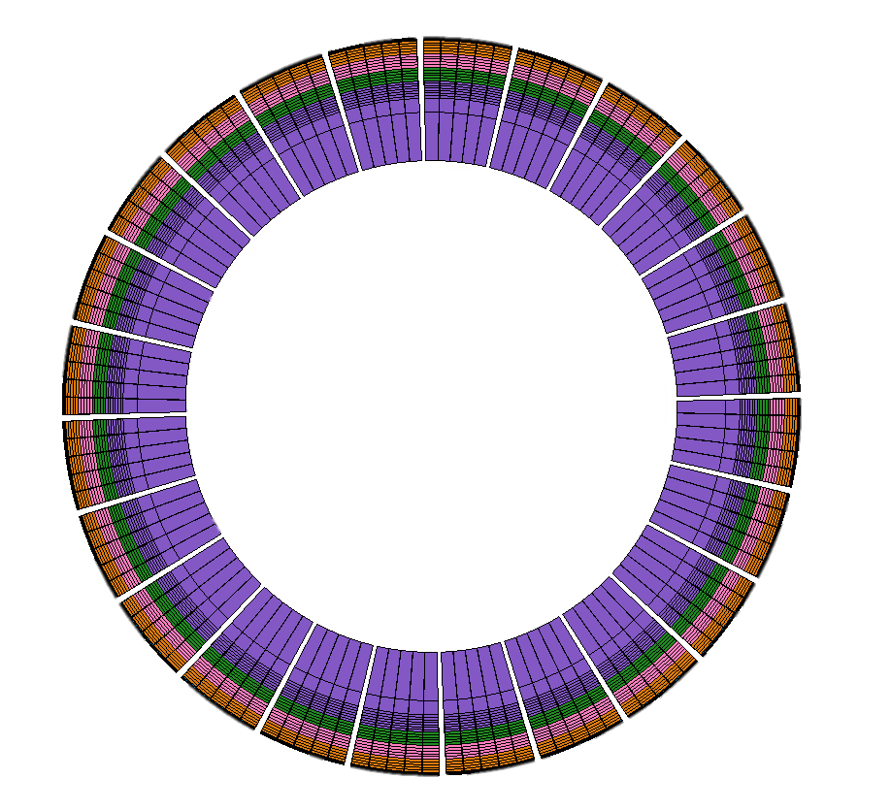
Wedge Azimuthal Profile
Goal: Allow for Maintenance of the Barrel Calorimeter.
Wedges separated to allow for clearance when maintenance is required.
Due to the deflection expected in the wedge elements at the 3 and 9 o'clock positions there is a 5mm gap between the wedges built into the structure.
Each wedge covered with a thin (3mm) skin of aluminum to protect internal structure.

Slide 6
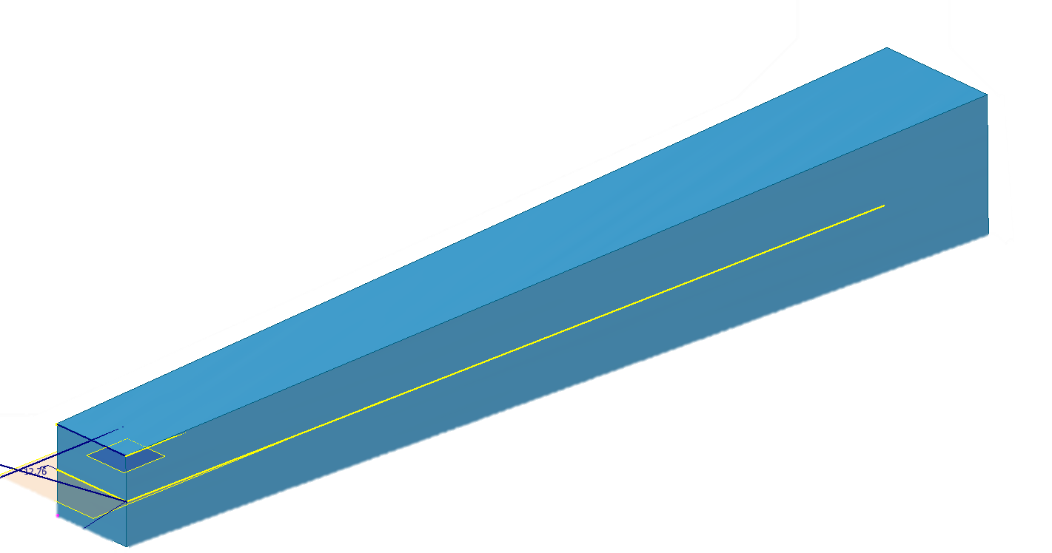
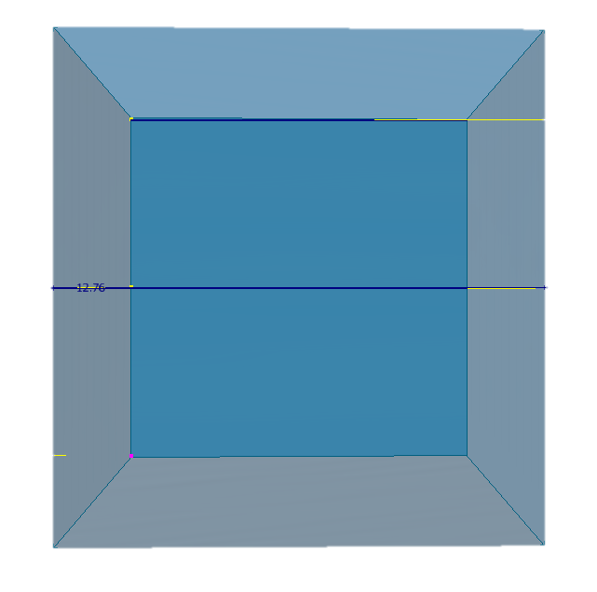
Sci-Glass Families
Goal: Design the Sci-Glass Families to minimize the free air gap between the blocks with optimal number of families
50cm
The Sci-Glass Family Characteristics.
  Based on a original rectangular prism 4x4x45.5 or 4x4x40 cm.
  Long axis angular deflections (flare) set to allow the centerline axis of each family starting and ending block to pass through the correct point in the 50cm region.
  Rotational axis angles determined by family to allow for the trailing end radial surfaces of each family end block to be parallel with their radial neighbors.
  Both angles combined produce a truncated rectangular pyramid.
  Each block within the respective family is identical.
Family 1 Block Example

Slide 7
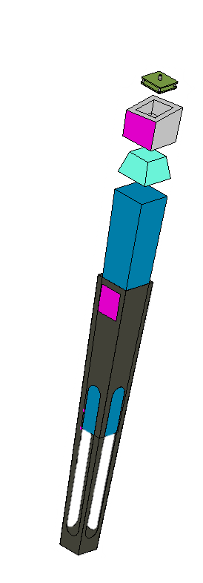
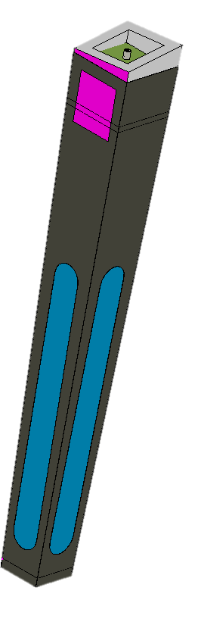
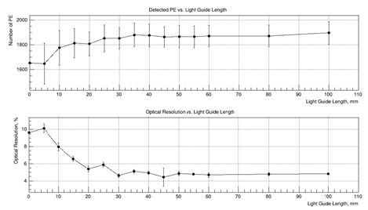
Sci-Glass Tower Module Overview
SiPM & Electronics
Mounting Collar
The blocks are encased in tapering carbon fiber tubes forming a grid structure.
  Wall thickness 0.25mm.
  Blocks grouped into “SuperModules”.
Light Guide of PMMA Acrylic with a length of 3.5cm used to connect the Sci-Glass towers to the SiPM reducing the surface area of tower.
Sci-Glass wrapped in both Reflective ESR material and light tight Tedlar.
Aluminum mounting collar is glued to the inside of the carbon fiber tube.
  This transfers the load of the tower to the support structure on the outer radius of the wedge.
SiPM and electronics inserted into the support Collar.
Light Guide
Sci-Glass Tower
Carbon Fiber
3.5cm
Light guide optimization simulation

Slide 8
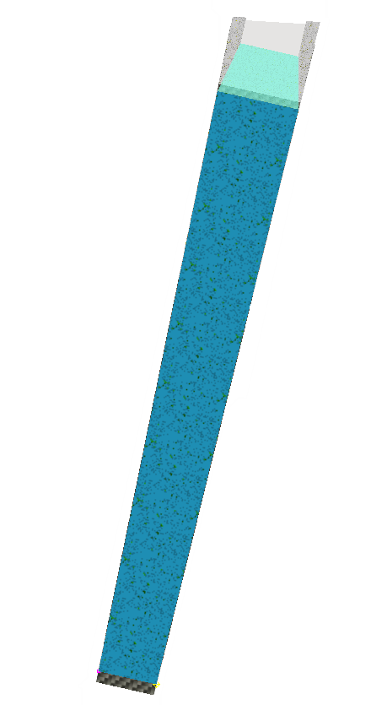
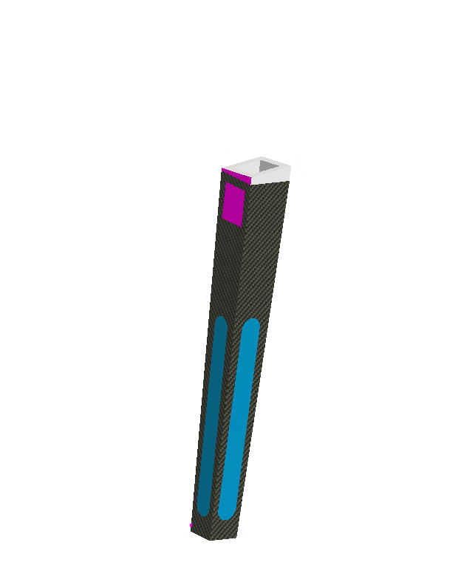
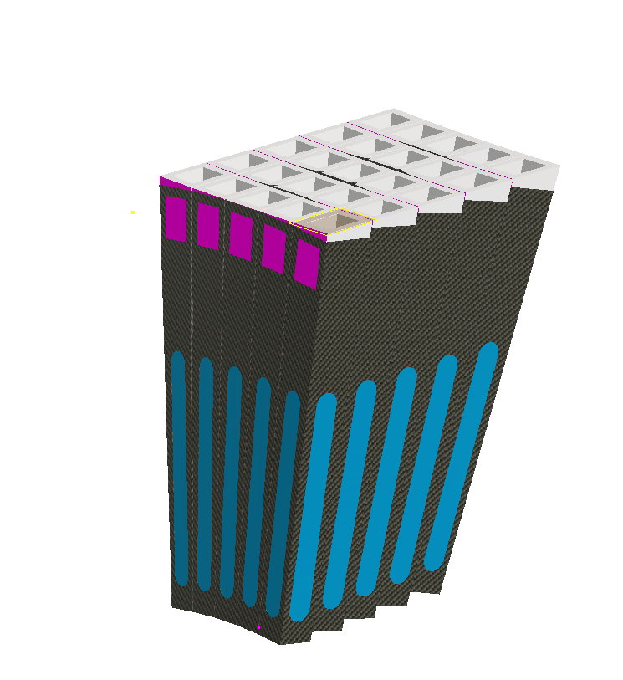
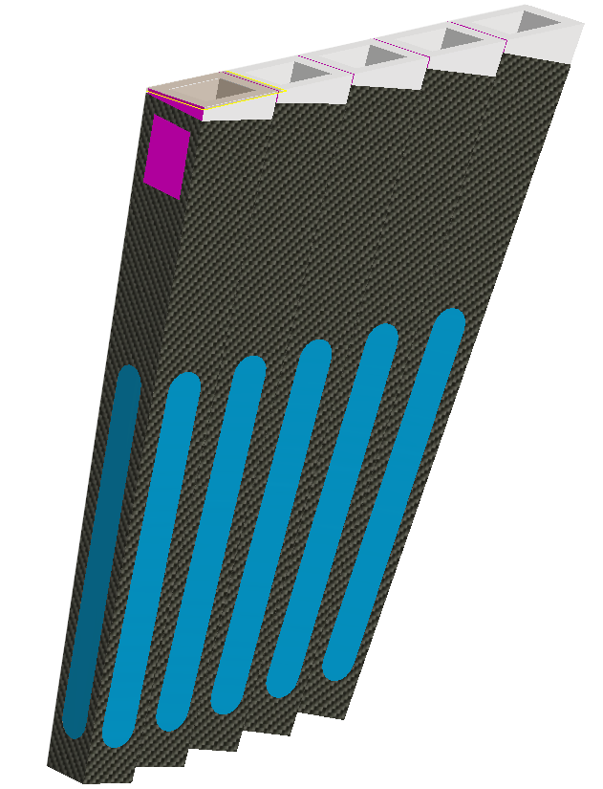
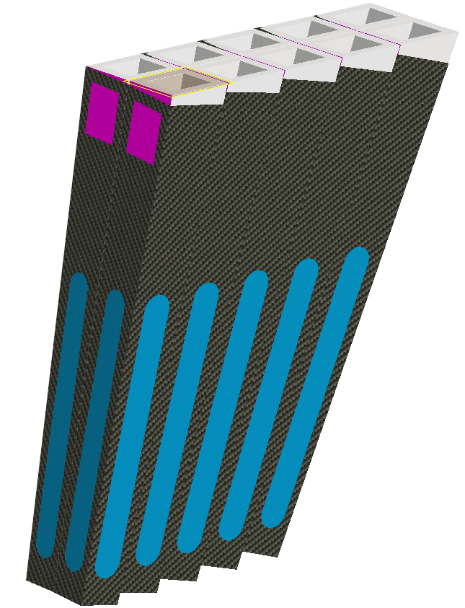
SuperModule Assembly Process
Each Tower is assembled individually, then towers are grouped together into full SuperModules.
Each SuperModule being sufficiently supported it can then be attached to the support beam.
Once the SuperModules are loaded they can be fitted with their electronics and cabling.
Process

Slide 9
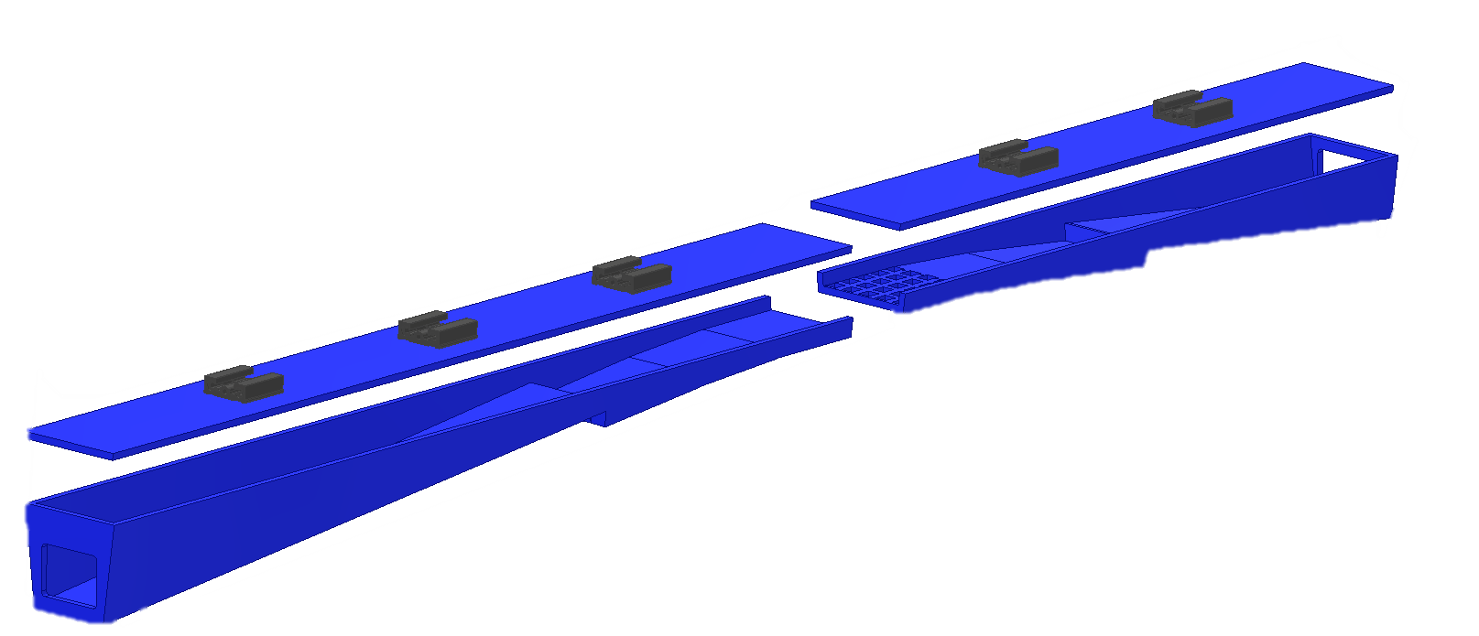
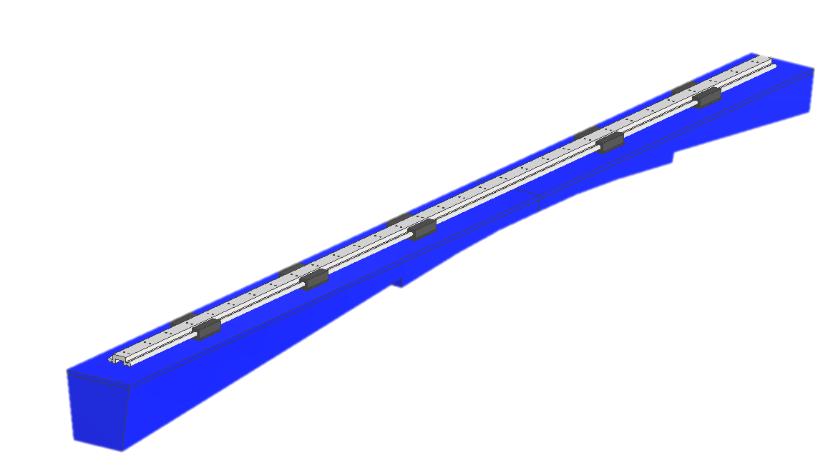
Support Beam Description
Goal: Provide rigid structure attaching to the external support frame for the SuperModules and provide space for cable routing.
The beam is constructed using 2cm thick aluminum.
  Outer plate holds the pillow blocks that attach to Thomson rails on the next support structure.
  Main beam profile is then attached to this plate as well as the Sci-Glass Families’ SuperModules.
Support Beam divided along the mid-plane of Family 1 where the towers form a vertical separation.

Slide 10
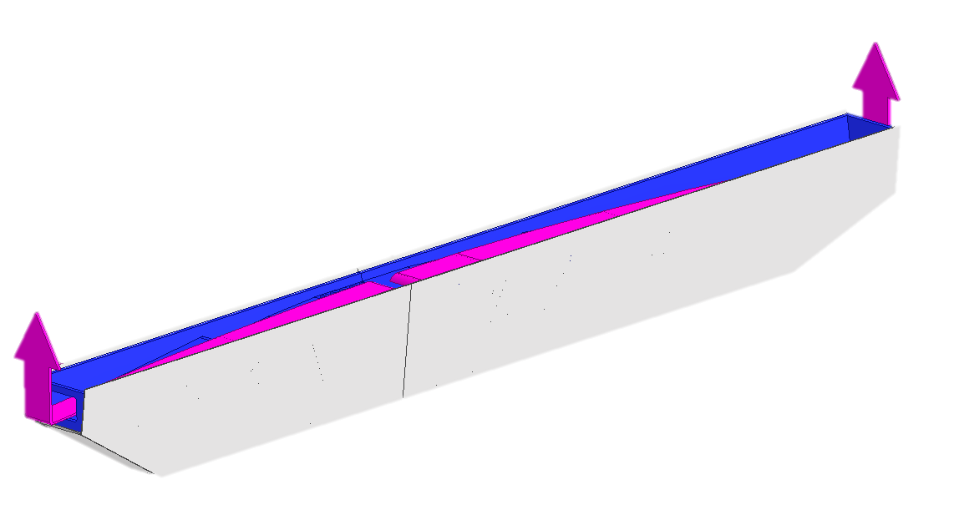
Cabling/feedthrough
Cables for low voltage supply and signal will be run through the hollow region inside the support beam and pass through the ends of the beam via feed through plates.
Disconnects are implemented at both ends of the wedge.
  Currently envisioned 8,160 signal and low voltage supply channels required to fully instrument the detector.
  Space saving strategies will include micro-coaxial ribbon cable
  Backend readout electronics and power supplies will be similar to those used in the Endcap Electromagnetic Calorimeter.

Slide 11
Cooling Considerations
Cooling to be considered:
  Sci-Glass is not a temperature dependent material, therefore the only factor is the cooling of the electronics.
  The SiPM produce very little parasitic heat (~30 W for the entire detector).
  The only significant source of heat will be the amplifier/circuit that is attached to the SiPM.
We anticipate that the cooling requirements can be accomplished with air cooling by use of dry nitrogen purge along with air circulation and heat exchange.
More concrete numbers can be provided once a circuit design is finalized.

Slide 12
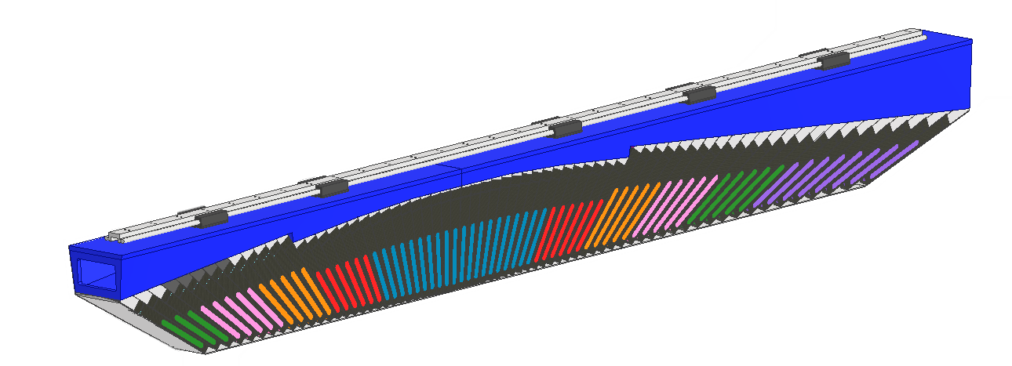
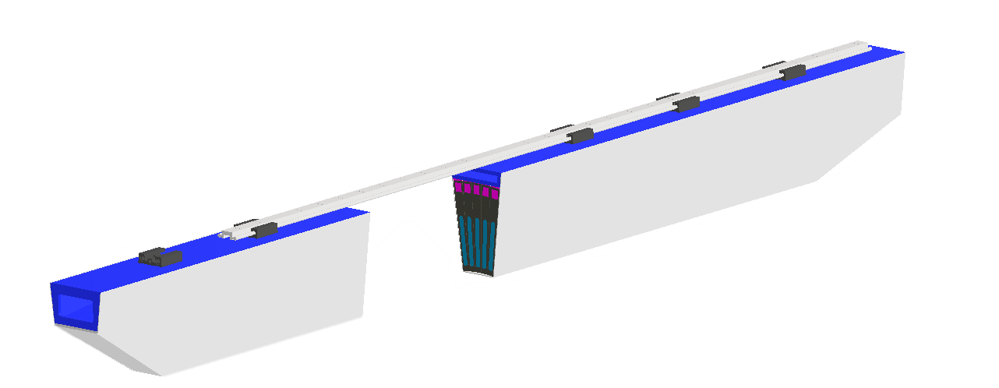
Full Wedge
Each wedge weighs 1500kg including Sci-Glass and Aluminum.
The wedges are then covered with a 3mm plate which connects to the sides of the support beam.
Wedge segmented into two components.
  Both segments mounted onto the same rail.
  Longer segment installed first.
Installation Direction

Slide 13
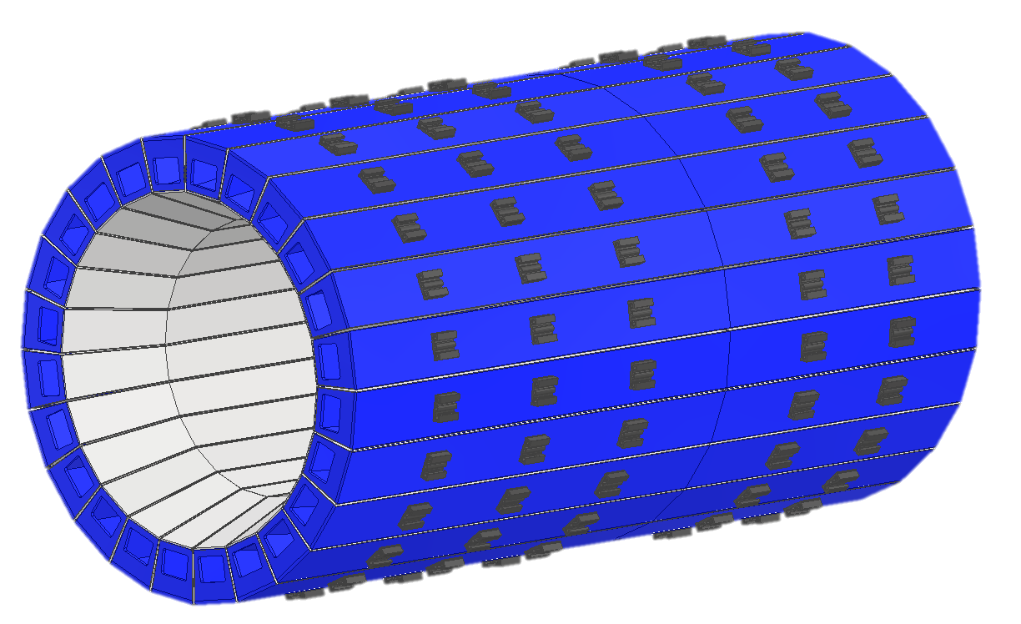
Barrel EMCal Mechanical Design Summary
Rail Pillow Blocks (5x per wedge)
Overall Barrel detector supported by external frame that surrounds it and attaches to the Barrel HCal inner surface
In order to allow for maintenance the detector is segmented into 24 wedge segments which can be removed individually by extracting them along the long axis of the detector.
Barrel Wedge Segments (x24)

Slide 14
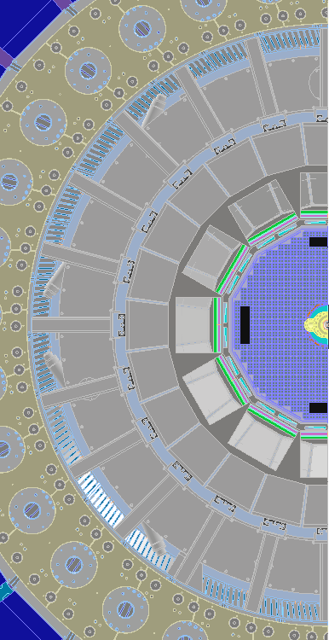
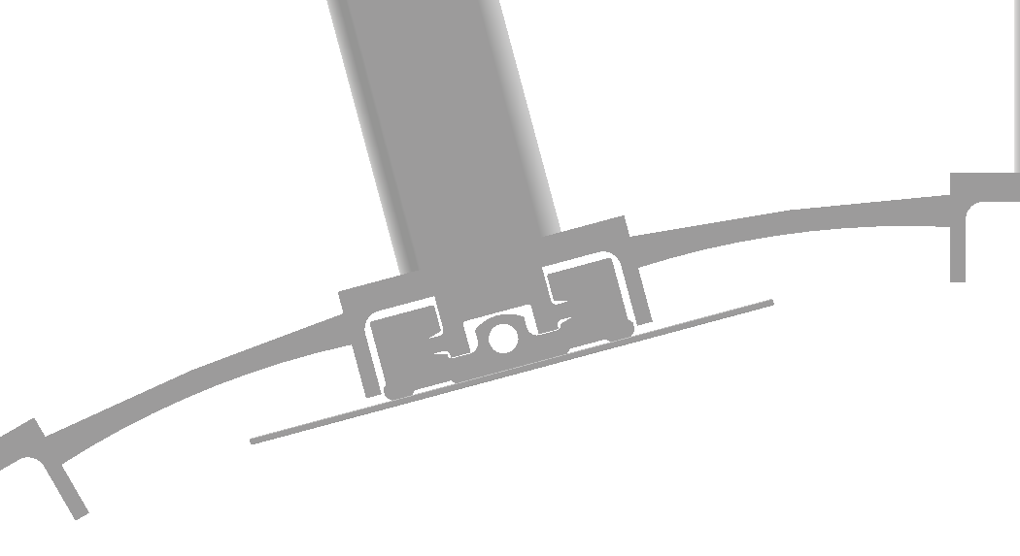
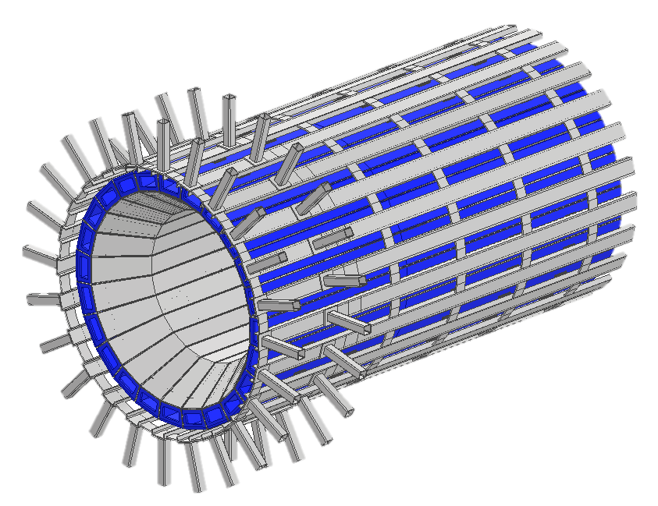
External Support Structure
Goal: Transfer the load from the wedges to the inner radius of the HCAL via support members at both ends of the detector.
In our design, individual wedges segments are loaded along the longitudinal axis into the support frame
Support Struts
(connected to HCal)
C-Channel
75.5mm

Slide 15
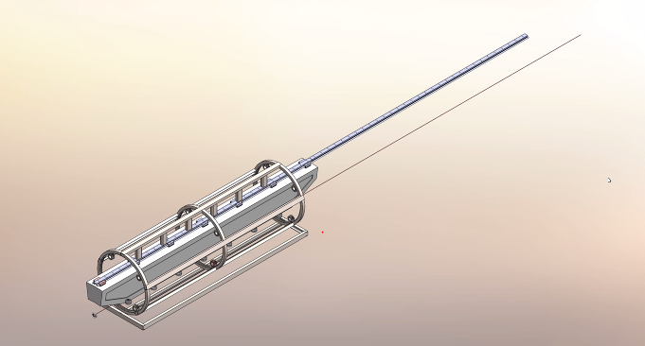
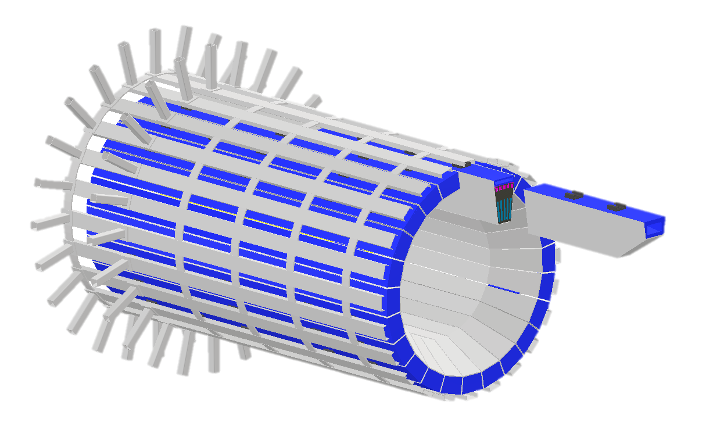
Assembly & Maintenance
For maintenance and installation individual wedges will be extracted or inserted along the long axis of the detector.
A custom support cradle will be required in order to align the wedges onto the support rails.

Slide 16
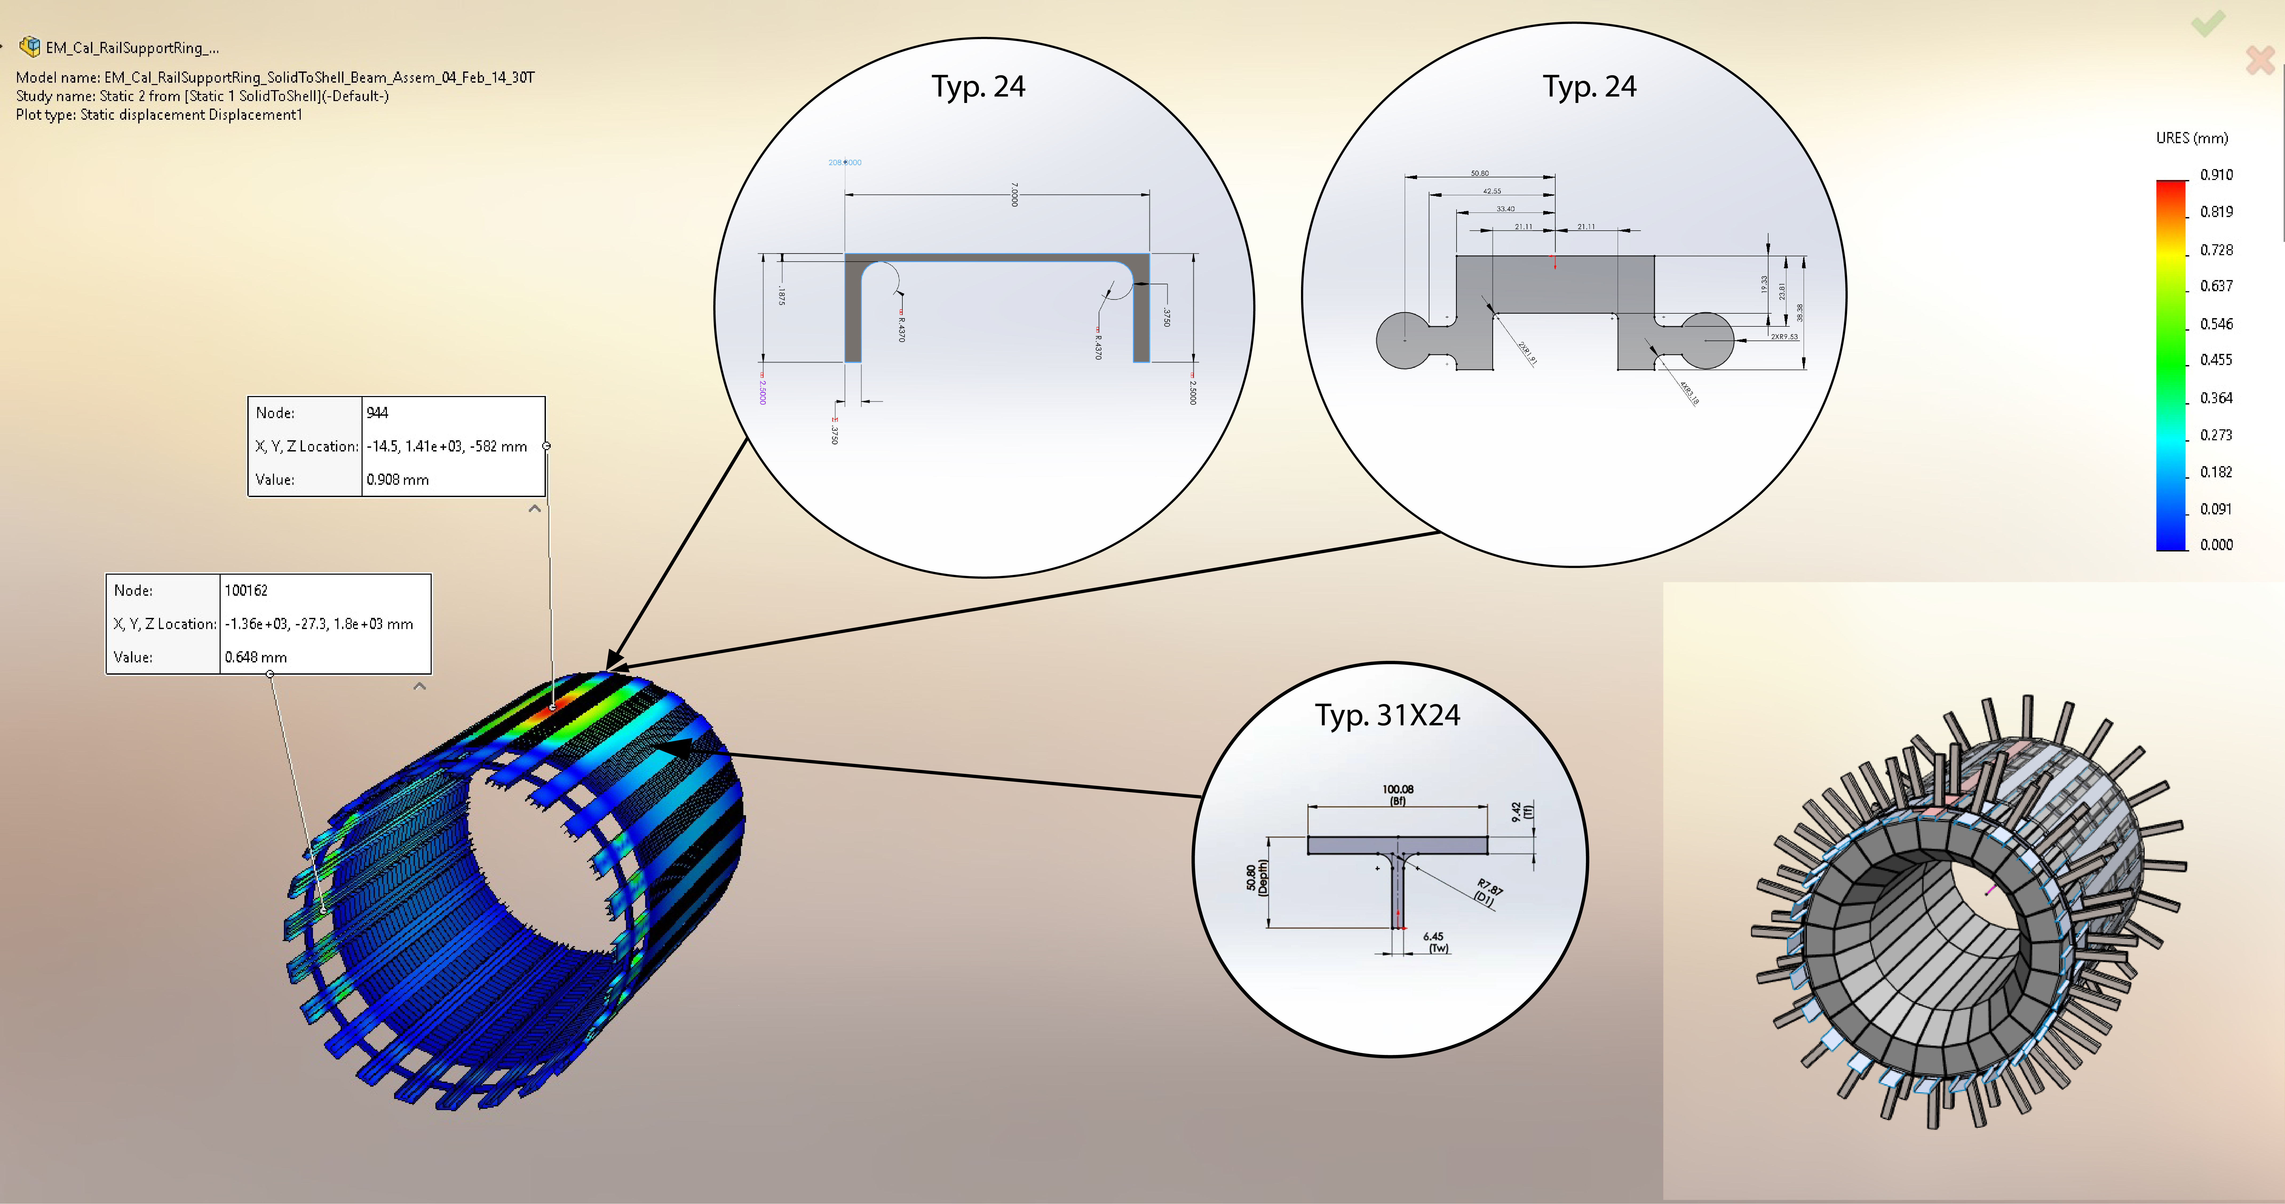
Support Structure Mechanical Simulation
Latest simulations with the support frame constructed with aluminum results in 1.6mm deflection maximum.
Credit: Avishay Mizrahi

Slide 17
Summary
Mechanical model for the Barrel is maturing with efforts in integrating the design smoothly into the overall detector.
  Good initial pass model that sets the interaction points and volume constraint requirements.
  The Sci-Glass BEMCal model is integrated into the design for the main EPIC detector to ensure agreement with its surrounding detector elements and service feedthroughs.
  Mechanical simulations have shown that there is a working support structure that will be sufficient to mount the detector.
  Further mechanical modeling and tests are planned for this year.
  More physical details will be added as more information becomes available.
    Continued development/refinement of internal structure.
    Inclusion of higher detail model components, mounting fixtures etc.

Slide 18
Thank You!

Slide 19
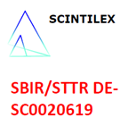
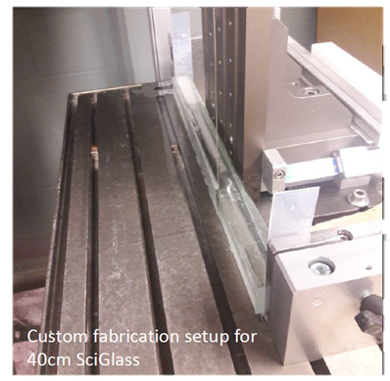
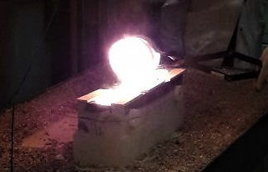
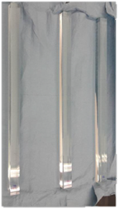
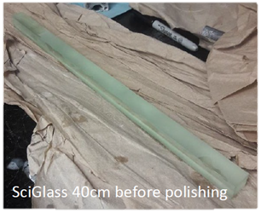
Glass Scintillator Production
Scintilex in collaboration with the VSL at CUA has made much progress with the development and fabrication of Sci-Glass over the last 3 years
Scintilex has an SBIR phase-II award to start large-scale production of larger blocks (40+ cm, rectangular and projective shapes) to meet the specific schedule of the EIC
Sci-Glass of length 20cm can now be produced reliably and 40cm long blocks can now be produced routinely – so far we have received 3 lab size batches (10-20 samples), most recently 10 blocks of 40cm length and 16 more blocks are anticipated early in 2023
Glass pouring into the mold at Scintilex/VSL
After polishing

Slide 20

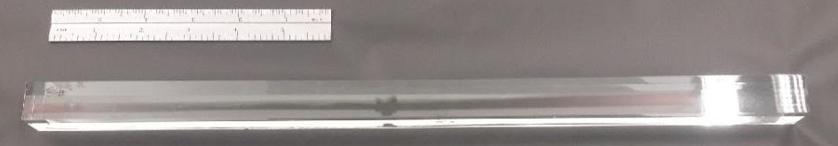

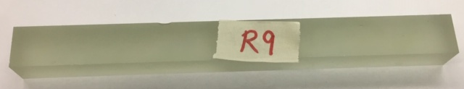
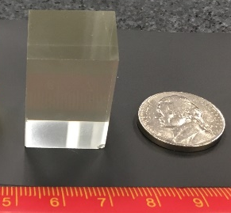
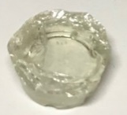
Glass Scintillator Scale-Up
Significant progress made over the past years.
SCINTILEX
Scale up Size
Latest production 40cm length blocks currently used in beam testing
2cm x 2cm x 40cm
20cm length blocks for verification tests of material properties
4cm x 4cm x 40cm
2cm x 2cm x 20cm
2cm x 2cm x 20cm
2cm x 2cm x (2-4)cm
Early test samples
1cm x 1cm x 0.5cm
Test sizes only
2019
2020
2021
2022
Year
20

Slide 21
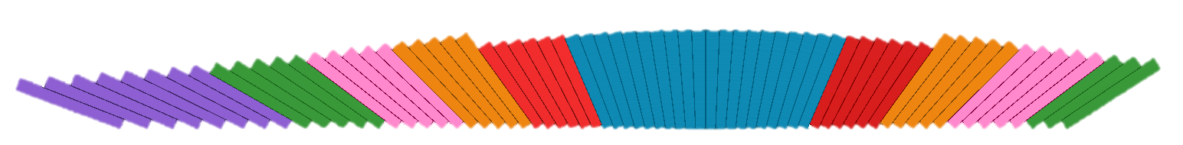
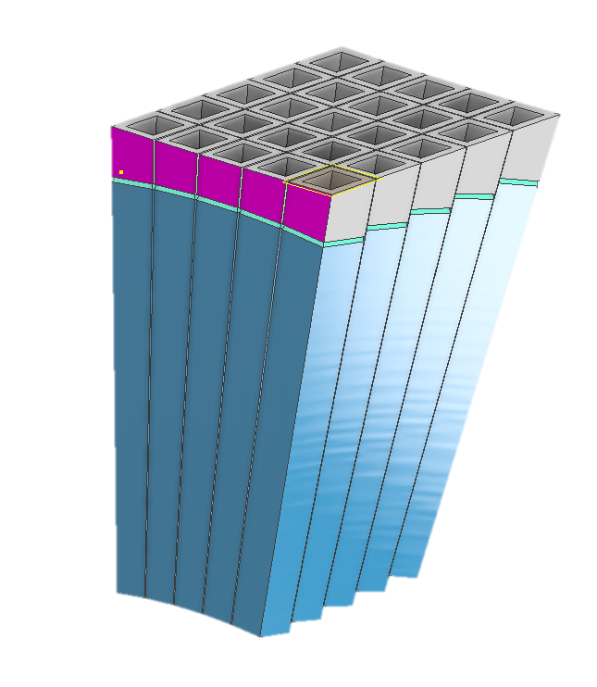
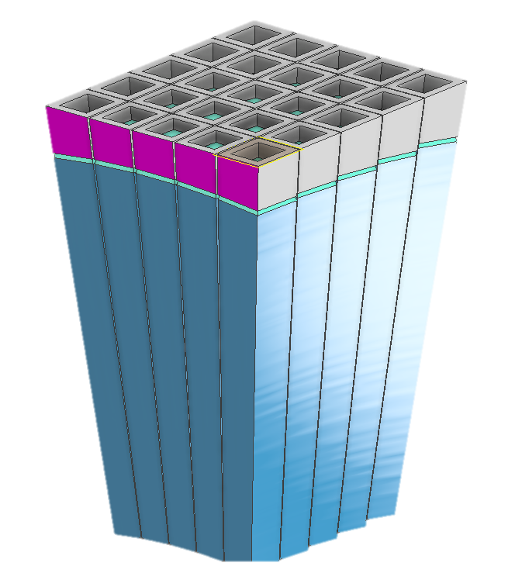
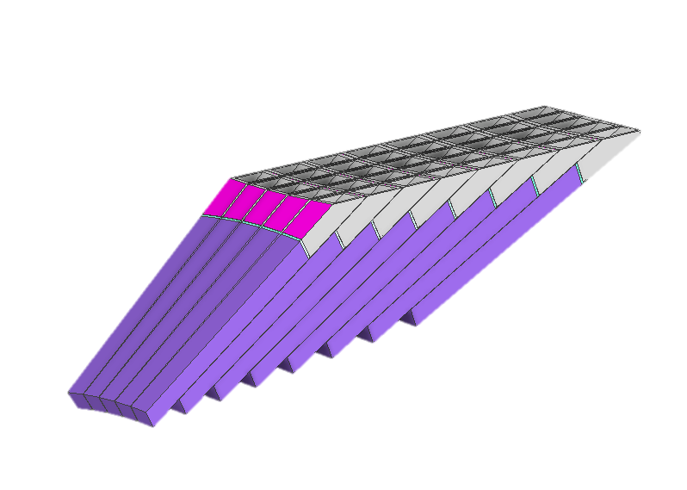
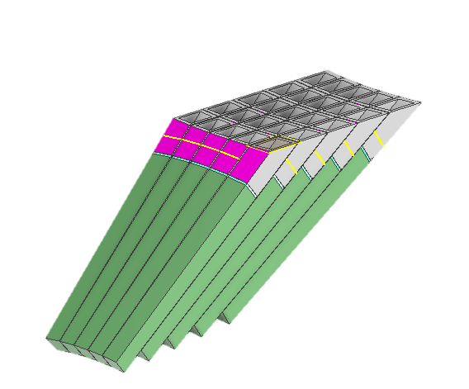
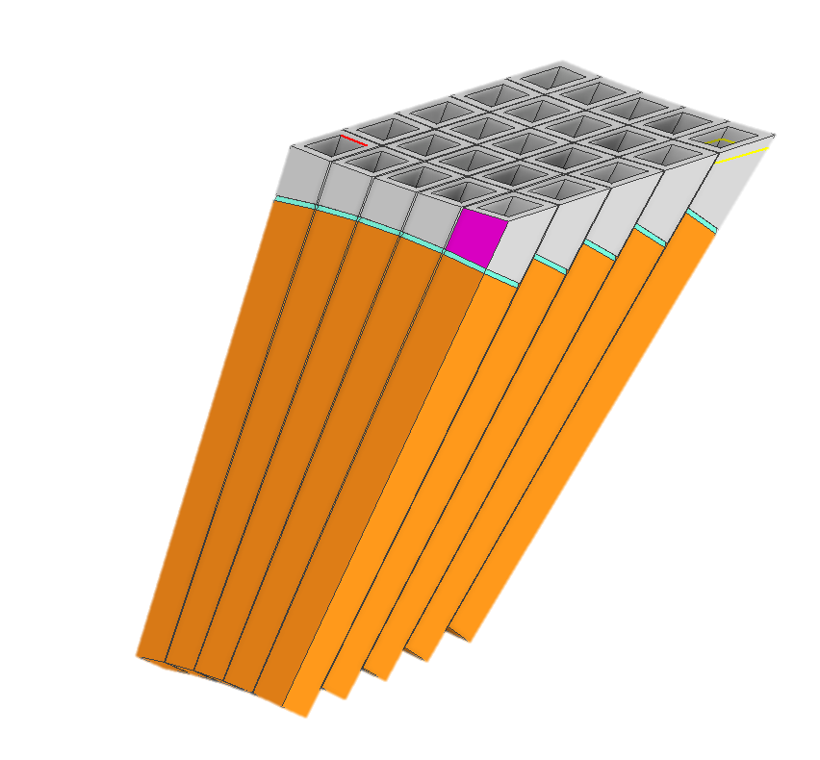
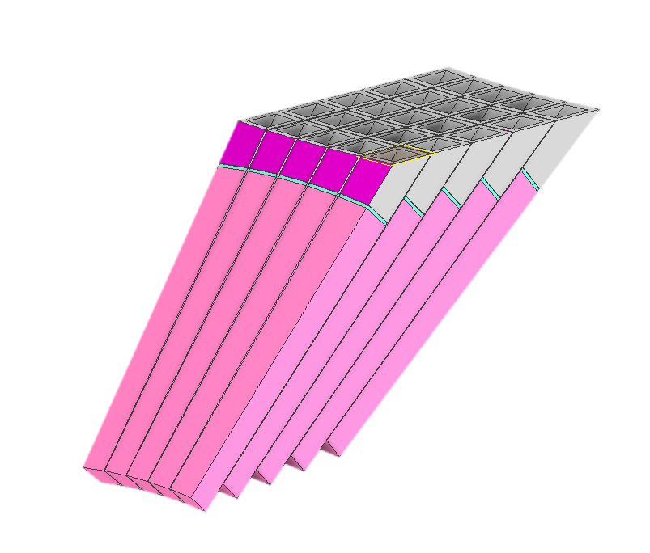
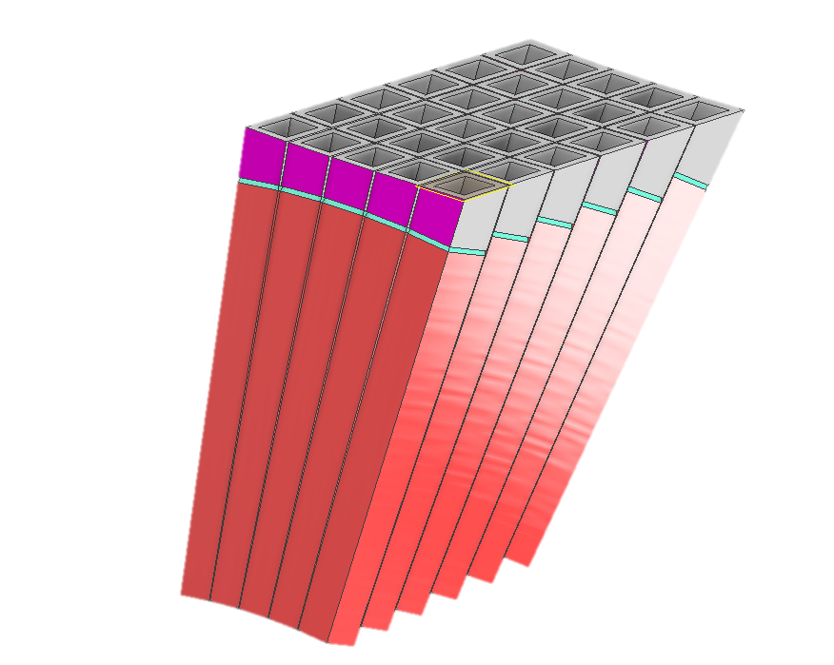
Family SuperModules
Design variants of family SuperModules
  Families are mirrored across the detector midline.
  Family six only occurs in the electron going direction of the barrel
  Family 5 is shortened to 3 towers in length on the hadron going end of the barrel.

Slide 22


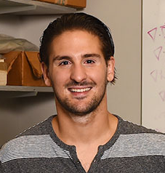


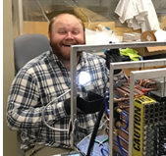



Consortium Electromagnetic Precision Calorimetry
Experienced team of institutions (AANL, CUA, FIU, JMU, UK, MIT..) including many early-career researchers working on design, simulation, and prototypes.

