Slide 1
TCAD Simulation for Deep Gain Layer
https://indico.bnl.gov/event/18522/
Gabriele Giacomini
March 1st 2023
eRD112/LGAD Consortium Meeting

Slide 2
TCAD simulations – Breakdown Voltage
50-um thick DC-LGAD
Gain layer implanted at 380keV (current BNL tech) vs 1MeV
Once the energy is decided, fine tune the dose to have a V_{BD} ~ 200V

Slide 3
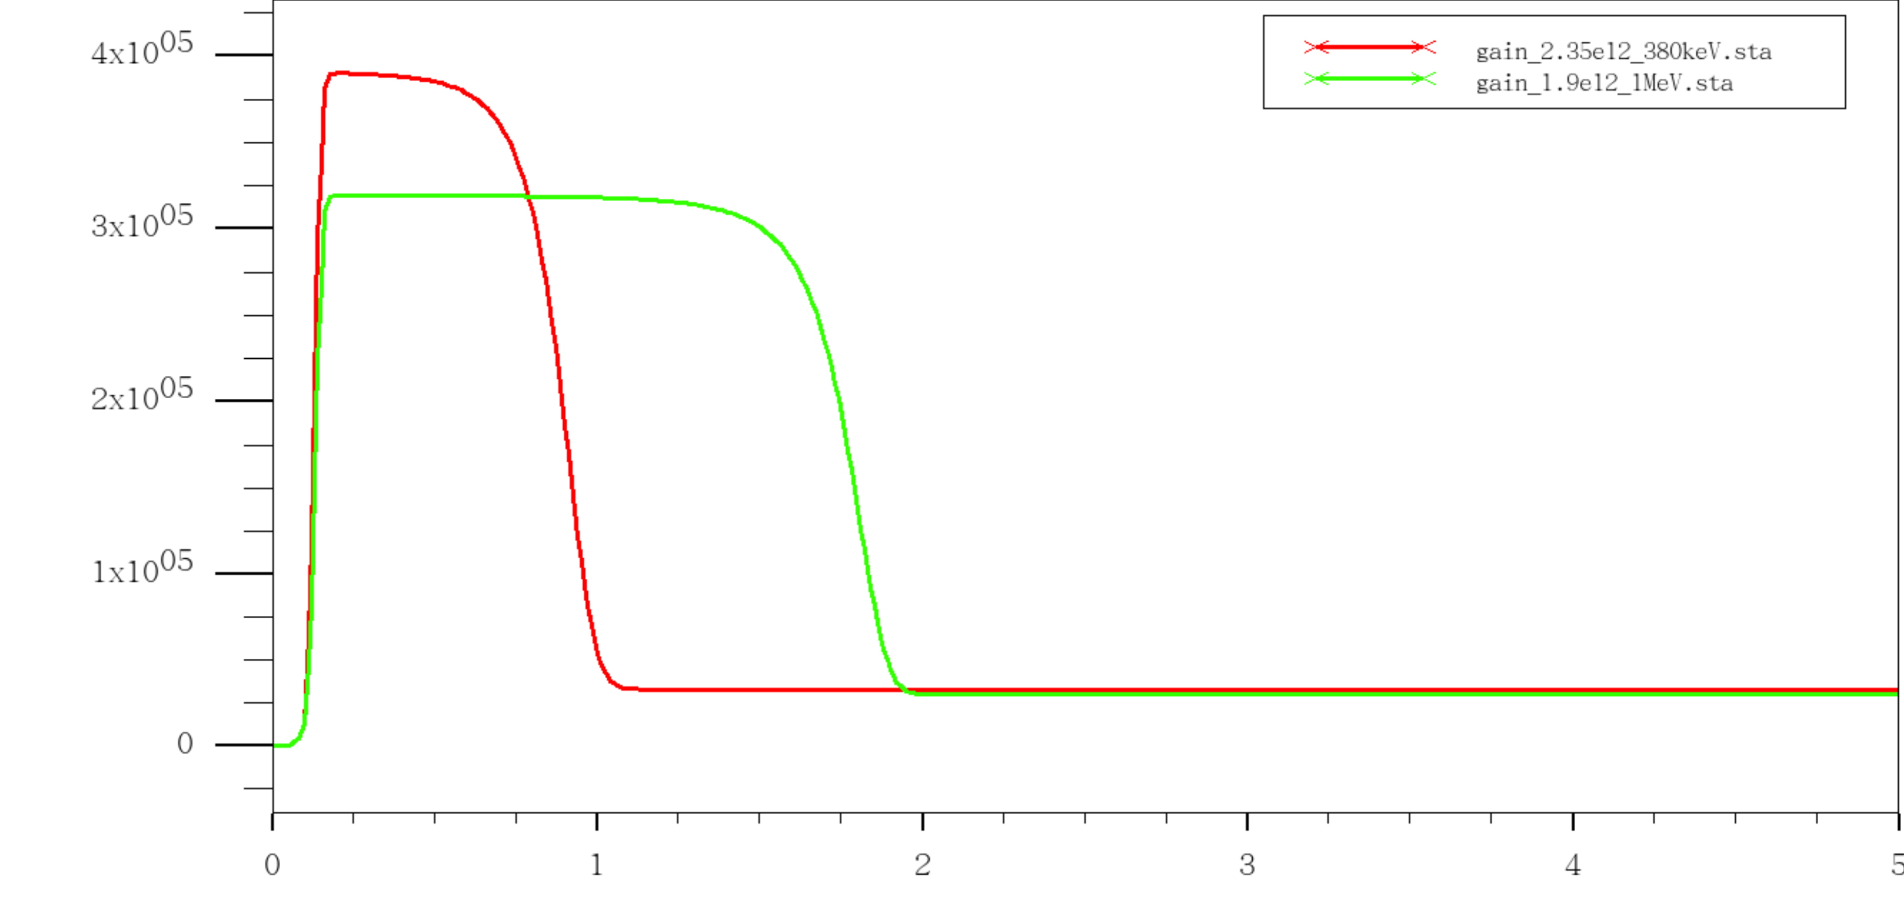
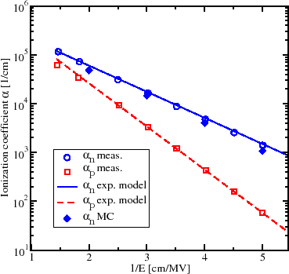
TCAD simulations – Electric field
1/E = 2.56 cm/MV
E (V/cm)
380keV
1/E = 3.125 cm/MV
1MeV
Depth into substrate (um)
α_{e}/α_{h} (1 MeV) > α_{e}/α_{h} (380 MeV)
→ Hence higher gain is expected

Slide 4
Some measurements
Low-noise charge measurements with charge sensitive preamplifier (shaping time ~ 1us)
Beta hitting the LGADs
Doping concentration of the gain layer (extracted from CV)
HPK
BNL new LGAD

Slide 5
EICROC
1 x 50, 30, 20 um thick substrates : passivation to be opened this week
Test on wafer and then dicing.
EICROC bump-bond compatible
2cm x 0.5cm
0.5cm x 0.5cm
0.2cm x 0.2cm
Compatible with EICROC

Slide 6
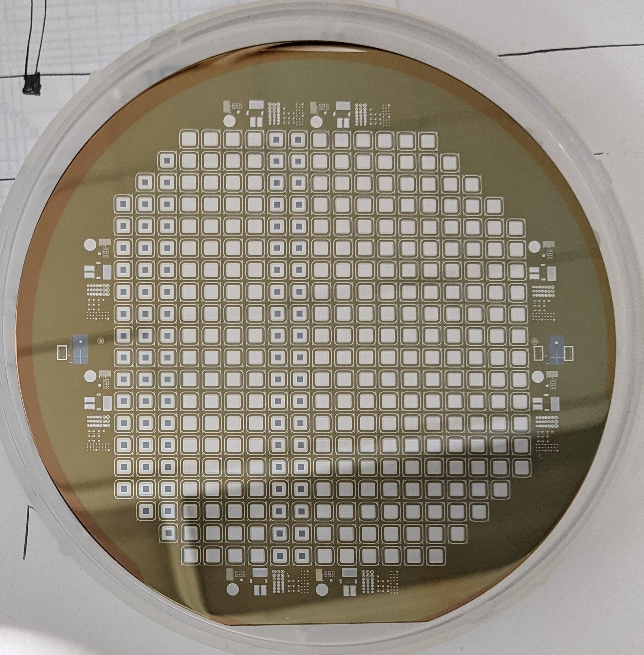
Next: LGAD & AC-LGAD with higher gain
With present technology, max gain = 60 for mips
To have more gain, we need higher UNIFORM implantation energy (380keV → 1Mev)
Test on small devices:
Single channel LGADs (1.3 mm x1.3mm)
EICROC for AC – LGAD
3 + 3 wafers, one per thickness
First litho done, out for first implant (JTE) next week

