Slide 1
EICrecon task force
Dmitry Romanov
2023-03-06

Slide 2
Discussion topics
CI not working and double free()
PODIO updates
EICrecon issues categories
Calorimetry issues
PID updates and libIRT
AOB

Slide 3
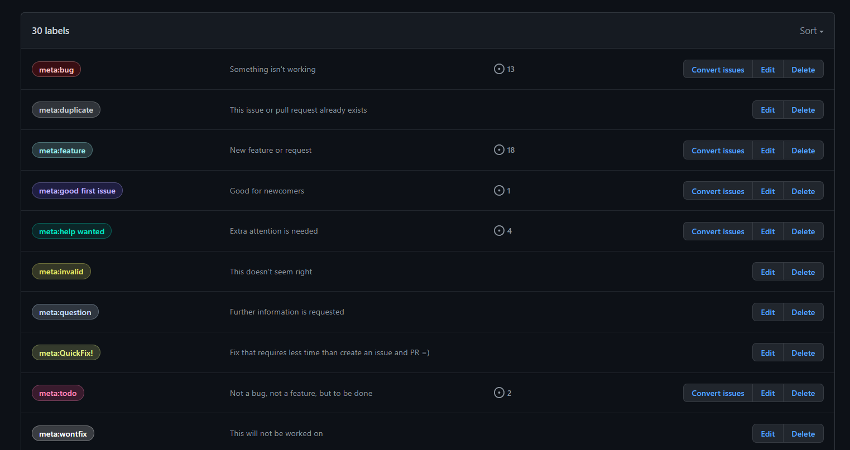
GitHub labels:
30 labels
…

Slide 4
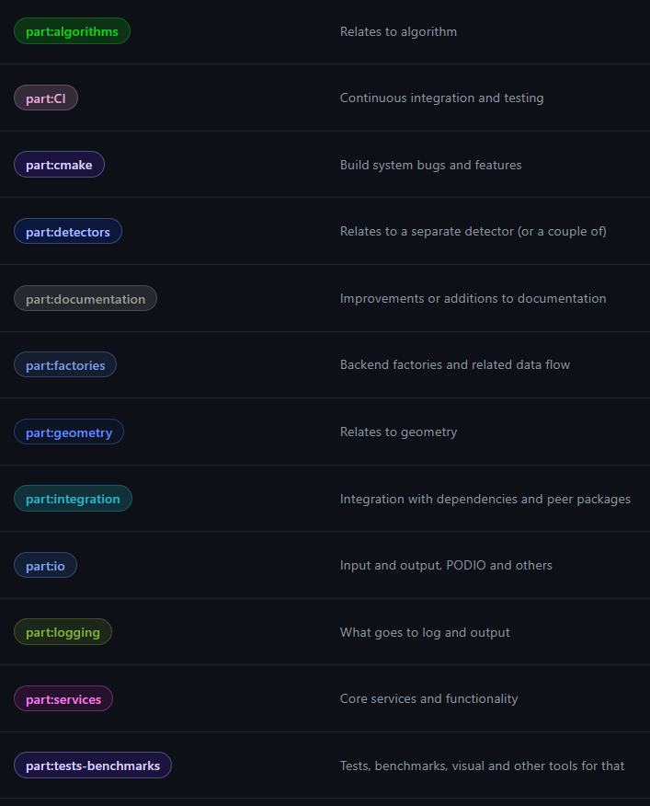
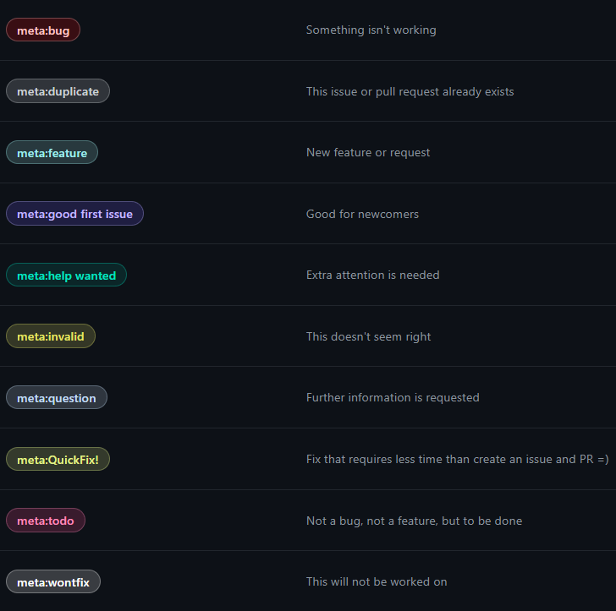
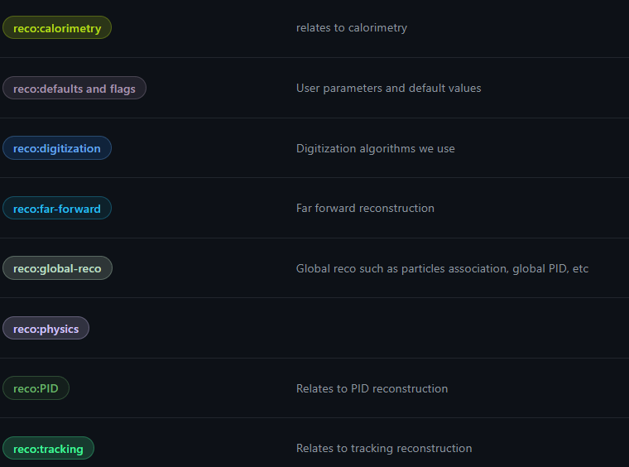
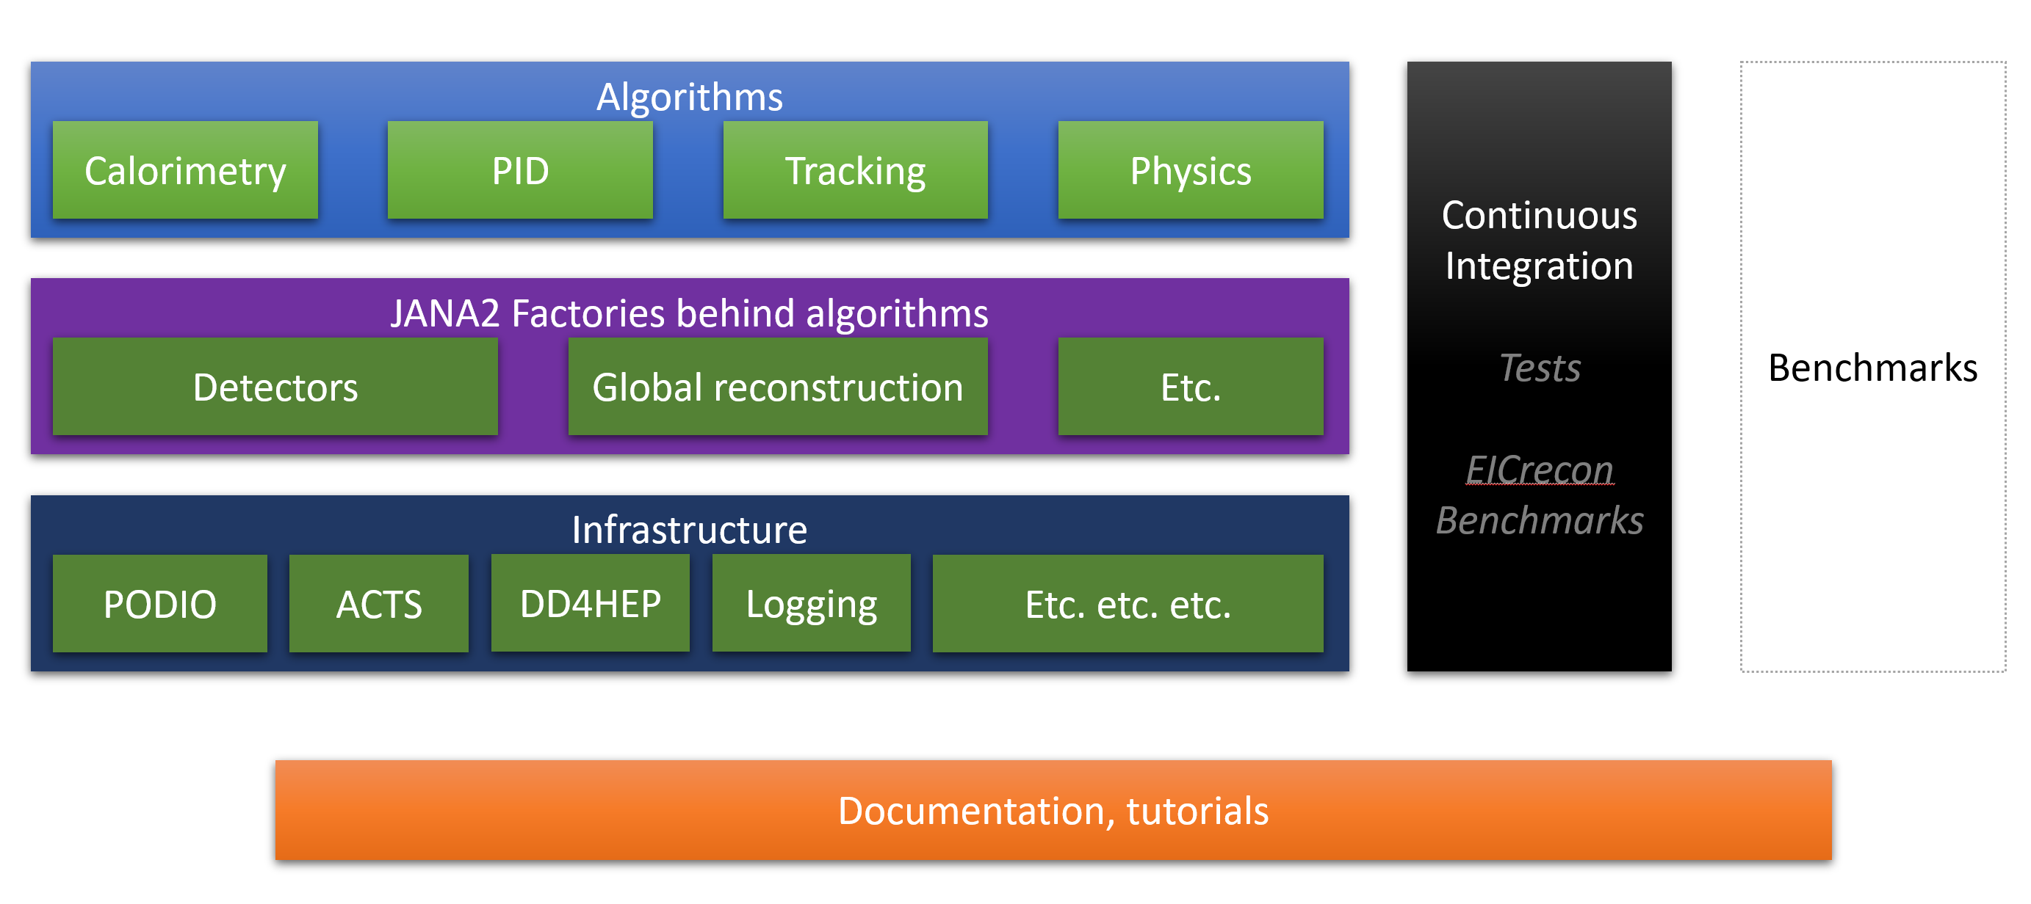
Label categories
[part]
(EIC recon part)
[meta]
(Usual labels)
[reco]
(Reconstruction context)

Slide 5
Discuss if possible
(Dmitry K., Nathan, David) Non-unique type_info for Jug::BField::DD4hepBField
(Dmitry K., Nathan, David) enable __GXX_MERGED_TYPEINFO_NAMES globally (Dmitry K., Nathan, David) Move to only static libraries or only shared libraries
(Wouter) Closed - Occasional segfault in eicrecon loading acts plugin
(C.Dilks, Wouter) Closed - EICrecon build fails to find IRT in eic-shell container build when not yet in /usr/local

Slide 6
BACKUP

Slide 7
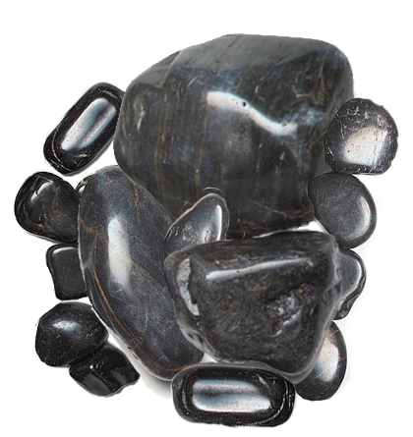
Big rocks, small rocks
MCParticles to Hits, Clusters, Tracks associations
… logging work in acts…
… error X when Y…
Realistic seeding working and tuned

Slide 8







Big rocks, small rocks
EICrecon
EPIC detector
JANA2
ACTS
Modularity
task force
PODIO

Slide 9
Task force goals
Just go yesterday and fix all bugs!

Slide 10
Task force goals
Just go yesterday and fix all bugs! (not really)
Build a better throughput of tasks, shape workflow,
(so there won't be piles of outdated issues)
Priorities, planning, metrics to meet deadlines
Always have a road map
Feedback, help, documentation

Slide 11
Deadlines
Calorimeter review – Middle of March
Simulation campaign – End of March
Resulting:
All bugs/features for Calorimeter Review -> Highest priority
Only subset of issues could be solved to Simulation campaign
so we have to set priorities

Slide 12
EIC recon parts. Algorithms
Algorithms
Calorimetry
PID
Tracking
Physics
Each algorithm :
Require some global context
(geometry, logging, ACTS)
Process events
Configuration
Algorithms has no links to JANA2 or EICrecon,
they are completely independent.
No services or any other elements are used.
Live in their own separated folder
Separate build system
They are built like regular libraries (not plugins)
Usable in any other framework out of the box
Algorithms are isolated from each other, so if one takes a single algorithm and just drop it to another framework - it will work with no any code modification.

Slide 13
EIC recon parts. Middle factories
Algorithms
Calorimetry
PID
Tracking
Physics
JANA2 Factories
Detectors
Global reconstruction
Etc.
Middle factories:
Backend factories provide context, event data and configs
Uses framework infrastructure
Define data flow order

Slide 14
EIC recon parts. Middle factories
Algorithms
Calorimetry
PID
Tracking
Physics
JANA2 Factories
Detectors
Global reconstruction
Etc.
Middle factories:
Backend factories provide context, event data and configs
Uses framework infrastructure
Define data flow order

Slide 15
EIC recon parts. Infrastructure
Algorithms
Calorimetry
PID
Tracking
Physics
JANA2 Factories behind algorithms
Detectors
Global reconstruction
Etc.
Infrastructure
PODIO
ACTS
DD4HEP
Logging
Etc. etc. etc.
Infrastructure factories and services:
Provide proper initialization for underlying services
Uses framework infrastructure
Define data flow order

Slide 16
EIC recon parts. CI Testing
Algorithms
Continuous Integration
Tests
EICrecon
Benchmarks
Benchmarks
Calorimetry
PID
Tracking
Physics
JANA2 Factories behind algorithms
Detectors
Global reconstruction
Etc.
Infrastructure
PODIO
ACTS
DD4HEP
Logging
Etc. etc. etc.

Slide 17
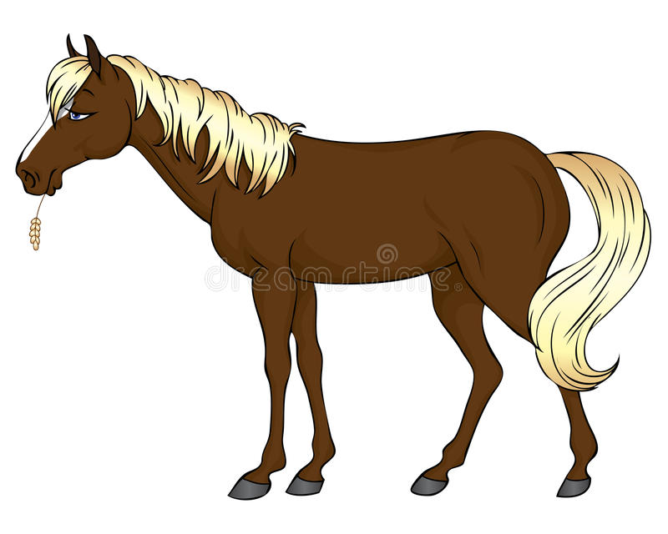
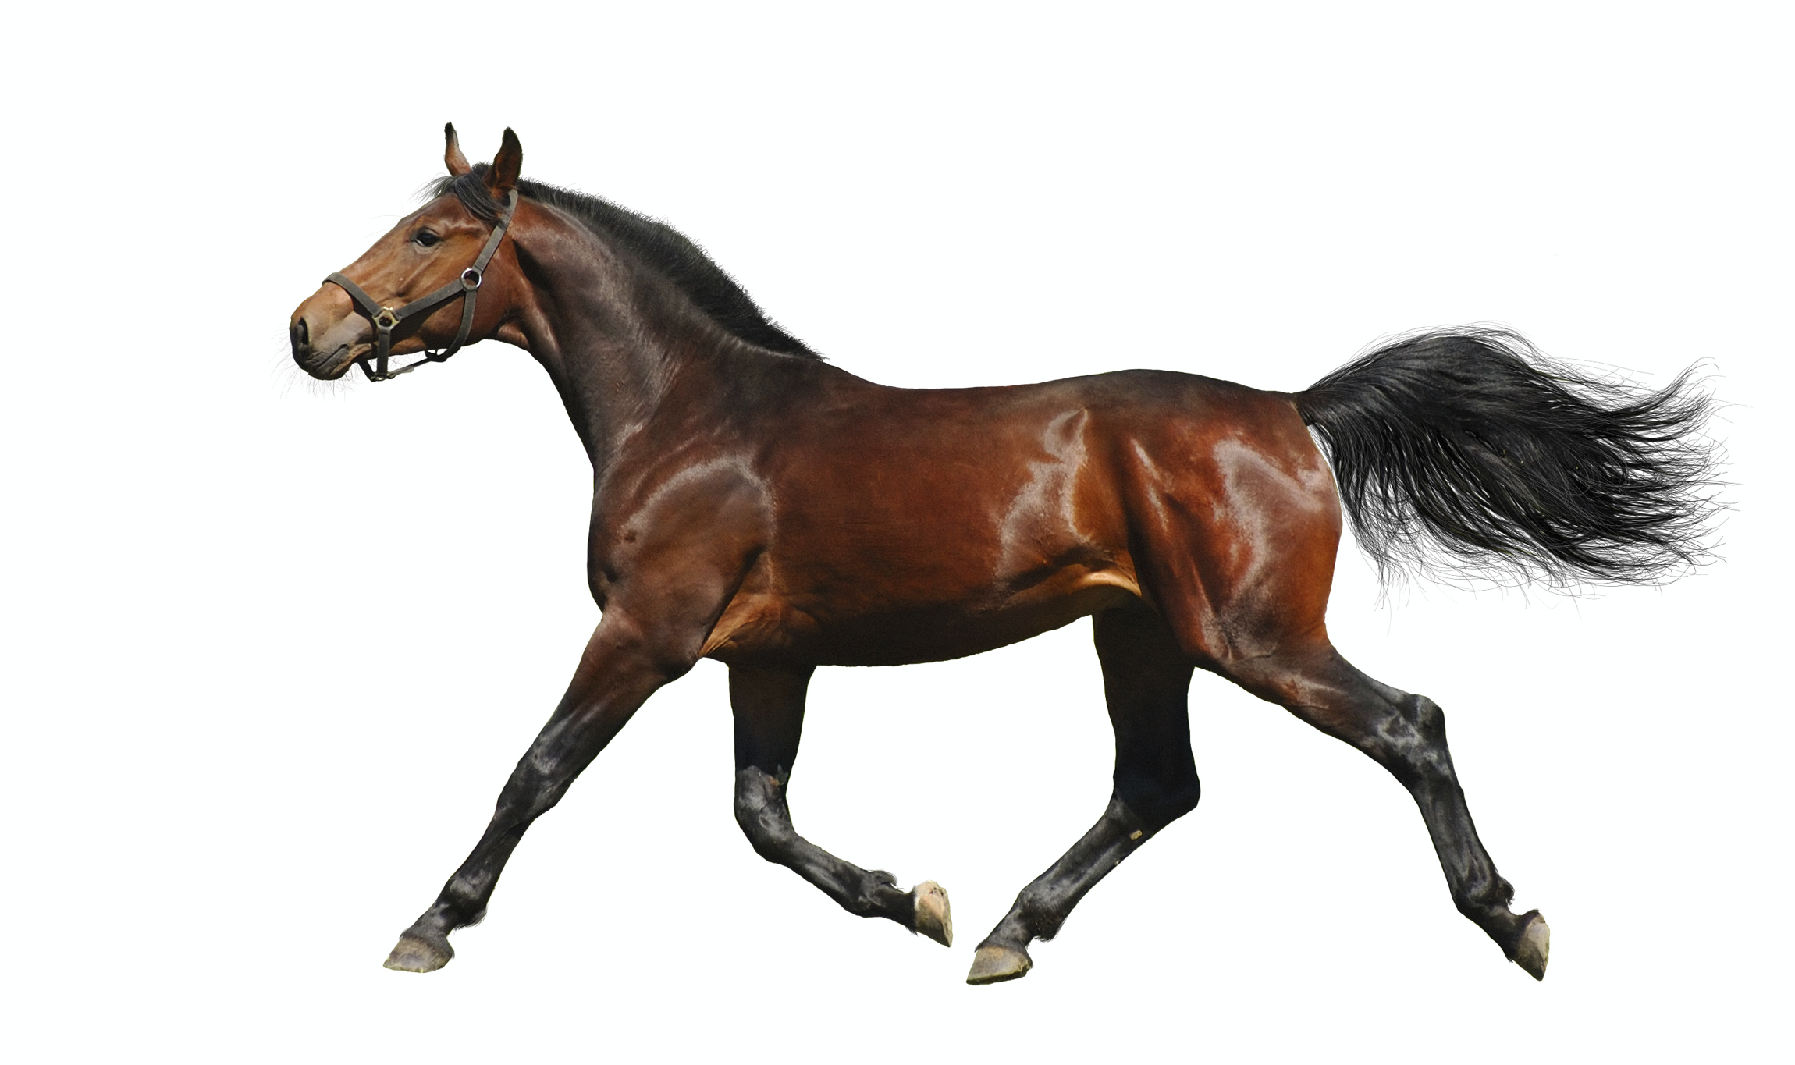
EICrecon -> Algorithms road map
How it is going to be
EICrecon
Algorithms
Library
Dynamic data flow
Databases
New shiny life
TIME
t

Slide 18
EIC recon parts. Infrastructure
Algorithms
Modified
to fit new API
Calorimetry
PID
Tracking
Physics
JANA2 Factories behind algorithms
Heavy rework
Detectors
Global reconstruction
Etc.
Infrastructure
Mostly intact
fit new API
PODIO
ACTS
DD4HEP
Logging
Etc. etc. etc.

Slide 19
Responsibilities
Algorithms
Continuous Integration
Tests
EICrecon
Benchmarks
Benchmarks
Calorimetry
PID
Tracking
Physics
JANA2 Factories behind algorithms
Detectors
Global reconstruction
Etc.
Infrastructure
PODIO
ACTS
DD4HEP
Logging
Etc. etc. etc.
Documentation, tutorials

Slide 20
Discussion
The most wanted issues to be fixed
Coding conventions and documentation
GitHub changes
Organization improvement

Slide 21
Next meetings
Do on the regular basis:
Go over issues
Identify priorities and possible workforce (who could fix what)
Discuss any problems and progress with solving what we have
EICrecon open hours

