Slide 1
pfRICH Design Update
By Alex Eslinger (JLAB)
1 March 2023

Slide 2
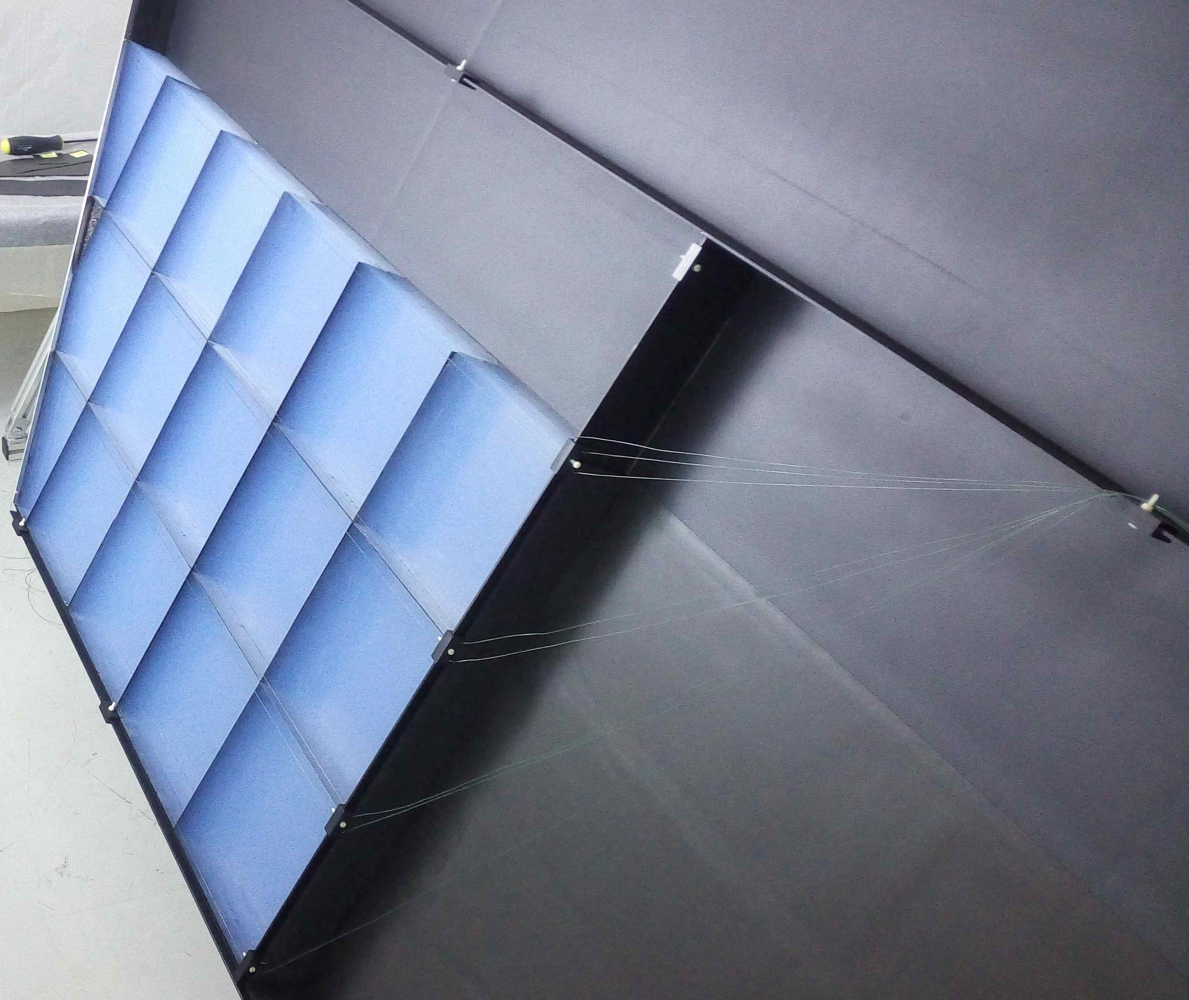
Aerogel Wall Details
Material: Carbon Fiber Disc/Dividers (~0.5mm thickness).
Dimensions:
Outer Radius -> ~62.5cm
Inner Dimension -> Beam pipe flange + 5mm clearance for installation.
Total height: 4.05cm
More Details:
3 radial bands of aerogel tiling
4 cm thick aerogel tiles
Thin clear filament to be strung across the grid to hold tiling into place. (Detail not shown; conceptual)
Aerogel tiles are kept within 20x20 cm maximum dimension to allow for production
Estimated weight: ~1.8kg

Slide 3
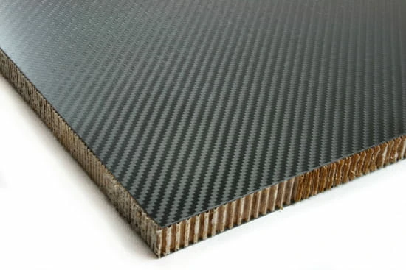
Containment Walls
Material: Carbon Fiber Sandwich Structure with aluminum rings around the edge
Dimensions:
Outer Radius -> ~63.8cm
Inner Dimension -> Beam pipe flange + 5mm clearance for installation.
More Details:
Front Wall and Inner Wall thickness = ~1/4” (6.35mm)
Outer Cylindrical Wall thickness = ~1/2” (12.7mm)
Aluminum sealing rings around outside perimeter are 1/2“ (12.7mm) in size
Aluminum Sealing rings around beam pipe are 1/4“ (6.35mm) in size
Weight not estimated due to carbon fiber sandwich construction

Slide 4
Outer Conical Mirror System
Material: Carbon fiber sandwich with reflective surface (~1/4” [6.35mm] thick)
Dimensions:
Upstream Radius: ~62.4cm
Downstream Radius: 54cm
More Details:
Intended to be segmented into 8 sections radially
Mounting points will be provided by machinable foam pads around the circumference
Current thought for foam is polyurethane foam available in different densities
3 mounting points per mirror segment
Mirrors have a tapered section as they approach the aerogel to maximize internal space
Weight not given due to carbon fiber sandwich structure

Slide 5
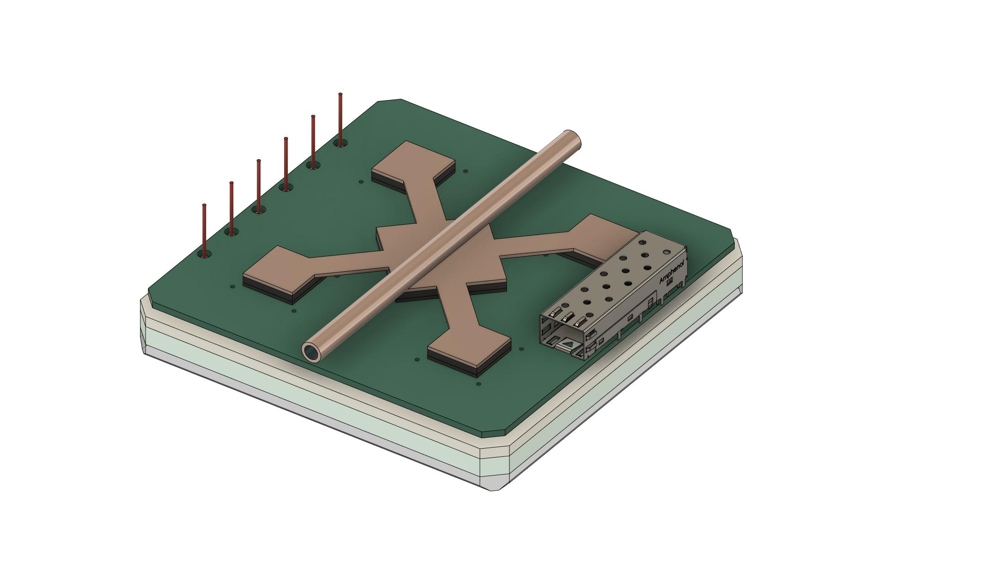
(Most) Current Sensor Design
HV Cabling
Cooling Representation
5cm clearance for cable bends and routing
SFP Fiber Port
- Sensor design shown here is changing frequently; however, it is a good visual for the rest of the design - Estimated sensor weight: ~485g

Slide 6
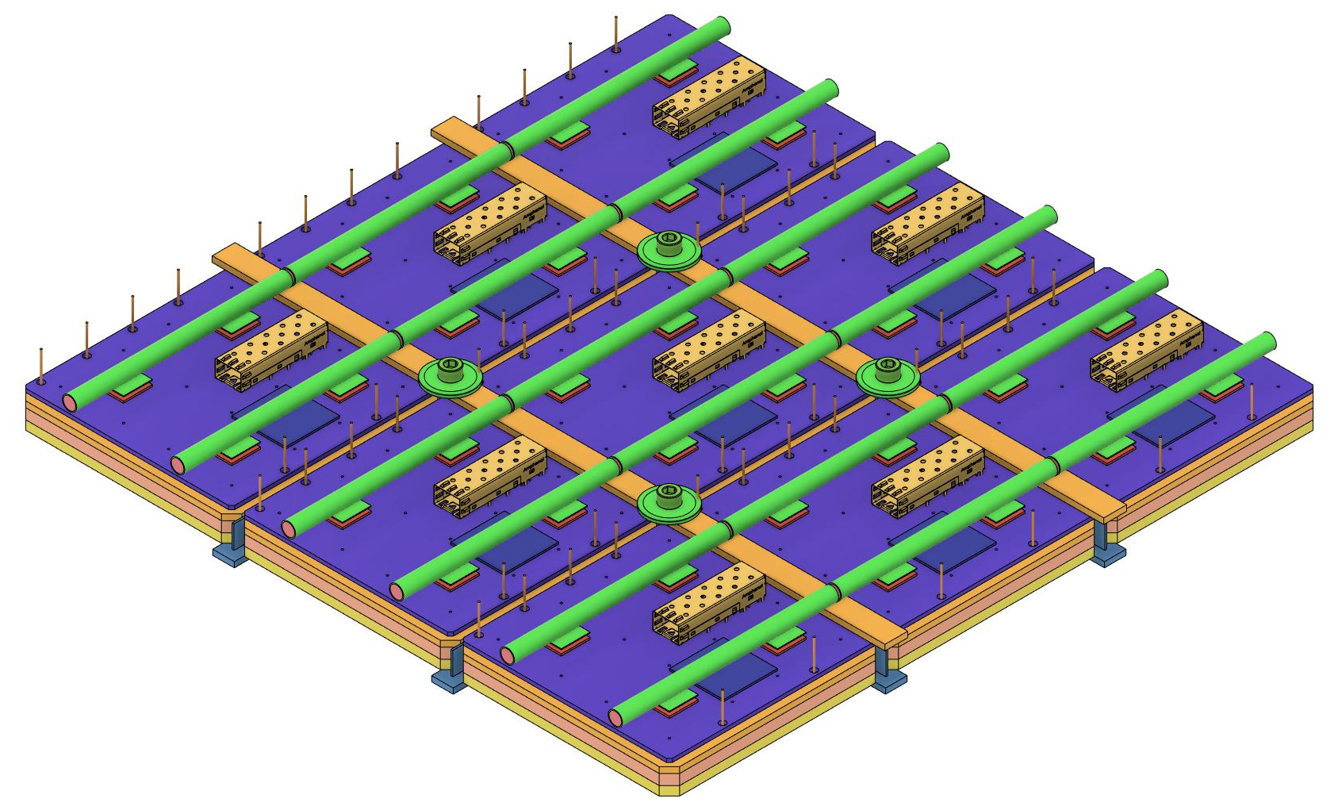
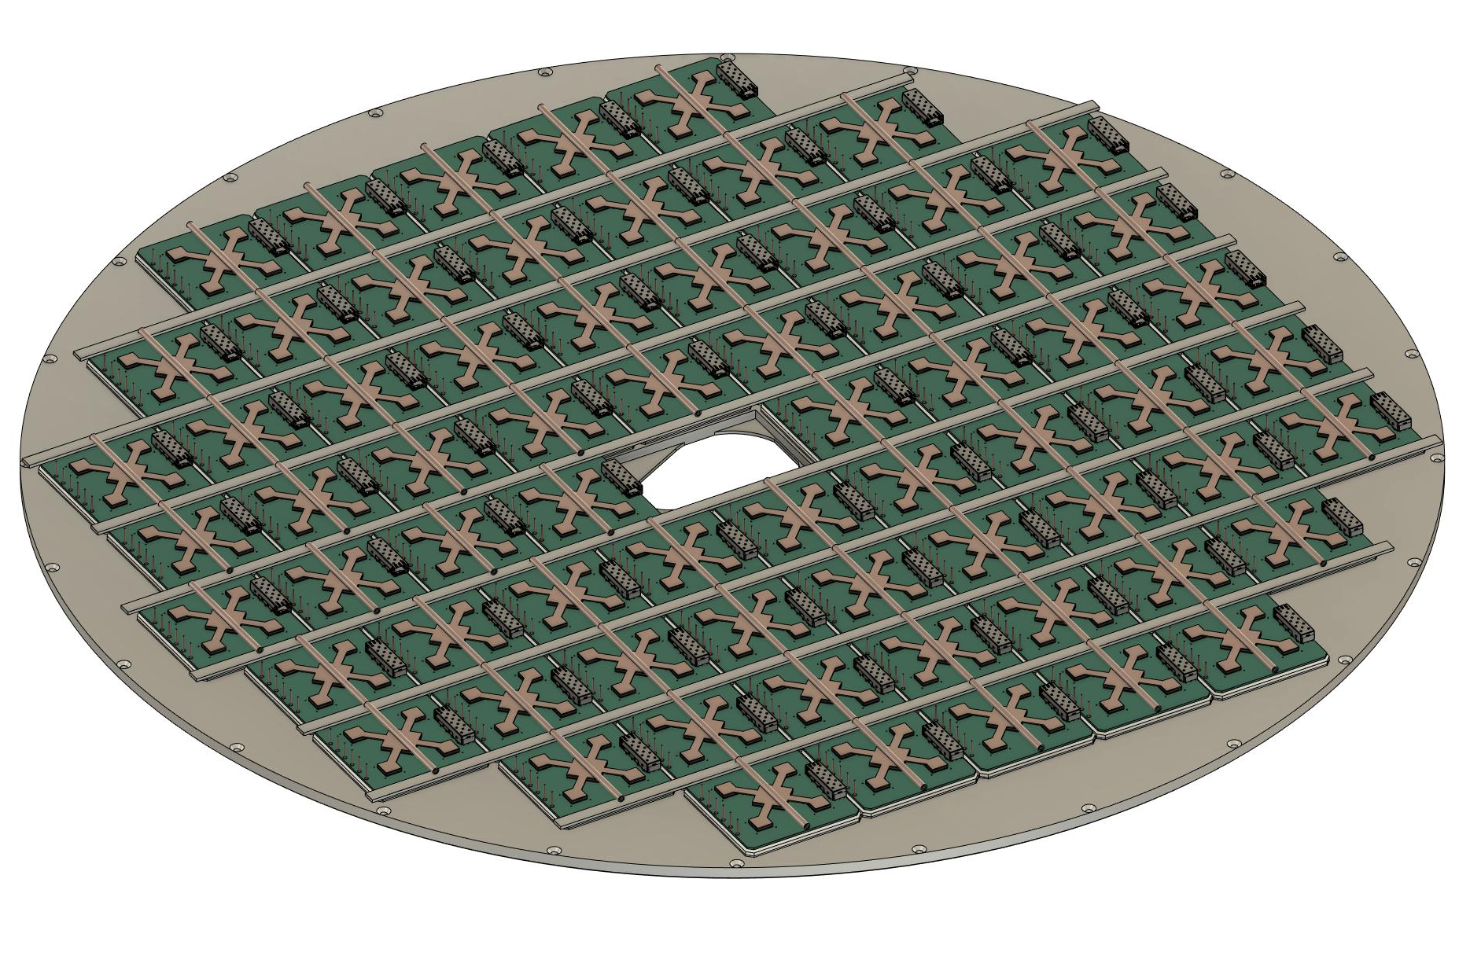
Sensor Wall/Grid
Material: Aluminum (1/2” [12.7mm] maximum thickness)
Dimensions:
Outer Radius -> ~63.8cm
Inner Dimension -> Beam pipe flange + 5mm clearance for installation.
More Details:
68 Sensors; 12cm x 12cm
Estimated weight for Aluminum Disc = 10.7kg
Countersunk fasteners along perimeter allow bolting and sealing to center cylinder section of the containment structure.
Intended to be machined from one piece of aluminum for rigidity
Strapping perpendicular to the liquid cooling pipes
Allows for mounting of the pipes
Creates a more rigid structure
Strapping is intended to be standard 1/8” (3.175mm) thick aluminum

Slide 7
Sensor Wall/Grid (Cont’d)
Liquid Cooling Assy
Sensor hold down hardware
Strapping
Sensor Assemblies
Webbing: 1mm between sensors
Aluminum Grid
Grid Face: 12mm x 3mm
Tapped holes at corners

Slide 8
Detector Assembly Procedure (Concept)
Build out the aerogel wall
Build out the containment walls
Insert aerogel wall while containment vessel is face down
Add foam blocks to support inner and outer mirrors
Insert inner and outer mirrors
Place aluminum grid on top of containment vessel
Add sensors into aluminum grid and affix with the strapping
Add liquid cooling to the back of the sensors

Slide 9
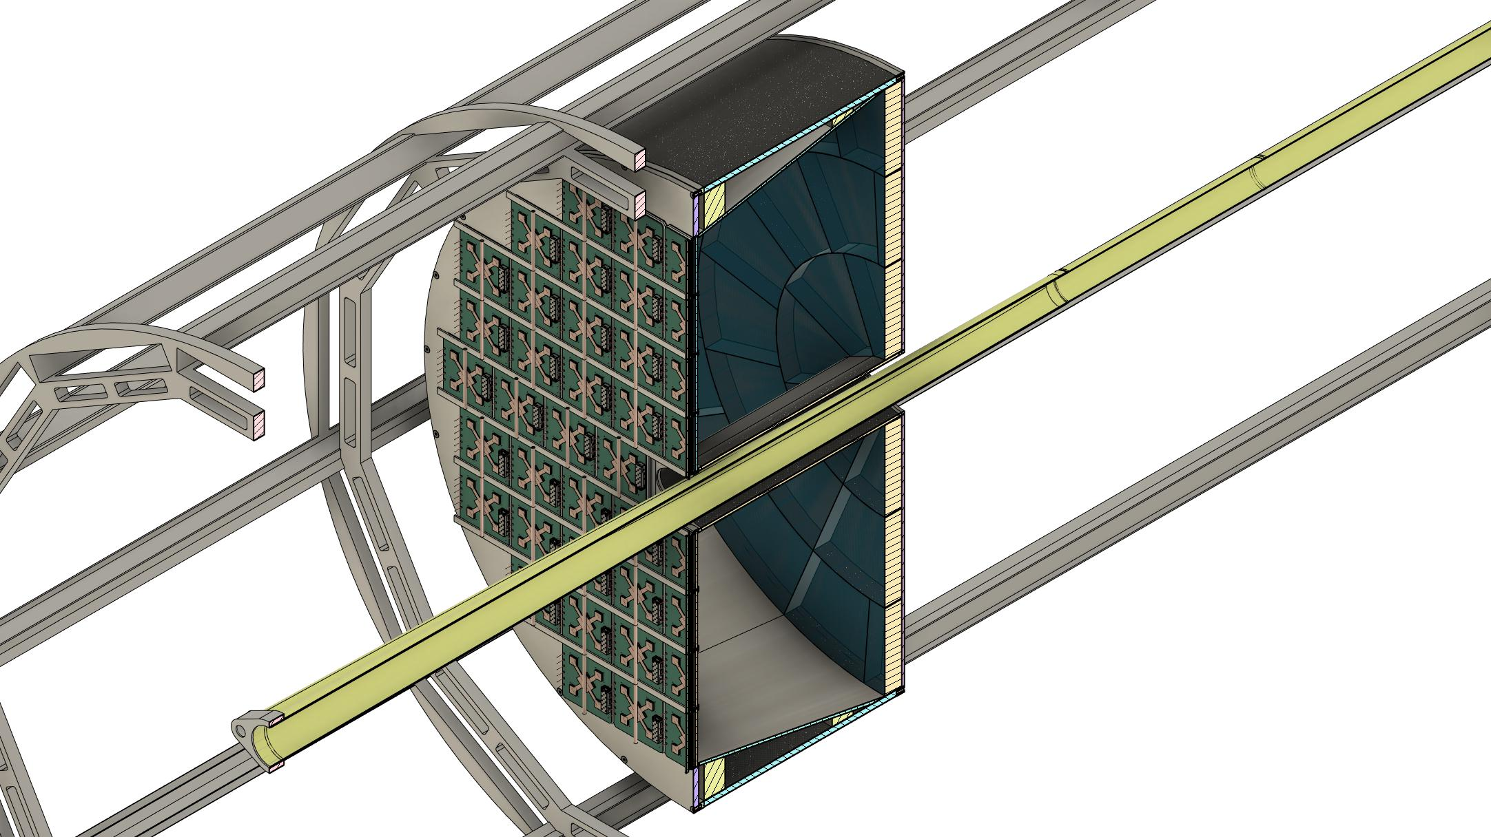
Entire Assembly (a/o 1Mar23)

Slide 10
What’s Missing?
Inner Conical Mirror Assembly and a Support Structure scheme have been conceptualized but not yet integrated into the design. Will be integrated and presented on 3 March 23.
System for optical isolation has not been fully developed. Current concept is that we should be able to seal the sensors at the front face where the grid meets the glass and cover the side walls of the individual sensors with an epoxy, but this solution is far from ideal.
Services and cooling will need to be roughly finalized before the review. There are some floating concepts of how to accomplish this, but the junction boxes and bend radii need to be considered as well as the full liquid cooling loop.
Thermal analysis needs to be done on the ASICS and for the situation where the detector is in place for the beam pipe bakeout (i.e. are the sensors able to handle the thermal load or will we need to insulate? Can the containment vessel handle the thermal load?)

