Slide 1
Magnetic Field Testing at Argonne National Laboratory
M. Popecki, Junqi Xie & Jack McKisson
February, 2023

Slide 2
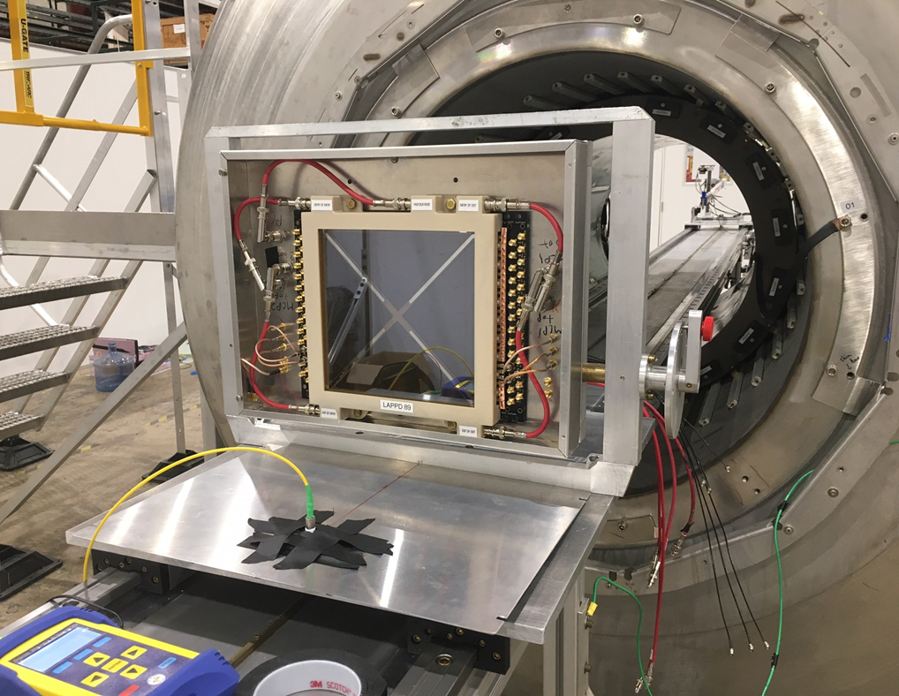
Two LAPPDs & One HRPPD at a Solenoid Magnet
Two capacitively coupled LAPPDs and One HRPPD
144, 20 um, glass
139, 20 um, ceramic
One directly-coupled HRPPD: 6
Magnetic field strength: 0.02 T to 2.0 T
Dark box
Aluminum case
Laser input fixed in the center near the bottom – on the centerline of the solenoid when the LAPPD is vertical.
Waveforms collected for 12 pixels (LAPPD) and 16 pixels (HRPPD D/C)
Rotation in the magnetic field:
LAPPD tips into or out of the region of stronger magnetic field
Move the LAPPD in or out at each angle to compensate for the change in field strength
Data products
Gain
Position
Position resolution
Transit Time Spread
Afterpulse rate
Detection efficiency estimate
Dark rates

Slide 3
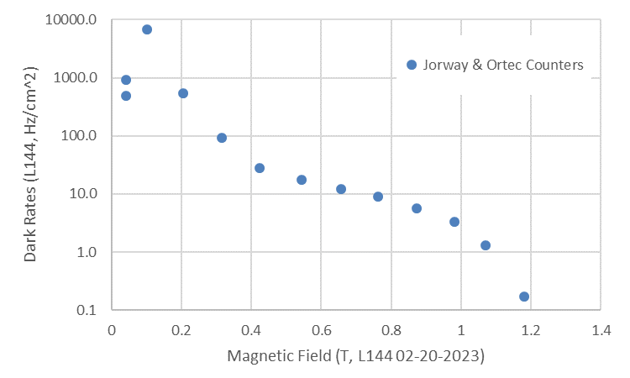
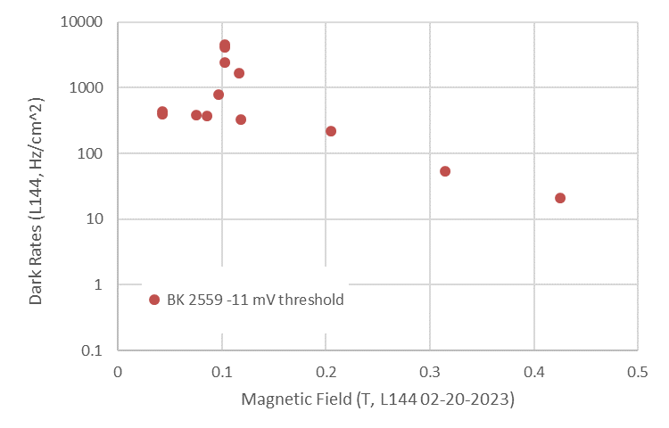
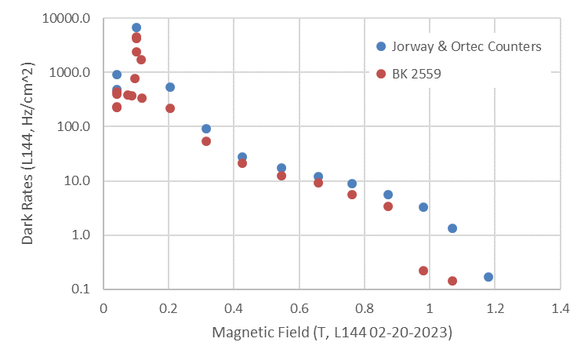
Dark Rates vs. Field Magnitude
Dark rates measured using:
Two pulse counters – Jorway counter and an Ortec 778
BK 2559 oscilloscope with trigger crossing counter
Dark counts decline with increasing magnetic field strength
A persistent count rate peak was observed at one field strength.
The response was isolated to a narrow range of field strength, much like a resonance.
LAPPD144 02-15-2023.xlsx, see AF78

Slide 4
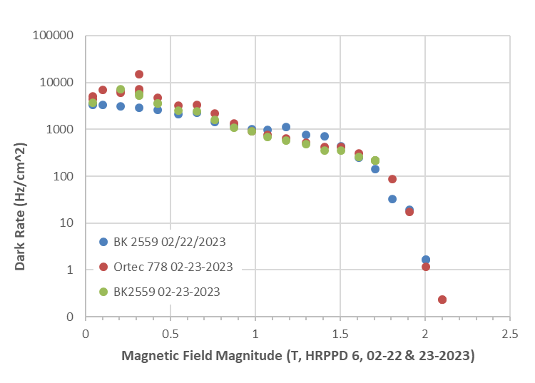
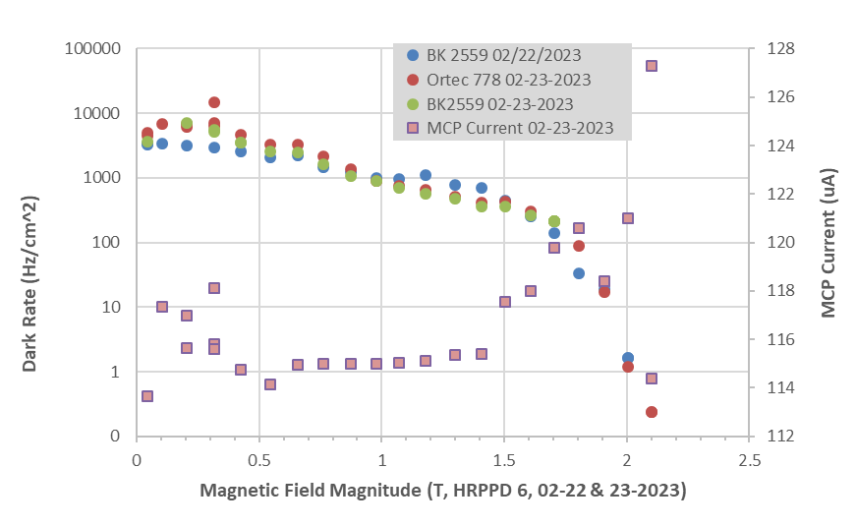
Dark Rates & Magnetic Field Magnitude: HRPPD 6
HRPPD 6
B field perpendicular to the window.
Dark rates were measured with both an oscilloscope counting trigger threshold crossings and two integrating counters. Results were similar.
The MCP current increased at stronger magnetic fields, even though the signal amplitude was reduced.
The previously observed resonance-like feature in dark rates on L144 was not as strong here with H6. See 0.65 T.
The dark rates continue in H6 out to 2.0T, rather than falling off at 1.2 T as with the 20 um L144.
HRPPD 6
LAPPD 144

Slide 5
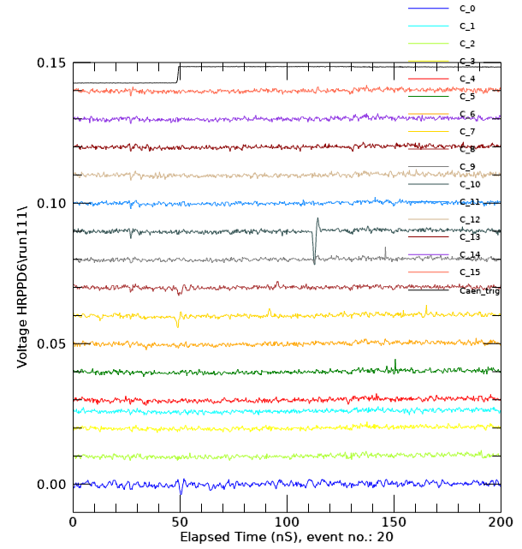
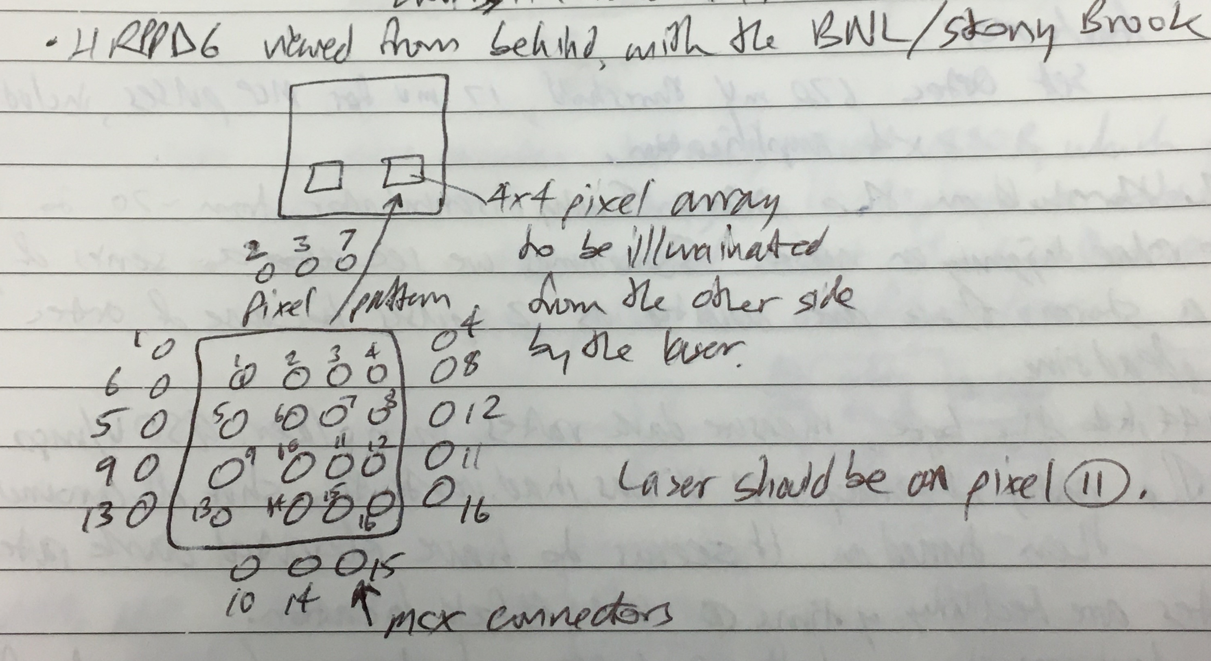
Localization of Directly Coupled Signal: H6
1.0 T
B field perpendicular to the window
3 mm discrete pixels
The signal appears to be confined to a single 3 mm pixel.
Pixel 11
Pixel 12
Pixel 10

Slide 6
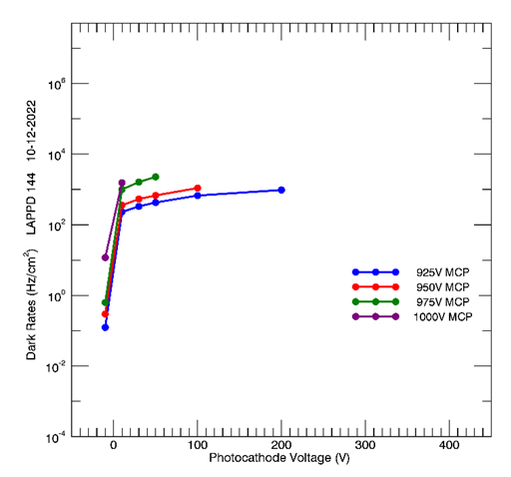
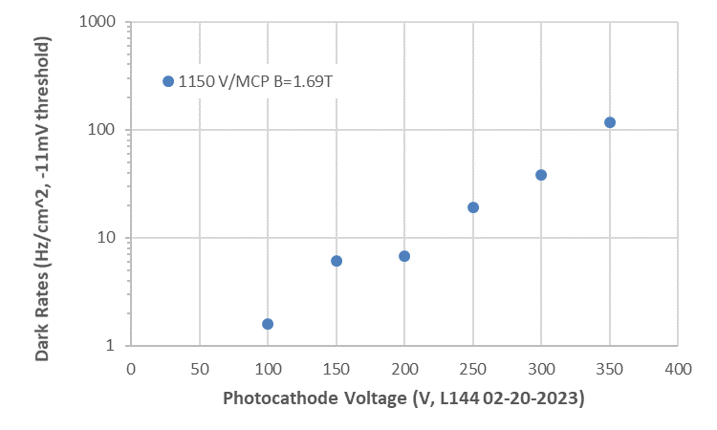
Dark Rates vs. Photocathode Voltage
Dark rates increased with photocathode voltage.
Rates are lower at 1.69 T than at the Earth’s field.
Is the magnetic field reducing the emission from the photocathode more than reducing the gain?
-11 mV threshold
1.69T
-4 mV threshold
Earth’s B field

